Slide 1
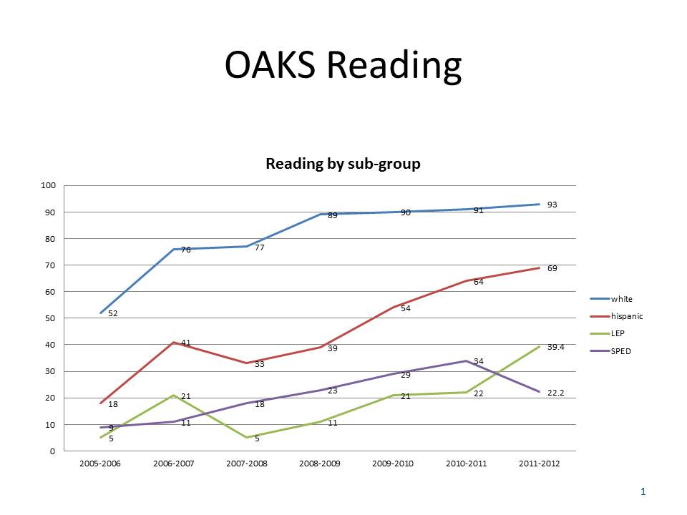
Improving the English Language Development for All Students through School Wide English Language Development
Brian Sica, Assistant Principal, Hillsboro High School
Introduction
Advantages of School Wide ELD
Implementation Plan
Project Timeline (Through 2012-2013)
The Need for Improved English Language Development
Hillsboro High School has undertaken major reform initiatives over the past six years. The development of Smaller Learning Communities and the Expansion of the IB to include the MYP has had significant impact on student achievement.
Instruction in core academic areas integrates rigorous goals for language acquisition, literacy, and grade-level proficiency in content standards
We transfer what we know between languages. What we know is mostly independent of the language we are speaking.
Academic/cognitive “lag” hinders student achievement. Students don’t need to wait to acquire English in order to learn academic content at high levels.
The School Community works together to address the challenges of the outcomes in our current system.
Language, specifically bilingualism, is thought of as a college and career readiness trait.
Spring 2012- Reallocate staffing allocation to include a 1.0 FTE (Job Shared) instructional coaching position. This shift will reduce the number of sections offered exclusively by the ESL department, specifically a reduction in ESL 4 stand alone courses. Those students will now be served within grade level Language Arts Courses.
Summer 2012- Initial cohort of 10 teachers receiving Constructing Meaning training.
August 2012- Data analysis with the full Hilhi staff focusing on both the school wide need to improved English Language Development and the need for improved systems for ELL’s
Fall 2012- Staff professional development regarding the use of sheltered instruction techniques, specifically Language Targets, Language Forms and Functions, and sentence frames.
Fall 2012- Begin instructional coaching through the PLC structure.
Spring 2013- Reformat Academic Seminar Time to PLC meeting time. Hold parallel mini sessions for staff to choose to attend. Topics to include:
Fine tuning your language targets
Writing Sentence Frames using Tier Three Vocabulary
Student Specific Strategies with ELL and Special Education Case Managers.
Accommodations and Modifications
Spring 2013- Progress Monitoring. Reviewing both qualitative and quantitative data to make claims regarding our goals.
However, a closer look at the data suggests that there is still significant improvement to be made in the area of English Language Development, not only for English Language Learners, but for all students.
Program Costs
Bilingual Instructional Coaches
A 1.0 FTE is split between two staff members in order to plan and develop staff professional development, provide small group and individual instructional coaching, as well as support in the development of ELL case managers.
*This is not an increase in overall staffing, rather a re-allocation reducing the number of pull out offerings.*
94% of ELLs do not have access to a comprehensive bilingual program.
Only 15% of ELLs have access to any primary language support.
100% of our students can graduate from high school. Over 45% of ELLs don’t.
48% of current seniors are at risk of not graduation resulting from not meeting Oregon Essential Skills in Reading and Writing
Academic Seminar Professional Development
Planning and Development:
Implementation:
1.0 Certified FTE Facilitation
4.0 Certified FTE Support
45 Certified FTE Participation
TOTAL: 50 Certified FTE for 6.0 hours @ $49/hour = $14,700
Predicted Results
Possible Approaches
Observations show 90% implementation of Language Objectives used during lessons
Observations show oral practice of high-level academic language in 90% of lessons.
ELLs progress one proficiency level per year. ELD is integrated across content areas, allowing ELLs full access to rigorous curriculum while acquiring English.
Significant Increases in the number of ELL students meeting state benchmark standards.
Significant Decrease in the number of students not meeting the Essential Skills graduation requirements
Content Literacy:
In this model, foundational language development is taught exclusively in the Language Arts and ESL departments. School Wide literacy is accomplished primarily through the use and application of Tier-Three vocabulary within content areas.
Pull-out ELD:
While this model is not necessarily independent of a content literacy focus, the philosophy is significant. ELL’s are typically removed from grade level classes until their language skills are deemed sufficient.
School Wide ELD:
English Language Development instruction is systematic, articulated, and integrated into content. English Language Proficiency Standards are taught within the level curriculum
Additional Constructing Meaning Training: Using District CM Trainers.
Three days of sub coverage $405//staff member
Materials $200/Staff member
35 FTE @ $605 each = 21,175
This is a Federal SLC Grant Expenditure
Sources
Lindholm-Leary, K. & Genesee, F. Alternative educational programs for English Language Learners. In Improving Education for English Learners: Research-Based Approaches, Sacramento, CA: California Department of Education, 2010.
Aguila, V. & Ong, F. ed. Improving Education for English Learners: Research-based Approaches. Sacramento, CA: California Department of Education, 2010.
Herrell, A. & Jordan, M. 50 Strategies for Teaching English Language Learners. Columbus, OH: Pearson, 2008, 3rd ed.
Collier, V.P. & Thomas, W.P. Educating English Learners for a Transformed World. Albuquerque, NM: Fuente Press, 2009.
Hillsboro School District Bilingual Program Implementation Rubric. Planning Document, 2012
Contact Information
For further information, or sources contact Mr. Brian Sica at sicab@hsd.k12.or.us.

