Slide 1
Choosing Colors
Kelly Sattler
Michigan State University Libraries
Twitter: ksattler
Nov. 10, 2021
Notes:
Hello. As you know, I’m Kelly Sattler from Michigan State University Libraries and I’m here to talk to you today about choosing colors.

Slide 2
Agenda:
Quick Introduction
Tool list:
  Pick colors from PowerPoint or website
  Test contrast for fonts and links
  Palette generators
An example using this PowerPoint theme
Live Demo of the Tools
Questions
Notes:
Our agenda for today includes
- a very quick introduction
- a list of the tools I’m planning to talk about – including ways to pick a color from a site, websites to test color contrast, and a few palette generators/color pickers
- a quick example of doing this in Powerpoint,
- and then live demos, that I hope go well, of the various tools.
There should be time at the end for questions.

Slide 3

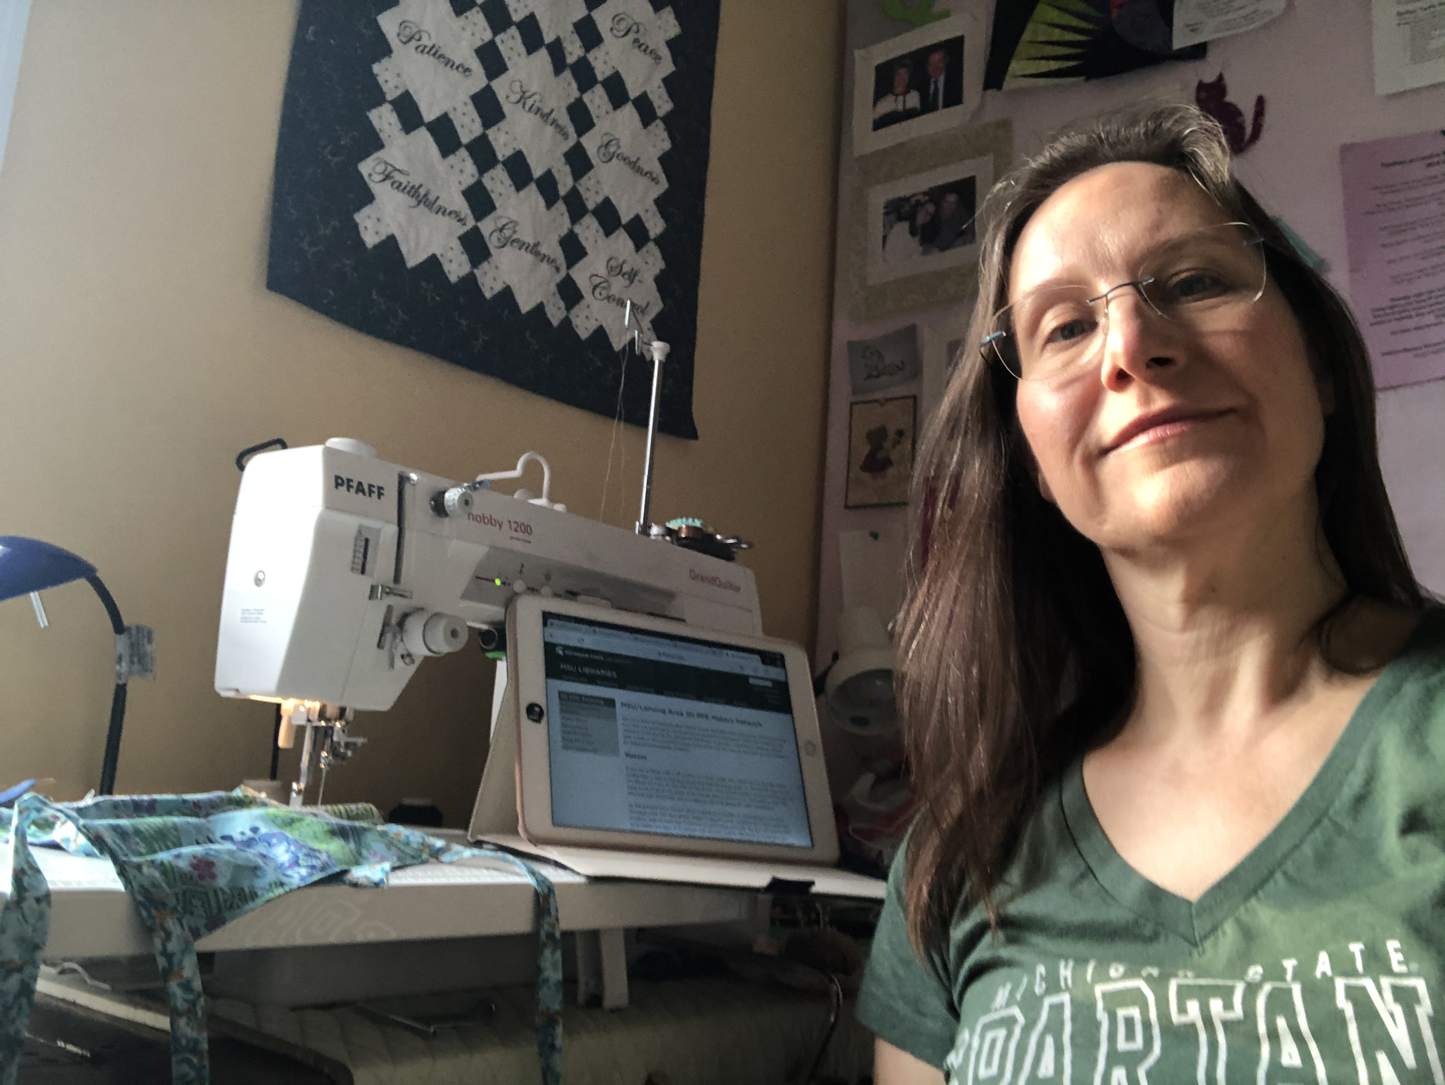
Me and MSU
Me:
Head of the Web Services unit for 15 years at MSU Libraries
Librarian and Computer Engineer
Past Usability Professional Association (UPA) – Michigan Chapter Board member
Quilter
Michigan State University
MSU’s branding page
MSU Green - #18453B
  (hard to tell it isn’t black)
Notes:
My credentials include having been the Head of the Web Services Unit at Michigan State University Libraries for 15 years. I have a degree in Computer Engineer and a Masters in Library and Information Science. I have served on the board of the local Michigan chapter of the Usability Professional Association. And I’m a quilter – this speaks to color selection.
MSU has issued brand standards, which I’m not going to show for the sake of time, but choosing colors from their palette can be tricky. Also, MSU Green is a very, very dark green that’s hard to tell it’s not black. So, it isn’t useful as a link color on the Libraries’ website. Given that the other university “color” is white, it doesn’t leave a lot for a web designer to work with. Hopefully, your institution has two colors that are not black or white.

Slide 4
Tools
Default Theme colors:
Colorzilla - enables color selection from a website that can be added to Firefox or Chrome
Webaim’s contrast checker – allows you to test your font color against the background color
Webaim’s Link Contrast Checker – includes body text check
Color Picker – use to design pleasing, effective, and accessible palettes
Cooler.co – another fancier color picker
ColorHexa – the one our web designer uses
Notes:
This slide shows the default colors for the PowerPoint theme that I picked for this presentation. I believed that the hyperlink text color was too light and did not have enough contrast with the background to pass accessibility. So, I’m going to show you what I did to test that theory.

Slide 5
Tools
Default Theme colors:
Accessible Theme colors:
Colorzilla – a color picker that can be added to Firefox or Chrome
Webaim’s contrast checker – allows you to test your font color against the background color
Webaim’s Link Contrast Checker – includes body text check
Color Picker – use to design pleasing, effective, and accessible palettes
Cooler.co – another fancier color picker with ios app, contrast checker, & more
Colorzilla – a color picker that can be added to Firefox or Chrome
Webaim’s contrast checker – allows you to test your font color against the background color
Webaim’s Link Contrast Checker – includes body text check
Color Picker – use to design pleasing, effective, and accessible palettes
Cooler.co – another fancier color picker with ios app, contrast checker, & more

Slide 6
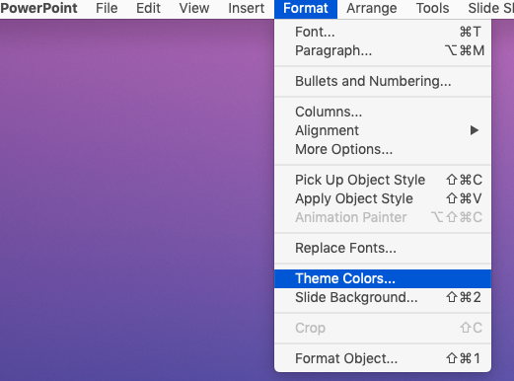
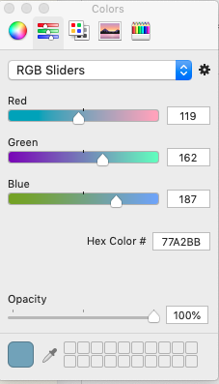
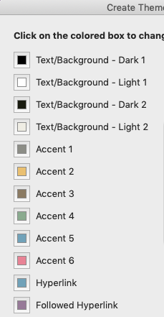
Doing this in Powerpoint
Find theme’s colors
Format -> Theme Colors
Click on the color to compare
“Colors” window pops up; choose RGB sliders to get hex color (hyperlink #77A2BB)
Can use eyedropper to get background color (#EFEDE3)
Notes:
First, I needed to find the theme’s colors by their hex number. To do this, you click on ”Format” in the top menu, which opens a drop down menu. From there selection “Theme Colors…” That will cause another pop up box to show up with the theme’s colors. I clicked on the Hyperlink color box to have the “Colors” pop up window show up. By selecting the second option from the menu, RGB Sliders, I was able to identify the hex color number as 77A2BB. Then at the bottom of the Color’s pop up box, there’s an eyedropper that allowed me to find the background color for the theme, which is EFEDE3. I also could have gone back to the Theme’s color list and clicked on the Background color.

Slide 7
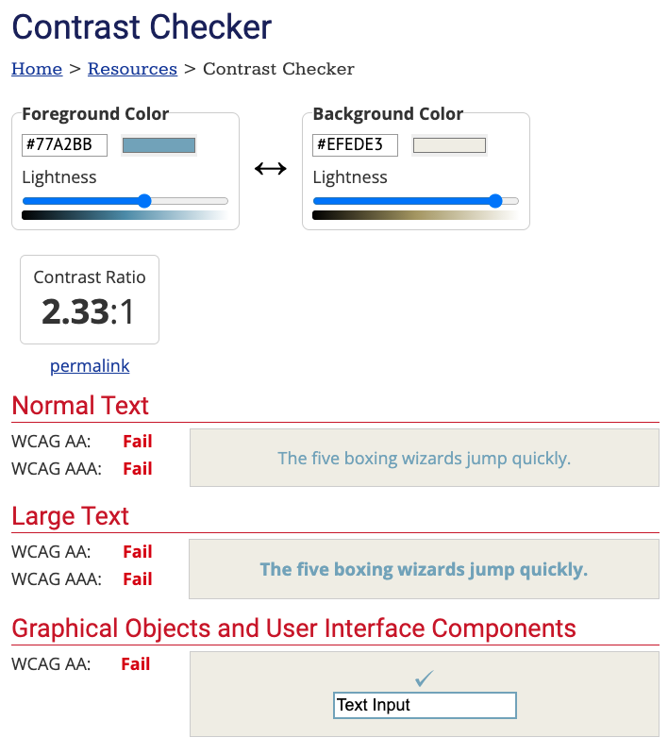
Check Contrast
I used Webaim’s contrast checker
Entered #77A2BB in foreground color field
Entered #EFEDE3 in background color field
Results in a FAIL
Notes:
Now that I knew the foreground and background colors, I could test their contrast value. I used Webaim’s contrast checker – my go to tool for checking contrast, and I was right! The color combination failed accessibility. The contrast was not enough between the two colors.

Slide 8
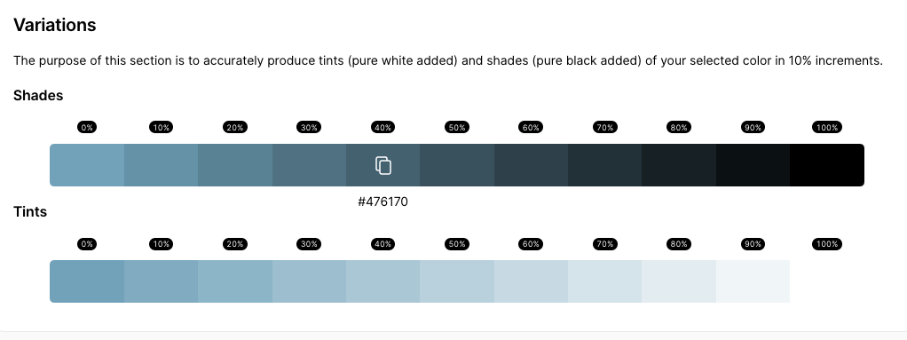
Pick a new color using Color Picker
Under Shades:
At 30%, passed Large Text WCAG AA and Graphical Objects
At 40%, passed everything except WCAG AAA
Notes:
On to picking a new color for the hyperlinks. I went to my default tool for a color picker and clicked in the boxes in the Shades section to get hex values. By clicking on a shade’s box, the website will copy that color’s hex number onto the clipboard. I then went back to the contrast checker until I found one that passed at least all of the large text options and the Normal text WCAG 2.0 AA option. However, this seemed to be a rather dark color and I wanted something brighter.

Slide 9
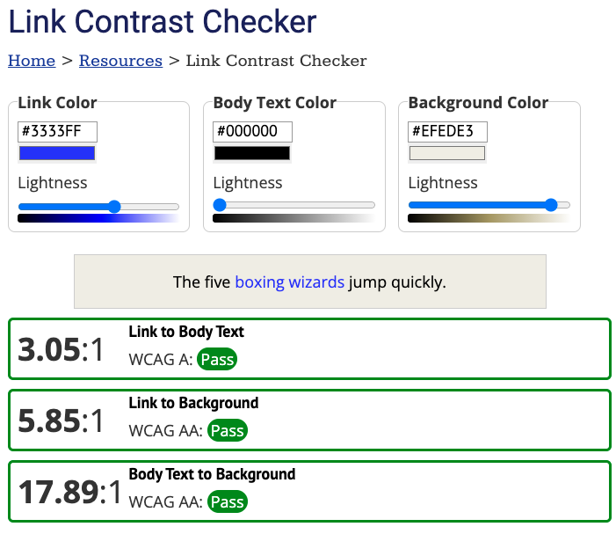
Pick a new color using Webaim’s Link Contrast Checker
This time I only changed the background color, which was originally #FFFFFF
The default link color passed all tests, so I chose it for the presentation.
Notes:
This is when I went to Webaim’s link contrast checker, which focuses on links specifically. By entering the background color of the presentation’s theme and leaving the other defaults, the blue the link contrast checker showed passed all the tests, was brighter, and therefore, I chose to use it for the link color in this presentation.

Slide 10
Live Demo
Colorzilla - enables color selection from a website that can be added to Firefox or Chrome
Webaim’s contrast checker – allows you to test your font color against the background color
Webaim’s Link Contrast Checker – includes body text check
Color Picker – simplest of the options
Cooler.co – another fancier color picker
ColorHexa – the one our web designer uses
Notes:
Now, I want to give a demo of the Tools themselves.
Colorzilla is a browser plugin that will allow you to identify a color on a webpage, or at least a color very close to it. It works in Firefox and Chrome.
Webaim has the two contrast checkers. The Link contrast checker also tests for the contrast of the link within a body text.
Then there are 3 color pickers that I have listed that are very similar in what they have to offer. If there’s time, I’ll show you all three, but if not, I’ll show one to give you ideas.

Slide 11
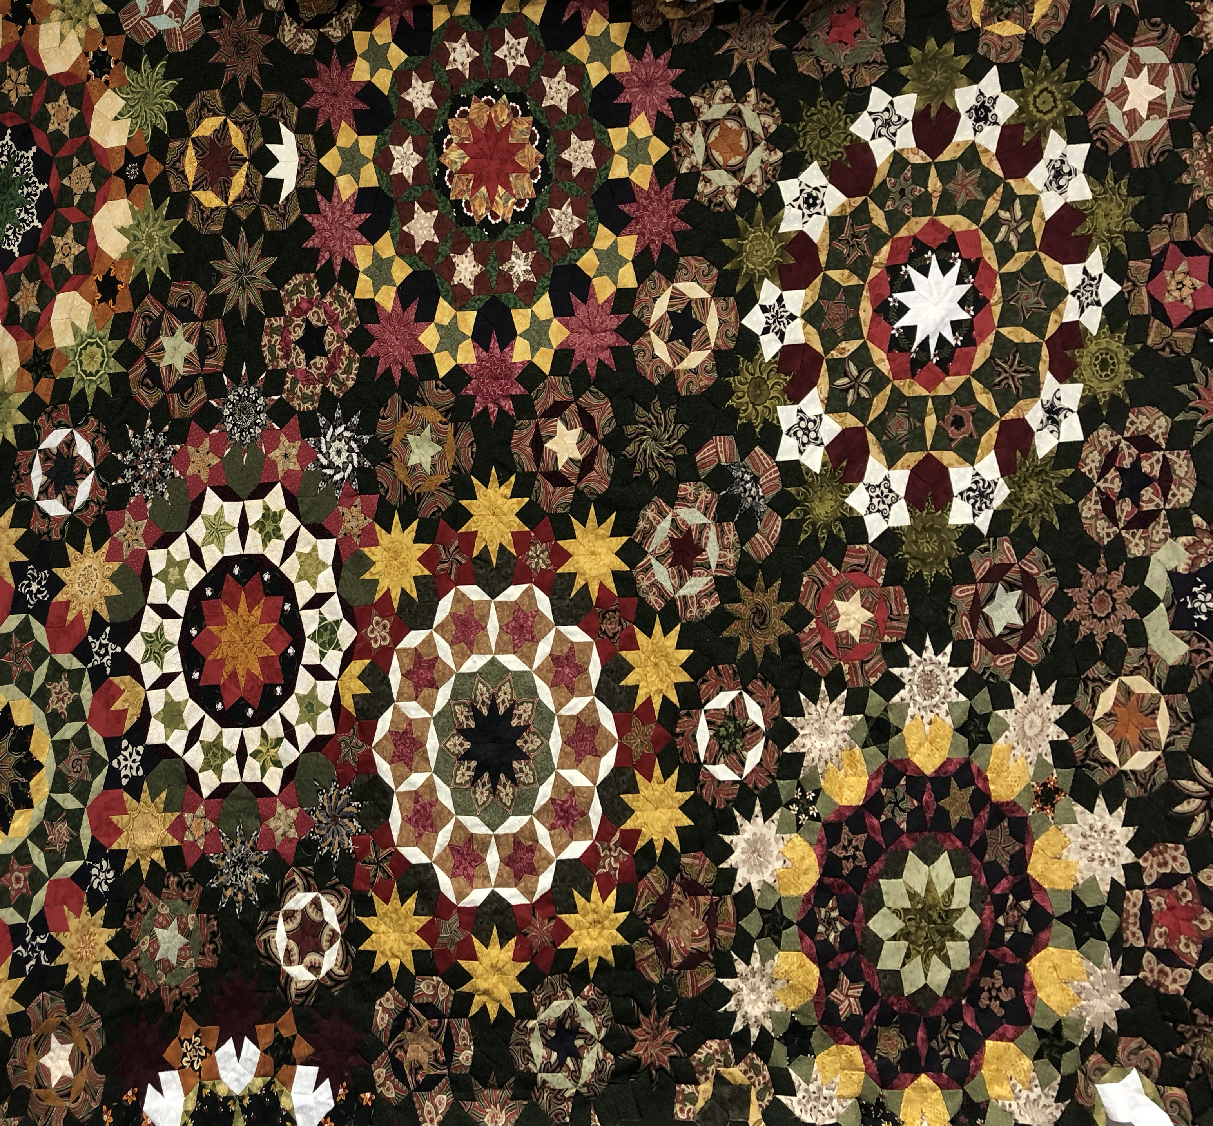
Questions?
A distorted photo of a quilt I hand-pieced

