Slide 1
Harden & Sophia McConnell
A glimpse at the personal side of their lives at Caltech, showing that this is more than a place where important scientific discoveries are made. Caltech is also a supportive community of scientists, staff, students, and their families.
An informal collection of photos and memories prepared for the celebration of the Inaugural Caltech Harden M. McConnell Lecture, April 24, 2018, and for future lectures in this series. Assembled by O. Hayes Griffith, Ph.D., 1965 with help and encouragement from Sophia and Jane McConnell, and Alvin Kwiram, Ph.D., 1963, and Gerald Liebling, Ph.D. 1965. Griffith, Kwiram, and Liebling were students of Harden McConnell at Caltech.

Slide 2
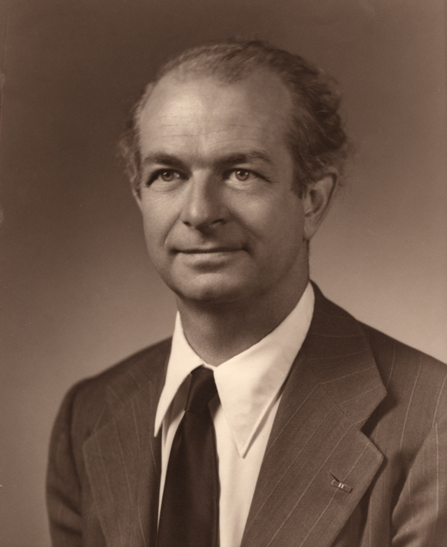
Harden as a Caltech Graduate Student
1947-1951
“On arrival at Caltech in 1947, I immediately went to see Linus Pauling and indicated I would like to be a theoretical chemist, meaning I wanted to work on molecular electronic structure problems.”
“Linus said that if I wanted to be a theoretical chemist I would need to know all there was to know about chemistry, physics and biology. For a moment I thought he was joking, but after looking at him a second time, I realized that he was serious.”
Harden McConnell, Ann. Rev. Biophysics. 39, 1 (2010)
Linus Pauling
Credit: NIH

Slide 3
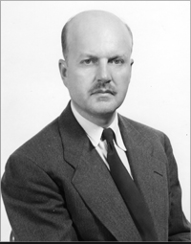
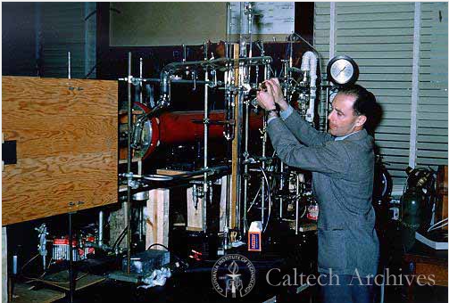
Harden as a Caltech Graduate Student
“I then went to see John Kirkwood,
who asked me what I knew about Hilbert space. I said I didn’t know much about Hilbert space, which was an exaggeration. I had never heard
of Hilbert space.”
John Kirkwood
Credit: American Institute of Physics
“I began to suspect that I was
going to be in serious trouble at Caltech.”
“I was saved by Norman Davidson, who presented me with an interesting, understandable, and practical research problem.”
Norman Davidson
Credit: Caltech Archives

Slide 4
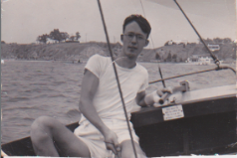
Harden at play
Harden wrote on this photo: “A good close-up of the entrance channel”. Small sign on cockpit: This boat is not allowed in ocean or entrance channel
Credit: Sophia and Jane McConnell

Slide 5
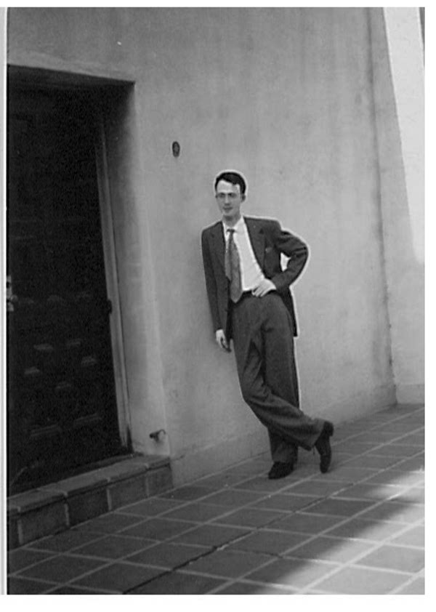
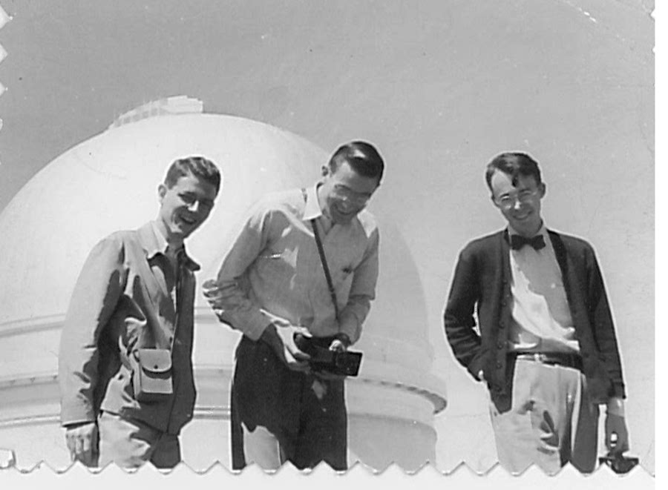
Harden with friends in Pasadena
Harden = “Mac”
Harden (right) with friends at Palomar Observatory
Credit: Sophia and Jane McConnell

Slide 6
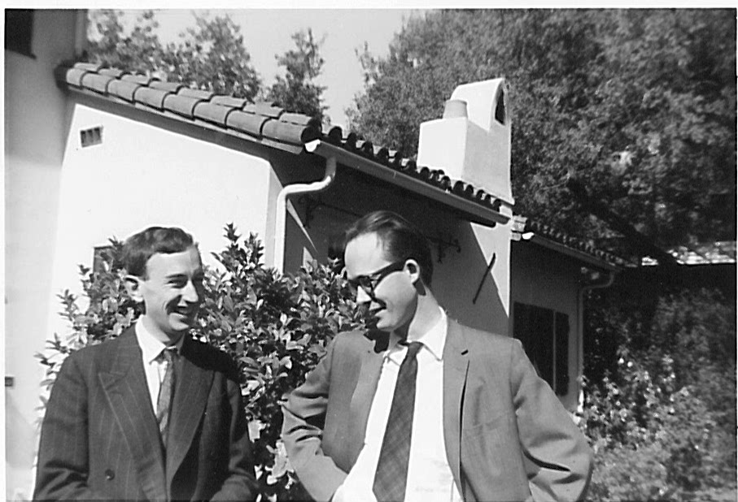
Harden is called back to Caltech in 1956 by Linus Pauling to be a member of the Chemistry faculty.
Harden and Sophia were married 10-6-1956
Credit: Sophia and Jane McConnell
Harden with visitor, Andrew McLachlan. The McConnell home in background: 2062 New York Drive, Altadena, CA. 3 miles north of Caltech.

Slide 7
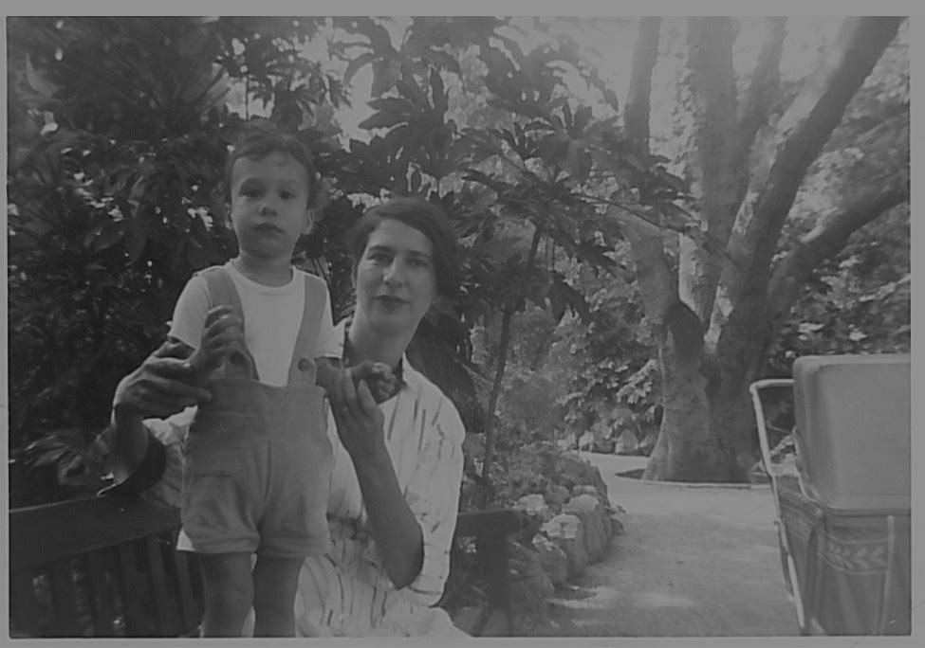
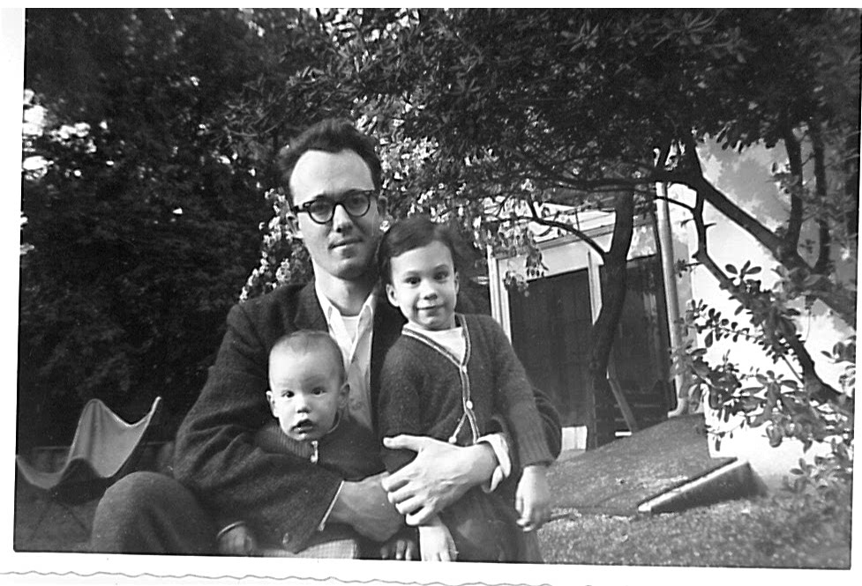
Sophia McConnell and boys – Hunter & Trevor
Credit: Sophia and Jane McConnell
Credit: Sophia and Jane McConnell
Sophia with Hunter
Harden, Trevor and Hunter

Slide 8
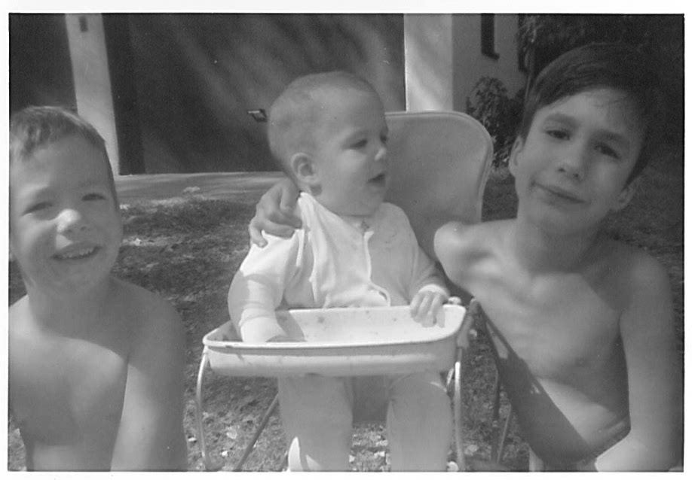
And then came Jane:
Credit: Sophia and Jane McConnell
Trevor, Jane and Hunter McConnell

Slide 9
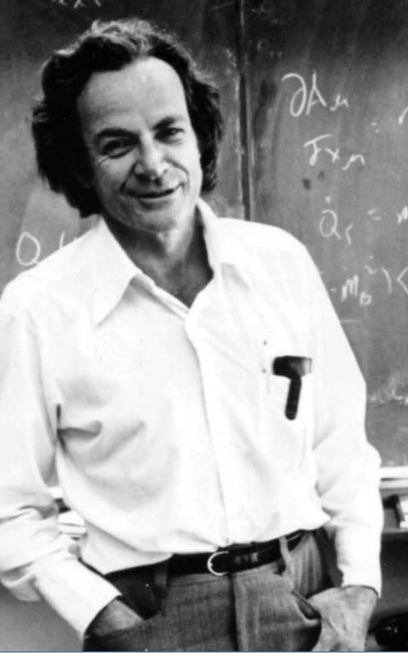
Harden McConnell gave a pre-arranged Department of Physics seminar at Caltech within hours of Jane’s birth
Richard Feynman was sitting in the front row and started asking penetrating questions. What did Harden McConnell do?
McConnell took the long spear-like pointer lying on the table, and rotated it, so that it pointed at Feynman. With each question, Harden advanced the tip of the pointer towards him. Soon the questions stopped. Both men were in good humor.
Richard Feynman
Photo date: 1974, Credit: Caltech Archives

Slide 10
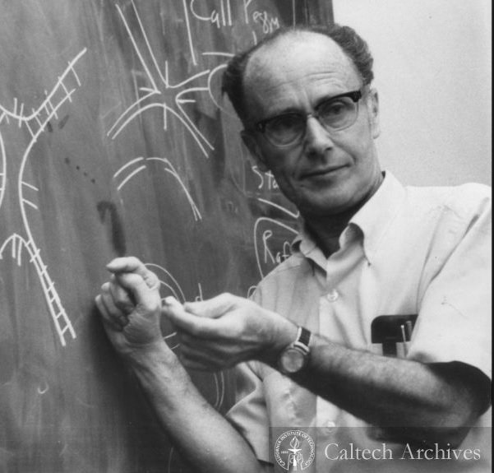
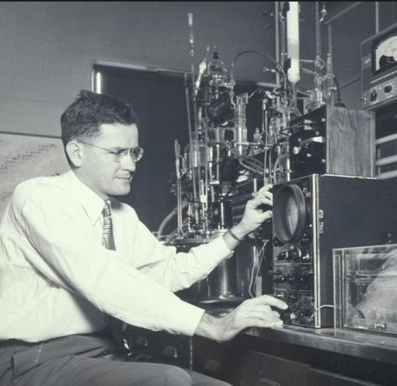
Trevor’s and Jane’s middle names honor Caltech faculty
Hunter Scott McConnell
Born 7/7/57
Trevor Marsden Davidson McConnell
Born 11/21/58
Jane Roberts McConnell Born 2/14/63
Norman Davidson
Credit: Caltech Archives
John D. “Jack” Roberts
Credit: NY Times

Slide 11
Harden McConnell on Caltech Faculty
1956-1964 – A rising star
Background: In the late 1950s and early 1960s commercial NMR and ESR spectrometers became widely available to chemists in academic and industrial laboratories.
McConnell provided links between theory of molecular structure and the new NMR and ESR data, and made discoveries in the laboratory. He derived simple equations that made it possible for scientists in many fields to advance their own work.
Awards for work largely done at Caltech:
  California Section Award of the ACS (1961)
  National ACS Award in Pure Chemistry (1962)
  Election to the National Academy of Sciences (1965)

Slide 12
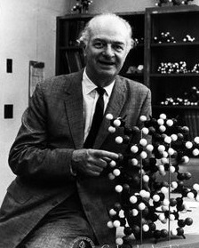
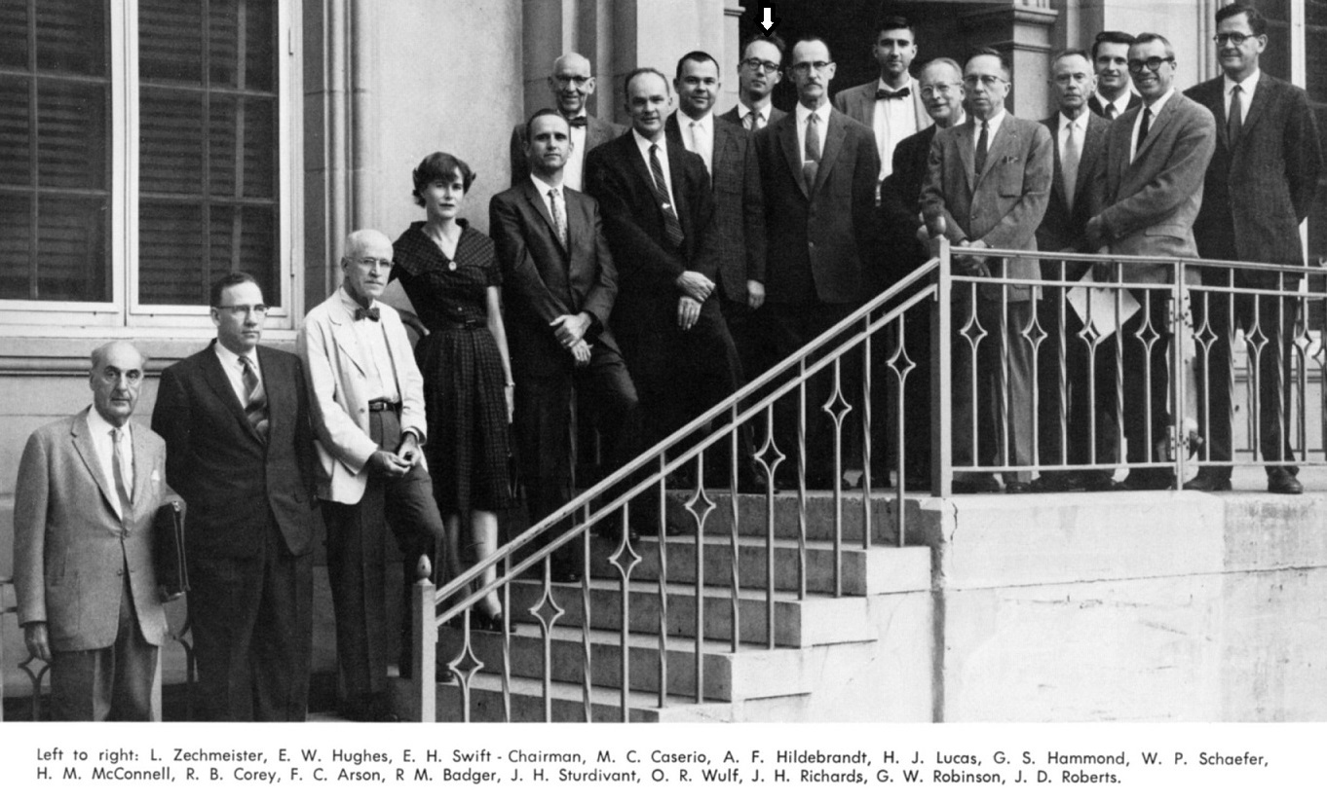
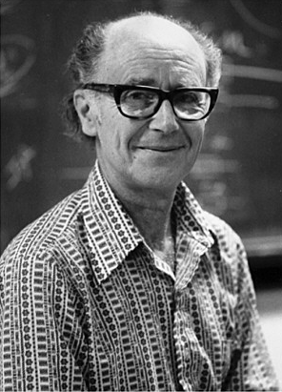

Caltech Chemistry Faculty in the McConnell era
Mac
Mac’s lab in basement
Linus Pauling
Credit: Caltech Archives
Sunney Chan
1967
Credit: S. Chan
Norman Davidson
Credit: National Academy Press
West end of the Laboratories of Gates and Crellin.
Photo from Big T 1961 yearbook. Credit: Caltech Archives

Slide 13
Why did Harden McConnell leave Caltech?
“I moved from CIT to Stanford University with great reluctance; both are great institutions with strong chemistry departments and great faculty.”
“I moved because I had a strong distaste for the LA smog prevalent at that time. Had it not been for the smog, I would have certainly stayed at CIT”
Source: “Research Studies of Harden M. McConnell” Hardenmcconnell.org

Slide 14
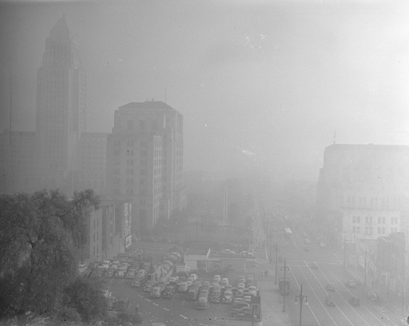
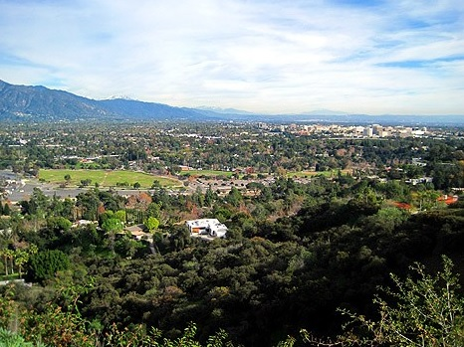
Smog in the LA – Pasadena Area.
Credit: UCLA Library
Credit: Brigham Yen
L.A. Civic Center masked by smog. (1948)
View of Pasadena from hills above Rose Bowl (2011). The air pollution is significantly reduced.
Important Lesson: We must strive to protect our environment

Slide 15
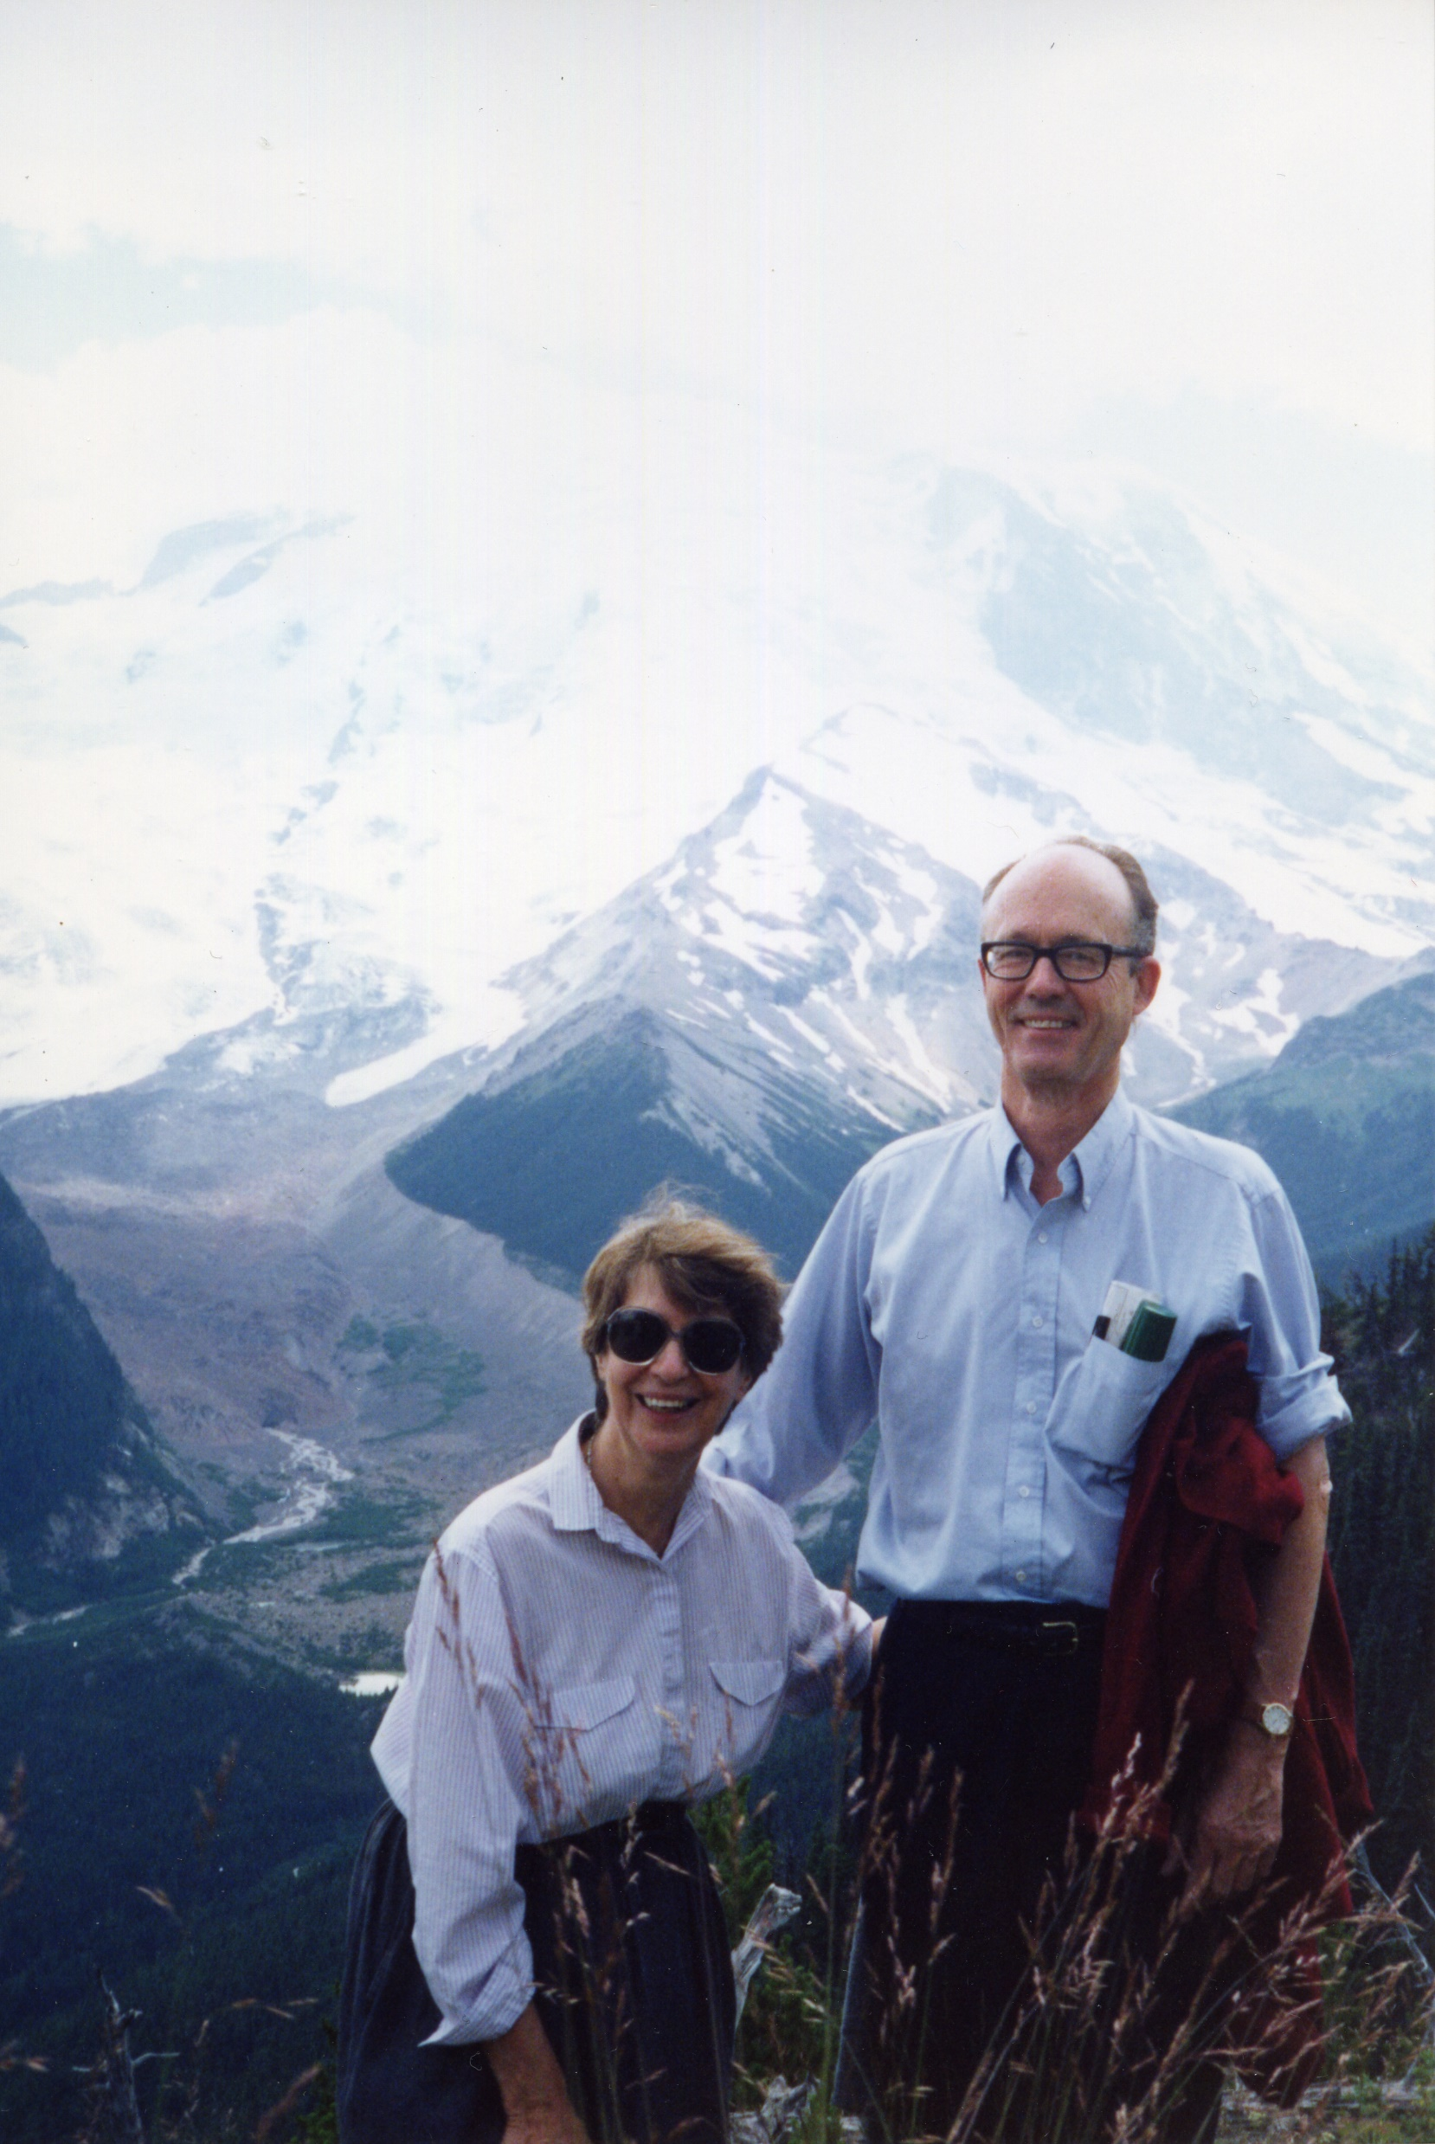
Credit: Alvin Kwiram
Sophia and Harden McConnell
1990, Mt. Rainier WA

Slide 16
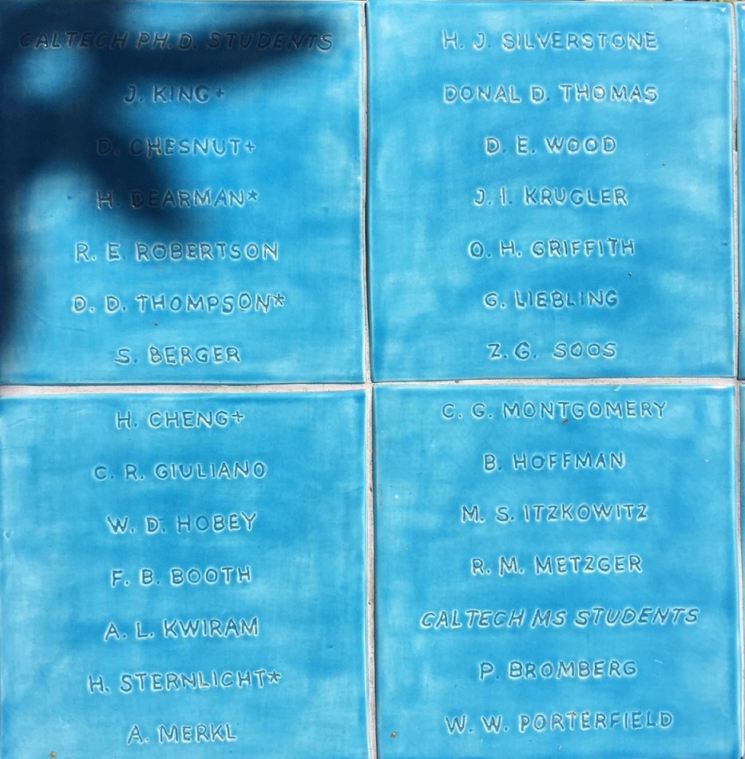
Names of all McConnell graduate students and postdocs at Caltech were inscribed on tiles by scientist-artist Dr. Karen Mason-Kiemle
Caltech students’ names inscribed on blue tiles.
Credit: Alvin Kwiram

Slide 17
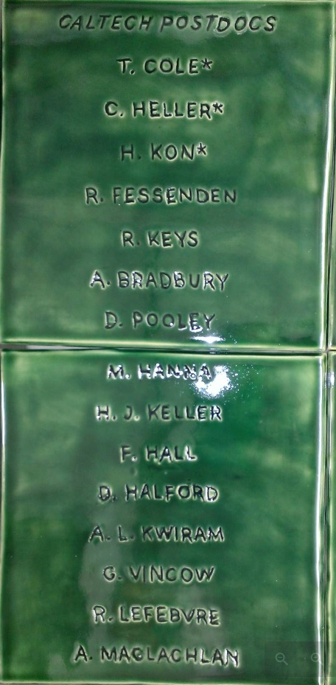
Names of Caltech postdoctoral fellows and visiting scholars on green tiles.
Credit: Karen Mason-Kiemle

Slide 18
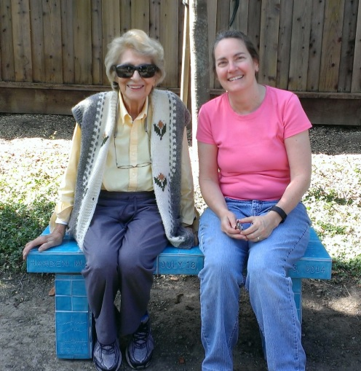
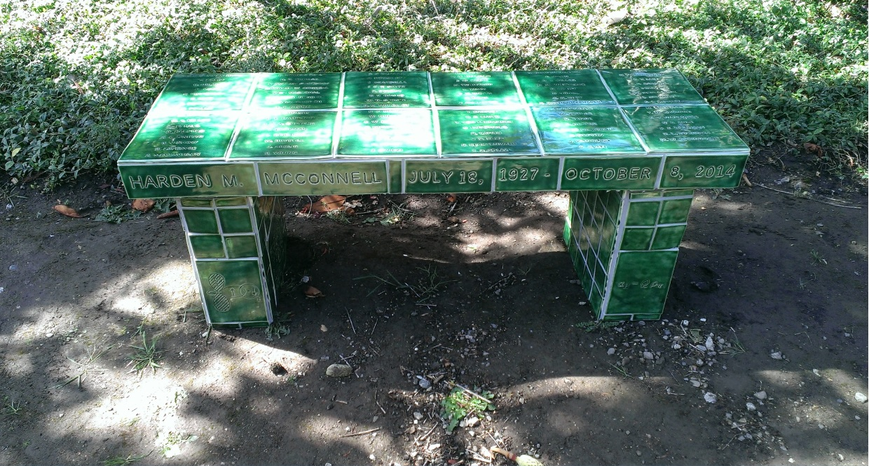
Credit (above) K. Mason-Kiemle; (right) Jane McConnell
Green bench with names of all McConnell postdocs and visiting scholars, Caltech and Stanford. The tiles are all “fired” and thus permanent. The two Benches were finished in 2015 and are currently located at the McConnell home in Atherton CA.
Sophia McConnell and Karen Mason-Kiemle (artist, right) sitting on the finished blue bench which has names of all McConnell’s graduate students (Caltech and Stanford). Karen earned her PhD at Stanford in Harden’s lab.

Slide 19
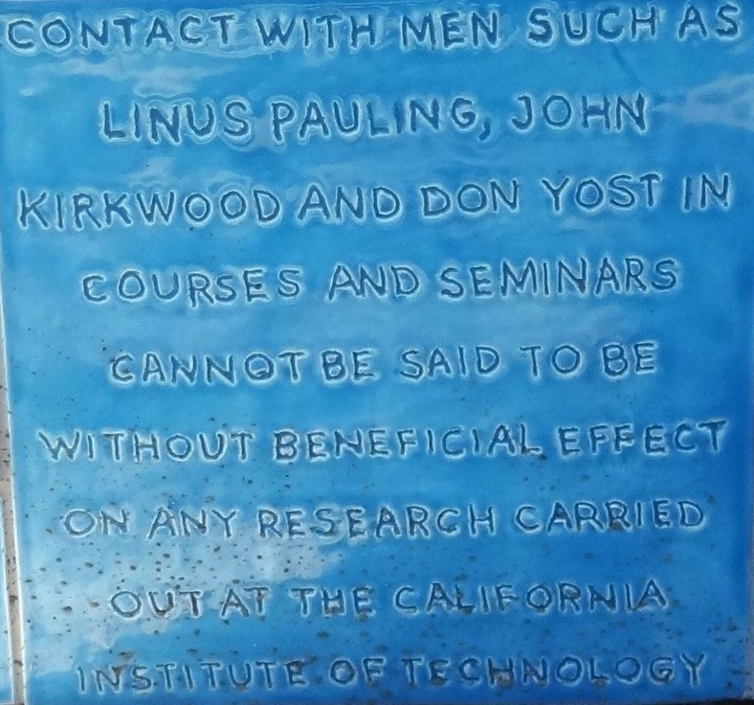
Quote from Harden McConnell’s Caltech Ph.D. thesis, 1951. Karen inscribed these words and many diagrams from McConnell’s research on the tiles, which she then mounted on two unique benches.
Credit: Jane McConnell

Slide 20
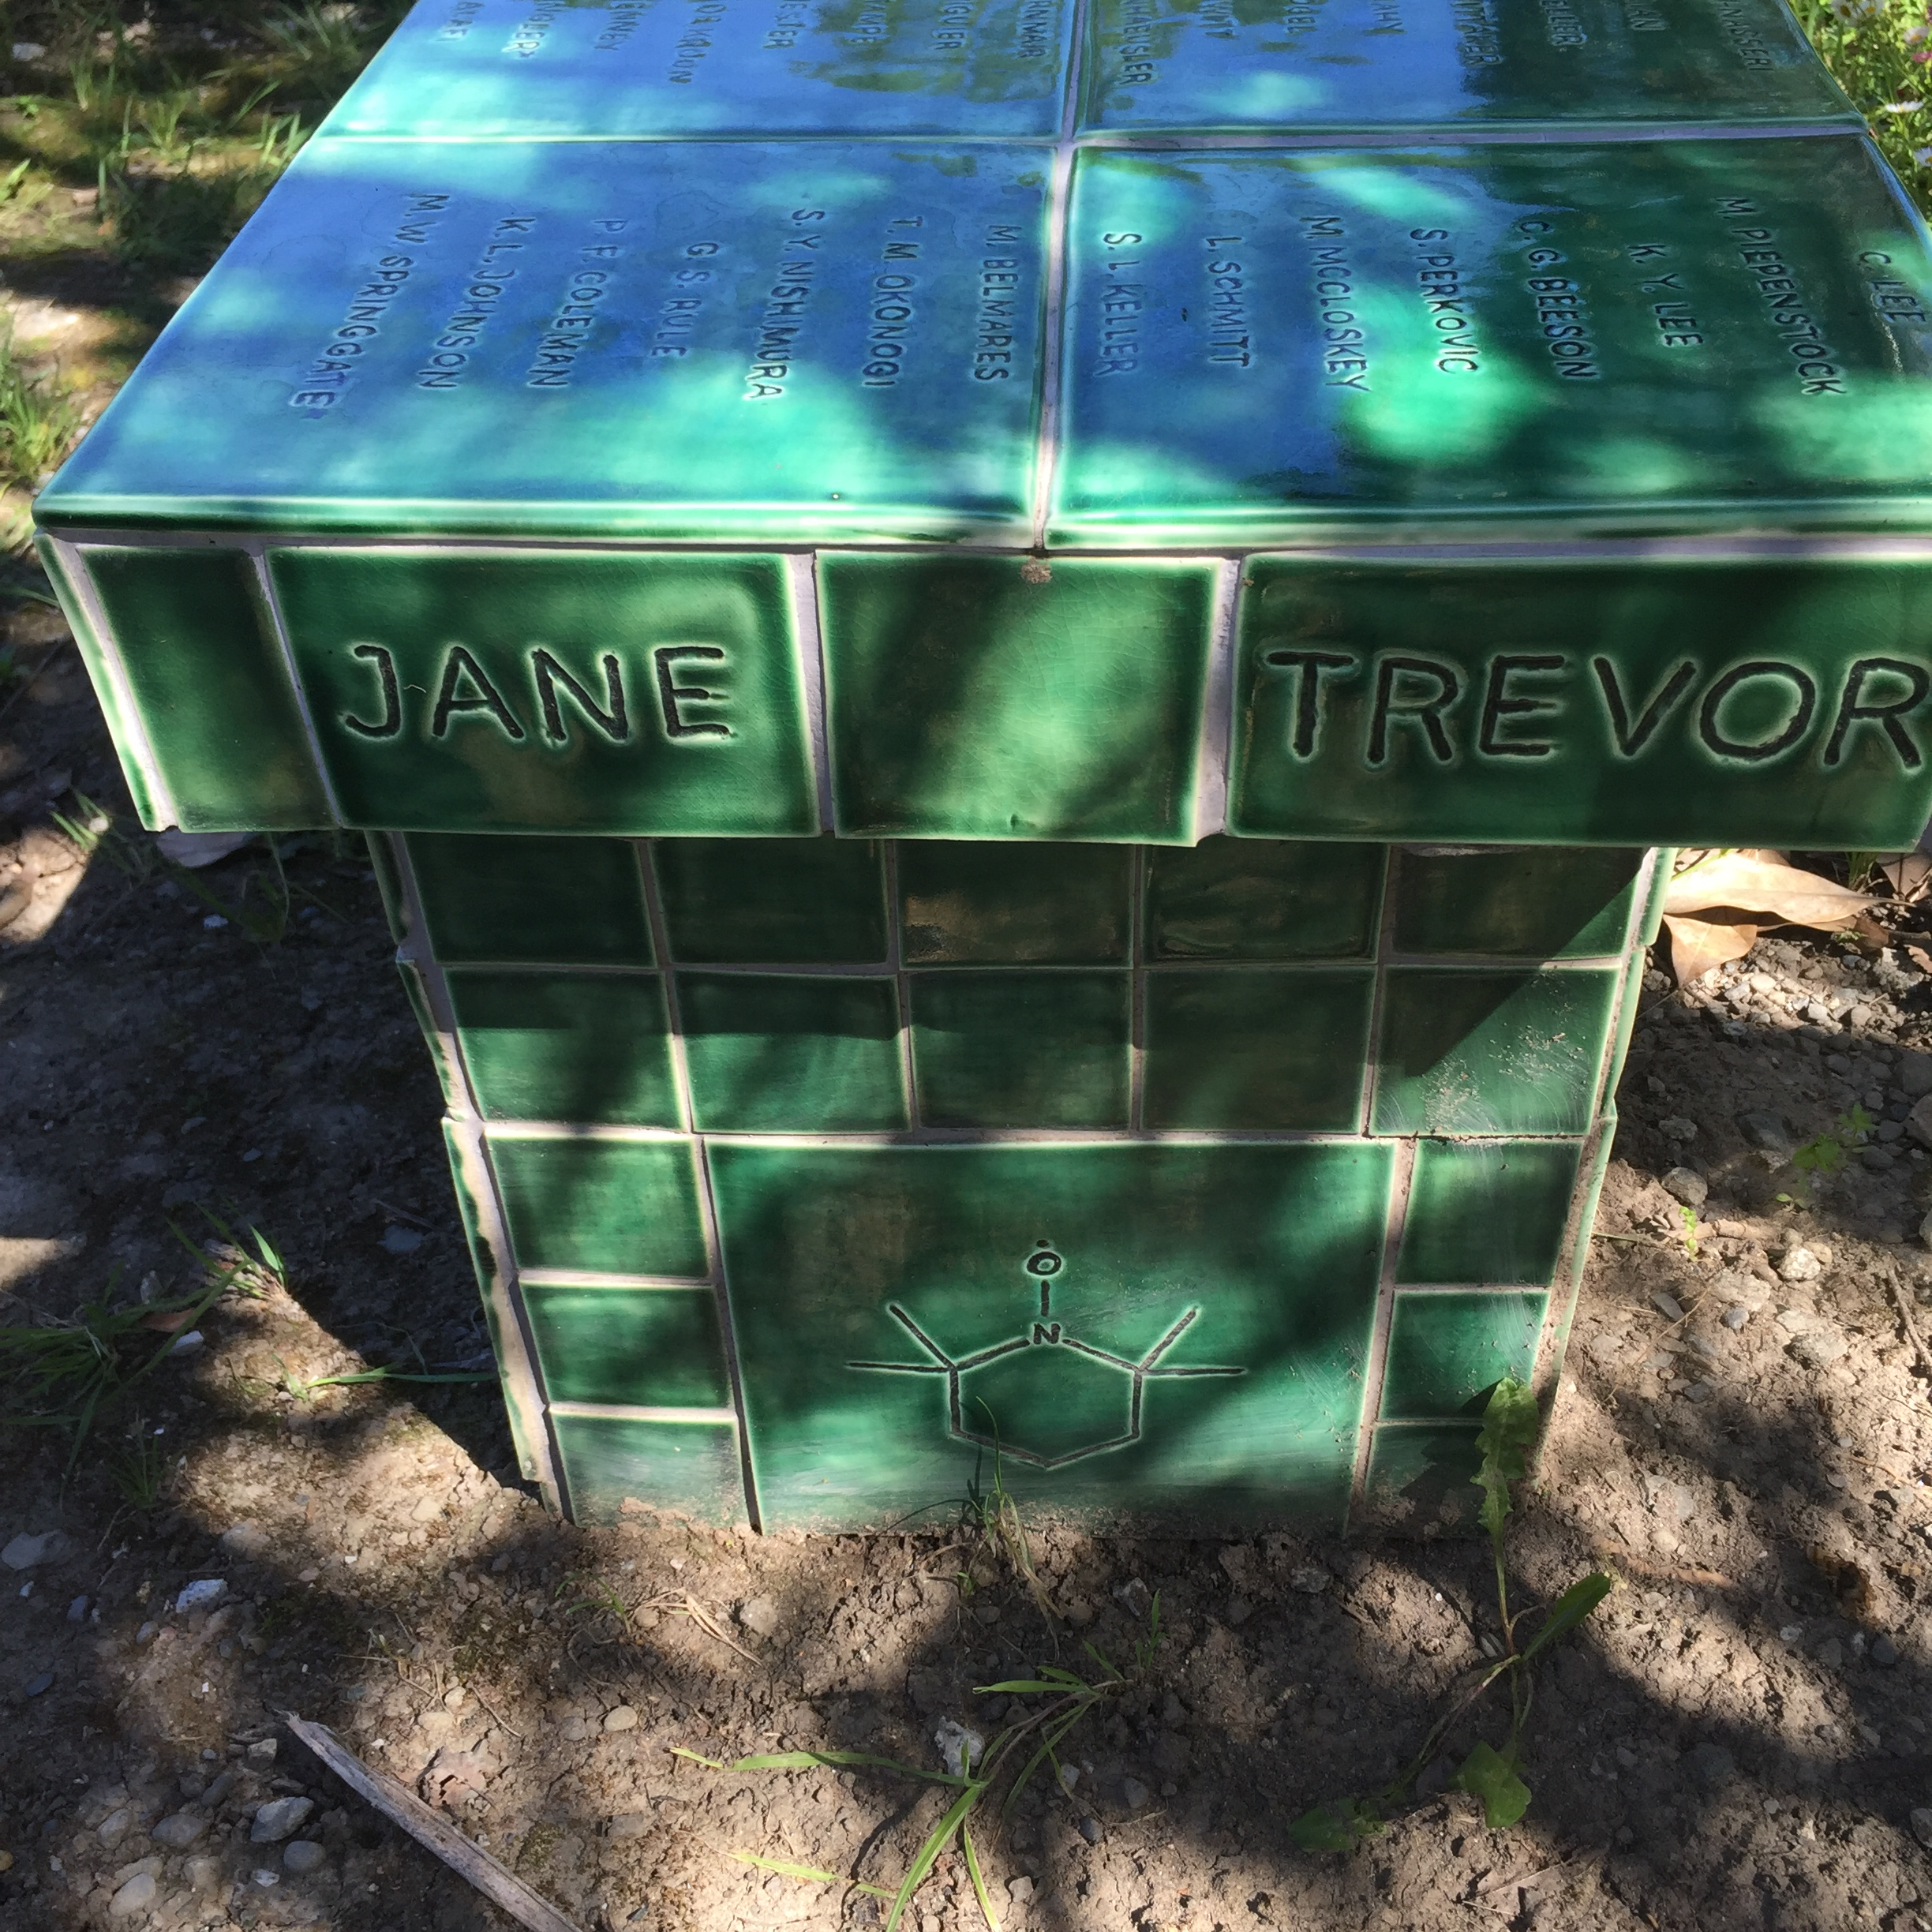
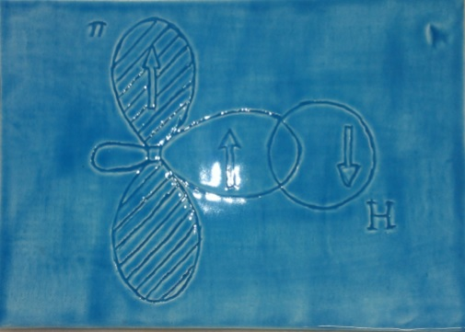
Spin polarization diagram associated with the McConnell equation. A simple sketch of spin correlation by Pauling during a seminar at Caltech planted the seed, and McConnell developed the idea for his application.
Diagram of a nitroxide free radical. ESR and chemical stability examined at Caltech, and then applied widely at Stanford to biological problems as “spin labels”.
Credit: Karen Mason-Kiemle
Credit: Alvin Kwiram

Slide 21
Jane McConnell after the move to Stanford
Graduated from Castilleja High school, 1981
B.A. Stanford, Creative writing, English Dept.
Transitioned to science: U. of Oregon and Stanford.
Ph.D. Univ. of Wisconsin (Madison) Biology
Joined the faculty of Castilleja School, 2008, Science Dept.

Slide 22
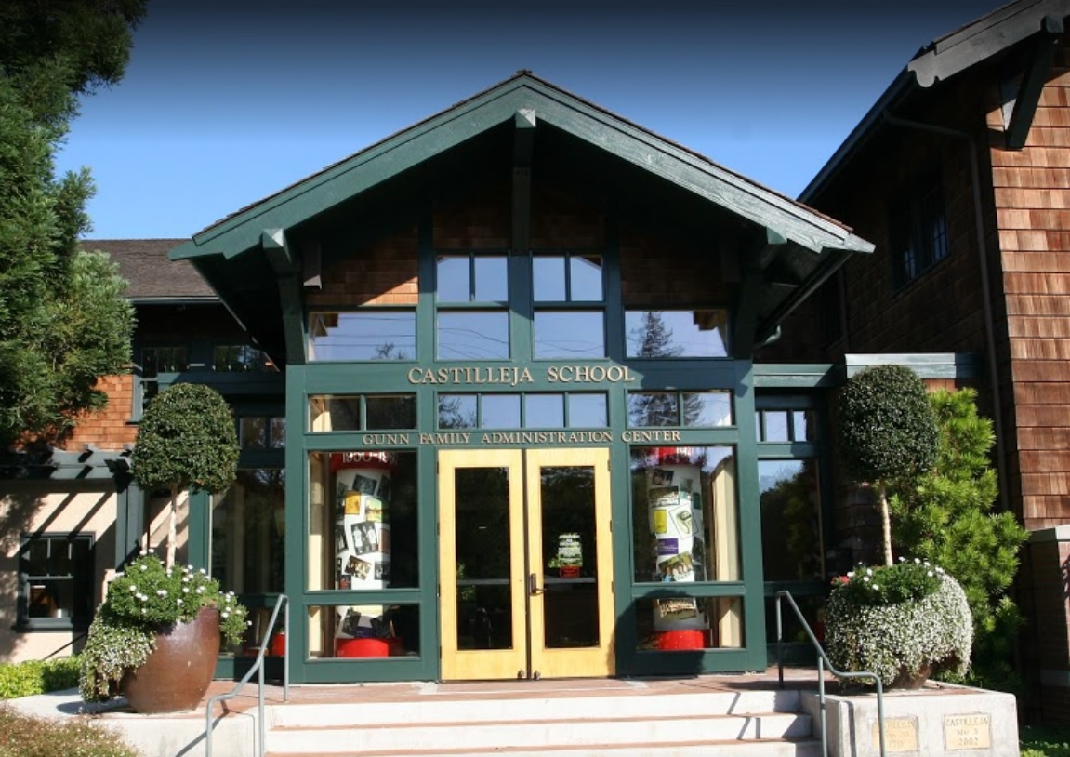
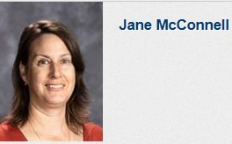
Jane R. McConnell 2018
Credit: Castilleja School
Jane teaches 2nd yr. Biology to seniors, and has led field trips connecting with nature; biotechnology and engineering sustainable solutions.
Credit: Castilleja School
Castilleja School, Palo Alto.
All-girls middle and high school
“Women Learning, Women Leading”

Slide 23
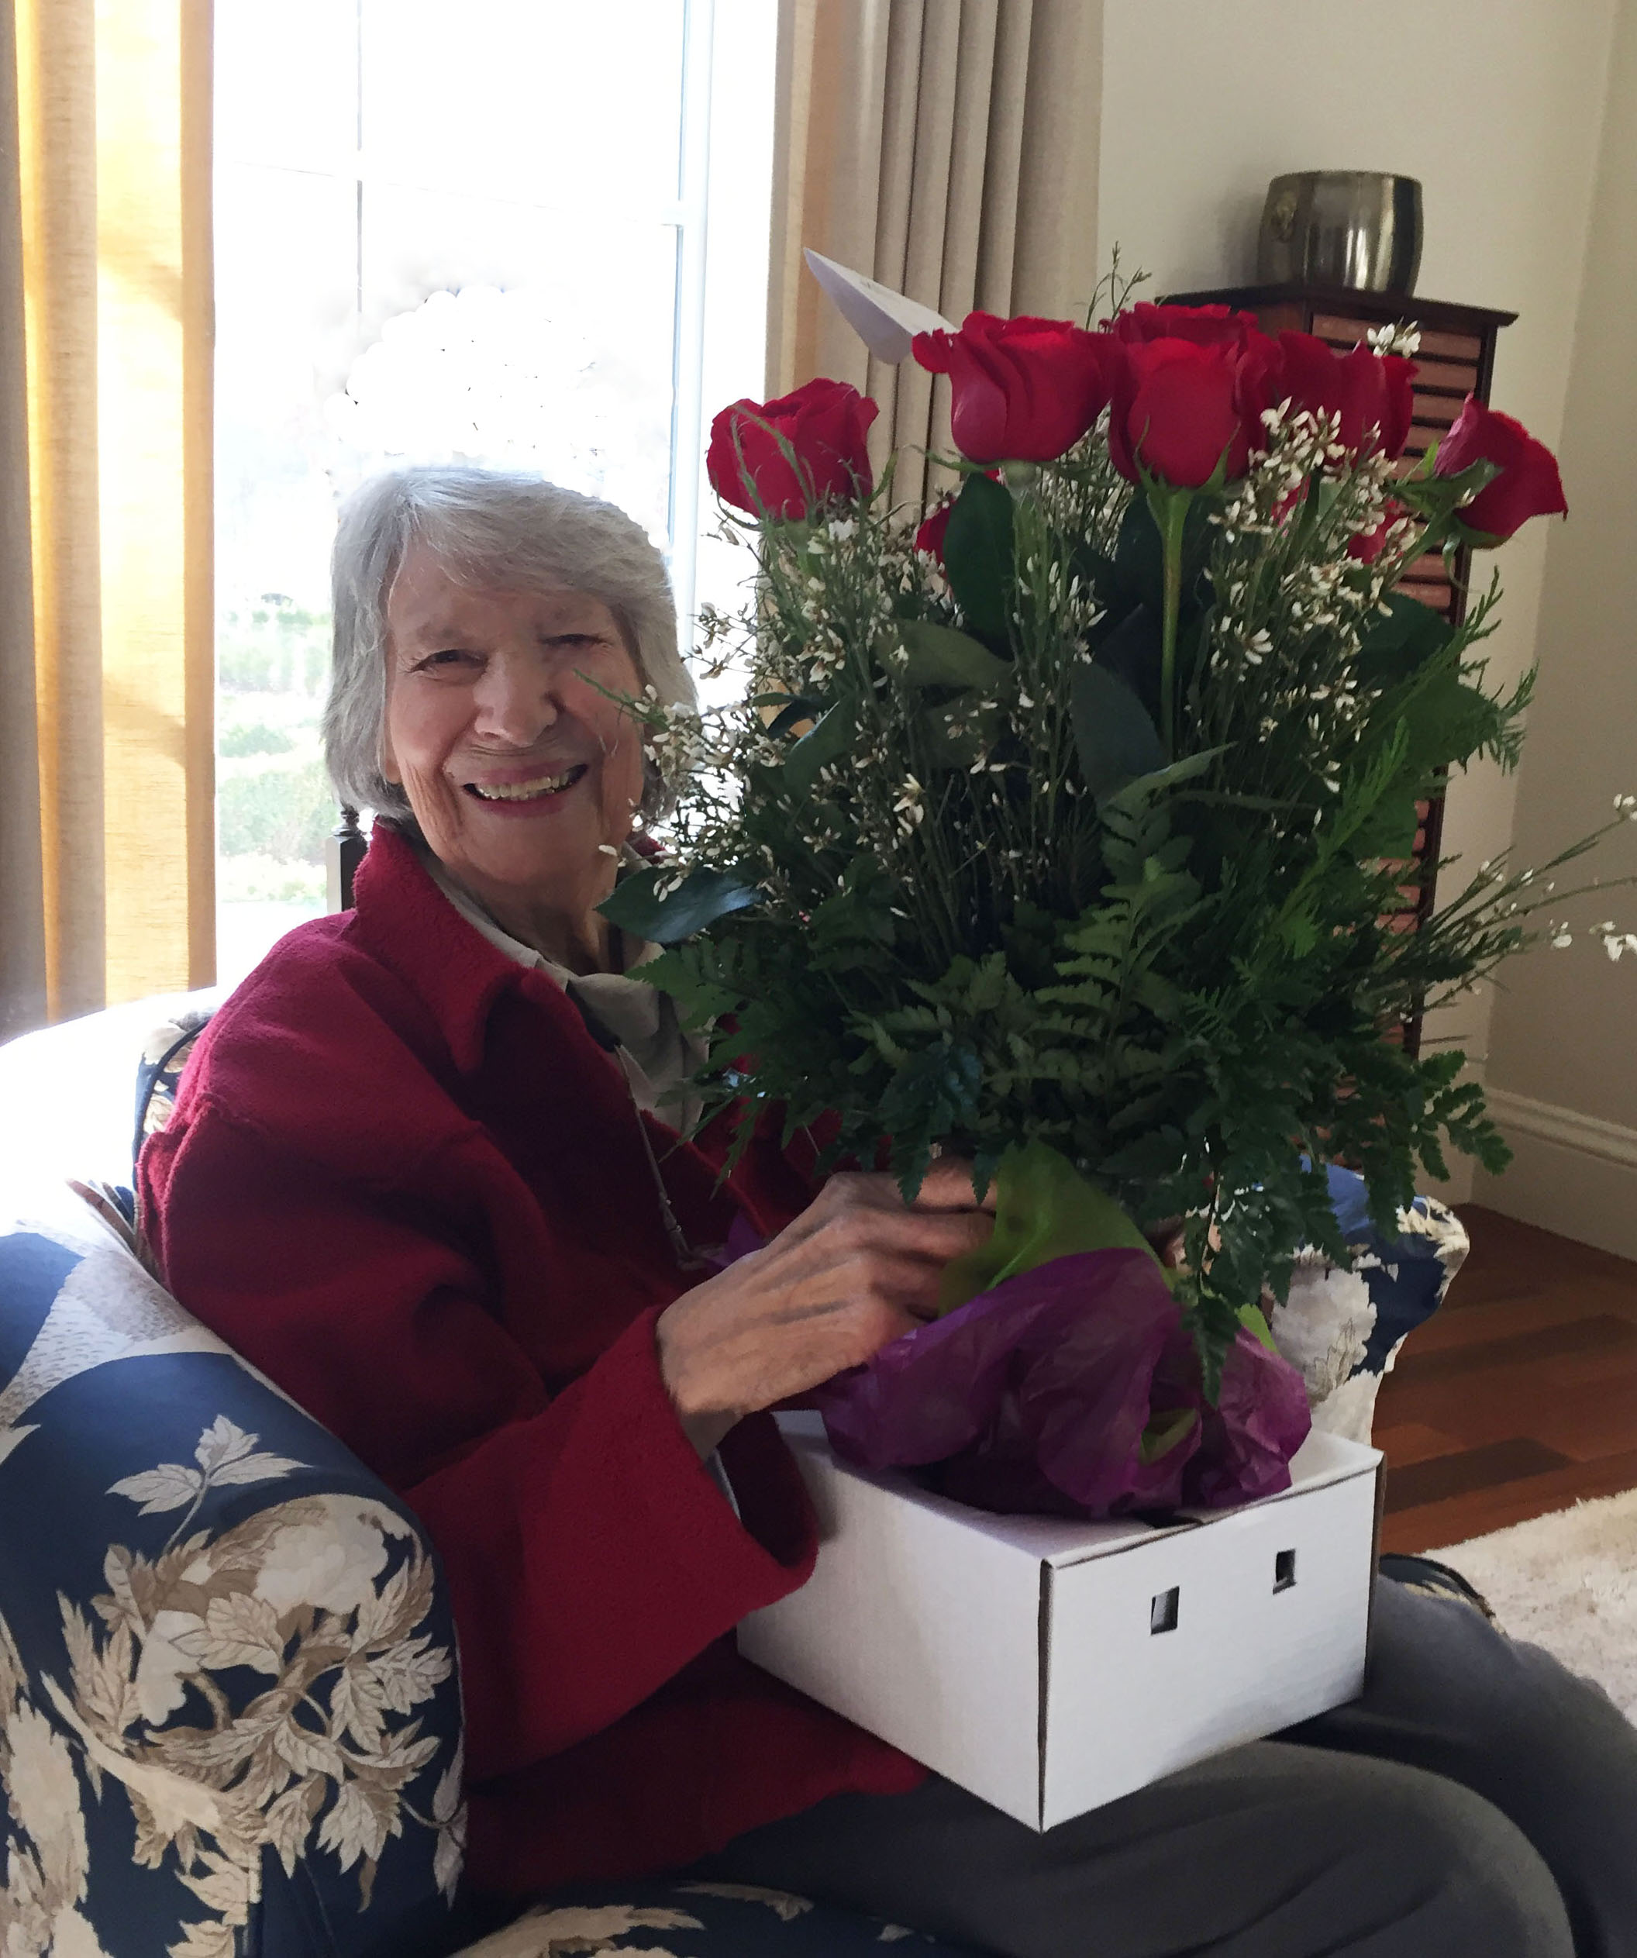
Sophia McConnell 2018
Sophia celebrating the successful completion of the fund drive for the Caltech Harden M. McConnell Lectureship Endowment.
Atherton CA, Dec. 14, 2017
“The Caltech years were simply the best of my life”
Credit: O. Hayes Griffith

Slide 24
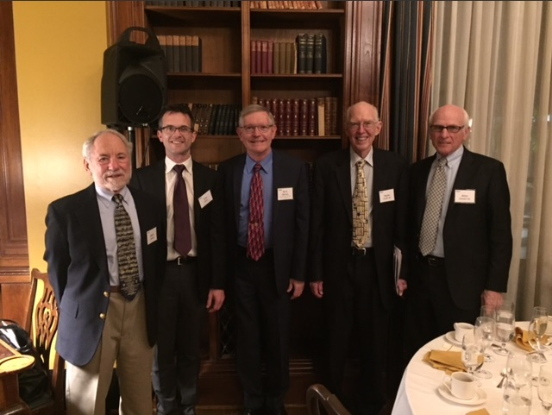
Celebration following the Caltech Inaugural Harden M. McConnell Lecture by Professor W. E. Moerner, Harry S. Mosher Professor of Chemistry at Stanford, Nobel Laureate. April 24, 2018
Credit: Sharon Moerner
Left to right: Gerry Liebling, Tom Miller (Caltech professor and host), W. E. Moerner, Hayes Griffith, and Alvin Kwiram. Photo taken after the dinner in the Athenaeum library.

