Slide 1

Florida Atlantic University Libraries
State of the Collections Budget
and
Faculty Perceptions
Presentation of
Carol Hixson, Dean of University Libraries
hixson@fau.edu
February 16, 2018

Slide 2
Budget for Collections
Rate of Inflation for Library Collections (Print & Electronic)
  7-10% annually
  83.8% over last ten years
FAU Libraries Budget for Collections
  2008 $ 3 million
  2017 $3 million
To Keep Pace with Inflation: $5.5 million

Slide 3
How Have the Libraries Been Coping?
Reducing the amount spent on monographs
  Since FY 13/14: 47% less spent on print books, 86% less spent on e-books, 69% less spent on books overall
Supplementing the collections budget with salary savings
  Already used $144,000 to keep T&F going this year
  Allocated $150,000 before the end of this fiscal year for print books
  Asked to keep aside $300,000 to put into collections next year
Supplementing the collections budget with Technology Fee proposals
  This year, 10 of 19 Tech Fee proposals were requests to purchase scholarly content, for a total of $715,859
  Last year, we were awarded $159,889 for four proposals to purchase scholarly content

Slide 4
In general, how often do you use the library's electronic services or resources from your office, home or other off-campus location?

Slide 5
If the library’s electronic resources were to be significantly reduced, how much would this affect your:
  Very Significant or Significant Impact on:
    Teaching 80.34%
    Research 90.86%
    Remaining at FAU 63.08%

Slide 6
In general, how often do you use the library's print resources (books, journals, etc.)?

Slide 7
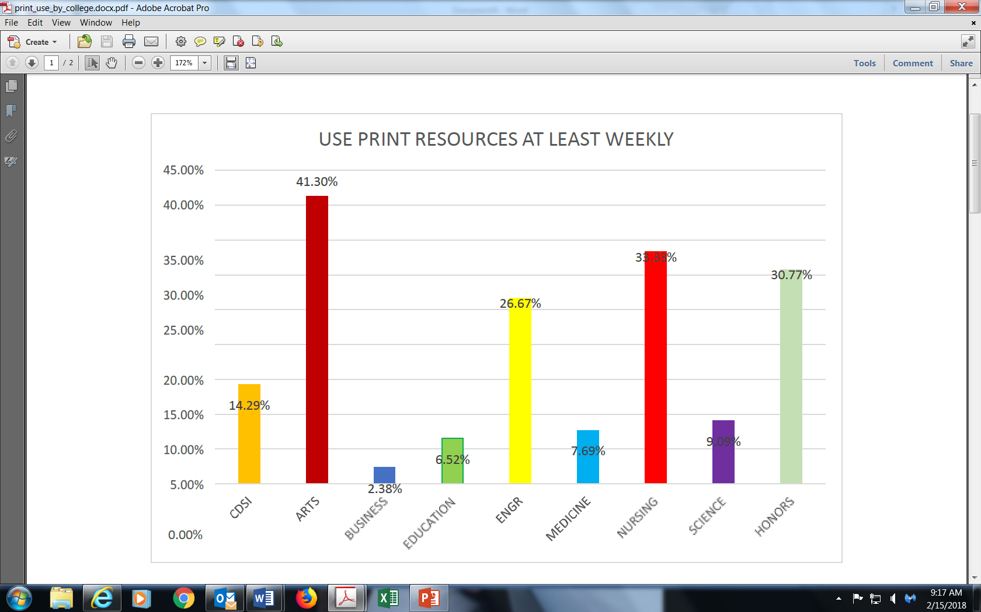
Use print at least weekly by College

Slide 8
If the library’s physical collections were to be significantly reduced, how much would this affect your:
  Very Significant or Significant Impact on:
    Teaching 61%
    Research 67%
    Remaining at FAU 46%

