Slide 1
Forging a new path for instructional development:
Trailblazing for high-impact teaching using peer observation and coaching
Mary K. Oberlies, William & Mary | Sara DeWaay, University of Oregon
Kristin Buxton, University of Oregon | Annie Zeidman-Karpinski, University of Oregon

Slide 2
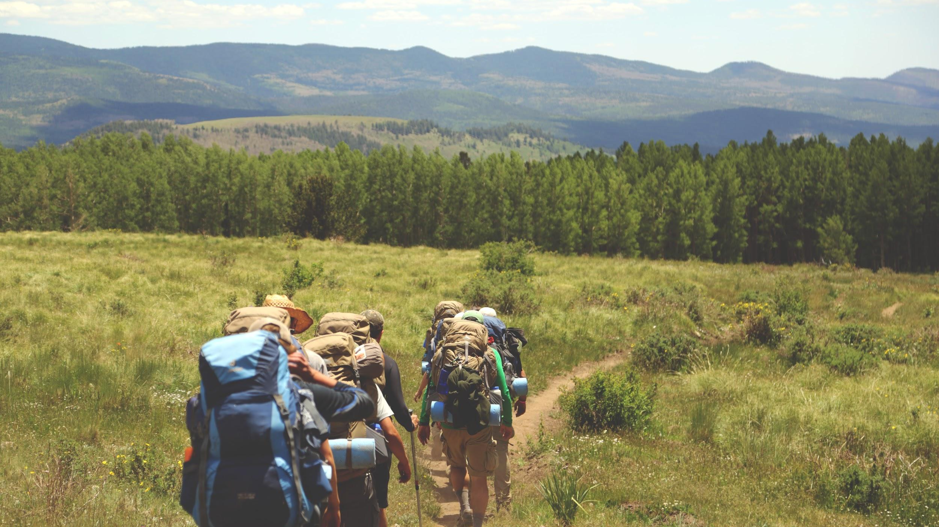
Forging a new path for instructional development:
Trailblazing for high-impact teaching using peer observation and coaching
Mary K. Oberlies, William & Mary | Sara DeWaay, University of Oregon
Kristin Buxton, University of Oregon | Annie Zeidman-Karpinski, University of Oregon
Notes:
AZK
Welcome and here is how what we are going to do in the next 40 minutes will help/change your life/make things better.
ONE MINUTE
I want to start by telling you a story about Carl Wieman. He is a physics professor, he happens to have won a nobel prize, and he also teaches large classes in STEM. Students LIKED his lectures fine, but when he asked them what was the point of his lesson, he found out that very few students could name the main ideas. He discovered that lecturing wasn’t getting his important points across. So, he did some research. He looked into what others had done and found out that there were things he could do to make his classes more effective.
Ok. this is also a story relevant to us. We have learners in our classroom for such a short amount of time and there is so much they NEED to know. How do we make sure that they remember what we covered? How do we know that it was worth our time and was useful for the students too?
We are here to tell you about 3 tools we customized, two from Wieman, that can help you understand what is happening in your classes and identify ways to improve the quality of our instruction.
We use peer observation and mentoring to help you identify evidence-based practices, understand what occurred in your classes, and lead to student-focused teaching. This presentation will discuss these tools and our initial findings.
https://unsplash.com/photos/juHayWuaaoQ
https://www.youtube.com/watch?v=T7uC3NYUCH0

Slide 3
Scenario: What would you do?
We have an awesome way you can improve your instruction, but you must invite another librarian into the classroom to observe you.
  There is NO WAY I would do this.
  I would CONSIDER doing this, but I’d need more information.
  I MIGHT do this with someone I trust.
  I would DEFINITELY do this.
Notes:
SD
We would like to start with a quick activity. Throat vote is the 2nd most effective, after clickers, in large classrooms for getting students to respond. Using throat vote, which means that only we up here can see your choice because you put your answer in front of your neck like so <demo>.
“We have an awesome way you can improve your instruction, but you must invite another
librarian into the classroom to observe you.
1. There is NO WAY I would do this
2. I would CONSIDER doing this, but need more information
3. I MIGHT do this with someone I trust
4. I would DEFINITELY do this
Great – so I'm seeing…

Slide 4

Student success
Skills needed to thrive.
Ability to contribute meaningfully in their futures.
Positive library experiences help!
Notes:
Photo by Austin Schmid on Unsplash
SD
I'm Sara and I'm going to give you an overview of this project and later talk about impact.
One of the reasons we undertook peer observation at University of Oregon (or UO) Libraries is because we have an interest in supporting student success beyond graduation and retention rates. We want to foster life-long learners, students who have the critical thinking, research and analysis skills, and the inquiry needed to succeed in their future careers. We want them to thrive and contribute meaningfully in today's global society.
To do that, we aim to create a culture of learning through engagement. We already know that there are positive relationships between retention and higher GPAs for students who use the library at least once during their first year at the university. We also see that active learning during one-shot library instruction appears to have a positive relationship with higher GPAs and persistence. So, we know that libraries do good things to support the institutional definition of student success, but we can go a little further to create a culture of engagement. And we need to understand if the services we provide and the instruction we give in one-shot sessions are doing this.

Slide 5
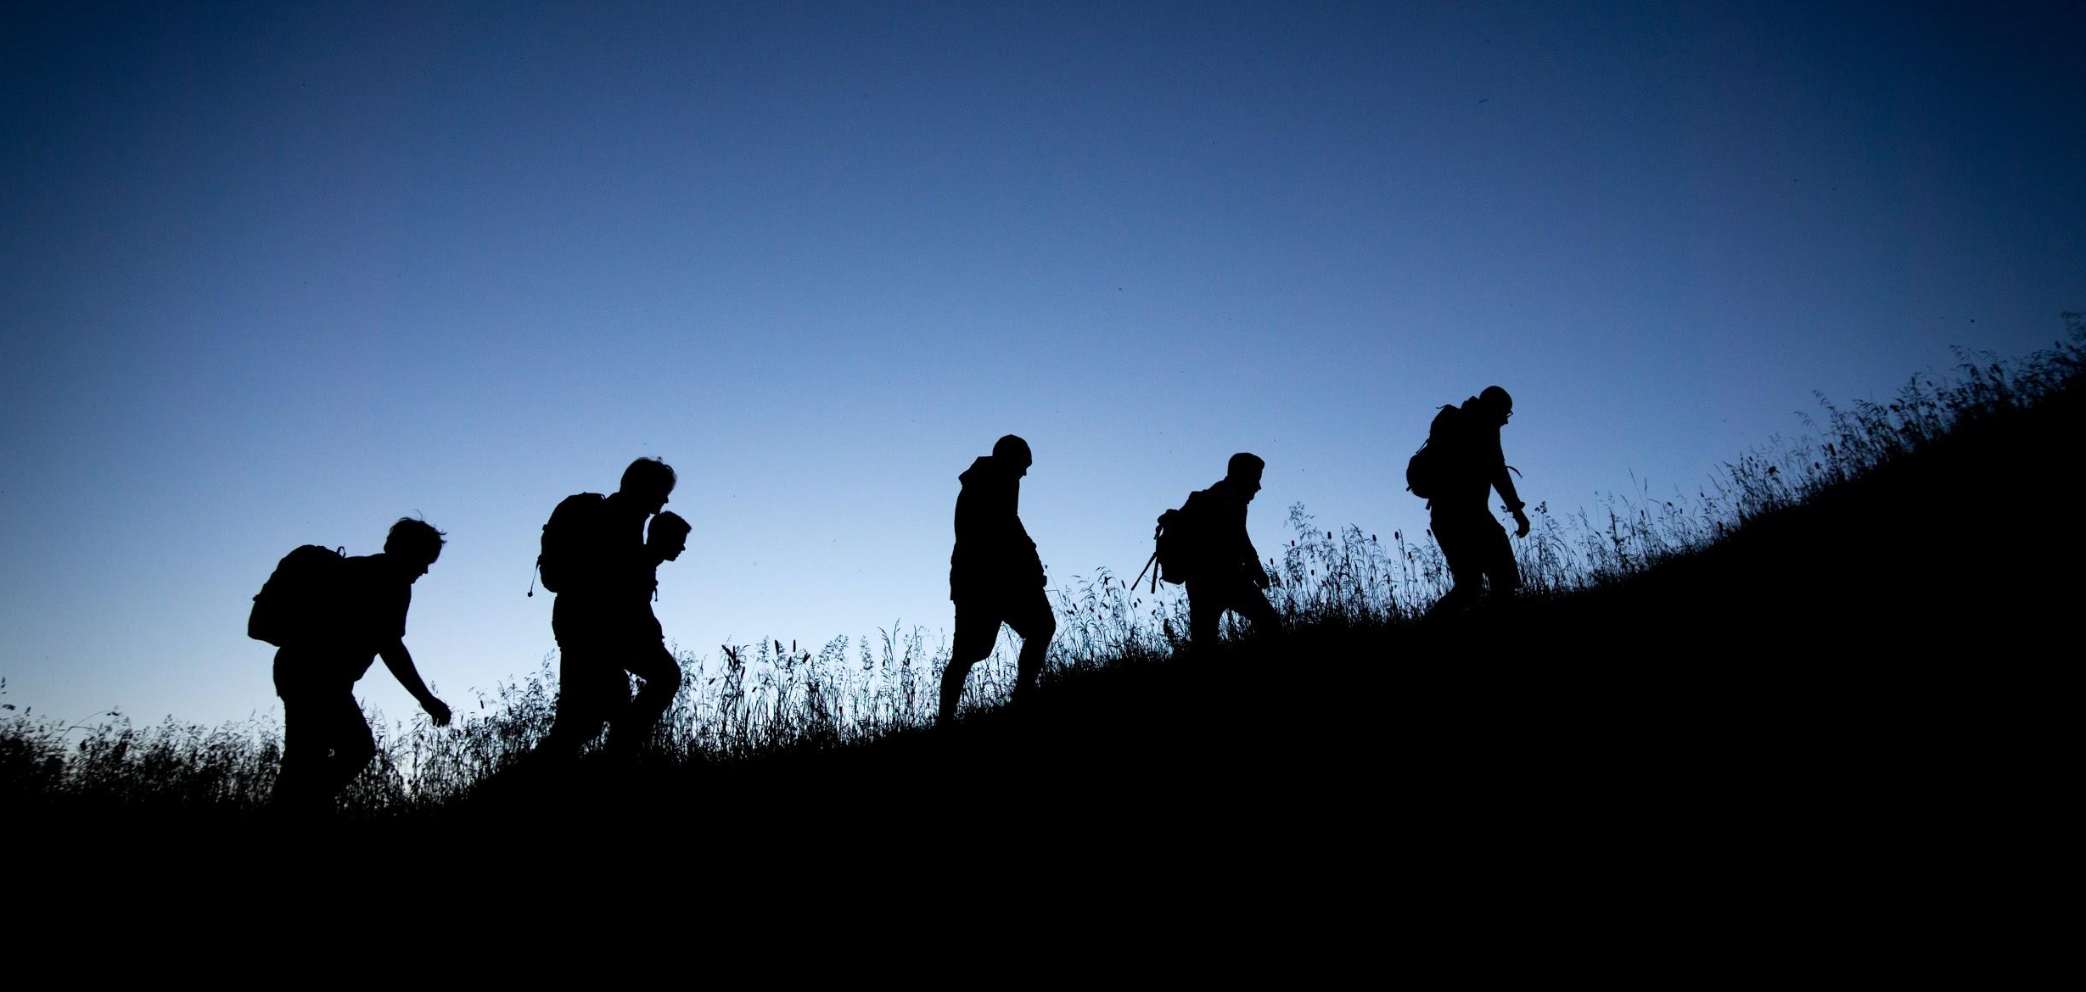
Why supportive peer observation & mentoring?
Conducted with those you trust, ground rules, and unbiased tools, peer observation helps us understand our instructional practices and move towards student-centered teaching.
Mentorship and reflection create environments for learning and improvement.
Notes:
Photo by Tobias Mrzyk on Unsplash
SD
This is where observation comes in: through the tools we are going to elaborate on in this presentation, we are able to measure and look more closely at how our time is used and the work that students are doing while in a library instruction session to best structure our work and focus on engagement. Peer observation is what helps us understand whether or not we are practicing student-centered teaching – it tells us if we are encouraging engagement.
The way we implemented these practices at UO is formative – it is voluntary and designed to encourage reflective practice and to facilitate the instructors' individual growth, rather than to be used as an evaluation process for things like promotion and tenure, although they could be used for that. For us, we needed to grow trust in each other and test this process by creating safer spaces, setting norms, and focusing on personal growth.
Peer observation relates directly to mentorship. Observation can feel scary, but most of us will agree that mentoring is valuable. I think many of us will admit that our MLIS program did not offer a lot of support for learning how to teach, so we can really benefit in learning from what others have tried and reflecting on our own attempts.
Supporting librarians and creating a culture of reflective teaching and active learning can result in more organized, clear, and engaged one-shot library instruction that is student-centered. Building trust and support with each other to move away from judgment towards mentorship allows us to try new things and improve our instruction. In other words, student success is amplified by teacher development.

Slide 6
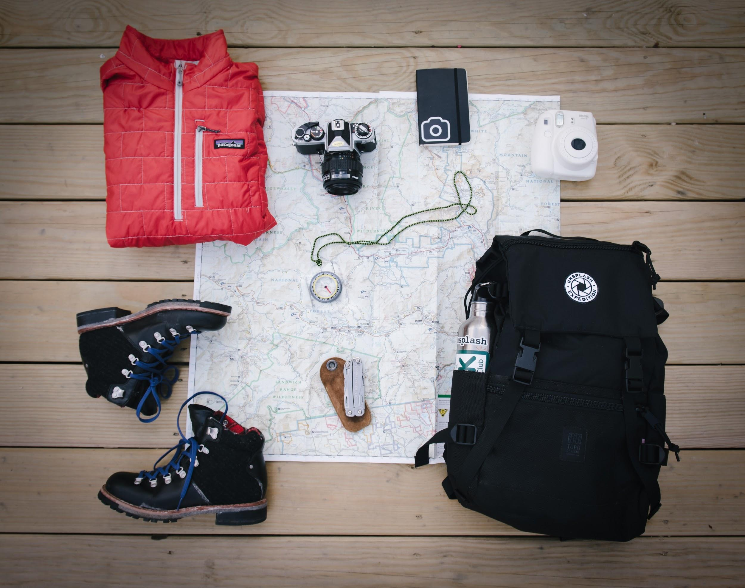
Three tools to help improve teaching
Teaching Practices Inventory - Information Literacy Instruction
Teaching Squares
Classroom Observation Protocol for Information Literacy
Notes:
Photo by Alice Donovan Rouse on Unsplash
SD
These are the tools we are going to talk about today. Kristin will talk about the Teaching Practices Inventory – Information Literacy Instruction (or TPI) which is helpful in promoting self-reflection and can be used alone or with either of these peer-observation methods. Mary will address Teaching Squares, a supportive, group-based, observation model. And Annie will complete the trail with the Classroom Observation Protocol for Information Literacy (or COPIL) which is a one-on-one observation tool that helps measure student and teacher activity during a class session.

Slide 7
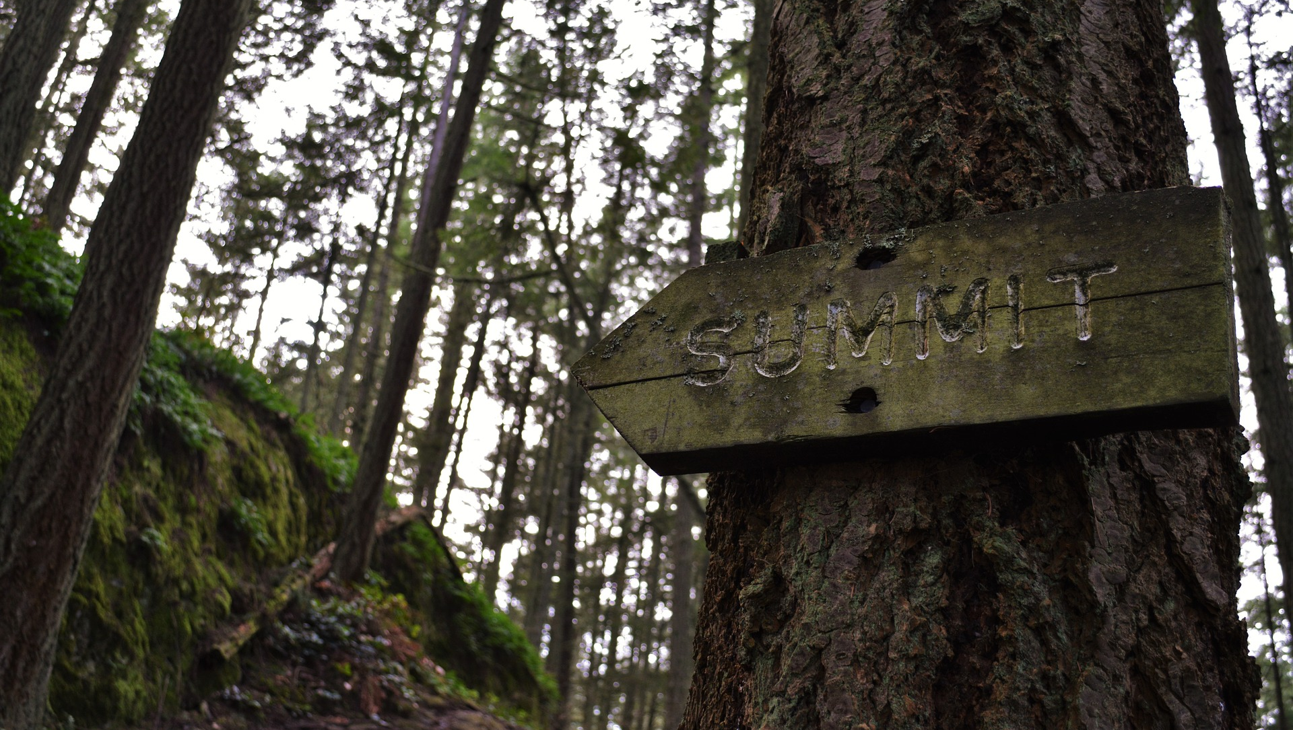
Teaching Practices Inventory (TPI)
Created to quantify the teaching practices of STEM faculty (Weiman, Gilbert & Dolan, 2014).
Focuses on high impact activities.
Encourages reflection.
Notes:
Image by mcfisher from Pixabay
The original Teaching Practices Inventory (TPI) was developed by Wieman and Gilbert in 2014 to quantify the teaching practices used by science, technology, engineering, and mathematics instructors. They created the inventory based on prior research into effective teaching practices in STEM courses. The inventory consists of 72 items an instructor might include in a course. These include items like providing students with a list of topics to be covered, how many times per class students have small group discussions, and whether you discussed how to teach the class with colleagues. Each item has a point value assigned according to its efficacy based on evidence. For individual instructors, TPI can provide a list of practices they are already using, provide high impact activities they might want to adopt, and a method to quantify changes in their teaching over time. The TPI helps with reflective teaching practices and is designed to give instructors a clear path to understanding, and then using, best practices in their classes

Slide 8
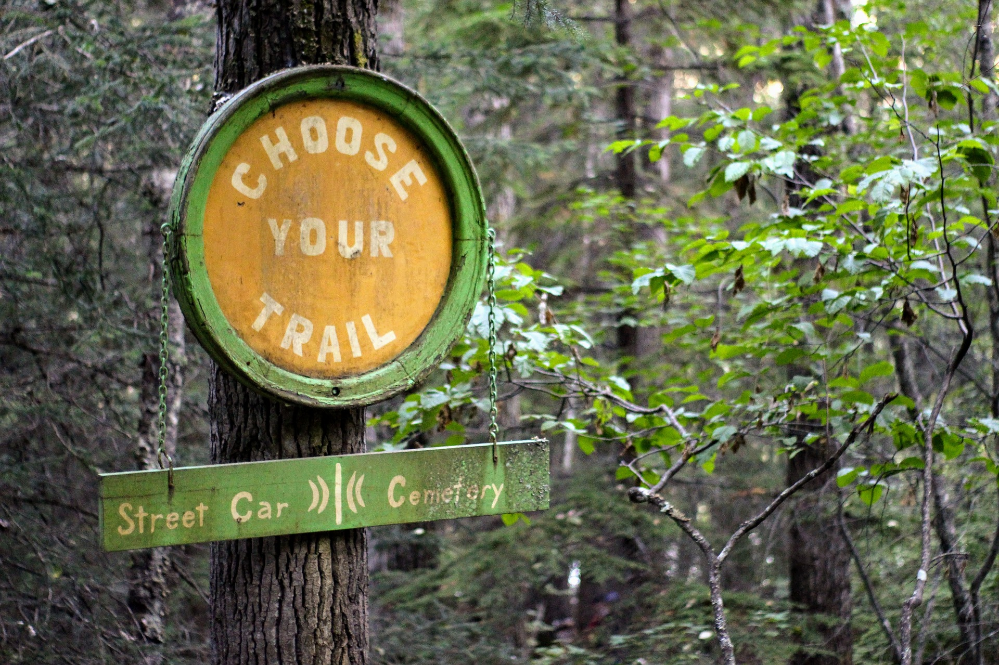
Teaching Practices Inventory - Info Lit Instruction
Adapted for one shot instruction.
New order: before class, during class, and post-class activities.
Clarified roles of librarian instructors & course instructor.
Added library specific items like LibGuides.
Notes:
Image by Andrew Becks from Pixabay
When we started to apply this to our information literacy one shots, we realized it wasn’t a perfect fit since it was geared towards term-long credit courses. We decided to create a modified version, Teaching Practices Inventory-Information Literacy Instruction (TPI-ILI), specifically aimed at librarian instructors. While we left much of the inventory alone, we did make changes in multiple areas. We changed the focus from a full term class to a single session, removed some items, and rearranged the items to fall into pre-class, during class, and post-class activities. We also clarified the roles of the course instructor and librarian since they are assumed in the original TPI to be the same person. Finally, we added library-specific items such as providing a LibGuide or other electronic resources to the students. The original TPI has weighted scores for each item, which we have not yet added to TPI-ILI. We’re hoping librarians at other schools will help us fine-tune and validate the tool.
TPI-ILI is a tool you can use for reflection on your own teaching. While we encourage people to use it with one or both of the next tools we’ll be presenting, it can be used on its own, and you can use it even if the rest of your colleagues don’t adopt it.

Slide 9
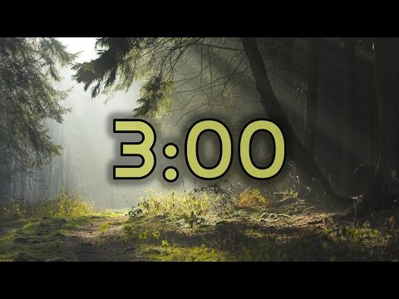
Think about a class you recently taught and complete the TPI-ILI in front of you, or take the online version at: http://bit.ly/loex-TPI-ILI
Notes:
Image by Greg Montani from Pixabay
KB

Slide 10
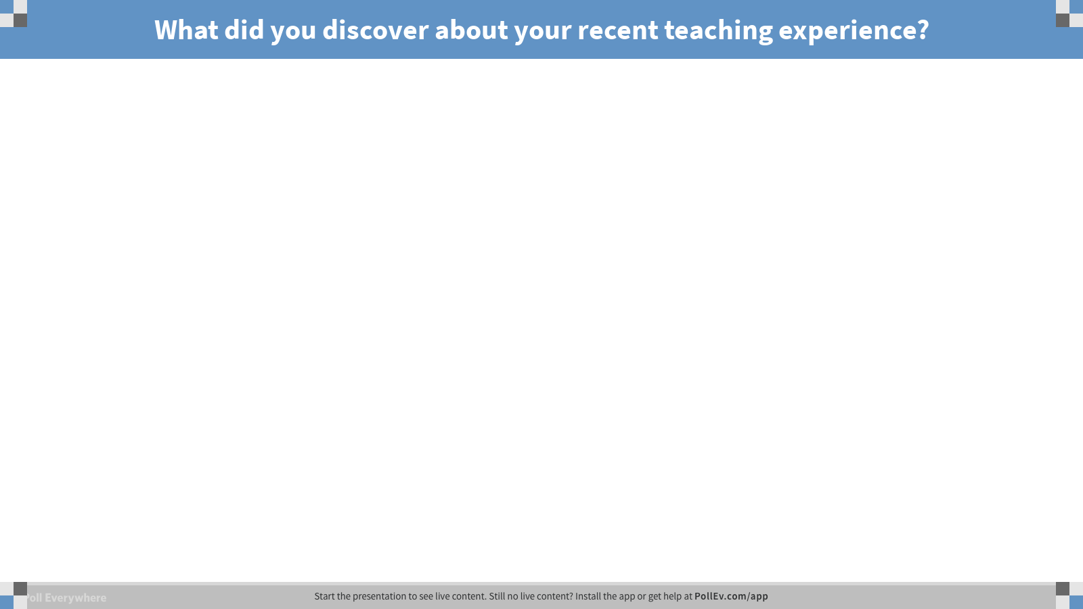
Notes:
KB
TPI-ILI Share out
Pollev needs chrome and the chrome extension installed

Slide 11

Teaching Squares
A non-evaluative program of peer observation that fosters reflection and establishes a community of practice.
“Unsure about something? Square to the rescue!”
Notes:
Teaching Squares was developed by Anne Wessley at Stonehill College, and it has been adopted by several library instruction programs at this point, including George Mason University, University of Oregon, and the University of Alabama. It is a non-evaluative program of peer observation that fosters reflection and establishes a community of practice. The intention is to create a low stress, supportive environment that encourages reflection on personal instruction goals with three of your peers. Each Square consists of four librarians who agree to observe each other teach, reflect on what they’ve seen and meet to share what they have learned from observation and reflection. An instruction coordinator, or someone in a similar role, assign participants to their Squares taking into consideration: years of experience with teaching, subject expertise, social networks, and teaching methods. This helps to create a blended Square so participants see a range of teaching styles, interact with people they might not always get a chance to, learn from others, and see how teaching happens in different subject areas. Trust between Square members is important, so giving people an opportunity to provide input on its membership is helpful.
Within the Squares each member establishes a teaching goal they would like to focus on during the program and the Square meets to share these goals, talk about what they hope to get out of the Square and begin setting up times to observe one another. Prior to the observation, it is helpful for the member teaching to share information about the class and anything they’d like the member observing to make note of during the session. For example, in my first Square at George Mason, I requested my Square-mates look out for problems with clarity in my instruction and make note of the examples I was using and whether they worked. I loved referencing Indiana Jones, but I found out from one of my Square partners, that while she also loved the reference, the students weren’t making the connection. The member observing the session takes notes about what happened during the instruction and reflects on what they saw and how they could apply it to their own instruction. Following the observation, the teaching librarian also reflects on the experience. Once the program concludes at the end of a term, semester or year (depending on how you want to structure it), the Square meets again to share about the experience, what they’ve learned and how they would like to proceed.
I’d like to mention that Teaching Squares do not have to be only about observation, they can also be an opportunity for members to explore a new teaching practice. In one of my Squares we decided we would like to focus on learning about problem-based learning and how we could incorporate that into our teaching. We began with identifying literature, and met to discuss the readings and how we thought we could translate that to our own teaching. One thing to note though, is that members only get out of the experience, what they put into. Teaching Squares can be powerful, but if the members do not participate 100% it won’t be as effective as it could be.
The bottom line. Teaching Squares embraces the ethos of celebrating and appreciating the work of colleagues, reflecting on observations, and considering how to apply those observations to personal instructional growth.
Photo by Arthur Poulin on Unsplash

Slide 12

Reflective Practice
Multiple levels of reflection - personal instruction, peer instruction, Square experience.
Notes:
I want to focus a little bit more on the reflective practice within Teaching Squares. It inherently has multiple layers of reflection, making it a great way to practice and turn reflection into an everyday practice.
Focusing first the individual teaching: Each librarian reflects on their own instruction - we provide our librarians with Char Booth’s Three things you’ve done well/Three things you’d like to change/improve - but any type of prompt can help librarians get the synapses connecting and begin reflecting. Once it becomes more of a habit, prompts aren’t as vital to help with the process.
Second, the individual observing: Each observer in our program completes a double-entry form where they record what is happening and their personal reflection on what they have seen. This is an opportunity for the observer to take in information and think about how they could use that for their own instruction. This can also serve as a chance to overcome imposter syndrome, connect with another librarian, and gain new insights.
Third and finally, the group: Each Square wraps up its work with a Teaching Square Self-Reflection - we provide each group with 5 questions (what they did, what they gained, how they plan to integrate this new knowledge, what they would change or wouldn’t change, and did the Square help them progress toward their goals).
These three reflections help the Square accomplish their final activity - the Square Share - where they meet at the end of the program to discuss the experience and where they want to go for the future.
Photo by Keegan Houser on Unsplash

Slide 13

Time for a Commercial Break
Create a group
Whose name comes first alphabetically - you’re the leader this round!
The leader is provided a task
Group cheers the leader on, counting off each answer (“1-2-3”)
Party like it’s 1999 when the leader finishes the task!
Notes:
MO
Activity 2: cheering : We are going to do an activity, it may seem a little odd, but trust us, we’ll explain more about what we are trying to do afterwards.
In groups, identify whose name come first alphabetically. You are going to lead your group in this round and will go first. I’m going to give the leader a task, and the rest of the group will cheer them on by counting off each answer - so “1 - 2 - 3”. Once the leader finishes the task, I want the whole group to cheer on their success and congratulate them!
Name 5 colors
Name 5 languages
Name 5 rivers
What were we doing?
First off this activity is meant to get you moving. It’s early and we want you energized. Second it puts you in a different mindset by creating a supportive and positive atmosphere. You’ve also just mimicked the nature of a Teaching Square. I mentioned before that Teaching Squares embraces an ethos of celebration and appreciate the work of colleagues. As you cheered on the person responding to the task, your group created a supportive atmosphere for that person. It no doubt helped the next person feel more confident about being the new leader of the group, because they already knew that the rest of you were going to be cheering on their work and success. With this activity we’ve laid the groundwork for the creation of a community of practice. When you identify a group of people who will listen to you, support you and cheer you on - and you do the same for them, you’ve found a community you can go back to over and over again.
Image from: https://unsplash.com/photos/pPquxoraq_M

Slide 14
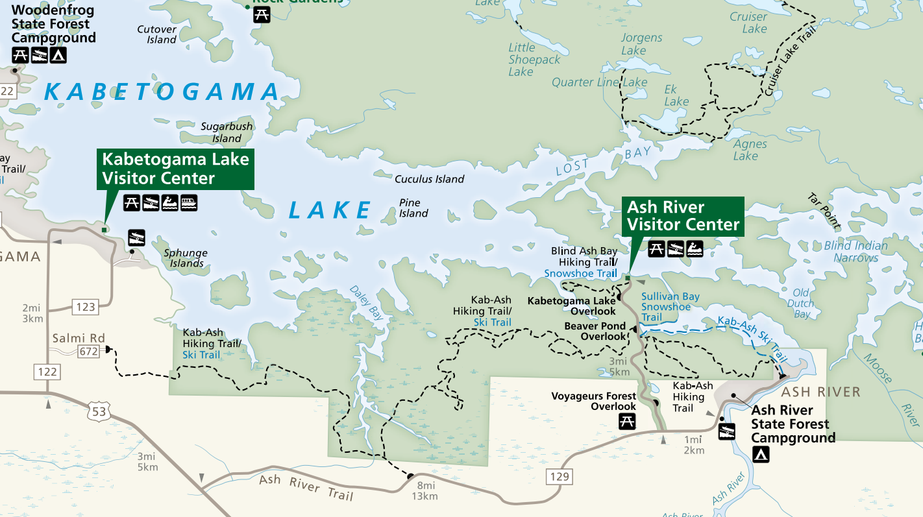
Classroom Observation Protocol for Info Lit
Documents how the instructor(s) and students are spending their time in the classroom.
A snapshot of your current practice.
See what works and what you want to change.
Notes:
National Park Service, Voyageurs Park Map: https://www.nps.gov/voya/planyourvisit/upload/VOYA22113s2-pdf-2-22-13.pdf
Based on COPUS, used in large enrollment classes in STEM and now one for lab classes too
COPIL has a trained observer recording a class session being taught by the librarian, the observed. The ObservER, documents what the students and teaching librarian are doing using specific observation codes in small time increments. The obserVER codes typical classroom activities, interactive activities, and non-instructional activities as well as evidence-based practices.
For our program, we asked librarians who participated in TS to complete a COPIL observation in the spring. Before an observation they had meeting, sometimes by email, to make sure they both know basic information about the class, lesson plan, and instructional goals. Afterwards they close the loop using the TPI-ILI and a structured post-instruction written reflection and we strongly think that an in person meeting with the observer is important.

Slide 15
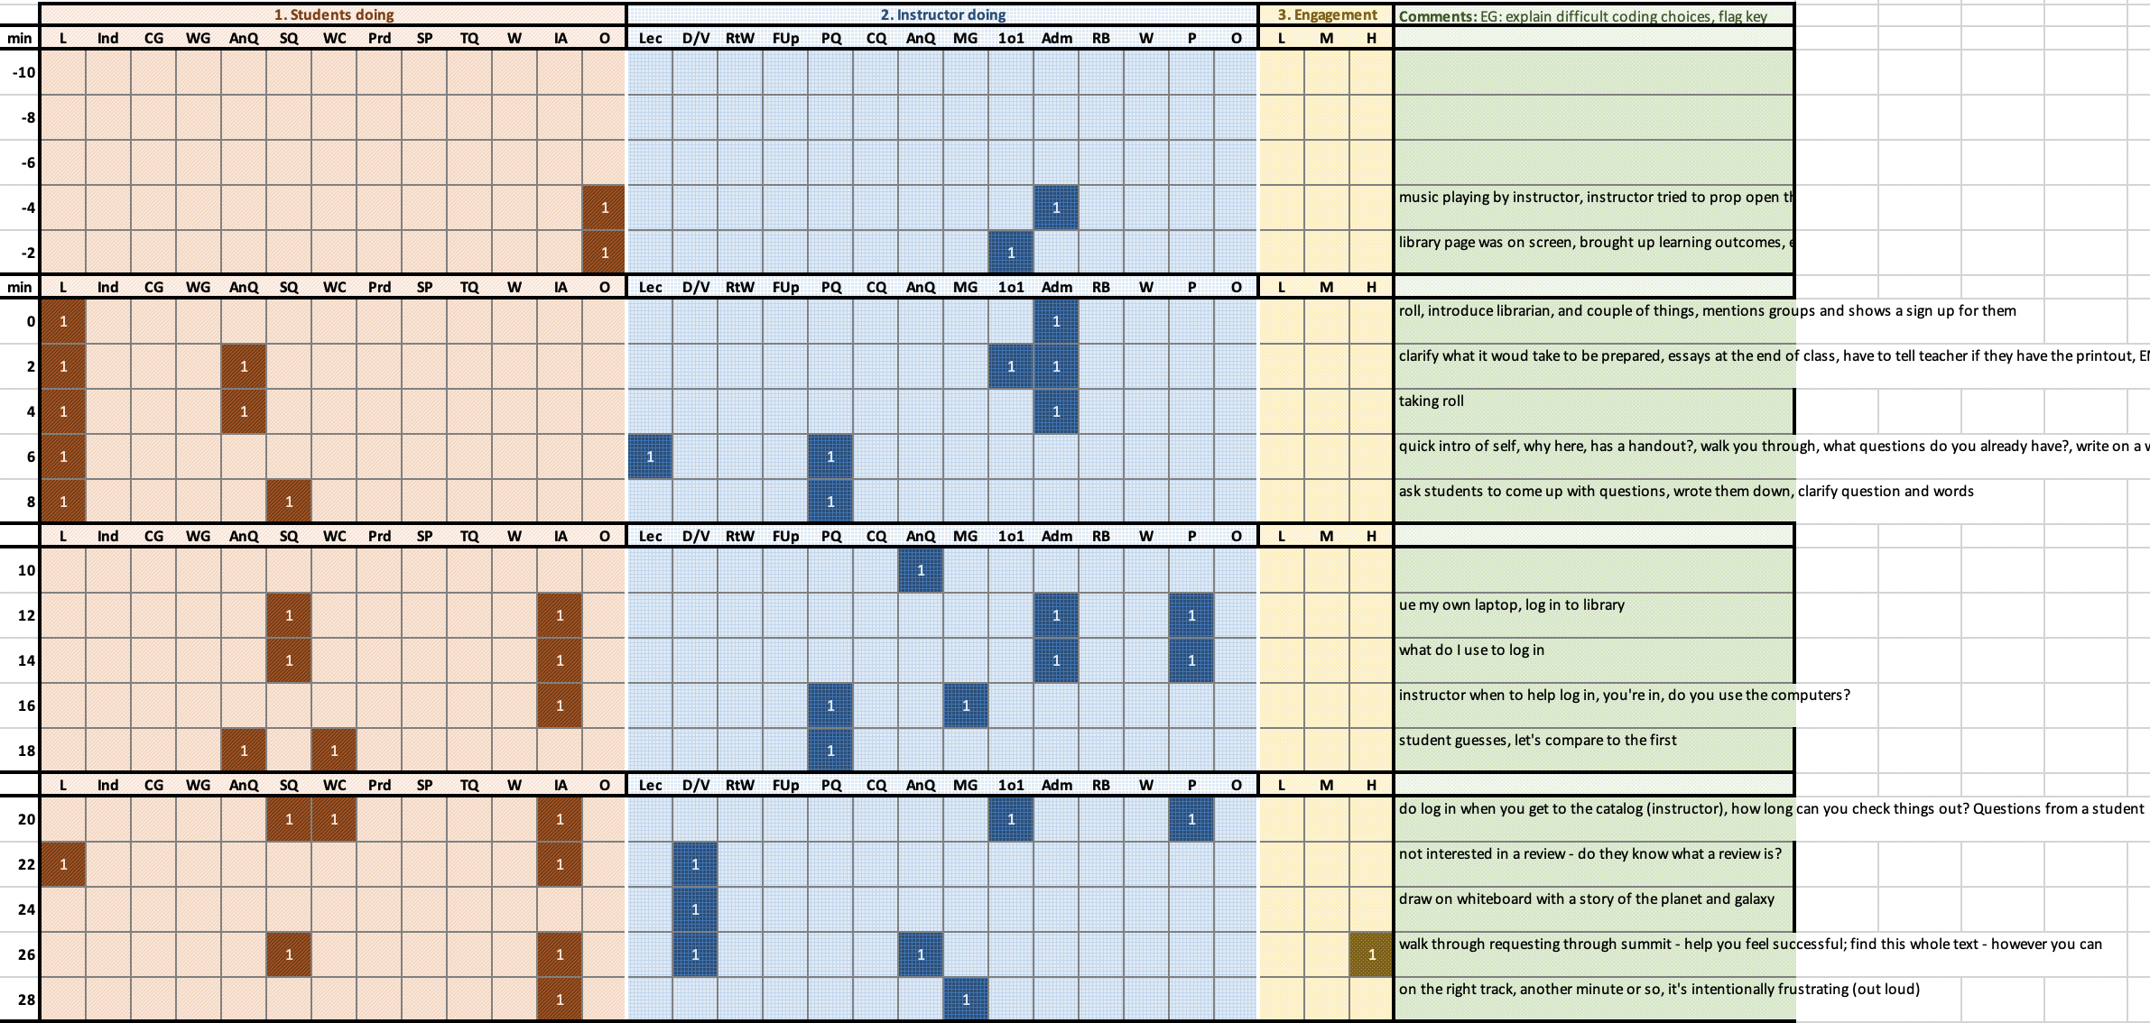
Notes:
AZK: Snapshot –
2 minute increments
Forces you to observe and classify what is happening into one of 13 categories

Slide 16
Notes:
Student listening, instructor is lecturing
Students are answering question, instructors posing questions (here instructor asking about HW requirements)
Student ask a question, instructor answers
Other uses:
Can aggregate scores to find areas for improvement/training
You can generate some interesting data visualizations….

Slide 17
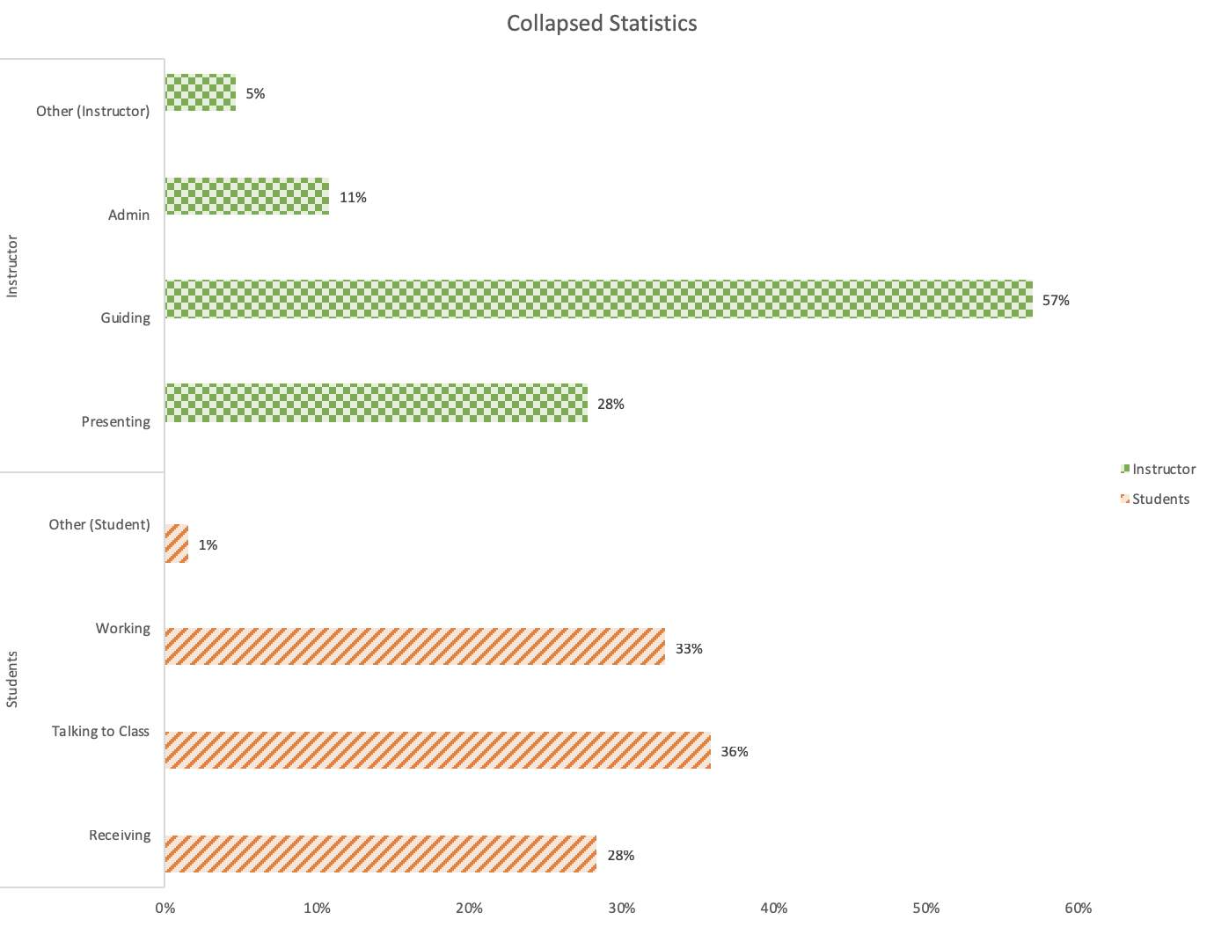
Notes:
AZK
The observation spreadsheet creates graphs that provide visual representations of how time was spent in the classroom, including the percentage of time spent conducting specific activities.
Notes what is happening, codes what's happening, and produces graphs of what you're doing in a class session.
Takes the buckets and puts it into 4 groups
Correlary of one to other

Slide 18
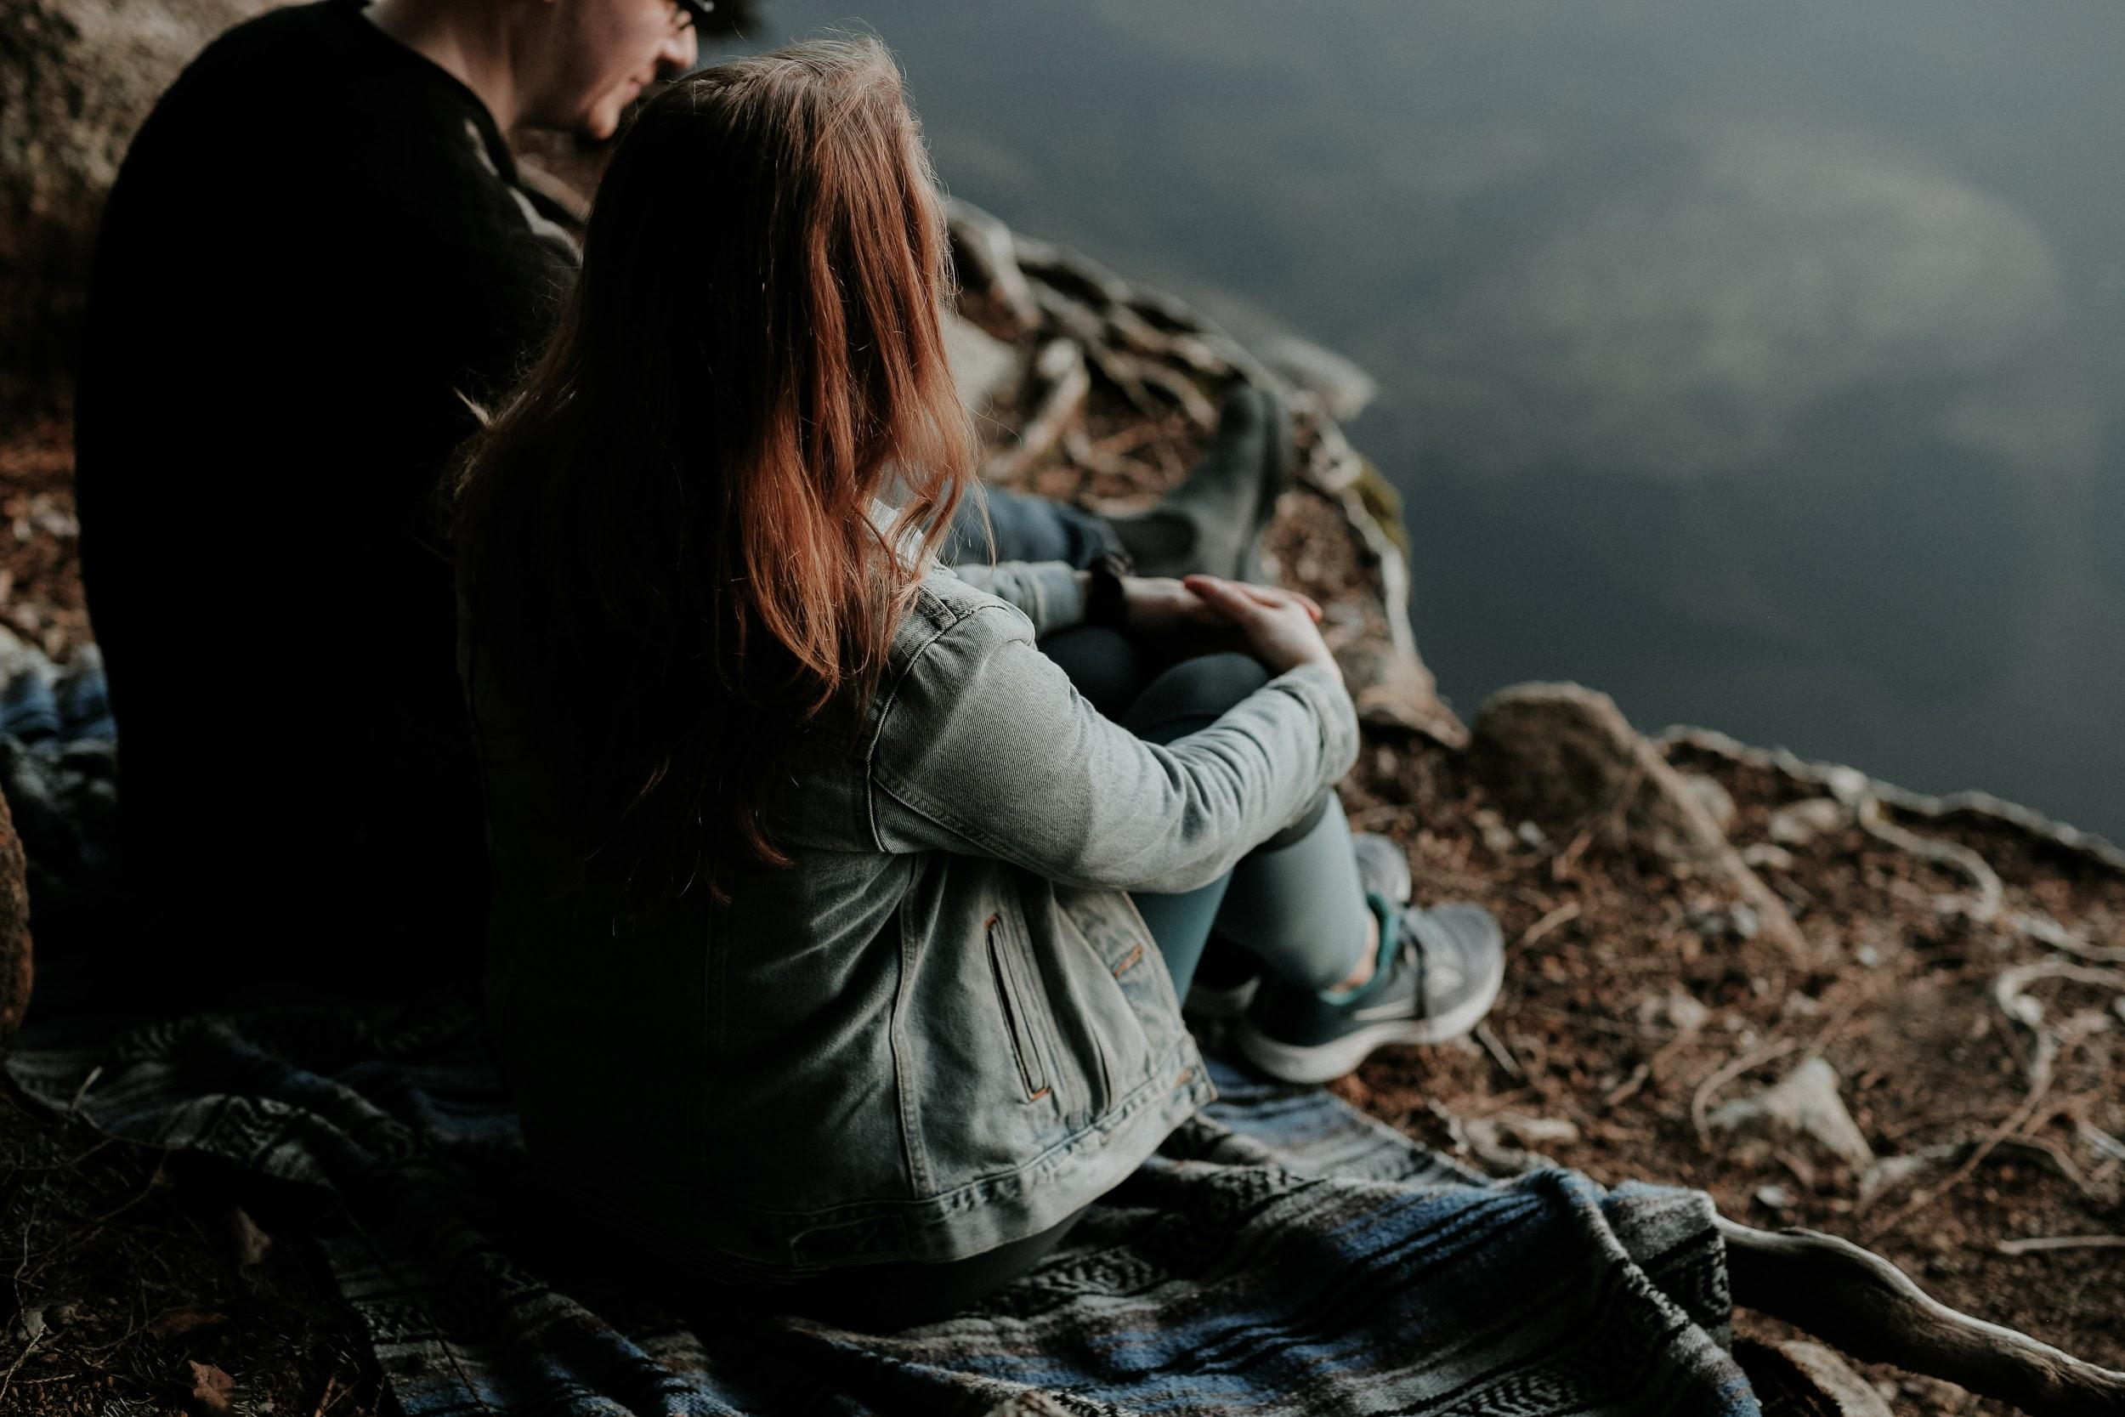
Reflection Element
What went well? What do you want to change?
What can we do to support you?
CONFIDENTIAL
Notes:
AZK - These pieces build on each other!!!!!!
The teaching librarian has the chance to note any differences between their two TPI-ILI results (TS session and COPIL session), reflections, and their teaching goals to measure change/growth. During the post-instruction meeting, the observer and the person observed will review the COPIL codesheet and graphs, and complete the COPIL and TPI-ILI follow-up reflection document.
Some questions in the TS document and COPIL reflection overlap. The intention behind this repetition is to encourage reflection as normal habit after teaching. The COPIL reflection template contains pre-instruction and post-instruction interview questions, which encourage librarians to compare their teaching plan, the actual events of the class, and ideas for future instruction.
All of the information gathered in this program, TS, TPI-ILI and COPIL, is confidential and for the sole use of the observed librarian. For the observER as you complete the reflection, you have a chance to think about what you saw. 1 of the questions is also about what the observER can do to support the observed. You can use the observations to document your work, goals and growth for contract renewals, promotions, or anything else. We aren’t tenure-track faculty at our libraries, but this is a tool modified from one used for tenured instructors from other disciplines and may be of particular interest to librarians who include instruction evaluations in their tenure files.
Turn this over to Sara about what we learned from the pilot.
Training for COPIL, if asked:
COPIL observers require training to accurately complete the observation matrix consistently with other observers. The COPIL training takes about 2 hours and consists of watching instructional videos and repeatedly completing the COPIL observation matrix, discussing findings, and comparing scores with others in the training. By the conclusion of the training, the observers should understand how each code is used so they can document the same information from observation to observation. A cohort of observers should be identified and trained on COPIL before the start of the second half of the academic year.
Photo by Priscilla Du Preez on Unsplash

Slide 19
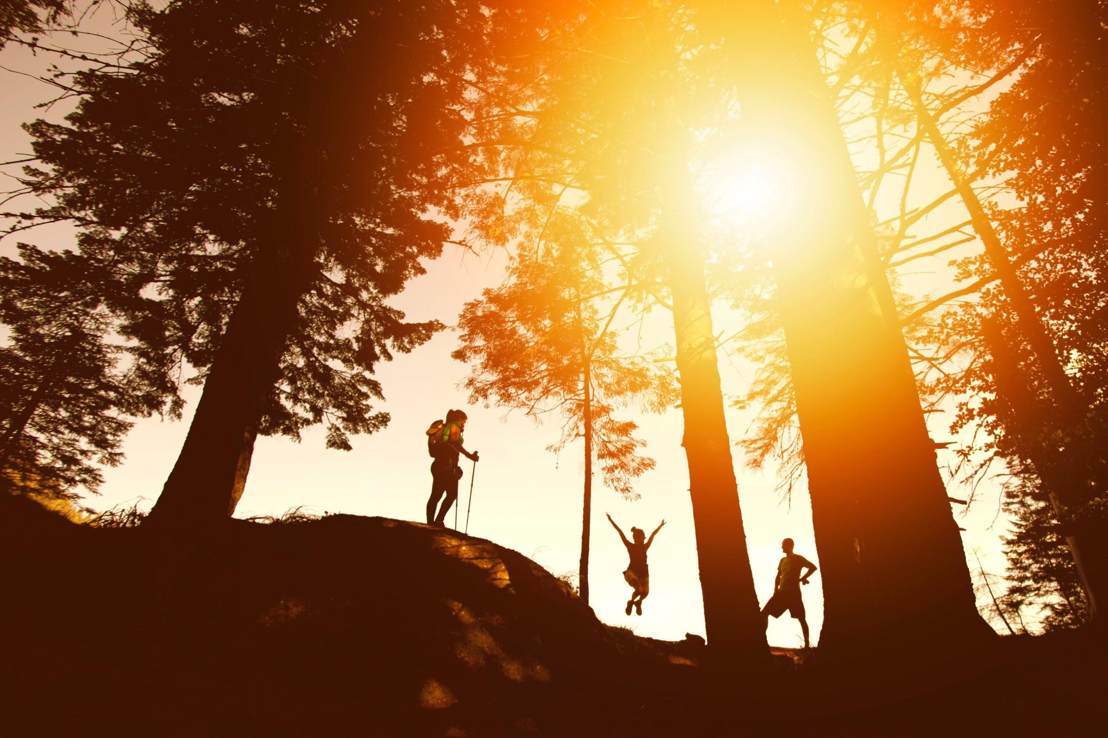
Impact on Teaching - Teaching Squares
Gain insight into your teaching practice.
Discuss teaching with peers and generate ideas.
Create a safe, respectful, and mutually supportive environment for feedback and growth.
Encourage reflective practice.
Notes:
Photo by photo-nic.co.uk nic on Unsplash
SD
Overall the goals of these methods are to encourage reflective teaching practices, help us understand how we are using time in order to encourage student-centered teaching, create safe spaces for feedback and improvement, and encourage discourse about instruction. Based on a survey we sent to everyone who participated, these goals were met.
Teaching Squares:
Everyone agreed that they gained insight into their own teaching practice by observing their peers; that TS encouraged conversations about teaching with their peers; and that the experience was respectful, safe, and supportive.
Additionally, everyone found that the feedback from their peers was a least somewhat helpful and most people said feedback was VERY helpful in giving them insight into their teaching practice.
Most people got new ideas from their colleagues that they will use in future classes and agreed that Teaching Squares opened up unique spaces for reflection.
We also had some free-form questions, and one thing that I found compelling was that 5 out of the 7 respondents said that they and their partners agreed to share constructive critique as part of the process rather than sticking to the program as described – so at least our pilot group was interested in hearing what they needed to work on in addition to the positive qualities of their work, which to me suggests possibilities for future iterations of peer observation at UO. One comment that someone wrote is that "Two different librarians observed the same activity in different terms and were able to give me feedback that let me see if the changes I made were helpful." Another wrote that they got a comment about how often they kept talking after giving students an assignment – they had no idea they were doing that and now are working on changing it. So this is exactly what we want – safe spaces and feedback to improve.

Slide 20
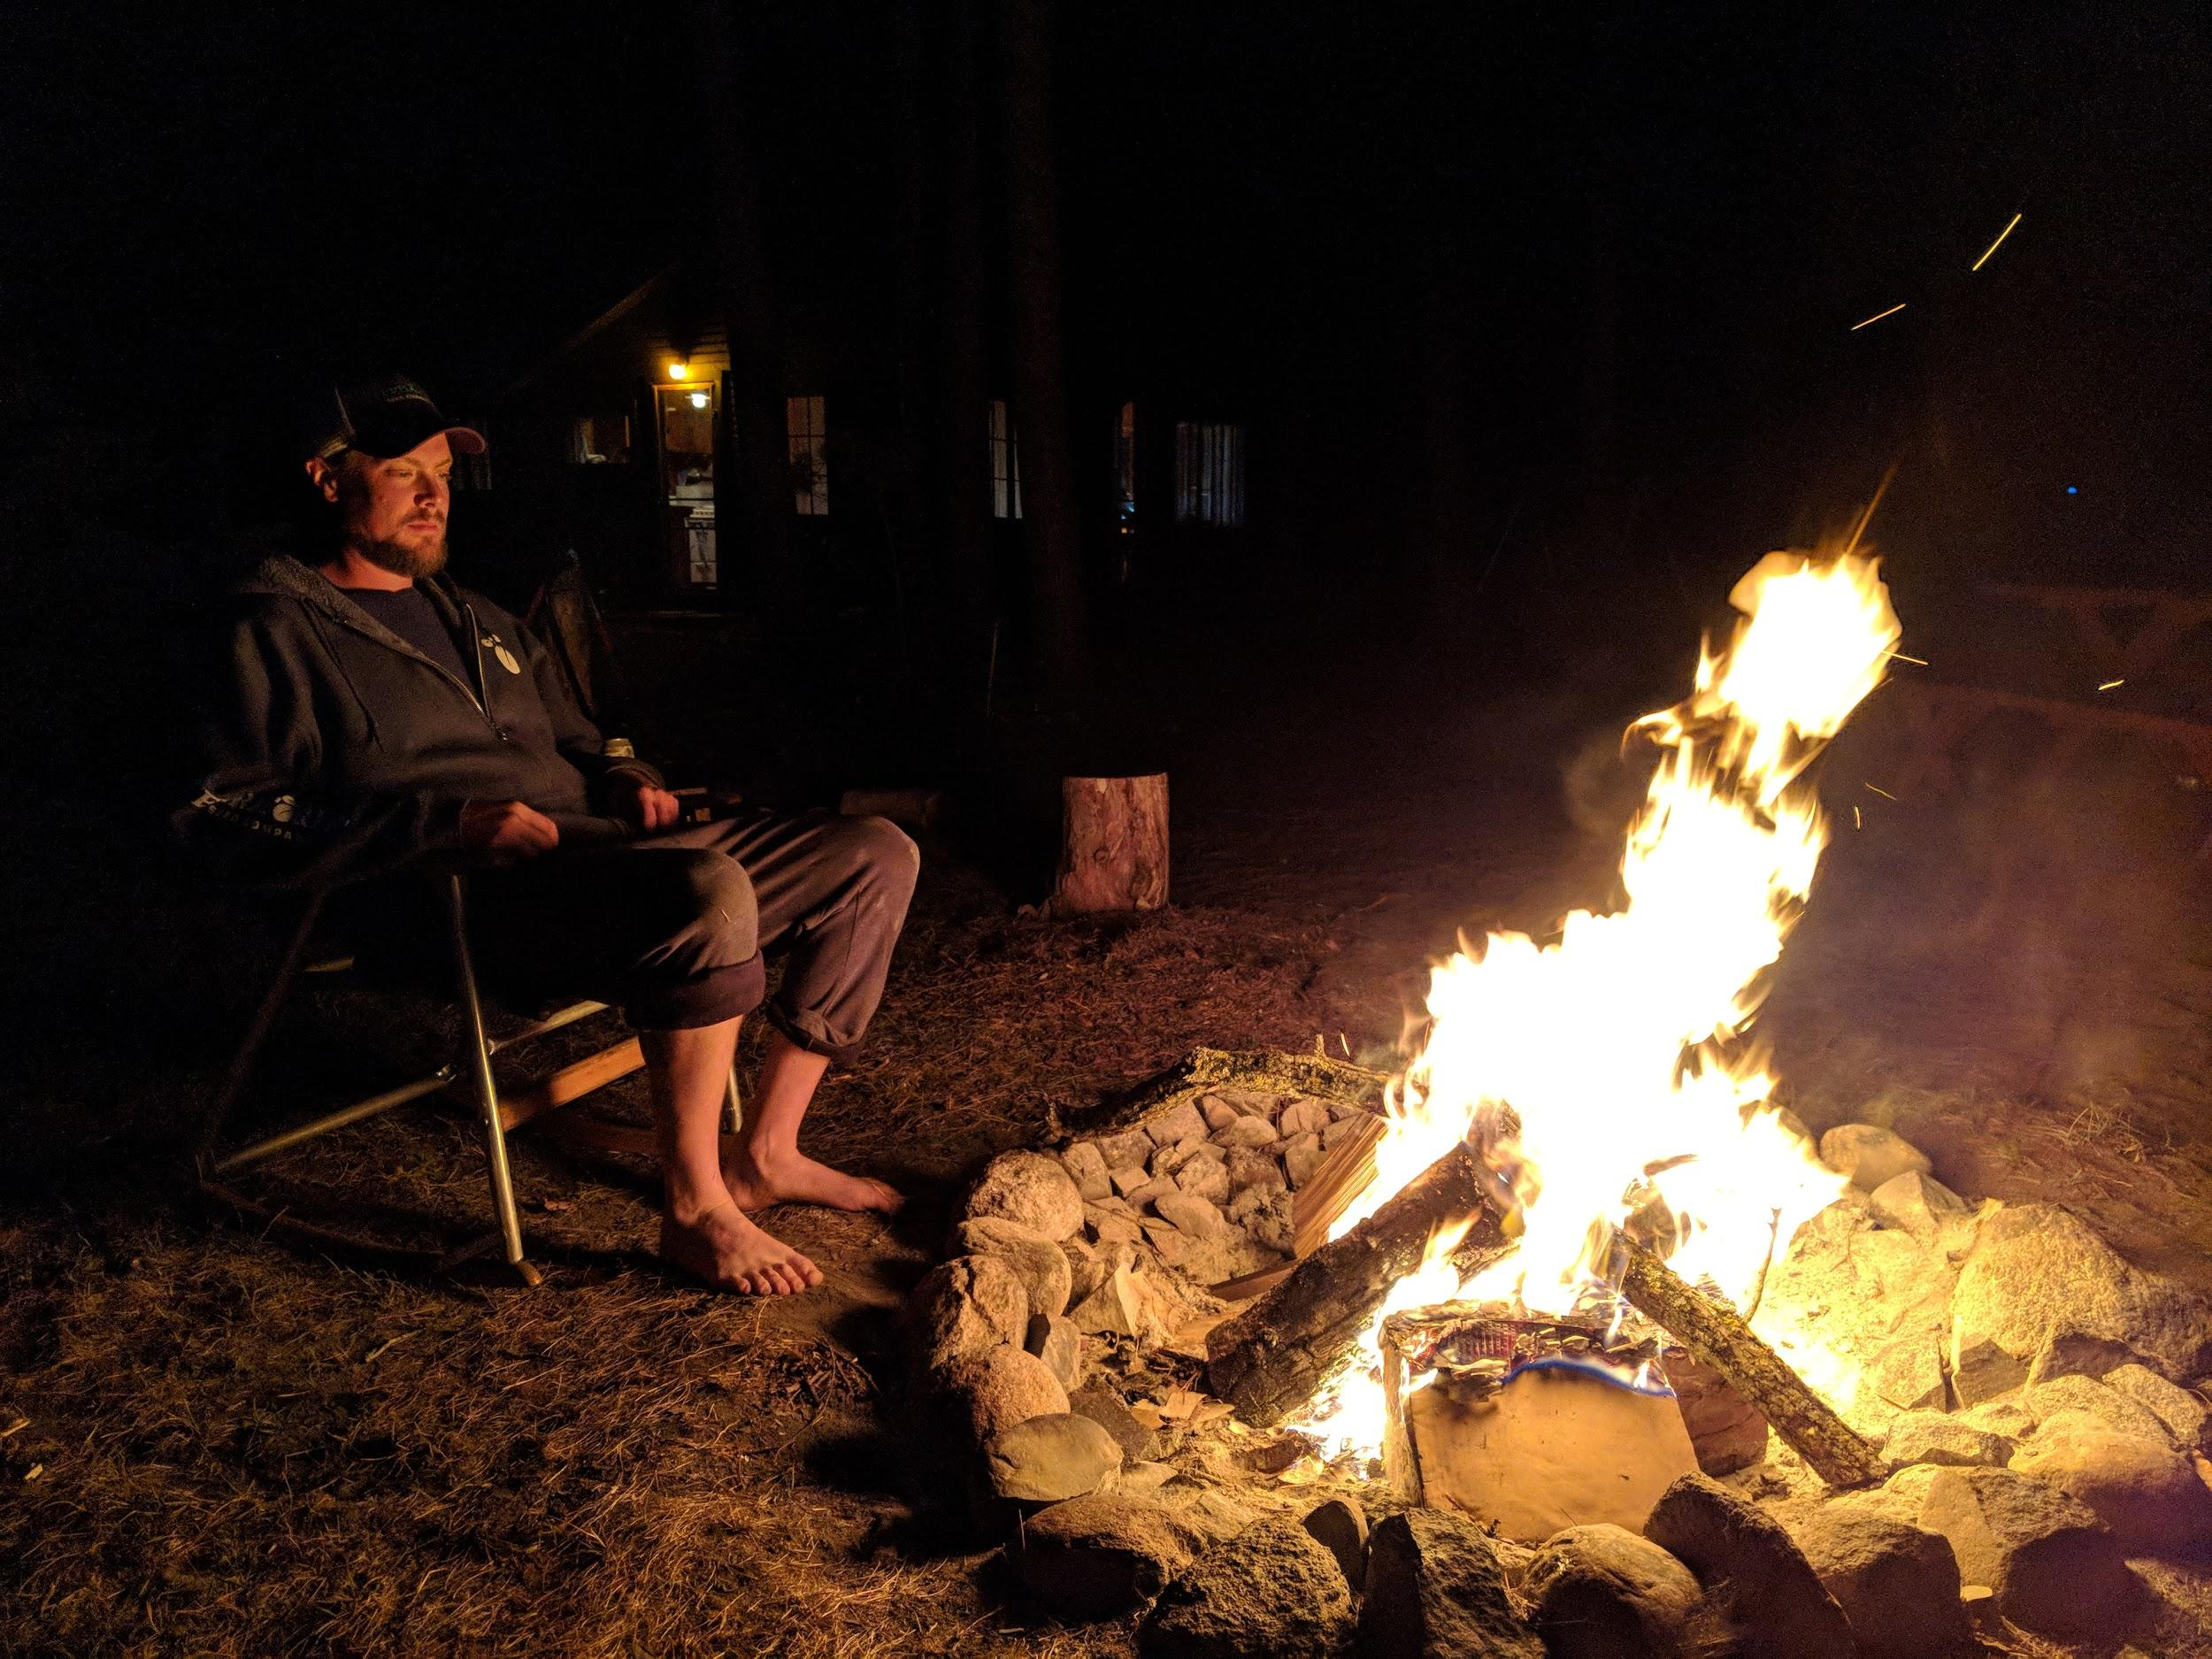
Impact on Teaching - COPIL
Visualize instruction practices and student activity.
Identify ways to adjust teaching to increase student engagement.
Encourage reflective practice.
Notes:
Photo by photo-nic.co.uk nic on Unsplash
SD
In terms of COPIL, everyone felt that they learned more about how they use their time and how students used their time during instruction and that through the protocol they were encouraged to reflect on their teaching practice
Most people said that they see reflective practice as beneficial to becoming a better instructor and that COPIL helped them identify areas where they could adjust their teaching to increase student activity, and that they will use that information to make future adjustments. This points to the movement towards student-centered teaching that we are looking for. One participant left the comment "It made me realize I had more opportunities to have the students doing active learning, which is something I've tried to incorporate more and more since then."
We also found through the survey, that people were confused about how the TPI was to be used in conjunction with Teaching Squares, and it was used inconsistently. This has led us to make some changes to the TPI, and we will also work on being more specific about how to use it in future iterations of peer observation. But over half of the people did or could see the TPI as valuable in conjunction with peer observation.

Slide 21
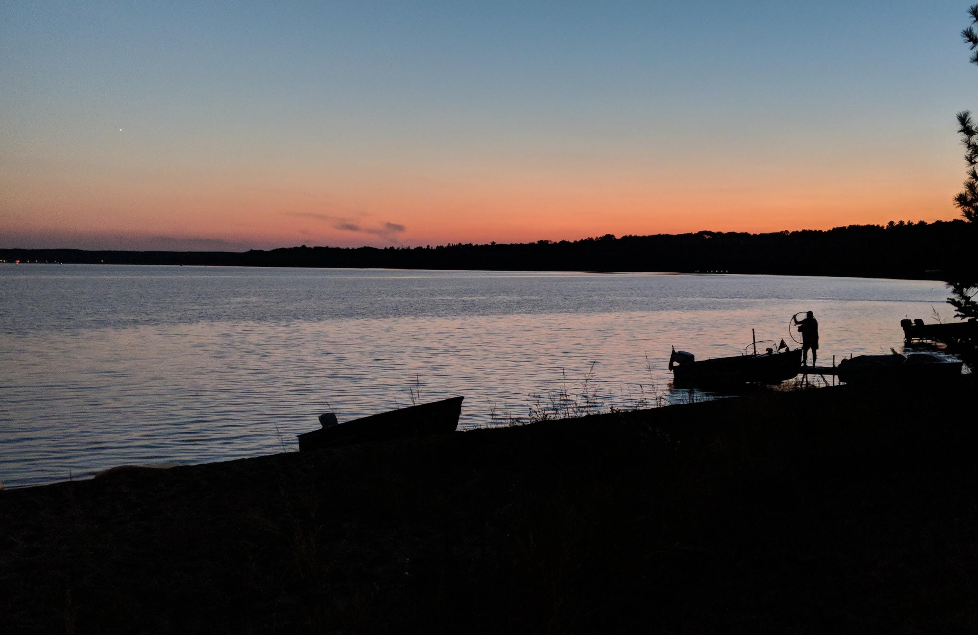
The Experience
Learning and improving.
Establishing an informal Community of Practice around instruction.
Practicing self-reflection.
Notes:
SD
Teaching squares gave me a chance to engage with my colleagues around teaching. I think we all can point out a couple of people in our institutions that we know to go to for help and ideas related to instruction. What I learned is that pool is much larger than I thought. Not because all of us amazing teachers, but rather because we've all done some teaching and the number of us that want to get better is significant – we want to share ideas, solve problems, and support students as best we can.
One person I observed wasn't someone I knew of as a person that I would go to for instruction brainstorming, but as I watched her teach popular and scholarly I found the missing piece in my own popular/scholarly exercise, and next time I taught I was able to take some elements of her exercise and combine it with mine to improve how I taught.
Similarly, COPIL helped me better understand how I taught and how I used my time. Did you know that while teaching I ask a lot of questions that don't really need answers? See what I did there? ;) COPIL taught me to either ask a question and wait for an answer, or if I was really trying to deliver information, make a statement.
To me though, I think two of the most valuable things that came out of these processes were:
1. An informal community of practice. My circle of people I can bounce ideas off of grew significantly, and now, even outside of observation, I have people I can contact and say "Hey, I'm trying to come up with an annotated bibliography exercise for a class, but I've never taught it before – Do you have any ideas?" The peer observation process has given me an opportunity to brainstorm and learn from people who are passionate about instruction.
2. Self-reflection as a regular practice – even without using these frameworks – it's not super realistic or desirable to have every class observed or to expect your colleagues will always have time to provide feedback. Using the TPI and then debriefing it in conjunction with either of these tools started me, at the end of every class, taking 5 minutes to say "Okay, what are three things I could do better, and what are three things that went well?" And I can use that information, even in this informal state to better engage students in the next class.
In other words, my individual experience corroborates the overwhelming positivity of the survey results. By using observation, we are working on becoming better teachers, building safe spaces to collaborate and learn, and working towards a culture of engagement to support student success.

Slide 22
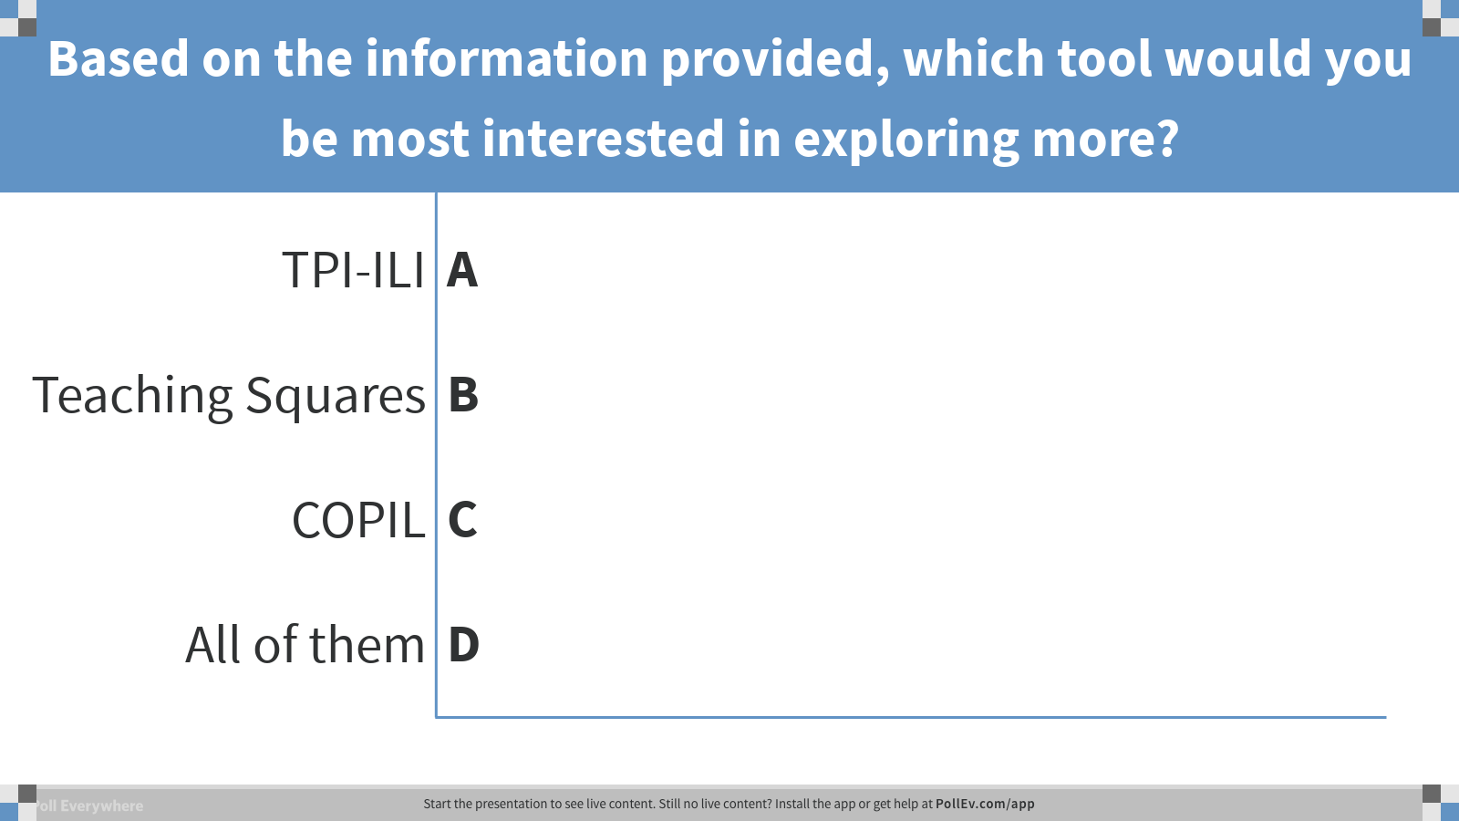

Slide 23
Further Reading
Oberlies, M.K., Buxton, K. & Zeidman-Karpinski, A. (2019) Adapting Evidence-Based Practices to Improve Library Instruction: Using customized tools to support peer observation. Manuscript submitted for publication.
Models:
Haave, N. (2014). Teaching Squares: A Teaching Development Tool. The Teaching Professor, 28(10), 1.
Smith, M. K., Jones, F. H. M., Gilbert, S. L., & Wieman, C. E. (2013). The classroom observation protocol for undergraduate stem (COPUS): A new instrument to characterize university STEM classroom practices. CBE Life Sciences Education, 12(4), 618-627. https://doi.org/10.1187/cbe.13-08-0154
Wieman, C., Gilbert, S., & Dolan, E. (2014). The Teaching Practices Inventory: A New Tool for Characterizing College and University Teaching in Mathematics and Science. CBE—Life Sciences Education, 13(3), 552–569. https://doi.org/10.1187/cbe.14-02-0023

Slide 24
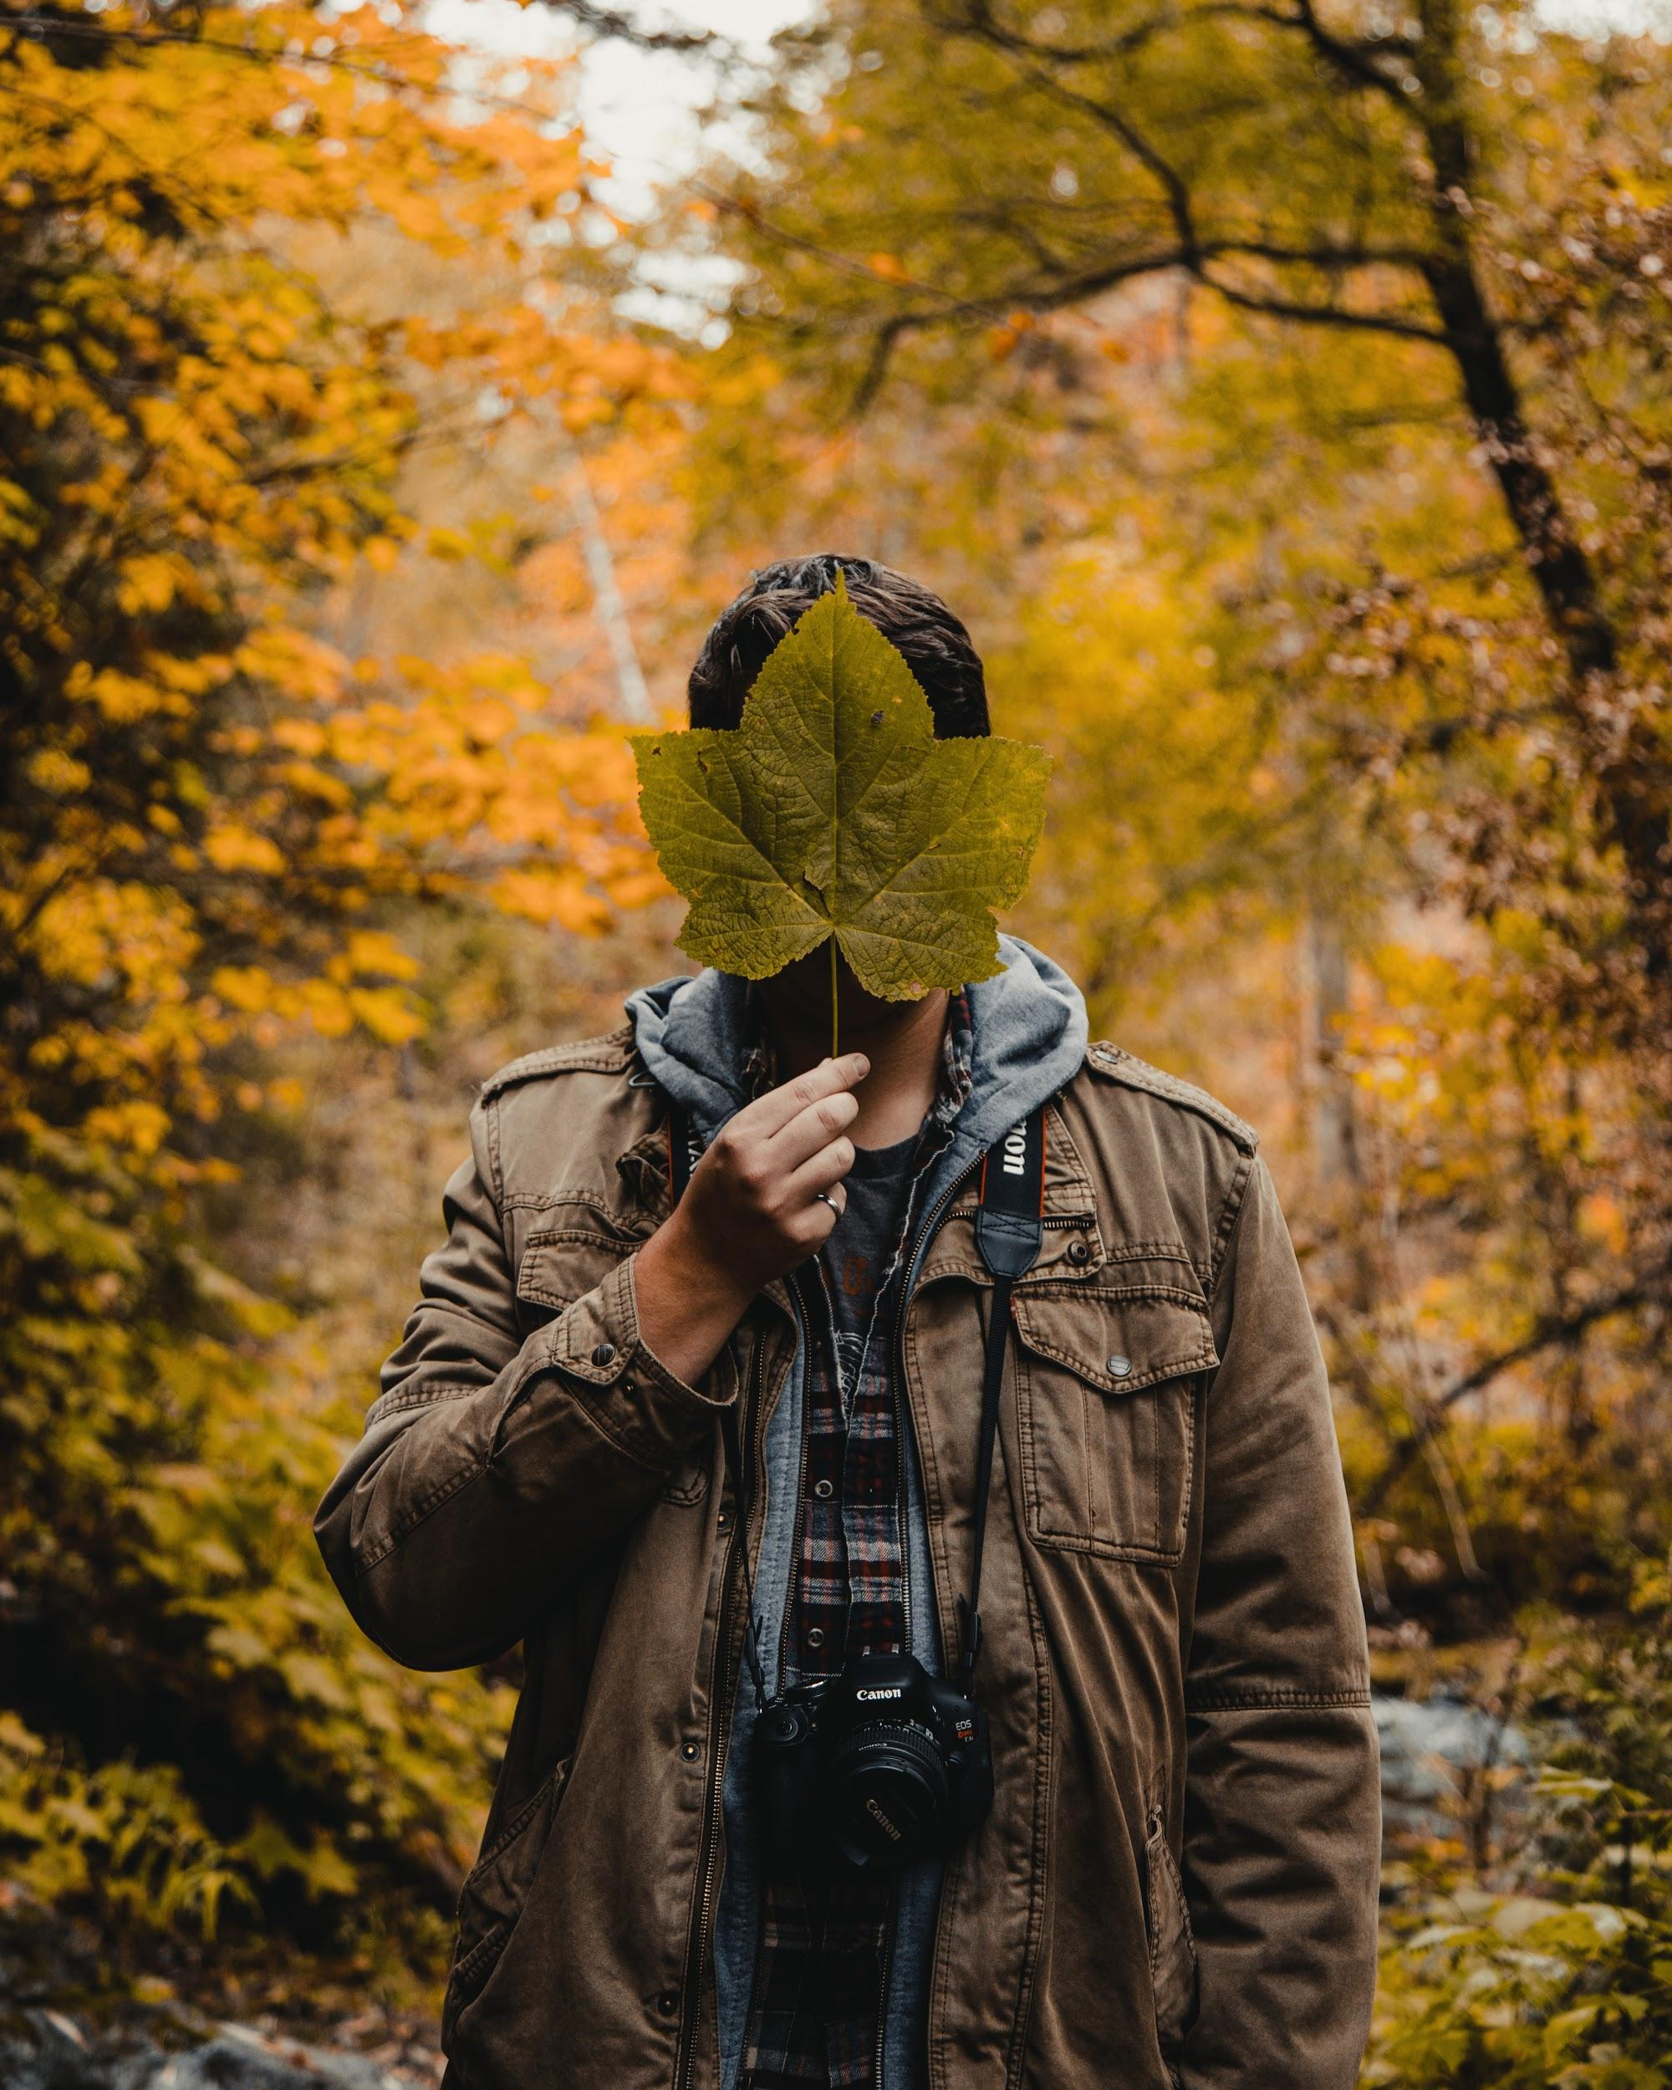
Questions?
Find all the tools at http://bit.ly/loex-peer-observation
Mary Oberlies: mkoberlies@wm.edu
Sara Dewaay: sdewaay@uoregon.edu
Kristin Buxton: kbuxton@uoregon.edu
Annie Zeidman-Karpinski: annie@uoregon.edu
Notes:
Photo by Josh Hild on Unsplash

Slide 25

Questions?
Find all the tools at http://bit.ly/loex-peer-observation
Mary Oberlies: mkoberlies@wm.edu
Sara DeWaay: sdewaay@uoregon.edu
Kristin Buxton: kbuxton@uoregon.edu
Annie Zeidman-Karpinski: annie@uoregon.edu
Notes:
Photo by Josh Hild on Unsplash
[AZK - ideas For those of you who saw the excellent presentation by about motivating students to change their research behaviors - why would we do an expert demo and then expect students to go away and replicate it on their own? Getting up and showing a search in our fav db is like riding a unicycle around the room and expecting students to ditch their perfectly useful bike to use a complicated DB. You can see what you are doing with these tools, set goals and get help trying to change. Did you ask questions that were effective? Other ideas?]

