Slide 1

Organizing the Peacock Parade
Faculty Buy-In for the Institutional Repository and
Open Access Publishing
by Carol Hixson, Deborah Henry, and Tina Neville
Nelson Poynter Memorial Library
University of South Florida St. Petersburg
A Webinar hosted by ALCTS,
Association for Library Collections & Technical Services
September 24, 2014
http://dspace.nelson.usf.edu/xmlui/handle/10806/11969

Slide 2
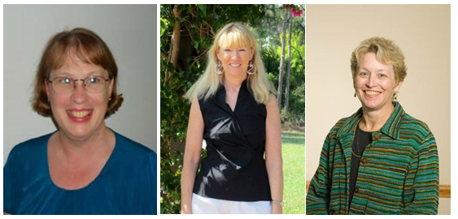
Your presenters
Tina Neville Carol Hixson Deb Henry

Slide 3
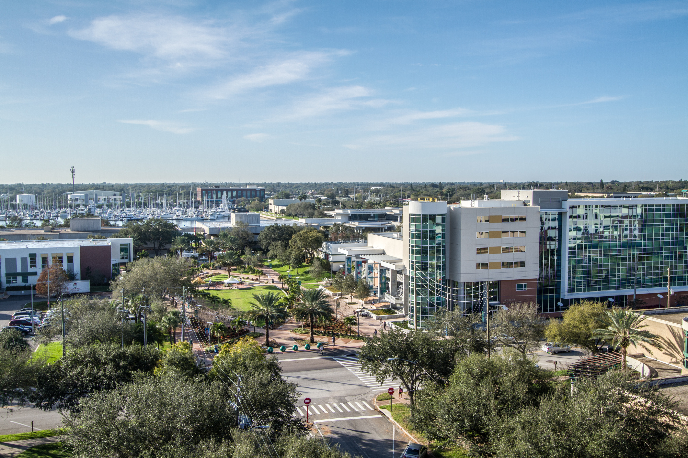
University of South Florida St. Petersburg (USFSP)
Photo by Lisa Ferrante

Slide 4
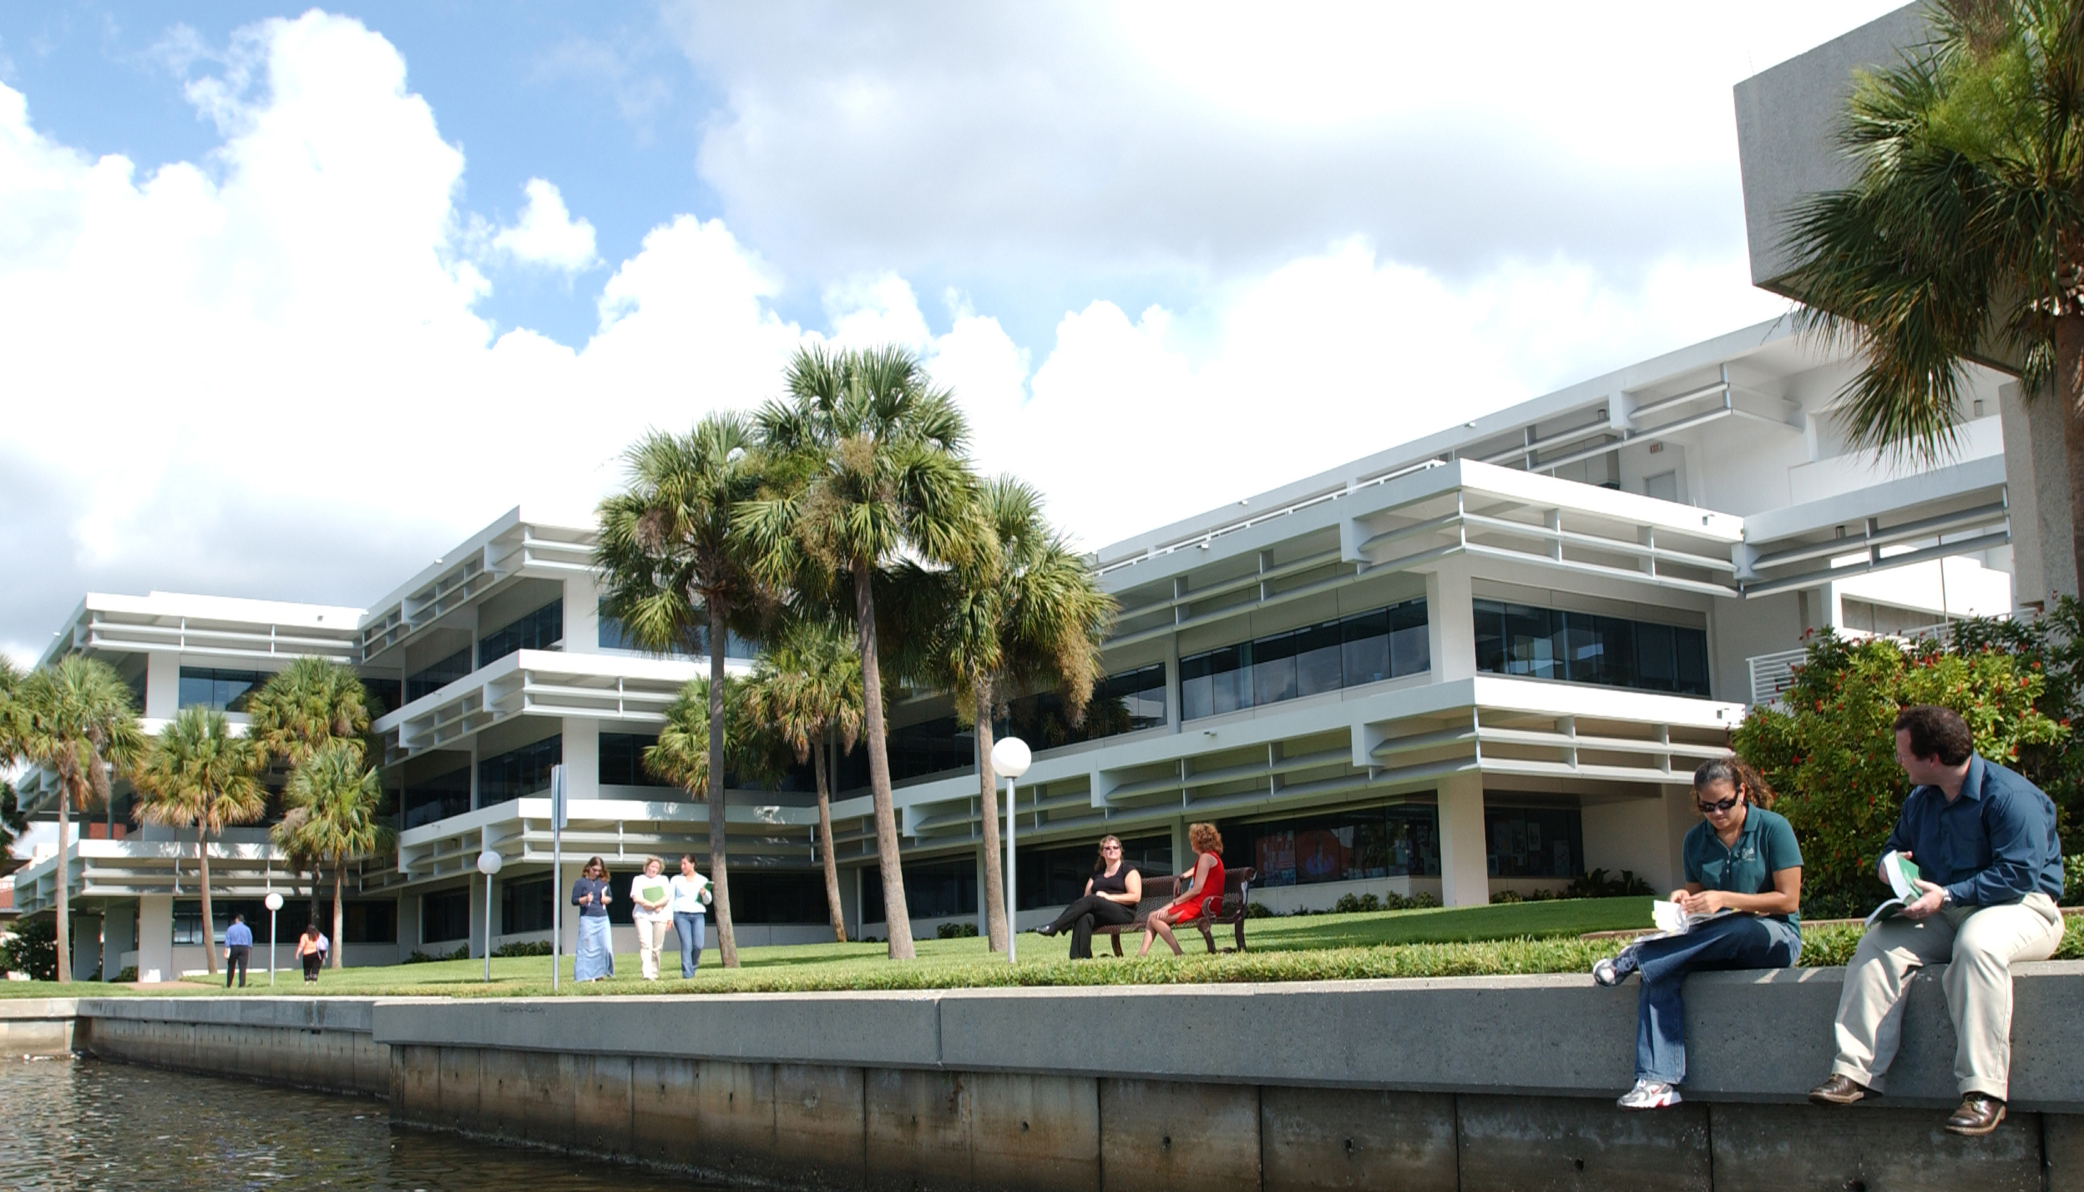
Nelson Poynter Memorial Library

Slide 5
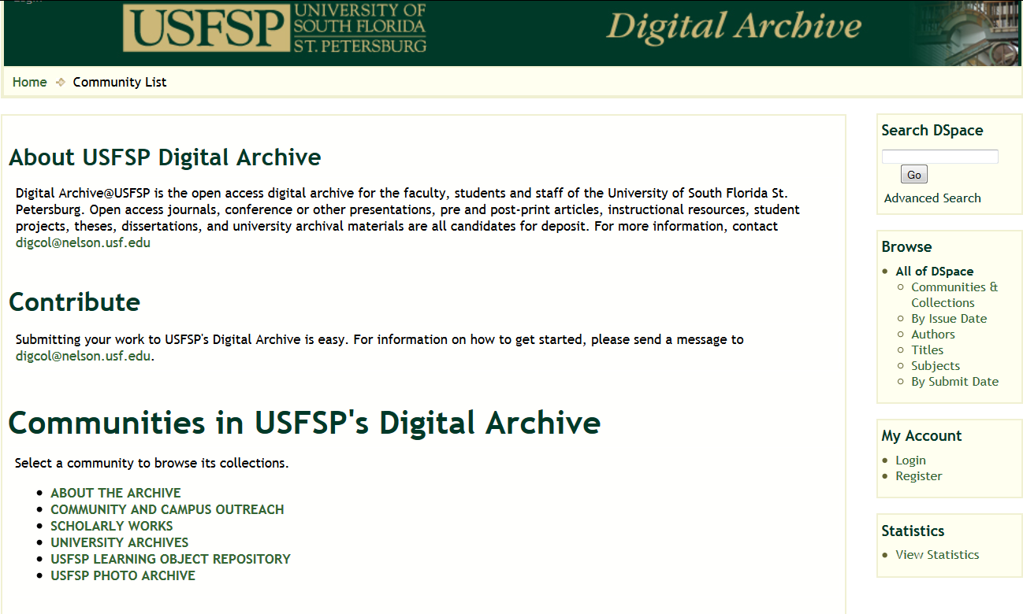
USFSP Digital Archive http://dspace.nelson.usf.edu/

Slide 6
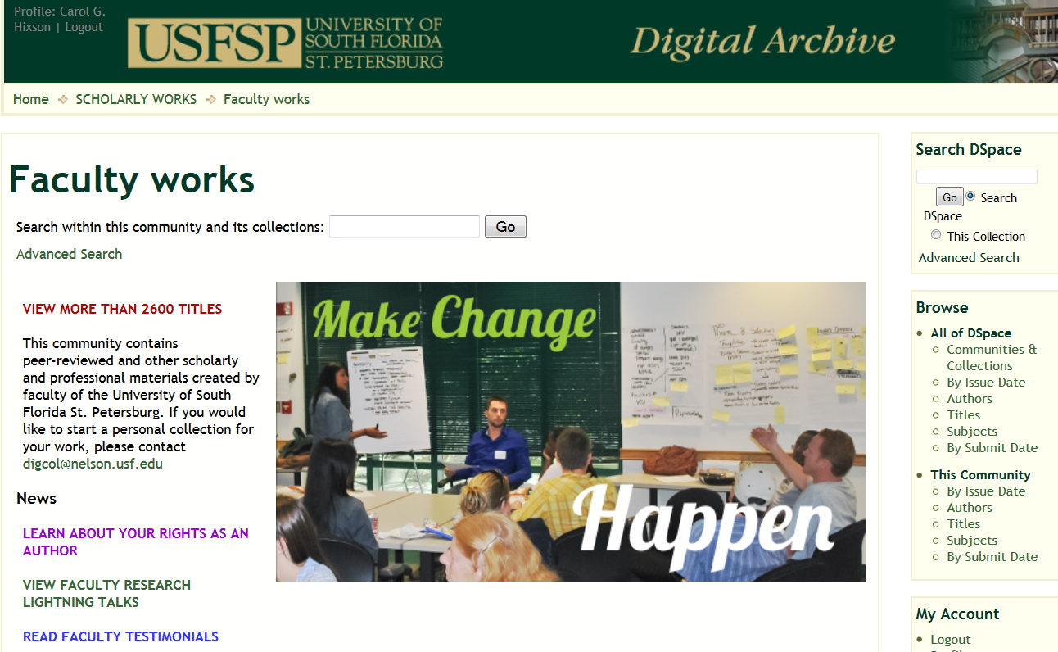
Faculty Participation Rates
76 %

Slide 7
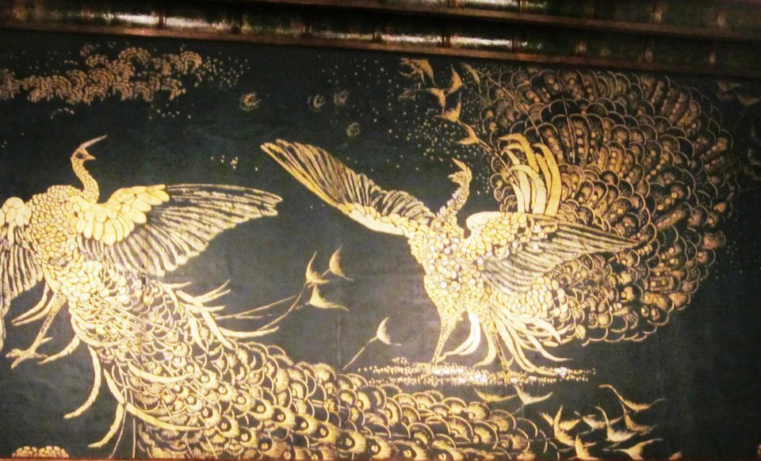
Why Peacocks?
Photo by Carol Hixson

Slide 8
How to Achieve Faculty Buy-In
Talk to them
Present models
Don’t ask them to change
Personalize
Don’t expect them to do anything
Educate them over time
Market , market, market
Be reliable and innovative

Slide 9
Talk to Faculty
Faculty at USFSP
Want to have their work better known and more widely
cited
Are risk-averse
Do not want to disrupt the scholarly publishing model
Know very little about open access
Generally do not understand copyright
Have no spare time
Often lose track of their own work

Slide 10
Policies
WHO IS ELIGIBLE TO ESTABLISH A PERSONAL COLLECTION OF PROFESSIONAL MATERIALS?
Any currently employed permanent member of the USFSP faculty
Any retired or emeritus member of the USFSP faculty
Adjunct or visiting faculty must have the agreement
of their department head or College Dean
Library staff will create the collection home page and
keep it updated with appropriate contact and other information

Slide 11
Policies
INSTITUTIONAL COMMITMENT TO AUTHORS
The Library commits to preserving and making available the materials submitted to the USFSP Digital Archive
The Archive retains all materials whether the authors continue their affiliation with USFSP or not
Materials will not be withdrawn because an author is no longer affiliated with the University
All USFSP authors who subsequently leave USFSP will still be able to access and add to their work

Slide 12
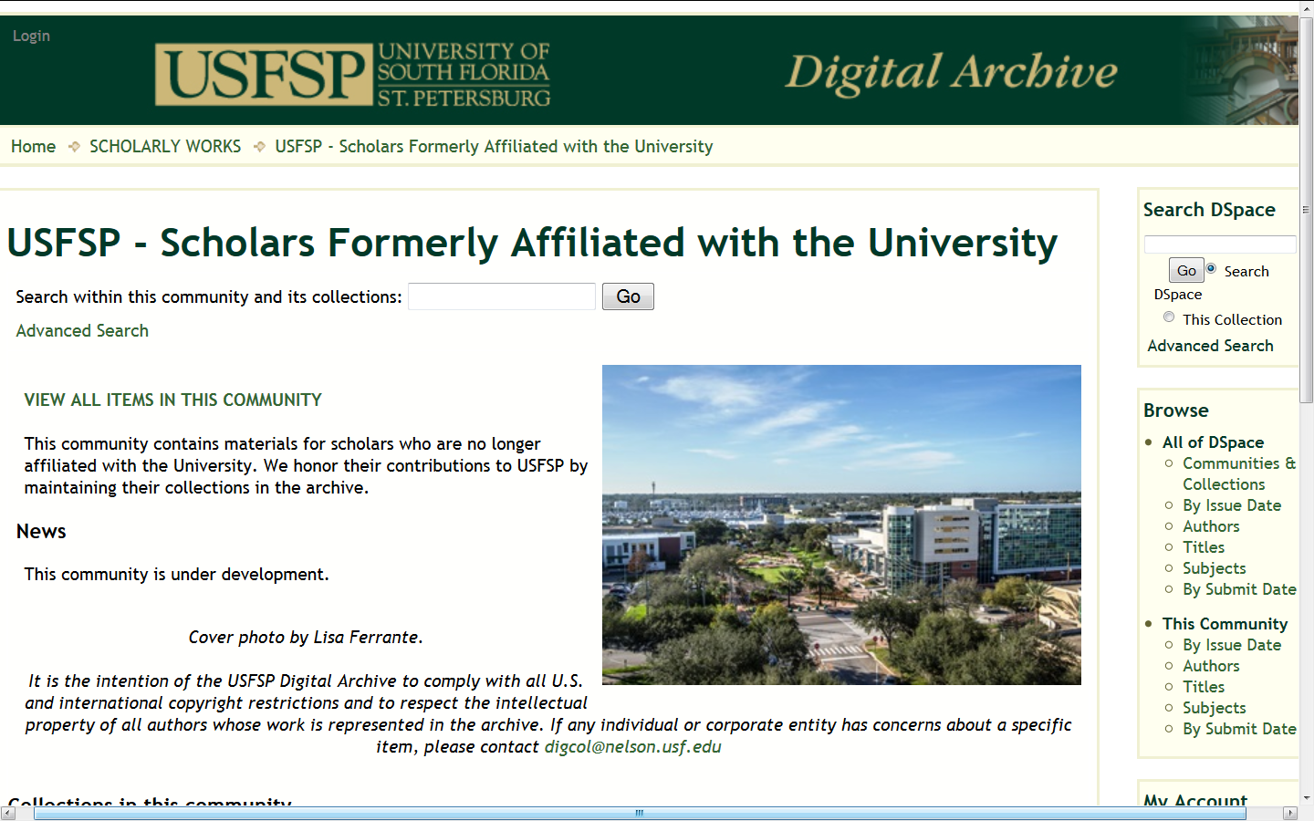
Policies

Slide 13
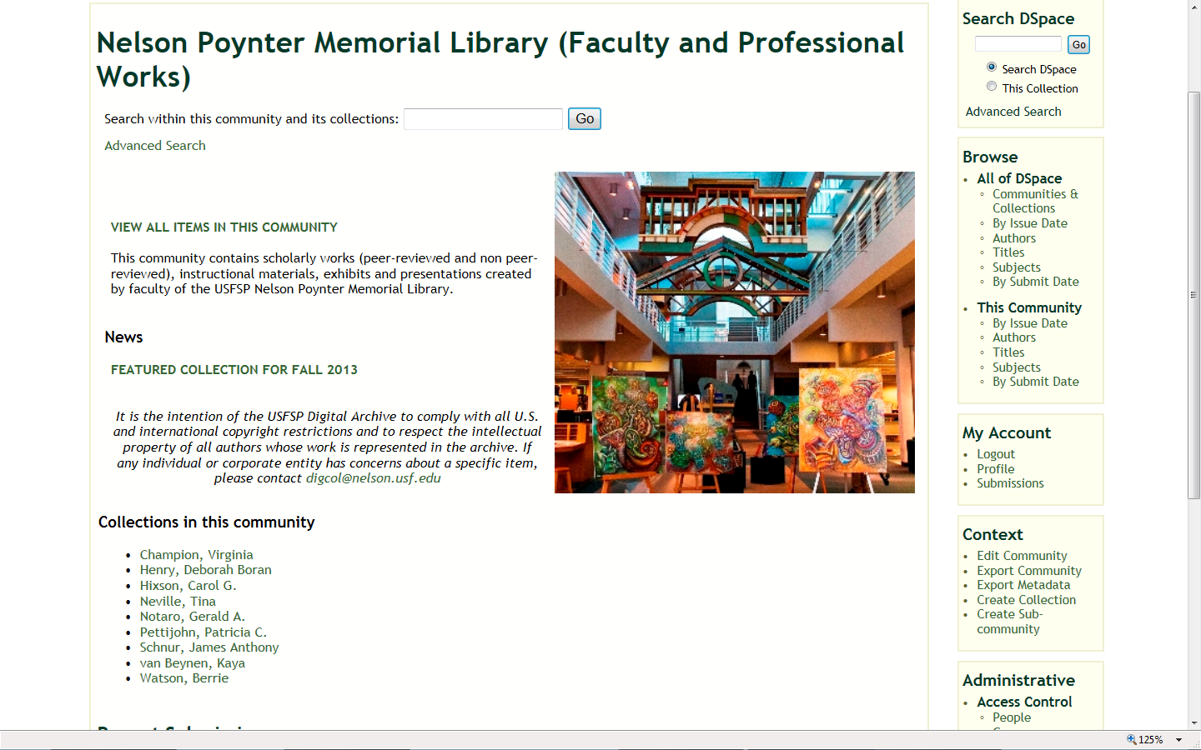
Models

Slide 14
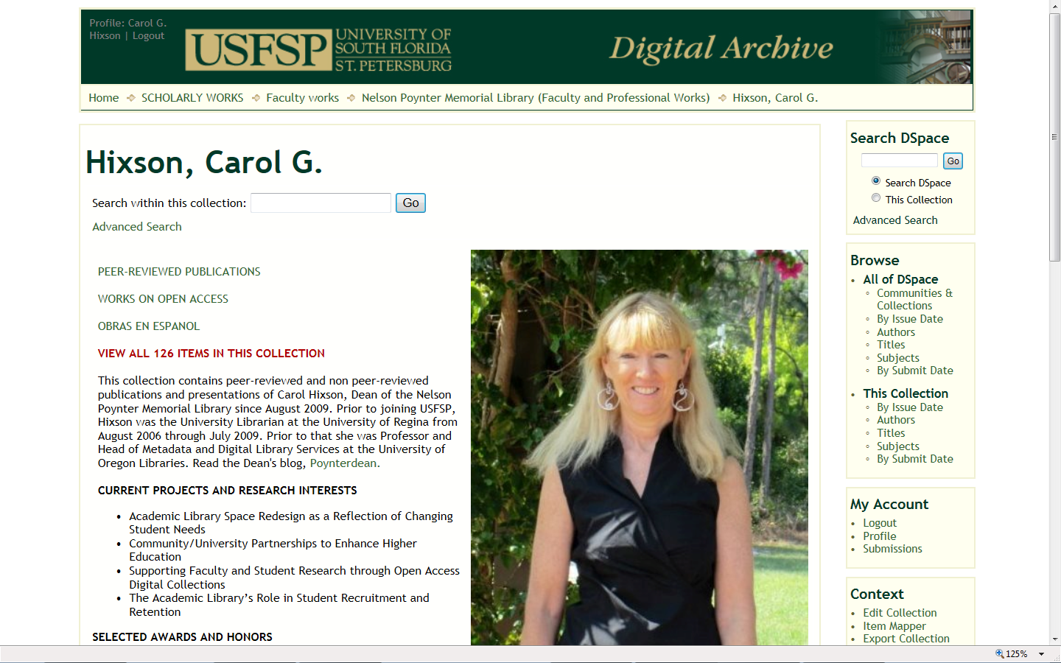
Models

Slide 15
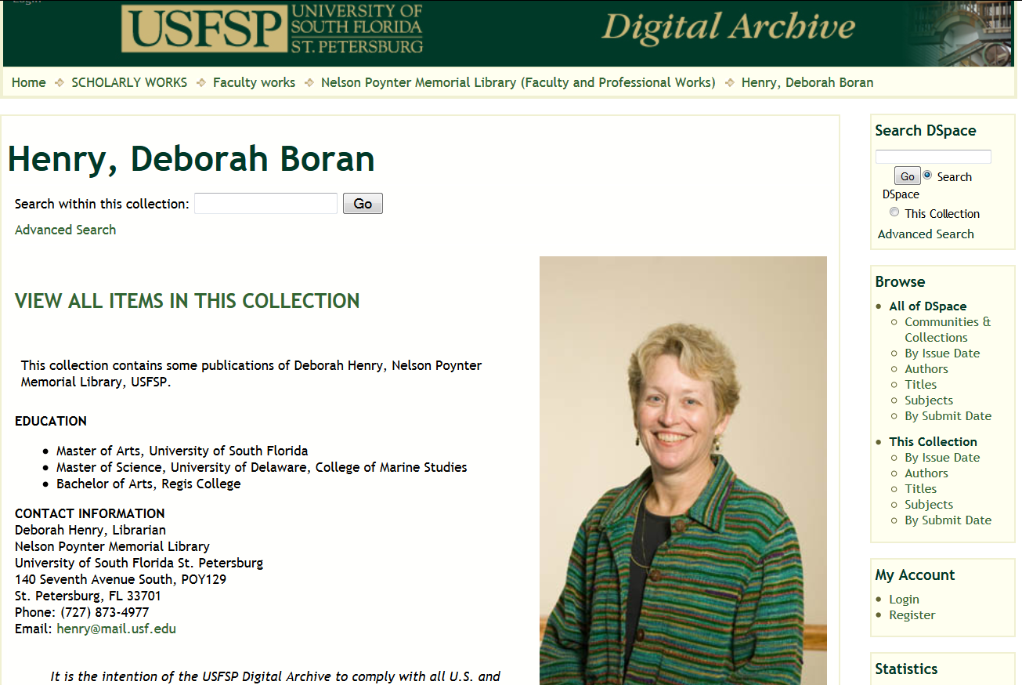
Models

Slide 16
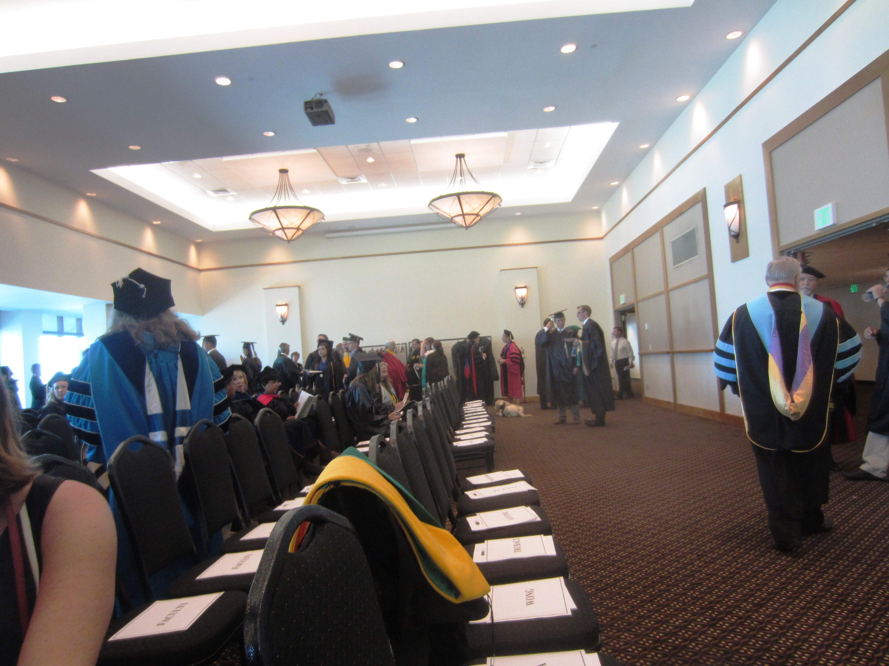
No Change:
Build on What They Know
Photo by Carol Hixson

Slide 17
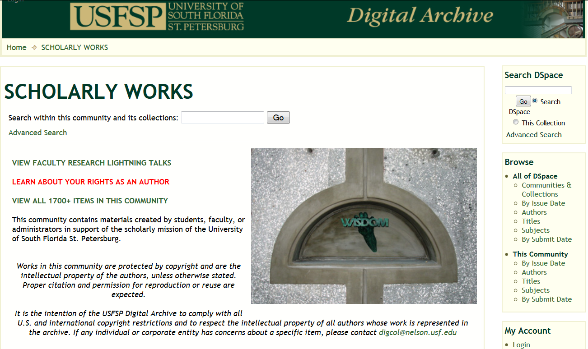
Build on What They Know

Slide 18
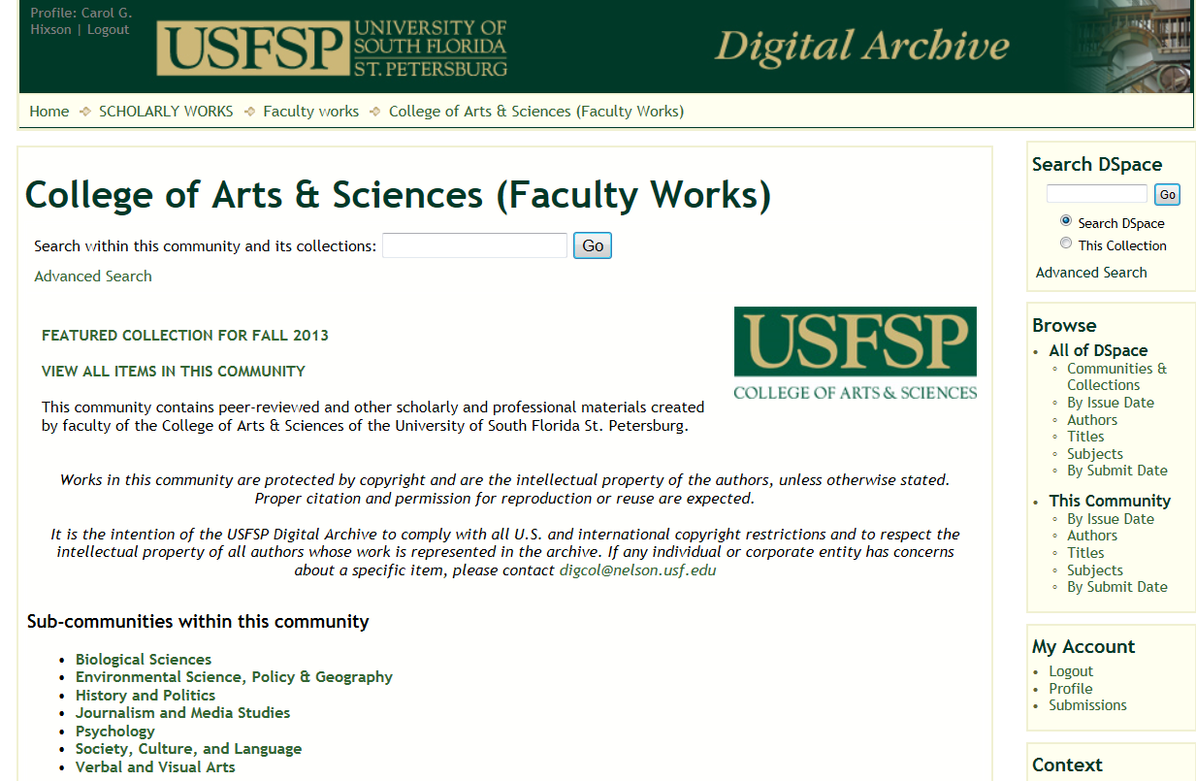
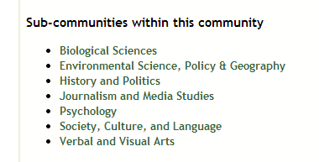
Build On What They Know

Slide 19
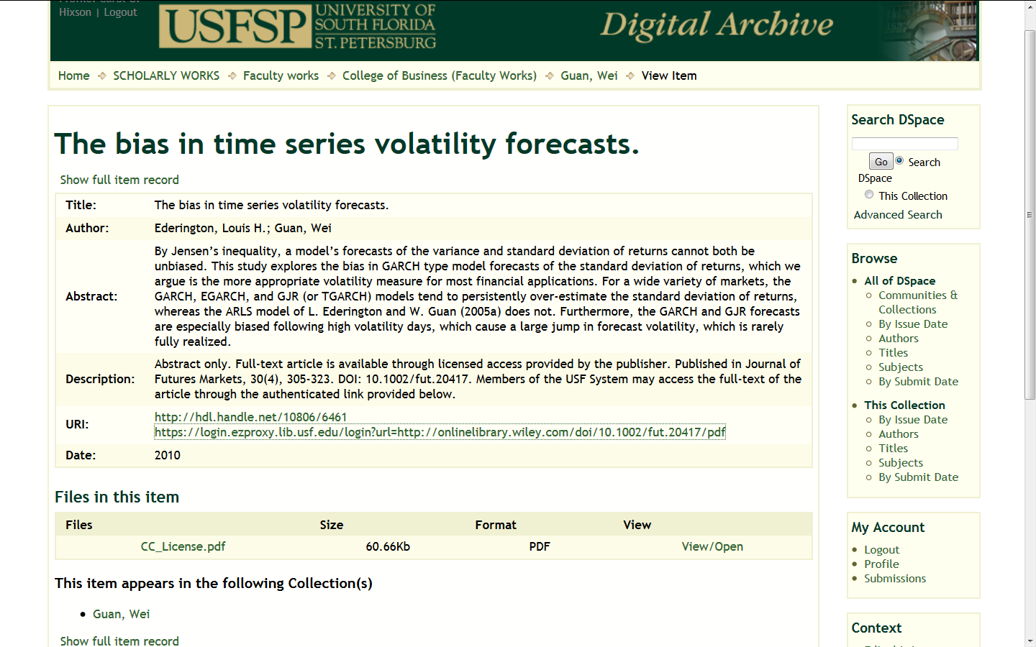
Build On What They Know

Slide 20
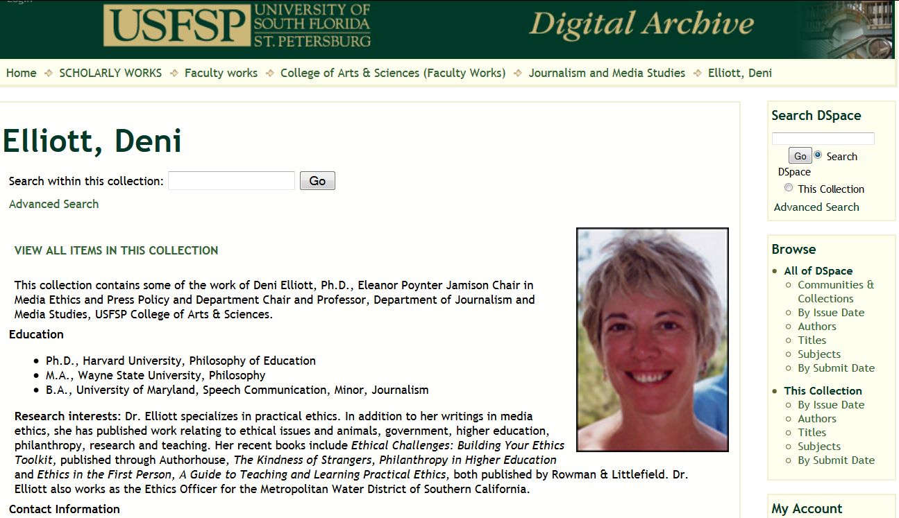
Personalized Support

Slide 21
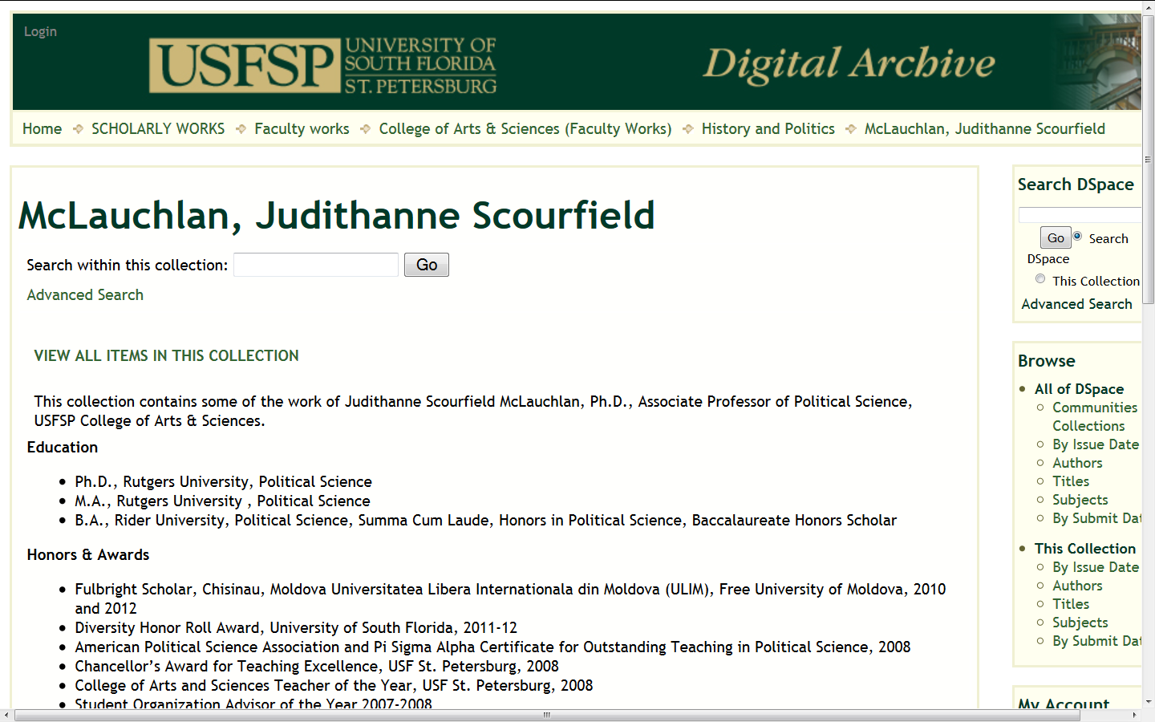
Personalized Support

Slide 22
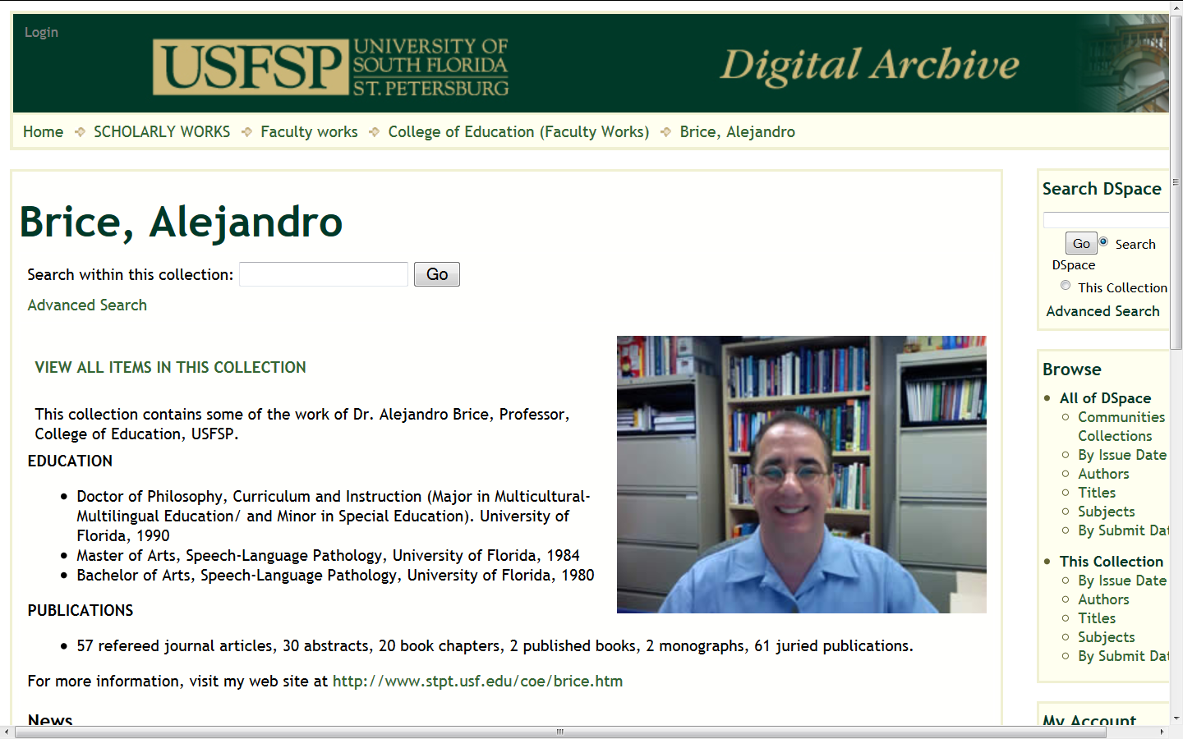
Personalized Support

Slide 23
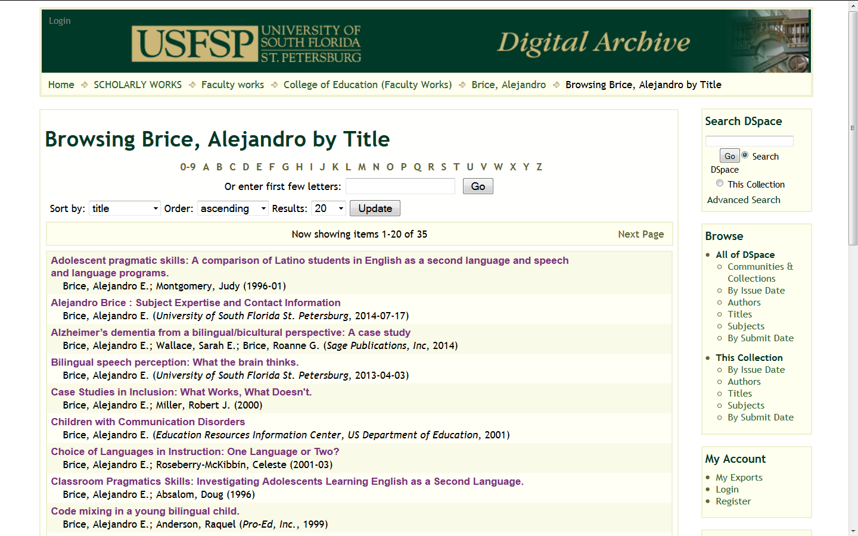
Comprehensive Digital Portfolios

Slide 24
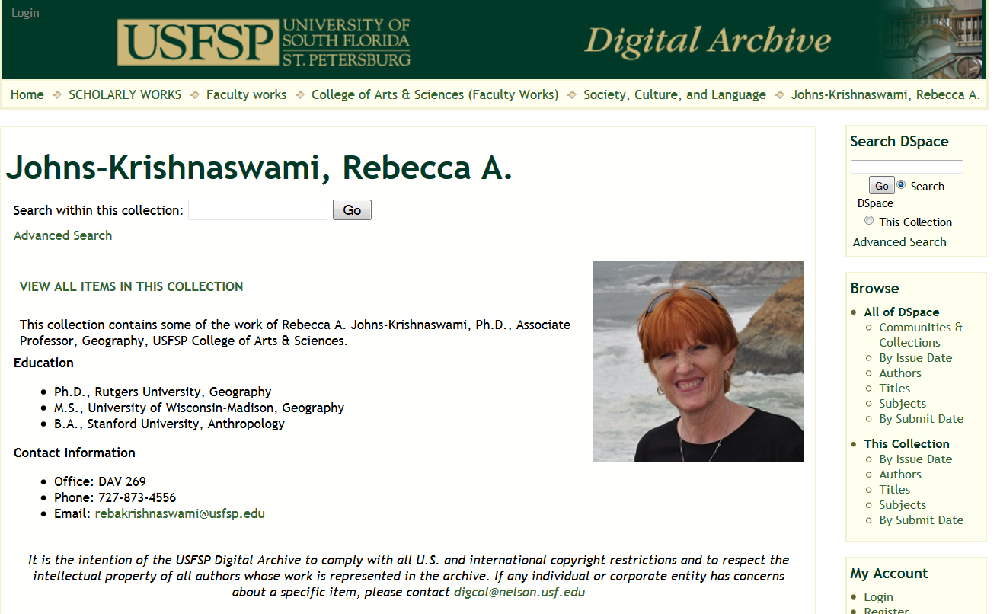
Comprehensive Digital Portfolios and Copyright

Slide 25
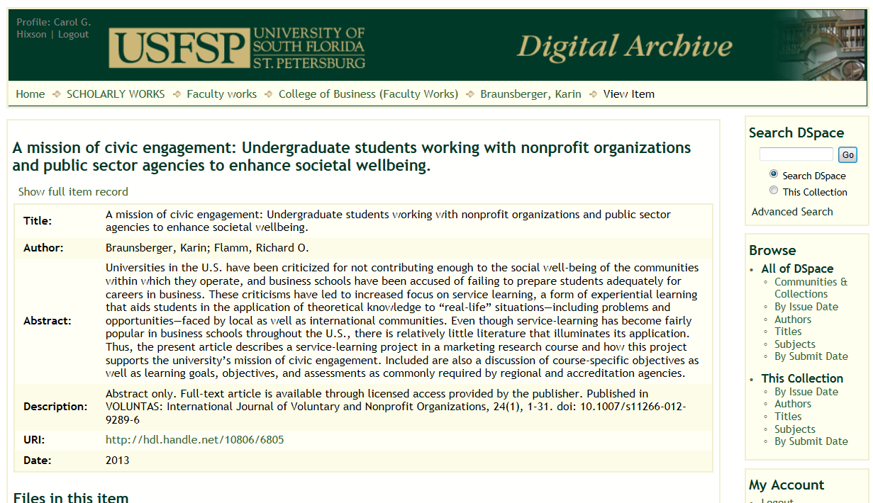
Comprehensive Digital Portfolios:
At Least An Abstract

Slide 26
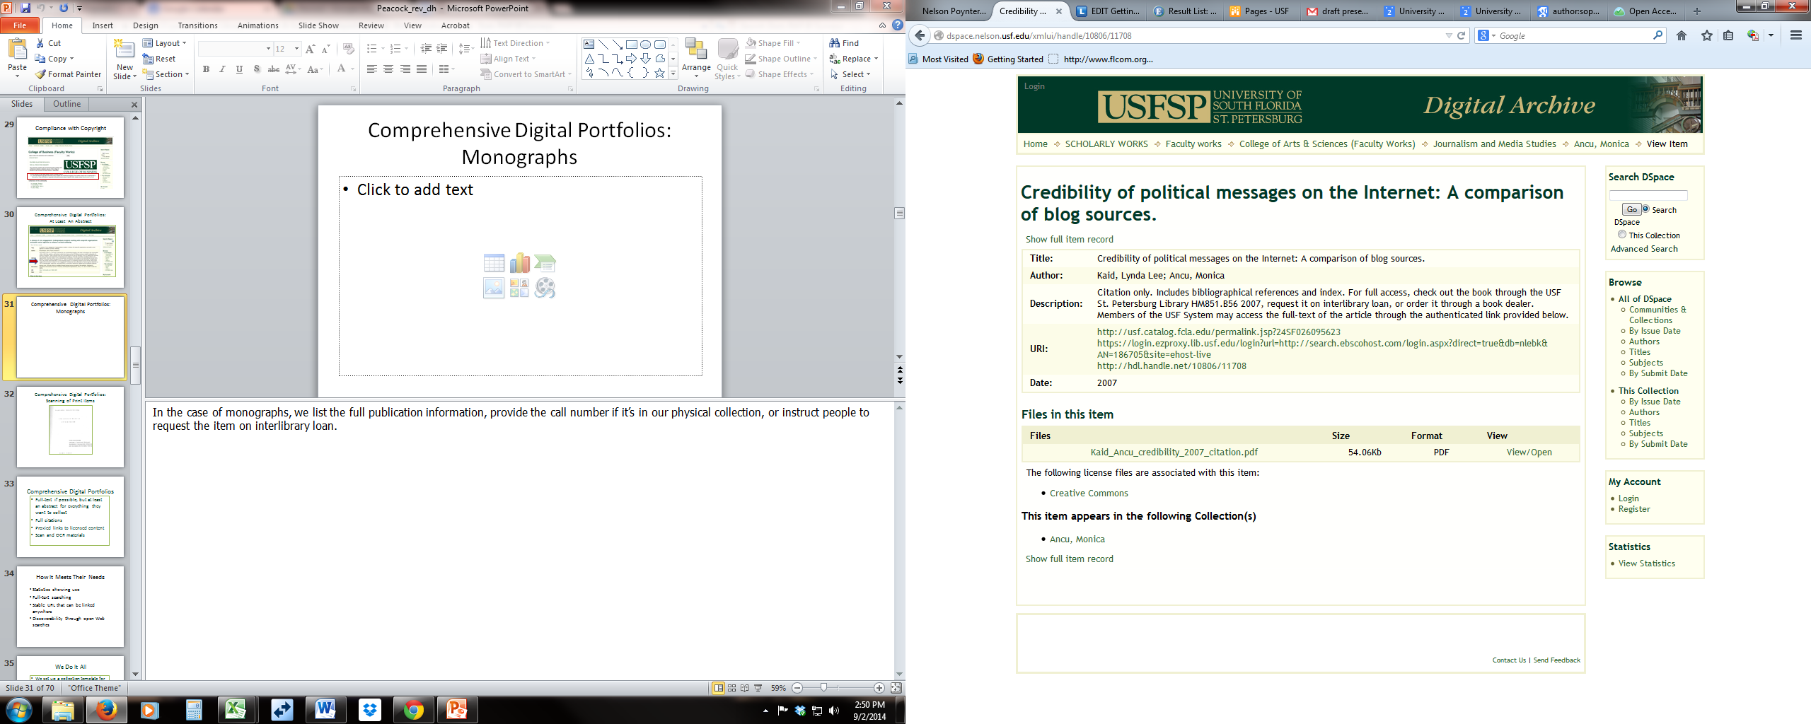
Comprehensive Digital Portfolios:
Monographs

Slide 27
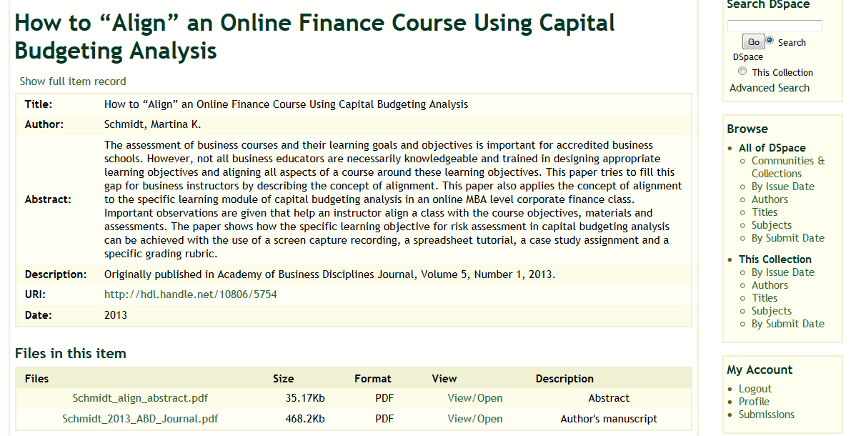
Comprehensive Digital Portfolios: Track Embargo Periods

Slide 28
Comprehensive Digital Portfolios
In compliance with copyright
Full-text if possible
Abstract or excerpts if possible
Full and corrected citations
Proxied links to licensed content
Scanned print materials

Slide 29
How It Meets Their Needs
  Statistics showing use
  Full-text searching
  Stable URL that can be linked anywhere
  Discoverability through open Web searches

Slide 30
We Do It All
We collect their CVs and work from them
We verify and correct citations from their CV
We add in items for them

Slide 31
We Do It All
We run citation alerts
We send statistical reports
We investigate copyright using Sherpa and publishers’ websites
Sometimes we contact publishers on their behalf and ask for permission

Slide 32
Educate Over Time
We inform about OA but we don’t require it
We use every opportunity to inform them and get them to reconsider their approach
We provide access to SPARC and other resources
We introduced an Open Access Resolution from Library faculty to Faculty Senate

Slide 33
Educate About Publishers’ Agreements
Be willing to look over publishers’ agreements
Offer options to consider
Refer them to resources
Stress their personal responsibility

Slide 34
Informational Materials
SPARC Authors’ Addendum
Predatory publishers lists
What’s In It For You
Step-by-Step Guide on Submission
Links to presentations about the archive
Searching guide to the archive

Slide 35
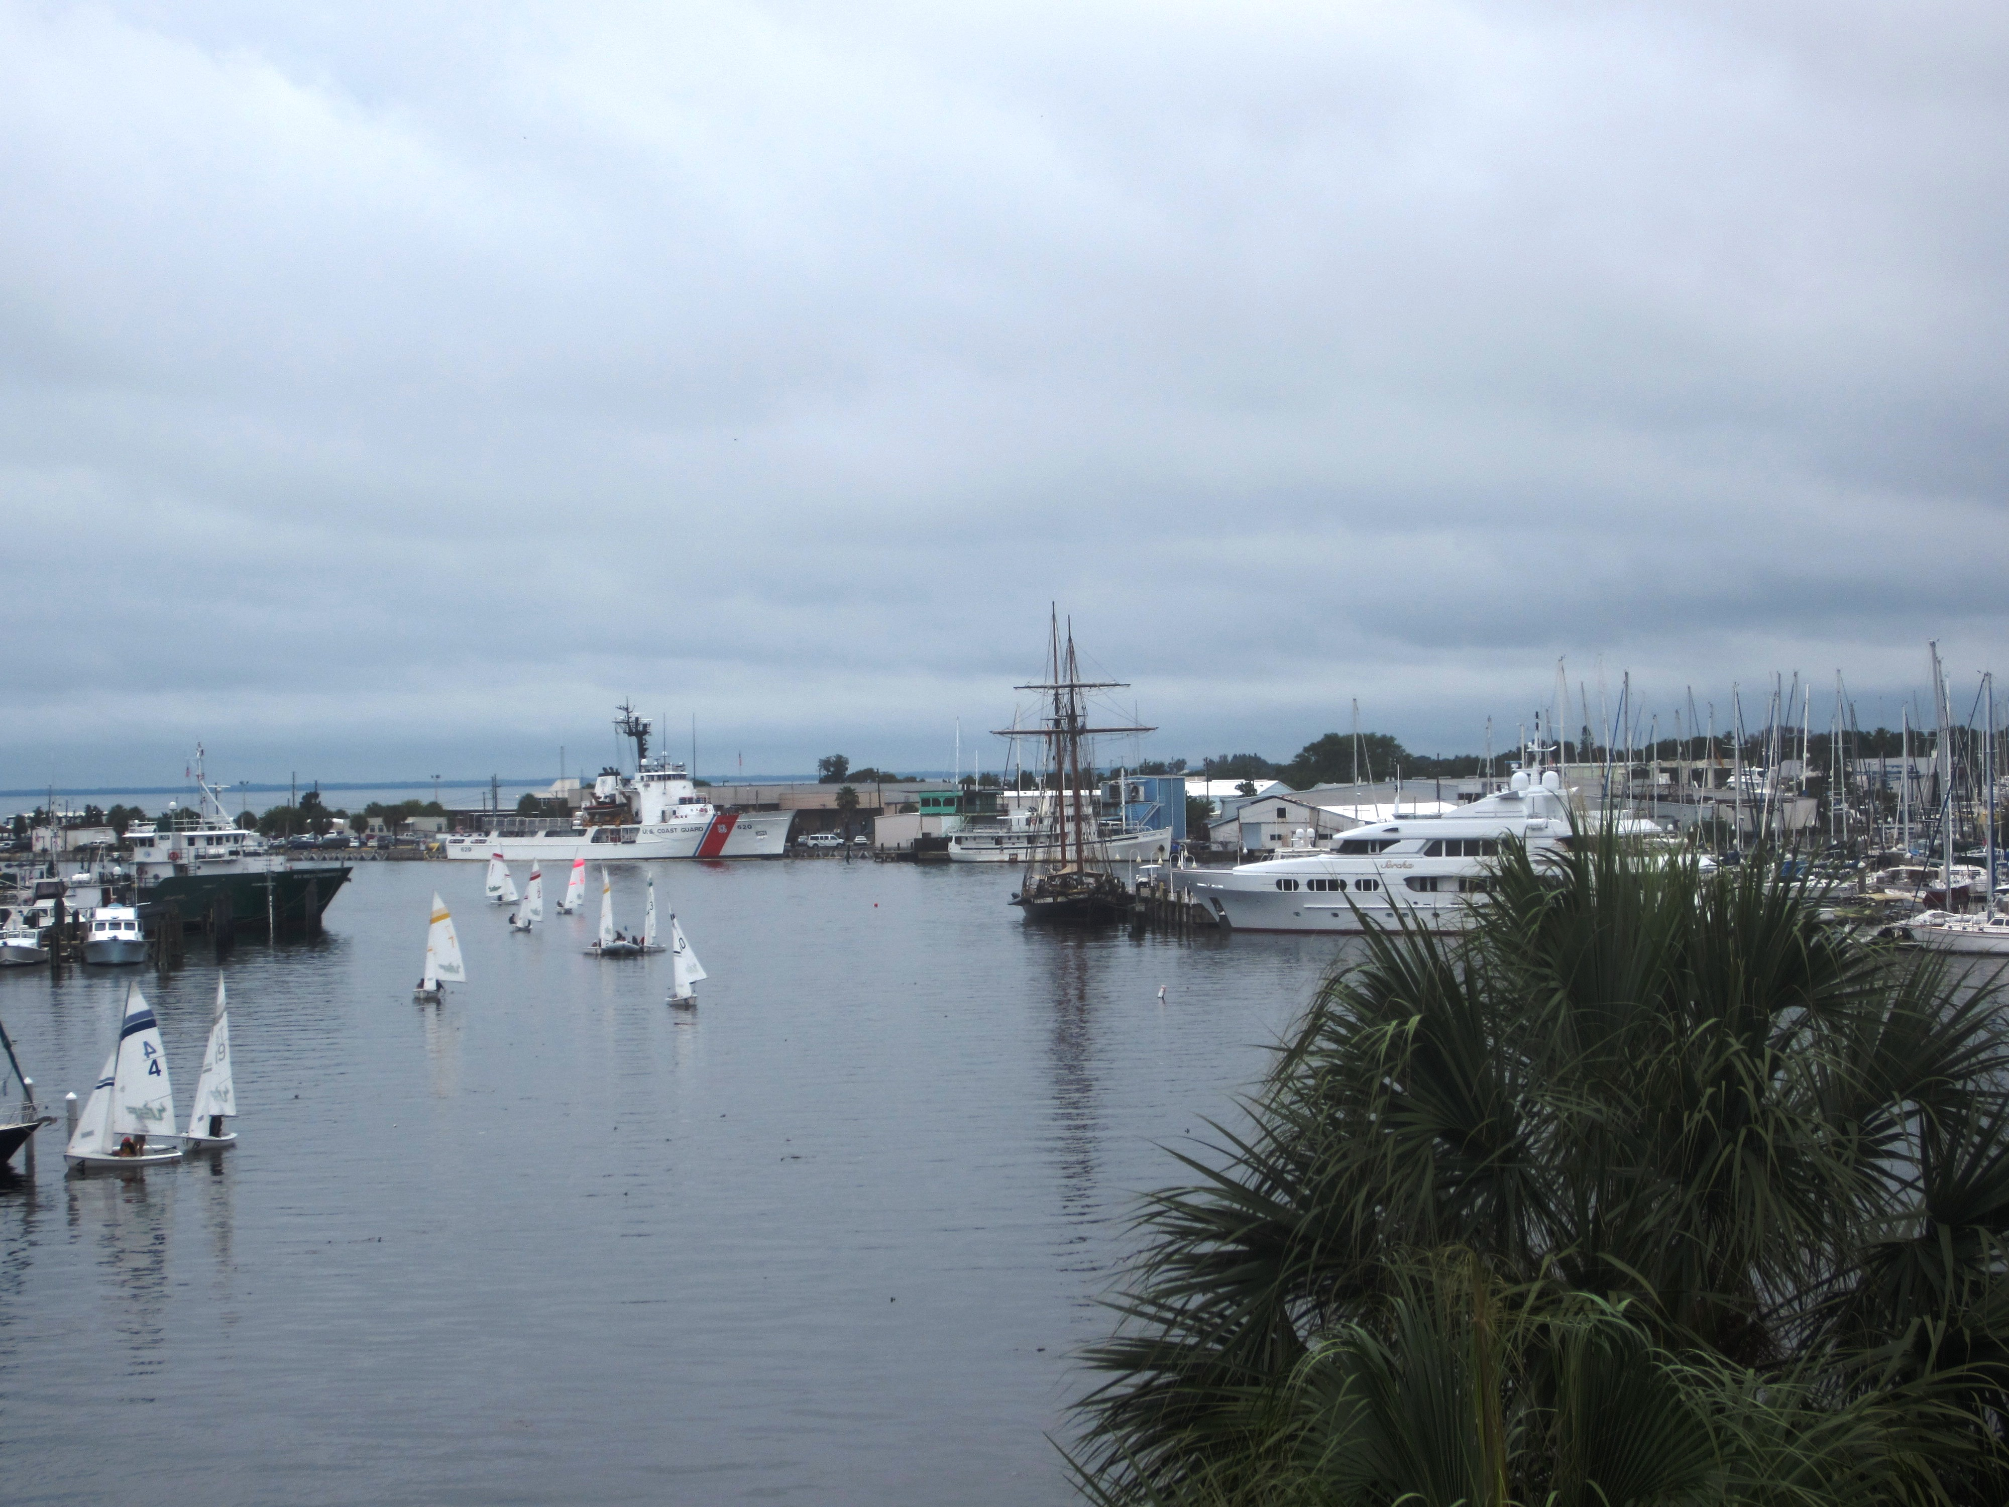
Marketing³
Photo by Carol Hixson

Slide 36
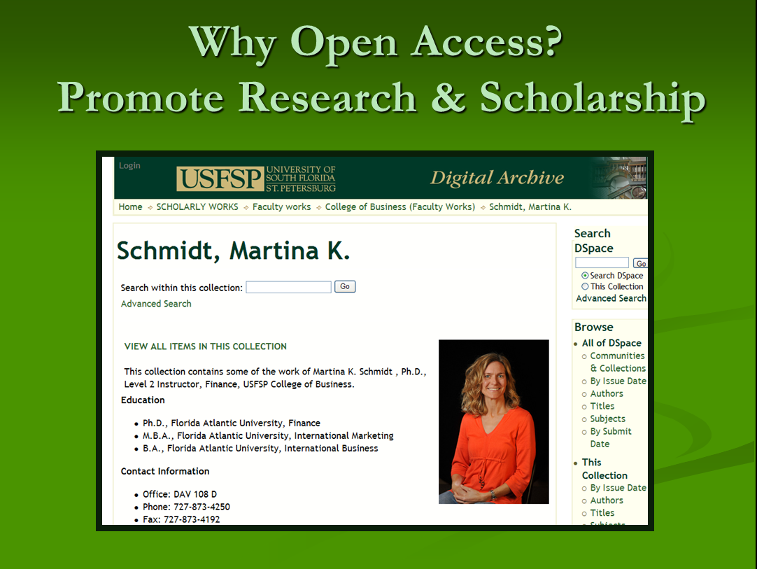
Marketing Strategies

Slide 37
Marketing: Reaching Out to
Individual Faculty
Following announcements of presentations, or new publications
When new faculty are introduced
To collect course-specific student work

Slide 38
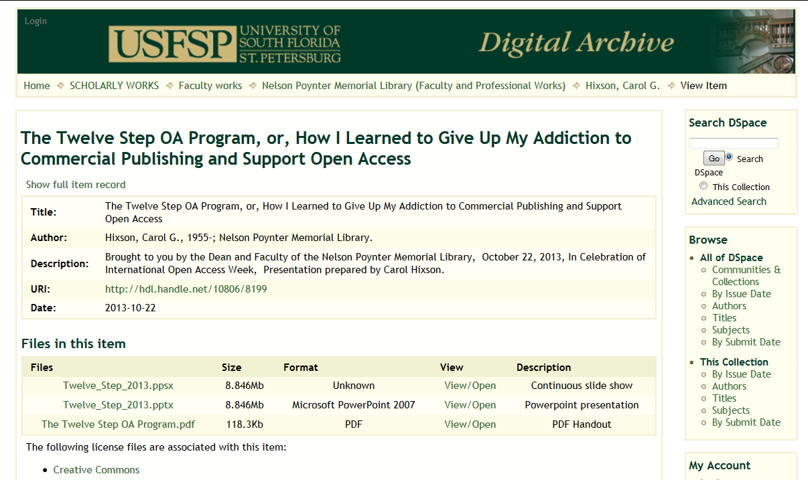
Marketing : Presentations & Events

Slide 39
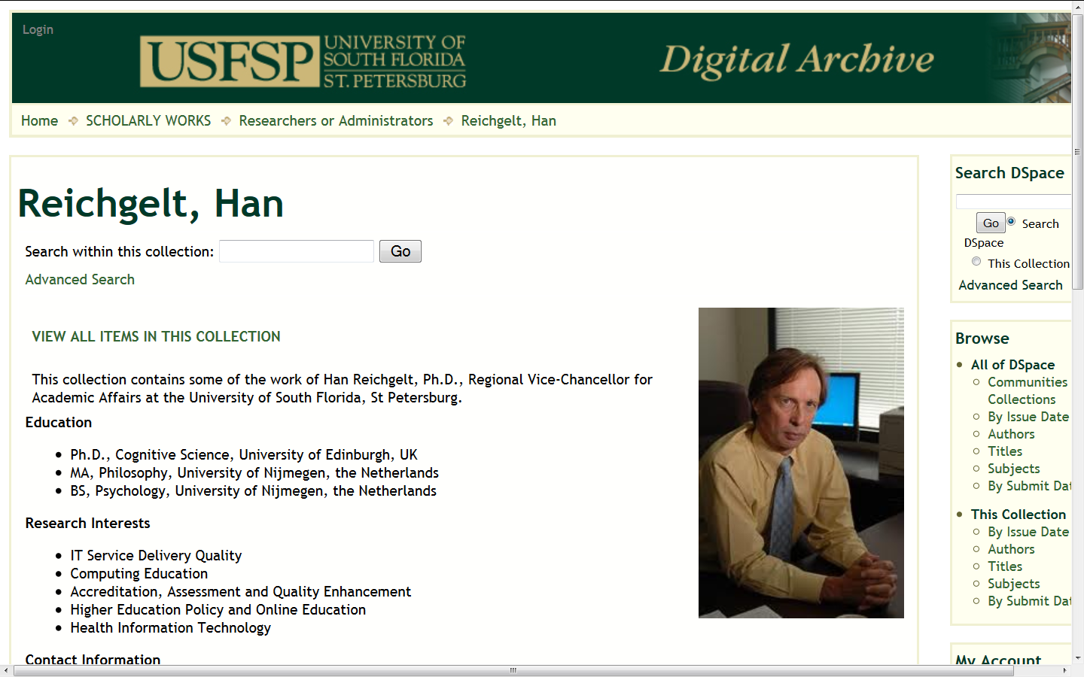
Marketing: Administrative Support

Slide 40
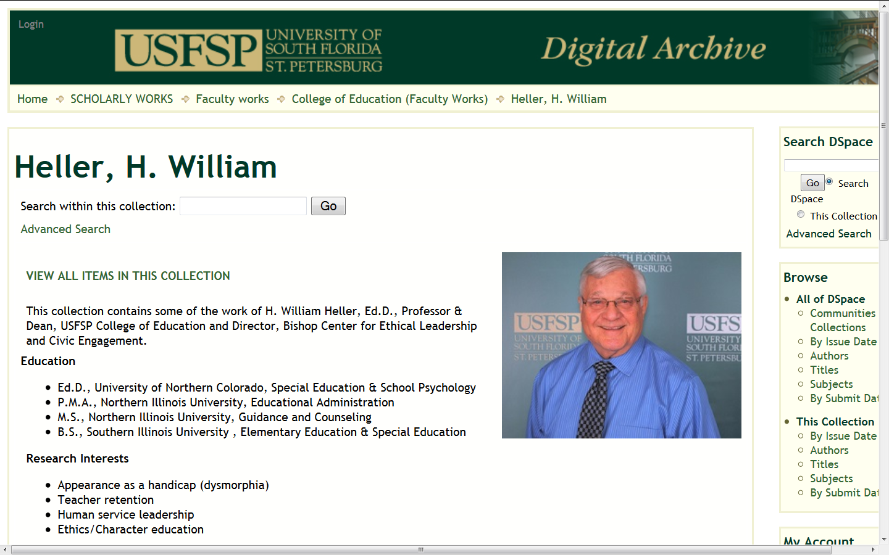
Marketing: High Profile Collections

Slide 41
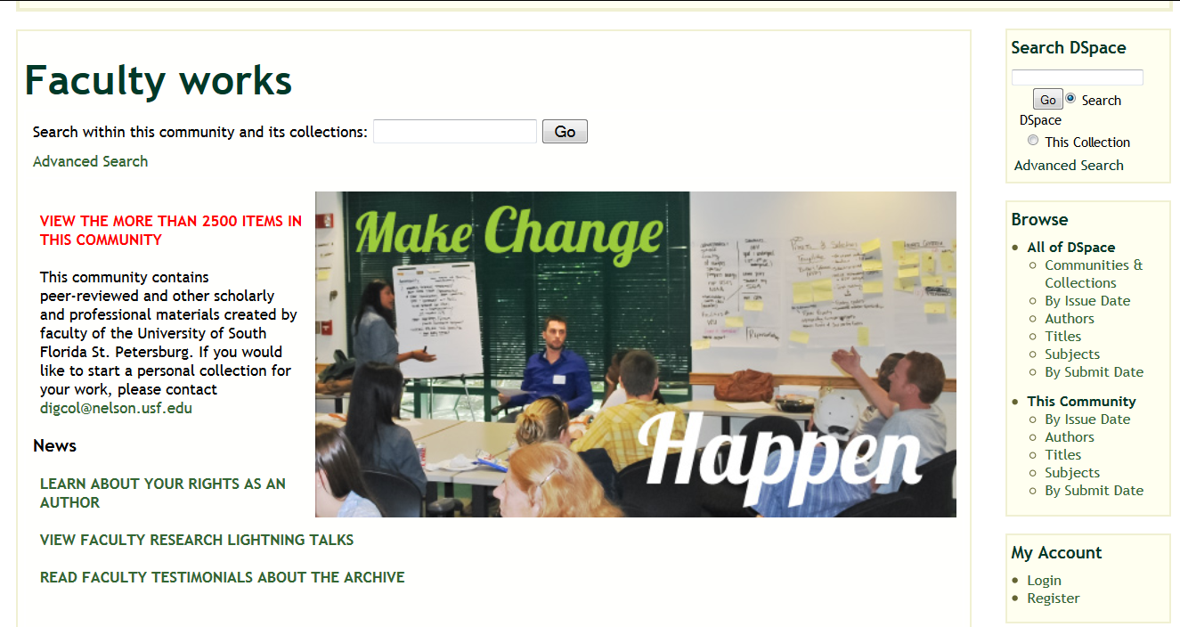
Marketing : Faculty Testimonials

Slide 42
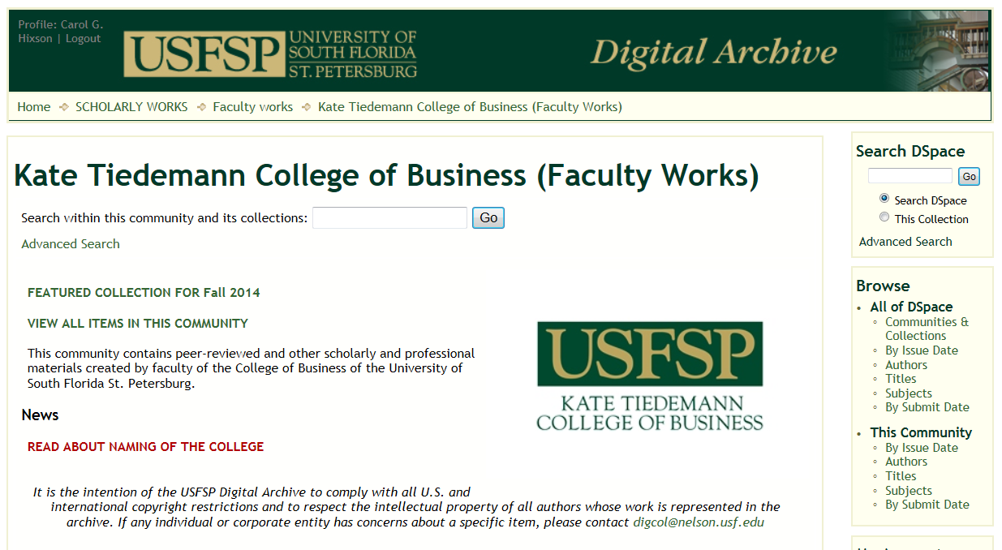
Marketing: Featured Collections

Slide 43
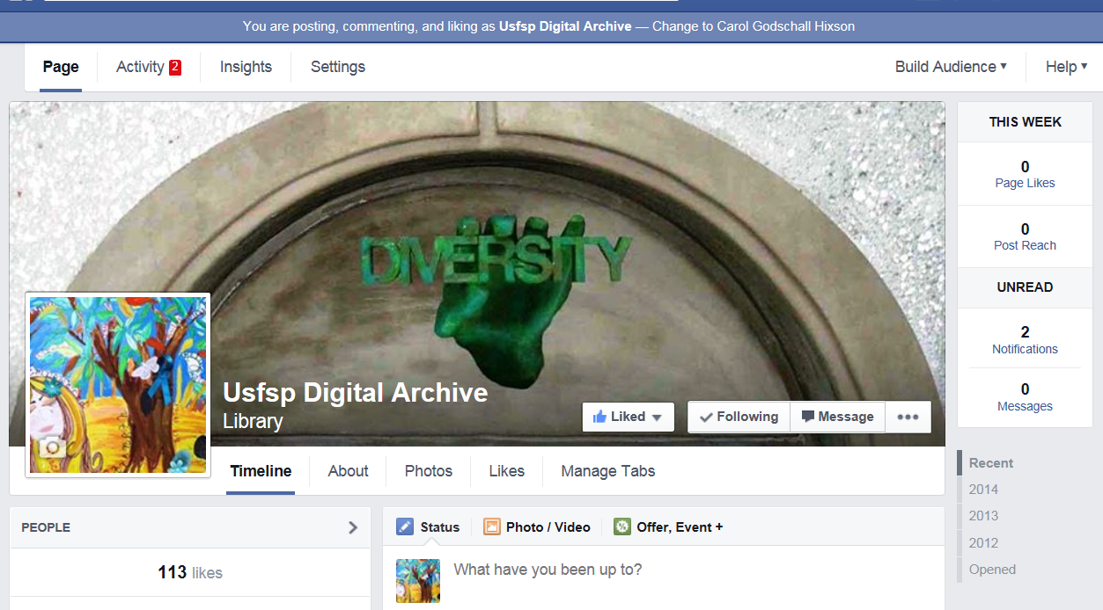
Marketing: Use of Social Media & Blogging

Slide 44
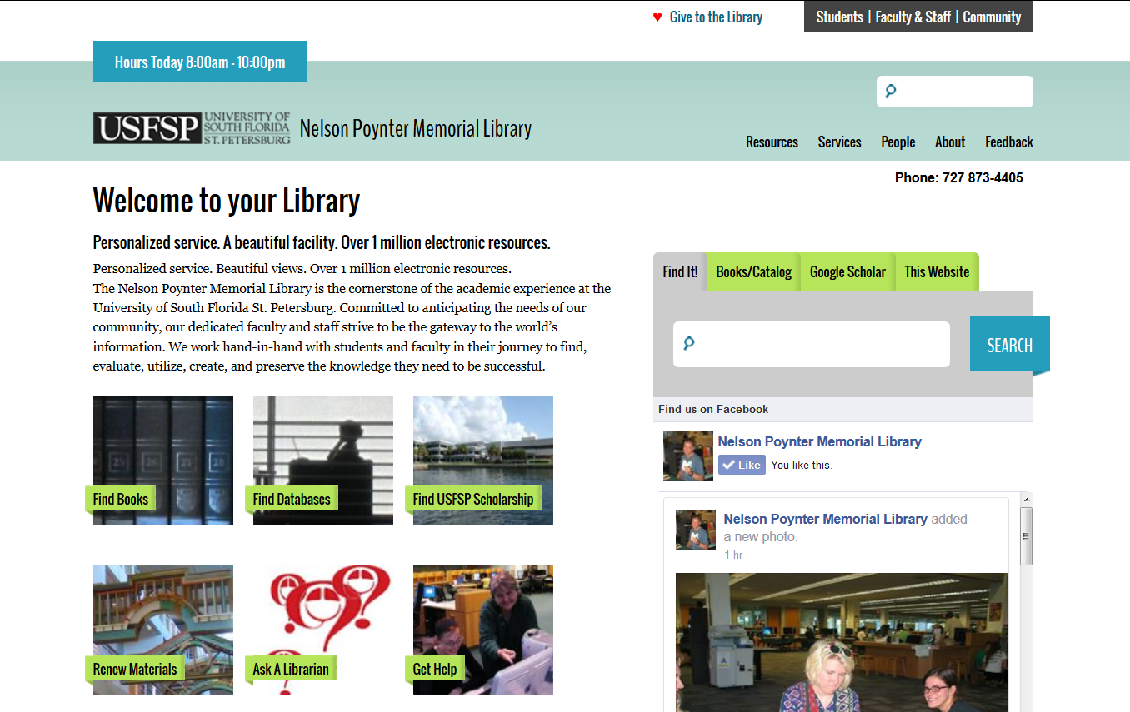
Marketing: Web Sites

Slide 45
Be Reliable and Innovative
Deliver what you say you will
Be responsive
Listen to suggestions
Implement what you can
Develop new features and services

Slide 46
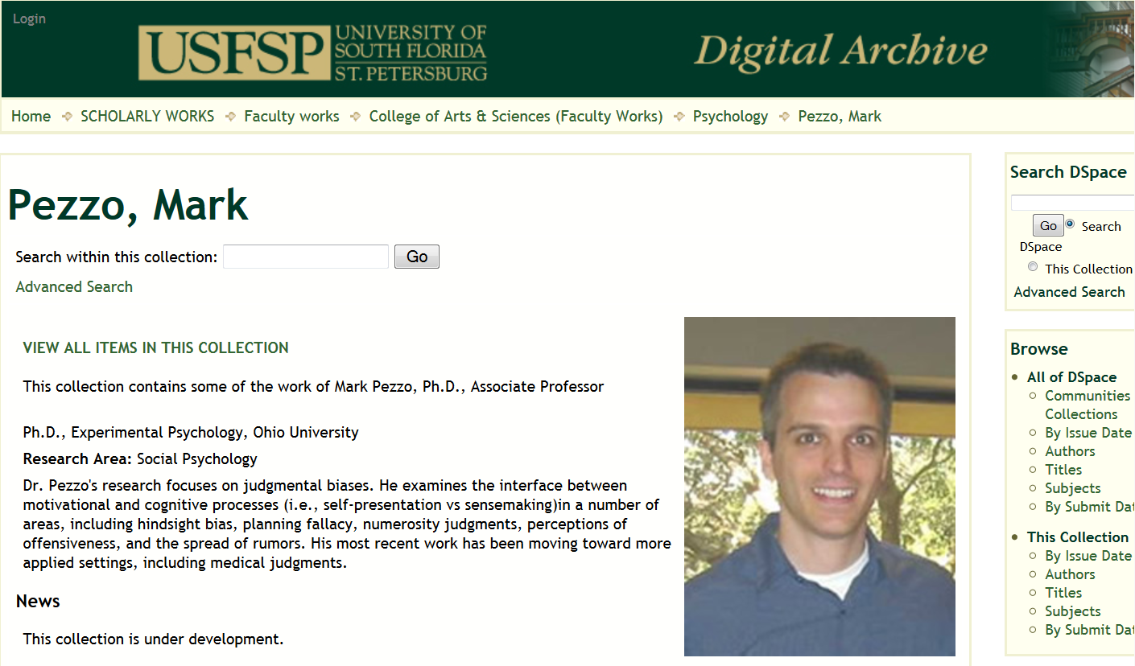
Be Responsive

Slide 47
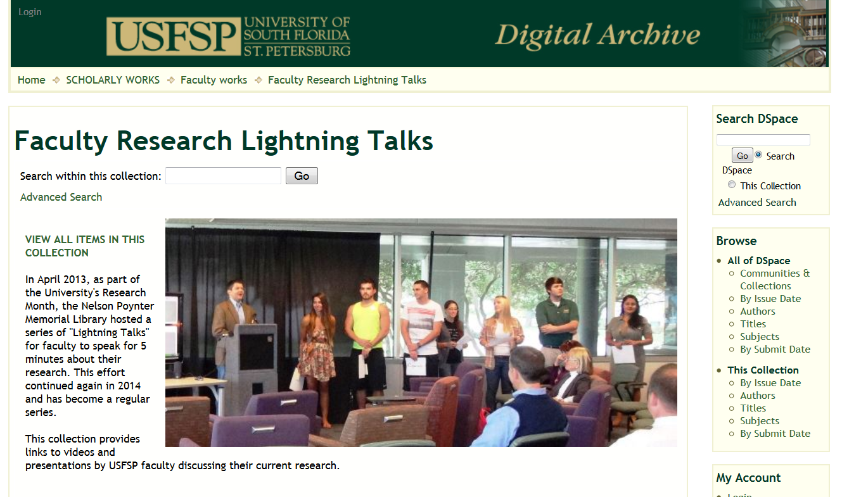
Services : Lightning Talks

Slide 48
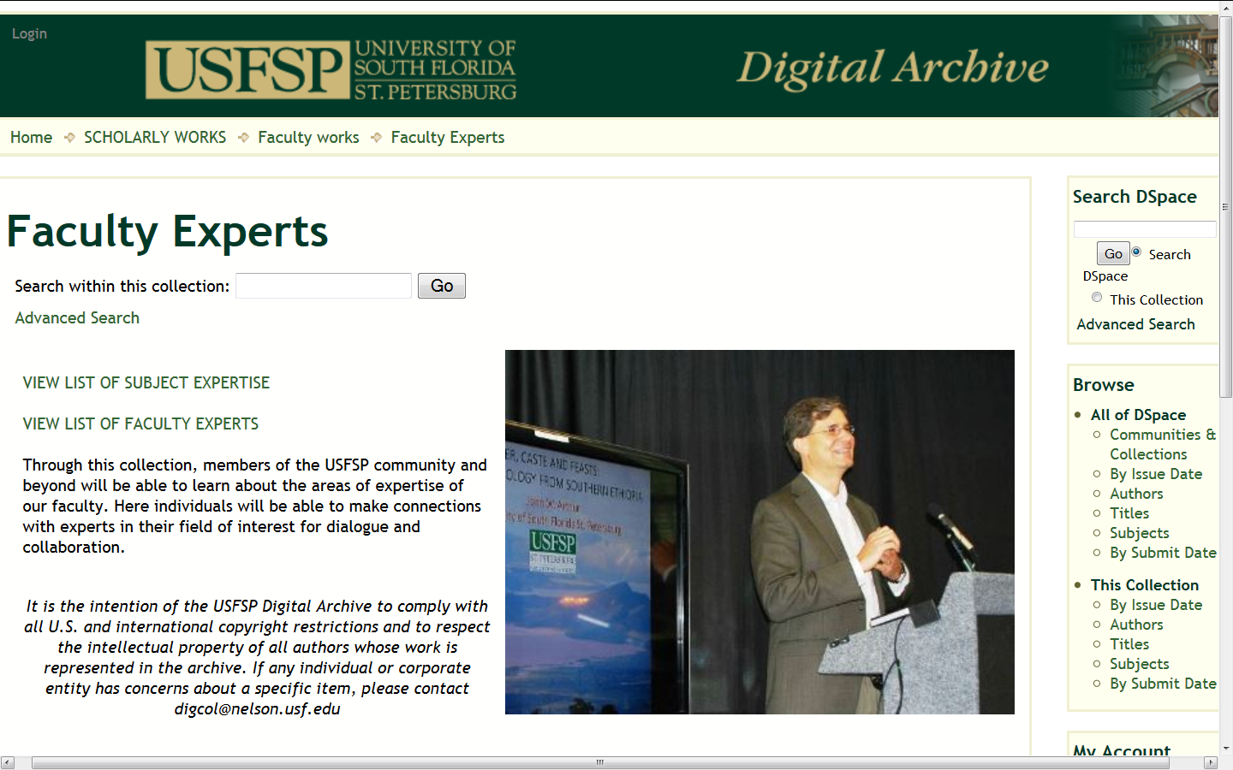
Services : Faculty Experts

Slide 49
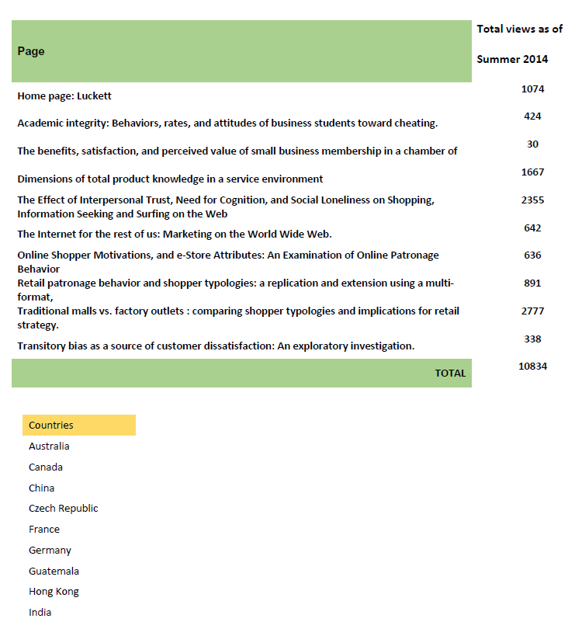
Services: Statistical Updates

Slide 50
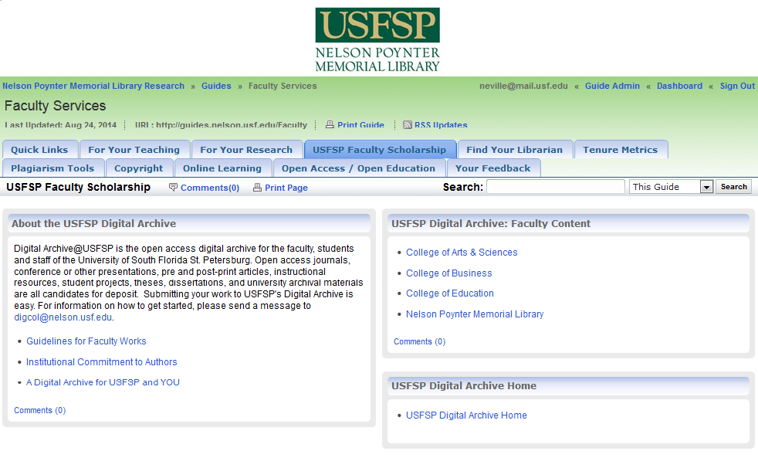
Services : LibGuide

Slide 51
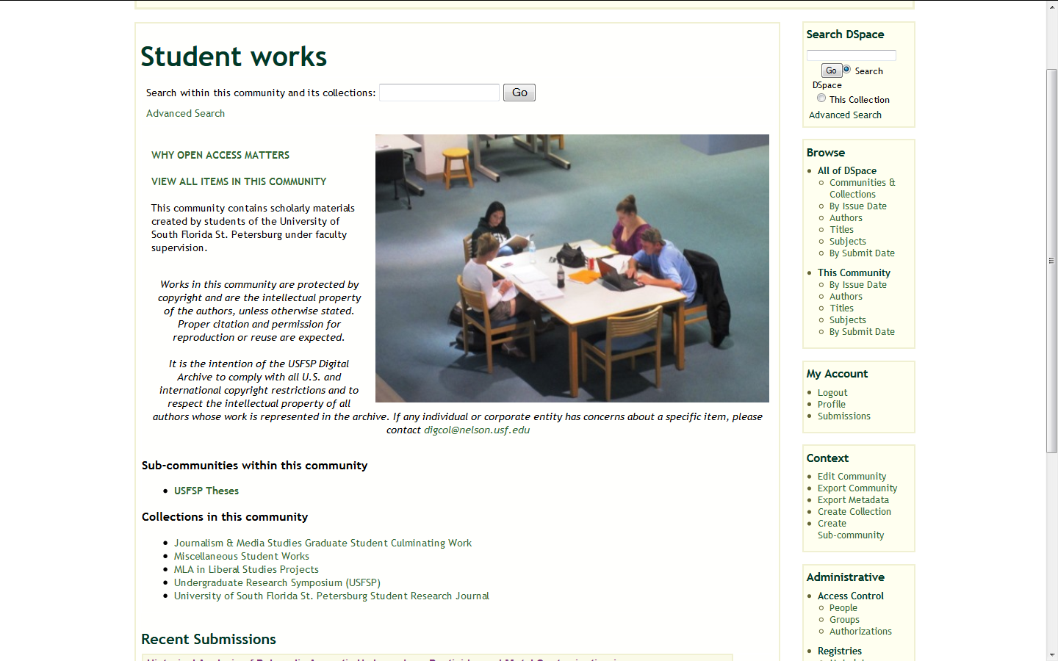
Services: Collect Students’ Work

Slide 52
Business Plan
Know your limitations and be realistic
Tie to institutional strategic plans
Do pilot studies with different models
Outline the operational, technical, policy, marketing, management and staffing costs
Consider the costs of in-house versus hosted
Don’t market beyond your capacity
Add new services gradually

Slide 53
Workflows
Specifics depend on software, staffing, services provided
Delegate work to lowest level
Share responsibilities
Share project information
Document processes

Slide 54
Challenges
Software limitations and no in-house expertise to modify
Selling senior faculty on the “legacy” aspect
Time, time, time!
Self-submission

Slide 55
Next Steps
Continue to develop innovative services & marketing
Improve software and technical infrastructure
Obtain funding for dedicated staffing
Coordinate with state or national archival initiatives
Develop support for research data

Slide 56
How to Achieve Faculty Buy-In
Talk to them
Present models
Don’t ask them to change
Personalize
Don’t expect them to do anything
Educate them over time
Market , market, market
Be reliable and innovative

Slide 57
Thank you!
Handouts and slides available at: http://dspace.nelson.usf.edu/xmlui/handle/10806/11969

