Slide 1

Florida Atlantic University Libraries
Library Update
Presentation of
Carol Hixson, Dean of University Libraries
to the University Faculty Senate
With the assistance of
Jeff Sundquist, Assistant Dean for Research and Collections
Maris Hayashi, Head of Collection Management
February 25, 2019

Slide 2
Facilities: East side of Wimberly
HVAC and plumbing in Wimberly
  5th floor men’s room leak caused damage to HVAC on floors 3, 4, and 5.
  Affected part of 5th floor has 100+ student seats, 5 group study rooms, storage for collections, and staff work areas for Recorded Sound Archives
  Facilities has been working with us for short-term mediation of the problem
  Due to age and design of building, the permanent fix is expensive, will be disruptive, and will take time. Costs covered by University
  Special Collections are secure – separate HVAC unit for the vault has not been affected

Slide 3
Facilities: Microfilm
Recently discovered that our microfilm collections are deteriorating due to “vinegar syndrome, ” a condition caused by high heat and humidity and temperature fluctuations, which describes conditions in Wimberly
Microfilm is made from cellulose acetate that is susceptible to chemical decay. Known as "vinegar syndrome" because of the characteristic vinegar odor of acetic acid produced by decomposing acetate, the degradation may also cause distortion, shrinkage, and brittleness, rendering the film unusable
We are working with SUS colleagues who have also dealt with this. They have withdrawn materials and found alternatives, where they could
We have analyzed our collection to determine what is available electronically and are working to determine what is available to us through ILL

Slide 4
Budget for Collections: Recap
Rate of Inflation for Library Collections (Print & Electronic)
  6-10% annually
FAU Libraries Budget for Collections
  1989 $2.7 million
  2008 $3 million
  2018 $3 million

Slide 5
How Have the Libraries Been Coping?
Reducing the amount spent on monographs
    Since FY 13/14: 89.8% less spent on books/monographs (from $544,250 in FY14 to $55,563 in FY18)
Supplementing the collections budget with salary savings
  Allocated $100,000 last fiscal year for monographs and have allocated $120,000 for monographs this fiscal year
  Used $300,000 to prepay some packages for fiscal year 2018/2019
Supplementing the collections budget with Technology Fee proposals
  Requested $570,006 for six proposals in 2019 to purchase scholarly content. We always request more support than we get
  Awarded $163,003 in 2018 and $159,889 in 2017

Slide 6
Where are we?
We have not cut any electronic package to date, due to prepaying this year using salary savings
We negotiate consortial pricing deals with the SUS and other state institutions. Getting harder because institutions are pulling out of some deals due to their budget challenges
We are unable to add any new packages without cutting others
We are losing ground in our print and monograph collections and have reached the point where we can no longer even maintain the appearance of the status quo for electronic resources

Slide 7
Where are we?
We have requested increases to our collections budget every year
Unless we get a significant, permanent increase in the budget, we will eventually have to make cuts to electronic resources. We have reached the end of what we can accomplish through creative and alternative sources of funding
The Libraries Collections Advisory Committee, with faculty representation from most of the Colleges, is giving us guidance on how to approach upcoming cuts

Slide 8
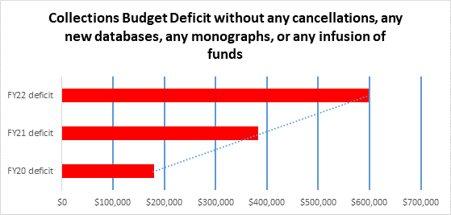
Projected deficits for next 3 years based on rising costs for current electronic packages

Slide 9
How Do We Move Forward?
Continue to lobby for budget increase in support of scholarly content
Raise money through development
  We are about to hire a development officer for the Libraries – which will reduce our salary savings significantly going forward
Pursue grants (we continue to look for grants that support collections)
Explore more cost-sharing with Colleges (CoM and CoB models)

Slide 10
How Do We Move Forward?
Continue to utilize supplemental funding as possible to fill gaps (not a long-term solution & limits ability to meet other needs)
Continue to meet with faculty to raise awareness and gather input (Forums, College Councils, Graduate Council, UFS, Collections Advisory Committee)
The Collections Advisory Committee recommends that FAU follow examples set nationally (including at other universities in Florida) and cancel one of our six most expensive journal package bundles for FY20, using a portion of the package’s price to subscribe to only the most essential journals à la carte.

Slide 11
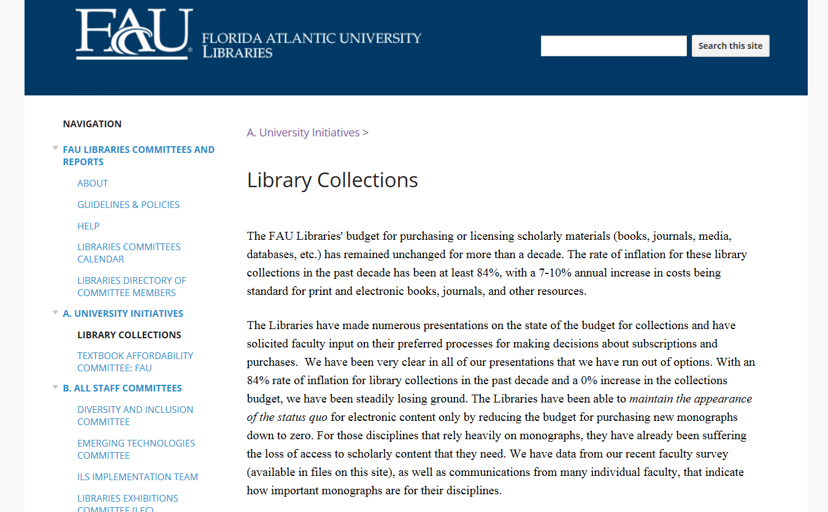
https://sites.google.com/a/faulibs.com/committees// university-committees/library-collections

Slide 12
Questions and Comments
Contact information:
hixson@fau.edu
7-3717

