Slide 1


Making Change from Within
Integrating Accessibility into
Strategic Planning and Assessment
Digital GLAM Spaces Conference
November 10, 2021
Jacqueline L. Frank, Instruction & Accessibility Librarian
Scott W. H. Young, User Experience & Assessment Librarian
Montana State University
Notes:
Hi everyone, and welcome to our presentation on Making Change from Within: Integrating Accessibility into Strategic Planning and Assessment. We are happy to be with you today from the Montana State University Library in Bozeman, Montana.

Slide 2


Hi!
Jacqueline Frank
Accessibility & UDL
Diversity, Equity, Inclusion
Public Services
Scott Young
UX & Assessment
Service Design
Professional Ethics
Notes:
I'm Jacqueline Frank, and I'm the Instruction and Accessibility Librarian. My focus is in advancing accessibility through the lens of diversity, equity, and inclusion, by promoting Universal Design for Learning in our instruction efforts and public services.

Slide 3

Hi!
Jacqueline Frank
Accessibility & UDL
Diversity, Equity, Inclusion
Public Services
Scott Young
UX & Assessment
Service Design
Professional Ethics
Notes:
Hi everyone, and I'm Scott Young. I’m the user experience and assessment librarian at MSU, so I focus on UX and assessment. I also do service design, and I think about professional ethics. So you can see that Jacquie and I are great collaborators for bringing together accessibility and assessment in our library, and we’re happy to be here today to talk to you about it.

Slide 4
Outline & Introduction
Notes:
To get us started today we'll go over a brief outline, and then pose some framing questions to think about throughout the rest of the presentation.

Slide 5
Outline
Framing Questions
Accessibility at MSU
Integrating Accessibility into Strategic Planning
Strategic Planning in Action: Examples
Successes & Challenges
Conclusion: UX and accessibility work can fit in most strategic plans
Notes:
After the framing questions, we'll give an overview of the evolution of Accessibility efforts at the MSU Library, discuss how we've integrated accessibility into our Library Strategic Plan, show our strategic plan in action with specific examples of our initiatives and progress, talk about some of the challenges and limitations, and then leave you with some possible ideas of how UX and accessibility work can fit into many different areas of an institutions existing strategic plan, so that you have an idea of how you can do this at your various institutions.

Slide 6
Introduction
Accessibility is more than compliance
  Commitment to professional values
Barrier: the operational status quo
Notes:
But first, we'd like to acknowledge that accessibility is more than compliance—it’s a commitment to the professional values of access, diversity, and social responsibility. However, accessibility work often involves changing the status quo of operations, and many times barriers can get in the way of us from making change and realizing the promise of accessibility.

Slide 7
Introduction, cont.
How do we confront barriers, work within our existing structures, and realize our values?
  We offer one answer to that question.
Notes:
So how do we find actionable ways to confront these barriers, work within our existing structures, and realize our values? We’d like to offer one answer to that question.

Slide 8
Introduction
How do we confront barriers, work within our existing structures, and realize our values?
  Understand context & systemic challenges
  Leverage Strategic planning: a common apparatus
  Our perspective: the Balanced Scorecard
Adapt our approach at your institution
Notes:
By realizing that we operate within different contexts and complicated systemic challenges, and that we are necessarily working from within that context, we have taken advantage of our library strategic plan and used it as a mechanism to propel and assess our accessibility efforts. Strategic planning is a common apparatus within our higher education context, and we show how it can be used to advance accessibility and improve the user experience.
We will speak from our perspective of using the Balanced Scorecard, which is a specific structure for strategic plans, and share our strategies for making change from within, by integrating accessibility into library strategic planning and UX assessment efforts. Then to extend the reach, we will discuss how UX and accessibility work can fit into many different areas of various strategic plans.

Slide 9
Framing Questions
Notes:
As we start to move ahead, we’d like to offer a few framing questions to help prompt your thinking and to show where we are headed. We will also offer our conclusion up front here, so you can see where we will end up, and then we will connect the dots along the way.

Slide 10
Framing Questions
What are the main barriers you face at your institution in implementing accessibility?
What is your library's culture of planning and assessment?
Where is accessibility work happening in your library?
How can this work be aligned—your projects, your library's strategy, your university's mission?
Notes:
As we start to move ahead, we’d like to offer a few framing questions to help prompt your thinking and to show where we are headed. We will also offer our conclusion up front here, so you can see where we will end up, and then we will connect the dots along the way.
So as we move forward, we would like you to keep in mind questions like:
What are the main barriers you face at your institution in implementing accessibility?
What is your library's culture of planning and assessment?
Where is accessibility work happening in your library?
How can this work be aligned—your projects, your library's strategy, your university's mission?

Slide 11
Main Takeaways for Today
You may already be doing accessibility
You may already have a strategic plan
Our main takeaway: integrating accessibility into your library's strategic plan can align interests and help you accomplish accessibility
Notes:
Our main takeaways for today, if we were to summarize our message, it would be that you may already be doing accessibility – you probably are, since you are here – and you may already have a strategic plan at your library that you may already be a part of. So our main takeaway is that by integrating accessibility into your library's strategic plan it can align interests and help you accomplish accessibility.

Slide 12
Accessibility at
Montana State University
Notes:
So now we are going to talk about how we have done that at our Library, and we’ll start by giving a very brief history of accessibility at Montana State University.

Slide 13
Before A11y was in our Strategic Plan
We already had the values, but not the plan
Accessibility work was happening:
  Distributed and scattershot
  Under-the-radar
Accessibility work often happens without, or outside a strategic plan
Sound familiar?
Notes:
Before accessibility was officially tied to our Strategic Plan, we already had the values of DEI at our institution and in our library, but we didn't have a specific plan on how to execute on those values. That isn't to say that work wasn't already happening in these areas, because efforts were indeed already happening in various areas. However, that accessibly work was distributed and scattershot, or happening under the radar without much awareness from of others across the library. And mostly people had chosen to incorporate accessibility work because they wanted to or saw the importance, not because it was officially in their job description or duties.
This may sound familiar to you, and is a common place to be for many libraries and institutions. And that's ok, because accessibility work often happens without a strategic plan, or outside of a strategic plan.
However, we have found multiple benefits from tying accessibility initiatives directly to our strategic plan.

Slide 14
Evolution of A11y Efforts at MSU Library
DEI values as the foundation of Accessibility
MSU Web Accessibility Policy: Compliance Standards & Remediation Timeline
Faculty Hiring with Accessibiligy Focus
Accessible Content Strategy
New Accessibility Projects
Notes:
So how did we do that? Well, we already had expressed and written values of diversity, equity, and inclusion. So by considering that accessibility supports the foundation of DEI, combined with a new institution-wide web accessibility policy that outlined compliance standards, and specific dates on a multi-year timelines for meeting those standards, it created a need for leadership and dedicated time for accessibility work.
This led the MSU Library to fill a vacant faculty position, but with a new focus in accessibility. I was lucky enough to be hired for that position in February 2020, as the Instruction & Accessibility librarian, with a focus in helping our library meet the compliance standards and increasing the accessibility of our library instruction and public services.
Over the last two years part of that work included outlining an accessible content strategy, to support an internal Library Web Content Strategy, which had already been created for our library website.
So with this in mind, we’ve decided to tackle a few specific accessibility projects that support our internal content strategy, the MSU Web accessibility policy, and ultimately our institutional values. And We could have continued on, doing this work, knowing it’s meaningful and supports these areas and values.

Slide 15
After A11y was in our Strategic Plan
We found the mechanisms of strategic planning can:
  Focus the work
  Identify leadership & areas of collaboration,
  Bring resources
  Increase awareness & tell the story
Notes:
Although we were also looking for ways to organize and report on the work, so we used strategic planning as an established mechanism to help us.
And we found that by integrating accessibility initiatives into our strategic plan, it helped focus the work, identify leadership and areas of collaboration, increase resources for the work, even just increased time and support, and ultimately increase awareness of these projects and tell the story of our efforts to improve accessibility, because progress reports on our strategic plan are periodically given to the entire library.
So now Scott is going to give a brief overview of what our library's strategic plan looks like, and then we will take a closer look at three specific accessibility projects we have identified as initiatives under the plan.

Slide 16
Integrating Accessibility into
Strategic Planning
Notes:
Now I’ll talk a little bit about how we have integrated our accessibility efforts into our strategic plan, and our library.

Slide 17
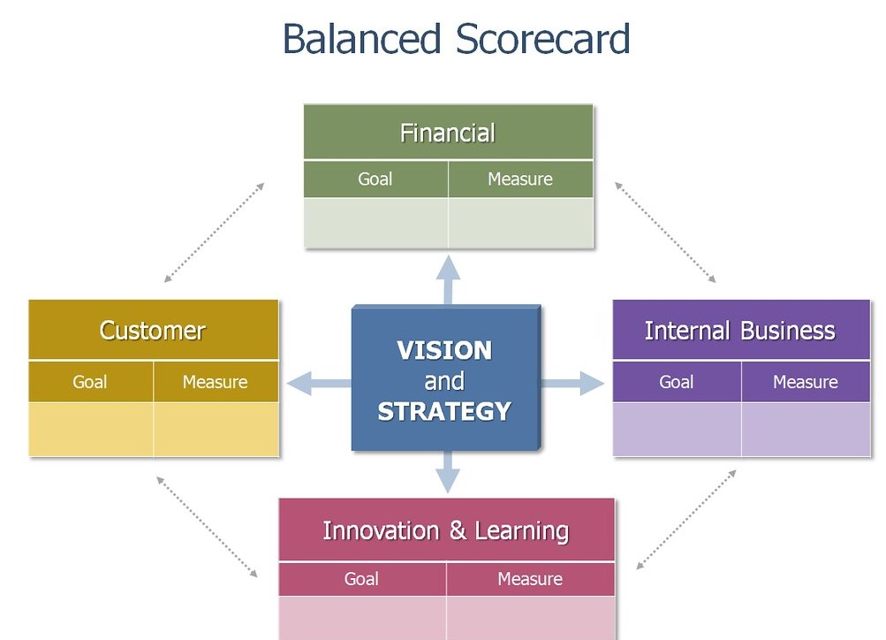
Notes:
At our library, we used the Balanced Scorecard, which is a standard planning and assessment framework. What you are seeing here is the overall structure. It was developed with terminology such as technology and customer, and we adapted it to libraries. It has four main areas to see an organization strategy. None of them outweighs the other, and are all seen as co-equal in terms of importance. The purple is Internal Business, which we have rephrased to Internal Processes. There is Innovation & Learning, which we rephrased to be learning & growth, and the customer perspective we rephrased to the user perspective. Within each perspective, there are a number of goals or objectives that can help accomplish the main things your organization identifies as important under each heading. Then each objective gets one or more measures that helps demonstrate whether progress is being made towards the main goal. So it’s multifaceted, and this is just one high level view of it, and it can get pretty complicated which we will see in just a second.

Slide 18
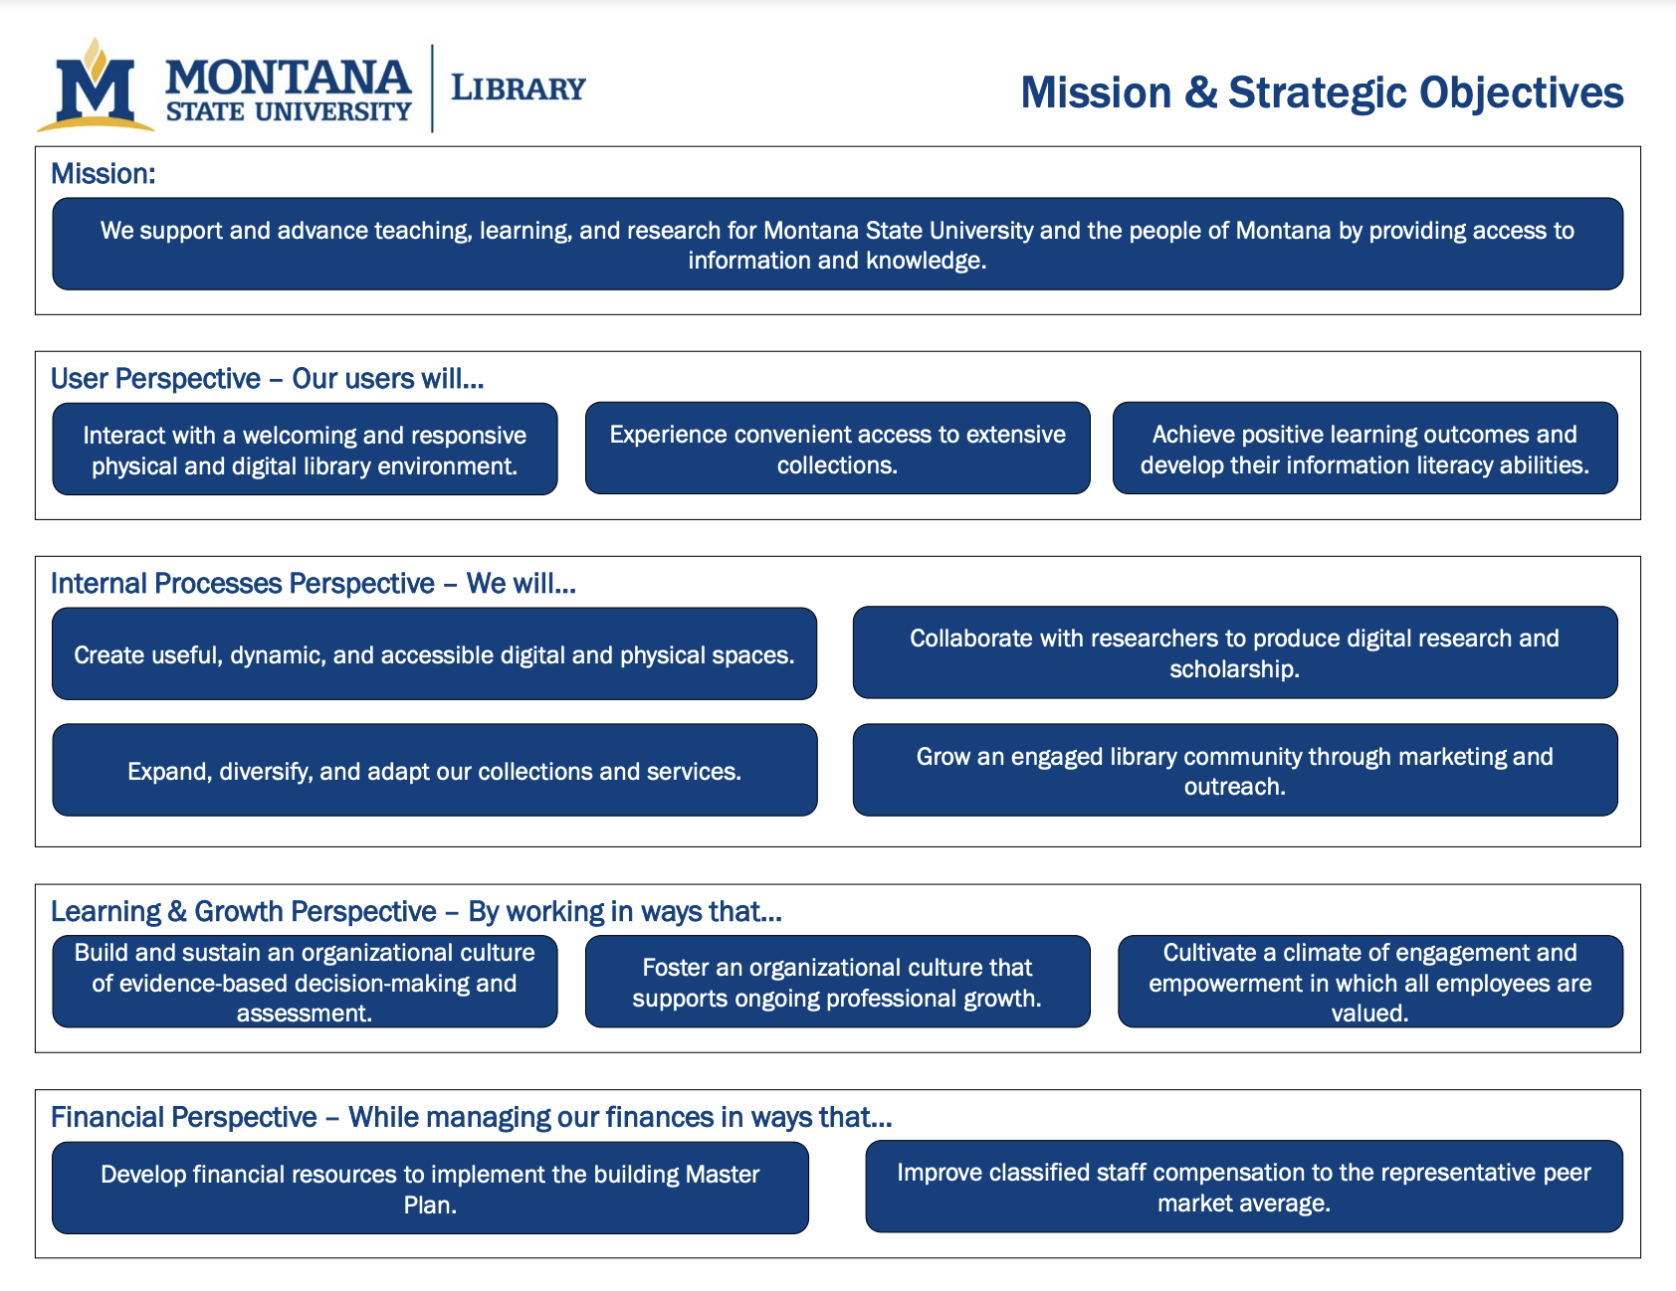
Notes:
Here is the balanced scorecard for the Montana State University Library. It’s a lot of text, and we will not go through every single one. But this shows the broad scope of strategic planning, and we’ll talk about our way of making accessibility work within this framework. However, strategic planning is all sort of similar, and there is a way to be flexible and adaptable and help accessibility find a way into it. Our way of creating this, we hired a consultant who joined our organization for a few months, and we had a collaborative, participatory process for co-authoring this strategic plan. So there was a a lot of opportunity to contribute to the plan, and see ourselves in the plan, and that helped us get accessibility in here in the first place.

Slide 19
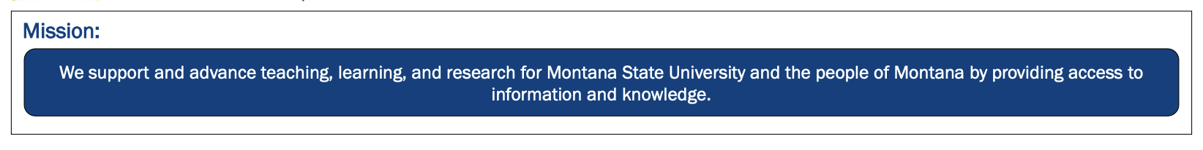
Notes:
So I’ll take us through step by step, for how accessibility fits into our plan. Here’s the mission that we articulated for the library: We support and advance teaching, learning, and research for Montana State University and the people of Montana by providing access to information and knowledge.

Slide 20
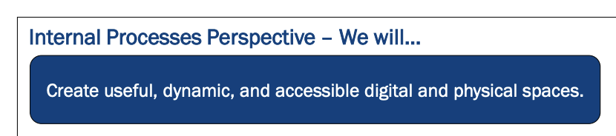
Notes:
Then under the internal processes perspective, we articulated a goal saying: We will create useful, dynamic, and accessible digital and physical spaces. We articulated this goal, which then supports the mission from the internal processes perspective. We also were able to create these different parts of this goal, including accessibility, which we focus into and were able to put that into the plan, which creates all the possibility for developing accessibility within the strategic planning framework.

Slide 21
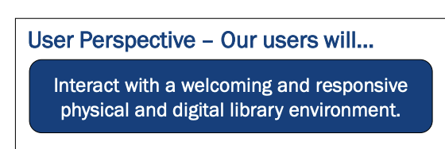
Notes:
We also got creative under the user perspective, where as a strategic objective we said that users would interact with a welcoming and responsive physical and digital library environment. Even though accessibility doesn’t appear directly here, in our work we have interpreted welcoming and responsive to fall within an accessibility frame of mind, so this allows us to match our internal processes with what our users perceive. So we are connecting dots within our strategic plan, around accessibility.

Slide 22
Initiatives in Support of these Strategic Objectives
Hiring an Accessibility Librarian
Accessibility Testing for Digital Spaces
Physical Space Accessibility Audit
UX with students with disabilities
Internal communications and reporting
Notes:
The specific accessibility initiatives that have develed from this language, are that we have hired an Accessibility Librarian; we have started to conduct accessibility Testing for Digital Spaces; likewise with the physical spaces, we’ve conducted a Physical Space Accessibility Audit; we are conducting UX projects with students with disabilities; and we have a robust approach for internal communications and reporting.

Slide 23
Strategic Planning in Action
Objectives, Measures, and Initiatives
Data Collection, Analysis, and Reporting
Notes:
Yeah, thanks Scott. So now we are going to dive a bit deeper into those few initiatives that Scott just mentioned, to look at the data we've collected, and how we are analyzing and reporting out on our progress.

Slide 24
Measures:
Physical ADA Compliance
Digital Accessibility
Measures:
Website UX
Notes:
Our strategic plan also identifies what we'd like to measure for each objective. Under the objective to create useful, dynamic, and accessible digital and physical spaces, our measures include Physical ADA Compliance, and Digital Accessibility. And under the objective to have users interact with a welcoming and responsive physical and digital library environment, our measures include Website UX.

Slide 25
Initiatives:
2.1a Physical Space Accessibility Audit
2.1b Accessibility Testing for Digital Spaces
Initiatives:
1.1b Website UX with students with disabilities (to be completed Spring 2022)
Notes:
Under those measures, we've identified three specific accessibility projects as initiatives for our strategic plan. Those include 1) conducting a Physical Space Accessibility Audit, and 2) Accessibility Testing for Digital Spaces to meet compliance standards, which involves testing, identifying, and addressing accessibility improvements on our website, and 3) conducting a website user experience project with students with disabilities.

Slide 26
Data Collection: Website UX
Timeline: to be conducted Spring 2022
  Students *will complete eight (8) tasks using the Library Web site. Data to be collected: task success rate; pain points,
  Students *will complete a survey on usability, appearance, loyalty, trust, & emotional response using the SUPR-Q & SAM scale. Data to be collected: survey responses on usability
  Compare to results from similar study in 2017
Notes:
So let's take a look at the data we've collected, and how we are analyzing and reporting out on it.
We are planning to conduct a project on website user experience with students with disabilities, and are planning to collect data in the spring of 2022. We will ask participants to complete eight (8) tasks using the Library Web site, and the data we will collect will be the task success rate, and pain points that users express or are observed. We will also ask participants to complete a survey on usability, appearance, loyalty, trust, & emotional response using the SUPR-Q & SAM scale. The data we will collect from that portion will be their survey responses on usability. We will then compare the results from similar study in 2017 to identify themes, recommended improvements, and next steps.

Slide 27
Data Collection: Physical ADA Audit
Timeline: Spring – Summer, 2021
  Combined two tools:
    IFLA Access to libraries for persons with disabilities - CHECKLIST
    Project Enable ADA Checklist
  Walked around the physical building to answer 125 different questions
Notes:
For the physical ADA compliance audit we conducted, we used two tools specific to libraries to walk around our building and answer 125 different questions related to space requirements.

Slide 28
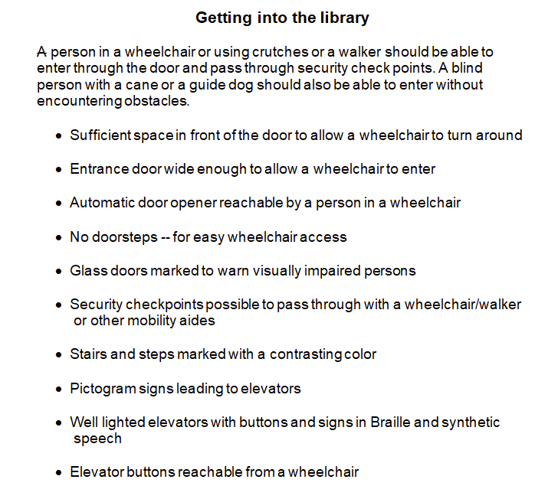
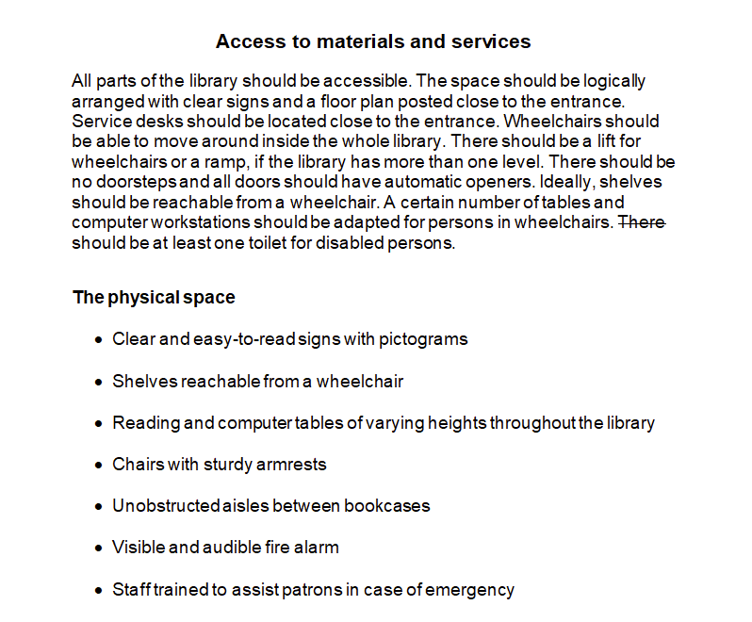
IFLA Checklist: Example Questions
Notes:
This slide shows an example of what the IFLA Access to Libraries for Persons with Disabilities Checklist looks like, with bulleted lists of questions broken out into various sections of the library..

Slide 29
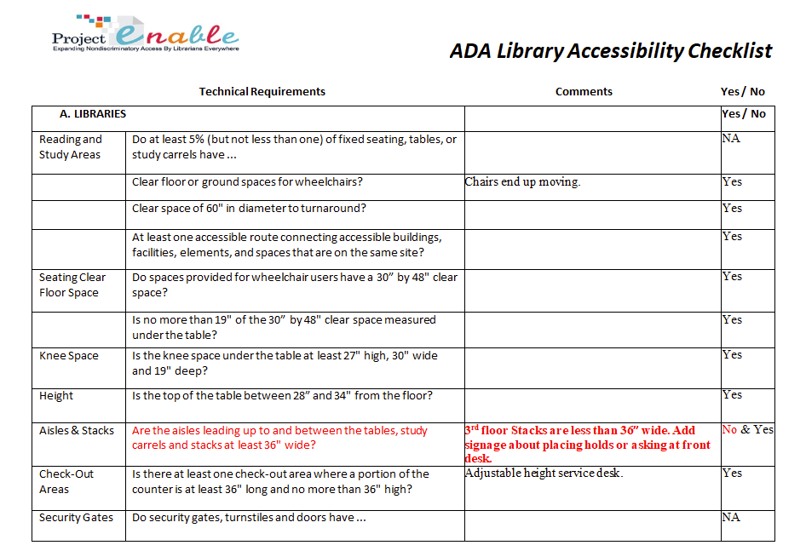
Project Enable Checklist: Example Questions
Notes:
And this is an example of what the Project Enable ADA Library Accessibility Checklist looks like, which is outlined in more of a spreadsheet view again broken out into different sections, but with columns for comments, and a clear yes/no answer of if it meets compliance.

Slide 30
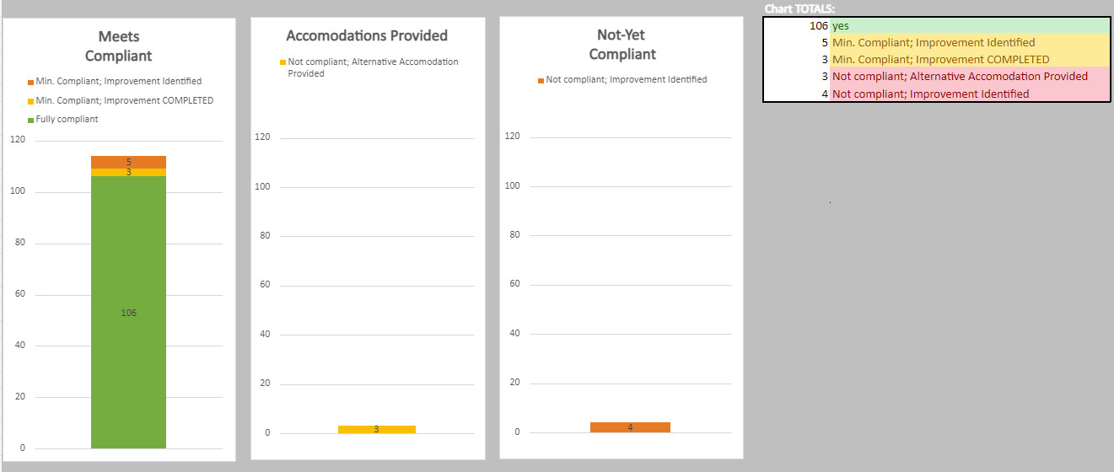
Analysis & Reporting: Physical ADA Audit
Notes:
We created our own, combined spreadsheet, with all 125 questions that were compiled from the two tools. We also identified five (5) levels of compliance that we will use to track our progress over time: 1) meets compliance; 2) meets minimum compliance but an improvement was identified, 3) meets minimum compliance and an improvement was already completed (which helps track our improvements over time) - those three all make up the first chart on the left. Level 4) is does not meet compliance but we provide an alternative accommodation, which is the middle chart, and level 5) does not meet compliance, with notes about what needs to be done to improve it. Laying out the number of items in each of these categories in these three charts helps show that we are almost fully compliant, and the few items where we are not are due to an old building with a split-level first floor.

Slide 31
Analysis & Reporting: Physical ADA Audit, 2.
Beyond compliance, we identified Forty-eight (48) improvements in our project report:
  Six (6) immediately completed
    e.g. lower public printers & ensure adequate knee space
  Forty-two (42) more costly or difficult:
    e.g. Add Restroom to 1st floor because without power, there are no accessible restrooms on the main level
Notes:
Beyond compliance, we identified Forty-eight (48) improvements in our project report, six (6) of which we immediately completed. For example, lowering our public printers to ensure adequate knee space underneath. The remaining forty-two (42) are more costly or difficult, for example adding a restroom to 1st floor because without power, there are no accessible restrooms on the main level.

Slide 32
Analysis & Reporting: Physical ADA Audit, 3.
We completed the original initiative by conducting the initial audit
Moving forward: we plan to establish a new initiative, to implement those improvements and track our progress of over time, as our next strategic initiative.
Notes:
We completed the original 2.1a initiative by simply conducting the audit. However, moving forward we plan to outline a new initiative, to implement the improvements and track our progress of over time.

Slide 33
Data Collection: Digital Accessibility
Timeline: Spring 2020 – Spring 2022
  Using the built-in CMS accessibility checker, conduct website inventory to identify all accessibility errors/tasks on library webpages
  Created spreadsheet listing every webpage, and the number of accessibility tasks
  Working to address accessibility errors/tasks on website
Notes:
For our iniative to test our digital spaces for accessibility, namely the library website, we are using an accessibility checker that is build into our website CMS. This allows us to conduct a website inventory of each webpage, and identify all accessibility errors/tasks on those webpages. So we have created a spreadsheet listing every webpage, and the number of accessibility tasks on each page, and we are working to address any accessibility errors/tasks we find on the website.

Slide 34
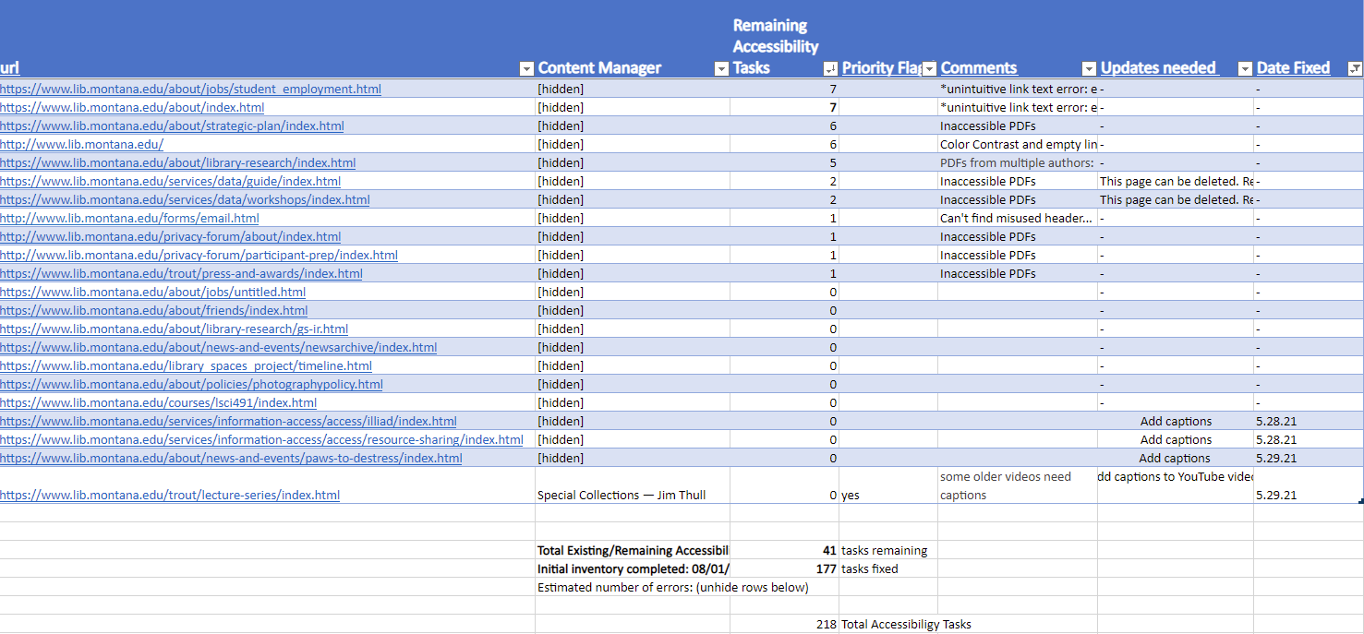
Analysis & Reporting: Digital Accessibility
Notes:
That spreadsheet looks something like this, with the page URL listed, who created or updates the page content, and if there are any accessibility errors or improvements.

Slide 35
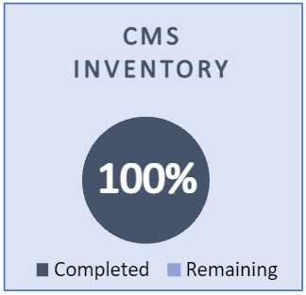
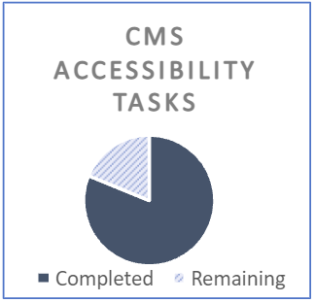
Analysis & Reporting: Digital Accessibility 2.
Notes:
Then we summarize the results of that table into a few final charts. The CMS inventory chart shows that we have looked at all webpages across our library website, and the CMS Accessibility Tasks chart shows the number of errors or tasks identified and how many have been completed.
So now that we've seen some of the nuts and bolts of these three initiatives, including the data we're collecting and tracking, and how we are reporting on our progress, Scott is going to talk about some of the successes and challenges along the way.

Slide 36
Successes and Challenges
Notes:
I’m going to summarize what we have seen as success and challenges to strategic planning. When we encourage you to think about incorporating accessibility into your own strategic planning, we are thinking of Strategic planning at the highest levels which can be thought of as setting goals, and measuring progress. If your goal at your university or library is to implement accessibility, the strategic planning framework can help you do that. So we’ll see what we’ve seen go well, and what could be better.

Slide 37
Successes
An aligned approach to accessibility: administration, librarian, staff, users
Project planning can be structured into strategic planning
Intentionally integrate accessibility into the strategic plan to raise the visibility of the work—first awareness, then resources.
In sum: leverage the tools and priorities of strategic planning to amplify accessibility work
Notes:
We’ve seen that project planning can be structured into strategic planning. There are ways to be creative and interpretive within the strategic planning framework, so discrete accessibility projects can be integrated into the broader framework, which can help make forward progress. Then intentionally integrate accessibility into the strategic plan, can raise the visibility of the work. We’ve seen that first there is an awareness, then resources come from that awareness. That can be incredible valuable for getting accessibly work done, just getting resources behind it. We’ve created a new position in our library, in that sense we have a budget behind accessibility which is really awesome. Jacquie, as a part of her work in that role, regularly updates the library about accessibility progress, so people are thinking about it, Jacquie is activating people throughout the library through workshops and other trainings, and so accessibility work is really happening, and then it’s been sort of credited through strategic planning. To summarize, leveraging the tools and priorities of strategic planning can amplify accessibility work.

Slide 38
Challenges
Strategic planning can be complicated
  How is the plan administered? Who is responsible for the big picture and all the different moving parts?
  How big is the strategic plan? What is the organizational capacity?
Culture of planning and assessment can be variable
Notes:
This approach is not without its challenges. Strategic planning can be complicated, which we referenced earlier, but there is a complexity to it with so many stakeholder interests and perspectives. That is sort of the other side of the coin of alignment, which is the work of actually aligning all of those different perspectives. Accessibility is just one part of a broader plan, so there are questions about how the ia plan administered, and who is responsible for the big picture and all the different moving parts? Accessibility may be one part of the broader plan, so how does your accessibility work fit in and correspond to the other parts. How big is the strategic plan, and what is the organizational capacity to fulfil the strategic objectives that have been identified? You saw above that we have several goals articulated. We have a seven (7) year plan, so we try to create a prioritization where we identify a subset of goals to focus on for a certain year, so there is some additional work there to see if and where accessibility falls within those priorities. This all to say that the culture of planning assessment can be variable. There can be different organizational interests and capacities to actually do this work, but if the capacity is there, and a strategic planning framework, then there can be some big wins for accessibility.

Slide 39
Extending Accessibility
You can integrate accessibility into your strategic plan too!
Notes:
Before we leave, we also want to make it clear how you can do this at your library. Going back to our main takeaways: that you may already be doing accessibility work, you may already have a strategic plan, and by integrating accessibility into your library's strategic plan it can align interests and help you accomplish your accessibility goals, we'd like to offer some examples of how you might be able to integrate accessibility into your strategic plan.

Slide 40
Extending Accessibility
Accessibility can fit under many broad areas of a strategic plan:
  Diversity, Equity, and/or Inclusion efforts
  Improving Physical Spaces
  Improving the User Experience
  Improving Digital Resources and/or the library website
  Supporting student information literacy
  Get creative!
Notes:
We've shown you just one example of how we used our library strategic plan to do this, which has worked well for us. But that's only one strategic plan, and we already had accessibility written into it explicitly. So what if you already have a strategic plan, that does not include accessibility? How can you integrate accessibility anyway, and tie it to the existing plan? We believe that accessibility can fit under many broad areas that might already be in your institutions strategic plan, including Diversity, Equity, and/or Inclusion efforts, Improving Physical Spaces, Improving the User Experience, Improving Digital Resources and/or the library website, supporting student information literacy, and more. Bottom line, get creative or brainstorm with someone else, because there is likely a place that accessibility can fit.

Slide 41
Thank you!
Discussion Questions:
What are the main barriers you face at your institution in implementing accessibility?
What is your library's culture of planning and assessment?
Where is accessibility work happening in your library?
How can this work be aligned—your projects, your library's strategy, your university's mission?
Notes:
Thank you for joining us today, and we hope you have found our presentation useful.
We'd like to offer the framing questions again as a place to start our discussion. What are the main barriers you face at your institution in implementing accessibility? What is your library's culture of planning and assessment? Where is accessibility work happening in your library? How can this work be aligned—your projects, your library's strategy, your university's mission?
With that, what are your thoughts, and what questions do you have for us?

