Slide 1

Florida Atlantic University Libraries
Reinventing the Library Experience

Slide 2
Slideshow created by
Dean of University Libraries, Carol Hixson
With technical assistance from Patricia Koppisch
To run in the background at a tabling event hosted by the Dean
in the Wimberly Library atrium
September 2015

Slide 3
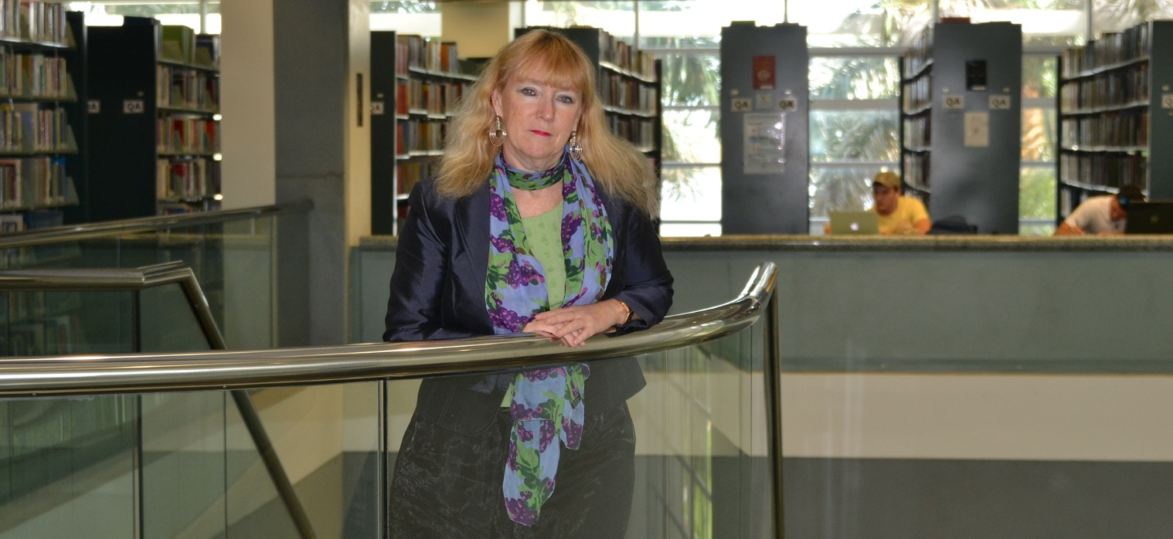
Carol Hixson
Dean of University Libraries
MEET THE DEAN

Slide 4
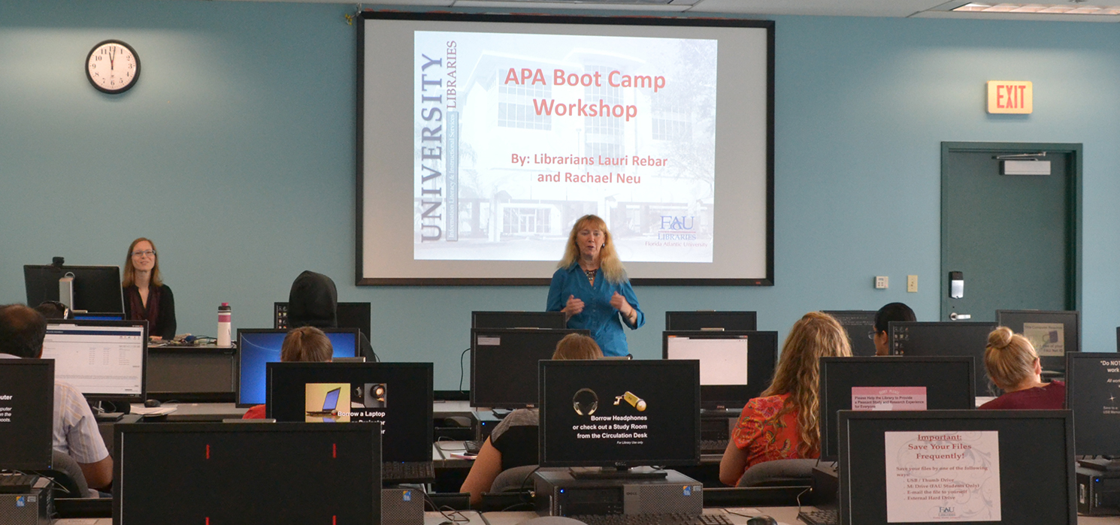

Slide 5
“We need flexible, vibrant, student-centered spaces.”
Carol Hixson
Dean of University Libraries

Slide 6
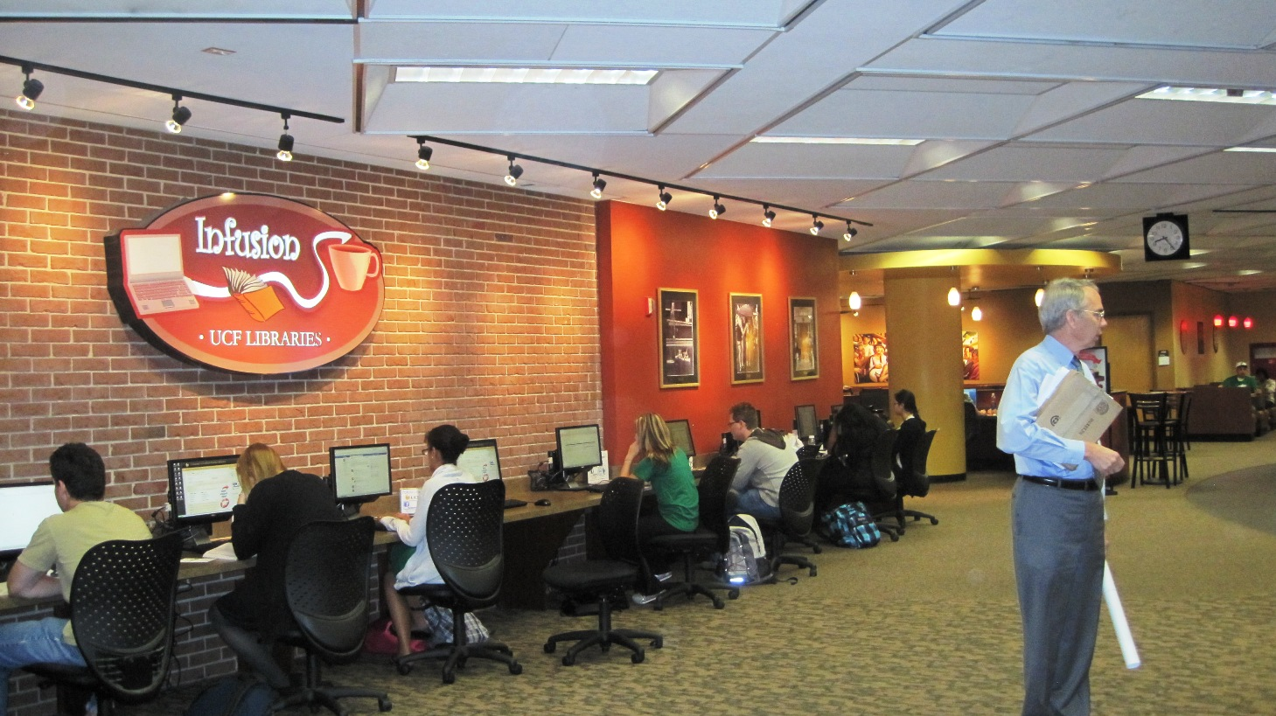
UCF Library

Slide 7
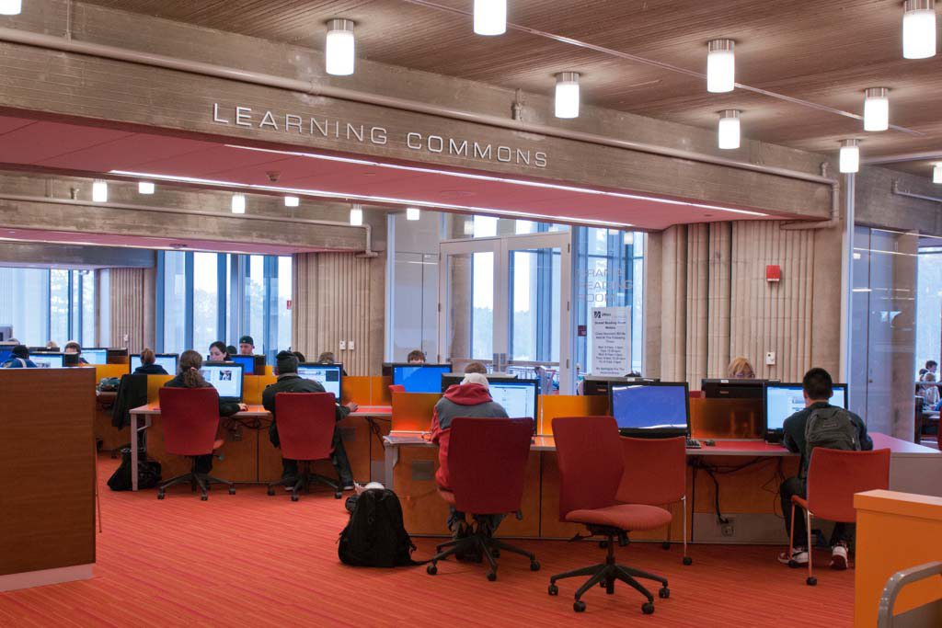
University of Massachusetts Dartmouth Carney Library

Slide 8
Florida Atlantic University Libraries
Reinventing the Library Experience

Slide 9
“We need colorful, comfortable, technology-rich spaces where students can study – alone or together – and create their own work.”
Carol Hixson
Dean of University Libraries

Slide 10
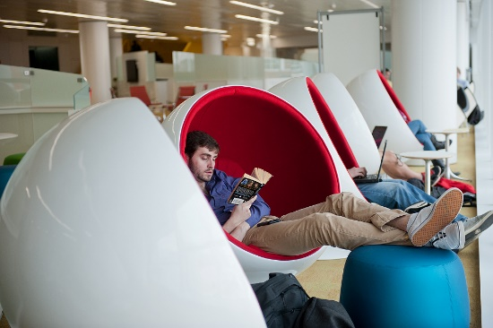
North Carolina State University Library

Slide 11
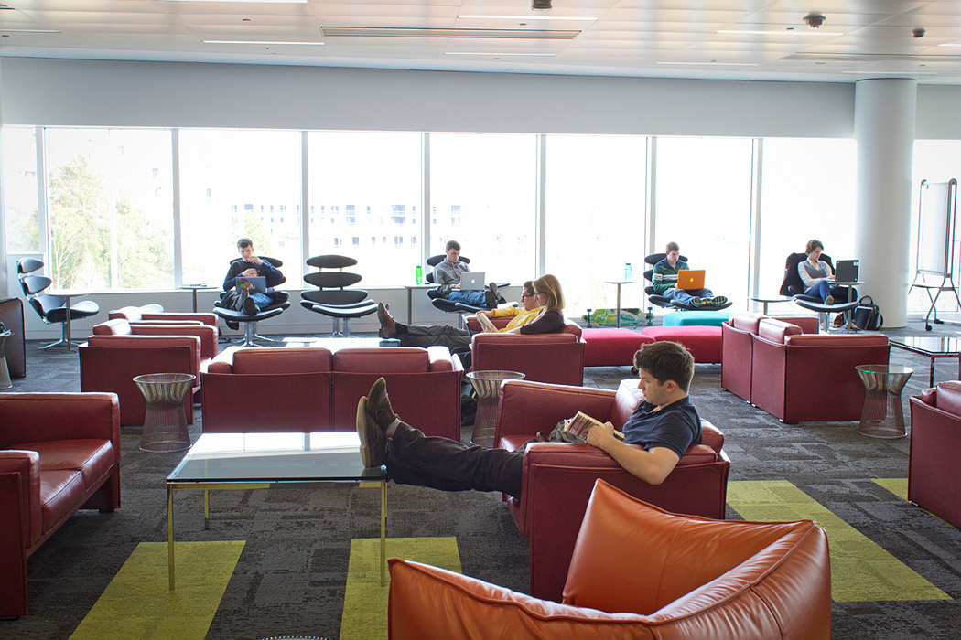
North Carolina State University Library

Slide 12
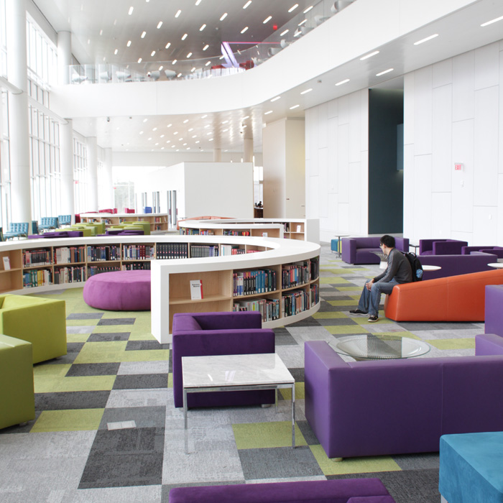
North Carolina State University Library

Slide 13
“Our guiding principles must be engaging with our users, responding to their needs, and being creative and flexible so we can continually evolve.”
Carol Hixson
Dean of University Libraries

Slide 14
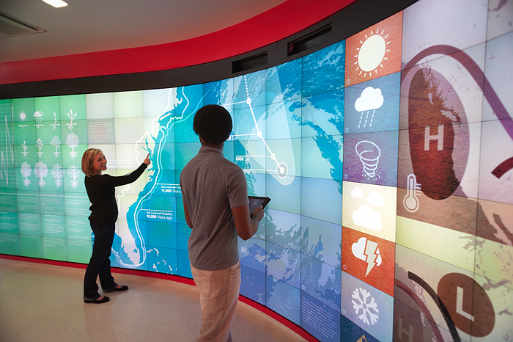
North Carolina State University Library

Slide 15
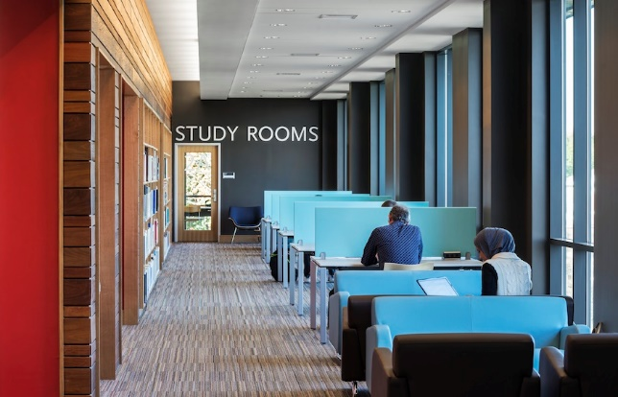
Southern
New Hampshire University Library

Slide 16
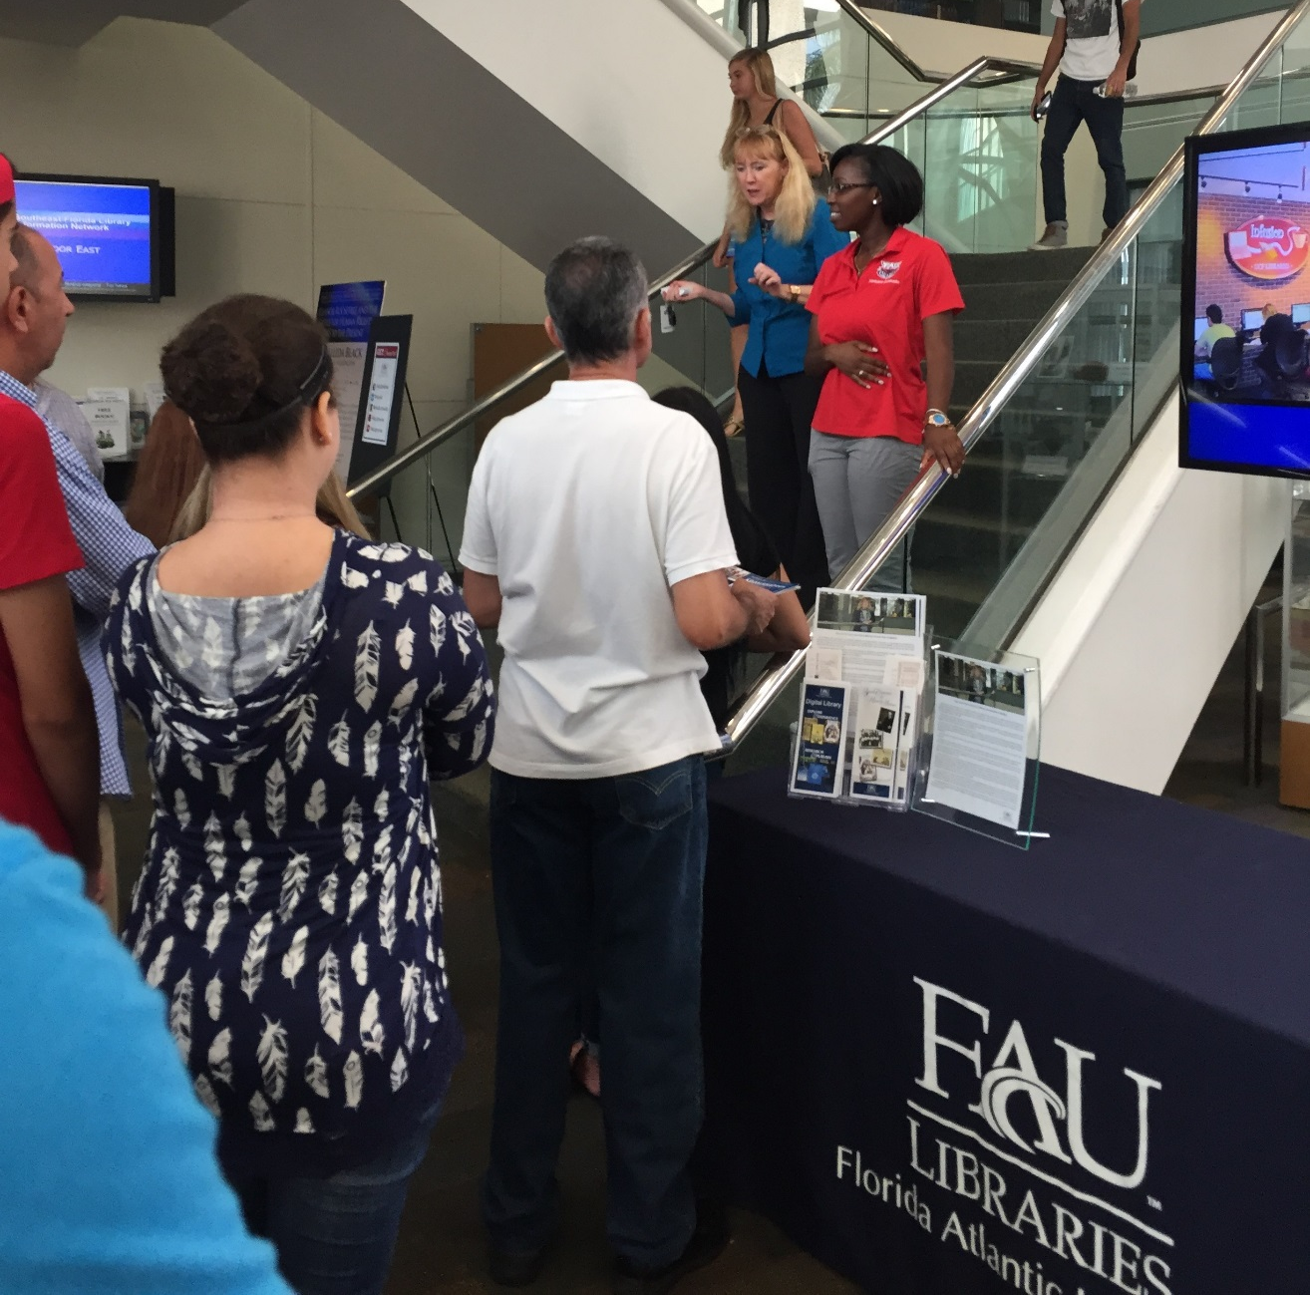

Slide 17
Florida Atlantic University Libraries
Reinventing the Library Experience

Slide 18
“The library should support and inspire student scholarship and creativity.”
Carol Hixson
Dean of University Libraries

Slide 19
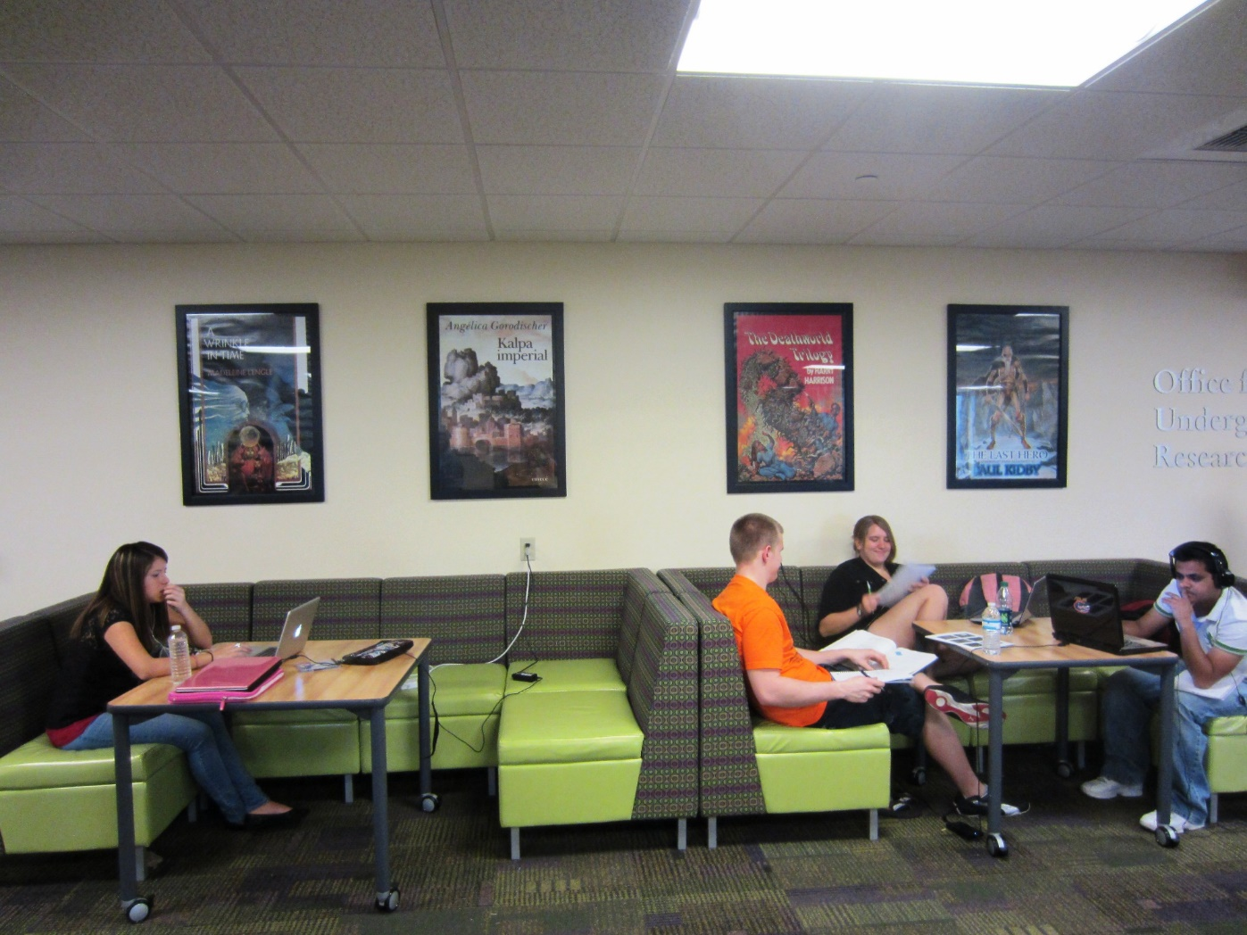
USF Tampa Library

Slide 20
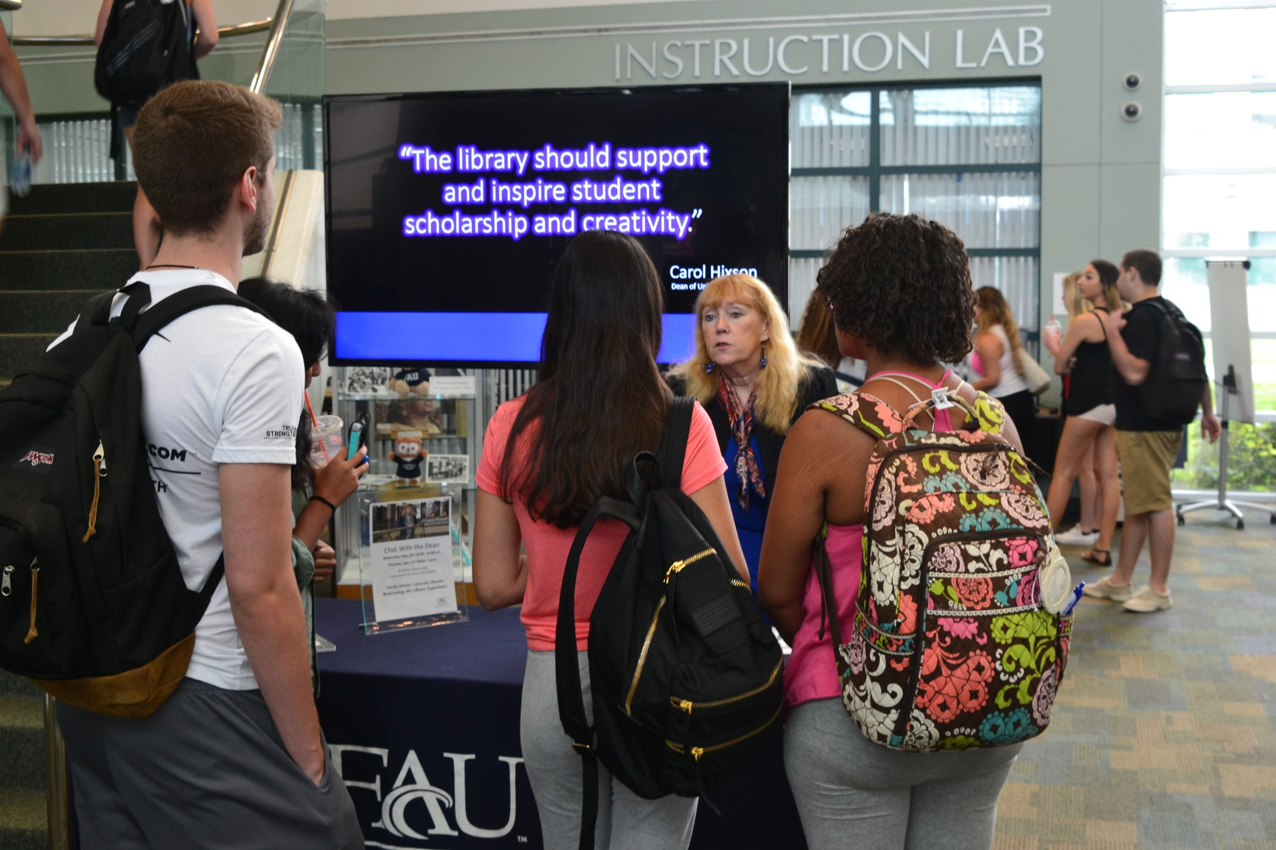

Slide 21
“The Libraries and everyone in them are here first and foremost to help the students succeed.”
Carol Hixson
Dean of University Libraries

Slide 22
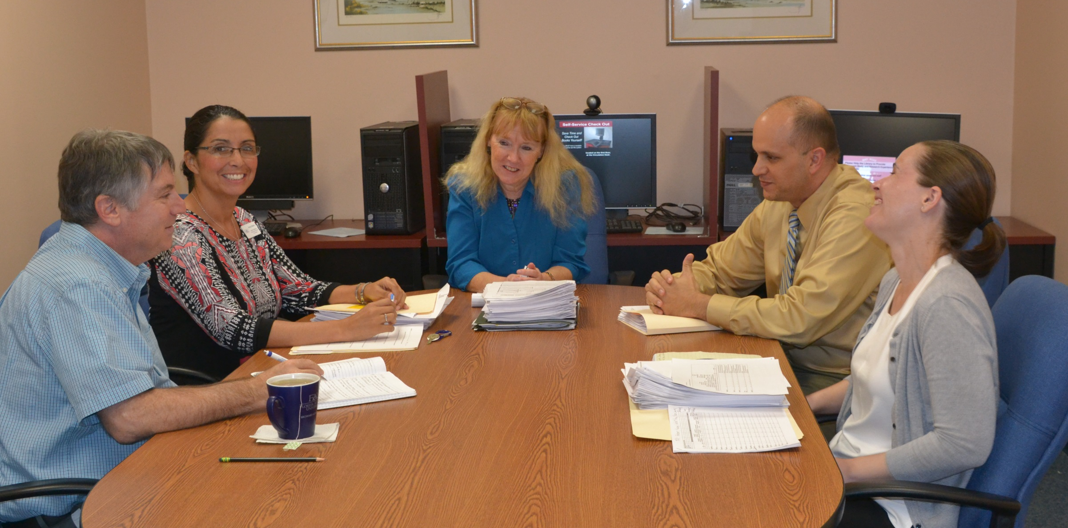

Slide 23
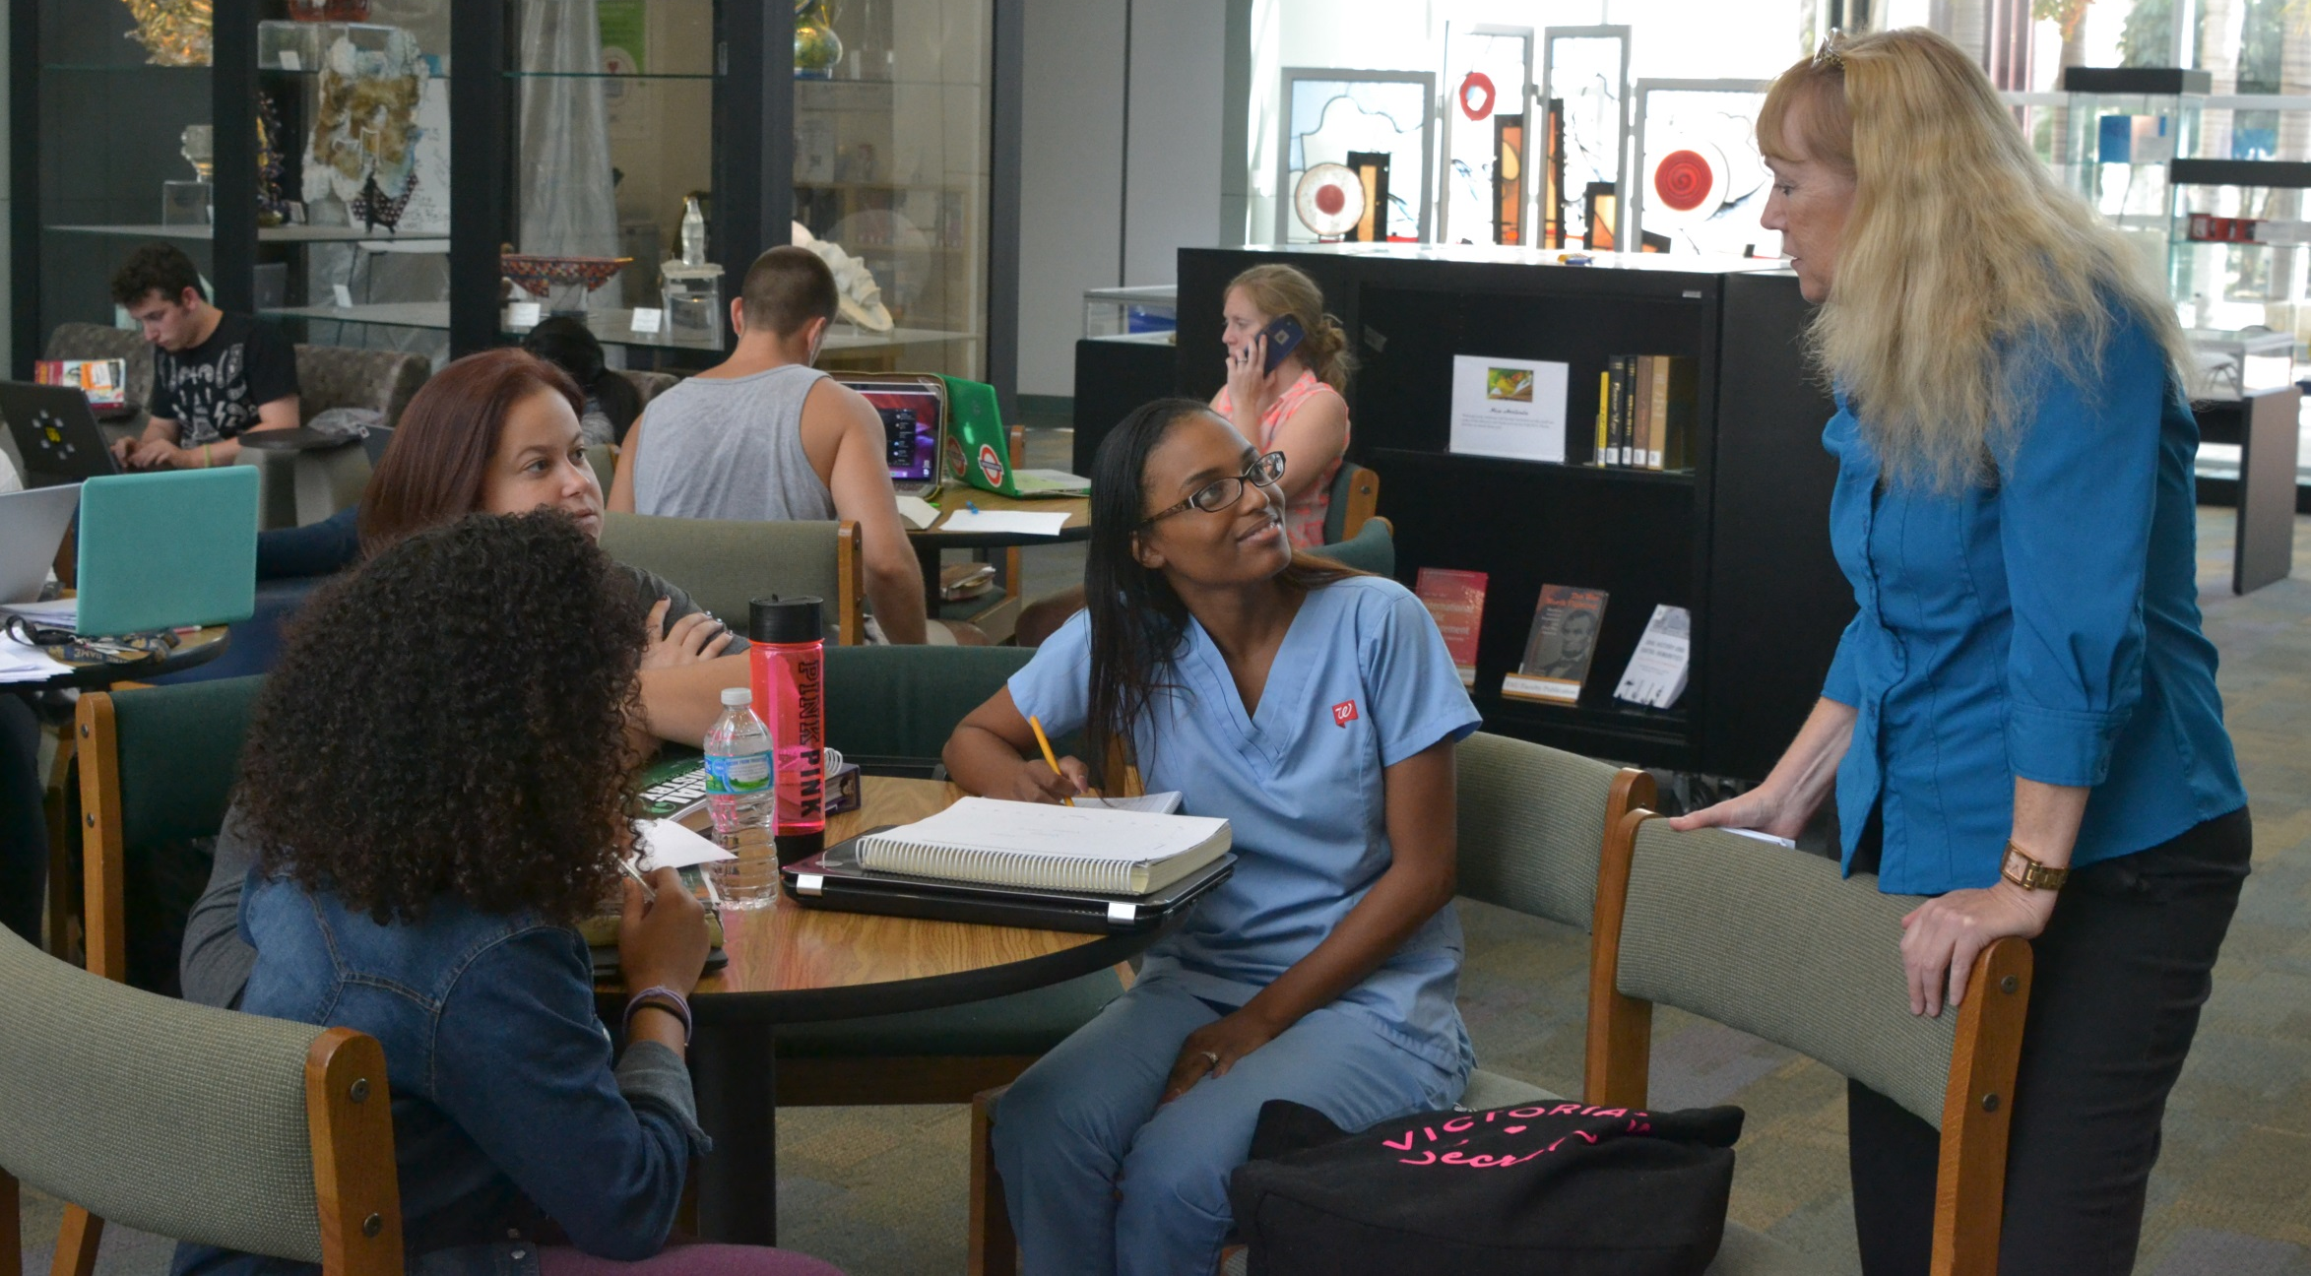

Slide 24
Florida Atlantic University Libraries
Reinventing the Library Experience

Slide 25
“We need new kinds of physical and virtual spaces for students to collaborate effectively and share their creative energy.”
Carol Hixson
Dean of University Libraries

Slide 26
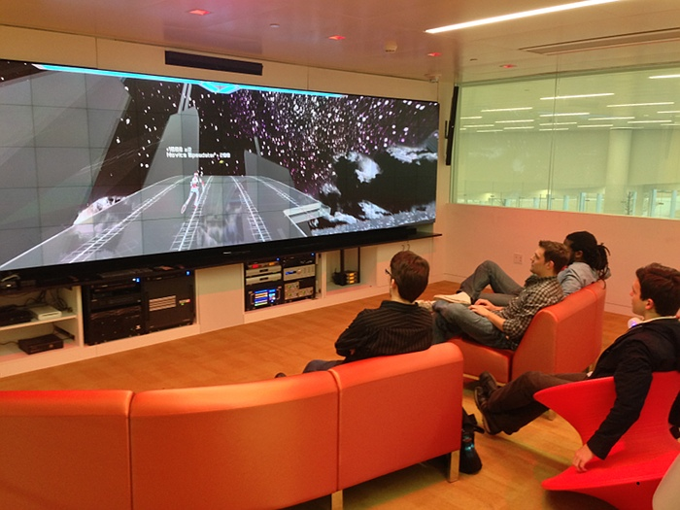
North Carolina State University Library

Slide 27
University of Massachusetts Dartmouth Carney Library

Slide 28
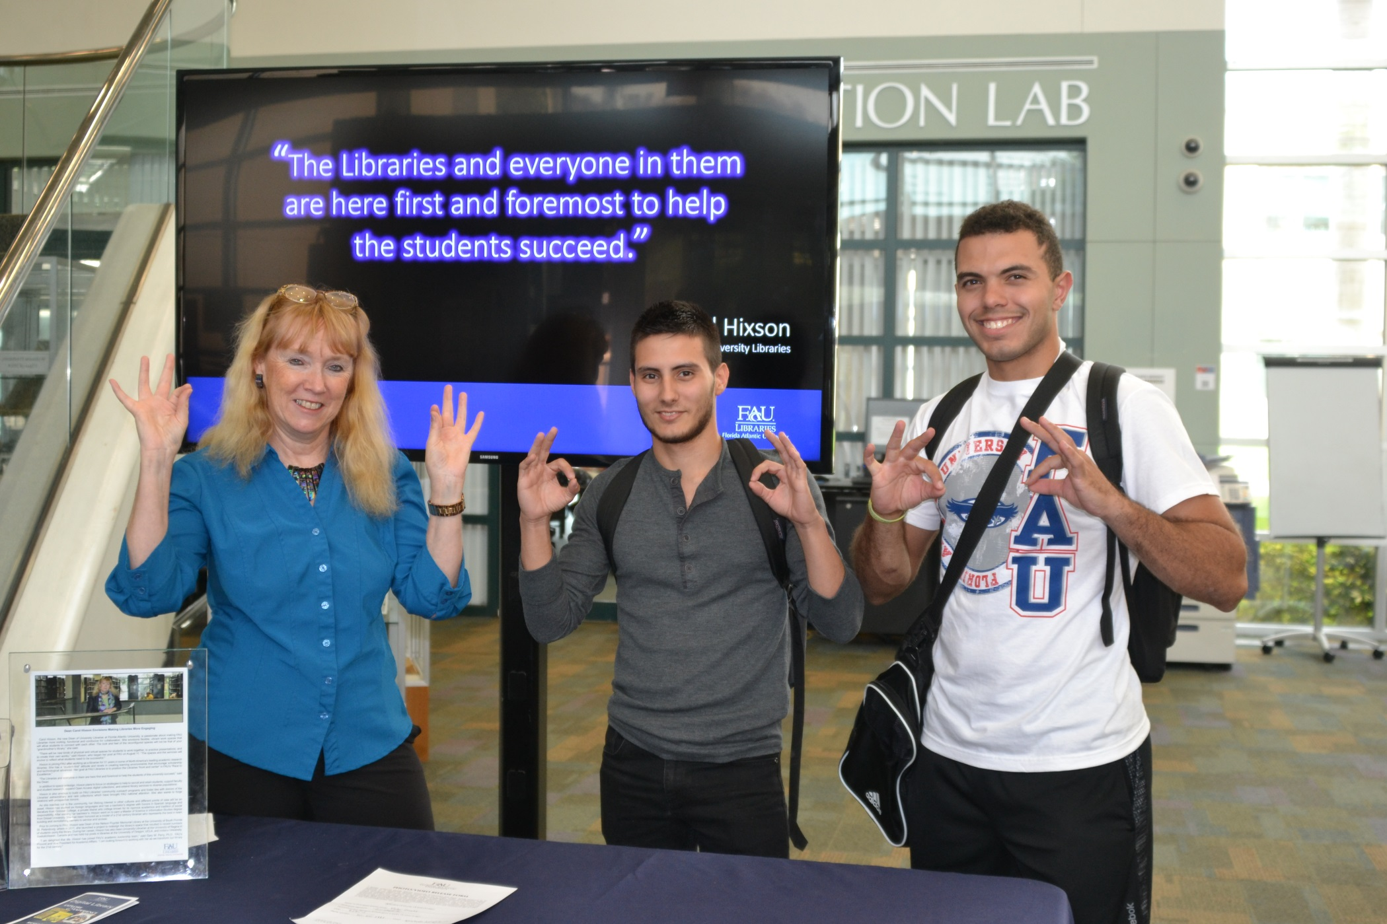

Slide 29
“The library’s spaces and the services must evolve to provide what today’s students need to be successful.”
Carol Hixson
Dean of University Libraries

Slide 30
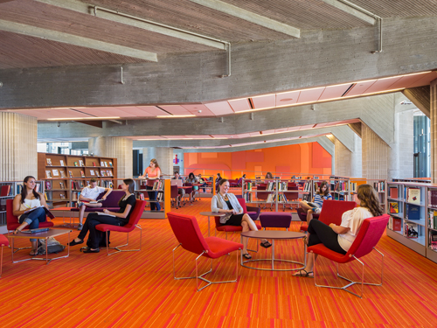
University of Massachusetts Dartmouth Carney Library

Slide 31
UNF Library

Slide 32
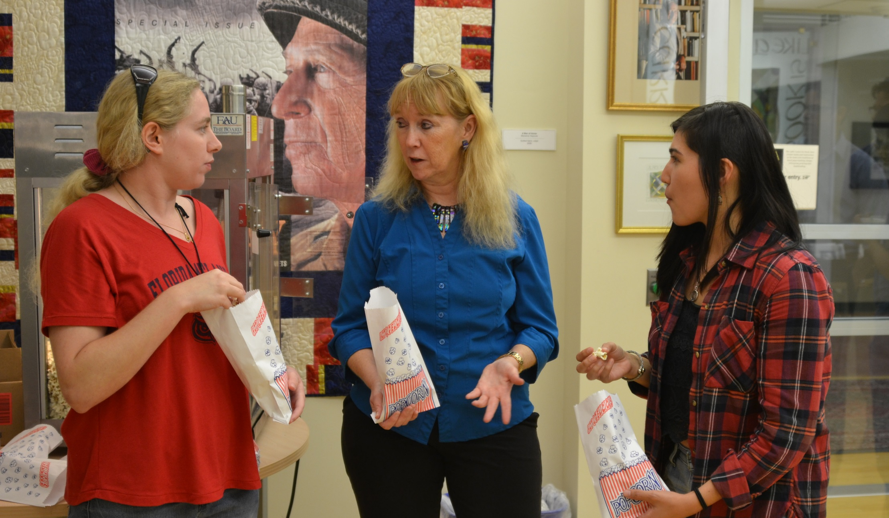

Slide 33
“Today’s libraries must have a variety of spaces and services to meet the needs of users expecting innovation while relying on trusted foundations.”
Carol Hixson
Dean of University Libraries

Slide 34
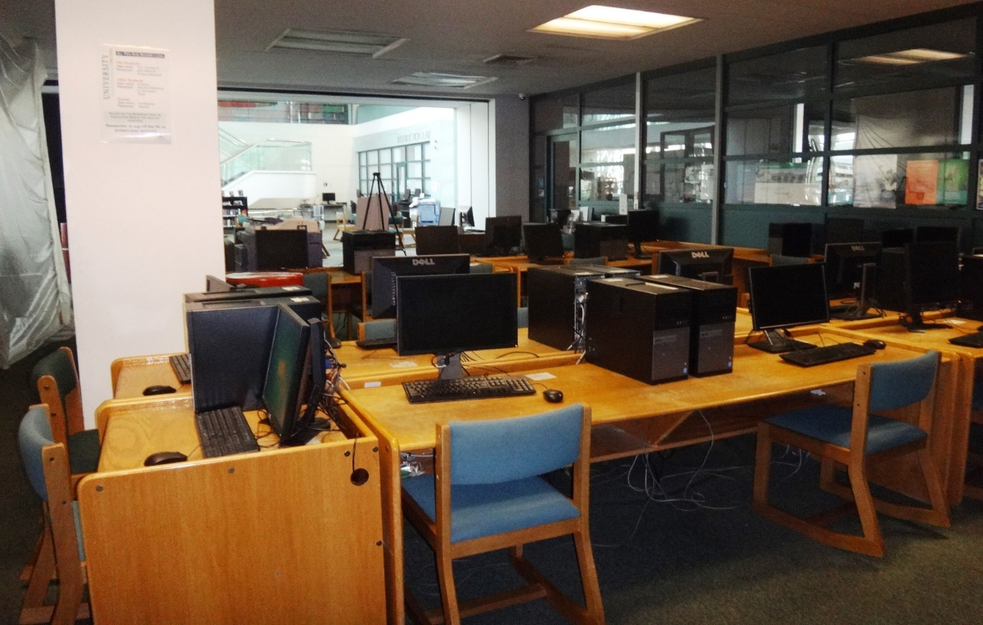
How Do We Get from Here to There?
Wimberly Today
Future Vision

Slide 35
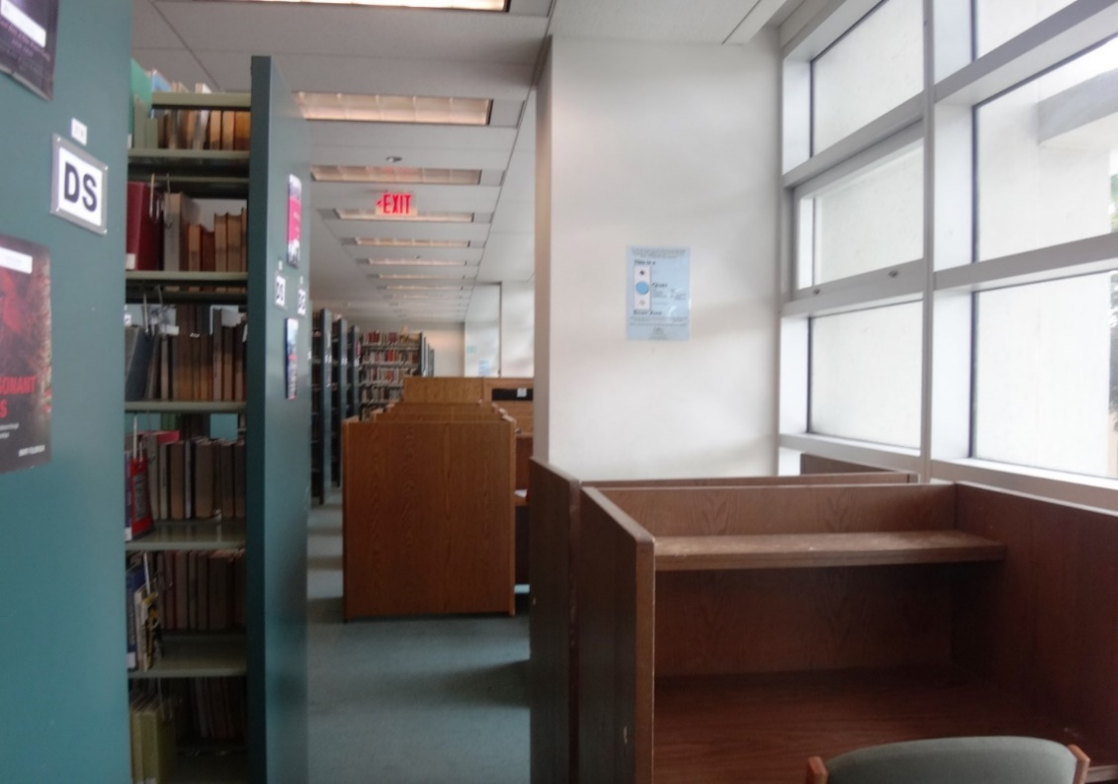
How Do We Get from Here to There?
Wimberly Today
Future Vision

Slide 36
Florida Atlantic University Libraries
Reinventing the Library Experience

Slide 37
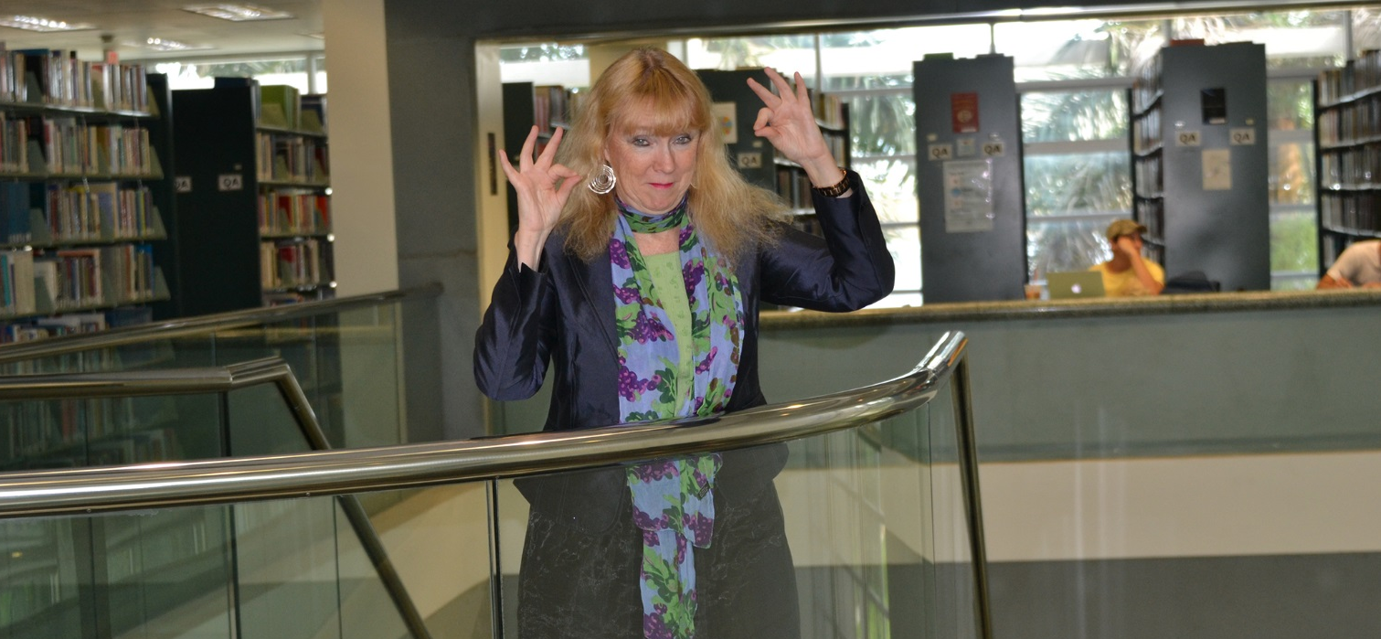
GO OWLS!
Carol Hixson
Dean of University Libraries

