Slide 1


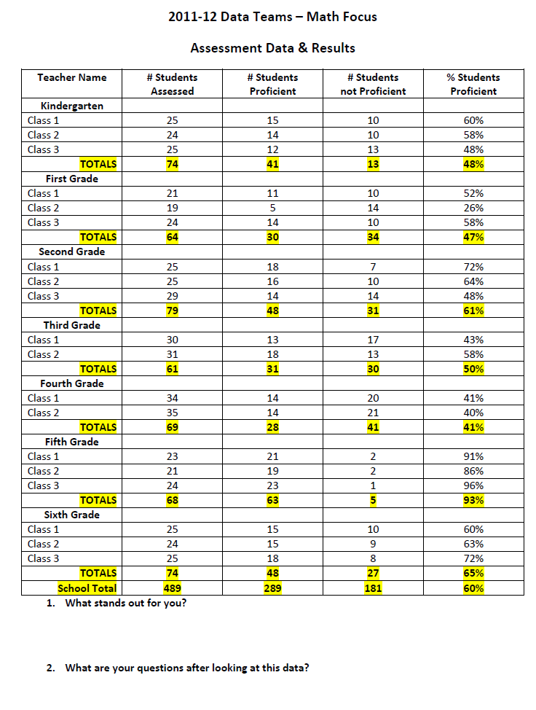
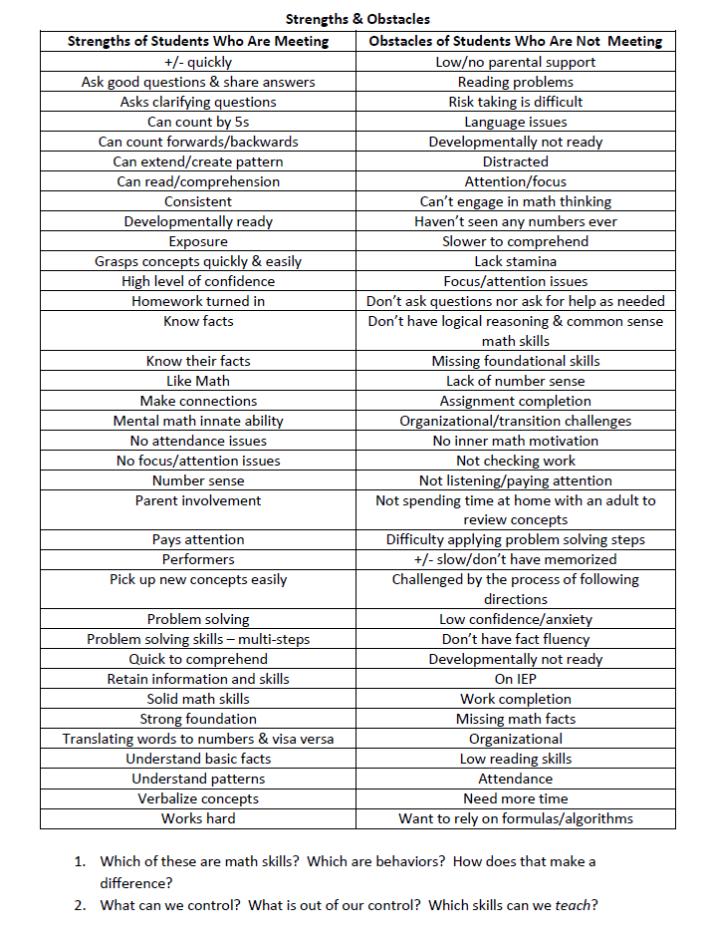
Improving Math Instruction through
Data Team Study and Skill Based Grouping
Sara Deboy, University of Oregon, EDLD 655, Winter 2012
Lake Oswego School District
University of Oregon
Introduction
Data Team Study – Process and Goal Setting
OAKS Strand Data
Next Steps for Students and Staff
Over the course of the last five years, the teachers at Lake Grove Elementary have been taking on the task of examining student data from summative and formative assessments. Teaching teams have become increasingly skilled in disaggregating data, using multiple sources of information, analyzing strengths and weaknesses of students, and developing goals to help students reach higher levels of achievement. Learning to look at data from a whole grade level perspective down to an individual student study has helped us to assess our instructional approach.
This year, the staff chose to focus on the area of Mathematics.
Given the recent change in cut scores and the upcoming common core standards, the way in which we teach Math has had to change dramatically beginning this year. Teachers are now focusing on fewer areas and drilling deeper into concepts to bring students to a higher level of mastery. Not only has it been strange for teachers to abandon some topics and expand others, but it has also been very difficult to veer away from following a broad, scripted curriculum and towards a program that is developed by teachers for particular student needs. While there is a feeling of freedom, there is also a sense of risk. However, we all agree that the current Math adoption is not capable of meeting the needs of all students, so we must work together to create a curriculum that will.
Percentage of Students Meeting & Exceeding in Math, 2011-2012
Our Goal:
To improve math performance at Grades 3, 4, 5, and 6 using instruction that is targeted and informed by data.
Our Challenges:
As you can see from the strengths and weaknesses listed by staff in the center column, one of the major challenges we face is letting go of the things we cannot control. Students may go home to an environment that is not conducive to their learning. They may not have support from their parents, the ability to have a tutor, or a quiet place to study. Some of them may have difficulty with attention and focus that has not been addressed.
Another challenge is addressing the needs of the smaller percentage of students who are not meeting benchmark. We are striving to find strategies for team teaching and small groupings that focus on missing skills and concepts that hold our students back from understanding, learning, and growing. As shown in the teacher observations, many students are stuck on learning their basic facts, basic concepts of patterning and number sense, and problem solving.
Our Options:
We have considered the option of having students pulled out by assistants, thereby missing other content. We also began flooding with assistants at 3/4 this year during the math block and adding a 3/4 teacher to the 5th grade math team to reduce numbers. This has not been enough, and the pull out of students from other content area was the least desirable option.
Our choice has been to regroup according to the strand data from OAKS and our classroom formative assessments to create a small group of students that works with a classroom teacher. All students begin by hearing the grade level material presented by the teachers. Then, the small group divides off to work on content at their rate and level. The rest of the group is divided in thirds for independent work time, supervised by a classroom teacher and two assistants. The teacher with the small group of struggling students is using an intervention curriculum and reviewing basic, foundational concepts with increased practice.
Impacts:
Our belief is that implementing this at all grade levels beginning next year will allow for students to continue to be exposed to all the grade level curriculum while getting the small group focus they need to compensate for deficits. The groups will be flexible and progress monitored so that students are receiving targeted and skill based instruction that is necessary; we anticipate that some students will always need the support, while others will need isolated skills.
The financial impact is limited to cost of additional intervention materials, which to this point has not been necessary, as much of it has been teacher generated or free. No additional staff will be hired.
 | Grade 3 | Grade 4 | Grade 5 | Grade 6
State of Oregon | 33 | 41 | 36 | 40
Lake Oswego SD 7J | 67 | 75 | 66 | 70
Lake Grove Elementary | 81 | 85 | 65 | 75
Recent Research
In a recent article published in Mathematics and Science, Nancy Love (2004) describes the pitfalls of working with data when only one source is considered. She articulates the need for “data literacy” in which teachers become adept at considering multiple sources of data, triangulating the results, consulting recent research, and engaging in collegial discourse to determine future steps. She argues that while many schools are understanding that data must take a more critical role in our decision making, educators often get stuck in the what and who without allowing it lead to real changes for improving instruction in the classroom. This, Love claims, is because of a lack of explicit process and expected products. She suggests that teams begin with some predictions before looking at data to activate their own prior knowledge and recognize bias, then make factual observations only followed by interpretations.
Meisels et al (2003) conducted a study examining the impact of curriculum-embedded performance assessments on standards-based assessments. They proposed that using multiple forms of assessment to inform instruction also impacted student performance on national tests, such as the Iowa Basic. Some assessments may be less traditional and based more on teacher perceptions, portfolio pieces, developmental guidelines, and checklists. Finally, in the Teachers Learning Together Project, Verma et al (2009) utilized data driven instructional techniques to differentiate for Mathematics and develop strategies that appealed to various learning styles and student needs. In their study, they found that children not only expanded their skill set, but also developed higher levels of engagement with Mathematics lessons. The targeted instruction, informed by student data, made the difference in learning gains.
As seen above, teaching teams disaggregate data based on student performance on classroom assessments. After identifying strengths of students who are meeting benchmarks and weaknesses of students who are still developing (below), teachers write specific, measurable goals and design instructional approaches to meet the needs of students. This may include flexible, fluid grouping and team teaching.
Timeline
2011-2012 School Year
August | Scheduling Committee, Focus on Math Block, Class Lists
September | Create Math Groupings based on 2011 Spring Assessments
October | First Data Teams, Creation of Assessment Walls, Staff Development With Shannon McCaw
November | Analyze Strengths and Weaknesses of Students, Discuss Instructional Goals
December | Update Assessment Walls, Calculate New Percentages
January | Districtwide Inservices with Shannon McCaw, Develop Spring Units
February | OAKS First Round, Problem Solving Training, Check In on Recent Assessments
March | Update Assessment Walls, Introduce Professional Learning Communities for the Coming Year
April | Grades 1 & 2 Work With Shannon McCaw to Prepare for Next Year, Second Round of OAKS
May | Final Update of Assessment Walls, Interpretation of Growth for Year, Spring Assessments for Use in 2012-2013
June | Check and Complete Binders, Schedule August Inservices
 | Grade 3 | Grade 4 | Grade 5 | Grade 6
Does Not Meet | 8 | 8 | 14 | 12
Nearly Meets | 11 | 7 | 21 | 13
Meets | 26 | 32 | 38 | 47
Exceeds | 55 | 52 | 27 | 28
References
Love, N. (2004). Taking data to new depths. Journal of Staff Development, 25(4), 22-26.
Meisels, S. (2003). Impact of instructional assessment on elementary children's achievement. Education Policy Analysis Archives, North America. Available at http://epaa.asu.edu/ojs/article/view/237/363. Date accessed: 13, Feb. 2012.
Verma, V., Elliot, F., Imrie, J., Gear, B., Berg, M. (2009). Teachers learning together project: Differentiation in math. Teaching and Learning, 5(1), 45-52.
Contact Information and Acknowledgements
For further information, contact Sara Deboy at deboys@loswego.k12.or.us. Many thanks to the teachers and students of Lake Grove Elementary.

