Slide 1

Florida Atlantic University Libraries
All-Staff Meeting
April 26, 2018
Presentation by Dean of University Libraries
Carol Hixson

Slide 2
Agenda
ITS Consultation: Recommendations and follow-up actions (20)
Student survey: preliminary results (15)
Faculty survey: results and follow-up (15)
Upcoming searches (5)
Strategic plan (5)
Space plans for the summer and beyond (10)
Emergency preparations (5)
Updates and questions from the floor (15)

Slide 3
ITS Consultation: Recommendations
Hire a department head
  Position description has been written
  Search committee is being formed
  Position will be posted shortly
Establish an IT Service Level Agreement (SLA) and an IT Service Catalog to define quality expectations between key stakeholders and Libraries IT
  Being worked on

Slide 4
ITS Consultation: Recommendations
Refocus on providing excellent customer service
  departmental name change
    Information Technology Services
  create a high-availability central IT service desk to answer customer calls
    Being worked on now – looking for feedback
  open the current IT space to customer interaction. Consider replacing the locked, solid door with a glass door that is open during business hours. The entry should be welcoming and staffed by the service desk employee or employees who are handling calls, emails, and the ticket queue. This could also be a service point for technology lending for staff.
    Glass panel to be inserted in door

Slide 5
ITS Consultation: Recommendations
Customer Service training be made mandatory for all IT staff on an annual basis
  Fits in with Libraries Strategic Plan and is routine for many areas
OIT recommended that Libraries IT move their remaining servers to the OIT data center
  Being planned to move critical servers, MOU being developed
Increase student assistant staffing for the Computer lab (LY215)

Slide 6
Student Survey
Opened April 3 and closes April 28
Effective marketing involving many
1110 responses as of 8 a.m. April 26
79% completion rate
Very useful data already being shared

Slide 7
Student Status

Slide 8
College Status

Slide 9
Student Classification

Slide 10
Age

Slide 11
Gender

Slide 12
Campus Library Normally Used

Slide 13
How Often Do You Physically Visit the Libraries?

Slide 14
Why Do You Come to Library?

Slide 15
How Satisfied Are You With the Following
 | Very Satisfied | Satisfied | Dissatisfied |  | Very Dissatisfied |  | Never Used | Unaware of
Print books, etc. | 19.70% | 36.21% | 2.16% | # | 0.38% |  | 36.34% | 5.21%
E-resources | 27.65% | 43.94% | 2.90% | # | 1.14% |  | 19.19% | 5.18%
Libraries' website | 23.69% | 49.68% | 4.84% | # | 0.51% |  | 17.58% | 3.69%
AV resources | 11.24% | 18.52% | 1.28% | # | 0.38% |  | 56.83% | 11.75%
Computers, etc. | 39.22% | 42.50% | 4.41% | # | 0.88% |  | 11.22% | 1.77%
Wi-Fi | 38.99% | 46.16% | 5.79% | # | 0.75% |  | 6.16% | 2.14%
Course reserve | 11.89% | 16.62% | 1.28% | # | 0.90% |  | 47.57% | 21.74%
Library classes | 10.65% | 16.73% | 1.27% | # | 0.38% |  | 50.57% | 20.41%
Circ./Info.Desk | 24.49% | 40.15% | 3.91% | # | 2.02% |  | 25.00% | 4.42%
Interlibrary Loan | 14.83% | 20.66% | 1.90% | # | 0.51% |  | 51.46% | 10.65%
Overall quality | 32.44% | 48.60% | 4.58% | # | 0.76% |  | 10.31% | 3.31%
Spec. Collections | 14.47% | 24.62% | 1.40% | # | 0.63% |  | 43.78% | 15.10%

Slide 16
Rate Quality of Interactions with Library Staff and Librarians in These Areas
 | Very Good | Good | Poor
Knowledge/Expertise | 57.14% | 40.15% | 2.70%
Approachability | 53.93% | 37.84% | 8.24%
Welcoming Attitude | 52.19% | 37.63% | 10.18%
Helpfulness | 57.57% | 37.52% | 4.92%

Slide 17
To What Extent do the Libraries Contribute to your Academic Success?
Greatly 47.93%
Moderately 32.12%
Somewhat 13.86%
Slightly 3.11%
Unsure 2.98%

Slide 18
Faculty survey
Opened September 18; closed October 23
385 responses
Very useful data already being used across campus
Planned meetings with individual library departments to go over feedback and review services

Slide 19
How Do You Find Out About library Services?

Slide 20
How Often Do You Physically Visit the Libraries?

Slide 21
What Brings You to the Library?

Slide 22
Please Select Your Primary Campus

Slide 23
College

Slide 24
Satisfaction with the Following Services
 | Very Satisfied | Satisfied | Dissatisfied | Very Dissatisfied |  | Never Used | Unaware of
Website | 35.11% | 53.92% | 5.33% | 1.57% |  | 2.82% | 1.25%
Circ desk | 36.16% | 44.34% | 0.94% | 1.26% |  | 15.41% | 1.89%
ILL | 42.09% | 36.39% | 3.80% | 1.27% |  | 14.87% | 1.58%
Reserves | 17.92% | 28.34% | 1.30% | 0.33% |  | 45.93% | 6.19%
Reference | 26.05% | 27.33% | 1.29% | 1.61% |  | 36.33% | 7.40%
Research help | 26.21% | 25.57% | 1.94% | 1.62% |  | 40.78% | 3.88%
Library Instruction | 28.06% | 22.26% | 0.65% | 0.65% |  | 42.26% | 6.13%
Digital Library | 21.22% | 34.08% | 6.75% | 0.64% |  | 27.33% | 9.97%
Special Collections | 17.61% | 23.92% | 1.66% | 0.33% |  | 48.17% | 8.31%
Overall | 31.92% | 52.44% | 4.23% | 1.95% |  | 7.17% | 2.28%

Slide 25
In general, how often do you use the library's electronic services or resources from your office, home or other off-campus location?

Slide 26
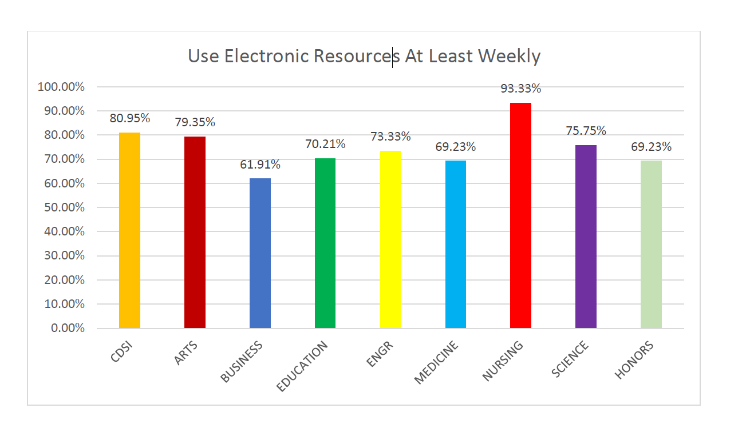
Use E-Resources at Least Weekly by College

Slide 27
If the library’s electronic resources were to be significantly reduced, how much would this affect your:
  Very Significant or Significant Impact on:
    Teaching 80.34%
    Research 90.86%
    Remaining at FAU 63.08%

Slide 28
Faculty Comment
“There are other factors that may impact my remaining at FAU beyond the collection of the library. This said, not having an up-to-date or top-tier "research" library will affect whether or not research faculty from other institutions will come to FAU. Becoming a Research1 institution has many components to it and I would hazard a guess that having a top-notch library is one of those details.”

Slide 29
In general, how often do you use the library's print resources (books, journals, etc.)?

Slide 30
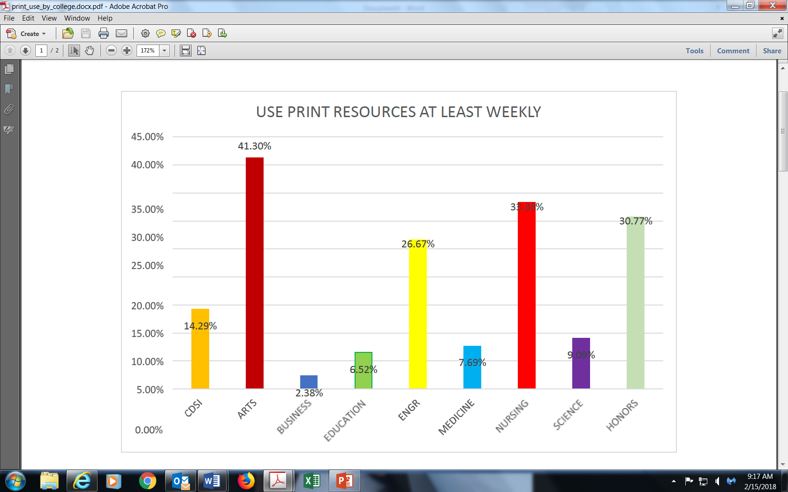
Use print at least weekly by College

Slide 31
Faculty Comment
“I find the library's staff to be very friendly and professional when working with me and our students, even though they are dealing with many issues that are beyond their control. 1) the building that clearly has seen its better days decades ago and while they have managed to make small inroads into improving the quality of the library experience for everyone, the building still presents itself as the library that time has forgotten. In its current physical state I would find it hard to believe it could compete against libraries at many of our state competitors let alone outside the state. The building simply does not convey the image one would come to expect for a university marketing itself as a high research institute…”

Slide 32
Upcoming Searches
Head of IT Services
  Search committee being formed
Director of Scholarly Communication
    Search committee being formed
Reference Position
  Position description being reviewed

Slide 33
Strategic Plan
Finalized and on Web Site
Specific Goals of Working Groups
  Revised by LLT and being used as working, non-public document to track progress
New planning coming in the next year or two

Slide 34
Strategic Plan
Mission
As leaders at Florida Atlantic University, we connect people to knowledge and global communities of learning across time and space. Reimagining services and spaces, we enable users to explore, collaborate, educate, and create in their journey toward academic excellence and lifelong learning.
Strategic Goals
Support the University’s research and instructional mission by providing innovative and responsive collections, services, and programs that are uniquely suited to the curriculum, the region, and the academic community.
Increase effective use of technology to improve library services and support a collaborative research and learning environment, including the expansion of web-based and other virtual library services and locally created digital collections.
Reimagine the physical and virtual spaces and services of the libraries to provide a welcoming, safe and effective place for people to explore, study, create, and collaborate.
Champion the advancement of distance education at FAU through developing and enhancing a wide range of support services in collaboration with the Center for E-Learning and the Colleges.
Develop and strengthen a culture of assessment to provide for continuous improvement undertaken in collaboration with the FAU community and external partners.
Cultivate a broad base of alumni and community support that secures funding needed for excellence and innovation.
Enhance the provision of excellent service through ongoing training and the adoption of strong customer-centric service models.
Foster an appreciative environment that engenders a skilled, inclusive, and innovative staff and enables them to succeed in meeting the demands of the changing workplace and in strengthening the Libraries’ participation in the University’s mission.
Develop a culture that serves as a model of diversity and inclusion for staff and for the Libraries’ patrons.

Slide 35
Upcoming Space Plans
4th Floor renovation this summer
Special Collections office space
Converting staff offices to study rooms
2nd Floor Computer Lab and Collaboration with Arts & Letters on Makerspace
Possible Makerspace in Jupiter

Slide 36
Emergency Plans
That Time of Year

Slide 37
From the Floor
Updates, questions from the group

