Slide 1
Collaborative Purchase on Demand: Update from the University of Oregon:
Orbis-Cascade eBook Pilot
Dave Fowler, May 4, 2011

Slide 2
Orbis-Cascade for the Uninitiated
36 member libraries in Oregon, Washington and now, Idaho serving 225,000 students.
Cooperative licensing of databases and journal packages.
Cooperative collection development.
Operates the Summit union catalog/borrowing system.
Cooperative lending: 400,000 items loaned within Alliance each year.
Supports the Northwest Digital Archives.

Slide 3
UO eBook Providers
Á la carte providers:
EBL
Ebrary
Elsevier
Myilibrary (Law School only)
NetLibrary
Safari
Sage
Springer
Wiley

Slide 4
UO eBook Providers
Collection purchases:
Cambridge Histories Online
Early English Books Online
Gale Virtual Reference Library
MIT CogNet
Oxford Scholarship Online
Springer
Synthesis

Slide 5
Orbis-Cascade eBook Pilot
Three vendors asked to bid:
EBL
Ebrary
NetLibrary

Slide 6
Orbis-Cascade eBook Pilot
Criteria:
Must be able to integrate into YBP’s GOBI ordering platform.
Must be patron-driven.
Must be accessible by all Alliance libraries.
Usable with mobile devices.

Slide 7
Orbis-Cascade eBook Pilot
EBL was selected:
Ebrary did not yet have a robust patron-driven capability, and there were quality issues raised about their end products. Since purchased by ProQuest.
NetLibrary had just been purchased by EBSCO, and was in a period of transition; EBSCO was not yet able to offer a solid bid due to uncertainty about the platform.
Both platforms could be considered again in the future.

Slide 8
Orbis-Cascade eBook Pilot
What does the Pilot look like?
All 36 libraries participate and contribute to a common pot of money.
An agreed-upon subset of the EBL collection will have their records placed in all Alliance catalogs.
5,000 titles in the pool by September 1
There will be “unlimited” (actually, 1625) simultaneous users.
Users get a five-minute “free” browse before it gets counted as a “loan.”
After five minutes, it gets counted as a short-term loan.

Slide 9
Orbis-Cascade eBook Pilot
Any downloading or printing triggers a short-term loan.
The same user can view the same book multiple times in a 24-hour period, and it will still be counted as one loan.
After Alliance libraries make an aggregate total of 7 to 10 loans, the Alliance buys the book.
For books we only loan out, cost will be 10-15% of list price.

Slide 10
Orbis-Cascade eBook Pilot
EBL estimates 60% of browsed titles will trigger a short-term loan.
Of those loaned, about 20% will likely be purchased.
A pool of over $200K (exact amount is sensitive with publishers) is expected to last a fair amount of time, due to the short-term loan provision.
Cost will be 5x list price.
EBL is negotiating with major publishers to have their books to be made available to us.
Notes:
Originally proposed to be 10x list price.

Slide 11
Potential Issues
Getting the right mix of titles and publishers available for the pilot.
Setting acceptable pricing thresholds, so that we don’t break the bank.
Creating the Alliance itself as a holdings “location” in Summit and local catalogs.
Getting acceptable catalog copy for the libraries for the pilot; Must be able to be easily removed at the conclusion of the pilot.

Slide 12
Final Thoughts
There has never been a shared, demand-driven project of this scale before.
Alliance will provide training, evaluation and support for libraries…and an evacuation plan if we decide to discontinue it.
Catalog records loaded by mid-May.
Alliance plans to go live on May 30.
Will do a post-pilot review in October.

Slide 13
Orbis-Cascade eBook Pilot
Questions?

Slide 14
Collaborative Purchase on Demand: Update from the University of Oregon:
Reference – ILL Project
Margaret Bean, May 4, 2011

Slide 15
Background
541-346-2419
Increase in ILL Borrowing Requests
Impact of NRE and WorldCat Navigator

Slide 16
Background
March 2008: 502 Filled Loan Requests
March 2011: 2046 Filled Loan Requests
308% Increase

Slide 17
Background
More Request for Just-Published Items
More Hard-to-Track Down Items
More Foreign Items
More AV Requests
Bibliographic Verification No Longer an Issue

Slide 18
Goals
Fill More Faculty Requests
Fill or Complete Requests More Quickly
Increase Subject Specialists Understanding of Faculty Research Needs
Stepping Stone to Purchase-on-Demand
Increase Collaboration Between Reference and ILL Departments
Increase Subject Specialists’ Understanding of ILLiad and ILL

Slide 19
Why Subject Specialists?
Subject Expertise
Language Expertise
Contact with Faculty
Specified Collection Knowledge

Slide 20
Which Subject Specialists?
Music
East Asia
Social Sciences
History
Romance Languages

Slide 21
Why Only Faculty
Concerns about Subject Specialists’ Workload
More Specialized Requests

Slide 22
Methodology
Installed ILLiad 7.4 on Subject Specialists’ Laptops/Workstations
Basic Training for Subject Specialists in ILLiad

Slide 23
Workflow
Requests Taken as Far as Possible by ILL Staff
Requests Vetted by ILL Librarian
Requests Routed to Subject Specialists using ILLiad E-Mail Routing Rules

Slide 24
ILLiad Customization
Awaiting Processing by Librarian
Canned Email (Note to Subject Specialist)
Requests Routed to Subject Specialists using ILLiad E-Mail Routing Rules

Slide 25
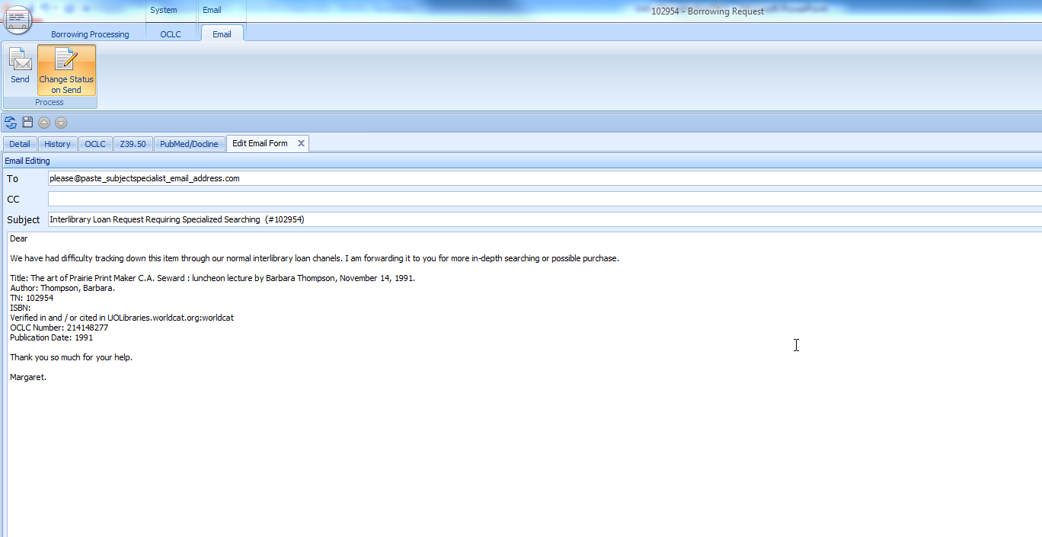
ILLiad Customization

Slide 26
Results - Numbers
Requests since May 2010: 103
Purchased: 55
Alternate OCLC Number Given: 4
Cancelled: 32
Available Online: 9
Other Sources: 3
Notes:
Cancellation reasons include: No response from faculty member, not available via ILL or for purchase, for personal use, not yet published, faculty member declined purchase offer, too expensive, out of print
Local library holding

Slide 27
Results – Subject Specialists
Not a Burden on Subject Specialists
Additional Point of Contact with Faculty
Insight into Types of Materials Requested by Subject Specialists
Enjoyed Learning About ILLiad Software

Slide 28
Results – Faculty
Appreciate the Contact from Subject Specialists
Appreciate the Chance to Have an Item Purchased
Appreciate the Additional Explanation of an Unfilled Request

Slide 29
Next Steps
Train Subject Specialists to Use ILLiad 8.0, Especially ILLiad Addons
Include Graduate Student Requests
GIST Pilot Project

Slide 30
ILLL – Reference Collaboration
Questions?

