Slide 1
Open sesame!
Dali’s Philosophy as Intellectual Precursor to the Open Movement
By
Carol Hixson, Dean
Nelson Poynter Memorial Library
December 5, 2012

Slide 2
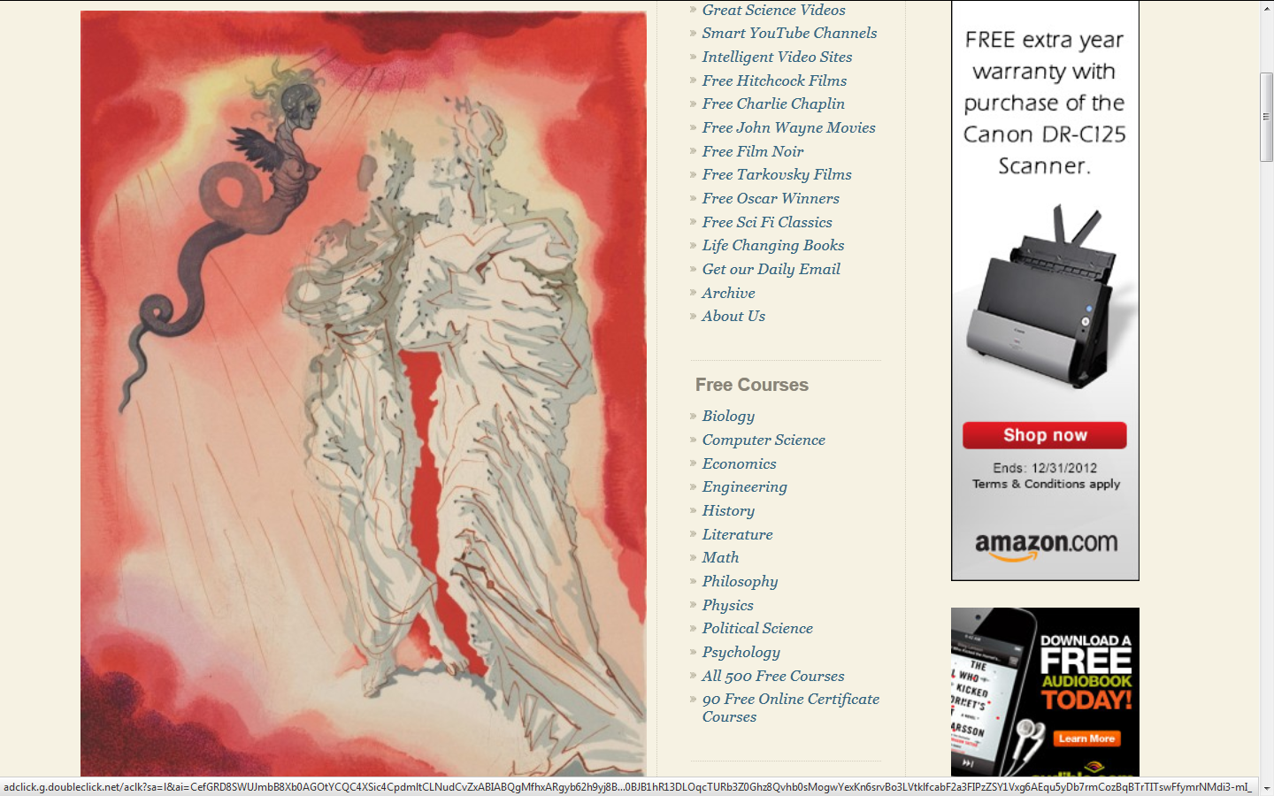
Dali Illustration for Dante’s Divine Comedy

Slide 3
Today’s Goals
Understand a bit about Open Movement
  Open Source
  Open Access/Open Data
  Open Content
  Open Courses
  Open Education
Discuss what it all means

Slide 4
The Open Movement
Open source software
Open access (research)
Open data
Open content
Open courses
Open educational resources
Open educational practice

Slide 5
Open Source Software
No licensing restrictions or fees
Source code is open and readily available for download and reuse
License must allow modifications and derived works
License must not discriminate against any person of group

Slide 6
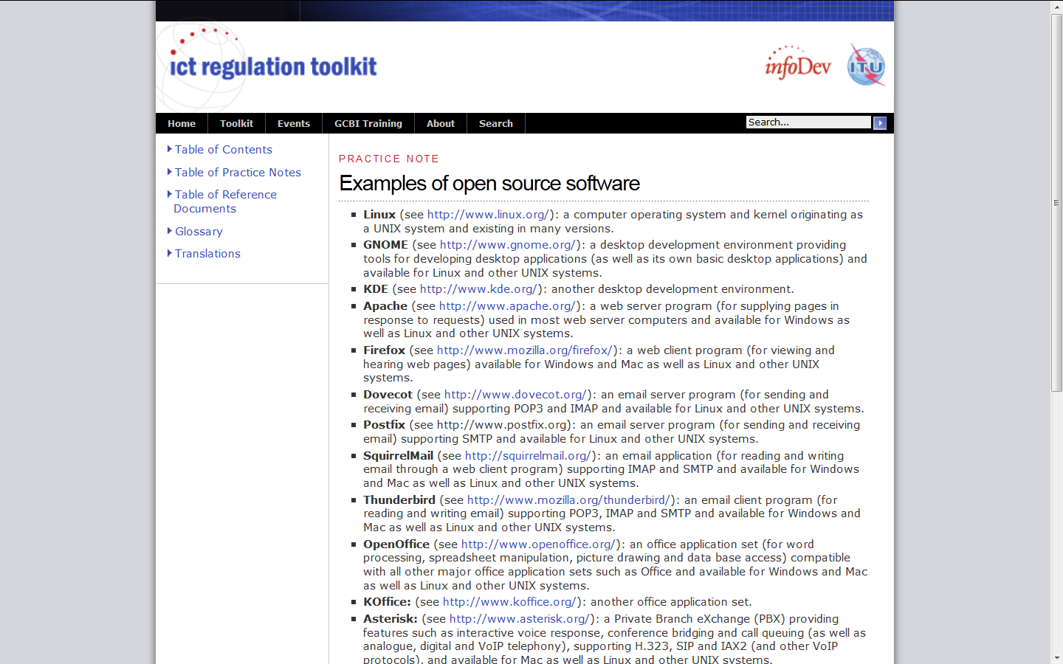
Open Source Examples

Slide 7
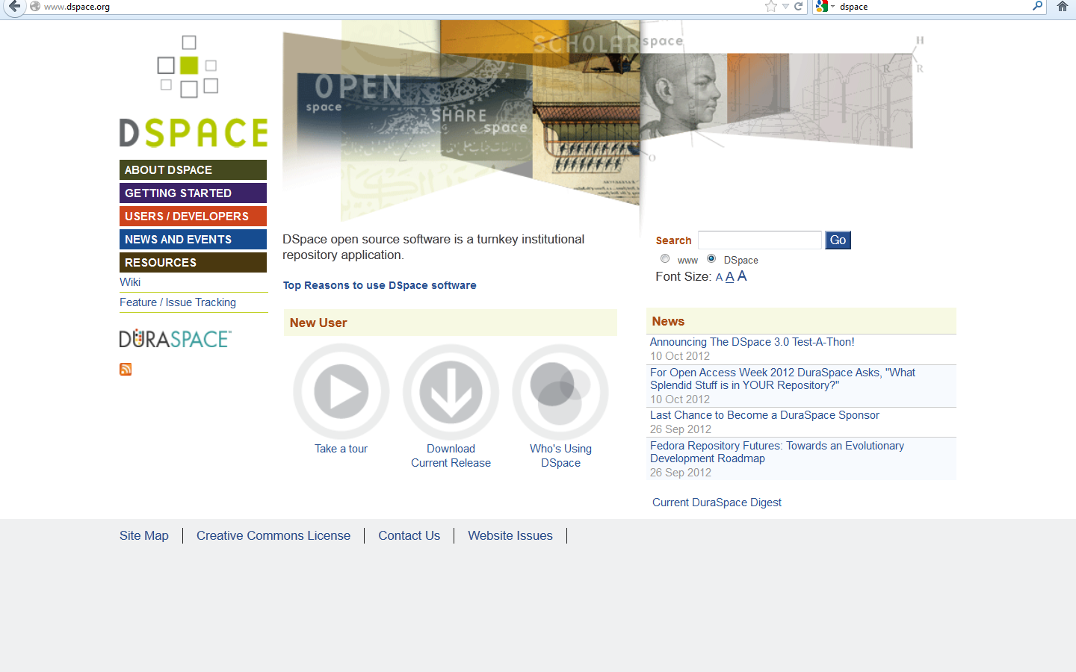
Open Source Example
DSpace

Slide 8
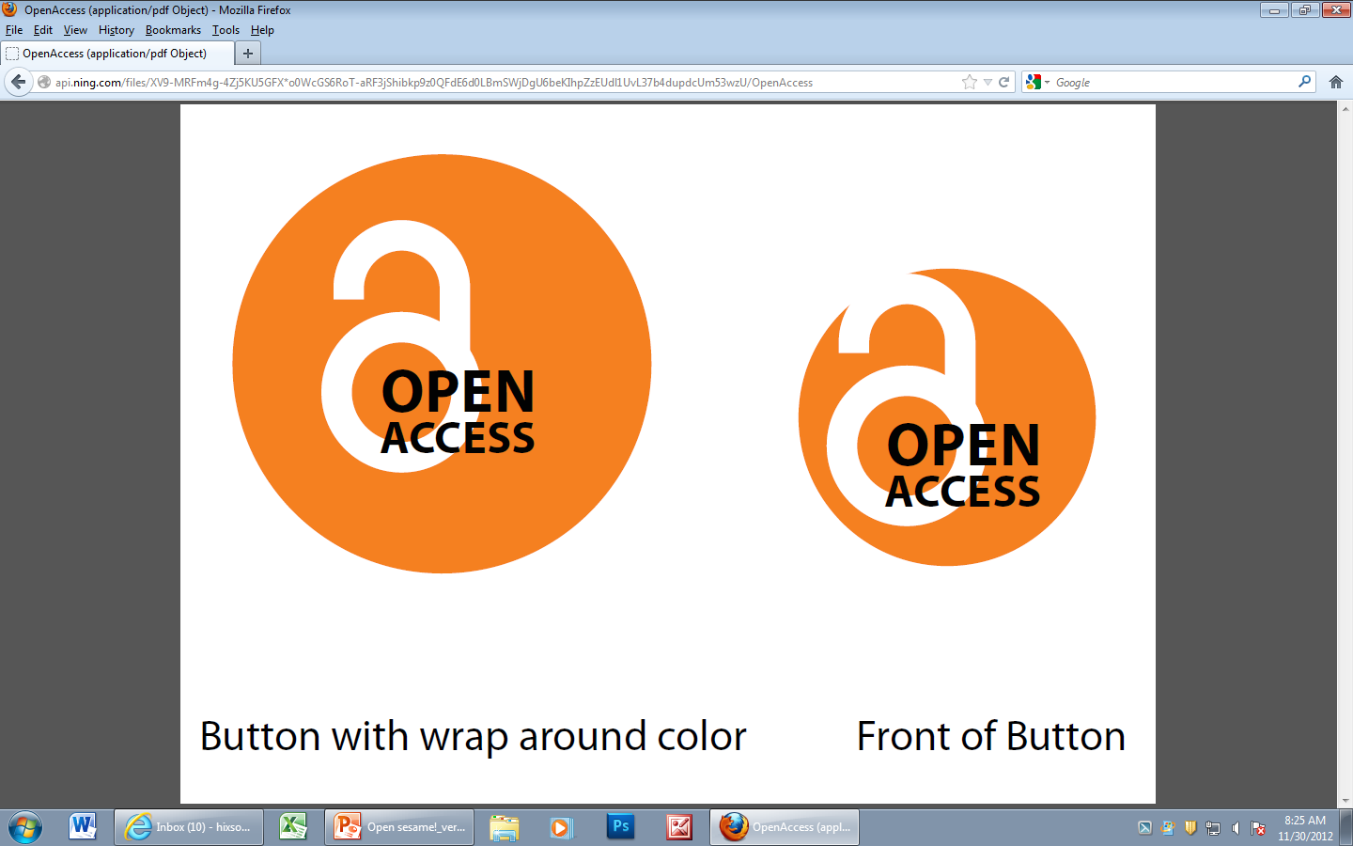
Open Access

Slide 9
Open access
Open-access (OA) literature is
  digital
  online
  free of charge, and
  free of most copyright and licensing restrictions.
Source: Peter Suber, A Very Brief Introduction to Open Access

Slide 10
Why Open Access?
Journal prices rising much faster than inflation
Scholarly output increasing
Libraries able to provide access to smaller percentage of total scholarly output

Slide 11
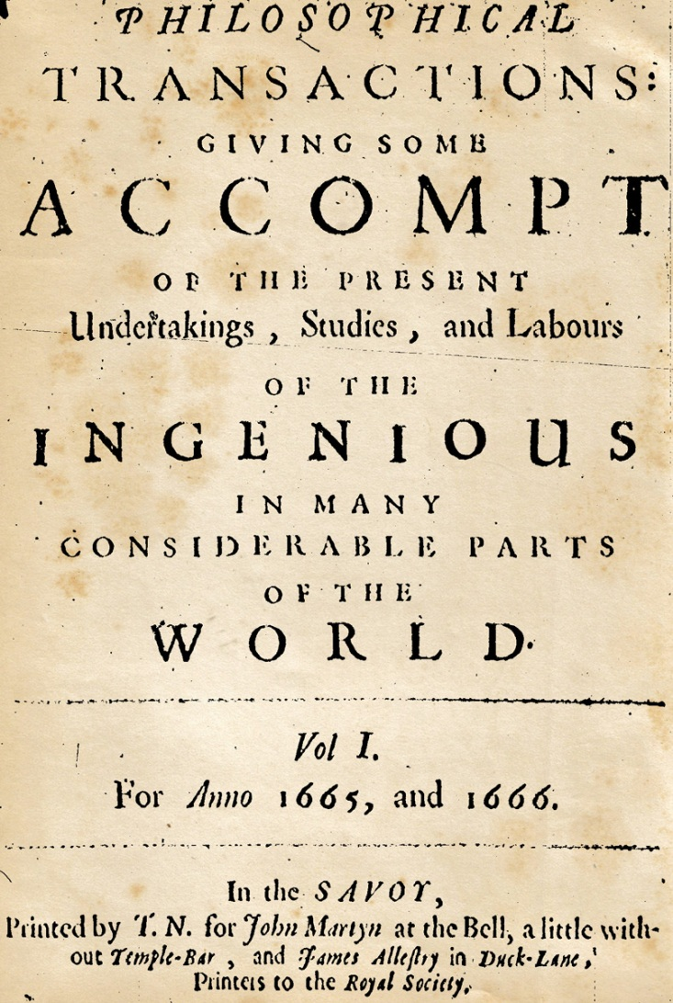
Scholarly Journals

Slide 12
Peer Review
Evaluation of creative work by other people in the same field
Often done anonymously to avoid bias
Depends on the independence and expertise of the reviewers
Used extensively in academia as an indication of quality
Pre-publication normally but continues on after publication

Slide 13
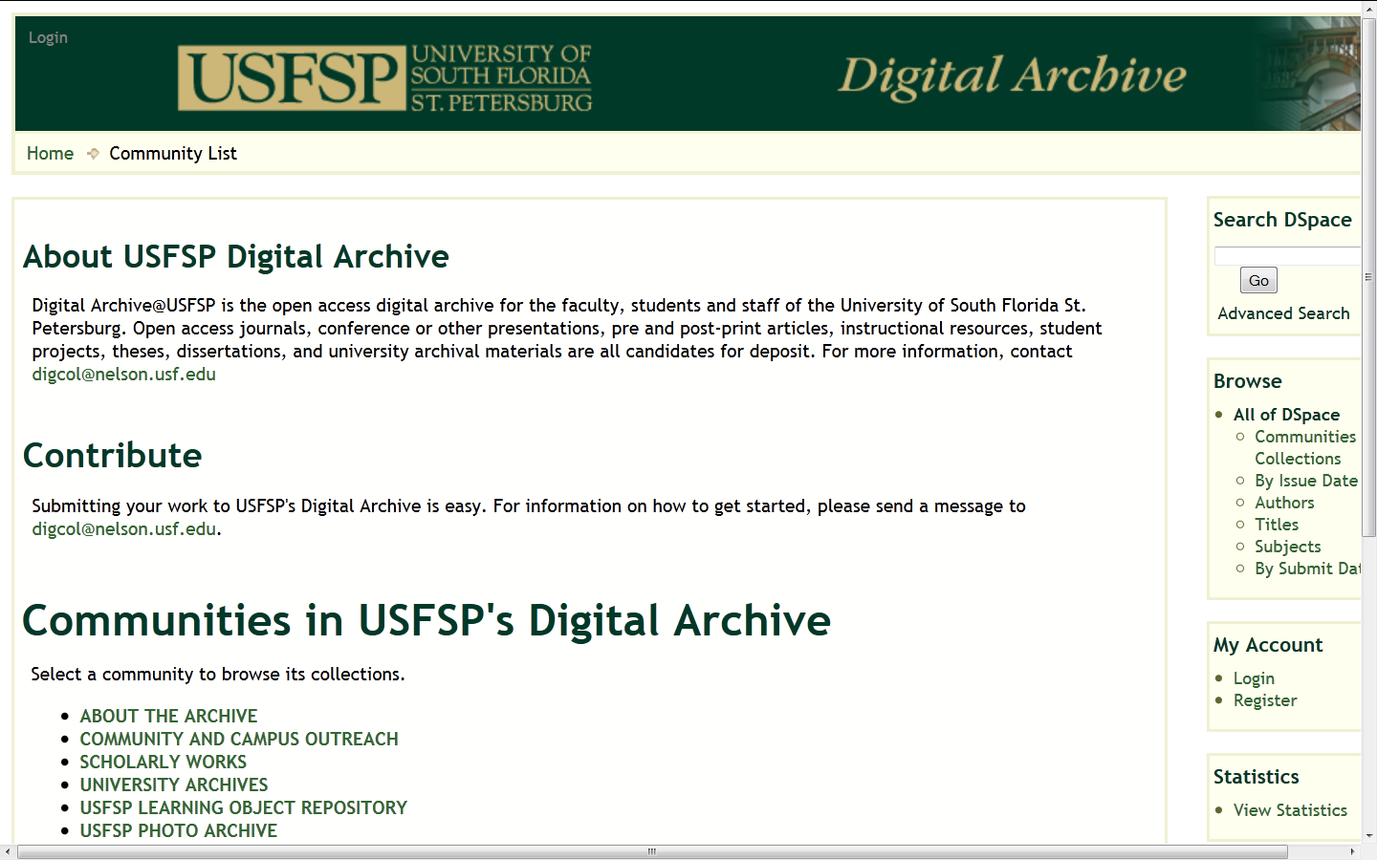
Open Access Example
USFSP Digital Archive

Slide 14
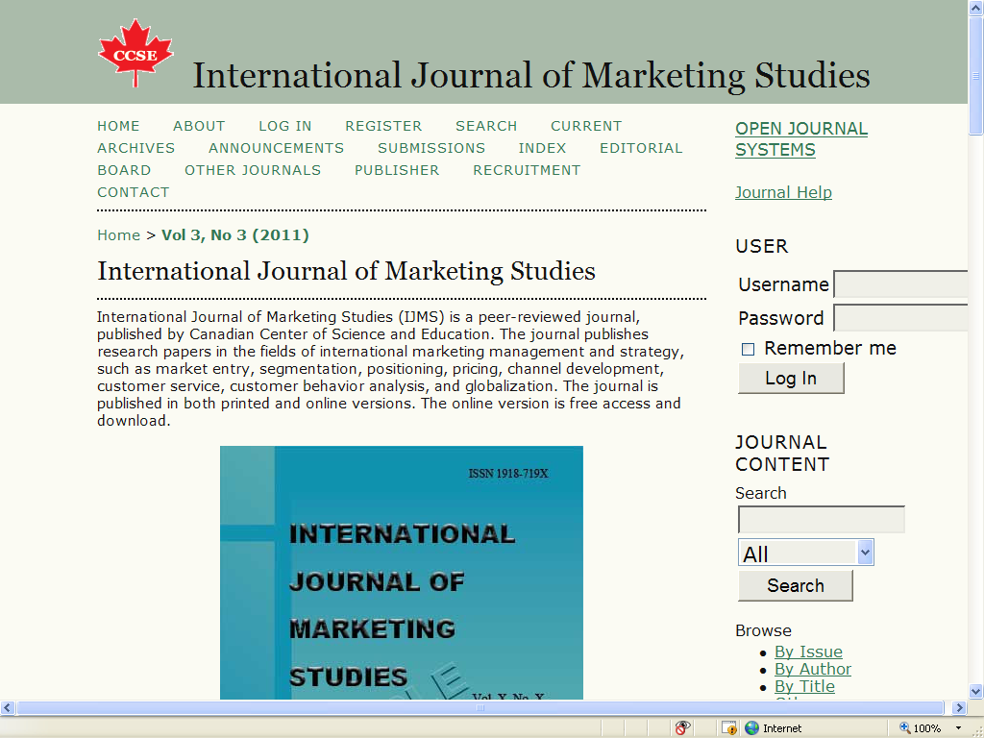
Open Access Journal

Slide 15
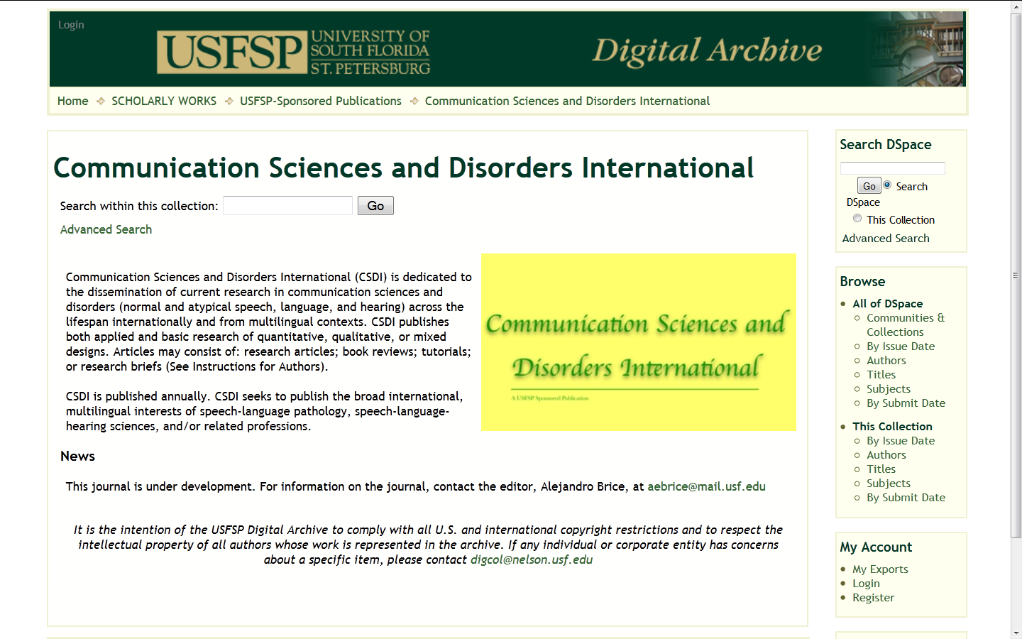
USFSP Open Access Journal

Slide 16
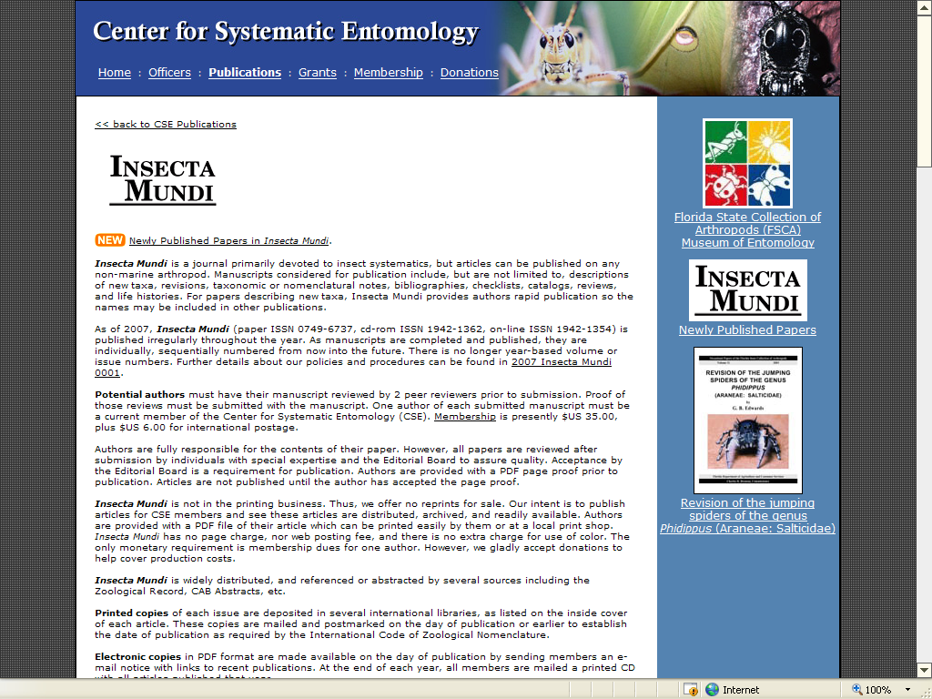
Open Access Journal

Slide 17
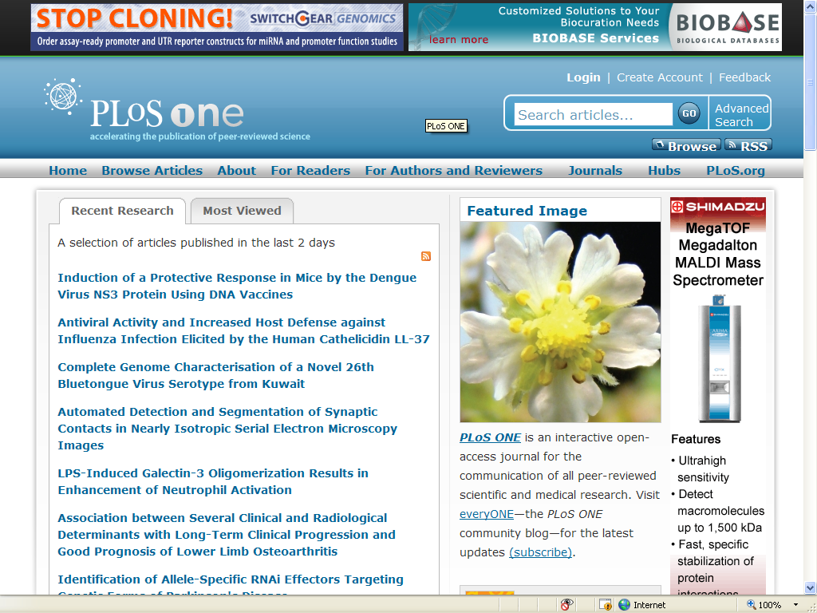
Open Access Database

Slide 18
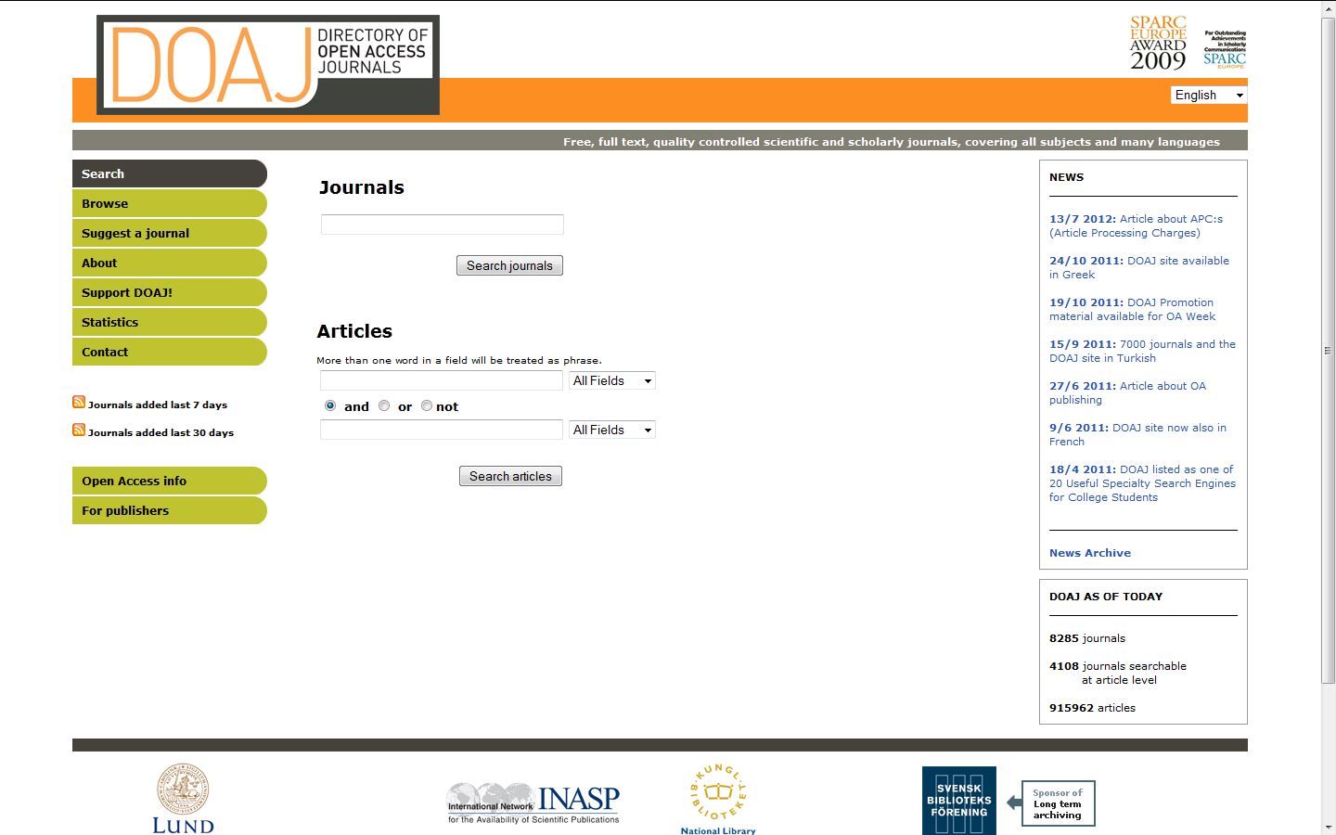
Open Access Directory

Slide 19
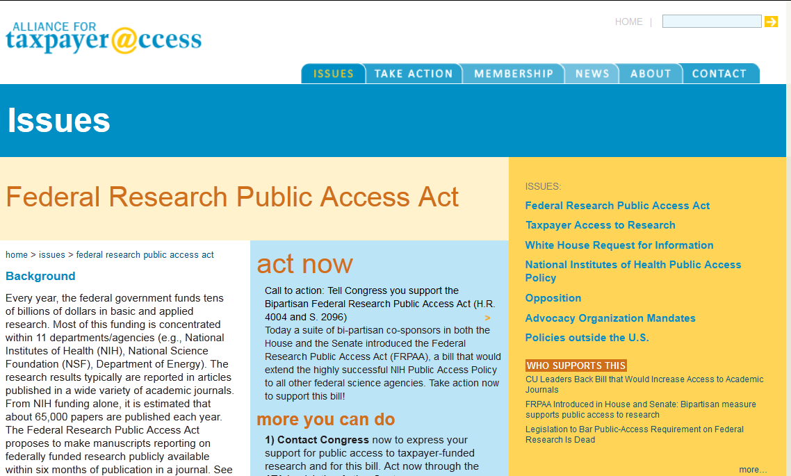
Why Open Access?
For the Public Good

Slide 20
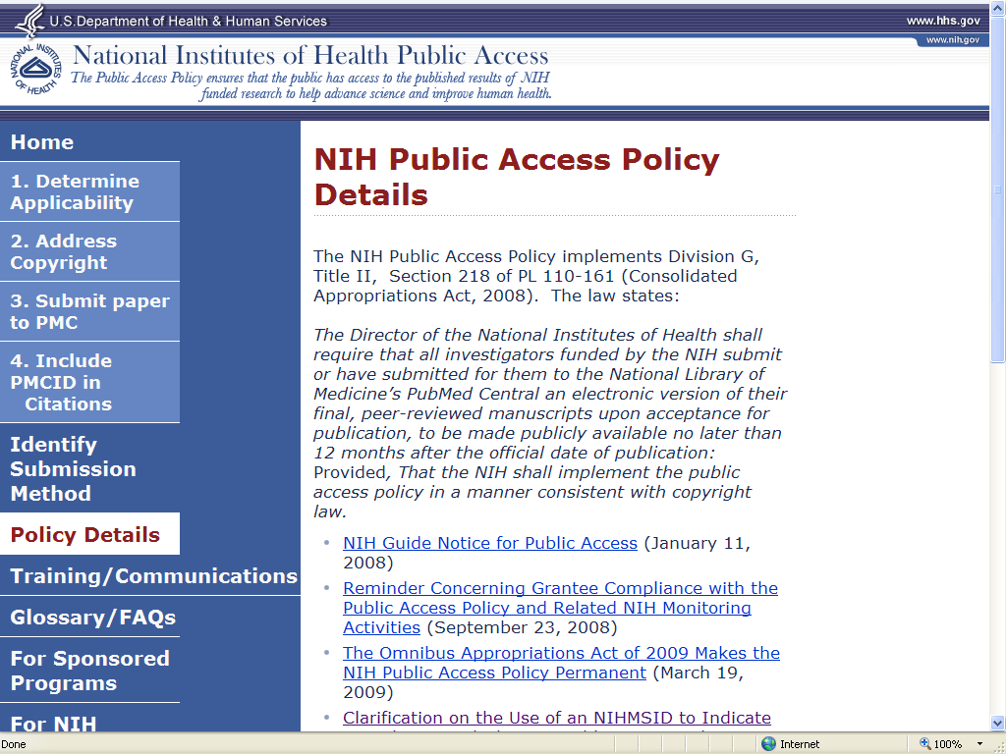
Why Open Access?
Funding Agencies Support It

Slide 21
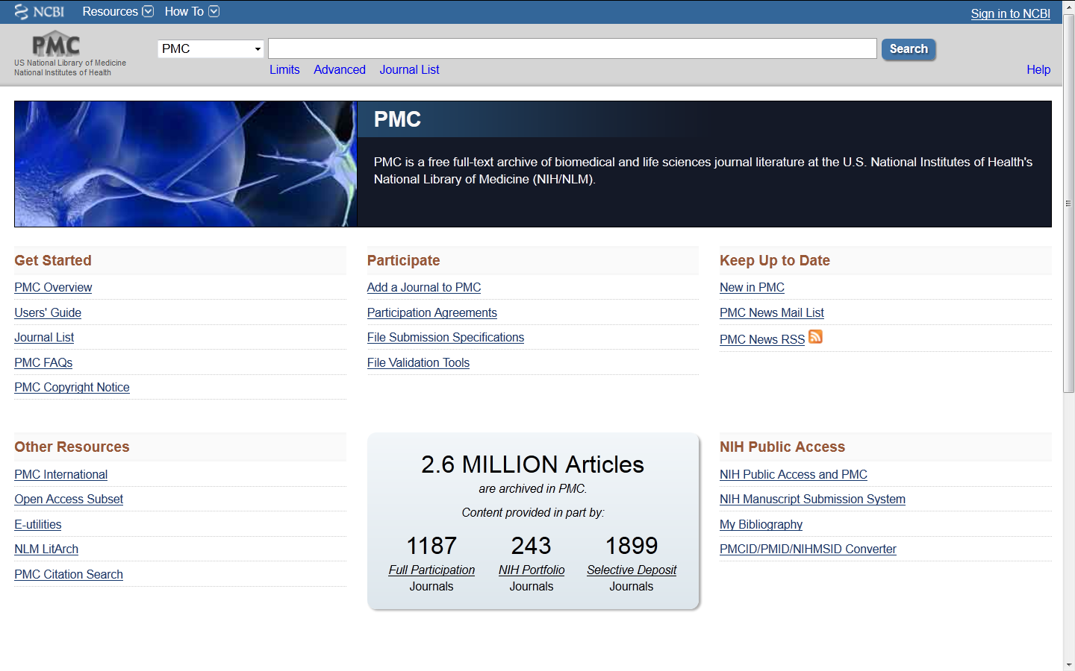
Why Open Access?
Funding Agencies Support It

Slide 22
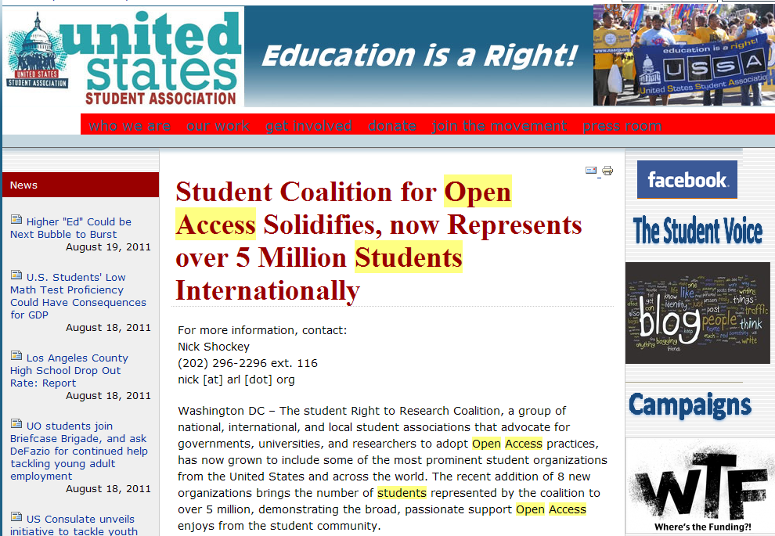
Why Open Access?
Student Support

Slide 23
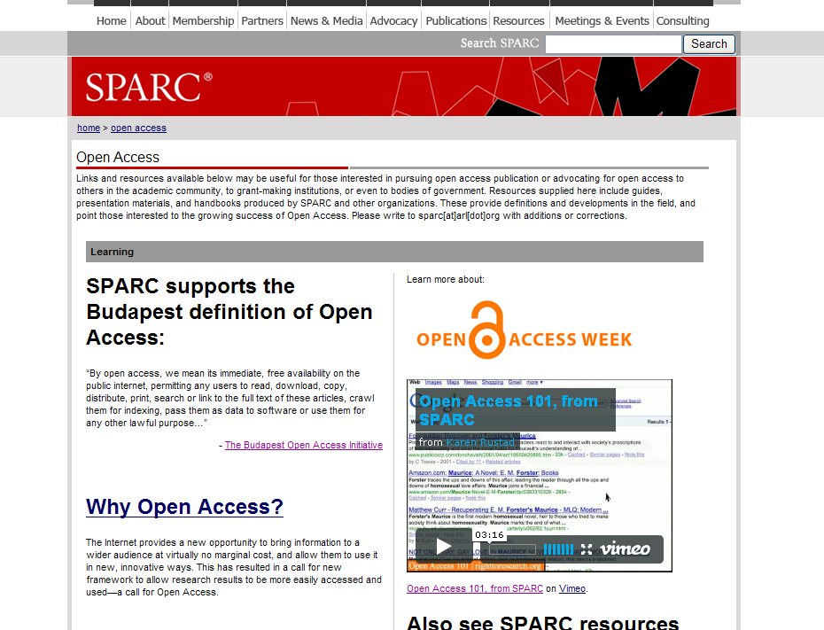
Why Open Access?
International Support

Slide 24
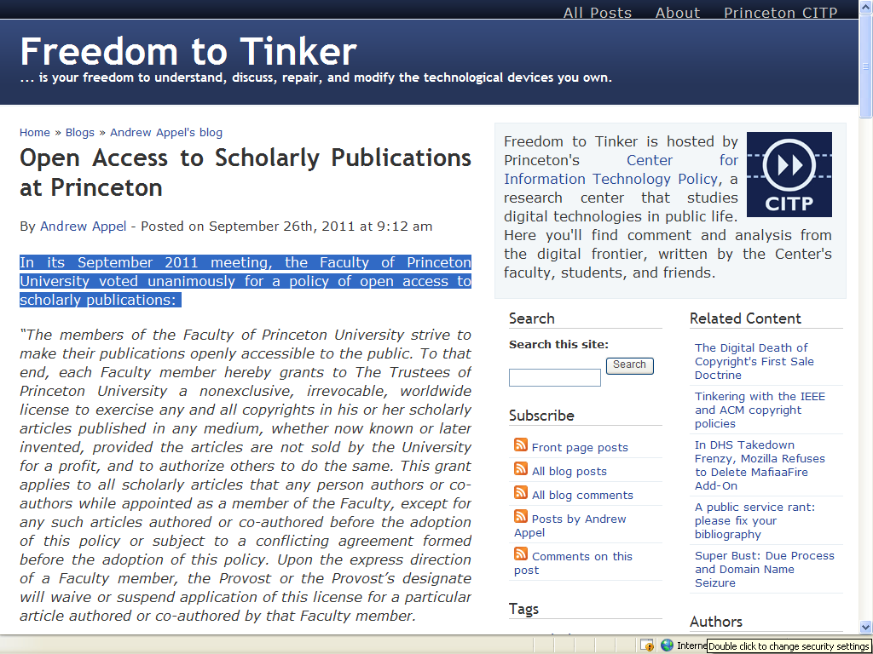
Why Open Access?
Faculty Support

Slide 25
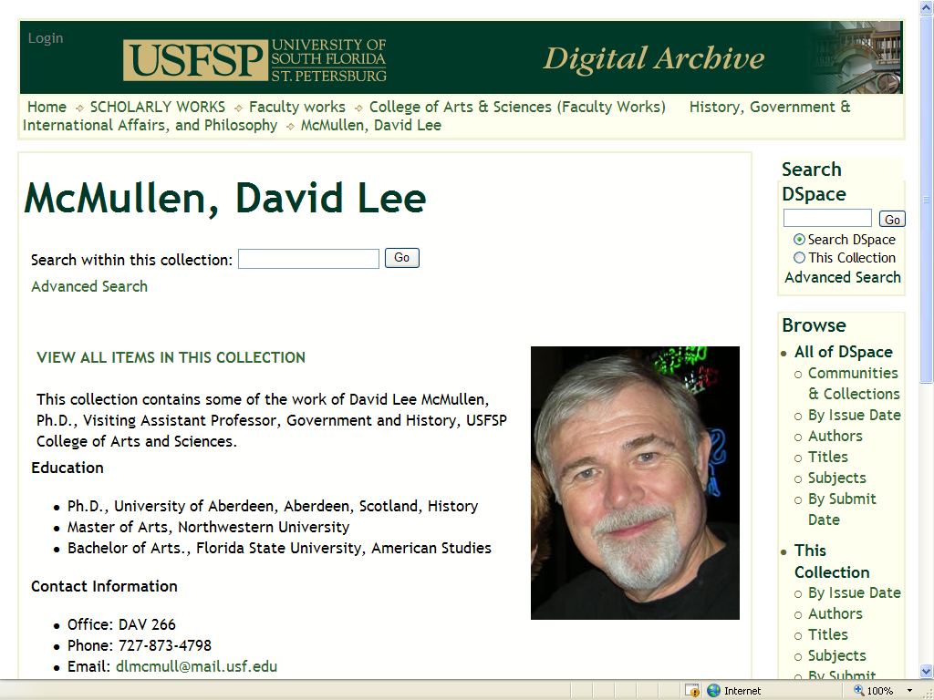
Why Open Access?
Promote Research & Scholarship

Slide 26
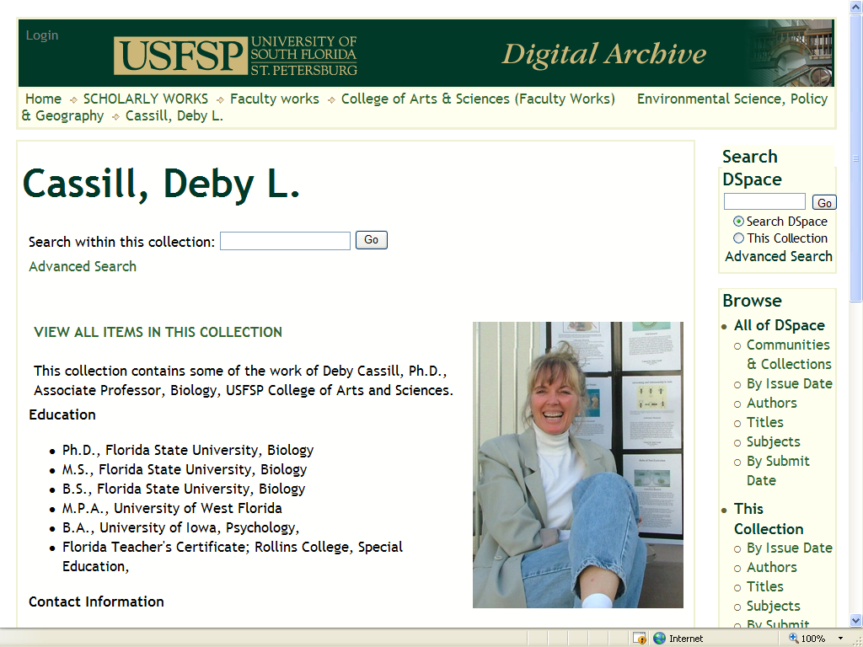
Why Open Access?
Promote Research & Scholarship

Slide 27
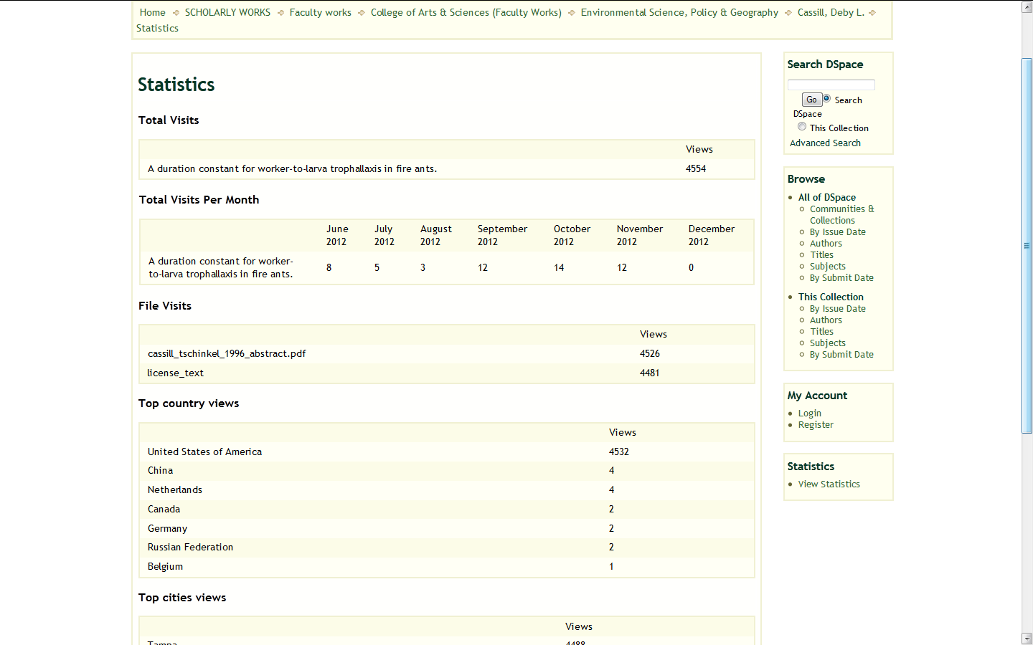
Why Open Access?
Greater Exposure for Research

Slide 28
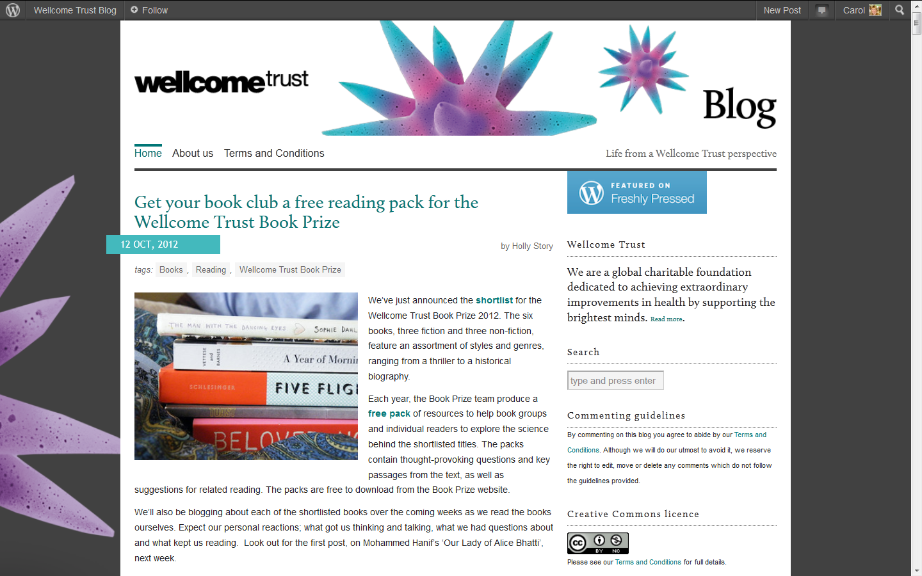
Why Open Access?
International Support

Slide 29
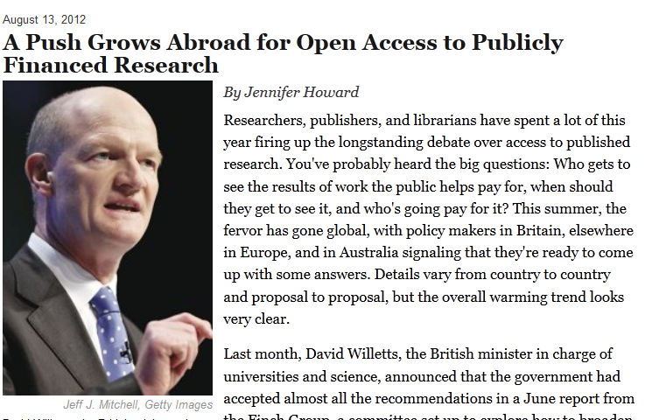
Why Open Access?
International Support

Slide 30
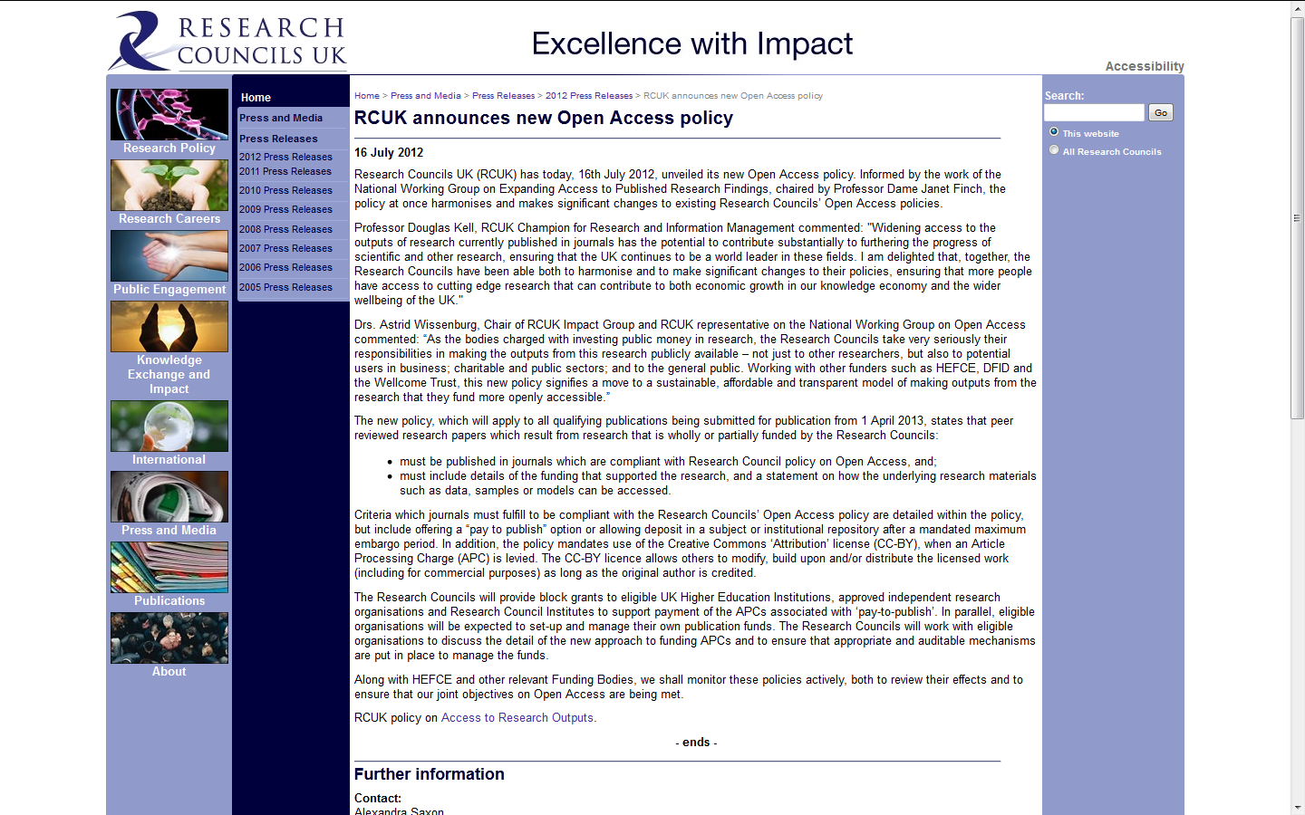
Why Open Access?
International Support

Slide 31
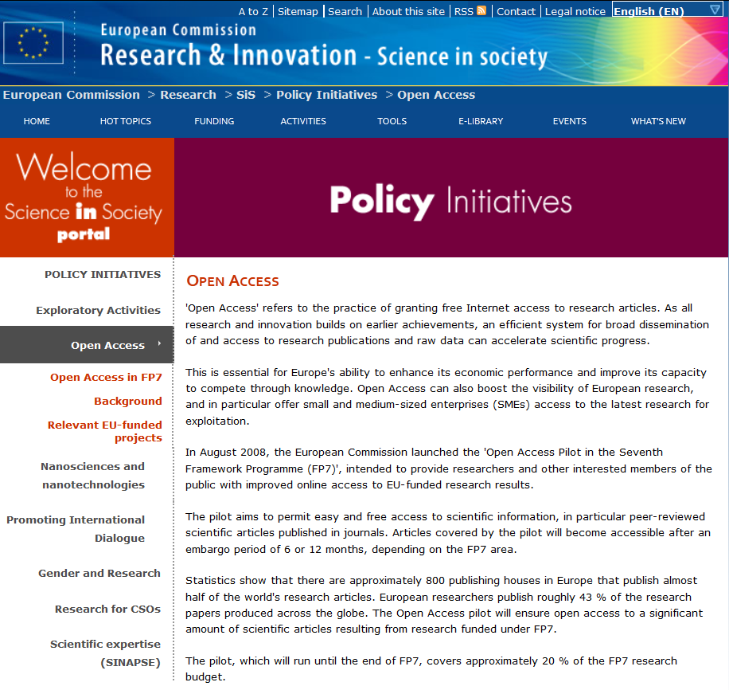
Why Open Access?
International Support

Slide 32
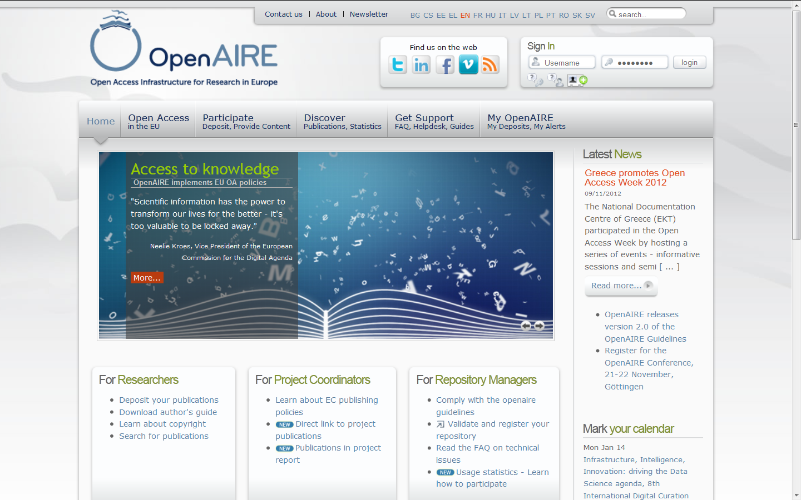
Why Open Access?
International Support

Slide 33
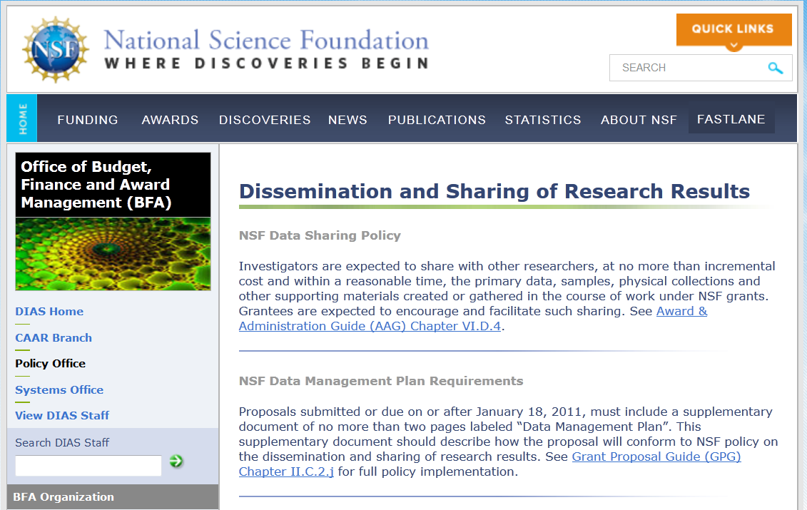
Open Data

Slide 34
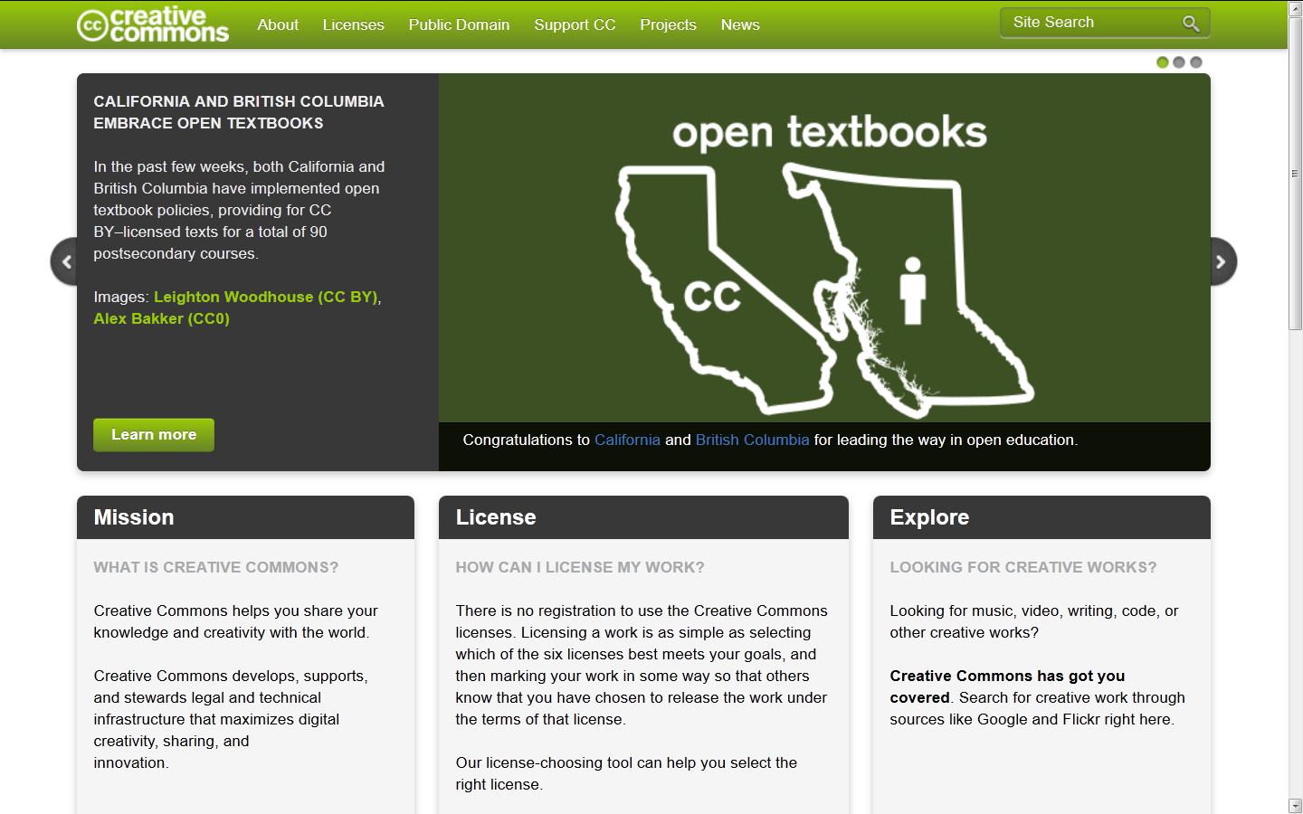
Tools for Open Access & Open Data
Creative Commons

Slide 35
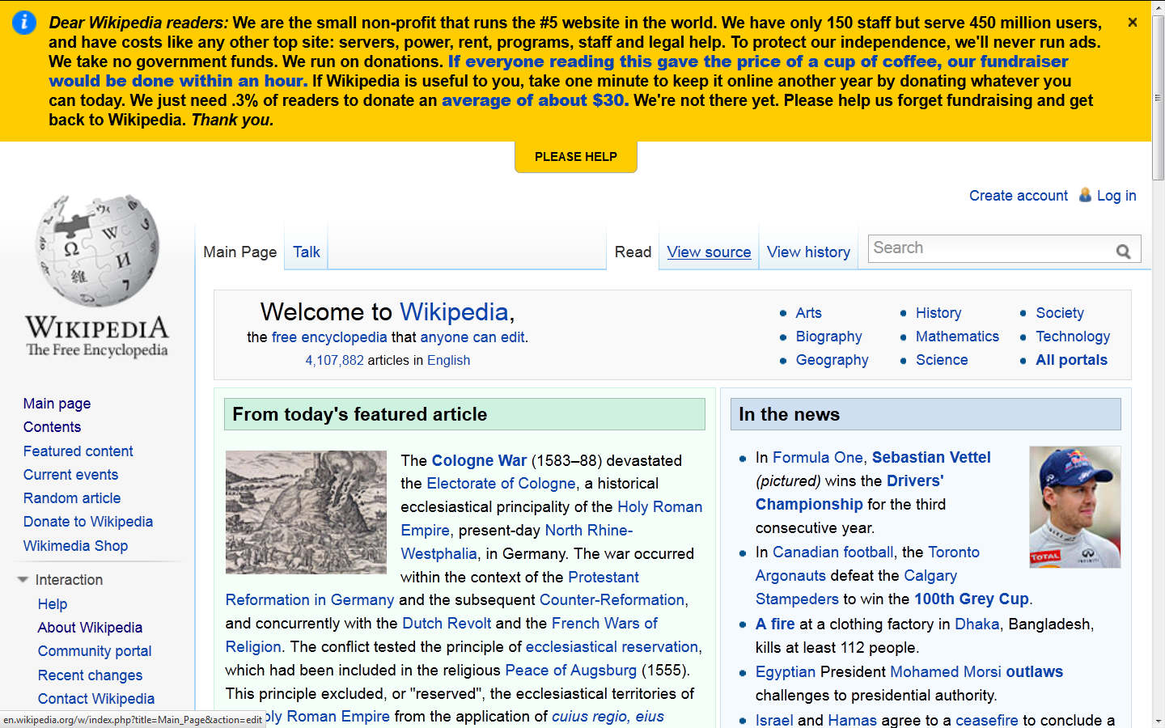
Open Content

Slide 36
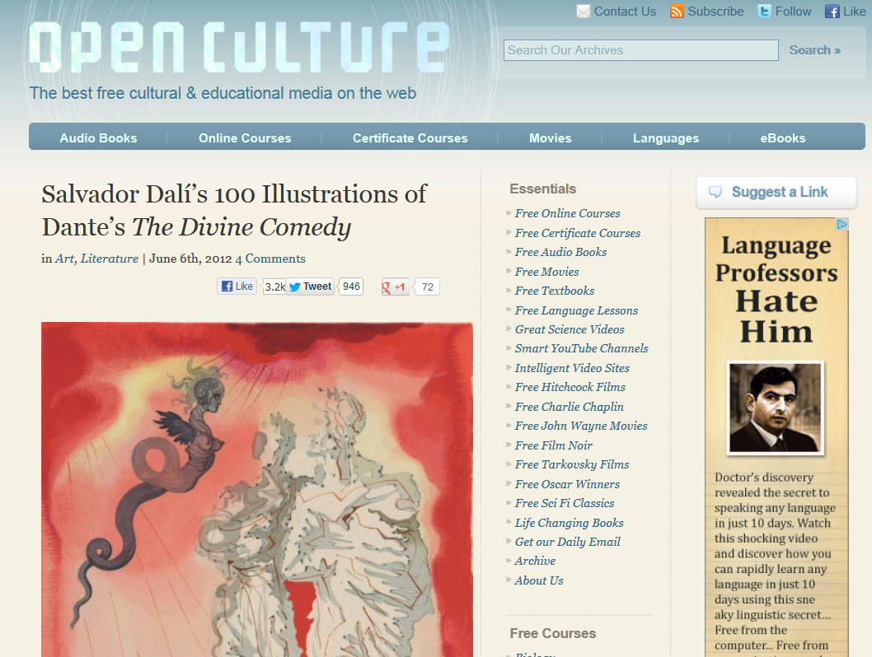
Open Content

Slide 37
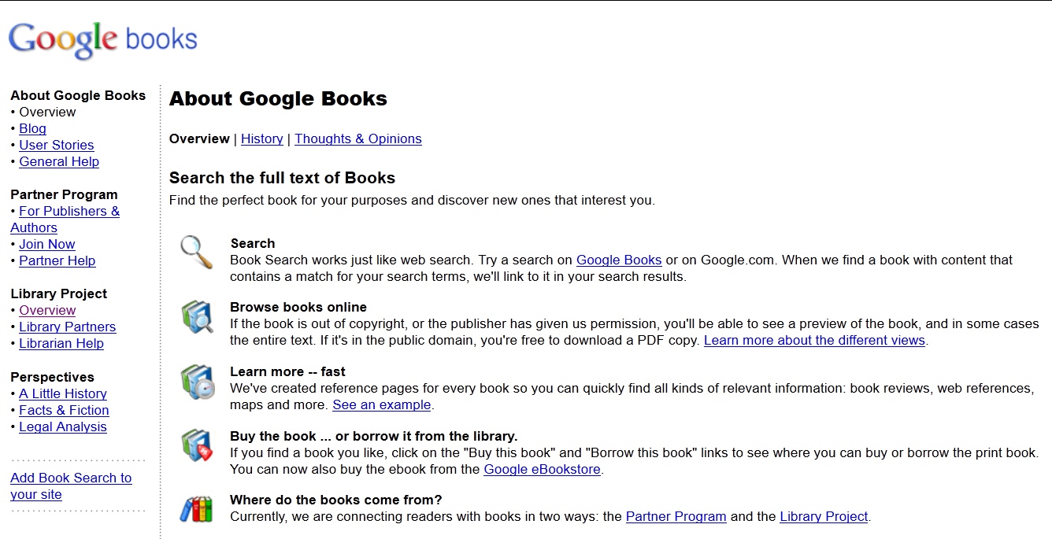
Open Content
Google and Digital Libraries

Slide 38
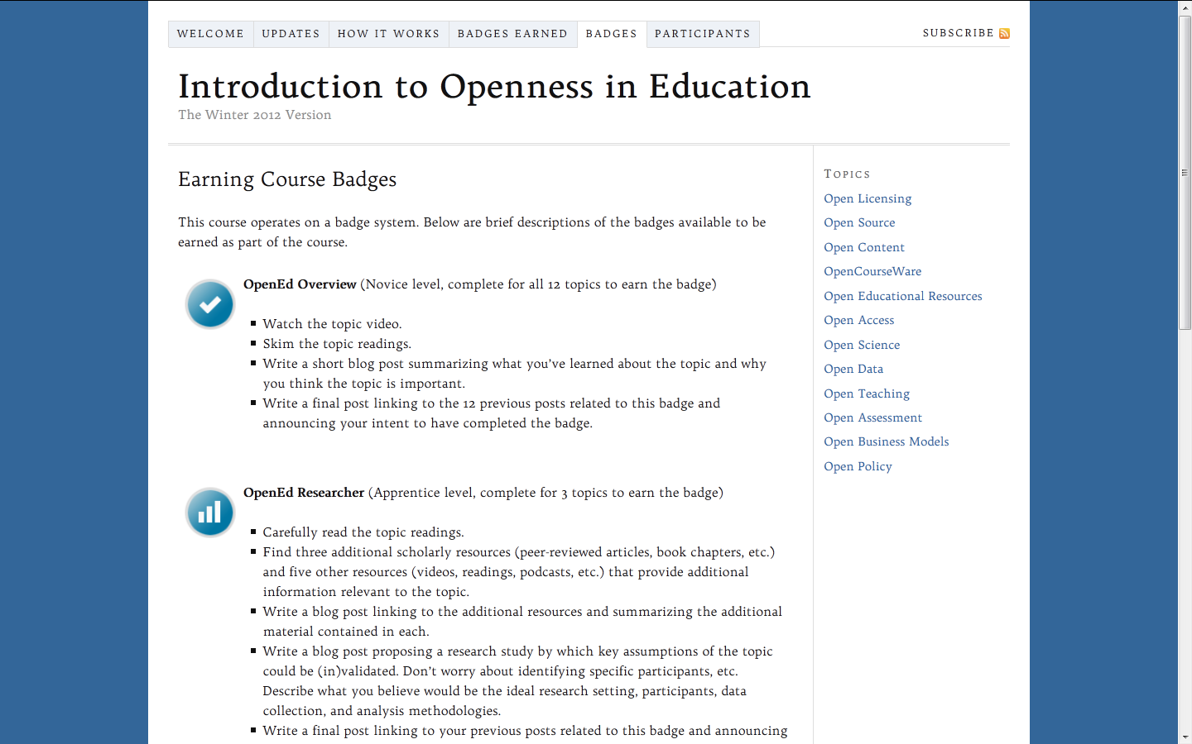
Open Courses

Slide 39
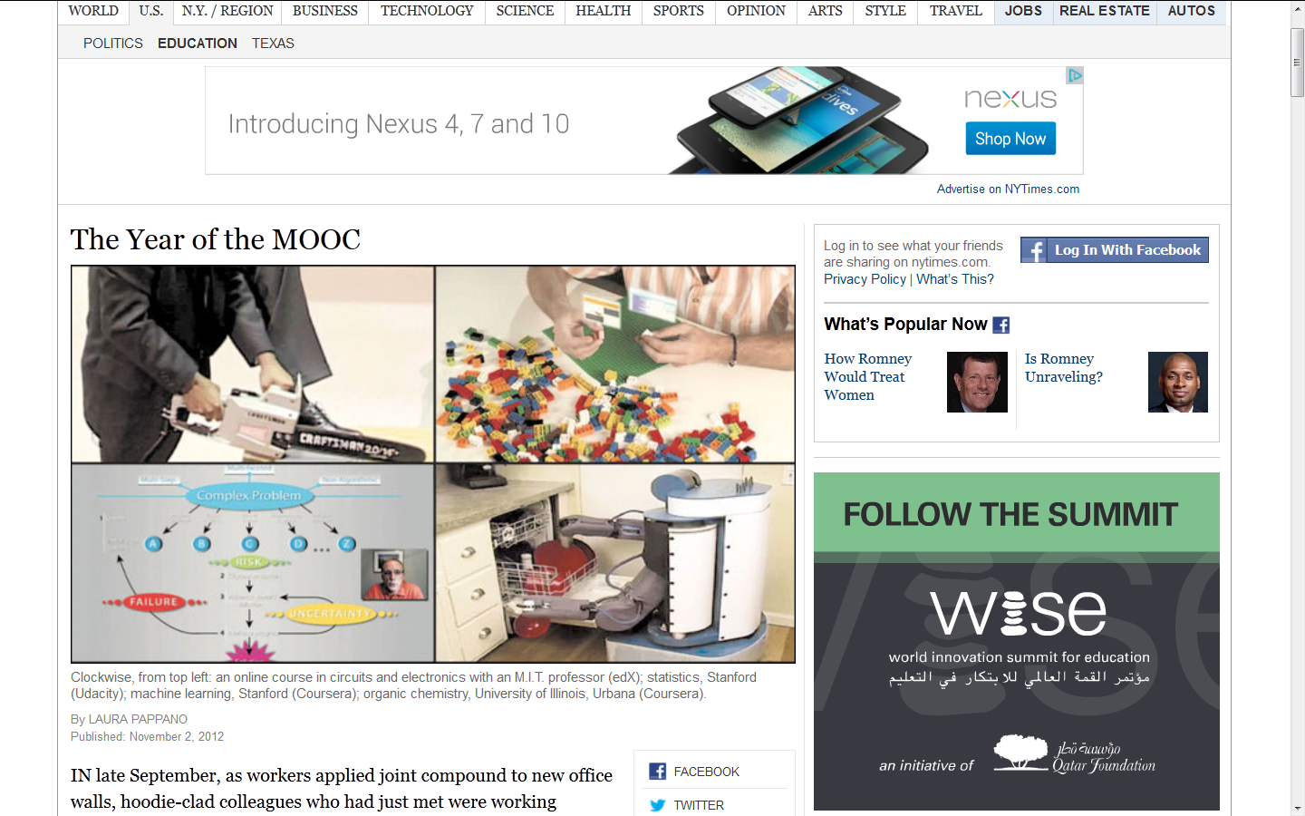
Open Courses
MOOCs

Slide 40
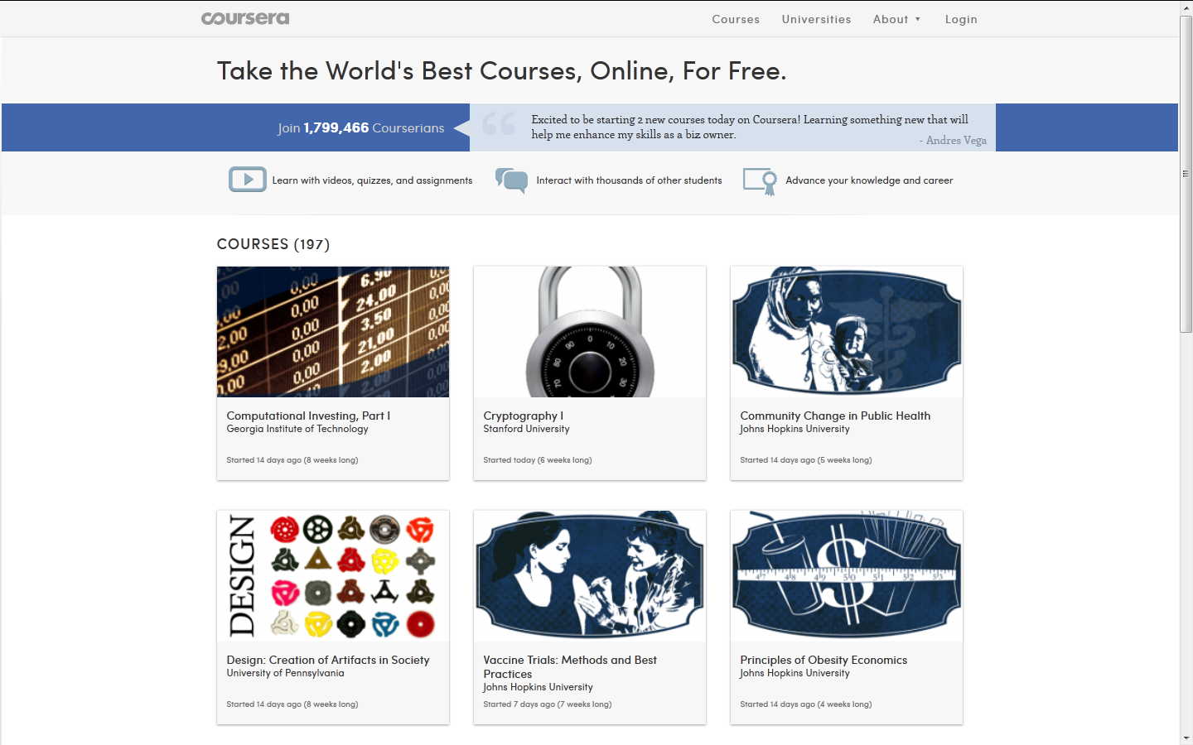
Open Courses
Coursera

Slide 41
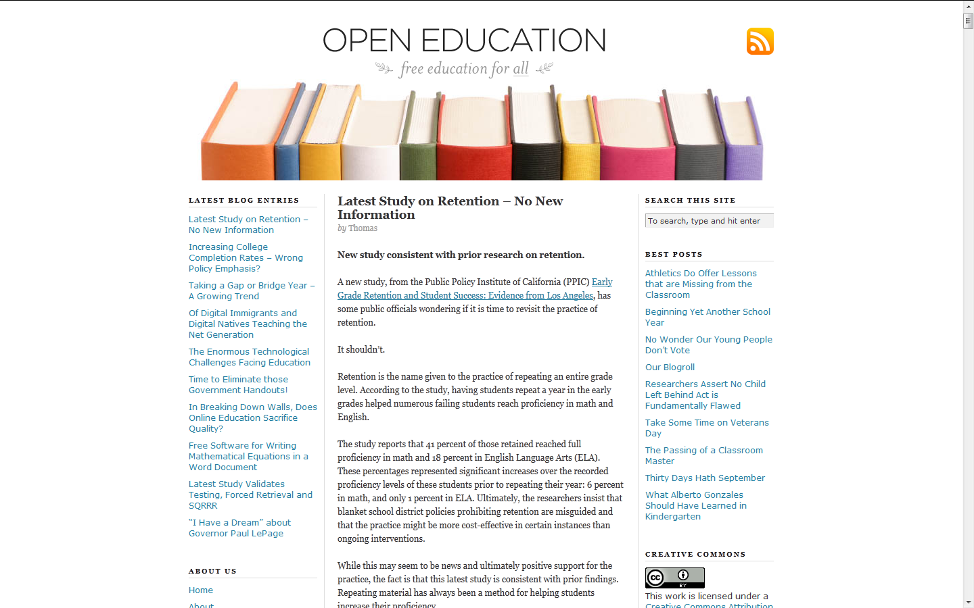
Open Educational Resources
Open Education

Slide 42
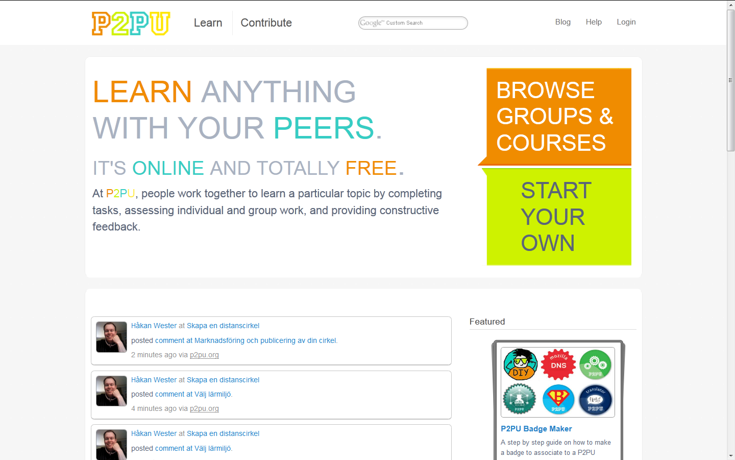
Open Educational Resources
P2PU

Slide 43
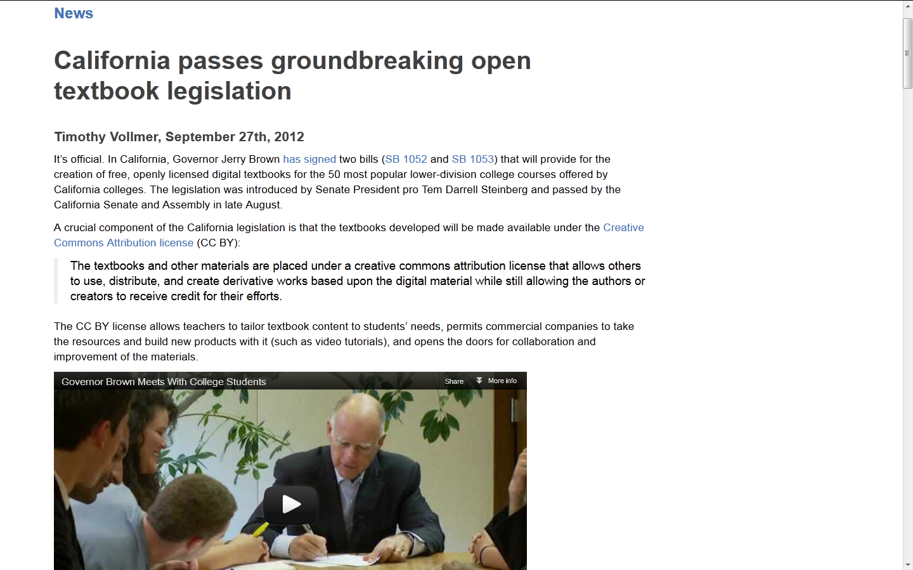
Open Educational Resources Open Textbooks

Slide 44
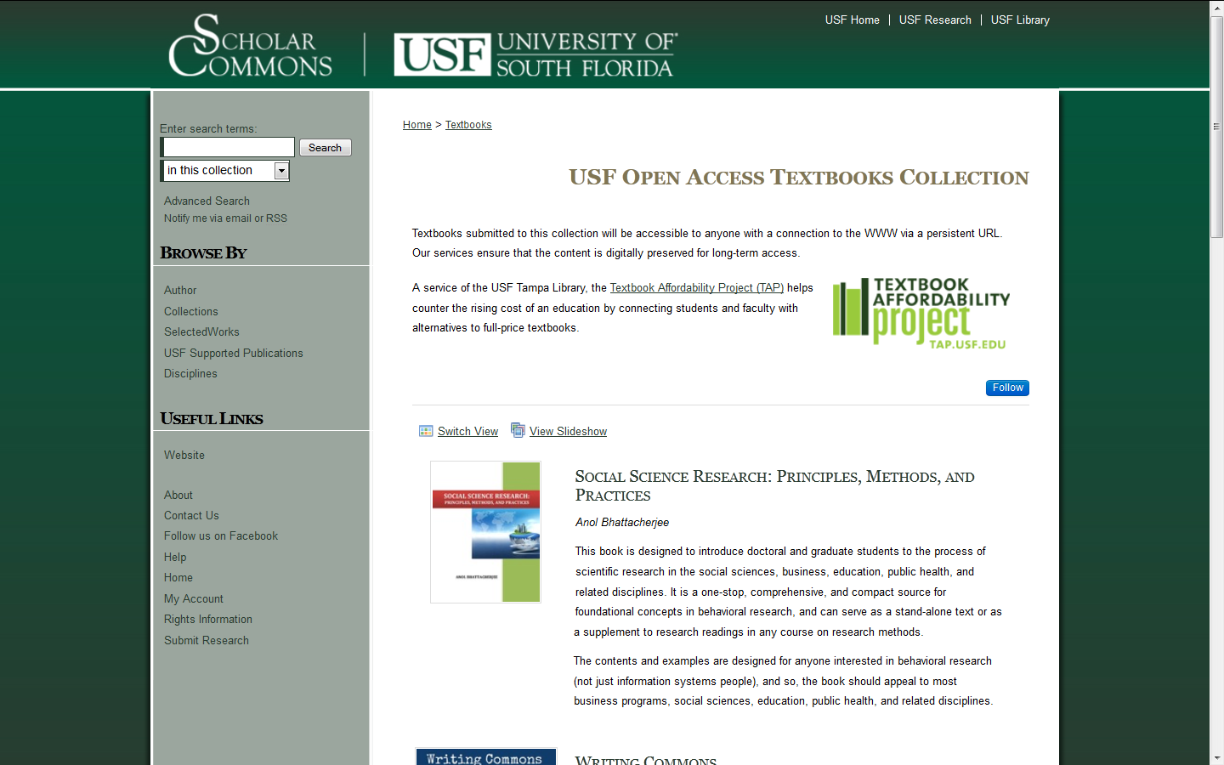
Open Educational Resources http://tap.usf.edu/

Slide 45
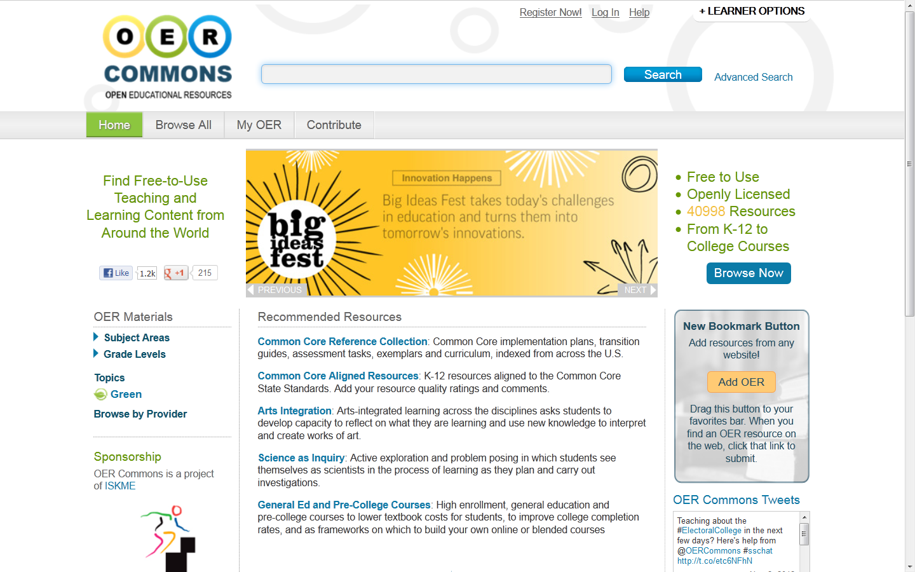
Open Educational Resources
OER Commons

Slide 46
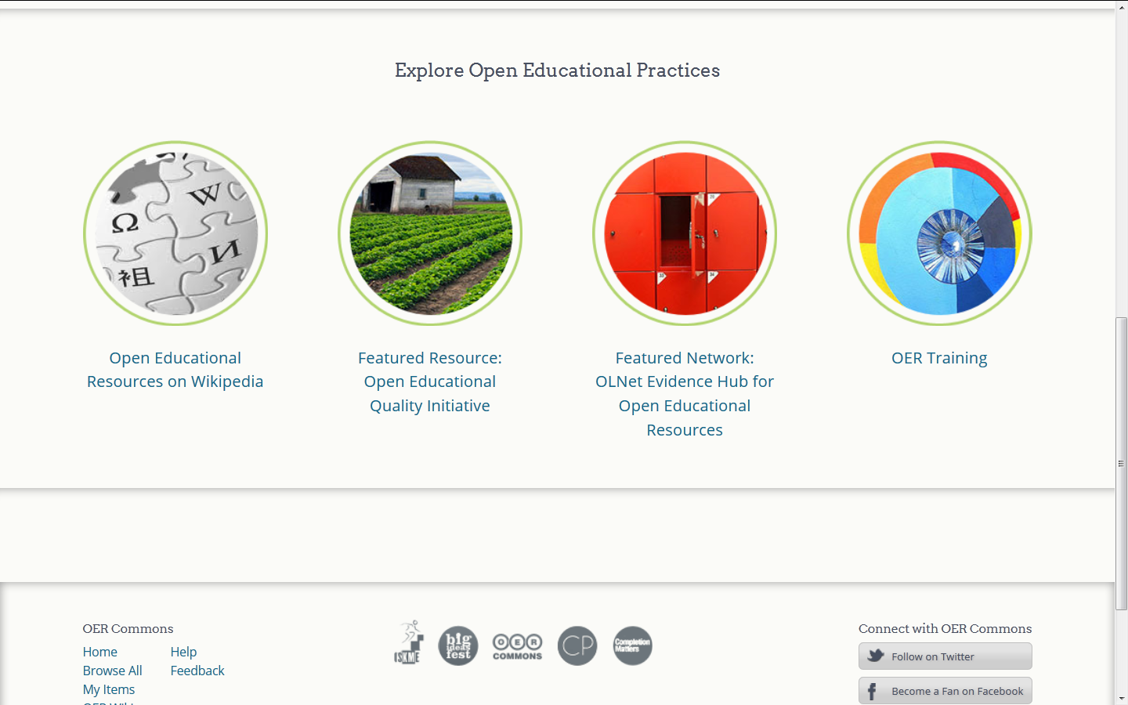
Open Educational Practice

Slide 47
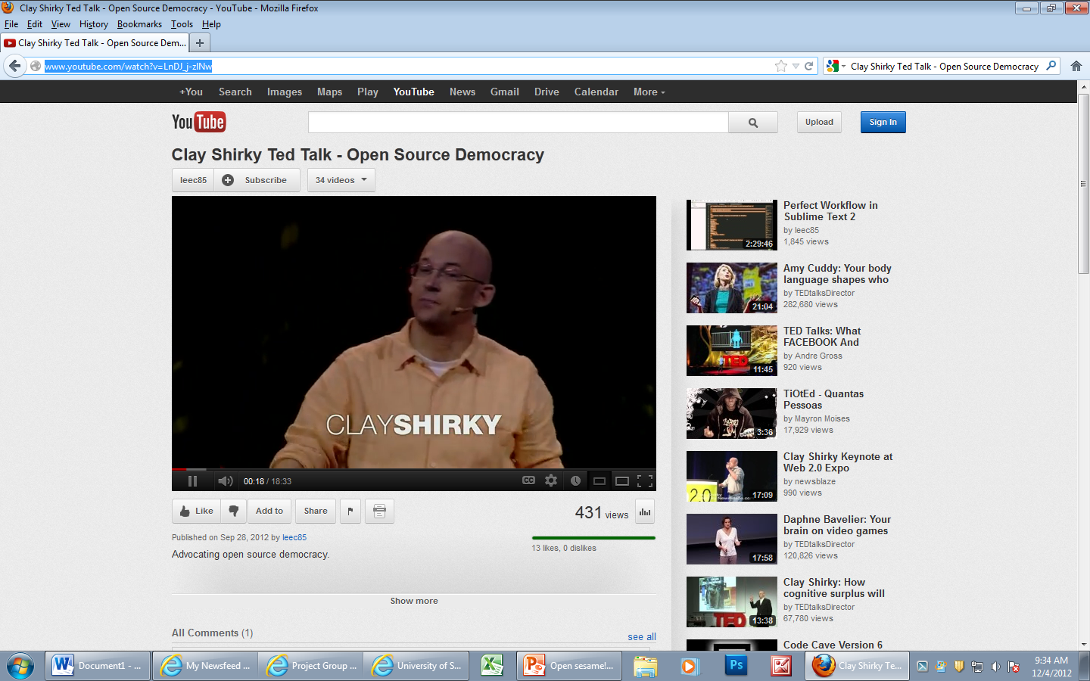
Open Source Democracy http://www.youtube.com/watch?v=LnDJ_j-zlNw

