Slide 1

CRISIS BRINGS CONNECTION
Virtual Programming for Older Adults
AMANDA LENSING
Senior Living Communities Program Coordinator, University of Iowa Stanley Museum of Art
Co-Director, Connected for Life: Object-based Digital Programming to Foster Active Minds for Senior Living Communities

Slide 2
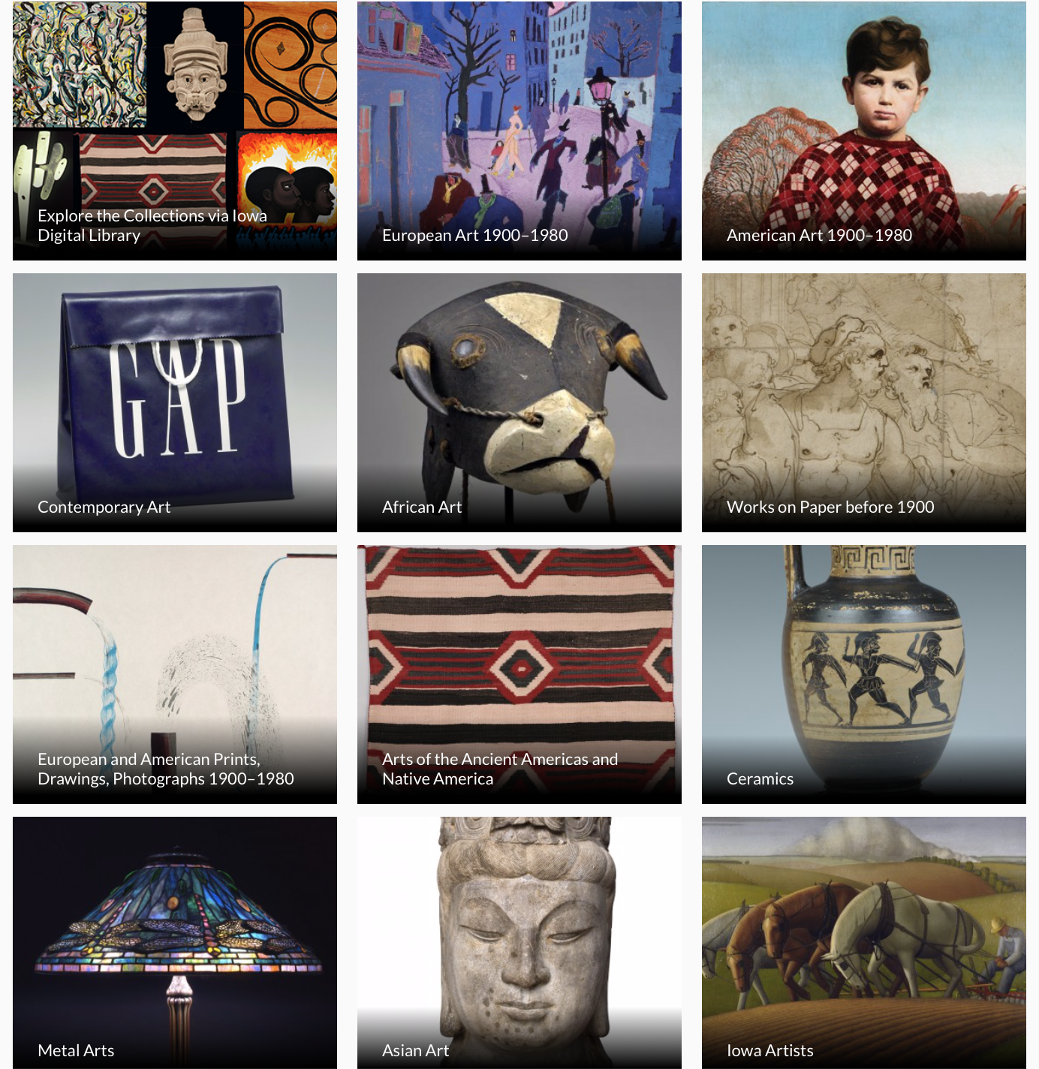
Stanley Museum of Art
UNIVERSITY OF IOWA
Iowa City, Iowa

Slide 3
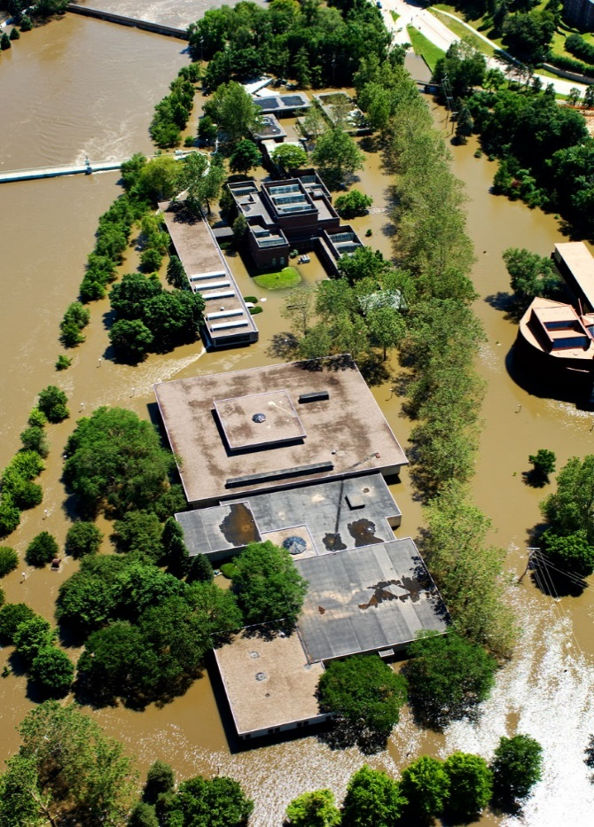
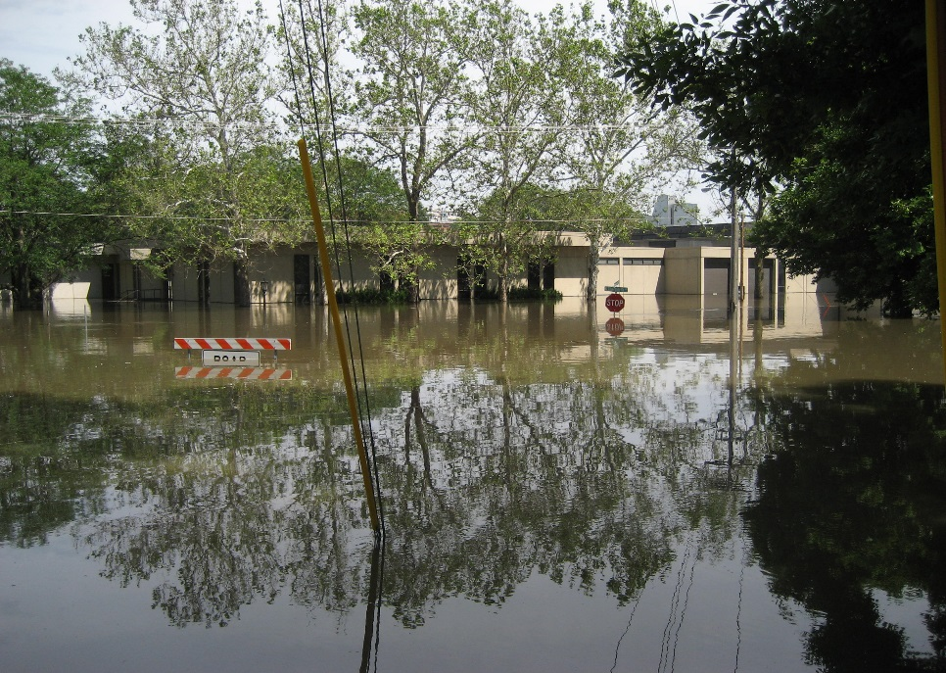

Senior Living Communities (SLC) Program
PURPOSE: To improve a person's sense of happiness and social connection through creative engagement, and to reduce isolation and depression among older adults.
GOAL: To create programs that can be shared with participants of ALL interests and ALL ability levels.
stanleymuseum.uiowa.edu/education/older-adults

Slide 4
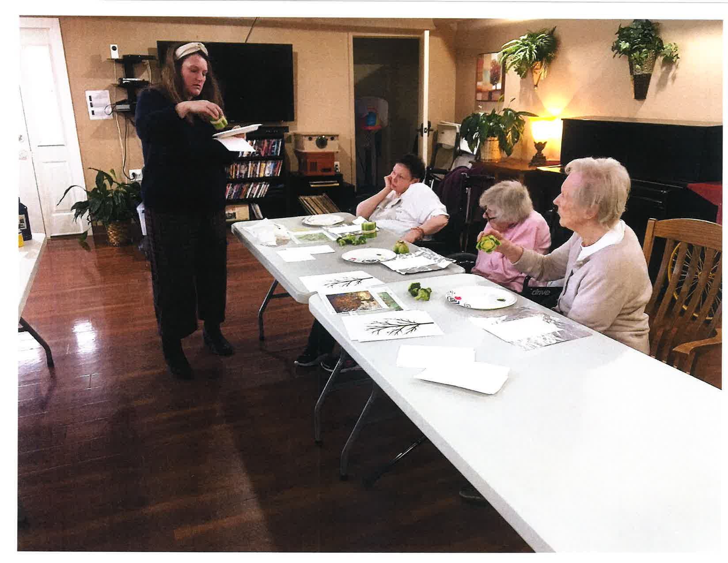
SLC Program – By the Numbers
2018-19 | Pre-COVID-19:
18 monthly presentations
25 locations and a waiting list
4 counties
160 presentations
2,232 participants
10-20 participants in programs
45-60 minutes program length
FREE for all to attend and participate

Slide 5
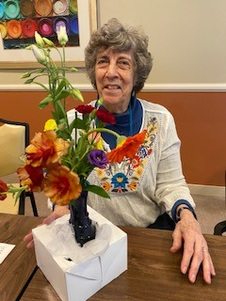
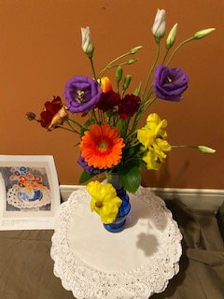
SLC Program – March-September 2020
Museum From Home Emails
Supply Boxes to Local SLC
Livestream Virtual Programs with Closed Captioning
Funding and Education on Ageism
stanleymuseum.uiowa.edu/education/older-adults/slc-museum-from-home-emails

Slide 6






Institute of Museum and Library Services CARES Act Grant
Coronavirus Aid, Relief, and Economic Security Act Grant is to support the role of museums and libraries in responding to the coronavirus pandemic.

Slide 7
Connected for Life – Goals
Object-based Digital Programming to Foster Active Minds for SLC
Serve older adults and SLC in Iowa, populations especially vulnerable to COVID-19 and underserved in outreach and engagement programs;
Increase participants’ sense of connection, engagement, and well-being and decrease feelings of isolation through synchronous virtual programs;
Create a robust and vibrant web portal that responsively adjusts to audience needs based on assessment data; and
Develop a meaningful channel for coordinated programming among the four world-class collecting units on campus. By combining our efforts, we will develop meaningful connections across diverse collections, and bolster our ability to deliver high impact content to the broader Iowa community.

Slide 8
Connected for Life – Timeline
FUNDING: September 2020-September 2022
October 2020:
  Needs assessment with SLC and older adult groups
  Program Brainstorm
  Pilot Programs (October-December 2020) with CART captions
November-December 2020:
  Baseline and Formative Assessment with the University of Iowa School of Social Work – IRB approved in August 2021
  January 2021:
    First program – January 13
    Website live – lifelonglearning@lib.uiowa.edu

Slide 9
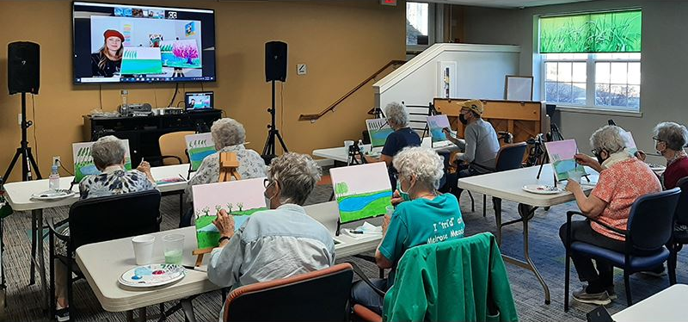
Connected for Life – Requirements
A stable internet connection for participating in a live program on Zoom.
A central large screen/projection or individual screens connected to the internet for participants to watch.
A web cam and a microphone so that we can hear and see participants through Zoom. Speakers are helpful so that participants can more clearly hear us. This will help us and the participants with engagement. If you have questions about equipment, please let us know.
FOR LARGE GROUP PROGRAMS:
Microphones should not be muted, and camera(s) should be facing residents so that we can see their faces. This helps with engagement since they will be seeing us as well.
A SLC staff member must stay in the room during programming to help with set-up and questions during the program. It is often difficult for us to hear participants who are sharing one microphone or see raised hands from participants who are sharing one camera, so we rely on staff to help us with engagement.

Slide 10
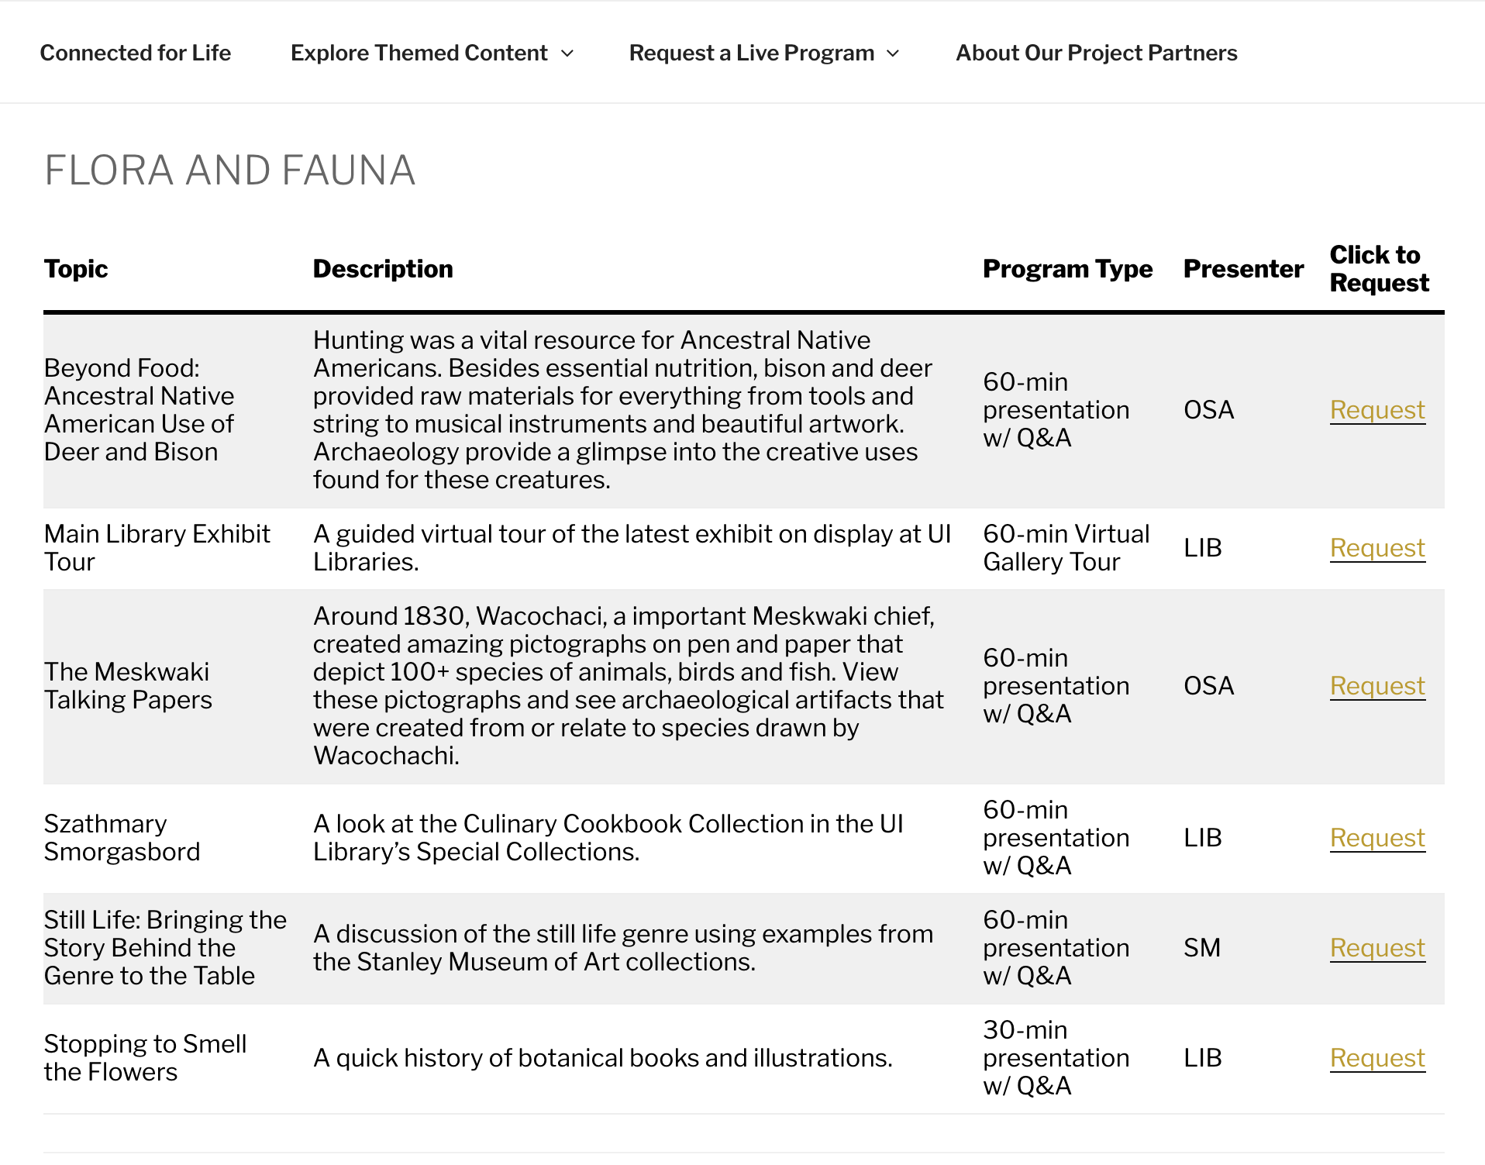
Connected for Life – Programs
Livestream and Pre-recorded
Collaborative and Individual Unit
30 and 60-minute Discussions, Lectures, and Gallery Tours by theme:
  Agriculture
  Exploration
  Flora and Fauna
  Identity
  Fashion

Slide 11
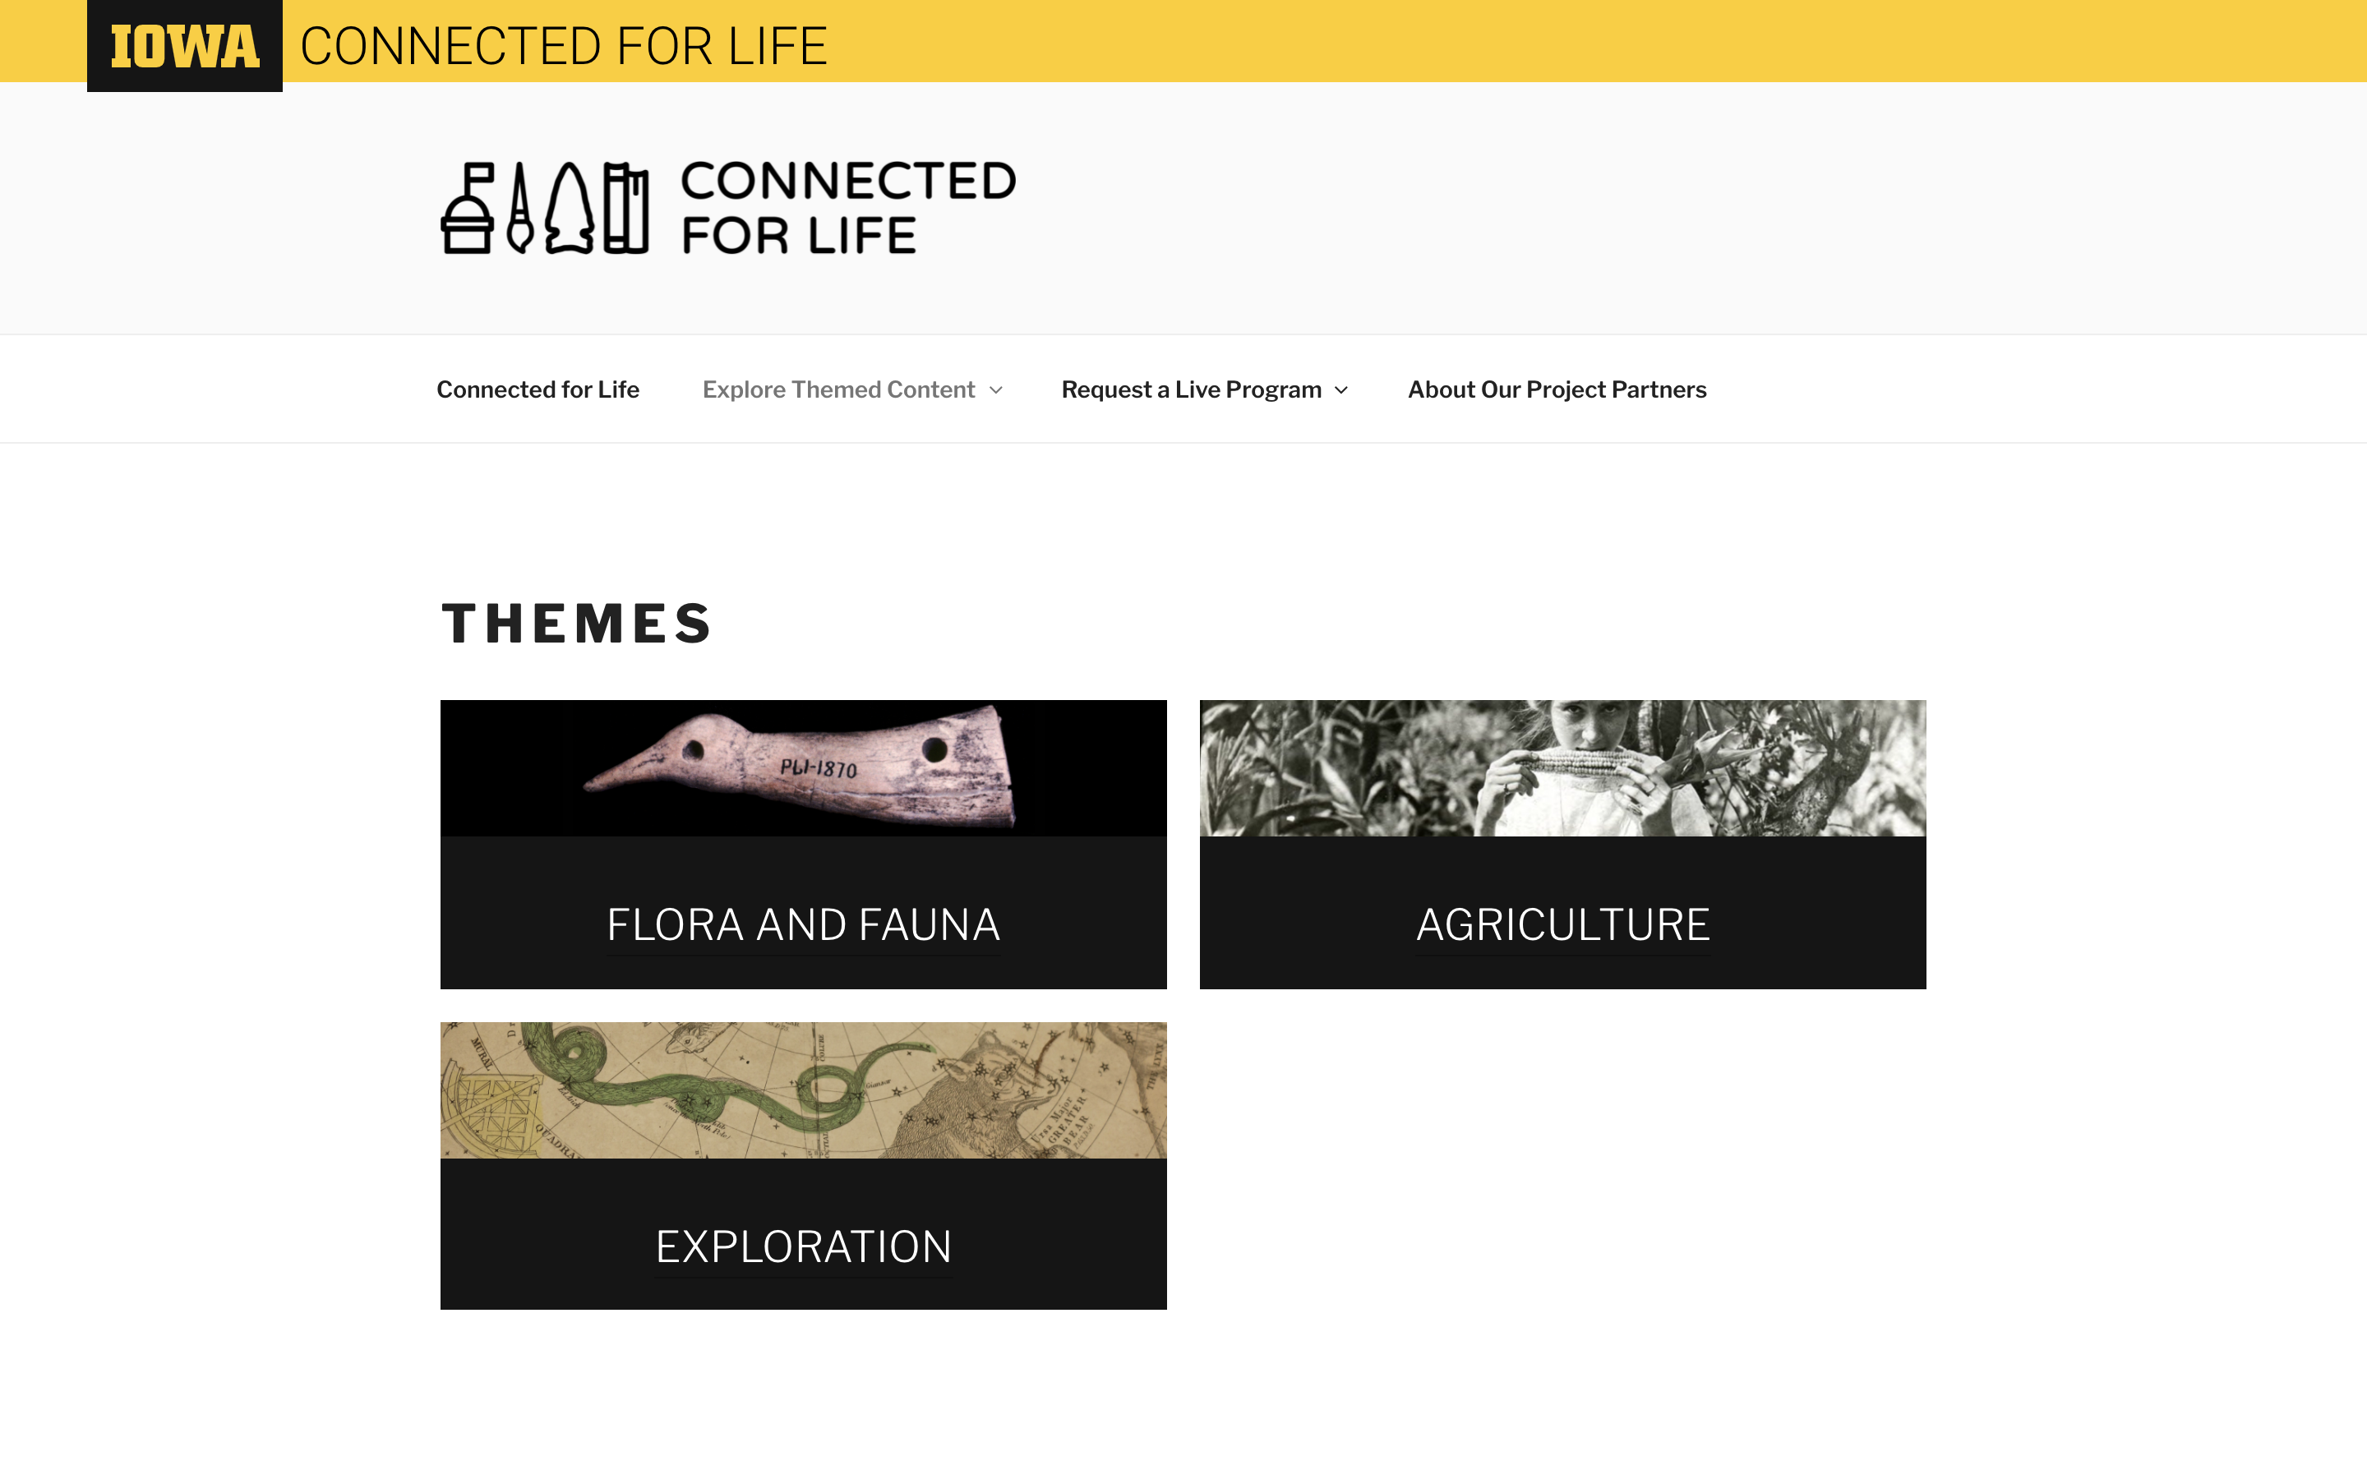
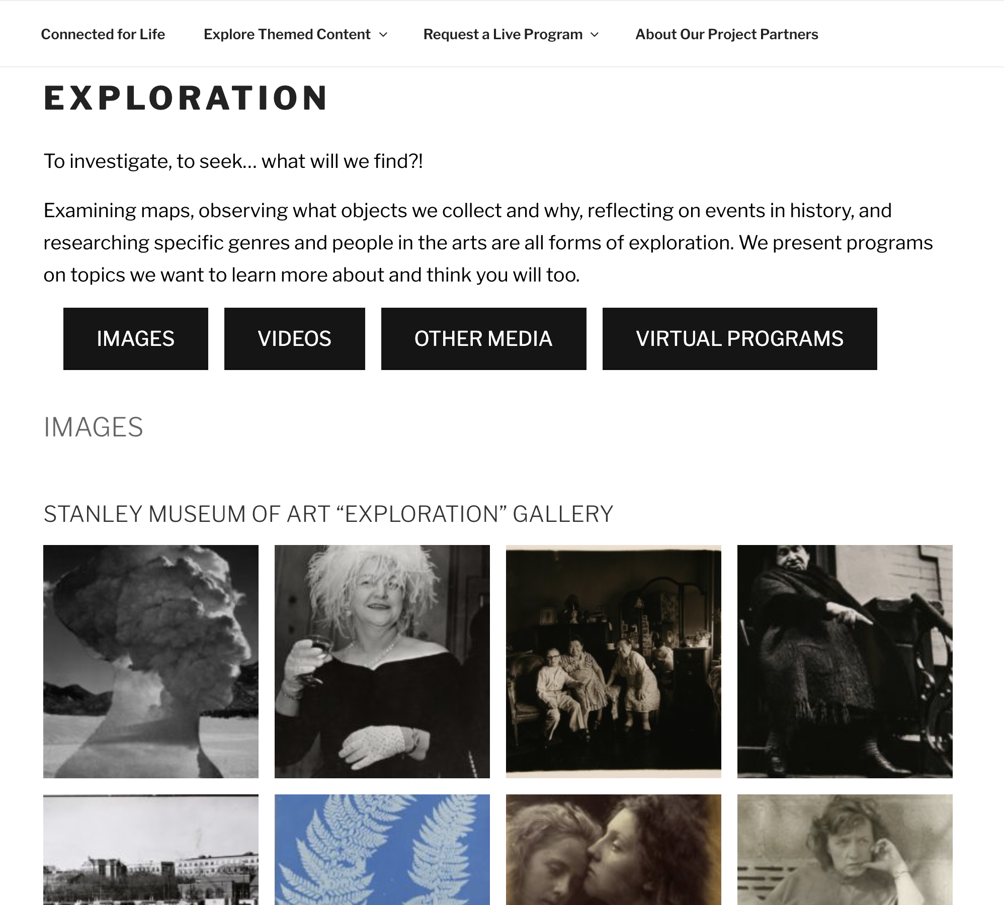
Connected for Life – Technology and Accessibility
lifelonglearning@lib.uiowa.edu

Slide 12
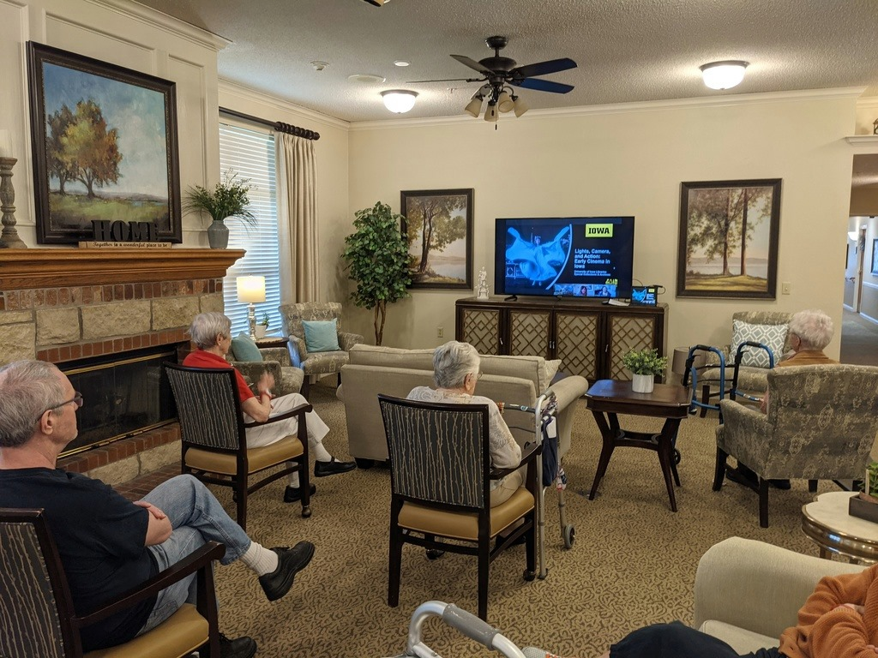
Connected for Life – Technology and Accessibility
Equipment
  Think Link software
  Laptops
  Microphones
  Light Rings
  Tabletop document camera
  Camera for image capture
Tech Boxes

Slide 13
Connected for Life – By the Numbers
6-11 monthly presentations
54 programs scheduled (January-December 2021)
3 counties
347 participants
5-15 participants in programs
45-60 minutes program length
FREE for all to attend and participate

Slide 14

This project was made possible in part by
AMANDA LENSING
EMAIL ui-connectedforlife@uiowa.edu WEB lifelonglearning.lib.uiowa.edu

