Slide 1
Auditing Accessibility with Remote User Testing
Nora Burmeister, Content Strategy Librarian
Felicity Walston, UX Graduate Research Assistant

Slide 2
Roadmap
Project context
Survey development and details
Participant recruitment and support
Analysis of results
  Mapping testing standards to VPATs
Communicating our findings with vendors
  Vendor responses and feedback
Presentation resources and links available at go.unc.edu/accessaudit

Slide 3
Where We Started
When COVID-19 hit, many UNC-Chapel Hill Libraries employees needed remote tasks. The UX department saw an opportunity for these employees to perform remote accessibility testing of subscription e-resources with freely available digital accessibility evaluation tools.
You’ll gain:
An understanding of our e-resource accessibility audit process
Further familiarity with the standards, guidelines, and laws related to digital accessibility
Strategies to assess and advocate for accessibility with your e-resource vendors
Notes:
NORA

Slide 4
Context & Definitions
Americans with Disabilities Act: The Americans with Disabilities Act is a federal civil rights law that prohibits discrimination against people with disabilities.
Section 508: This section of the federal Rehabilitation Act requires federal agencies to use information and communication technology that is accessible to people with disabilities.
WCAG 2.0: As of January 2018, Section 508 uses WCAG 2.0 AA level accessibility as the standard to define accessibility in digital spaces.
Digital Accessibility: Optimizing digital environments to be navigable and accessible to all users, regardless of ability level.
VPAT: Voluntary Product Accessibility Template. Vendors can complete these to assess their product on WCAG 2.0 standards.

Slide 5
Recruitment
COVID-19 restrictions on physical, in-person work meant many library staff needed work that could be done remotely.
Recruited participants through UNC Libraries Work From Home project group, matching staff with time for remote work with remote projects.
Total participants for this project: 20 project members (both staff and student employees)
Notes:
NORA

Slide 6
Supporting Participants
Teams site
  Created a Microsoft Teams site to facilitate conversation, file sharing among project members
  Project description, survey links provided through shared Teams tab
Training and support
  Developed a VoiceOver training video to show testers what to look for (readability, alt text on images, formatting of headings, and readable links)
Notes:
NORA + FELICITY

Slide 7
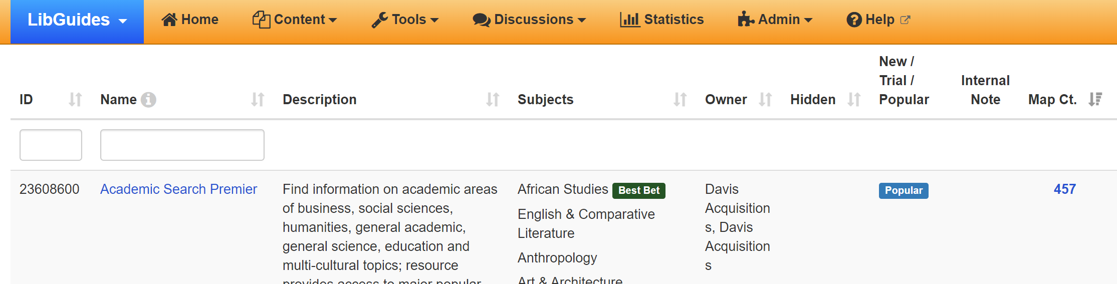
Survey Development
Databases selected for evaluation based on total number of LibGuide mappings
Standards selected based on ease of evaluation. Standards needed to be clear-cut and able to be evaluated without inspecting the resource code.
Surveys were developed and delivered through institutional Qualtrics subscription. Results were collected anonymously.
Each survey evaluates 8 resources. Each resource is evaluated on 6 accessibility criteria.
Notes:
NORA

Slide 8
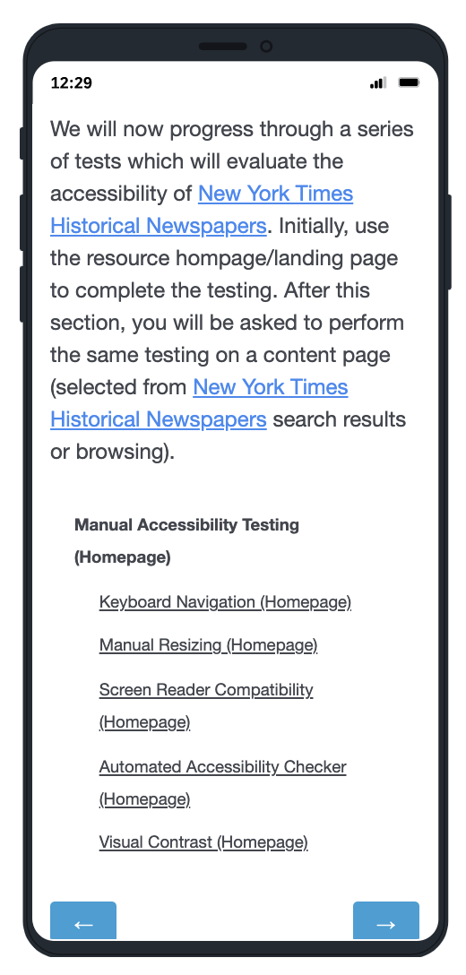
Survey Details
For each resource, testers visited the homepage and a random content page
Criteria tested:
Keyboard navigation
Focus indicator visibility
Manual resizing
Screen reader compatibility
Color contrast
PDF content availability
Results were entered into a Qualtrics survey
Notes:
NORA

Slide 9
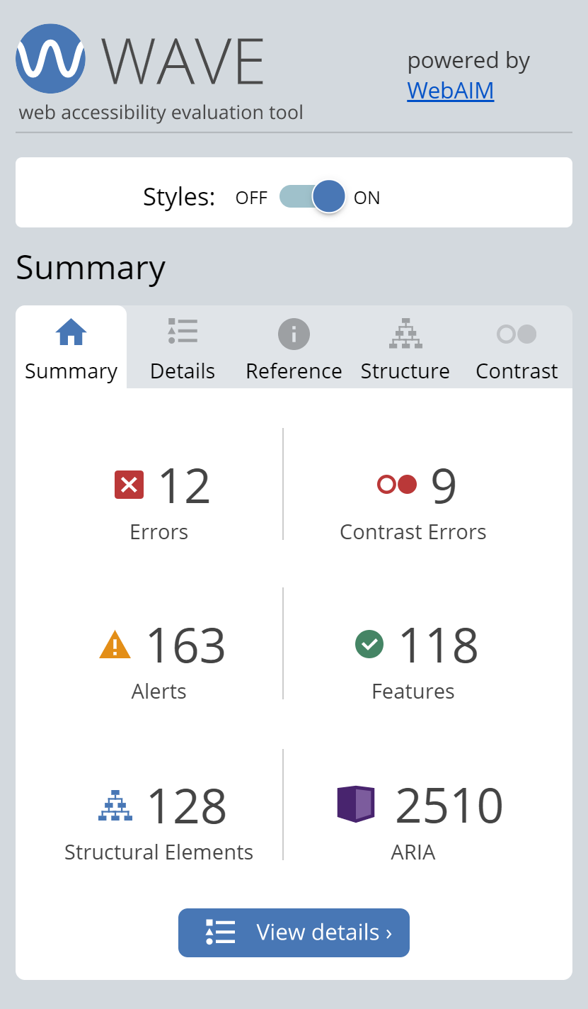
Free Assessment Tools
NVDA screen reader - a free screen reader from NV Access
WAVE accessibility checker - a browser extension that allows you to see accessibility errors on a page
WCAG color contrast checker - a browser extension that allows you to check the color contrast on a page
Snipping tool (or other screen capture tool) - a program that allows you to capture a portion of your screen as an image

Slide 10


By The Numbers
Total surveys completed: 582
Total number of general resources evaluated: 80
Total number of video resources evaluated: 33
Total length of project: ~1 year

Slide 11
Metrics & Analysis
Development
Some recurring issues on every resource
More critical issues appeared on fewer resources
Creating Deliverables
Turned accessibility audit results into one-page summaries of each resource
Notes:
FELICITY

Slide 12
Sample Snapshot
Criteria | Specific Issues
Keyboard Navigation | On a content page: one tester could not tab inside embedded PDF
Manual Resizing | [No issues]
Focus Indicator | [No issues]
Screen Reader Compatibility | -On a content page one tester (using NVDA) could not get it to read the embedded PDF; they tried on multiple pages -On a content page: another tester (using NVDA) could not get it to read the abstract
Color Contrast: Lowest Ratio | 2.19:1 for small text
PDF Content Availability | - 1/10 could not find a way to download a PDF of content - 1/9 could not highlight or copy and paste from the PDF

Slide 13
Mapping Testing Standards to VPATs
Keyboard navigation maps to 2.1.1 Keyboard
Manual resizing of content maps to 1.4.4 Resize text
Focus indicator maps to 2.4.7 Focus Visible
Screen reader compatibility maps to 1.1.1 Non-text Content / 1.3.1 Info and Relationships / 4.1.2 Name, Role, Value
Color contrast maps to 1.4.3 Contrast (Minimum)
PDF content maps to 1.4.5 Images of Text
Notes:
NORA

Slide 14
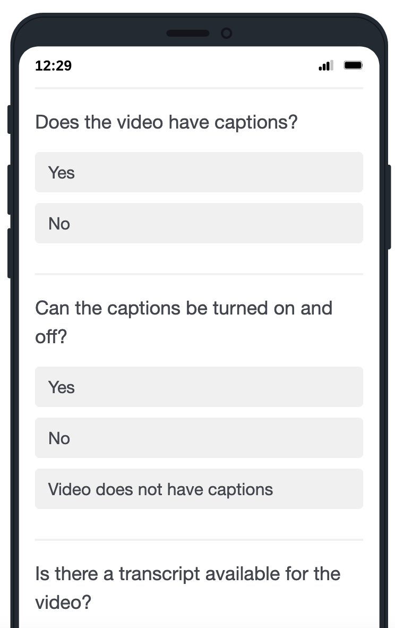
Expanding our evaluations
Implementing the same technique, but on video resources
Sign language translation
Criteria:
Captions
Transcript
Audio description
Notes:
FELICITY

Slide 15
Communications with Vendors
Composing emails to each vendor listing issues found with their resources and the matching WCAG standards
Working with Resource Acquisitions & Management department to locate vendor contacts
Tracking vendor responses in shared documents
Notes:
NORA + FELICITY

Slide 16
Snapshots of Positive Vendor Responses
Wiley:
"We welcome any additional input or priorities specific to UNC-Chapel Hill Libraries which you would like us to consider. I have passed along your audit findings to our product team as this level of detail will be helpful to them as they work toward WCAG 2.1 compliancy. I would like to share where we are in this process."
EBSCOhost:
"I have a team working specifically on EBSCOhost accessibility for the next 2 weeks, and may be able to send this one along to them to fix quickly if I can get some specific details."

Slide 17
Snapshots of Positive Vendor Responses
Infobase:
"First, about what date did the accessibility audits take place for Today’s Science?"
"Second, we want to give you a concrete roadmap that addresses the issues you found."
Social Explorer:
"I wanted to reach out and confirm that we fixed all the issues that were part of your feedback (except map accessibility, which we agreed is a large task and will be done at a later date)."
"Thank you again for your feedback, I really appreciate the fact that somebody is using and checking our accessibility - it makes all the effort we put in really worth it."

Slide 18
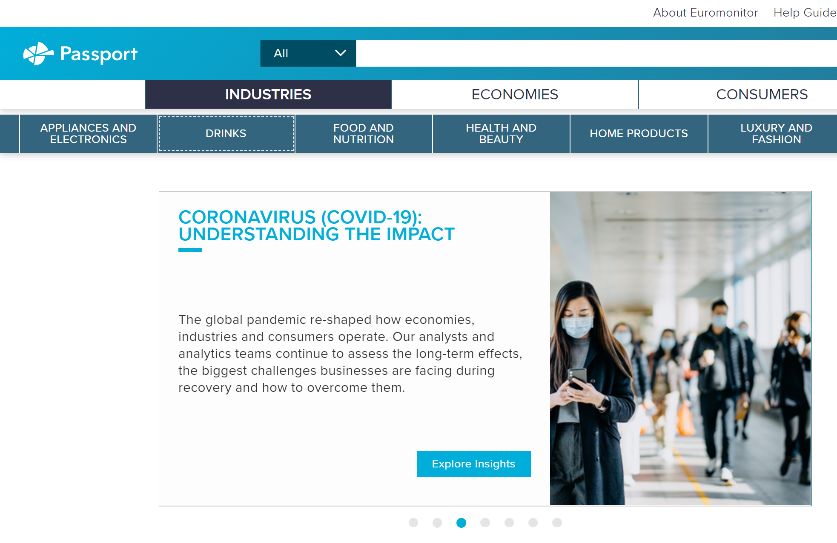
Snapshots of Positive Vendor Responses
Passport GMID:
We saw prototypes of specific changes made starting Oct. 25:
- Increased screen reader compatibility (e.g. lists and top navigation menu)
- More visible focus indicator
- Increased functionality of tab navigation

Slide 19
Snapshots of Less Positive Vendor Responses
One vendor responded with a sales brochure.
One vendor agreed that their product is not in WCAG compliance but offered no plan to address our accessibility concerns.
Seven out of twenty-three vendors have not responded at all.
This demonstrates vendors' lack of education or understanding about accessibility and WCAG compliance.
We encourage libraries to communicate with vendors on topics of accessibility to continue to boost their awareness and concern.

Slide 20
Communication With Our Librarians
- We are developing a LibGuide to show librarians which resources work well with specific assistive technology tools.
- Librarians can prioritize resources with minimal accessibility issues.

Slide 21
Takeaways
Evaluating electronic resources is a way to give remote workers productive tasks with relatively low start-up time. Qualtrics was a useful tool to standardize accessibility evaluation.
Some vendors are highly responsive to feedback regarding the accessibility of their products and will gladly meet to discuss issues and remediation in depth. We are pleased to see that many larger vendors have positions or working groups dedicated to improving the accessibility of their interfaces.
Other replies indicate that some vendors need further education on the importance and practical application of accessibility principles. Advocacy from subscribing institutions is instrumental to convincing vendors of the necessity of digital accessibility.
Notes:
NORA + FELICITY

Slide 22
Thank you!
Contact us:
Nora Burmeister
nkburm@email.unc.edu
@norakb
Felicity Walston
felicity@email.unc.edu
Resources:
eResource Accessibility Testing Survey Template
Accessibility Testing Tools
Sample Vendor Contact Letter
Presentation resources and links available at go.unc.edu/accessaudit

