Slide 1

Florida Atlantic University Libraries
State of the Collections Budget
and
Faculty Perceptions
Presentation of
Carol Hixson, Dean of University Libraries
February 16, 2018

Slide 2
Budget for Collections
Rate of Inflation for Library Collections (Print & Electronic)
  7-10% annually
  83.8% over last ten years
FAU Libraries Budget for Collections
  2008 $ 3 million
  2017 $3 million

Slide 3
Budget Needed to Keep Pace with Inflation
$ 5.5 million

Slide 4
Other Changes Affecting Collections
Scholarly output increasing (doubling every 9 years)
  Able to buy smaller and smaller percentage of scholarly output
Greater reliance on electronic content
  Easier for publishers to produce and market electronic
  User preference in many cases (anywhere, any time access)
  Space considerations (we’re not getting new buildings)
  Consortial pricing packages are often advantageous
  However, prices for electronic access rising faster than the rate of inflation (eating up more of the collections budget just to maintain current subscriptions)
Notes:
“Bibliometric analysts Lutz Bornmann, at the Max Planck Society in Munich, Germany and Ruediger Mutz, at the Swiss Federal Institute of Technology in Zurich, think they have a better answer. It is impossible to know for sure, but the real rate is closer to 8-9% each year, they argue. That equates to a doubling of global scientific output roughly every nine years.”

Slide 5
How Have the Libraries Been Coping?
Reducing the amount spent on monographs
  Since FY 13/14: 47% less spent on print books, 86% less spent on e-books, 69% less spent on books overall
Supplementing the collections budget with salary savings
  Already used $144,000 to keep T&F going this year
  Allocated $150,000 before the end of this fiscal year for print books
  Asked to keep aside $300,000 to put into collections next year
Supplementing the collections budget with Technology Fee proposals
  This year, 10 of 19 Tech Fee proposals were requests to purchase scholarly content, for a total of $715,859
  Last year, we were awarded $159,889 for four proposals to purchase scholarly content

Slide 6
Faculty Needs and Perceptions
Faculty Survey Opened September 19; Closed October 23
  Questions on collections and services
Responses from 385 FAU faculty
  Across all Colleges, disciplines, and campuses
  All ranks of faculty responded

Slide 7
In general, how often do you use the library's electronic services or resources from your office, home or other off-campus location?

Slide 8
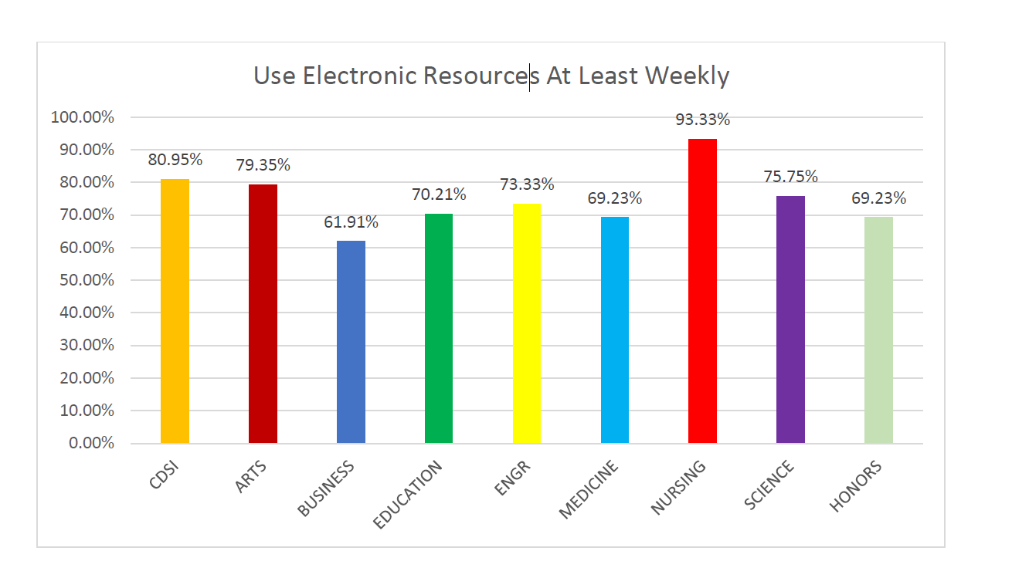
Use E-Resources at Least Weekly by College

Slide 9
If the library’s electronic resources were to be significantly reduced, how much would this affect your:
  Very Significant or Significant Impact on:
    Teaching 80.34%
    Research 90.86%
    Remaining at FAU 63.08%
Notes:
One comment: “Why would you even consider this?” The information on the state of the budget makes clear that we are being forced to consider it

Slide 10
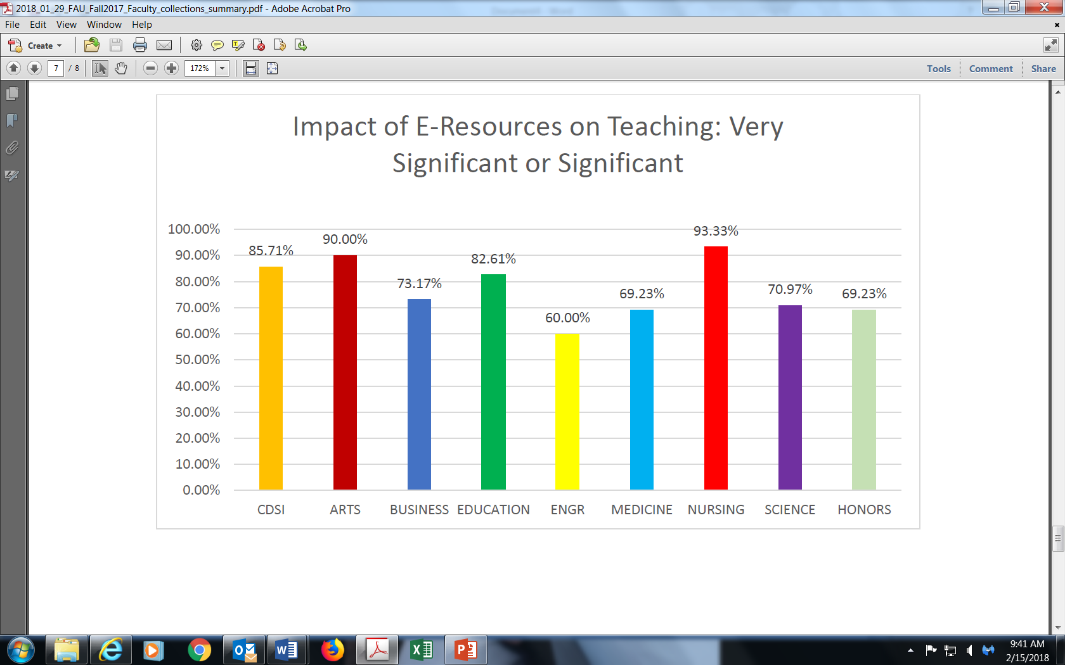
E-Resource Impact on Teaching by College

Slide 11
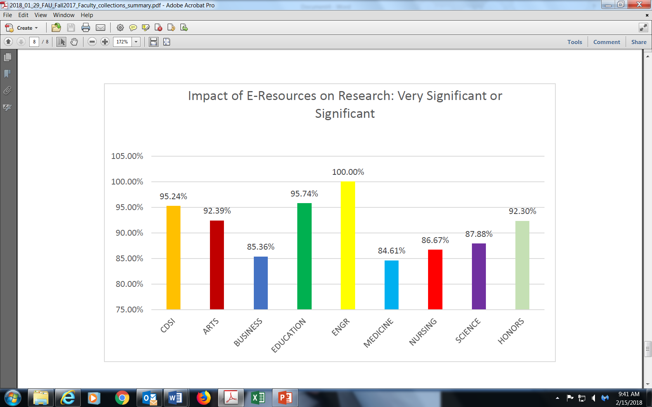
E-Resource Impact on Research by College

Slide 12
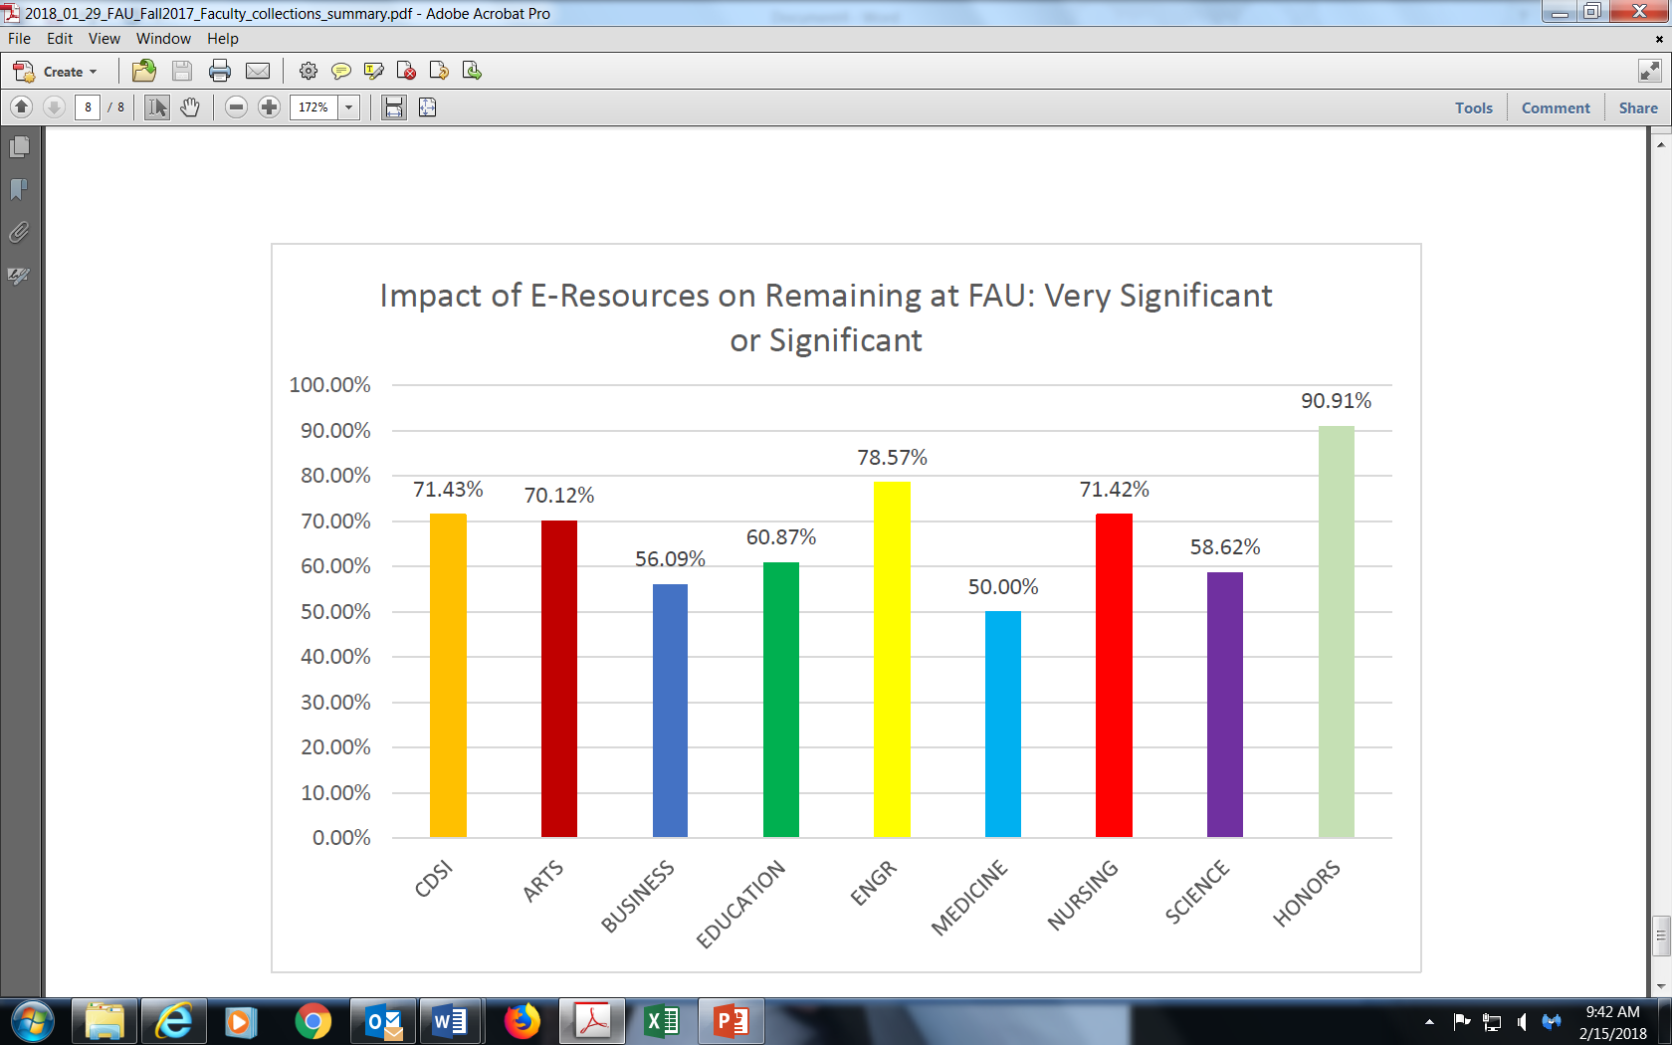
E-Resource Impact on Remaining at FAU by College

Slide 13
In general, how often do you use the library's print resources (books, journals, etc.)?

Slide 14
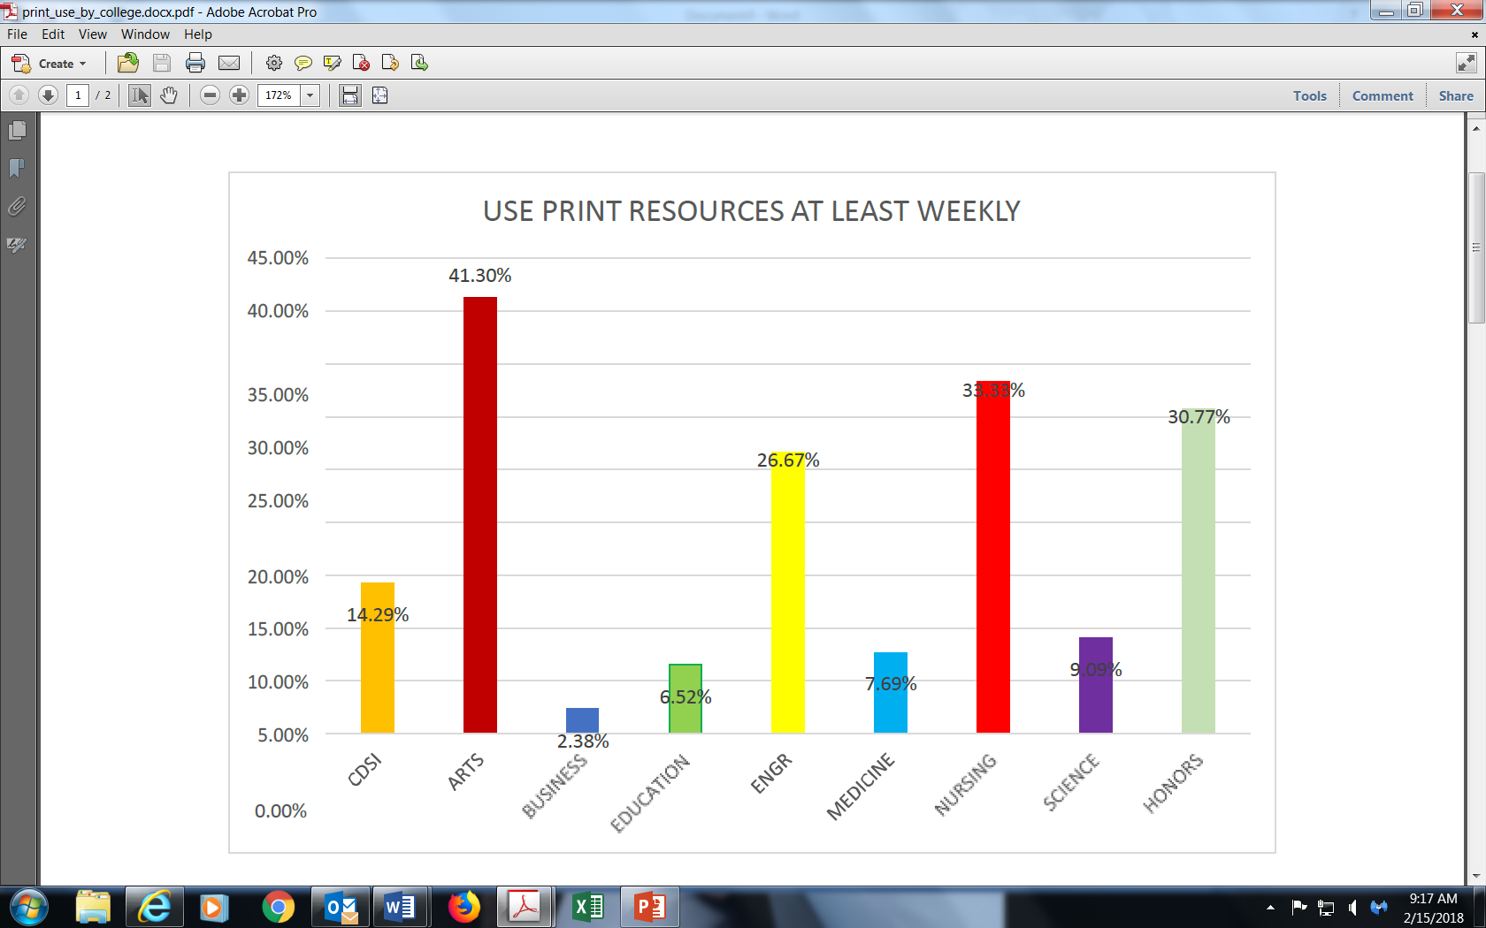
Use print at least weekly by College

Slide 15
If the library’s physical collections were to be significantly reduced, how much would this affect your:
  Very Significant or Significant Impact on:
    Teaching 61%
    Research 67%
    Remaining at FAU 46%

Slide 16
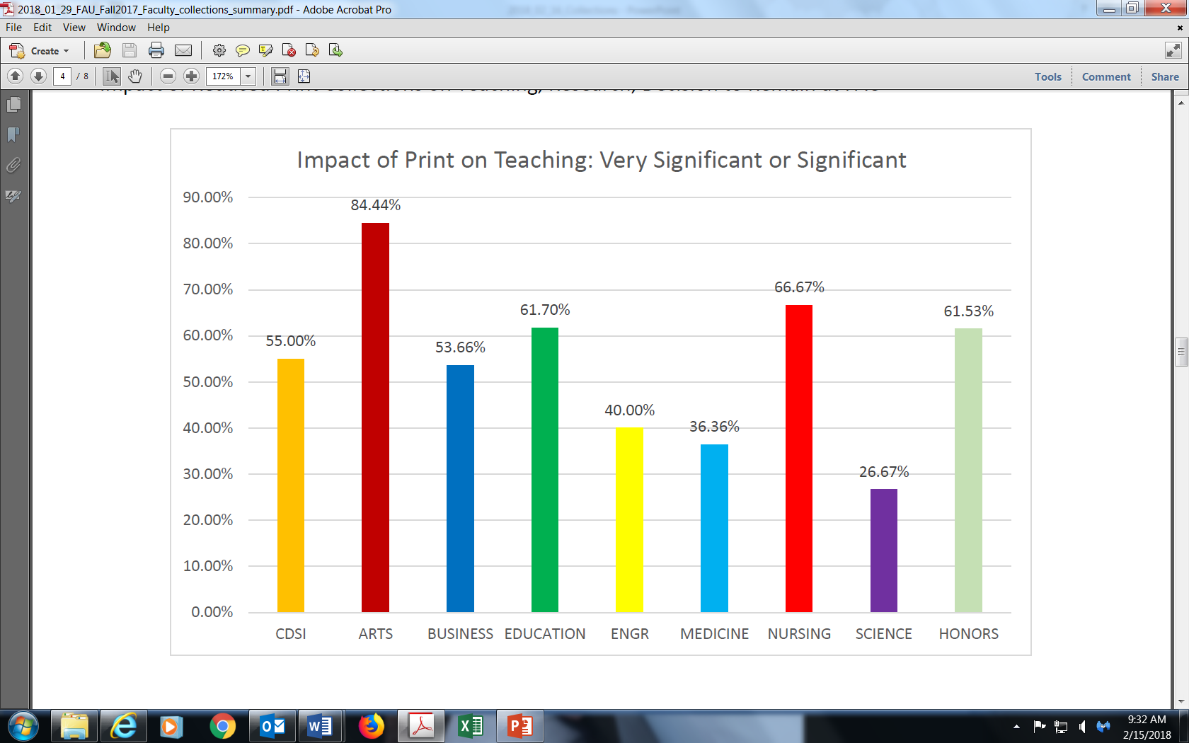
Impact of Print on Teaching by College

Slide 17
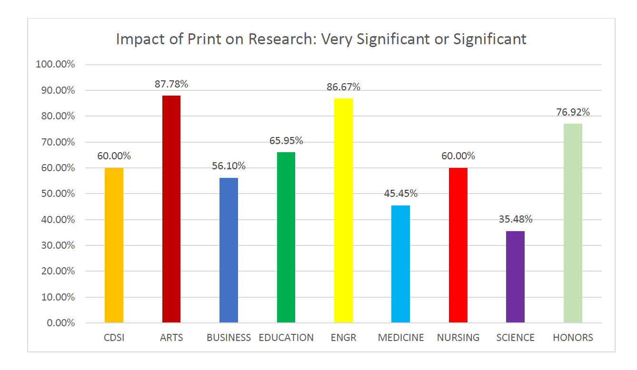
Impact of Print on Research by College

Slide 18
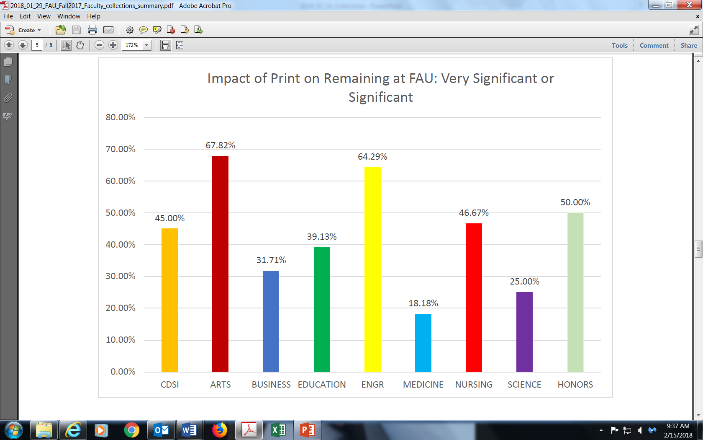
Impact of Print on Remaining at FAU by College

Slide 19
Questions and Comments
Contact information:
hixson@fau.edu
7-3717

