Slide 1

Bridging The Gap:
Aligning Funder Goals And Newsroom Realities In Philanthropic Support For Local Journalism
Damian Radcliffe (University of Oregon)
April 2016
2026 Local Journalism Researchers Workshop

Slide 2
Project origins
Post-COVID era willingness to federally fund journalism
Growing interest in role of philanthropy
New entrants e.g., Community Foundations
Increasing state-level conversations
Newsrooms increasingly moving away from advertising-dependency

Slide 3
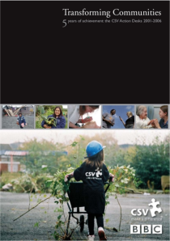

Shaped by concerns + Past experiences
Risk of new funders reinventing the wheel.
Are funders and newsrooms speaking the same language?
  Editorial firewalls
  KPIs + measuring success
  Administrative / reporting burdens
  Timeline of investment (and exit)
Reduction in journalism $$$ by Facebook and Google
Saw firsthand

Slide 4

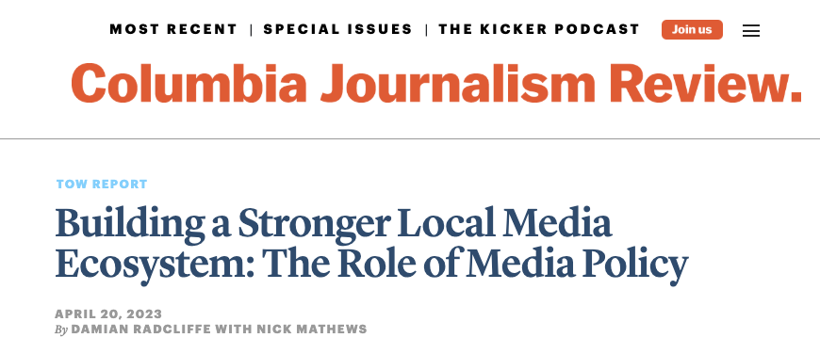
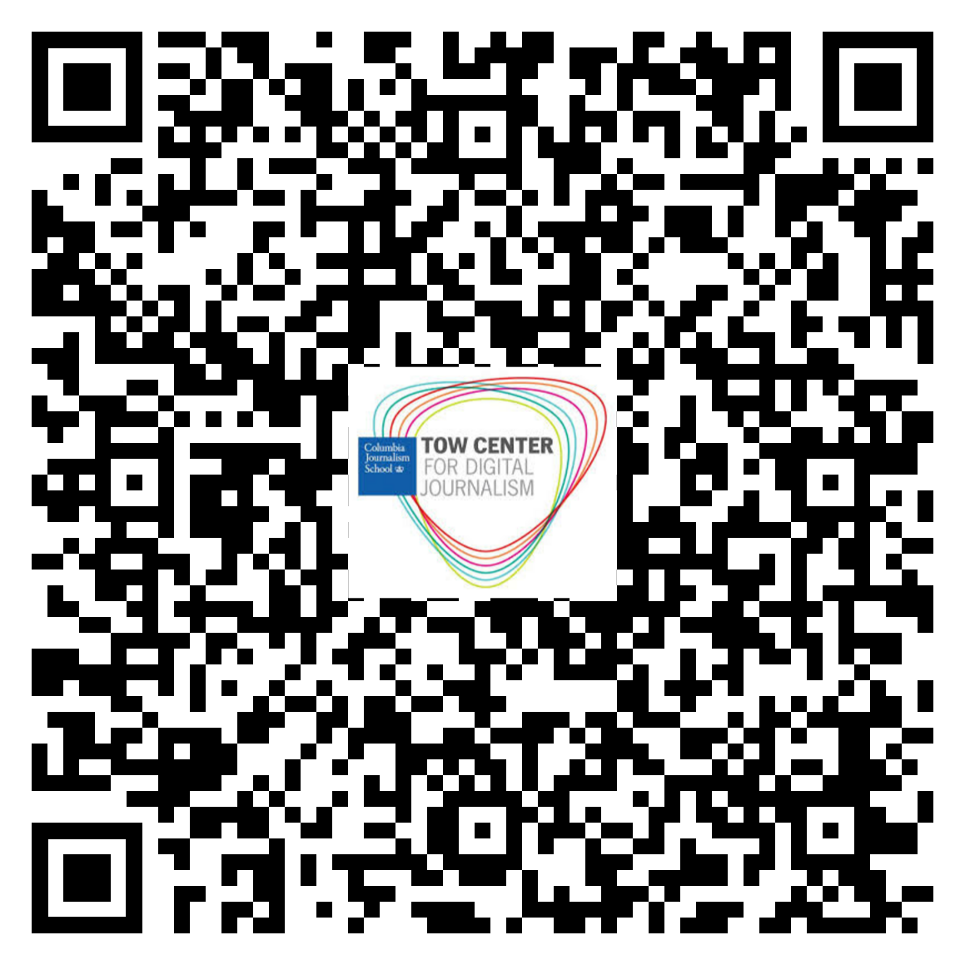
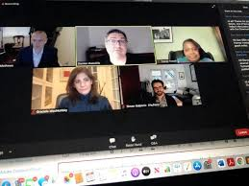
Follow on from previous work, INCL.
Five-part webinar series hosted by the Tow Center between October 2021 and January 2022.
  The webinars set out to address the question: “What role can (and should) media policy play in supporting a strong, sustainable, vibrant local media sector in the United States?”
Subsequent 2023 report.

Slide 5
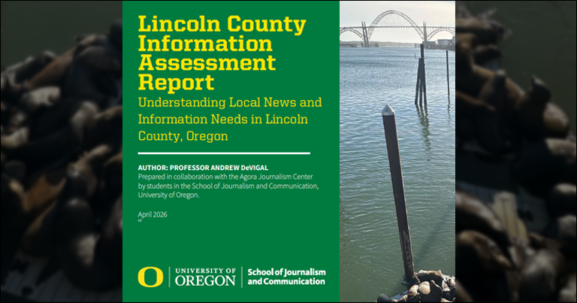
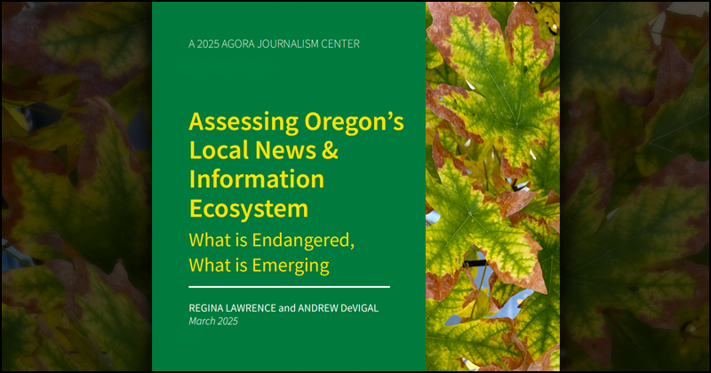
Agora journalism center
The Agora Journalism Center at the University of Oregon’s School of Journalism and Communication is the forum for the future of local news and civic health in Oregon and beyond.
Outputs include:
Hosting the Gather platform for engaged journalism practitioners.
Working to strengthen Oregon’s Local Information Ecosystem – policy, mapping, research.
Assessing local information ecosystems in Oregon communities
Promoting community-centered journalism.
Educating the next generation of journalists.

Slide 6
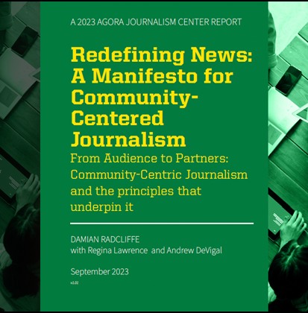
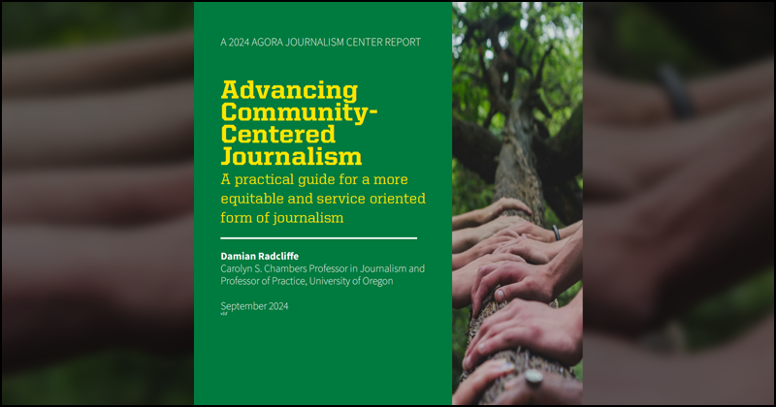

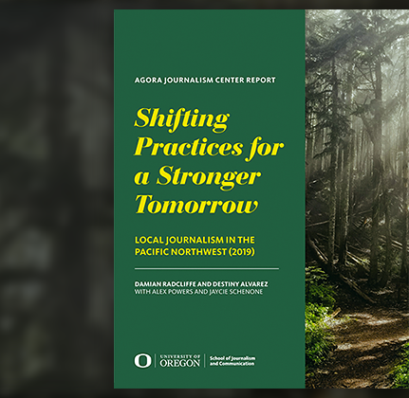
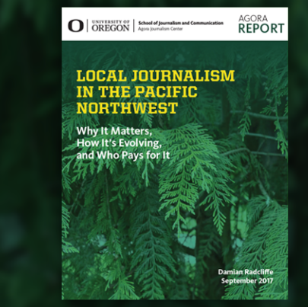
Builds on my previous work for AGORA
Scan the QR code to go direct to the Agora website

Slide 7

approach
20 x in-depth interviews with funders and newsrooms.
Oregon newsrooms as proxy for wider industry.
Iterative interviews.
Goal: Produce a playbook for newsrooms and funders new to this space.
Funders
AJP
Knight
LMA
Democracy Fund
Pivot Fund
Newsrooms
OPB
Oregonian
Underscore News
Eugene Weekly
Lookout Local
Other Experts
Impact Architects
Free Press
Rebuild Local News
And more…

Slide 8
Top three findings
Information disconnects
Shifting strategies
Capacity and timelines

Slide 9

1. Information disconnects
TLDR: Funders often seek quantitative metrics or policy outcomes.
Journalists struggle to quantify concepts like "trust" and "civic health.”
We need to better define – and broaden impact beyond traditional "Capital J" journalism.
    Newsrooms need to better articulate value to audiences and funders. Funders need to understand this is supporting informed communities, not just keeping a newsroom open. (Jim Brady)
    ”Impact" looks different depending on the community being served. (Tracie Powell)
    Newsrooms need to develop impact frameworks not just to satisfy grant reports, but to genuinely inform their own editorial and community engagement strategies (Lindsay Green-Barber)

Slide 10

2. Shifting strategies
How We Were
Risk of financially strapped newsrooms reactively chasing grants dollars. Funder dictates editorial mission.
Recognition that ”all money is not good money” (Tracie Powell). > Be prepared to walk away. If a grant does not align with your core mission, or if the administrative burden outweighs the financial benefit
Where We Are Going
Newsrooms e.g. The Columbian proactively pitching funders. And using storytelling to do so.
Newsrooms must use "community listening" to identify what the audience needs before approaching a funder.
“If you're not solving a community problem, maybe that's partly why you have a business problem.”
(Frank Mungeam)

Slide 11

3. Capacity and Timelines
Recurring issues:
Profound disconnect between the fast pace of news cycles and the slow(er) machinery of philanthropy. News orgs must plan revenue pipelines accordingly. Cultivating a major donor can take three to five years.
Grant Management can be too onerous and negate impact/value of $$$. (Therese Bottomly, The Oregonian)
Newsrooms need to build the basic capacity to seek out, apply for, and manage grants. (Lisa Heyamoto, AJP)
Funders must move away from often highly restricted, short-term project grants and towards flexible, unrestricted general operating support. And funding exits need a longer runway…

Slide 12
Emerging issues / Changing narratives
Mutual Education: Foundations must understand the ethical firewalls and capacity constraints of journalism, and newsrooms must learn the language of impact and long-term donor cultivation.
Shiny Object Syndrome: Legacy, BIPOC and rural outlet often feel left behind as philanthropic dollars flow disproportionately toward trendy digital startups.
The Myth of the "Non-Profit Only" Requirement: Hybrid and for-profit models are also actively utilizing philanthropic support.
Local vs. National: ”News" is often conflated with toxic, partisan, (or pink-slime) content. Outlets must market themselves as non-partisan and invested in local civic good.
Match Making Opportunities About: Newsrooms guessing which funders might support them. Foundations don't know who to fund. What does a Centralized "Clearinghouse” look like?

Slide 13

Looking ahead

Slide 14
BLUEPRINT FOR MUTUAL SUCCESS > Funders
Move away from short-term, highly restricted, or project-specific grants. Transformational impact requires multi-year, general operating support that gives newsrooms the runway to plan and build.
Move at the "speed of news": Funders should streamline application and reporting processes and move with more urgency when issues emerge.
Invest in grassroots and community-led organizations, not just large national intermediaries or the "usual suspects".
Fund capacity, not just content: A newsroom cannot survive on reporting grants alone. Capacity-building support and overheads also need support.
Respect the firewall: Supporting a healthy democracy means accepting that independent journalism might eventually point a critical lens at a funder’s own interests or institutional peers.

Slide 15
BLUEPRINT FOR MUTUAL SUCCESS > NEWSROOMS
Be willing to walk away: Newsrooms must develop the discipline to say no.
Communicate your own impact: Newsrooms must actively market their civic value, explicitly telling audiences and donors when their reporting leads to positive community changes, rather than assuming the work speaks for itself.
Build business and operational capacity: Editorial excellence is not enough. Newsrooms must invest in demonstrating and tracking impact, as part of wider revenue diversification efforts.
Be proactive, not reactive: Don’t wait for an open call… having identified a critical community need, newsrooms can develop a proposition and use their journalistic storytelling skills to pitch funders directly.
Stronger together: By embracing partnerships and collaboration, news outlets can pitch funders on supporting a healthier overall information ecosystem. This can create more impact and moves beyond the notion of philanthropy being used to save a particular news brand.

Slide 16

Ultimately…
As Teresa Gorman from the Democracy Fund points out, this work is not about "saving an industry" but building healthier communities.

Slide 17


Thanks for listening
Ideas and Insights will be explored in more detail in an upcoming report!
Email: damianr@uoregon.edu
X/Twitter: @damianradcliffe
Web: www.damianradcliffe.com
Notes:
http://poster.keepcalmandposters.com/5742859.jpg

