Slide 1
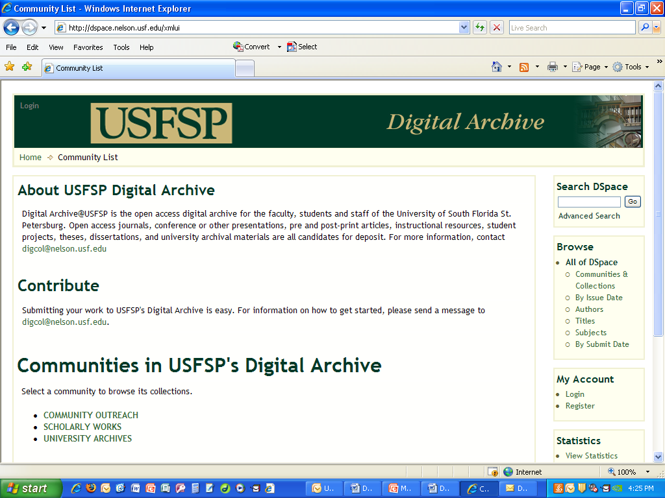
The USFSP Digital Archive:
An Overview
Presented to Chancellor Wisniewska
By Carol Hixson
Dean, Nelson Poynter Memorial Library
July 15, 2013
Notes:
The Library established this archive two+ years ago.
Uses open source software, freely available, most widely used software for this type of archive in the world

Slide 2
Mission of the USFSP Digital Archive
Capture and preserve in digital form the intellectual and administrative output of the university community
  Not just for formal publications
  Not just for faculty
  Open or restricted access to materials, depending on nature and intended use
Provide services for the management and dissemination of digital materials
Increase faculty and student awareness of benefits of open access

Slide 3
Why here and now?
Growing amount of digital content that needs a safe, reliable and easy-to-use home
Need to be able to locate and reference content quickly and accurately
Strengthen our USFSP identity and promote our programs and services
Meet demands of accrediting bodies and funding agencies for ready access to data and information
Provide backup to important records in the event of a disaster

Slide 4
What can a digital archive do?
Highlight individual and institutional achievement
Increase institutional visibility
Improve access to and discoverability of materials
Preserve access to institutional records
Provide opportunities for community engagement
Notes:
These are some of the things that an institutional archive can do – and that ours is doing right now

Slide 5
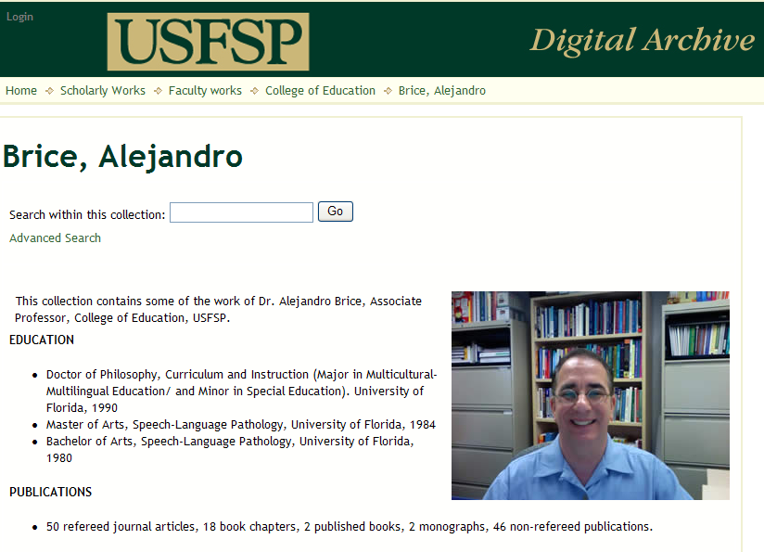
Highlight individual achievement
Notes:
This is one of 62 individual faculty collections we have established in the archive for USFSP faculty.
They all provide an online CV and access to full-text of articles and books, when allowed by copyright.
If not allowed by copyright, we provide an abstract and citation to full text or print publication

Slide 6
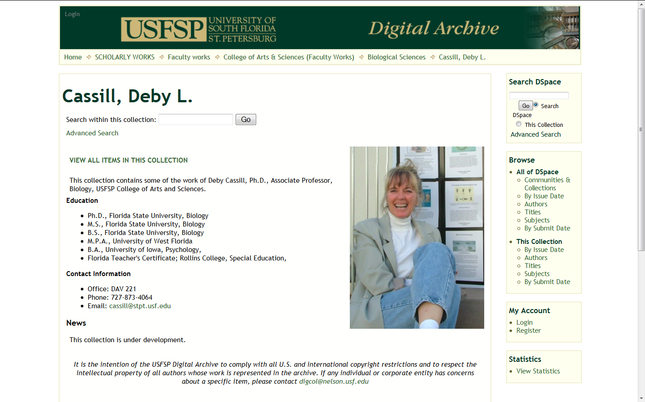
Highlight individual achievement
Notes:
Another of our individual faculty collections. These links are driving people to find the research and scholarship of our faculty.
Faculty are being contacted by publishers and editors who are finding through web searches that draw them into the archive.

Slide 7
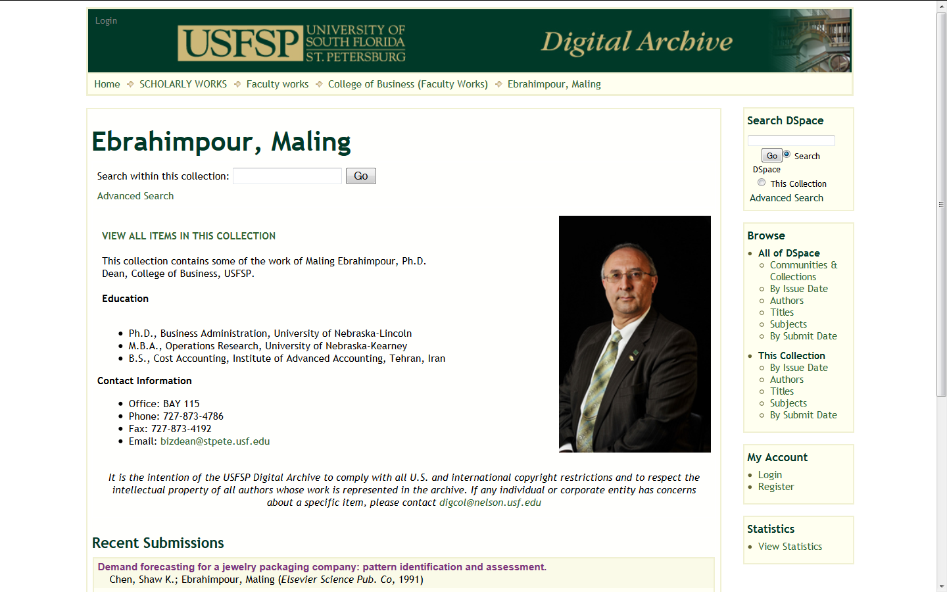
Highlight individual achievement
Notes:
Faculty collections are linked to their college or unit. Individual entries can appear in multiple collections.
For instance, deans may have entries that are both administrative and research-oriented.
A single item can be mapped to different collections.

Slide 8
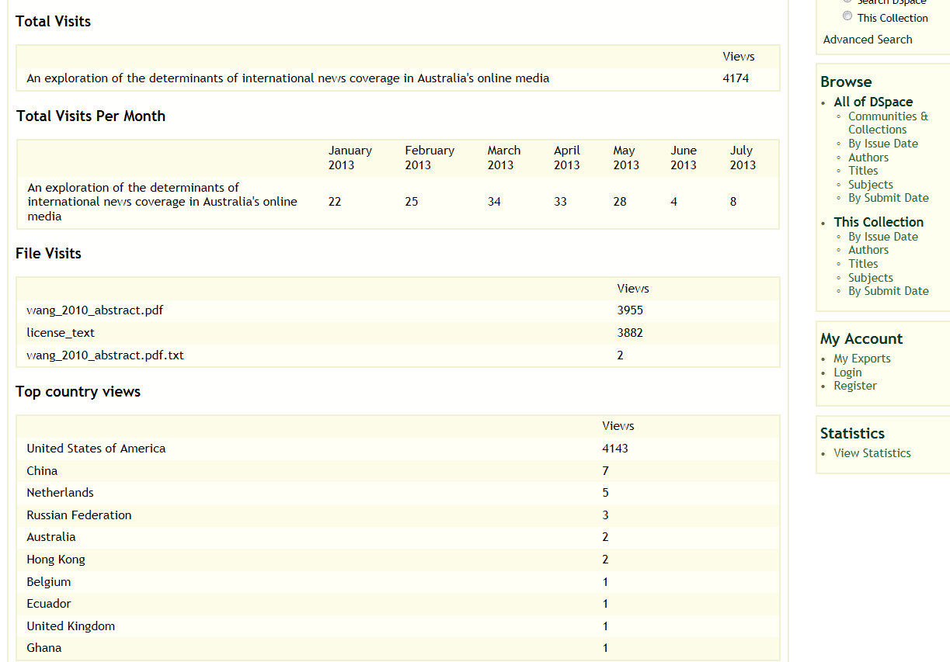
Highlight individual achievement: use statistics
Notes:
Statistics are kept for all content – entire collections, communities or individual items in a collection.
This abstract of an article by Professor Wang has been looked at almost 4200 times.
The amount of exposure far exceeds what most people experience through traditional journals, even when online.

Slide 9
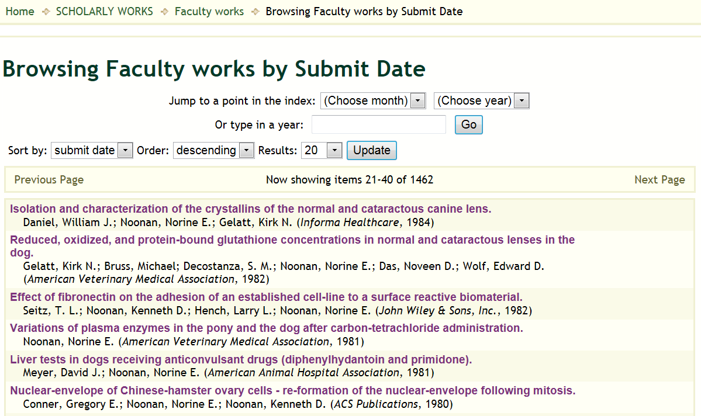
Highlight institutional achievement: record of faculty scholarship
Notes:
This shows that we have almost 1500 entries by USFSP faculty and we have many more faculty to collect.
With one link, we can show the world the depth and range of our faculty’s research and scholarship.

Slide 10
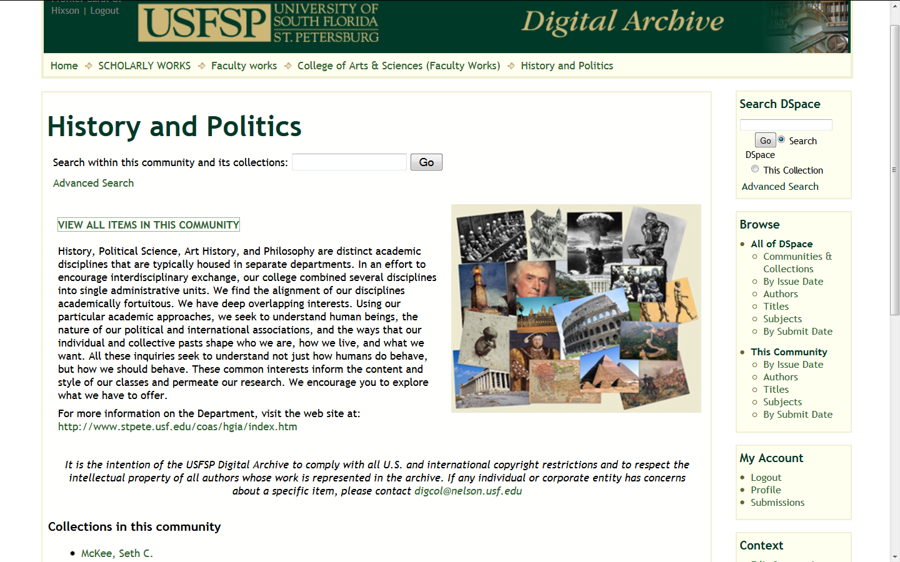
Highlight institutional achievement
Notes:
Academic departments or units can pull the record of their faculty’s achievement together.
We have established collections for all academic departments, the Colleges, and the Library.

Slide 11
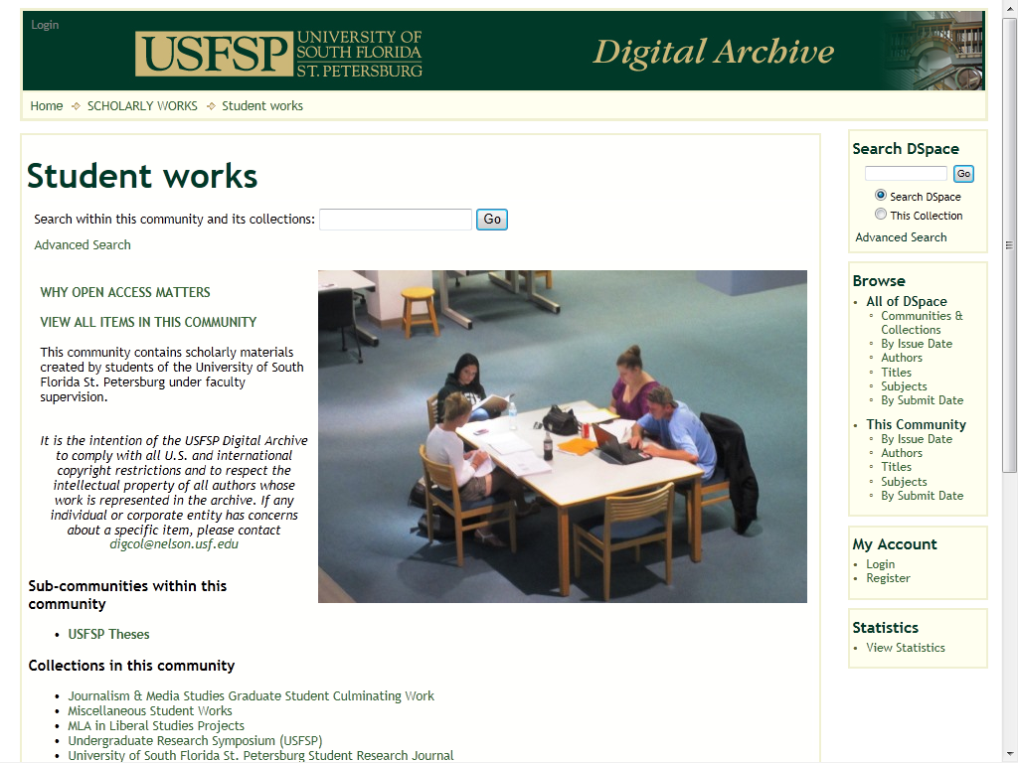
Highlight institutional achievement
Notes:
We have a separate section for student works that has 291 items in it so far.
We are working with departments, Colleges, programs, and individual faculty to capture and archive a wide range of student work that has been vetted and approved by faculty

Slide 12
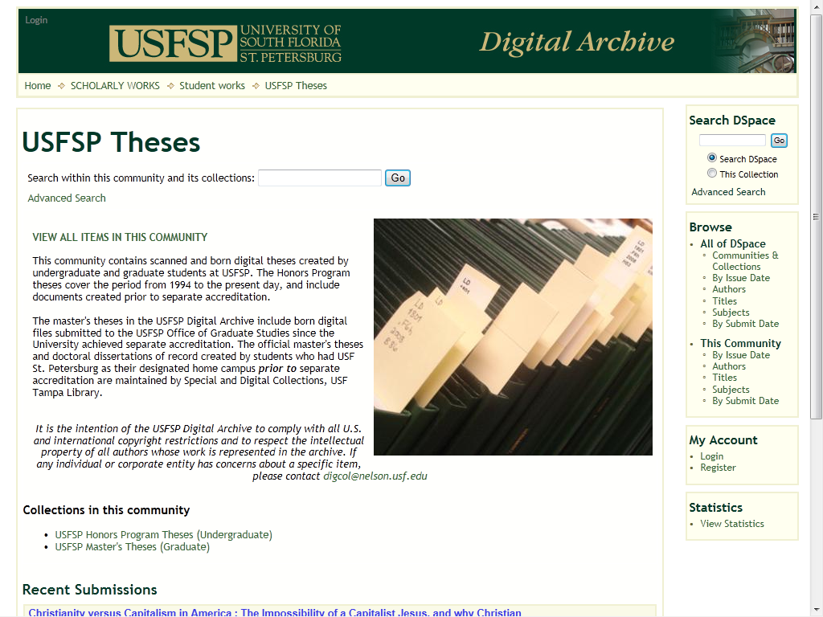
Highlight institutional achievement
Notes:
We have digitized all previous USFSP theses and now collect the new ones in their born digital form.

Slide 13
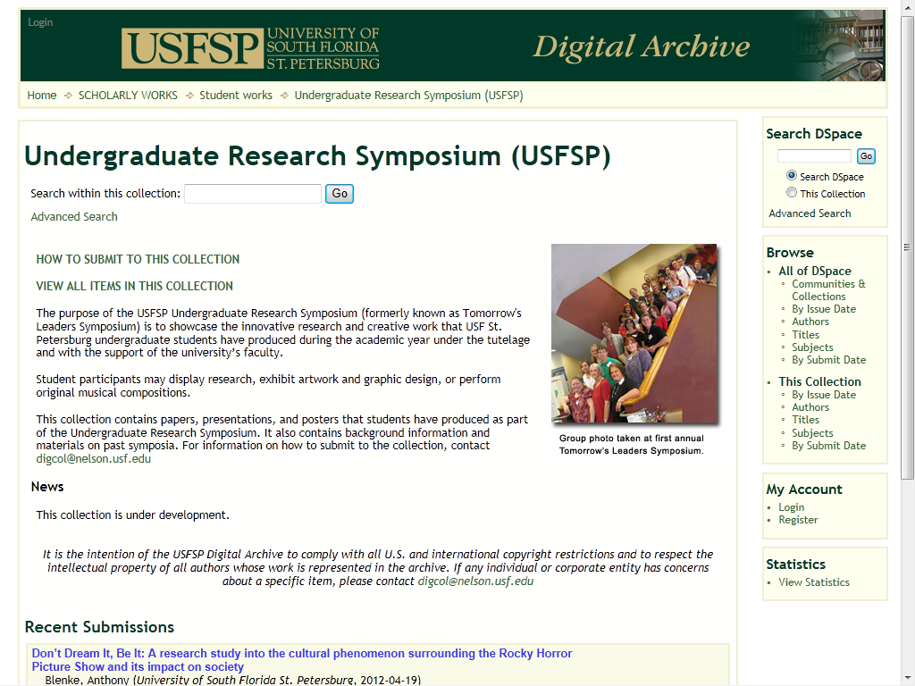
Highlight institutional achievement
Notes:
This was the second year that we provided a space for students to post their research from the Undergraduate Research Symposium.
We work hand-in-hand with the Research Council and faculty sponsors on this.

Slide 14
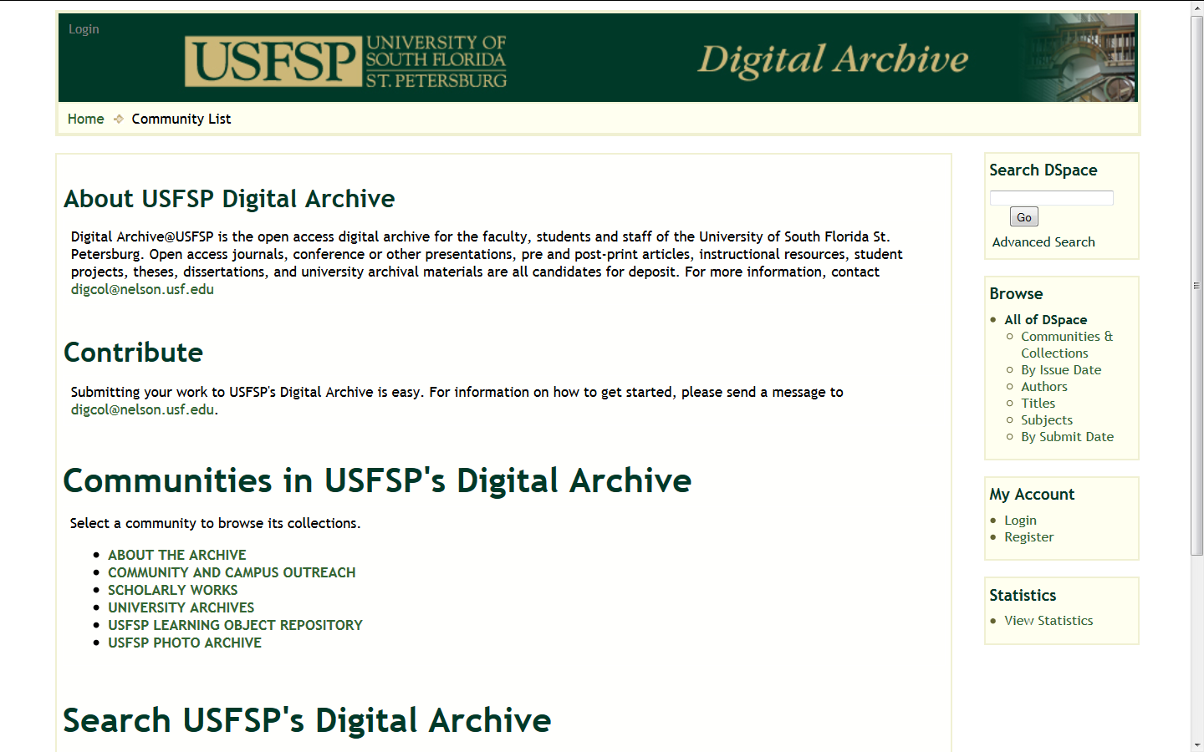
Increase institutional visibility
http://dspace.nelson.usf.edu/xmlui/
Notes:
Our archive has over 6800 items in it so far, reflecting a high degree of buy-in from the campus.

Slide 15
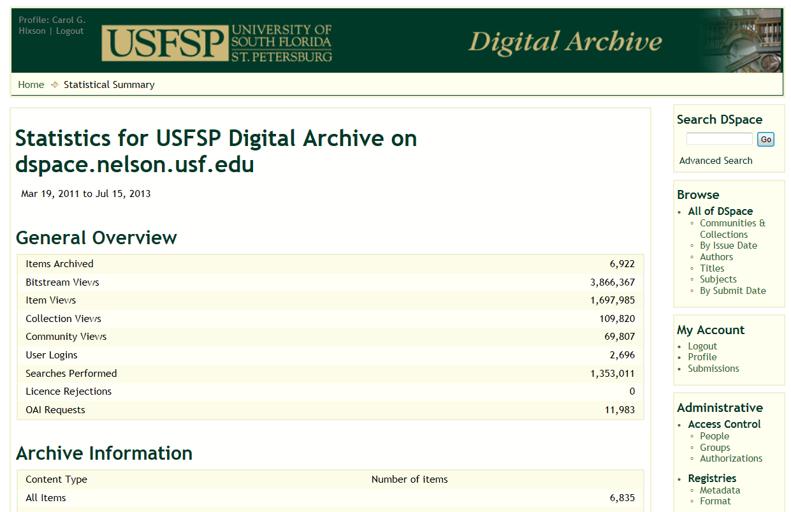
Increase institutional visibility
Notes:
This shows overall statistics for the archive.
The bitstream views (when a file is actually opened) are over 3 million – 3,866,367.
This represents an enormous return on investment – and all without any special advertising.

Slide 16
Increase institutional visibility
Over 6800 items in two and a half years – many items have more than one file
Users of the archive from more than 100 countries and all 50 U.S. states
Findable on Google, Google Scholar and more – people drawn into the archive by searching elsewhere
Uses international standards that are the basis for cross-repository discovery

Slide 17
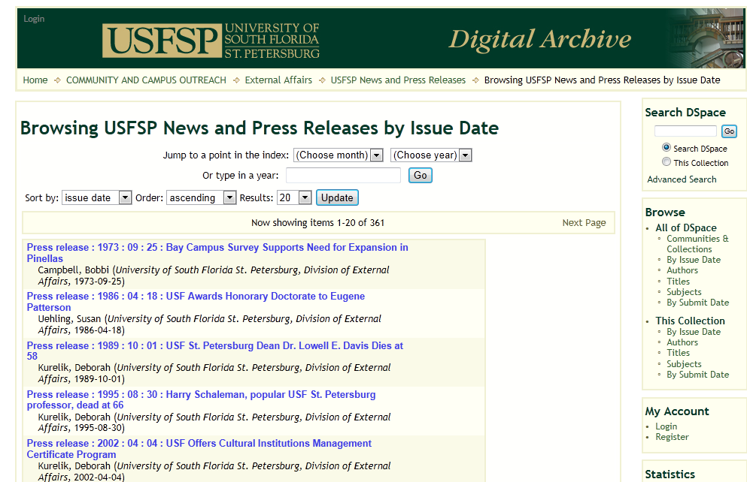
Increase institutional visibility
Notes:
One of the collections we have created has captured old news releases scattered far and wide and now harvests the new ones, providing one place to find them all and providing an additional backup in the event that there is a problem or interruption of service with our websites.
One of the challenges of web sites is that old content is frequently taken down or lost when new content replaces it. Capturing it in the archive ensures continued access over time.

Slide 18
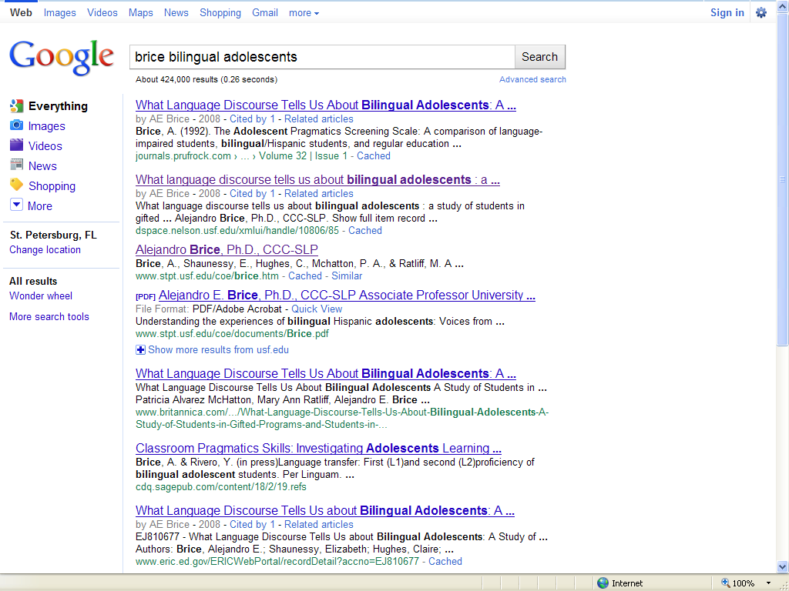
Increase access and discoverability
Notes:
This shows how content in the archive is indexed by Google and others.
People are drawn into the archive when they do searches on the Internet.

Slide 19
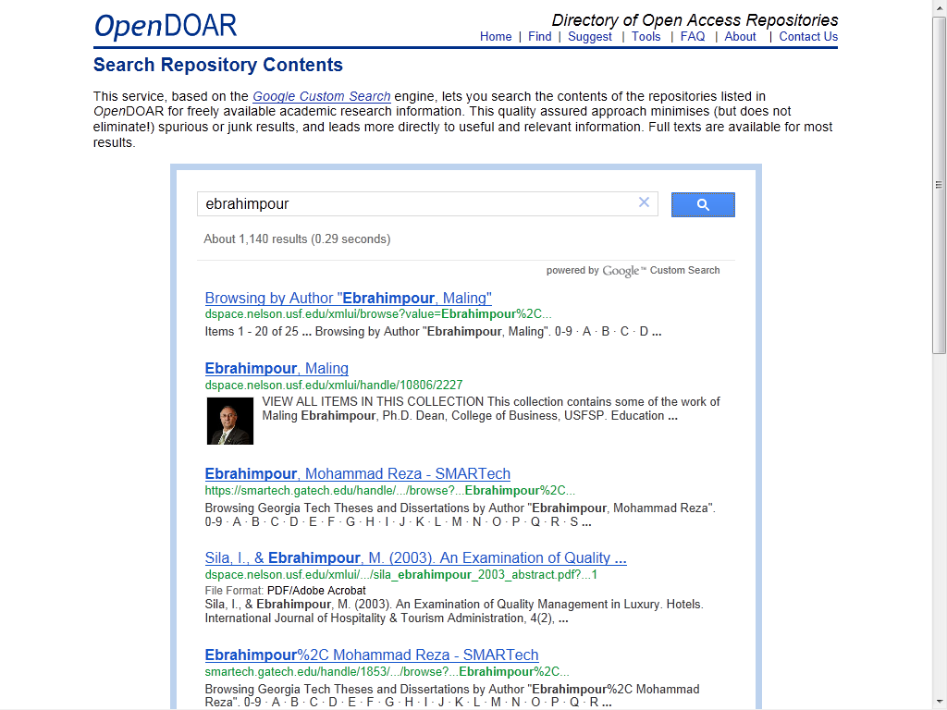
Increase access and discoverability
Notes:
This is one example of a shared repository that indexes all sites that register with it and that use the same set of underlying international standards.
For example, searching under Dr. Ebrahimpour’s name finds his collection in our archive and draws people into our archive.
This is yet another way to get the word out about who we are and what we are doing.

Slide 20
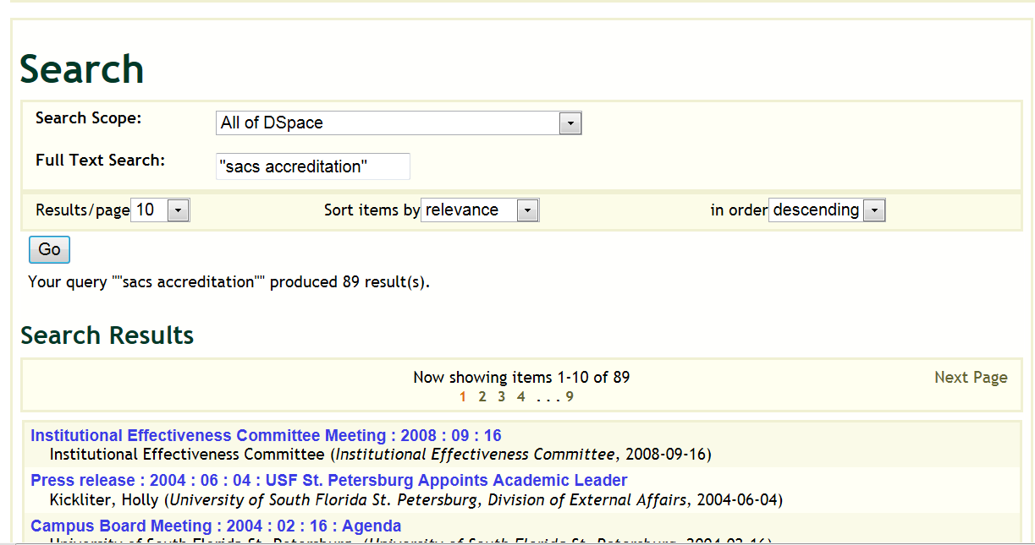
Improve access : full-text searching
Notes:
Every night we run a program to provide full-text indexing of all newly added items.
Searching today (July 15, 2013) on the phrase “sacs accreditation” uncovers 89 items that contain that phrase. Such an archive allows us all to research concepts and issues across the history of the institution

Slide 21
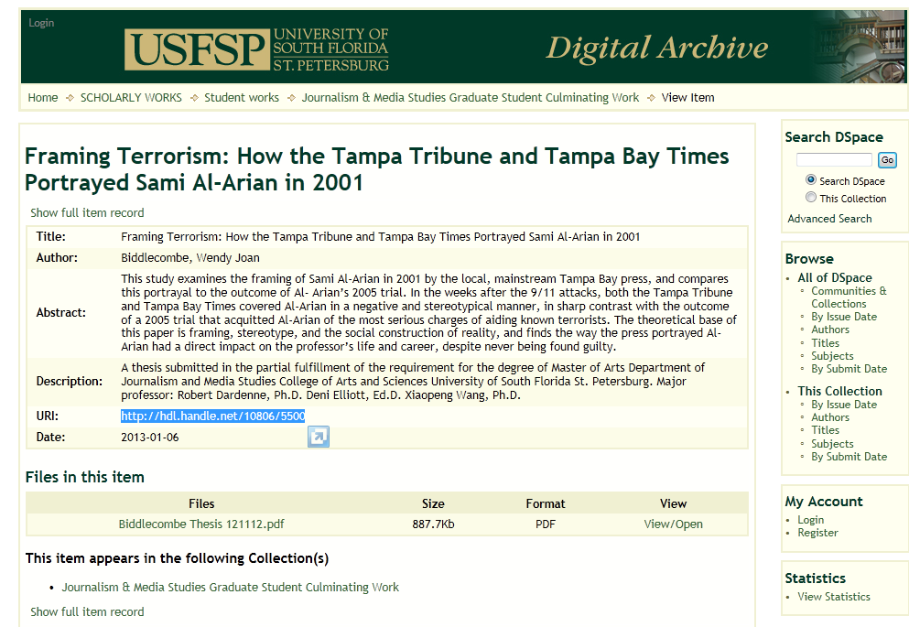
Improve access: stable URLs
Notes:
Everything in the archive – every page, every item, every file is automatically assigned a unique and stable URI, called a handle.
We pay $50 a year to the Corporation for National Research Initiatives for the service that activates these stable identifiers. The Handle System provides efficient, extensible, and secure resolution services for unique and persistent identifiers of digital objects, and is a component of CNRI's Digital Object Architecture.

Slide 22
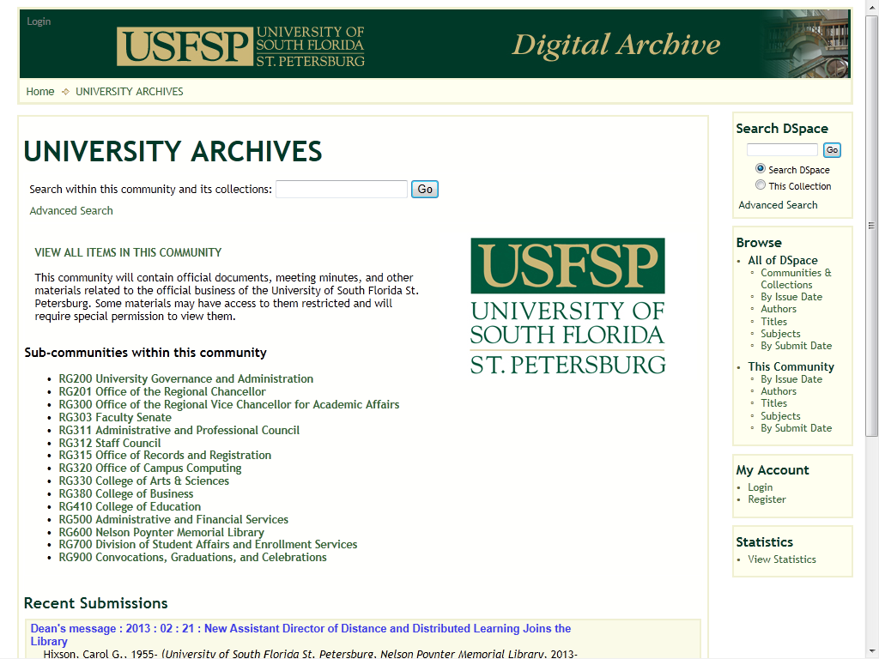
Preserve access to institutional records
Notes:
One entire section of the archive is called University Archives and this is where official documents and records of the business of the University are captured.
There are dozens of collections under these broad headings and we have so far over 3500 items working closely with academic and administrative units of the University.

Slide 23
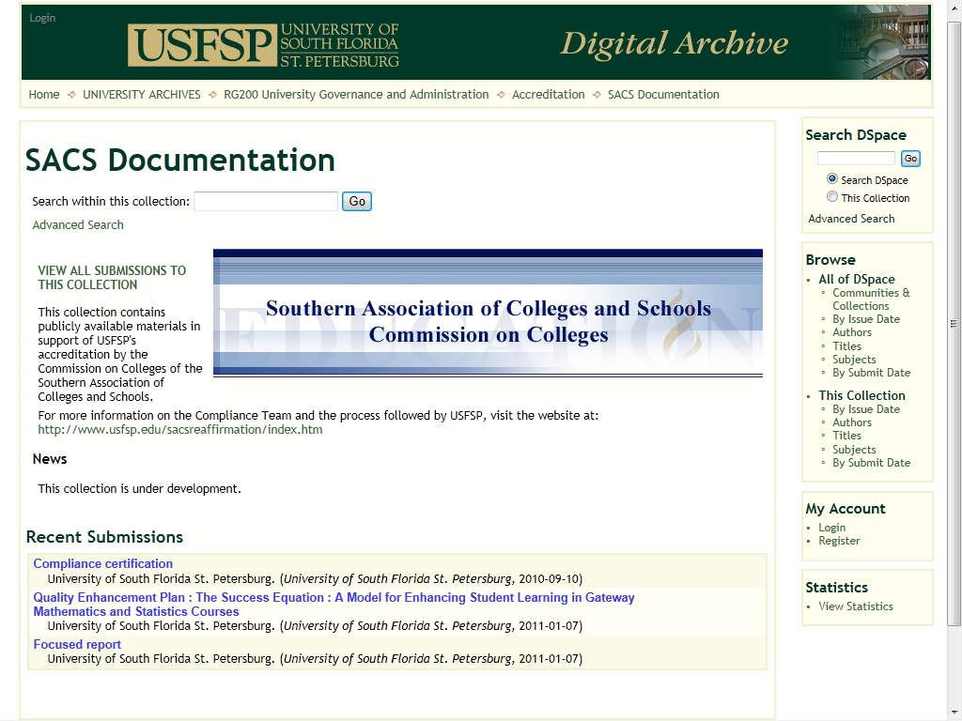
Preserve access to institutional records
Notes:
This is one example of important materials in the archive that can be found by anyone and that will enable us to work more easily with our accrediting agencies in the future.

Slide 24
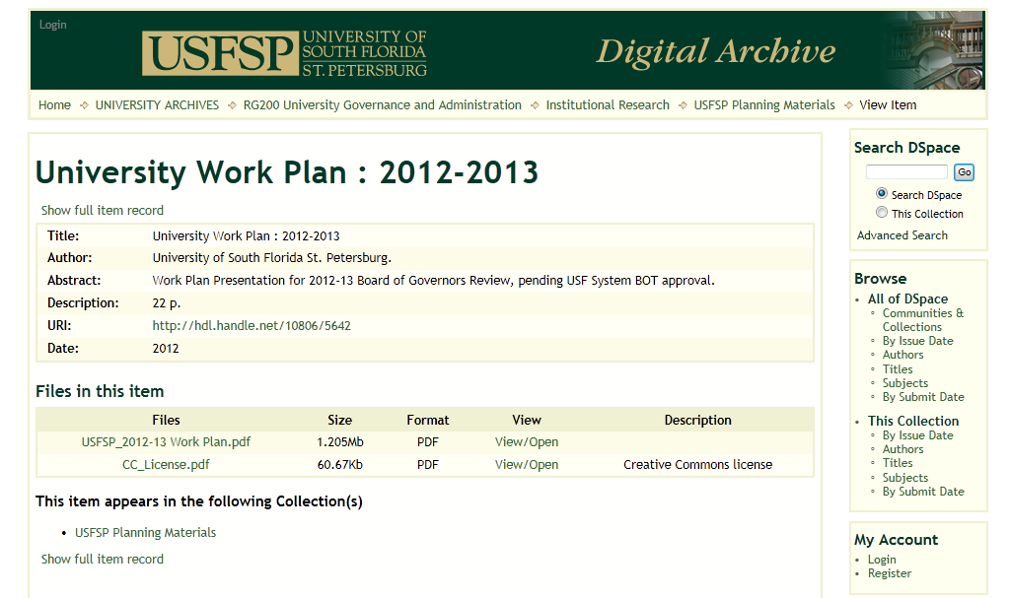
Preserve access to institutional records
Notes:
We have harvested many important documents from open web sites around the state – this is an example of one.

Slide 25
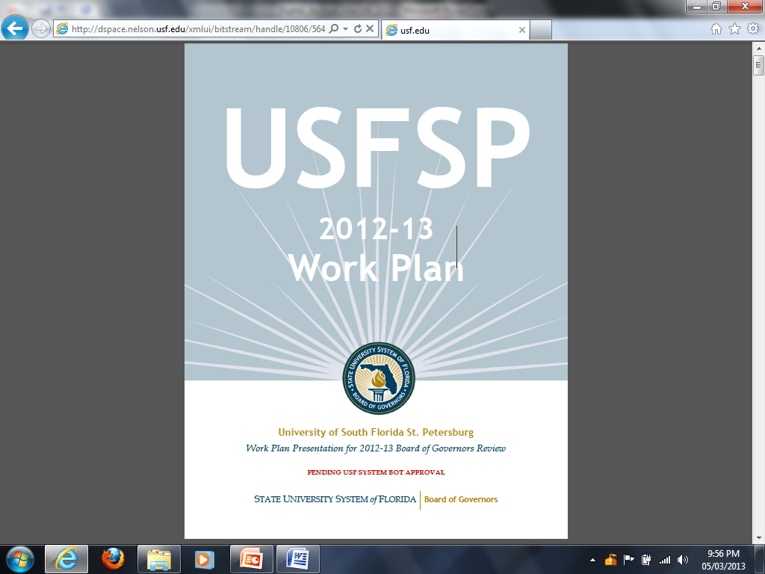
Preserve access to institutional records
Notes:
This is what the actual file looks like when opened from within the archive.

Slide 26
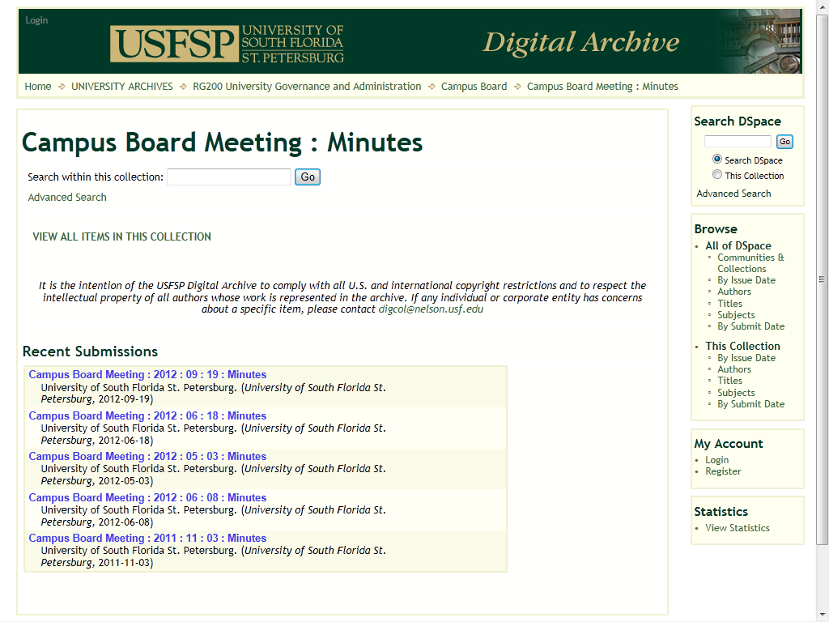
Preserve access to institutional records
Notes:
Another important collection documenting the business of the institution.

Slide 27
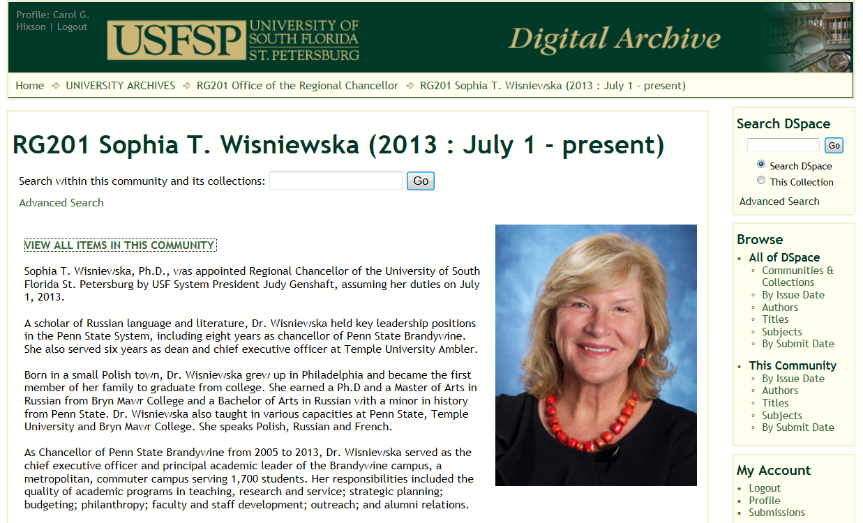
Preserve access to institutional records
Notes:
As the University changes, the Library keeps the record of administrative changes.

Slide 28
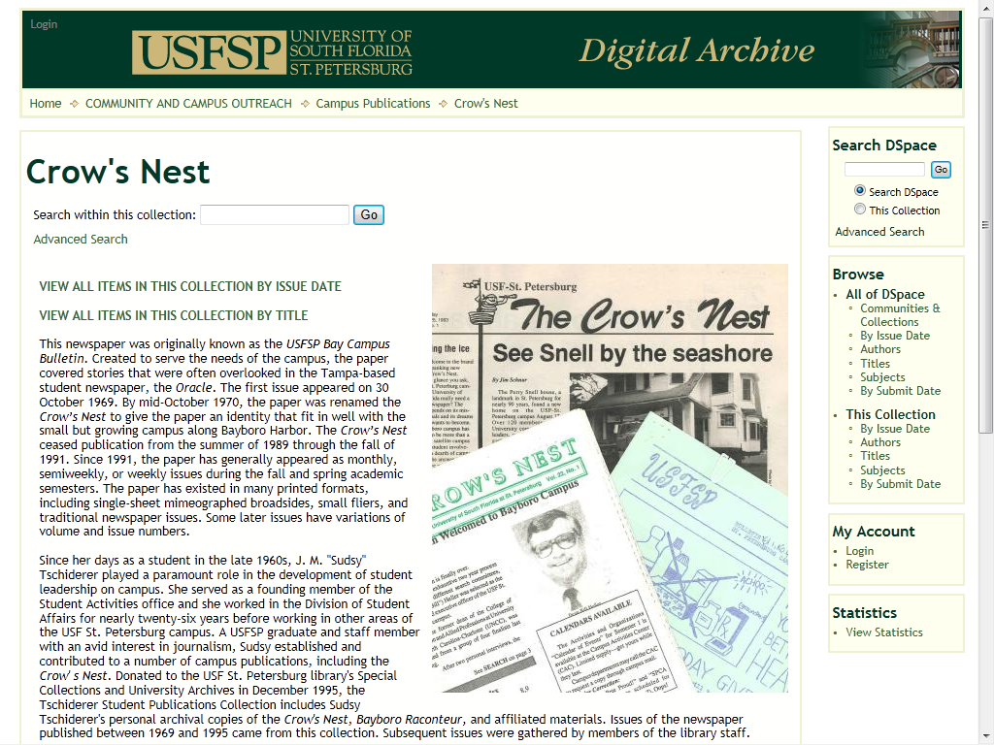
Preserve institutional memory
Notes:
We have digitized numerous historical collections and, if the collection is ongoing – like the student newspaper – we are working with them to capture the new items as they are produced electronically.
These collections capture and preserve the past and are moving into the future

Slide 29
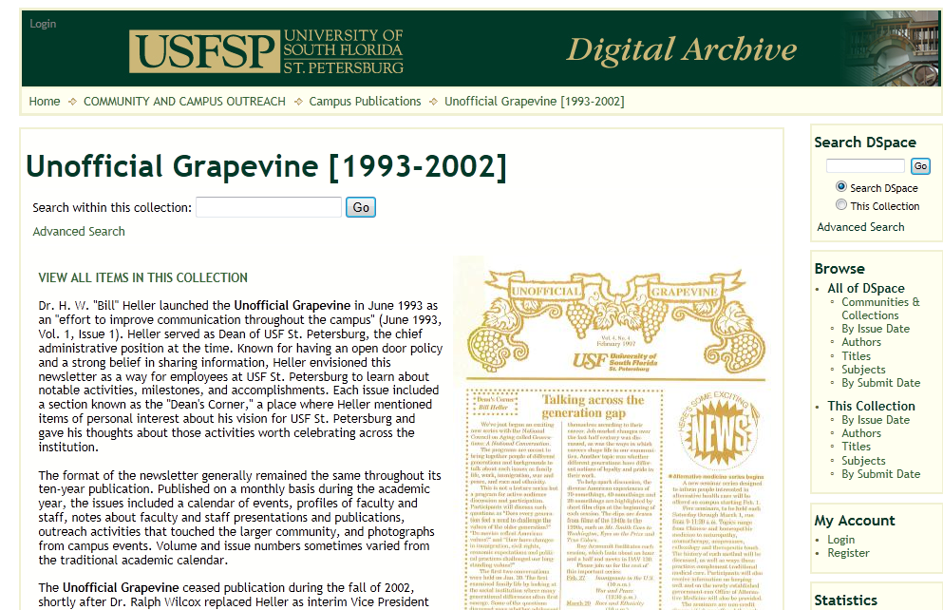
Preserve institutional memory
Notes:
This is another collection we have scanned.
Because the quality of the original was so poor, we have also done manual editing of files to provide accurate indexing to the full text.

Slide 30
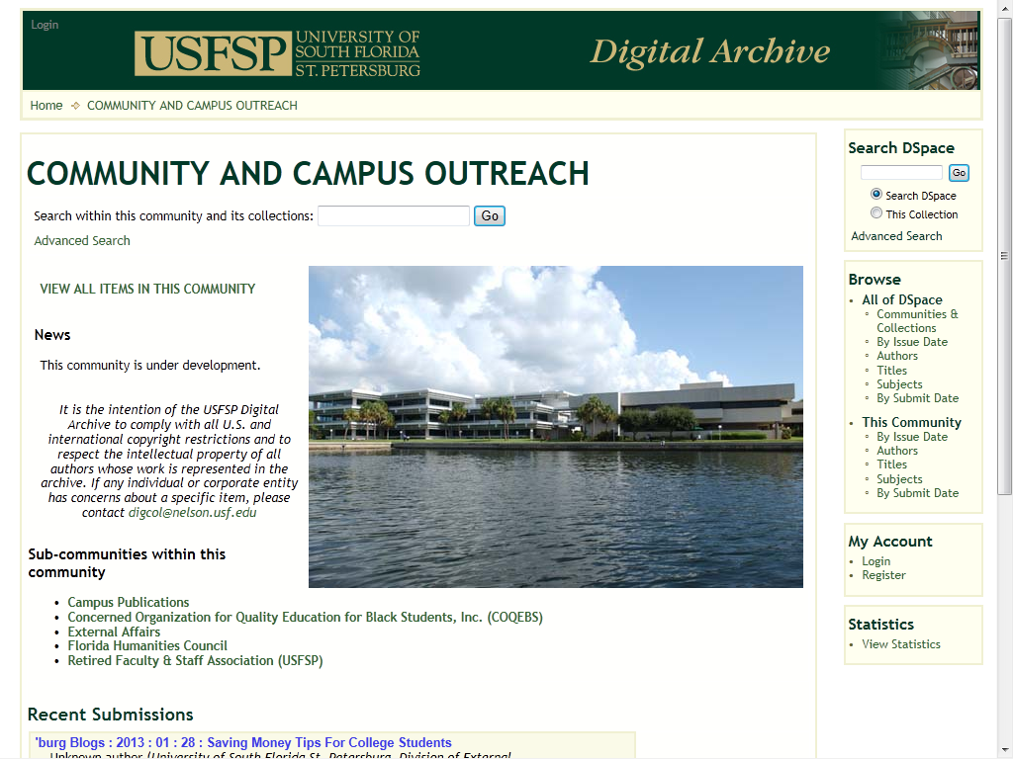
Provide opportunities for community engagement
Notes:
We have a section called Community and Campus Outreach which currently has almost 1700 items in it, divided up into a number of different sub-communities and collections.
An entire community can be searched at once or specific collections can be searched individually.
It is easy to find materials without having to know where they have been stored.

Slide 31
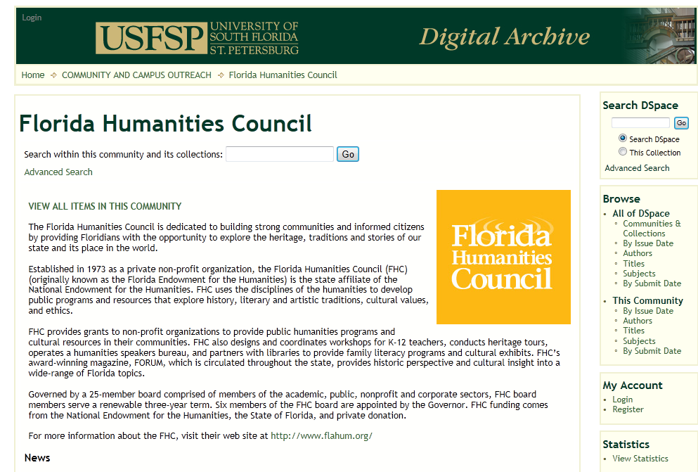
Provide opportunities for community engagement
Notes:
We have been working with several partners who have donated content to us and we are providing access to that content.
We believe these partnerships will serve the university well.
Libraries have always accepted donations of content but now we are taking that traditional function and moving it into the digital age.

Slide 32
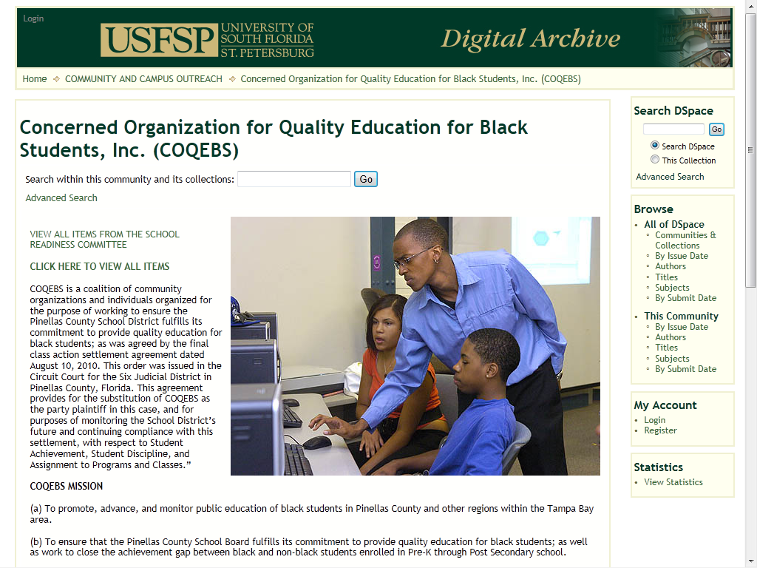
Provide opportunities for community engagement
Notes:
This is another example of a community organization whose content we have accepted into our collections.
These endeavors create enormous goodwill for the institution, as well as provide access to materials that would otherwise be hard to find.

Slide 33
Library expertise
Dean Carol Hixson - set up institutional archives twice before (University of Oregon and University of Regina)
Tina Neville – Public Services
Jim Schnur – Special Collections and University Archives
Deborah Henry – Public Services
Berrie Watson – Systems and Digital Technology
Notes:
Within the Library we have a team of people who are working to administer the archive and build the content.
We are cross-trained so that the success of the archive is not dependent upon any single individual.
Several of us have also divided up the collection of content so that we are able to gather more material more effectively.
Four of us have received national or international training in digital content development and preservation.

Slide 34
Faculty Advisory Committee for USFSP Digital Archive
Mark Walters, College of Arts and Sciences
Michael Luckett, College of Business
Alejandro Brice, College of Education
Notes:
We have worked with College faculty from the beginning, setting the policies that guide the archive.

Slide 35
Types of collections
Works of individual faculty or students
Group collections from a College, program, or department
Administrative documents
Informational materials about the University and its programs
Archival materials or records of the University
Primary resources for research or study
Donated collections from important community partners
Photos, documents, spreadsheets, videos, web pages, presentations, and more
Notes:
The success of our archive – and that sets it apart from many such efforts across the U.S. – is that it is inclusive and meets a wide variety of institutional needs.

Slide 36
Content Types
Notes:
This graph represents the current breakdown between the three main sections of the archive.

