Slide 1
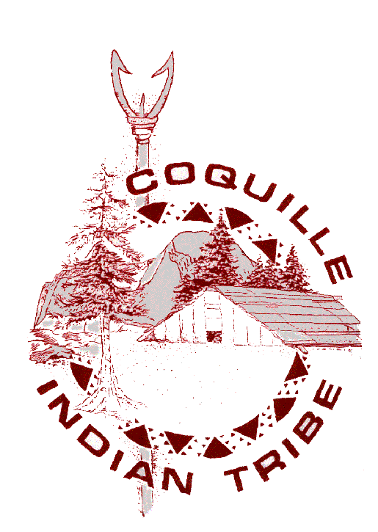
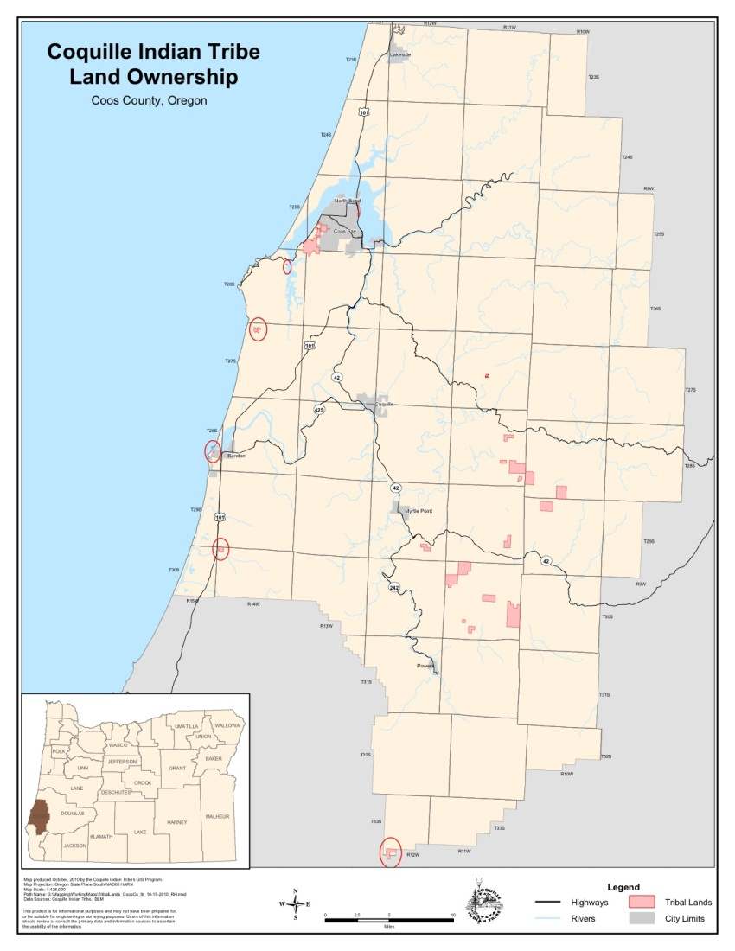
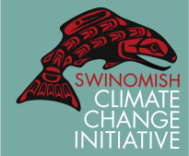
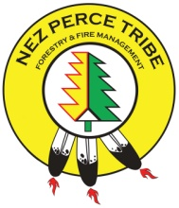
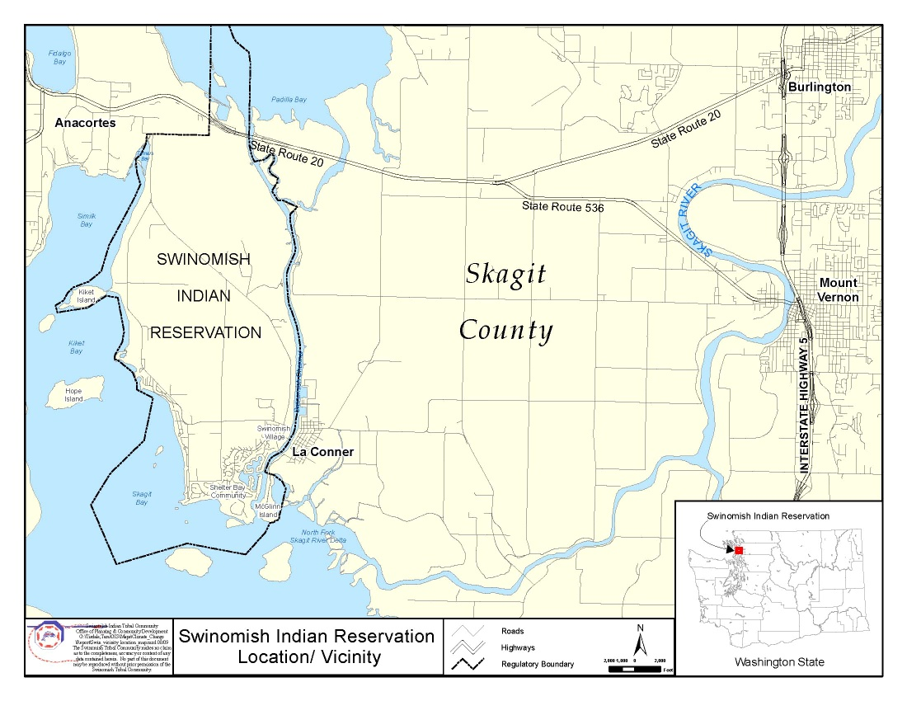
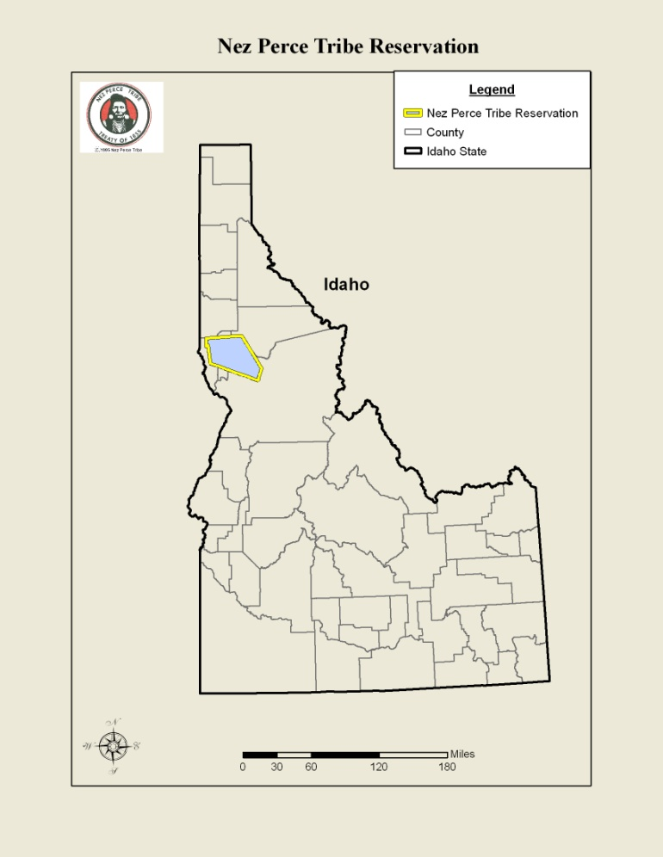
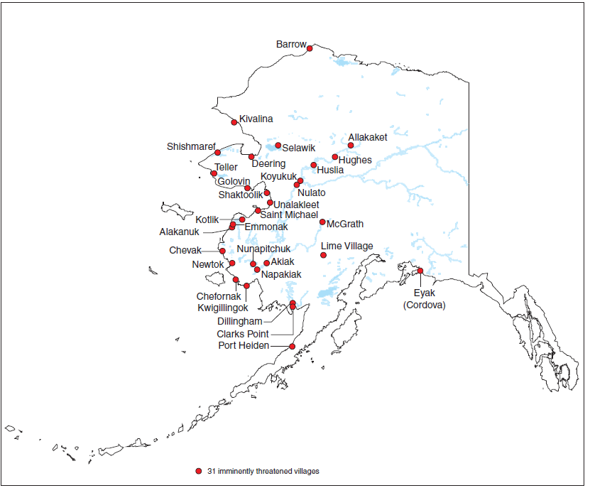
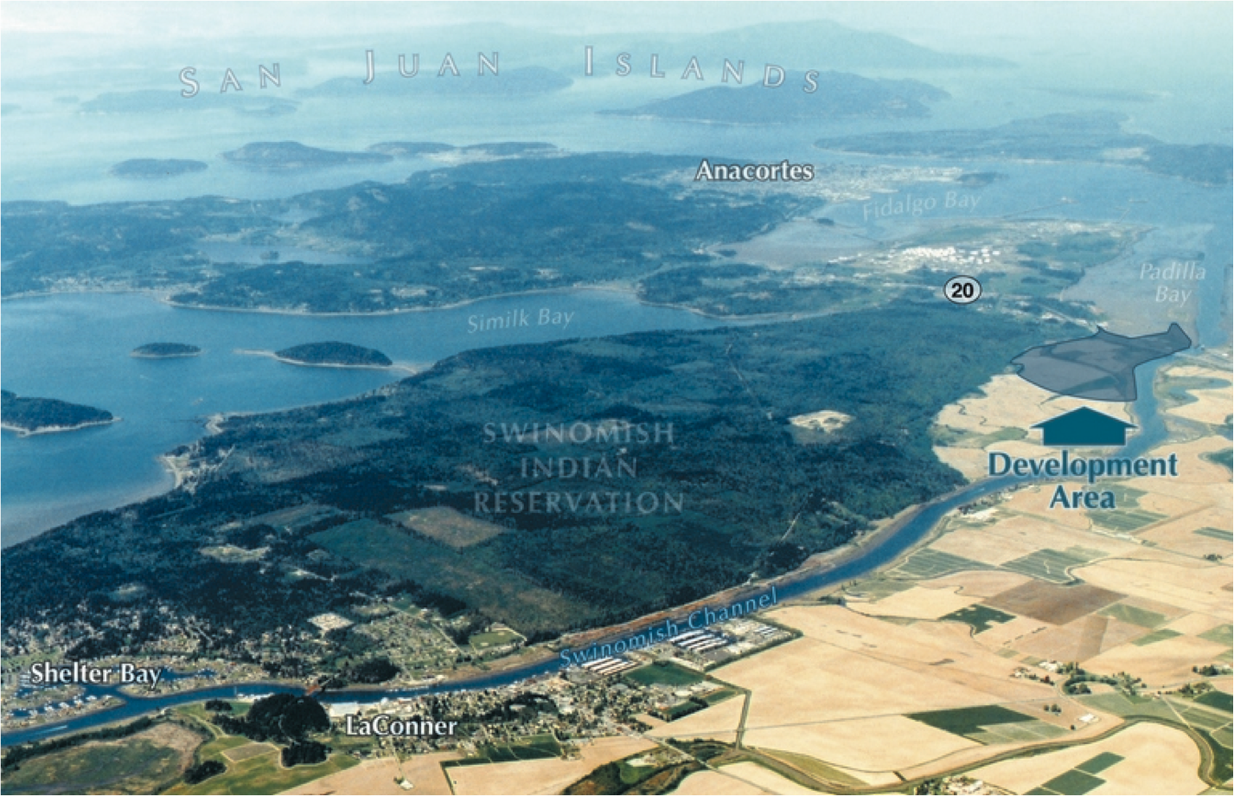
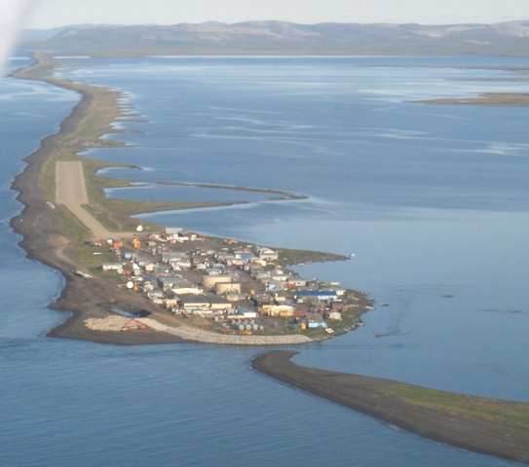

Tribal Climate Change Project
Issues and Opportunities for Native American tribes in planning for the physical
affects of climate change and reducing greenhouse gas emissions
http://tribalclimate.uoregon.edu
The University of Oregon Environmental Studies Program and the USDA Forest Service Pacific Northwest Research Station are engaged in a collaborative study focused on understanding tribal climate change initiatives around the United States. The study will result in knowledge transfer through the dissemination of presentations, resources and publications to assist tribes throughout the United States in addressing climate change. Through this study, we also hope to build awareness among non-tribal communities, organizations, and agencies about issues, challenges, and opportunities that tribes face in the context of climate change.
Coquille Indian Tribe
Climate Change Committee
In 2008, the Coquille established a Climate
Change Committee to become familiar
with the causes and consequences of climate
change, and to make recommendations for
the Tribe and its members.
Swinomish Climate Change Initiative
In recognition of the potential impacts from climate change and the increase in climate-related natural disasters around the world, the Swinomish Tribe passed a Climate Change proclamation in 2007.
Nez Perce Tribe Carbon
Sequestration Program
In the mid 1990’s, the Nez Perce developed a strategy to market Carbon Sequestration Credits. The Nez Perce carbon portfolio eventually reached the present Status of 33 different projects in two different portfolio’s covering approximately 3,375 acres of land.
The tribe planned to reinvest revenue from the sale of carbon to acquire previously forested lands and then replicate the process with additional afforestation projects (planting trees on land that was not previously forested). This effort would also contribute to the tribe’s goal of acquiring former tribal lands. Subsequent carbon offset projects have included wildfire rehabilitation (restoration of forests heavily damaged by wildfire) and forest development.
In their initial impact assessment, the Tribe found that approximately 15% of Swinomish tribal land is at risk of inundation from rising
sea level. The assessment also indicated potential impacts to tribal agricultural land, shellfish beds, fishing docks, and private residential development.
Key Concerns and Potential Impacts to the Coquille Tribe from Climate Change
Temperature variation | Warmer – drought, species migration Colder – reduced agricultural production
Sea level rise | Inundate roads, bridges, cut off reservation Impact homes, buildings – Mill Casino Hotel & RV
Seasonal fluctuations | Affect pollination and growing season timing, including cranberry pollination and production Affect salmon runs and subsistence fishing
Extremes, variability | Increases risk of flooding, storm surges, droughts and wildfires
Pests and disease | Affect cranberry, timber production and harvests Spread Swiss Needle Cast fungus Increase red tides, toxic algae
Habitat changes, species shifting | Affect economic, cultural, and wildlife resources Increase invasive species: wildlife predators, Gorse Reduced ability to gather traditional and wild foods Affect traditional knowledge and cultural food traditions: eels, clams, oysters, cockles, mussels, crab, salmon Affect species mix, habitat characteristics Impact fish runs - Humboldt squid, SF Sea Lions, Pelicans
Swinomish Climate Change Initiative Planning Process
Phase 1 (2007 – 2009) Tribal buy-in leads to issuance of 2007 Climate Change Proclamation Identification of partners, development of advisory committee and identification of roles and responsibilities Development of the Impact assessment - Data review/analysis - Risk zone mapping/inventory - Vulnerability assessment - Risk analysis Policy/strategy scoping (intergovernmental) Community Outreach Conducted storytelling workshop with tribal members - Formed tribal outreach group - Held public meetings - Conducted personal interviews of tribal members and elders - Conducted storytelling workshop with tribal members
Phase 2 (2010) Development of the Action plan Adaptation goals Strategy evaluation and priorities Action recommendations Coordination, funding needs Other implementation issues
Phase 3 (future work) Action Plan Implementation Monitoring and Adaptive Management Update of the Impact Assessment
Program Successes and Challenges
Improved water quality through watershed protection, reduced soil erosion and sedimentation
Employment opportunities for tribal members associated with tree planting seedling protection and thinning jobs in the future
Increased awareness and education carbon sales process
The uncertainty and lack of federal legislation on climate change has reduced the current value of carbon and the willingness of the tribe to invest in carbon offset projects
Relocation Challenges
for Alaska Native Villages
Tribal Strategies to Address Climate Change
Plan for hazards and disasters
Pursue strategies to increase Tribal land access and ownership, including co-management of ancestral homelands under Bureau of Land Management ownership.
Integrate long-term forest and natural resource management practices into climate change adaptation strategies.
Pursue opportunities and strategies to expand, diversify and stabilize the local economy and the Tribe’s revenue through financial and strategic planning
Develop a community garden and expand the Tribe’s agricultural &food production.
Incorporate waste reduction and recycling at Tribal offices, buildings and facilities, including the Mill Casino Hotel & RV Park and Heritage Place.
Consider climate change and sustainability in housing development and maintenance
Increase energy efficiency and reducing greenhouse gas emissions through conservation and developing renewable energy facilities that utilize forest biomass.
Many Alaska Native villages are being forced to consider relocation as a result of climate change. Warming temperature exacerbate problems of permafrost erosion, flooding, and melting ice barriers, and according to the Government Accountability Office, flooding and erosion affects 86% of Alaska Native villages to some extent.
Imminently Threatened Alaska Native Villages: 2004 GAO Report
Only a few villages have begun the
relocation process, which is complicated by culture, cost, and politics:
Culture: Breaking from uniquely adapted traditions developed over
thousands of years to develop
Cost: Hundreds of millions to relocate several hundred people
Politics: Alaska’s unique structure of organized boroughs means that
many Native village do not qualify for government funding.
While the Kivalina community has been engaged in relocation efforts over the past 20 years, the high cost of relocation – estimated to be $95-$120 million to relocate the community’s 400 residents – precludes its viability. As a result, the Kivalina has shifted its focus from relocation to evacuation.
For More Information:
Kathy Lynn University of Oregon Environmental Studies Program kathy@uoregon.edu | Ellen Donoghue USDA Forest Service Pacific Northwest Research Station edonoghue@fs.fed.us
http://tribalclimate.uoregon.edu/
Swinomish Tribal Archives
Mille Hawley, President Kivalina IRA Council

