Slide 1

Wikipedia: the basics
What you need to know to contribute to the world’s largest encyclopedia that anyone can edit.
Sarah Stierch
@sarah_stierch
sarah@sarahstierch.com
CC BY SA 3.0

Slide 2
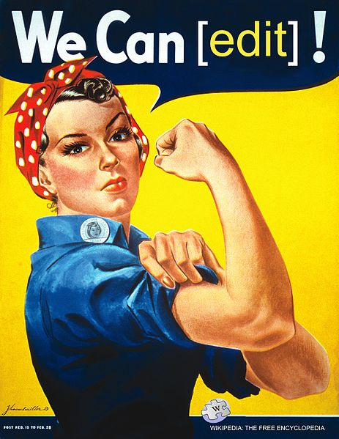
WikiWomen Welcome!

Slide 3
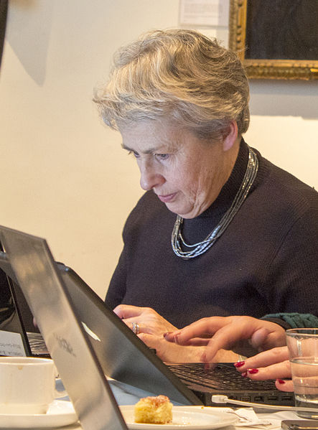
First things first: you can edit
You just have to BE BOLD.

Slide 4
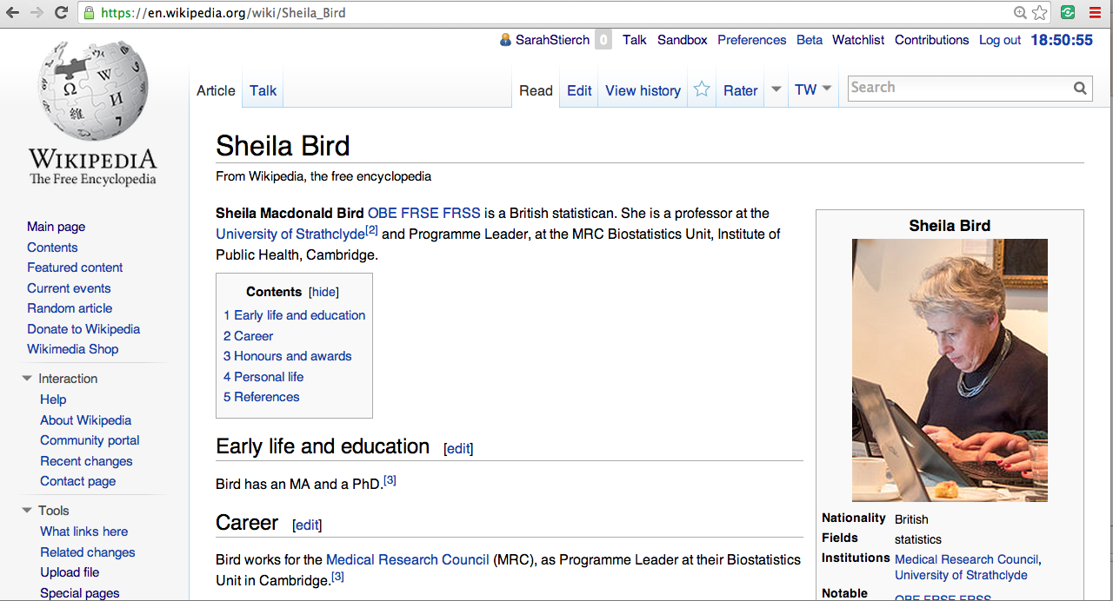
Notes:
Sheila Bird’s photo is her editing Wikipedia! Ha ha!

Slide 5
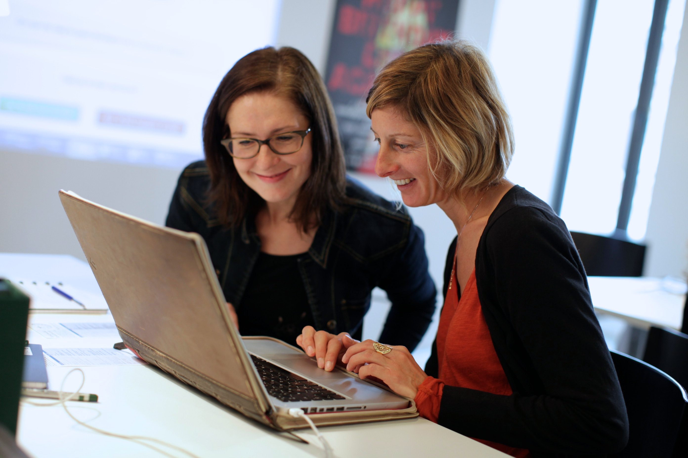
To make an account or not to make an account, that is the question
Track your contribution history
Your IP can be tracked without an account by anyone
You can use the same account on any Wikimedia project
Tips:
You don’t have to use your real name
Don’t use a name associated with your organization or company

Slide 6
What do Wikipedians love more than editing Wikipedia?

Slide 7
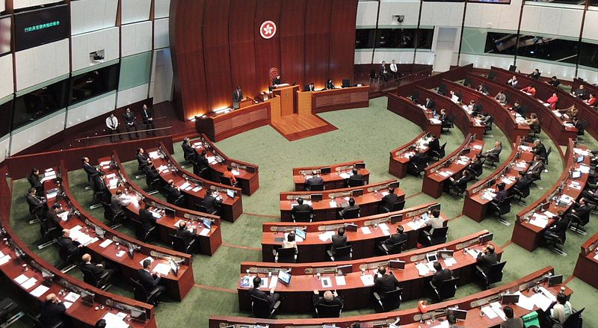
Making policies on how to edit Wikipedia

Slide 8
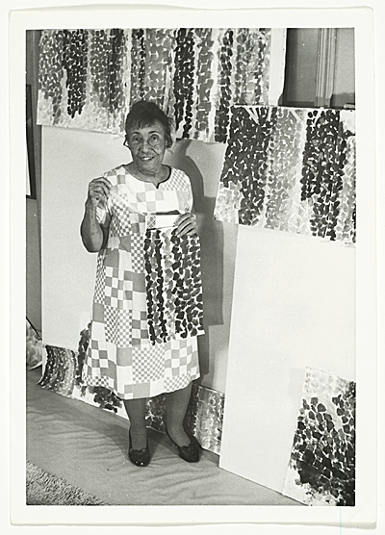
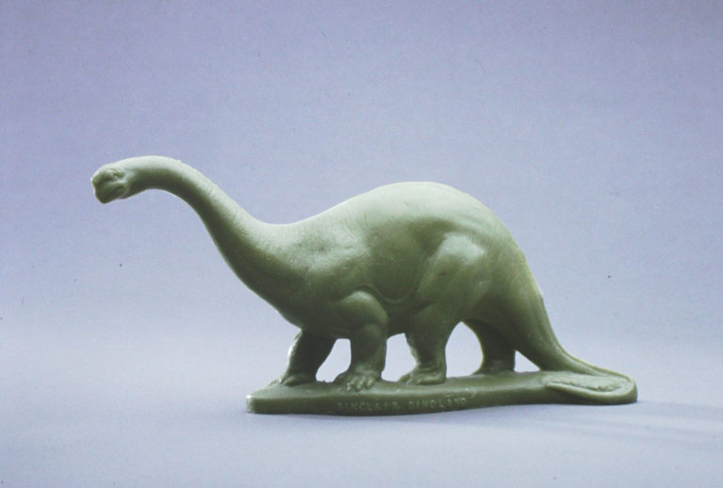
Notability
  Subject must receive significant coverage in reliable sources that are independent of the subject, and is presumed to meet criteria for its own stand-alone article or list.
Notes:
That means, your subject has to be addressed, in detail, in verifiable published sources, such as major news organizations or scholarly publications. Significant means that your subject should be a major part of the coverage. For example, they are interviewed in the New York Times or are being interviewed frequently in academic publications and major news media because of their expertise on a subject. Or perhaps they have been the subject of a book, for example. I’ll talk about reliable sources in a few minutes. Independent means that your sources cannot be created by or affiliated with the subject – such as press releases, university bio’s, the subjects own website, etc. These can be used sparingly, but cannot be used to establish notability.
Now, just because your article meets the criteria, doesn’t mean it’s eligible for it’s own article. It might be eligible to be blended or mentioned about in another article. An article about a company might include a brief biography about the CEO of the company, instead the CEO of that company having their own article. This may be because there isn’t enough information to be collected about them, and their own Wikipedia article would be very small and lack opportunities for expansion. So we just put a section in their company article about them.
Artist Alma Thomas has her own article about herself – there are many reliable secondary sources about her, but this tiny plastic Sinclair oil dinosaur from 1964 does not warrant it’s own article, as there has been little to no coverage about these tiny 1964 plastic toys. But, it might merit a mention of it in the Sinclair Oil Corporation article.

Slide 9
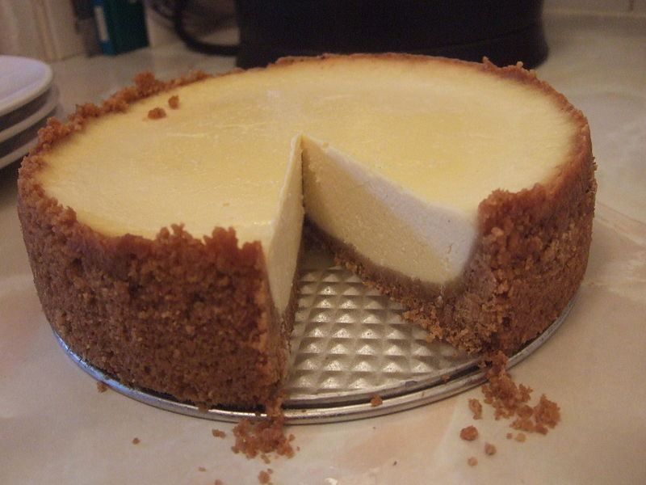
No original research
  Wikipedia does not accept:
  facts, allegations, gossip, ideas, and stories for which no reliable source exists.
Notes:
No original research is allowed. For example, you can’t edit the article about cheesecake using what you remember about your mother making cheesecake, or using a recipe card. However, you can use an article about cheesecake that you read in a cooking magazine to expand the cheesecake article. Another example: you hear a rumor that a colleague of yours at another university got fired. Don’t go edit the article about them and write “she got fired in January 2013,” without having a reliable source to back it up. Rumors, word of mouth, and “fun facts” don’t work on Wikipedia, and will be removed with little question.
One fact: if you’re using oral histories you can use them sparingly and use basic factual information to fill in something you’re missing about a subject, but don’t base your whole article around a subjects oral history.

Slide 10
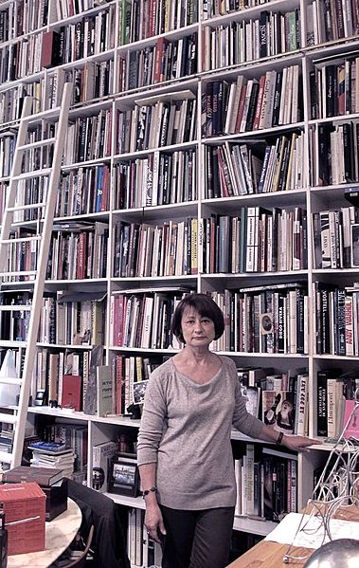
Sources
  Anything that could be challenged must be backed up by a reliable source.
  A reliable source is content from a trusted news source or publisher.
  Wikipedia prefers secondary sources. Primary e.g. (oral history, subjects website) are OK if used sparingly.

Slide 11
What NOT to use
What TO use
Self published sources
  e.g. Blogs, patents, newsletters, official websites, message boards, mailing lists
  Facebook, Twitter, Myspace (do people still use that?), Tumblr, etc.
  Self-created materials
    Press release
    Academic biography
Trusted news sources
  New York Times
  Washington Post
  Register-Guard
Academy, peer-reviewed, scholarly publications
Blogs from trusted sources – NYT, Smithsonian, etc.

Slide 12
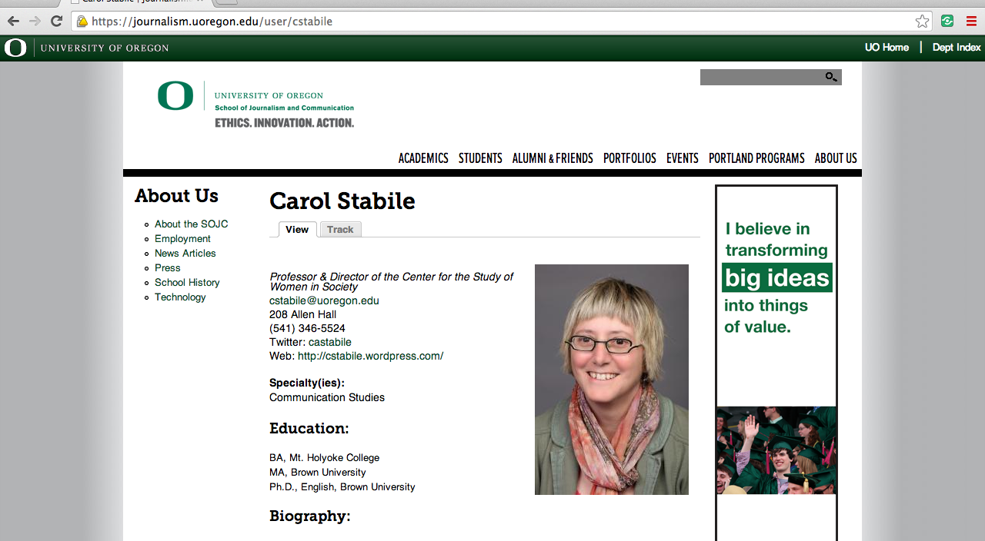
RELIABLE OR NOT?
NOT RELIABLE

Slide 13
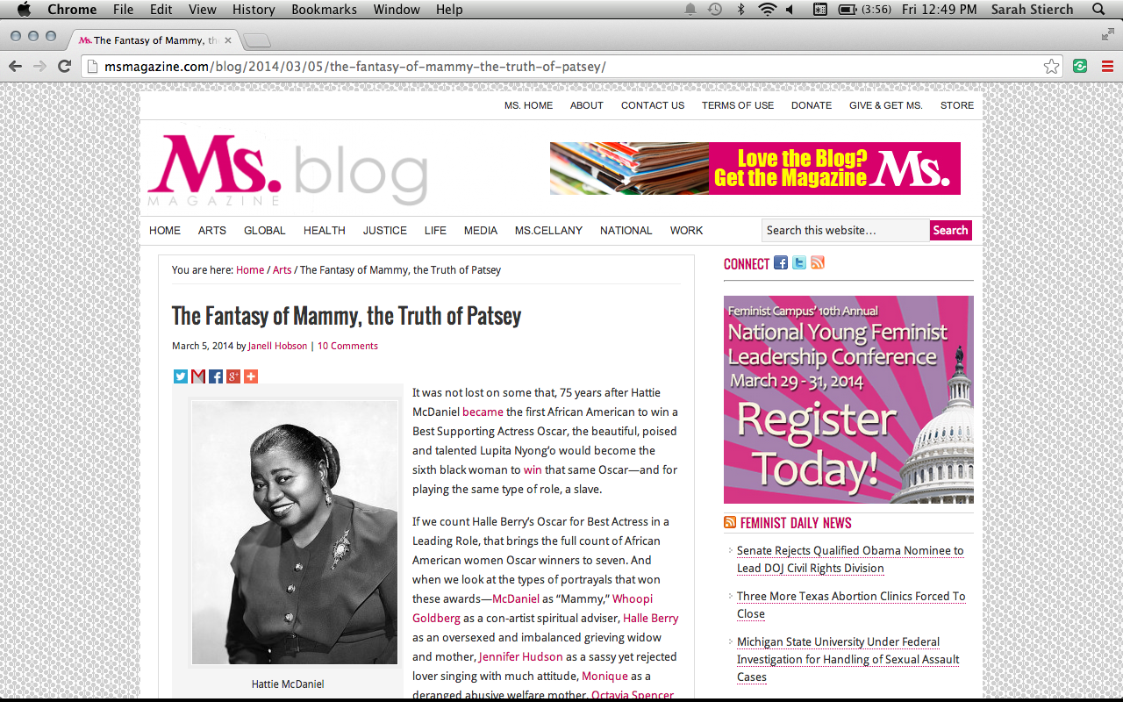
RELIABLE OR NOT?
RELIABLE

Slide 14

RELIABLE OR NOT?
RELIABLE

Slide 15
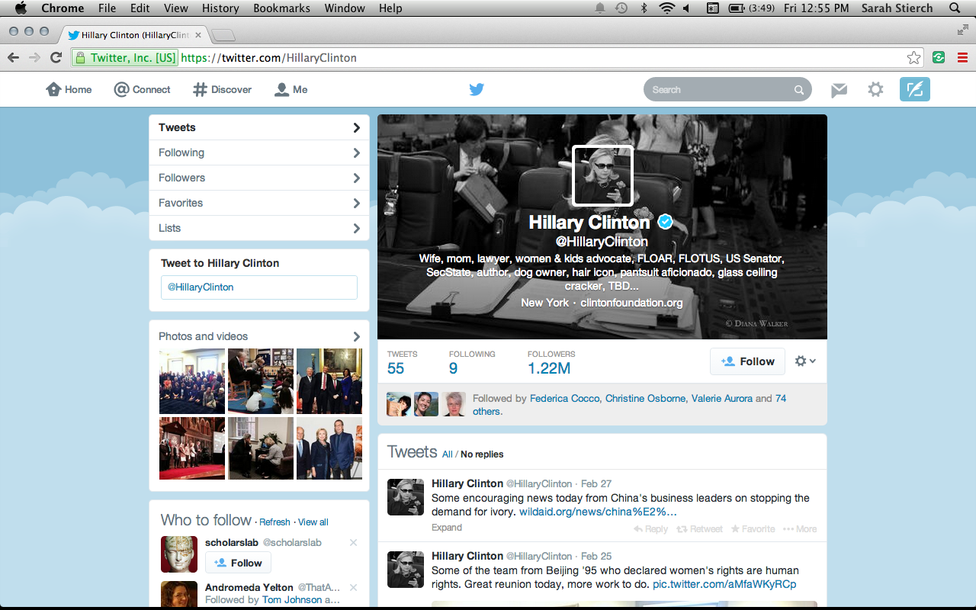
RELIABLE OR NOT?
NOT RELIABLE

Slide 16
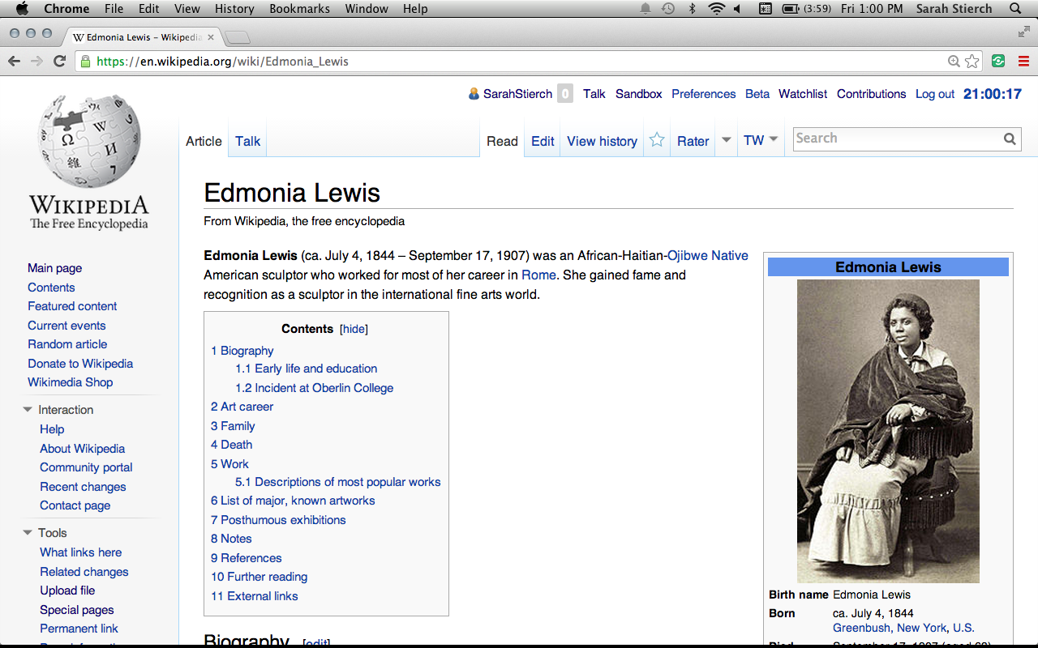
RELIABLE OR NOT?
NOT RELIABLE

Slide 17

RELIABLE OR NOT?
NOT RELIABLE

Slide 18
Conflict of interest
  Where advancing outside interests is more important to an editor than advancing the aims of Wikipedia, that editor stands in a conflict of interest.
  Examples:
  Writing or editing your institutions Wikipedia article, and doing it in a promotional way.
  Adding external links to your website on Wikipedia pages (aka spam)
  Creating an account called “UniversityofCA” to serve as an institutional group account to make edits.

Slide 19

Conflict of Interest
DO create a user account for you and you only.
DO create a userpage that describes your position, institution, and area of expertise/editing interest
DO edit as yourself, not as your institution/department/company
DO improve articles and content related to your passion & interests, you know the right sources & tools to improve Wikipedia!

Slide 20
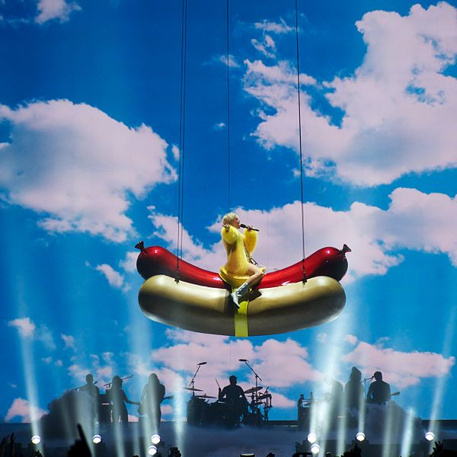
Sarah’s Editing Tip #1: Be boring
If your subject is interesting enough, your boring Wikipedia article will speak for itself. Don’t get flowery – this is an encyclopedia, after all.

Slide 21

Sarah’s Editing Tip #2: Find friends
Find community on Wikipedia through WikiProjects and mailing lists.
WikiProject Feminism, Women’s history, California
Gender Gap Mailing List: https://lists.wikimedia.org/mailman/listinfo/gendergap
WikiWomen’s Collaborative
  Facebook https://www.facebook.com/WikiWomensCollaborative
  Twitter https://twitter.com/WikiWomen

Slide 22
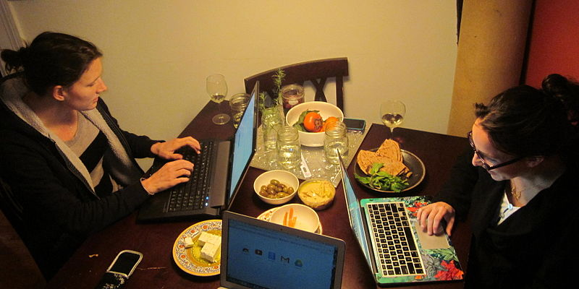
Sarah’s Editing Tip #3: WIKIPARTY!!!
21st century sewing bee
Have your own edit-a-thons and parties to edit Wikipedia. Wikipedia is always more fun to edit with wine.

Slide 23
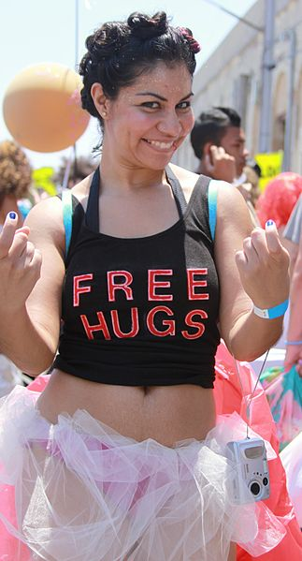
Sarah’s Editing Tip #4: Be nice
Troll and annoying bossy Wikipedian repellant: kill them with kindness.

Slide 24
Edit-a-thon to-do list
Make a Wikipedia account.
Discover a topic you want to write about, whether a new article or subject already on Wikipedia.
Start editing!
Ask questions, raise hands, be patient
There are no dumb questions
YOU CAN EDIT!
#wikiwomen

Slide 25
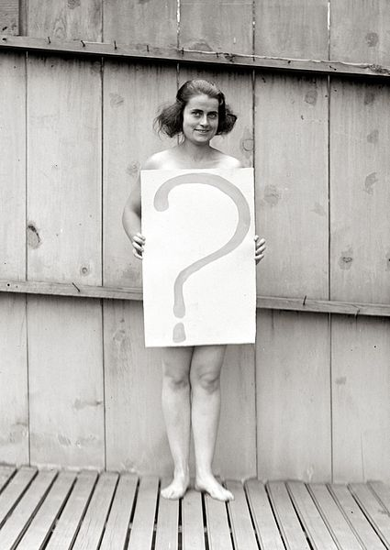

Slide 26
Image credits
Thank you to everyone who has freely licensed images and materials for the world to use without charge or fear of copyright infringement.
Wikipedia logo, trademark Wikimedia Foundation, CC BY SA 3.0
“We Can Edit!” by Tom Morris, public domain reuse of J. Howard Miller’s “We Can Do It!” poster
Professor Sheila Bird, cropped by Katie Chan, from an original image by Katie Chan, CC BY SA 3.0
Europeana fashion edit-a-thon, by Ter-burg, CC BY 3.0
2013 Policy Address, Voice of America, public domain
Alma Thomas in her studio, 1968, by Ida Jervis. Used under fair use rationale.
Sinclair Dinosaur plastic Brontosaurus, 1964, The Children's Museum of Indianapolis, CC BY SA 3.0
Catherine Millet par Marc Bervillé, CC BY SA 3.0
Screenshot from University of Oregon, copyright University of Oregon, used under fair use rationale.
Screenshot from Ms., copyright Ms., used under fair use rationale
Screenshot of Hillary Clinton’s Twitter page, used under fair use rationale
National Enquirer cover used under fair use rationale
WikiWomen4, Maia Weinstock, CC BY SA 3.0
Wikipedia screenshots, CC BY SA 3.0
Miley Cyrus, 2014, Rob Sinclair, CC BY SA 2.0
WikiWomen’s Logo, Heather Walls, CC BY SA 3.0
Mermaid parade goer, Joe Mazzola, CC BY SA 2.0
WikiWomen editing party, Seeeko, CC BY SA 3.0
Unclothed woman in Washington, D.C. with a ? Sign, 1922, public domain

Slide 27
Wikipedia: the basics
What you need to know to contribute to the world’s largest encyclopedia that anyone can edit.
Sarah Stierch
@sarah_stierch
sarah@sarahstierch.com
CC BY SA 3.0

