Slide 1

Florida Atlantic University Libraries
Wimberly Library:
Reinventing the Library Experience
By Dean of University Libraries, Carol Hixson
January 4, 2017

Slide 2
Wimberly Library Facility
Very heavily used facility
Typically, 120,000 to 130,000 visits per month
So far, all-time record high was September 2014: 137, 911
September and February are typically the busiest months
Students frequently sit on the floor because of lack of available seating

Slide 3
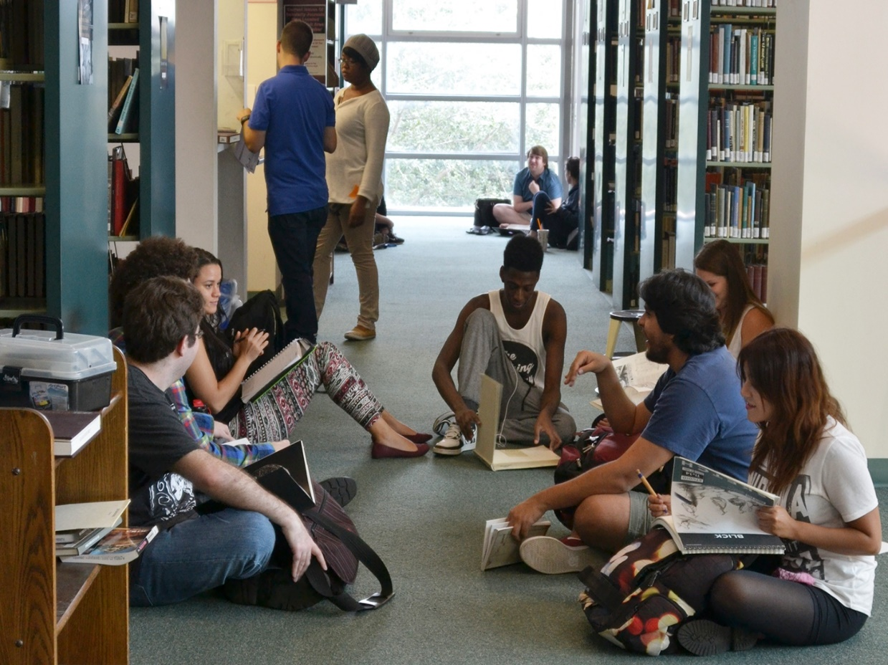
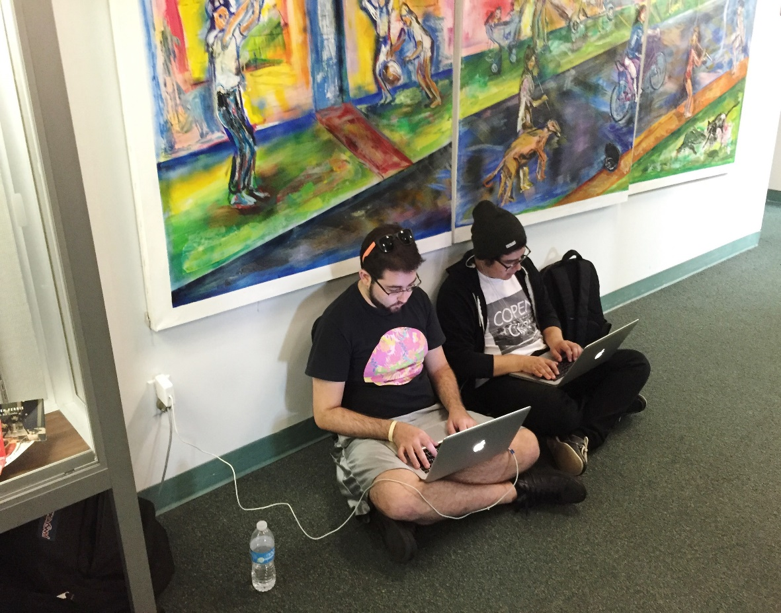
Wimberly Library Today

Slide 4
Seating and Study Capacity in Wimberly Library
The seating capacity is 1300 seats, including study rooms (increased seating by about 18% in past year)
28 group study rooms: 8 large study rooms for 3 or more people and 20 smaller rooms for 2 or more people (increased capacity by 11% in past year)
High demand daily, with extremely high demand before and during midterms and final exams
Peak demand days/times are M-F, 10:00 a.m. – 3:00 p.m. Pagers notify people on a waiting list when rooms become available

Slide 5
Main Building Constructed in 1964
Building Age and Backlog of Deferred Maintenance Is Taking a Toll
A 2013 study determined that it would cost $1,710,000 to update the HVAC system in the Wimberly Library
A 2016 study of the electrical system determined repairs would cost $335,000
A 2016 study of the building envelope found substantial issues with all windows, exterior walls, and the roof – more detailed study needed
Recent flood in the Jaffe Center floor has yet to be repaired
428 maintenance requests placed in FY 15-16; another 215 requests placed since July 1, 2016

Slide 6
Students Want Space, Power, Better Connectivity, Updated Facility – Sept-Oct. 2015 Survey

Slide 7
Student Comments from Sept. 2015 Survey
the library needs more floors, more spaces, better structure. MAKE IT A REAL LIBRARY
it's too small – there is never space
just hard to find someplace in the middle of the day, especially access to outlets
dirtiest library ever!

Slide 8
Student Comments from Sept. 2015 Survey
have to sit between shelves to charge and study
make library nice looking with working stuff and places to sit
there are never any study rooms available; tables always taken
new building at some point; this one's foundation is ailing under the strain

Slide 9
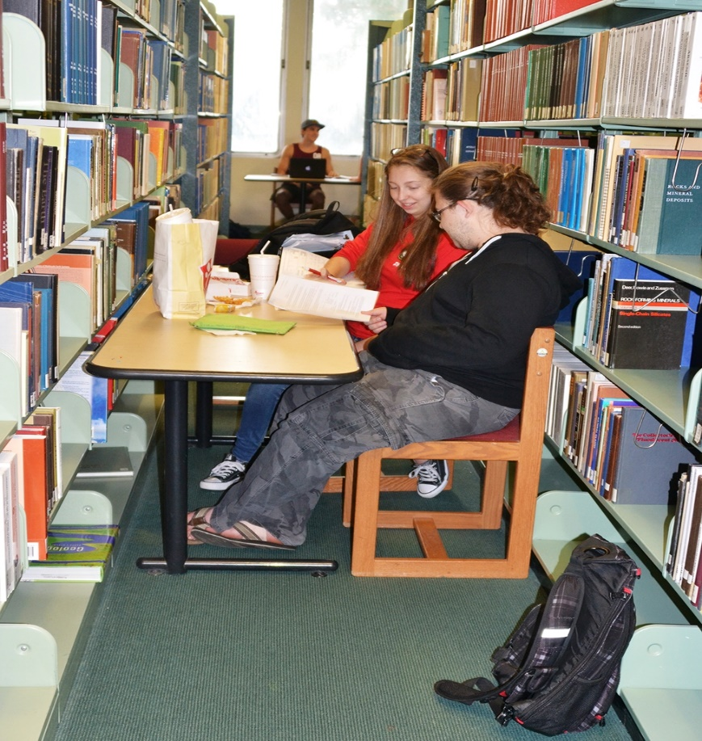
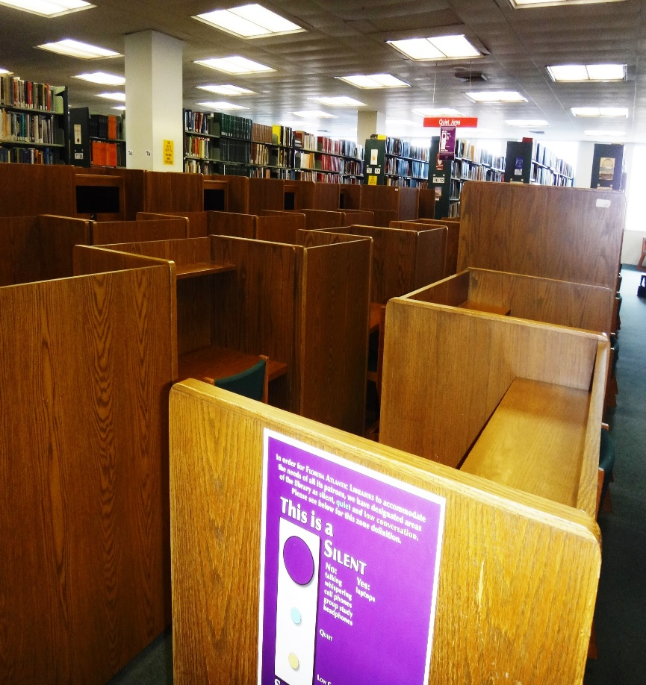
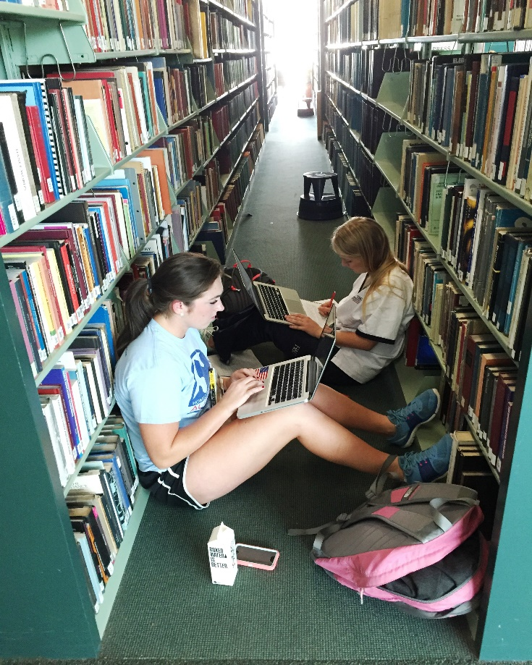
Wimberly Library Today

Slide 10
Future Vision for Wimberly
Stabilize and reverse deterioration of facility
Accommodate needs of today’s students
Service-centered rather than collection-centered
Flexible and multi-purpose design and furnishings
Technology-infused spaces to ensure competitive edge
Point of pride and clearly identifiable as an FAU facility

Slide 11
Work Underway in the Wimberly Library
In the short term, we are making several incremental changes:
With the help of the University Club, we created a study lounge for Graduate Students.
We are reviewing our physical collections and expanding our electronic collections so
that we can reduce shelving and open up more study space for students.
We have relocated some staff so that their former offices can be turned into group
study rooms.
Using end-of-year money in FY2015/2016, we purchased new furnishings for one of
the first-floor computer labs and for the open collaborative space just inside the atrium.
Using end-of-year money, we completed a minor facelift of the first and second
floors by repainting and resurfacing, using FAU colors and branding.
We are currently working to renovate the 5th floor and convert it to multi-purpose space
Notes:
We are doing a lot. A newly-established Space Allocation Committee has been carrying out research, making site visits, conducting student and faculty focus groups, and working with vendors. Some of the changes they have recommended are reconstituting an underutilized office space and turning it into a grad student lounge that should be opening in a few weeks. We are opening up more floor space as we can by moving shelving to create more open study space. We are relocating some staff offices so that we can turn their offices into group study rooms. We’re getting some new furnishings and we are – for the first time – going to give the facility a minor facelift and use FAU colors and branding.

Slide 12
5th Floor Renovation
Multi-purpose, open all the time
Paint and brand with FAU colors (done)
Reduce size of collection storage space (underway)
Get new furnishings (in process)
Redesign the board room for videoconferencing (bid received)
Redesign exhibit spaces to showcase collections better (being planned)
Strengthen community engagement on 5th floor

Slide 13
Digital Scholarship Center
Remove collections from first floor of Wimberly
Implement more collaborative spaces
High-end technology for individual and group use
  3-D printers
  Imaging equipment
  Wide array of printers, scanners, laptops,
  Video and audio studios
  State-of-the-art classrooms
  Technology-enriched collaboration rooms
  Electronic white boards

Slide 14
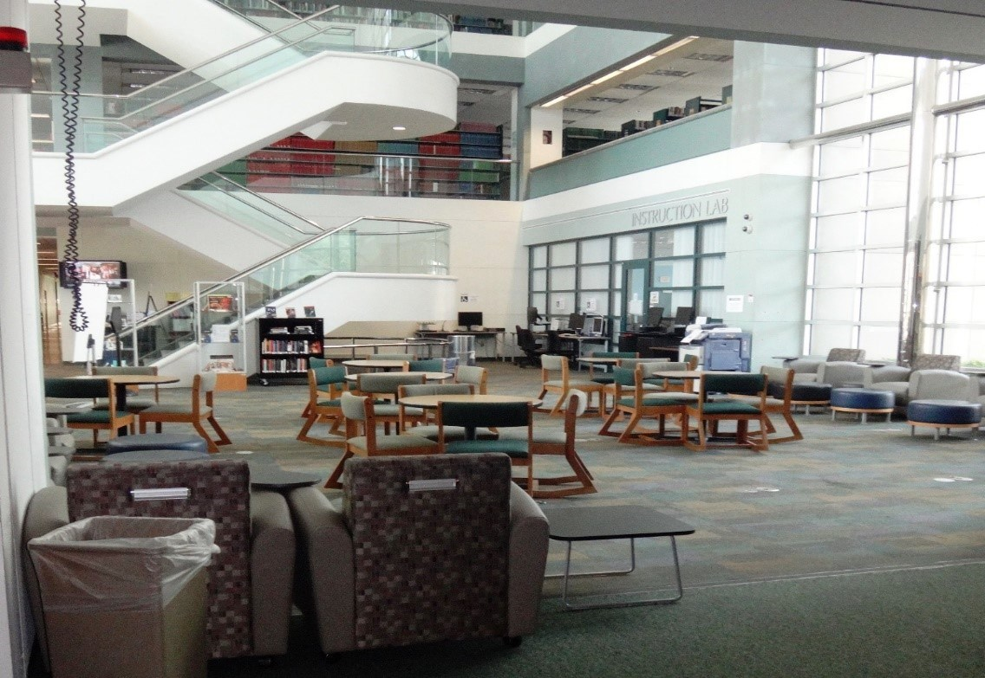
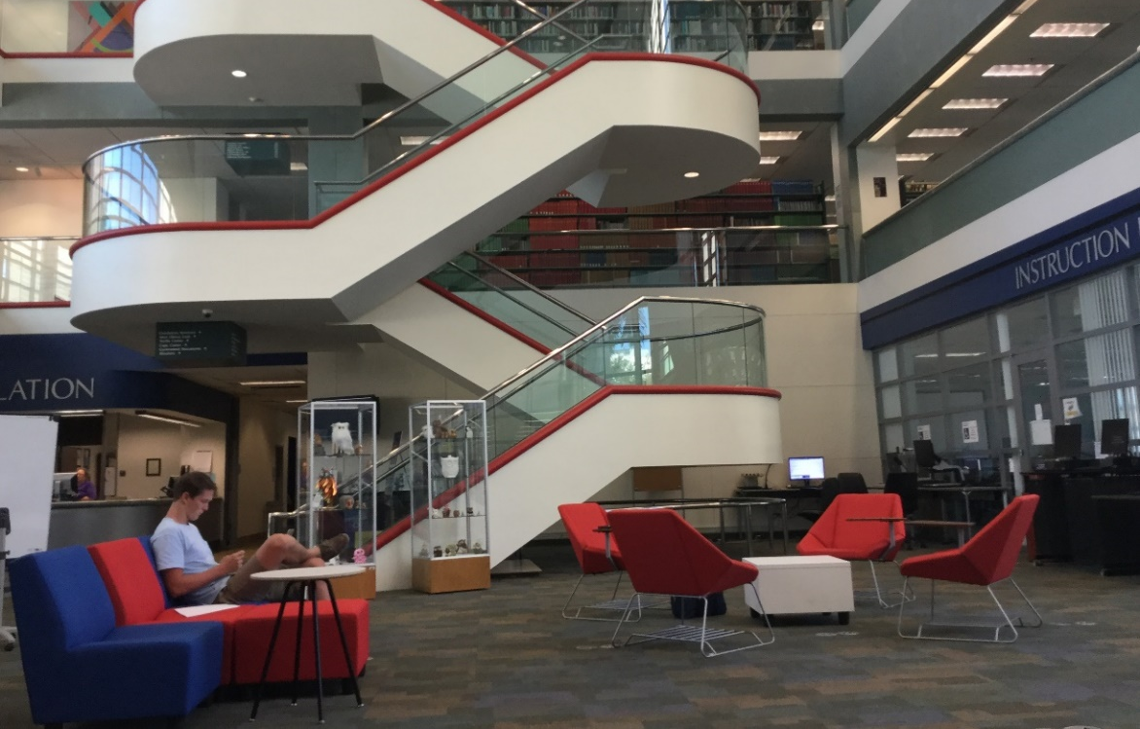
Wimberly Library Being Transformed
Before
After

Slide 15
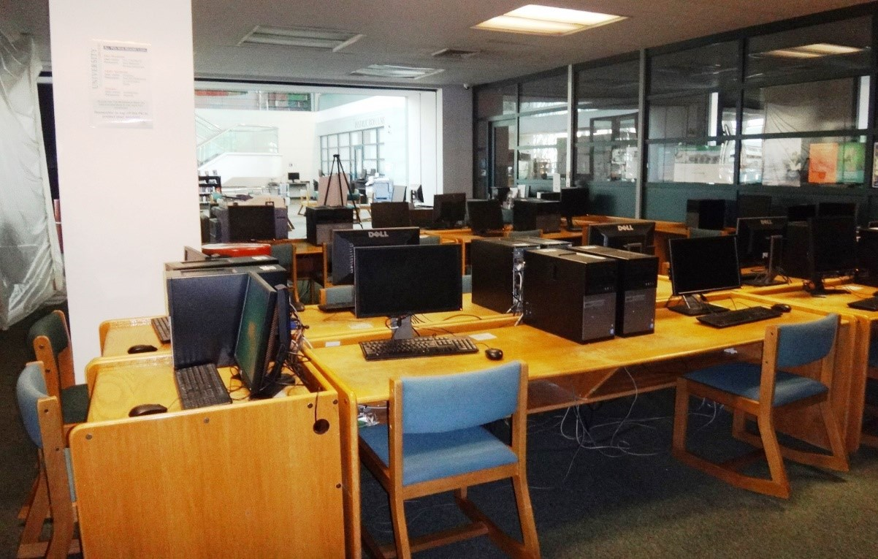
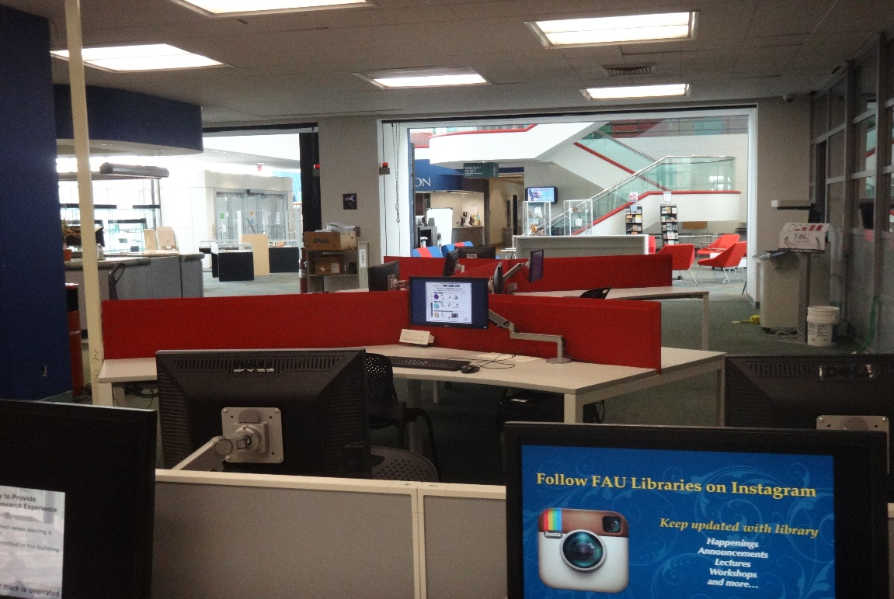
Wimberly Library Being Transformed
Before
After

Slide 16
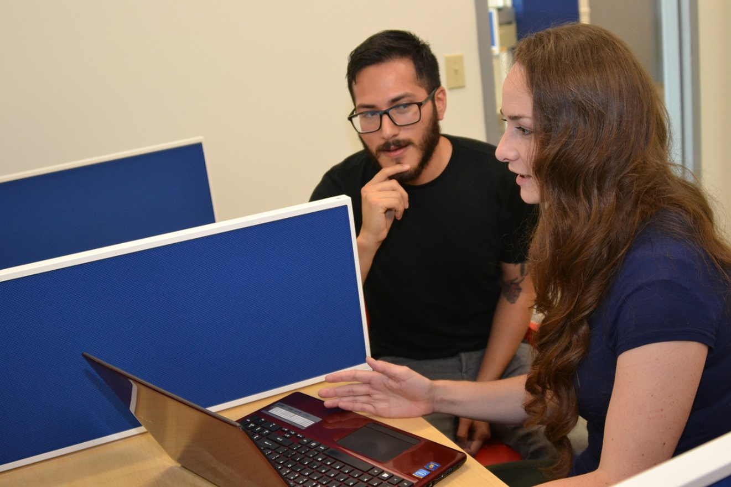
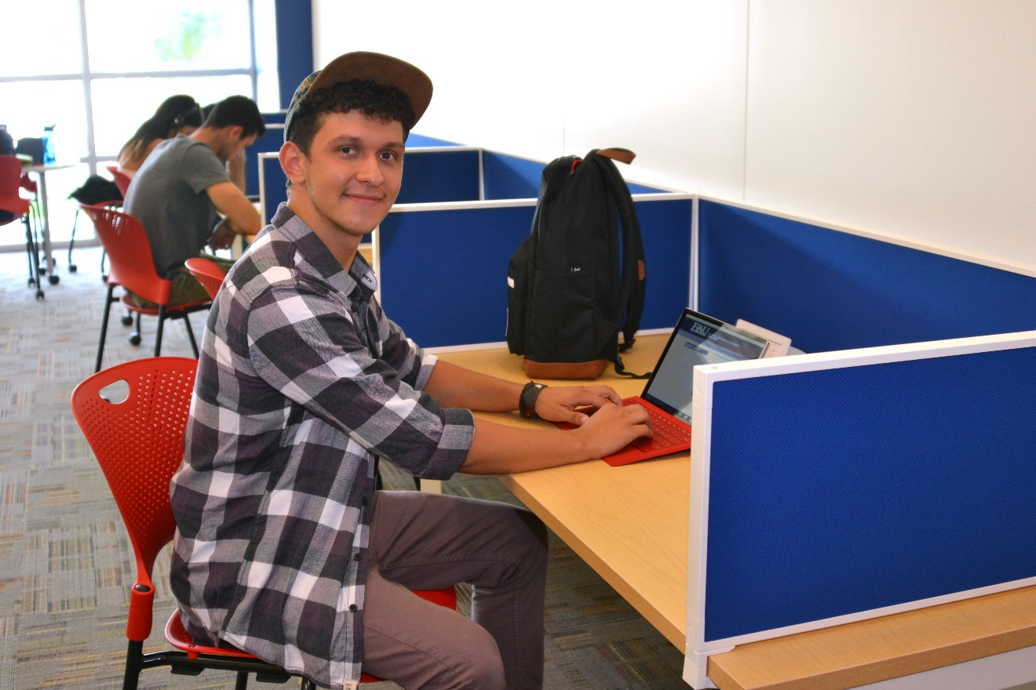
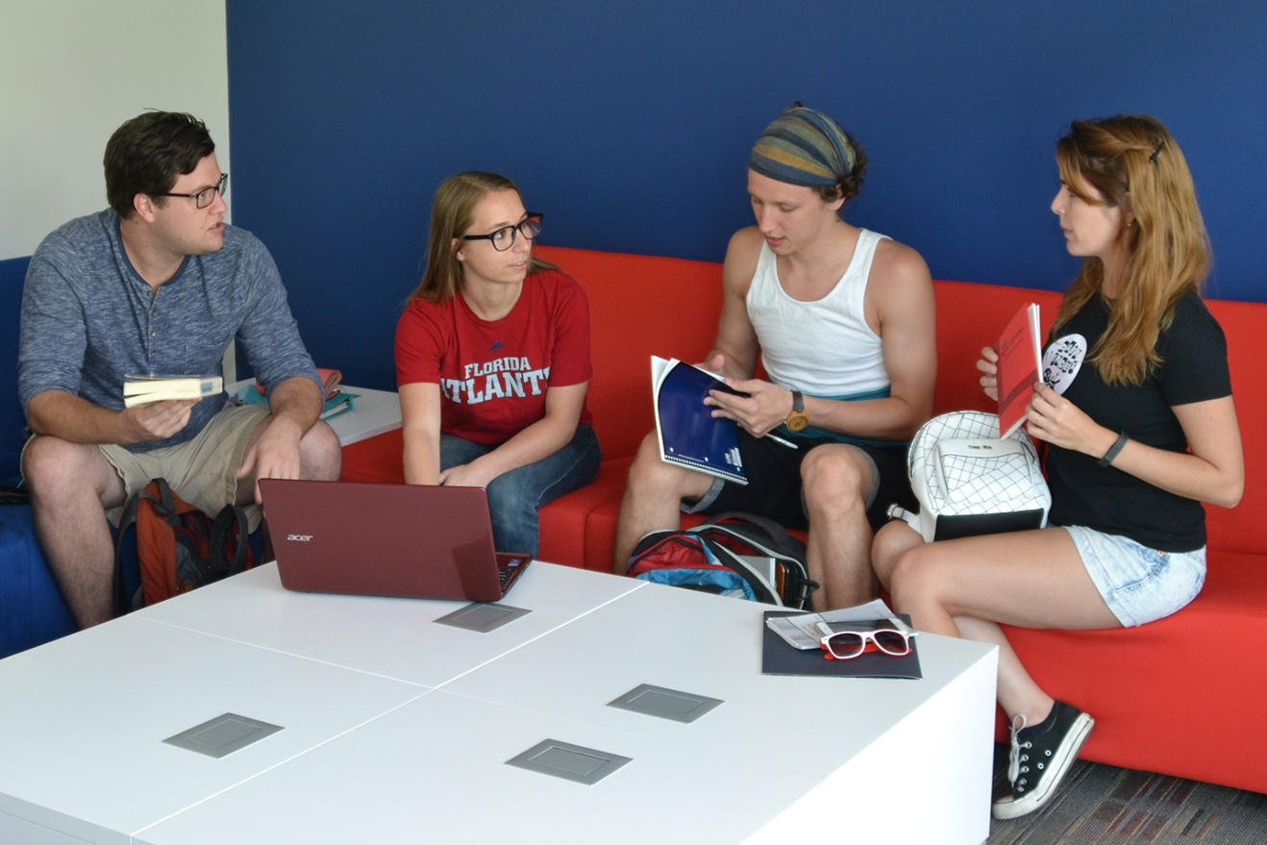
New Graduate Student Lounge
Wimberly Library Being Transformed

Slide 17
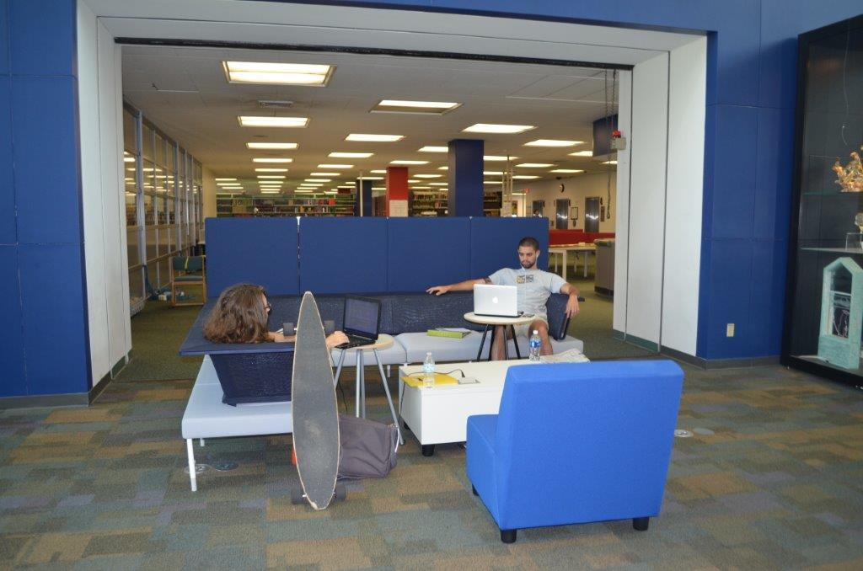
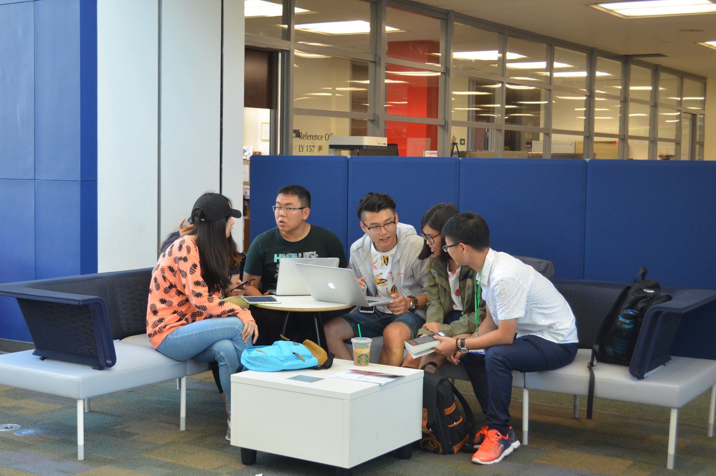
Wimberly Library Being Transformed
Students Enjoying the FAU Experience in the Wimberly Library

Slide 18
“We need colorful, comfortable, technology-rich spaces where students can study – alone or together – and create their own work.”
Carol Hixson
Dean of University Libraries

Slide 19
“We need flexible, vibrant, student-centered spaces.”
Carol Hixson
Dean of University Libraries

Slide 20
UNF Library

Slide 21
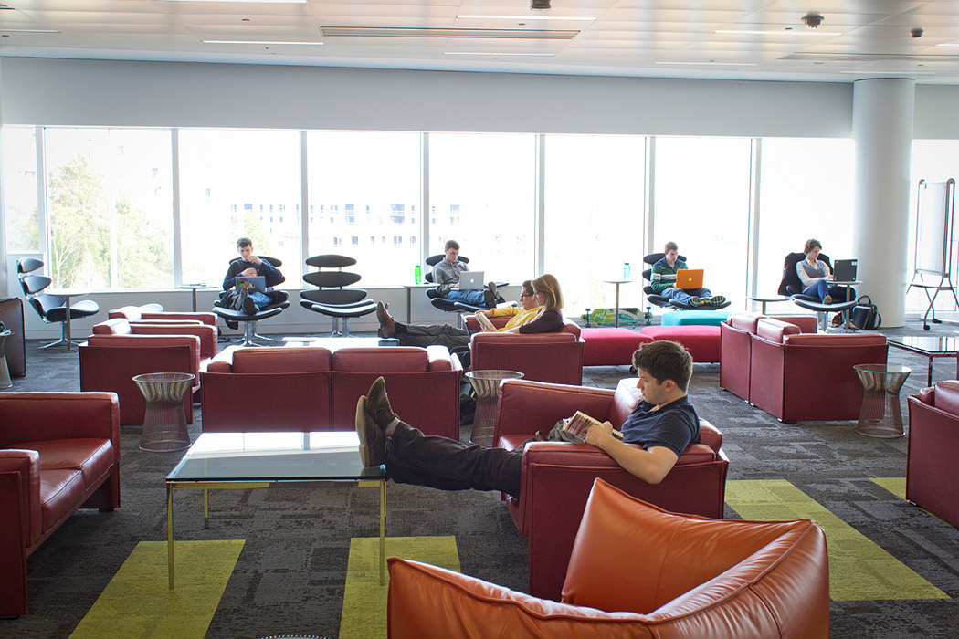
North Carolina State University Library

Slide 22
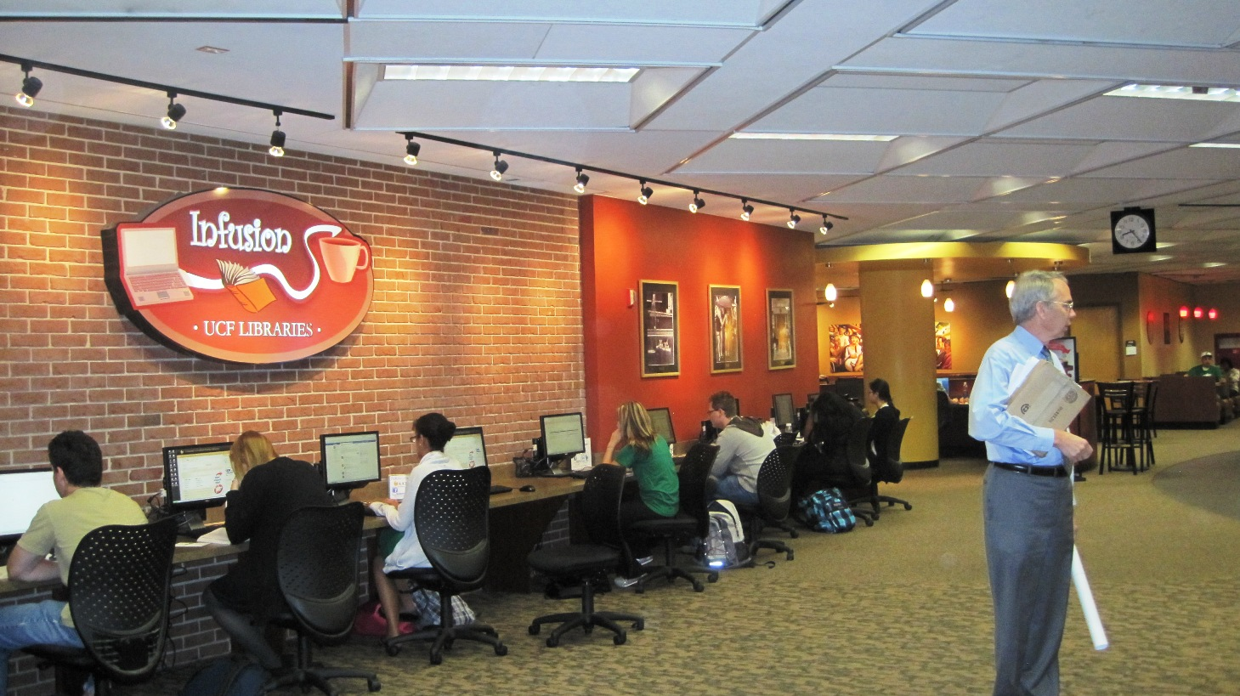
UCF Library

Slide 23
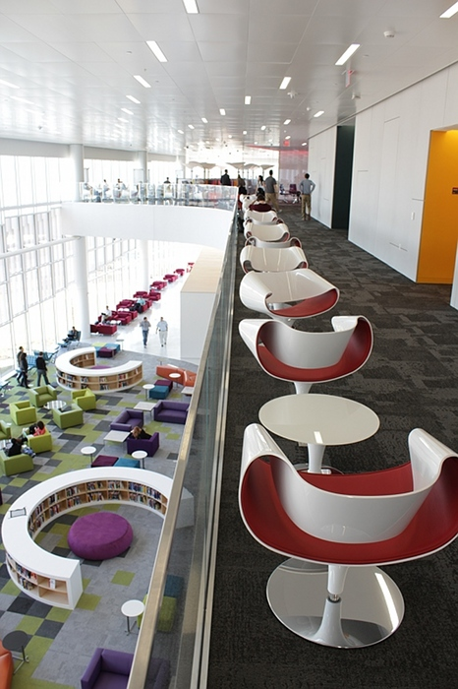
North Carolina State University Library

Slide 24
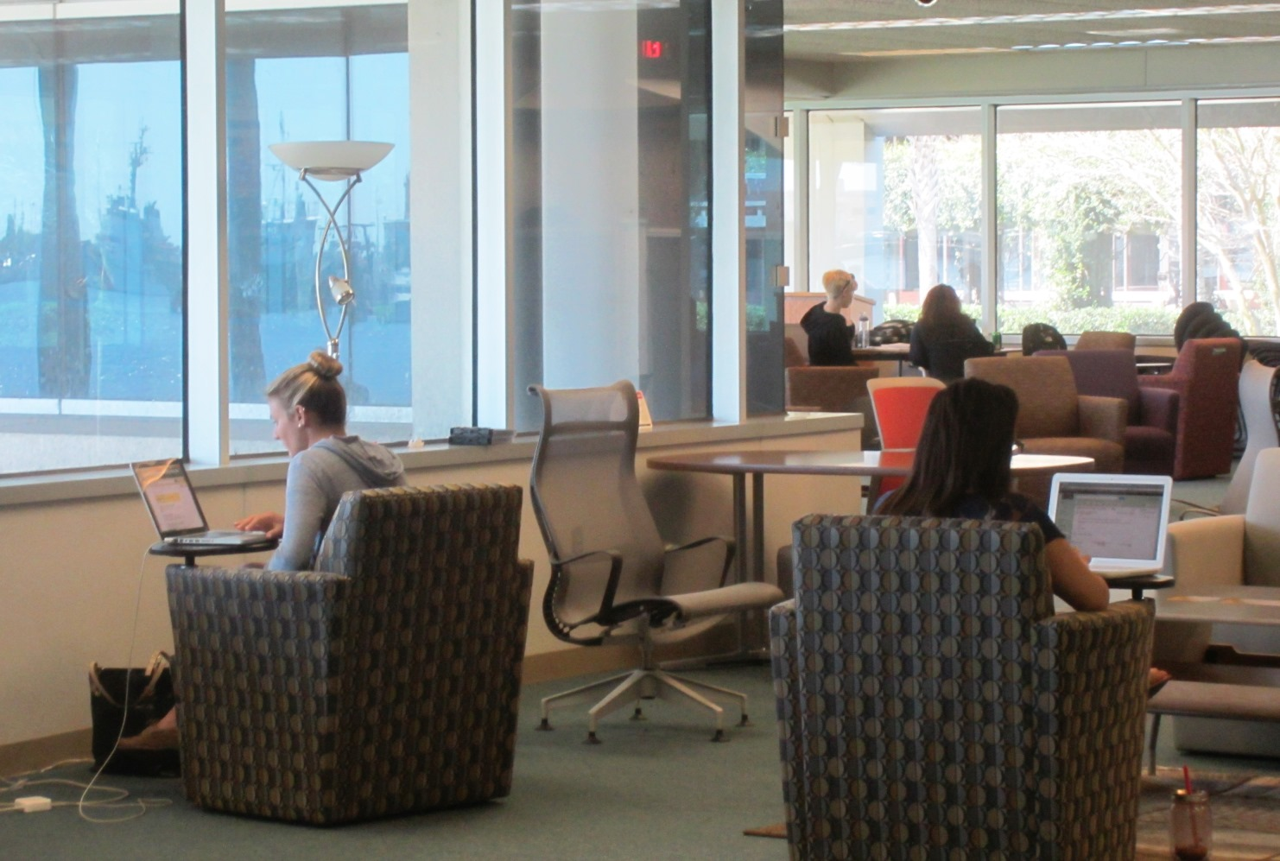
USF St. Petersburg Library

Slide 25
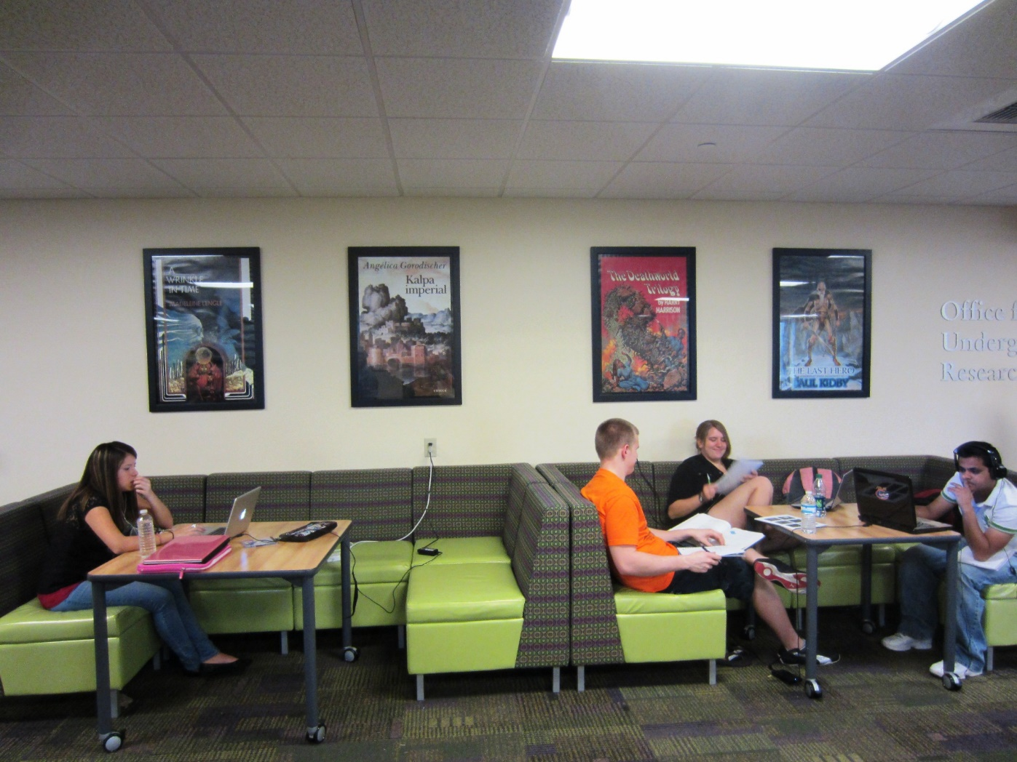
USF Tampa Library

Slide 26
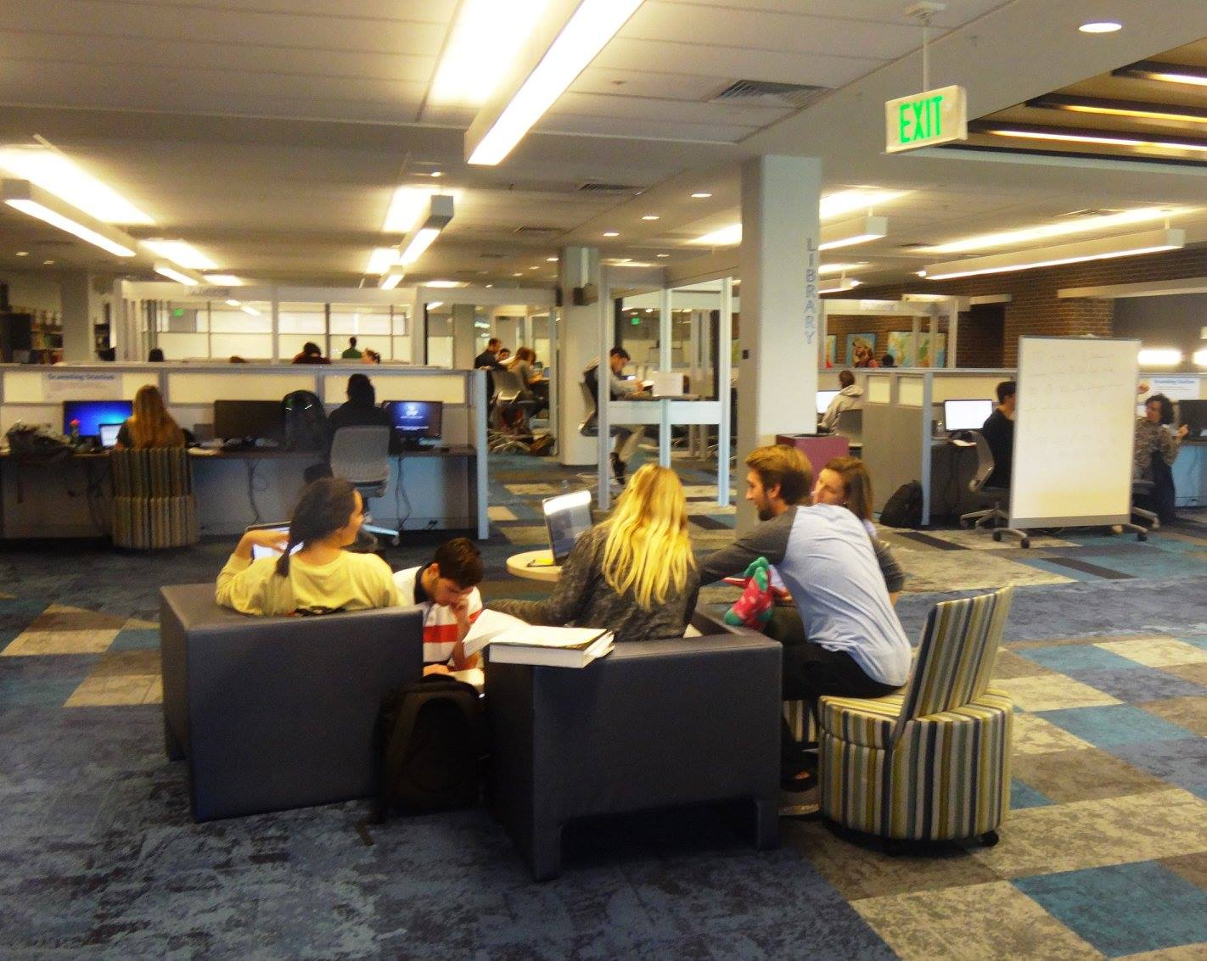
UNF Library

Slide 27
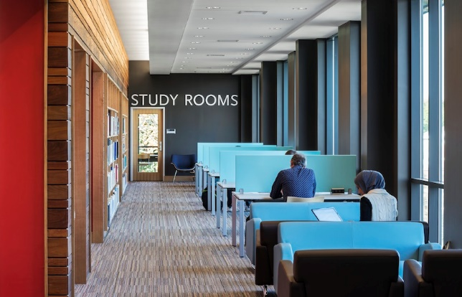
Southern
New Hampshire University Library

Slide 28
“The library should support and inspire student scholarship and creativity.”
Carol Hixson
Dean of University Libraries

Slide 29
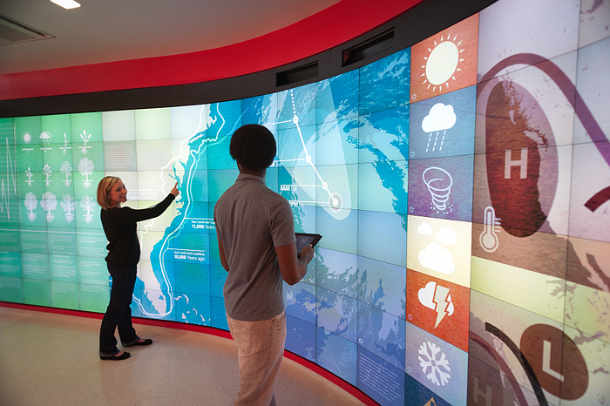
North Carolina State University Library

Slide 30
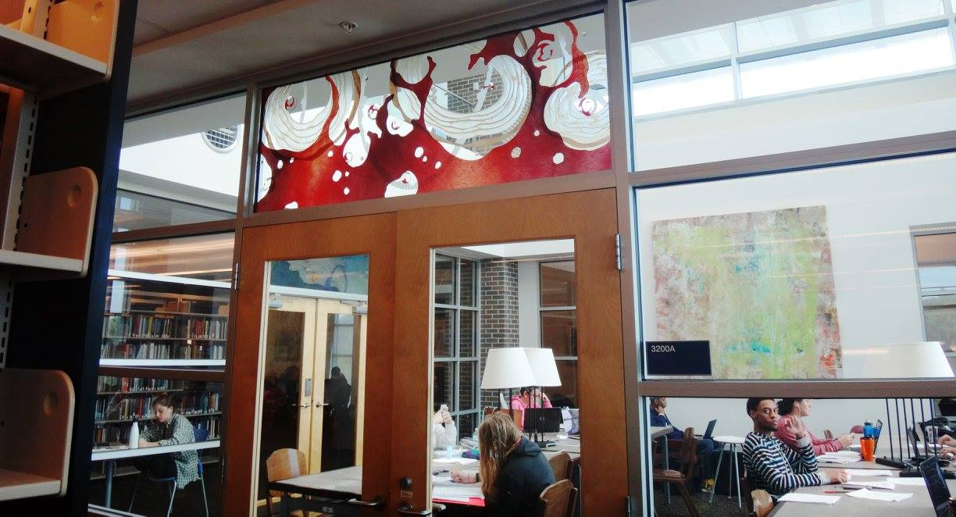
UNF Library

Slide 31
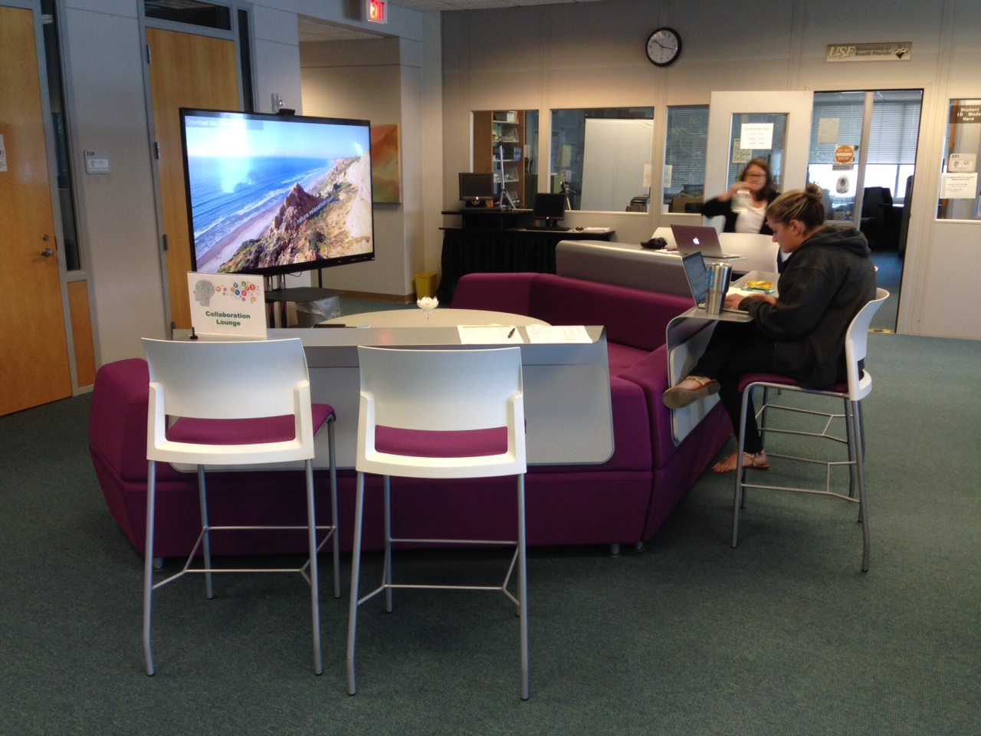
USF St. Petersburg Library

Slide 32
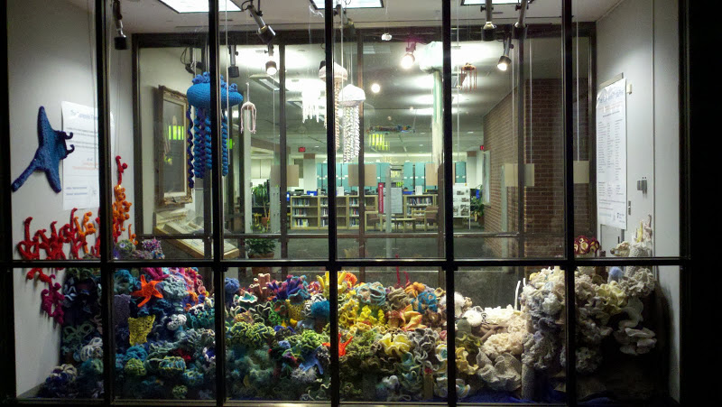
UF Marston
Science Library

Slide 33
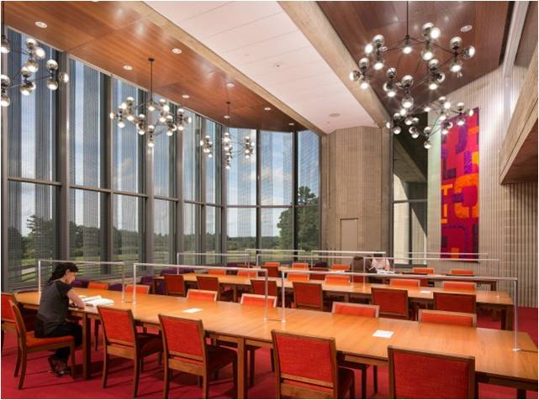
University of Massachusetts Dartmouth Carney Library

Slide 34
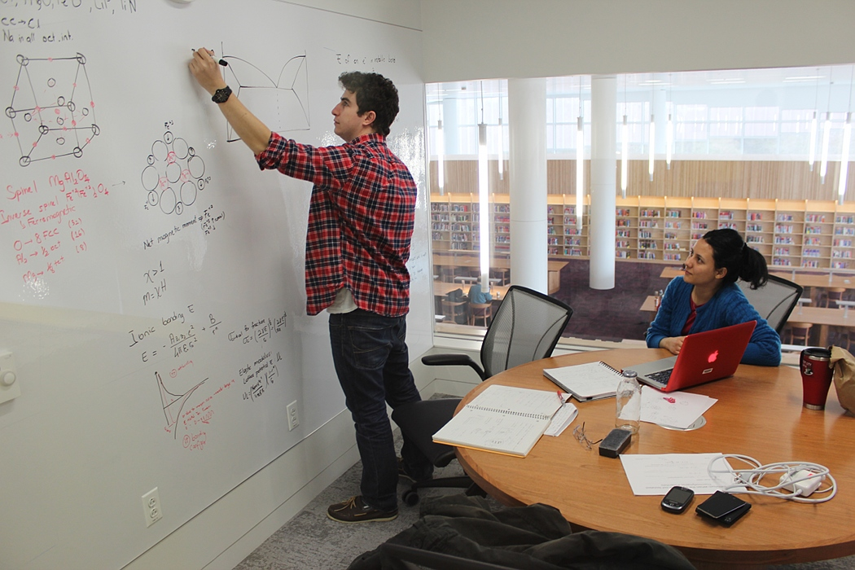
North Carolina State University Library

Slide 35
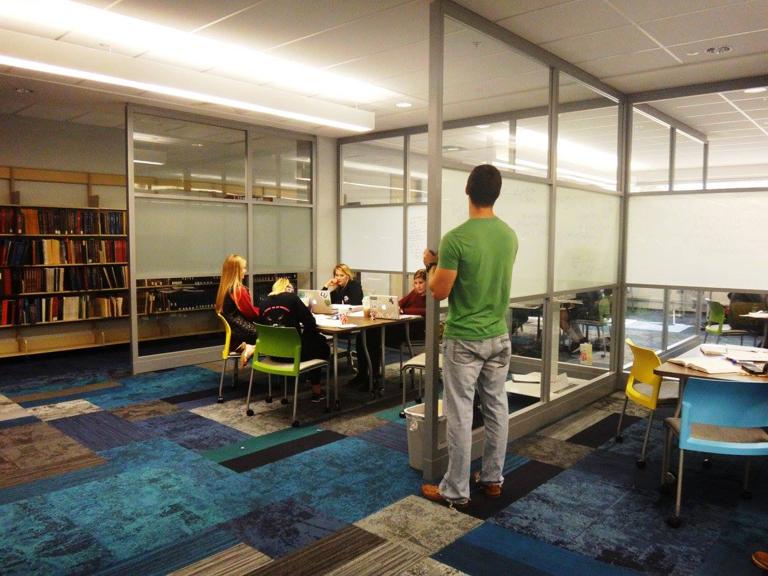
UNF Library

Slide 36
“We need new kinds of physical and virtual spaces for students to collaborate effectively and share their creative energy.”
Carol Hixson
Dean of University Libraries

Slide 37
UNF Library

Slide 38
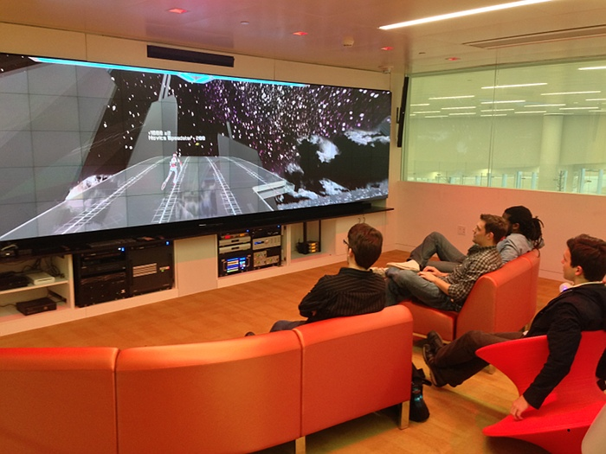
North Carolina State University Library

Slide 39
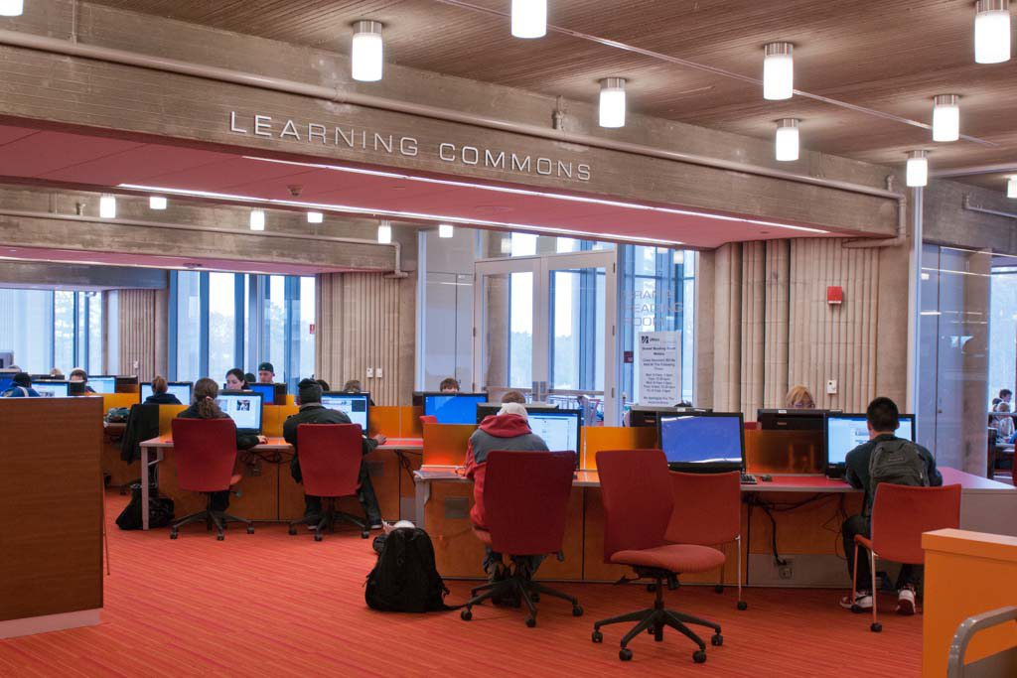
University of Massachusetts Dartmouth Carney Library

Slide 40
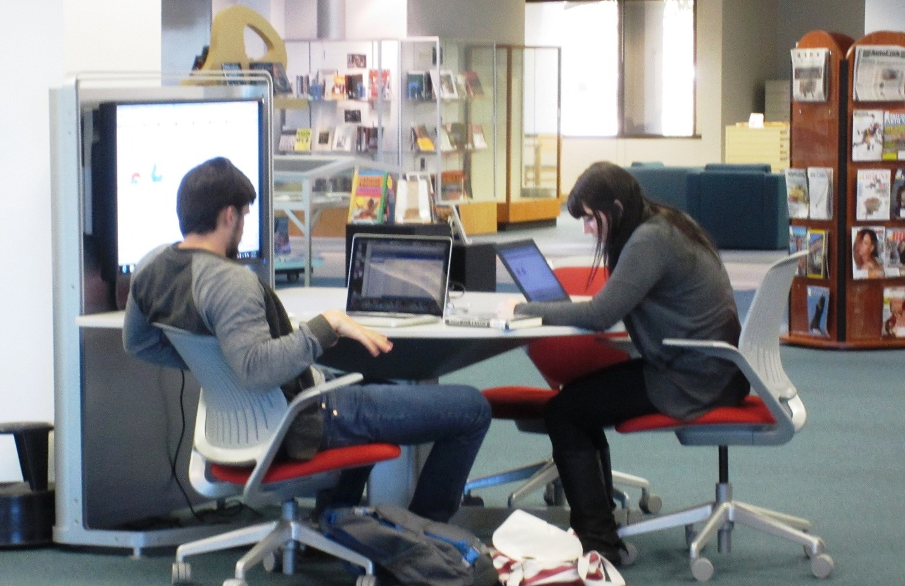
USF St. Petersburg Library

Slide 41
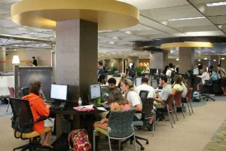
UCF Library

Slide 42
“Today’s libraries must have a variety of spaces and services meeting the needs of users expecting innovation while relying on trusted foundations.”
Carol Hixson
Dean of University Libraries

Slide 43
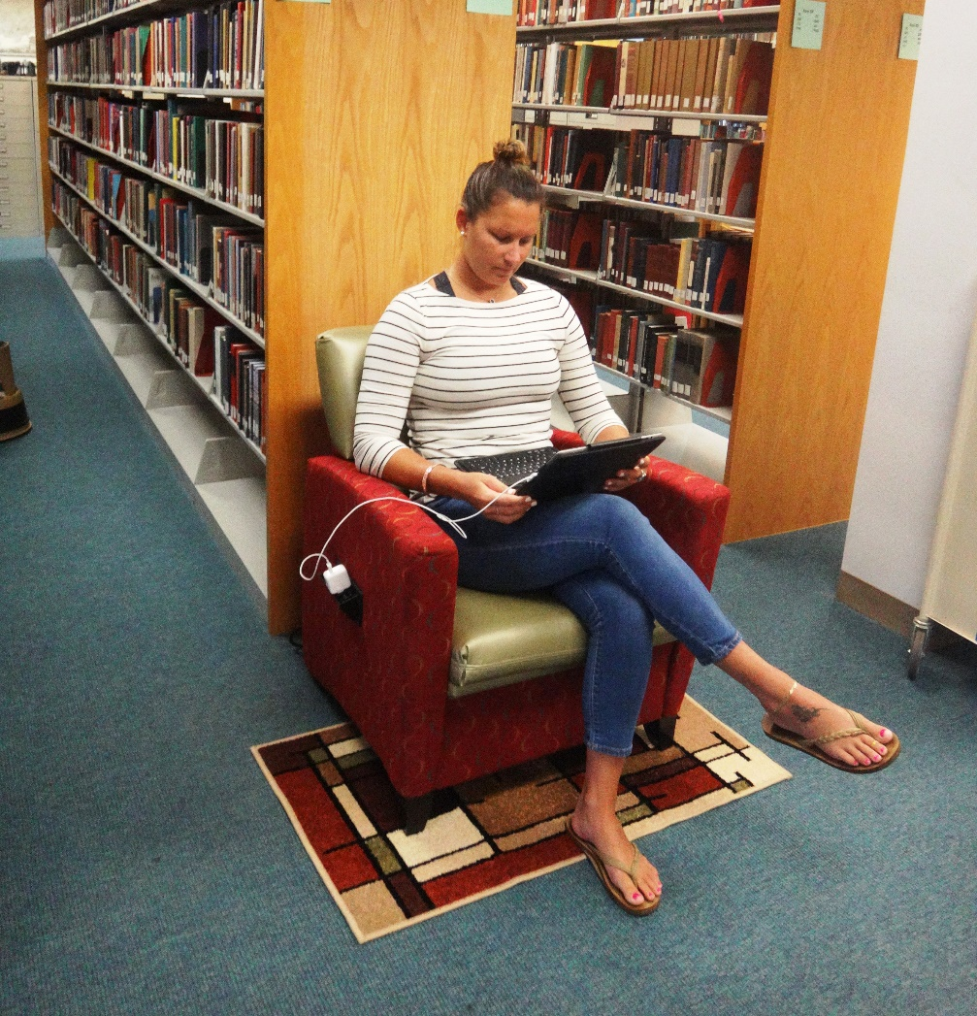
USF St. Petersburg Library

Slide 44
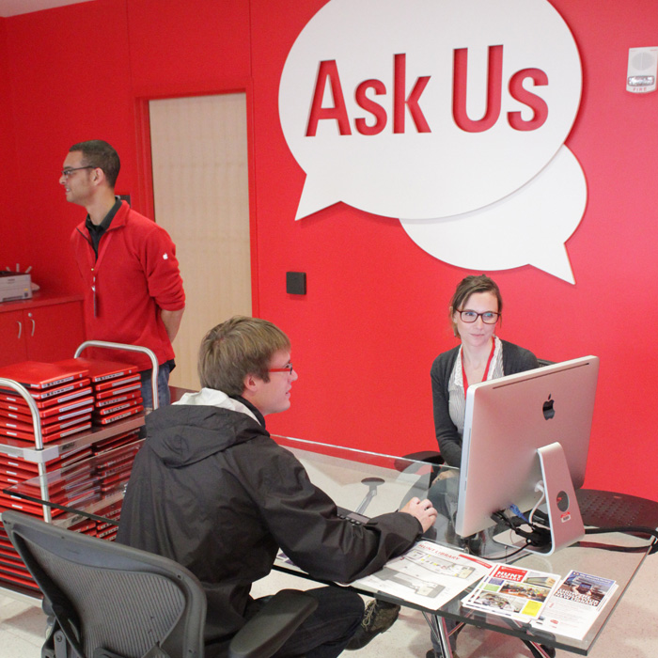
North Carolina State University Library

Slide 45
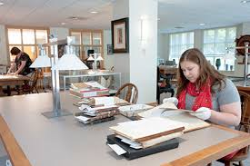
Southern New Hampshire University Library

Slide 46
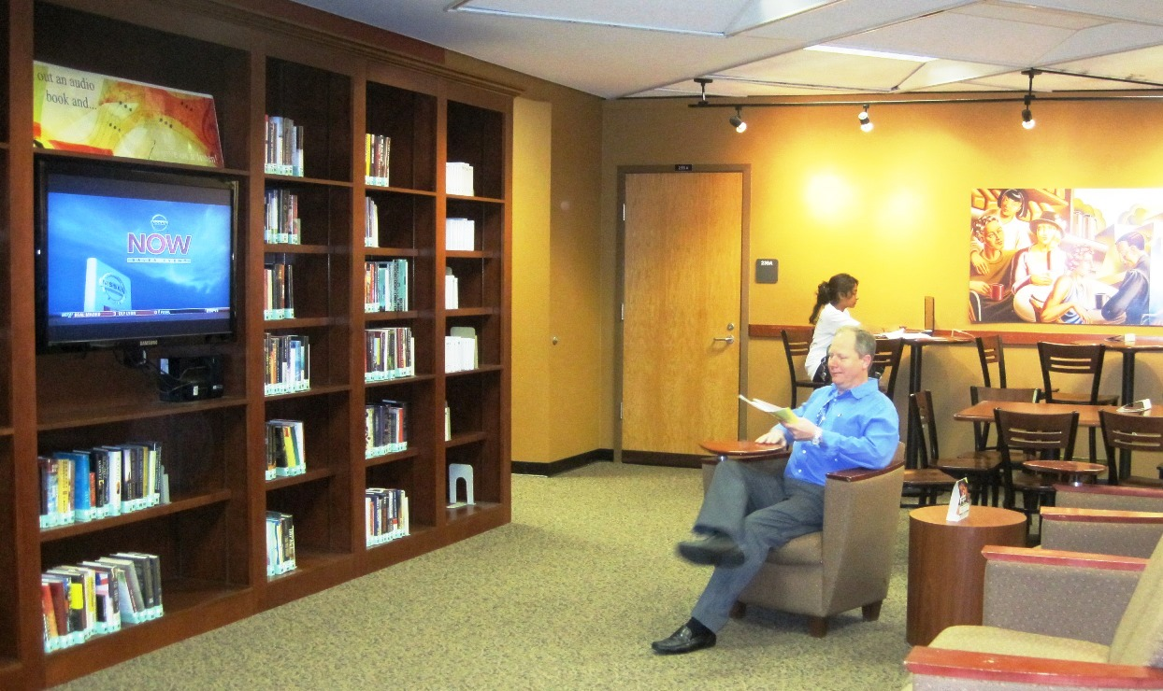
UCF Library

Slide 47
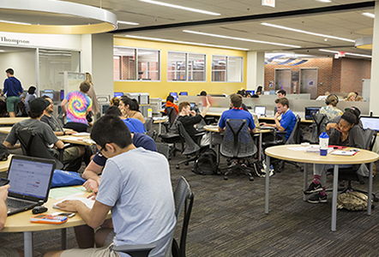
UF Marston Science Library

Slide 48
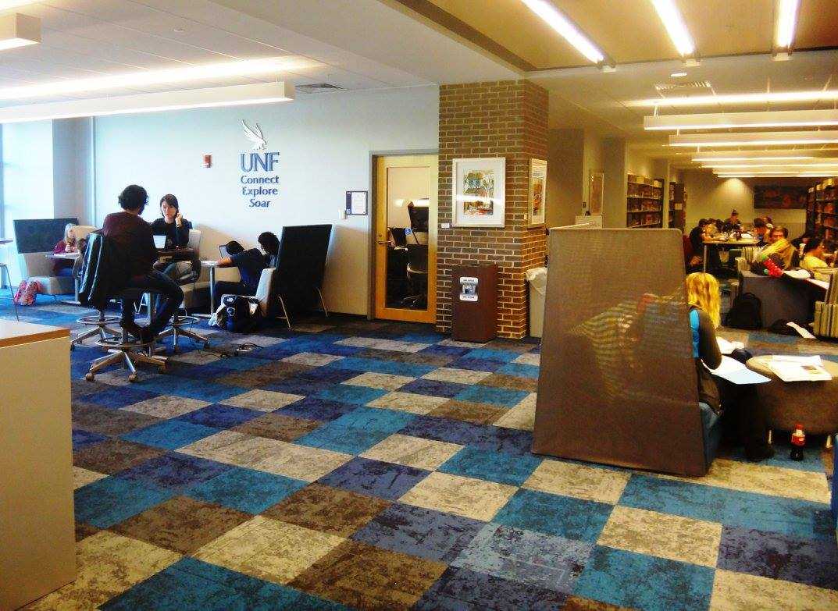
UNF Library

Slide 49
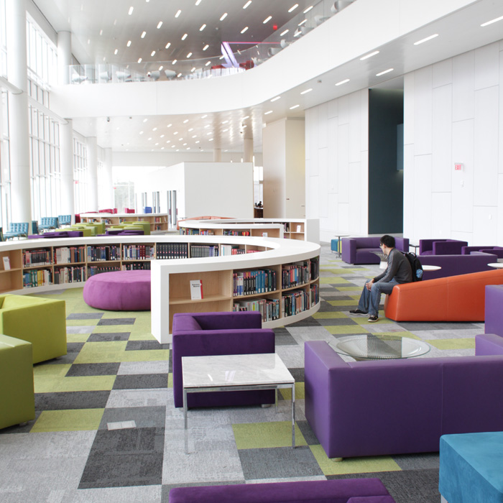
North Carolina State University Library

Slide 50
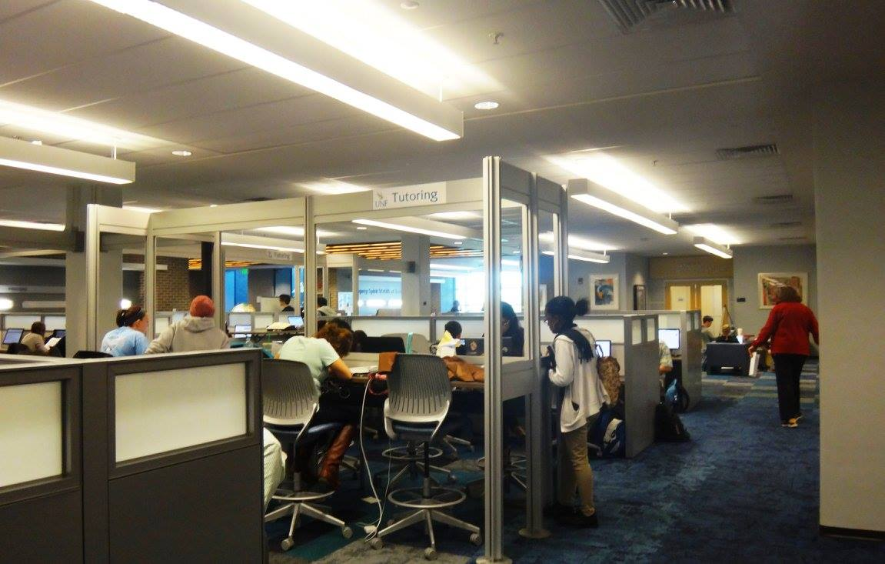
UNF Library

Slide 51
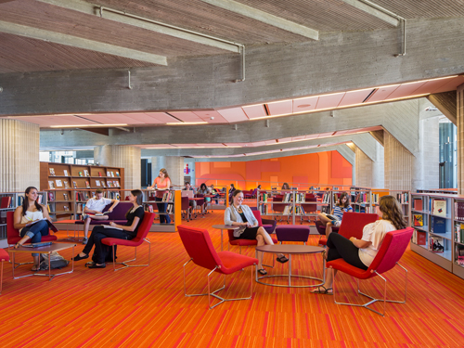
University of Massachusetts Dartmouth Carney Library

Slide 52
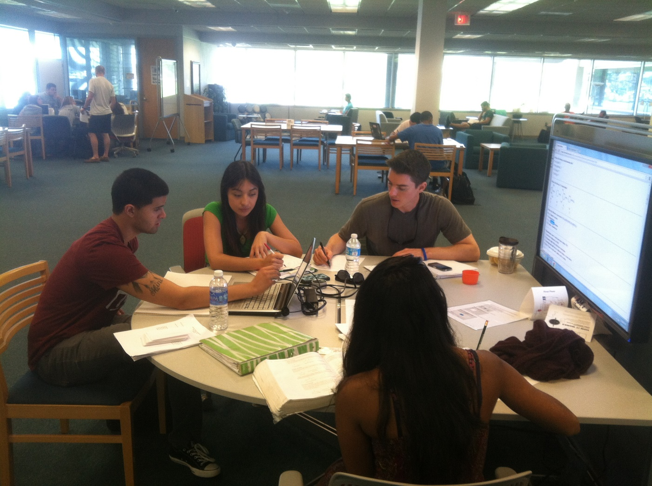
USF St. Petersburg Library

Slide 53
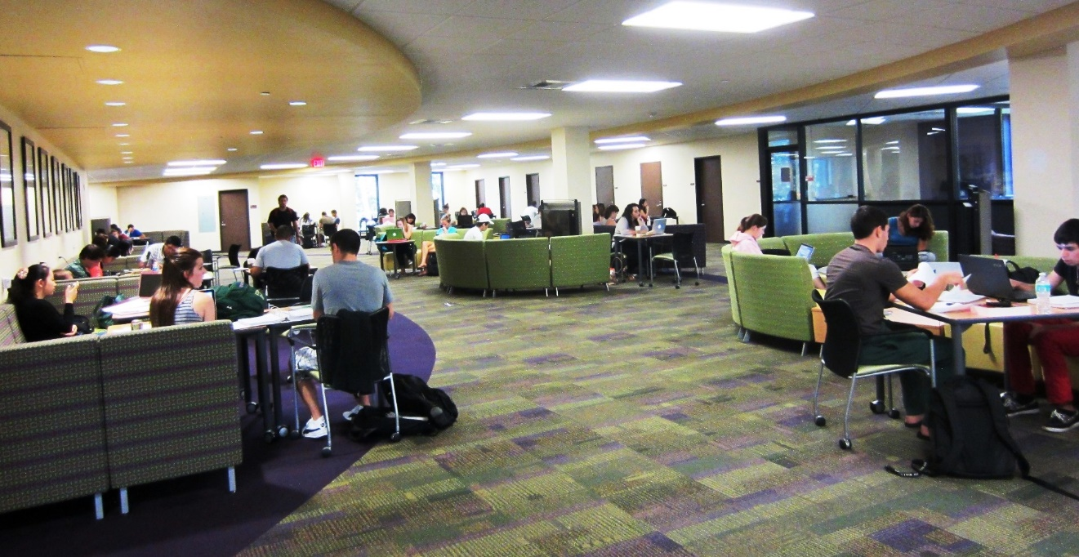
USF Tampa Library

Slide 54
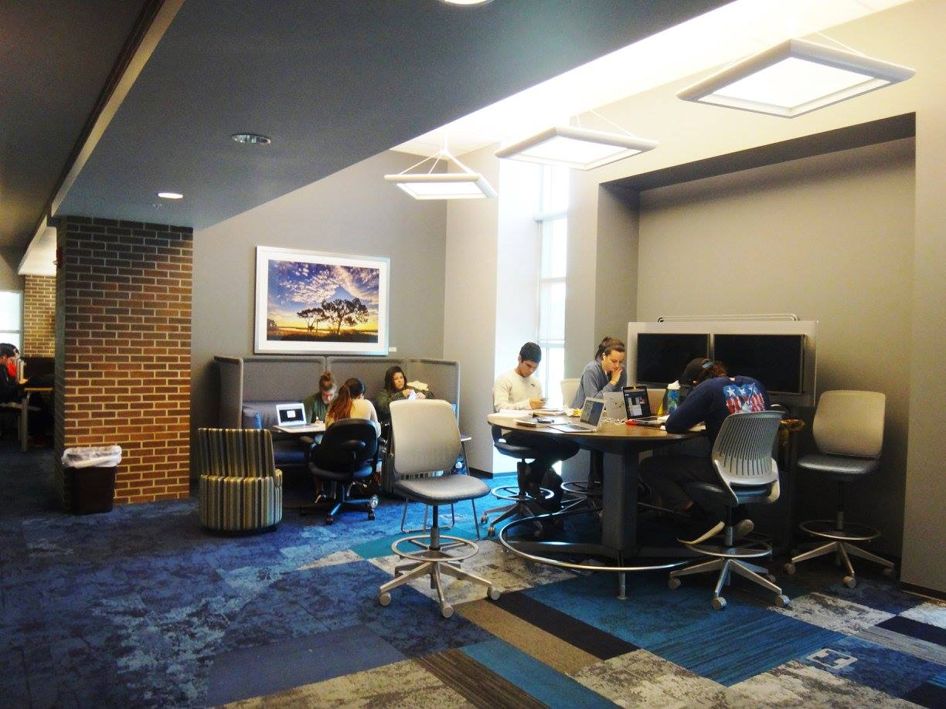
UNF Library

Slide 55
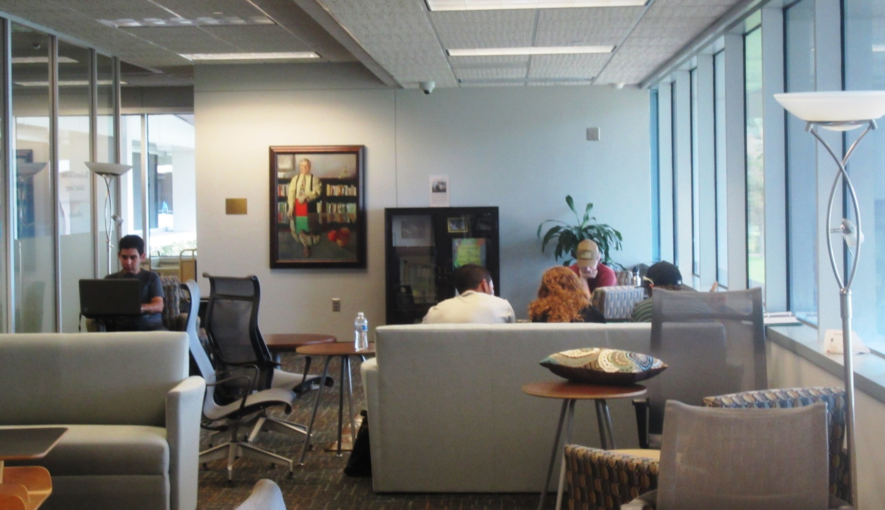
USF St. Petersburg Library

Slide 56
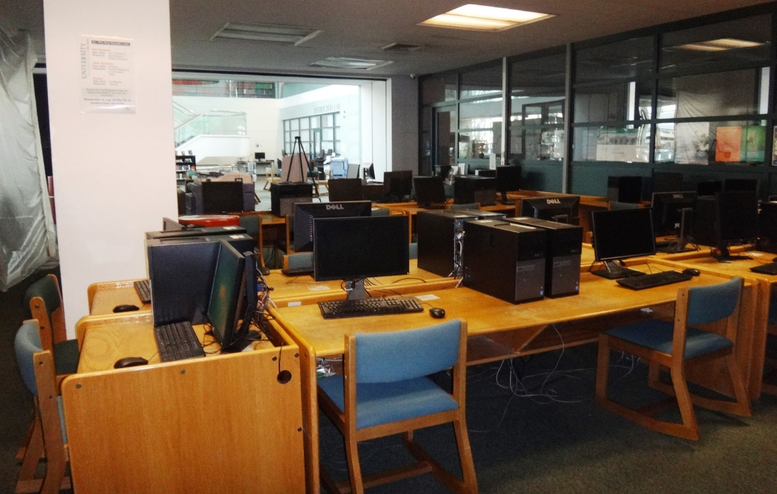
How Do We Get from Here to There?
Wimberly Today
Future Vision

Slide 57
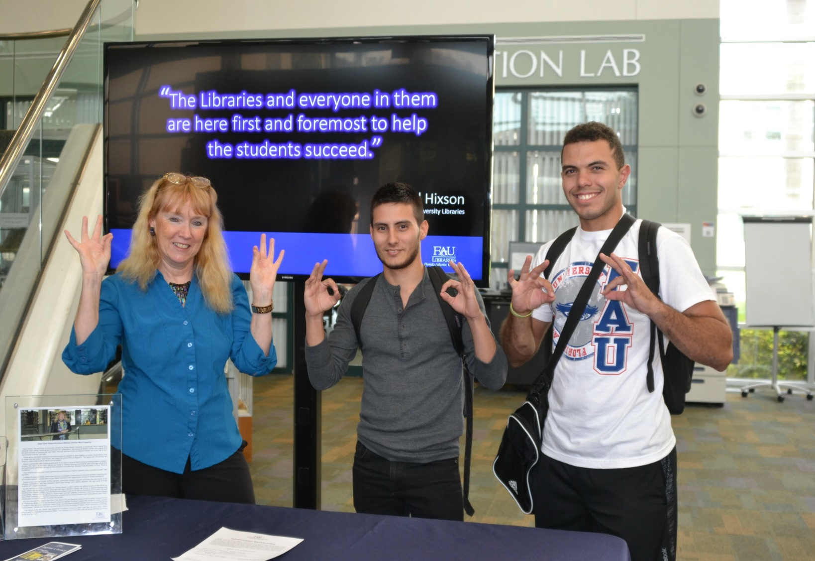
Listen to and Consult with Students

Slide 58

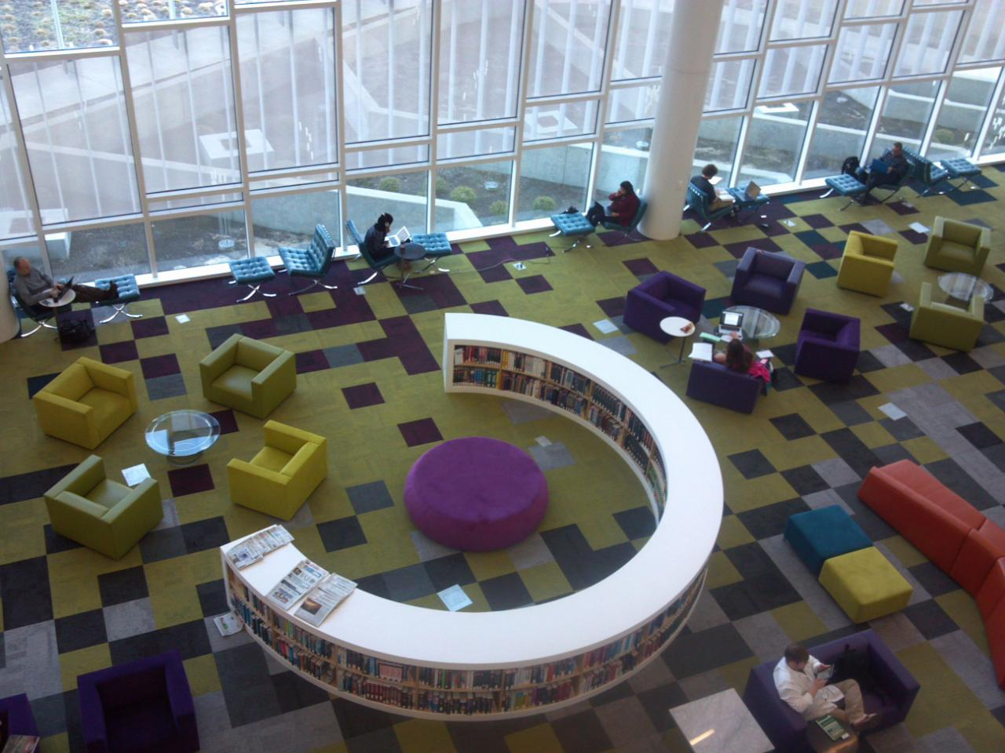
How Do We Get from Here to There?
Wimberly Today
Future Vision

Slide 59
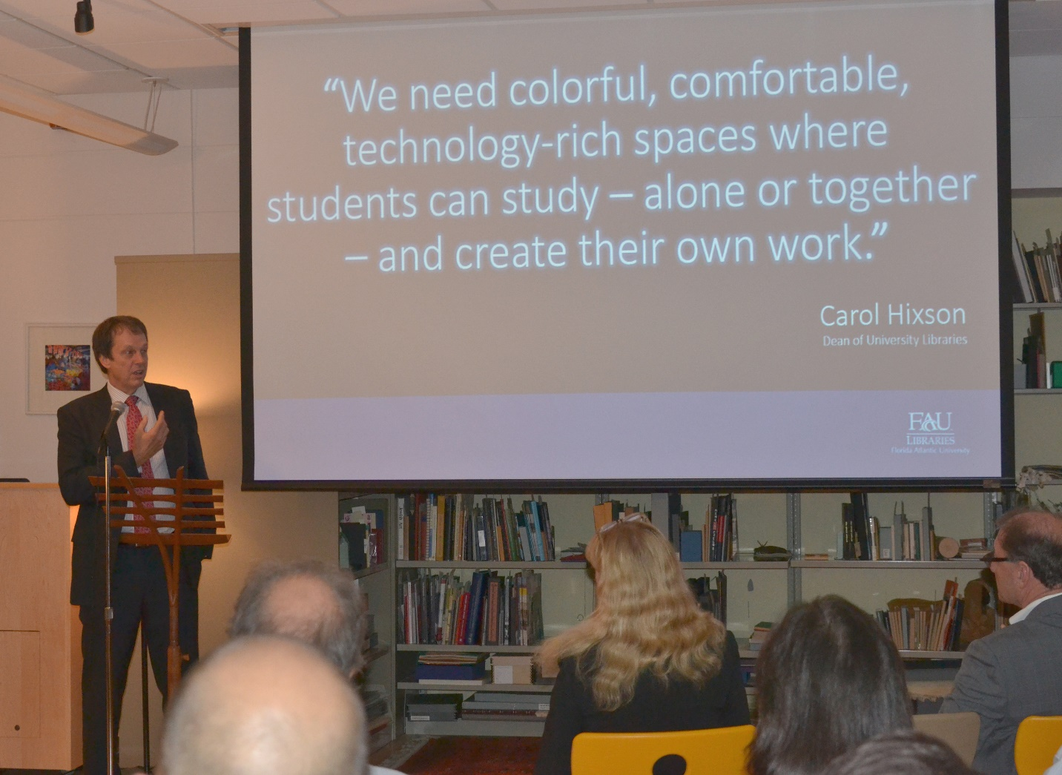
Develop a Shared Vision with Administration

Slide 60
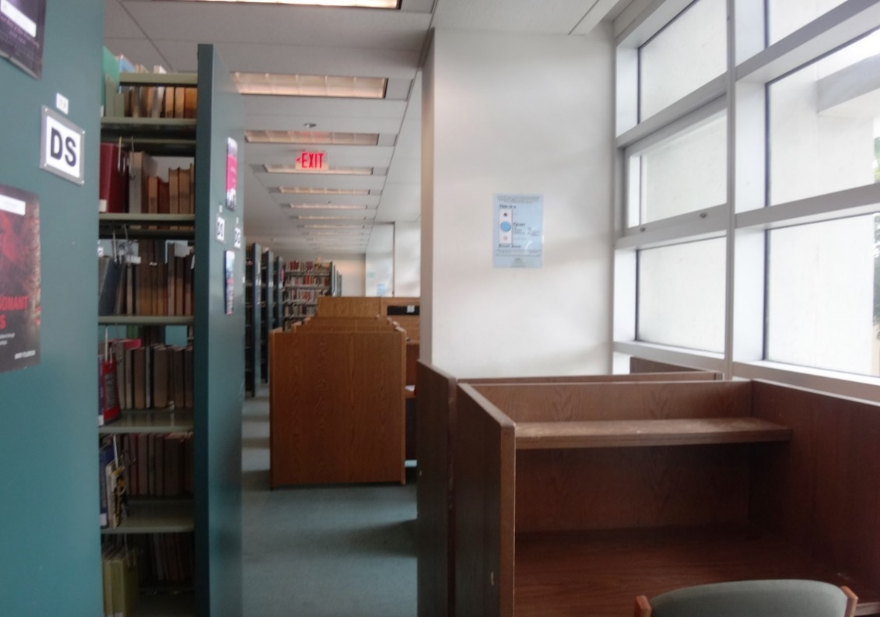

How Do We Get from Here to There?
Wimberly Today
Future Vision

Slide 61

Engage with the Community

Slide 62

How Do We Get from Here to There?
Wimberly Today
Future Vision

Slide 63

Inspire and Utilize Staff Creativity and Expertise

Slide 64

GO OWLS!
Carol Hixson
Dean of University Libraries

