Slide 1


Presenting VRA Core 5:
A Standard with Accessibility Baked In, Not Bolted On … and the tools to use it
Presenting VRA Core 5:
A Standard with Accessibility Baked In, Not Bolted On
…and the tools to use it
Notes:
Presenting VRA Core 5: A Standard with Accessibility Baked In, Not Bolted On…and the tools to use it: Welcome to a presentation from the Visual Resources Association’s committee for Cataloging and Metadata Standards (known as CaMS). We are excited to announce a comprehensive new project to update our metadata standard, VRA Core, to a new version (version 5), which will include accessibility support. Along with this update, we will also issue an updated supplement to the cataloging guide, CCO (Cataloging Cultural Objects).

Slide 2
Presenters
Presenters:
Bridget Madden, Associate Director, Visual Resources Center, University of Chicago
Susan Jane Williams, Independent Cataloger and Consultant
Notes:
Presenters: The “we” in question are Bridget Madden, Associate Director, Visual Resources Center, University of Chicago and Susan Jane Williams, Independent Cataloger and Consultant. We will show a video with narration, followed by a live Question and Answer discussion period. Please feel free to enter questions or comments in the chat section as the video plays; we will pick up on those afterwards.

Slide 3


Project Overview
Three Components
Project Overview
Three Components:
Database Tool with integrated VRA Core 5, CCO, and Authorities
Notes:
Project Overview, Three Components: So, our project entails three components: the updated VRA Core 5 metadata standard, the updated CCO (Cataloging Cultural Objects) cataloging guide, and a new database tool for cataloging which will integrate both of those in a practical workflow, as well as authorities from Library of Congress and the Getty. The database tool will serve as a “proof of concept,” an exemplar, and a springboard for demonstrating loading of the accessibility-ready data into a delivery system.

Slide 4
VRA Core, A Brief History
VRA Core, A Brief History:
Purpose built for Image and Work records
VRA Core 4 was published in 2007; first version to have an XML schema
The schema supports LOD (Linked Open Data)
An RDF ontology and transform was also developed from the XML expression
Project Overview
Notes:
VRA Core, A Brief History: The VRA Core standard was created by a committee within the Visual Resources Association and was purpose-built to describe both Works of cultural heritage and the Images or media that document them. VRA Core 4 (published in 2007) was the first version to have an XML schema, in other words, to become what is known as a transmission standard. Core 4 also supports using Linked Open Data (LOD), for example, to terms from the Getty vocabularies by means of a specific URI. Because of this, we have also published an RDF ontology and a transform to create RDF which supports LOD, from Core 4 XML.

Slide 5
Core 5, What’s New
Core 5, What’s New:
Accessibility support
One-point GIS for Work and Image records
Review of data values for IDEA (Inclusivity, Diversity, Equity and Accessibility)
Project Overview
Project Overview
Notes:
Core 5; What’s New: In the update we are calling VRA Core 5, we are adding accessibility support, which we will discuss shortly. We are also adding a simple one-point style GIS reference which can be used with both the Work and the Image records. This is the same type of reference which is published in Wikipedia articles about buildings. The Image reference would cite the position of the camera or recording device. The MARC standard has recently approved a similar reference. We are also doing a thorough review of not only our data standard and the publication CCO, but of all our support documentation and training materials for inclusivity, diversity, equity and accessibility issues (known under the acronym IDEA).

Slide 6
CCO (Cataloging Cultural Objects), A Brief History
CCO (Cataloging Cultural Objects), A Brief History:
Guideline for standardizing, formatting data entry, data values, published 2006
Joint project of VRA and the Getty
Can be used with multiple data standards, including museum standards
Project Overview
Notes:
CCO (Cataloging Cultural Objects), A Brief History: CCO is what is known as a data content standard, in other words a standard for guiding the substance and formatting of data values. It helps to promote good descriptive cataloging, shared documentation and enhanced end-user access. As a joint project of the Getty and the Visual Resources Association, it utilizes the Getty’s metadata standard, CDWA, as well as VRA Core to provide the structural framework for formatted examples. CDWA (Core Description of Works of Art) is a rich standard used in museum cataloging.

Slide 7
CCO, What’s New
CCO, What’s New:
A supplemental online PDF with new sections about:
Accessibility and how to provide for it
Using GIS references with work, site and image records
Review of inclusivity and equity in cataloging
Project Overview
Notes:
CCO; What’s New: In the short term, we will produce an online tagged PDF supplement to the 2006 publication. The original publication is also posted online as a free PDF. The supplement will have new sections about accessibility and how to provide for it; using GIS (global positioning) references for work, site and image records, and a review of inclusivity and equity in cataloging practices.

Slide 8
Proposed Database Tool as a Proof of Concept
Proposed Database Tool as a Proof of Concept
Integration of VRA Core 5, CCO, and cataloging Authorities in data entry
Utilizing automation of display values and transformation into accessibility-ready formats (via XSLT)
Will collaborate with delivery system vendors on collection templates and data loading protocols
Project Overview
Notes:
Proposed Database Tool as a Proof of Concept: The new database tool for cataloging will integrate both VRA Core 5 and CCO in a practical workflow, as well as authorities from Library of Congress and the Getty. It will automate things like creation of CCO style display fields. Most importantly, it will demonstrate the automatic transformation (via XSLTs) of the data entry to both the CSV (comma separated values) format and to HTML5 which supports screen reader accessibility, which will be an important step in loading data into digital collection delivery systems. We plan to work with major vendors to develop accessible collection templates and data loading protocols.

Slide 9
Accessibility Support within Digital Collections Delivery Systems
Accessibility Support within Digital Collections Delivery Systems
Thousands of records and items demand guided data entry, formatting automation, and data transformations
Project Overview
Notes:
Accessibility Support within Digital Collections Delivery Systems: Some of the accessibility work done to date involves online publications, or web pages that might be hand-coded with HTML5 edits and additions on an ad hoc basis. What we consider the most important focus of this project is creating accessibility specifically within digital collection delivery systems which may involve tens, if not hundreds, of thousands of records and images or other media. That scale demands solutions like guided data entry, formatting automation, and data transformations.

Slide 10
Creating Accessible Search and Delivery Support needed for Digital Collections
Creating Accessible Search and Delivery Support needed for Digital Collections:
Guided Suggestion (Browse) Lists
Linked Open Data (LOD) to authorities for definitions
Project Overview
Notes:
Creating Accessible Search and Delivery Support needed for Digital Collections: Another challenge of online collection delivery systems is enabling actions necessary for accessible search and selection of records and items. Some solutions which fill that need are the creation of guided search and browsing pick lists and the use of Linked Open Data (LOD) terms, which can link out to definitions via the Getty and other linked authorities.

Slide 11
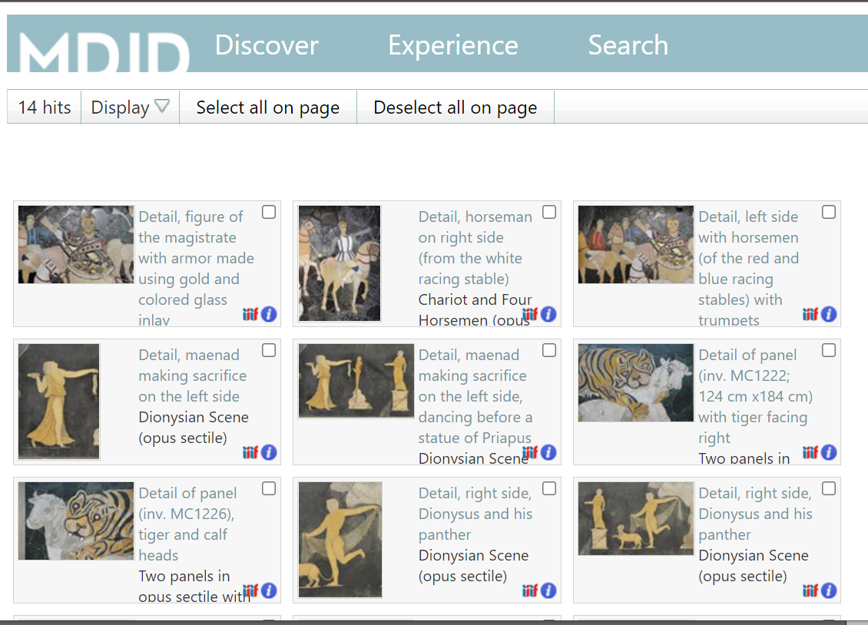
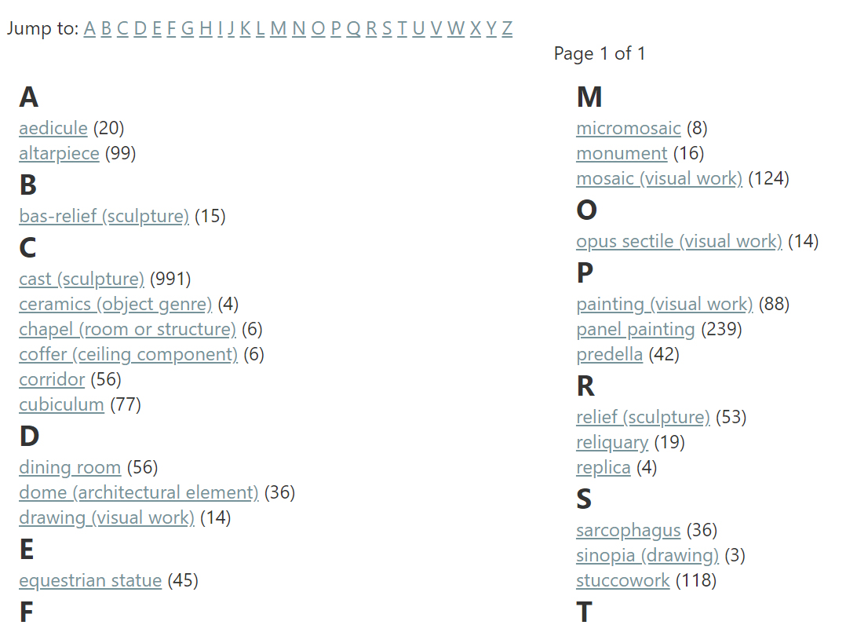

Guided Browsing
Guided Browsing:
Project Overview
Accessibility within Standards
Notes:
Guided Browsing: In this example, a “Who, What, Where, When” browsing function has been developed. The categories correspond to the VRA Core elements Agent, Work Type, Location and Style/Period. Within these categories alphabetically listed values link to items and records in the digital collection. Shown here is the “What” or Work Type list with the collection search hits that result from selecting the term “opus sectile.”

Slide 12
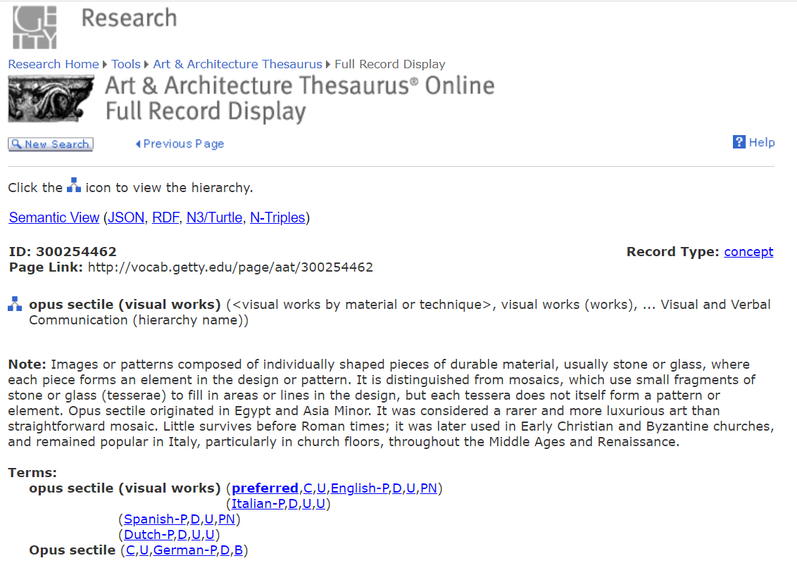
Guided Browsing and Linked Data
Guided Browsing and Linked Data:
Project Overview
Accessibility within Standards
Notes:
Guided Browsing and Linked Data: The “Who, What, Where, When” browsing function lists are auto-created from the VRA Core cataloging records, using the parsed index values from Agent, Work Type, Location and Style/Period. In VRA Core 4 and 5 cataloging, these can be accompanied by the linked data record number (known as the “ref ID”). Hence this link is also available should the user want to open the authority record as well. Shown here is the Getty authority record for the term “opus sectile” with the definition and other information.

Slide 13
System-driven Accessibility
System-driven Accessibility:
Determining what features require system-based solutions; for example, customizable font sizes
Accessibility within Standards
Notes:
System-driven Accessibility: Accessibility support must be evaluated in terms of identifying those features which demand a delivery system solution. An example of this would be customizable font sizes.

Slide 14
Data-driven Accessibility
Data-driven Accessibility:
Determining what stored data values can be translated into HTML5 tags
Project Overview
Accessibility within Standards
Notes:
Data-driven Accessibility: Because of the challenges represented by digital collections with thousands of records, it makes sense to find ways to automate, or “bake in” accessibility at the original data entry stage of the workflow. Our goal with VRA Core 5 is to determine all the ways we can store data values that can easily translate to HTML5 tags by means of an automatic transform like an XSLT upon export and loading to a delivery system.

Slide 15
Creating Stored Data “Triggers” for HTML5 Transforms from XML
Creating Stored Data ‘Triggers’ for HTML5 Transforms from XML
Example: Creating and storing the XML “type” value <alternativeText> can be easily automated to transform to the HTML5 markup alt=“ ”
Project Overview
Accessibility within Standards
Notes:
Creating Stored Data ‘Triggers’ for HTML5 Transforms from XML: For example, it is easy to configure the Core 5 standard to use the XML subelement “type” to store the value “alternative text”, which in XML, would be formatted between the angle bracket symbols and use no spaces, but intercaps, so the T in Text would be capitalized. This formatted value could be consistently recognized and be automatically transformed into the HTML5 markup, which is alt= (lower case a, l, t followed by the equal sign).

Slide 16
Determining Support Needs Specific to a Standard
Determining Support Needs Specific to a Standard
Standards are created for specific communities and cataloging parameters
Many standards differ in depth, or richness, of descriptive data
Accessibility will generally follow the same depth of detail
Accessibility within Standards
Notes:
Determining Support Needs Specific to a Standard: Standards are created for specific communities and answer specific cataloging parameters for those communities and their collections. Many standards differ in depth, or richness, of descriptive data. Accessibility will generally follow the same depth of detail for a given standard. Library professionals are well aware of time and money constraints on cataloging practices. How accessibility support factors into these practices will be an evolving discussion.

Slide 17
Support Specific to VRA Core 5
Support Specific to VRA Core 5
Richer than Dublin Core, less than CDWA (Core Description of Works of Art)
Accessibility support will redefine the notion of a “minimal record” for all standards
Project Overview
Accessibility within Standards
Notes:
Support Specific to VRA Core 5: VRA Core was conceived as a flexible standard that could be expressed in a minimal record form, or as a relatively rich record. It is more complex than Dublin Core, but less comprehensive than CDWA (the Getty’s museum standard). The need for accessibility support will, for the first time, expand the notion of what the minimal record will require, if data-driven accessibility is adopted.

Slide 18
Creating and Storing Alternative Text Within VRA Core
Creating and Storing Alternative Text Within VRA Core:
VRA Core is composed of 15 Elements plus some global attributes and other modifiers (“types”)
All of the Elements (like Title, Location, Description) can be applied to both Work and Image records
All Elements can be repeated (have multiple entries)
Project Overview
Accessibility within Standards
Notes:
Creating and Storing Alternative Text Within VRA Core: It makes sense that any efforts in creating alternative text, also called alt text, should be stored within the record just as one would do with any other data value. There are quite a few places in VRA Core where alt text might be written and included. VRA Core is composed of 15 Elements plus global attributes and other modifiers such as “types”. All 15 elements (like Title, Location, Description can be applied to both Work and Image records. All Elements may also be repeated (have multiple entries).

Slide 19
Creating and Storing Alternative Text: Proposed VRA Core Elements or “types”
Creating and Storing Alternative Text: Proposed VRA Core Elements or “types”
Description (in both Work and Image records)
Inscription
Transcription
Accessibility Hazard (alt text, e.g., “flashing lights”)
Translation
Audio Description
Captions
Project Overview
Accessibility within Standards
Notes:
Creating and Storing Alternative Text in VRA Core: As a first step, the comprehensive accessibility data values list for use in web schemas, developed by the W3 organization, was studied to determine accessibility support types that would be used in the VRA Core user communities. (This is still under review). A preliminary list identifies the existing VRA Core 4 Elements, Description and Inscription, which can be expressed for both Work and Image records. Transcription may be added as a Core 5 element or incorporated as a subelement or “type” modifier. Other terms to be incorporated include Accessibility Hazard, Translation, Audio Description and Captions.

Slide 20
Creating and Storing Accessible URIs
Creating and Storing Accessible URIs
Accessible URIs require both an alt text version of the link and an action or navigation choice
VRA Core supports linked data as well as “hrefs” (specific actionable links) which can be a subelement added to any Core element/field
Project Overview
Accessibility within Standards
Notes:
Creating and Storing Accessible URIs: While a good deal of attention is paid to the creation of alt text, true accessibility support is more complex. Linked data is an important part of modern cataloging. Creating accessible URIs requires both an alt text version of the link, and further action or navigational choices. (For example, opening the link in a new page or tab). VRA Core supports linked data as well as additional “hrefs” (specific actionable links to sources outside the database). Hrefs are a global element, a subelement which may be added to any Core Element or field.

Slide 21
Storing Values for other forms of Accessibility
Storing Values for other forms of Accessibility Support (Working with Vendors)
Navigation and Download Options
Accessibility Hazards (alt text description plus action choices plus generic warning flags)
Stored values will probably be “type” modifiers
Project Overview
Accessibility within Standards
Notes:
Storing Values for other forms of Accessibility Support (Working with Vendors): Some accessibility support may still be data-driven but will also require working with vendors to function in specific systems. Examples of this are navigational and download options and accessibility hazards. Accessibility hazards will be multi-step, entailing an alt text description of the specific hazard (e.g., “flashing lights”) and action choices plus generic warning flags. Whether this will be expressed through a new Core 5 Accessibility Element or be handled with stored “type” modifiers is under review.

Slide 22
Storing Values for Non-English Language Support
Storing Values for Non-English Language Support
Screen readers can be configured to recognize and read non-English languages
The HTML5 tag includes the ISO-639 code for the language to signal the screen reader
VRA Core 4 already has ISO language support for titles; this will be expanded in Core 5
Project Overview
Accessibility within Standards
Notes:
Storing Values for Non-English Language Support: Screen readers can be configured to recognize and read non-English languages. The use of the HTML5 LANG tag (lang="“) signals the screen reader to switch to another language and includes the ISO-639 language code to identify it. VRA Core 4 already supports ISO-639 subelements in the Title field. The Title Element must identify one Title as the “preferred” Title in XML but may repeat to support alternate titles in the language native to the cultural object. This will be expanded in Core 5 to descriptive text such as Translation and Inscription.

Slide 23
Working with Vendors
Working with Vendors
One outcome of the Database Project would be two data format XSLTs: a complete, flat CSV (Comma Separated Values) version and another with HTML5 tagging
Would seek to work with vendors to test load data into systems and develop collection templates
Even for those not using Core 5, this might be a helpful model or springboard
Project Overview
Testing
Notes:
Working with Vendors: One of the specific goals of the Database Project would be the creation of two XSLT scripts; one which would produce a complete, flat CSV (Comma Separated Values) version and another which would produce an HTML5 tagged version, both from VRA Core 5 XML. Most collection delivery systems load data into the system via CSV. An outcome of the project would be to work with vendors to test load data, and to help them develop collection templates and accessibility support. Even for those not using Core 5, this might be a helpful model or springboard.

Slide 24
UX and Screen Reader Testing
UX and Screen Reader Testing
The Database Project is going to be aligned with output in the MDID delivery system and in our revamped web-based cataloging examples (for VRA Core and CCO)
This will allow us to test and adjust, as well as solicit user input
Project Overview
User Experience and Testing
Notes:
UX (User Experience) and Screen Reader Testing: The Database Project is going to be aligned with output in the MDID delivery system and will also be used in our revamped web-based cataloging examples (for VRA Core and CCO). This will allow us to test and adjust, as well as solicit user input.

Slide 25
Project Timeline
Project Timeline
The first step will be creation of the Core 5 XML schema
A draft of the Core 5 schema (and sample records) will be presented at the VRA Convention in March 2022 and made available for public review and comment
Project Overview
User Experience and Testing
Notes:
Project Timeline: The first step will be creation of the Core 5 XML schema. A draft of the Core 5 schema (and sample records) will be presented at the VRA Convention in March 2022, at which time it will be made available for public review and comments.

Slide 26
Links
Links
Cataloging and Metadata Standards Committee (CaMS)
CCO (Cataloging Cultural Objects)
VRA Core (Library of Congress site)
Accessibility Types from W3
Notes:
Links: Here is a short list of links including the CaMS committee page, CCO site, VRA Core site hosted by Library of Congress and the list of W3 schema accessibility types.

Slide 27
Contact Us
Contact Us
Bridget Madden
bridgetm@uchicago.edu
Susan Jane Williams
williams.susanjane@gmail.com
Notes:
Contact Us: Please feel free to contact us if you have questions or input about the project. We will also be seeking reviewers throughout the project. Thank You!

