Slide 1
Ordinary and Extraordinary Americans
A Celebration of African Americans Yesterday and Today
Exhibit prepared by Carol Hixson and Diane Arrieta

Slide 2
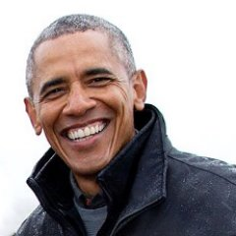
Barack Obama
“A change is brought about because ordinary people do extraordinary things.”
“I believe in evolution, scientific inquiry, and global warming; I believe in free speech, whether politically correct or politically incorrect, and I am suspicious of using government to impose anybody's religious beliefs -including my own- on nonbelievers.”

Slide 3
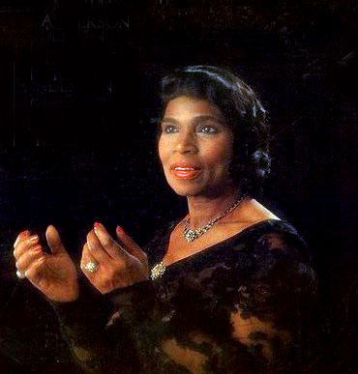
Marion Anderson
“When I sing, I don't want them to see that my face is black. I don't want them to see that my face is white. I want them to see my soul. And that is colorless.”
“Prejudice is like a hair across your cheek. You can't see it, you can't find it with your fingers, but you keep brushing at it because the feel of it is irritating.”

Slide 4
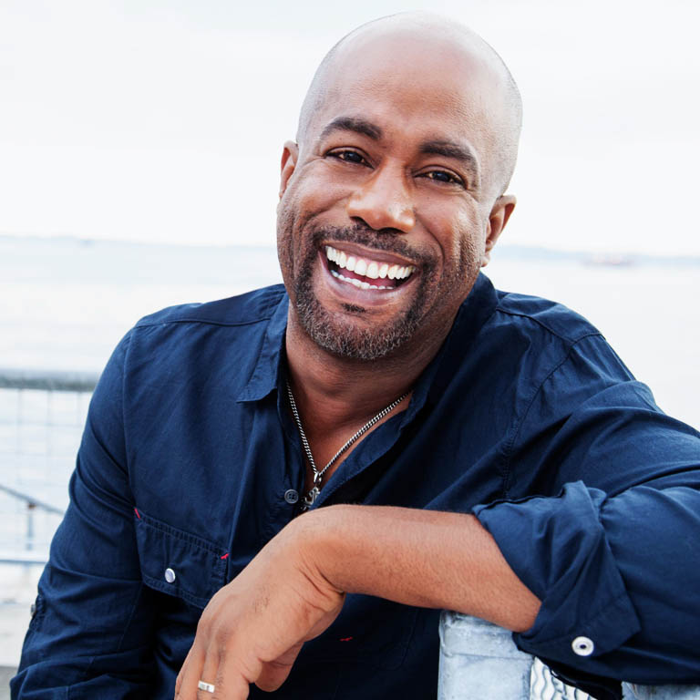
Darius Rucker
“I'm black because I was born this way. I'm proud of it. Thank God I am who I am.”
“When I was growing up, I always knew that if I ever got anything, I was going to give back as much as I can. I learned that all you have to be willing to do is give your time.”

Slide 5
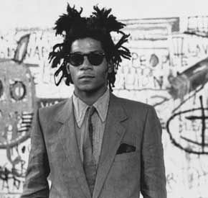
Jean-Michel Basquiat
“The black person is the protagonist in most of my paintings. I realized that I didn't see many paintings with black people in them.”
“I don't listen to what art critics say. I don't know anybody who needs a critic to find out what art is.”

Slide 6
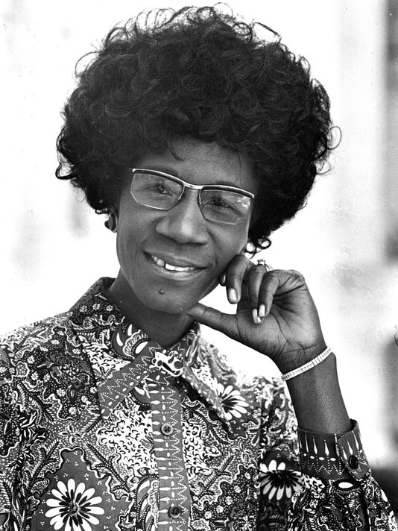
Shirley Chisholm
“When morality comes up against profit, it is seldom that profit loses.”
“The emotional, sexual, and psychological stereotyping of females begins when the doctor says: "It's a girl.”

Slide 7
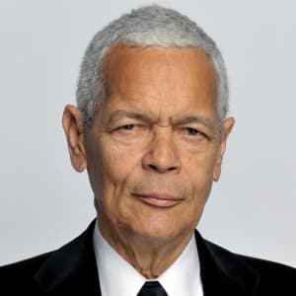
Julian bond
“The humanity of all Americans is diminished when any group is denied rights granted to others.”
“Violence is black children going to school for 12 years and receiving 6 years' worth of education.”

Slide 8
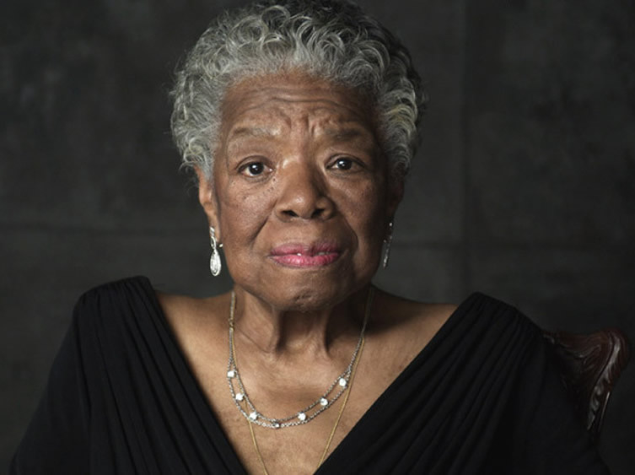
Maya Angelou
“I've learned that people will forget what you said, people will forget what you did, but people will never forget how you made them feel.”
“If you don't like something, change it. If you can't change it, change your attitude.”

Slide 9
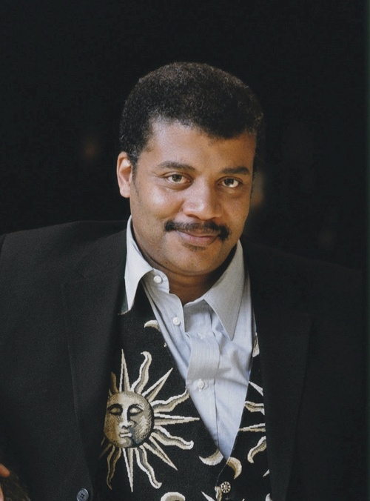
Neil deGrasse Tyson
“The good thing about science is that it's true whether or not you believe in it.”
“Curious that we spend more time congratulating people who have succeeded than encouraging people who have not.”

Slide 10
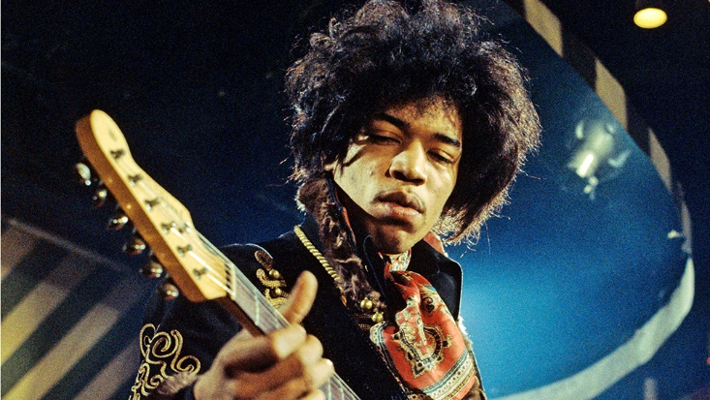
Jimi hendrix
“When the power of love overcomes the love of power the world will know peace.”
“To be with the others, you have to have your hair short and wear ties. So we're trying to make a third world happen, you know what I mean?”

Slide 11
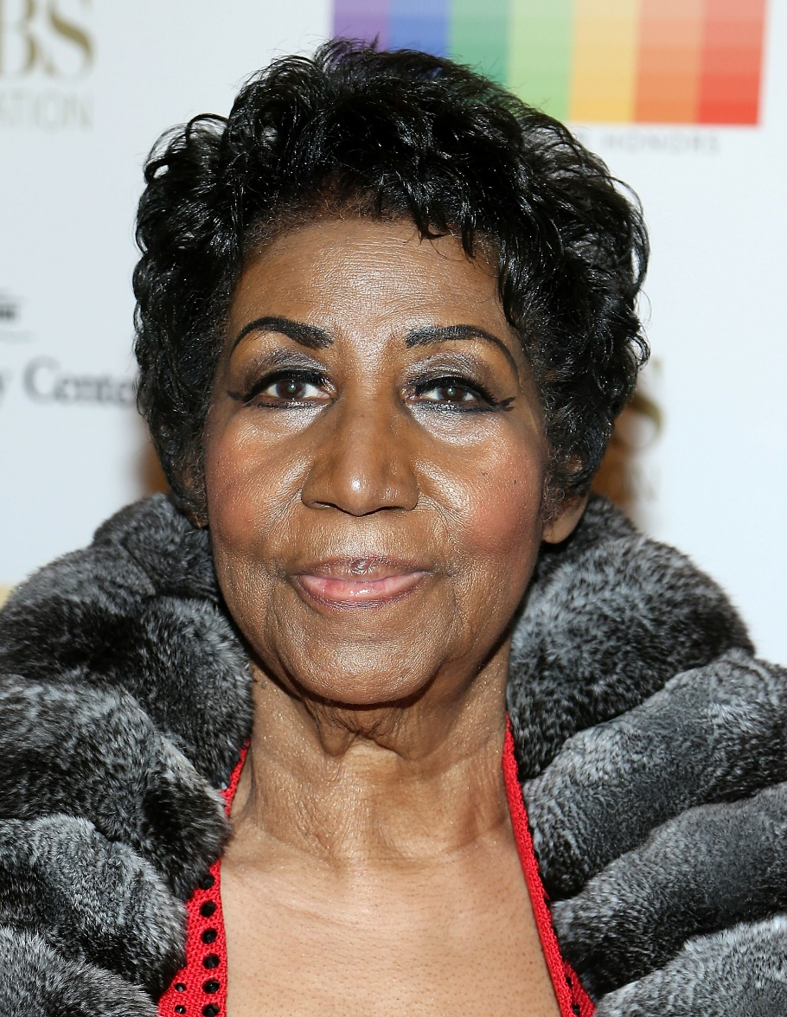
Aretha Franklin
“We all require and want respect, man or woman, black or white. It's our basic human right.”
“I sing to the realists, people who accept it like it is. I express problems. There are tears when it's sad and smiles when it's happy. It seems simple to me, but for some people, I guess feelin' takes courage.”

Slide 12
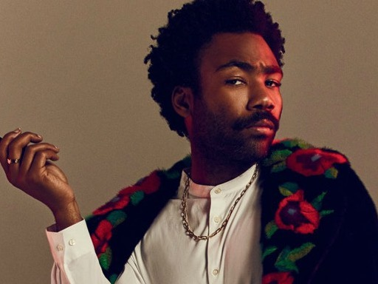
Donald Glover
“Black men struggle with masculinity so much. The idea that we must always be strong really presses us all down - it keeps us from growing.”
“When anybody pays you to be creative, you're very lucky”.

Slide 13
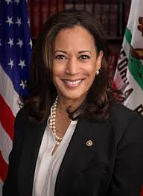
Kamala Harris
“I was raised to be an independent woman, not the victim of anything”
“We don't want to promote any system that treats the fact that an individual is LGBT as a personality disorder. And anything that perpetuates that perception is harmful - not only to that member of the community but the entire community.”

Slide 14
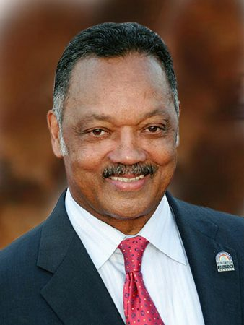
Jesse jackson
“Both tears and sweat are salty, but they render a different result. Tears will get you sympathy; sweat will get you change.”
“No one should negotiate their dreams. Dreams must be free to fly high. No government, no legislature, has a right to limit your dreams. You should never agree to surrender your dreams.”

Slide 15
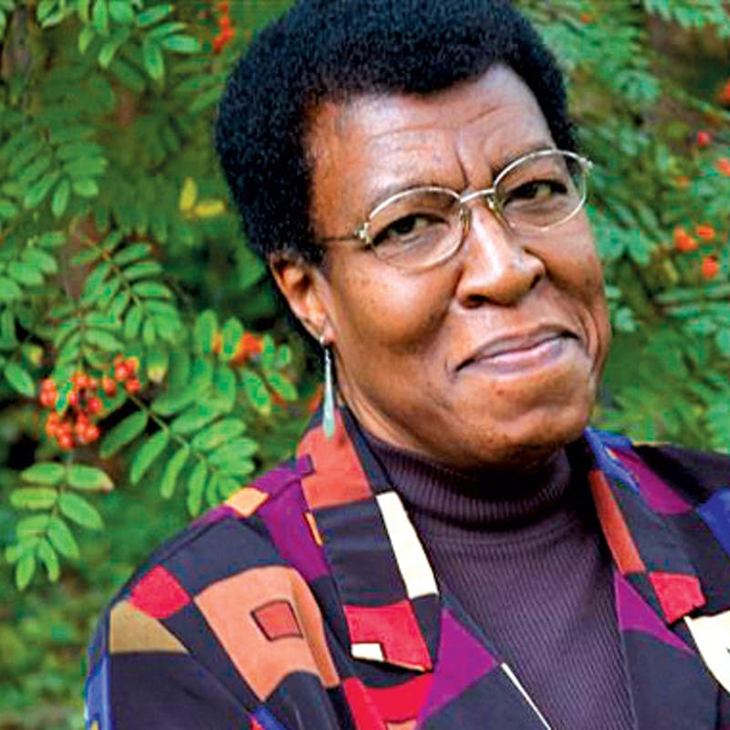
Octavia Butler
“People have the right to call themselves whatever they like. That doesn't bother me. It's other people doing the calling that bothers me.”
“Once you grow past Mommy and Daddy coming running when you're hurt, you're really on your own. You're alone, and there's no one to help you.”

Slide 16
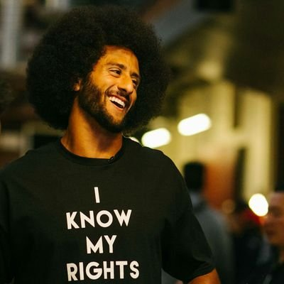
Colin Kaepernick
“People don't realize what's really going on in this country. There are a lot things that are going on that are unjust. People aren't being held accountable for. And that's something that needs to change. That's something that this country stands for: freedom, liberty and justice for all.”
“Most people don't want to change. They're comfortable and set in their ways. But in order to change, you have to be able to agitate people at times. And I think that's something that's very necessary for us to improve as a country.”

Slide 17
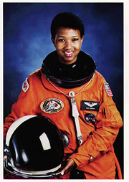
Mae C. Jemison
“Never limit yourself because of others' limited imagination; never limit others because of your own limited imagination.”
“What we find is that if you have a goal that is very, very far out, and you approach it in little steps, you start to get there faster. Your mind opens up to the possibilities.”

Slide 18
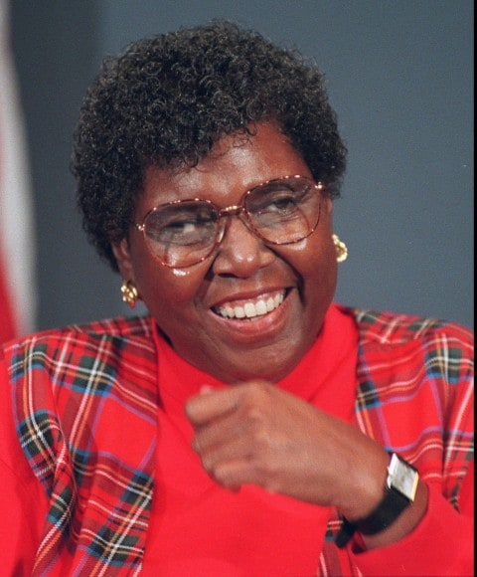
Barbara JOrdan
“A nation is formed by the willingness of each of us to share in the responsibility for upholding the common good.”
“But this is the great danger America faces. That we will cease to be one nation and become instead a collection of interest groups: city against suburb, region against region, individual against individual. Each seeking to satisfy private wants.”

Slide 19
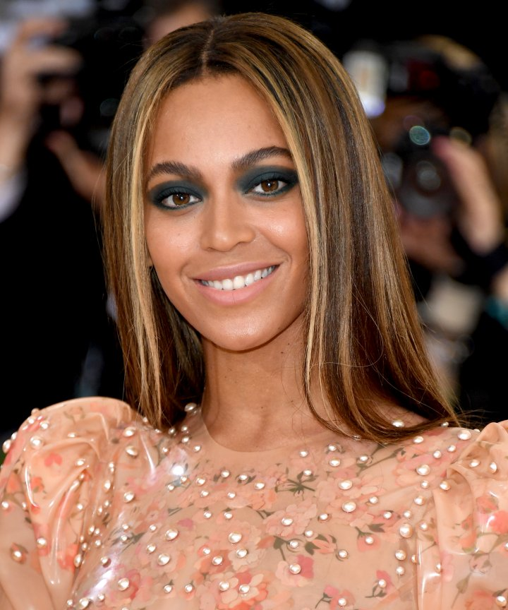
Beyoncé Knowles
“We have to teach our boys the rules of equality and respect, so that as they grow up gender equality becomes a natural way of life. And we have to teach our girls that they can reach as high as humanly possible.”
“We need to reshape our own perception of how we view ourselves. We have to step up as women and take the lead.”

Slide 20
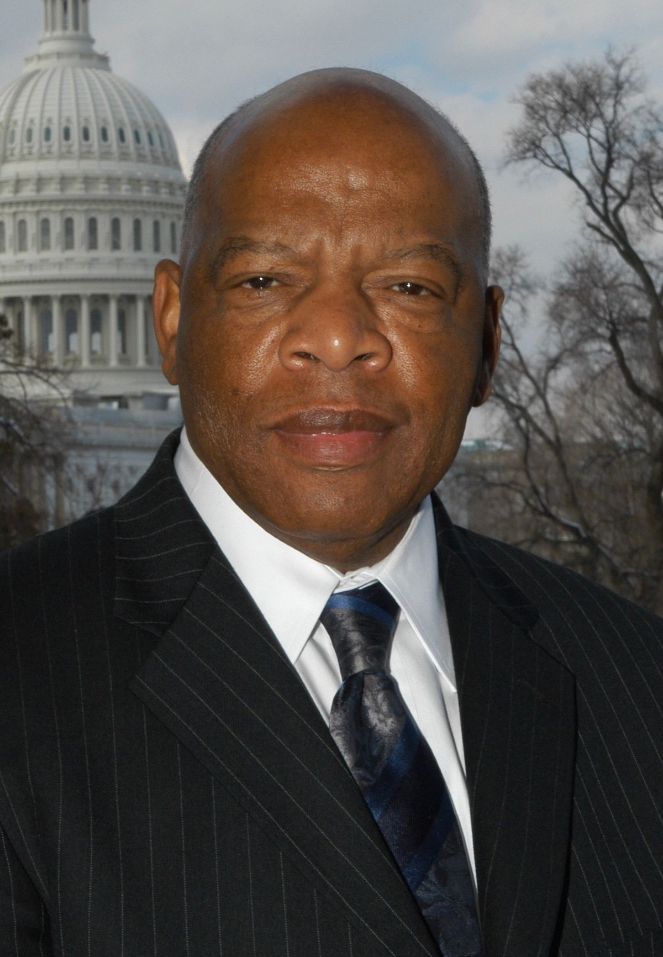
John lewis
“When you see something that is not right, not fair, not just, you have to speak up. You have to say something; you have to do something.”
“The vote is precious. It's almost sacred, so go out and vote like you never voted before.”

Slide 21
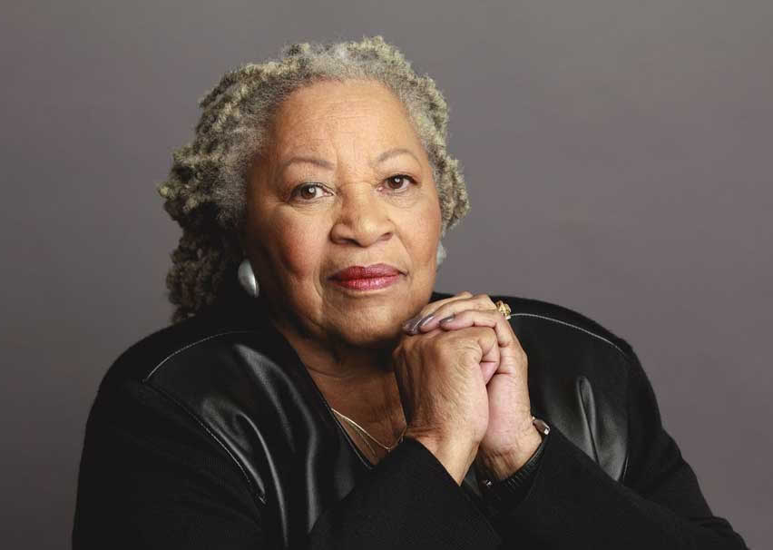
Toni morrison
“If you're going to hold someone down you're going to have to hold on by the other end of the chain. You are confined by your own repression.”
“Make a difference about something other than yourselves.”

Slide 22
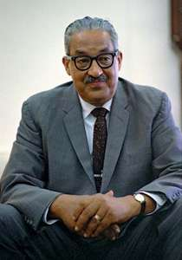
Thurgood marshall
“None of us got where we are solely by pulling ourselves up by our bootstraps. We got here because somebody - a parent, a teacher, an Ivy League crony or a few nuns - bent down and helped us pick up our boots.”
“To protest against injustice is the foundation of all our American democracy.”

Slide 23
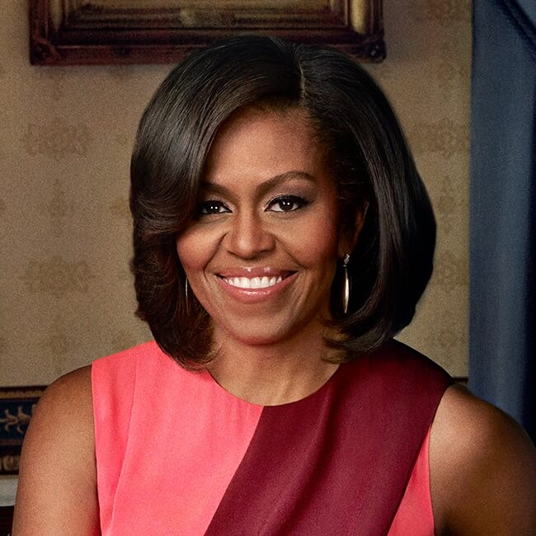
Michelle obama
“You may not always have a comfortable life and you will not always be able to solve all of the world's problems at once but don't ever underestimate the importance you can have because history has shown us that courage can be contagious and hope can take on a life of its own.”
“The one way to get me to work my hardest was to doubt me.”

Slide 24
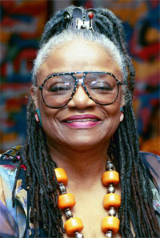
faith ringgold
“I had something I was trying to say and sometimes the message is an easy transmission and sometimes it's a difficult one but I love the power of saying it so I'm gonna do it whether it's hard or easy.”
“You can't sit around and wait for somebody to say who you are. You need to write it and paint it and do it”

Slide 25
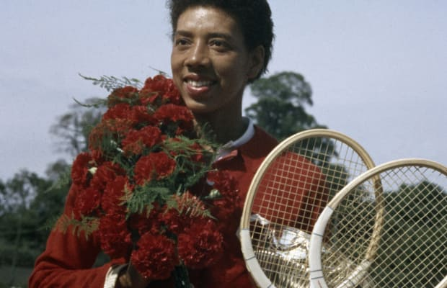
aLthea gibson
“In the field of sports you are more or less accepted for what you do rather than what you are.”
“Shaking hands with the Queen of England was a long way from being forced to sit in the colored section of the bus going into downtown Wilmington, North Carolina.”

Slide 26
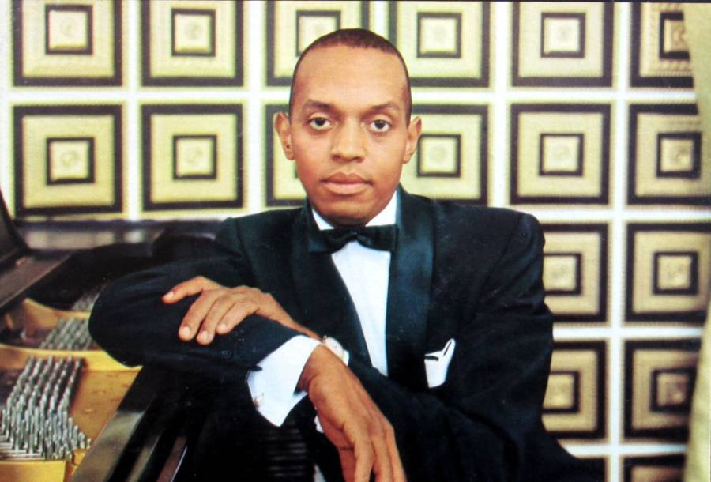
Don Shirley
“You never win with violence. You only win when you maintain your dignity.”
“It takes courage to change people’s hearts.”

Slide 27
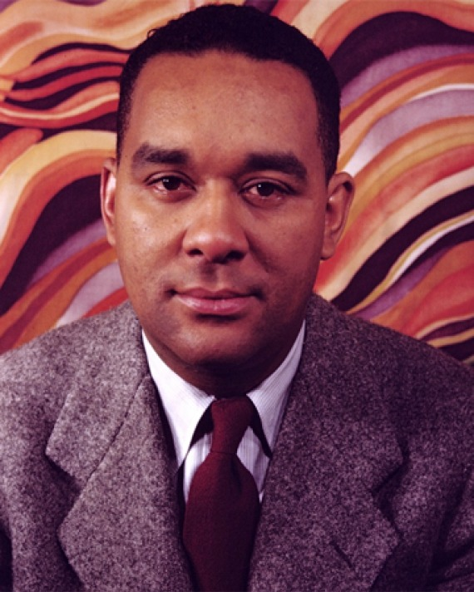
Richard wright
“They hate because they fear, and they fear because they feel that the deepest feelings of their lives are being assaulted and outraged. And they do not know why; they are powerless pawns in a blind play of social forces.”
“Men can starve from a lack of self-realization as much as they can from a lack of bread.”

Slide 28
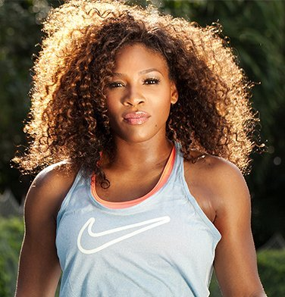
Serena williams
“You can be whatever size you are, and you can be beautiful both inside and out. We’re always told what’s beautiful and what’s not, and that’s not right.”
“I don’t like to lose — at anything… Yet I’ve grown most not from victories, but setbacks. If winning is God’s reward, then losing is how he teaches us.”

Slide 29
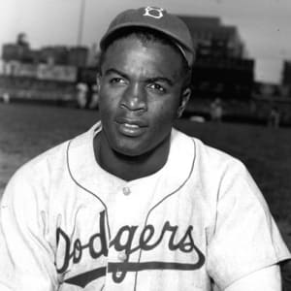
Jackie robinson
“A life is not important except in the impact it has on other lives.”
“I'm not concerned with your liking or disliking me... All I ask is that you respect me as a human being.”

Slide 30
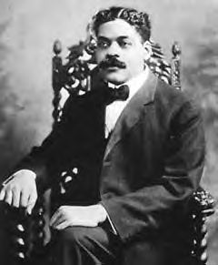
Arturo Alfonso Schomburg
“We need the historian and philosopher to give us with trenchant pen, the story of our forefathers, and let our soul and body, with phosphorescent light, brighten the chasm that separates us. We should cling to them just as blood is thicker than water.”
“Pride of race is the antidote to prejudice.”

Slide 31
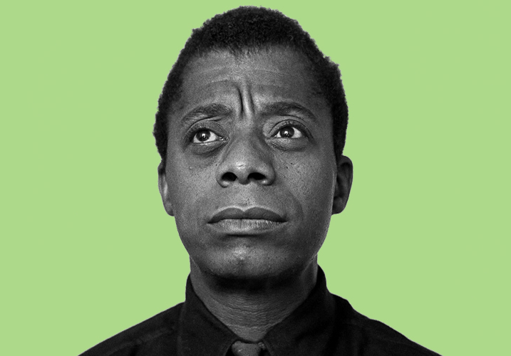
James Baldwin
“I imagine one of the reasons people cling to their hates so stubbornly is because they sense, once hate is gone, they will be forced to deal with pain.”
“I am what time, circumstance, history, have made of me, certainly, but I am also, much more than that. So are we all.”

Slide 32
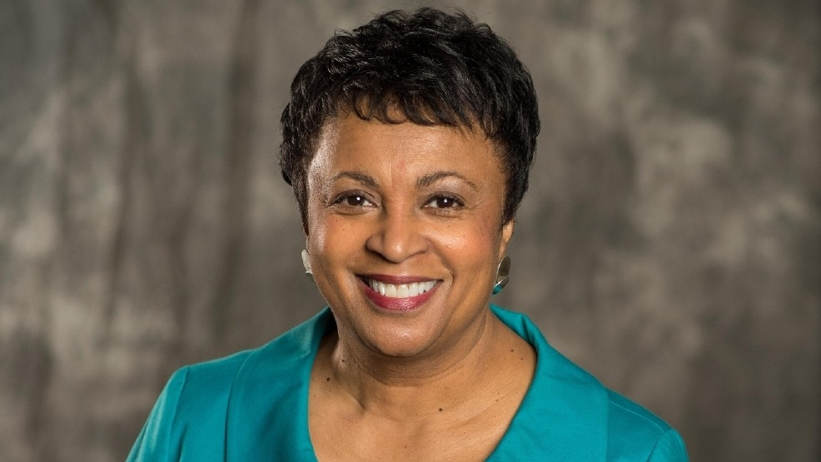
Carla hayden
“There is a hunger in this digital age to hear authors together, to participate in programs, to just be in a place, a community space.”
“Health information is just about the number one thing that people go into public libraries and connect to public libraries for. They're also looking for information about things that can make their lives better. It's a great equalizer.”

Slide 33
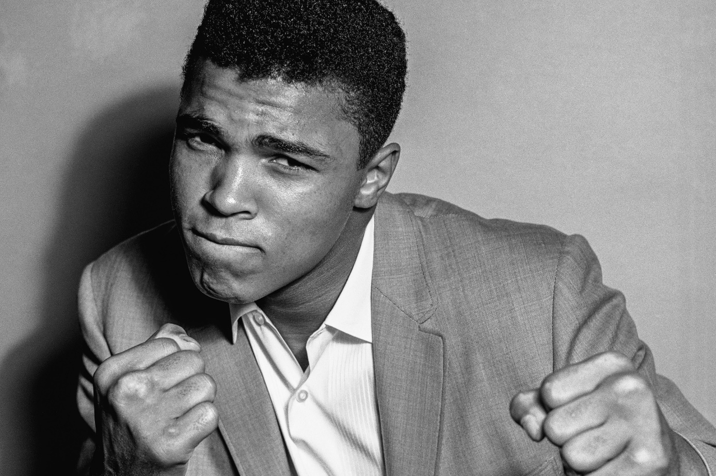
Muhammad Ali
“Service to others is the rent you pay for your room here on earth.”
“The man who has no imagination has no wings.”
“Don't count the days, make the days count.”

