Slide 1

Early, Often, and Iterative: A UX Research Strategy
Hannah Sistrunk, Digital Archivist
Rockefeller Archive Center
Digital GLAM Spaces Conference
November 10, 2021

Slide 2
My context
Archival repository and research center with no dedicated UX team.
Working to distribute UX knowledge and expertise across the organization.

Slide 3
What did we build?
DIMES (dimes.rockarch.org), a site for archival discovery and delivery.

Slide 4
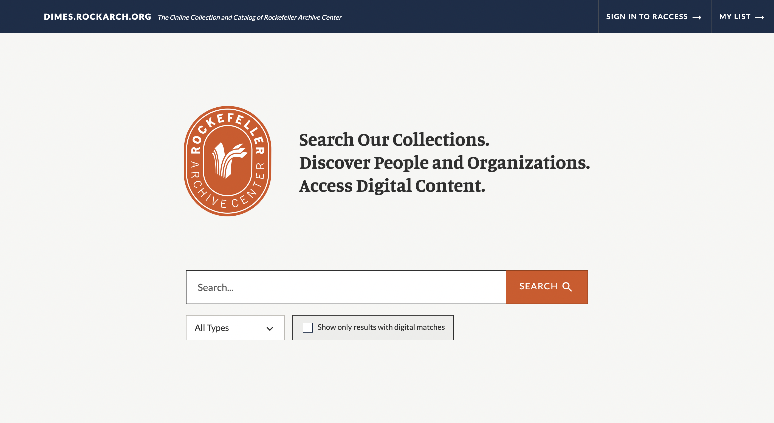
DIMES website homepage

Slide 5
Iterative Design Process
Research
Research
Research
Design
Build
Research
Research

Slide 6
Persona development with user stories
Example user stories:
As a researcher, I want access to digital content online.
As a records manager, I want to ensure equitable access to my organization's records.
As an archivist, I want to be able to search, browse and view digital files from my personal workstation so that I can assist researchers with reference questions.

Slide 7
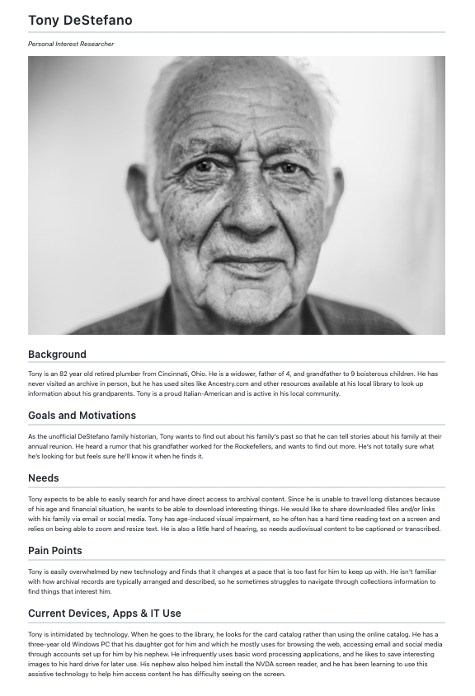
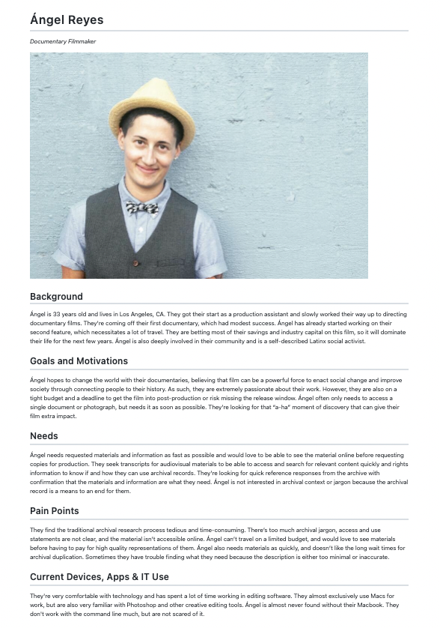
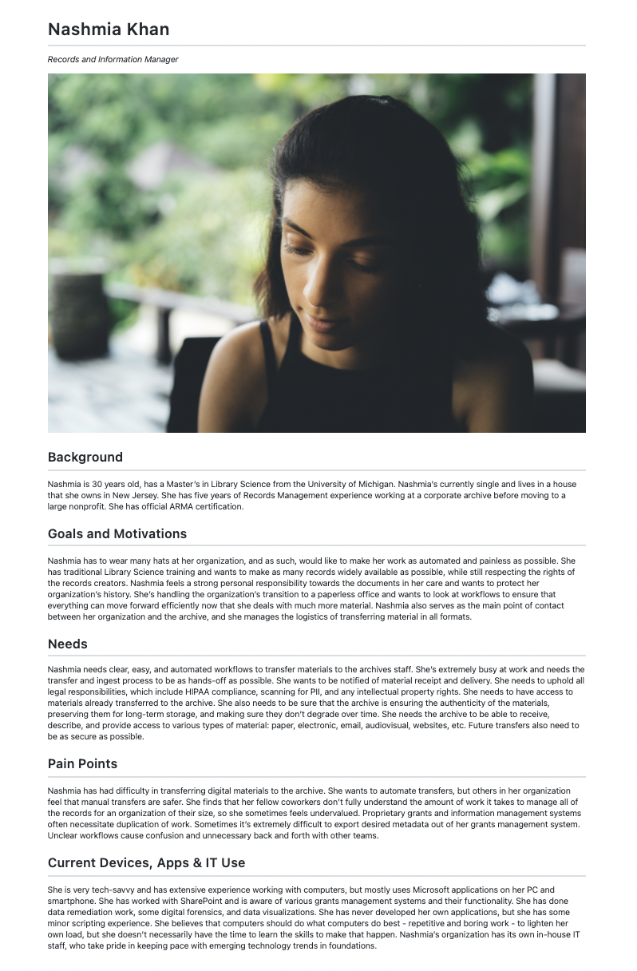
Persona review and revision

Slide 8
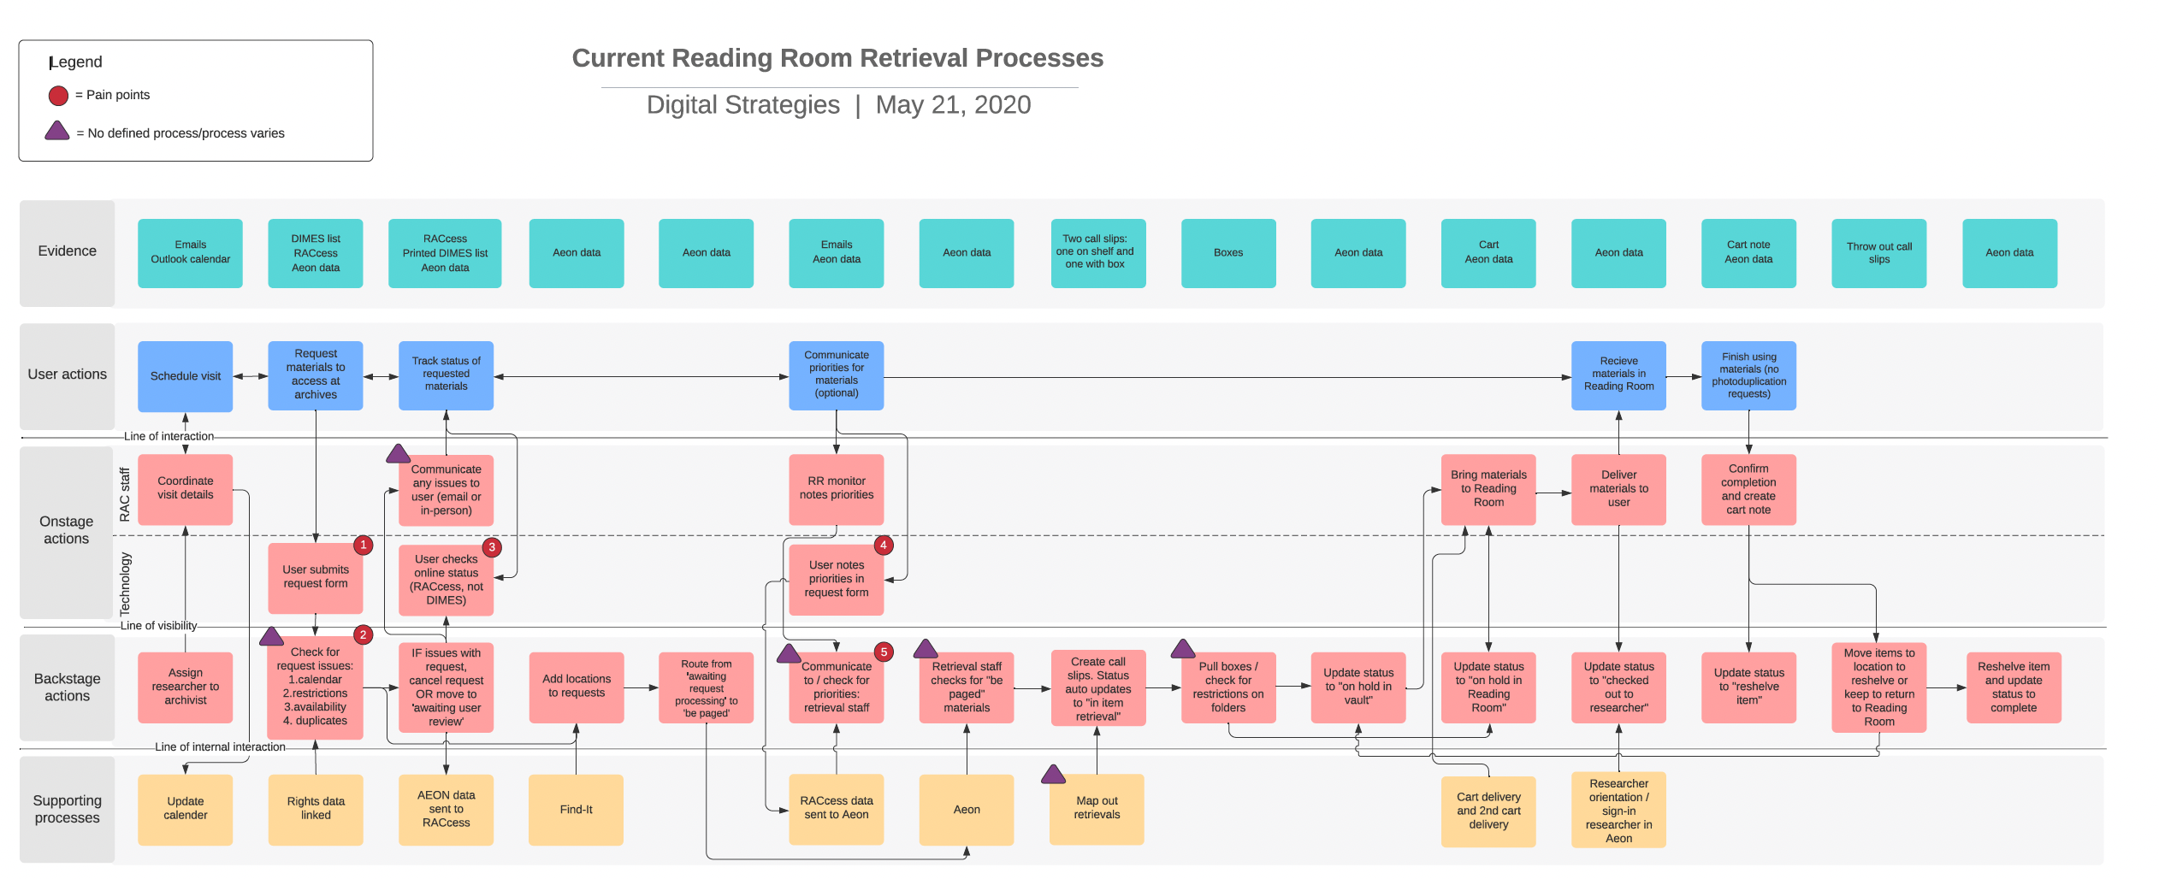
Service blueprints

Slide 9
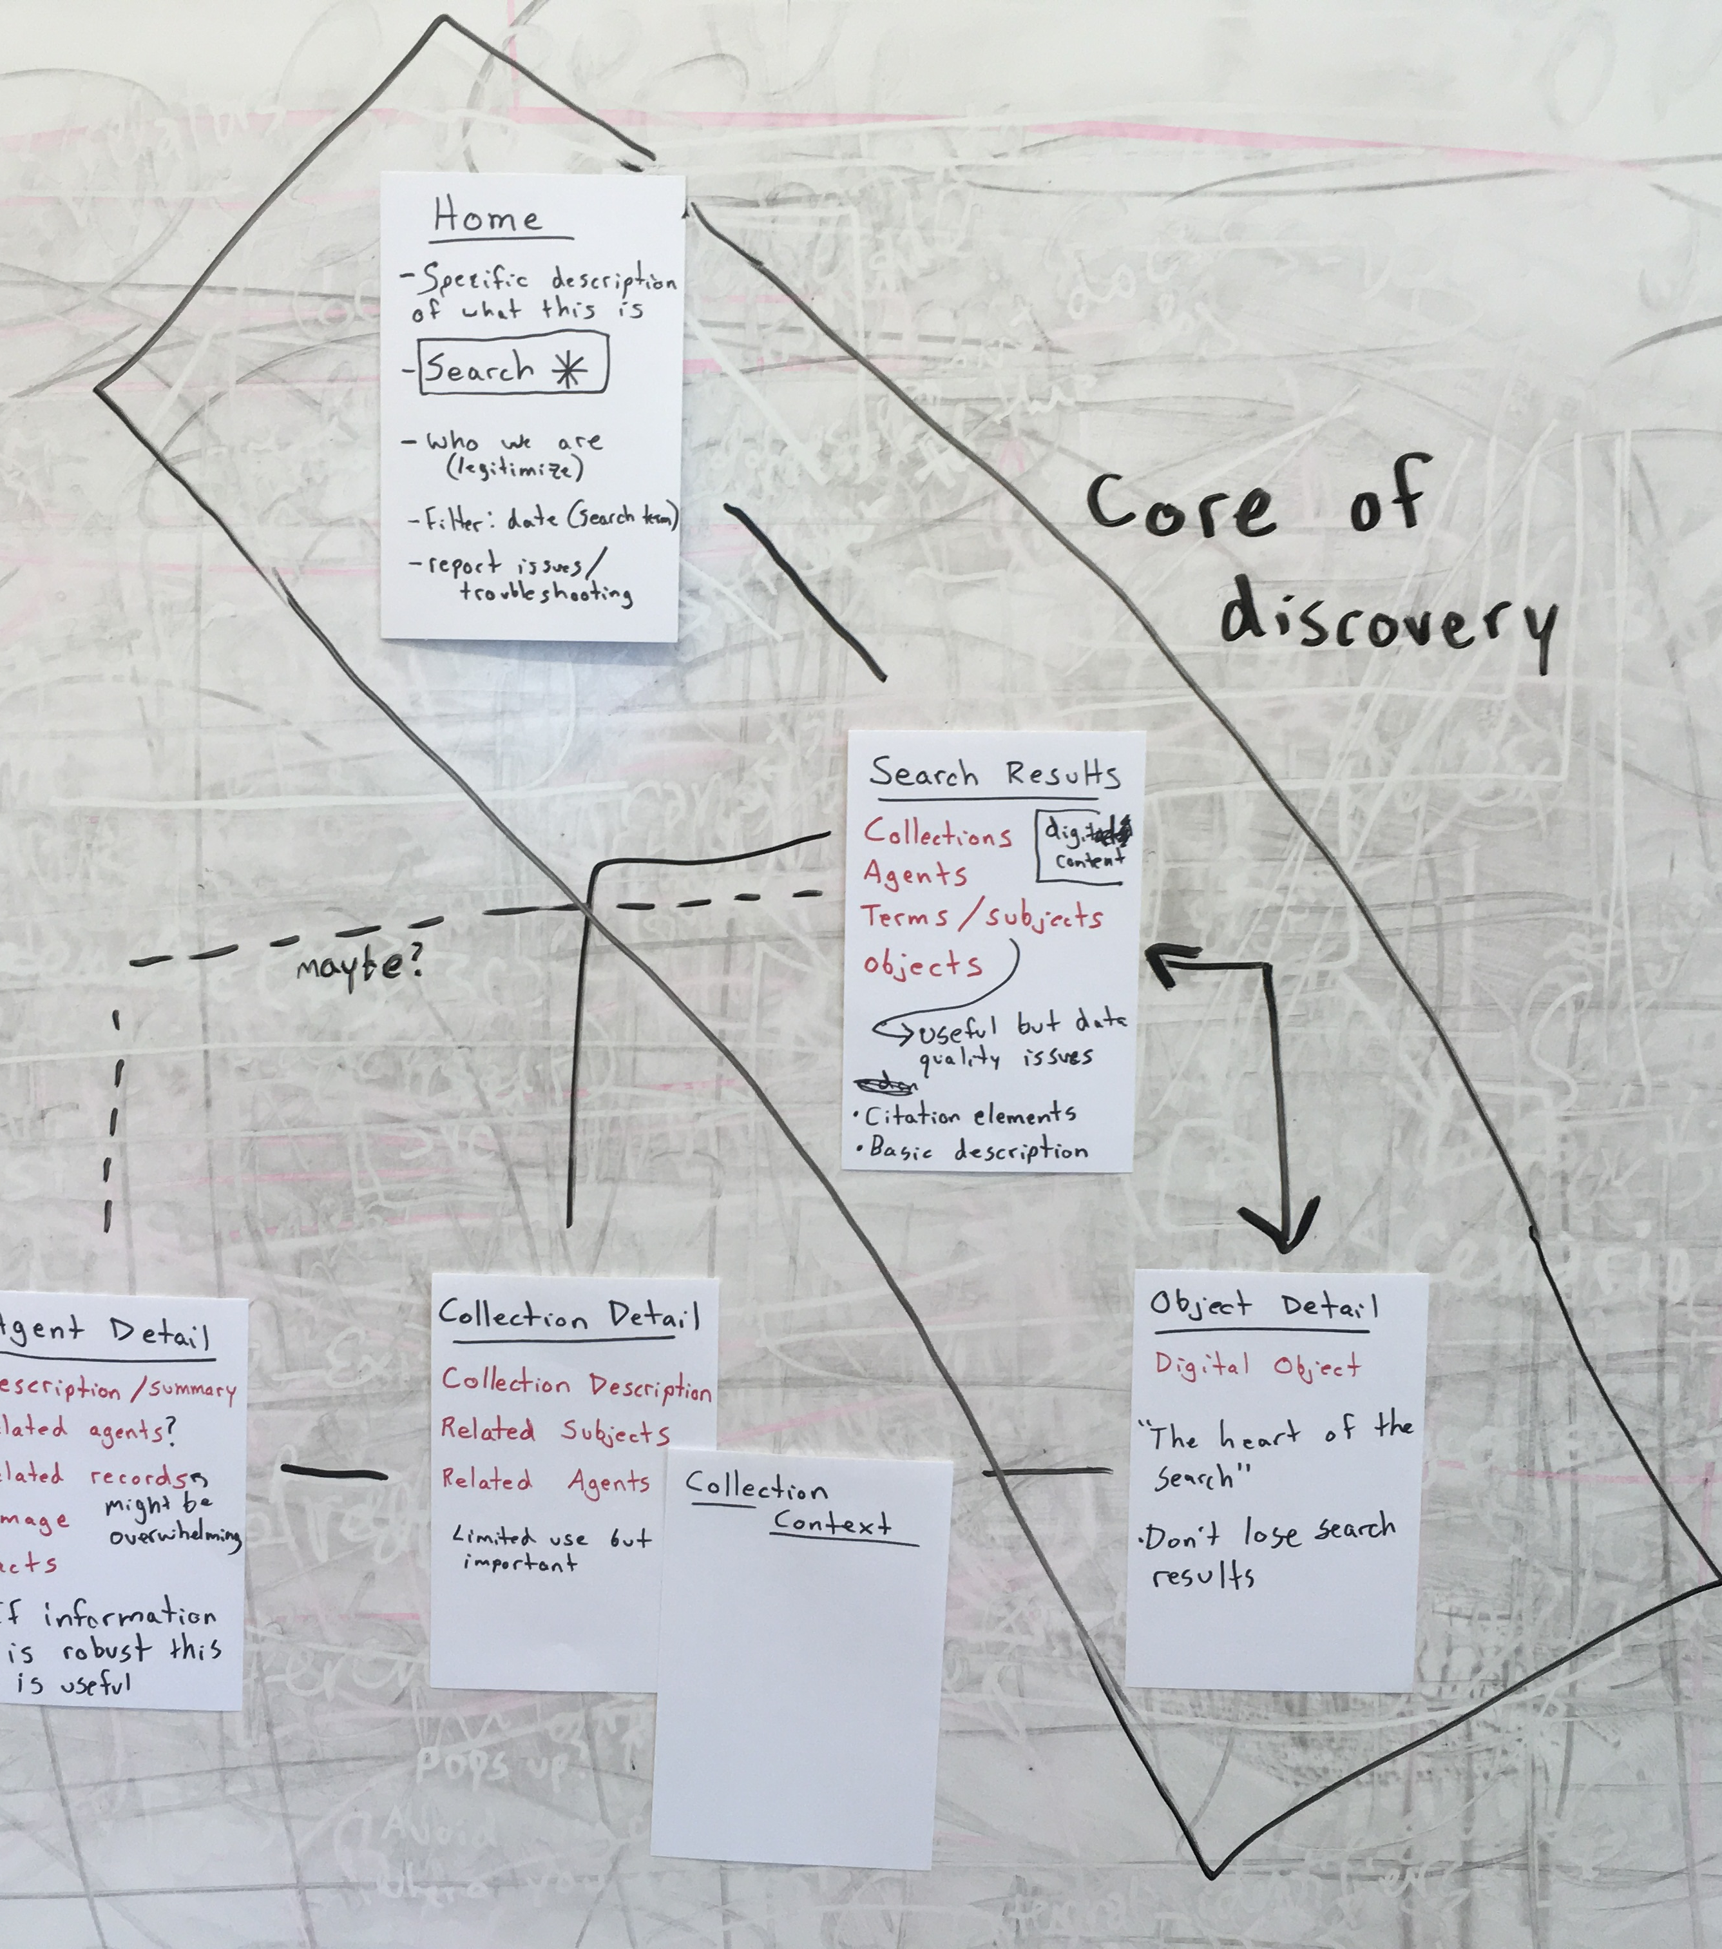
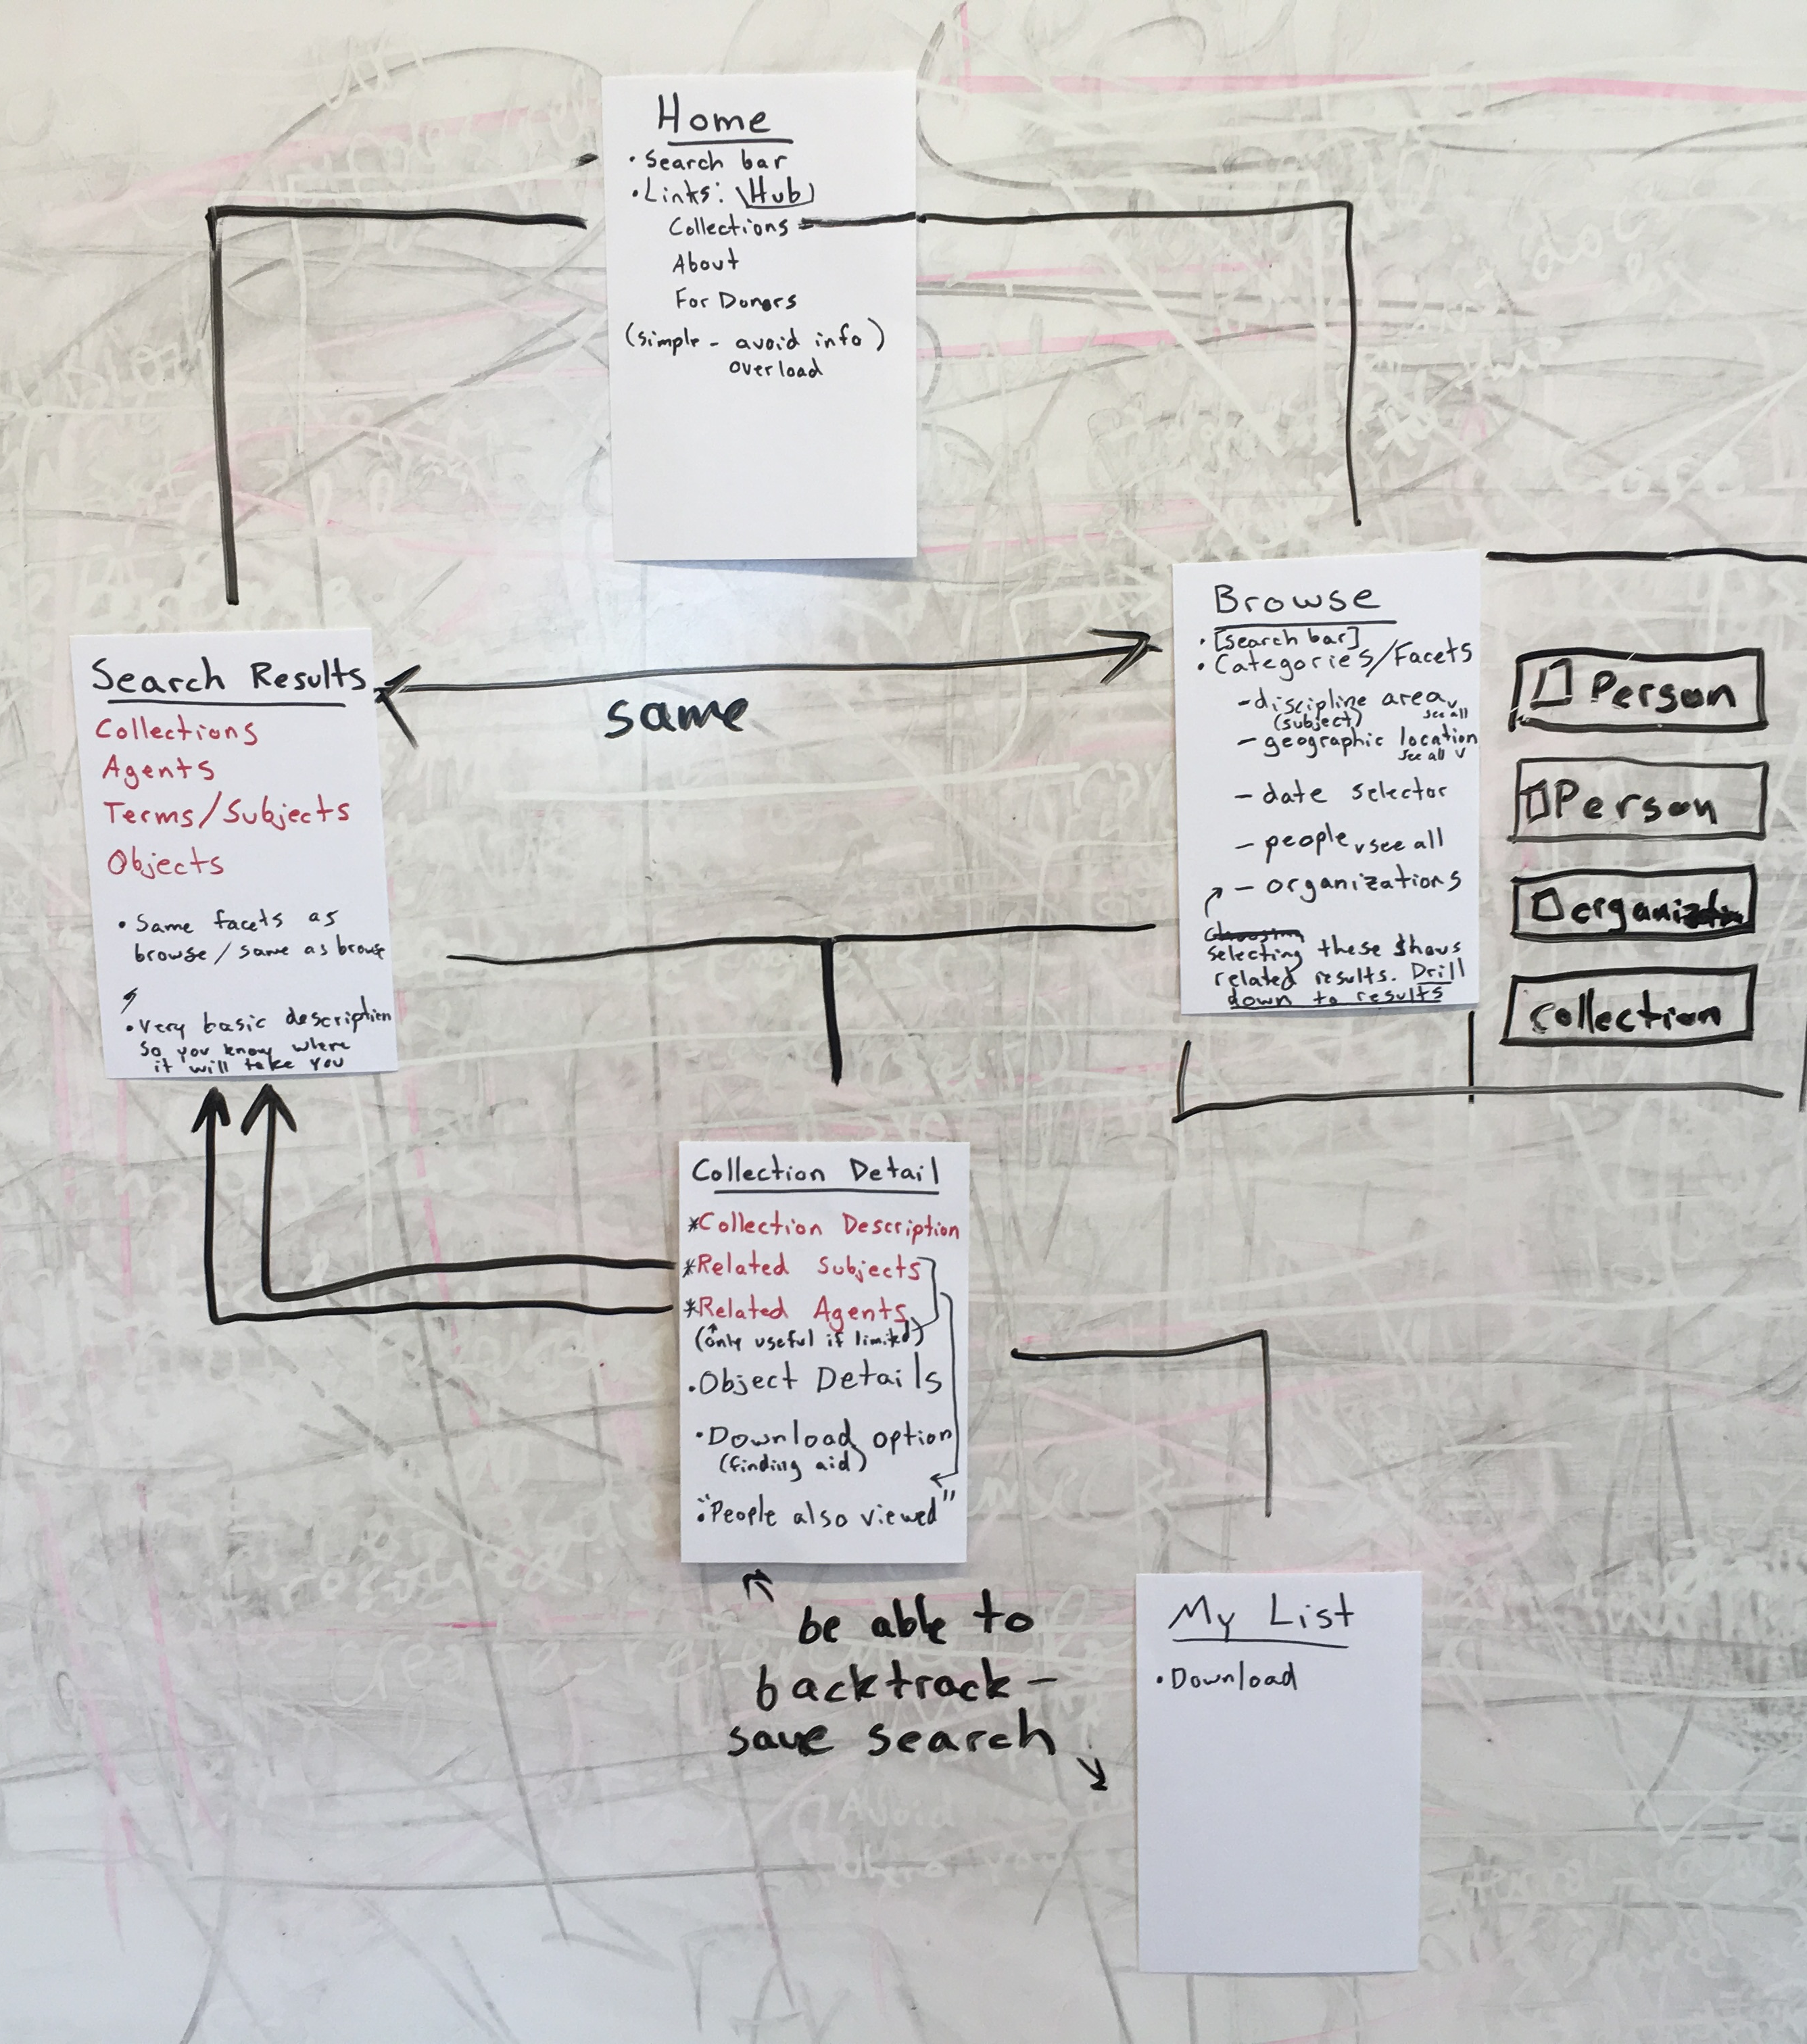
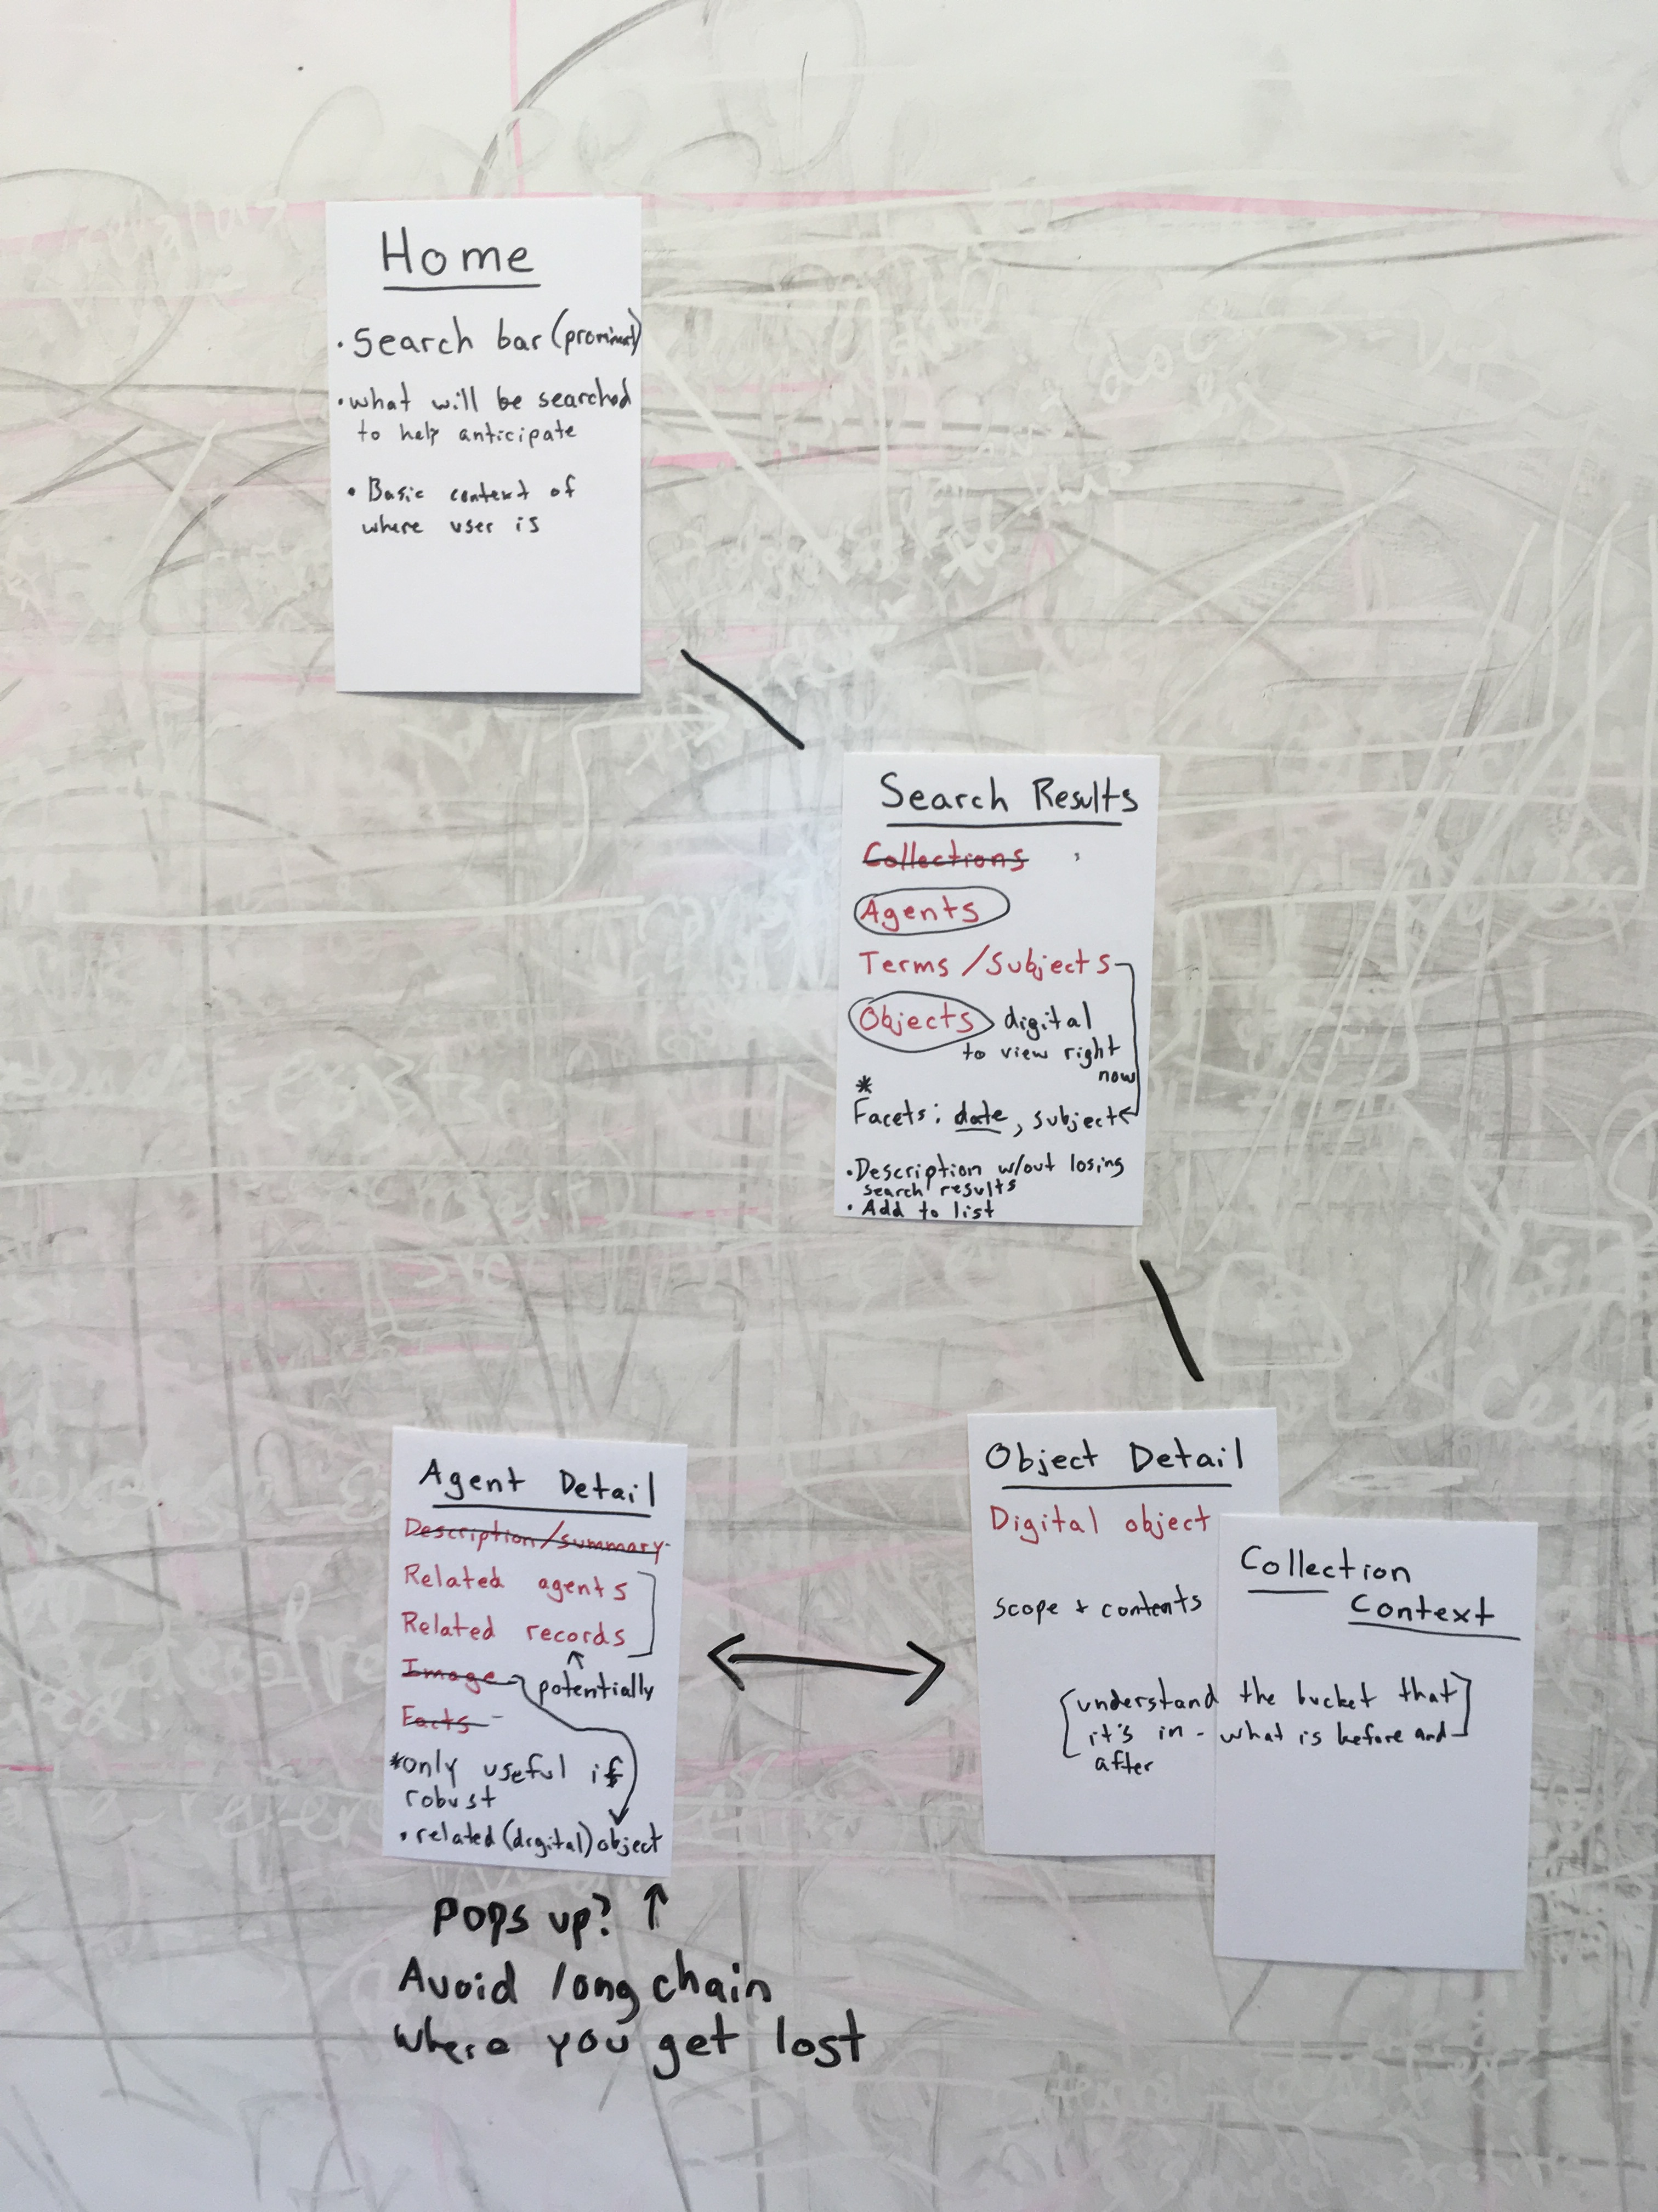
Conceptual site mapping activity

Slide 10

The Observers Team
A group of representatives from each program area that convenes after each round of usability testing to debrief and identify observed usability issues.

Slide 11
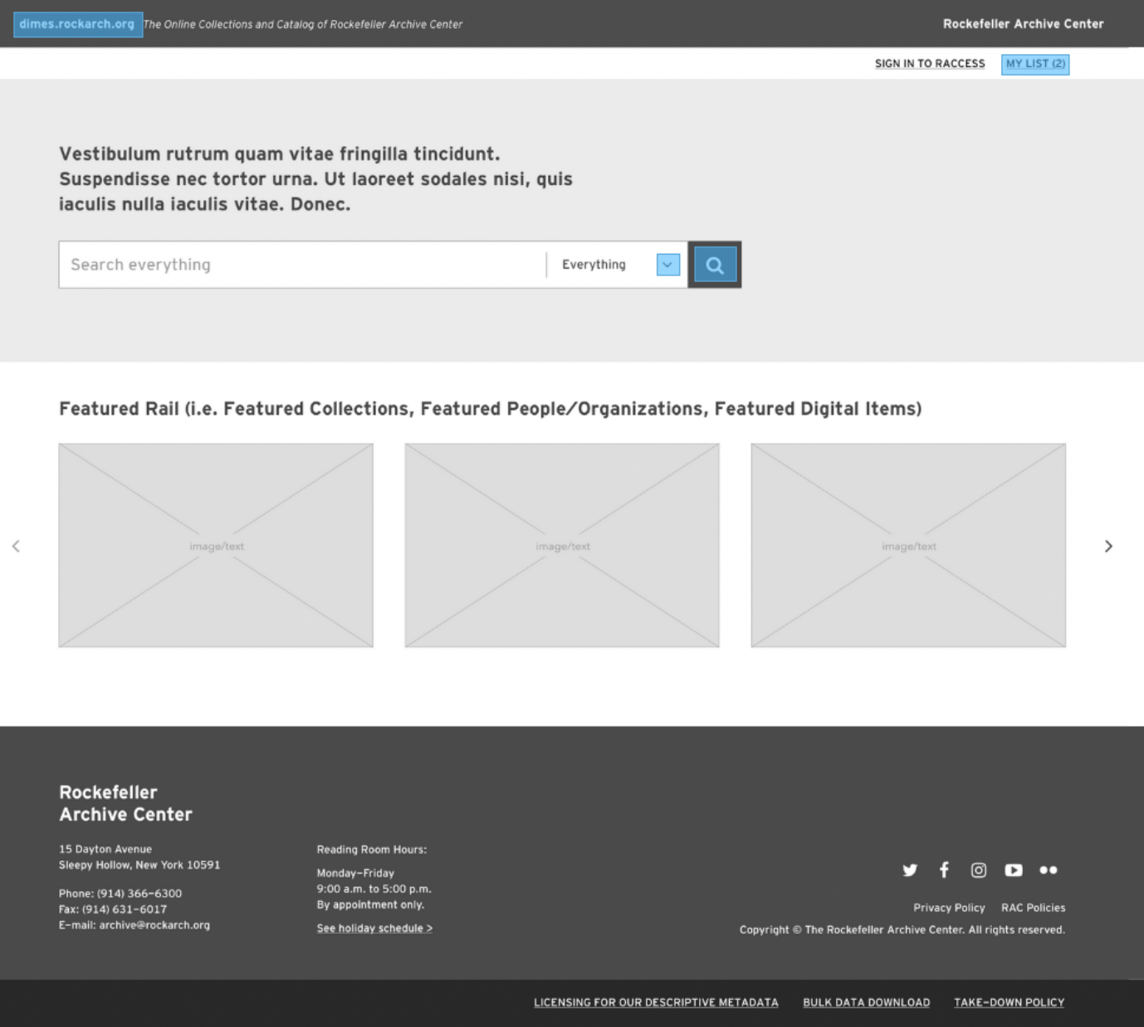
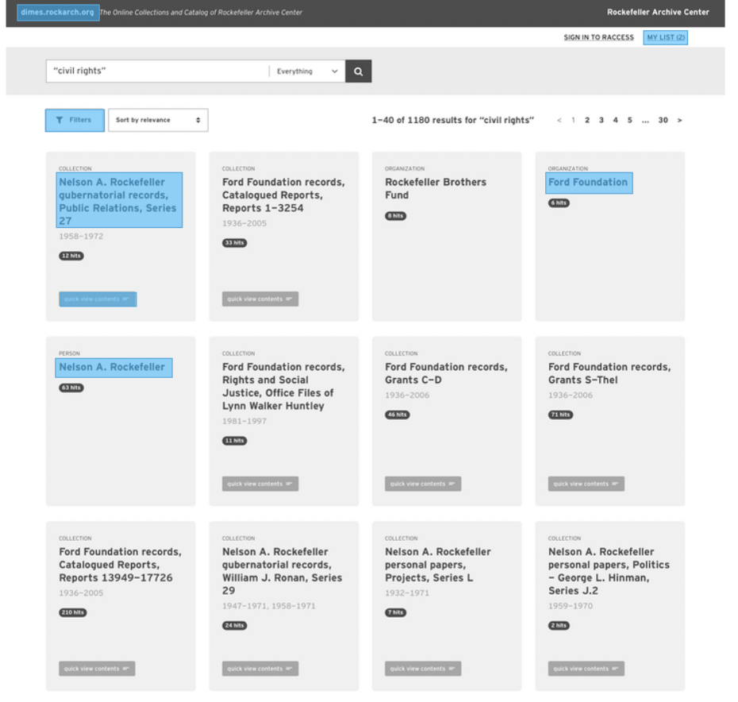
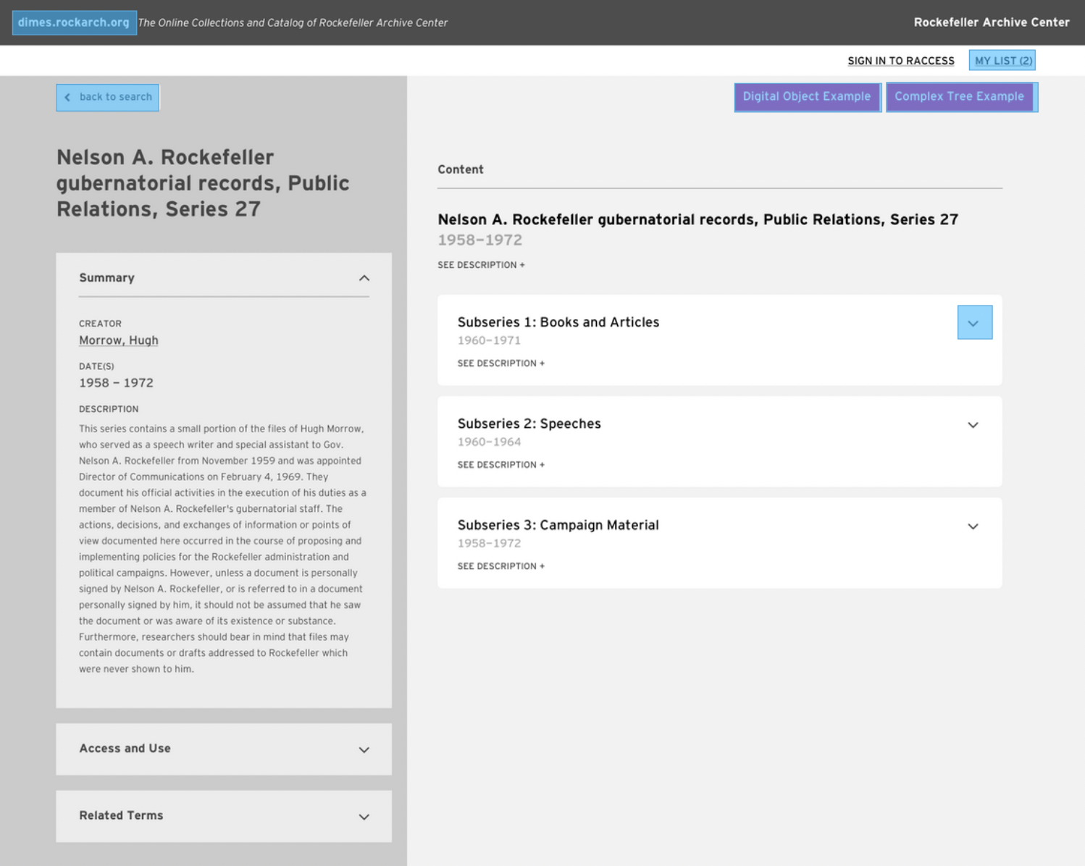
Clickable wireframes for early testing
*Site design created by ondesign using InVision.

Slide 12
Coordinating coding with testing
We built pages and features that we could start testing right away while continuing to build other areas of the site.

Slide 13
Usability testing process: early, often, and iterative
Build portion of site
Test site with three participants (and one pilot test)
Debrief with the Observer’s Team
Debrief with the developer
Make changes to site based on results, involving designers as necessary
Report results to Reference Team stakeholder group
Repeat!

Slide 14
Lessons learned
Design mockups provided important early feedback from users.
Test with real data/content in the site as soon as possible.
Do not blur lines between staff users and non-staff users.
Accessibility is part of usability, not just a set of technical requirements.

Slide 15
Early, Often, Iterative
Early = get user input before starting to design/build, and test early design concepts with users.
Often = conduct lightweight, short rounds of testing parallel to development
Iterative = keep moving around the cycle of researching, designing, and building.

Slide 16
Final thoughts
Involving colleagues in UX research served to…
Demonstrate the value of testing with users
Distribute knowledge about UX work across the organization
Break down barriers to engaging with tech development processes
Improve the usability and sustainability of our systems

Slide 17
Thank you!
Twitter: @HaSistrunk
Email: hsistrunk@rockarch.org

Slide 18
Resources
Rockefeller Archive Center Personas
DIMES open source code
Bits and Bytes, the Rockefeller Archive Center blog
Rocket Surgery Made Easy by Steve Krug
More about service blueprints from Nielsen Norman Group

Slide 19
Acknowledgements
DIMES, as part of the broader Project Electron initiative, was a collaborative effort of the entire Rockefeller Archive Center staff with leadership from President Jack Meyers and Director of Archives Robert Clark. I thank my colleagues who have contributed their labor, knowledge, and innovative ideas over many years.
The contributors whose work was specifically described in this case study include the Digital Strategies Program members Bonnie Gordon, Patrick Galligan, and Assistant Director Hillel Arnold; the usability testing Observers Team including Amy Fitch, Reuben Slater, Rachel Wimpee, and Liesel Vink; and service blueprint collaborators Kanisha Greaves and Brian Andreycak. Thanks to ondesign for their website design work.

