Slide 1

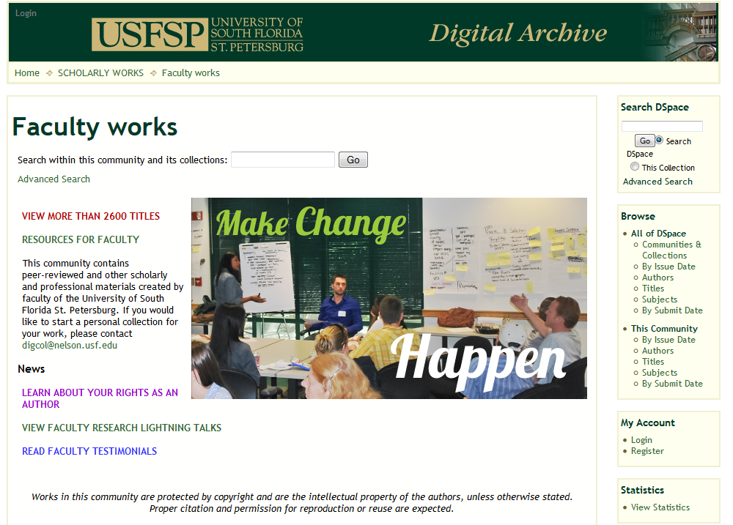
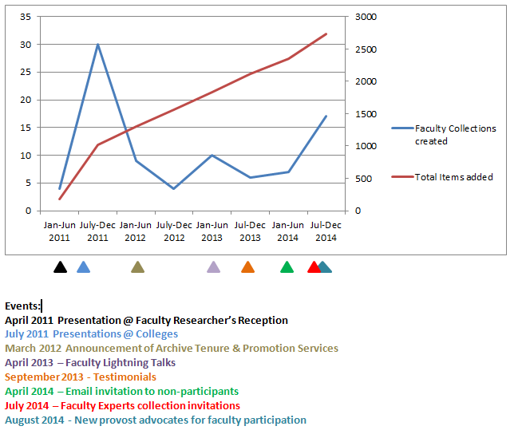
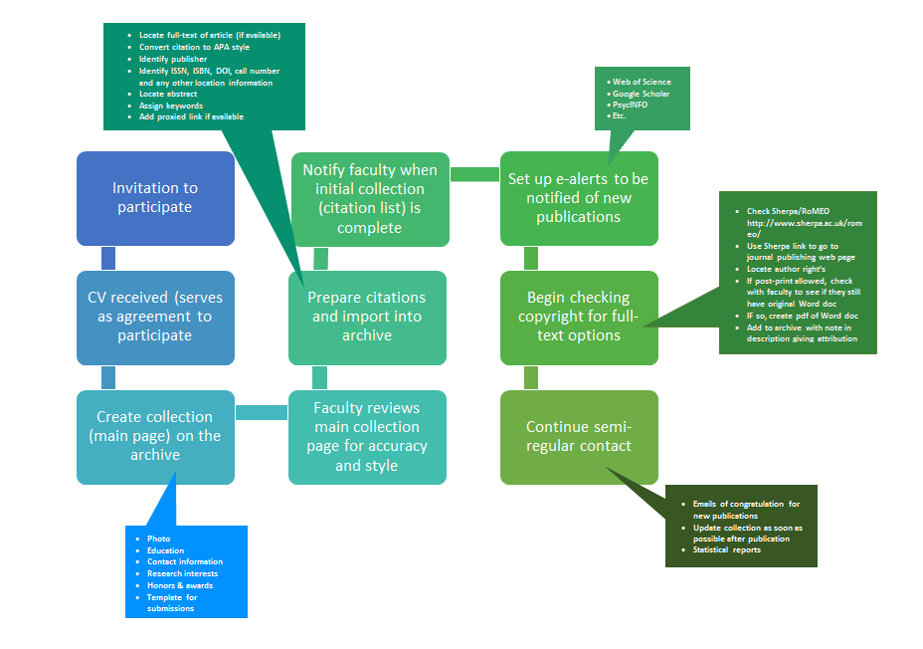
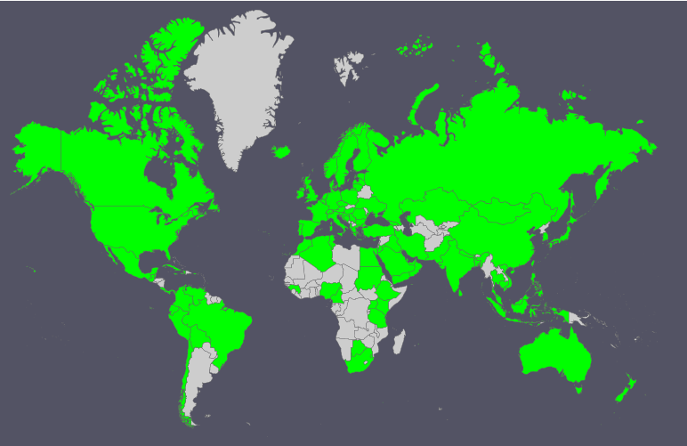
Promoting Faculty Scholarship through the USFSP Digital Archive
Deborah B. Henry, Tina M. Neville & Carol G. Hixson
USF St Petersburg, Nelson Poynter Memorial Library
Poster available at http://dspace.nelson.usf.edu/xmlui/handle/10806/12097
Poster available @ URL
Abstract
Marketing
The USFSP Digital Collections Team at Poynter Library created and manages an institutional repository which provides faculty with a new and professionally beneficial service. These digital portfolios showcase and promote their body of scholarship, on a stable platform and with a permanent URL. The USFSP Digital Archive offers 24/7 open access to the “Faculty Works” collections, provides full-text indexing that is harvested regularly by Google, Google Scholar, and other indexers, and tracks usage to demonstrate the increasing visibility of faculty work to researchers outside of the home institution. From the faculty member’s vita, the Faculty Archive Team researches and prepares the information needed to create each profile, requiring minimal effort from the faculty members themselves. Faculty participants are finding the Archive collections helpful in preparing for tenure and promotion, collecting non-traditional use metrics, using the profile as a launching site for published presentations, and access to handout materials. In addition to researching copyright permissions, members of the Archive Team also consult with faculty on how to negotiate author rights for new publications. Presented here are details on these services, as well as additional advantages of this new faculty initiative.
Reaching out to individual faculty
Presentations and events @ the Library & around campus
Administrative support
High profile collections
Faculty testimonials
Featured collections
Use of social media & blogging
Library web site
Growth of Faculty Works
Benefits to Faculty
24/7 off-site access e.g. when traveling or presenting nationally or internationally
Permanent URL
Archive displays items “mapped” to other profiles indicating collaboration among faculty
Opens up new opportunities for collaboration outside of the institution
Commitment to preserve profile if faculty leave USFSP
Access via Google and Google Scholar -- especially since we add in chapters and some presentation citations, not just published article citations
Consult on negotiating licensing rights for new publications
Alternative metrics for Tenure & Promotion
What We Learned
Brief History of Archive
Grounded in Poynter Library 2010-2014 Strategic Plan
2011 Steering Committee formed: Library & Campus Faculty
Policies established prior to launch
2011 Initial Digital Collections Team established
March 2011 - USFSP Digital Archive live!
April 2011 - Archive introduced at the Faculty Research Reception
Lead by example - some of the first collections were library faculty collections
2013 - Digital Collections Team expanded
2014 - More than 11,500 items
2014 - 76% participation of tenured and tenure-track faculty
Increases knowledge about faculty productivity
Fosters respect for faculty accomplishments
Helps promote the organization to outside community
Software limitations
You are not going to get 100% participation but keep marketing & inviting in a positive manner
Standardize
Requiring faculty to self-submit may hamper growth of archive
Total number of collections = 87
Total number of items = 2728
Highest view per item = 4988
Average views per item = 158
Average views per collection = 4339
Workflow
Other Uses of the Archive
International Outreach
Storing completed presentations
White papers
Dissertations & Theses
Faculty Lightning talks
Videos

