Slide 1

FAU Libraries:
Reinventing the Library Experience presentation to Professor Palina Prysmakova’s fundraising class
by
Carol Hixson, Dean
hixson@fau.edu
September 29, 2016
Notes:
Thank you for allowing me a few minutes today when I know you have so many other important matters to discuss. My name is Carol Hixson and I have been the Dean of FAU’s Libraries since August 2015. I was previously the dean of the library at USF St. Petersburg and before that at the University of Regina in Saskatchewan.

Slide 2
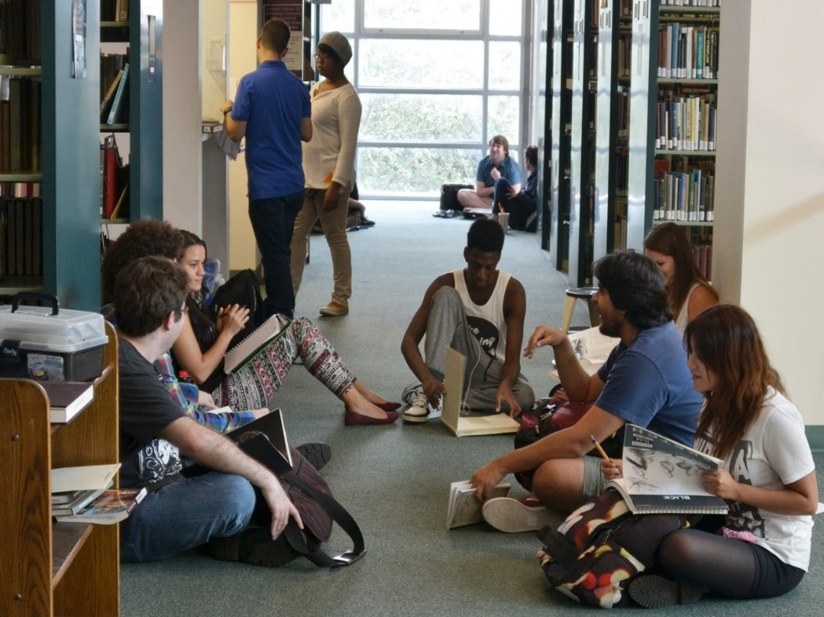
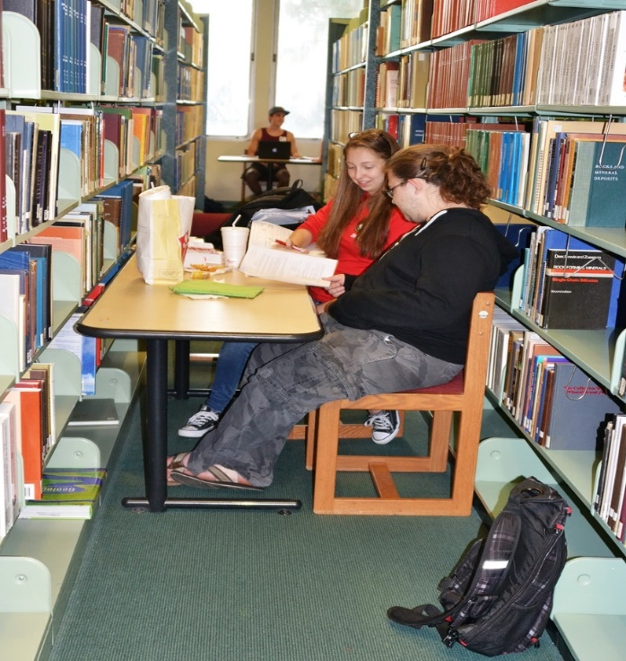
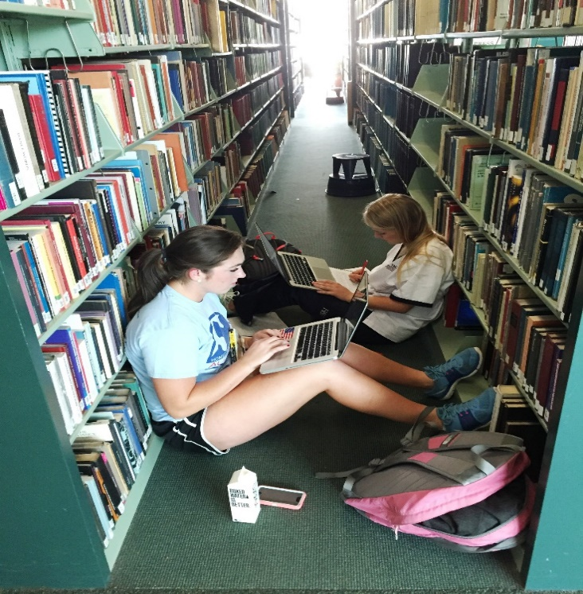
Wimberly Library Today
Notes:
With all the areas and services that we are reviewing, the Wimberly Library presents a special case that cannot be ignored.
Very heavily used facility. For example, 131,839 visits were made to Wimberly Library in September 2015.
The all-time record high was in September 2014 with 137, 911 visits.
September and February are typically the busiest months. Contrary to what some people think, students don’t just come in for Dunkin Donuts and leave. They stay for hours. And they often have no place to sit so they sit on the floor. And if you look at the floor, you know that is not a pretty thing.

Slide 3
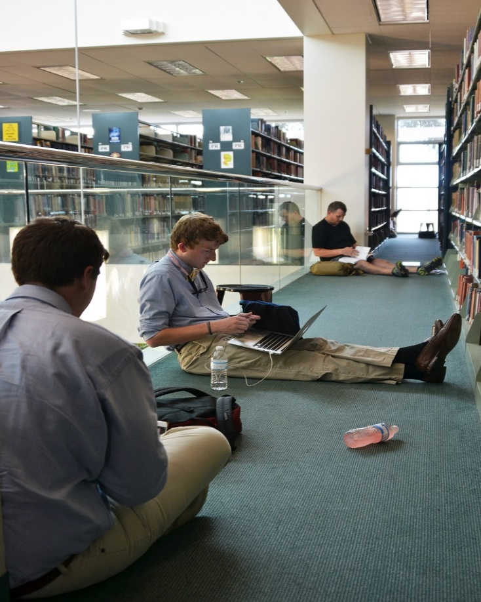
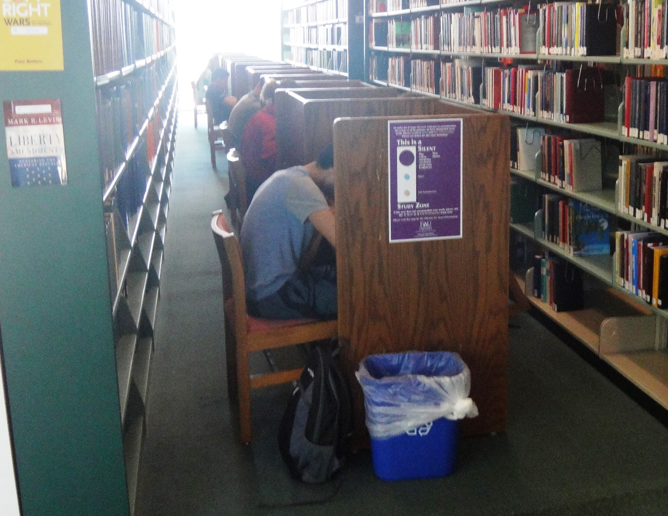
Wimberly Library Today

Slide 4
Students Want Space, Power, Better Connectivity, Updated Facility – Sept-Oct. 2015 Survey
Notes:
In September and October I spent a few hours a week for several weeks meeting with students in the atrium of the library and listening to their concerns. I also handed out a small survey and received over 500 responses. From that survey, these were their top concerns about the Wimberly Library building. They need more study rooms, access to power, more collaborative space, more quiet space, better Wi-Fi and more.

Slide 5
Constructed in 1964
Building Age and Backlog of
Deferred Maintenance Is Taking a Toll
A 2013 study determined that it would cost between $1.4 and $1.7 million to replace the HVAC system in the Wimberly Library. Studies have recently been conducted on the electrical capacity and the building envelope.
A 2016 electrical study determined it would cost $335,000 to upgrade the electrical capacity
A 2016 study determined that the roof, all windows, and parts of the foundation needed to be repaired or replaced – no dollar figure given
Notes:
The Wimberly Library is in serious condition and needs to be repaired and upgraded. Almost all of the other libraries within the SUS have had partial or complete renovations in the last decade.

Slide 6
Seating and Study Capacity in Wimberly Library
25 group study rooms: 5 large study rooms for 3 or more people and 20 smaller rooms for 2 or more people
High demand daily, with extremely high demand before and during midterms and final exams
Peak demand days/times are M-F, 10:00 a.m. – 3:00 p.m. Pagers notify people on a waiting list when rooms become available
The seating capacity is 1,099 seats including study rooms; 995 seats outside of study rooms
Students frequently sit on the floor because of lack of available seating
Notes:
We have seating for about 1100 students at this point, including the study rooms. Study rooms are in high demand and people are put on a waiting list.

Slide 7
Student Comments from Fall 2015 Survey
the library needs more floors, more spaces, better structure. MAKE IT A REAL LIBRARY
it's too small – there is never space
just hard to find someplace in the middle of the day, especially access to outlets
have to sit between shelves to charge and study
make library nice looking with working stuff and places to sit
there are never any study rooms available; tables always taken
new building at some point; this one's foundation is ailing under the strain
collaborative rooms with whiteboards, printers, tvs, and projectors
let people use the balconies instead of holding us in here like rats
more public spaces that won't interrupt quiet study space
dirtiest library ever!
get rid of mold
FAU-centric!
Notes:
Student comments from my impromptu survey are revealing and powerful. They are not happy with the facility and neither am I. They deserve better and we are working to improve things within our current capacity.

Slide 8
Future Vision for FAU Libraries
Stabilize and reverse deterioration of Wimberly facility
Accommodate needs of today’s students and faculty
Service-centered more than collection-centered
Flexible and multi-purpose designs and furnishings
Technology-infused spaces and services to ensure competitive edge
Collaborative spaces with other student support units
Presentation spaces to showcase faculty and student research
Points of pride and clearly identifiable as FAU facilities
Notes:
The vision for the FAU Libraries as a whole is to have safe, bright, comfortable spaces to meet the needs of today’s students and faculty. We need a variety of spaces because not everyone needs the same type of space and we need flexibility so that spaces can be redesigned on the fly by users. We need technology embedded in our spaces to ensure that our graduates have the competitive edge they need. . And we need facilities that look like they are part of FAU and can be a point of pride for all those prospective students and their parents who stop in the library on their tours of campus.

Slide 9
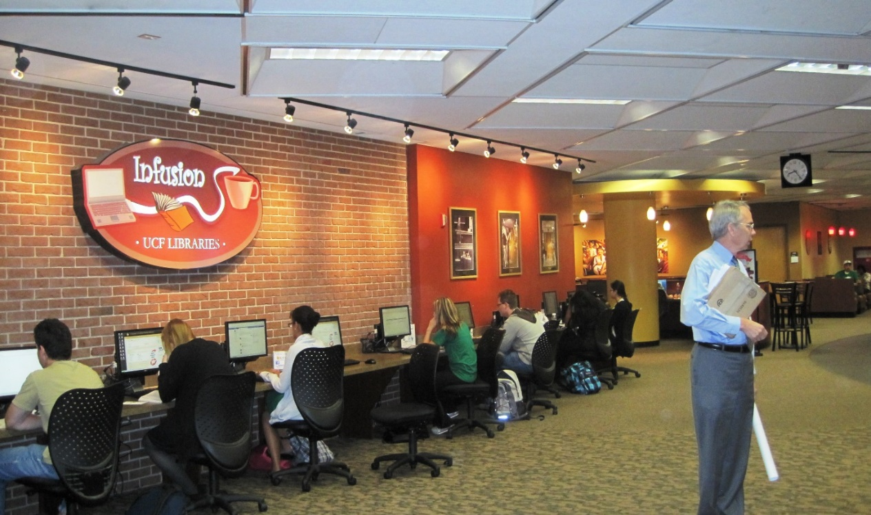
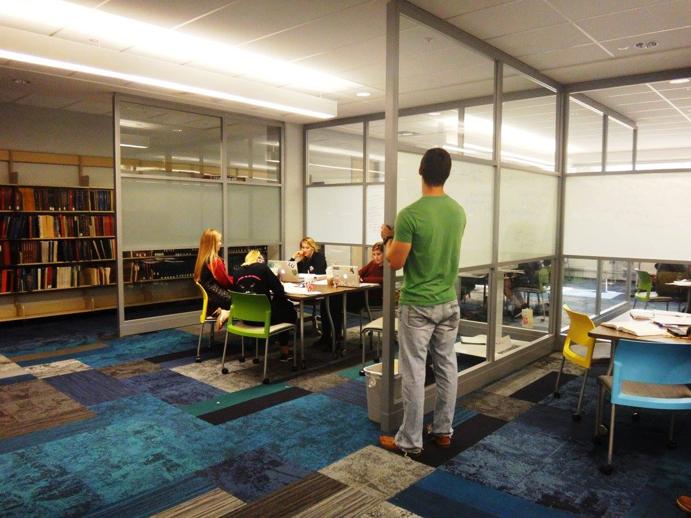
Models for the Future https://sites.google.com/site/faulibrariescommittees/select-presentations
UCF Library
UNF Library
Notes:
There are dozens of models out there for us to follow. I have prepared a more complete overview of some of those models for anyone who might be interested.

Slide 10
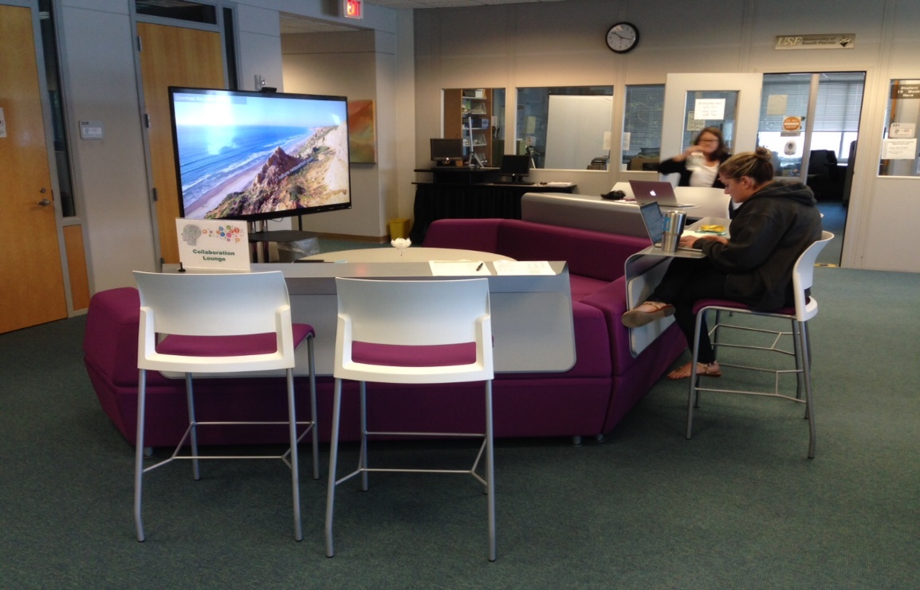
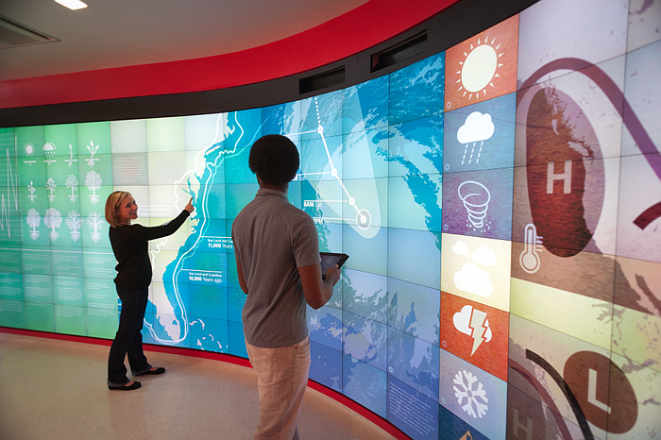
Models for the Future https://sites.google.com/site/faulibrariescommittees/select-presentations
USF St. Petersburg Library
North Carolina State University Library

Slide 11
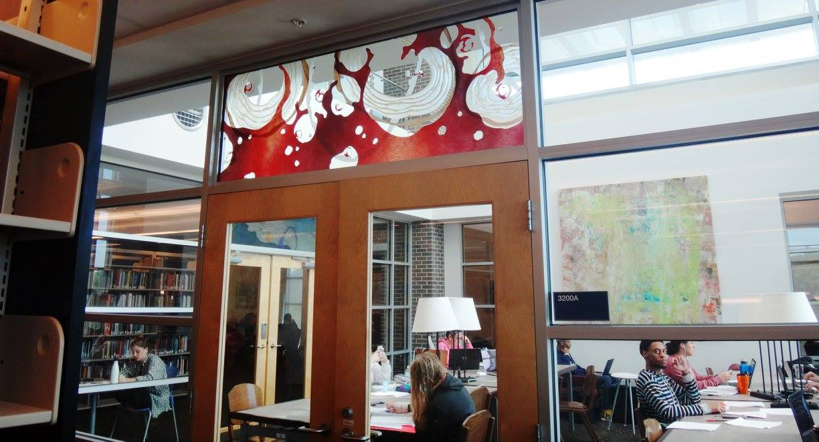
UNF Library
Models for the Future
https://sites.google.com/site/faulibrariescommittees/select-presentations

Slide 12
“The library should support and inspire student scholarship and creativity.”
Carol Hixson
Dean of University Libraries

