Slide 1

Florida Atlantic University Libraries
Library Collections
Presentation of
Carol Hixson, Dean of University Libraries
To Student Government Town Hall
April 9, 2018

Slide 2
FAU’s Libraries
3 FAU Facilities
  Wimberly (Boca Raton)
  MacArthur (Jupiter)
  HBOI (Fort Pierce)
2 Shared Facilities
  Broward County Main Branch (to serve Fort Lauderdale students)
  University/College Library, Broward College (to serve Davie students)

Slide 3
Collections
3.7 million items in FAU’s three libraries, including
  artists' books, sound recordings, print music, rare books and manuscripts
  selective depository library in the Federal Depository Library Program
  depository library in the Florida State Depository System
The Digital Library
  digitized collections of unique materials from Special Collections
  online database of student theses and dissertations
  University produced journals
Access to:
  over 80,000 electronic journals
  nearly 500 databases
  growing collection of e-books and streaming videos

Slide 4
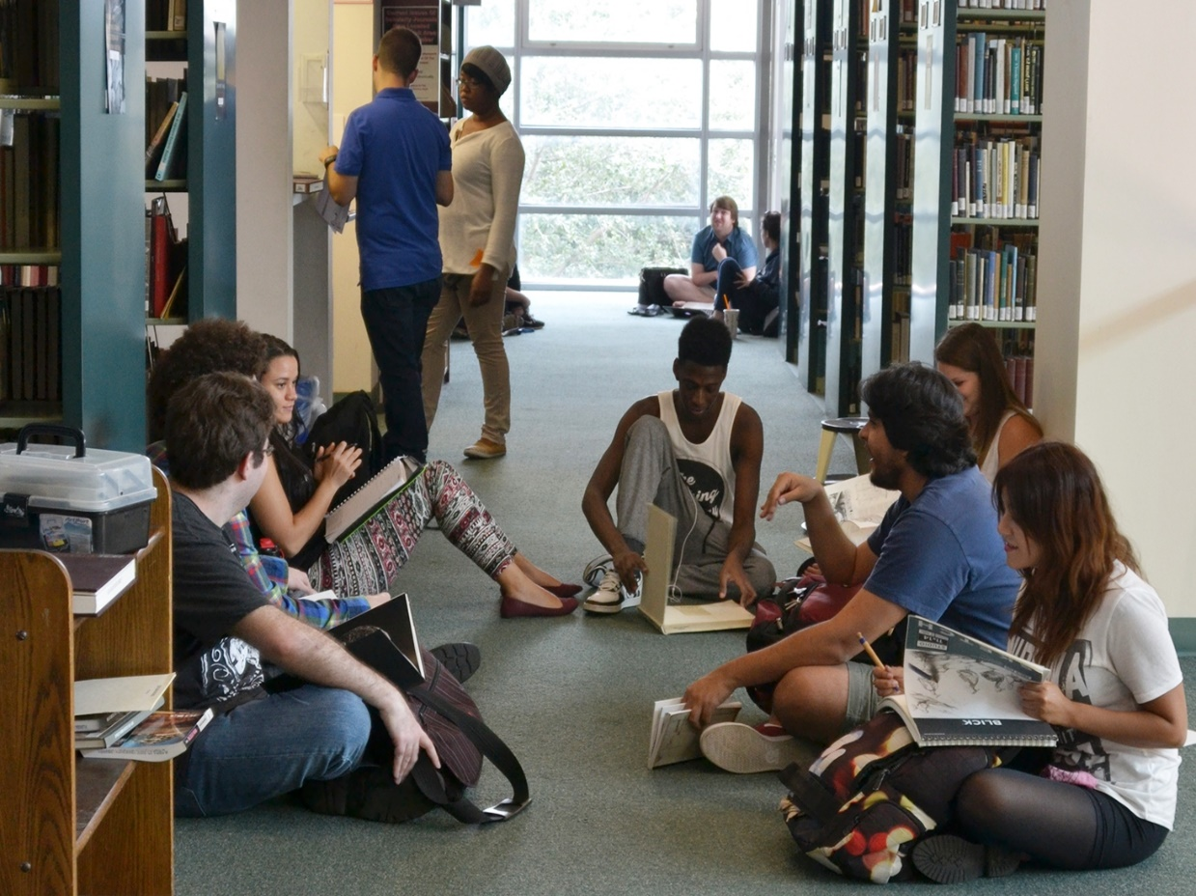
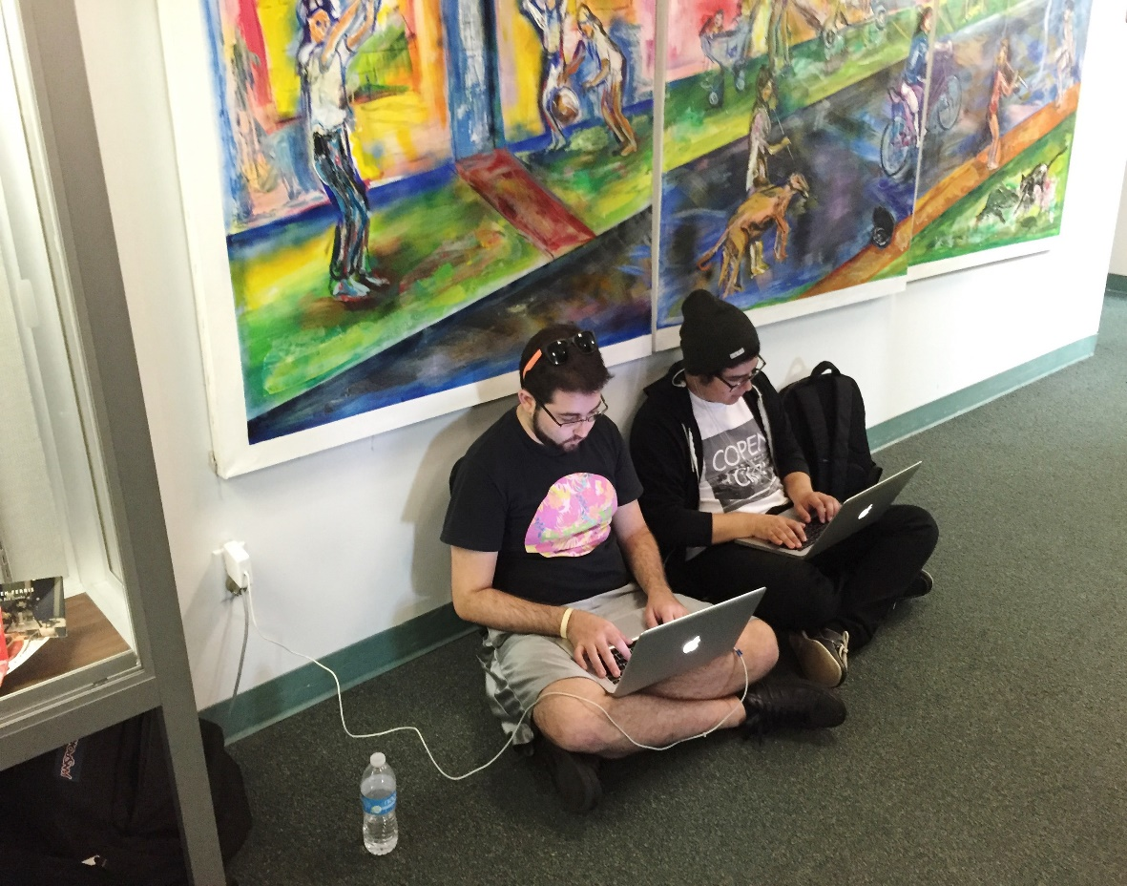
Wimberly Library Facility

Slide 5
Students Said They Wanted Space, Power, Better Connectivity, Updated Facility – Sept-Oct. 2015 Survey

Slide 6
Faculty comment from fall 2017 faculty survey
“I find the library's staff to be very friendly and professional when working with me and our students, even though they are dealing with many issues that are beyond their control. 1) the building that clearly has seen its better days decades ago and while they have managed to make small inroads into improving the quality of the library experience for everyone, the building still presents itself as the library that time has forgotten. In its current physical state I would find it hard to believe it could compete against libraries at many of our state competitors let alone outside the state. The building simply does not convey the image one would come to expect for a university marketing itself as a high research institute…”

Slide 7
Wimberly Library Facility
Very heavily used facility
Typically, 120,000 to 130,000 visits per month
So far, all-time record high was 137, 911
  Only tells partial story as students come in and stay for hours
September and February are typically the busiest months
Students frequently sit on the floor because of lack of available seating
They use footstools as desks

Slide 8
Seating and Study Capacity in Wimberly Library
We have been adding seats and study rooms in last 3 years
The seating capacity is 1400+ seats, including study rooms
30 group study rooms
High demand daily, with extremely high demand before and during midterms and final exams
Peak demand days/times are M-F, 10:00 a.m. – 3:00 p.m. Pagers notify people on a waiting list when rooms become available

Slide 9
Wimberly Library Facility
Minor upgrades in Boca Raton in the past 2 1/2 years funded by:
  $250,000 special allocation for the 5th floor
  $10,000 gift from University Club for Graduate Lounge
  $14,000 gift from Lifelong Learning Society for some painting and branding
  Tech fee money to upgrade computers and study room equipment
  Funds from Auxiliary accounts for limited branding, painting, furnishings, and new service desk

Slide 10
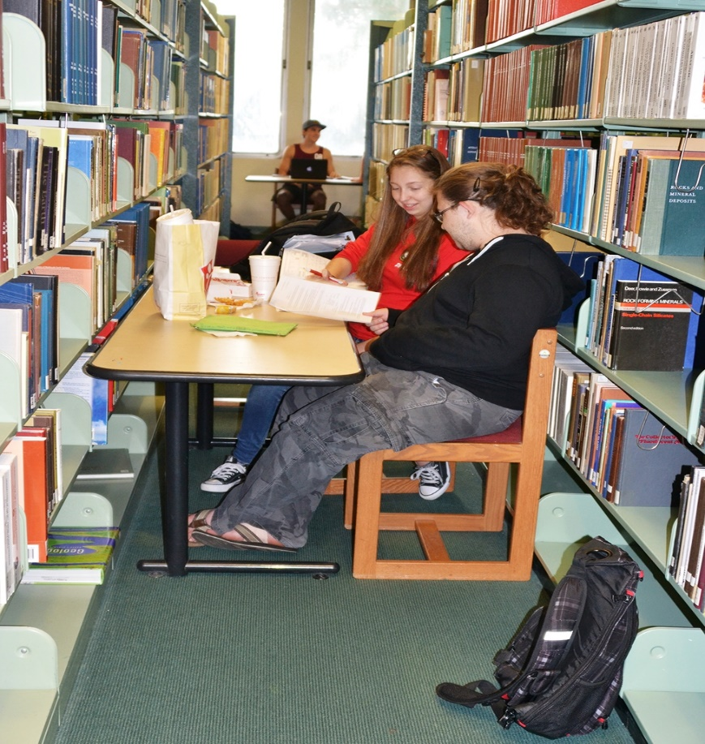
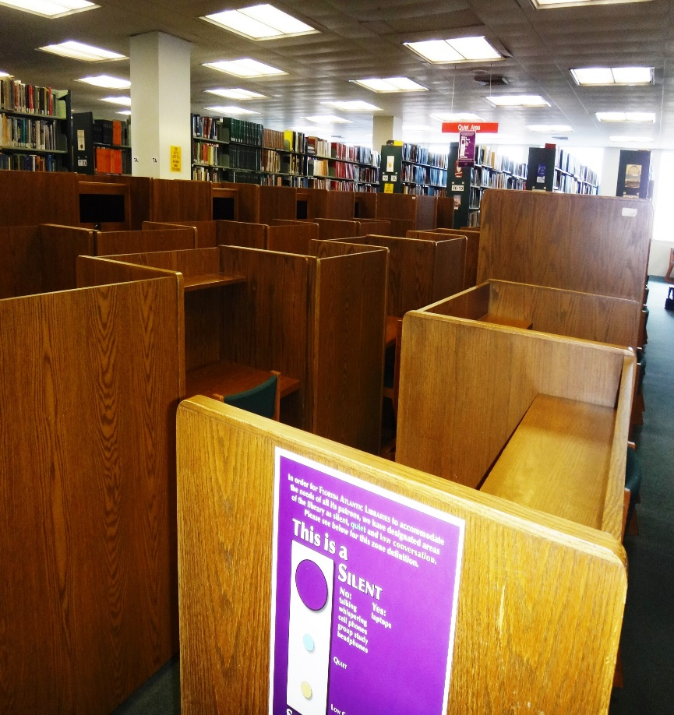
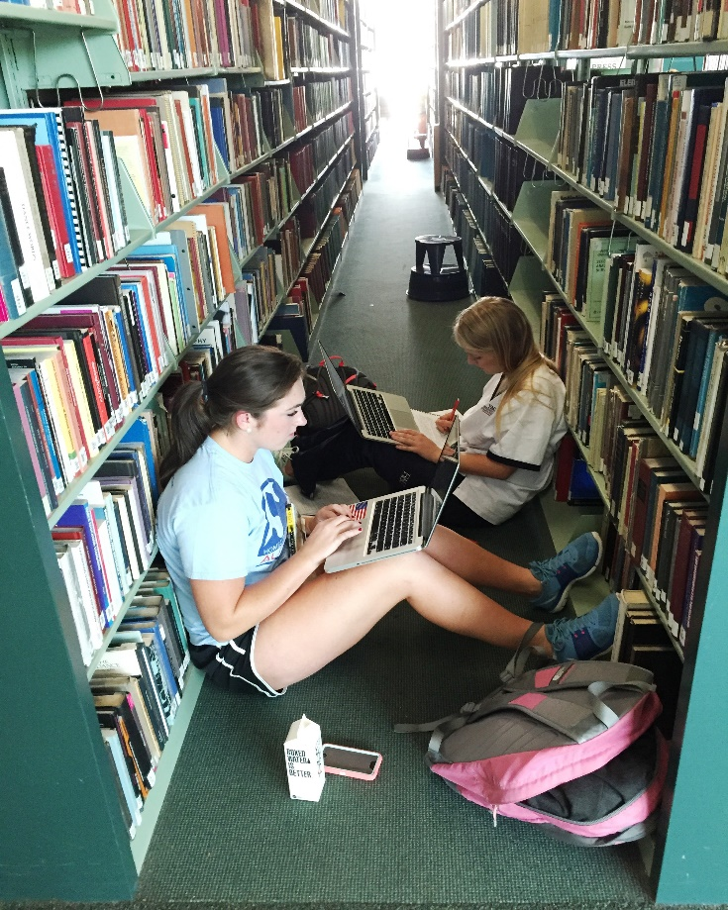
Wimberly Library Today

Slide 11
Vision for Wimberly
Stabilize and reverse deterioration of facility
Accommodate needs of today’s students
Service-centered rather than collection-centered
Flexible and multi-purpose design and furnishings
Technology-infused spaces to ensure competitive edge
Point of pride and clearly identifiable as an FAU facility

Slide 12
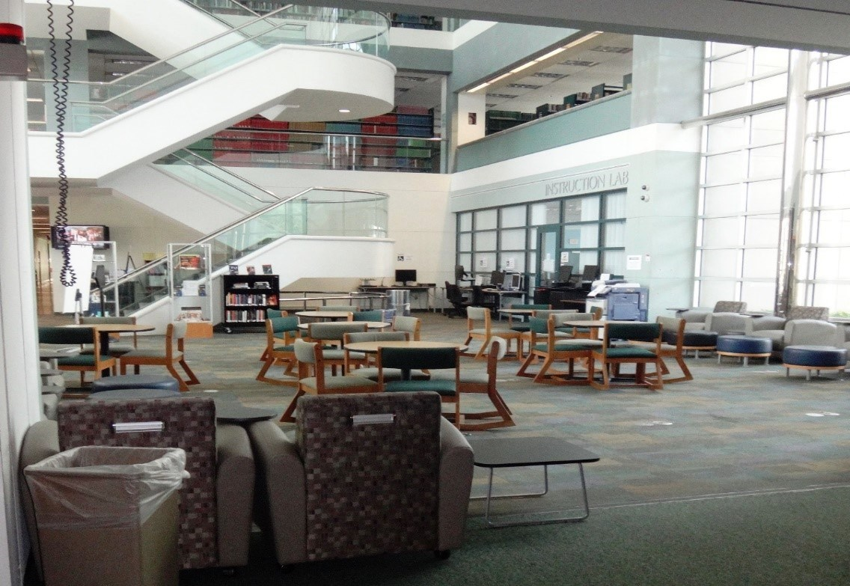
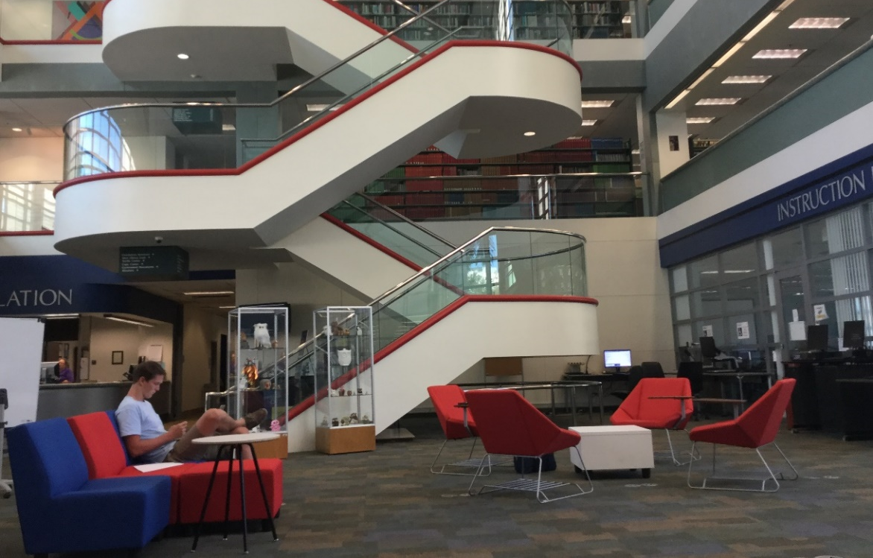
Wimberly Library Being Transformed
Before
After

Slide 13
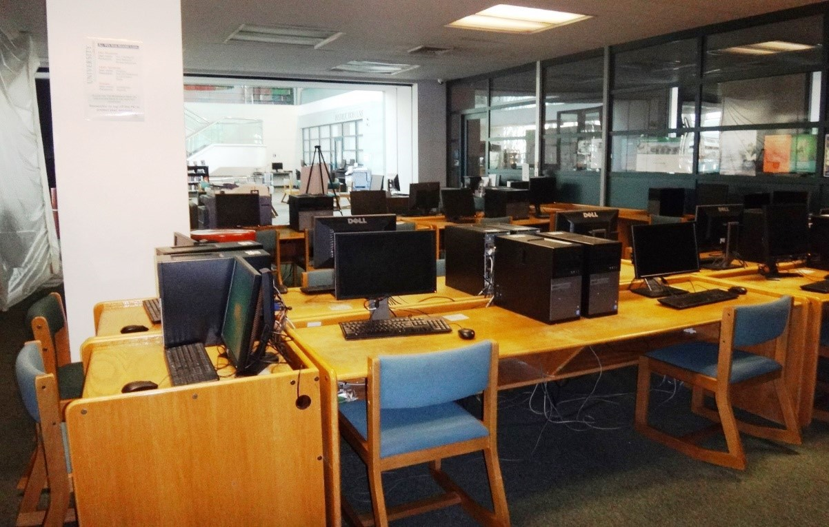
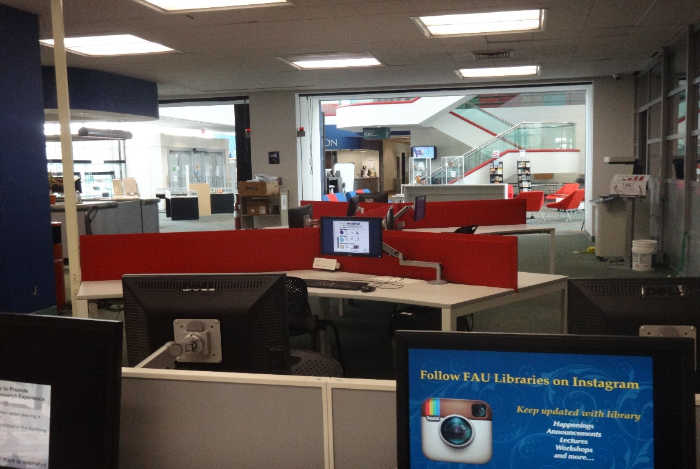
Wimberly Library Being Transformed
Before
After

Slide 14
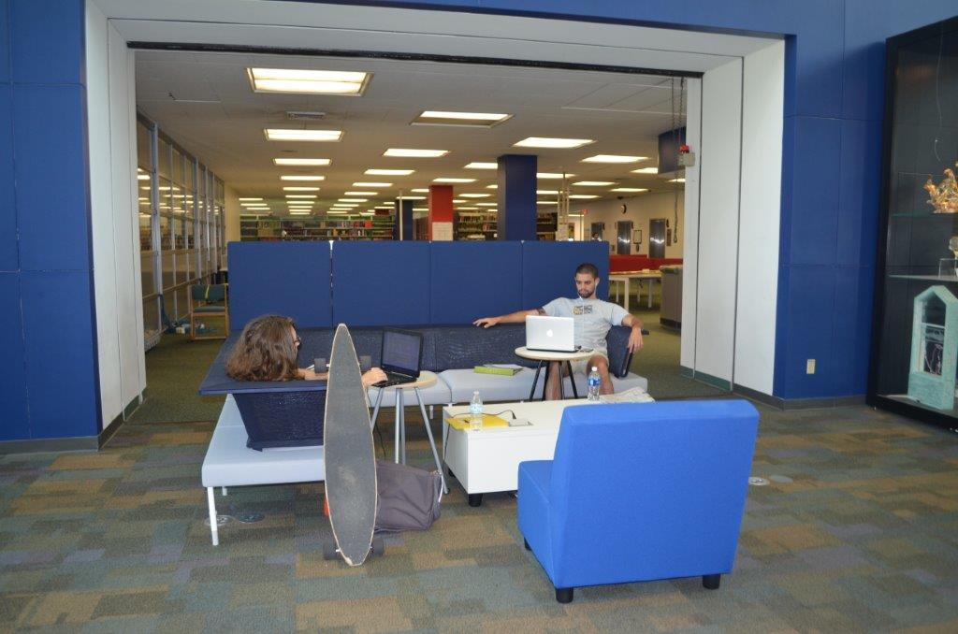
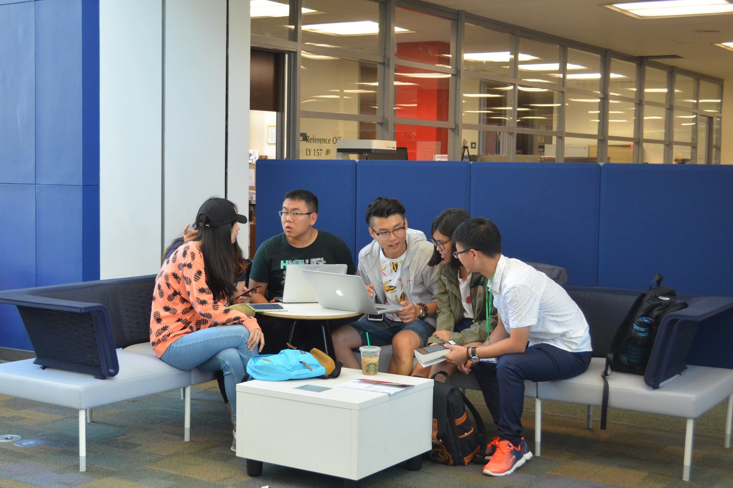
Wimberly Library Being Transformed
Students Enjoying the FAU Experience in the Wimberly Library 1st Floor Atrium

Slide 15
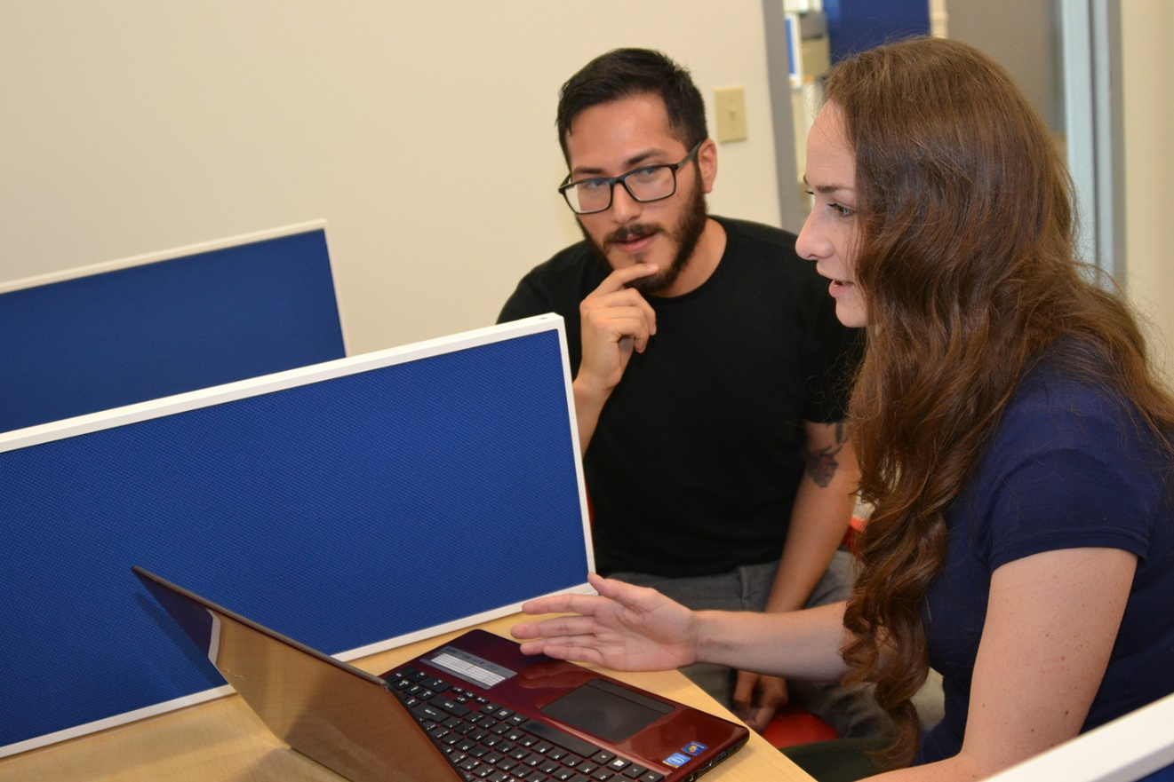
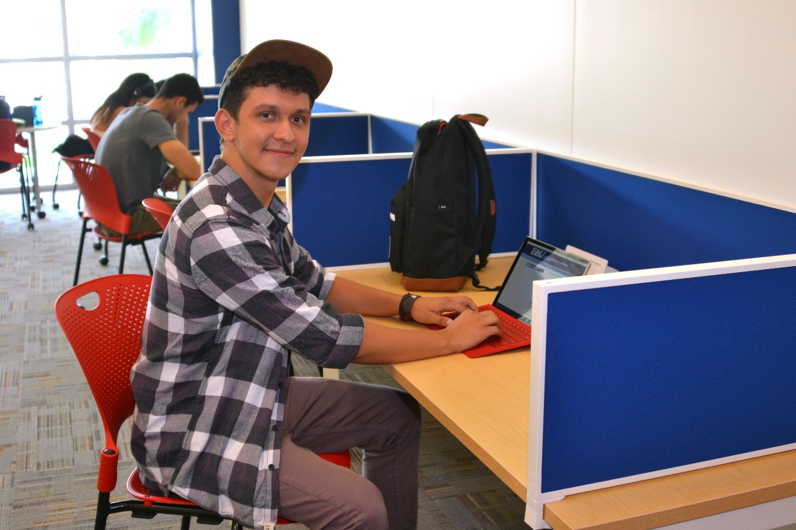
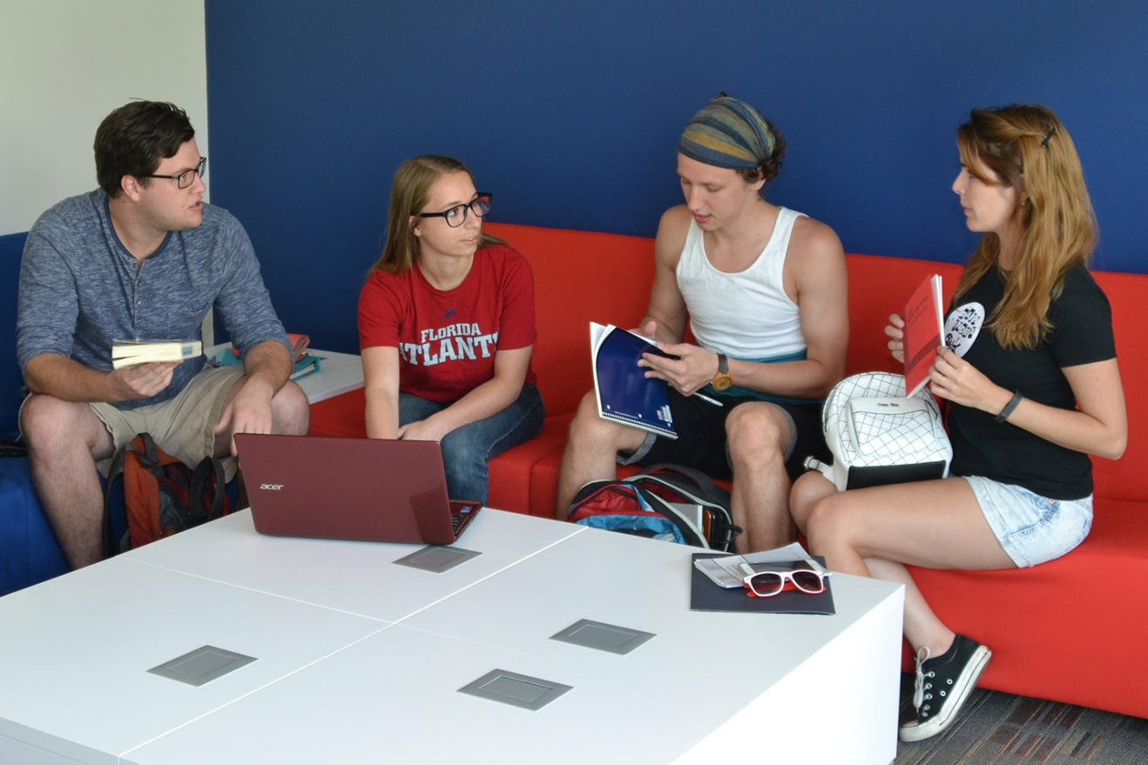
Graduate Student Lounge
Wimberly Library Being Transformed

Slide 16
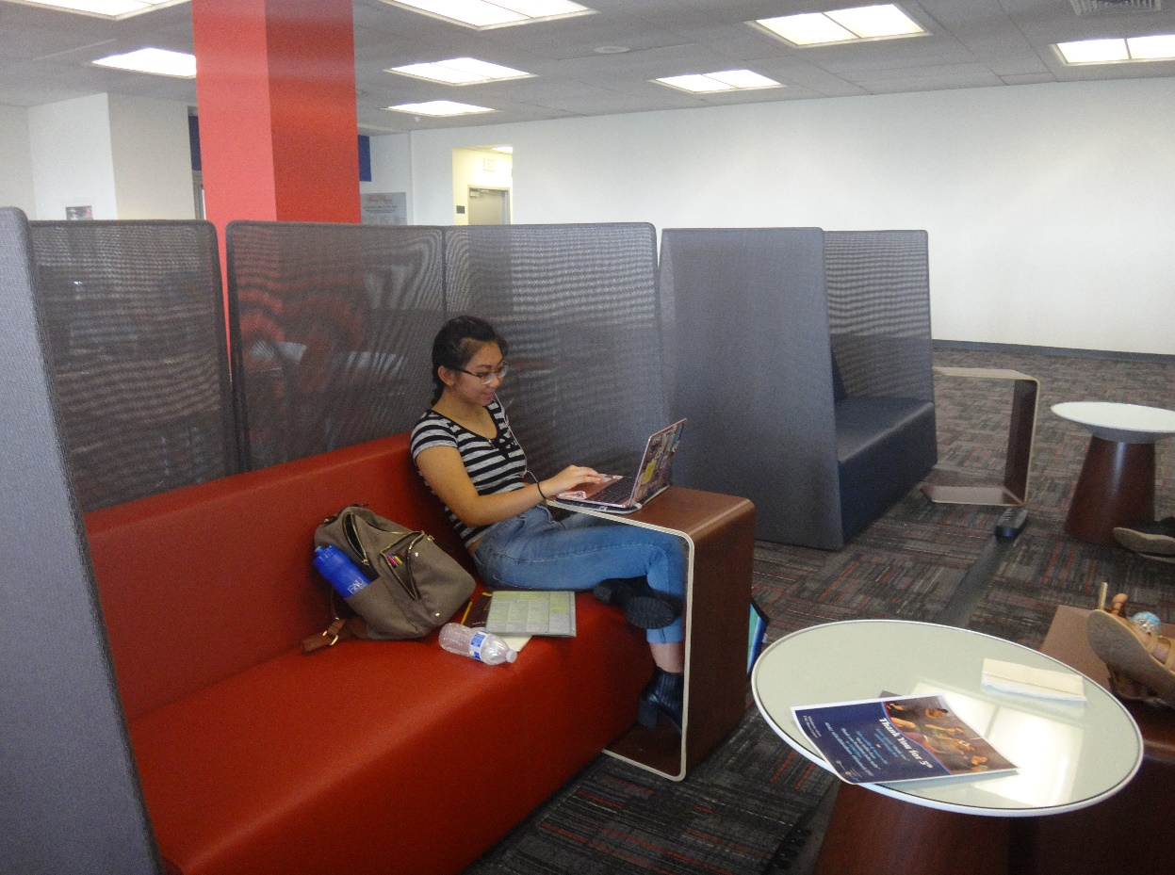
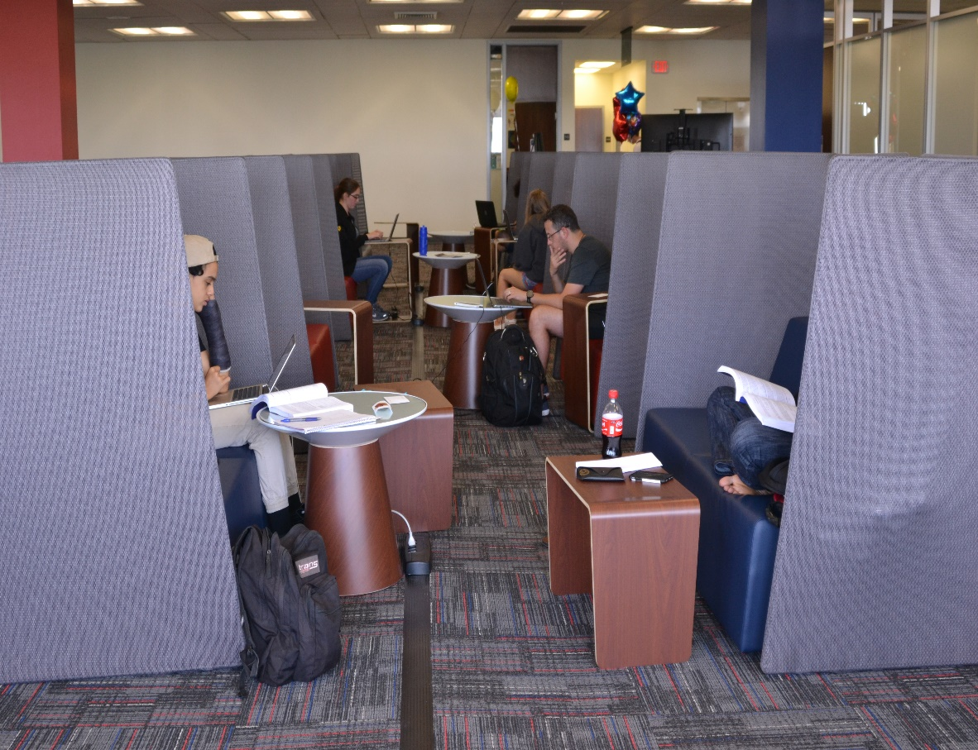
Wimberly Library Being Transformed
New 5th Floor in the Wimberly Library

Slide 17
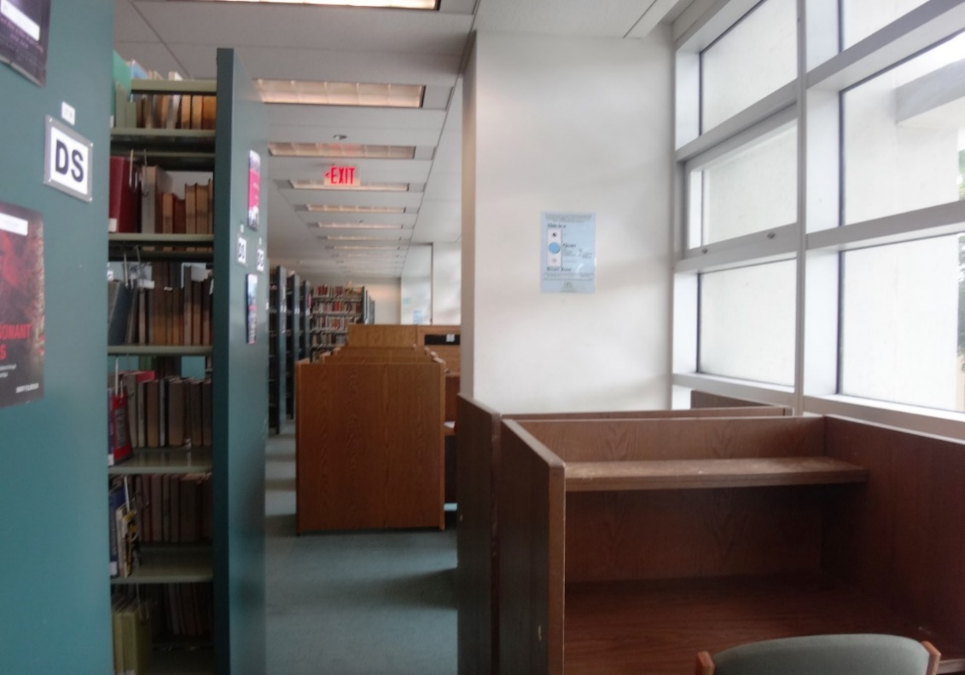
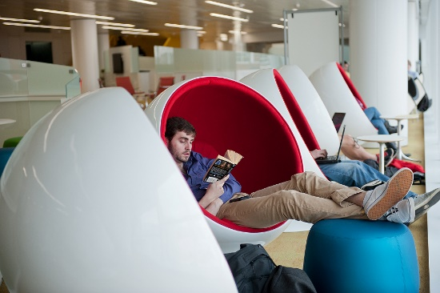
How Do We Get from Here to There?
Wimberly Today
Future Vision

Slide 18
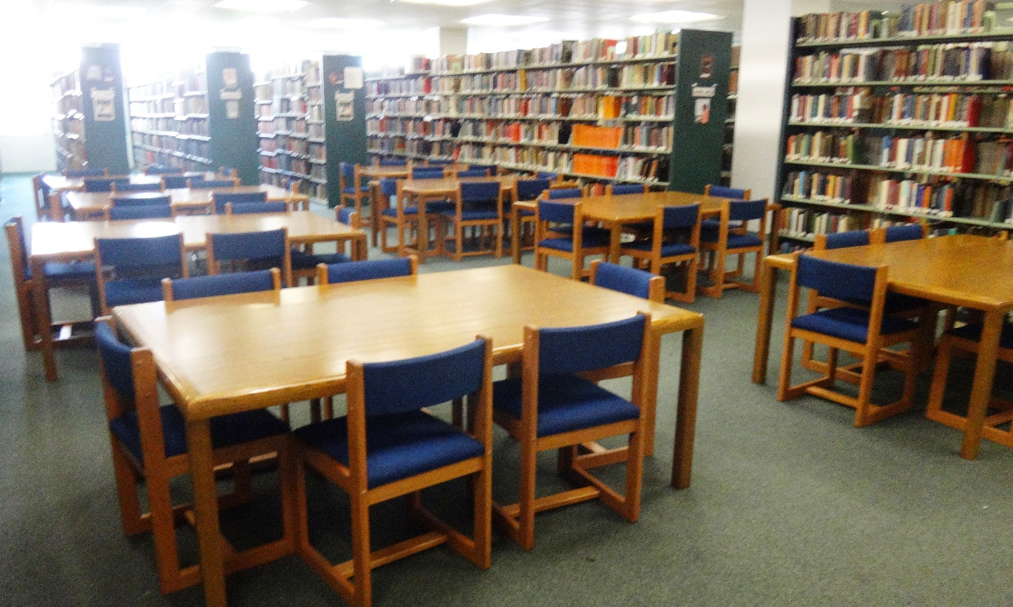
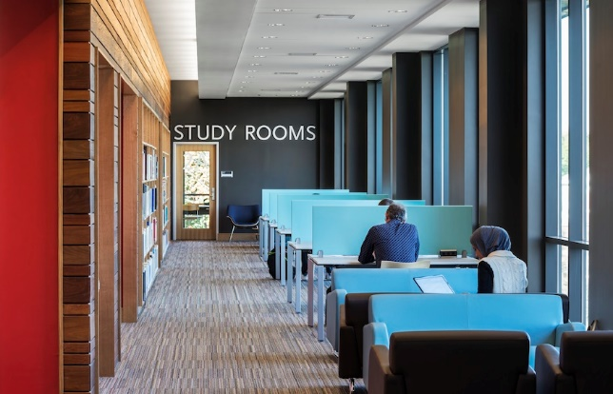
How Do We Get from Here to There?
Wimberly Today
Future Vision

Slide 19
Student survey: 3 days of responses
323 Responses as of 9 a.m. April 7, 2018 (open until April 23)
  Undergrads 88% (First Year 15%, Sophomore 14%, Junior 28%, Senior 33%)
  Grad Students 7.5%, FAU High 1%, PBSC .3%
  Primary Language English 86%; Spanish 5%; Portuguese, French
    and Creole 1.25%
  Female 48%, Male 47%
  95% Use the Wimberly Library Primarily

Slide 20
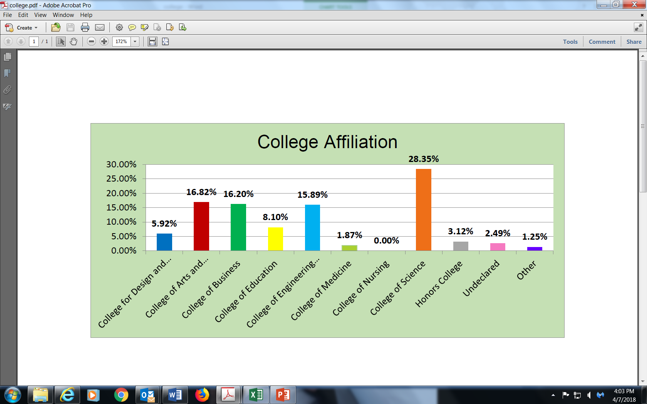
College Affiliation

Slide 21
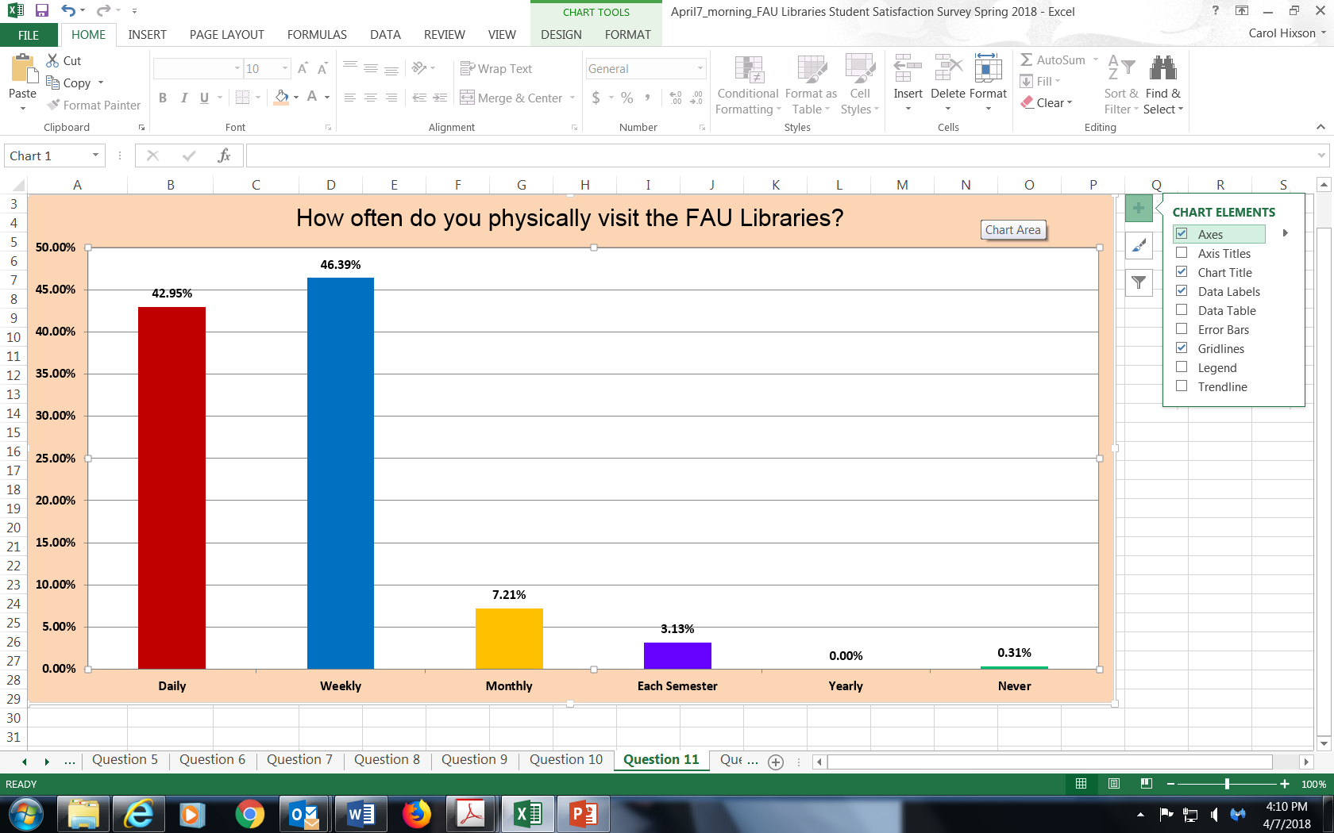
Frequency of Visits to Library

Slide 22
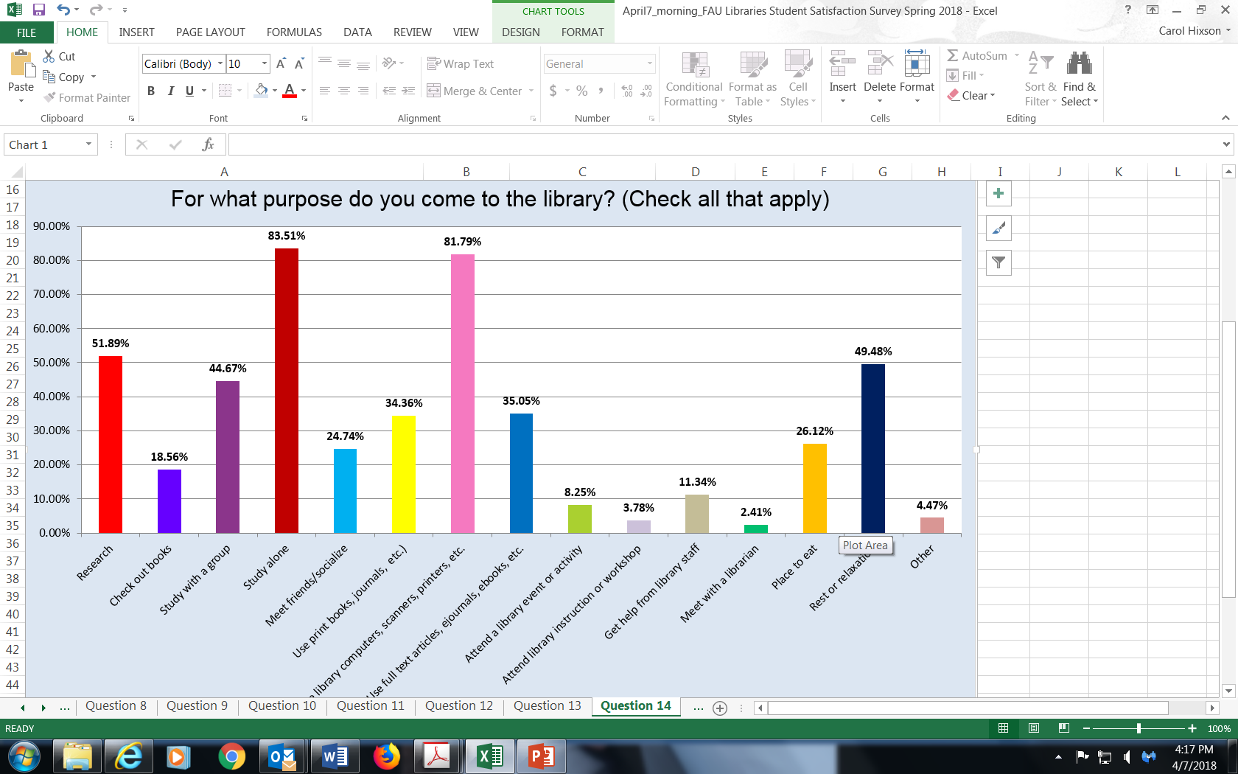
Reasons people Come to the Library

Slide 23
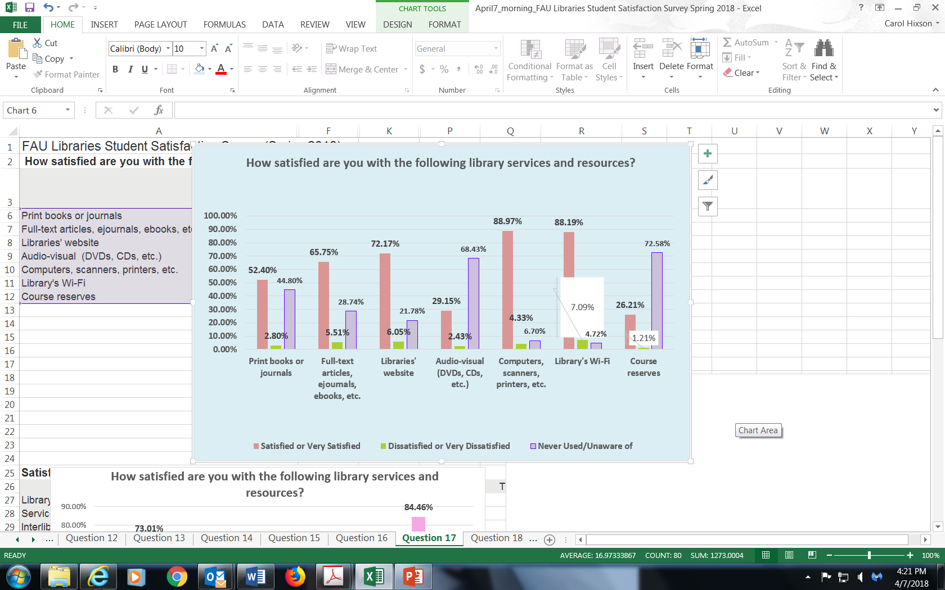
Satisfaction with Library

Slide 24
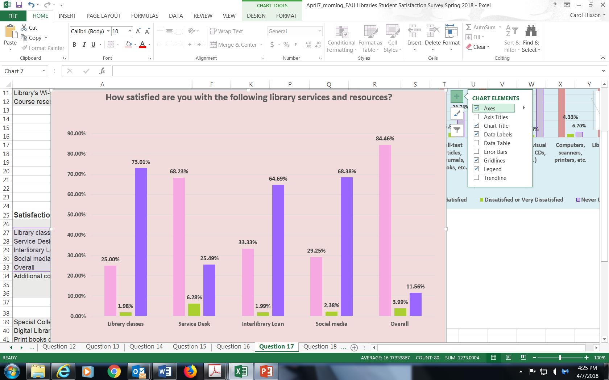
Satisfaction with Library

Slide 25
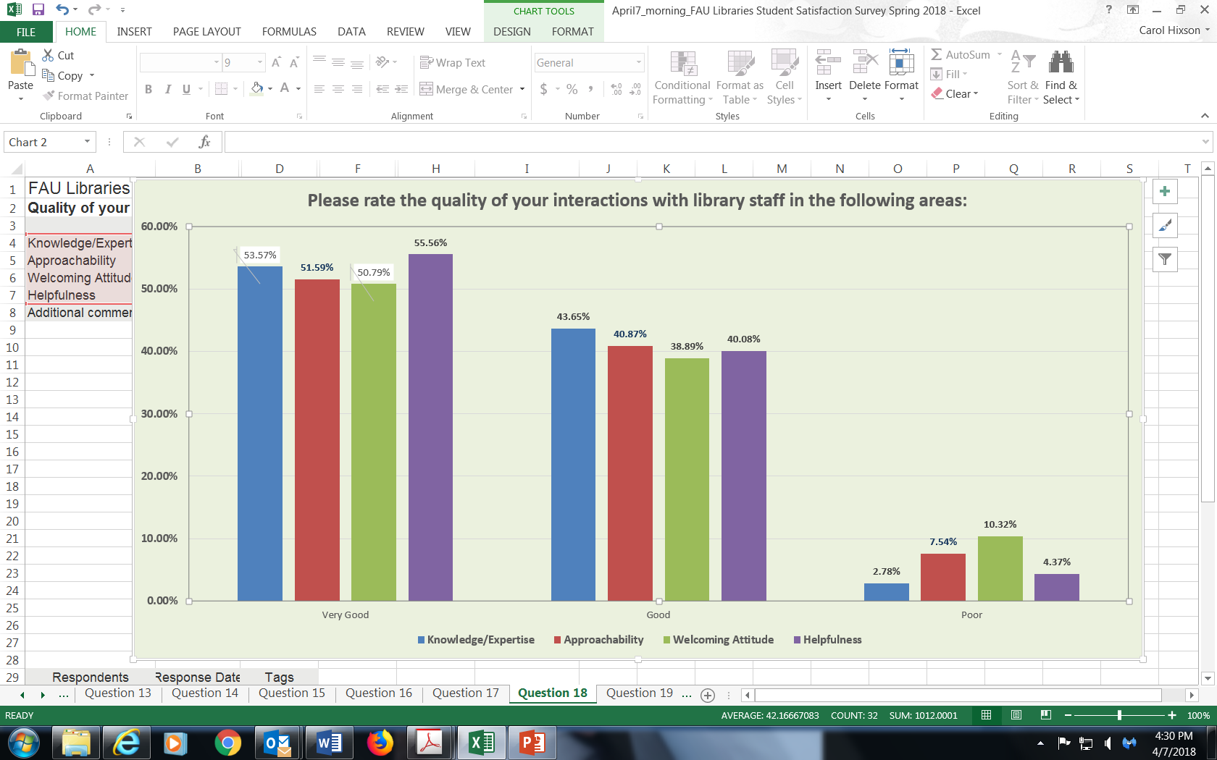
Quality of Interactions with Library Staff

Slide 26
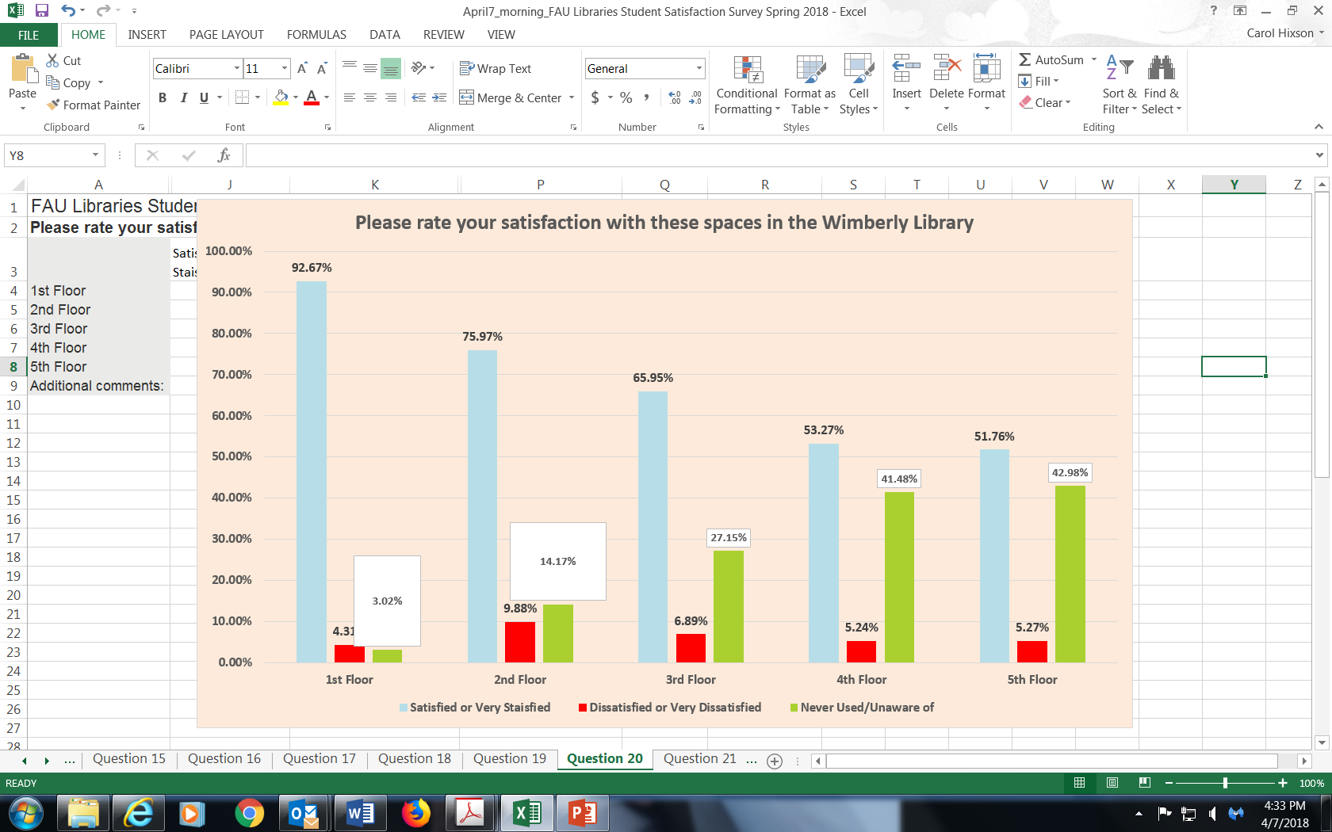
Satisfaction with Wimberly Spaces

Slide 27
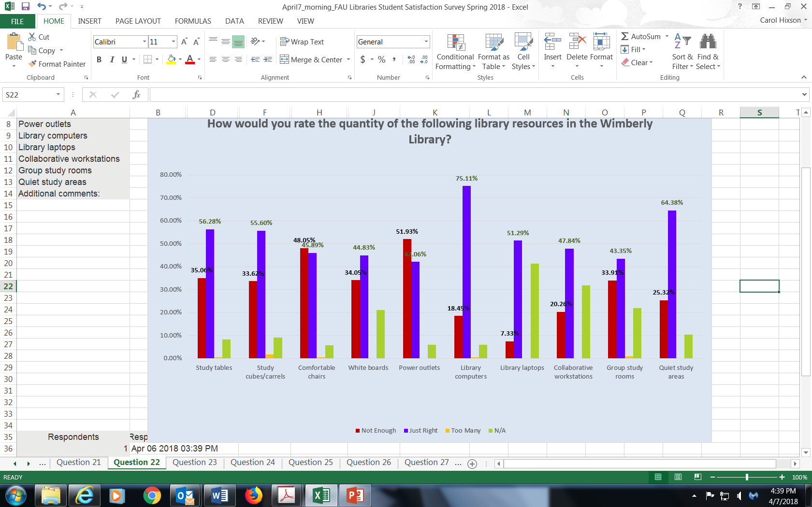
Quantity of Resources

Slide 28
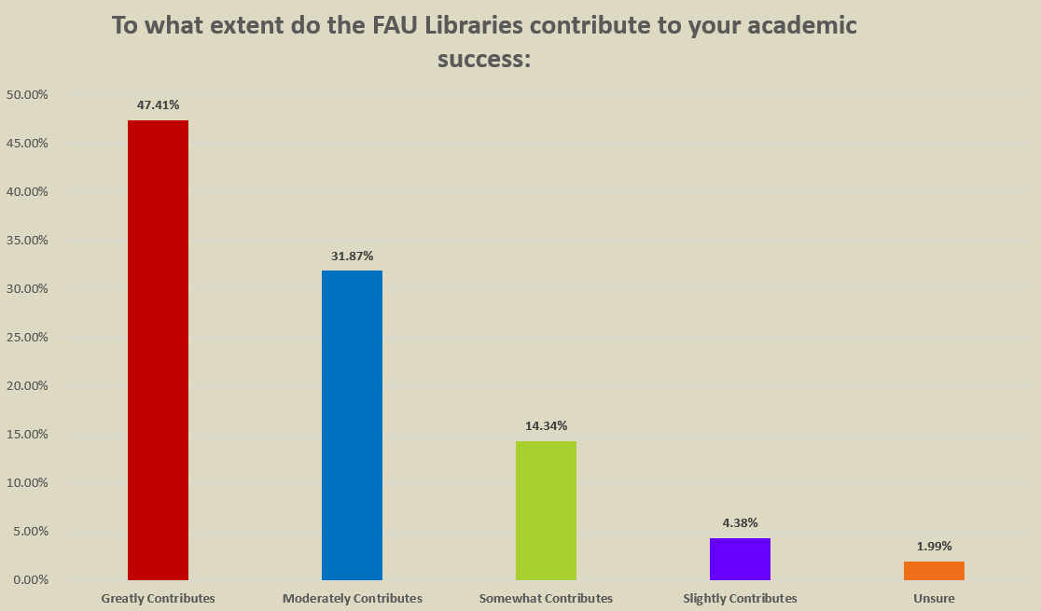
Academic Success

Slide 29
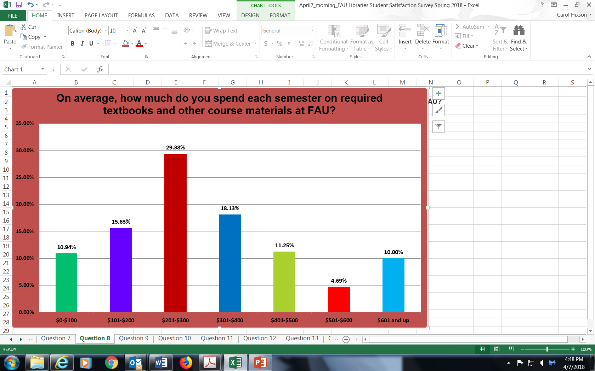
Cost of Textbooks

Slide 30
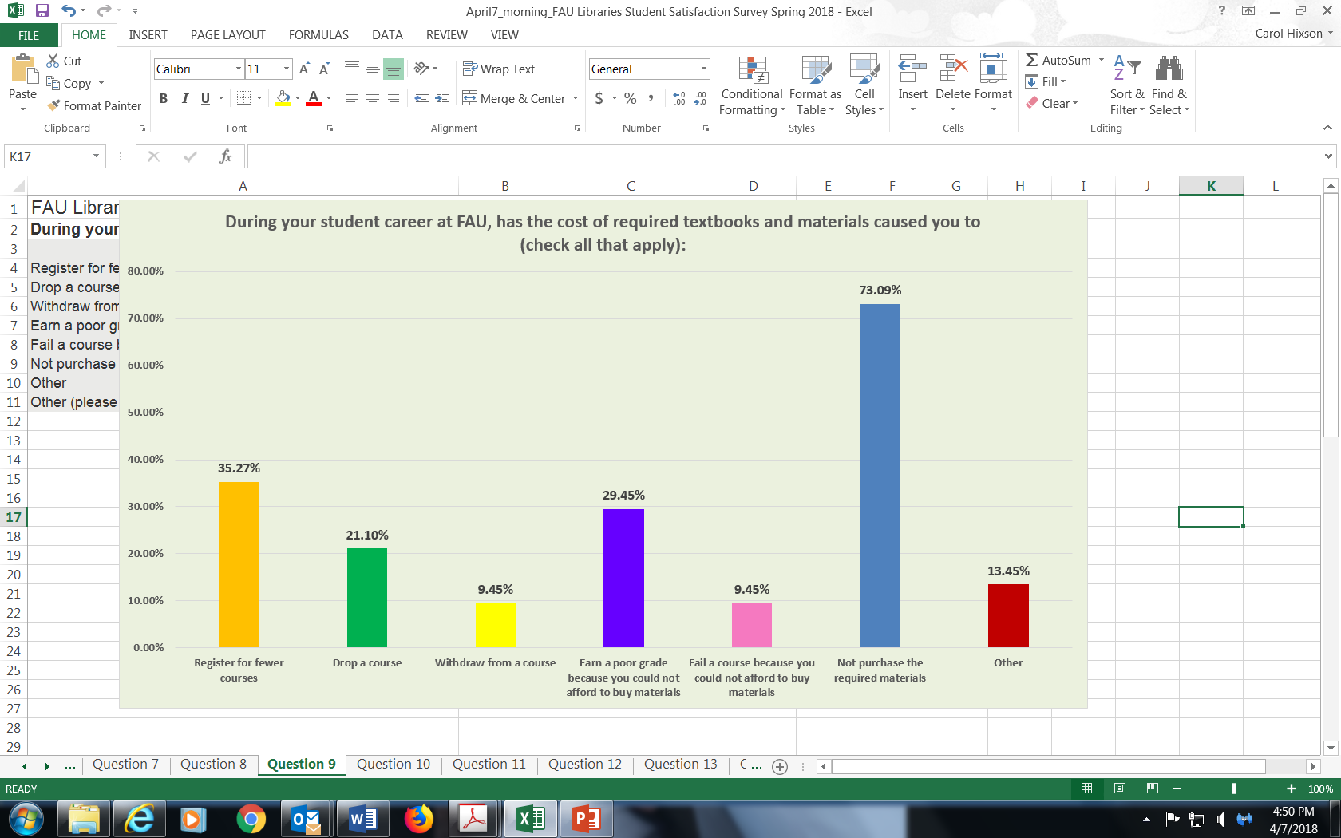
Impact of High Costs

