Slide 1
Promote and Publish Your Work
A Presentation to the USFSP
Undergraduate Research Symposium
April 11, 2013
http://dspace.nelson.usf.edu/xmlui/handle/10806/6415
Carol Hixson
Dean, Nelson Poynter Memorial Library
and
Alex Brice
Associate Professor, College of Education

Slide 2
Why Promote and Publish
Your Work?
Share the results of your research widely
Get credit for your work
Contribute new knowledge to your field
Build your portfolio for work or graduate school
Get connected with others interested in the same topic
Secure grant funding for more research

Slide 3
How to Promote Your Work
Submit work to the USFSP Digital Archive’s collection for the Undergraduate Research Symposium, and/or
Publish in the USFSP Student Research Journal

Slide 4
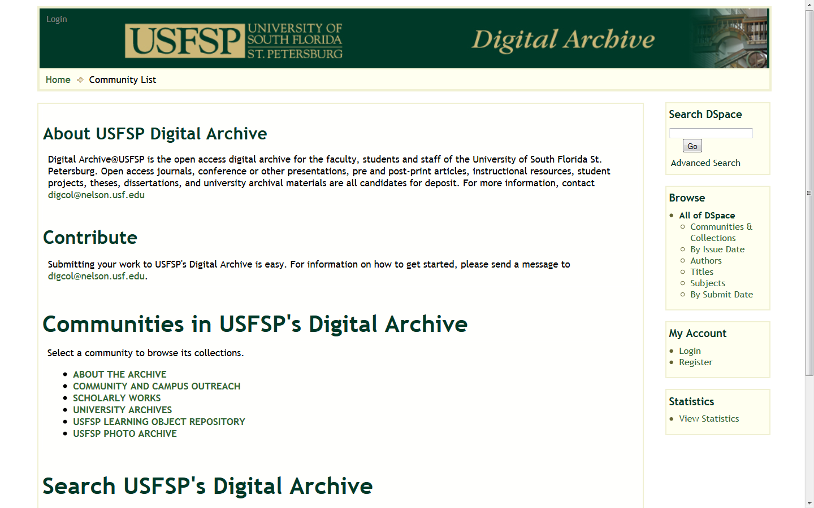
USFSP Digital Archive http://dspace.nelson.usf.edu/

Slide 5
What Does the USFSP Digital Archive Do?
Highlights individual, group, and institutional achievement
  Includes use statistics to track impact
Improves access to and discoverability of materials
  Provides unique and unchanging URL
  Full text indexing
  Indexed by Google, Google Scholar, etc.
    Increases visibility of USFSP

Slide 6
What Does the USFSP Digital Archive Do?
Protects intellectual property
  Credits authors and creators
  Provides date and time stamp for all work
  Provides copyright protection
Accepts all types of materials
  Multiple files per item and different file types
Preserves materials

Slide 7
USFSP Student Research Journal
The Student Research Journal follows a tradition of student scholarship found in many other schools, including Berkeley, Clemson, and Harvard. There are five guiding principles for the online USFSP Student Research Journal:
  The Student Research Journal is published through on-line submissions.
  The Student Research Journal is available online through a platform that indexes, retrieves, and tracks the usage of the articles in it.
  The American Psychological Association (APA) 6th edition will be used as the preferred style format.
  Submission procedures and form are accessible online.
  A rolling publication system allows for flexibility in publishing special issues and rolling out new editions.

Slide 8
Benefits of the Student Research Journal and the Digital Archive
Highlights individual, group, and institutional achievement
Improves access to and discoverability of materials
  Provides unique and unchanging URL
  Full text indexing
  Indexed by Google, Google Scholar, etc.
Protects intellectual property
  Credits authors and creators
  Provides date and time stamp for all work
  Provides copyright protection
Accepts all types of materials
Preserves materials

Slide 9
To Submit Your Research to the Digital Archive
Review Going Green – Instructions for Submitting to the Undergraduate Research Collection online http://dspace.nelson.usf.edu/xmlui/handle/10806/4509
OR
Contact Carol Hixson, Dean of Library
  873-4400
  hixson@usfsp.edu

Slide 10
USFSP Student Research Journal
Published in the USFSP Digital Archive at:
http://dspace.nelson.usf.edu/xmlui/handle/10806/10
To submit an article to the Student Research Journal, contact Dr. Alejandro Brice aebrice@mail.usf.edu

