Slide 1

Forging a New Path
Faculty Buy-In for the Institutional Repository and Open Access Publishing
by Carol Hixson, Deborah Henry, and Tina Neville
Nelson Poynter Memorial Library
University of South Florida St. Petersburg
Presented at the Open Access Un/Conference, San Jose State University October 25, 2013
http://dspace.nelson.usf.edu/xmlui/handle/10806/7729

Slide 2

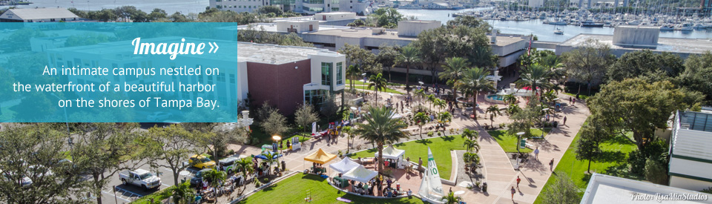
University of South Florida St. Petersburg (USFSP)

Slide 3
What is USFSP?
Master’s level comprehensive, separately accredited (SACS) institution within the University of South Florida System
3 Colleges (Arts & Sciences, Business and Education) offer 35 degree programs to 6,000 students, including 2 fully online degree programs
149 full-time faculty and 142 adjunct faculty

Slide 4
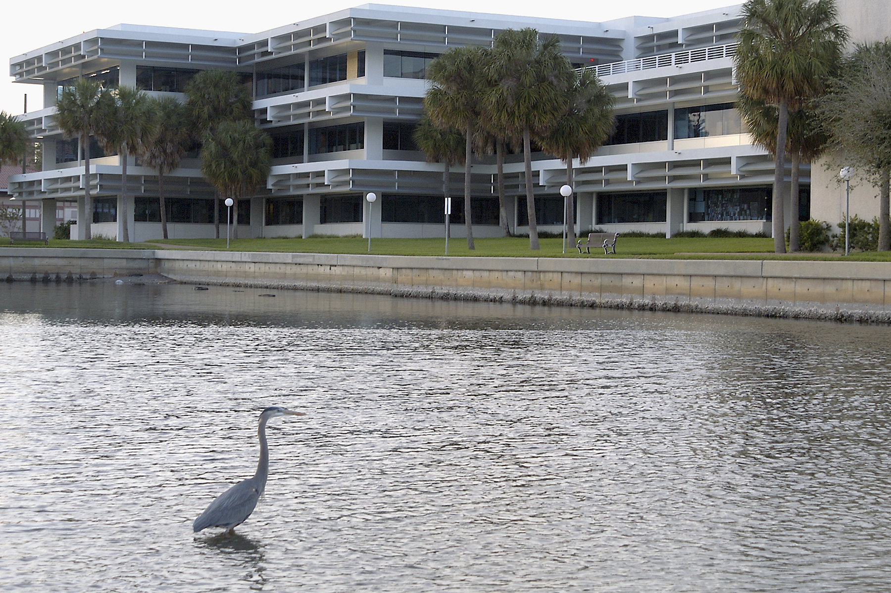
Nelson Poynter Memorial Library

Slide 5
Nelson Poynter Memorial Library
Separate from the USF Libraries and reporting to Regional Vice-Chancellor for Academic Affairs of USF St. Petersburg
ADA-compliant 81,000 square foot building open 79 hours a week
21 permanent positions with another 8-10 temporary positions and several FTE of student assistants
Full range of standard library services plus centralized campus support for distance/online learning and classroom technology support
On-site collections of 300,000 items plus access to million+ electronic resources through the USF System
Library-run institutional repository with 7700+ items and counting

Slide 6
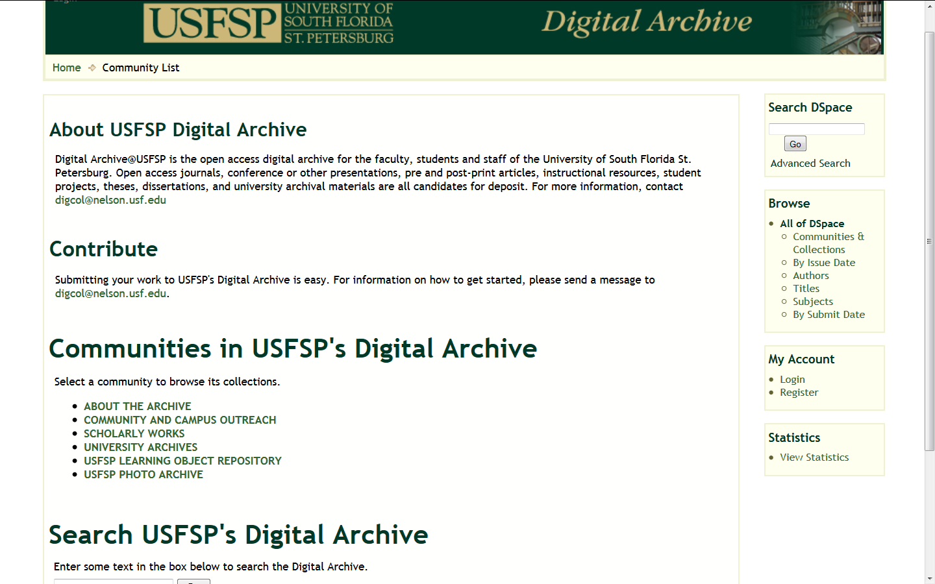
USFSP Digital Archive http://dspace.nelson.usf.edu/xmlui

Slide 7
USFSP Digital Archive
Grounded in strategic plan
Digital Collections Team established spring 2010
Brought up archive March 2011
More than 7700 items in the archive overall – and growing

Slide 8
USFSP Digital Archive
More than 7700 items in the archive
63 collections for individual faculty
  22% of all faculty
  38% of permanent faculty
  90% of faculty collections are for permanent faculty
More than 1515 items (20% of total submissions to the archive)

Slide 9
How We Achieved Faculty Buy-In
Steering Committee to set policies
  One faculty member from each College
  Started with policies developed at University of Oregon’s Scholars’ Bank
  Included the Library’s Digital Collections Team as part of the Steering Committee

Slide 10
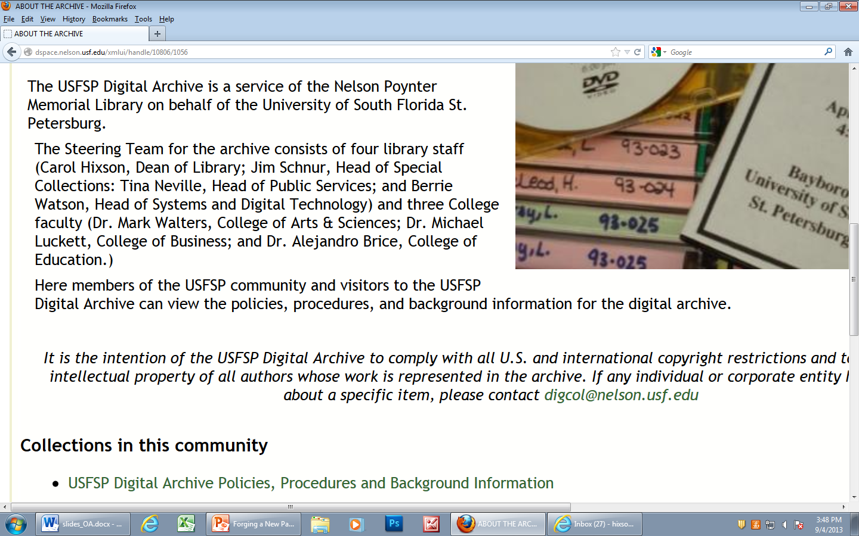
Steering Committee & Policies

Slide 11
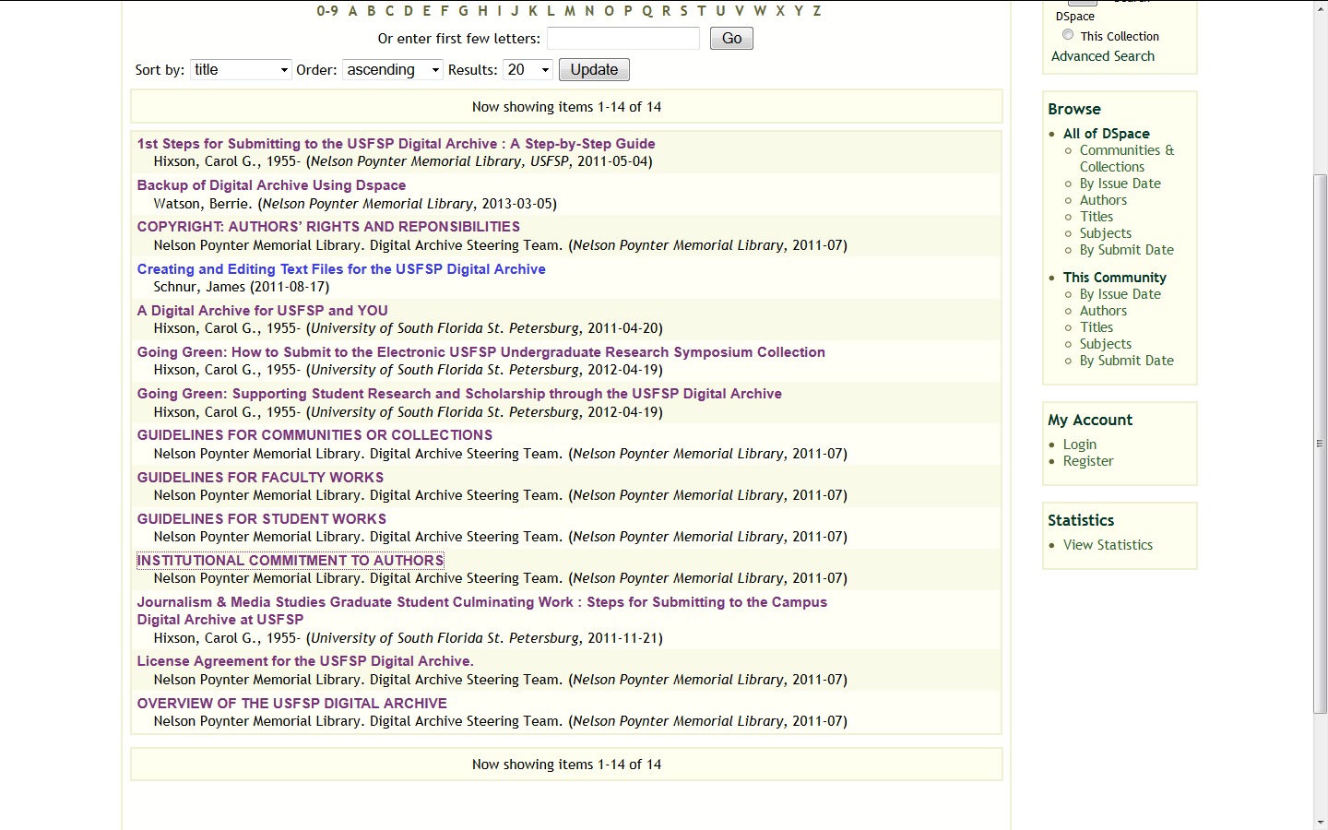
Policies and Procedures http://dspace.nelson.usf.edu/xmlui/handle/10806/1058

Slide 12
How We Achieved Faculty Buy-In
Steering Committee to set policies
Lead by example and follow-through

Slide 13
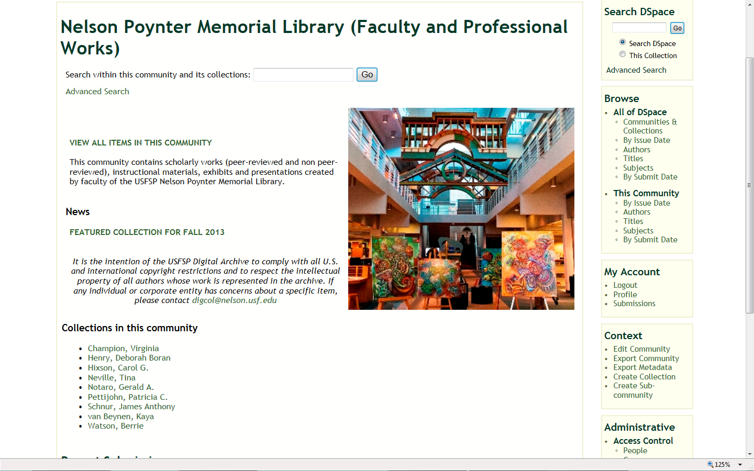
Lead by Example and Follow-Through

Slide 14
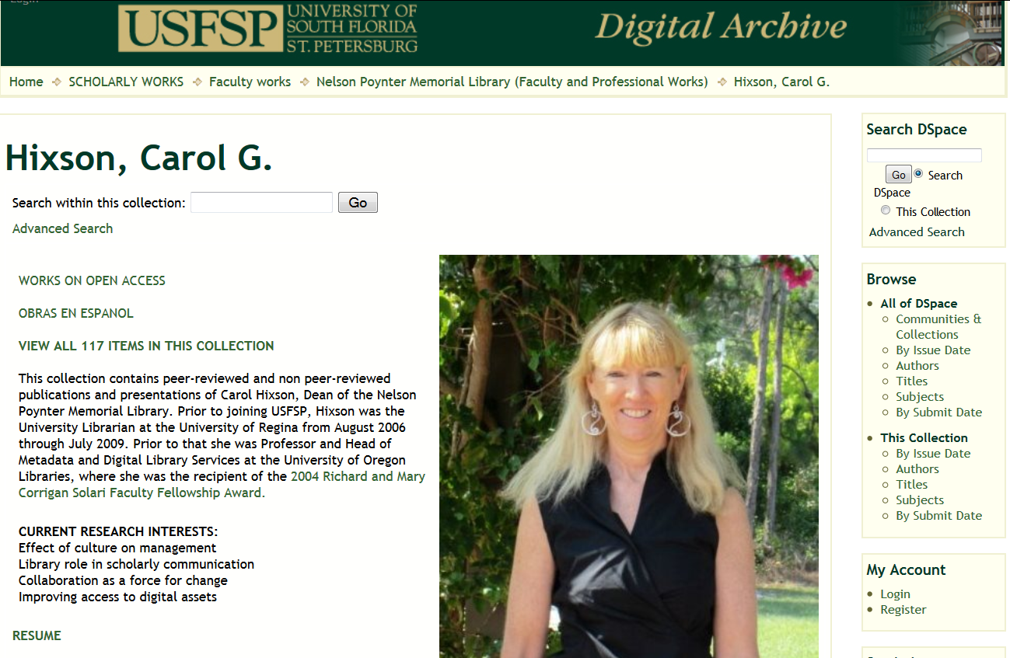
Lead by Example and Follow-Through

Slide 15
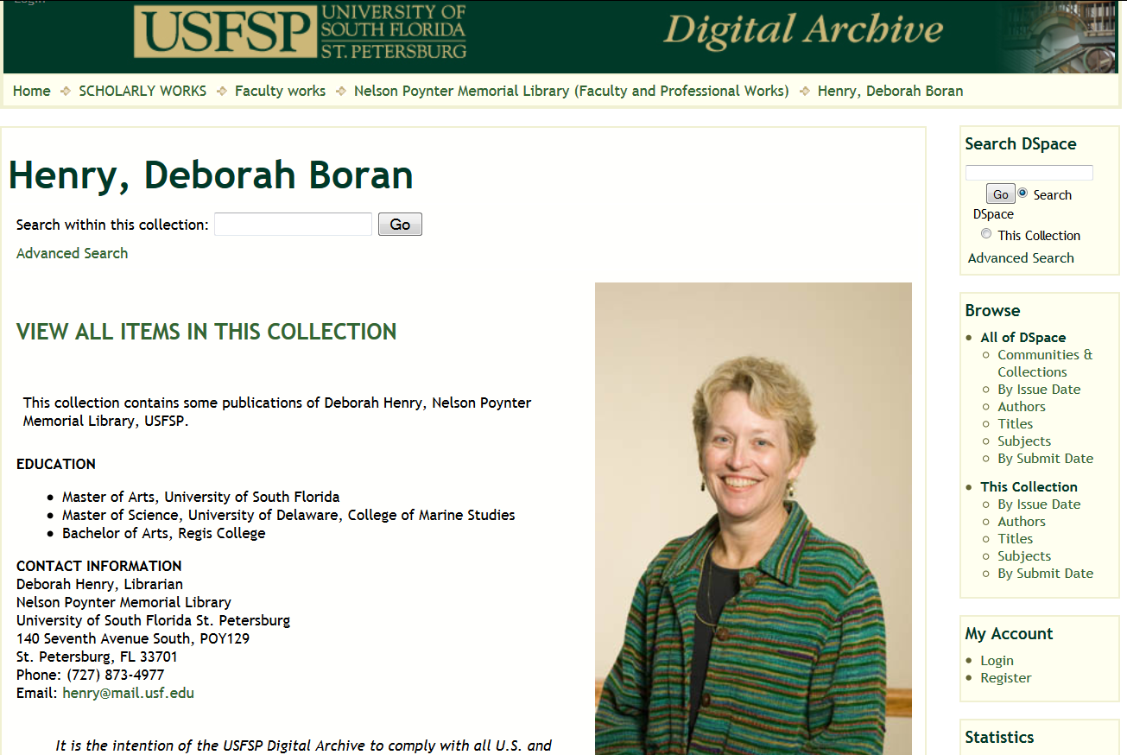
Lead by Example and Follow-Through

Slide 16
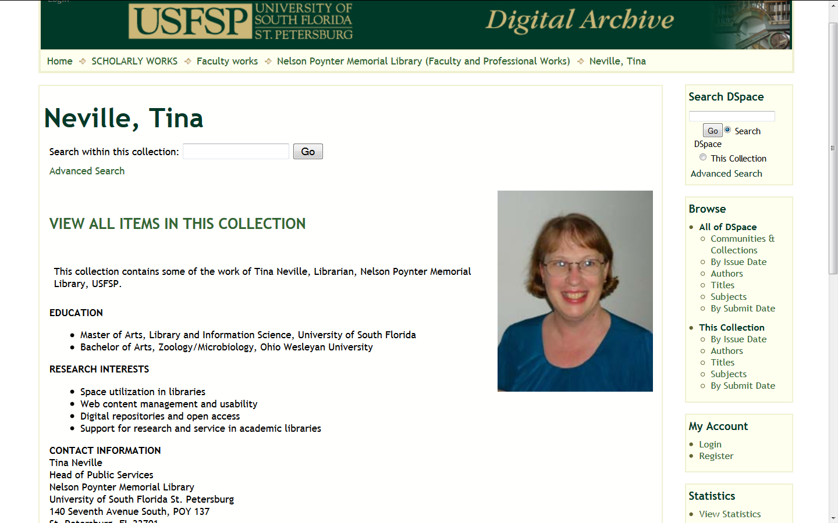
Lead by Example and Follow-Through

Slide 17
How We Achieved Faculty Buy-In
Active marketing
  Presentations to College Faculty Councils and academic departments
  Reaching out to individual faculty
  Open access events and presentations showcasing the archive
  High profile collections
  Faculty testimonials
  Use of social media & blogging

Slide 18
Reaching Out to Individual Faculty
Contacting faculty following announcements of presentations, on or off-campus
Contacting new faculty about archive as one of suite of library services
  What is open access?
  What’s in it for them?
Contacting faculty about collecting student work

Slide 19
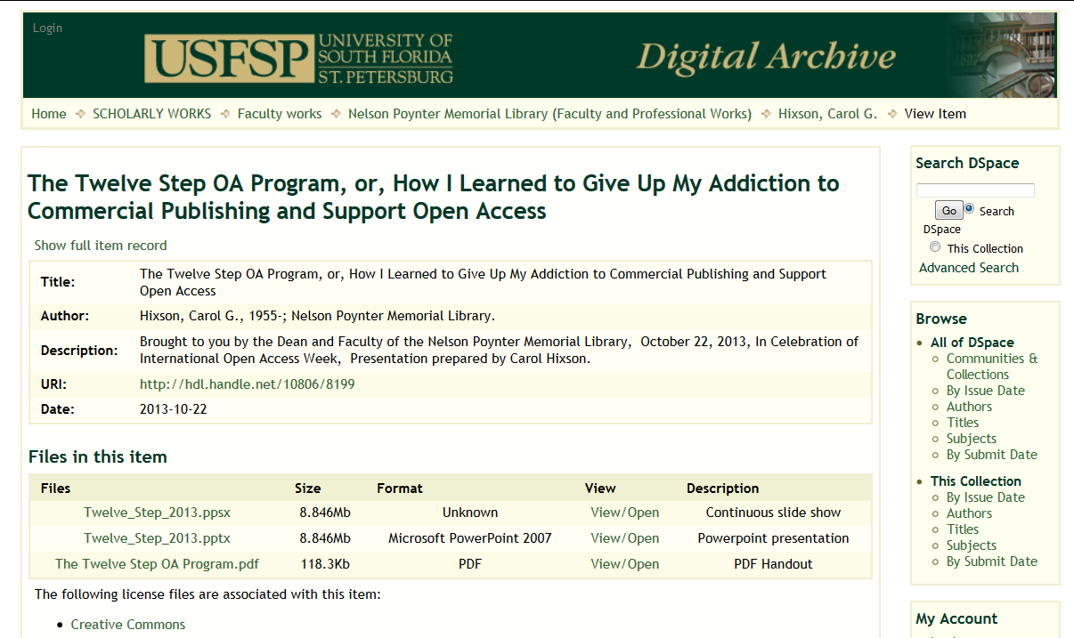
Marketing: Open Access Events

Slide 20
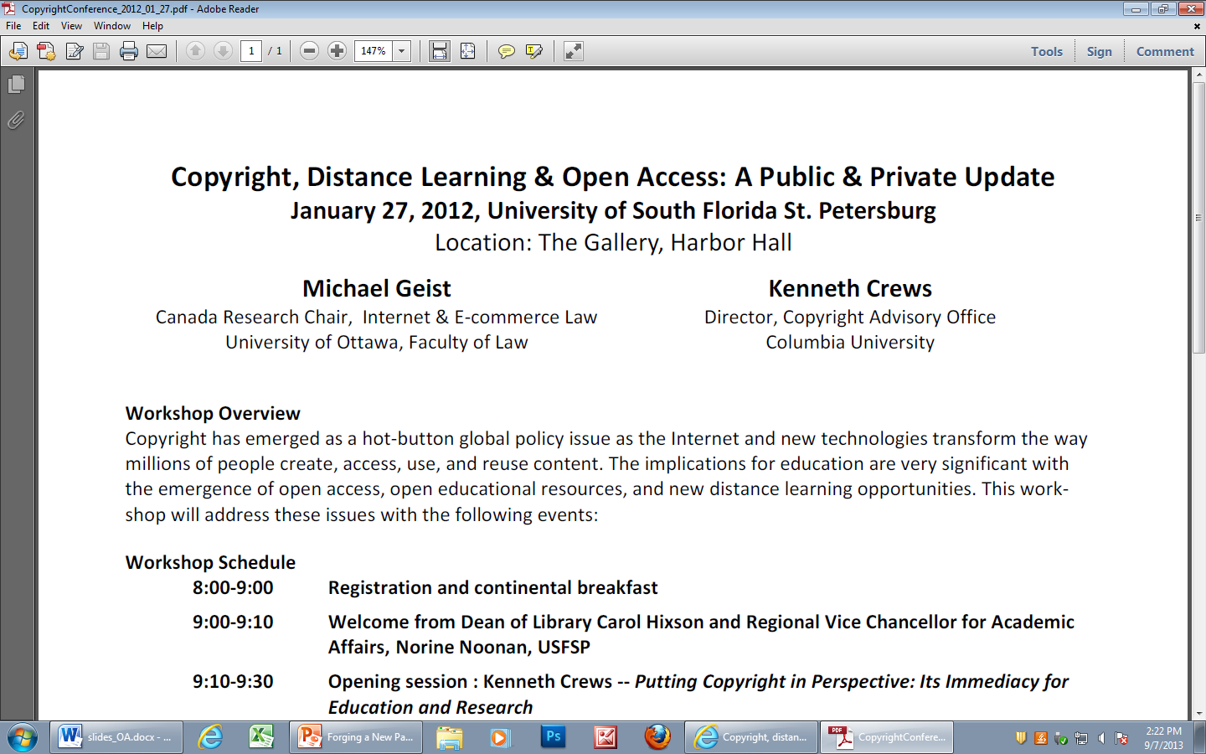
Marketing: Open Access Events

Slide 21
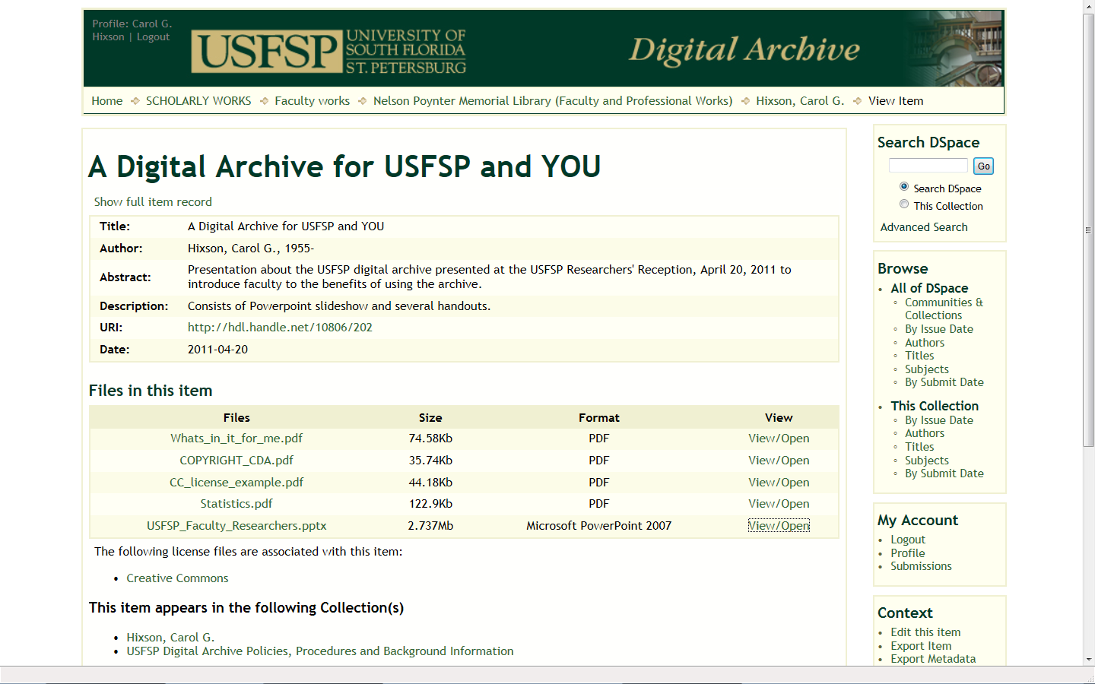
Marketing: Presentations on Archive

Slide 22
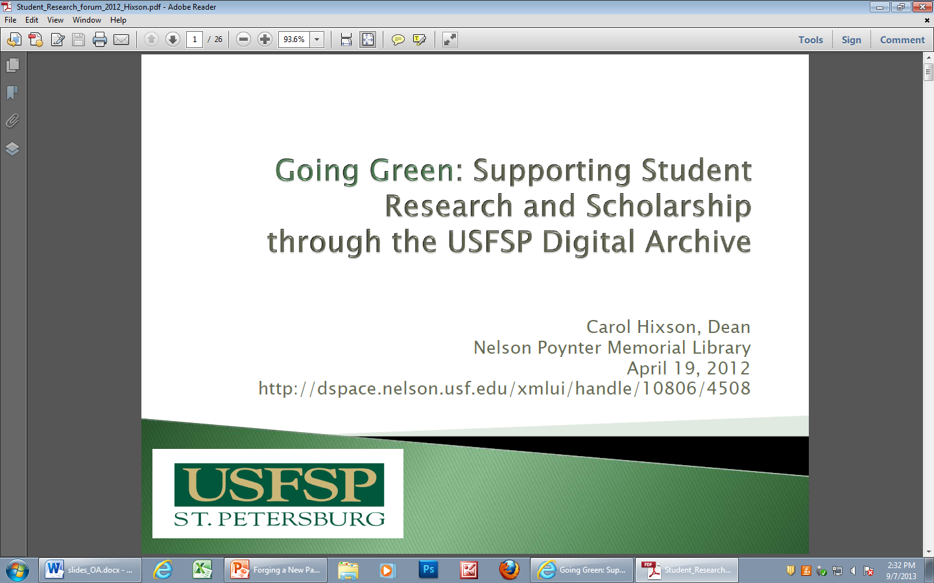
Marketing: Presentations on Archive

Slide 23
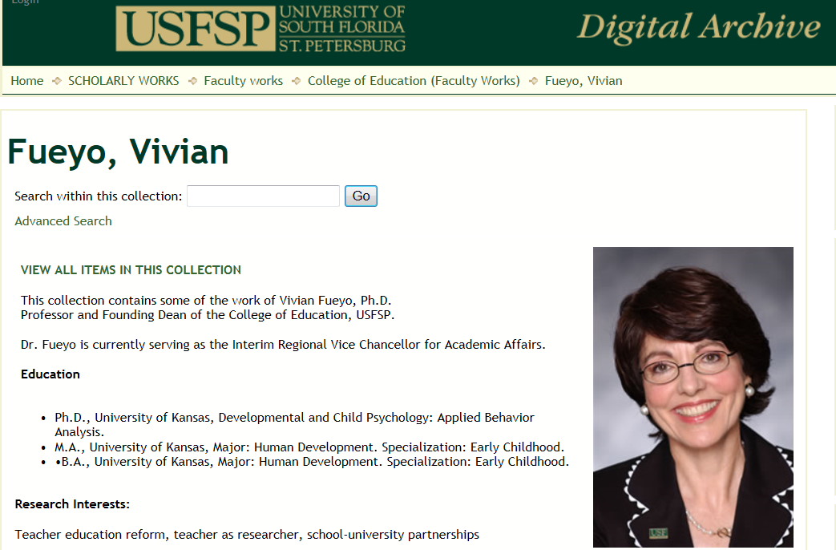
Marketing: High Profile Collections

Slide 24
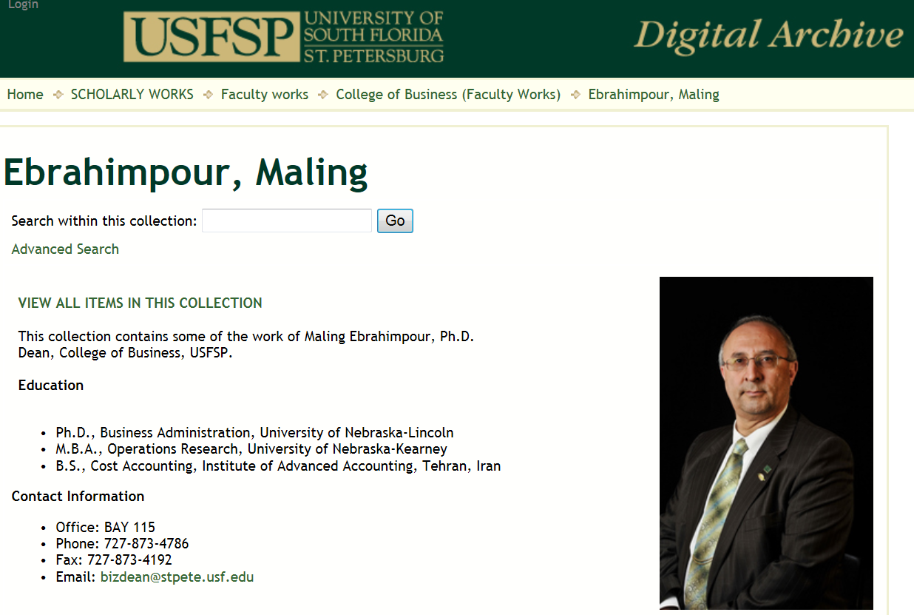
Marketing: High Profile Collections

Slide 25
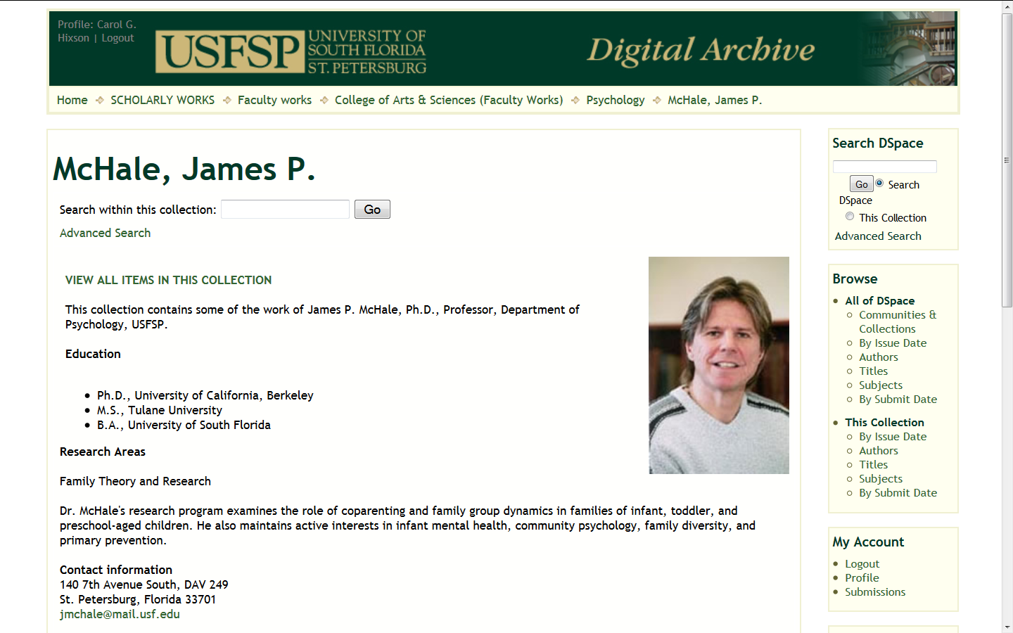
Marketing: High Profile Collections
Notes:
D

Slide 26
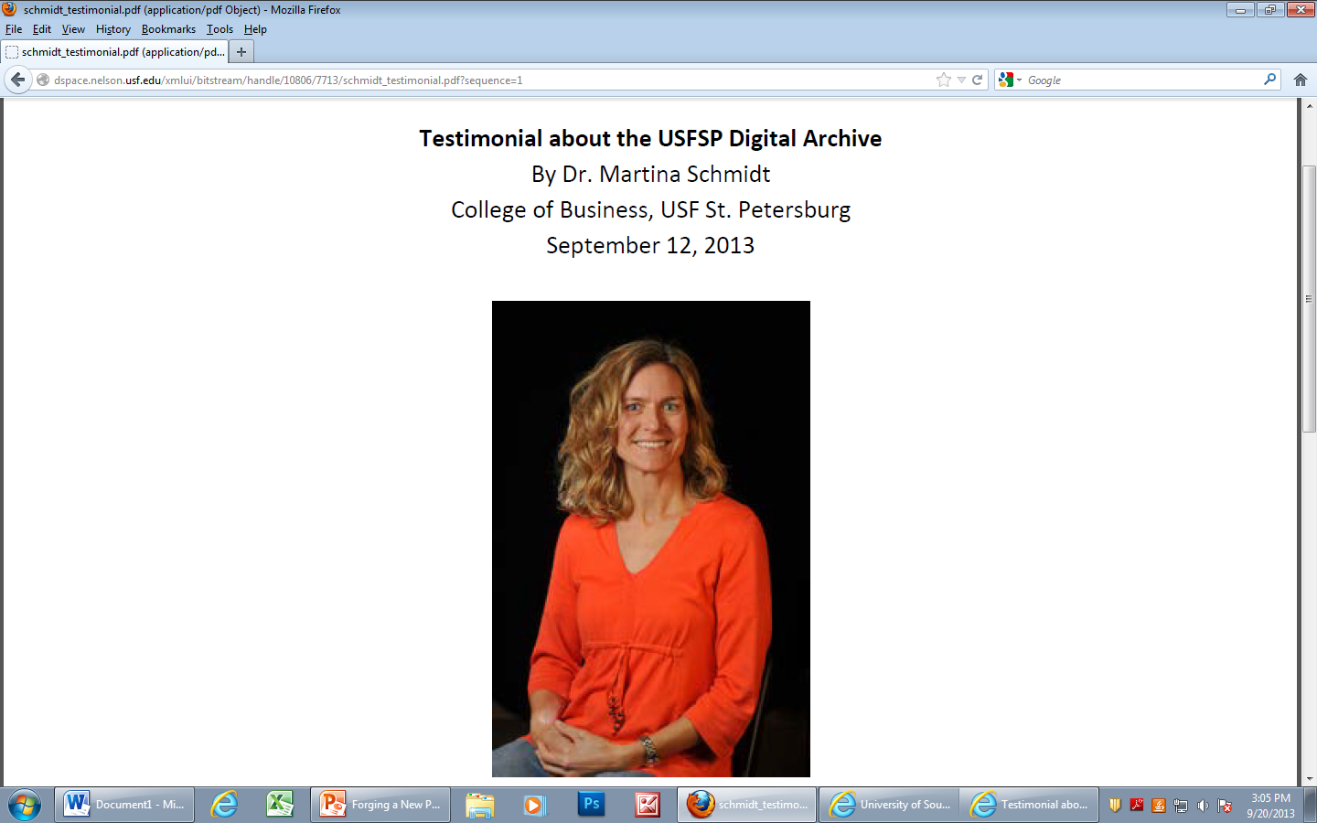
Marketing: Faculty Testimonials

Slide 27
Marketing: Faculty Testimonials
The online portfolio of my work that the Library has made available through the USFSP Digital Archive has been tremendously helpful in making my work more visible. Through the Digital Archive my research is being much more widely viewed around the world than would have been possible previously. For example, I have been contacted numerous times by researchers who found my research on the Digital Archive. The Library has also been very supportive during my negotiations with my publishers to get a more open licensing agreement. I believe that posting my research in the Digital Archive is a win-win situation for me, for my publishers, and for scholars and other people around the world who are interested in my area of research. – Dr. Martina Schmidt

Slide 28
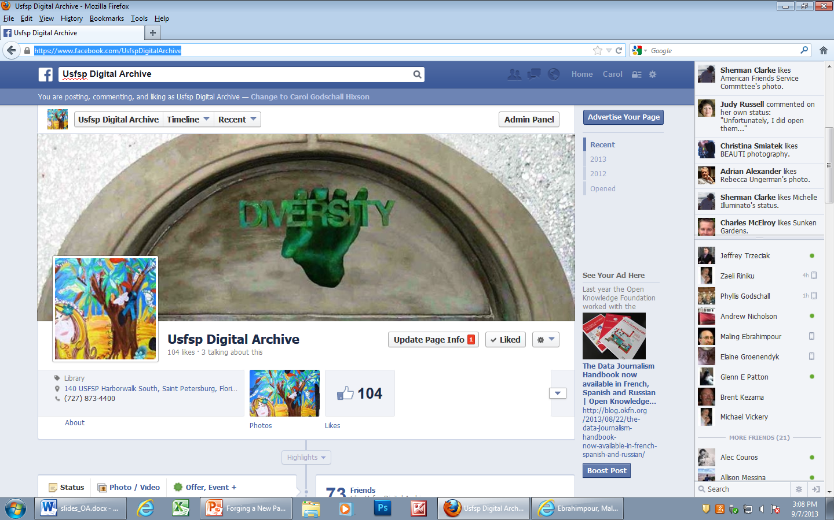
Marketing: Use of Social Media & Blogging

Slide 29
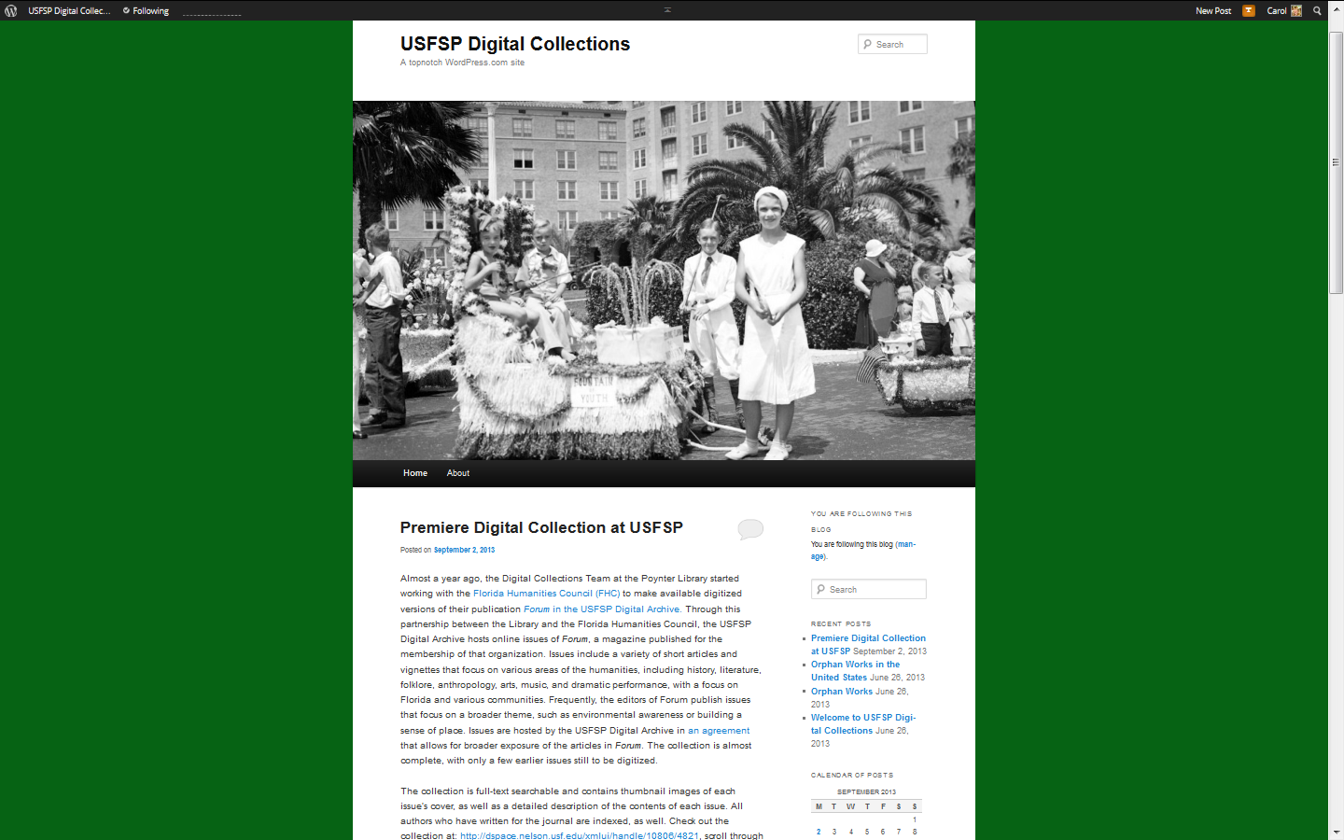
Marketing: Use of Social Media & Blogging

Slide 30
How We Achieved Faculty Buy-In
Lifetime support to faculty

Slide 31
Lifetime Support to Faculty
WHO IS ELIGIBLE TO ESTABLISH A PERSONAL COLLECTION IF PROFESSIONAL MATERIALS?
Any currently employed permanent member of the USFSP faculty
Any retired or emeritus member of the USFSP faculty
Adjunct or visiting faculty must have the agreement of their department head or College Dean
Library staff will create the collection home page and keep it updated with appropriate contact and other information

Slide 32
Lifetime Support to Faculty
INSTITUTIONAL COMMITMENT TO AUTHORS
The Nelson Poynter Memorial Library commits to preserving and making available the materials submitted to the USFSP Digital Archive
The USFSP Digital Archive retains materials that have been submitted to it, whether the individuals who have created and submitted the materials continue their affiliation with the University of South Florida St. Petersburg or not.
Materials will not be withdrawn from the Archive simply because an individual author is no longer affiliated with the University.
All authors who have submitted their professional work to the USFSP Digital Archive and subsequently leave the University of South Florida St. Petersburg will still be able to access and add to their work, as long as new items fit the archive’s collection guidelines

Slide 33
How We Achieved Faculty Buy-In
Lifetime support to faculty
Part of community of scholars

Slide 34
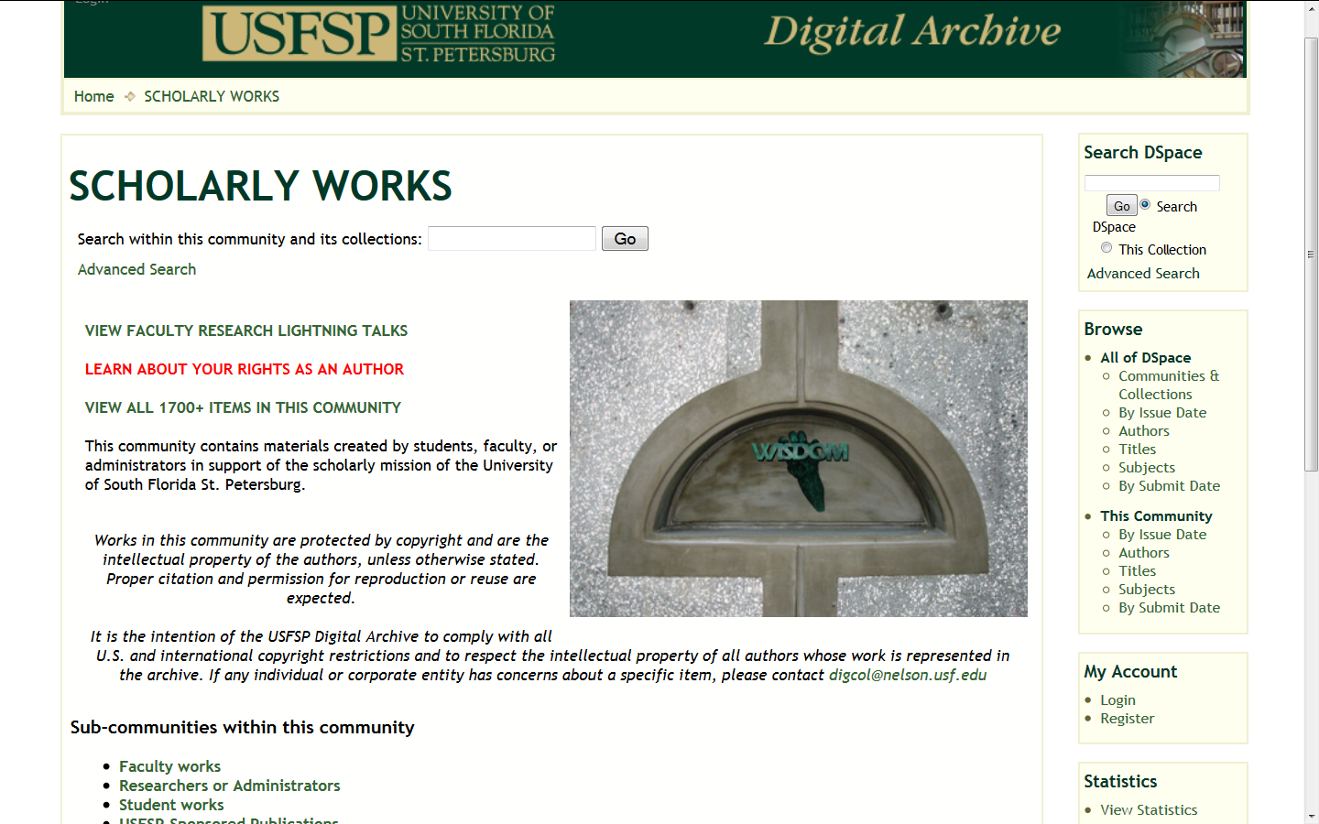
Community of Scholars

Slide 35
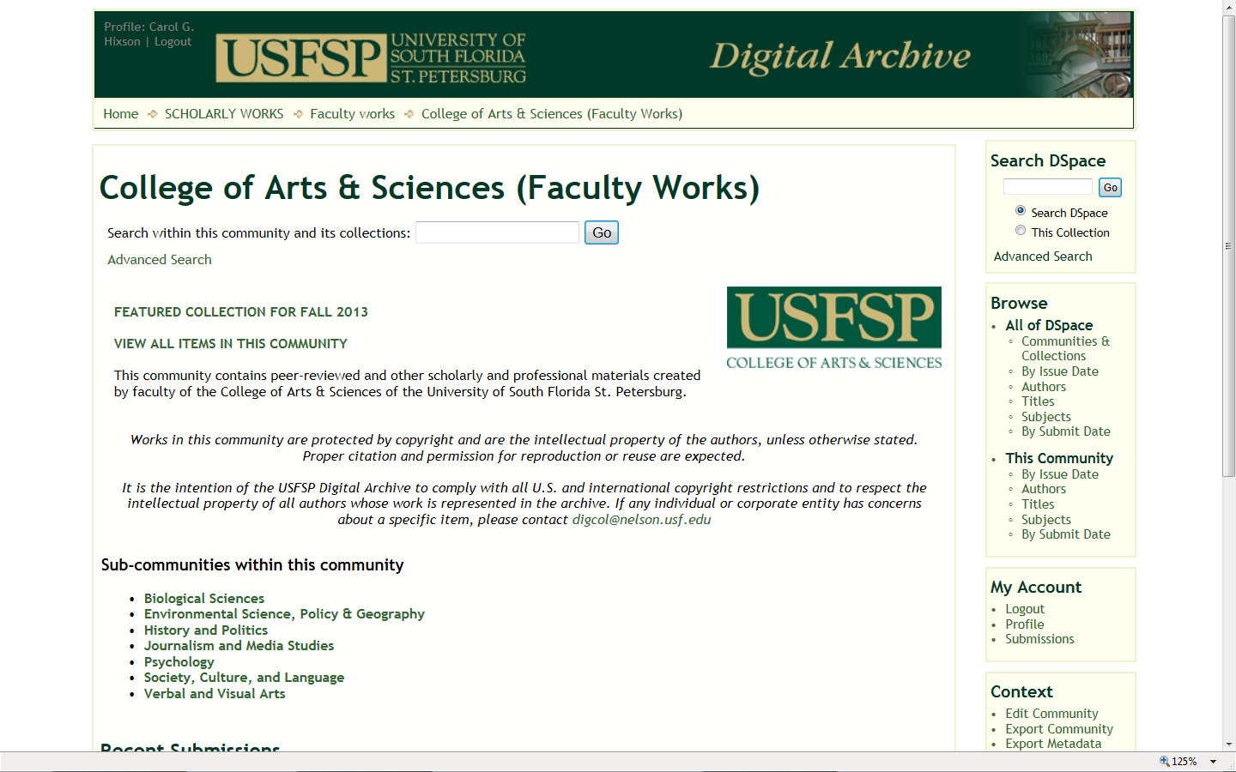
Community of Scholars : College Page

Slide 36
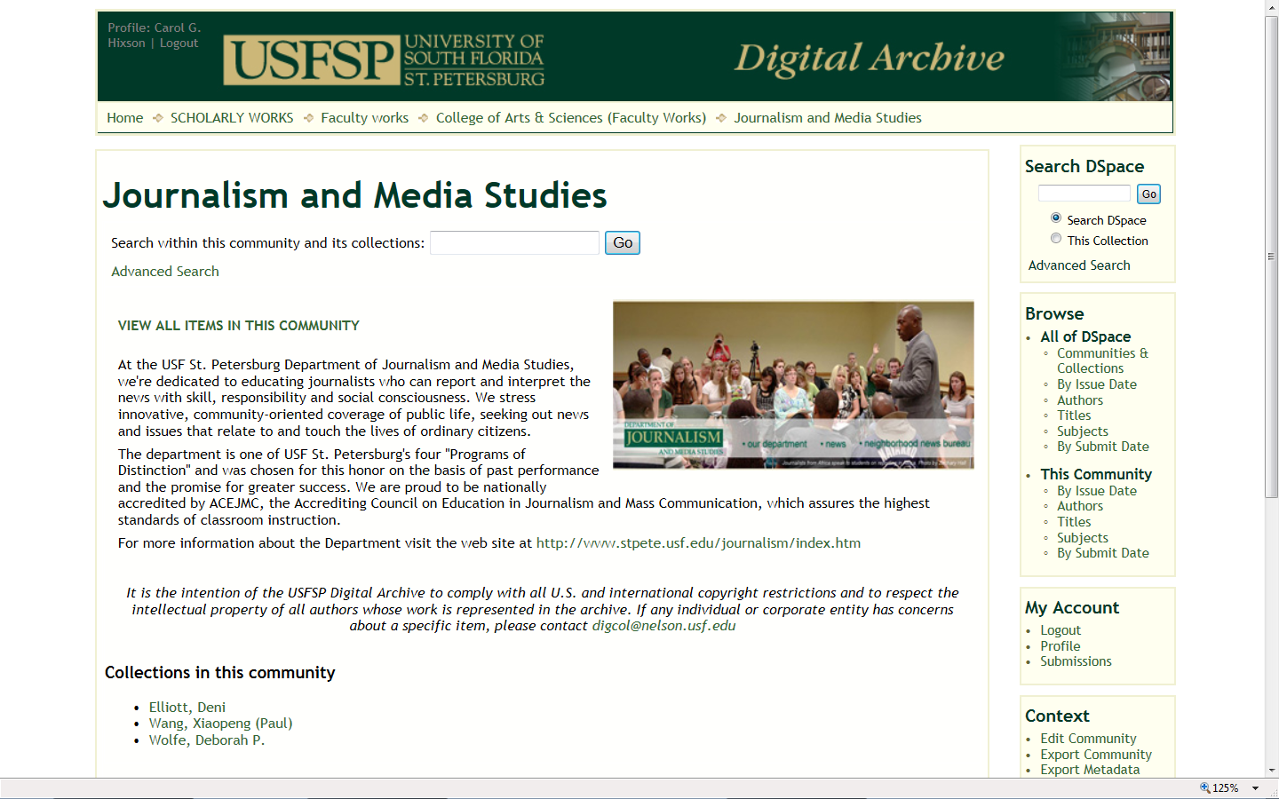
Community of Scholars:
Departmental Page

Slide 37
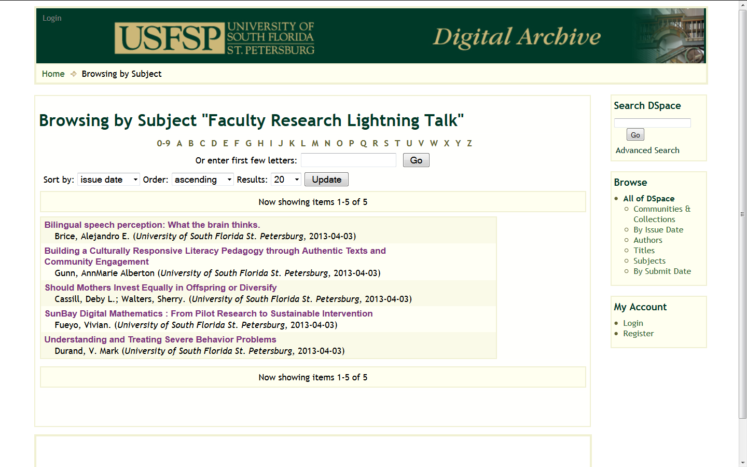
Community of Scholars: Lightning Talks

Slide 38
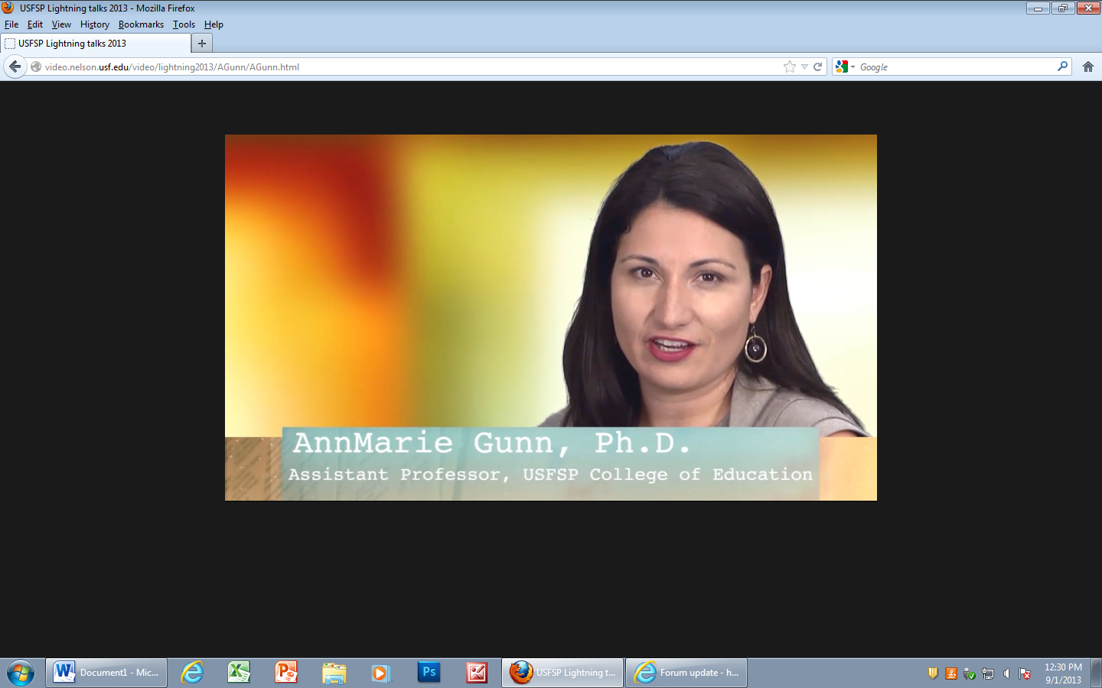
Community of Scholars: Lightning Talks

Slide 39
How We Achieved Faculty Buy-In
Lifetime support to faculty
Part of community of scholars
Personalized collections page

Slide 40
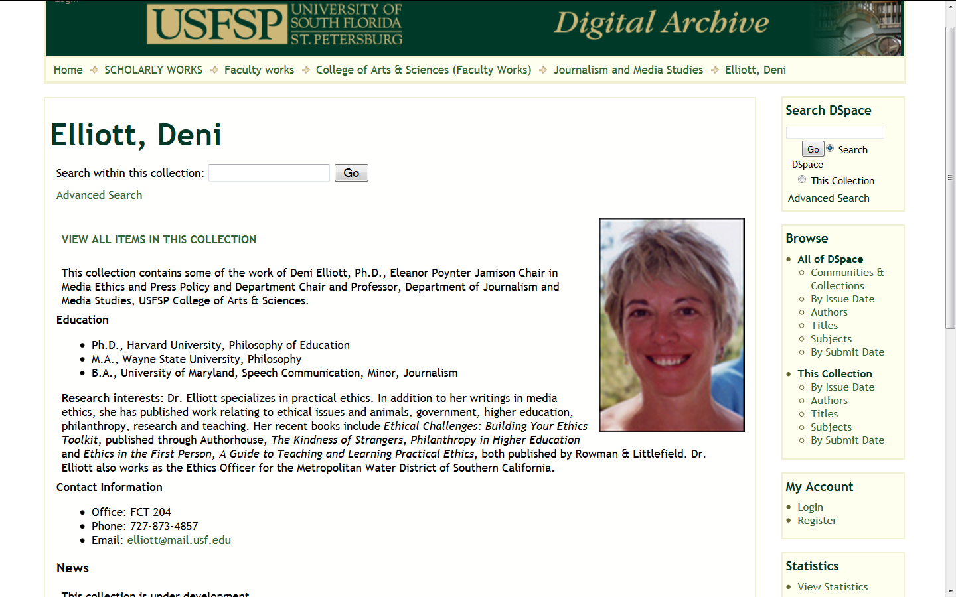
Personalized Collections Pages

Slide 41
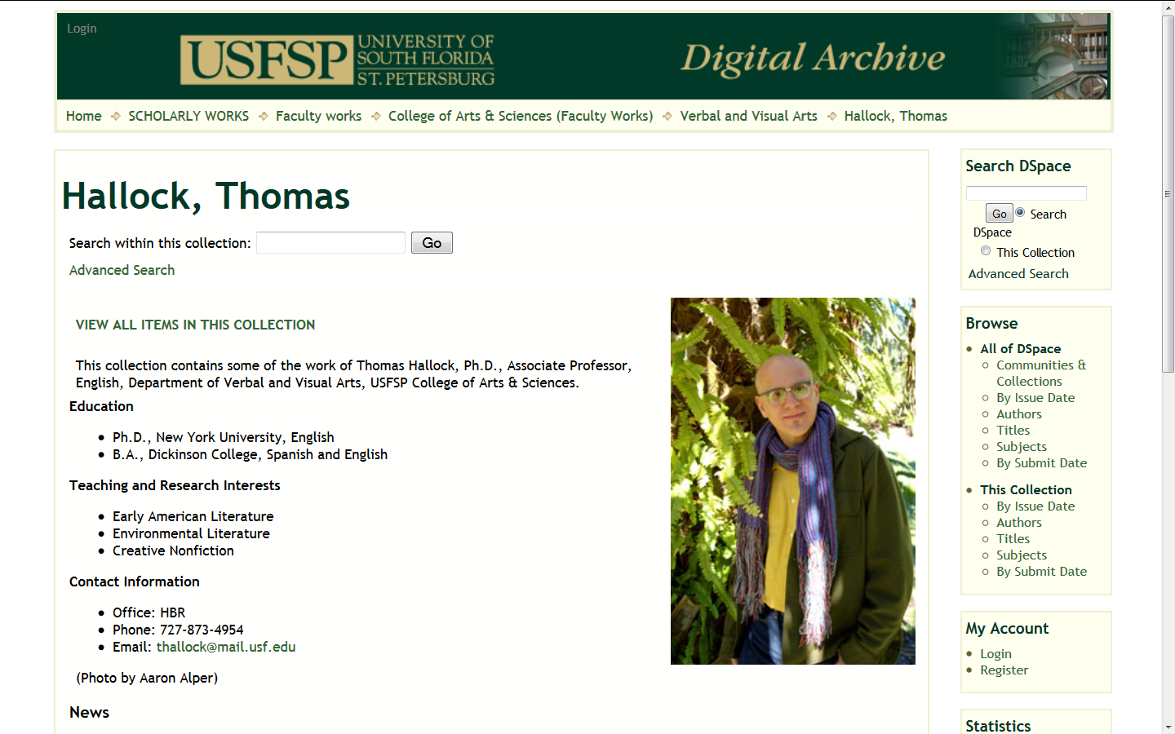
Personalized Collections Pages

Slide 42
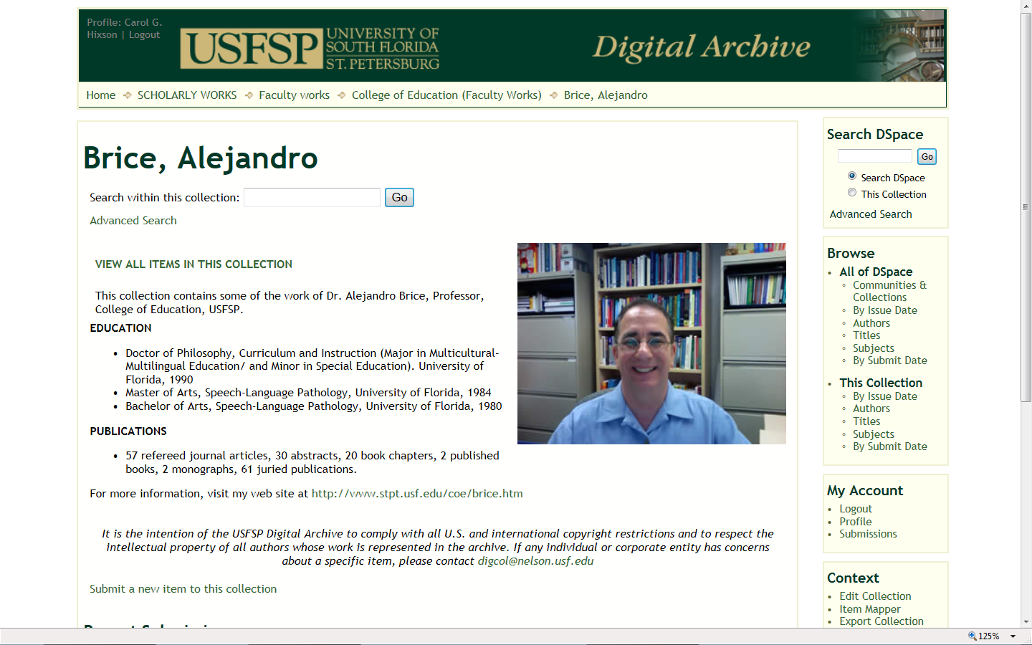
Personalized Collections Pages

Slide 43
How We Achieved Faculty Buy-In
Lifetime support to faculty
Part of community of scholars
Personalized collections page
Comprehensive digital portfolios

Slide 44
How We Achieved Faculty Buy-In
Comprehensive digital portfolios
  Full-text if possible but at least an abstract for everything they want to collect
  Proxied links to licensed content
  We will scan and OCR materials

Slide 45
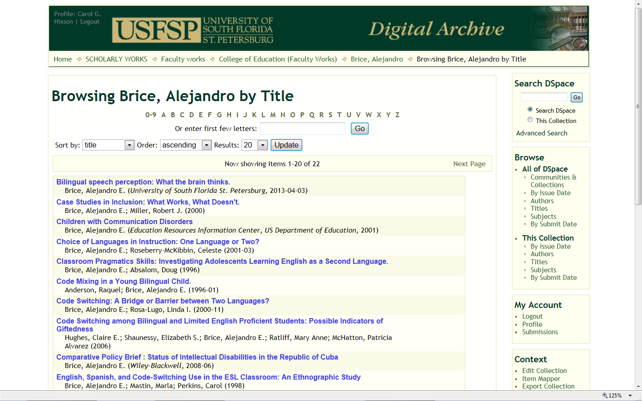
Comprehensive Digital Portfolios

Slide 46
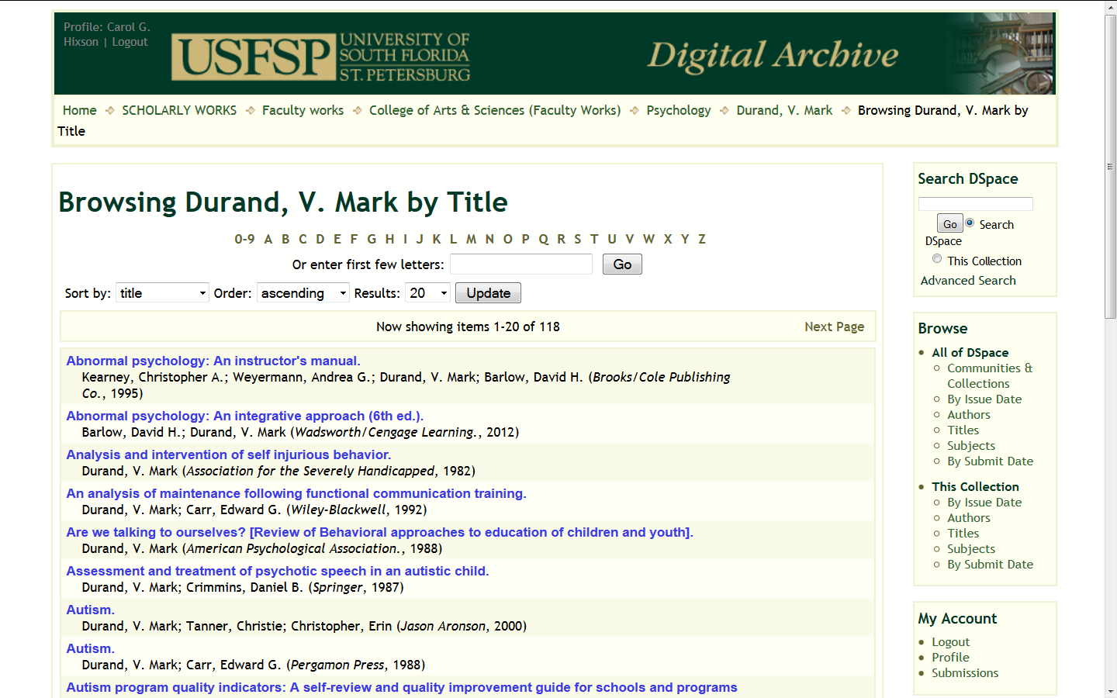
All Items from CV
Unless They Want Only Select Items

Slide 47
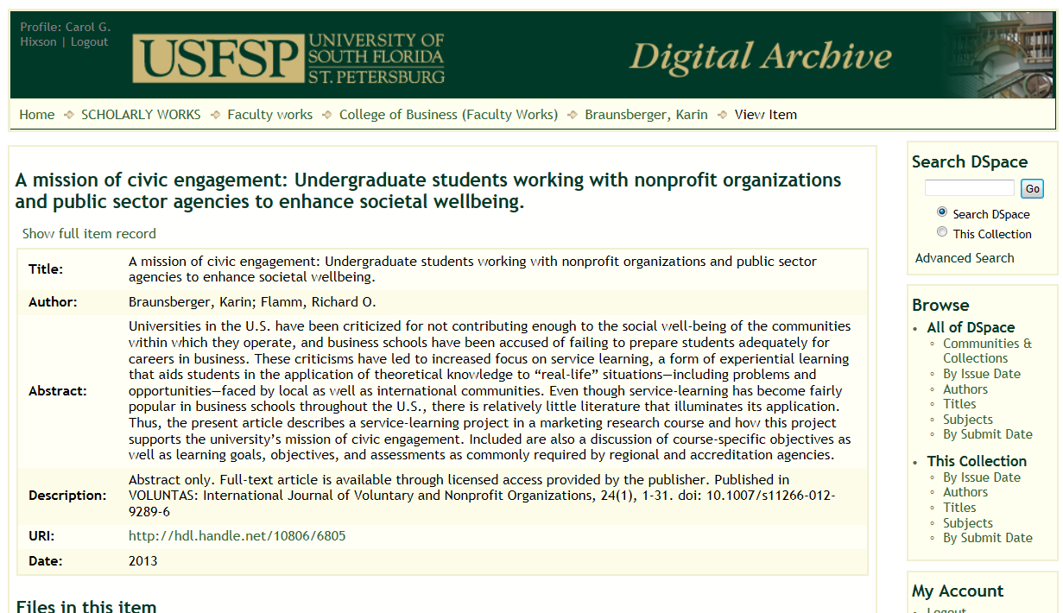
Comprehensive Digital Portfolios:
At Least An Abstract

Slide 48
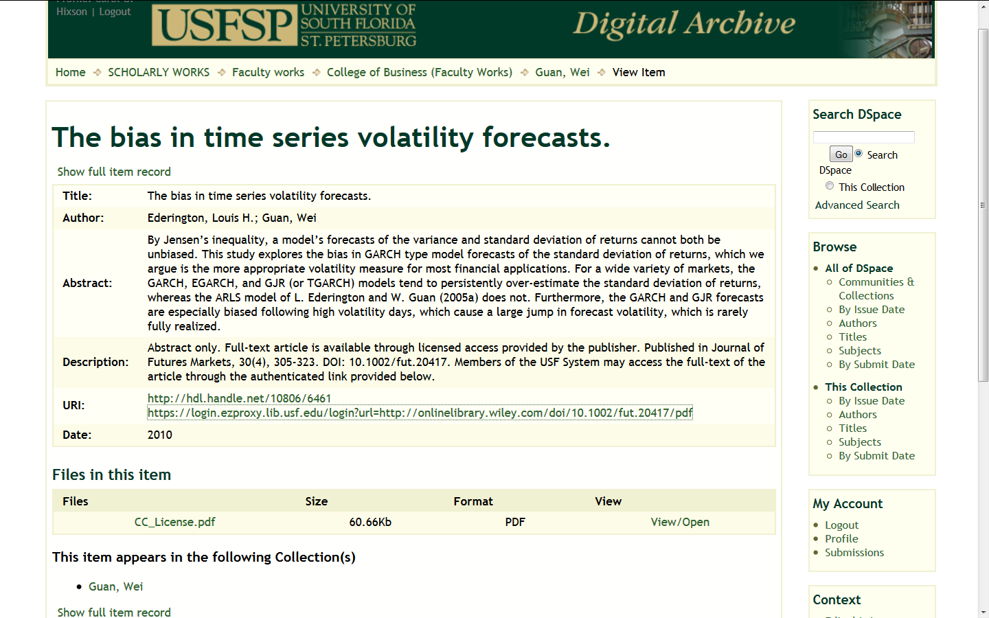
Comprehensive Digital Portfolios:
Proxied Links to Licensed Content

Slide 49
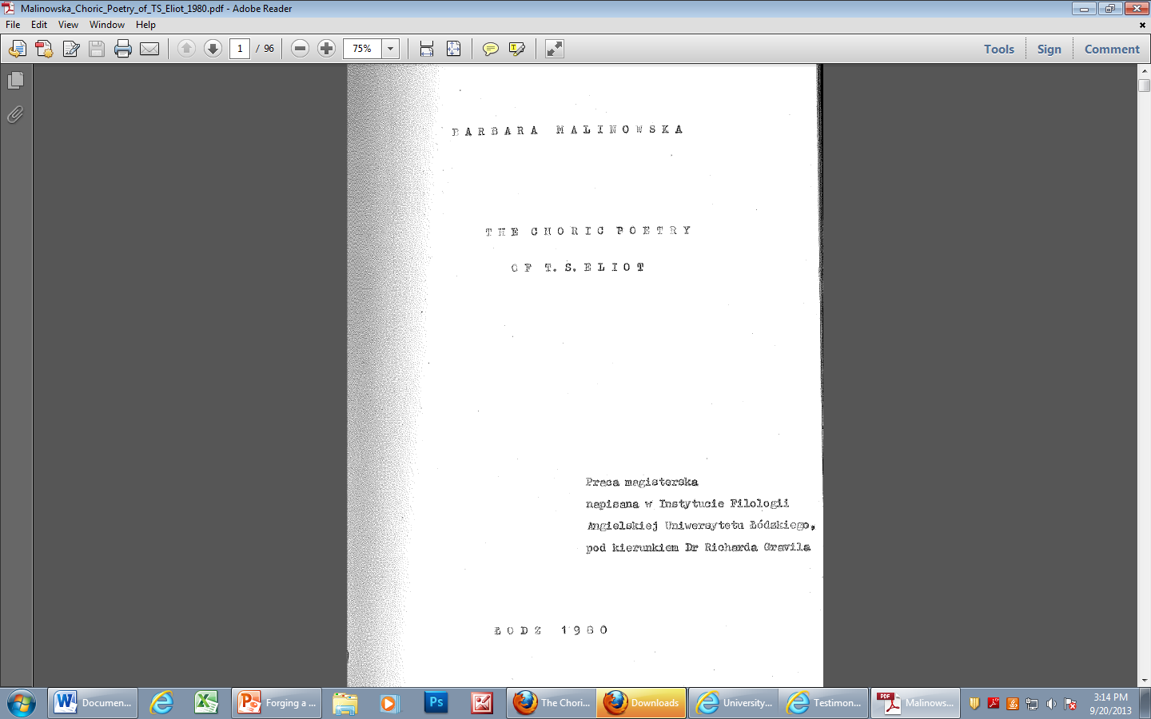
Comprehensive Digital Portfolios:
Theses Scanned, If Desired

Slide 50
How We Achieved Faculty Buy-In
Lifetime support to faculty
Part of community of scholars
Personalized collections page
Comprehensive digital portfolios
Library handles all the work of submitting

Slide 51
We Do It All
We set up a collection template for submissions to their collections
We collect their CVs and work from them
We add in items for them
  If they want to submit their own, we set that up for them (only two faculty do their own)

Slide 52
How We Achieved Faculty Buy-In
Robust services and supporting materials
  Investigate copyright on individual items
  Work with faculty to understand publishers’ agreements
  Tracking embargo period for published materials
  Share statistical information about their collections
  Incorporate archive statistics into their T & P portfolios

Slide 53
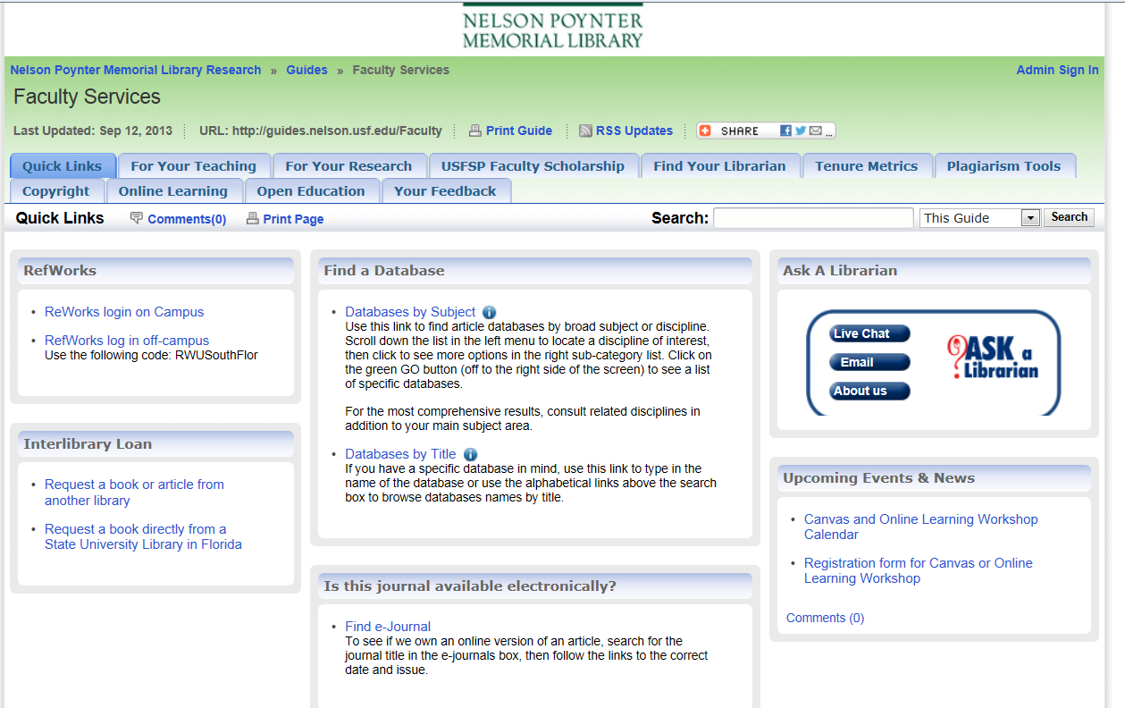
Robust Suite of Services

Slide 54
Services: Investigate copyright
Check Sherpa/RoMEO http://www.sherpa.ac.uk/romeo/
Review publishers’ web sites for copyright & authors’ rights information
Occasionally contact publishers for clarification

Slide 55
Services: Help Faculty Understand
Publishers’ Agreements
Faculty ask us to review publishers’ agreements for new publications
We give our opinion and suggest some possible options
It is always up to faculty to assess the risk and negotiate as they see fit with their publishers

Slide 56
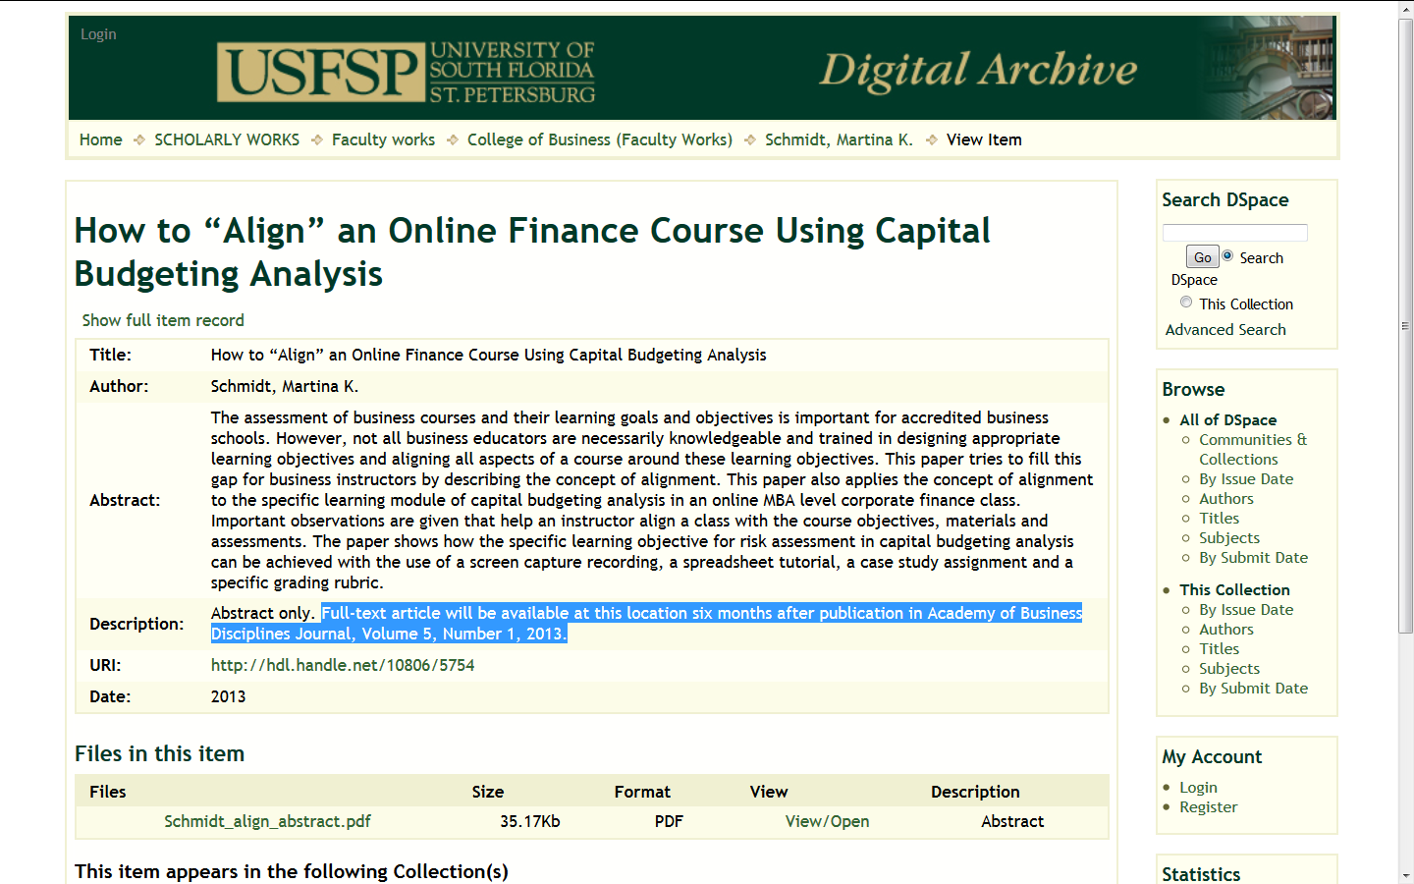
Services: Track Embargo Periods

Slide 57
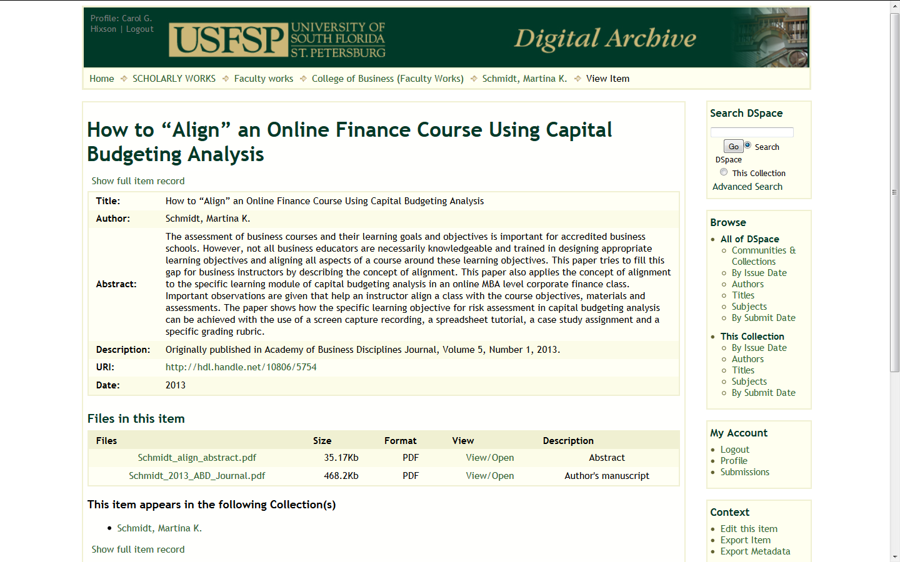
Services: Track Embargo Periods

Slide 58
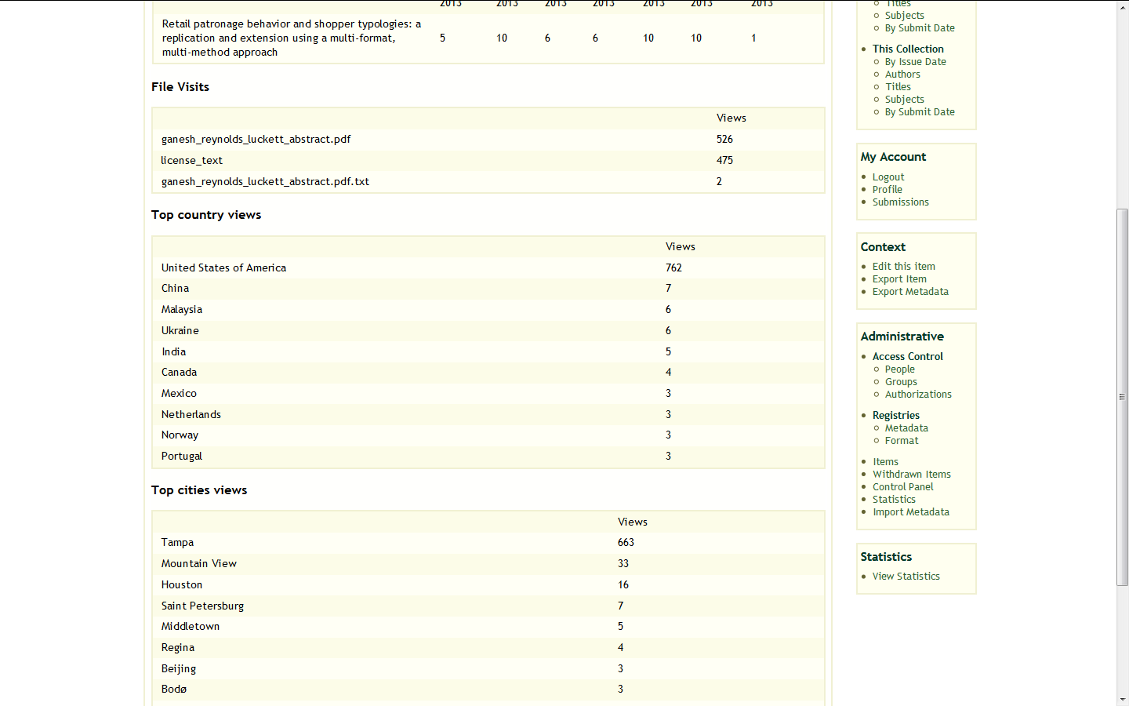
Services: Provide Statistical Updates

Slide 59
Services: T & P Portfolio Assistance
We help faculty review and understand the statistics generated from the archive
It is the responsibility of faculty to interpret those statistics and insert data into their tenure and promotion portfolios

Slide 60
How We Achieved Faculty Buy-In
Lifetime support to faculty
Part of community of scholars
Personalized collections page
Comprehensive digital portfolios
Library handles all the work of submitting
Robust services and supporting materials
Place to collect their students’ work

Slide 61
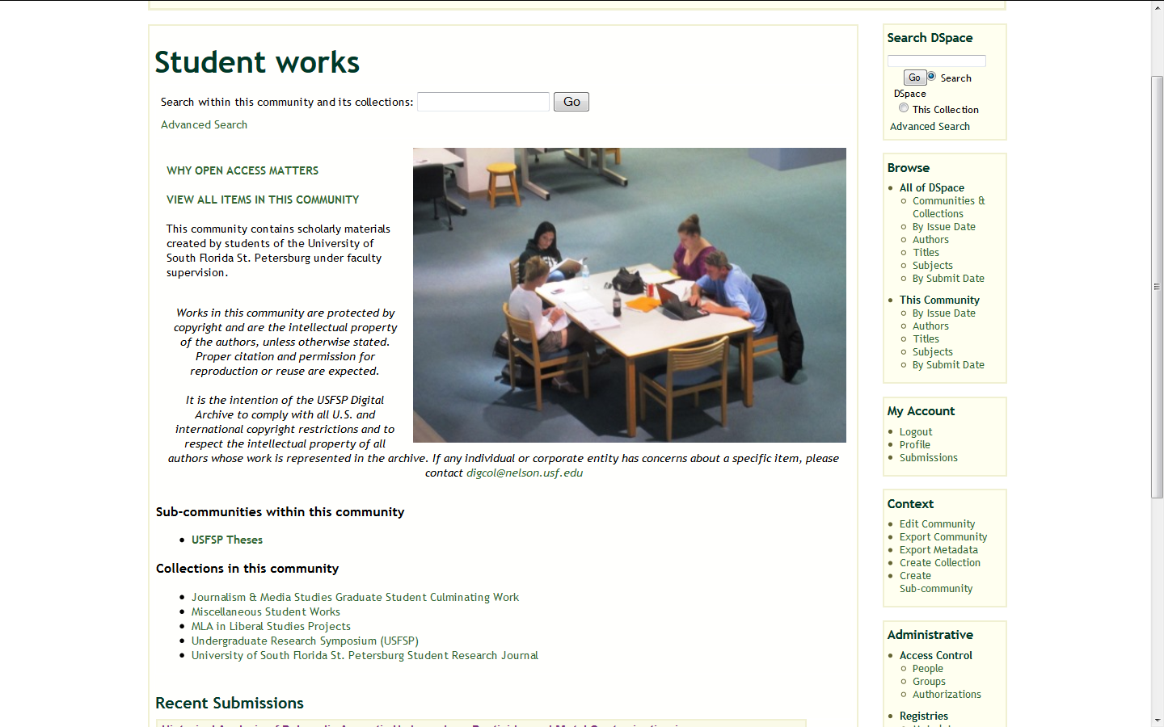
Collect Students’ Work

Slide 62
How We Achieved Faculty Buy-In
Lifetime support to faculty
Part of community of scholars
Personalized collections page
Comprehensive digital portfolios
Library handles all the work of submitting
Robust services and supporting materials
Place to collect their students’ work
Informational materials

Slide 63
Informational Materials
SPARC Authors’ Addendum
What’s In It For Me
Step-by-Step Guide on Submission
Links to presentations about the archive
How to Search the Digital Archive

Slide 64
Challenges
Software has some limitations and we don’t have in-house expertise to modify it
Some of the more senior faculty see no need as their careers are at the peak
  Trying to sell them on the “legacy” aspect
Having the time to go as far as we would like to go with our services
Getting new faculty to submit their own work

Slide 65
Next Steps
Continue to develop contextual materials and innovative marketing
Develop or hire expertise to pull out more useful and user-friendly statistics from the database
Find funding to provide focused staffing
Work into the statewide context for archives which uses a different platform

Slide 66
Keys to Success
Flexible vision – full text or abstracts
What’s in it for them
Not asking them to change up front
We do all the work
Personalized collections within community of peers
Peer testimonials – word of mouth

Slide 67
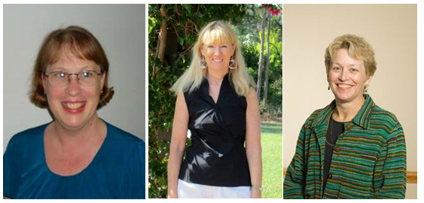
Thank you! http://dspace.nelson.usf.edu/xmlui/handle/10806/7729

