Slide 1


Open Access Week
October 24-30, 2011
Nelson Poynter Memorial Library
Faculty Reception, October 26, 2011

Slide 2
Open Access Videos
http://www.youtube.com/watch?v=GMIY_4t-DR0&feature=share
http://vimeo.com/6973160

Slide 3

What is Open Access?
Open-access (OA) literature is digital, online, free of charge, and free of most copyright and licensing restrictions – Peter Suber

Slide 4
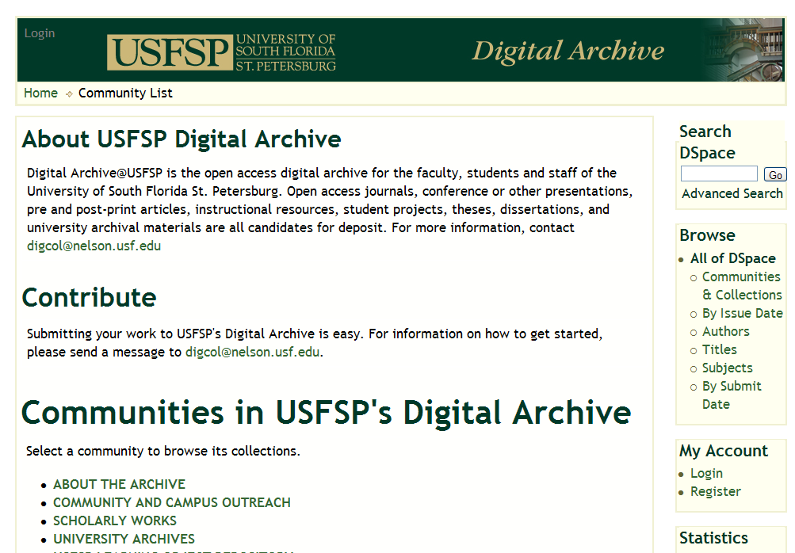
Open Access Examples

Slide 5
Why Open Access?
For the Public Good
  Allows all members of society
  to access relevant cultural and scientific achievements, in particular by encouraging the free (online) availability of such information

Slide 6
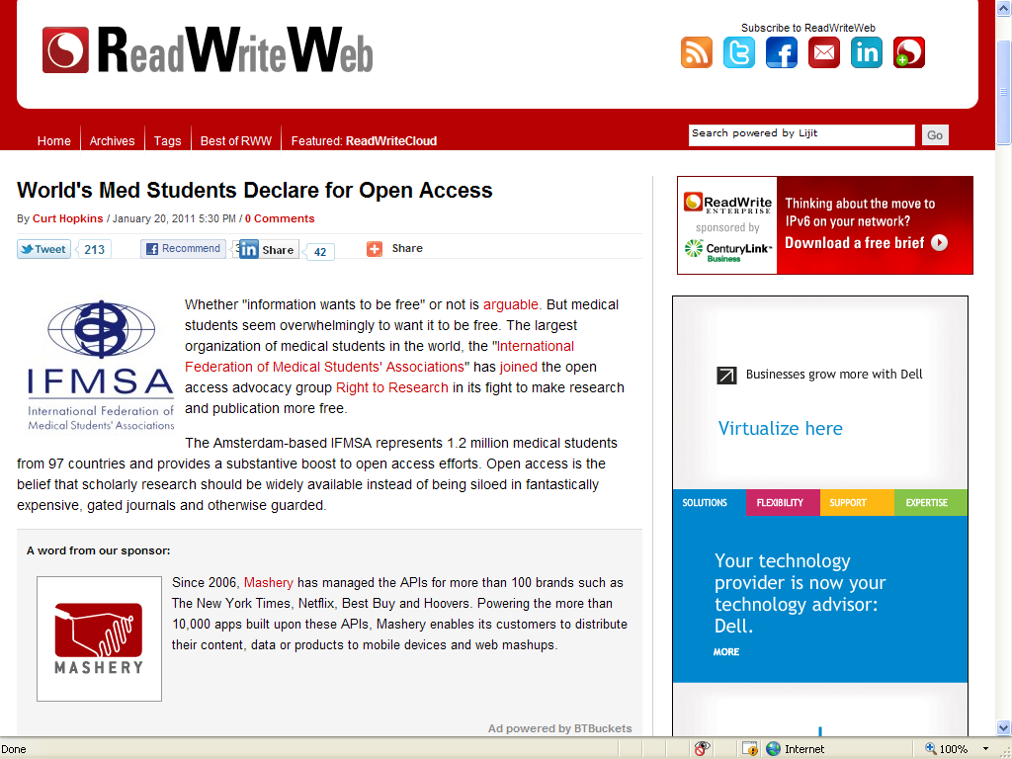
Why Open Access?
Student Support

Slide 7
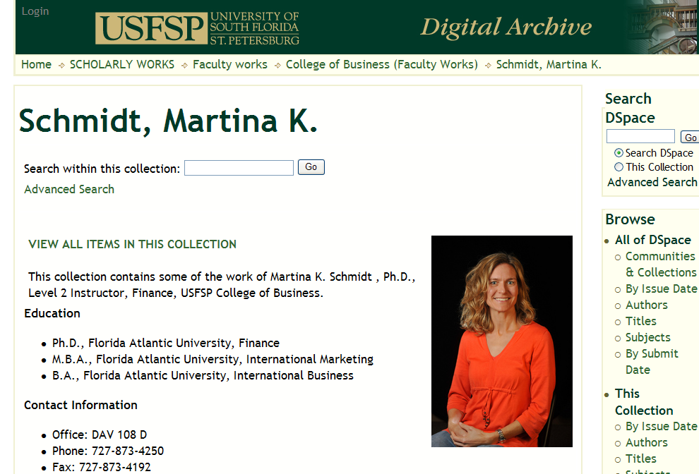
Why Open Access?
Promote Research & Scholarship

Slide 8
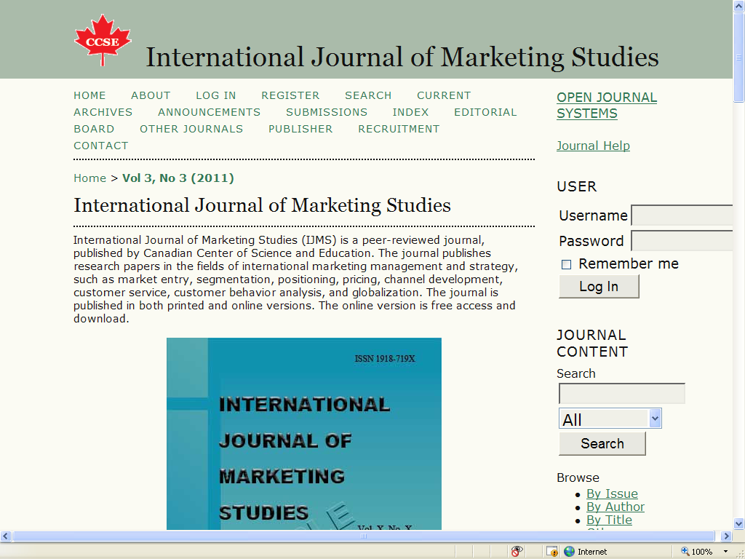
Open Access Examples

Slide 9
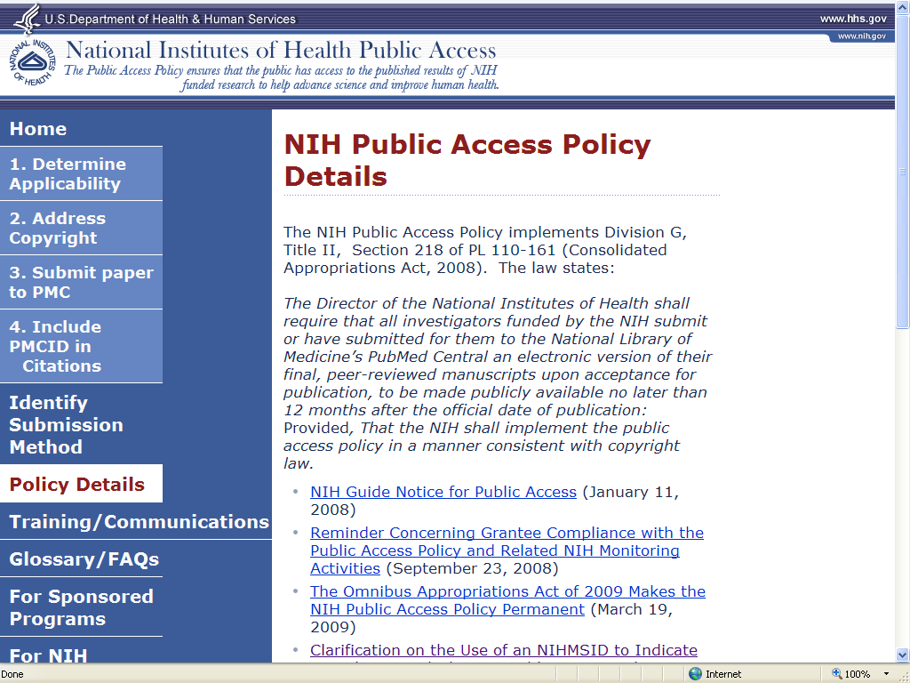
Why Open Access?
Funding Agencies Support It

Slide 10
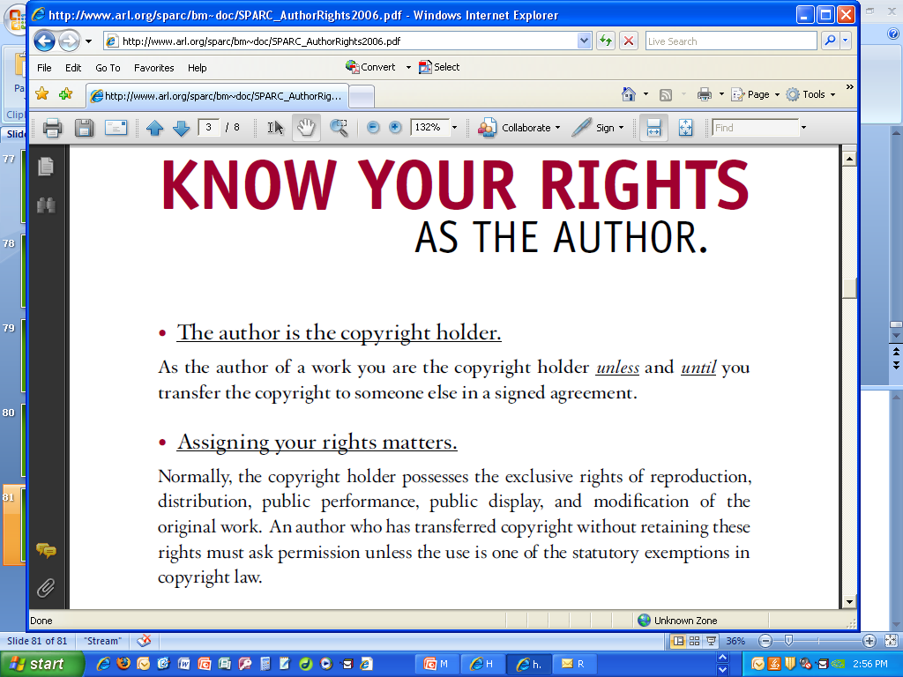
Why Open Access?
Because It’s Your Right!

Slide 11
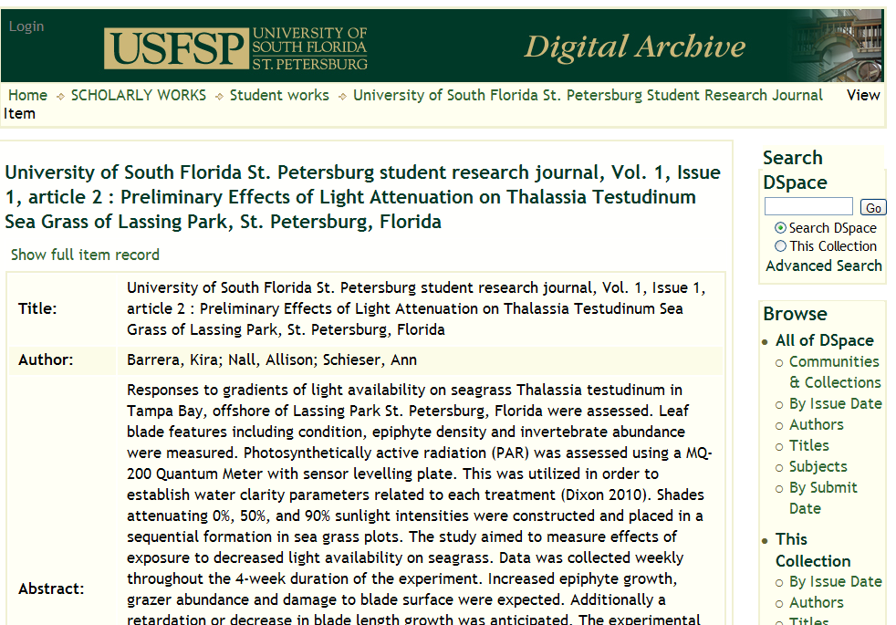
Open Access Examples

Slide 12
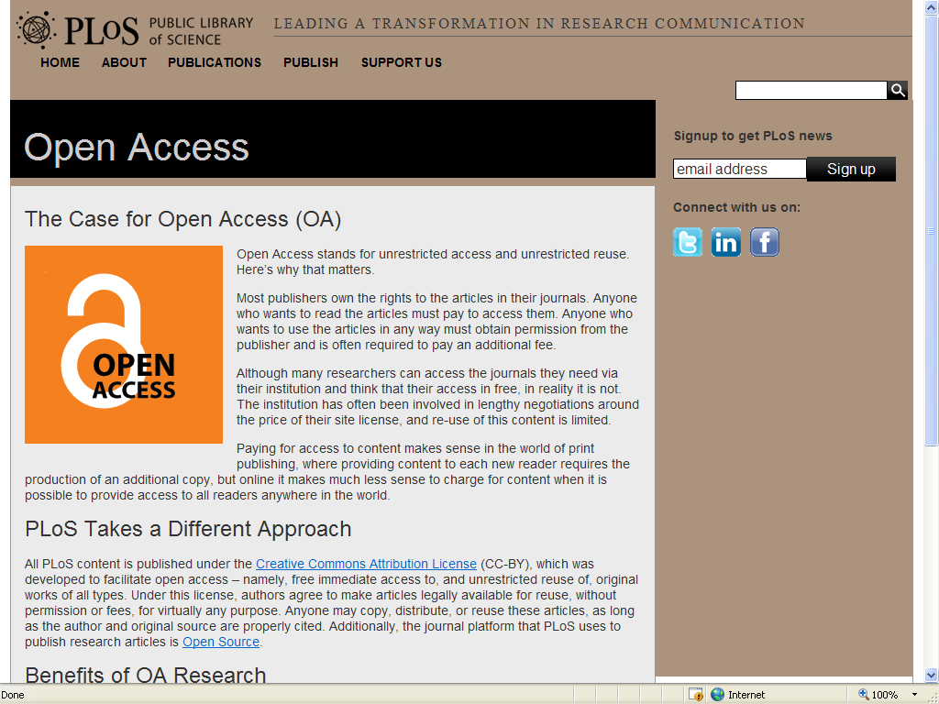
Why Open Access?
For the Public Good

Slide 13
Why Open Access?
We Can’t Afford Otherwise
Journal prices rising much faster than inflation
Scholarly output increasing
Libraries able to provide access to smaller percentage of total scholarly output

Slide 14
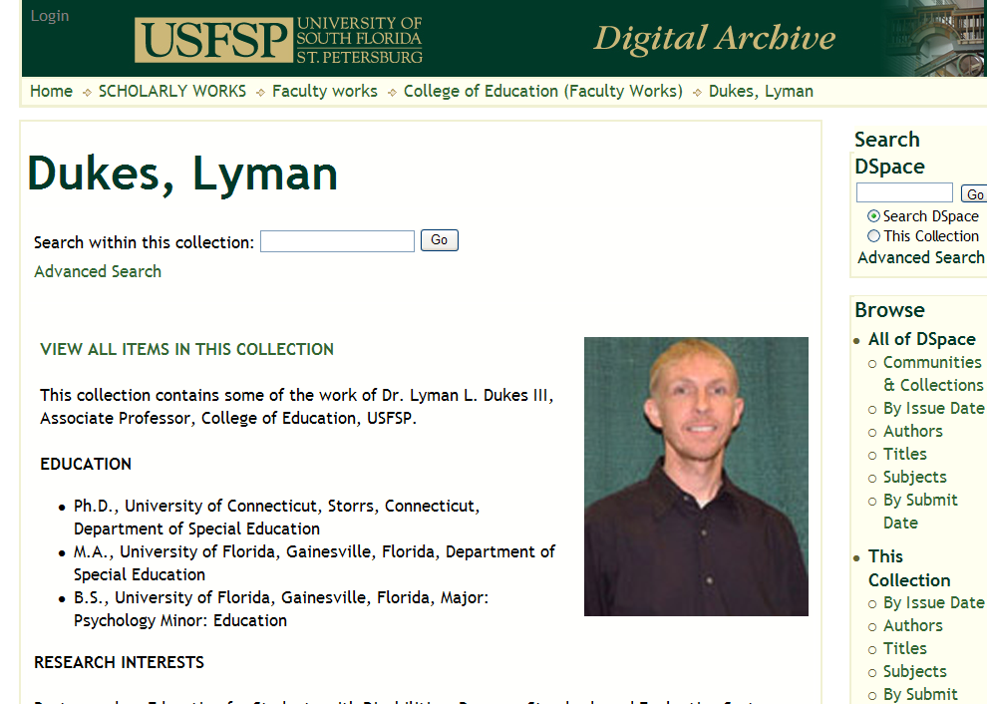
Why Open Access?
Promote Research & Scholarship

Slide 15
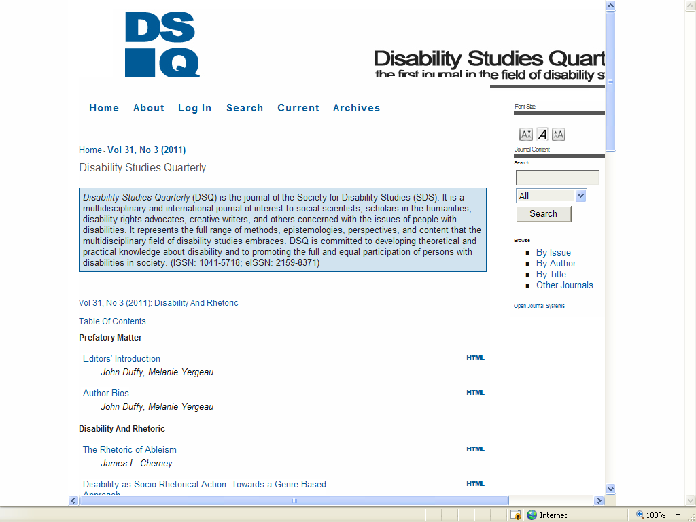
Open Access Examples

Slide 16
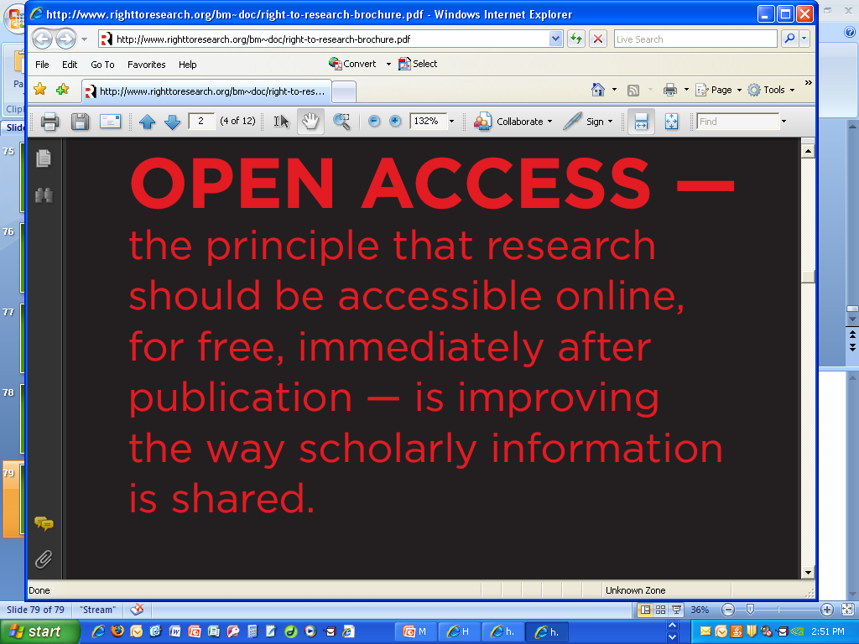
What is Open Access?

Slide 17
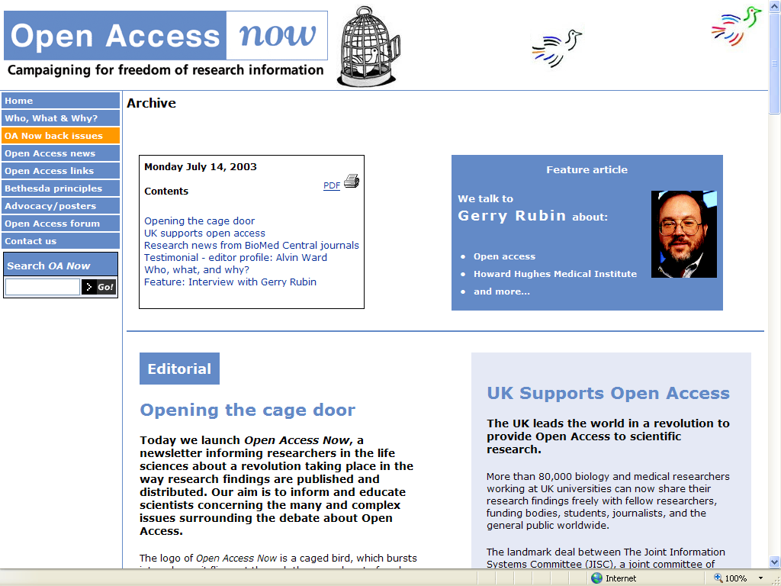
Why Open Access?
International Support

Slide 18
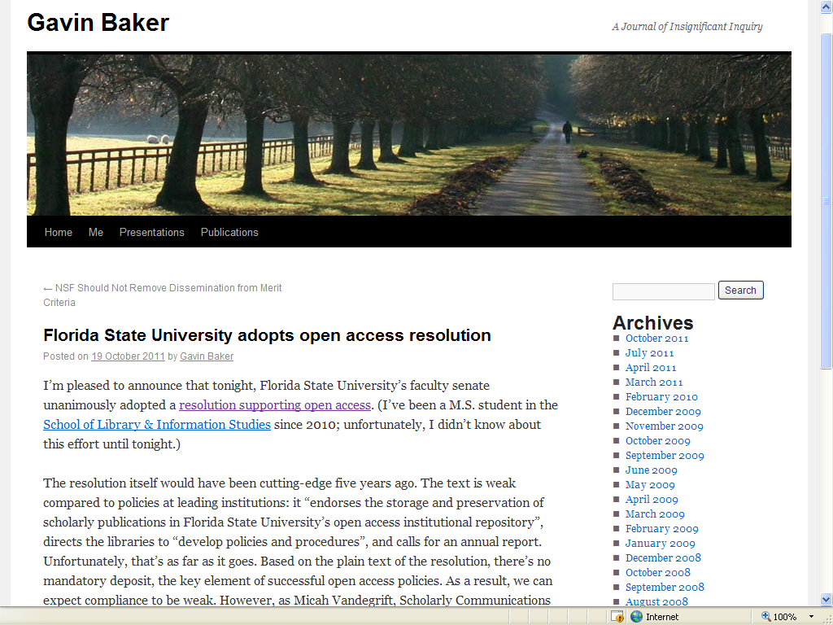
Why Open Access?
Faculty Support

Slide 19
Why Open Access?
Greater Exposure for Research
Widely disseminated and cited results—with no access restrictions!

Slide 20
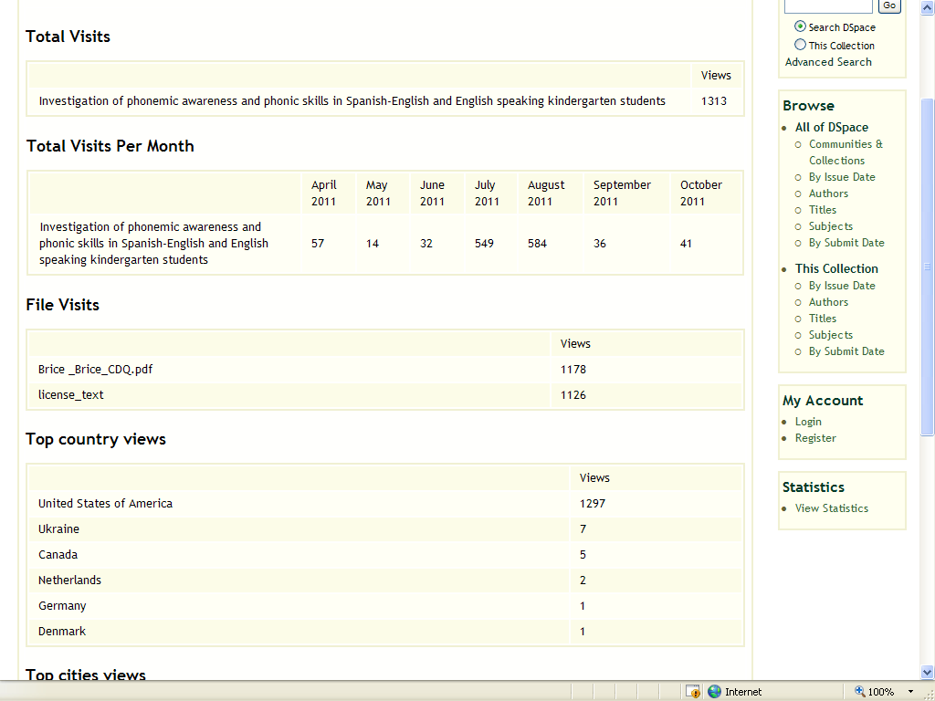
Why Open Access?
Greater Usage & More Citations

Slide 21
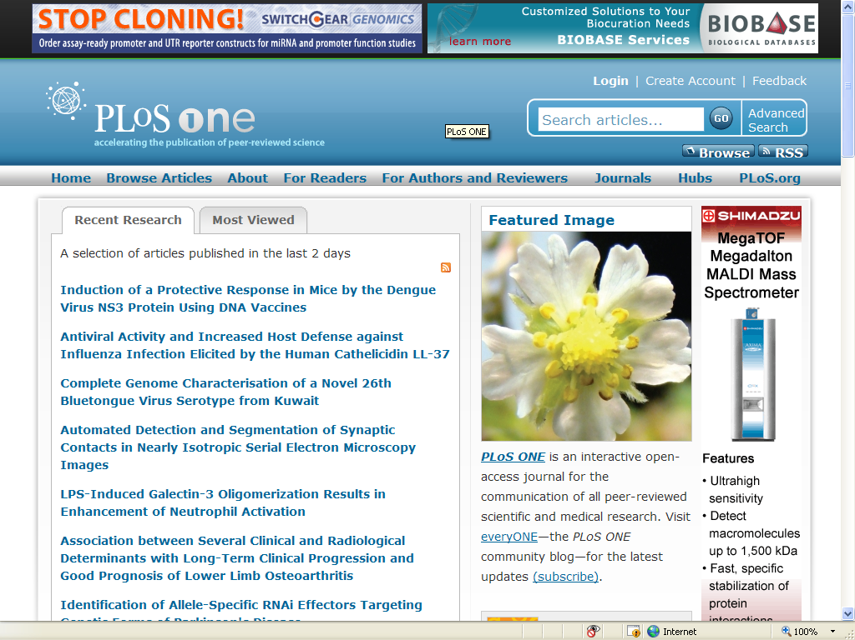
Open Access Examples

Slide 22
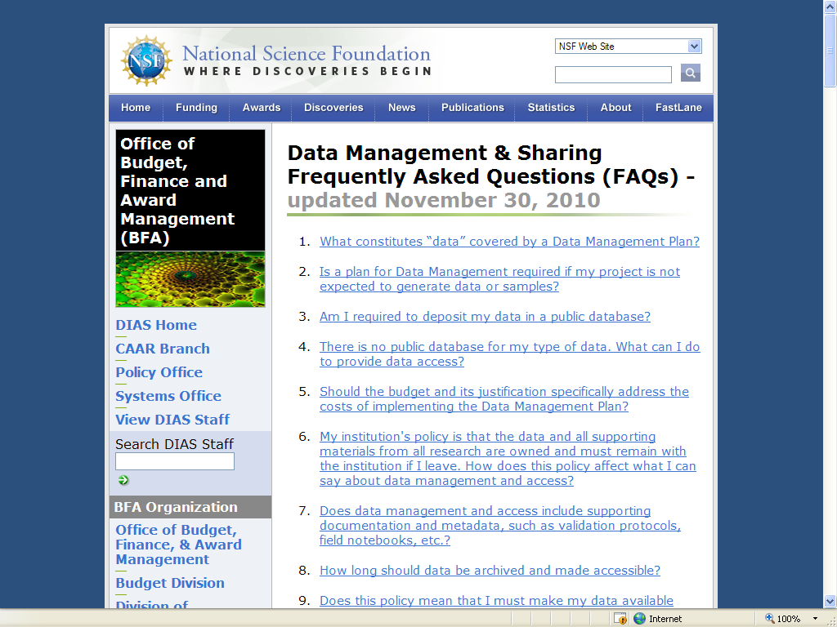
Why Open Access?
Funding Agencies Support It

Slide 23
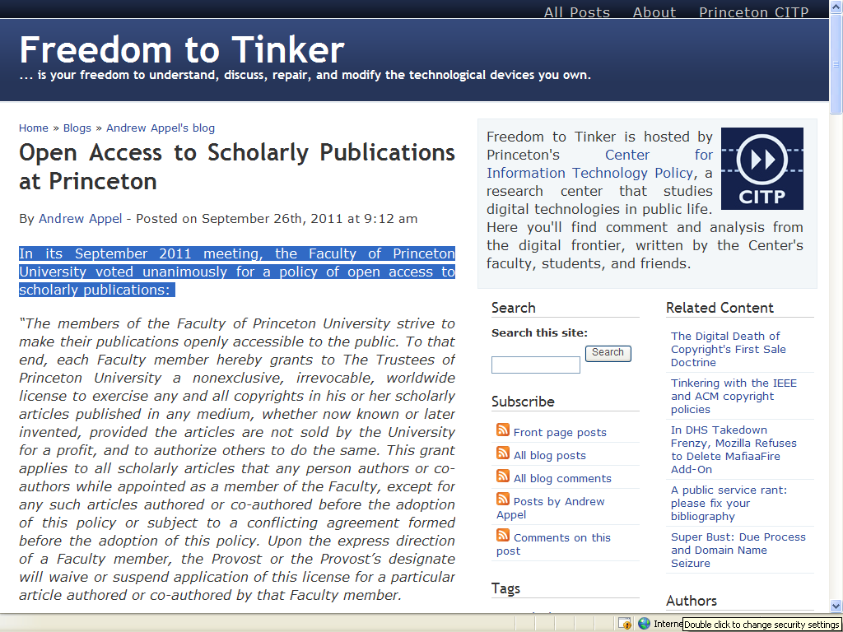
Why Open Access?
Faculty Support

Slide 24
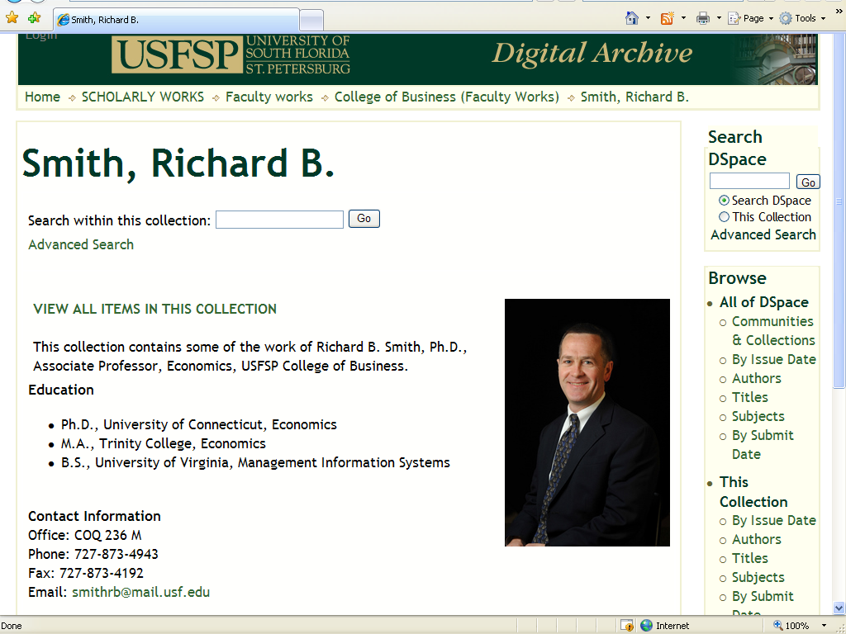
Why Open Access?
Promote Research & Scholarship

Slide 25
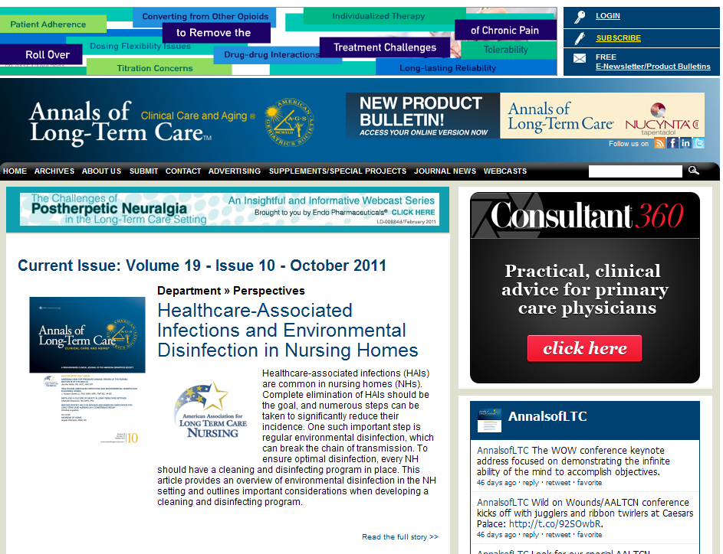
Open Access Examples

Slide 26
What is Open Access?
OA removes price barriers (subscriptions, licensing fees, pay-per-view fees) and permission barriers (most copyright and licensing restrictions)

Slide 27
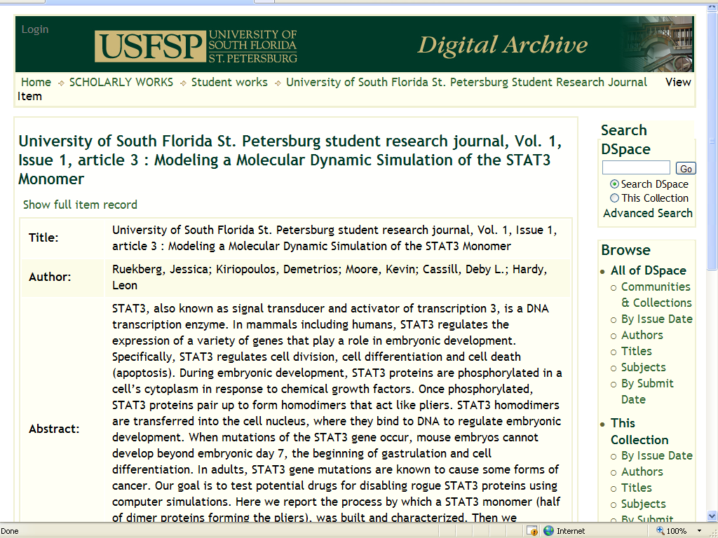
Open Access Examples

Slide 28
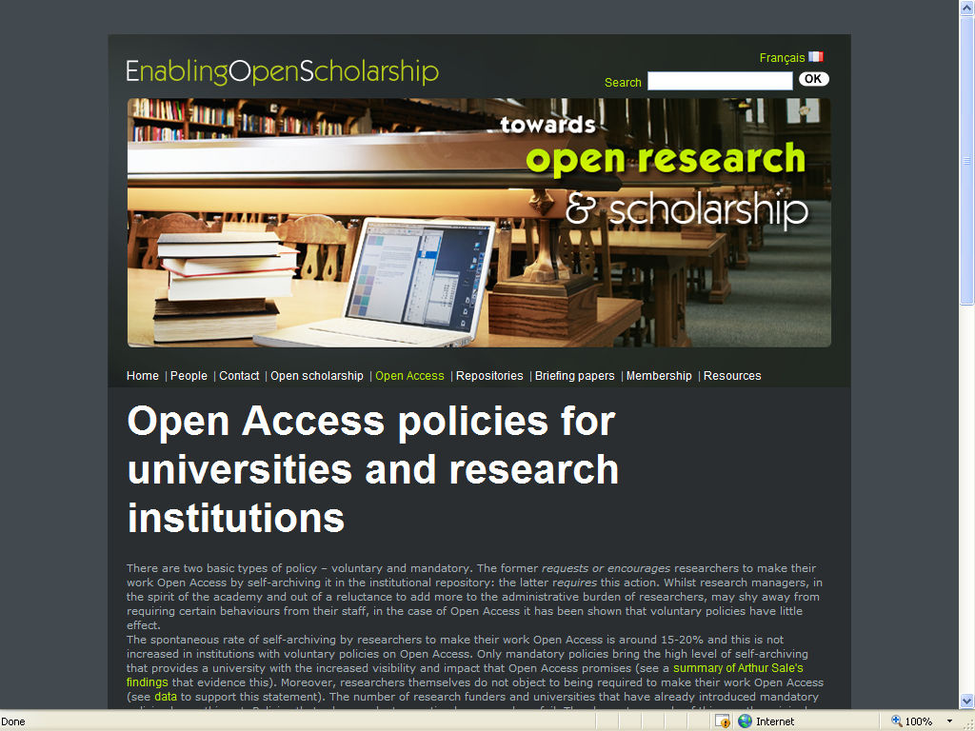
Why Open Access?
Faculty Support

Slide 29
Open Access Examples

Slide 30
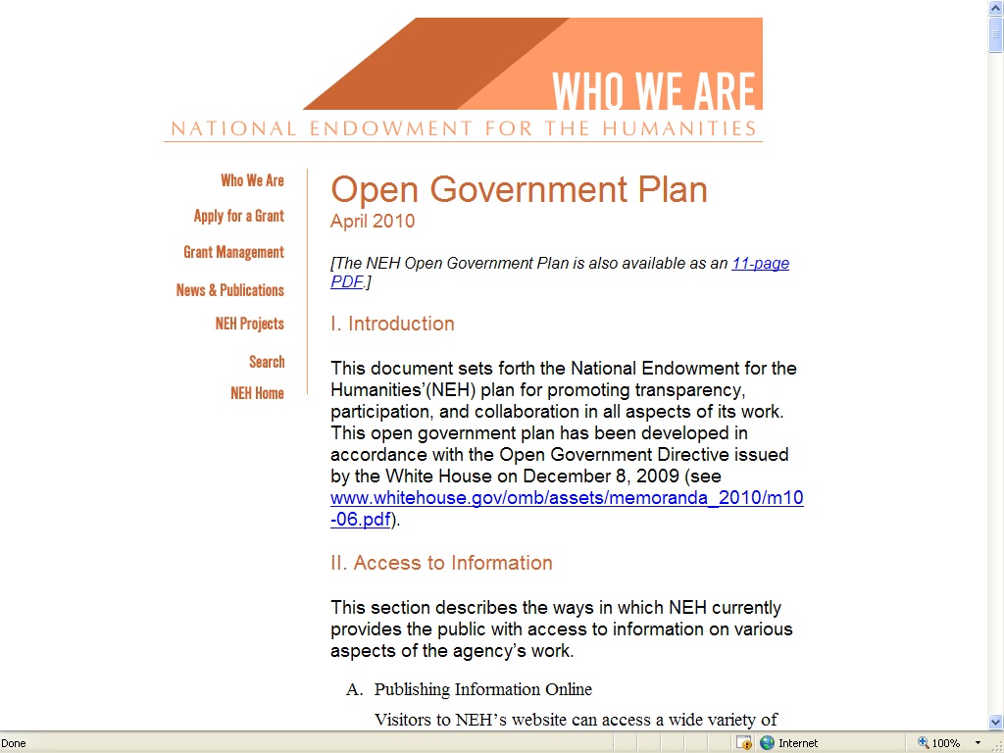
Why Open Access?
Funding Agencies Support It

Slide 31
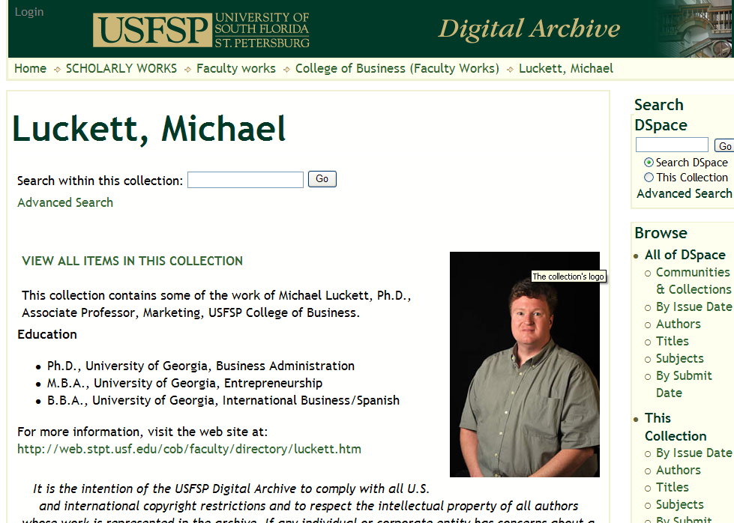
Why Open Access?
Promote Research & Scholarship

Slide 32
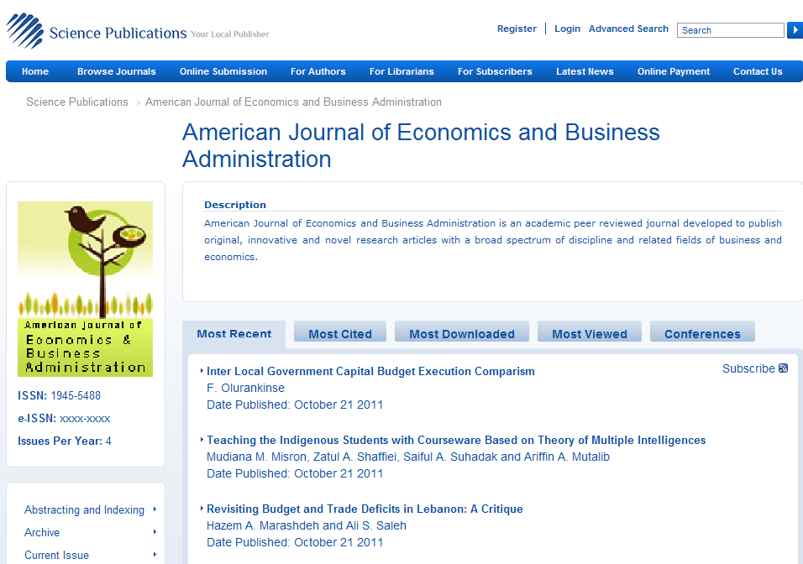
Open Access Examples

Slide 33
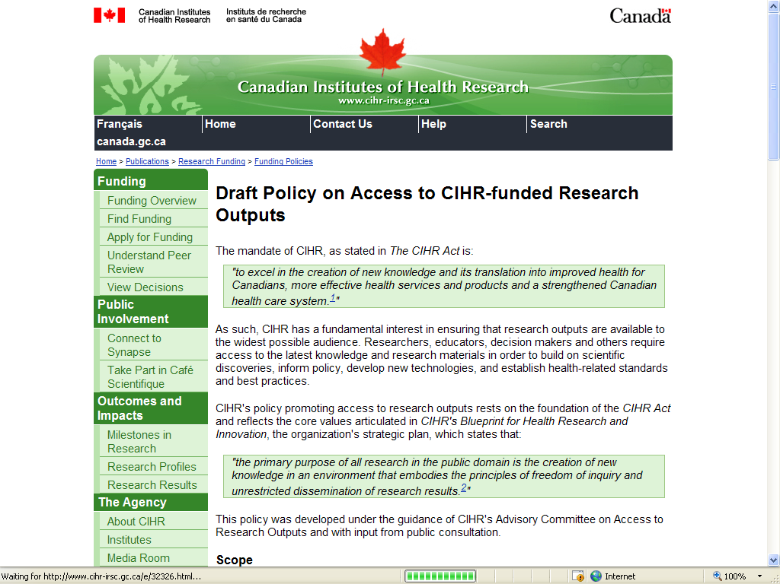
Why Open Access?
Funding Agencies Support It

Slide 34
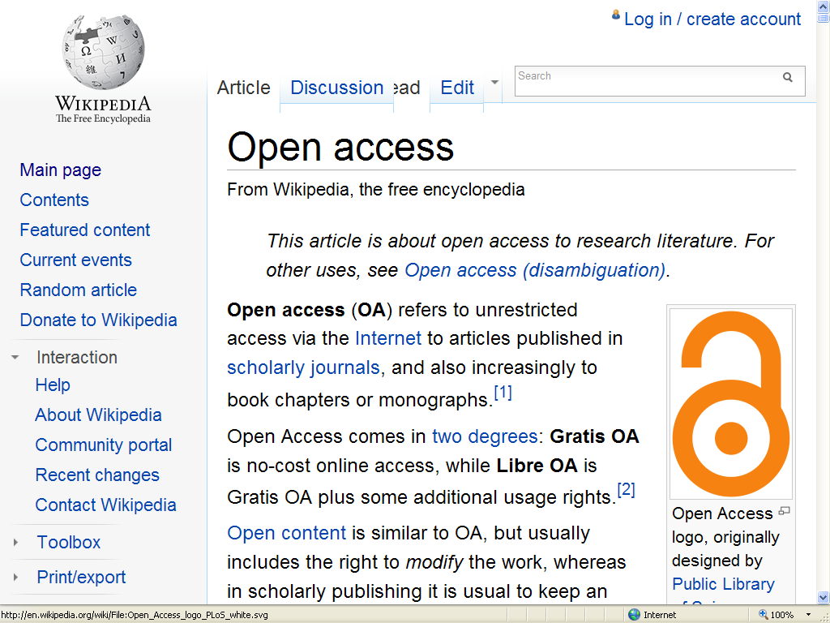
What is Open Access?

Slide 35
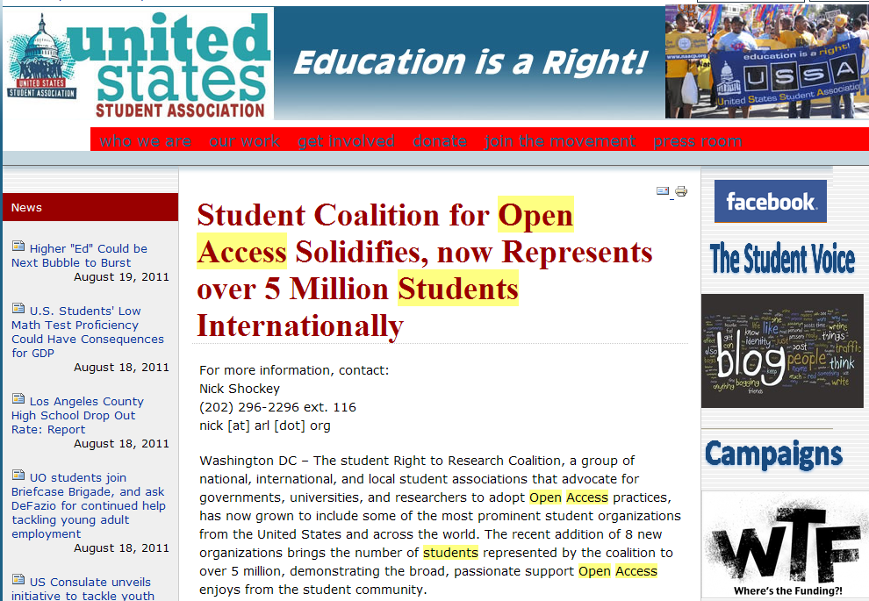
Why Open Access?
Student Support

Slide 36
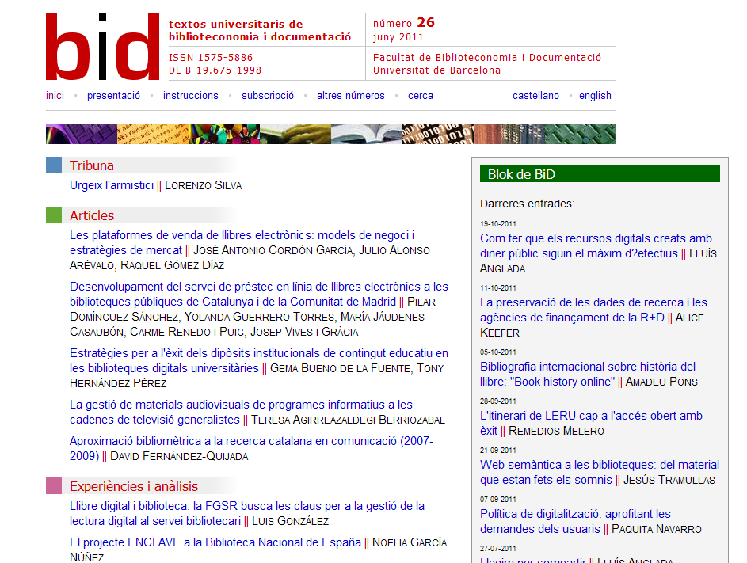
Open Access Examples

Slide 37
Why Open Access?
Greater Exposure for Research
Widely disseminated and cited results—with no access restrictions!

Slide 38
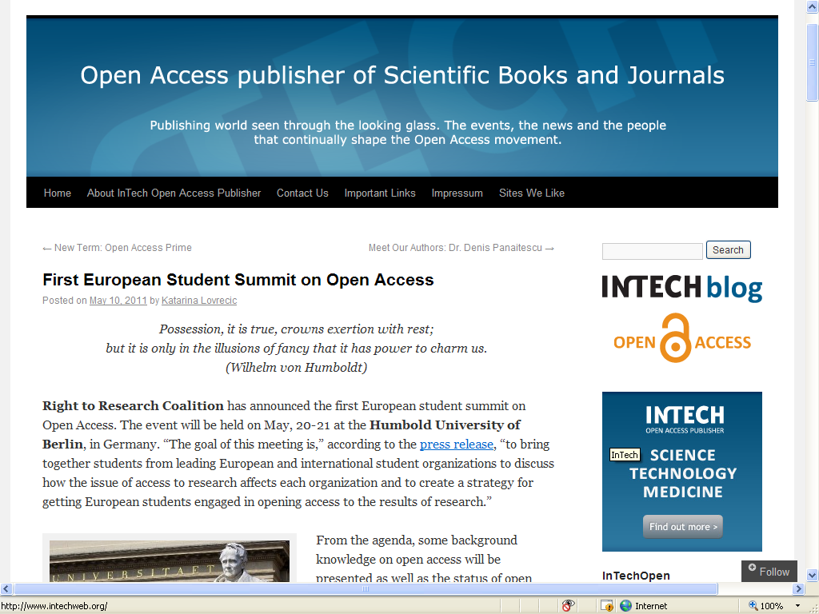
Why Open Access?
Student Support

Slide 39
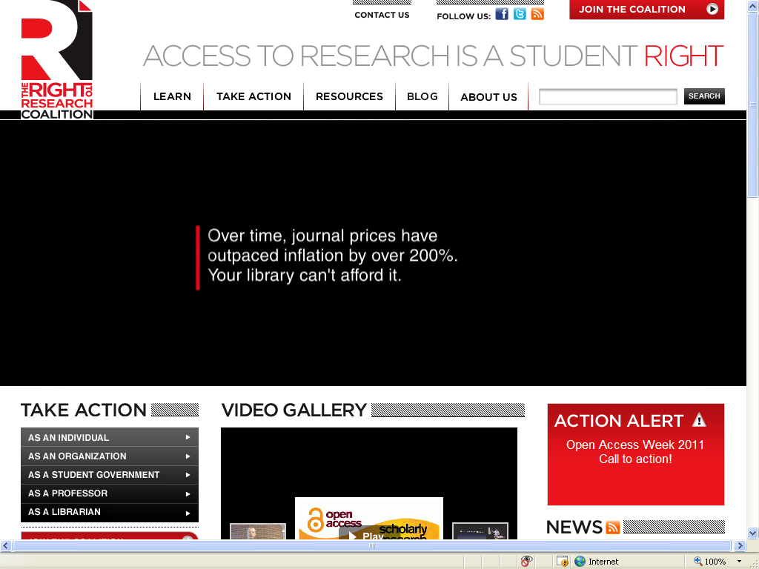
Why Open Access?
Because It’s Your Right!

Slide 40
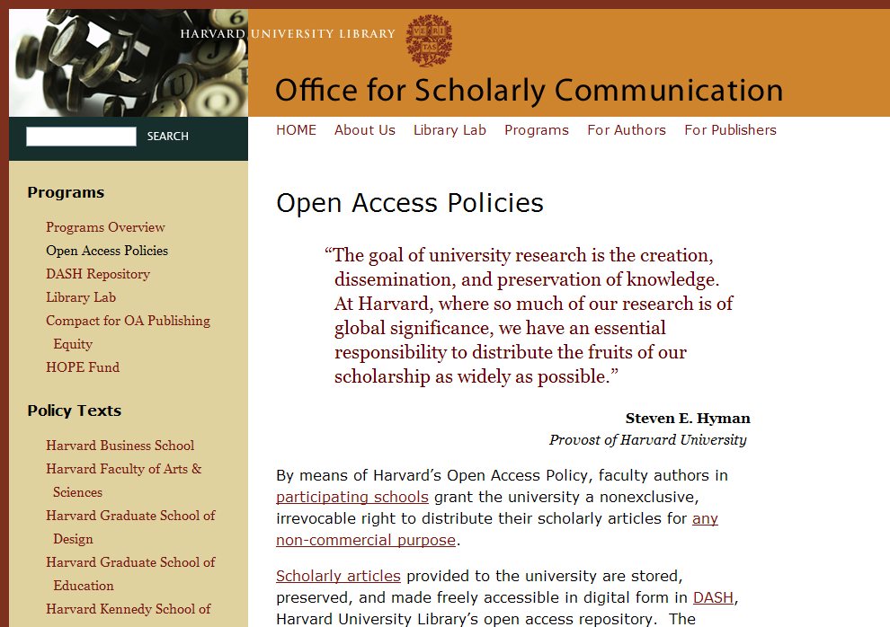
Why Open Access?
Faculty Support

Slide 41
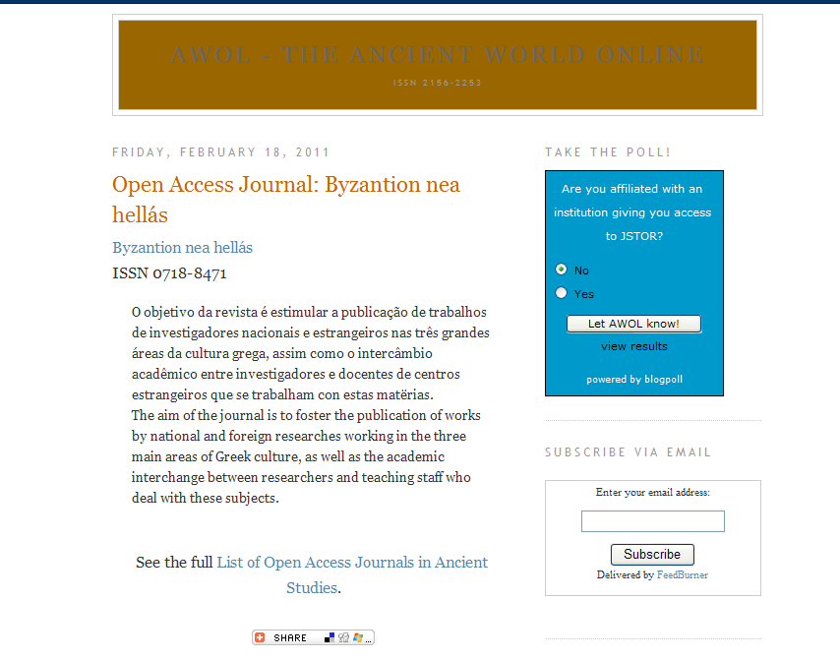
Open Access Examples

Slide 42
Why Open Access?
Funding Agencies Support It

Slide 43
Open Access Examples

Slide 44
Why Open Access?
We Can’t Afford Otherwise
Journal prices rising much faster than inflation
Scholarly output increasing
Libraries able to provide access to smaller percentage of total scholarly output

Slide 45
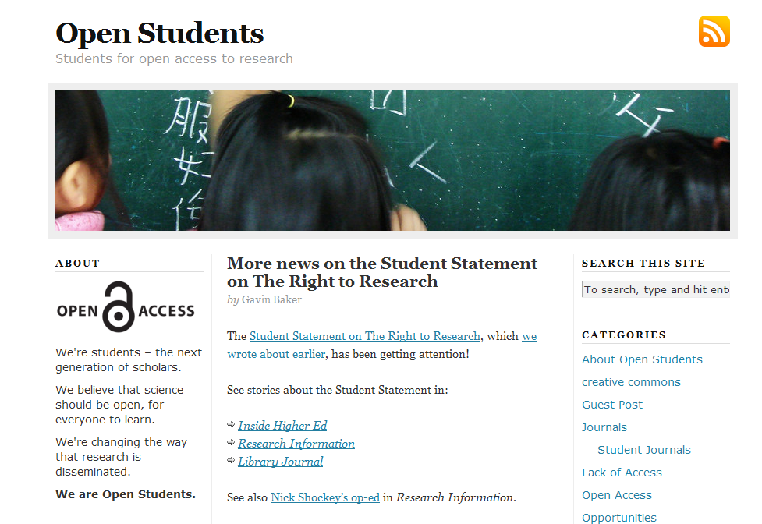
Why Open Access?
Student Support

Slide 46
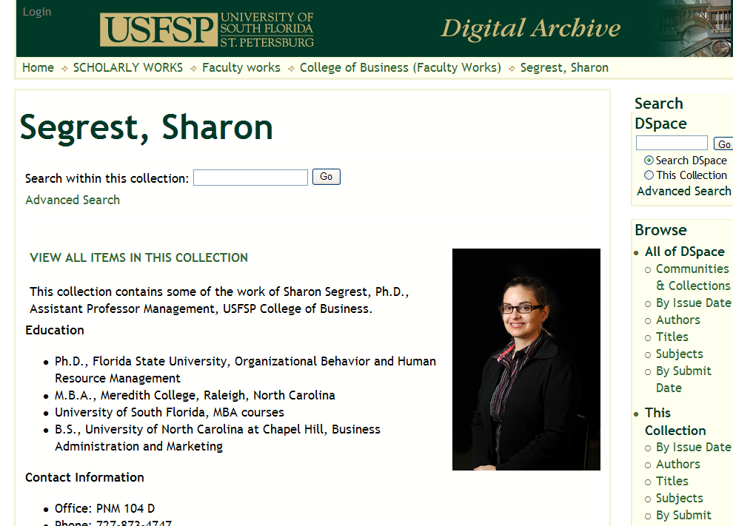
Why Open Access?
Promote Research & Scholarship

Slide 47
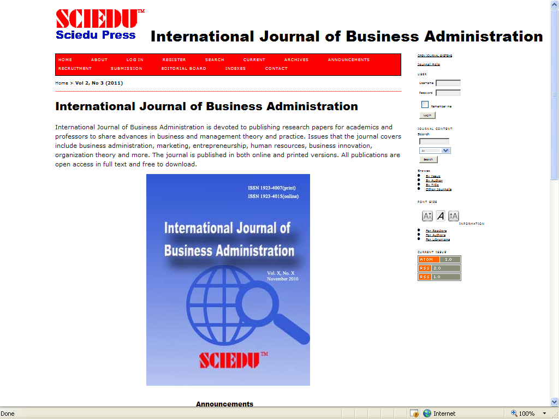
Open Access Examples

Slide 48
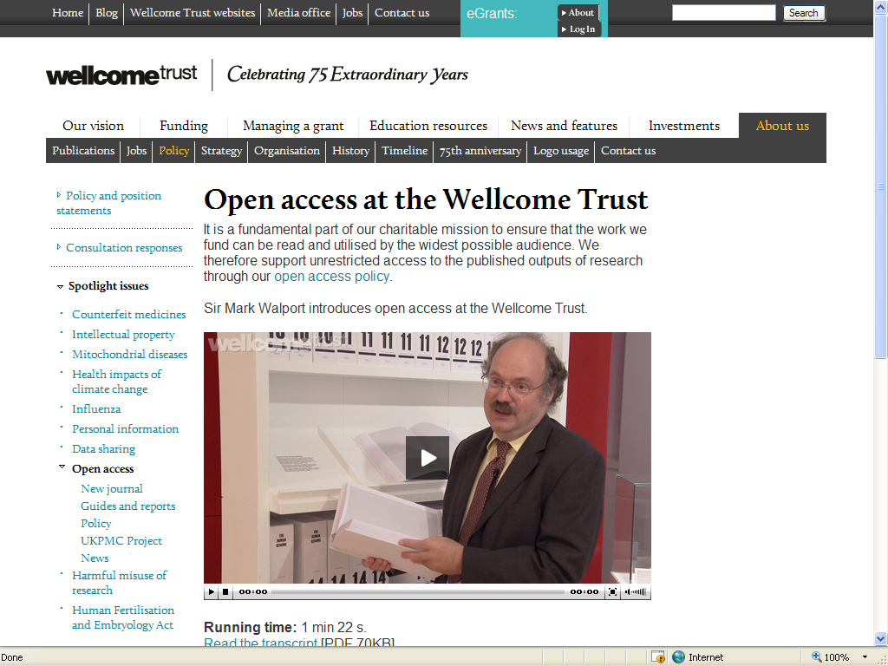
Why Open Access?
International Support: UK

Slide 49
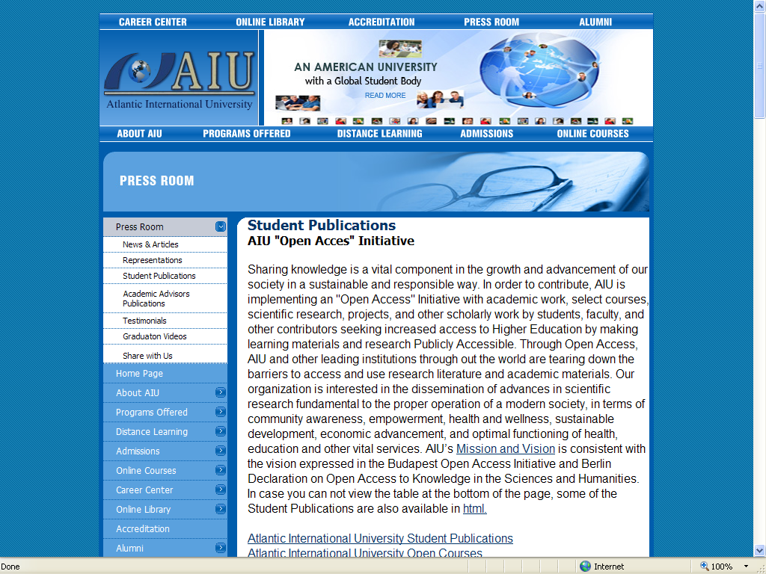
Why Open Access?
Student Support

Slide 50
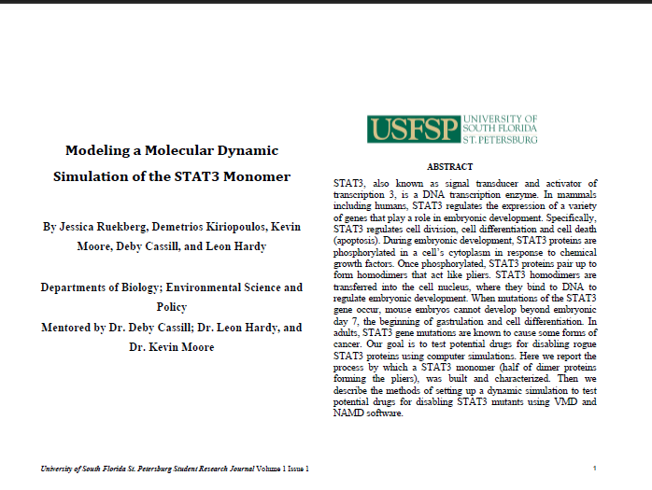
Open Access Examples

Slide 51
Why Open Access?
Faculty Support

Slide 52
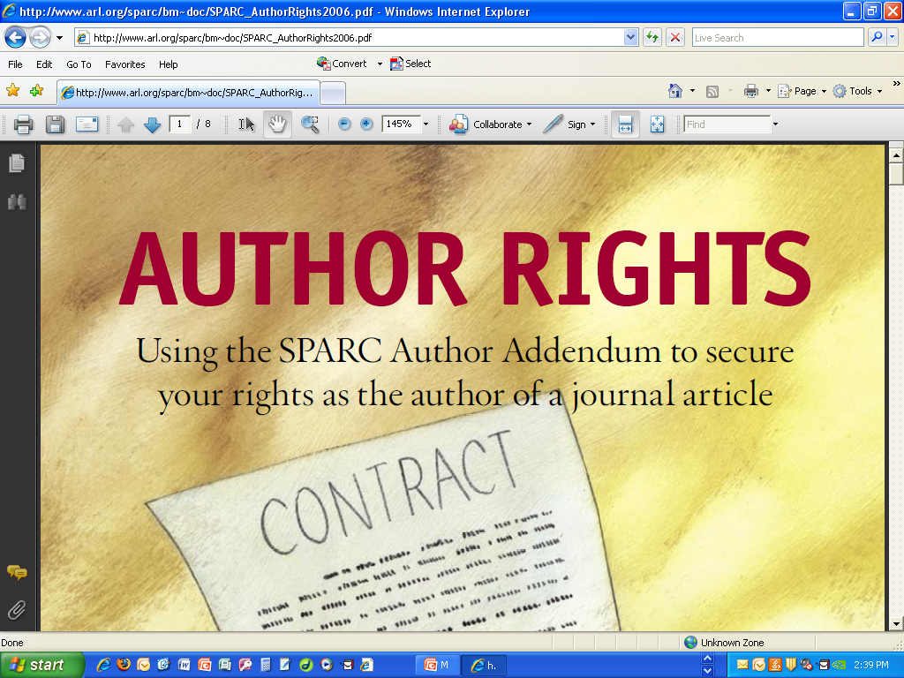
Why Open Access?
Because It’s Your Right!

Slide 53
What is Open Access?
Open-access (OA) literature is digital, online, free of charge, and free of most copyright and licensing restrictions – Peter Suber

Slide 54
Why Open Access?
Student Support

Slide 55
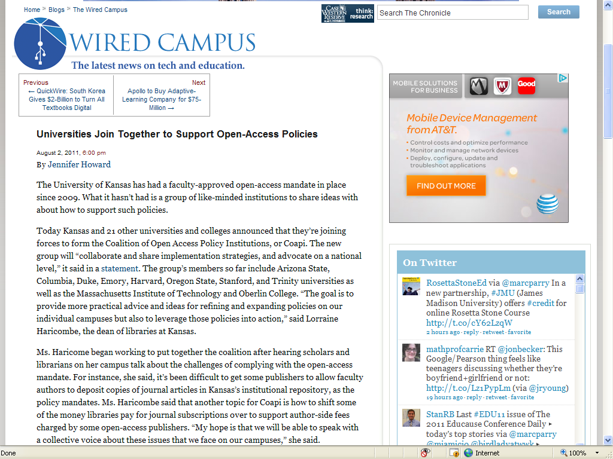
Why Open Access?
Faculty Support

Slide 56
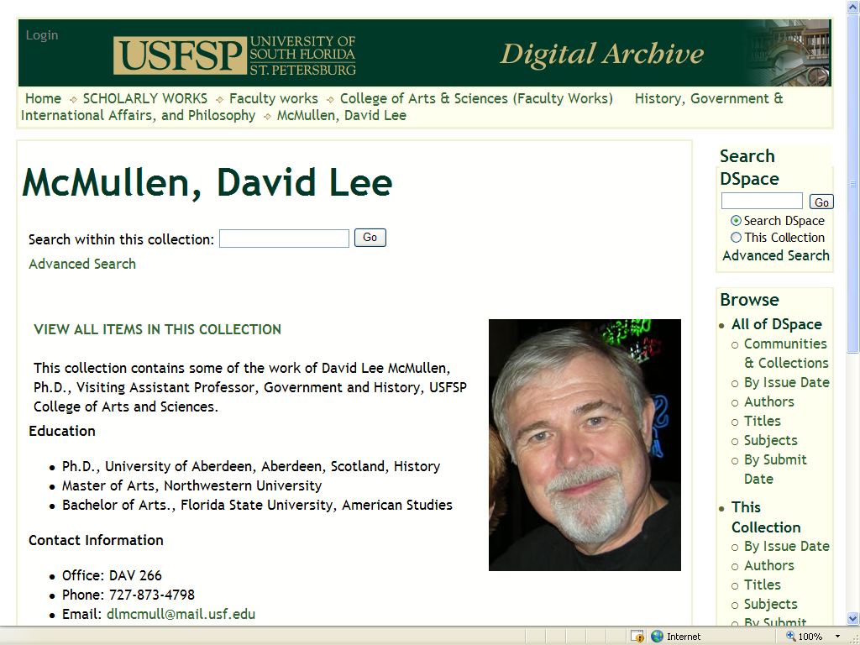
Why Open Access?
Promote Research & Scholarship

Slide 57
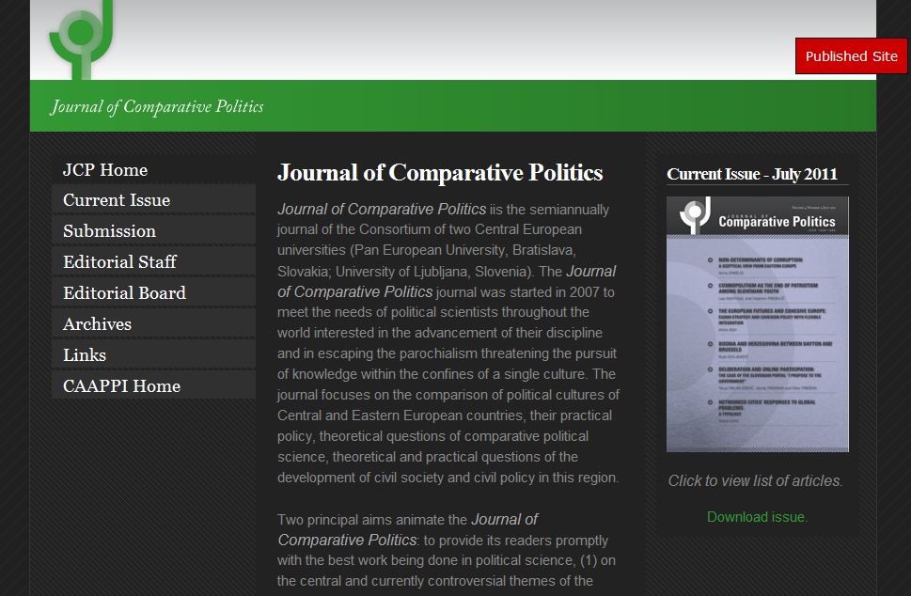
Open Access Examples

Slide 58
Why Open Access?
Because It’s Your Right!

Slide 59
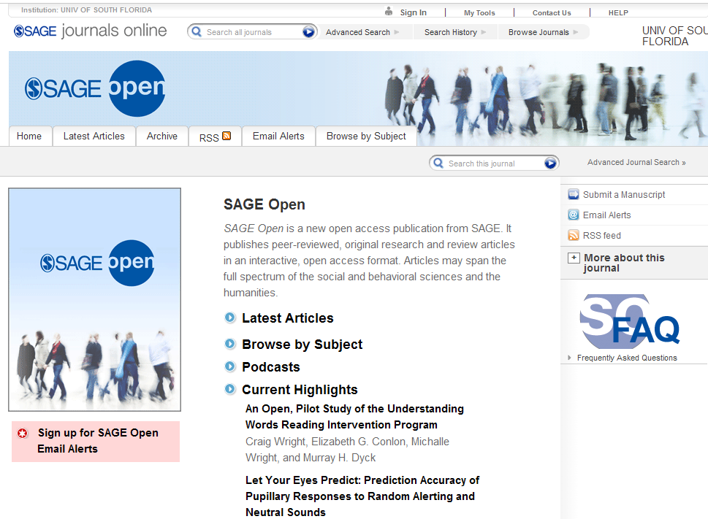
Open Access Examples

Slide 60
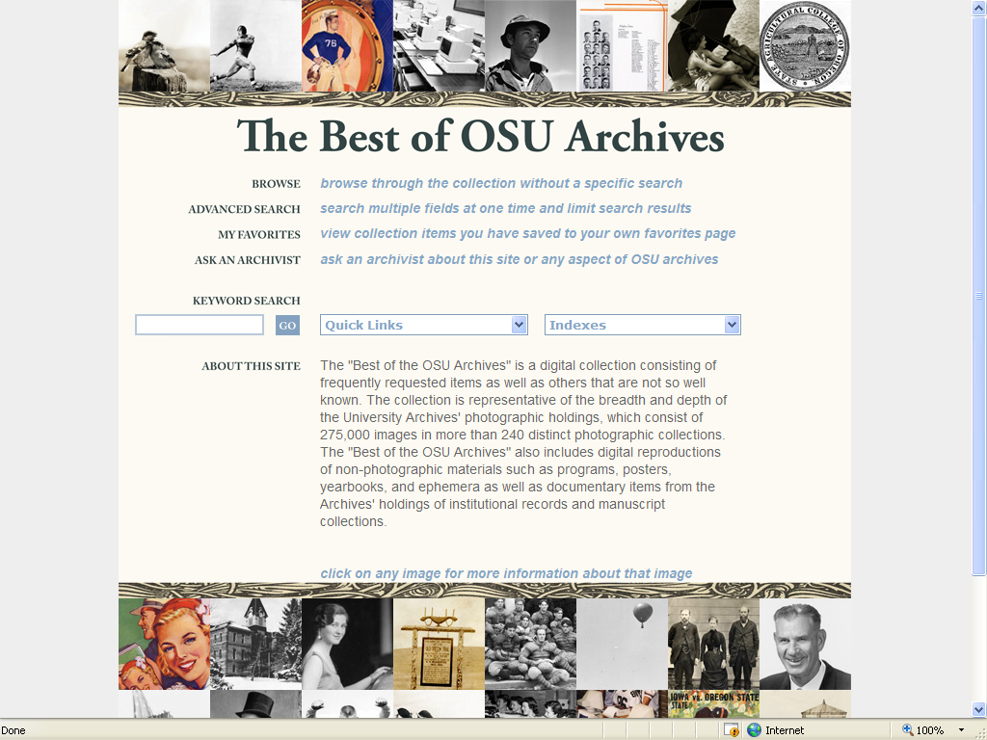
Why Open Access?
Improve Access

Slide 61
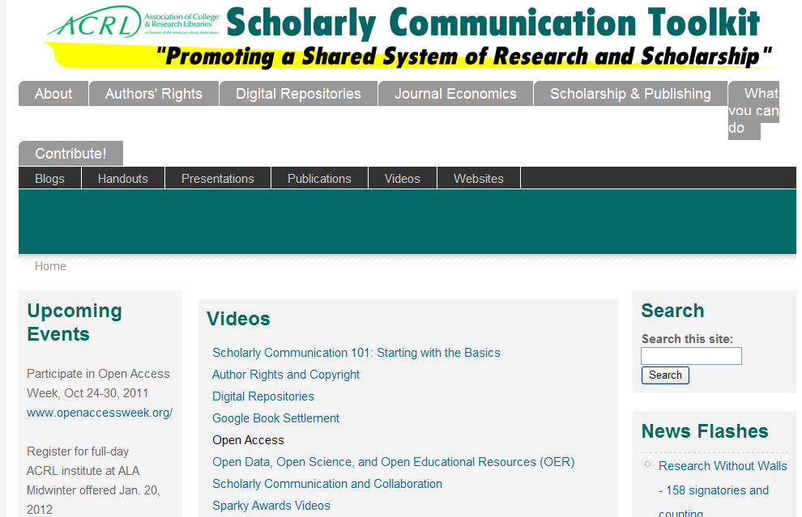
Why Open Access?
National Support

Slide 62
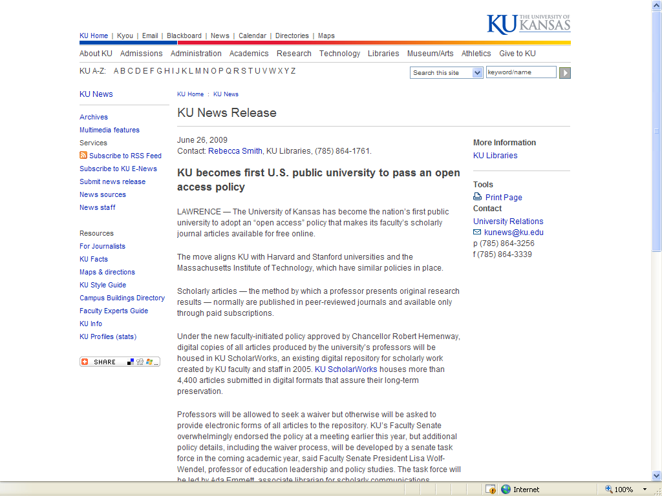
Why Open Access?
Faculty Support

Slide 63
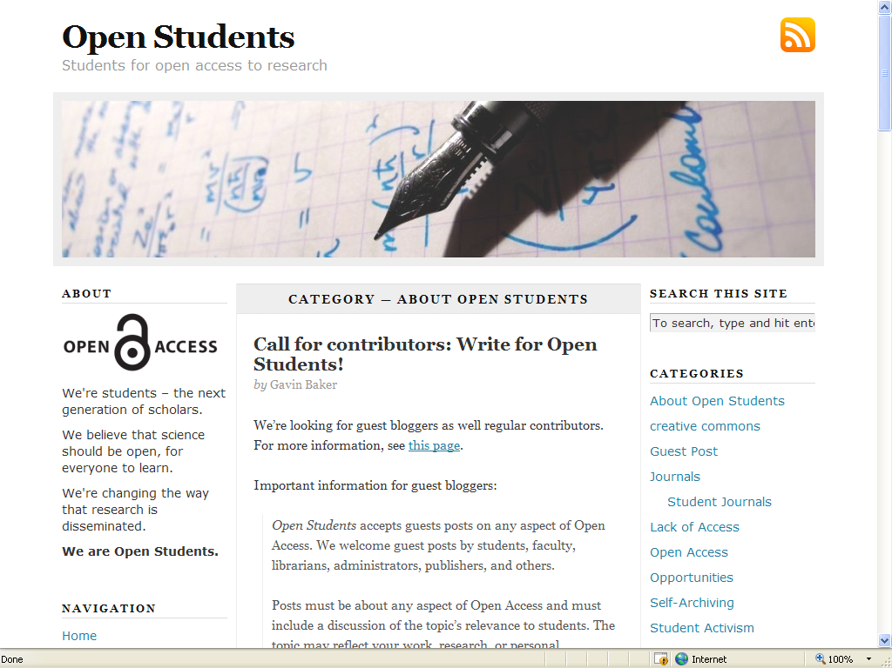
Why Open Access?
Student Support

Slide 64
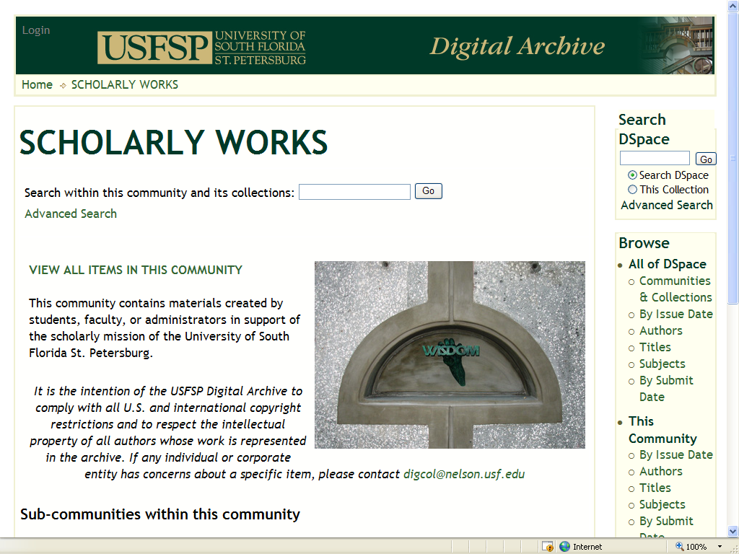
Why Open Access?
Promote Research & Scholarship

Slide 65
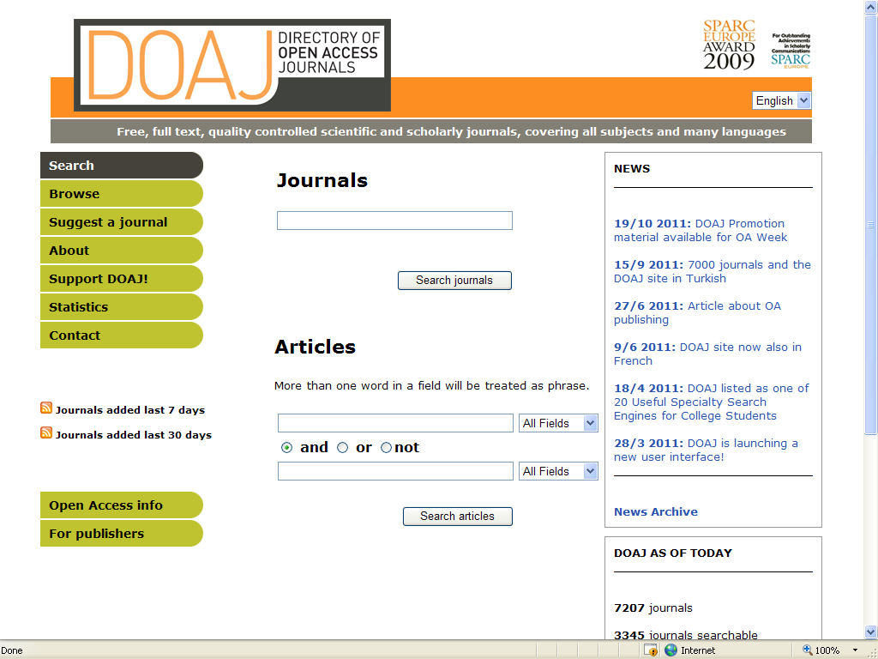
Open Access Examples

Slide 66
Why Open Access?
We Can’t Afford Otherwise
Journal prices rising much faster than inflation
Scholarly output increasing
Libraries able to provide access to smaller percentage of total scholarly output

Slide 67
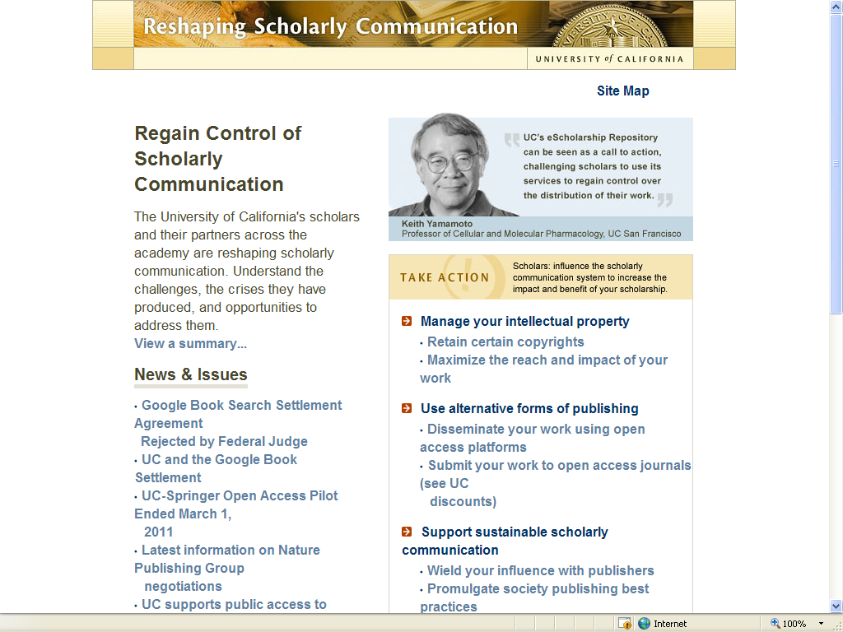
Why Open Access?
Faculty Support

Slide 68

Why Open Access?
Promote Research & Scholarship

Slide 69

Open Access Examples

Slide 70
Why Open Access?
Greater Usage & More Citations

Slide 71

Why Open Access?
Improve Access

Slide 72
What is Open Access?

Slide 73

Why Open Access?
Improve Access

Slide 74

Why Open Access?
International Support

Slide 75

Berlin Declaration on Open Access

Slide 76

Open Access Examples

Slide 77

Why Open Access?
Promote Research & Scholarship

Slide 78

Open Access Examples

Slide 79

Why Open Access?
National Support

Slide 80
Why Open Access?
Because It’s Your Right!

Slide 81

Open Access Examples

Slide 82

Why Open Access?
International Support: Europe

Slide 83

Why Open Access?
Promote Research & Scholarship

Slide 84

Open Access Examples

Slide 85

Why Open Access?
Increase Collaboration

Slide 86

Why Open Access?
Improve Access

Slide 87

Why Open Access?
International Support: UK

Slide 88

Why Open Access?
Promote Research & Scholarship

Slide 89

Open Access Examples

Slide 90

Why Open Access?
Student Support

Slide 91

Why Open Access?
International Support: Canada

Slide 92

Why Open Access?
Promote Research & Scholarship

Slide 93

Open Access Examples

Slide 94

Why Open Access?
Improve Access

Slide 95

Why Open Access?
Promote Research & Scholarship

Slide 96

Why Open Access?
International Support: Australia

Slide 97

Why Open Access?
Promote Research & Scholarship

Slide 98

Open Access Examples

Slide 99
What is Open Access?

Slide 100

Why Open Access?
Improve Access

Slide 101

Why Open Access?
Promote Research & Scholarship

Slide 102

Why Open Access?
Increase Collaboration

Slide 103

Why Open Access?
Promote Research & Scholarship

Slide 104

Why Open Access?
International Support: Europe

Slide 105

Why Open Access?
Promote Research & Scholarship

Slide 106

Open Access Examples

Slide 107

Why Open Access?
Because It’s Your Right!

Slide 108

Why Open Access?
For the Public Good

Slide 109

Why Open Access?
Promote Research & Scholarship

Slide 110

Open Access Examples

Slide 111

Why Open Access?
Improve Access

Slide 112

Why Open Access?
International Support: Africa

Slide 113

Why Open Access?
For the Public Good

Slide 114

Why Open Access?
Promote Research & Scholarship

Slide 115

Open Access Examples

Slide 116
What is Open Access?
Open-access (OA) literature is digital, online, free of charge, and free of most copyright and licensing restrictions – Peter Suber

Slide 117

Why Open Access?
For the Public Good

Slide 118
Why Open Access?
Increase Collaboration

Slide 119

Why Open Access?
International Support: Japan

Slide 120

Why Open Access?
Faculty Support

Slide 121

Why Open Access?
Greater Usage & More Citations

Slide 122

Why Open Access?
Promote Research & Scholarship

Slide 123

Open Access Examples

Slide 124

Why Open Access?
Because We All Need It!

Slide 125
Why Open Access?
For the Public Good

Slide 126

Why Open Access?
International Support

Slide 127

Why Open Access?
Promote Research & Scholarship

Slide 128

Open Access Examples

Slide 129

Why Open Access?
For the Public Good

Slide 130
Why Open Access?
Because We All Need It!

Slide 131

Why Open Access?
Promote Research & Scholarship

Slide 132

Open Access Examples

Slide 133

Why Open Access?
International Support: Latin America

Slide 134
Why Open Access?
Promote Research & Scholarship

Slide 135
Why Open Access?
Increase Collaboration

Slide 136
What is Open Access?

Slide 137

Why Open Access?
Because It’s Your Right!

Slide 138

Why Open Access?
Promote Research & Scholarship

Slide 139

Open Access Examples

Slide 140

Why Open Access?
International Support: ROAR

Slide 141
Why Open Access?
Increase Collaboration

Slide 142

Why Open Access?
Promote Research & Scholarship

Slide 143

Open Access Examples

Slide 144
Why Open Access?
Because We Need It!
It’s good for students
It’s good for faculty
It’s good for the University
It’s good for the taxpayer

Slide 145
Why Open Access?
For the Public Good

Slide 146

Why Open Access?
Promote Research & Scholarship

Slide 147

Open Access Examples

Slide 148
Why Open Access?
Because It’s Your Right!

Slide 149

Why Open Access?
Promote Research & Scholarship

Slide 150

Open Access Examples

Slide 151
Why Open Access?
For the Public Good

Slide 152
What is Open Access?
OA removes price barriers (subscriptions, licensing fees, pay-per-view fees) and permission barriers (most copyright and licensing restrictions)

Slide 153

Why Open Access?
Promote Research & Scholarship

Slide 154
Why Open Access?
For the Public Good

Slide 155

Why Open Access?
Promote Research & Scholarship

Slide 156

Open Access Examples

Slide 157

Why Open Access?
To Improve Access

Slide 158

Why Open Access?
Promote Research & Scholarship

Slide 159

Open Access Examples

Slide 160

Why Open Access?
For the Public Good

Slide 161
Why Open Access?
Promote Research & Scholarship

Slide 162

Why Open Access?
Greater Usage & More Citations

Slide 163

Why Open Access?
Faculty Support

Slide 164
Why Open Access?
Because We All Need It!

Slide 165

Why Open Access?
Promote Research & Scholarship

Slide 166

Open Access Examples

Slide 167
Why Open Access?
Because It’s Your Right!

Slide 168
Why Open Access?
Funding Agencies Support It

Slide 169

Open Access Examples

Slide 170
Why Open Access?
Promote Research & Scholarship

Slide 171

Open Access Examples

Slide 172
Why Open Access?
Because We Need It!
It’s good for students
It’s good for faculty
It’s good for the University
It’s good for the taxpayer

Slide 173

Why Open Access?
Promote Research & Scholarship

Slide 174

Open Access Examples

Slide 175
Why Open Access?
Because It’s Your Right!

Slide 176

Open Access Examples

Slide 177

Why Open Access?
Faculty Support

Slide 178
What is Open Access?

