Slide 1

Florida Atlantic University Libraries
Issues and Challenges
Presentation of
Carol Hixson, Dean of University Libraries
to
University Faculty Senate
October 16, 2017

Slide 2
Issues Facing the FAU Libraries
  Budget for Collections
  Faculty Needs and Perceptions
  State of Facilities

Slide 3
Budget for Collections
Rate of Inflation for Library Collections (Print & Electronic)
  7% annually
  83.8% over last ten years
FAU Libraries Budget for Collections
  2008 $ 3 million
  2017 $3 million

Slide 4
Budget Needed to Keep Pace with Inflation
$ 5.5 million

Slide 5
Other Changes Affecting Collections
Scholarly output increasing (doubling every 9 years)
  Able to buy smaller and smaller percentage of scholarly output
Greater reliance on electronic content
  Easier for publishers to produce and market electronic
  User preference in many cases (anywhere, any time access)
  Space considerations (we’re not getting new buildings)
  Consortial pricing packages are often advantageous
  However, prices for electronic access rising faster than the rate of inflation (eating up more of the collections budget just to maintain current subscriptions)
Notes:
“Bibliometric analysts Lutz Bornmann, at the Max Planck Society in Munich, Germany and Ruediger Mutz, at the Swiss Federal Institute of Technology in Zurich, think they have a better answer. It is impossible to know for sure, but the real rate is closer to 8-9% each year, they argue. That equates to a doubling of global scientific output roughly every nine years.”

Slide 6
FAU Collections Budgets Compared to the SUS
Notes:
No one has kept pace with inflation
FAMU did not have 2008 data; New College and Florida Polytechnic did not respond
Average of 8 reporting – 28%

Slide 7
Change in Student Headcount
Notes:
Data not available for FAMU and New College of Florida.
Taken from BOG website; latest data available Fall 2016

Slide 8
Collection Dollars Per Student 2016-2017
Notes:
**Data not available for New College of Florida
FAU spends the least per student on library collections of all the SUS

Slide 9
Faculty Needs and Perceptions
Faculty Survey Opened September 19; Closes October 20
  Survey link on library website
  https://www.surveymonkey.com/r/fau-libraries-faculty-satisfaction-survey
  Questions on collections and services
Responses from about ¼ of FAU faculty – more needed!!
  Across all Colleges, disciplines, and campuses
  All ranks of faculty responded
  Average time to respond: just over 7 minutes

Slide 10
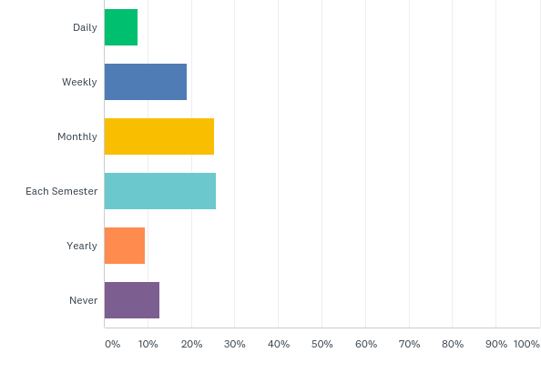
In general, how often do you physically visit the FAU Libraries?
Daily 8%
Weekly 19%
Monthly 25 %
Once a semester 25%
Yearly 9.5%
Never 13%
Notes:
Of those who come:
50% ILL
16% Dunkin Donuts
58% research
21% browsing print
51% checking out books
21% meet with a librarian
19% instructional sessions

Slide 11
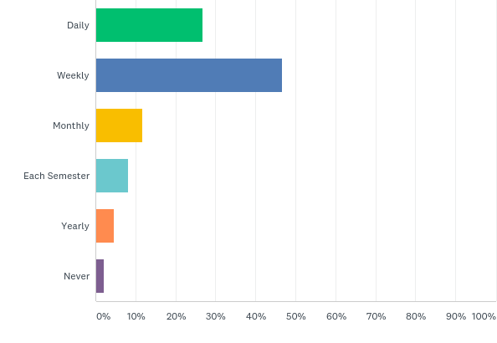
In general, how often do you use the library's electronic services or resources from your office, home or other off-campus location?
Daily 27%
Weekly 47%
Monthly 12%
Once a semester 7%
Yearly 4%
Never 2%

Slide 12
How satisfied are you with the following electronic resources?
  E-Books 64% Satisfied
  E-Books 10% Dissatisfied
  E-Books 26% Never used
  E-Journals 88% Satisfied
  E-Journals 6.5% Dissatisfied
  E-Journals 4% Never used
  Streaming media 40% Satisfied
  Streaming media 6% Dissatisfied
  Streaming media 54% Never used

Slide 13
If the library’s electronic resources were to be significantly reduced, how much would this affect your:
  Very Significant or Significant Impact on:
    Teaching 80%
    Research 94%
    Remaining at FAU 64%
Notes:
One comment: “Why would you even consider this?” The information on the state of the budget makes clear that we are being forced to consider it

Slide 14
Faculty comment
“I would be **unable** to perform my assigned research if the library's electronic resources were significantly reduced. This would be untenable, and would make it impossible for me to remain a faculty member at FAU.”

Slide 15
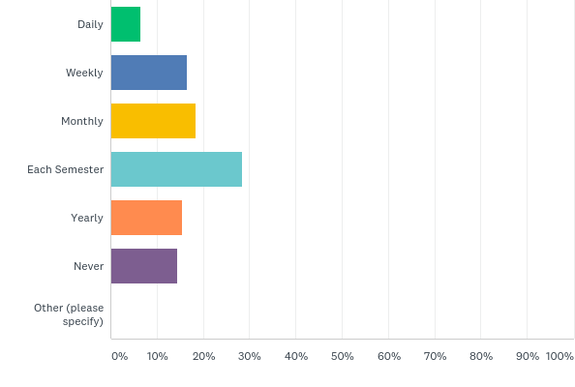
In general, how often do you use the library's print resources (books, journals, etc.)?
Daily 6.5%
Weekly 17%
Monthly 18%
Once a semester 28%
Yearly 15%
Never 14%

Slide 16
How satisfied are you with the following physical resources?
  Books 66% Satisfied Print Journals Satisfied 55%
  Books 17% Dissatisfied Print Journals Dissatisfied 10%
  Books 19% Never Used Print Journals Never Used 35%
  M-forms 24% Satisfied Media 39% Satisfied
  M-forms 5% Dissatisfied Media 11% Dissatisfied
  M-forms 71% Never Used Media 49% Never Used
  SpecColl Satisfied 36% GovDocs Satisfied 35%
  SpecColl Dissatisfied 4% GovDocs Dissatisfied 2.5%
  SpecColl Never Used 60% GovDocs Never Used 62%

Slide 17
If the library’s physical collections were to be significantly reduced, how much would this affect your:
  Very Significant or Significant Impact on:
    Teaching 64%
    Research 70%
    Remaining at FAU 50%

Slide 18
Faculty comment
“I feel that if the University wants to continue to move towards and market itself as a premier research institution, the library will need to be able to grow and add resources, of all types. (physical collections, electronic collections and the specialized collections as well)”

Slide 19
Faculty comment
“There are other factors that may impact my remaining at FAU beyond the collection of the library. This said, not having an up-to-date or top-tier "research" library will affect whether or not research faculty from other institutions will come to FAU. Becoming a Research1 institution has many components to it and I would hazard a guess that having a top-notch library is one of those details.”

Slide 20
State of the Facilities: Wimberly
Minor upgrades in Boca Raton in the past 2 years funded by:
  $250,000 special allocation for the 5th floor
  $10,000 gift from University Club for Graduate Lounge
  $14,000 gift from Lifelong Learning Society for some painting and branding
  Tech fee money to upgrade computers and study room equipment
  Funds from Auxiliary accounts for limited branding, painting, furnishings, and new service desk

Slide 21
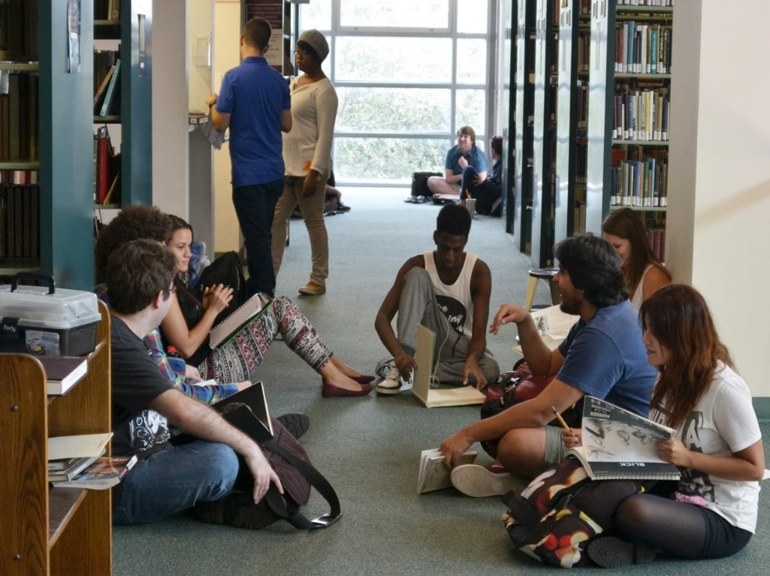
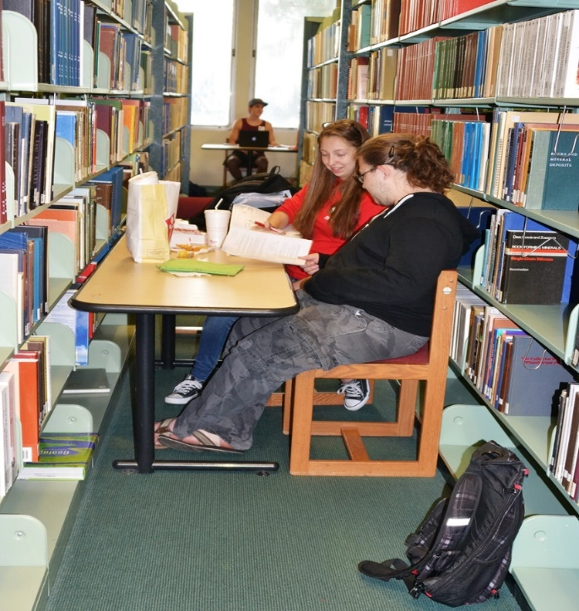
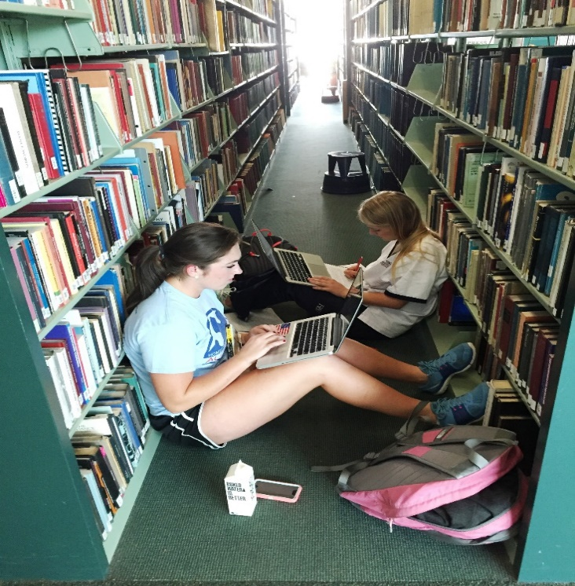
State of the Wimberly Library Today

Slide 22
Faculty comment
“I find the library's staff to be very friendly and professional when working with me and our students, even though they are dealing with many issues that are beyond their control. 1) the building that clearly has seen its better days decades ago and while they have managed to make small inroads into improving the quality of the library experience for everyone, the building still presents itself as the library that time has forgotten. In its current physical state I would find it hard to believe it could compete against libraries at many of our state competitors let alone outside the state. The building simply does not convey the image one would come to expect for a university marketing itself as a high research institute…”

Slide 23
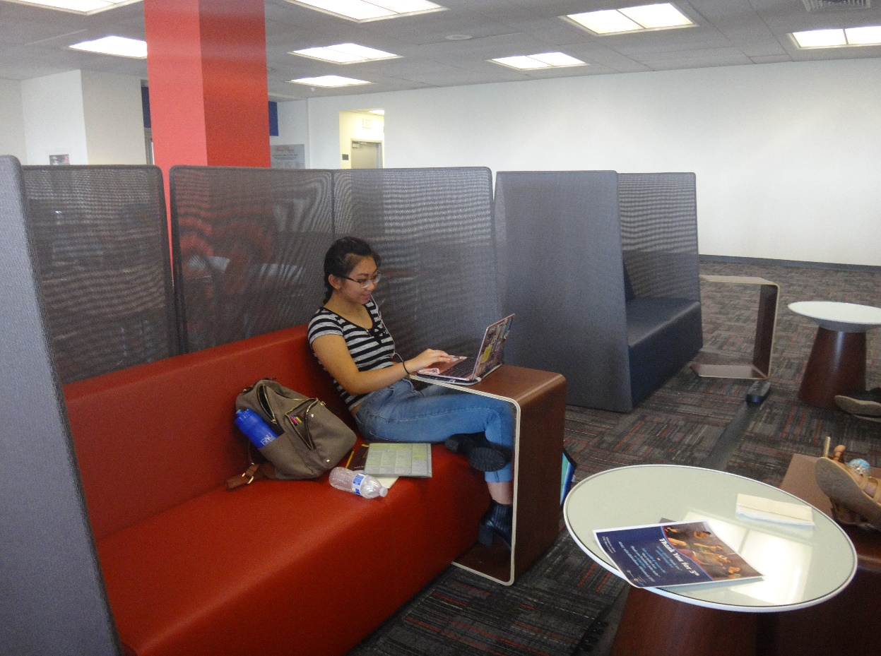
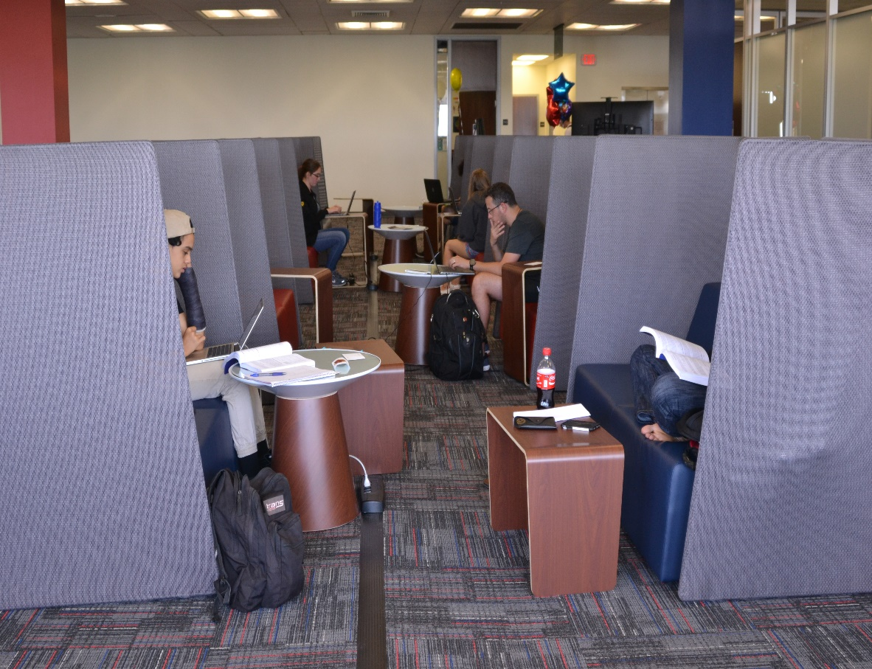
Progress in Wimberly
New 5th Floor in the Wimberly Library

Slide 24
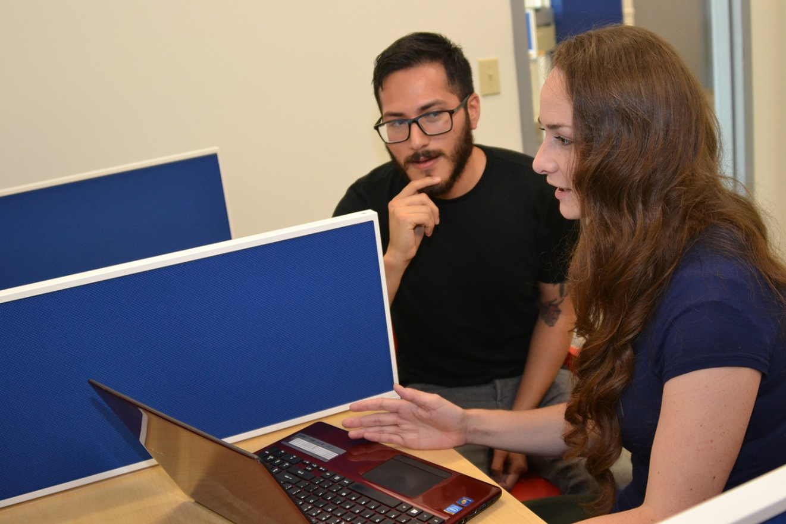
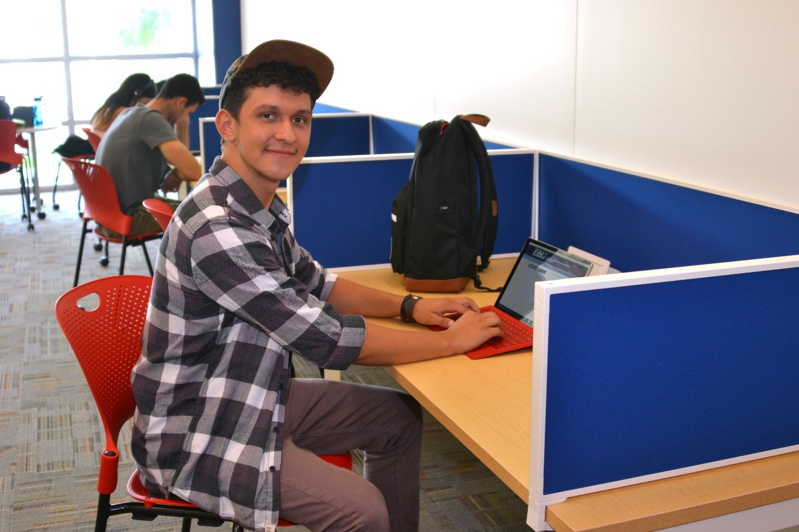
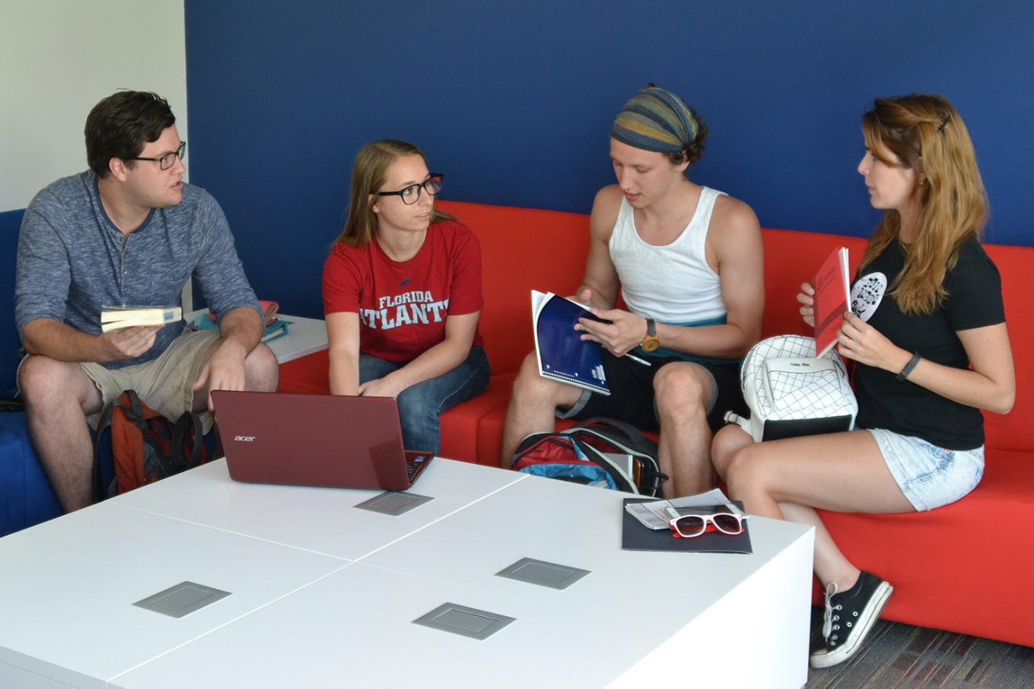
Graduate Student Lounge
Progress in Wimberly

Slide 25
Upcoming faculty forums
Faculty forum being scheduled in November in the Wimberly Library with streaming available for Jupiter and Harbor Branch
  Looking for faculty input on how to proceed with collection decisions and more

Slide 26
Questions and Comments
Contact information:
hixson@fau.edu
7-3717

