Slide 1

Going Green: How to Submit to the Electronic USFSP Undergraduate Research Symposium Collection
Carol Hixson, Dean
Nelson Poynter Memorial Library, USFSP
April 18, 2012
http://dspace.nelson.usf.edu/xmlui/handle/10806/4509
Revised November 24, 2013

Slide 2
Your Options
You have the option of turning your work over to the Library and letting them do all the work for you
If you want the Library to do everything for you, contact digcol@nelson.usf.edu and identify yourself as a student with work to add to the digital archive
If you want to do the work yourself, read on

Slide 3
Prerequisites for Submitting Your Files Yourself
An internet connection and a recent-model graphical web browser of your choosing
Files to be submitted available for uploading from your PC, networked drive, thumb drive or other source
A registration (explained later) to enable you to submit to the Undergraduate Research Symposium collection in the archive

Slide 4
What Types of Files Are Accepted?
For text, machine-readable PDF files
  The Library recommends that MS Word or other document files be converted to PDF for preservation purposes
Any other file type such as JPG, PPT, PPTX, XLS, GIF, etc.
If you have questions about acceptable file types, contact the Library at digcol@nelson.usf.edu

Slide 5
File Names
Naming your file(s) appropriately will help ensure better access to your work.
Use short descriptive names and connect elements with an underscore
Use the appropriate file extension (.pdf, xls, ppt, etc.) For example:
  Smith_John_biology.pdf
  conf_presentation.ppt
  precipitation_data.xls

Slide 6
Finding the Site
The University of South Florida St. Petersburg’s Digital Archive is at:
http://dspace.nelson.usf.edu/

Slide 7
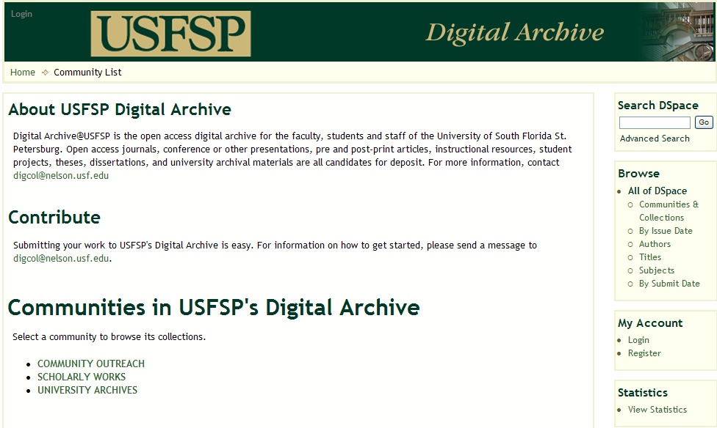
To get started, first register by going to the main site and clicking on Register.

Slide 8
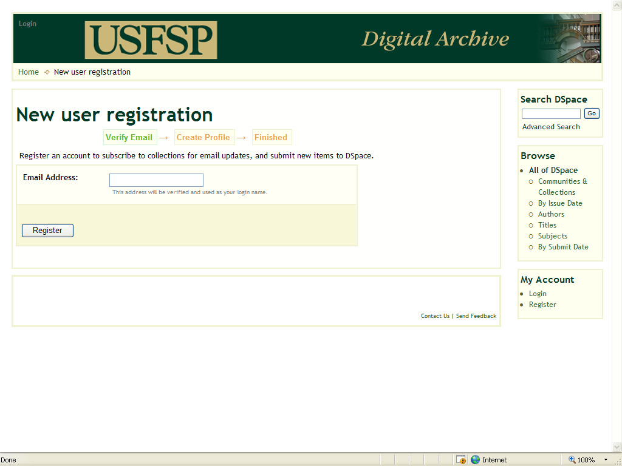
The following screen will appear. (DSpace is the name of the software used for the USFSP Digital Archive.) As a first-time user, click on Register.

Slide 9
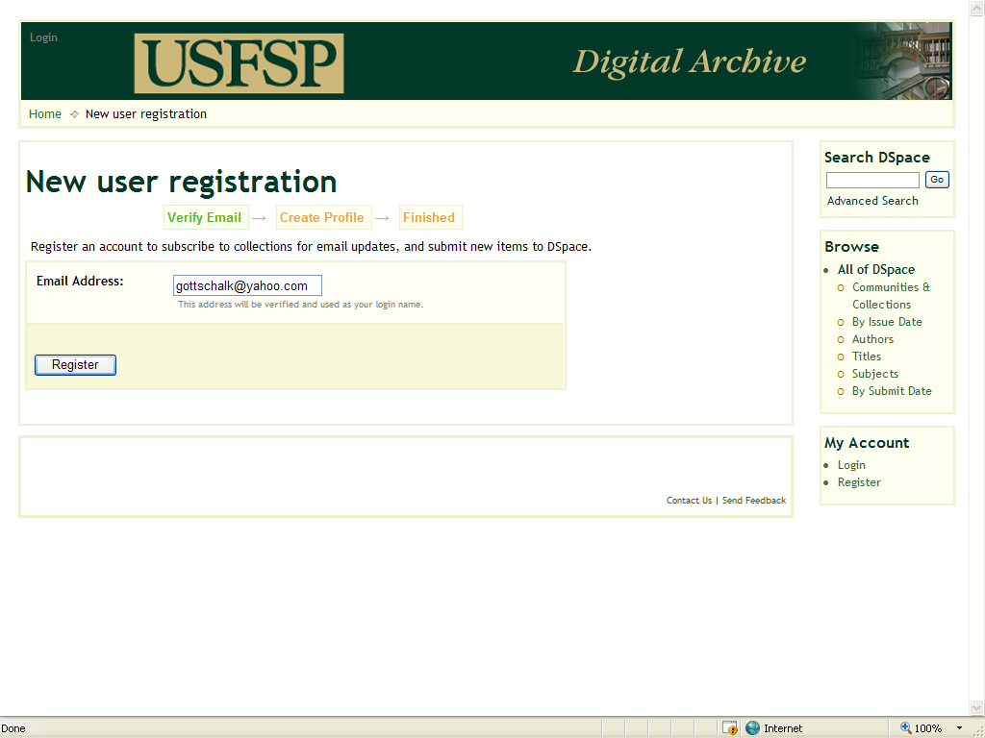
Follow the instructions on the registration screen, input your full email address, and click the Register button. You will receive email notification of your registration with instructions for setting your password.

Slide 10
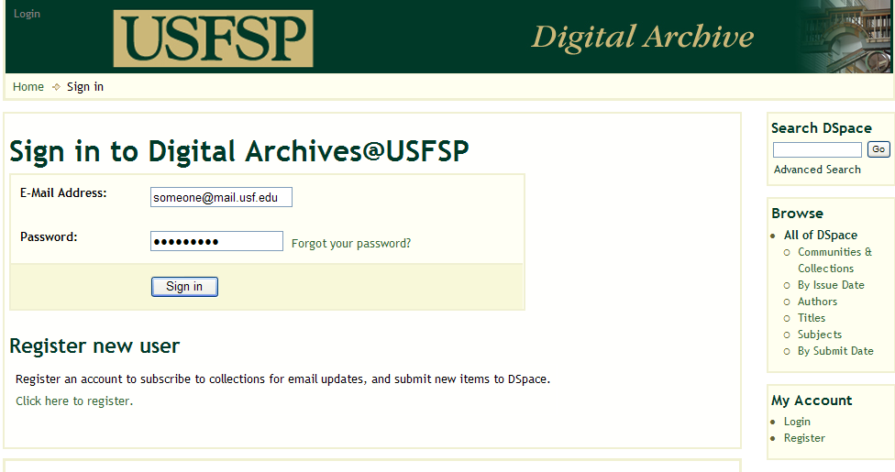
Once you are registered and have all the files for your submission available on your PC or your networked drive, log in with your FULL email address and password. For example: someone@mail.usf.edu
(The password will be the one you selected when you first registered with the USFSP Digital Archive. If you forget it, you can have a new link for resetting your password sent to you by clicking on the Forgot your password link)

Slide 11
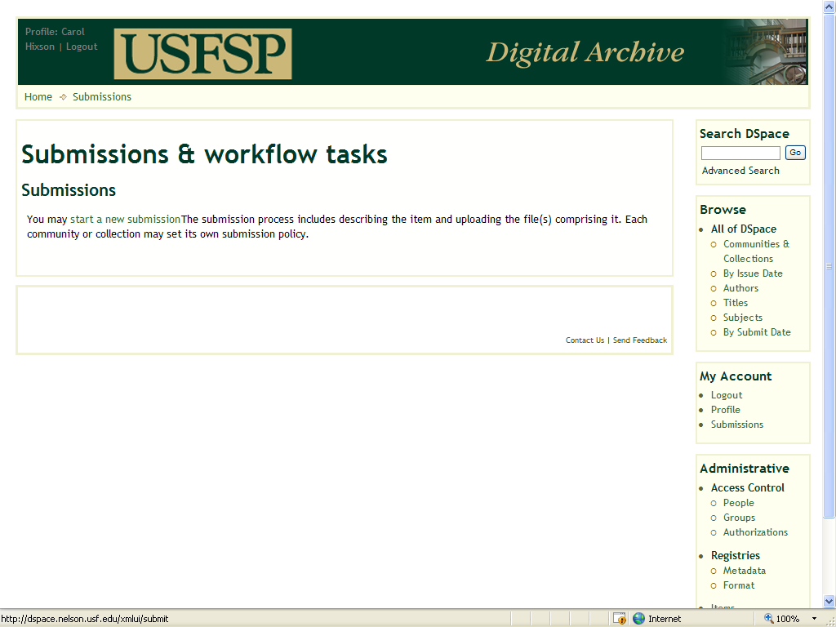
After logging in, you will be taken to a Submissions screen and
prompted to start a new submission. If you have questions or
problems, contact the Library at digcol@nelson.usf.edu

Slide 12
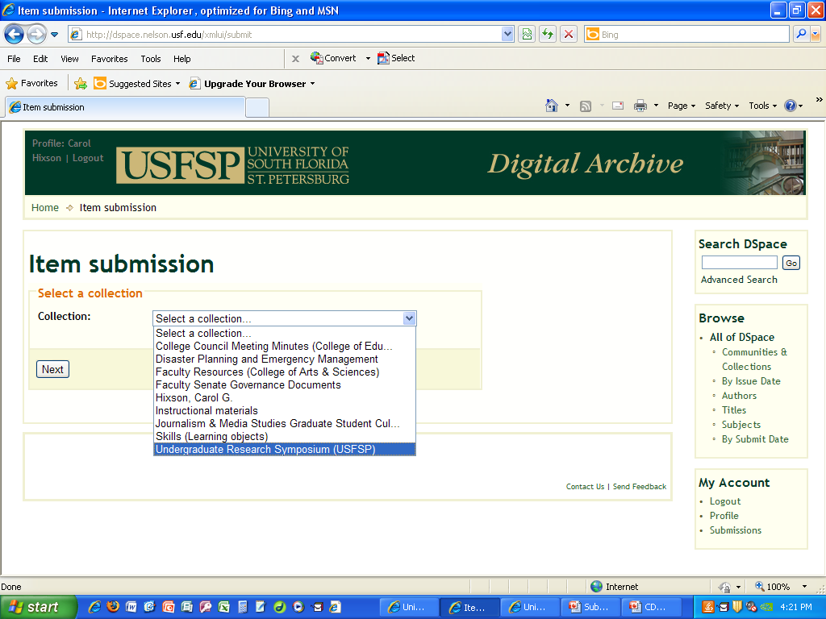
Locate the Undergraduate Research Symposium collection, select it from the list, and click on the NEXT button. You will be taken to the submission form and expected to fill in information about your work.

Slide 13
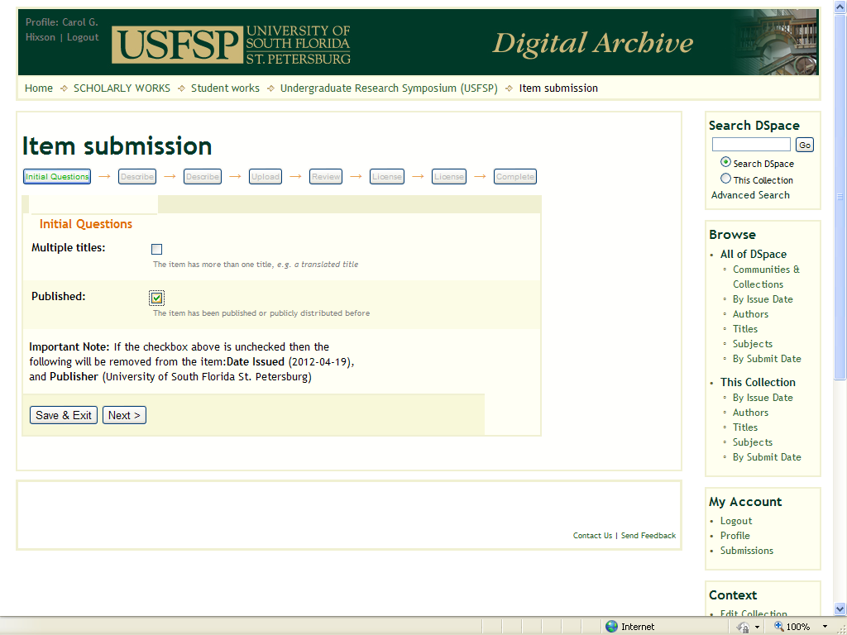
First screen of submission form
Check the box for PUBLISHED. Then click the NEXT button so that you can continue to fill in information about your research presentation.

Slide 14
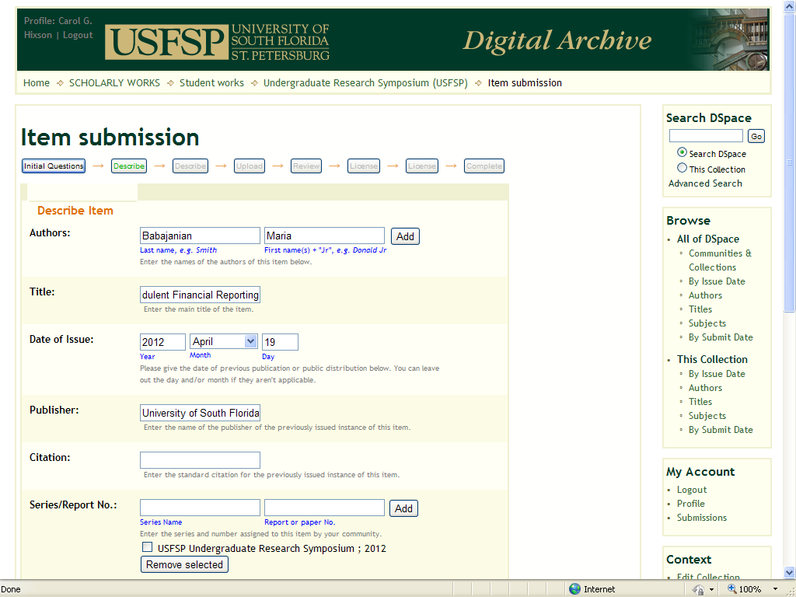
Add your name and title of your presentation
Authors: Your Last name goes in the first box and Your First Name and middle name or initial goes in the second box(then click the ADD button)
Title: Keep typing or scroll across to add in the complete title of your presentation

Slide 15
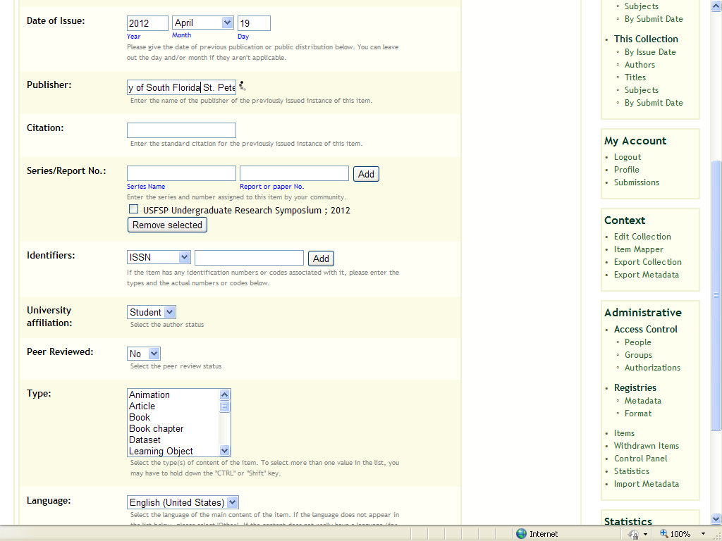
All other information on this screen is already supplied. Do not change any of it.
Scroll to bottom of screen and click on the NEXT button.

Slide 16
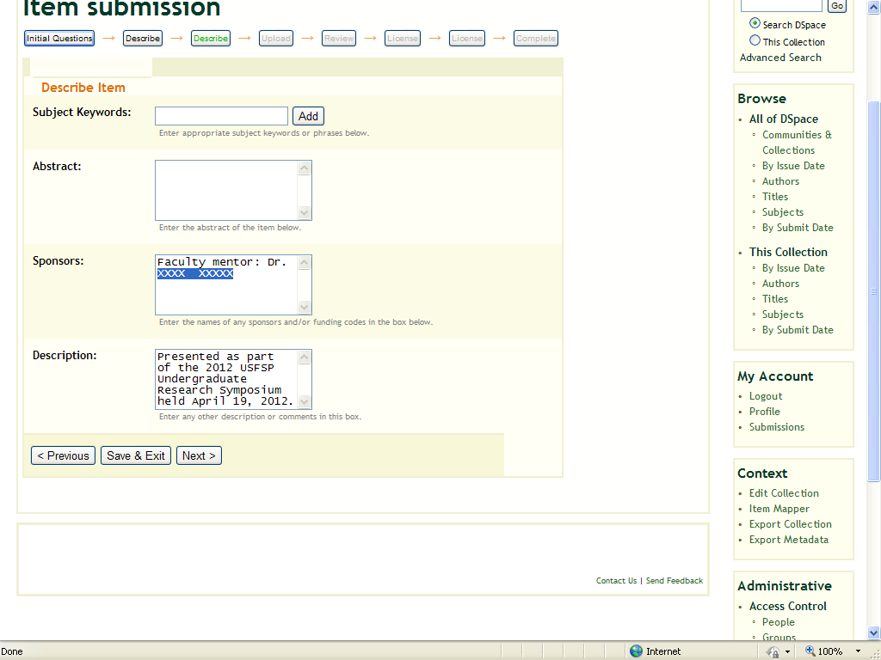
Fill in the name of your faculty sponsor.
Replace the XXXX XXXXX with the name of your faculty sponsor, such as Dr. Thomas Smith.
After supplying the name of your sponsor, click the NEXT button.

Slide 17
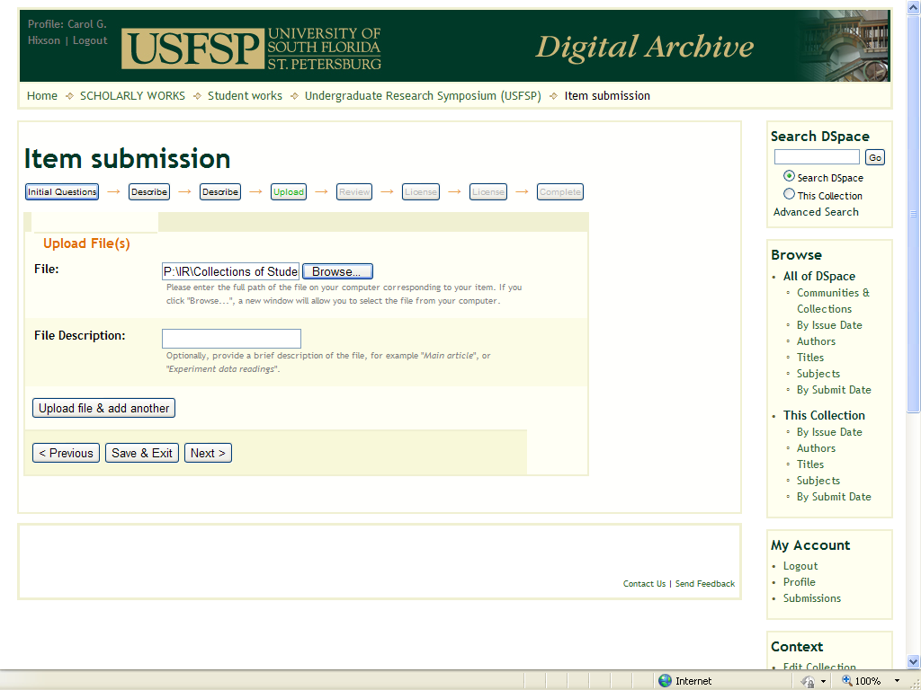
Load in the file(s) from your presentation.
Click BROWSE to find the file on your computer to load.
If you have more than one file to load, click on UPLOAD FILE & ADD ANOTHER. When done loading files, click on the NEXT button.

Slide 18
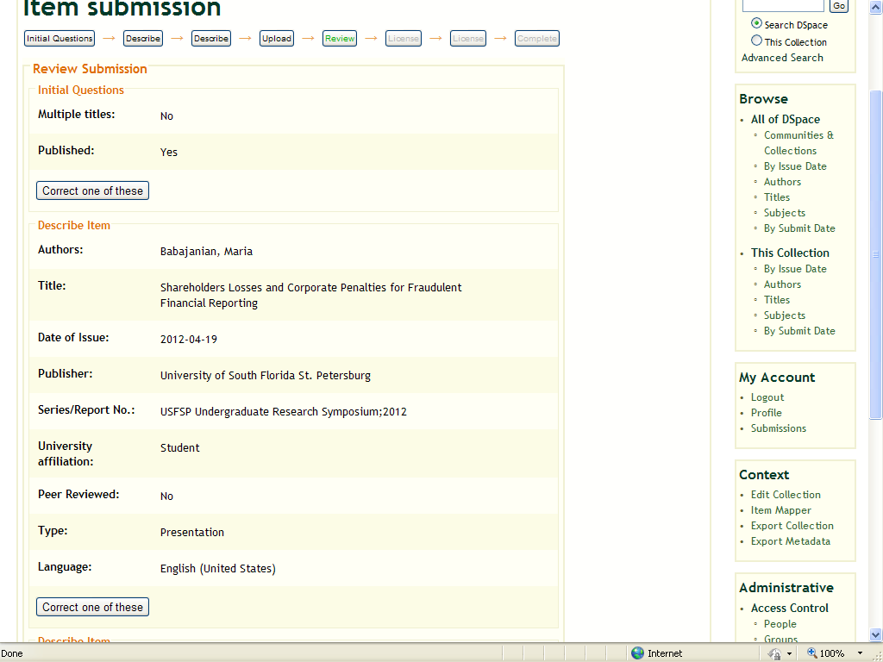
You get a chance to review what you entered by clicking on a button to CORRECT ONE OF THESE.
If no corrections are needed, click on the NEXT button at the bottom of the screen.

Slide 19
Next Step: How To License Your Work through Creative Commons
Creative Commons licenses tell the world how you expect your work to be used
You can choose to allow commercial entities to use your work
You can choose to allow other people to modify and adapt your work
You can choose to allow people only to read it and cite it

Slide 20
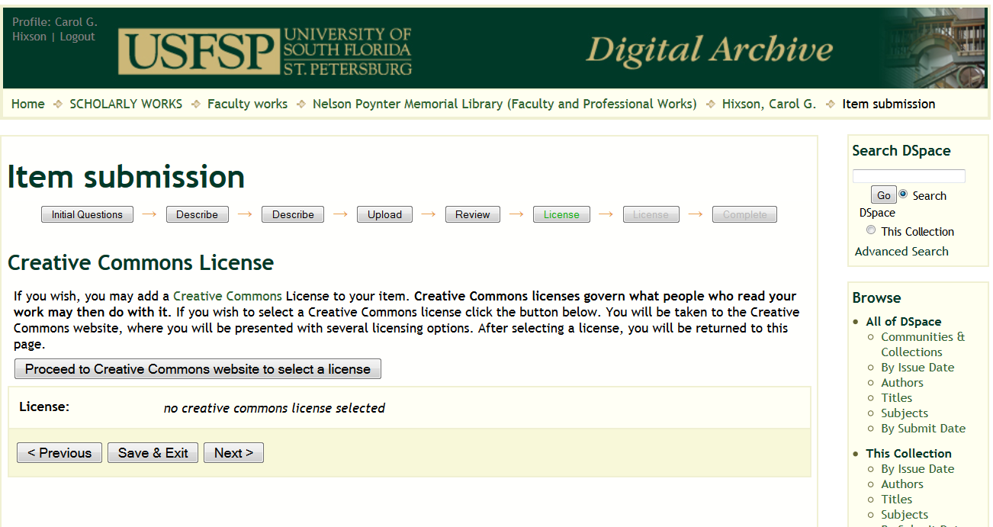
Click on “Proceed to Creative Commons website” or Skip this Step by Clicking “Next”

Slide 21
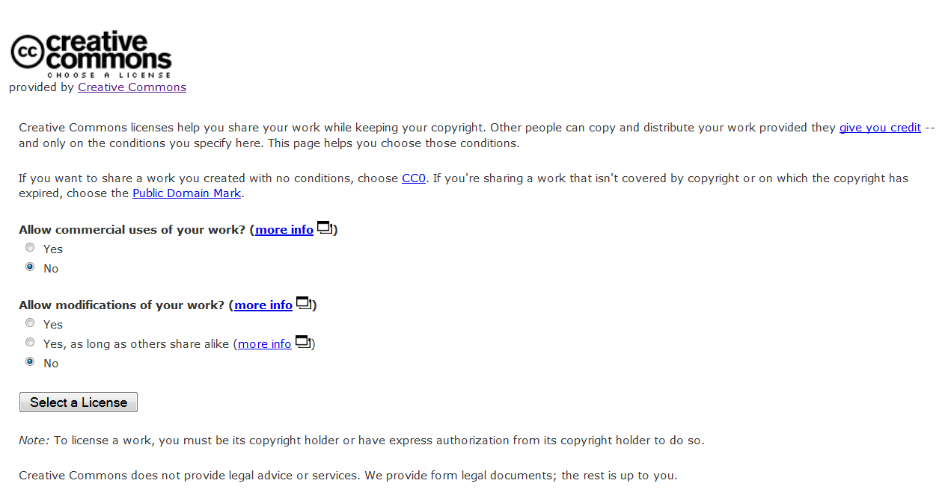
Choose the Type of License You Want – Choosing “No” to Both is Common
Click “Select a License” when ready

Slide 22
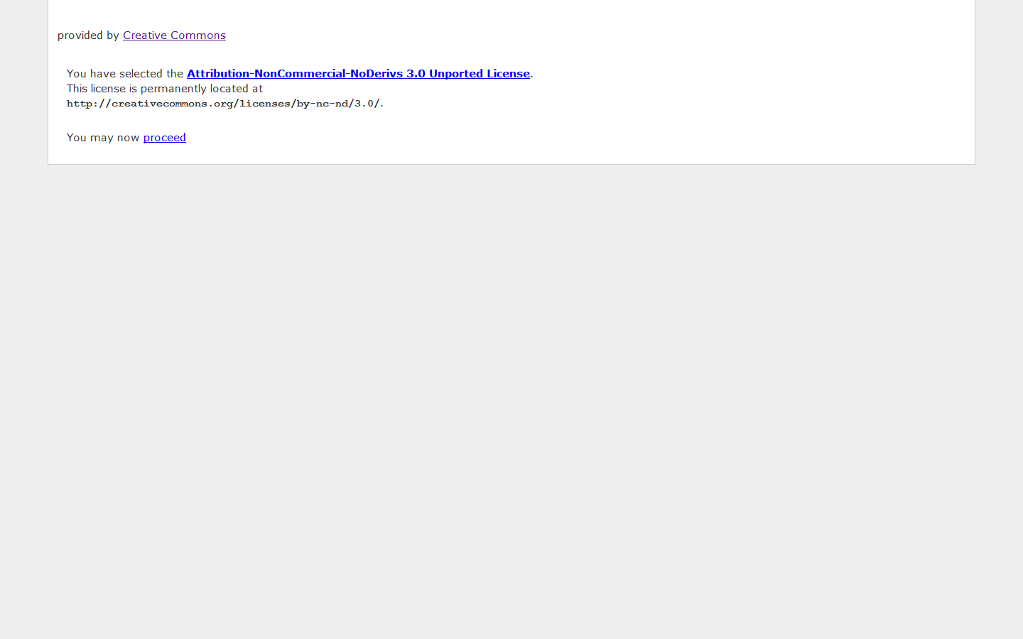
Click “Proceed” to Return to Submission

Slide 23
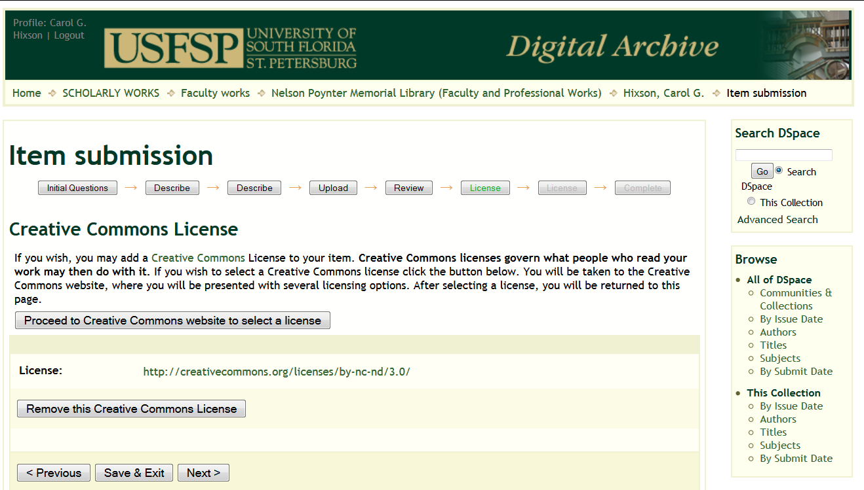
You Return to the Submission -
Click “Next” to Continue

Slide 24
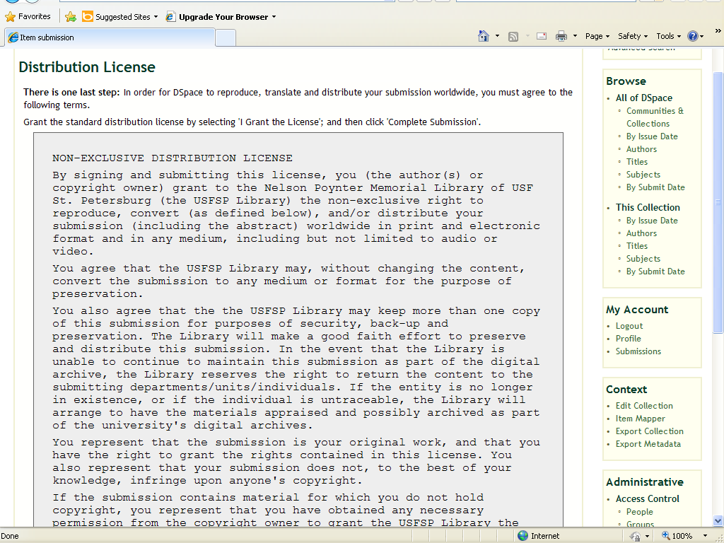
The Distribution License allows the library to preserve your files. You retain all other rights.
You as the author or creator of the presentation retain copyright over your work.

Slide 25
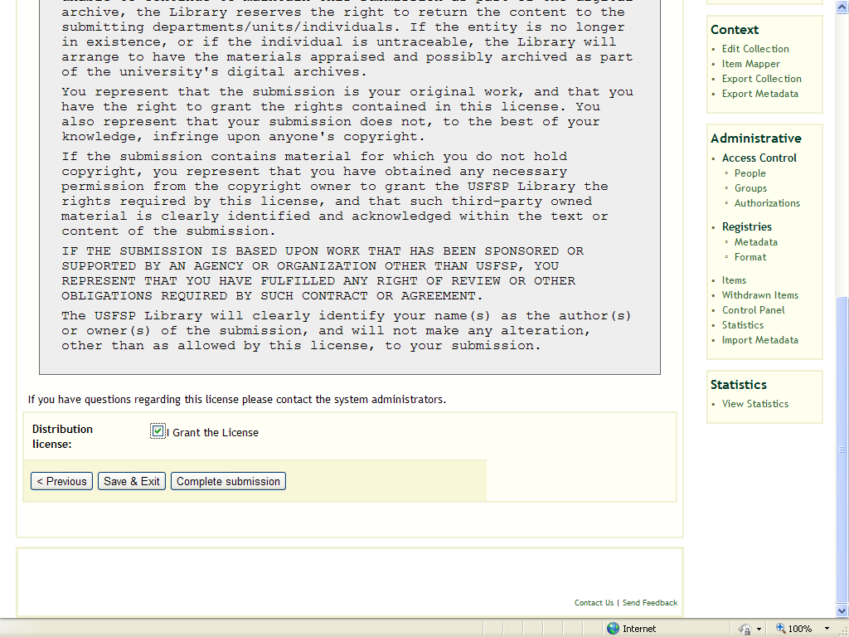
To proceed, you must agree to the license.
Put a check in the box next to I GRANT THE LICENSE and click on the COMPLETE SUBMISSION button.

Slide 26
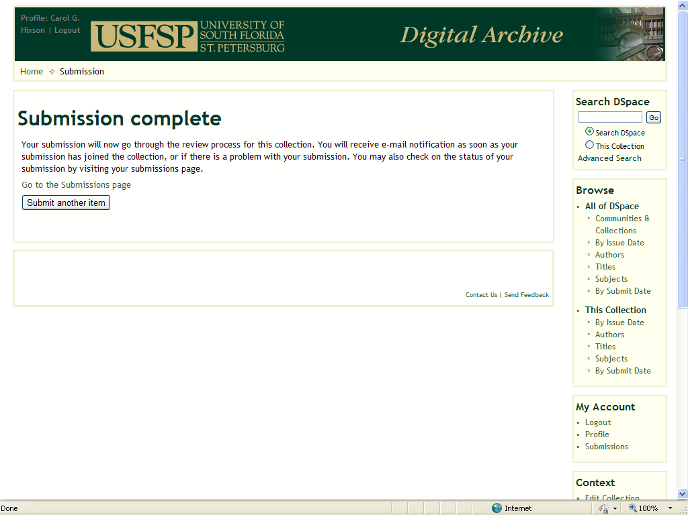
When done, you will see this screen.
Your presentation is now waiting for final approval before it becomes available to the public. The review will normally take from 1 to 24 hours.

Slide 27
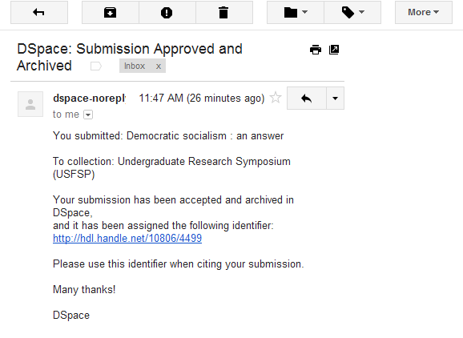
When your presentation has been added to the public archive, you will receive an email notification.
If you click on the link in the email, you will be able to see your presentation. This unique and unchanging URL will be what you use to cite and link to your research from this day forward.

Slide 28
Questions?
Contact
digcol@nelson.usf.edu
or
hixson@usfsp.edu

