Slide 1
Outside the Academy:
Academic Library Partnerships with Community Organizations
Poster by Claire A. Miller & Carol Hixson
Presented at
Florida Library Association Annual Conference
May 14th, 2015
http://dspace.nelson.usf.edu/xmlui/handle/10806/13669

Slide 2


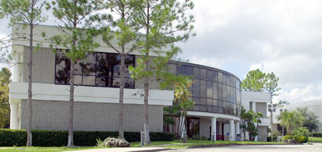
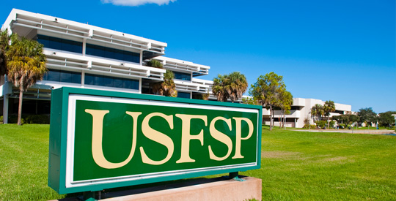
Our Libraries
Library
Serves the SFSC students, staff, faculty, and community of Highlands, Hardee, and Desoto counties.
College FTE: 2,280 (2012-2013)
Total Staff: 2 librarians, 2 full-time staff, 2 part-time staff
4 campuses
Serves USFSP students, faculty, staff of USFSP and the surrounding community in Pinellas County
University FTE: 4596 grad & undergrad students (2014-2015)
Total Staff: 9 librarians, 20 full-time staff, including instructional designers for online courses
1 campus

Slide 3
Why Do We Partner?
Promotes instutional values, including community engagement and expanding educational opportunities,
Accomplishes projects neither organization could accomplish alone,
Enriches educational experience for our students,
Raises awareness of college/university and library in the community,
Builds relationships and partnerships that provide professional development and opportunities for growth.

Slide 4
Types of Partnerships
Archival or Research
  Focus on preservation, access, or research for a specific collection or organization.
    SFSC African Art Collection
    St. Petersburg Arts Alliance
    Florida Humanities Council Forum Magazine Archive
Events
  Include collaborative and cross-promoted events inside or outside the library
    National Poetry Month Collaborative Programming with public libraries
    Multicultural Day at the Library
    Average Bureaucrat act-out highlighting new course team-taught by Dali Museum and USFSP
    Margaret Ross Tolbert event in cooperation with MOFAC
    SFSC African Art Reception
Exhibits
  Highlight collections and raise awareness
    MOFAC Exhibit Displays
    SFSC African Art Permeant Exhibit
    “Whoever Saves a Single Life… Rescuers of Jews During the Holocaust.” in partnership with the Florida Holocaust Museum

Slide 5
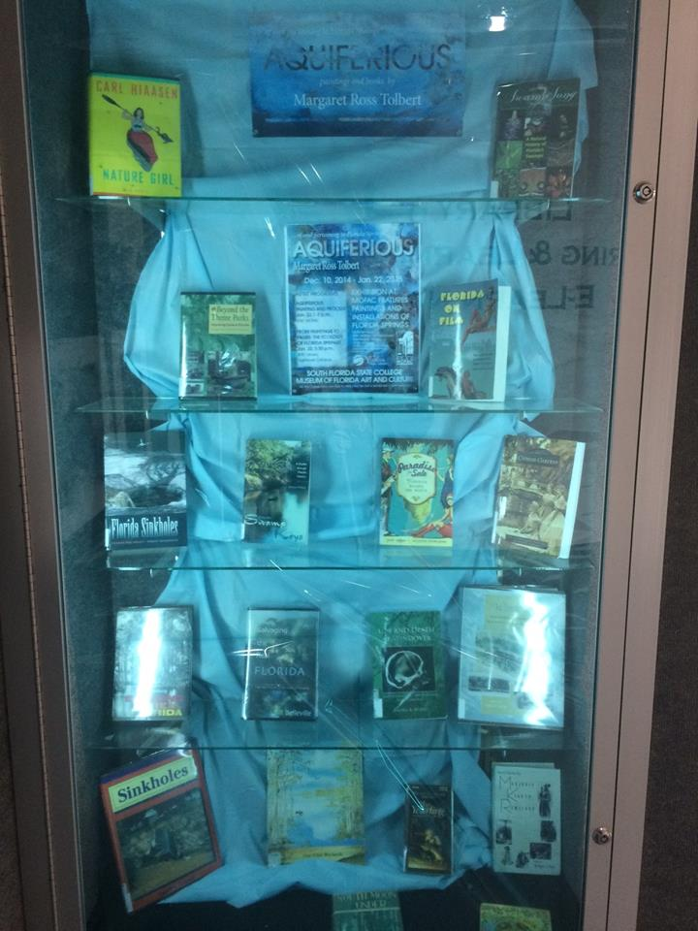
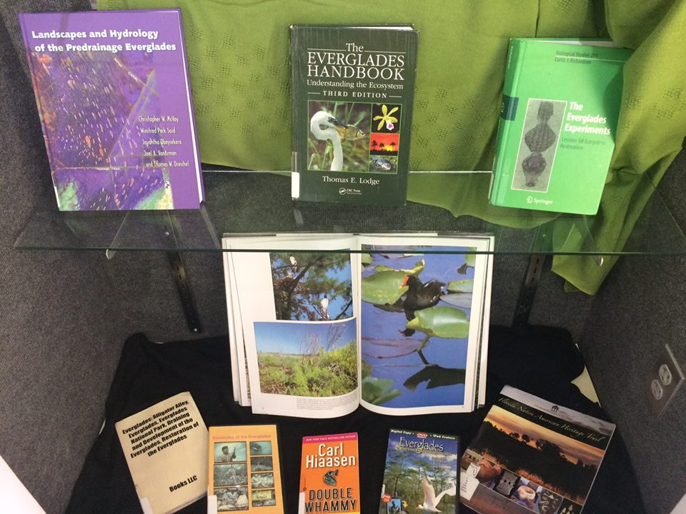
Museum of Florida Art and Culture (MOFAC) and SFSC Library Displays
SFSC Library partnered with the Museum of Florida Art and Culture (MOFAC), a museum housed on the campus of SFSC.
Project: Highlighting exhibits at MOFAC with library displays to raise awareness and promote library materials.
Outcomes:
  Co-marketing each other’s events and services led to some cross-over between our very different service populations.
  Led to other collaborations.

Slide 6
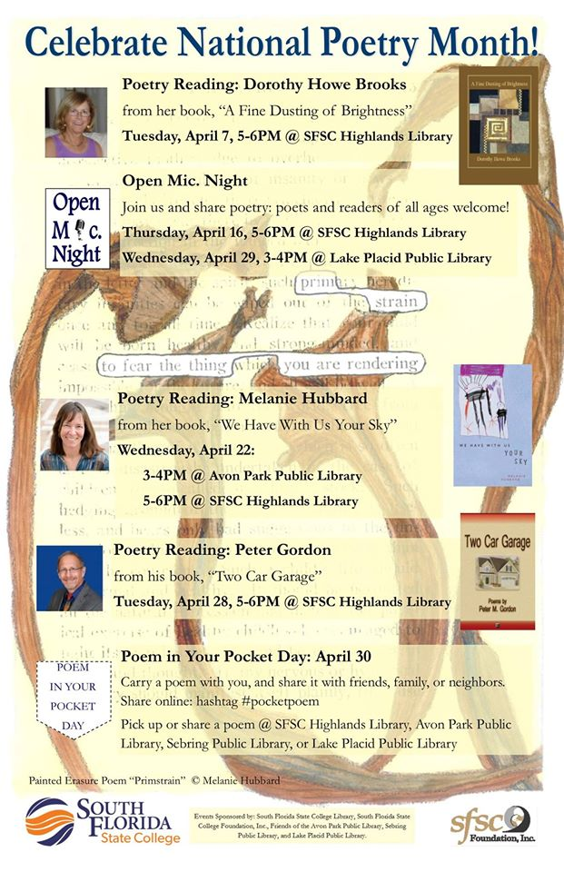
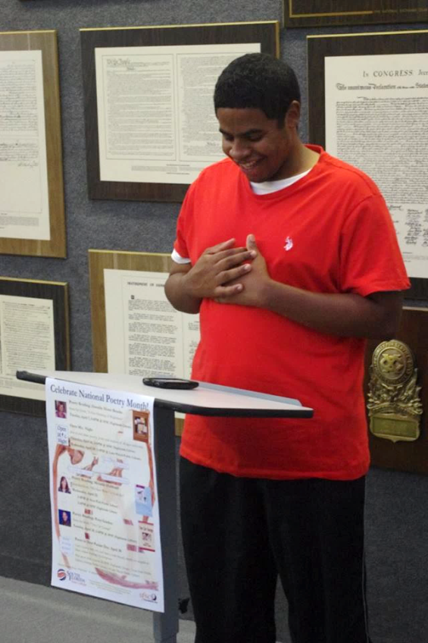
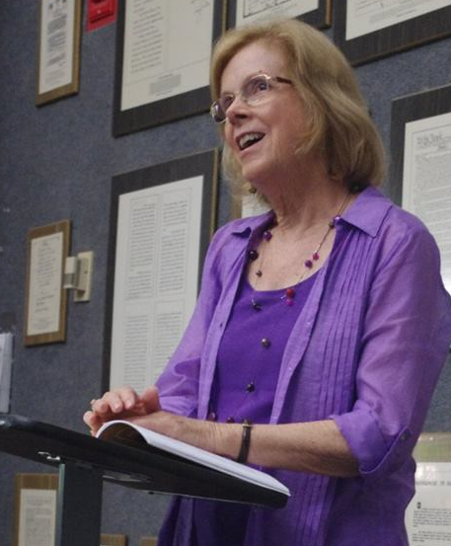
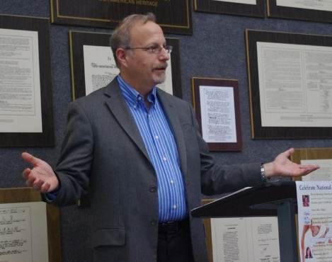
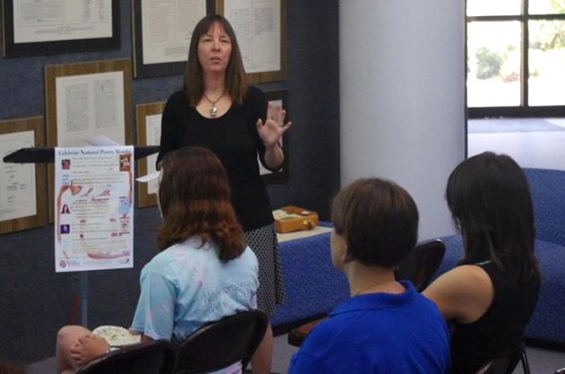
National Poetry Month Events
SFSC Library partnered with Avon Park, Sebring, and Lake Placid Public Libraries
Project: Cooperative events and promotion in celebration of National Poetry Month
Outcomes: Events at SFSC and Lake Placid Public Library (5 events, 47 total attendees). Libraries gave away a total of 336 poems

Slide 7
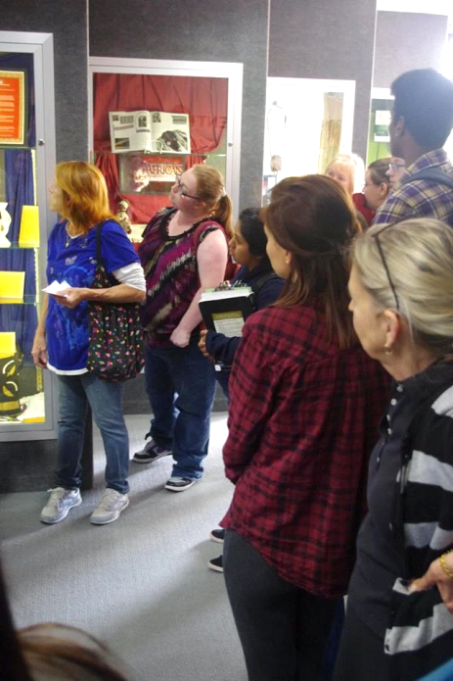
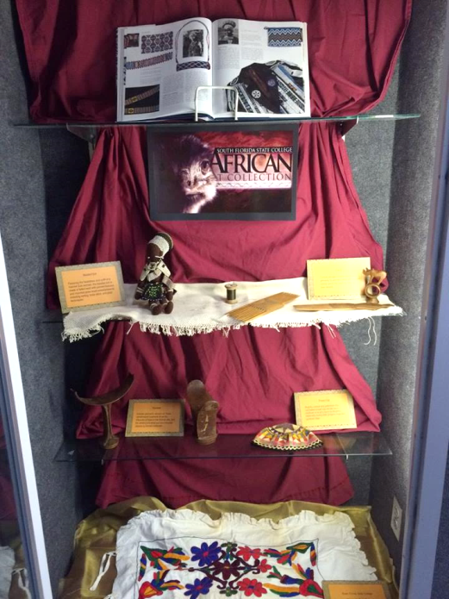
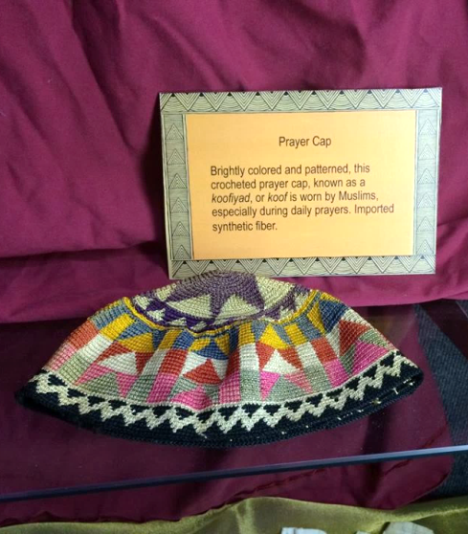
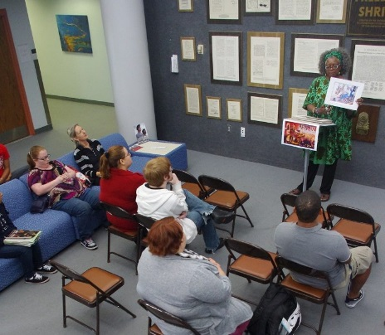
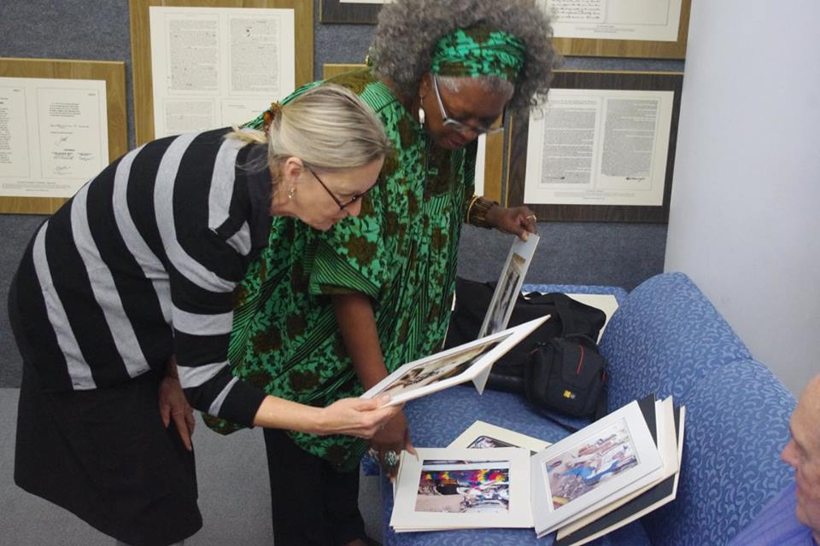
SFSC African Art Collection Exhibit
SFSC Library partnered with MOFAC to research and display SFSC African Art Collection, donated by an alumnae of SFSC.
Project: Developed student learning project to conduct oral history interviews with the collector, and research on the art. Partnered with MOFAC to develop signage and display materials.
Outcomes: 1st public display of the collection, exhibit reception featuring speaker on African Art (22 attendees), and interest from community in exhibit.

Slide 8
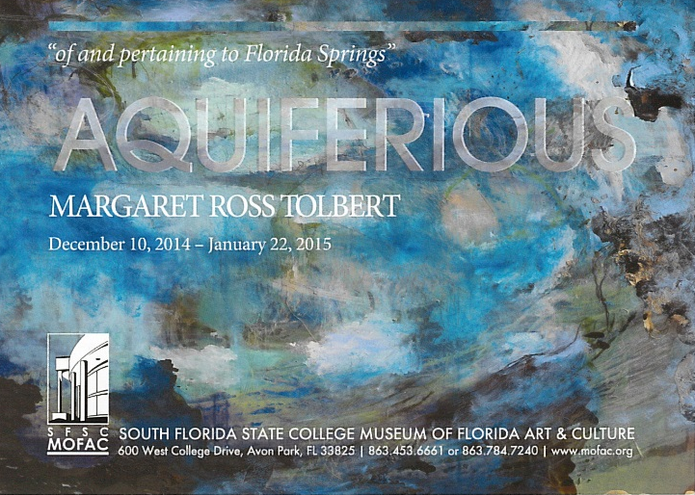
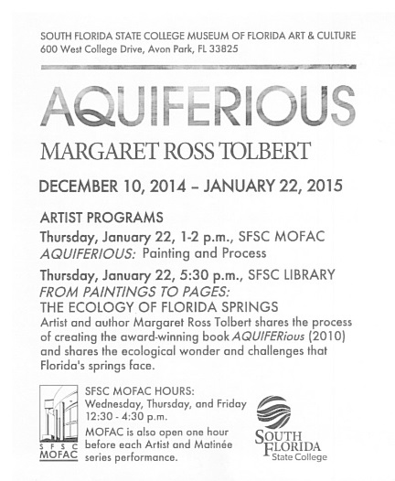
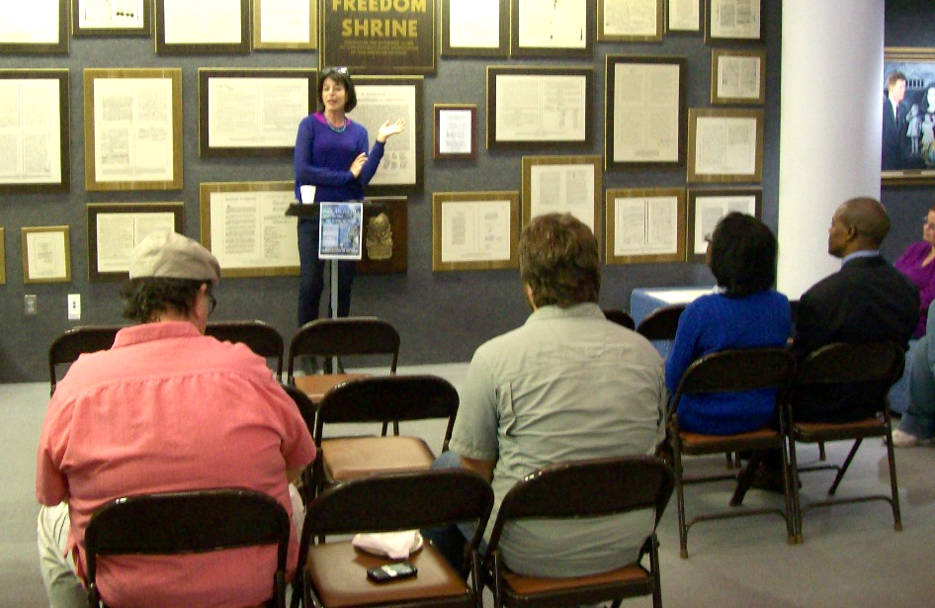
“Margaret Ross Tolbert:
From Paintings to Pages” Event
SFSC Library partnered with the South Florida State College Museum of Florida Art and Culture, a museum housed on SFSC Highlands Campus.
Project: Collaborative artist events to promote library collections and raised awareness of exhibit.
Outcomes: Shared expenses with museum to offer inexpensive program. Event attendance: 12.

Slide 9
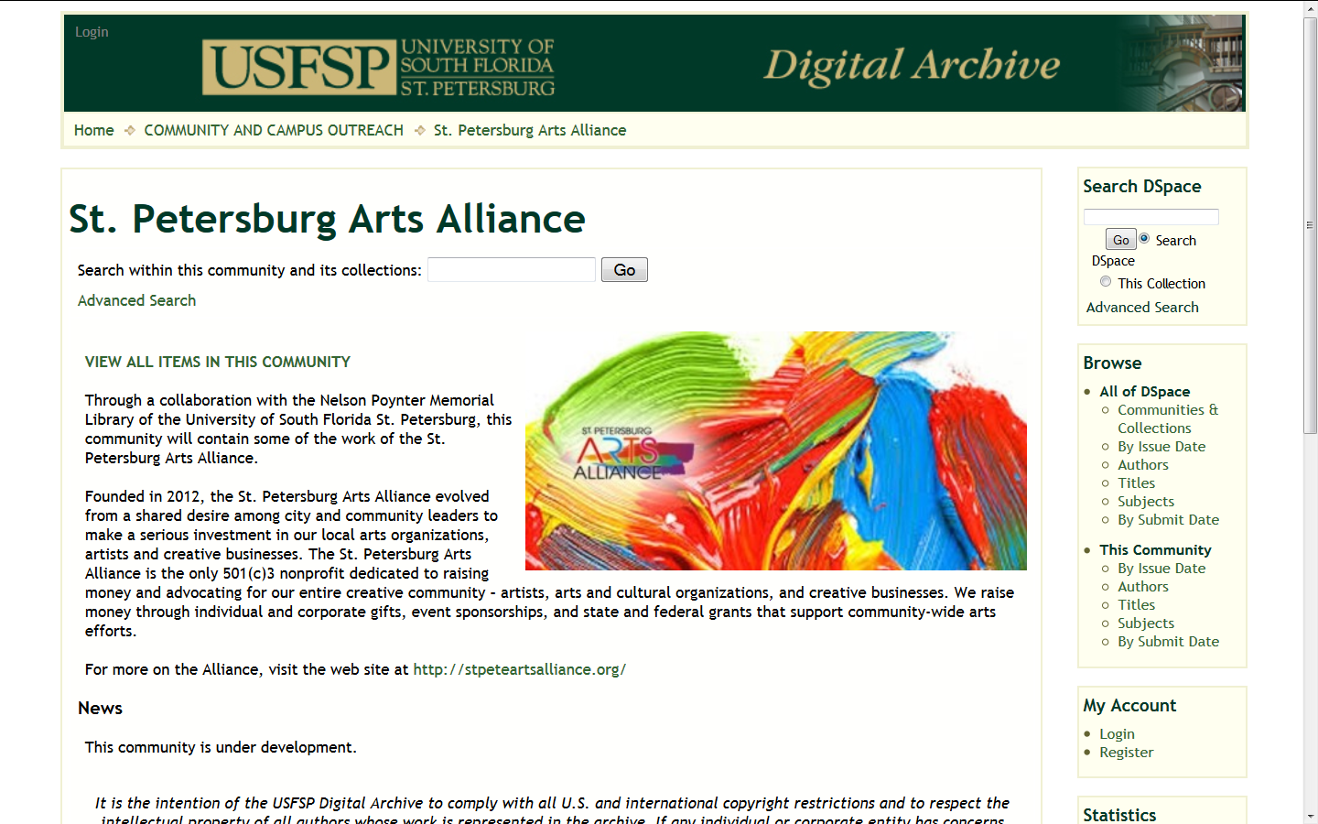
St. Petersburg Arts Alliance Archive
USFSP Library partnered with the St. Petersburg Arts Alliance, a 501(3)c organization that raises money through individual and corporate gifts, event sponsorships, and state and federal grants that support community-wide arts efforts.
Project: Harvesting their newsletters and other public announcements and depositing them in the USFSP Digital Archive.
Outcomes: Provides a permanent home for their materials and generates good will between the University and the local arts community.

Slide 10
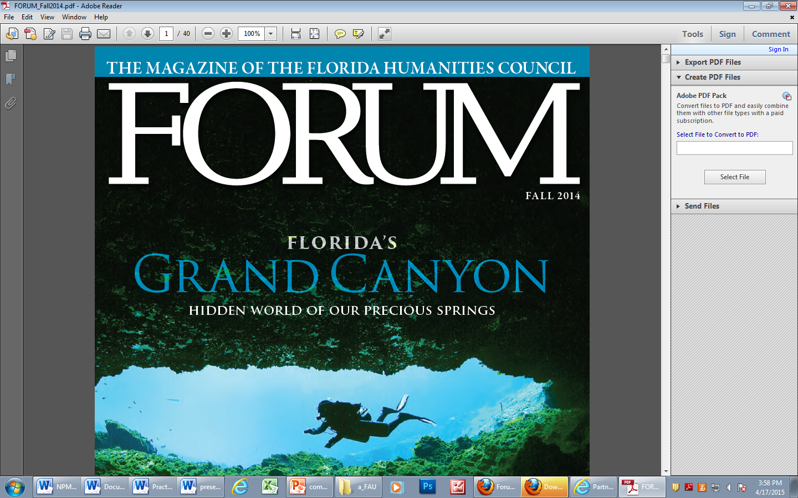
Florida Humanities Council
Forum Archive
USFSP Library partnered with the Florida Humanities Council, the state affiliate of the National Endowment for the Humanities, that provides grants to non-profit organizations and also designs and coordinates workshops for K-12 teachers, conducts heritage tours, operates a humanities speakers bureau, and partners with libraries to provide family literacy programs and cultural exhibits.
Project: We publish the electronic archive of the Council’s quarterly publication, Forum.
Outcomes: Provides a permanent home for their materials, increases awareness of their work, and generates good will between the University and the Florida Humanities Council. The journal has been viewed thousands of times from around the world through the USFSP Digital Archive.

Slide 11
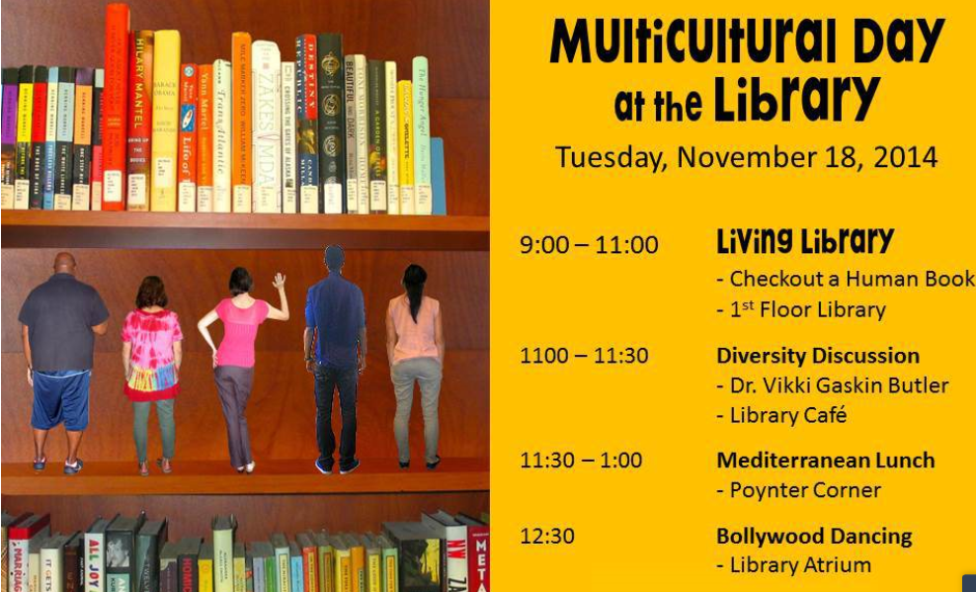
“Multicultural Day at the Library” Event
USFSP Library partnered with local churches, arts organizations and city government.
Project: Created a Living Library for two hours with individuals representing different backgrounds and experiences available for “check-out” to students for 20 minutes at a time.
Outcomes: Increased awareness of diversity and built connections between students and people from different walks of life in the community.

Slide 12
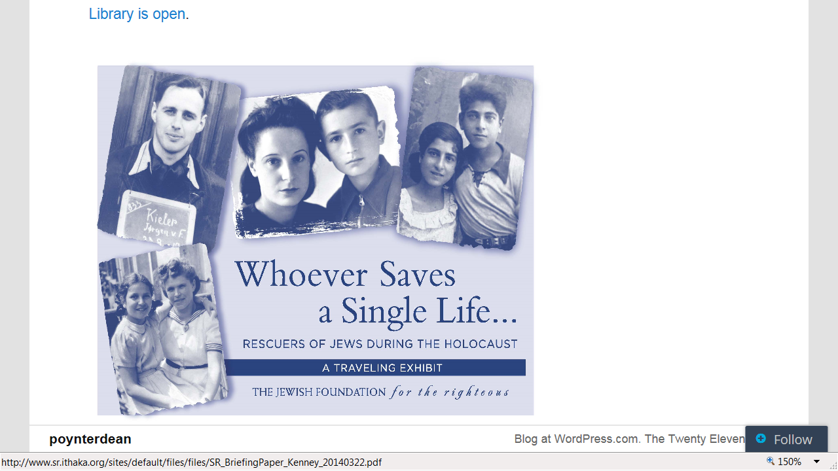
“Whoever Saves a Single Life… Rescuers of Jews During the Holocaust” Exhibit
USFSP Library partnered with the Florida Holocaust Museum, dedicated to teaching the members of all races and cultures the inherent worth and dignity of human life in order to prevent future genocides.
Project: Hosted the traveling exhibit, “Whoever Saves a Single Life… Rescuers of Jews During the Holocaust,” in the first-floor atrium of the Library from March 28 through April 24, 2014.
Outcomes: Provided an educational opportunity for our students, promoted tolerance, and drew in members of the local community.

Slide 13
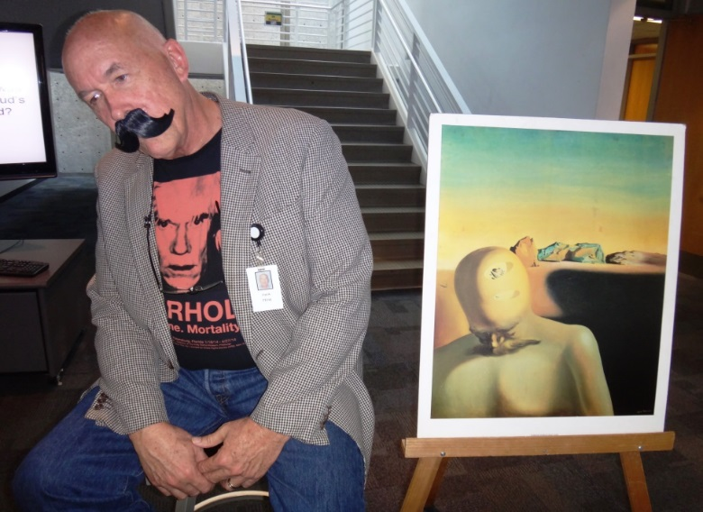
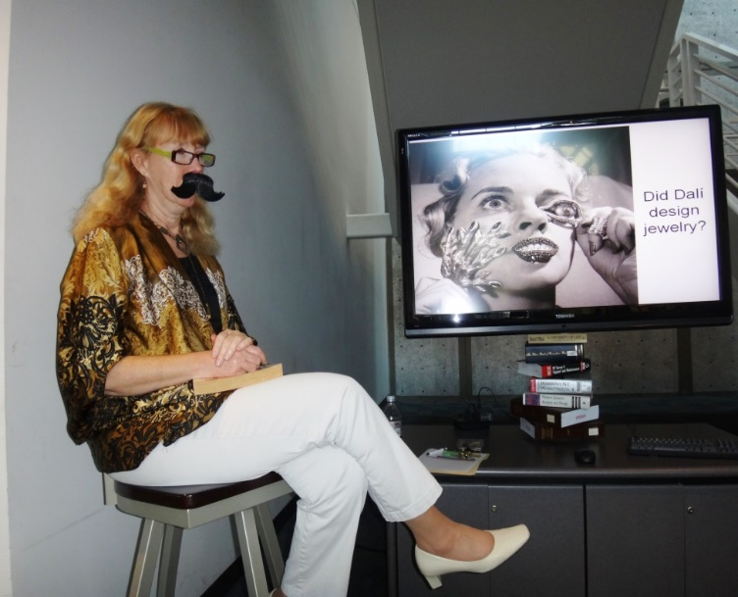
Average Bureaucrat Act-Out
Event
USFSP Library partnered with the Dali Museum.
Project: Members of the Dali Museum staff, the Library Dean, and the Dean of Arts & Sciences acted out the Dali Painting The Average Bureaucrat .
Outcomes: Advertised a new course being team-taught between USFSP and the Museum, increased student awareness of a nearby museum, and strengthened a long-term partnership between the Museum and the University.

Slide 14
Building Collaborations:
Process
Finding prospective partners
  Look around for organizations that are doing work that supports, expands, or serves a need for your campus. There are no shortage of possible partners! Consider:
    What the organization could bring to the table;
    What their current initiatives and priorities are;
    What links they have to your institution.
Deciding HOW to partner
  What are they doing that you want to support?
  Does a campus initiative fit with their mission?
  Do they have an unmet need that you can help with?
Making an offer
  Start with something small and specific: a program, a small project, or a cooperative event.
  Outline the benefits for both organizations and be realistic about the effort needed.
Developing programs, projects, or events
  Stay in contact and be persistent
  Have a point person for your partnership, but make sure other people know what is going on as well.
  Support each other’s efforts, even if things don’t go according to plan.
  Talk frequently about your successes and opportunities for change.

Slide 15
Building Collaborations:
Pitfalls and Concerns
Time Sinks
  Problems:
    Collaborating takes more time than doing it alone.
    Different organizations have different workflows, staffing, or budgets for projects.
    It is hard to estimate how long it will take.
  Ways to mitigate:
    Assume it will take more time than you think.
    Pad your timeline and talk candidly with your partners about how you will deal with delays.
    Start with a small, discrete project to get a feel for how long a larger project will take.
Mission Creep
  Problems:
    Forming partnerships is exciting, and it is easy to brainstorm your way into a bigger commitment than you planned.
  Ways to mitigate:
    Start small, and don’t promise more than you are CERTAIN you can deliver. If your small project works, you can expand your partnership further.
Attendance
  Problems:
    Sometimes, no one comes.
  Ways to mitigate:
    Tie your projects into classes, groups, or activities already happening on campus.
    Make sure your promotion is top notch, and try to offer times that work with a variety of schedules.
    Sometimes, the event is not a good fit for your community. Move on, and try something different next time.
“Everything takes more time than I thought it would!"
“Wait, what did I just agree to?”
“Well, no one came. Now what?”

