Slide 1
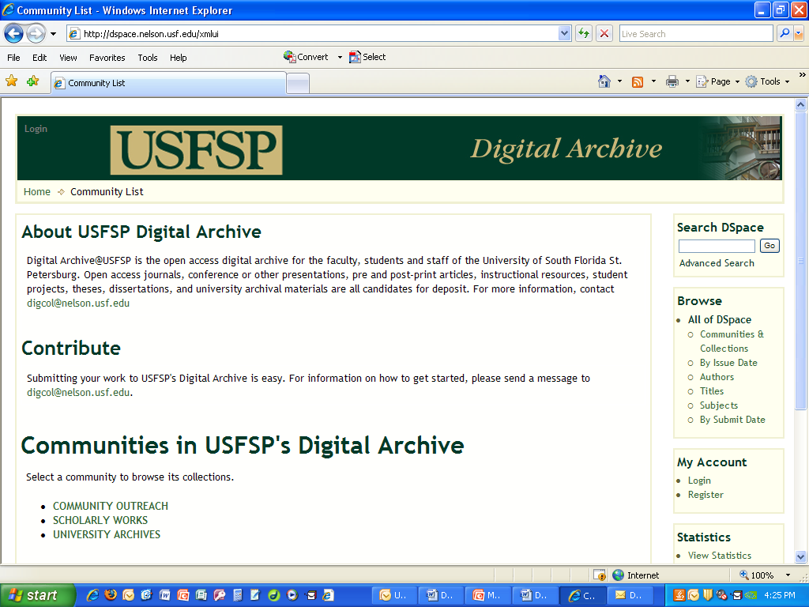
A Digital Archive for USFSP and YOU
Carol Hixson
Dean, Nelson Poynter Memorial Library

Slide 2
Presentation to
Faculty Researchers’ Reception
April 20, 2011
Poynter’s Corner
http://dspace.nelson.usf.edu/xmlui/handle/10806/202

Slide 3
Role of libraries
Acquire useful information
Organize materials for ease of use
Facilitate discovery of information
Preserve and provide access to information
Instruct in discovery and proper use

Slide 4
Poynter Library
Supports USFSP students, faculty, researchers in all aspects of research and study
Builds, organizes, provides access to, and preserves collections of information
Maintains University’s archives
Provides academic technology support (AV, distance learning, etc.)
Supports community in effective use of information and academic technologies
Keeps abreast of new technology to enhance services

Slide 5
Mission of a university digital archive
Capture and preserve in digital form the intellectual output of the university community
  Not just for formal publications
  Not just for faculty
  Open or restricted access to materials, depending on nature and intended use
Provide services for the management and dissemination of digital materials

Slide 6
Why establish a digital archive?
Highlight individual and institutional achievement
Increase institutional visibility
Improve access to and discoverability of materials
Preserve materials
Facilitate changes in scholarly communication
Increase collaboration

Slide 7
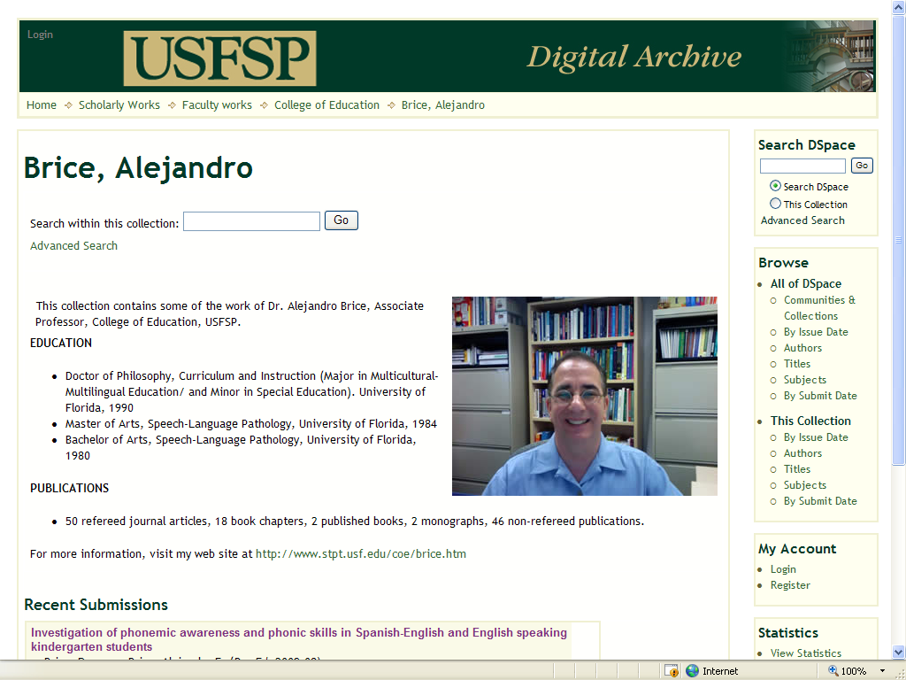
Highlight individual achievement

Slide 8
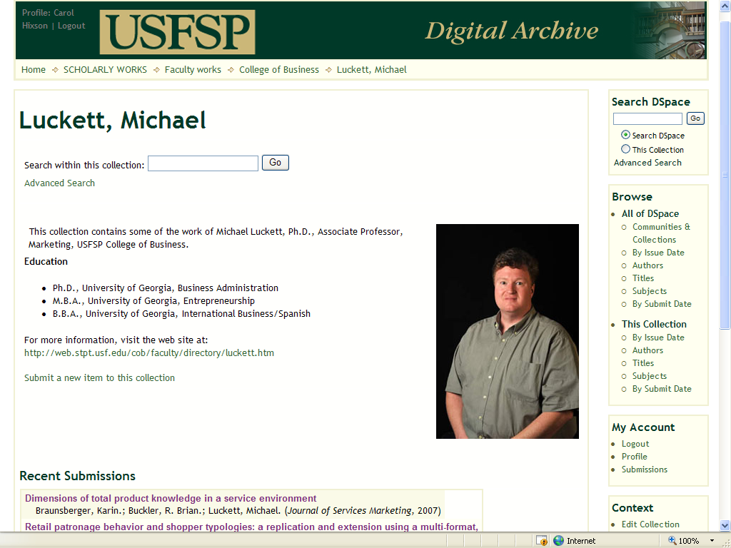
Highlight individual achievement

Slide 9
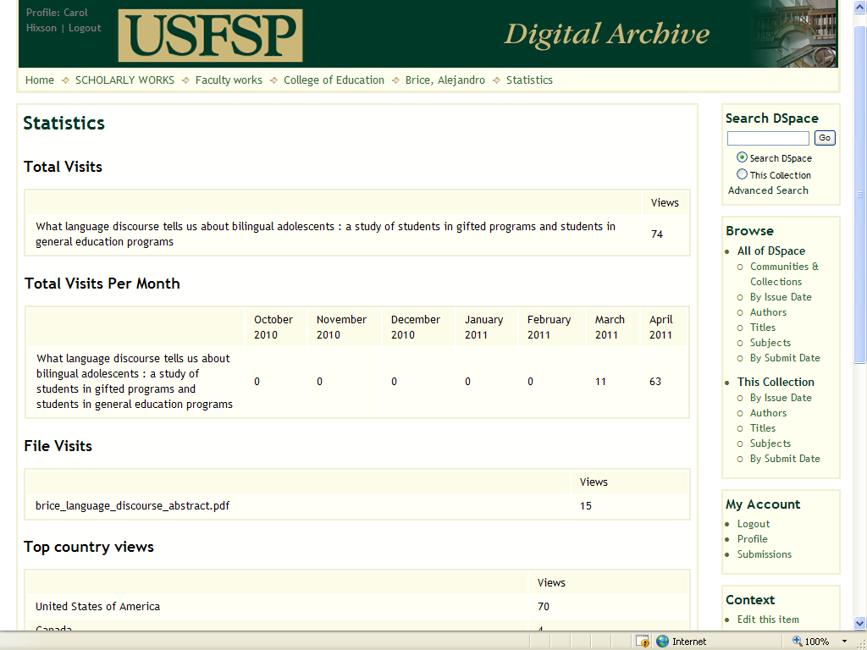
Highlight individual achievement: use statistics

Slide 10
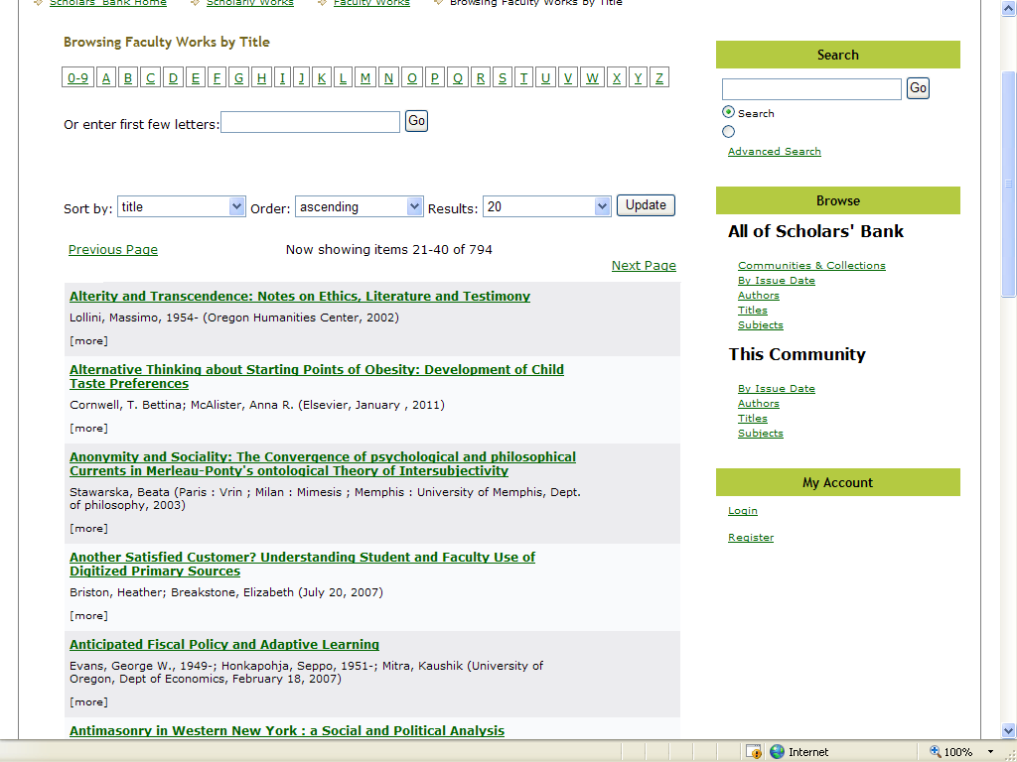
Highlight institutional achievement: all faculty works
(example from U. of Oregon)

Slide 11
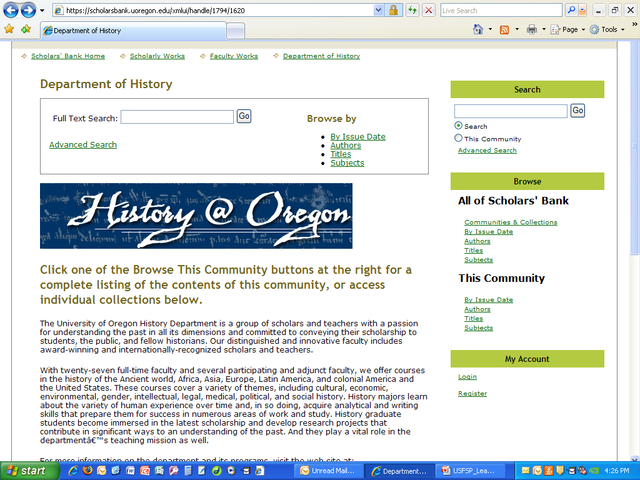
Highlight institutional achievement: departmental works
(example from U. of Oregon)

Slide 12
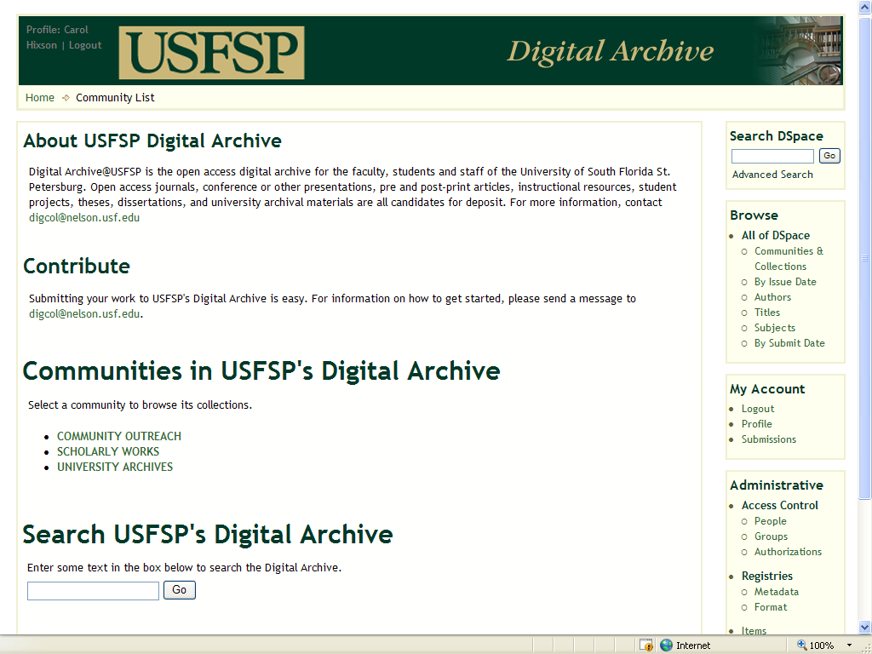
Increase institutional visibility
http://dspace.nelson.usf.edu/xmlui/

Slide 13
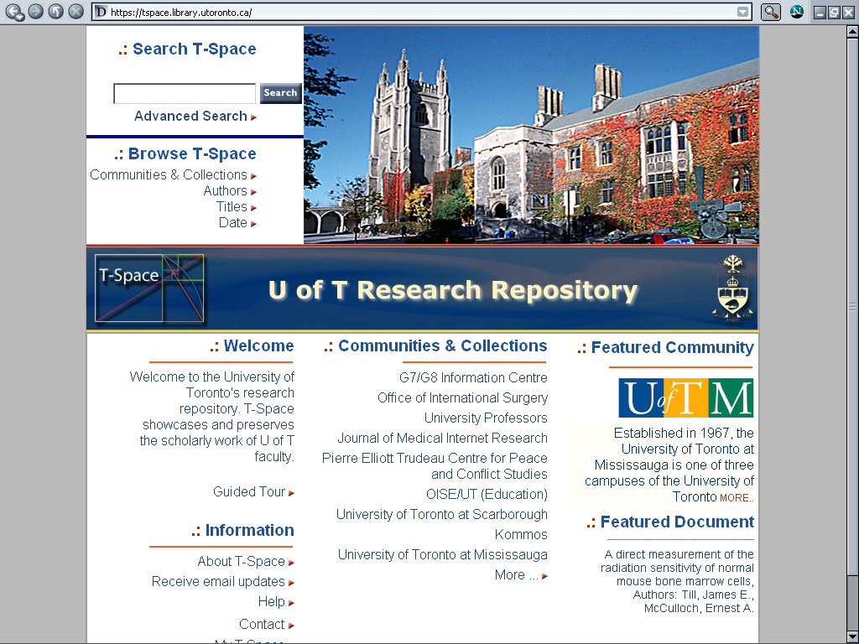
Increase institutional visibility
(example from U. of Toronto)

Slide 14
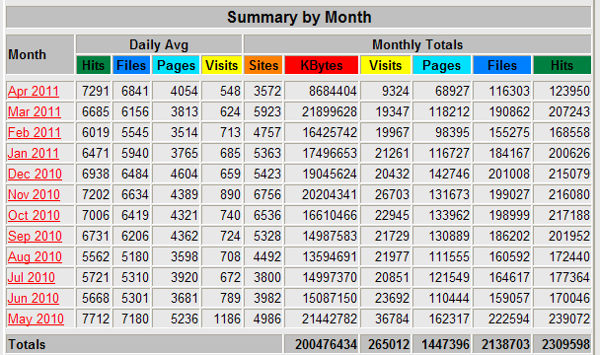
Increase institutional visibility: server statistics (example from U of Regina)

Slide 15
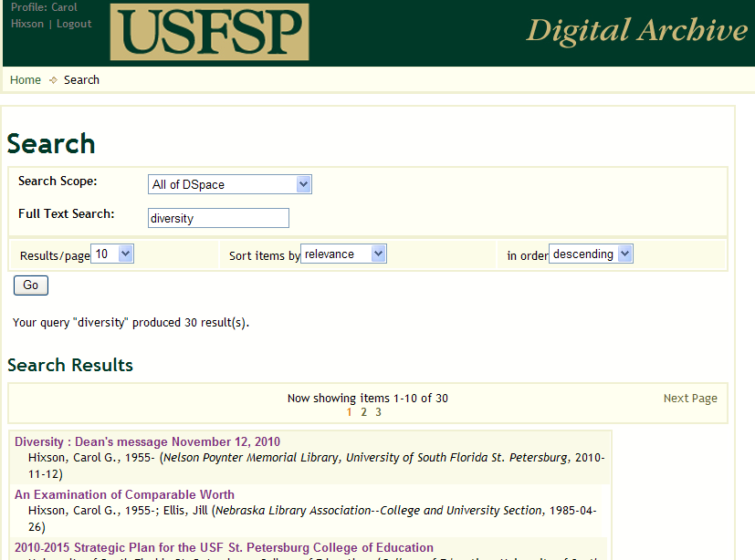
Improve access: full-text searching

Slide 16
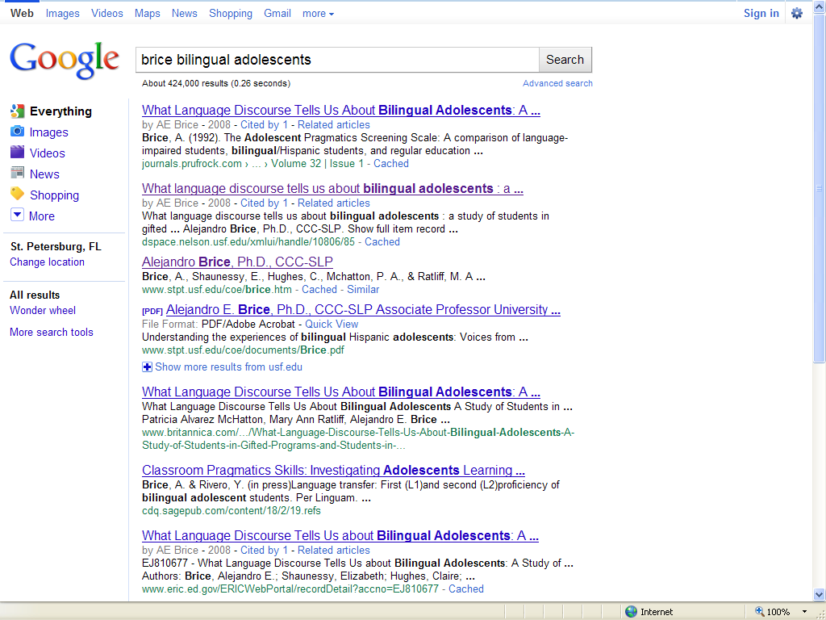
Increase exposure:
Google indexing

Slide 17
Digital preservation
Ensuring the long-term maintenance of a bitstream (the zeros and ones):
  Backing up files and keeping a copy at an offsite location
  Running checks to track the deterioration of storage media, files or bitstreams
  Providing continued accessibility of the contents

Slide 18
Why here and now?
Growing amount of digital content that needs a safe, reliable and easy-to-use home
Need to be able to locate and reference content quickly and accurately
Strengthen our USFSP identity and promote our programs and services
Meet demands of accrediting bodies and funding agencies for ready access to data and information

Slide 19
Library expertise
Dean Carol Hixson - set up institutional archives twice before (University of Oregon and University of Regina)
Tina Neville – Public Services
Jim Schnur – Special Collections and University Archives
Berrie Watson – Systems and Digital Technology

Slide 20
Faculty Advisory Committee for USFSP Digital Archive
Mark Walters, College of Arts and Sciences
Michael Luckett, College of Business
Alejandro Brice, College of Education

Slide 21
Types of possible collections
Works of individual faculty or students
Group collections from a College, program, or department
Administrative documents
Informational materials about the University and its programs
Archival materials or records
Primary resources for research or study

Slide 22
Copyright, permission, and access
Do authors have the right to post published materials in an institutional digital archive?
Usually yes, with some restrictions

Slide 23
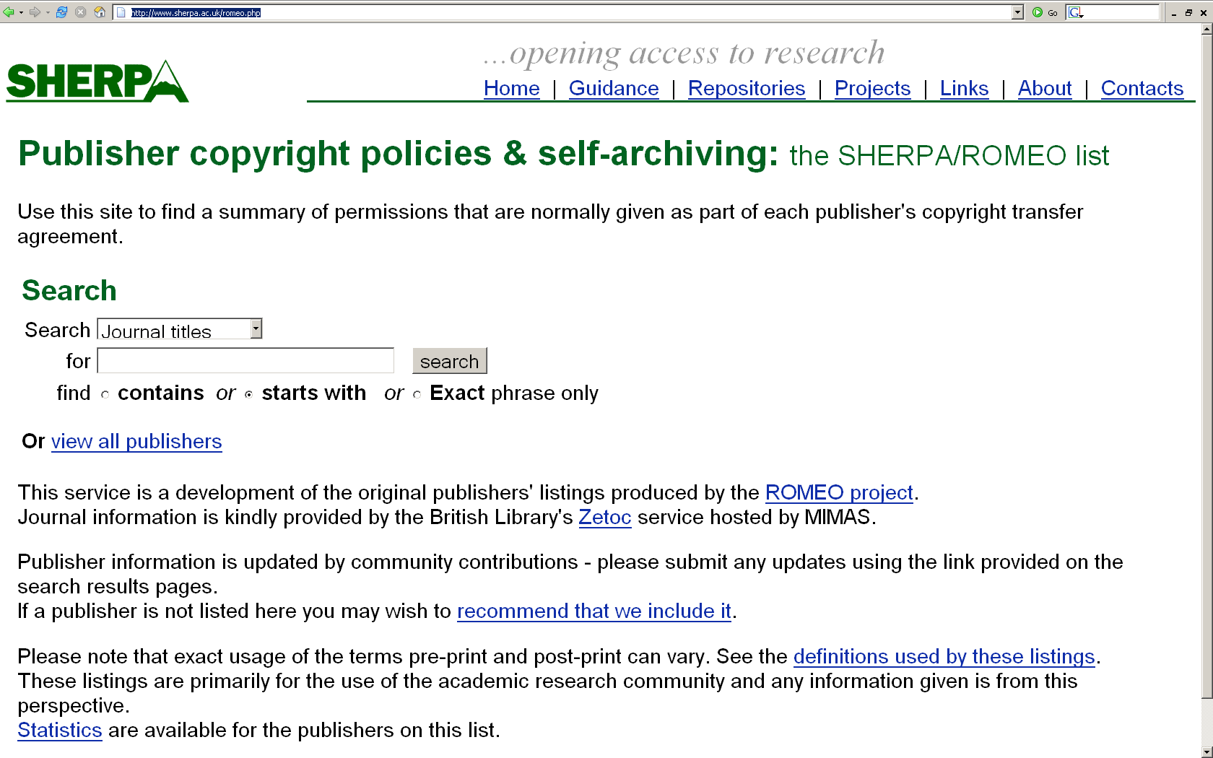
http://www.sherpa.ac.uk/romeo.php

Slide 24
Copyright, permission, and access
Will putting the work in the archive affect later publication or pending patents?
Embargoes of content (restricted access for a period of time) protect authors if there’s any question

Slide 25
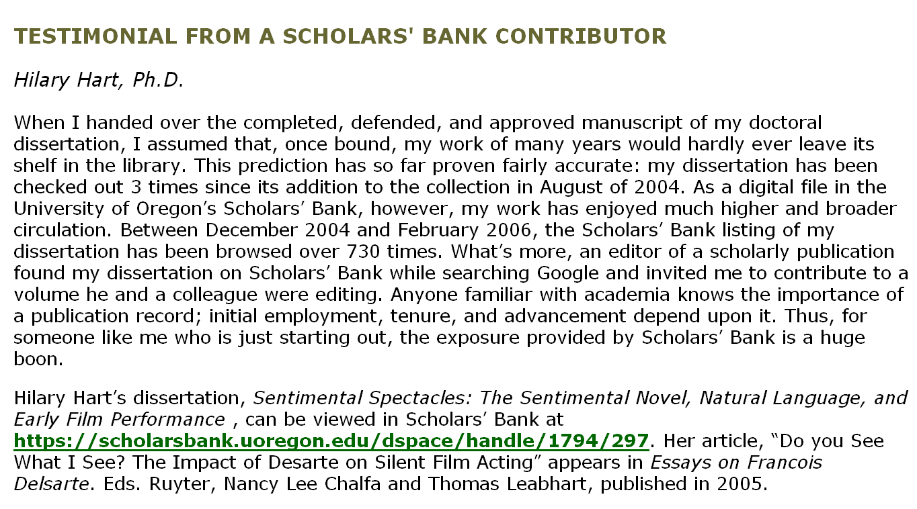
Later publication

Slide 26
Copyright, permission, and access
Are authors turning over copyright to the archive ?
No. Authors retain copyright and can use their content any way they want to in the future, as long as they have not given away their copyright to a third party vendor or publisher.

Slide 27
Copyright, permission, and access
Who gets to use content in the archive?
Anyone in the world, subject to the author’s restrictions.

Slide 28
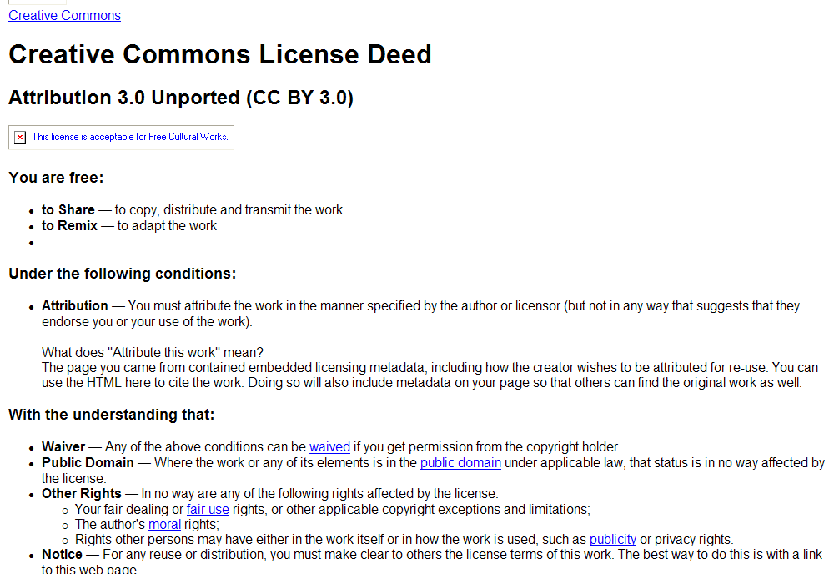
Use of content: Creative Commons Licensing

Slide 29
Copyright, permission, and access
What guarantees are there against plagiarism?
The same ones that exist for paper and other online versions of a work.

Slide 30
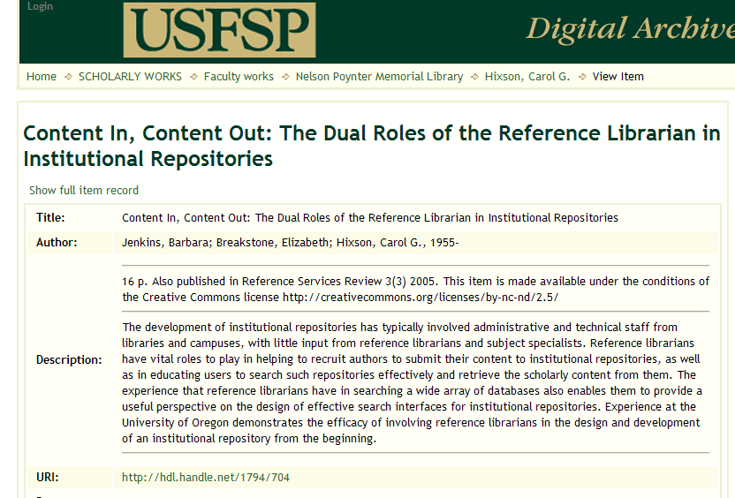
Proper citation

Slide 31
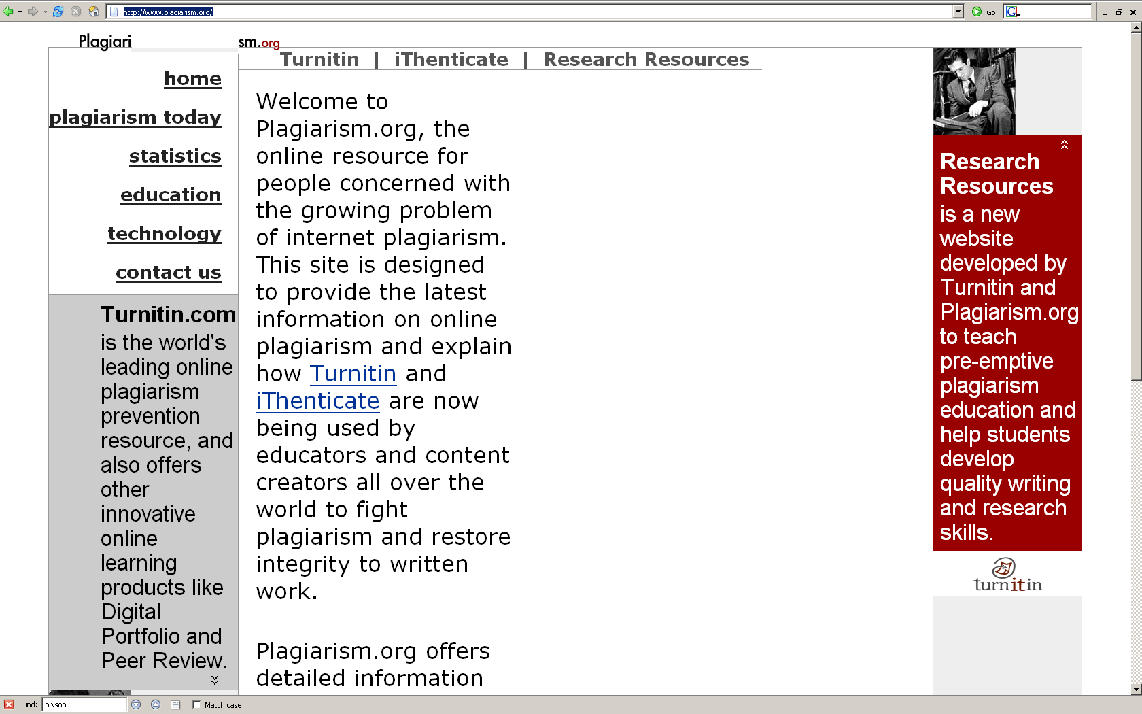
http://www.plagiarism.org/

Slide 32
What’s in it for you?
Preserves your intellectual legacy. You can collect in one place all results of your research, whether it be a conference presentation, working paper, peer-reviewed article, class lecture, book review, data set, or other type of work.
Provides a unique, automatic, and persistent URL for each work that can be cited and linked to forever.

Slide 33
What’s in it for you?
Protects your intellectual property. Items are date and time-stamped, marking them as having been created by you at that time.
You retain copyright unless you have signed or given it away to a third party.
Items can be open or restricted access and can be embargoed for a period of time while you pursue patents or formal publication.

Slide 34
What’s in it for you?
Protects your intellectual property. You can select a Creative Commons License to let the world know how your work may be used or cited.
Journal or conference citations can be put in to link to formal publications or to versions that have been previously made available through other venues.

Slide 35
What’s in it for you?
Increases exposure of your work. Submissions are indexed and available immediately after approval by the collection’s reviewer (usually you)
Full-text indexing is done nightly so that all materials are fully searchable by any word or phrase that occurs in an item.

Slide 36
What’s in it for you?
Increases exposure of your work. Google trolls the archive and adds links so that your work can be found through Google searches.
Statistics on usage of individual items are automatically updated daily.
Items can appear in more than one spot, such as a personal collection and a departmental collection.

Slide 37
What’s in it for you?
Increases your chances of getting grant funding for future research. NIH, NSF, NEH and other funding agencies are requiring or considering requirements that research results and/or data sets be preserved or deposited in archives such as USFSP’s digital archive.

Slide 38
What’s in it for you?
You’re in control. You decide what to archive.
You decide whether your work is open to the world or restricted to a select few.
You can select your own keywords or terms to describe your work.
You can put materials in without any third-party involvement.

Slide 39
What’s in it for you?
Saves you time and money. Every item is archived and preserved at no cost to you or to your home department or College.
You can stop storing documents and files on flash drives, networked drives, or on personal or institutional web space. You will always know where to find your work.
You can access your work anywhere in the world through the Internet.

Slide 40
What the Library will do for you
Help you investigate copyright for your publications
Set up collections according to your guidelines
Set up templates for you to save you time
Assist you with submitting your materials into the archive, if desired
Help you promote your work within and beyond the University

Slide 41
How to get started
Contact Carol Hixson, Dean of Library
  873-4400
  hixson@mail.usf.edu

