Slide 1
Promote and Publish Your Work
A Presentation to the USFSP
Undergraduate Research Symposium
April 11, 2013 http://dspace.nelson.usf.edu/xmlui/handle/10806/6415
Carol Hixson
Dean, Nelson Poynter Memorial Library
and
Alex Brice
Associate Professor, College of Education

Slide 2
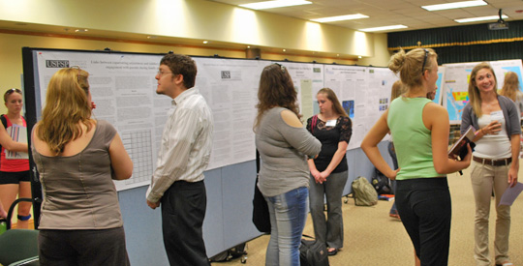
Undergraduate Research Symposium

Slide 3
Undergraduate Research Symposium
The purpose of the Undergraduate Research Symposium is to showcase the innovative research and creative work that USF St. Petersburg undergraduate students have produced during the year under the tutelage and with the support of the university’s faculty

Slide 4
Undergraduate Research Symposium
Student participants may display research, exhibit artwork and graphic design, or perform original musical compositions

Slide 5
Why Promote and Publish
Your Work?
Share the results of your research widely
Get credit for your work
Contribute new knowledge to your field
Build your portfolio for work or graduate school
Get connected with others interested in the same topic
Secure grant funding for more research

Slide 6
How to Promote Your Work
The Undergraduate Research Symposium
  Create poster and discuss
Present at meetings, conferences, or symposia
  With faculty and College support

Slide 7
How to Promote Your Work
Submit work to the USFSP Digital Archive’s collection for the Undergraduate Research Symposium, and/or
Publish in the USFSP Student Research Journal

Slide 8
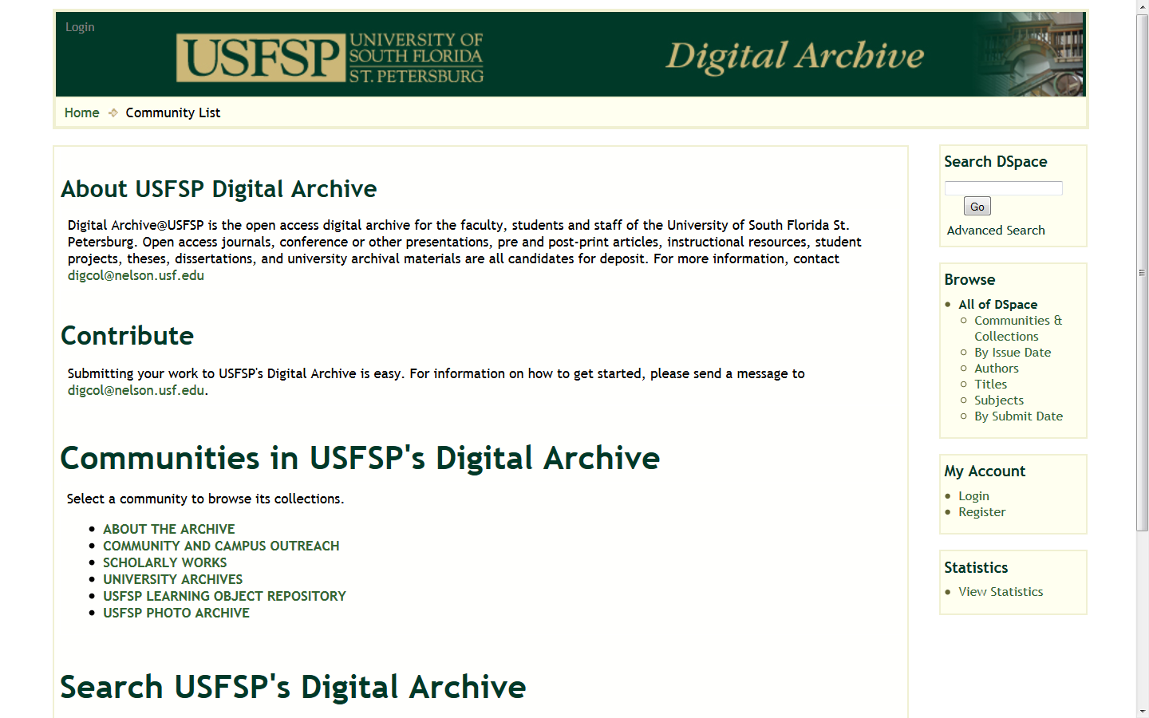
USFSP Digital Archive http://dspace.nelson.usf.edu/

Slide 9
Mission of the USFSP
Digital Archive
Capture and preserve in digital form the intellectual output of the university community
  Not just for formal publications
  Not just for faculty
Make materials widely and freely available
  Over the Internet
Provide services for the management and dissemination of digital materials

Slide 10
What Does the USFSP Digital Archive Do?
Highlights individual, group, and institutional achievement
  Includes use statistics to track impact
Improves access to and discoverability of materials
  Provides unique and unchanging URL
  Full text indexing
  Indexed by Google, Google Scholar, etc.
    Increases visibility of USFSP

Slide 11
What Does the USFSP Digital Archive Do?
Protects intellectual property
  Credits authors and creators
  Provides date and time stamp for all work
  Provides copyright protection
Accepts all types of materials
  Multiple files per item and different file types
Preserves materials

Slide 12
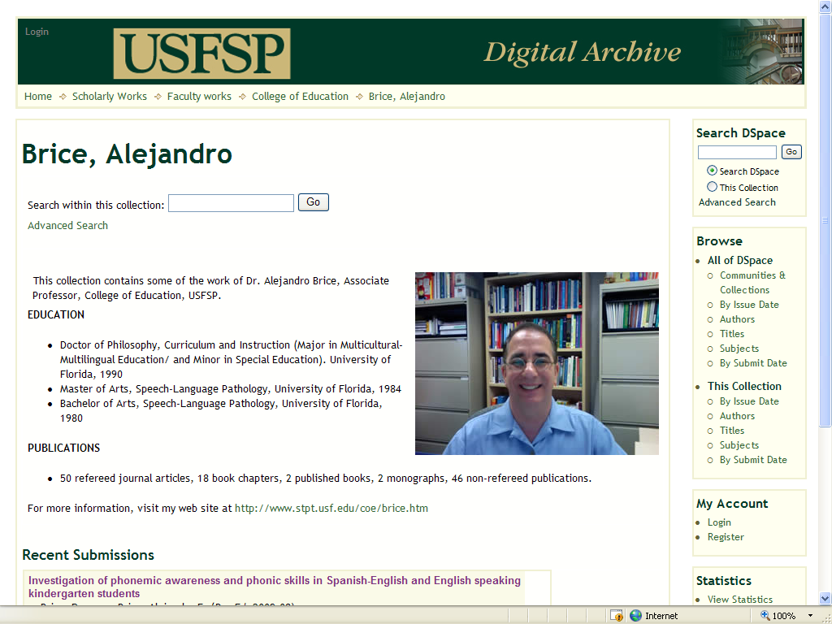
Highlight individual achievement

Slide 13
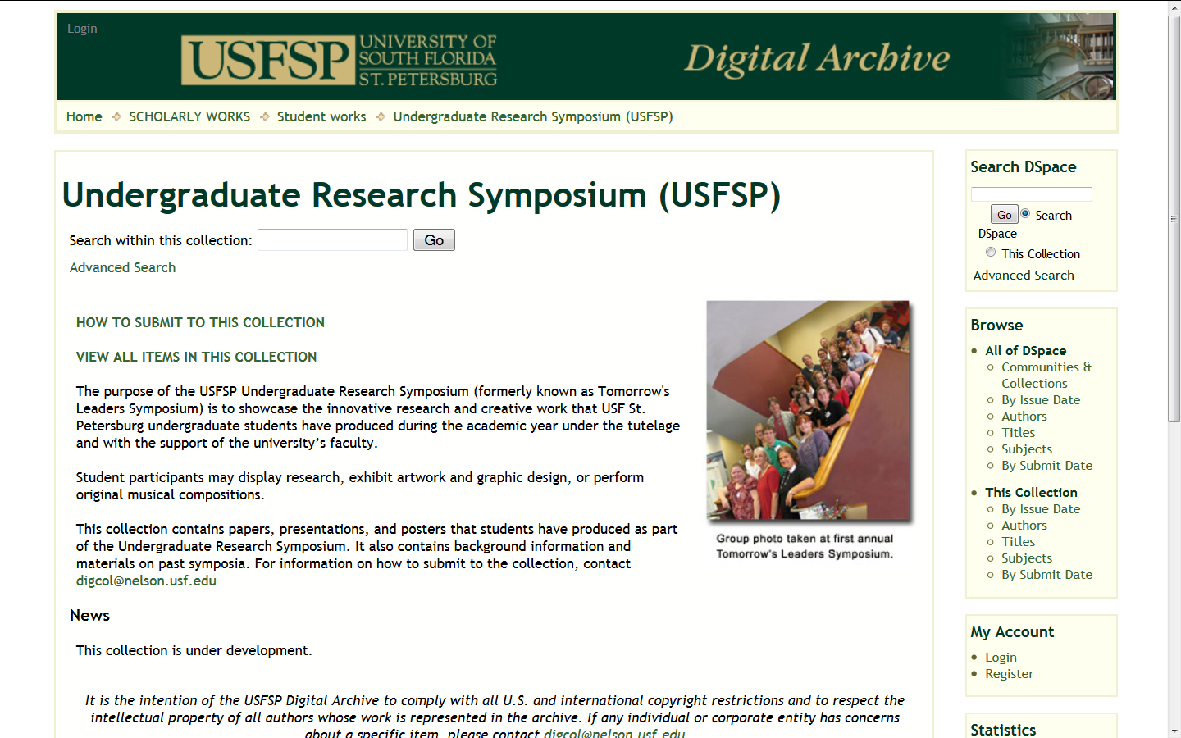
Highlight group achievement

Slide 14
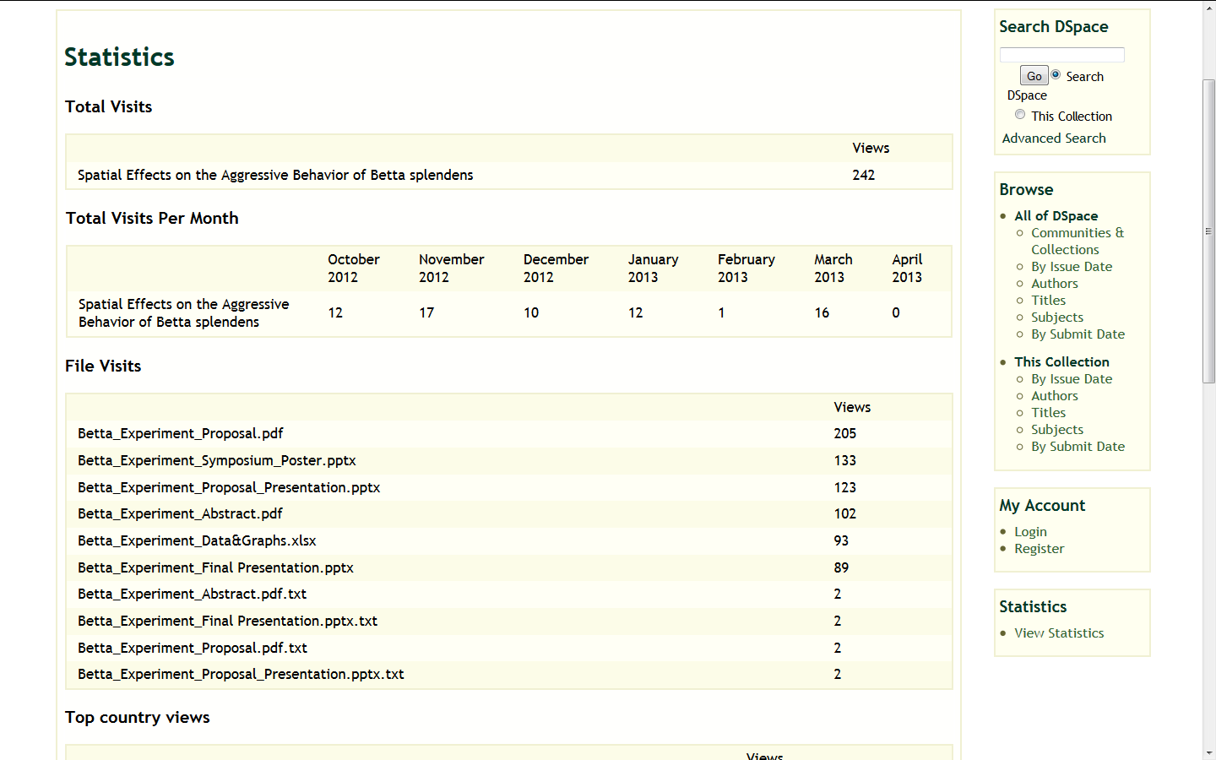
Highlight achievement: use statistics

Slide 15
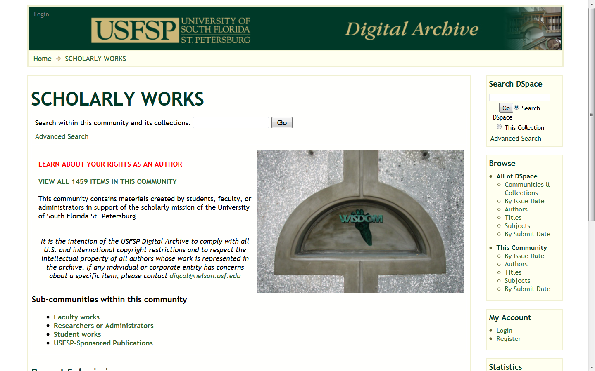
Highlight institutional achievement

Slide 16
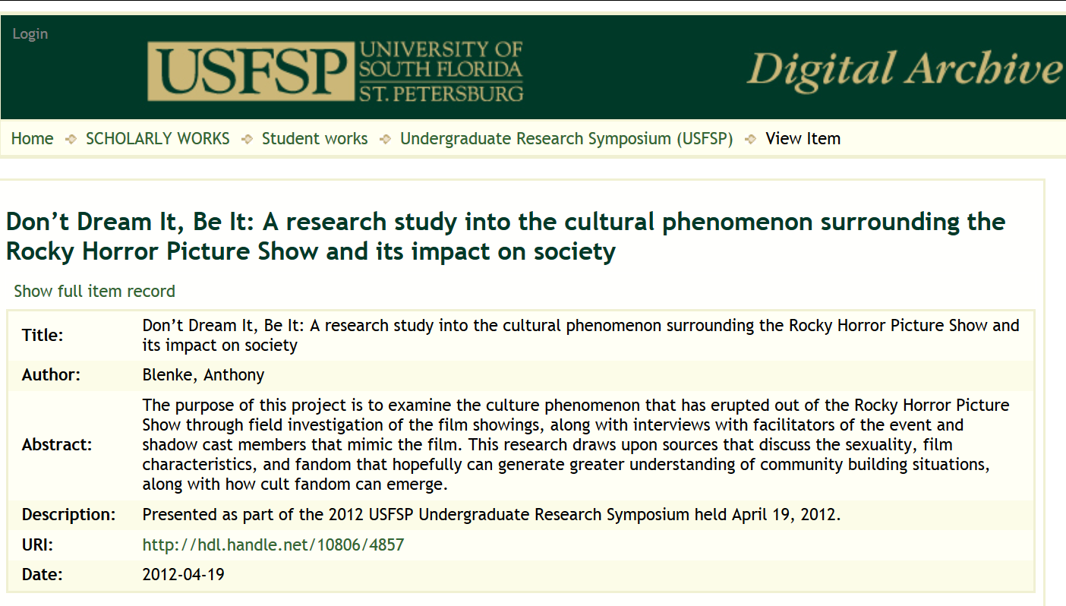
Unique and stable URL

Slide 17
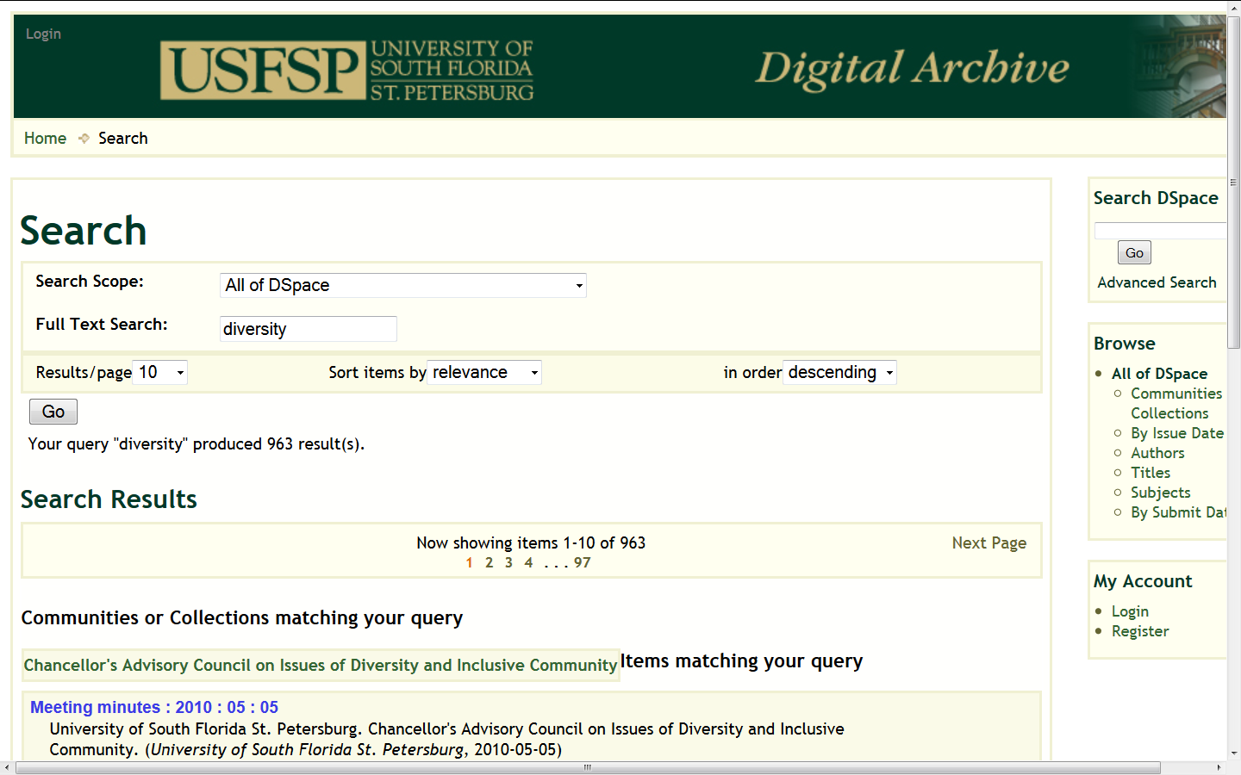
Full-text searching

Slide 18
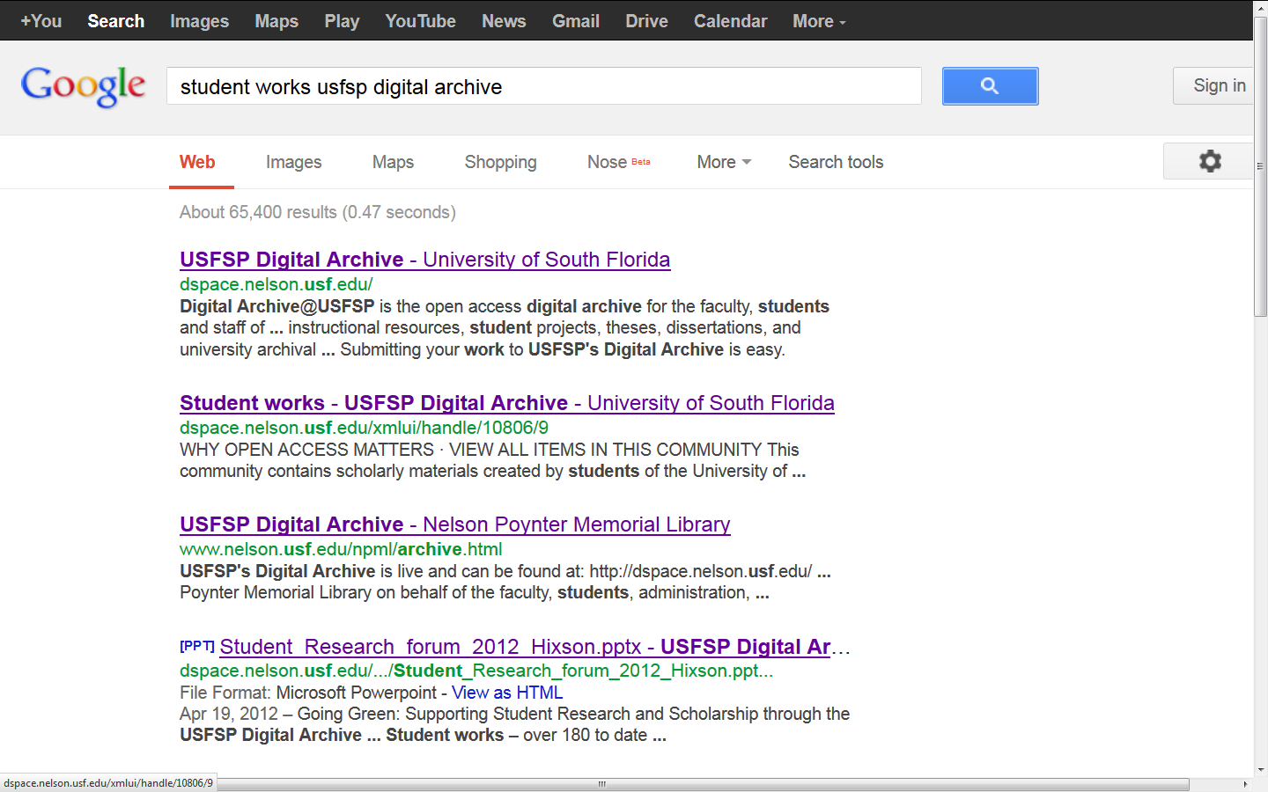
Google indexing – draws searchers into archive

Slide 19
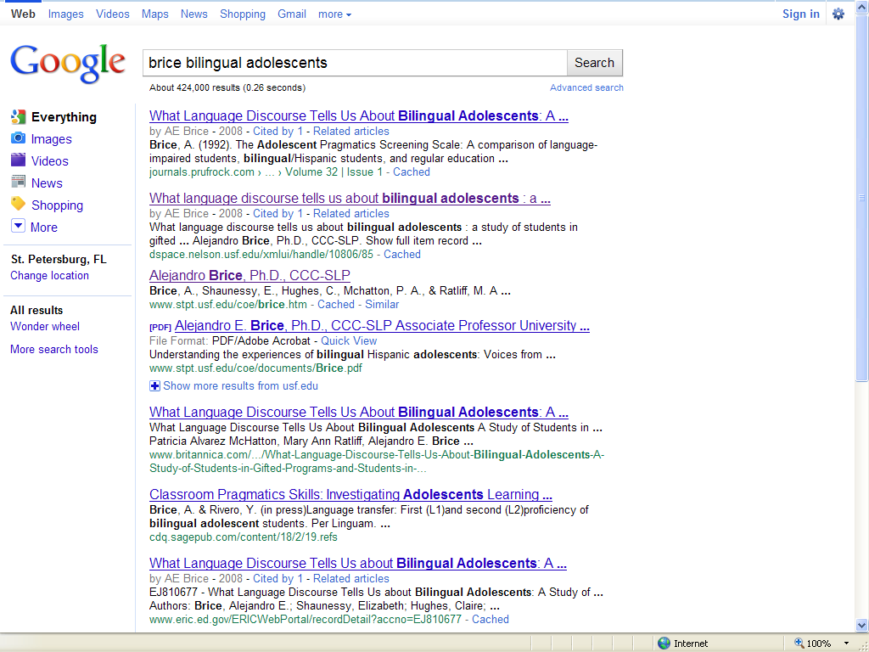
Google indexing – draws searchers into archive

Slide 20
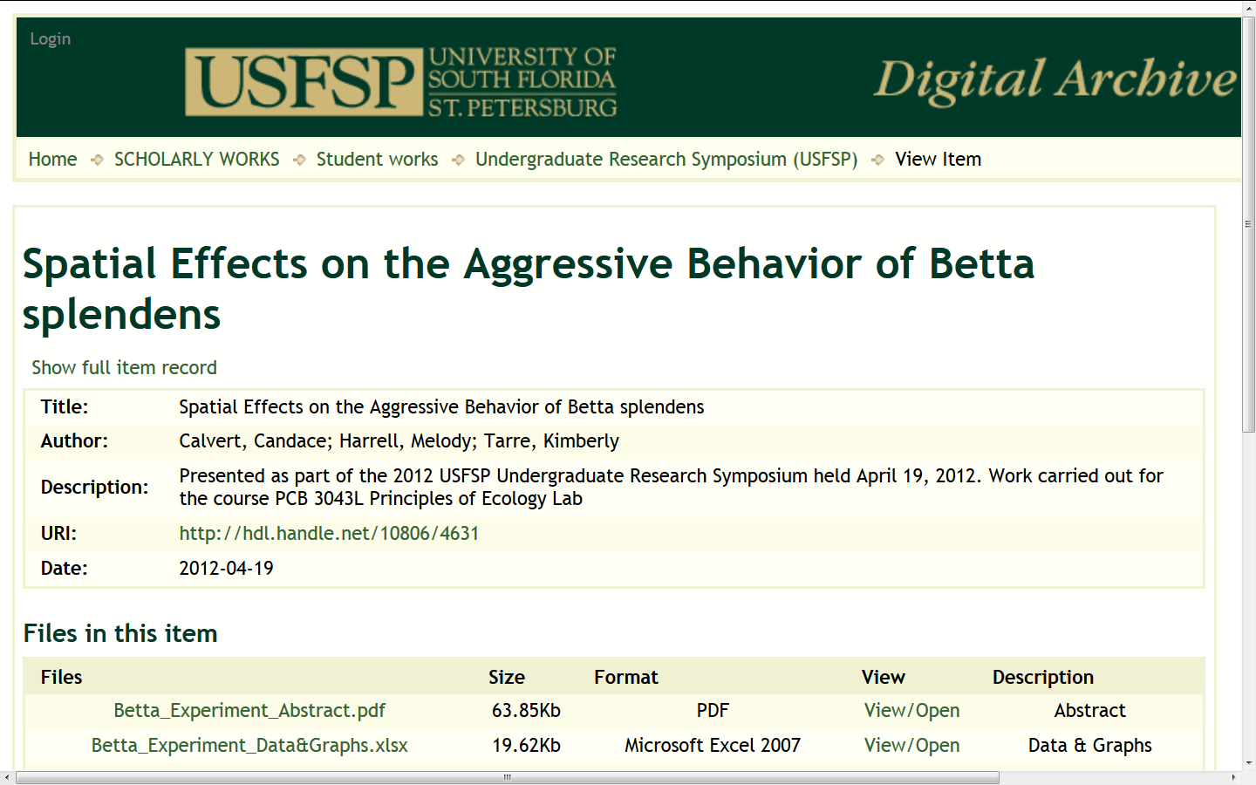
Protects intellectual property: credits authors and creators

Slide 21
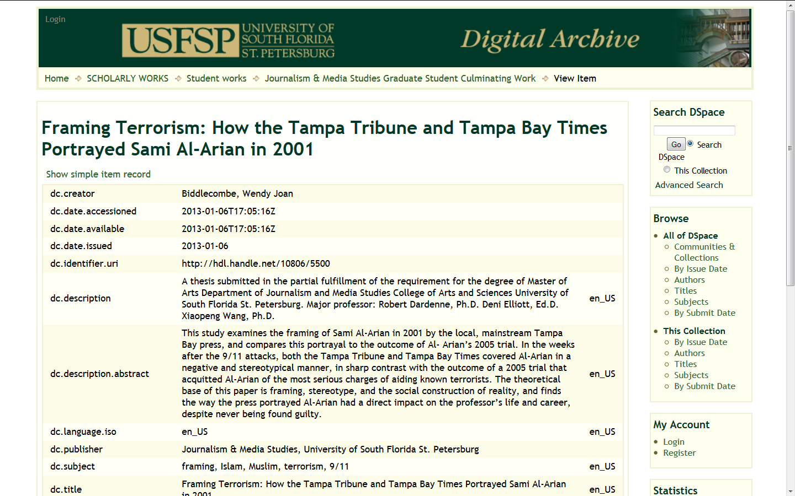
Protects intellectual property: date and time stamp

Slide 22
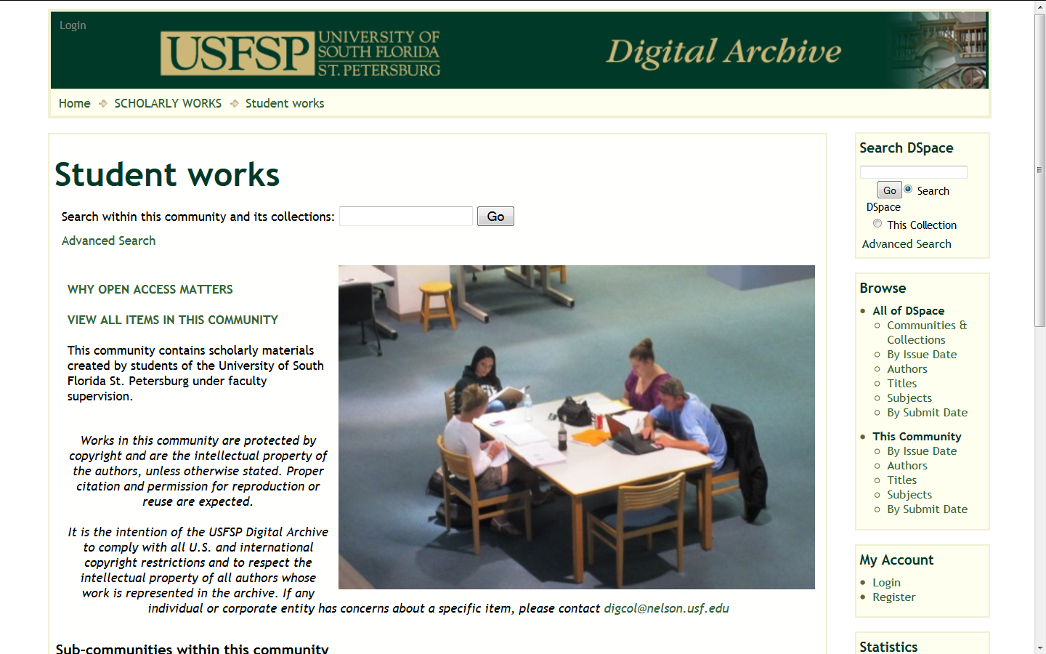
Protects intellectual property: copyright protection

Slide 23
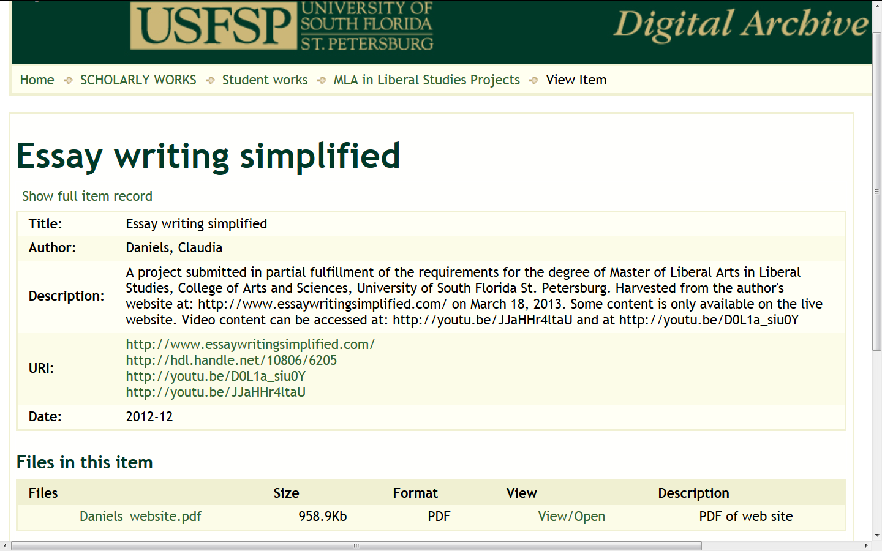
Accepts multiple files and file types

Slide 24
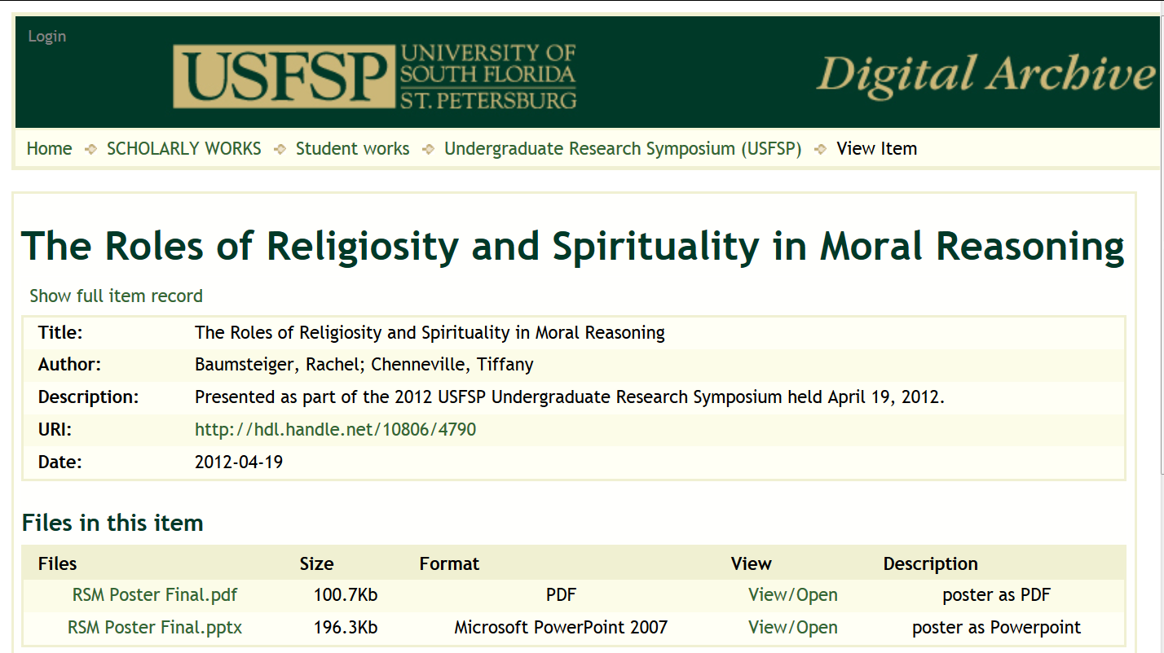
Accepts multiple files and file types

Slide 25
Preserves materials
Ensures the long-term maintenance of a bitstream (the zeros and ones):
  Backing up files and keeping a copy at an offsite location
  Running checks to track the deterioration of storage media, files or bitstreams
  Providing continued accessibility of the contents

Slide 26
To Submit Your Research to the Digital Archive
Review Going Green – Instructions for Submitting to the Undergraduate Research Collection online http://dspace.nelson.usf.edu/xmlui/handle/10806/4509
OR
Contact Carol Hixson, Dean of Library
  873-4400
  hixson@usfsp.edu

Slide 27
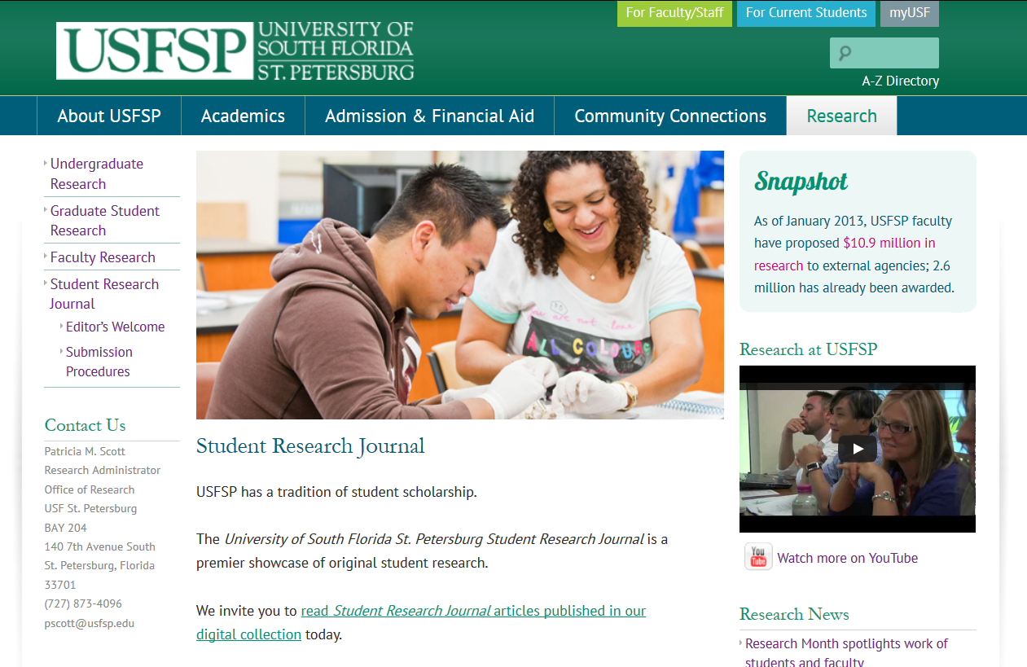
USFSP Student Research Journal http://www.usfsp.edu/research/student-research-journal/

Slide 28
USFSP Student Research Journal
The Student Research Journal follows a tradition of student scholarship found in many other schools, including Berkeley, Clemson, and Harvard. There are five guiding principles for the online USFSP Student Research Journal:
  The Student Research Journal is published through on-line submissions.
  The Student Research Journal is available online through a platform that indexes, retrieves, and tracks the usage of the articles in it.
  The American Psychological Association (APA) 6th edition will be used as the preferred style format.
  Submission procedures and form are accessible online.
  A rolling publication system allows for flexibility in publishing special issues and rolling out new editions.

Slide 29
Benefits of the Student Research Journal and the Digital Archive
Highlights individual, group, and institutional achievement
Improves access to and discoverability of materials
  Provides unique and unchanging URL
  Full text indexing
  Indexed by Google, Google Scholar, etc.
Protects intellectual property
  Credits authors and creators
  Provides date and time stamp for all work
  Provides copyright protection
Accepts all types of materials
Preserves materials

Slide 30
USFSP Student Research Journal
All the benefits of the USFSP Digital Archive outlined earlier also apply to the articles published in the Student Research Journal

Slide 31
USFSP Student Research Journal
Published in the USFSP Digital Archive at:
http://dspace.nelson.usf.edu/xmlui/handle/10806/10
To submit an article to the Student Research Journal, contact Dr. Alejandro Brice aebrice@mail.usf.edu

