Slide 1

Going Green: Supporting Student Research and Scholarship through the USFSP Digital Archive
Carol Hixson, Dean
Nelson Poynter Memorial Library
April 19, 2012
http://dspace.nelson.usf.edu/xmlui/handle/10806/4508

Slide 2
Your partner

Slide 3
Services for students @ the Library
Excellent print, AV, and electronic collections
Interlibrary loan access to world’s libraries
Reserves (print and electronic) for classes
Access to computers, laptops, printers, & photocopiers and with staff assistance
Instruction in how to find and use information needed for your classes and class projects available in-person, by phone, over email, & through chat
Varied and comfortable individual and group study spaces
USF ID card services
Unique research materials in Special Collections
Collections in the USFSP Digital Archive

Slide 4
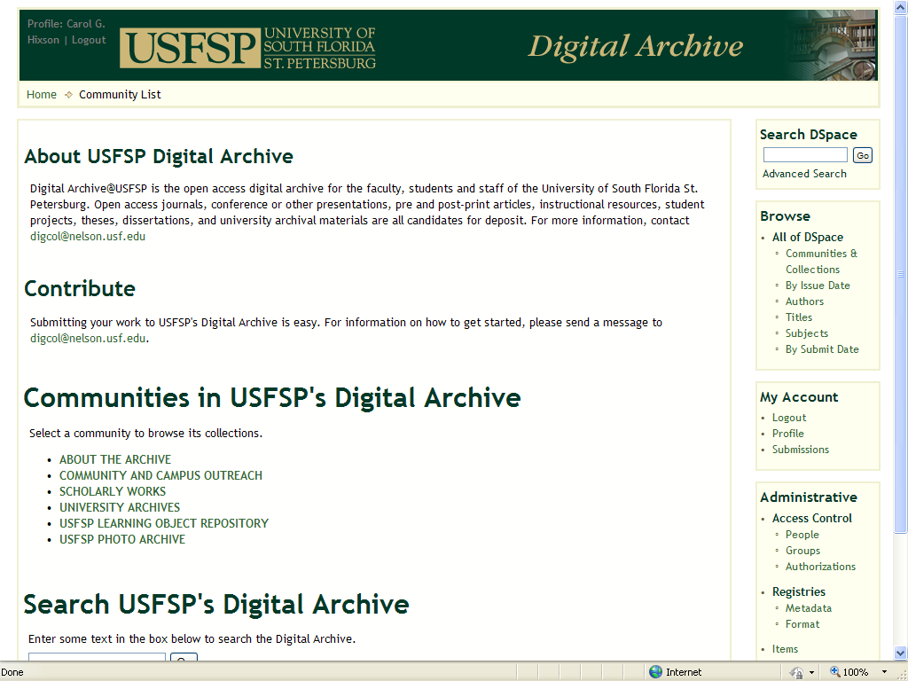
USFSP Digital Archive

Slide 5
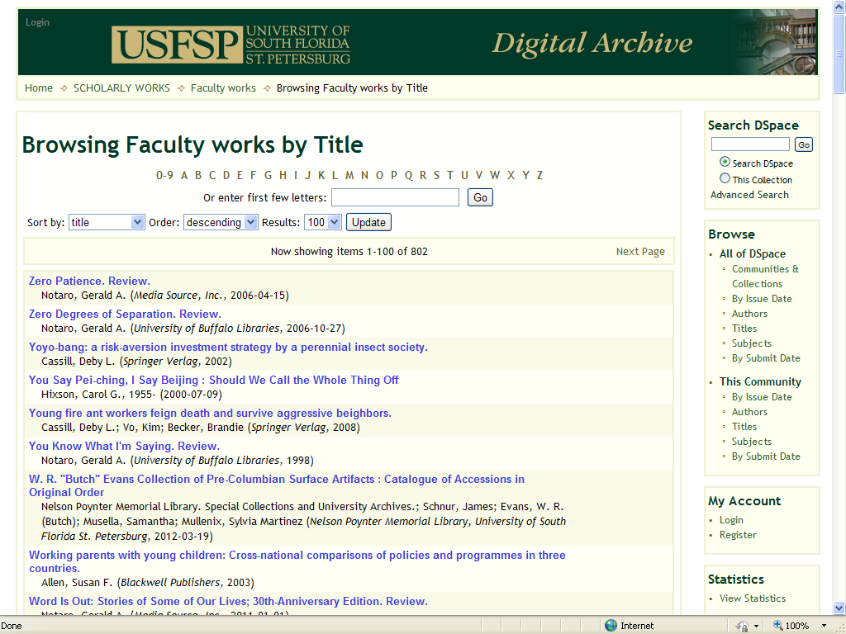
Faculty works – over 800 to date

Slide 6
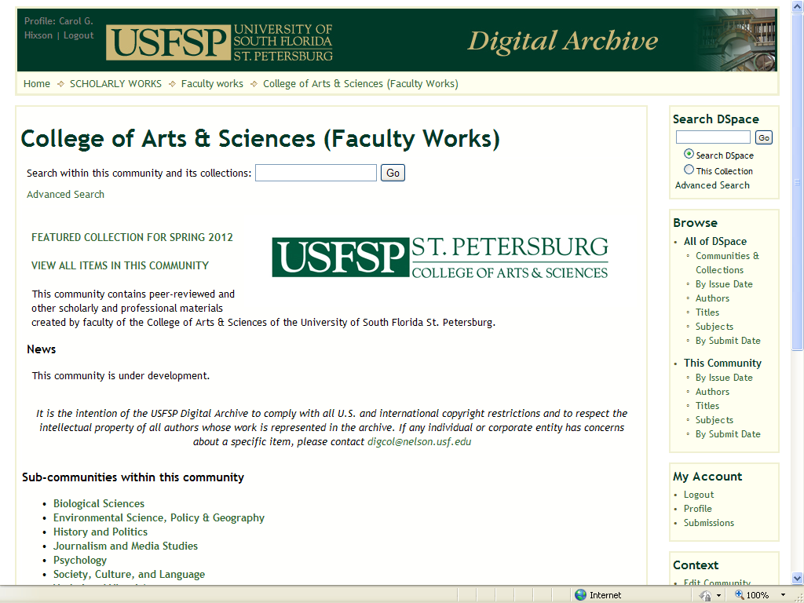
College of Arts & Sciences

Slide 7
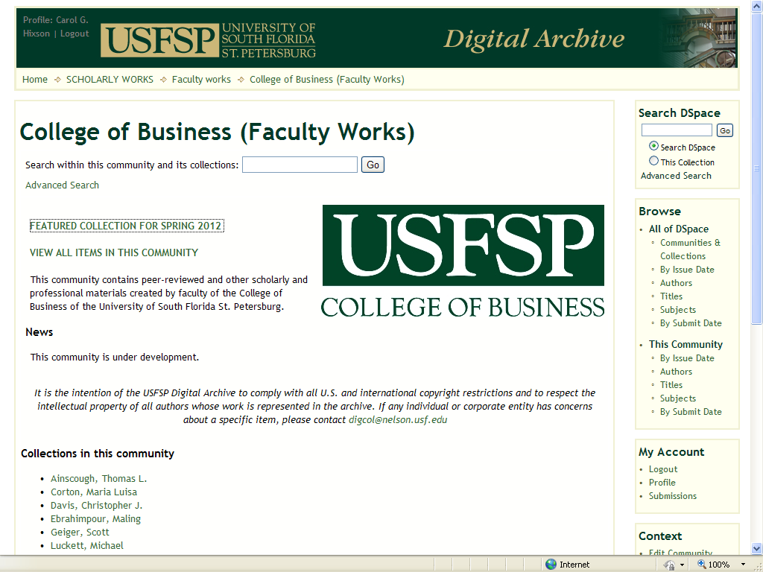
College of Business

Slide 8
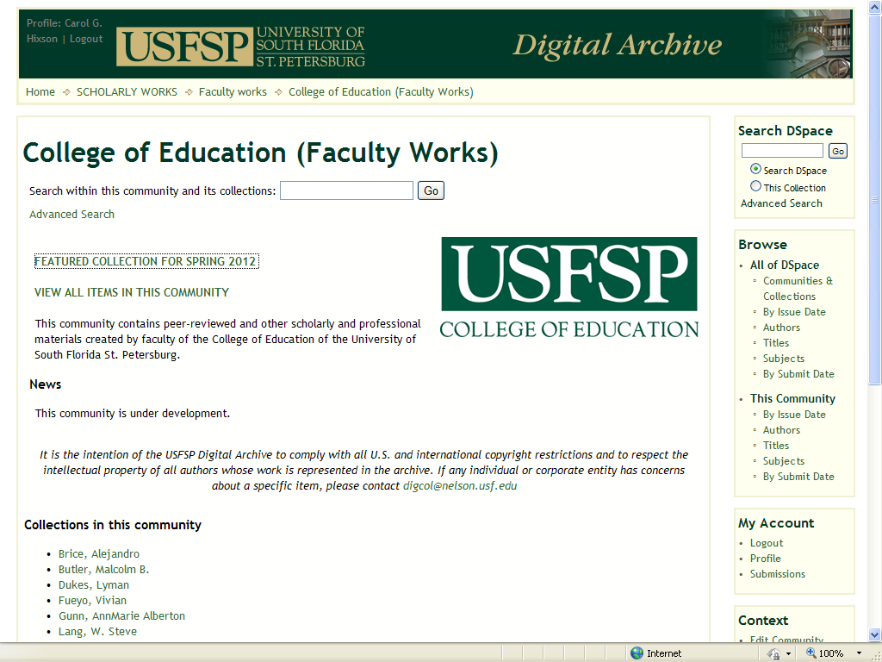
College of Education

Slide 9
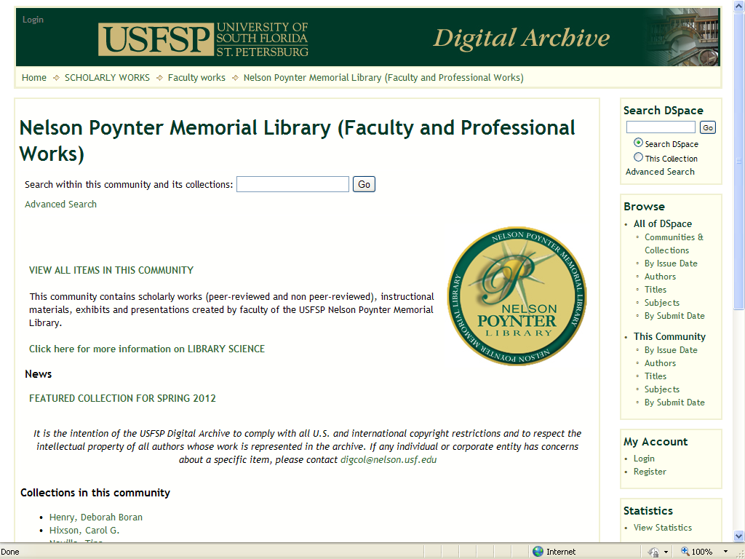
Nelson Poynter Memorial Library

Slide 10
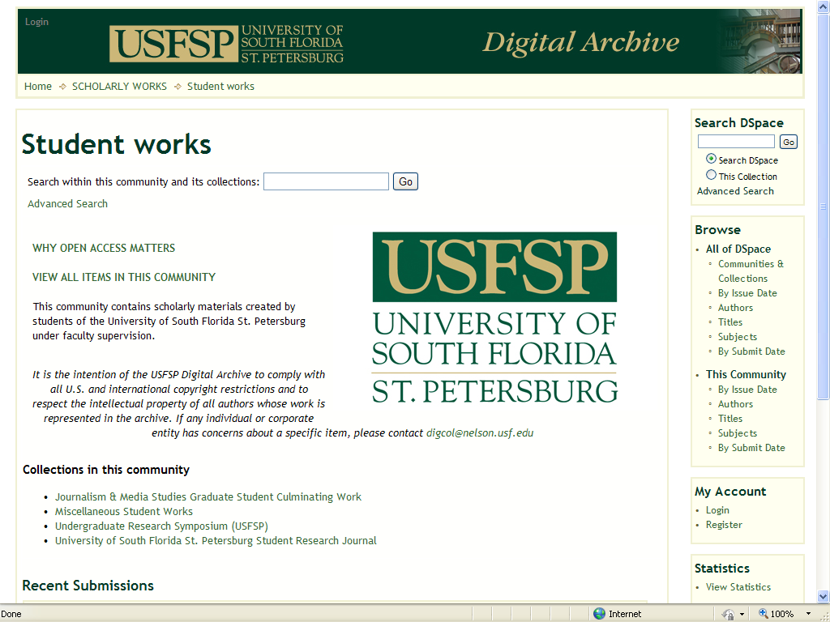
Student works

Slide 11
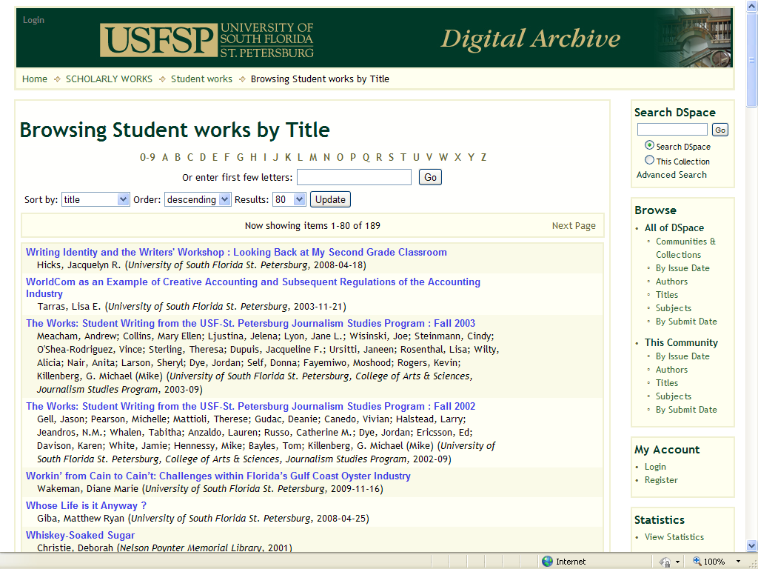
Student works – over 180 to date

Slide 12
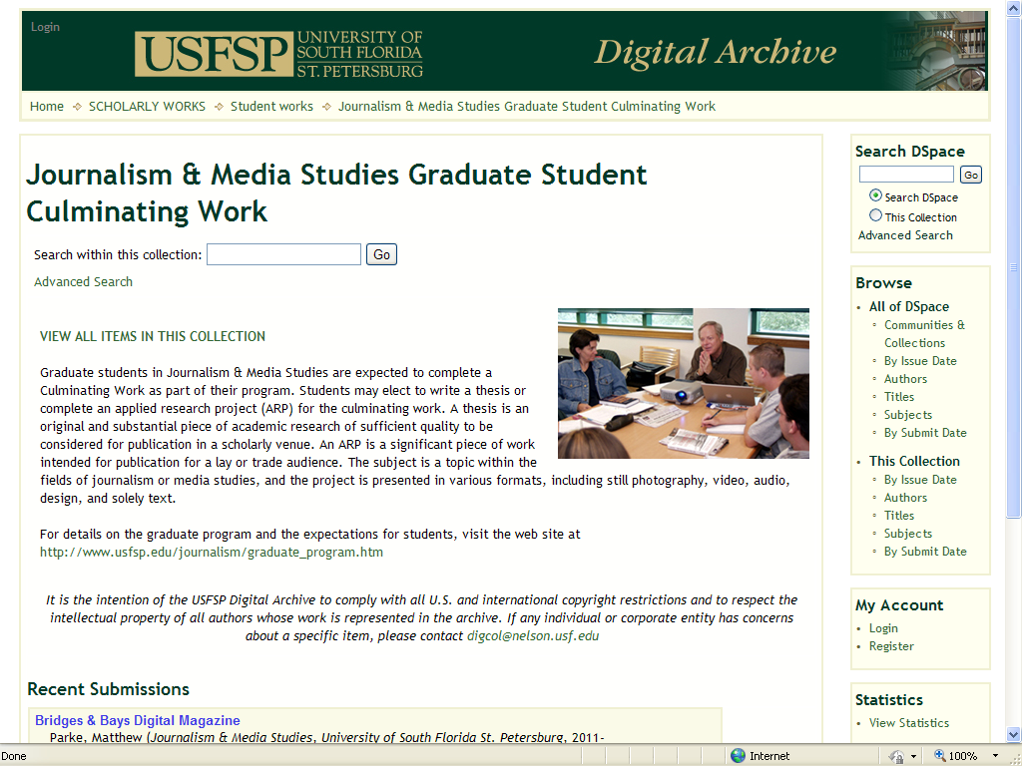
Journalism & Media Studies

Slide 13
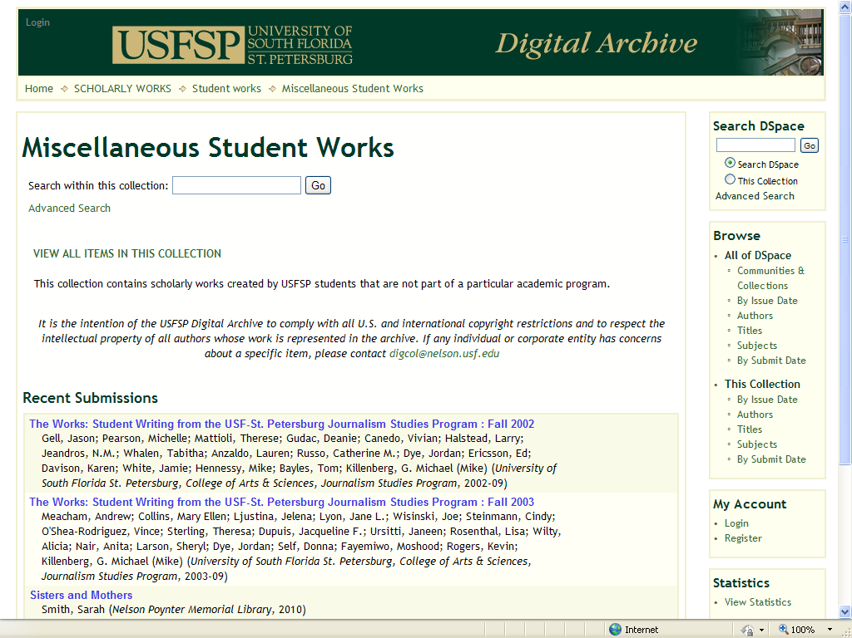
Miscellaneous Student Works

Slide 14
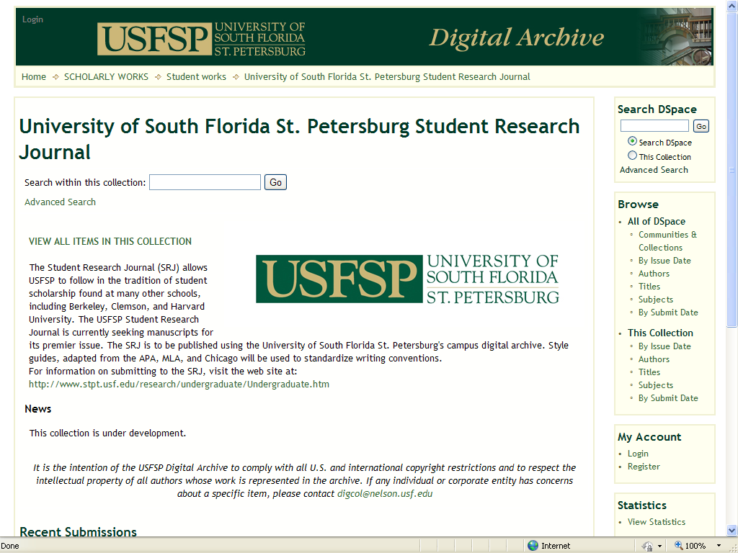
USFSP Student Research Journal

Slide 15
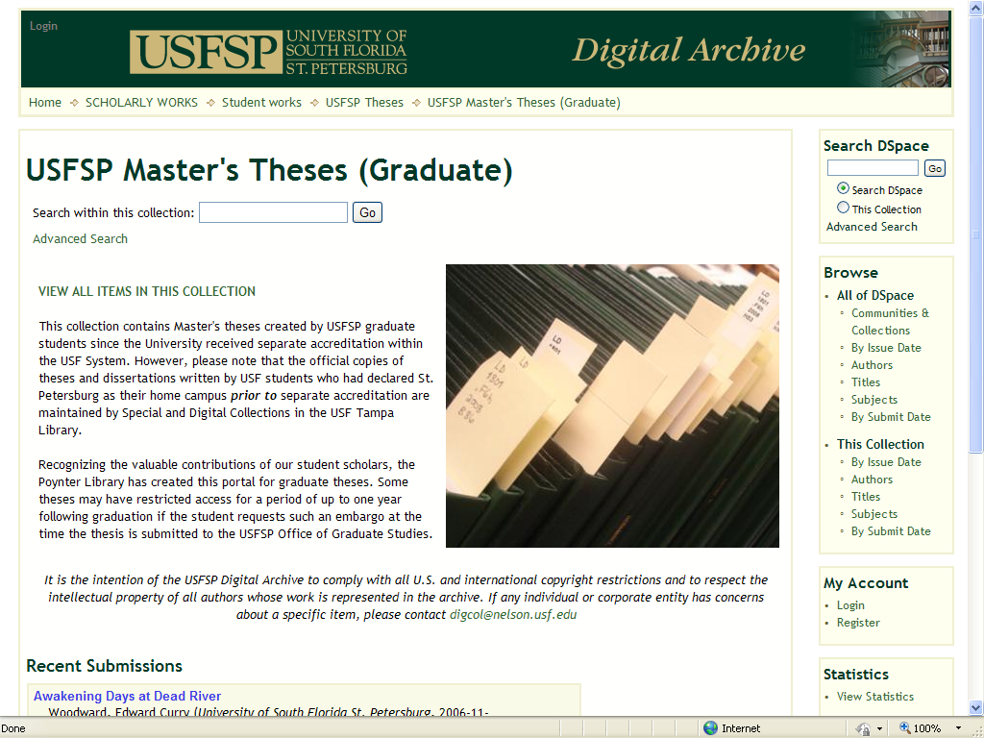
USFSP Master’s Theses

Slide 16
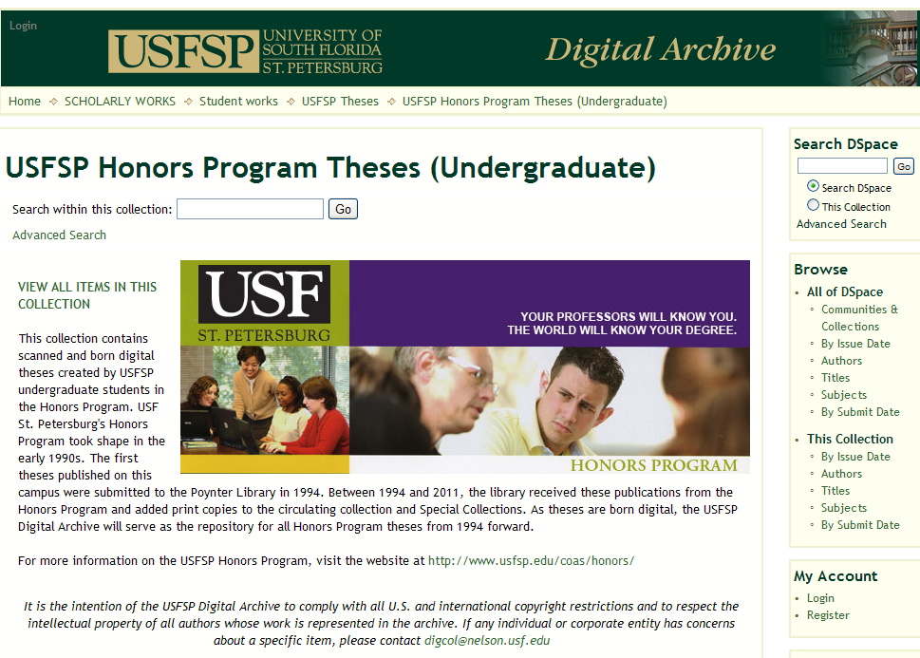
USFSP Honors Program

Slide 17
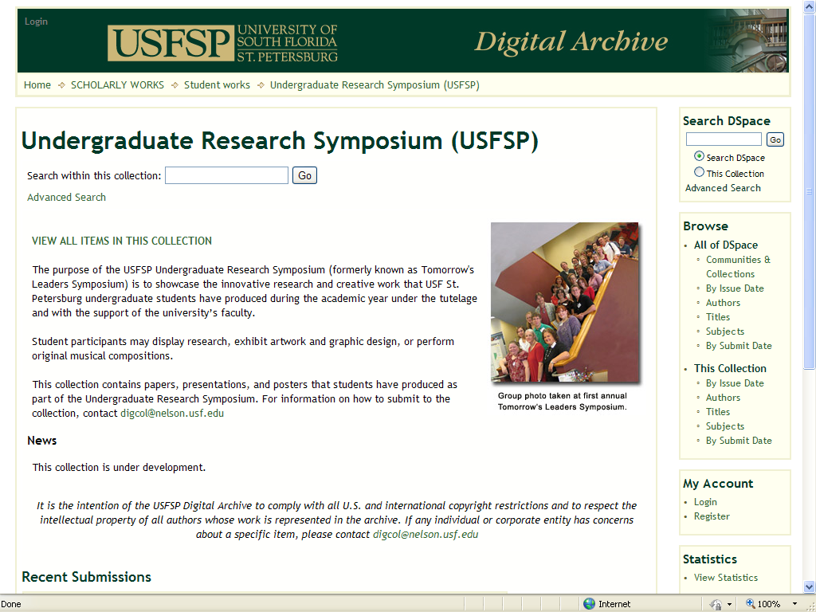
Undergraduate Research Symposium

Slide 18
What’s in it for you?
No need to keep or distribute paper copies
Join University’s scholarly community
Space to present and publicize your work
  Works much like a formal publication
Persistent URLs and preservation of your work
Wide exposure of your work over Internet
Automated statistics to show impact
A variety of file types can be accepted
  Such as: Powerpoint, PDF, Excel, JPEG, TIFF, HTML, etc.
Full-text indexing, and much more

Slide 19
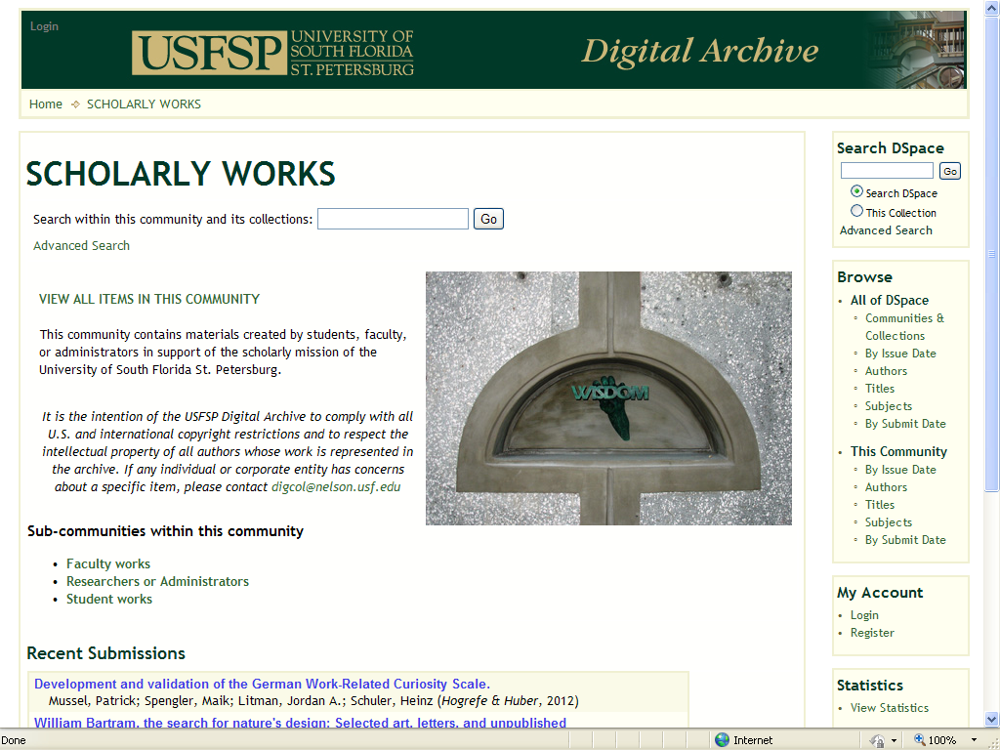
University’s scholarly community

Slide 20
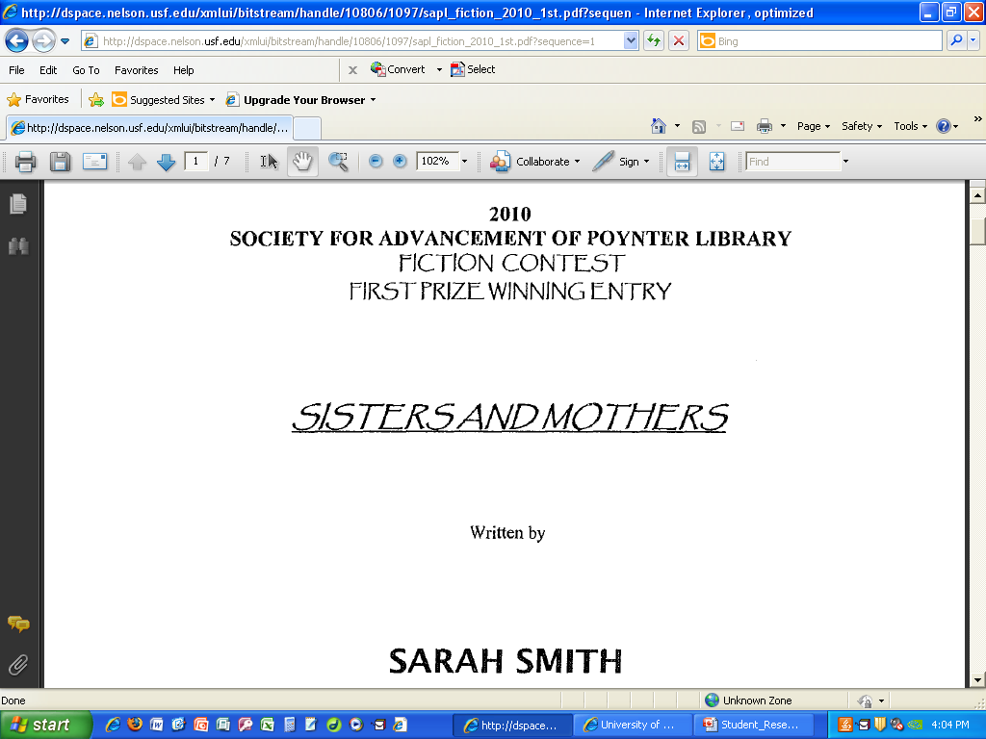
Present and publicize your work

Slide 21
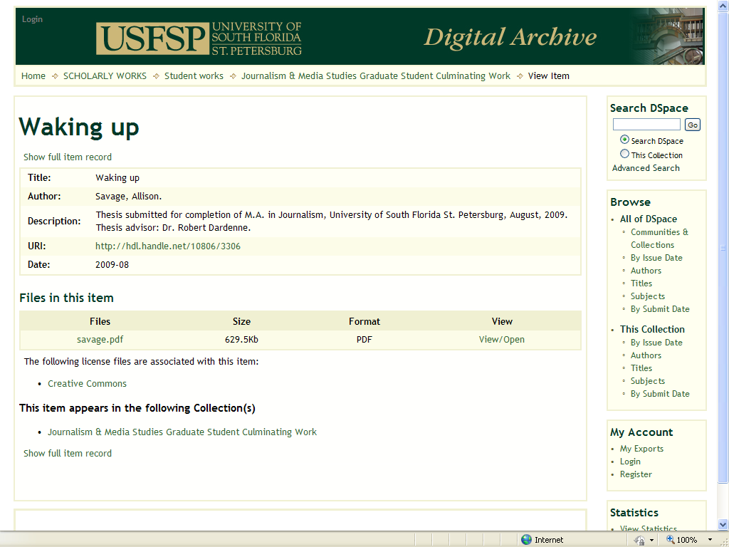
Persistent URLs

Slide 22
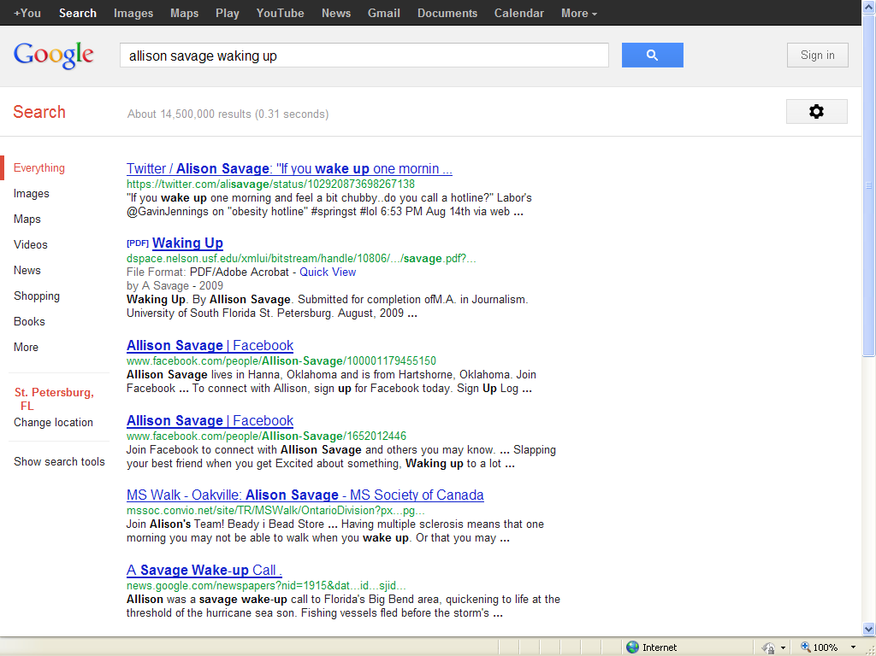
Exposure of your work on Internet

Slide 23
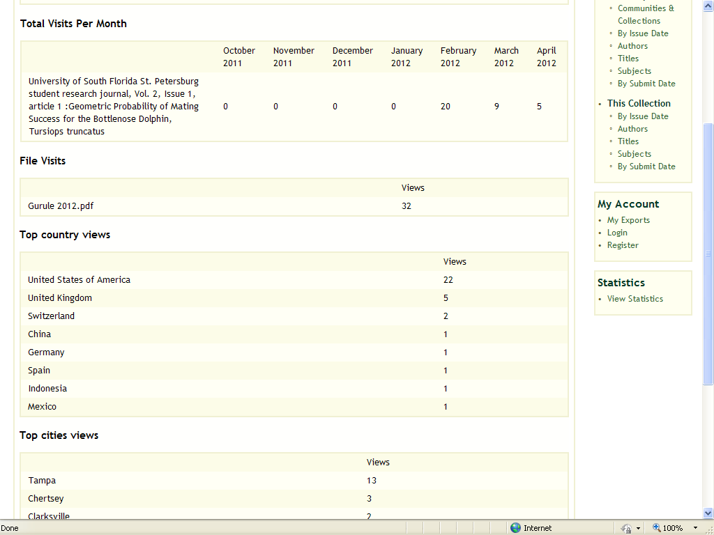
Automated statistics

Slide 24
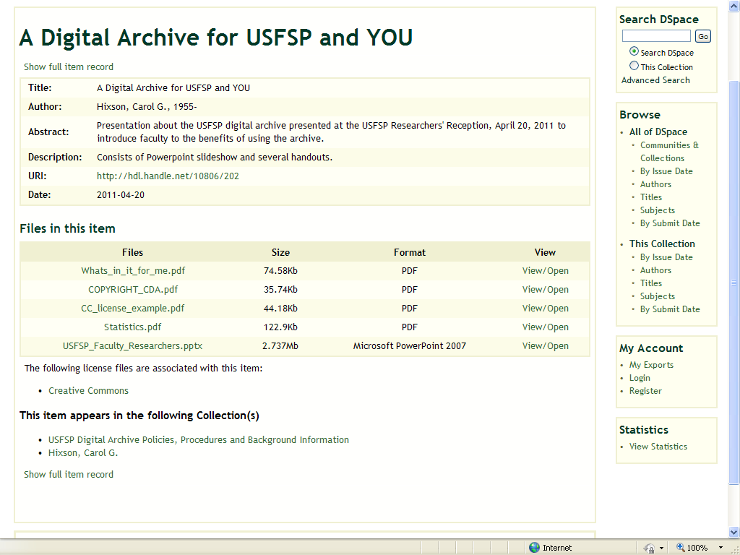
Variety of file types

Slide 25
How do you start?
Identify an existing collection in the digital archive that fits your work
  If none fits, begin discussion with Library to establish new one
Get faculty sponsor for your work
Contact the Library (digcol@nelson.usfsp.edu) or contact the Dean (hixson@usfsp.edu)
Submit your work to the collection you have been authorized to add to
Wait for an email indicating that the work has been approved and click on its URL
That’s it!!

Slide 26
Questions?
Contact
digcol@nelson.usf.edu
or
hixson@usfsp.edu

