Slide 1
Roundtable “Slavic Librarians with a Voice: From Publishing to Public Advocacy”
ASEEES Convention (Boston, MA November 21, 2024)
SLAVIC VOICES IN DIGITAL HUMANITIES :
UO LIBRARIAN, FACULTY, AND STUDENT COLLABORATION
ON AN INTERNET BIOGRAPHICAL ENCYCLOPEDIA
Prepared by Heghine Hakobyan with the assistance of Graduate Student Lina Turygina
University of Oregon Libraries and Russian, East European, and Eurasian Studies

Slide 2
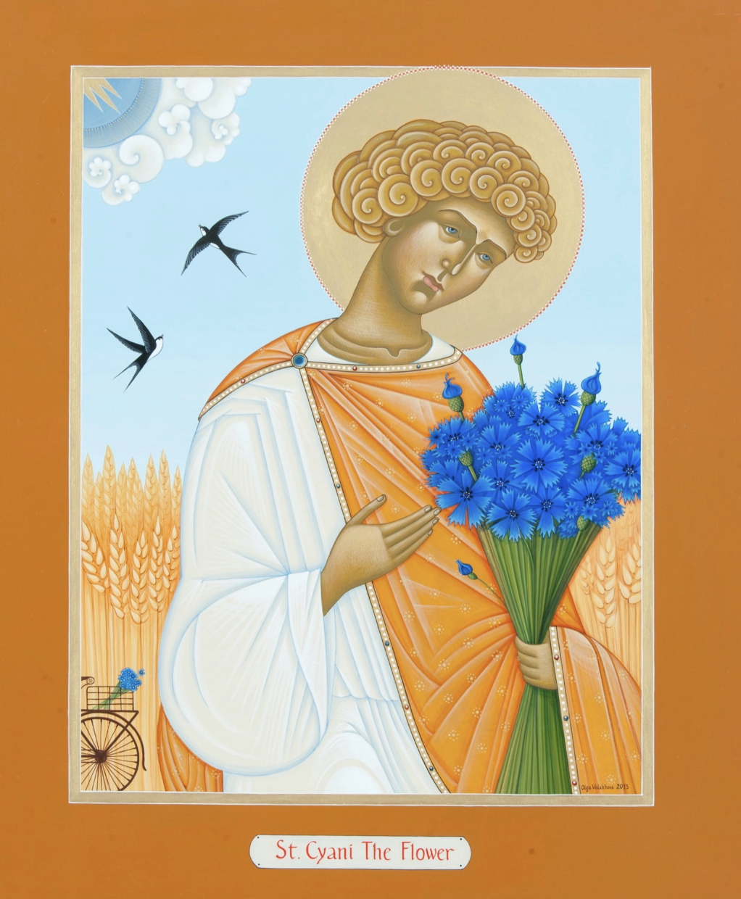
SIAN
Slavic Immigrant Artists in the Northwest
https://sian.uoregon.edu/

Slide 3
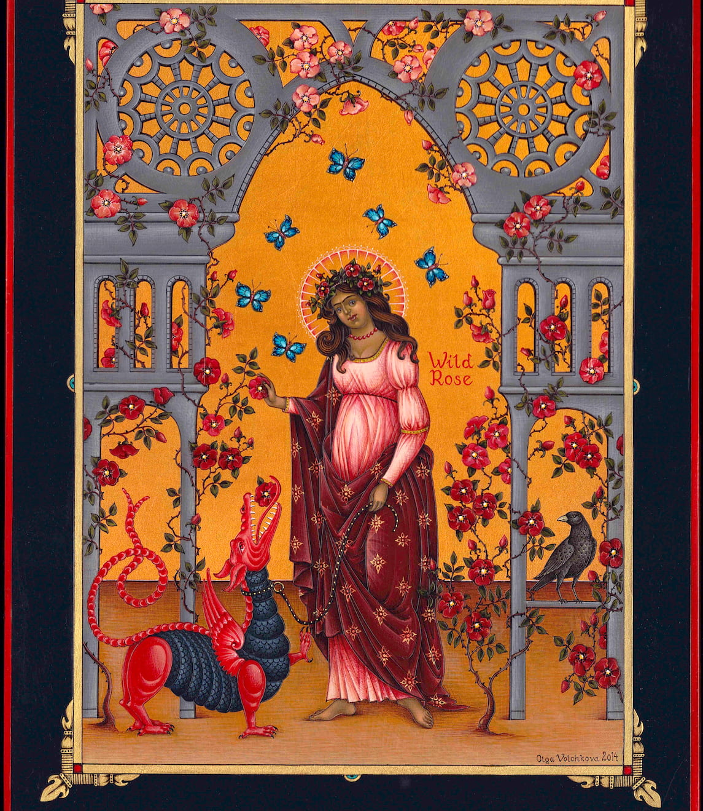
Advocating for Diversity and Inclusion
Our goal is related to embracing equity, diversity, and inclusion in teaching and studies as well as in all library and academic services. We are trying to advocate for diverse collections and programs that reflect the experiences of marginalized communities, thereby supporting social justice and inclusivity.

Slide 4
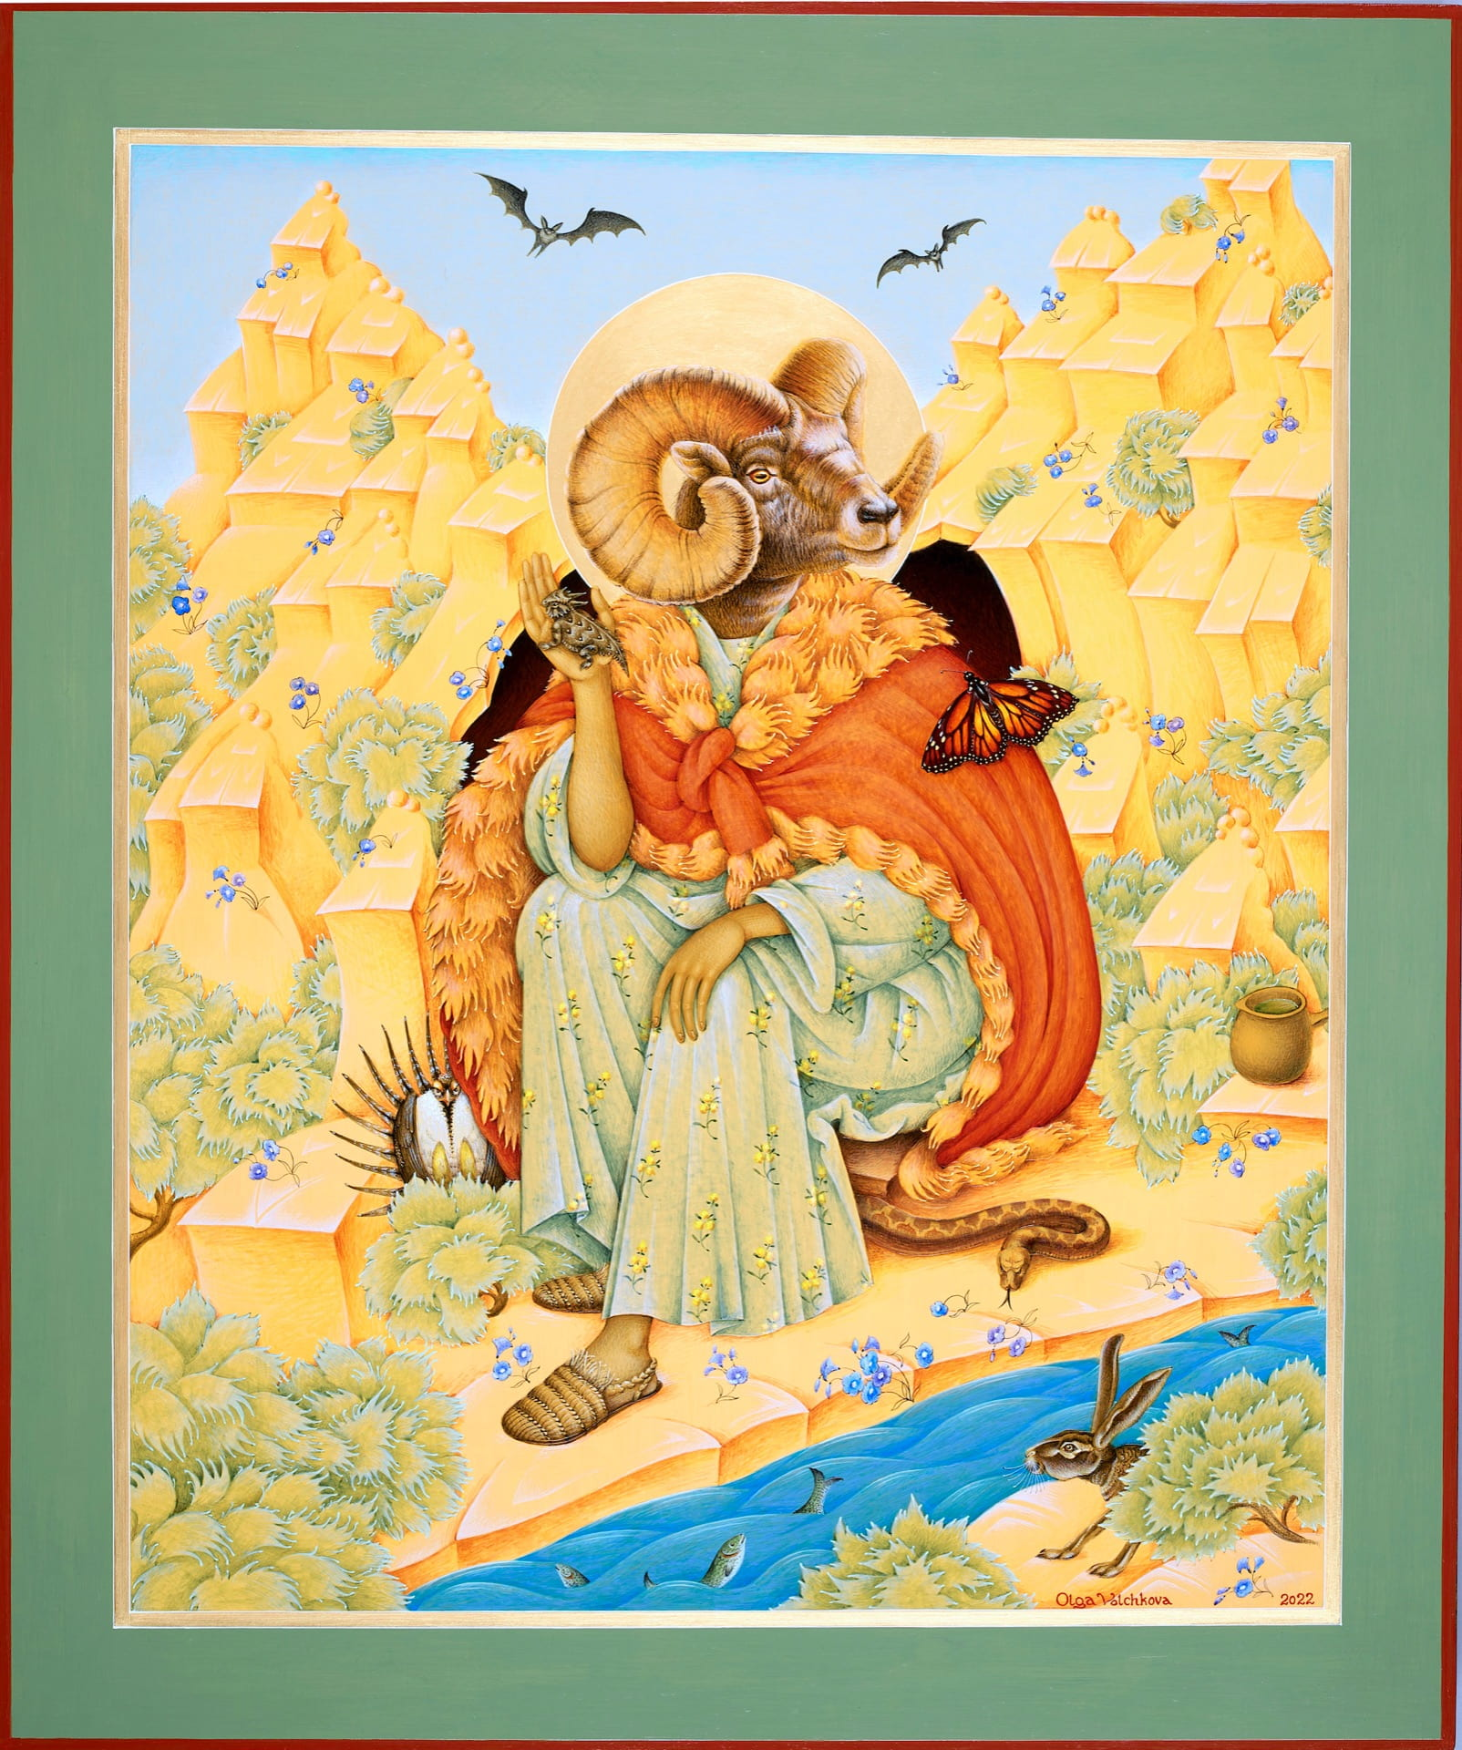
Utilizing Non-Traditional Media Outlets
We have chosen to utilize the university’s blog platform and other media outlets to reach wider audiences. Thus, we serve as a multicultural hub promoting cultural diversity and mutual understanding.

Slide 5
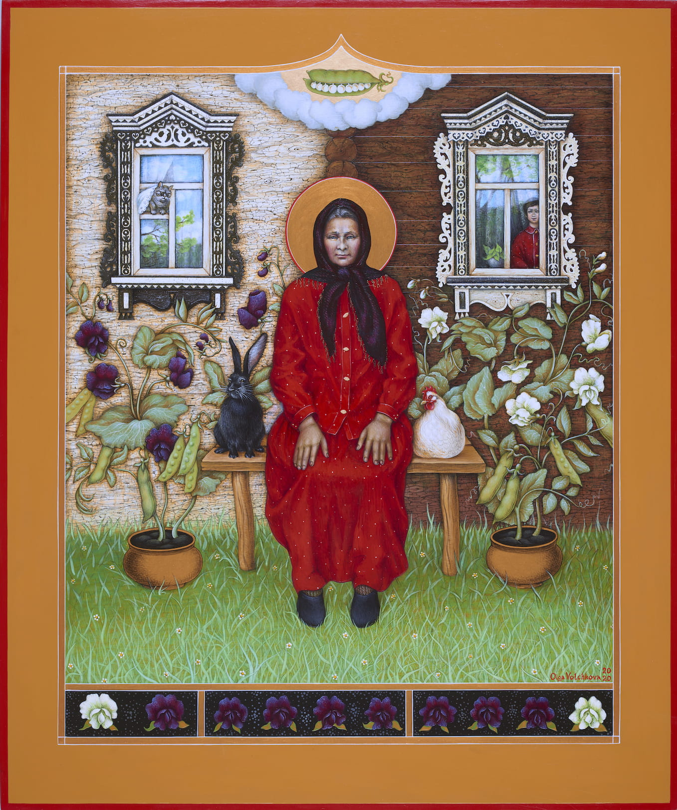
Contributing to Internet Encyclopedia Project
Our students contribute to this internet encyclopedia project by creating and editing biographical articles related to Slavic and East European immigrant artists in the Northwest. This not only disseminates knowledge to a global audience but also ensures the accuracy and reliability of information available online.

Slide 6
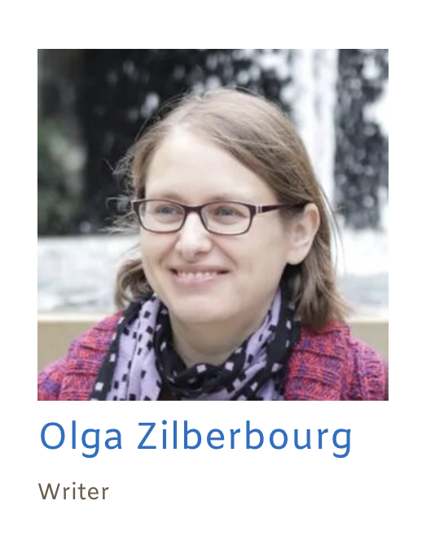
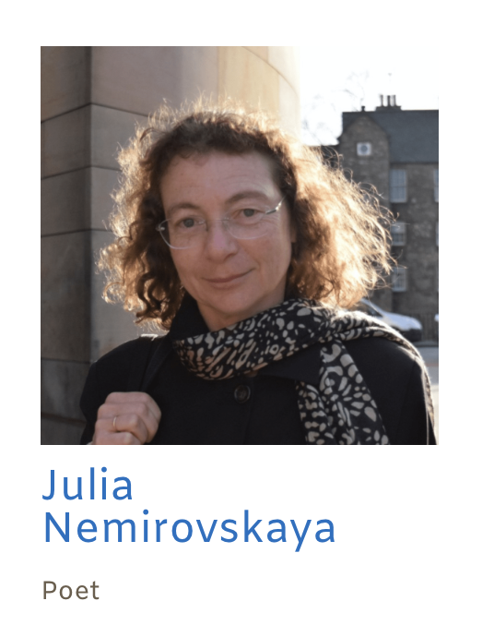
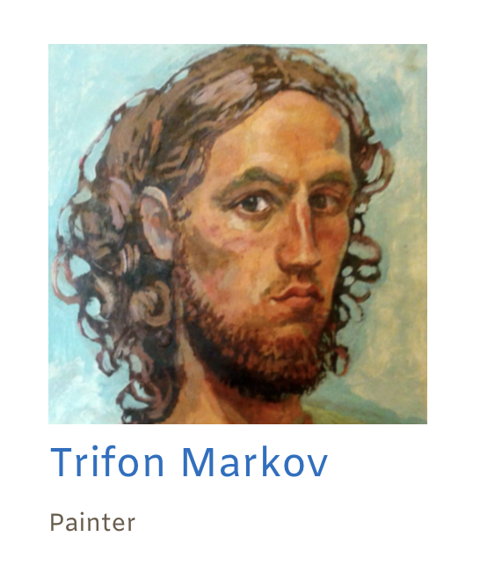
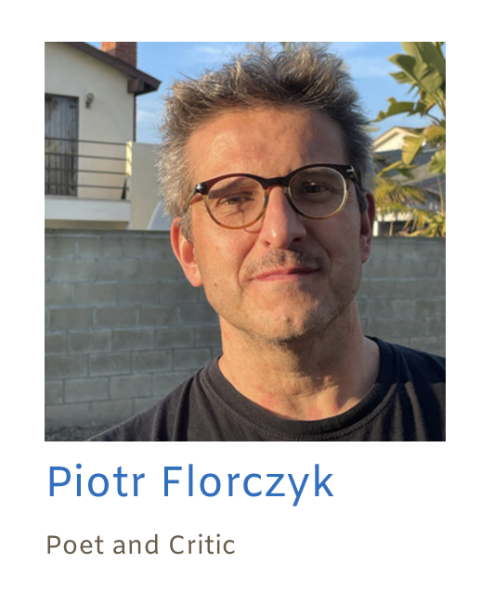
Focusing on Slavic Immigrant Artists in the Northwest (SIAN) provides a fascinating perspective on the cultural contributions of immigrants to the region and offers students an opportunity to engage deeply with local history, art, and immigrant experiences. This type of project examines the histories, artistic expressions, creative works, and community impact of Slavic immigrants in the Northwestern United States, emphasizing cities like Eugene, Portland, San Francisco, Seattle, and Vancouver which have notable East European communities.

Slide 7
Creating a digital humanities internship project focused on compiling biographies, interviewing artists, and generating galleries of their creative works offers students a unique way to engage with local cultural history and the arts community. This type of project allows students to develop research, interviewing, and digital presentation skills while contributing to the preservation and promotion of diverse artistic voices.

Slide 8
Creating a digital humanities internship project focused on compiling biographies, interviewing artists, and generating galleries of their creative works offers students a unique way to engage with local cultural history and the arts community. This type of project allows students to develop research, interviewing, and digital presentation skills while contributing to the preservation and promotion of diverse artistic voices.
Strategies and key elements of the SIAN internship

Slide 9
1.
2.
3.
4.
5.
Research and Preparation – Local Artist Identification – Biographical Research
Interview Process – Training Techniques for Conducting Interviews – Consent and Documentation
Compiling Digital Galleries of Artworks and Creative Authorship
Building an Open Access Internet-Based Biographical Encyclopedia
Skills Development and Reflection

Slide 10
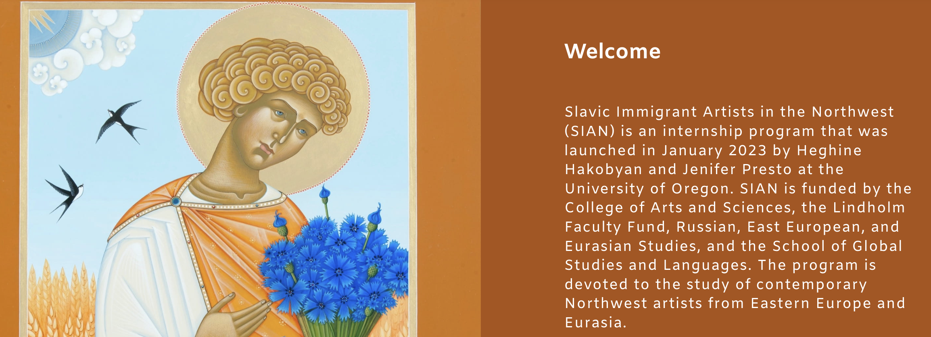
1.
4.
2.
5.
3.
Historical and Cultural Context of Slavic Immigration in the Northwest
Skills Development and Reflection
Compiling Digital Galleries of Artworks
Building an Internet-Based Biographical Encyclopedia
Interview Process – Training Techniques for Conducting Interview – Consent and Documentation

Slide 11
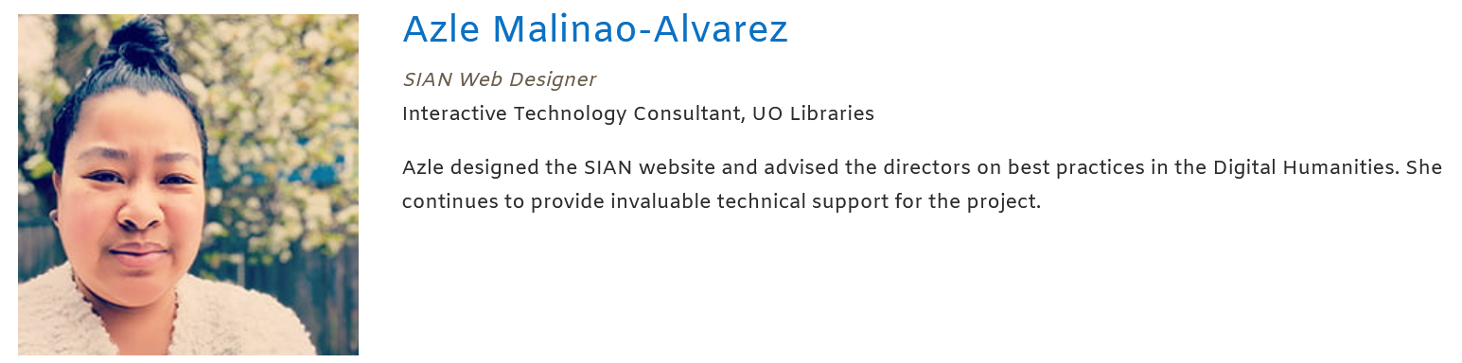
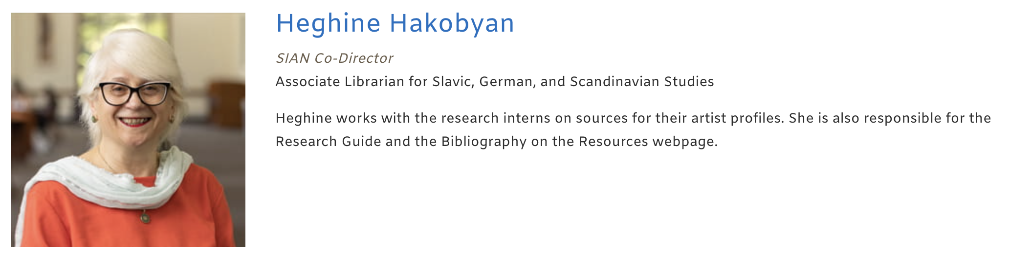

1.
4.
2.
5.
3.
Historical and Cultural Context of Slavic Immigration in the Northwest
Skills Development and Reflection
Compiling Digital Galleries of Artworks
Building an Internet-Based Biographical Encyclopedia
Identifying and Collaborating with Slavic Immigrant Artists

Slide 12
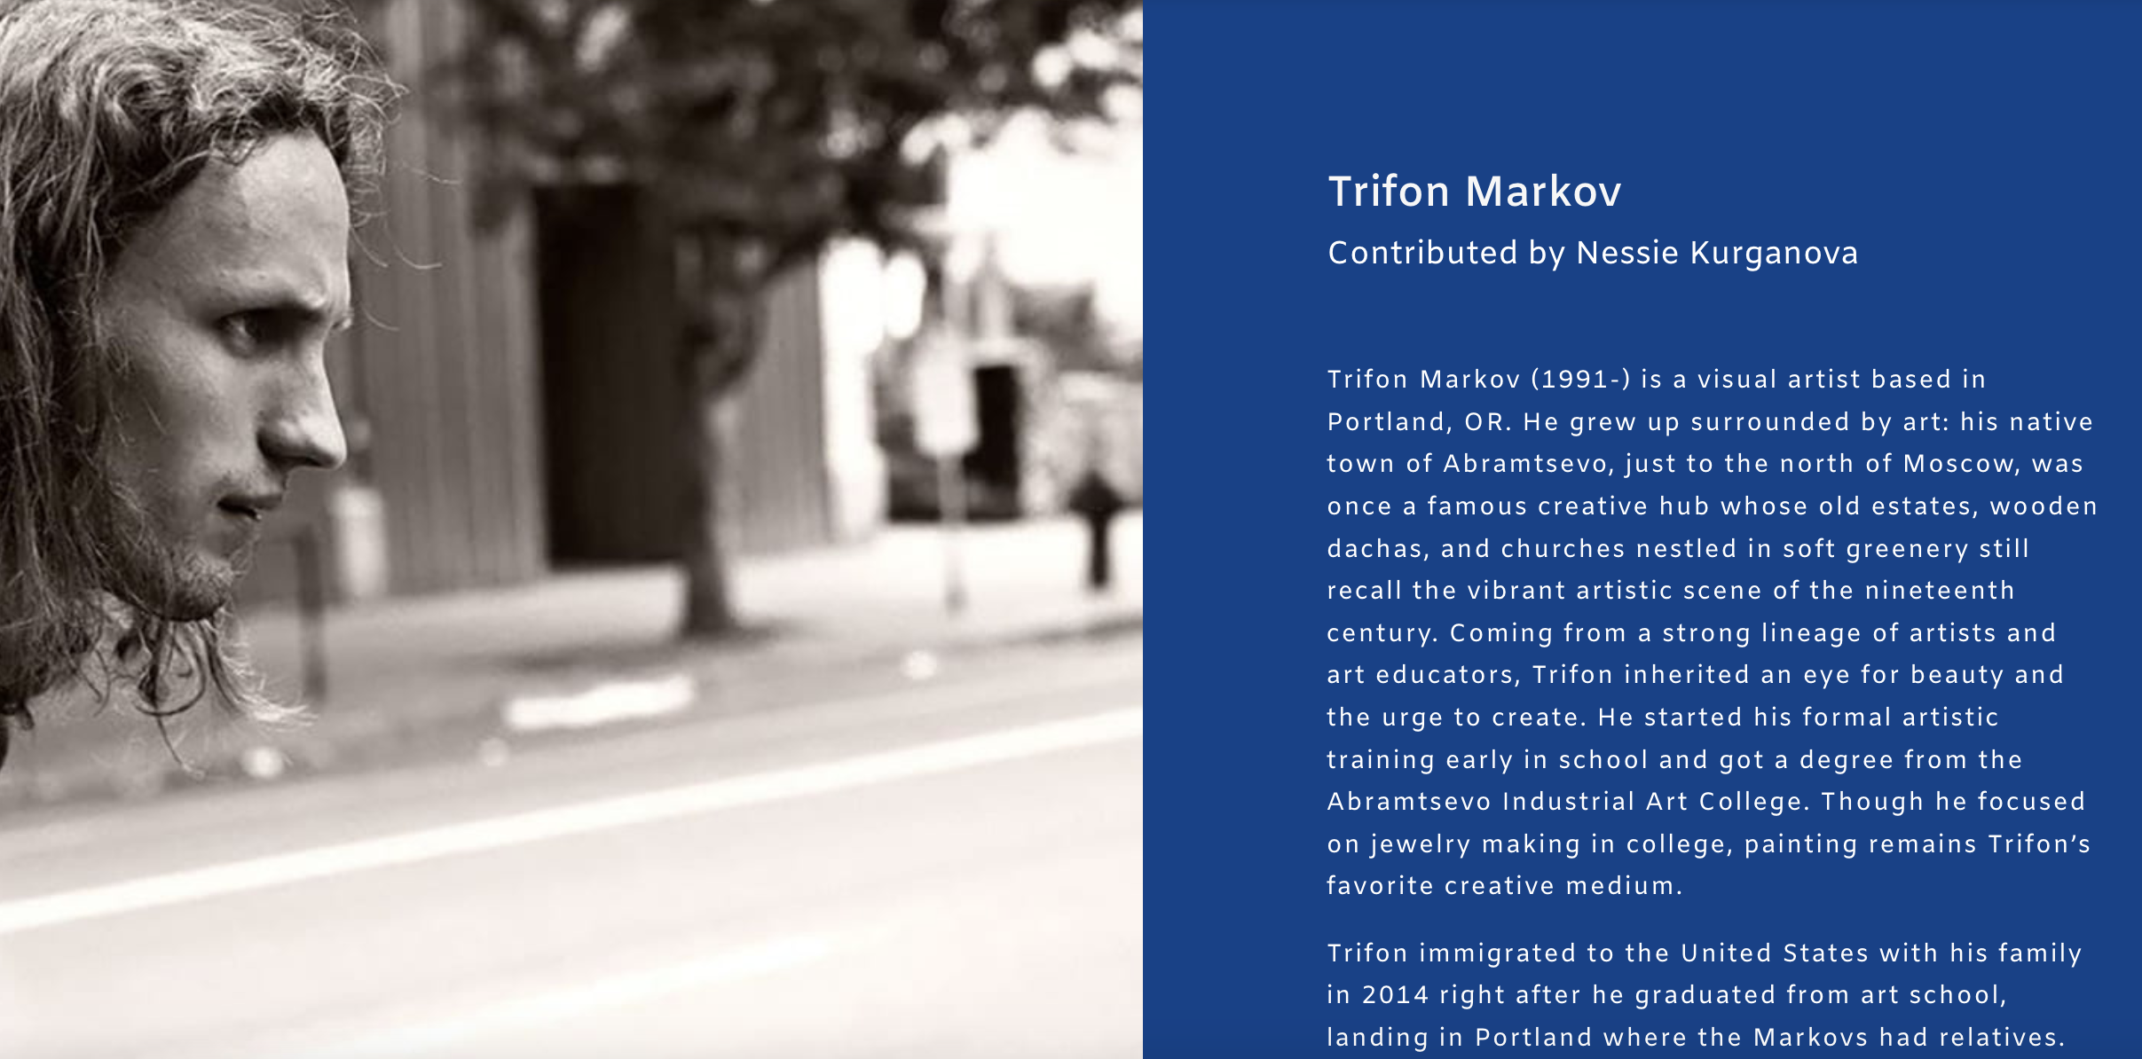
1.
4.
5.
3.
2.
Skills Development and Reflection
Compiling Biographies and Conducting Interviews
Building an Internet-Based Biographical Encyclopedia

Slide 13
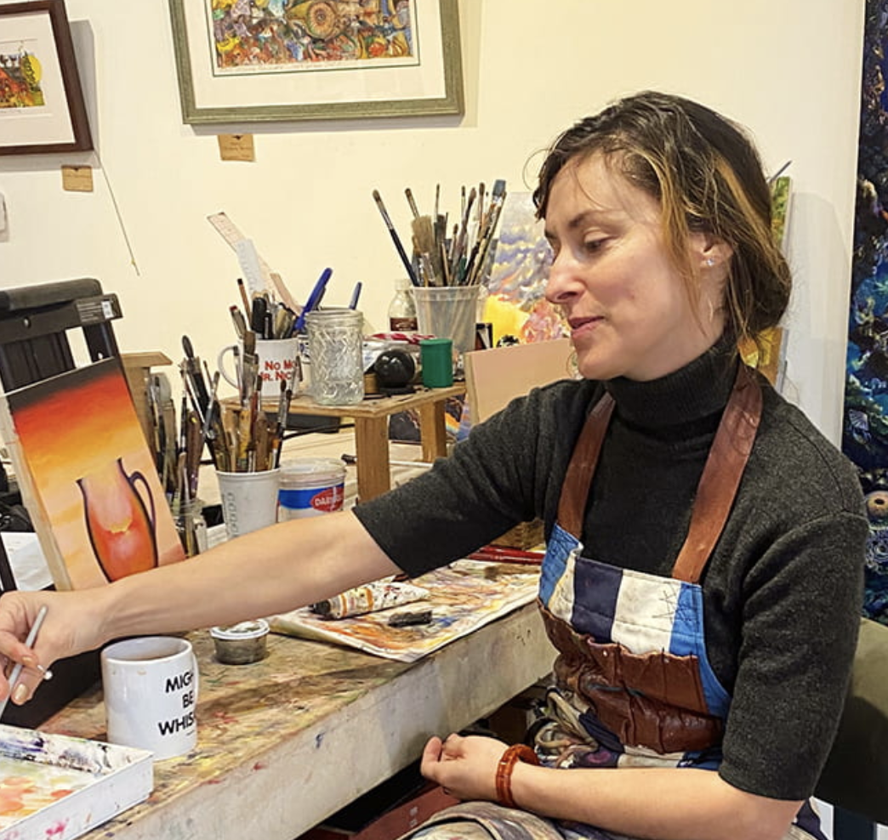

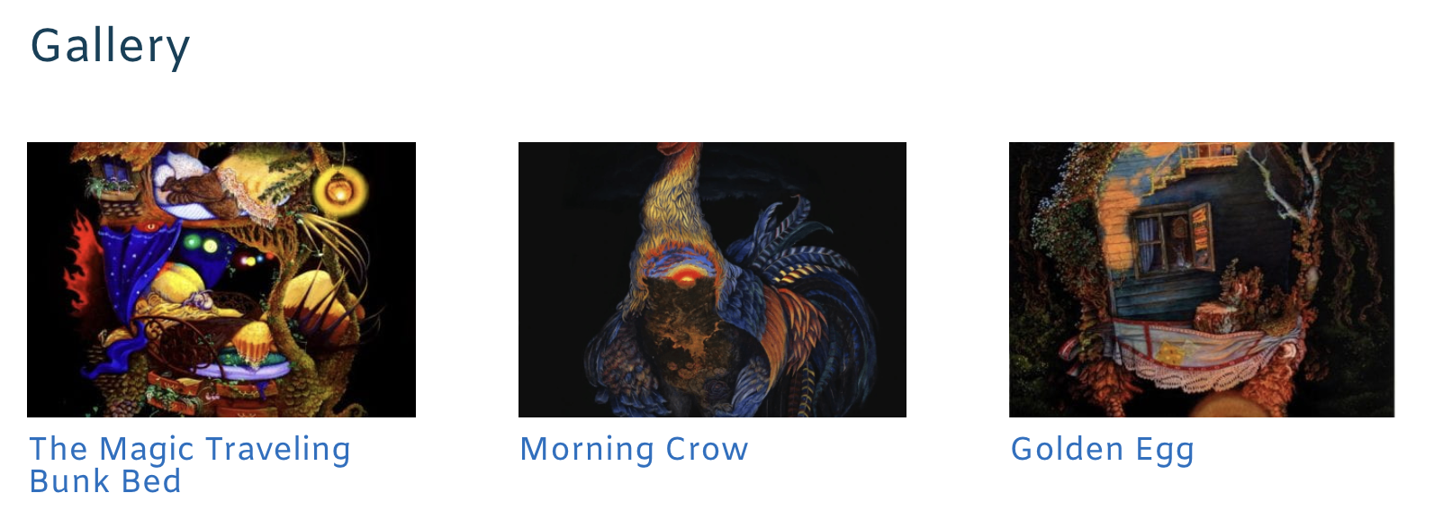
1.
4.
5.
3.
2.
Skills Development and Reflection
Compiling Biographies and Conducting Interviews
Creating a Digital Gallery of Artworks

Slide 14
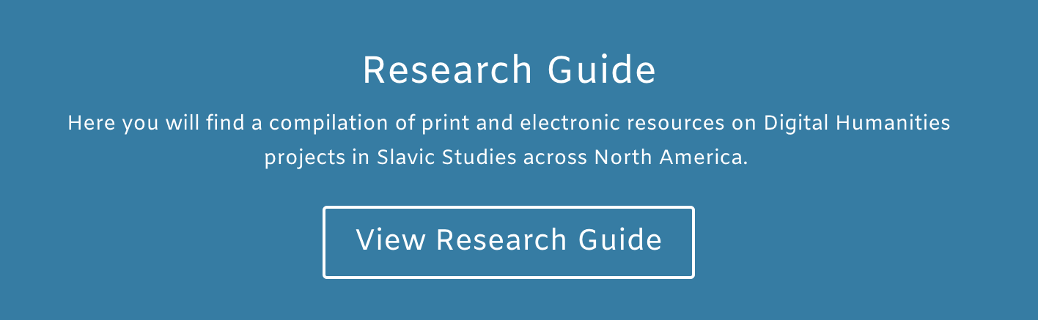
1.
4.
5.
3.
2.
Bibliography of Slavs in North America
Slavs, also known as Slavic peoples — historically located in Eastern and Southeastern Europe. In search of a better life due to various historical, political, economic, and social conditions, Slavs migrated from their homelands — thus extending their settlements across North Asia to the Pacific Ocean. This bibliography includes titles of books that reflect the history and culture of Slavs in the United States with a strong emphasis on Slavic immigrants’ representation in the Northwest. It also provides a number of links to Slavic associations and organizations operating in the United States.
Exploring Slavic Contributions to Northwest Art and Culture
Compiling Biographies and Conducting Interviews
Creating a Digital Gallery of Artworks

Slide 15
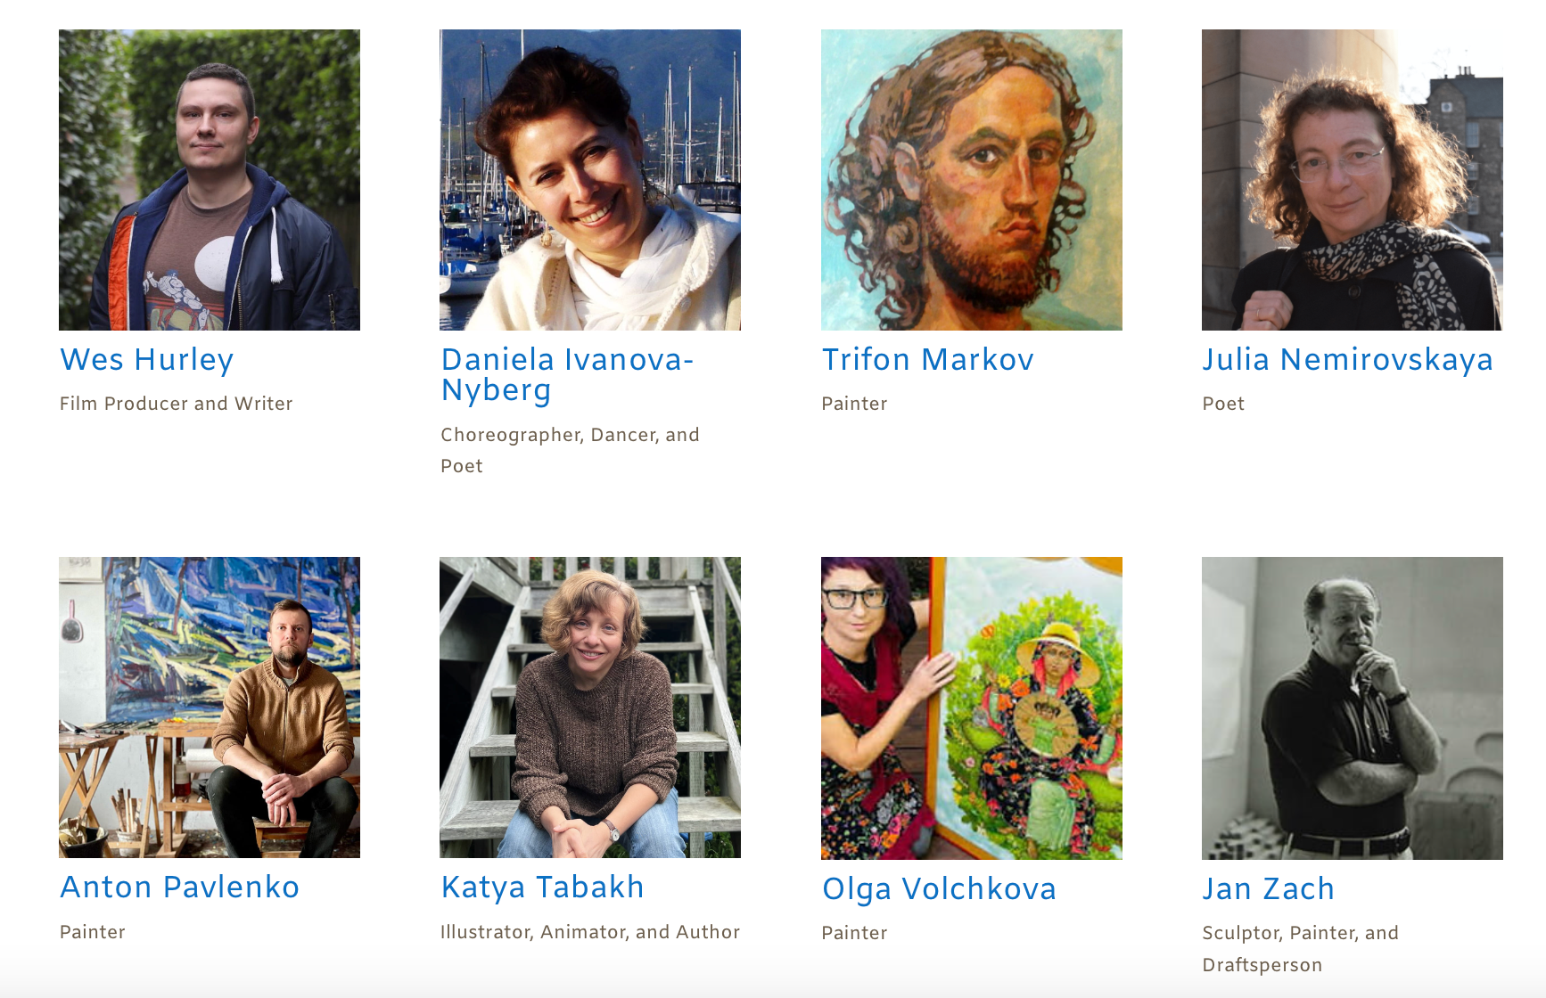
1.
4.
5.
3.
2.
6.
Wes Hurley
Film producer and Writer
Daniela Ivanova-Nyberg
Choreographer, Dancer, and Poet
Trifon Markov
Painter
Julia Nemirovskaya
Poet
Exploring Slavic Contributions to Northwest Art and Culture
Compiling Biographies and Conducting Interviews
Creating a Digital Gallery of Artworks
Publishing an Internet Encyclopedia of Slavic Immigrant Artists in the Northwest
Anton Pavlenko
Painter
Katya Tabakh
Illustrator, Animator, and Author
Olga Volchkova
Painter
Jan Zach
Sculptor, Painter, and Draftsperson

Slide 16
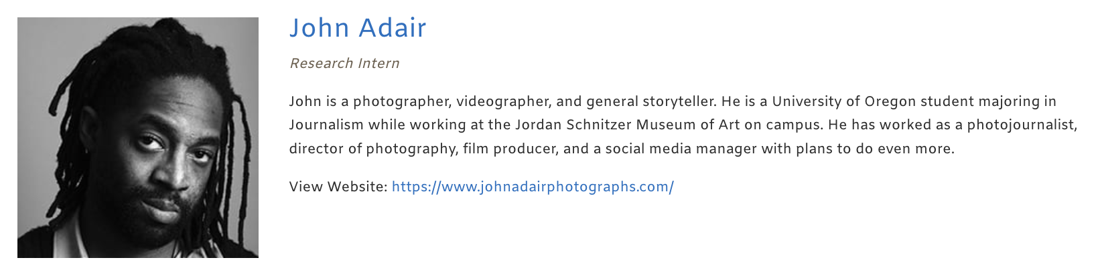

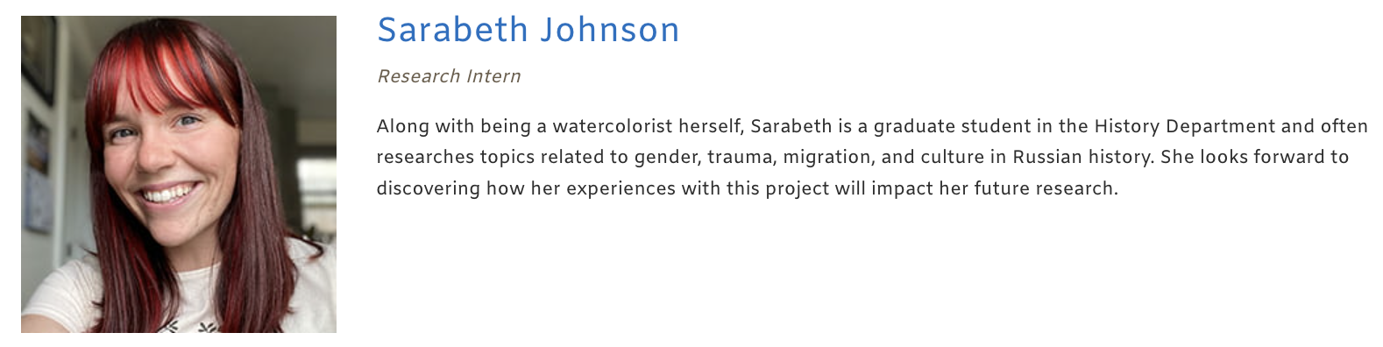
1.
4.
5.
3.
7.
2.
6.
Exploring Slavic Contributions to Northwest Art and Culture
Compiling Biographies and Conducting Interviews
Reflection and Impact Assessment
Creating a Digital Gallery of Artworks
Publishing an Internet Encyclopedia of Slavic Immigrant Artists in the Northwest

Slide 17
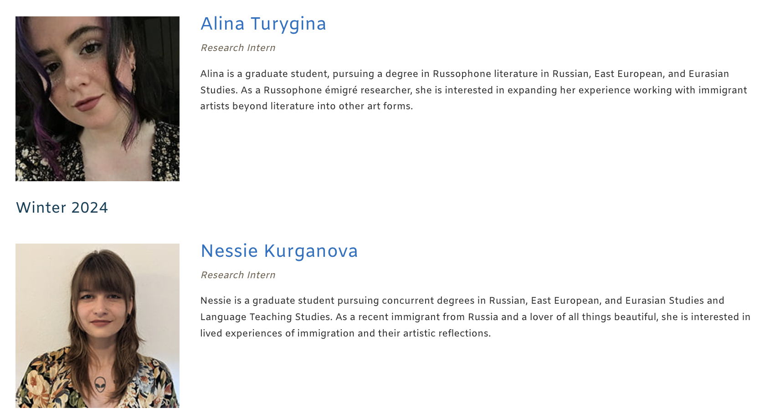
This project offers students a hands-on approach to learning about Slavic heritage and immigrant contributions to the Northwest, deepening their cultural understanding and providing the community with an enduring digital resource.

