Slide 1
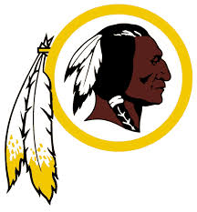
Selling Native Americans Through Sports
By Graham Sprague &
Garrett DeBeau

Slide 2
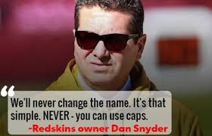
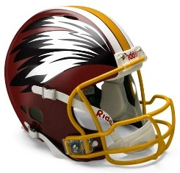
The Washington Redskins
Professional Football team based in Washington, D. C.
1769-1826: Term “Redskin” is created
1933: Football team changes name to Redskins to distinguish from baseball team
1988: National protests begin after teams appearance in Super Bowl XXII
March 2013: Bill introduced to House of Representatives to void any trademarks that “disparage Native American Persons or People, such as redskins.”
May 2013: Redskins owner Dan Snyder promises to never change to name of the team

Slide 3
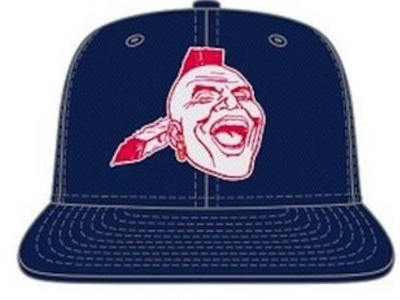
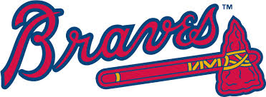
The Atlanta Braves
Professional Baseball team based in Atlanta, Georgia
1912: Introduced as the “Braves” at the beginning of the season
1992: Central Conference of American Rabbis issue resolution asking for end names that promote racism, particularly the Braves
1966: Braves debut “Screaming Indian” upon moving to Atlanta; logo retired in 1989
Dec. 2012: Atlanta considers bringing back the “Screaming Indian” logo; after public outcry the team decides to go with regular logo

Slide 4
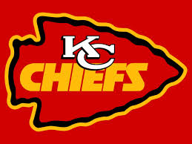
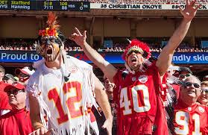
The Kansas City Chiefs
Professional Football team based in Kansas City, Missouri
1963: Moved from Dallas to Kansas City, where name “Chiefs” was acquired in honor of Kansas City’s mayor
1963: Chief’s mascot, a series of Pinto horses, is named “Warpaint” and is ridden by someone wearing a full Native American headdress
1988-89: Chiefs retire Warpaint and an unnamed Indian mascot in favor of their current mascot K.C. Wolf amid growing controversy

Slide 5
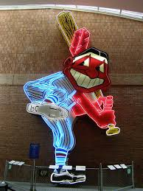
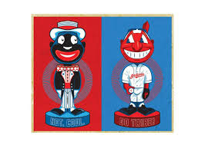
The Cleveland Indians
Professional Baseball team based in Cleveland, Ohio
1947: “Chief Wahoo” logo was created to embody “a spirit of pure joy and unbridled enthusiasm” that the team was looking for
1992: U.S. Commission on Civil Rights released on opinion opposing the use of Native American mascots; Chief Wahoo was never directly named
1997: Protests are held during the All Star Game and the World Series, both of which are in Cleveland.
As of the turn of the century, writers call the protests an “Opening Day tradition.”

Slide 6
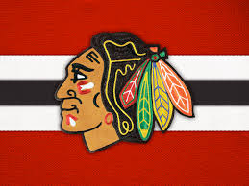
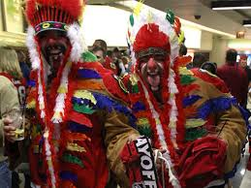
The Chicago Blackhawks
Professional Hockey team based in Chicago, Illinois
1926: Named “Black Hawks” by owner Frederic McLaughlin after his WWI Division, which was named for the Sauk nation war chief
1986: Change name to current spelling
2001: “Tommy Hawk” mascot introduced, a black hawk wearing a team jersey
2010: Dan Snyder of the Redskins asks why the Blackhawks aren’t also getting heat
2013: Blackhawks President John McDonough attends powwow to further understand Native American feelings towards his team’s name

Slide 7
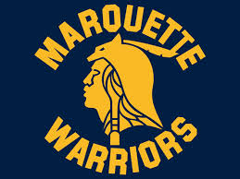
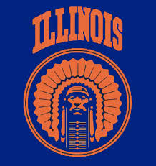
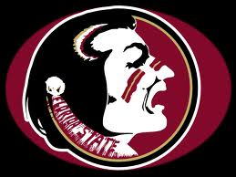
Other Sports Teams
NFL
  Kansas City Chiefs
NBA
  Atlanta Hawks
  Golden State Warriors
NHL
  Chicago Blackhawks
Including innumerable college and high school teams

Slide 8
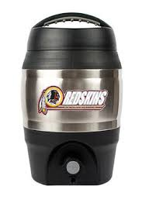
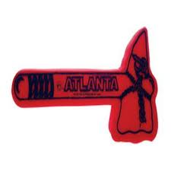
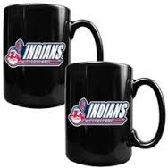
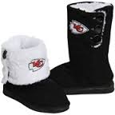
Native Americans as Commodities
These teams sell plenty of merchandise, much of it being plays on Native Americans.
While meant as a honor and tribute to the United States’ indigenous people, it instead comes off as insulting.
Simply put, doing a “Tomahawk Chop” with a foam tomahawk is blatant racism.

