Slide 1

Percent for Art: Opportunity for Collaboration Between USFSP and the St. Petersburg Public Arts Commission
Presentation by
Carol Hixson, Dean
Nelson Poynter Memorial Library
University of South Florida St. Petersburg
October 2, 2012
http://dspace.nelson.usf.edu/xmlui/handle/10806/4866
Notes:
My background:
At UCLA, UO, UR, here
Digital collections expert
Built digital collections at UO, Regina, and here
US State Dept fellow lecturing on digital collections in Spain 2005 and 2006
My staff:
Two librarians have training in digital preservation and experience building digital collections here
Systems person with expertise in managing web-based systems
Access to state-sponsored test site for building collections using CONTENTdm software

Slide 2
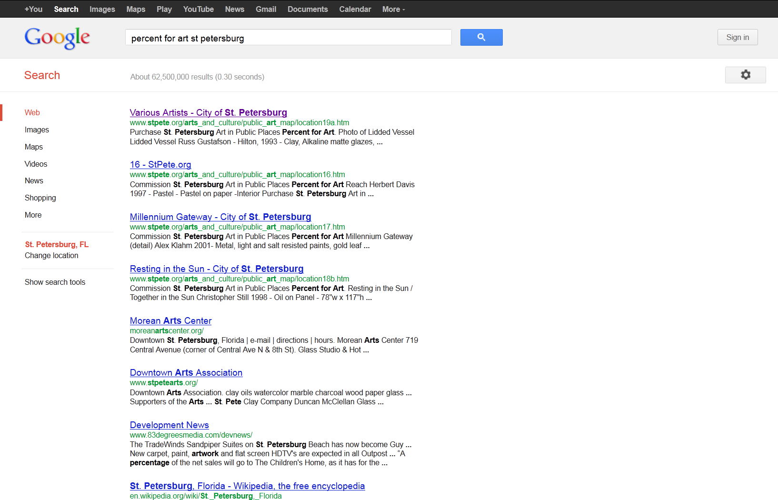
Google search on “percent for art st petersburg”
Notes:
Top hit on Google “percent for art st petersburg” is one of the works of art – doesn’t even take you to a central collection page

Slide 3
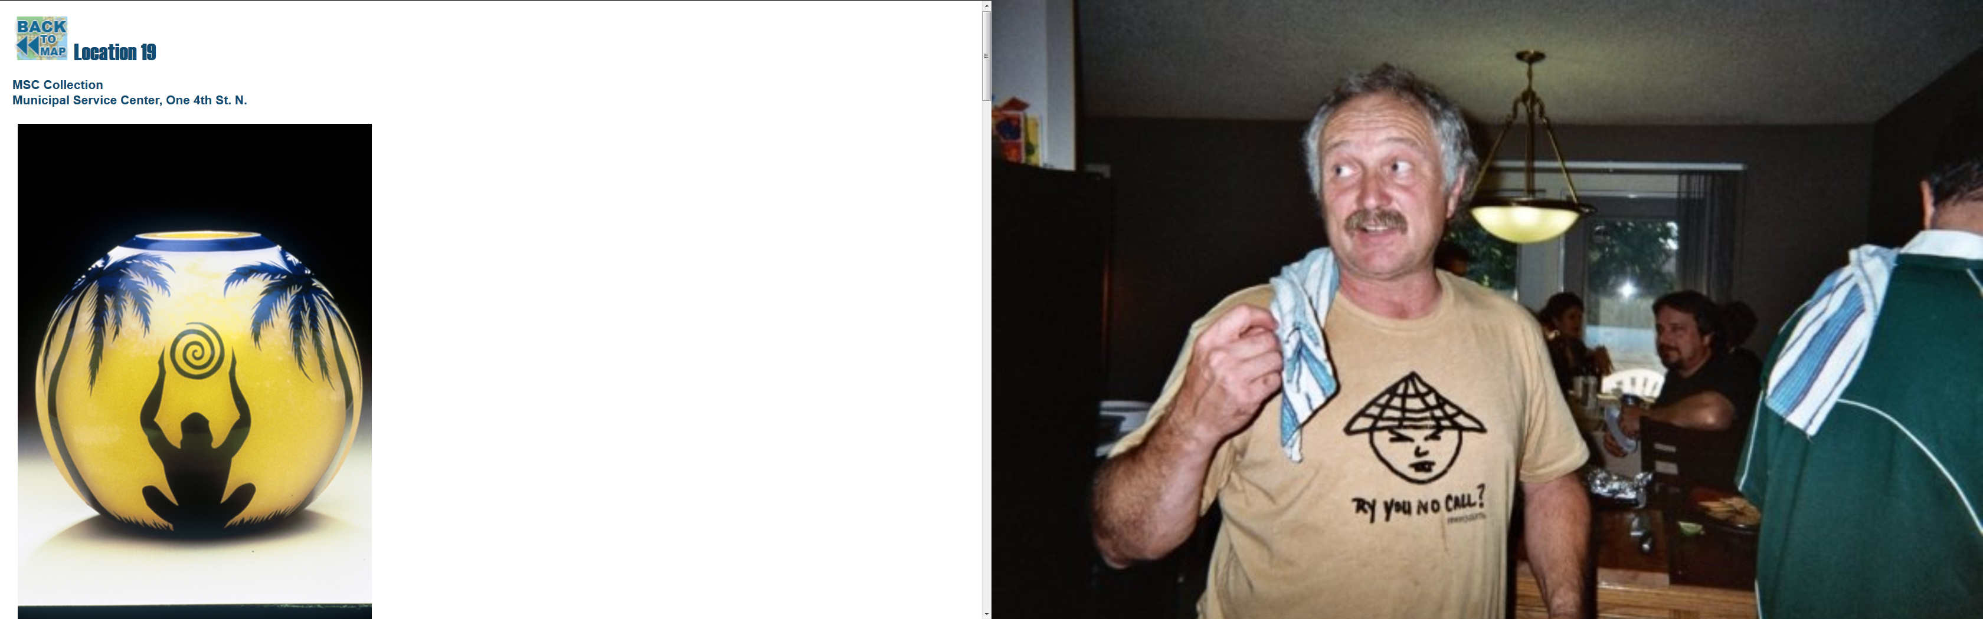
One of the works of art funded from the program
Notes:
This is the top hit on Google. Nice image but there is no way to get to any kind of home page for the collection from here. There is not much information about the object or the artist or where it’s located. The only link is to the map.

Slide 4
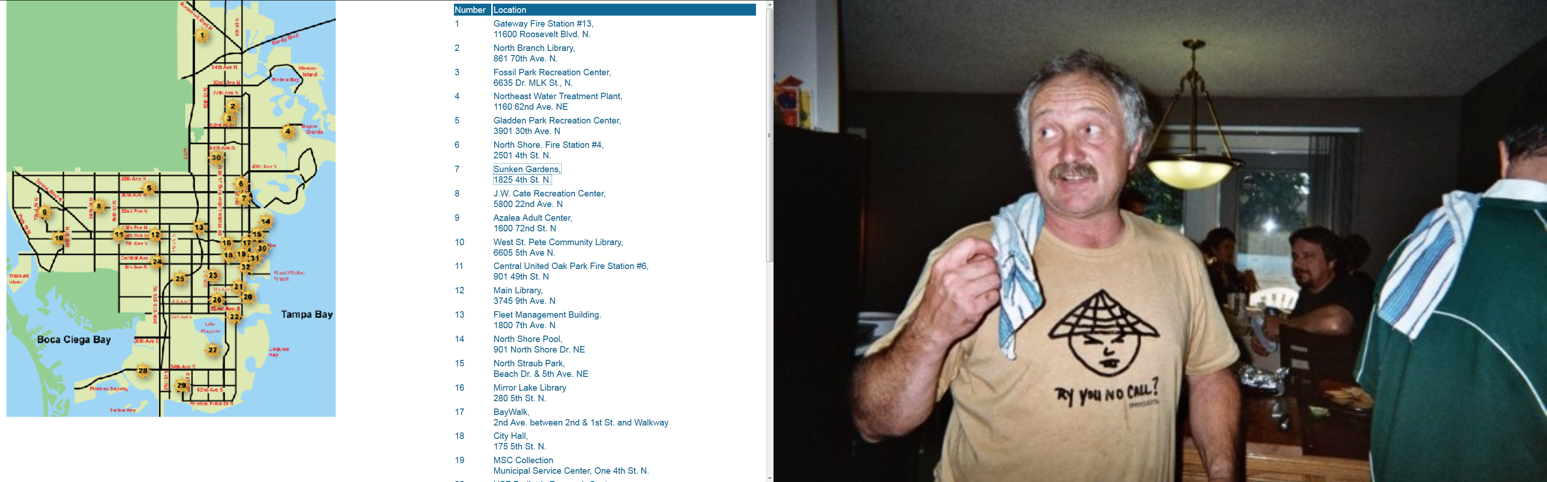
Map of the installations
Notes:
This is the map of the installations –
No link to a central page telling you about the collection or the program
No contextual wrapper

Slide 5
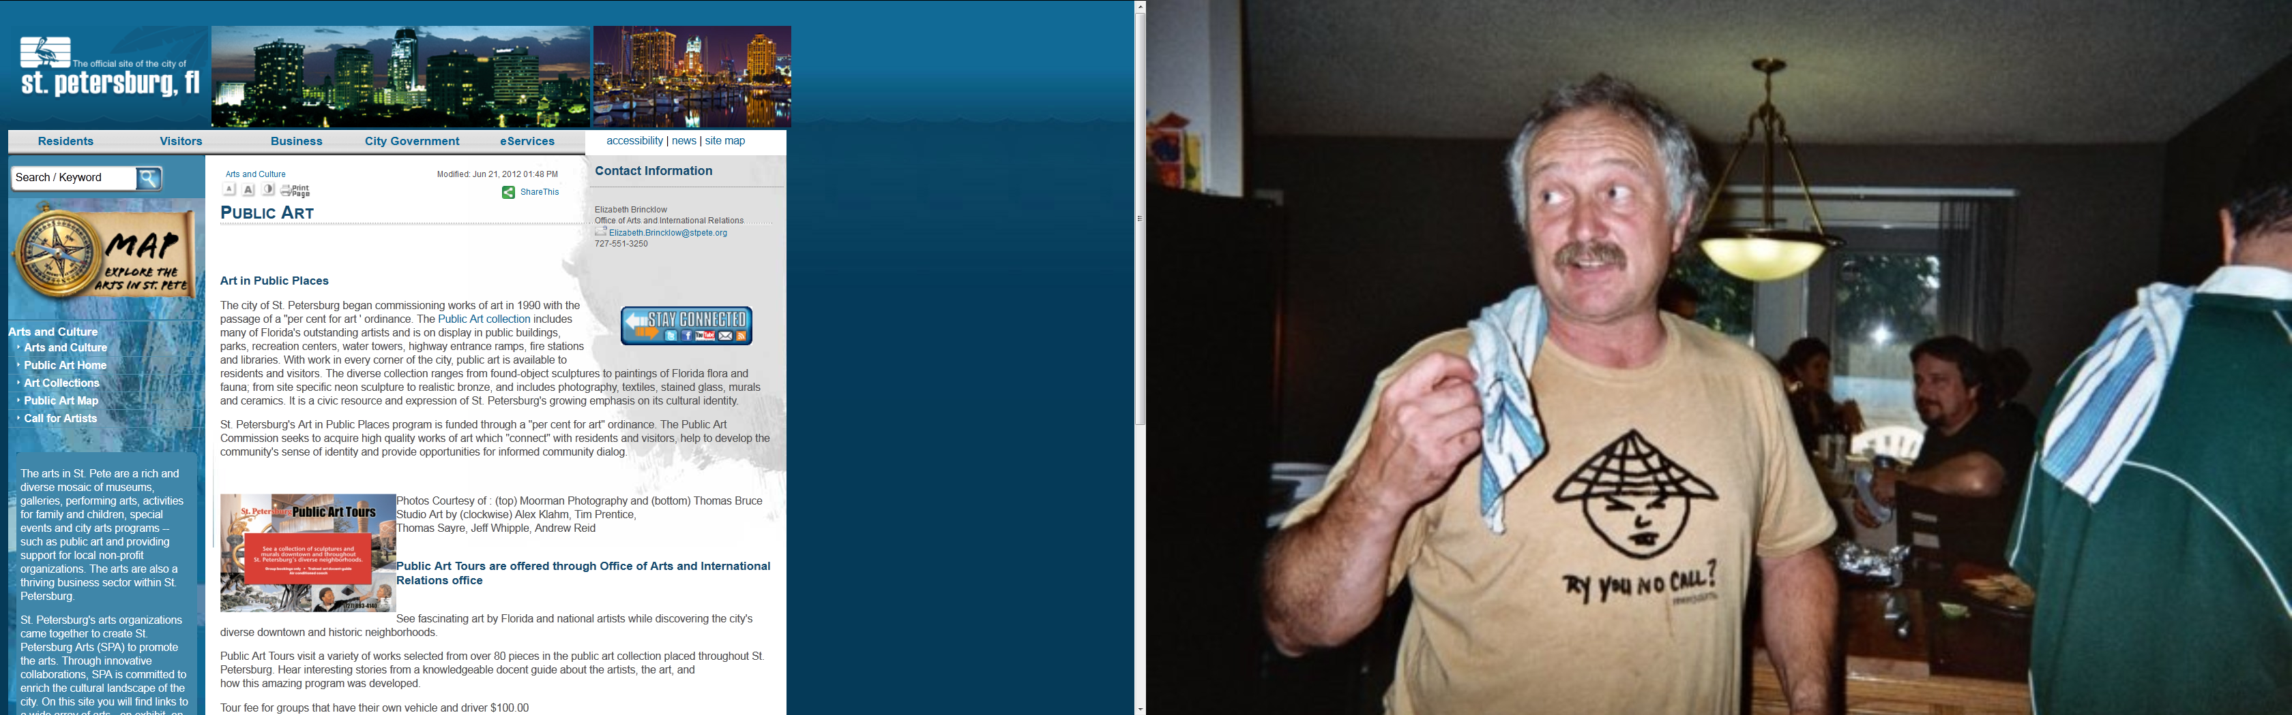
Home Page of the Percent for Art Program
Notes:
This is the closest to a central page describing the collection and the program.
The link on the left to “Art Collection” is the way into the listing of art objects.
Not intuitive what you will find when you click on that

Slide 6
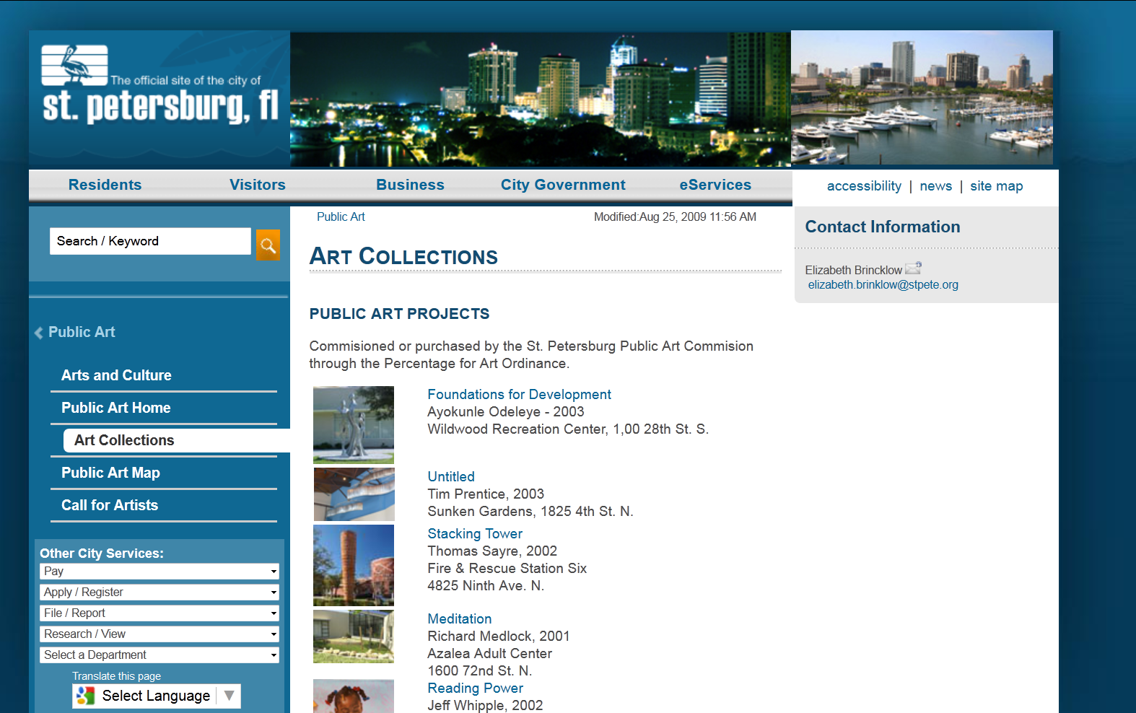
Listing of public art installations
Notes:
Clicking on that link brings up a listing of the public art installations.
You can select one and click through to the page featuring it.

Slide 7
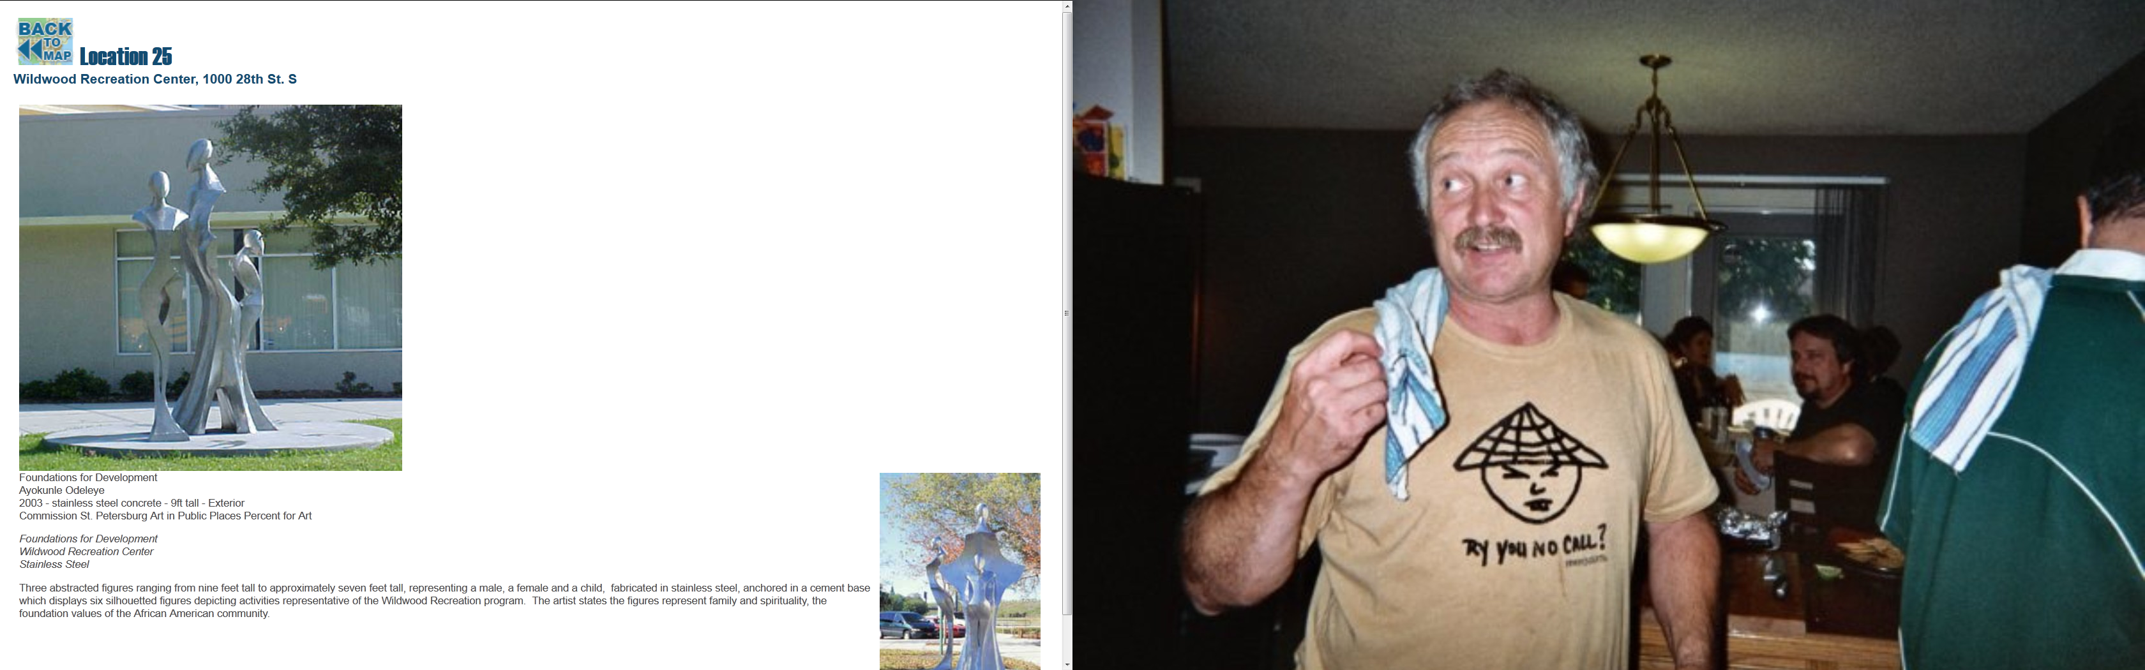
Page for one of the art installations
Notes:
This is what you see when you click through.
Gives some information about artist, year, installation site.
Stuck in a loop – can only now get to the map – cannot get back to the listing that brought you here.
No link to any kind of central page to provide context.

Slide 8
Map of the installations
Notes:
Here you are back again at the map and the only option from here is to select one of the installations

Slide 9
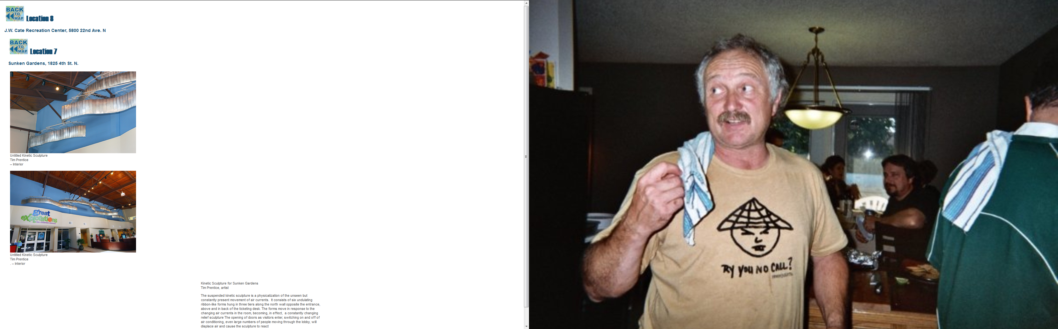
Another installation
Notes:
This page shows images from two different installations.
Some basic information and link back to the map

Slide 10
Drawbacks
Requires someone to develop and maintain a web site and keep it up to date
Hard to find
Inconsistent approach
Hard to market
Hard to move around between items
No contextual wrapper for collection
No indexes for discovery of similar items
Not based on standards so can’t be shared on other platforms
Not stable

Slide 11
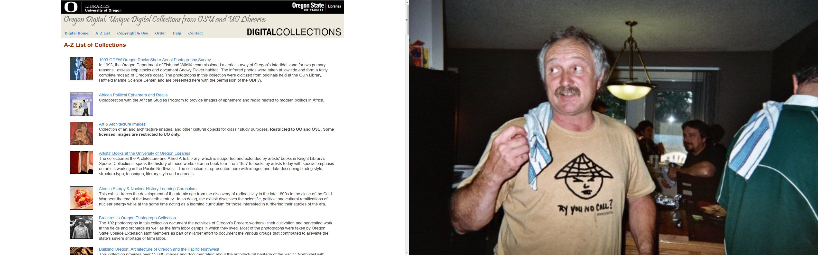
University of Oregon & Oregon State University Libraries
Notes:
Now I want to show you another approach.
This is what I worked on at the University of Oregon Libraries, where we built the first digital collections that they ever had.
This was before UO and OSU libraries merged their separate collections
They were able to merge their collections because they used the same underlying standards and software platform

Slide 12
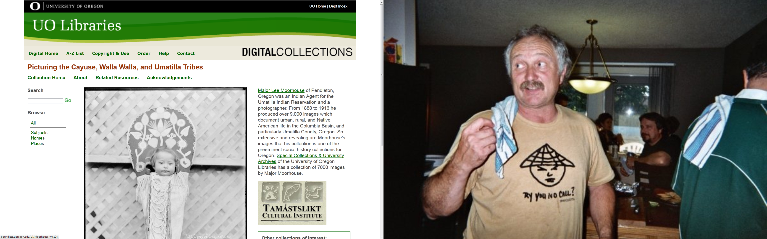
First digital collection for UO Libraries
Notes:
This is the first collection we built.
Collaboration between library and Tamastlikt Cultural Institute – Cultural center of the Confederated Tribes of the Umatilla in Eastern Oregon
Library owned glass plate negatives taken by Indian agent in 1920s and tribes had the cultural context to give the images meaning
Small seed grant
We taught ourselves everything
Complex collection and complex partnership

Slide 13
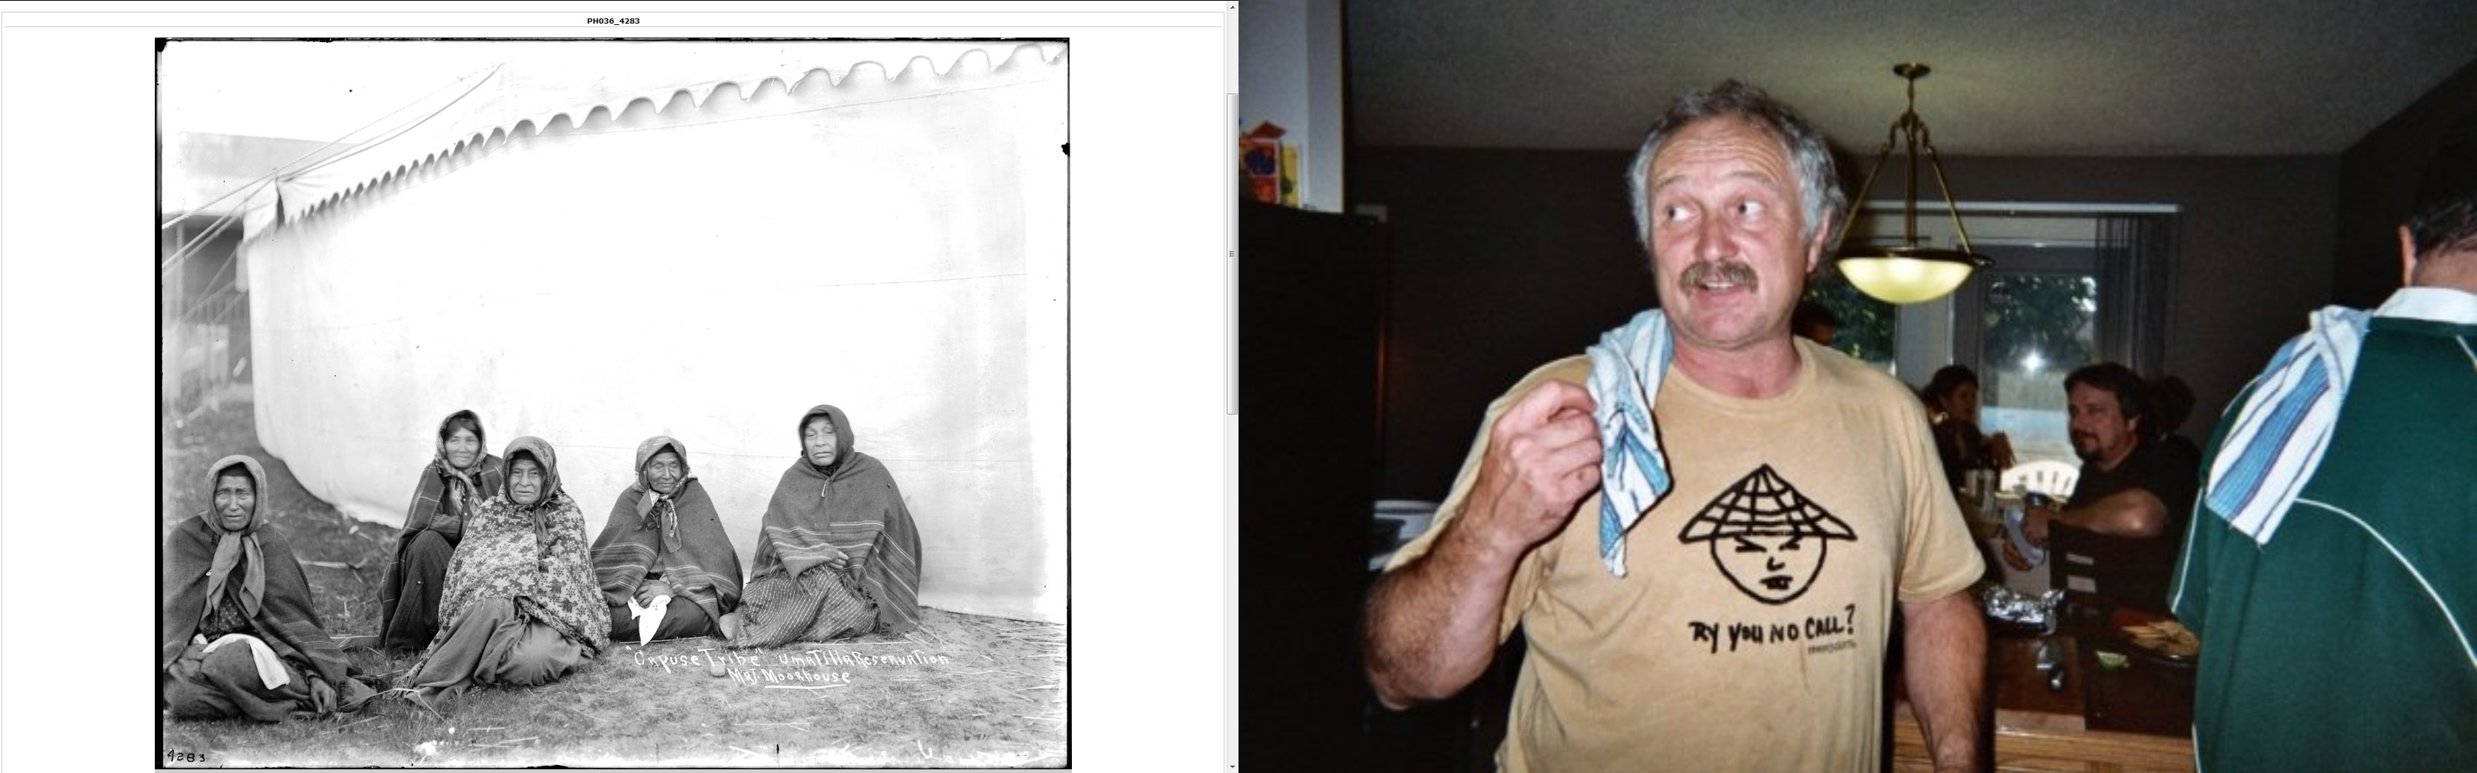
An image from the collection

Slide 14
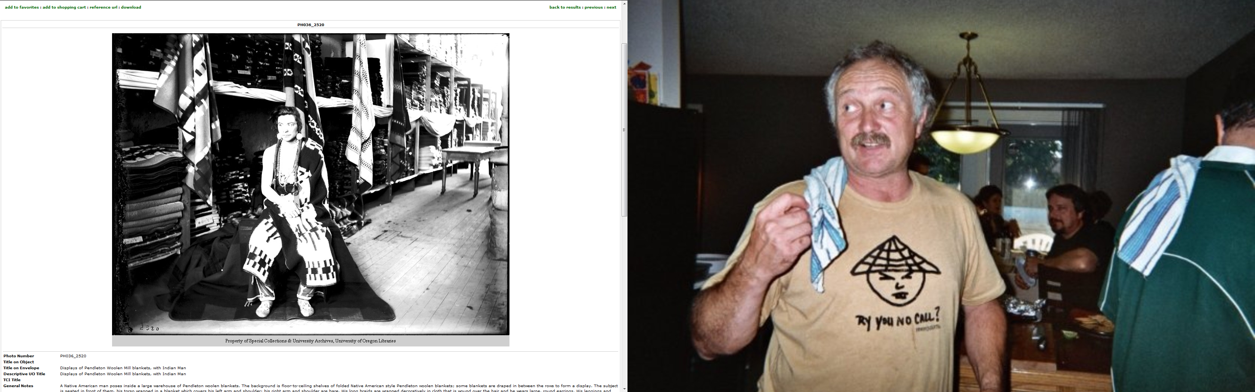
Another image from the collection

Slide 15
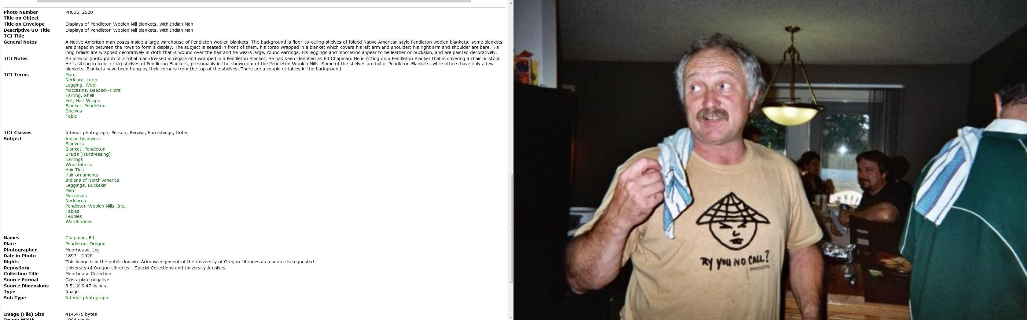
Rich description of the image
Notes:
We worked with the tribes and jointly provided rich description for each image.
We did what it was and they did what the image was about
Parts in green and actually indexes that can be clicked to search against the entire collection
Other description is full-text searchable

Slide 16
Click on one of the terms to see more
Notes:
If you click on one of the terms in green it will search that term against the database

Slide 17
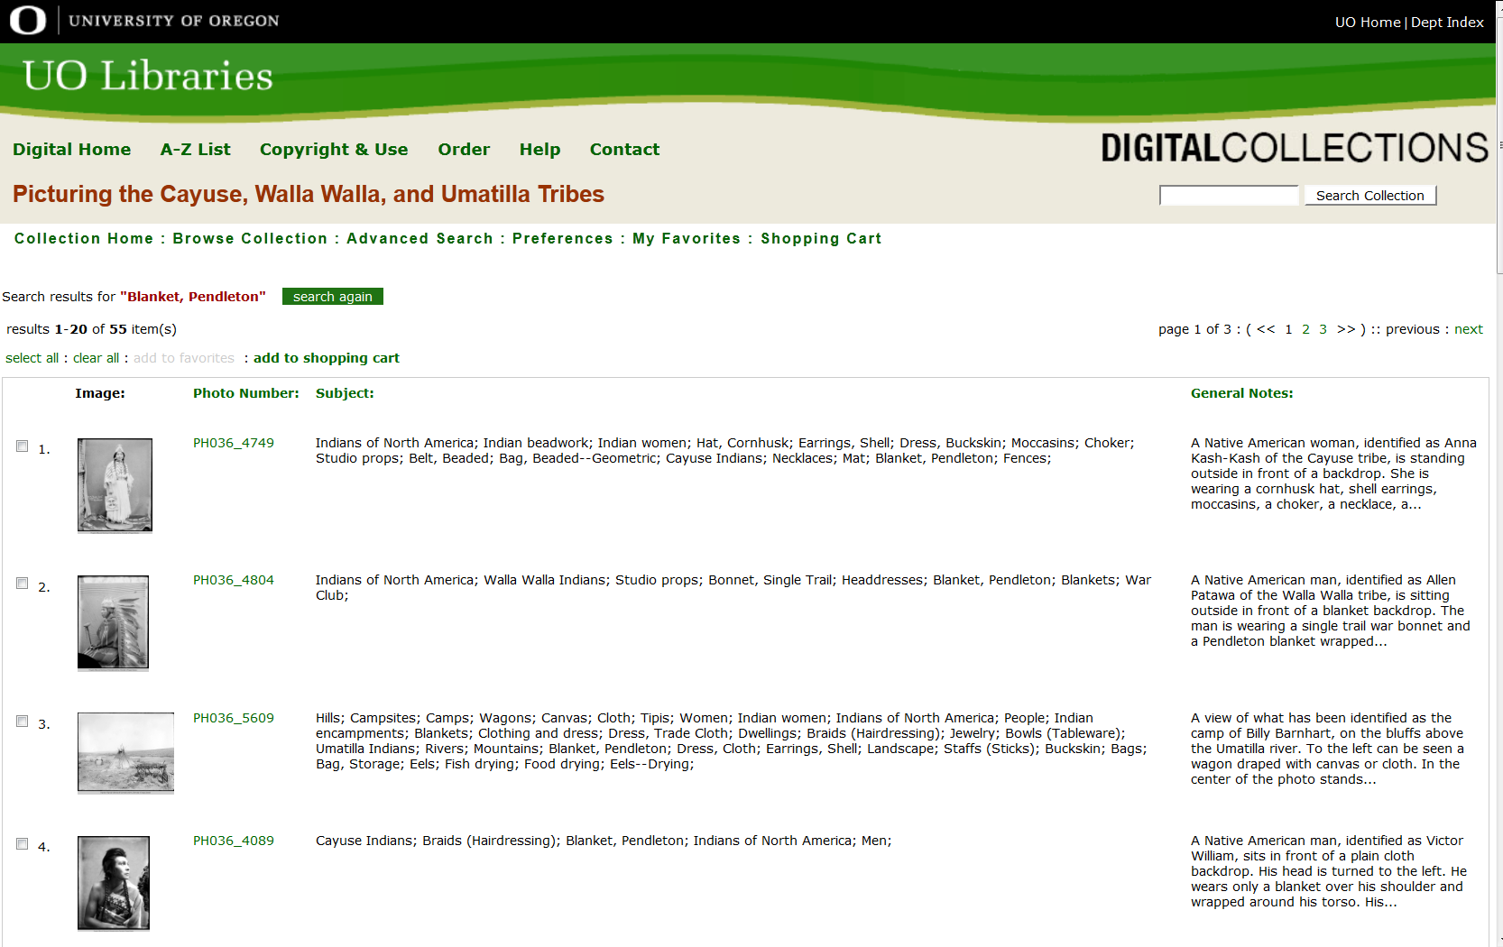
Results of search on term
Notes:
These are the results of searching against the TCI term “Blankets, Pendleton”
Get a listing of thumbnails and brief description.
Click on any one to see the full image and the detailed description

Slide 18
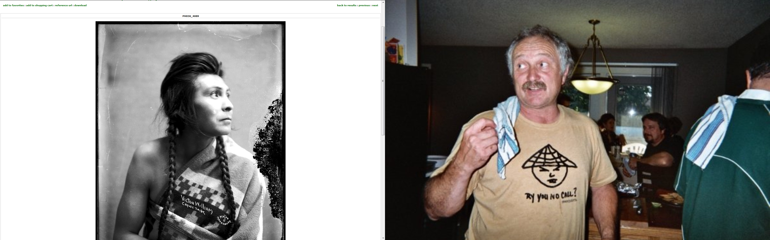
Another image with same term assigned to it
Notes:
This is another image that had the same term applied to it.
Descriptions can be as detailed or as brief as you want to make them.
The software provides total flexibility.

Slide 19
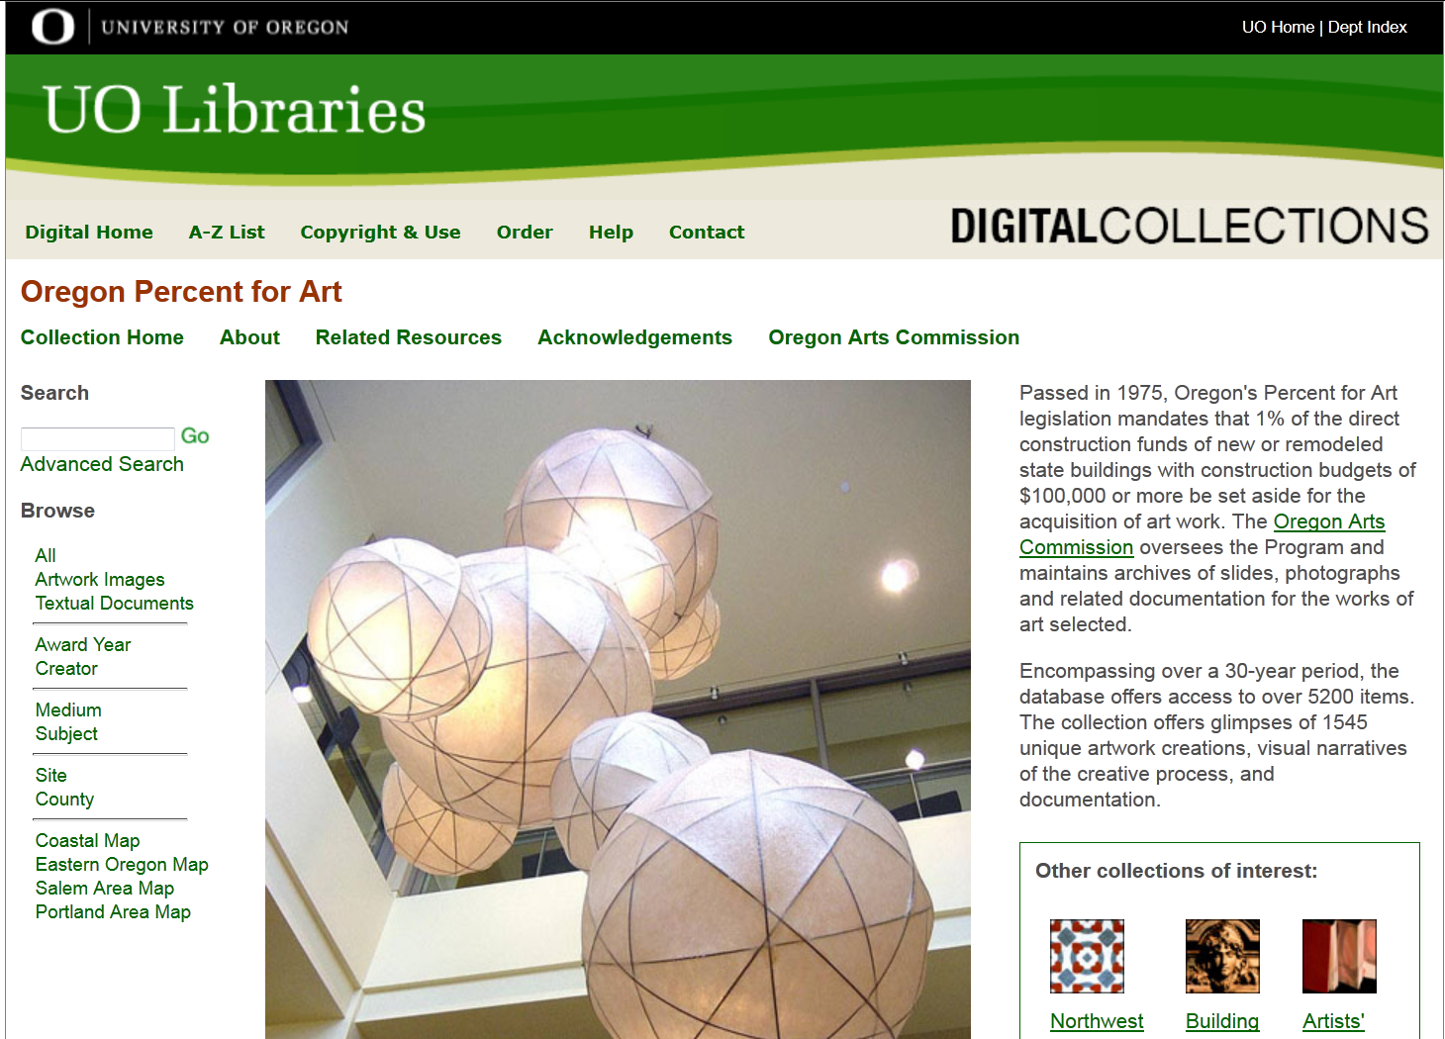
Oregon Percent for Art Collection
Notes:
This was grant-funded collection built with the materials owned by the Oregon Arts Commission using the equipment and expertise of the UO Libraries
We took their slides and created digital images
We digitized documents
We created the descriptions
We hosted the collection
Together we decided on the level of description and the types of indexes.
On left, you see the data elements that they wanted to capture: Award Year, Creator, Medium. Subject, Site location, County, various maps

Slide 20
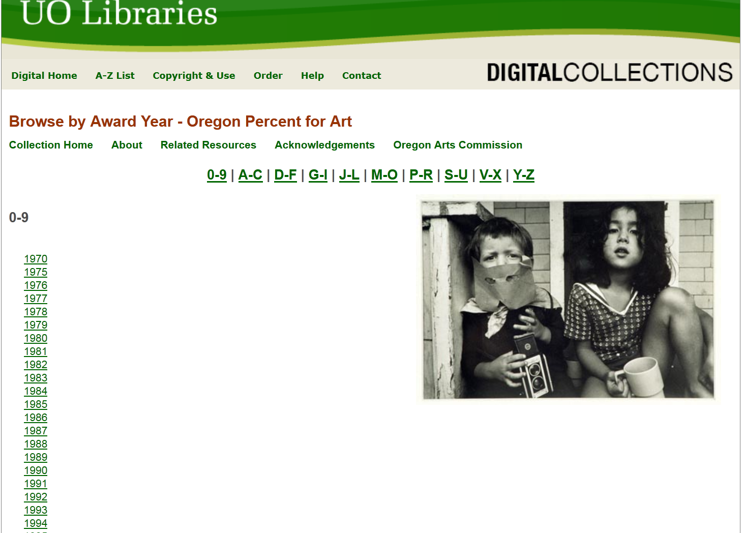
Example of one index – award year
Notes:
Click through on one year - 2005

Slide 21
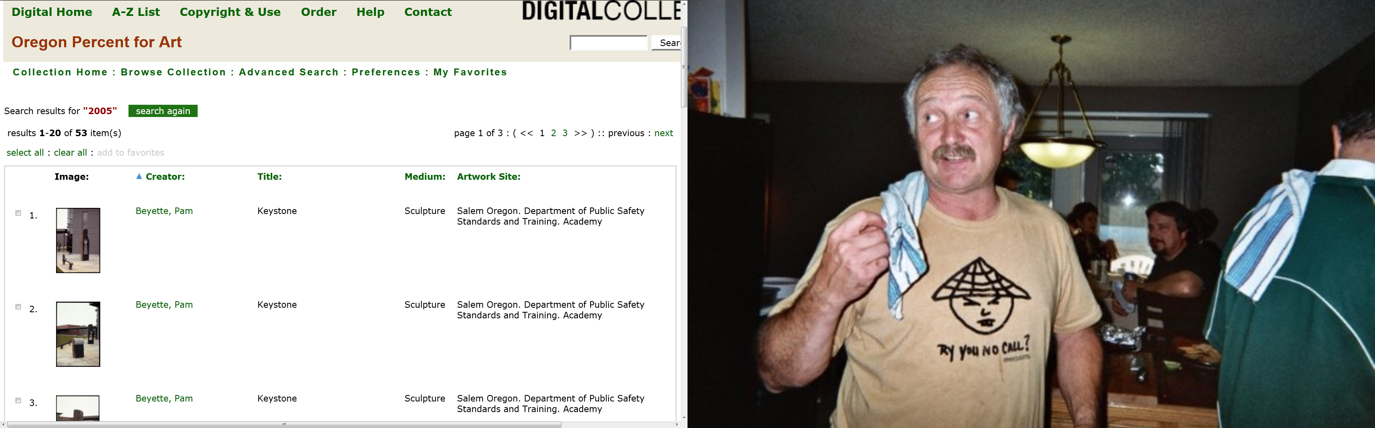
Results for 2005
Notes:
This is the results set for award year 2005 – 53 items were funded from that award year.
Clicking on any object will open up full image and full description.

Slide 22
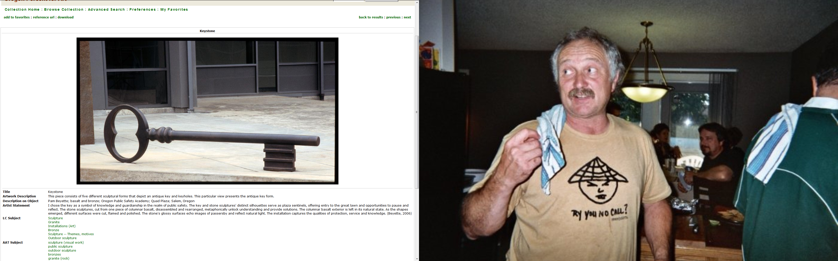
One image selected from all of 2005
Notes:
This is one artwork from that award year.
The description is full.
Green items are actually indexes you can search by clicking on them.

Slide 23
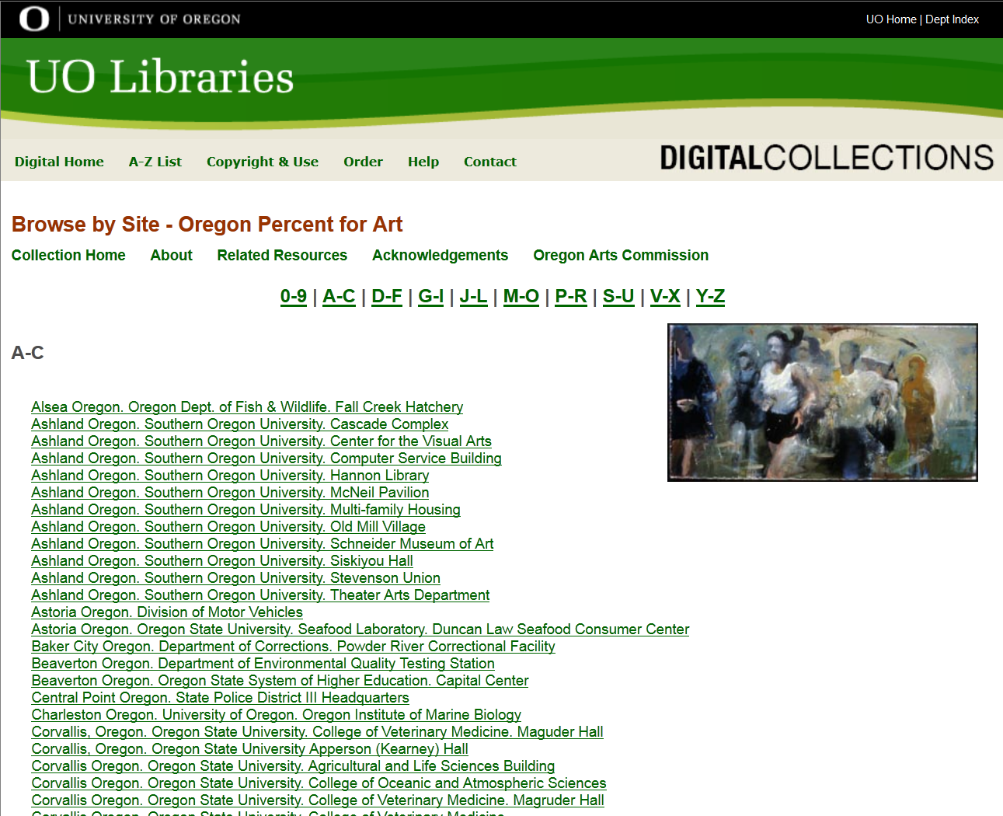
Site index – generated dynamically
Notes:
This is the site index – alphabetical listing of sites around the state.
Whenever a new item is added with that search term, it gets added to the list dynamically.

Slide 24
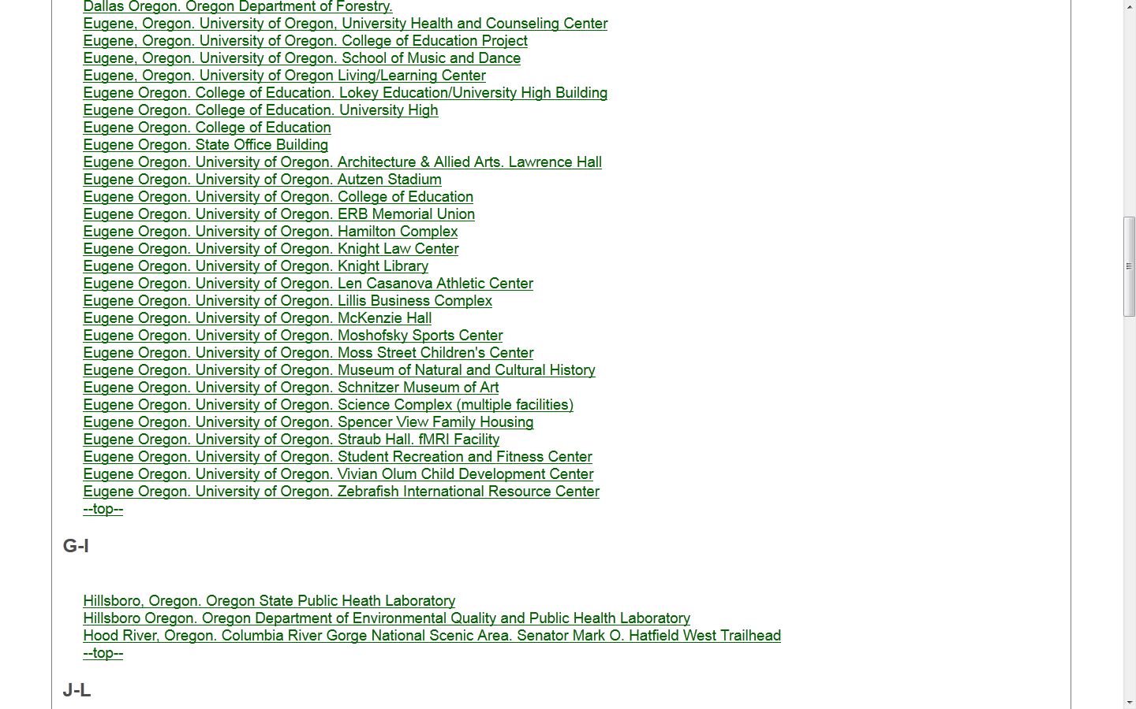
Select the building in which I worked
Notes:
If I select the building in which I worked – the Knight Library (named after Phil Knight of Nike fame) and click on it

Slide 25
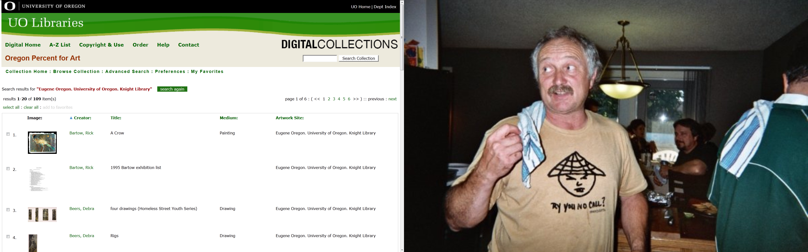
Listing of all art works in the building
Notes:
It shows 109 items in the building (including documents such as the artists’ statements about their work.)

Slide 26
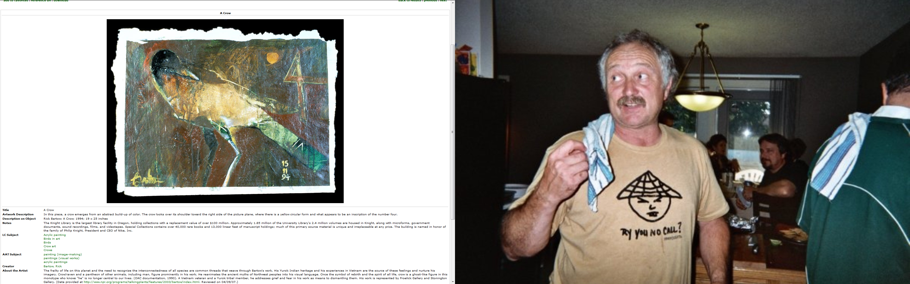
One image – rich description
Notes:
This is one image from that list and you can see part of the description below.
Items showing as green can be clicked to do a new search against that term

Slide 27
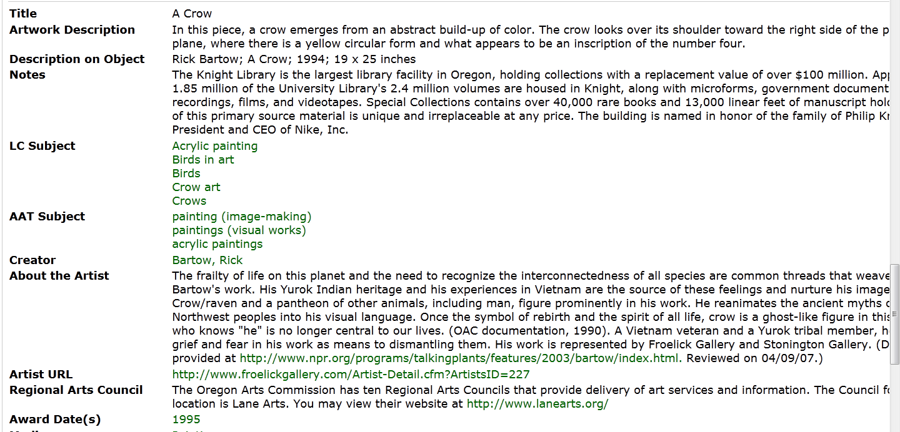
Rich description
Notes:
Look at the detail.
Detailed information on the site, the artist, and more.
Some of this can be built into a template so it doesn’t have to be keyed in every time.

Slide 28
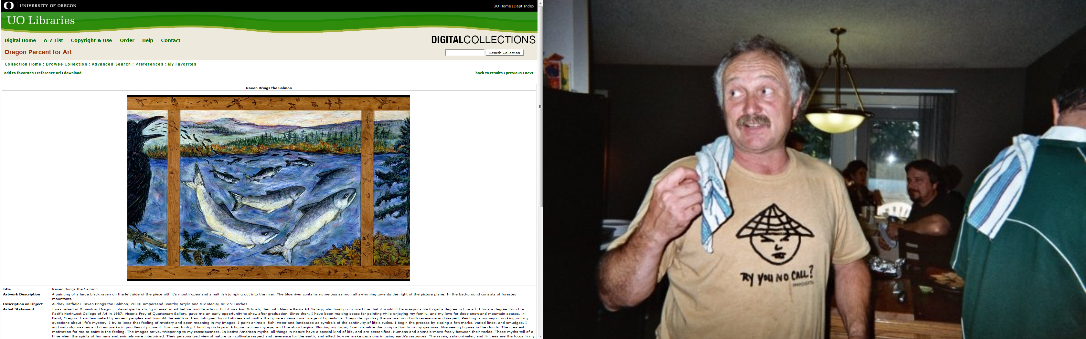
Another image from the collection
Notes:
Another image – nice quality. Oregon Arts Commission is using these images on their web site to promote the program.

Slide 29
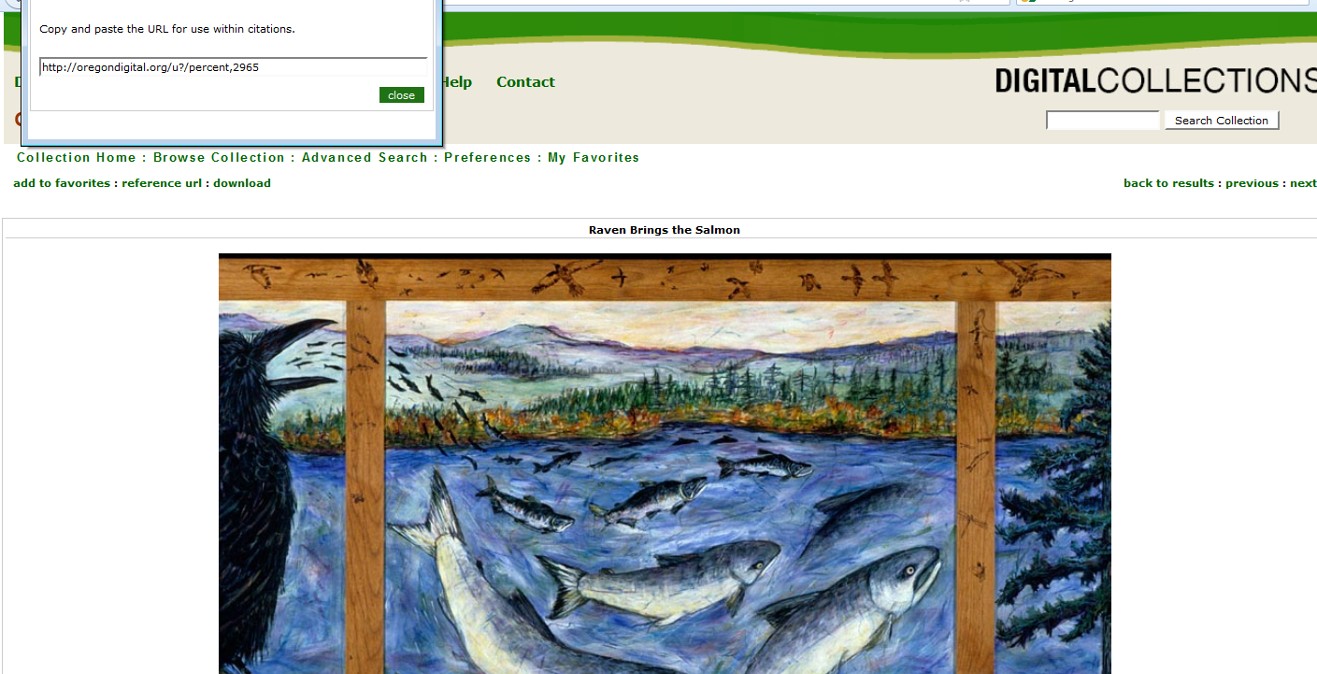
Each image/item has a unique URL
Notes:
Each image has a unique URL and you can get that by clicking on the “reference URL” button to pull up the pop-up box – or you can cut and paste from the web page like normal

Slide 30
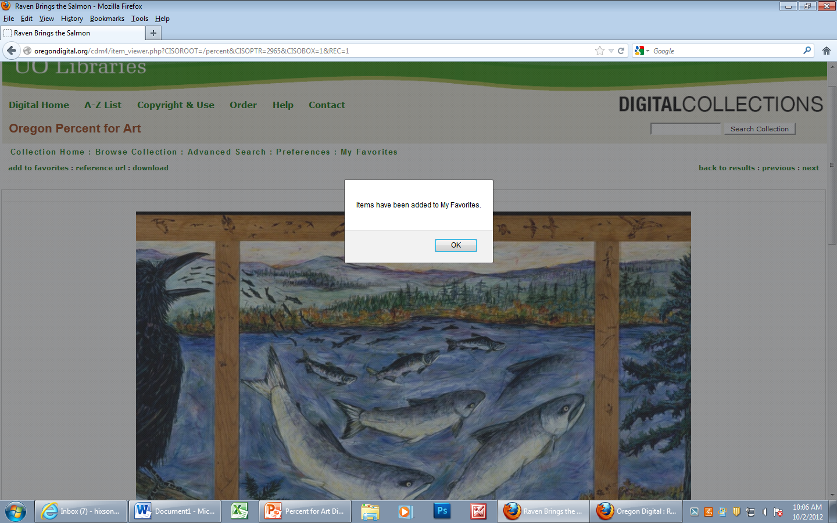
Can add items to favorites
Notes:
You can add items to your personal favorites list
Users do not need to have a userid or login to do this –it tracks by the IP address of the computer you’re using
You may need to have a userid to save these from session to session

Slide 31
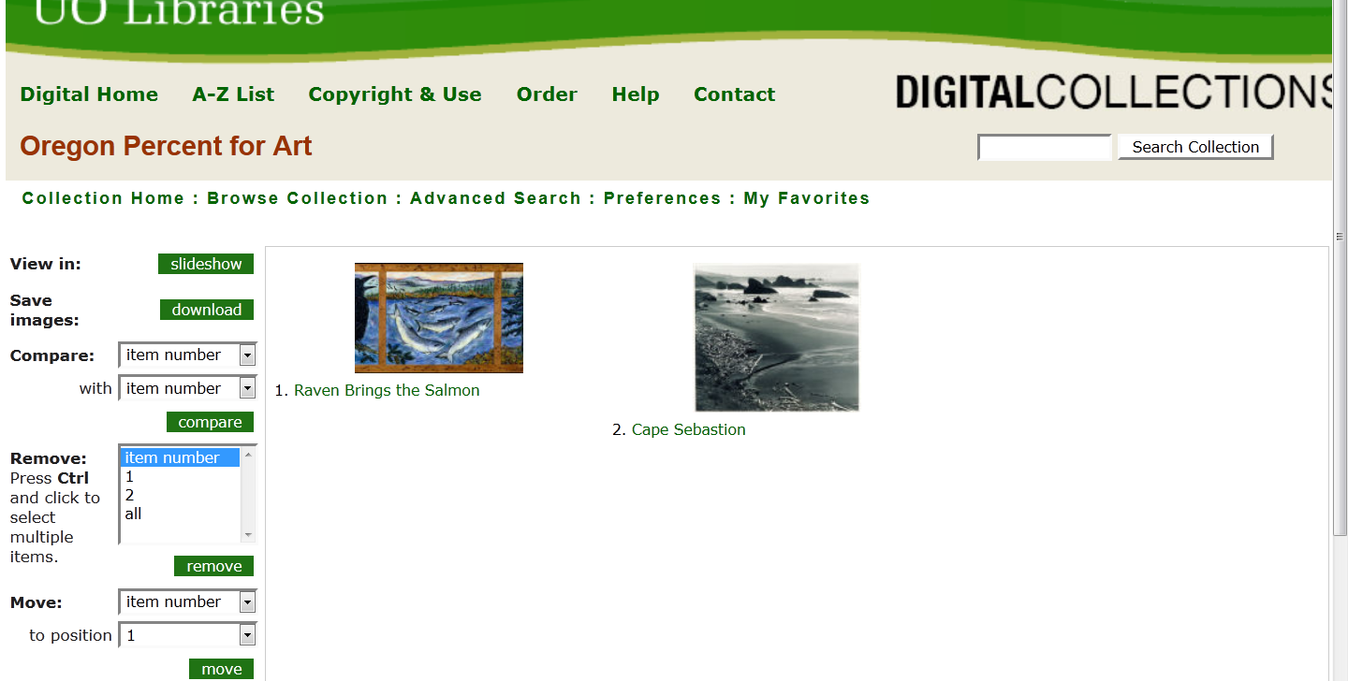
You can collect favorites
Notes:
You can collect favorites.
The second item here is a photo by Ansel Adams
You can then do different things like saving them, showing them as slideshow, and more.

Slide 32
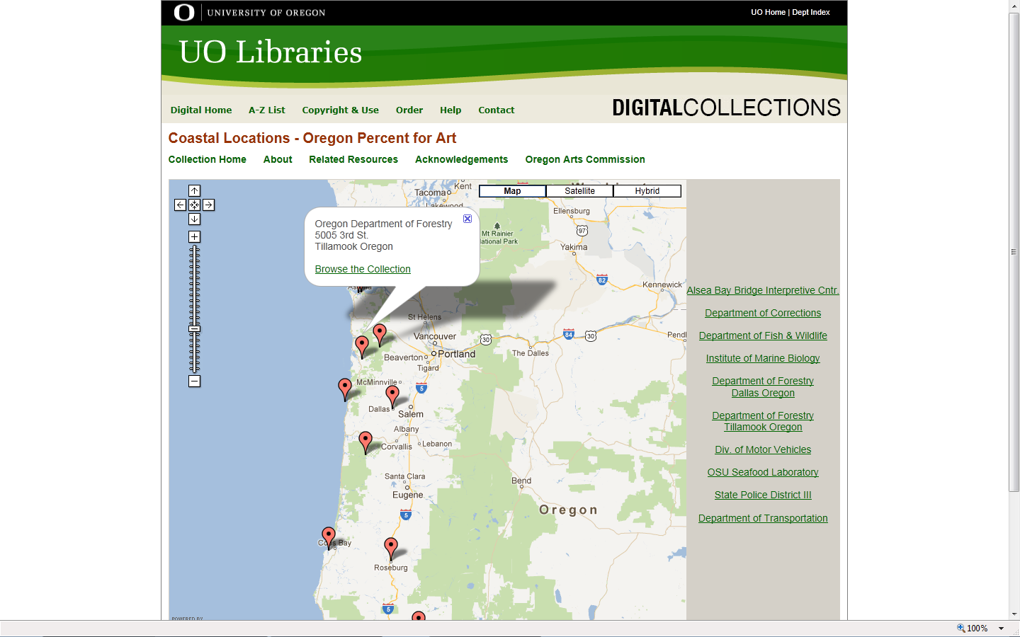
One of the maps locating items
Notes:
This is one of the maps that accompanies the collection
Clicking on a button brings up the pop-up box showing the location
Clicking on Browse the Collection searches the database for all items at that location
This was developed as an add-on by UO Libraries staff
The sidebars are also hotlinks to the different locations and searches against the full database for the collection

Slide 33
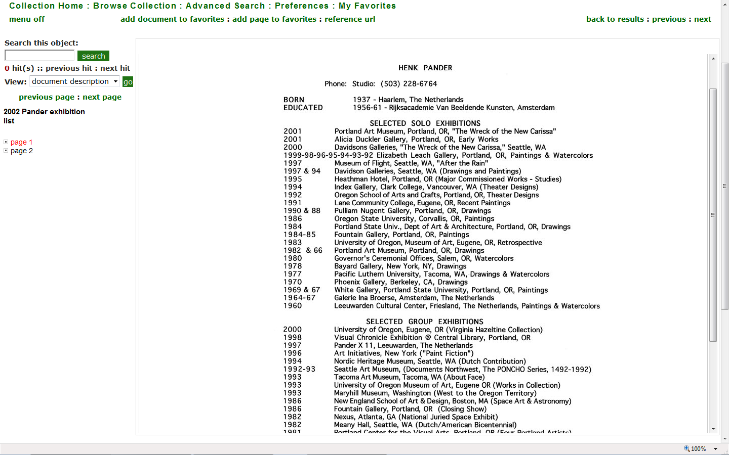
Example of a document
Notes:
This is an example of a document.
Documents can be set up for full-text searching.
The red highlights where you are in a multi-page document.

Slide 34
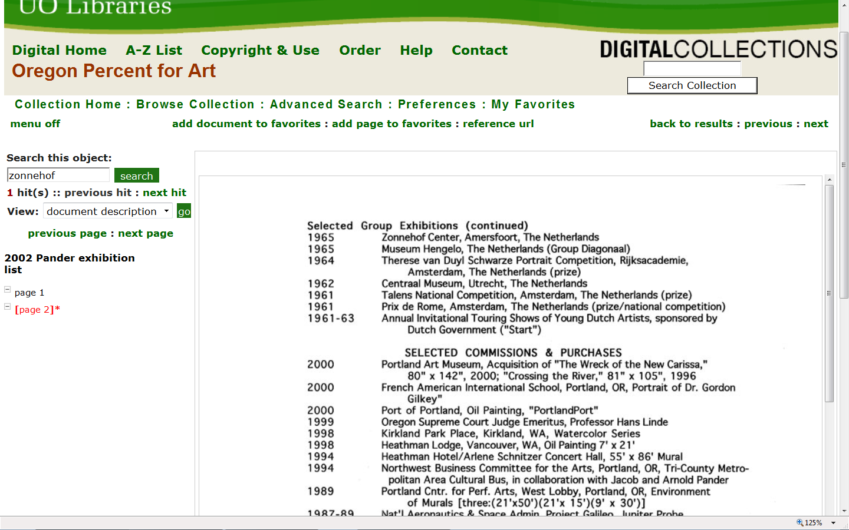
Example of full-text searching
Notes:
If you do a search against the object on a term, it will highlight in red on which page(s) the term or word appears.

Slide 35
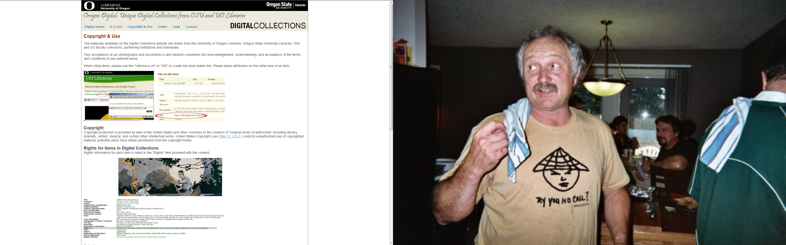
Copyright statements and other protections
Notes:
This is an example of a copyright statement.
Other ways to protect the intellectual property:
Watermarks, low resolution images, can also restrict access to collections and require a password

Slide 36
Advantages
Better searching and discovery
Consistency
Easy access
Customizable – you decide on indexes, labels, detail of description, etc.
Based on international standards
Marketability
  URLs that can be posted and linked anywhere
  Specific searches have unique URLs, as well as items, entire collections, or whole indexes
Multiple formats (images, documents, maps)
Items hosted and preserved for you
Organization and technical expertise of USFSP librarians and staff

Slide 37
Next steps
If yes, MOU would be needed
  Who does what? Responsibility? Sustainability?
Decide whether to apply for grant
Develop project plan and timeline
  How much detail? Types of indexes? Resolution of images? Contextual wrapper?
Load in images
Add descriptions
Develop web pages, as needed
Market

Slide 38
Resources
UO Digital Collections: http://boundless.uoregon.edu/digcol/
Picturing the Cayuse: http://boundless.uoregon.edu/digcol/mh/
Percent for Art:
http://boundless.uoregon.edu/digcol/oac/
Sample copyright statement:
http://boundless.uoregon.edu/digcol/rights.php
CONTENTdm software: http://www.contentdm.org/

