Slide 1
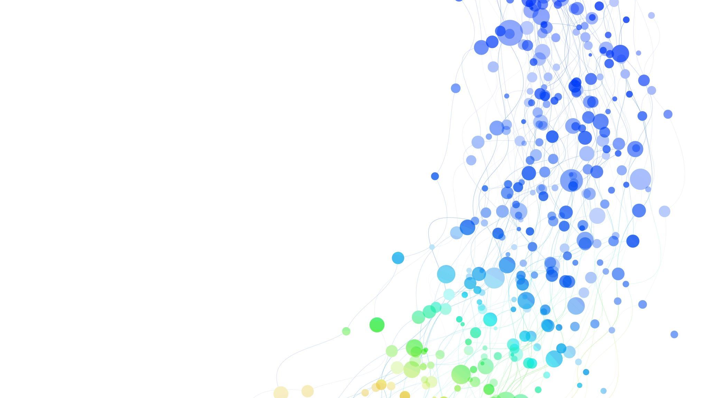
Automating for success:
Making invisible work visible
Lydia Harlan, Kristin Buxton, & Gabriele Hayden University of Oregon Libraries

Slide 2

Kristin's intro
Subject Librarian
Former Software Engineer
Science Fund Manager
No Cost per Use?

Slide 3

Gabriele's intro
Data Services Librarian
Former English Professor
Love to share knowledge
Always seeking projects to build technical skill set

Slide 4
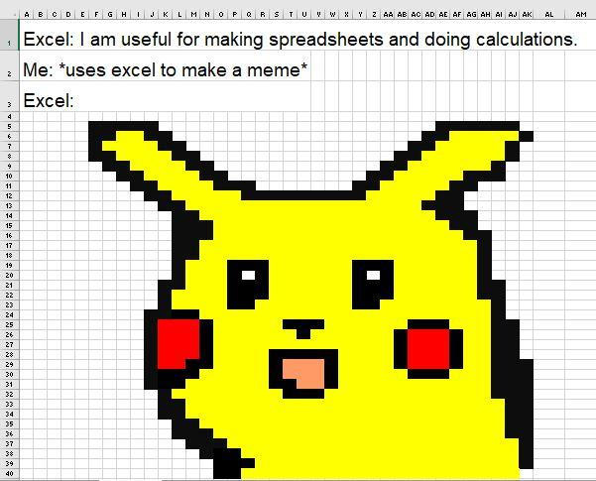
Lydia's intro
Worked in Acquisitions
Now Budget Analyst for my division
  including collections
Fun with Excel, Alma Analytics, and learn a little new-to-me tech thing every day.

Slide 5

How we made our invisible work visible.
It's literally about visualization
Show supervisors, colleagues, groups with an expanding scope.
  Collections Budget Group
  Collection Managers
  Subject Specialists
This presentation!
Article to come

Slide 6
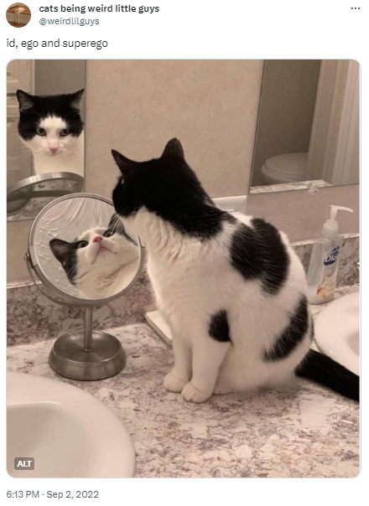
Reflection point
What kind of invisible labor do you do?
What barriers make your work invisible?
What would you need to do to get people to see your invisible labor?
Who could you get to see your work?

Slide 7

Reflection point
What kind of invisible labor do you do?
What barriers make your work invisible?
What would you need to do to get people to see your invisible labor?
Who could you get to see your work?

Slide 8

DESCRIBE PROJECT IN BAREST OF TERMS
Get cost
Get use
Join, transform data into Cost Per Use
Turn static data loads into APIs
Make it look pretty
Share it
Use it

Slide 9
The why of the project
Context: someone was manually doing all this work, on a long delay, with new analysis each time, and not as comprehensive as we would like
Breaking down silos.
Automating saves the work of several colleagues
Allows it to be much more up to date
In making invisible work visible, it’s not just visible it’s visualizations (taking it literally) 😊

Slide 10
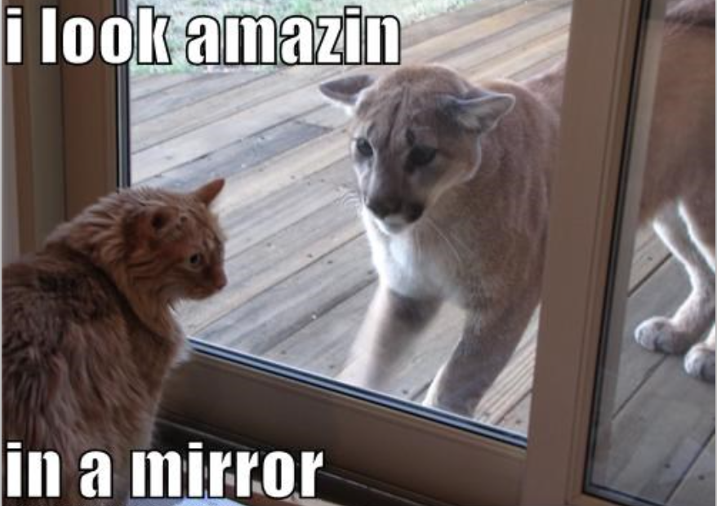
Reflection point
Is there a project you think would be solved by a cross functional team?
Is there a successful cross functional project you’ve worked on?
What made it successful?

Slide 11
Reflection point
Is there a project you think would be solved by a cross functional team?
Is there a successful cross functional project you’ve worked on?
What made it successful?

Slide 12
The why of the team
Bring different backgrounds and skills together to propel the library forward
We wanted to invest in ourselves and our skill set
Project became a catalyst to motivate and direct professional growth
The team became a cohort of people learning the same tools at the same time
Taught ourselves (loosely) about project management and productivity
Able to apply skills developed in this project to other projects
Contribute to a culture of growth, which in itself strengthens the organization

Slide 13
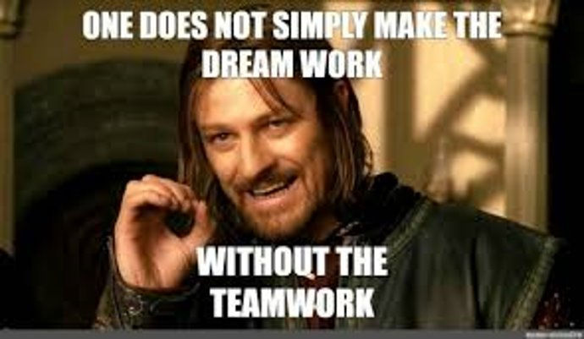
How did we work together?
Recognize differing levels of
  excitement
  engagement
  motivation
  prioritization
  and time over time
Communicate what you need
Celebrate small victories
Please and Thank You
Meme / GIF economy

Slide 14

Process
Weekly (ish) Zoom meetings
  Standing meetings
  Working meetings
  Occasional meeting clusters
  Tag-team challenging bits: no one is stuck all alone.
Break the project into tiny parts
Independent work
  Alma Analytics
  importing data into Power BI
  Python coding.
Find help:
  Campus Power BI Teams group
  Power BI course
  Lydia joined API working group

Slide 15
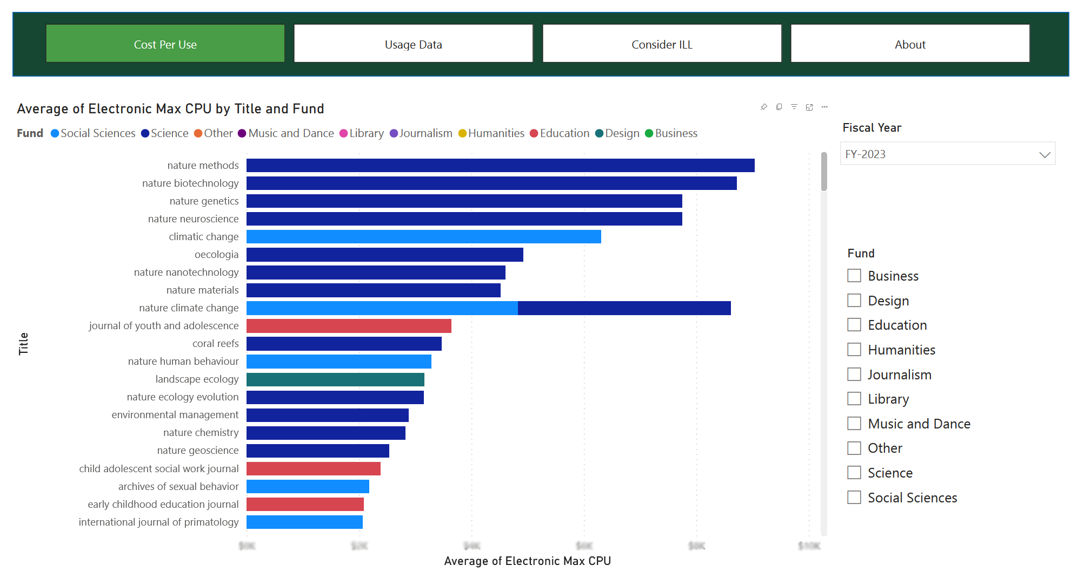
the project IN a BIT MORE DETAIL

Slide 16
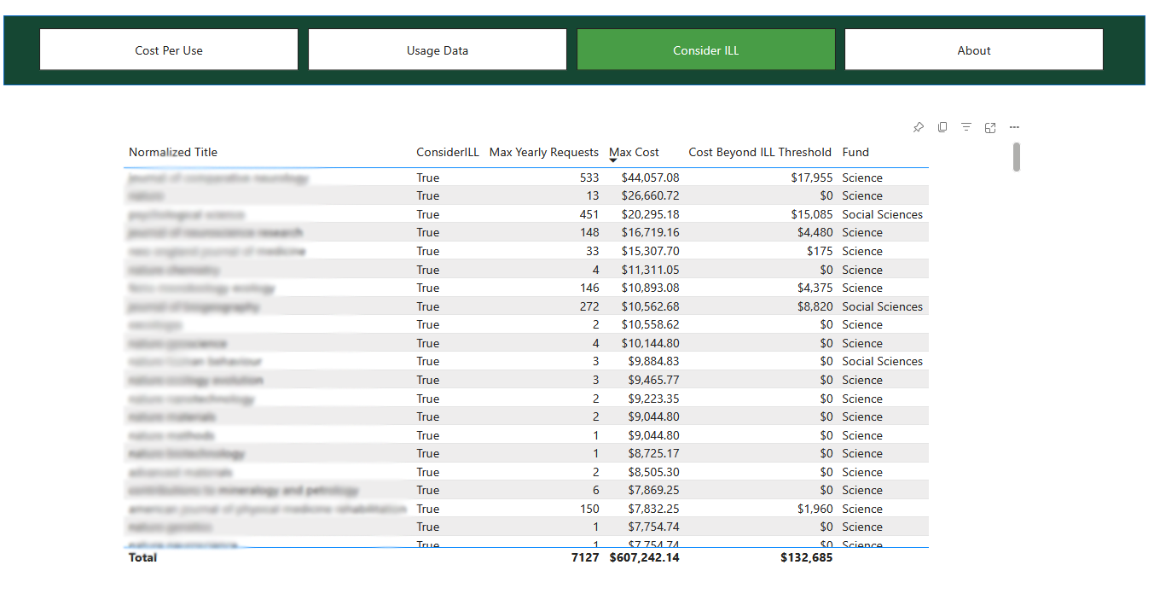
the project IN a BIT MORE DETAIL

Slide 17
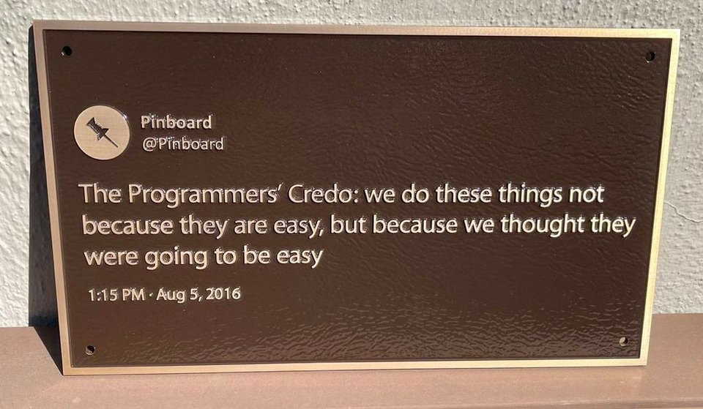
Defining our success
What does "done" look like?
Value of the skills we learned
Value of the final project
Value of opportunities to come

Slide 18
What did we learn? - Lydia
Lots of technical tools
I already used Power BI on another project about APC fees and impact metrics.
Not the fastest. Could have hired a consultant, but then we wouldn't have learned anything.
Cross-departmental friendships/relationships helpful for getting other things done.

Slide 19
What did we learn? - Gabriele
Iterative
Reusable technical skills:
  Python API skills
  Power BI
Kept having to recommit to the project in order to move past barriers or when we lost momentum.
More understanding of how things work in our various departments.

Slide 20
What did we learn? - Kristin
Will be using Power BI for another project looking at use of a physical library space.
Kept having to recommit to the project in order to move past barriers or when we lost momentum.
Power BI campus community – provided training. There are more resources out there than you think.
None of us could not have done this project alone. We needed all three of us to bring different knowledge, skills, and approaches.
Since we started the project all three of us have been promoted. Recognized for initiative?

Slide 21
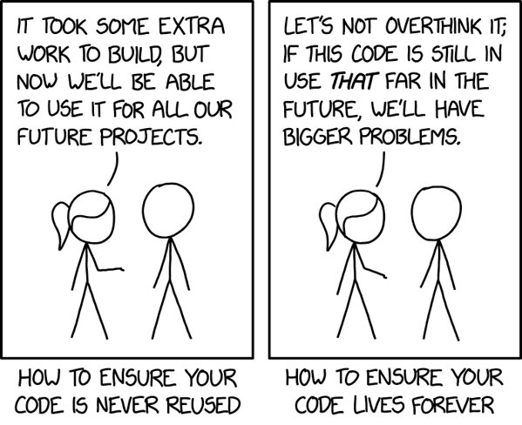
Questions?
Lydia Harlan, lharlan@uoregon.edu
Gabriele Hayden, ghayden@uoregon.edu
Kristin Buxton, kbuxton@uoregon.edu

Slide 22
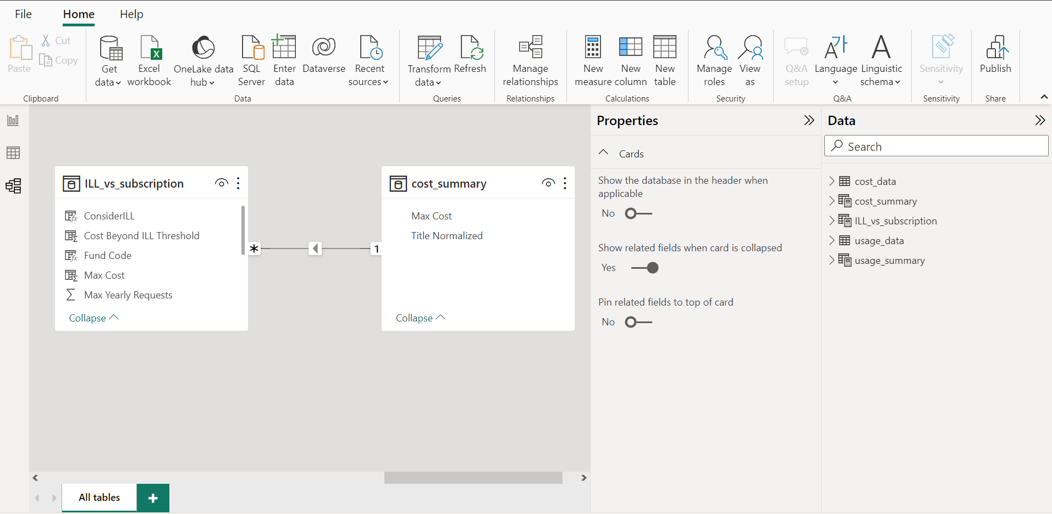
Nitty Gritty what power bi looks like

Slide 23
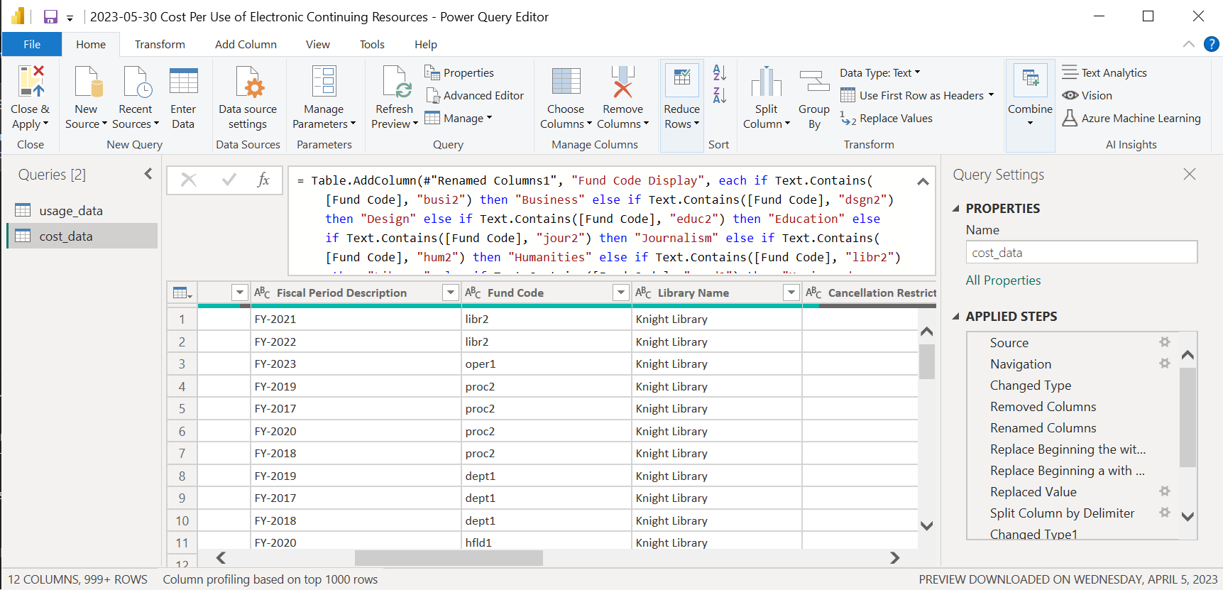
Nitty Gritty power bi m code

Slide 24
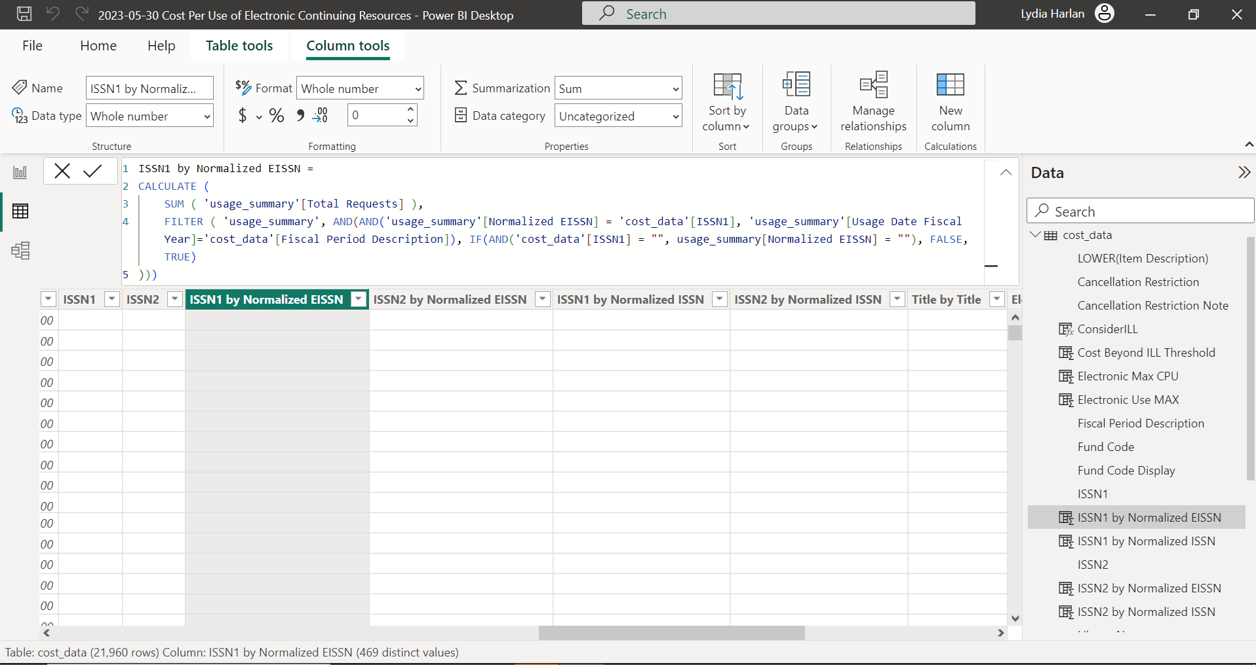
Nitty Gritty power bi dax

Slide 25
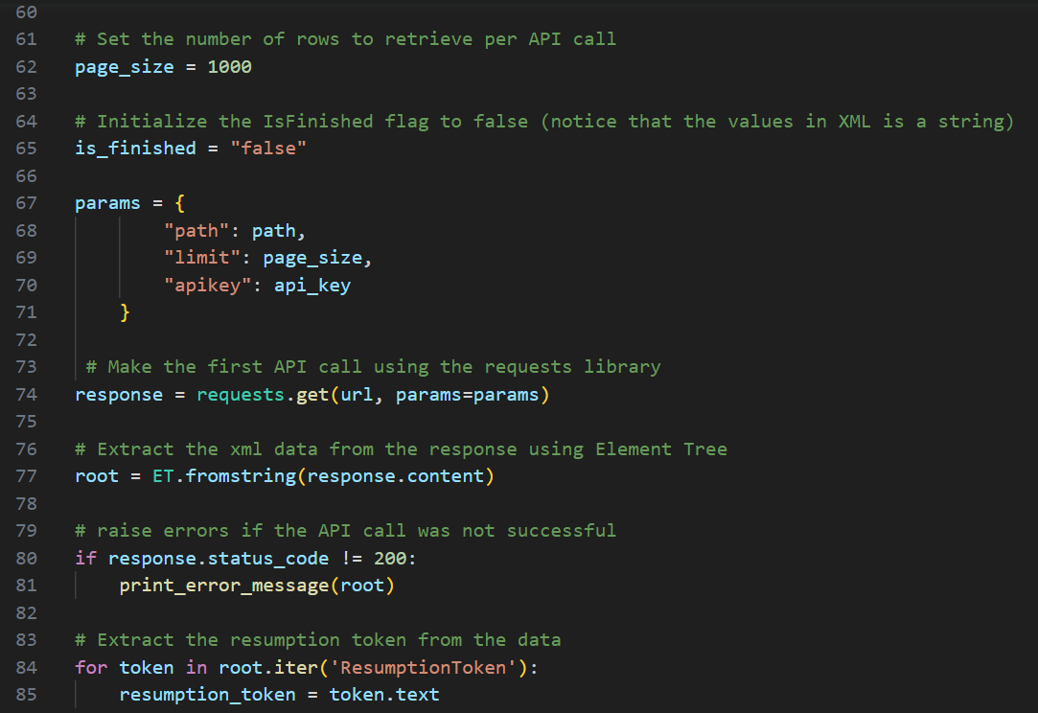
Nitty Gritty python

Slide 26
meme references - chronological
Surprised Pikachu [Digital image]. (2001). Retrieved from https://www.reddit.com/r/MemeEconomy/comments/9upm7x/alternate_to_popular_meme_hot_off_the_press/
Cats being weird little guys [Digital image]. 2022. Retrieved from: https://twitter.com/weirdlilguys/status/1565870440890806272
Pepe Silvia [Digital image]. (2008). Retrieved from https://knowyourmeme.com/memes/pepe-silvia
I look amazin in a mirror [Digital image]. Retrieved from https://cheezburger.com/5332046848/i-look-amazin
One does not simply make the dream work – without the teamwork [Digital image]. Retrieved from https://makeameme.org/meme/one-does-not-5c172f
Shia LeBouf magic [Digital image]. (2008). Retrieved from https://doughenningproject.com/2020/05/20/shia-lebouf-snl-sketch/
Programmer's credo [Digital image]. (2021). Retrieved from https://www.reddit.com/r/ProgrammerHumor/comments/nu3d5t/i_thought_same_somehow/
Day 4,321 [Digital image]. (2023) Retrieved from https://gregdeckler.com/2023/05/01/day-4312/
Code lifespan [Digital image]. Retrieved from https://imgs.xkcd.com/comics/code_lifespan.png

