Slide 1

Florida Atlantic University Libraries
Wimberly Library:
Reinventing the Library Experience
By Dean of University Libraries, Carol Hixson
May 18, 2018

Slide 2
Wimberly Library
Very heavily used facility
Typically, 120,000 to 130,000 visits per month
Record high was 137, 911 in one month
September and February are typically the busiest months
Not enough seats and study spaces

Slide 3
Vision for Wimberly
Student centered
Point of pride for FAU
Accommodate needs of today’s students
Flexible and multi-purpose design and furnishings
Technology-infused spaces to ensure competitive edge

Slide 4
Gather Student Input
Student survey conducted April 3-27, 2018
1136 students responded; 79% undergraduates
91% are based in Boca Raton and use the Wimberly Library
85% of undergraduates do their coursework or study in the
library

Slide 5
How Often Do Students Come to the Library?

Slide 6
Why Do Students Come to the Library?

Slide 7
Why Do Students Come to the Library?

Slide 8
How Satisfied Are Students?

Slide 9
How Satisfied Are Students with Wimberly Spaces?

Slide 10
Seating and Study Capacity in Wimberly Library
The seating capacity is 1300 seats, including study rooms
30 group study rooms: 8 large study rooms for 3 or more people and 20 smaller rooms for 2 or more people
  High demand daily, with extremely high demand before and during midterms and final exams
  Peak demand days/times are M-F, 10:00 a.m. – 3:00 p.m. Pagers notify people on a waiting list when rooms become available

Slide 11
What Do Students Want More of?

Slide 12
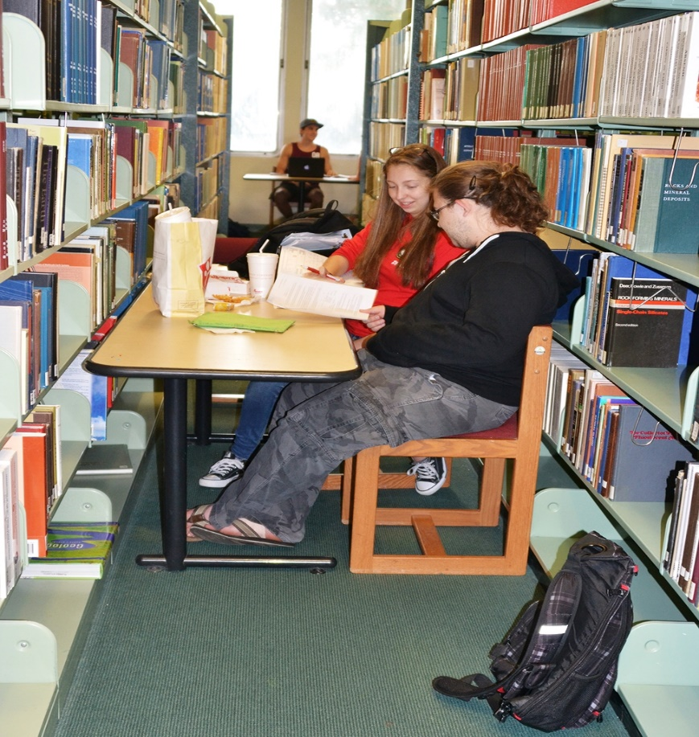
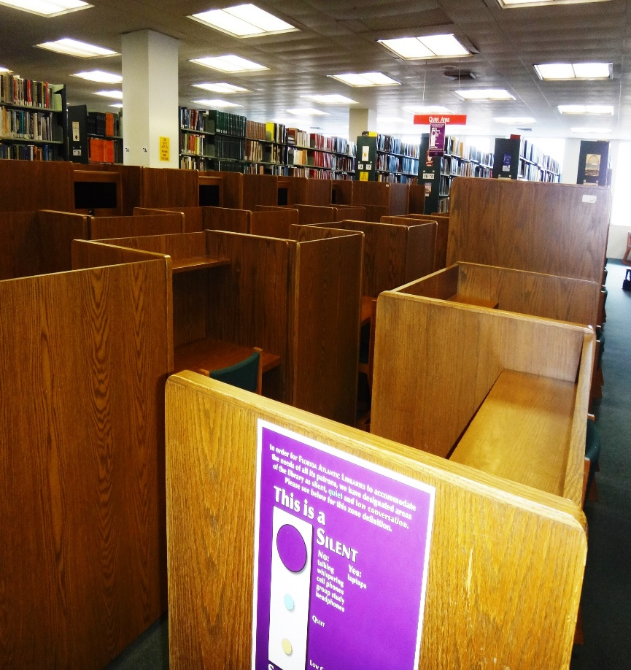
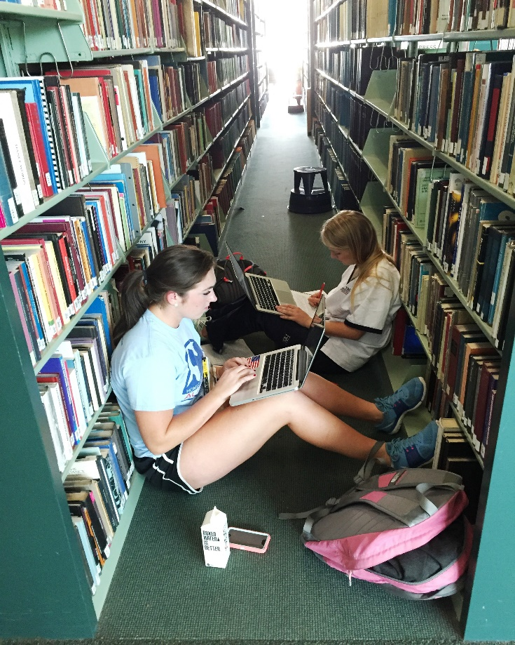
Wimberly Library: Work Still Needed

Slide 13
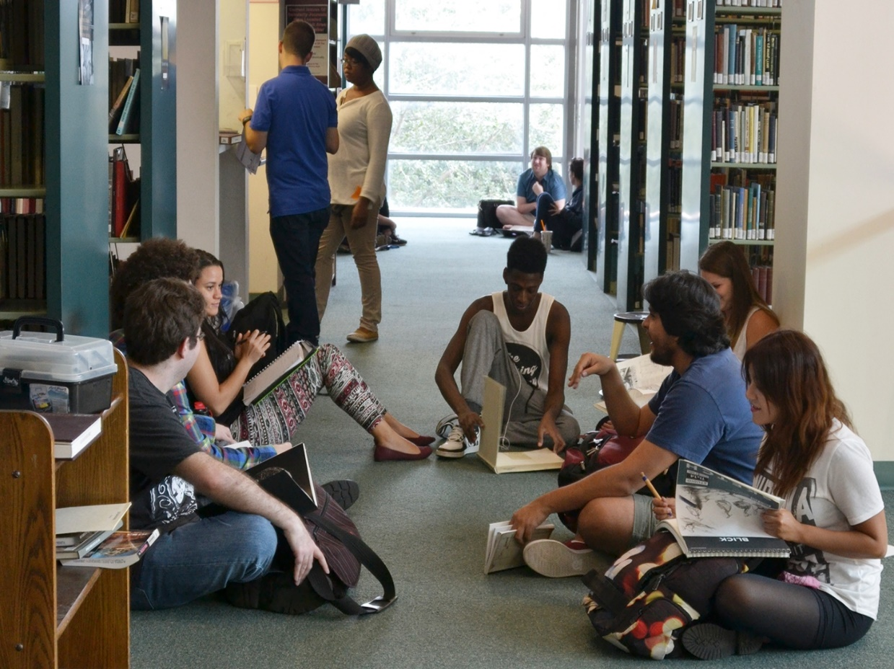
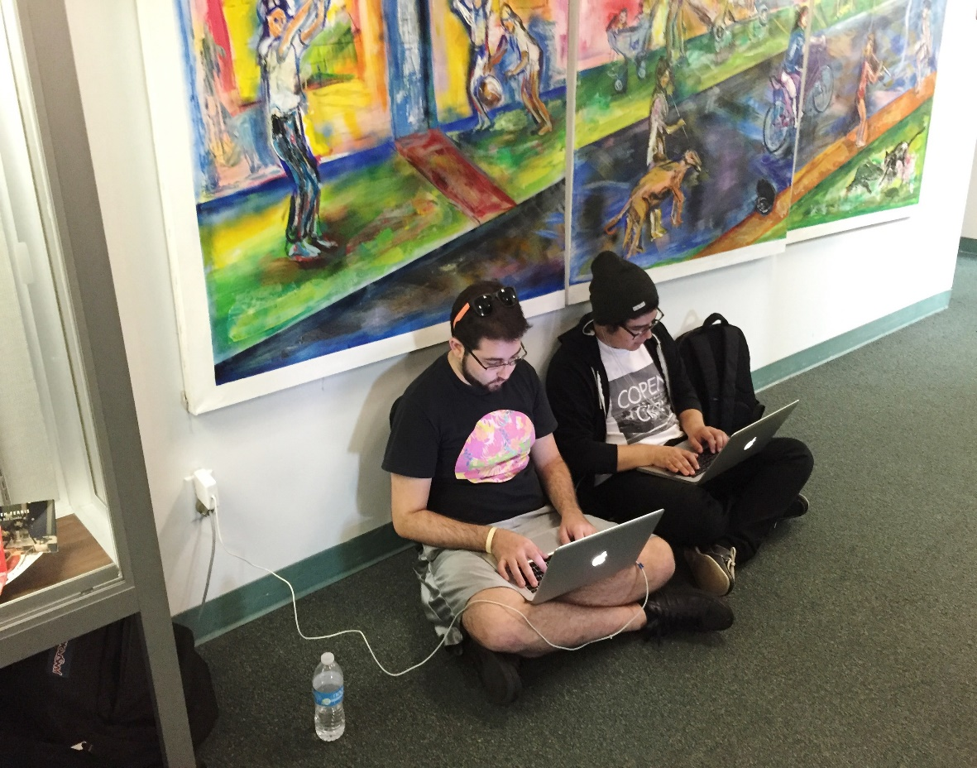
Wimberly Library: Work Still Needed

Slide 14
Work Undertaken in the Wimberly Library in Past Three Years
We created a study lounge for Graduate Students
We have reduced shelving to open up more study space for students
We relocated staff so that their former offices can be turned into group study rooms
We partially renovated the first floor to create more study space, improve computer labs,
and consolidate services
We completed a minor facelift of the first and second floors by repainting and resurfacing,
using FAU colors and branding
We renovated the 5th floor, opened it to students, and converted it to multi-purpose space
Notes:
We are doing a lot. A newly-established Space Allocation Committee has been carrying out research, making site visits, conducting student and faculty focus groups, and working with vendors. Some of the changes they have recommended are reconstituting an underutilized office space and turning it into a grad student lounge that should be opening in a few weeks. We are opening up more floor space as we can by moving shelving to create more open study space. We are relocating some staff offices so that we can turn their offices into group study rooms. We’re getting some new furnishings and we are – for the first time – going to give the facility a minor facelift and use FAU colors and branding.

Slide 15
Coming Improvements to the Wimberly Library
In time for Fall 2018:
We are renovating part of the fourth floor to create cleaner, more open quiet study space
with better access to power
We will be relocating more staff and opening six more group study rooms
We are upgrading the computers in the Alumni Alcove on the first floor
Working with the College of Arts and Letters, we are creating the first phase of a Digital
Humanities Center

Slide 16
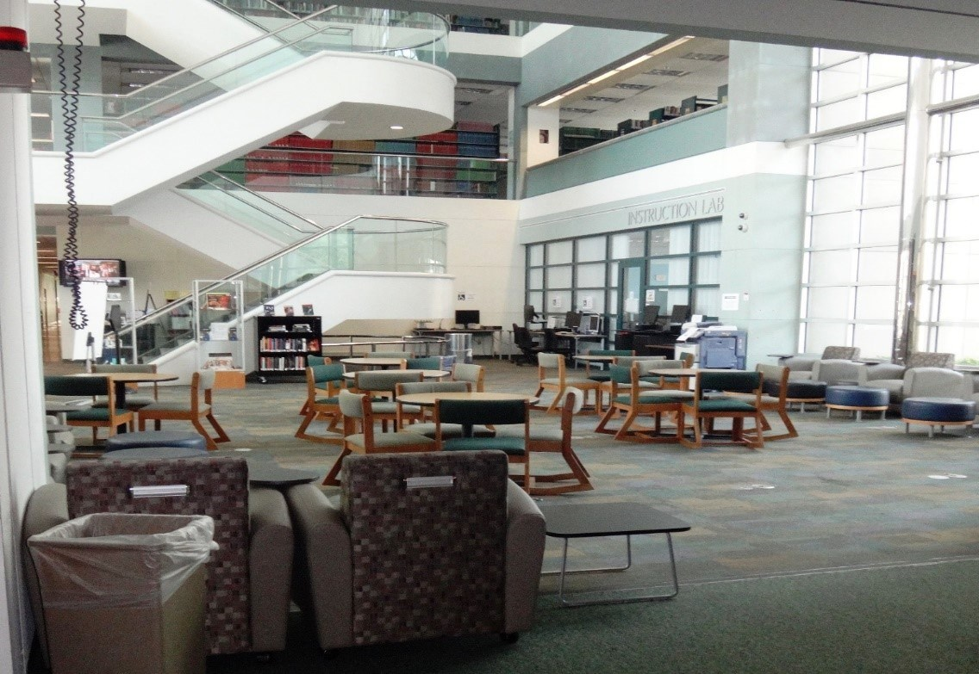
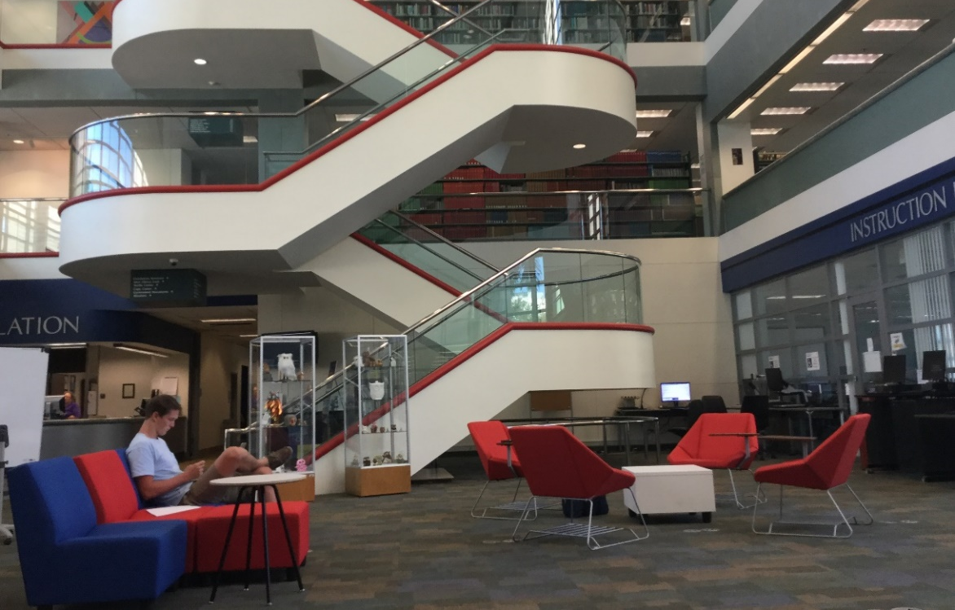
Wimberly Library Being Transformed
Before
After

Slide 17
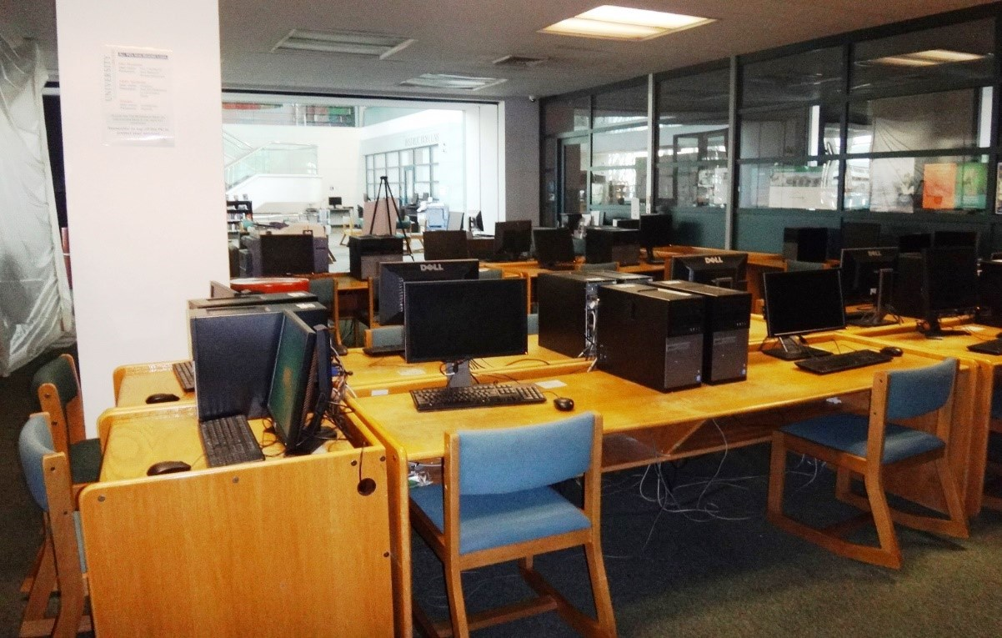
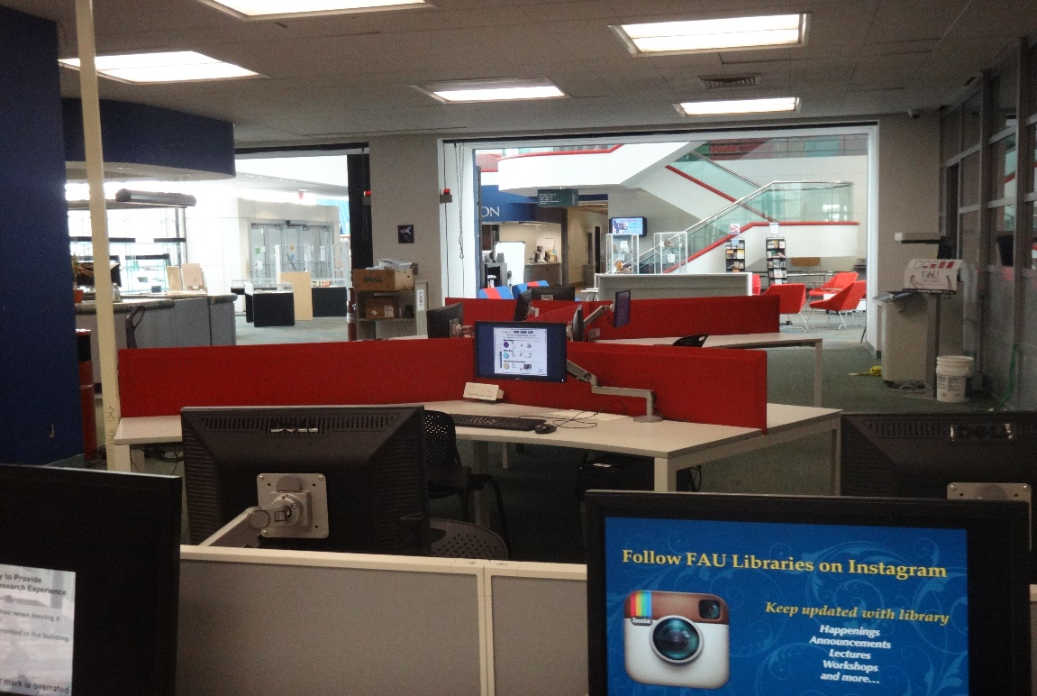
Wimberly Library Being Transformed
Before
After

Slide 18
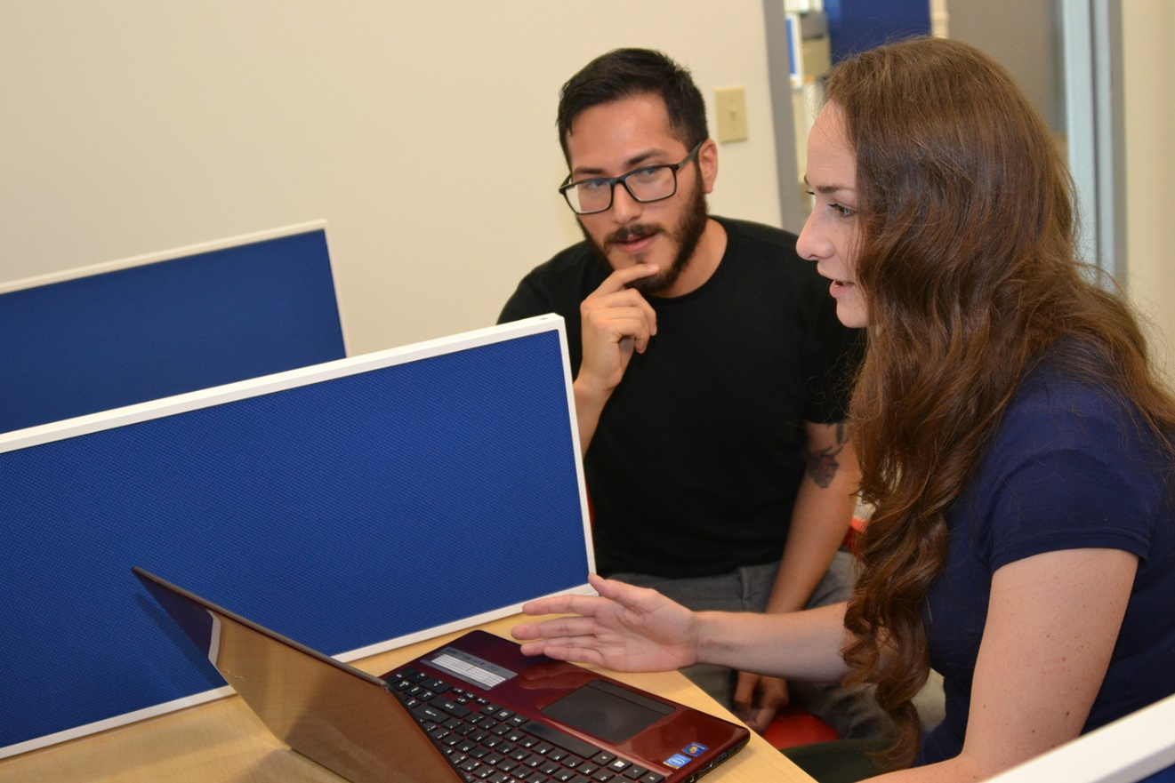
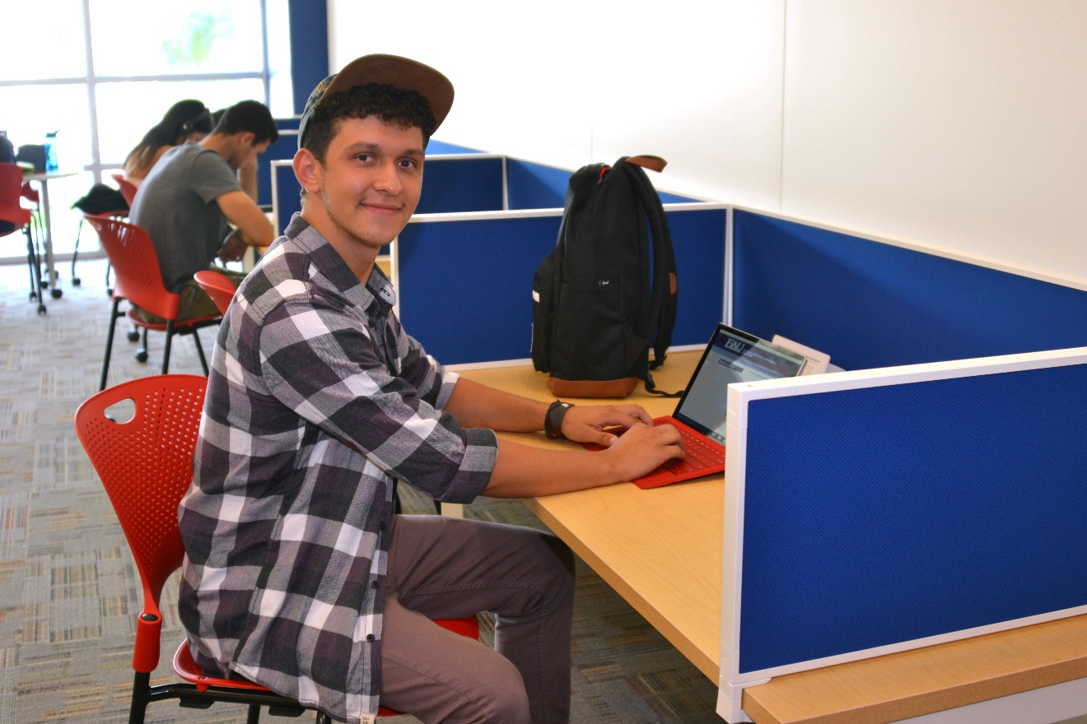
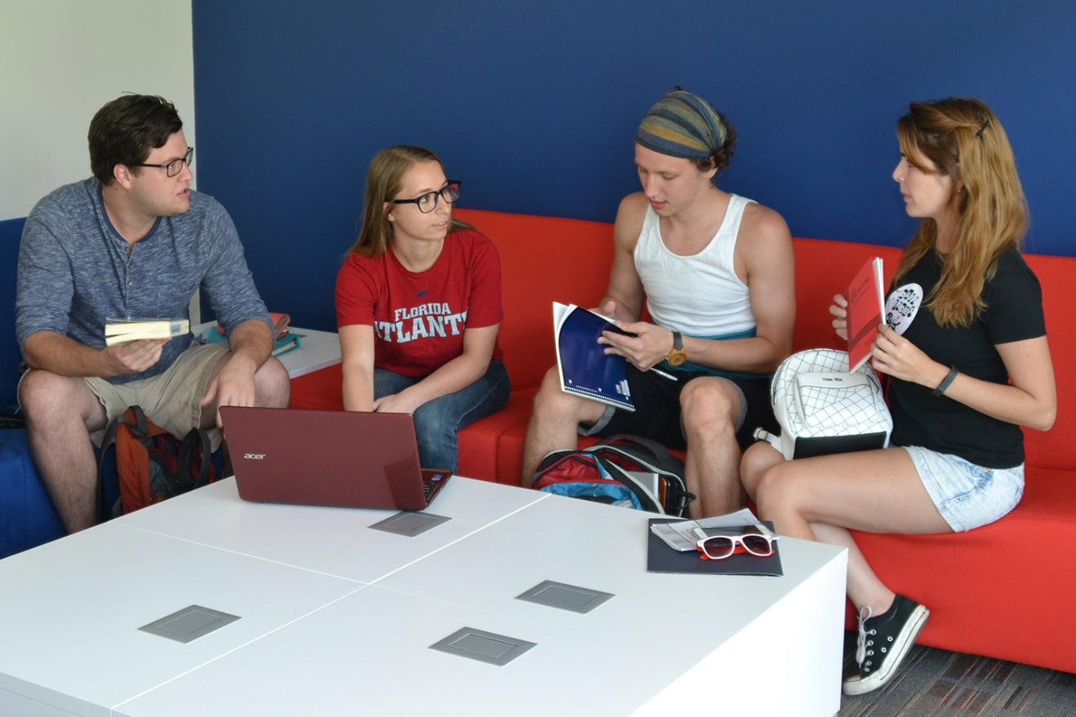
New Graduate Student Lounge
Wimberly Library Being Transformed

Slide 19
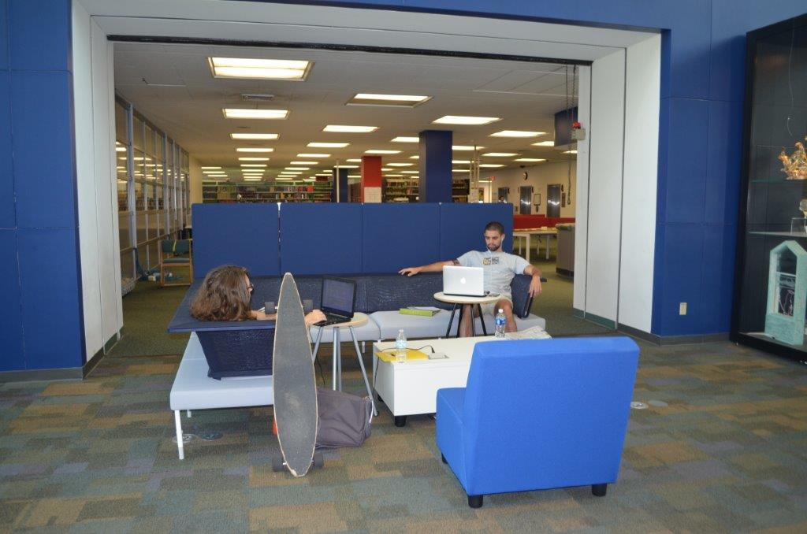
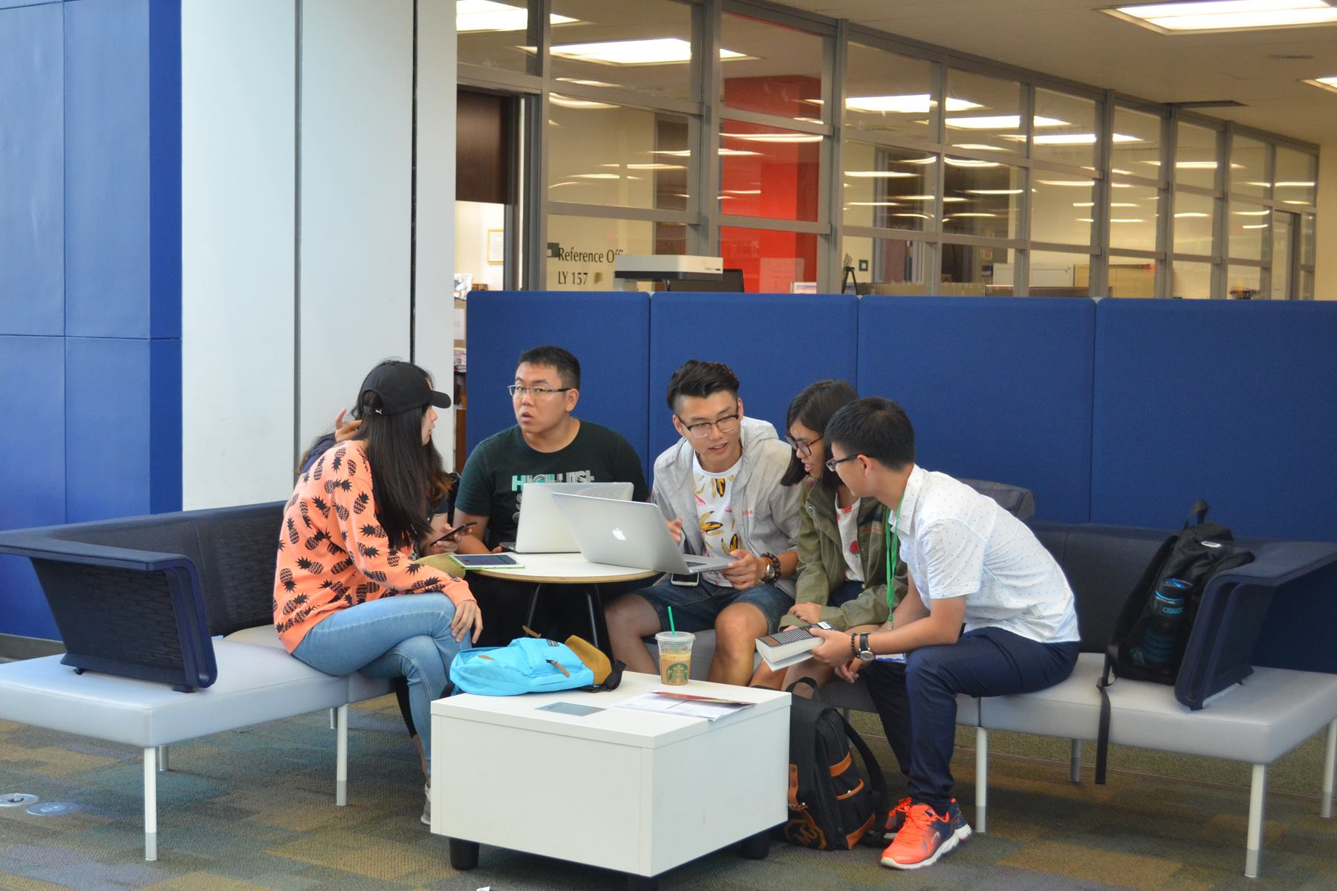
Wimberly Library Being Transformed
Students Enjoying the FAU Experience in the Wimberly Library

Slide 20
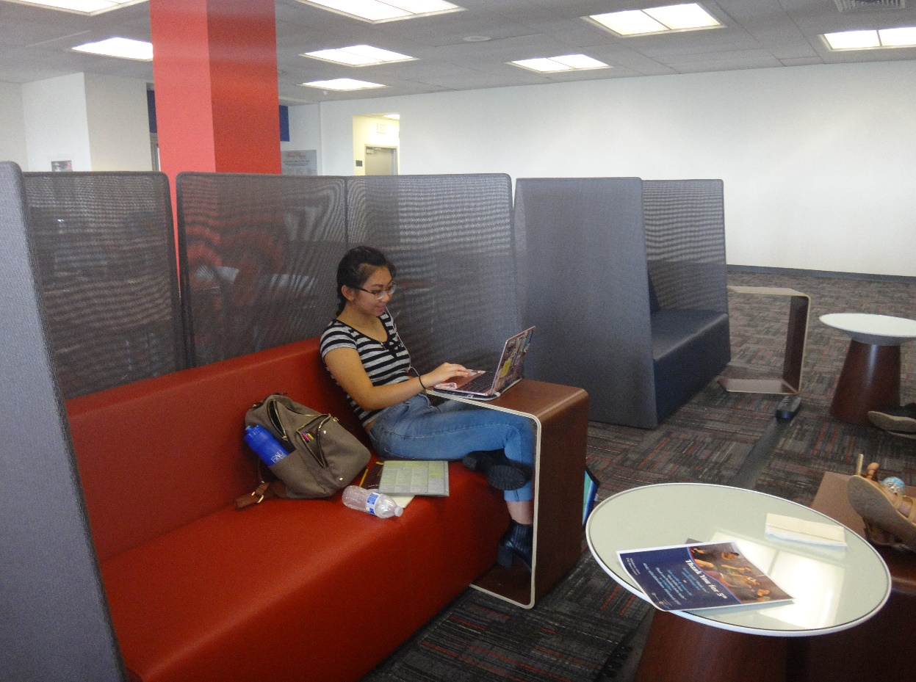
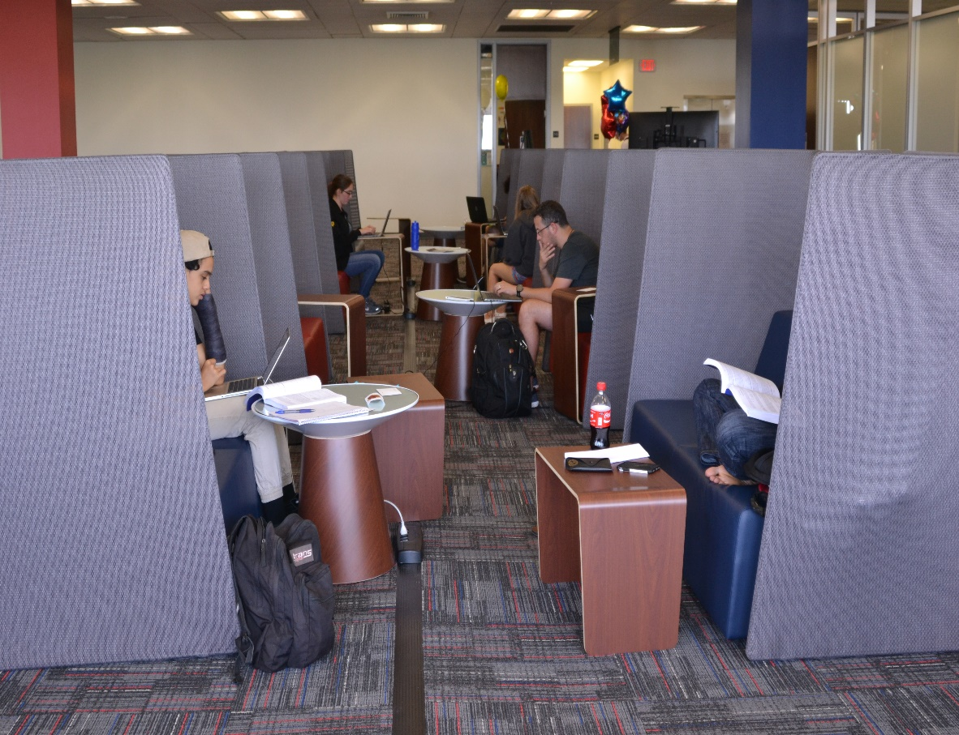
Wimberly Library Being Transformed
Students Enjoying the FAU Experience in the Wimberly Library

Slide 21
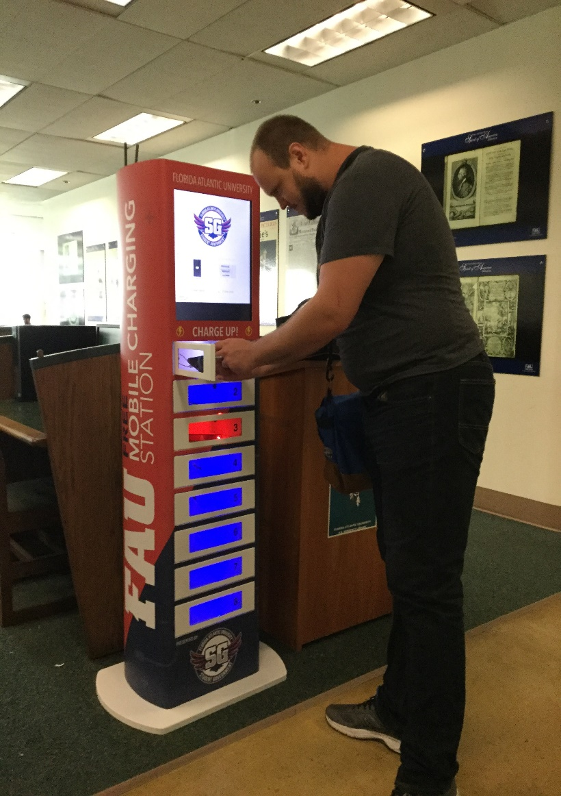
Charging Stations
Wimberly Library Being Transformed

Slide 22
“We need colorful, comfortable, technology-rich spaces where students can study – alone or together – and create their own work.”
Carol Hixson
Dean of University Libraries

Slide 23
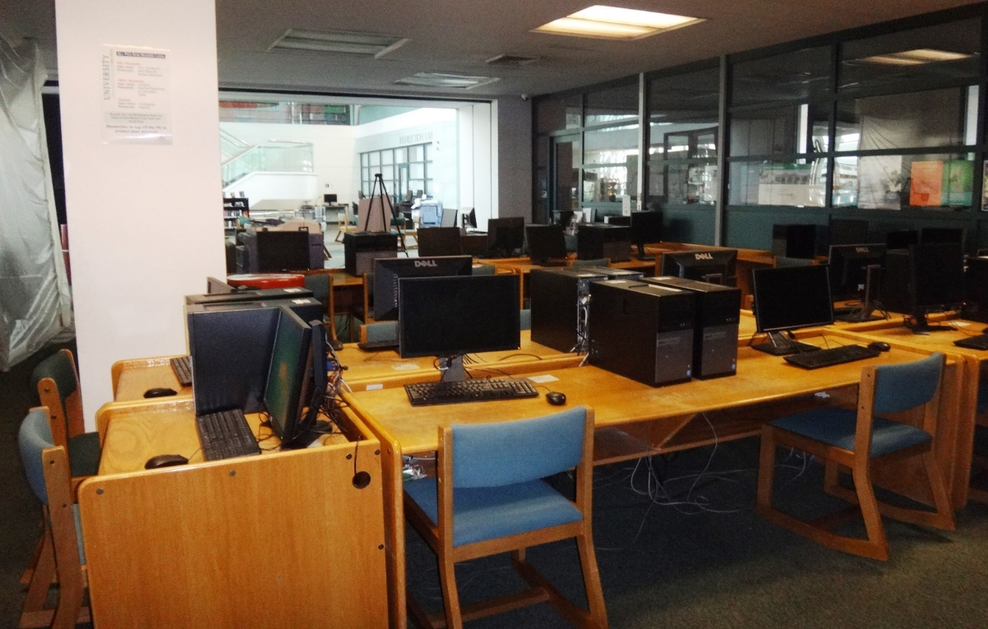
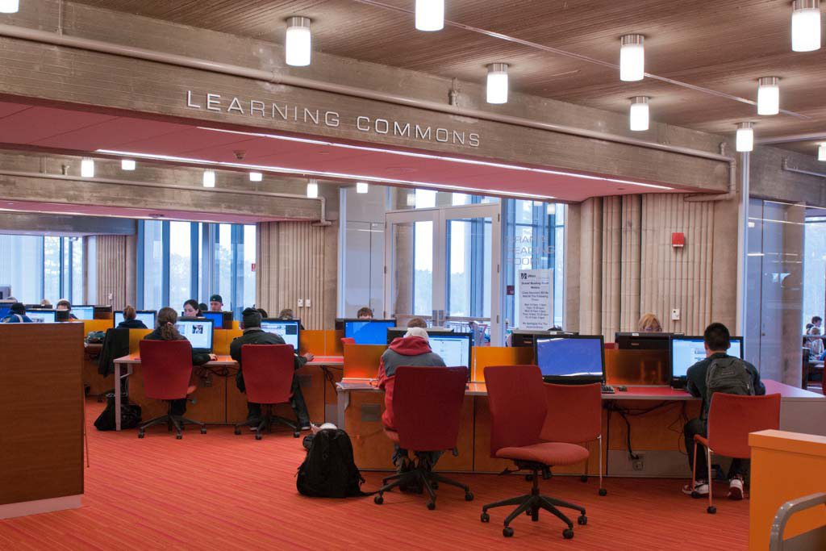
How Do We Get from Here to There?
Wimberly Today
Future Vision

Slide 24
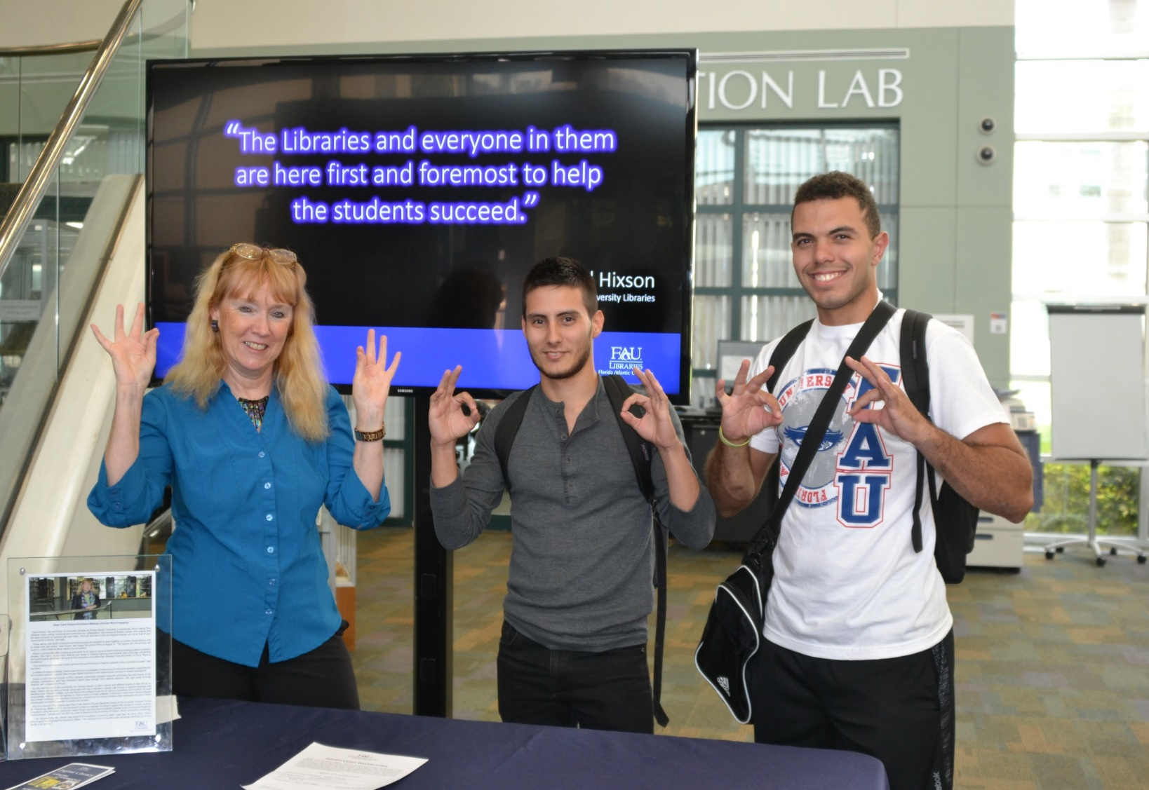
Listen to and Consult with Students

Slide 25

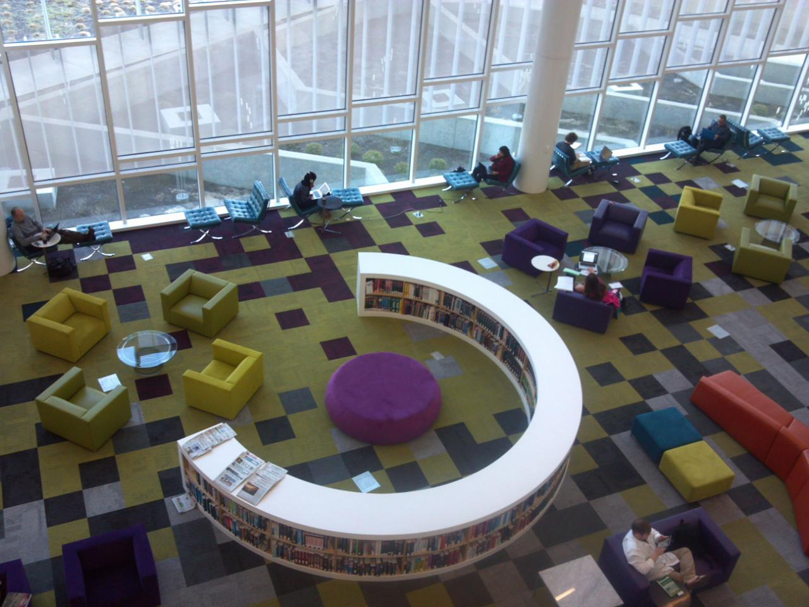
How Do We Get from Here to There?
Wimberly Today
Future Vision

Slide 26
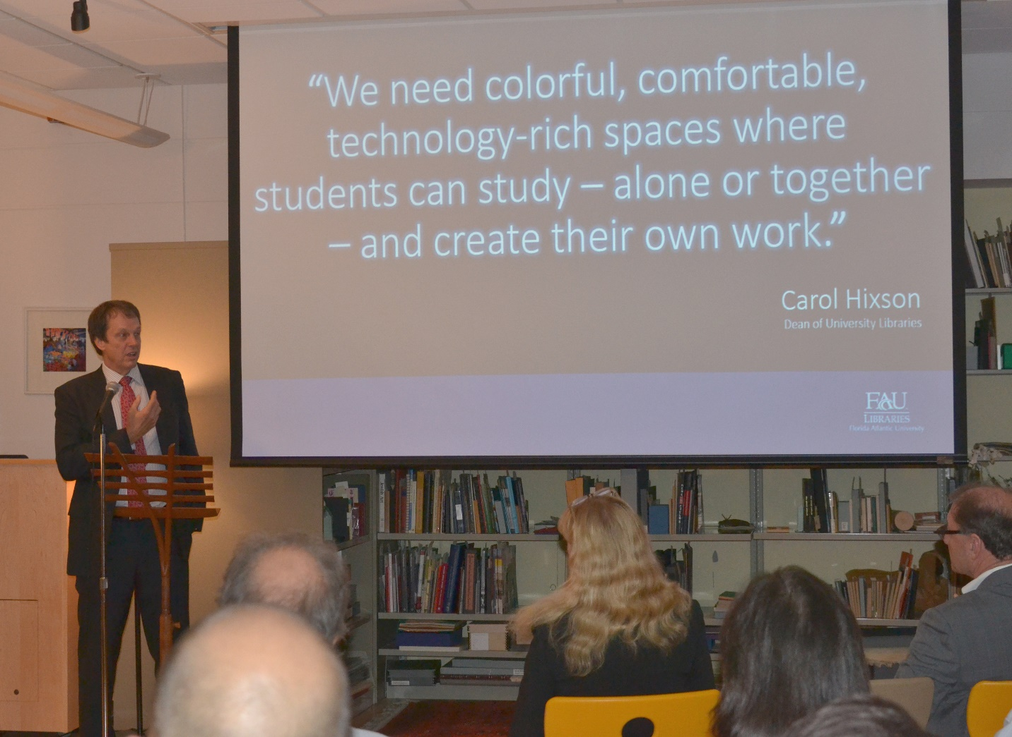
Develop a Shared Vision with Administration

Slide 27
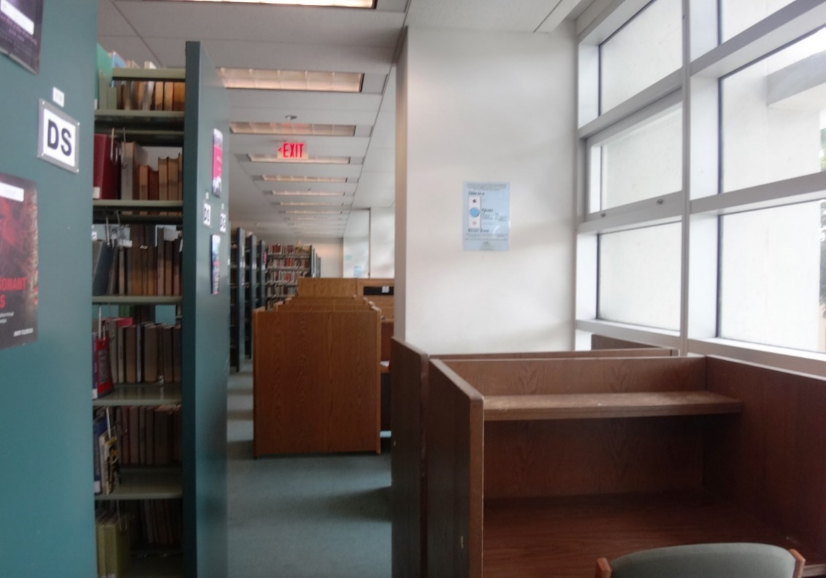
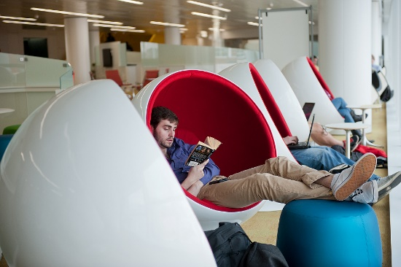
How Do We Get from Here to There?
Wimberly Today
Future Vision

Slide 28
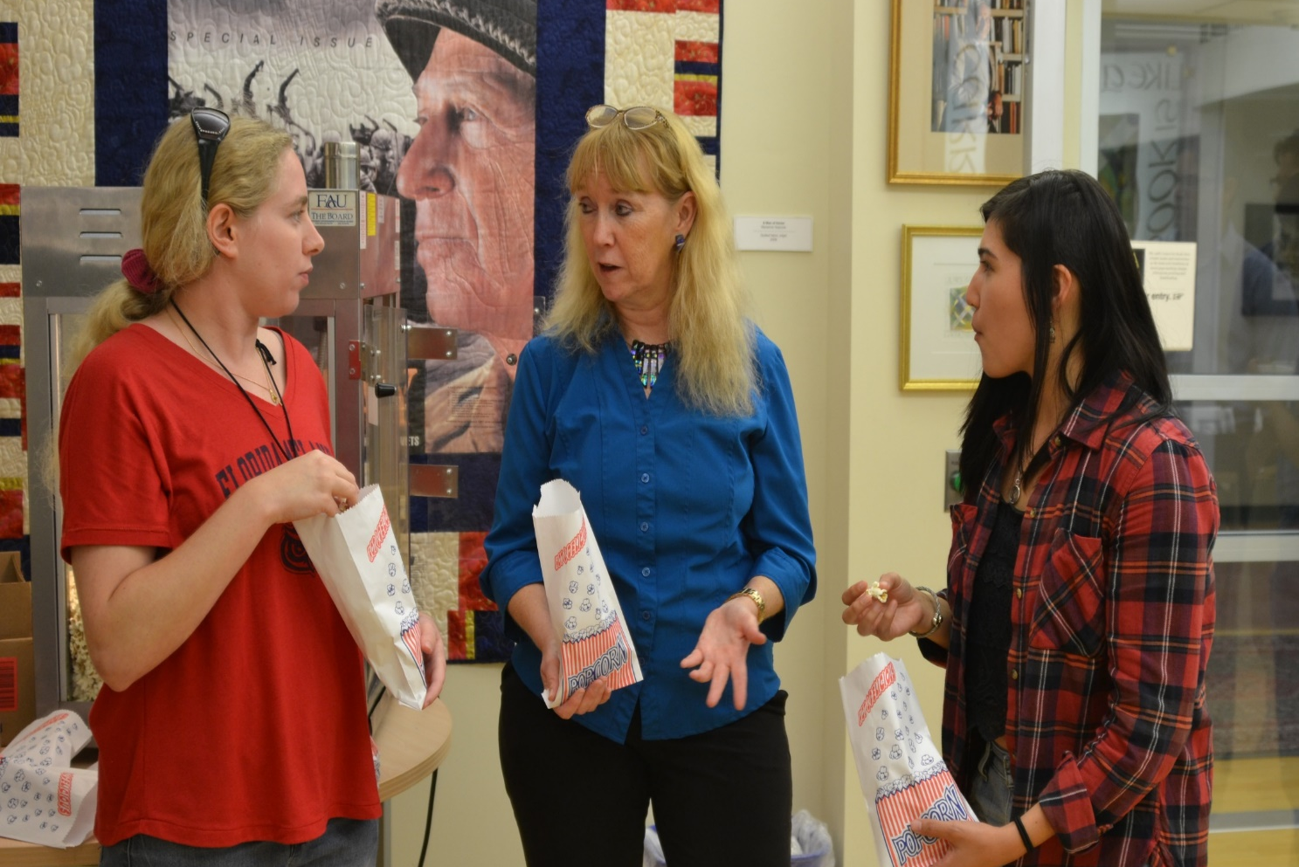
Engage with the Community

Slide 29
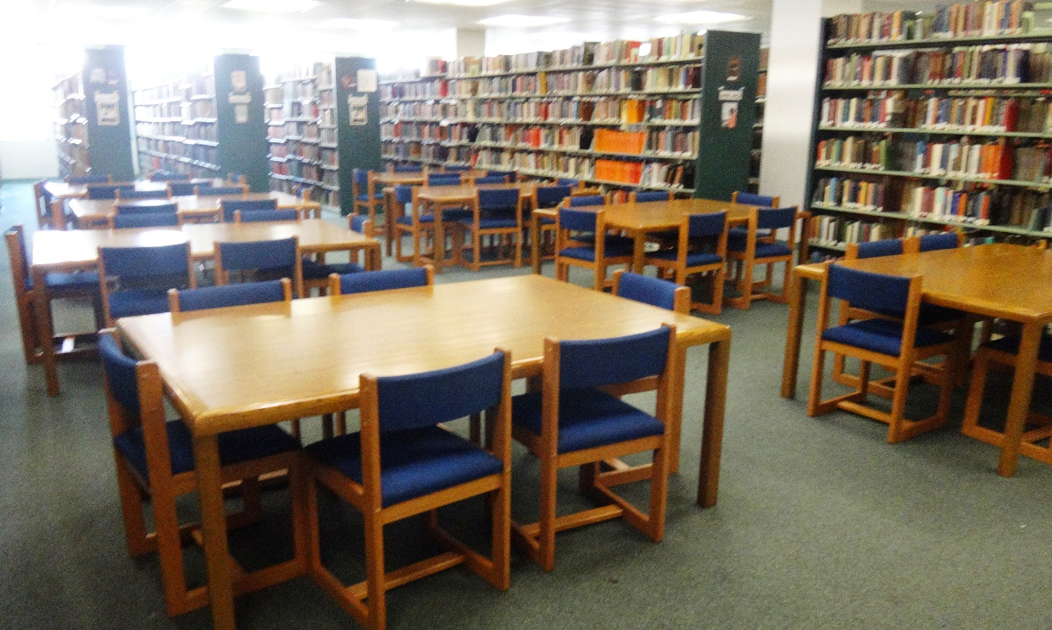
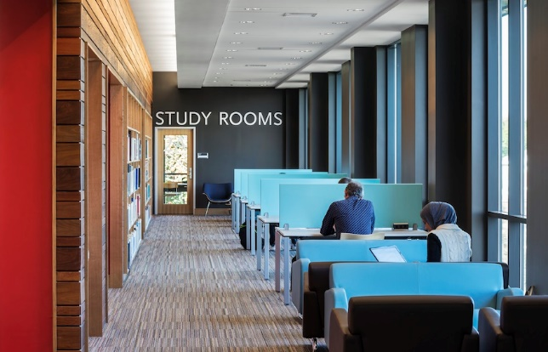
How Do We Get from Here to There?
Wimberly Today
Future Vision

Slide 30
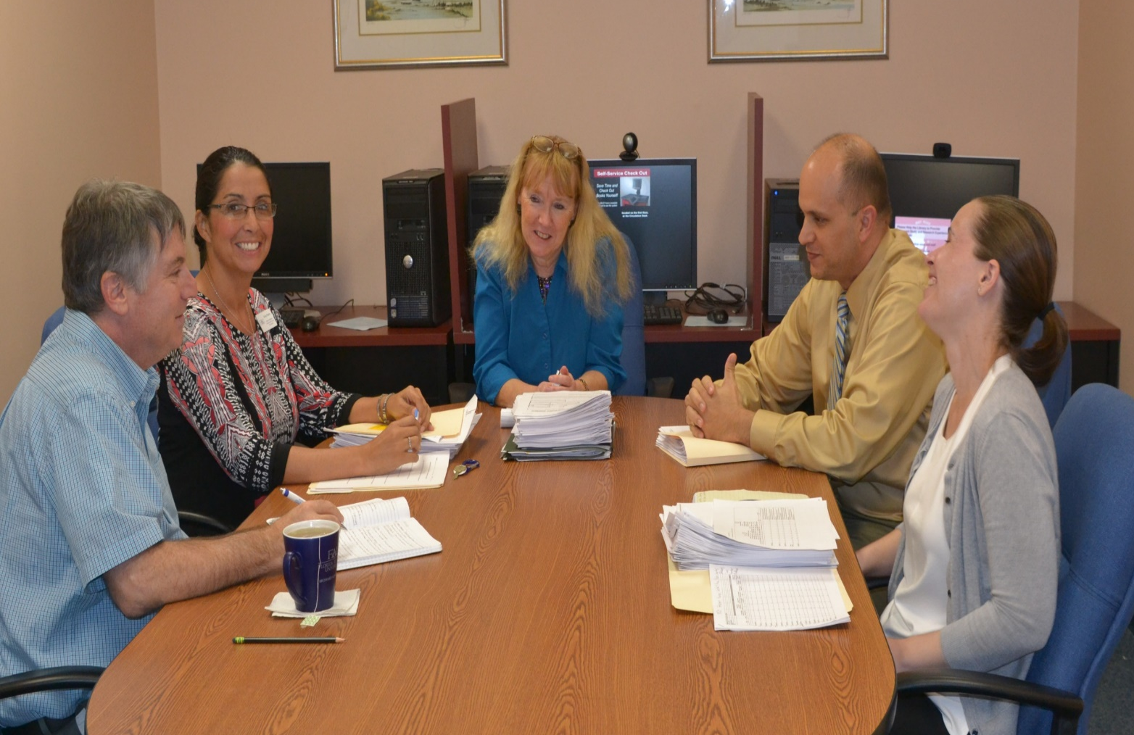
Inspire and Utilize Staff Creativity and Expertise

Slide 31
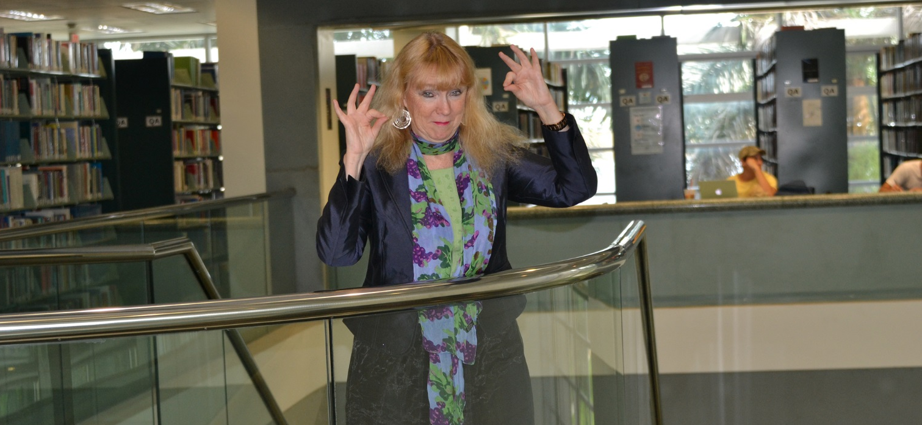
GO OWLS!
Carol Hixson
Dean of University Libraries

