Slide 1
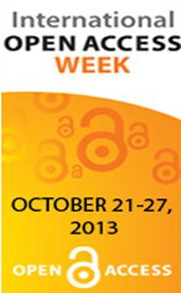

The Twelve Step OA Program, or, How I Learned to Give Up My Addiction to Commercial Publishing and Support Open Access
Brought to you by the Dean and Faculty of the Nelson Poynter Memorial Library
October 22, 2013
In Celebration of International Open Access Week
Presentation prepared by Carol Hixson

Slide 2
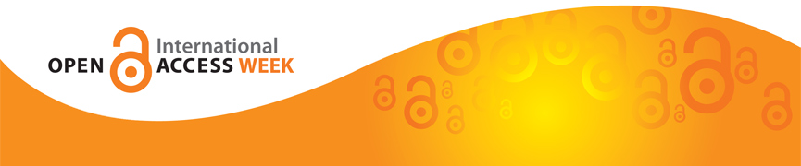
1. We admitted that we were powerless over publishers –and that our research publications had become unmanageable

Slide 3
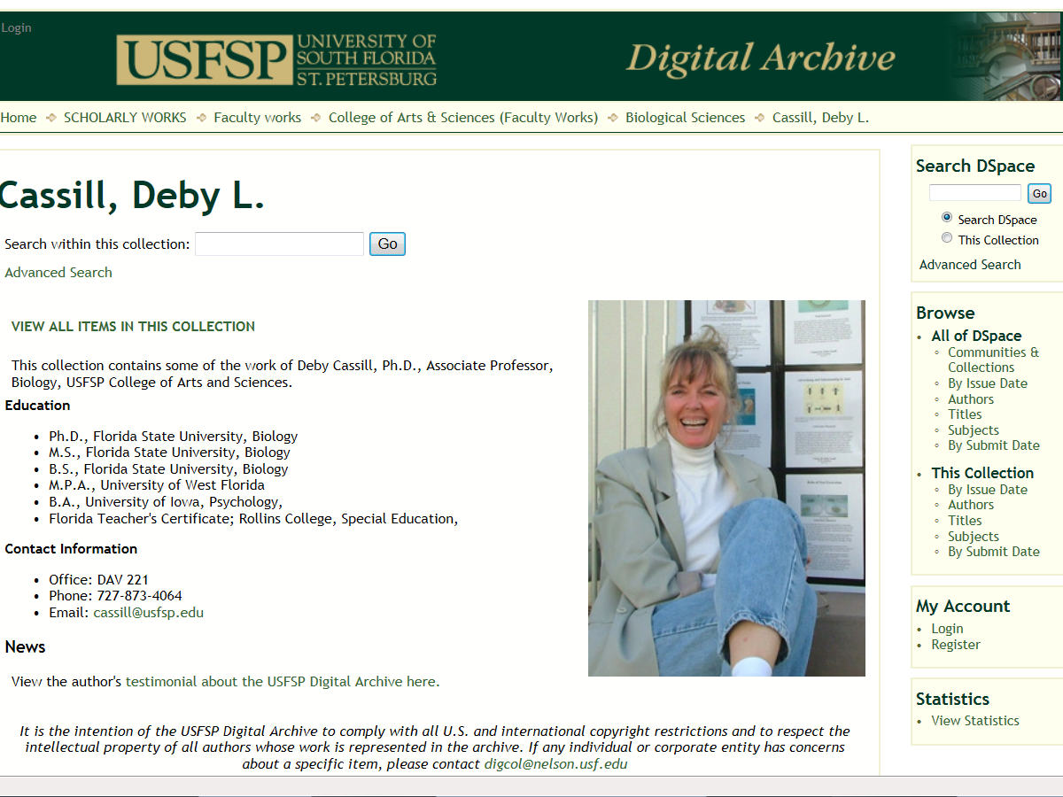
Recovering USFSP Academic

Slide 4
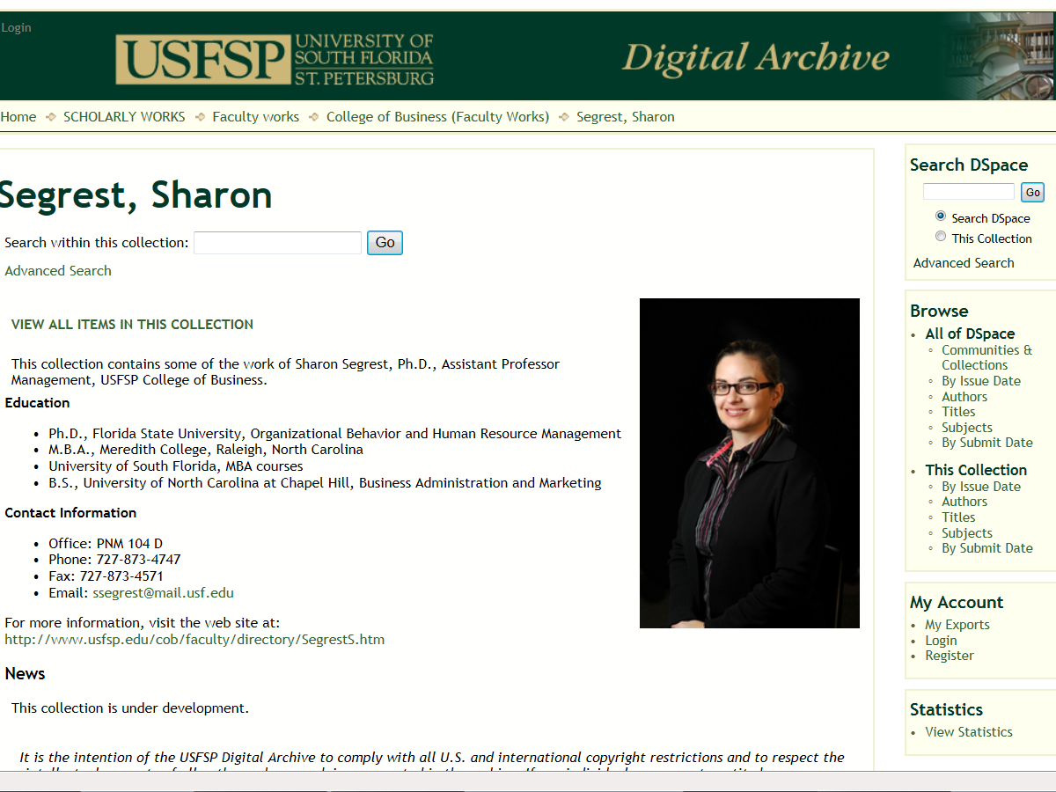
Recovering USFSP Academic

Slide 5
2. Came to believe that Open Access could restore us to sanity

Slide 6
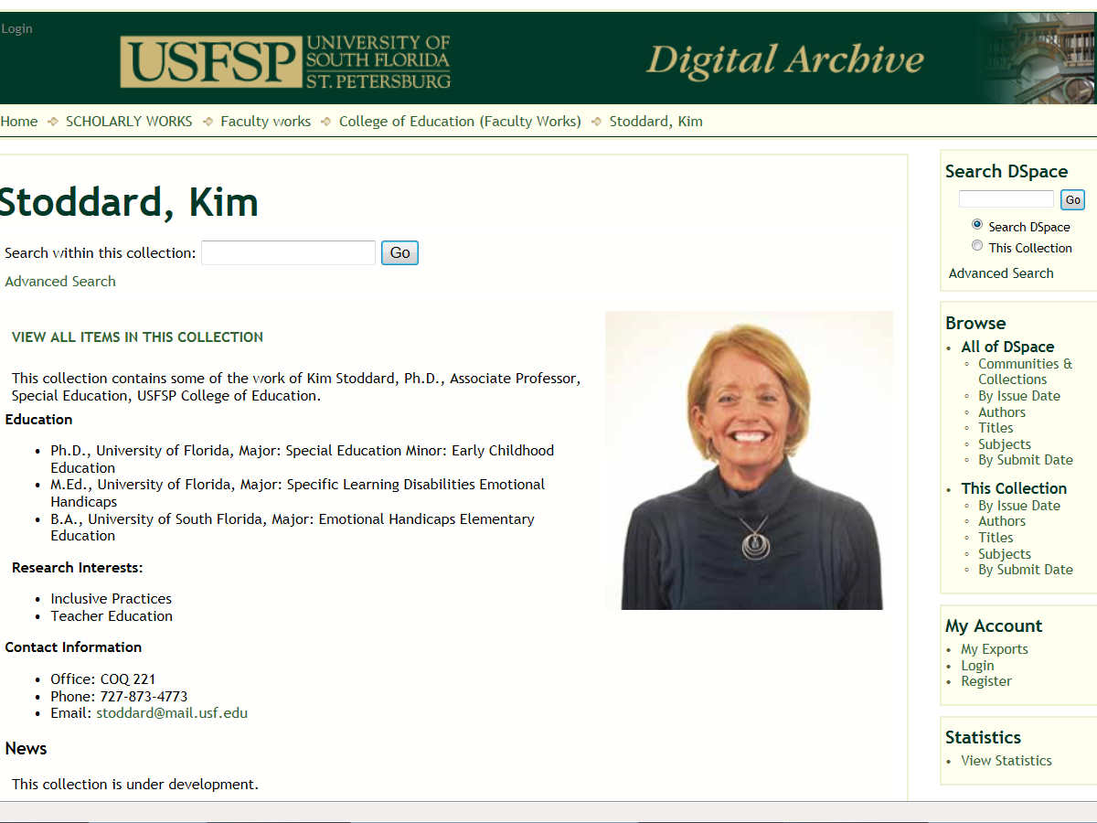
Recovering USFSP Academic

Slide 7
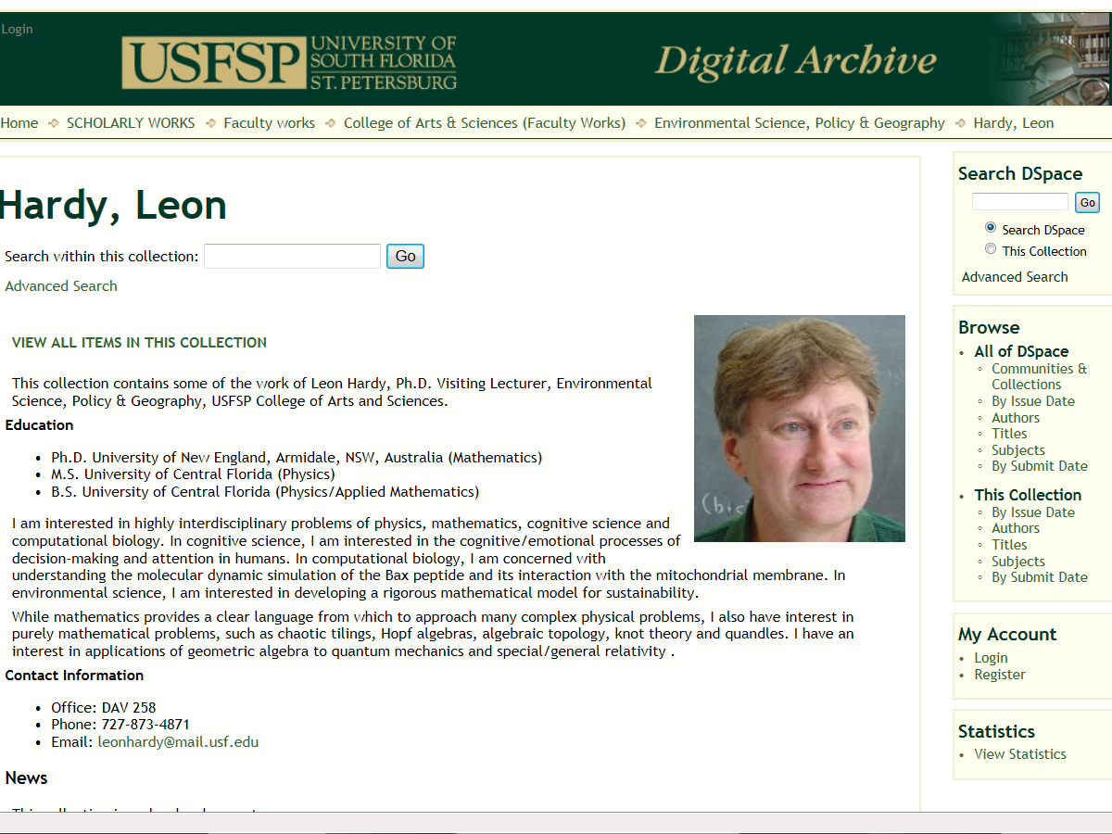
Recovering USFSP Academic

Slide 8
3. Made a decision to turn our scholarship over to the principles of Open Access

Slide 9
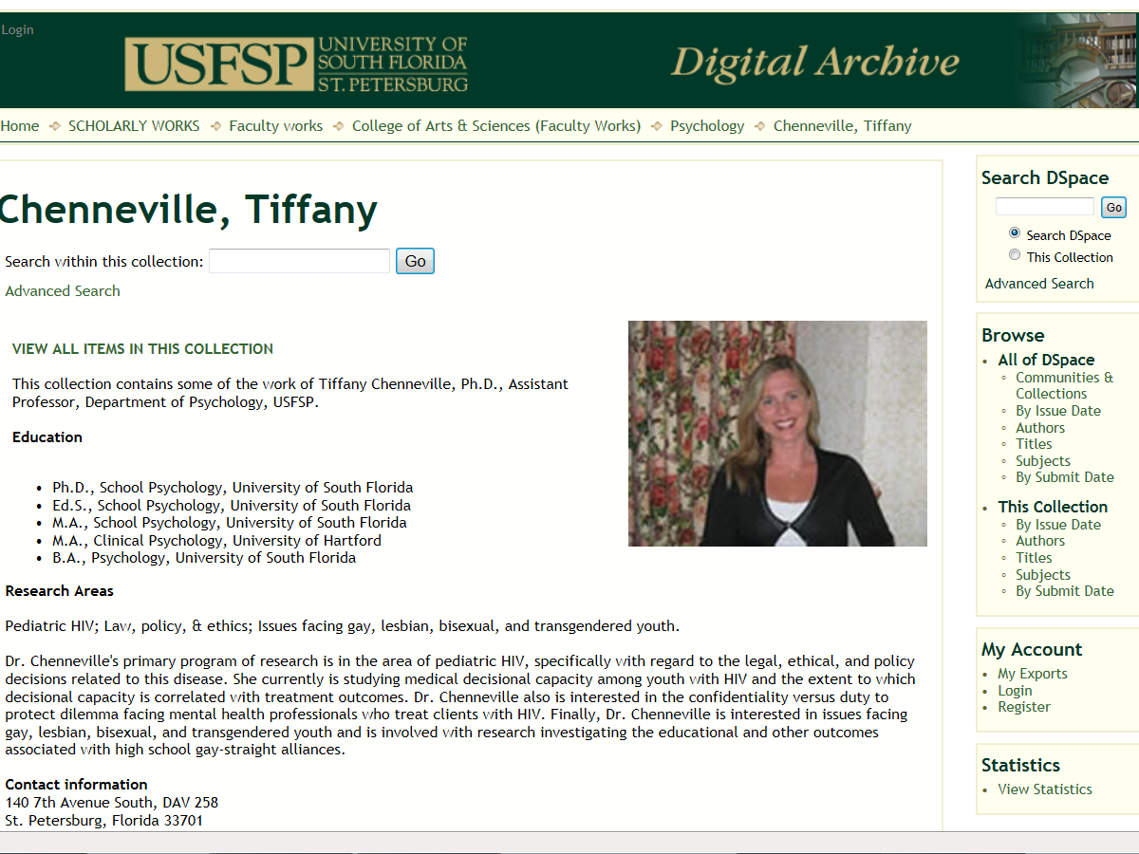
Recovering USFSP Academic

Slide 10
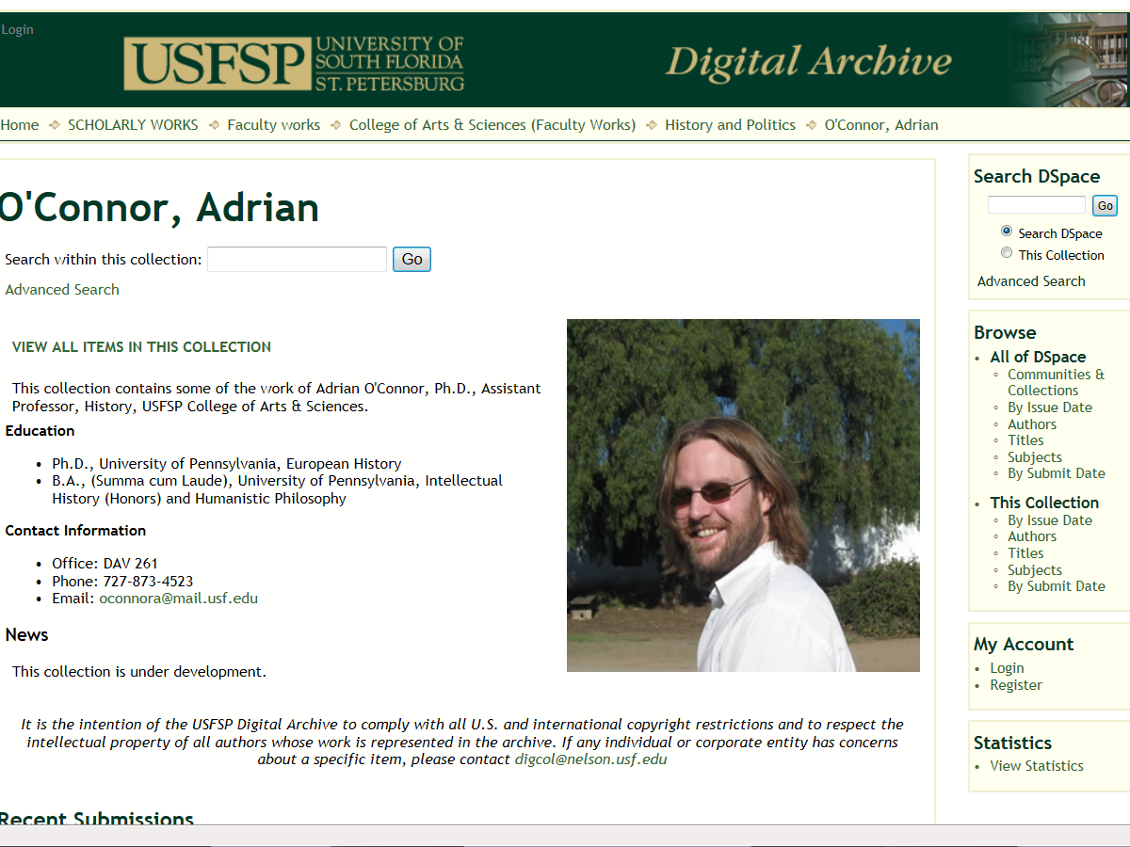
Recovering USFSP Academic

Slide 11
4. Made a searching and fearless inventory of our research production

Slide 12
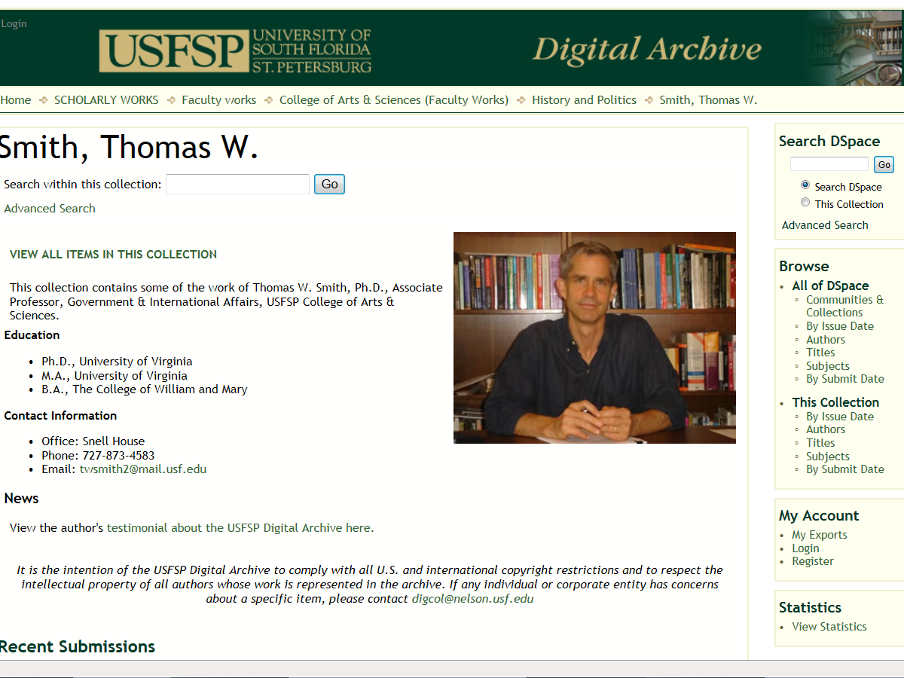
Recovering USFSP Academic

Slide 13
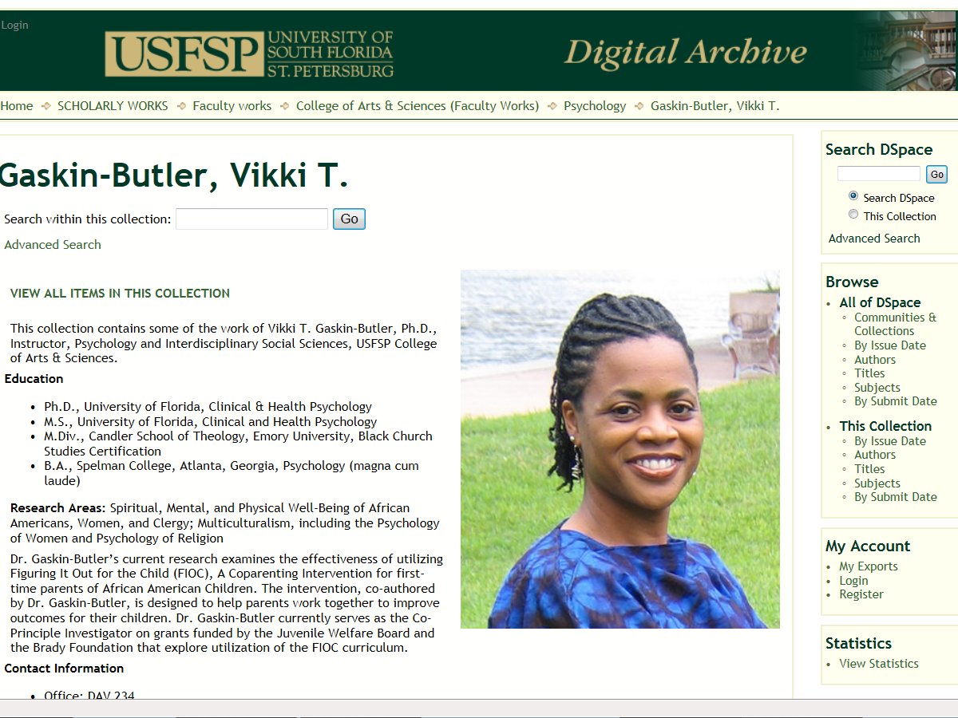
Recovering USFSP Academic

Slide 14
5. Admitted to our library, ourselves, and another colleague the exact nature of our intellectual property wrongs

Slide 15
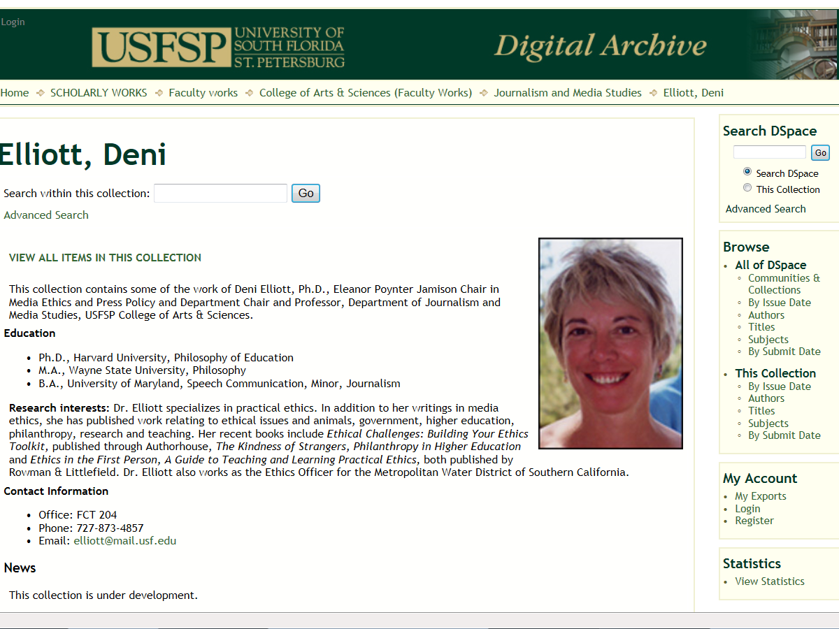
Recovering USFSP Academic

Slide 16
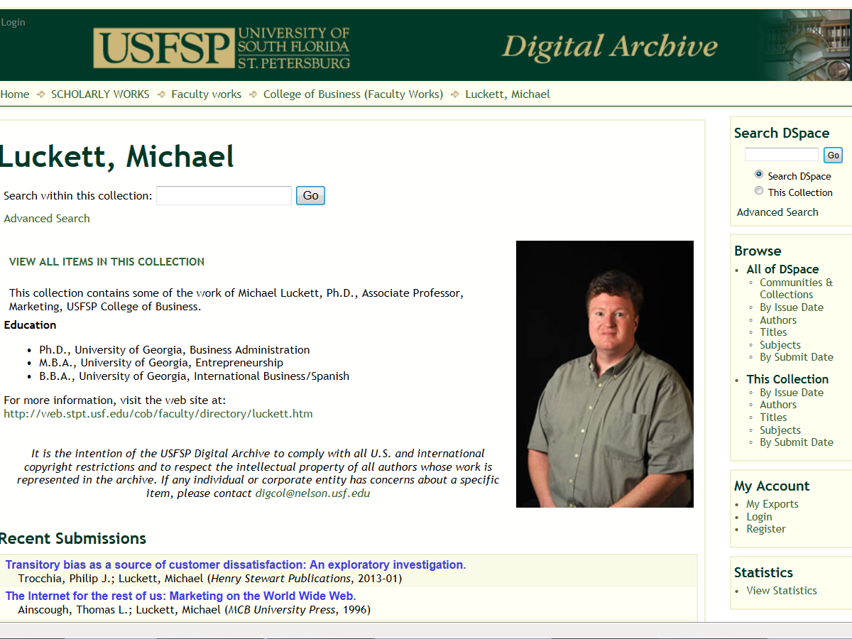
Recovering USFSP Academic

Slide 17
6. Were entirely ready to have Open Access remove all these defects of intellectual property weakness

Slide 18
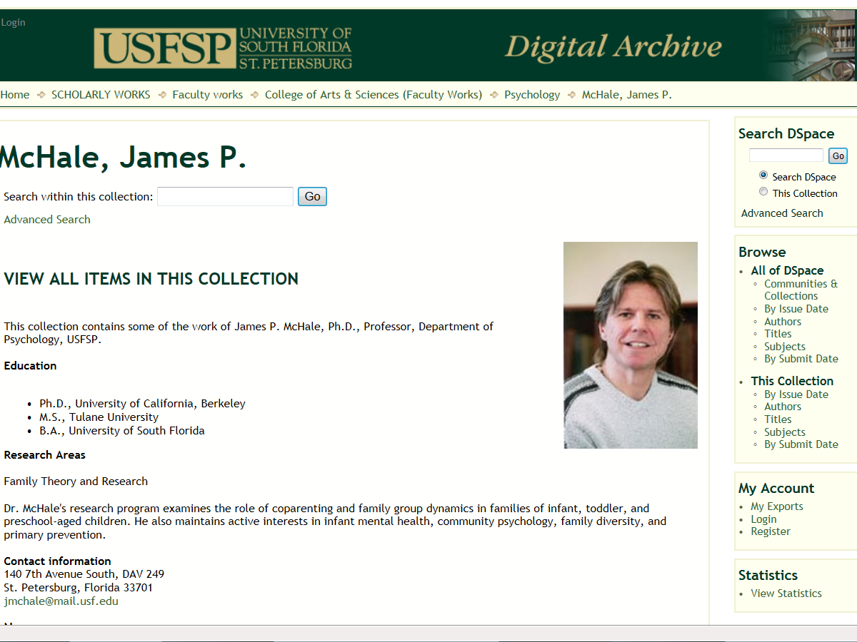
Recovering USFSP Academic

Slide 19
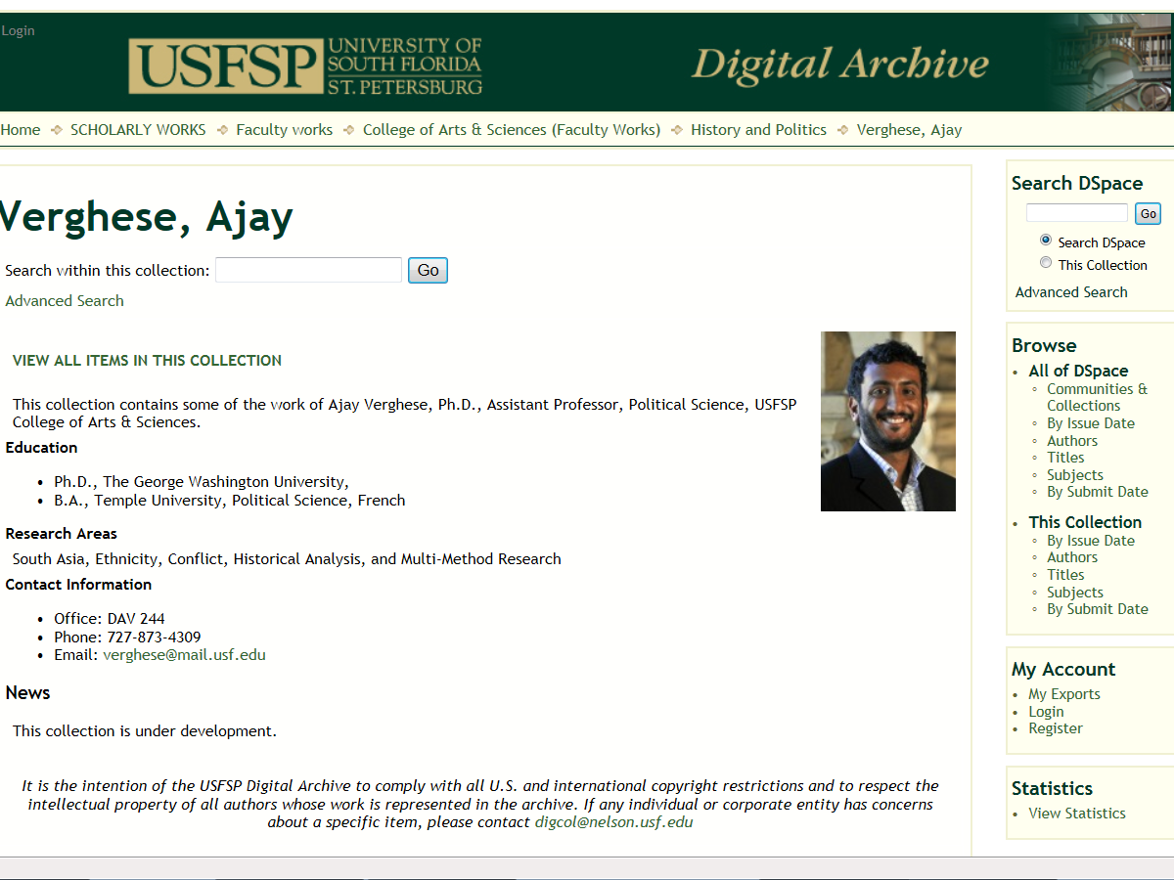
Recovering USFSP Academic

Slide 20
7. Humbly asked our colleagues to make our research widely available

Slide 21
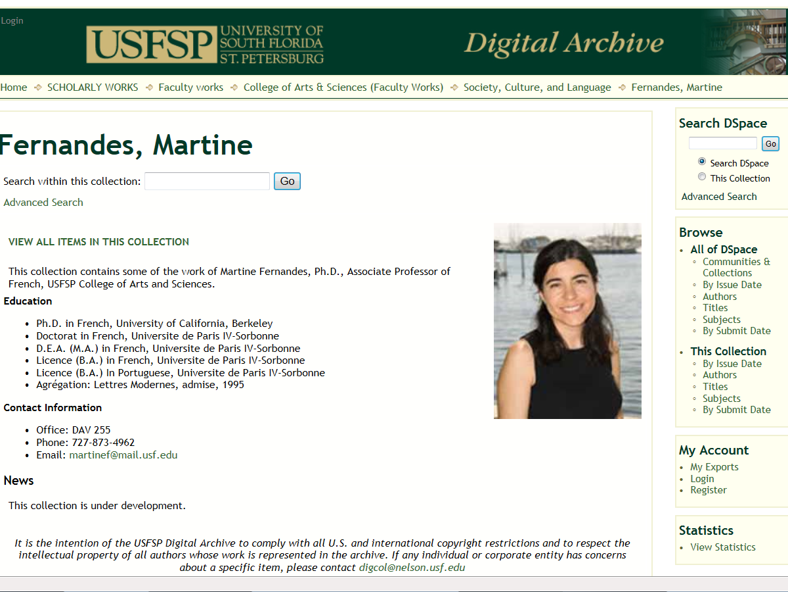
Recovering USFSP Academic

Slide 22
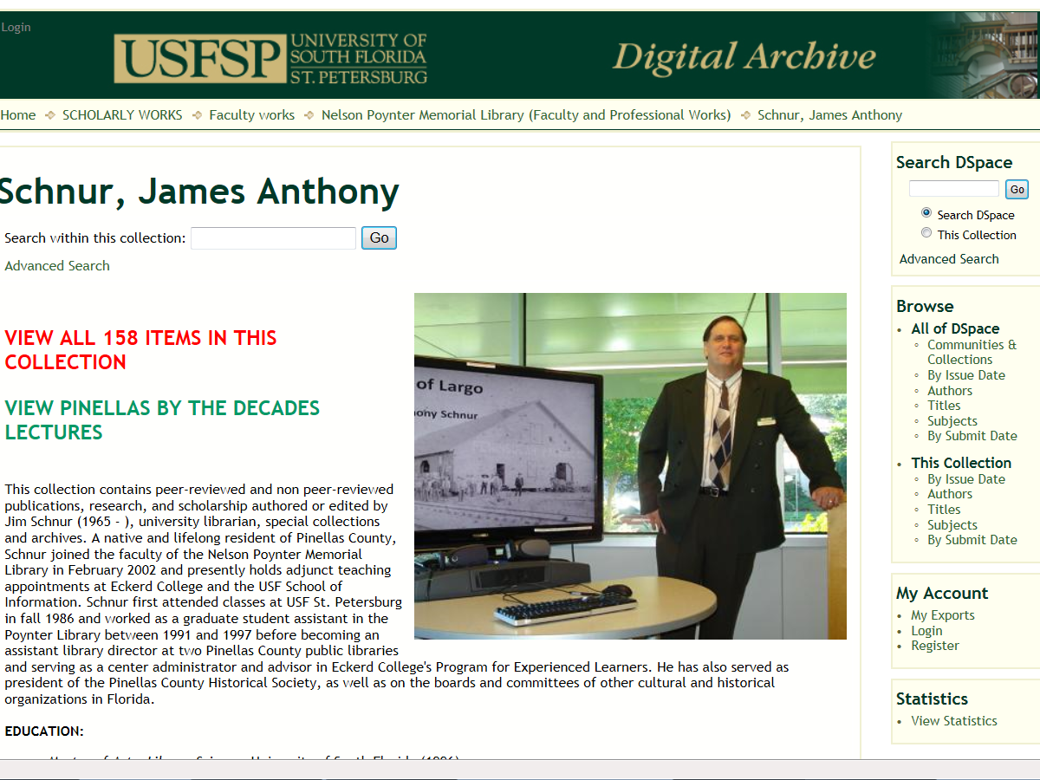
Recovering USFSP Academic

Slide 23
8. Made a list of all readers, colleagues and co-authors we had failed to support and became willing to help them achieve wider distribution of and Open Access to their research

Slide 24
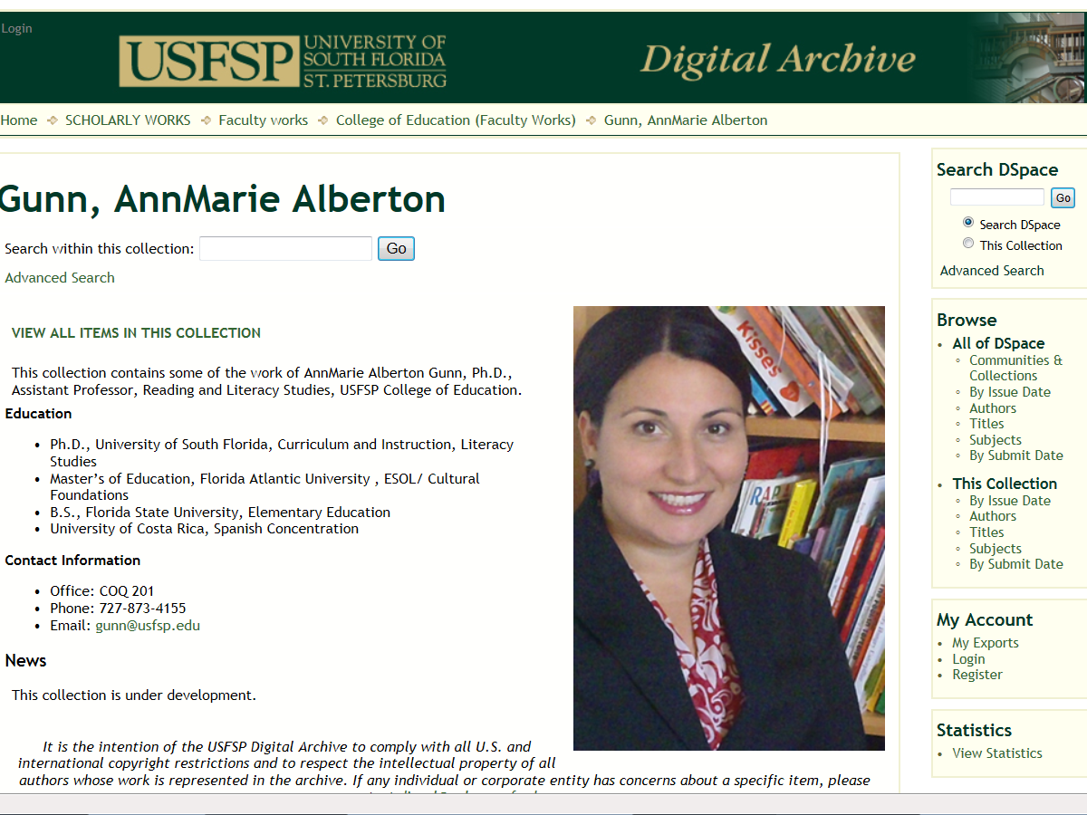
Recovering USFSP Academic

Slide 25
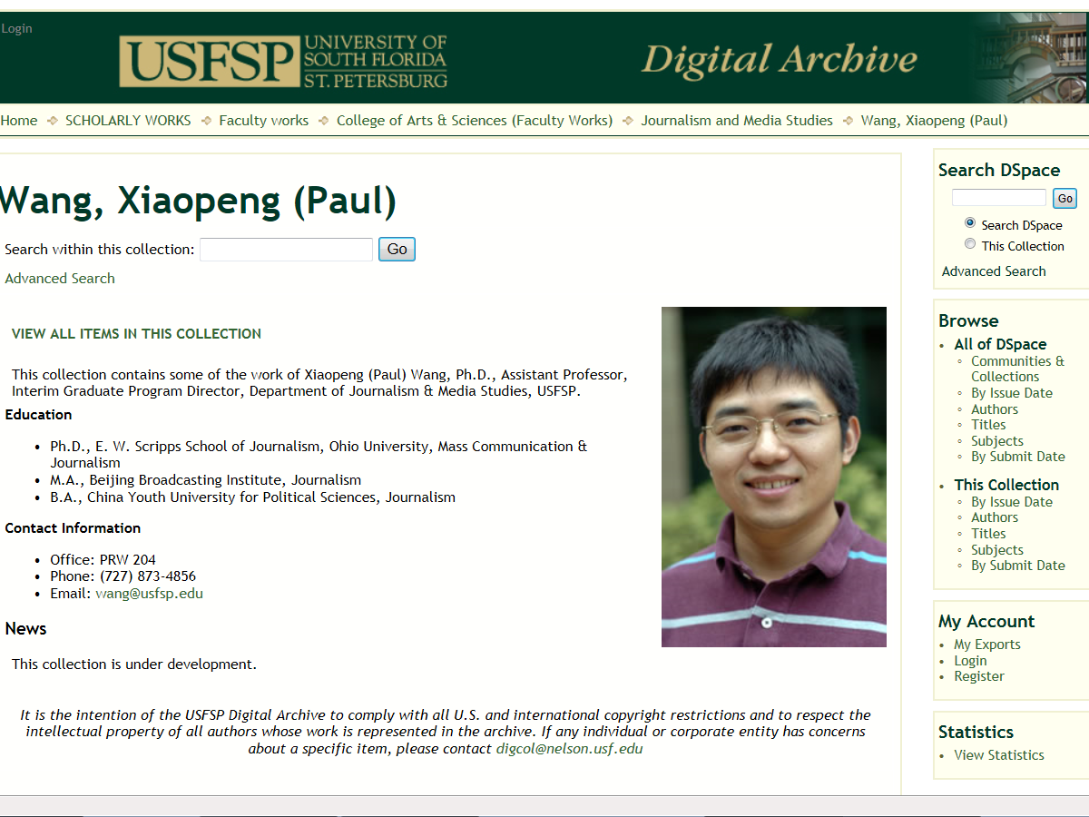
Recovering USFSP Academic

Slide 26
9. Made direct amends to such people whenever possible by helping to get the word out about their research, except when to do so would violate copyright

Slide 27
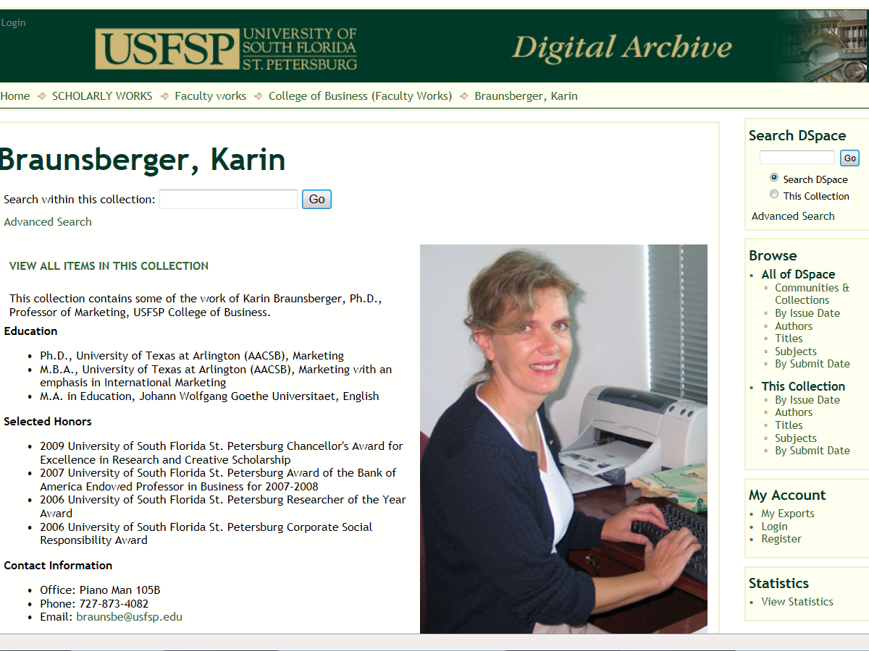
Recovering USFSP Academic

Slide 28
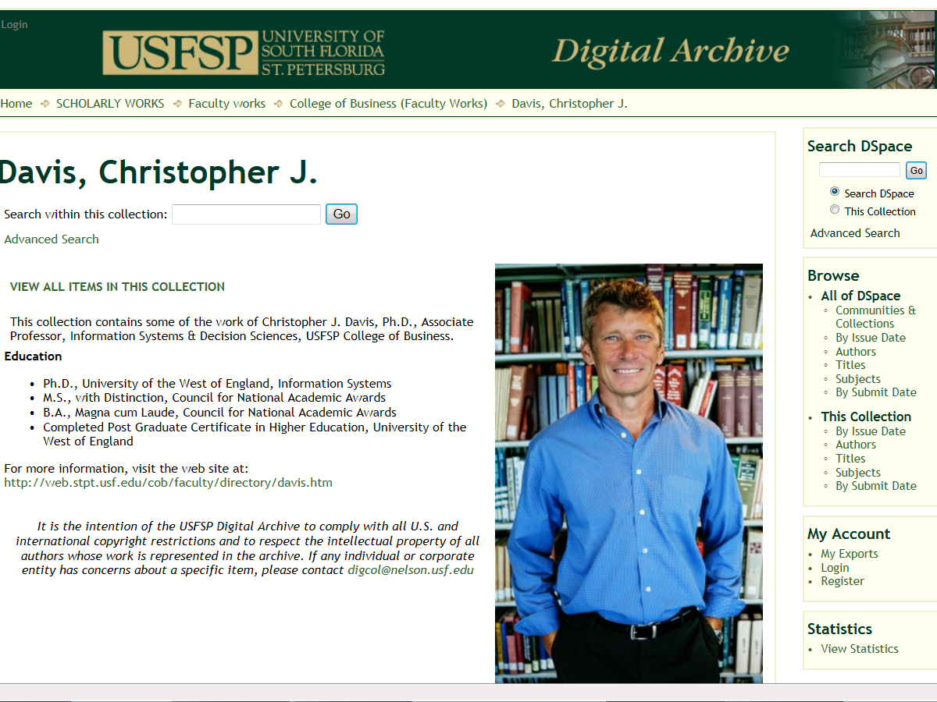
Recovering USFSP Academic

Slide 29
10. Continued to take personal inventory, and when we slipped up and were tempted to sign a publisher’s agreement without thinking, promptly admitted it

Slide 30
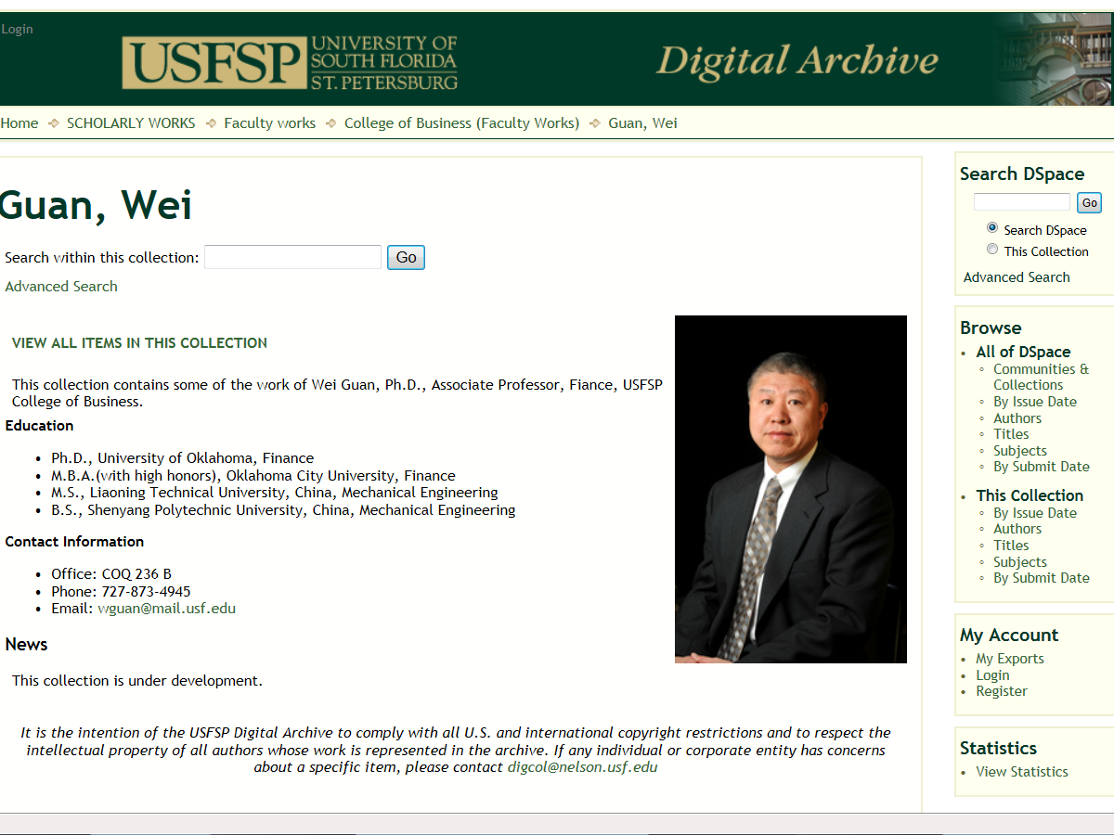
Recovering USFSP Academic

Slide 31
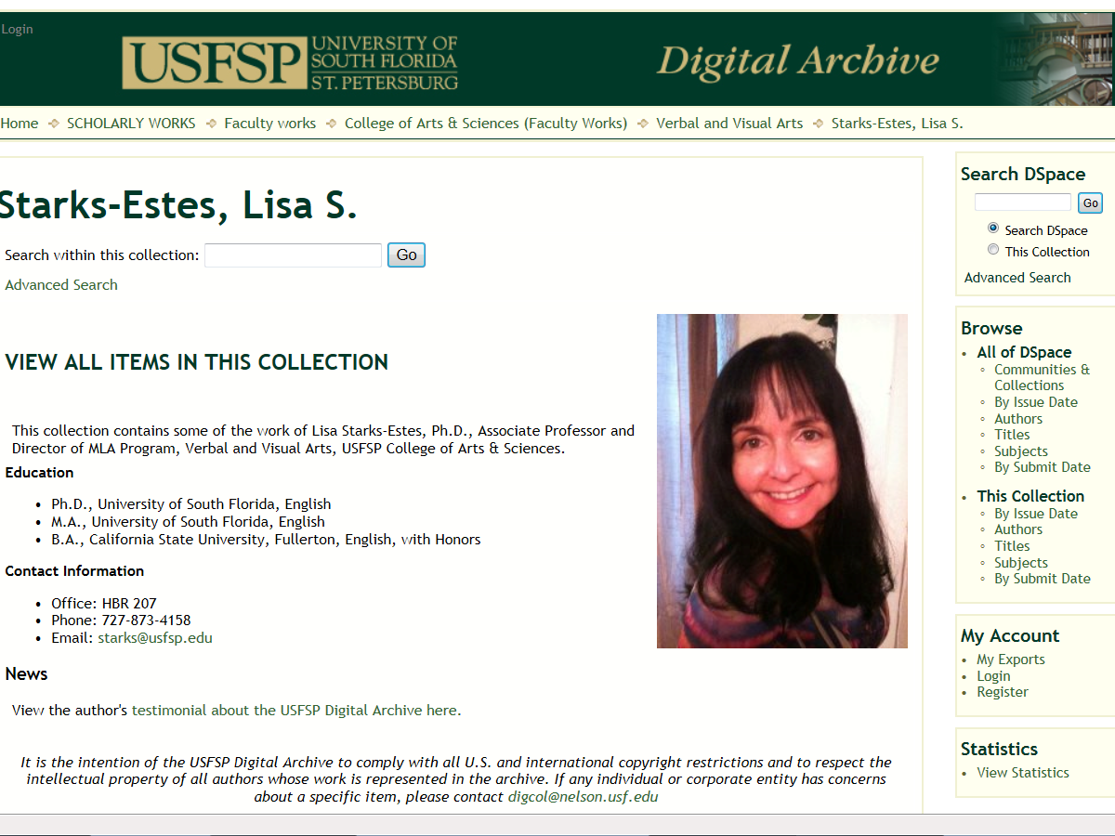
Recovering USFSP Academic

Slide 32
11. Sought, through careful reading of agreements and negotiation with publishers, to improve our commitment to Open Access

Slide 33
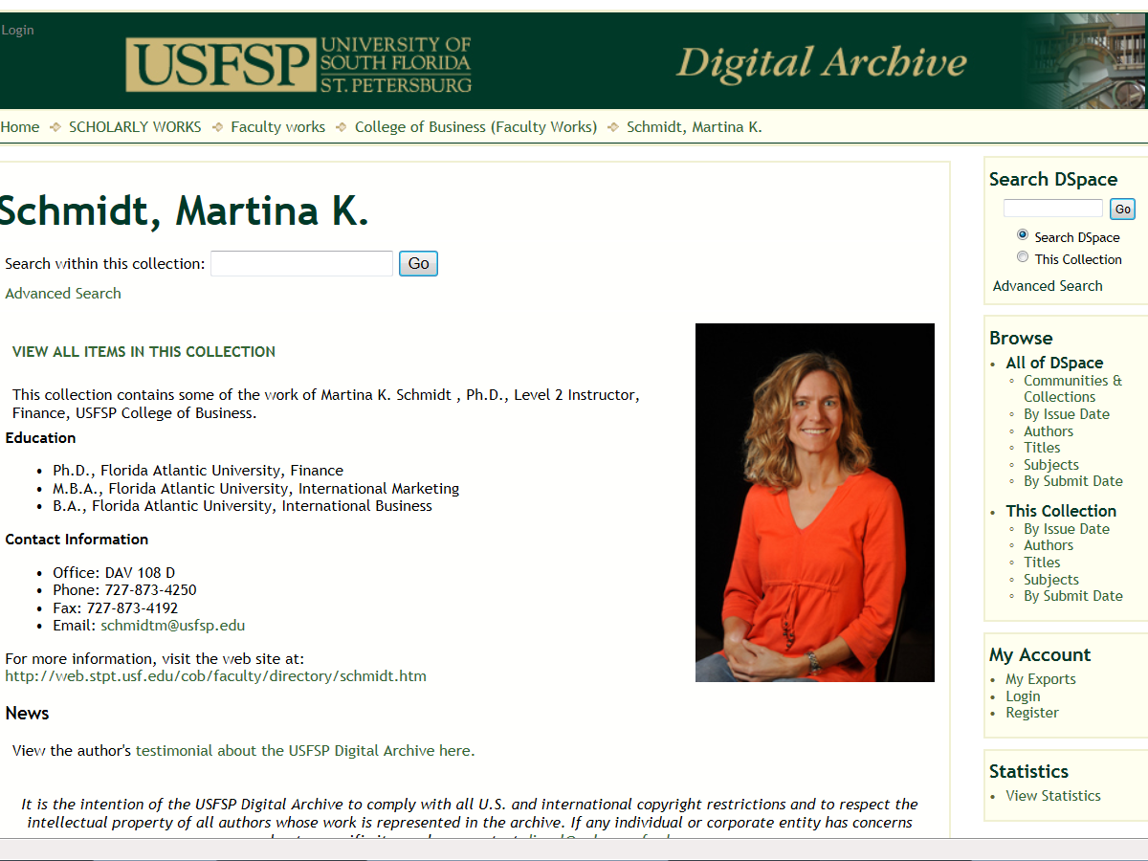
Recovering USFSP Academic

Slide 34
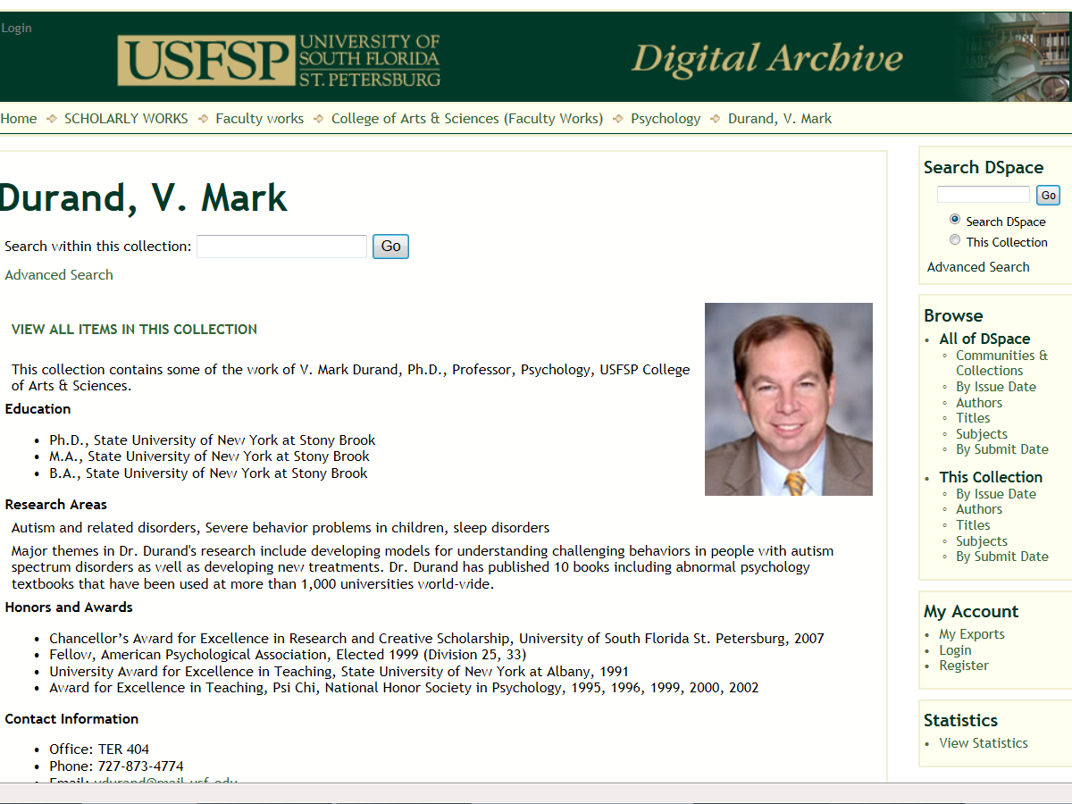
Recovering USFSP Academic

Slide 35
12. Having had an intellectual awakening as a result of these steps, we tried to carry this message to other academics, and to apply the principles of Open Access in all our publishing efforts

Slide 36
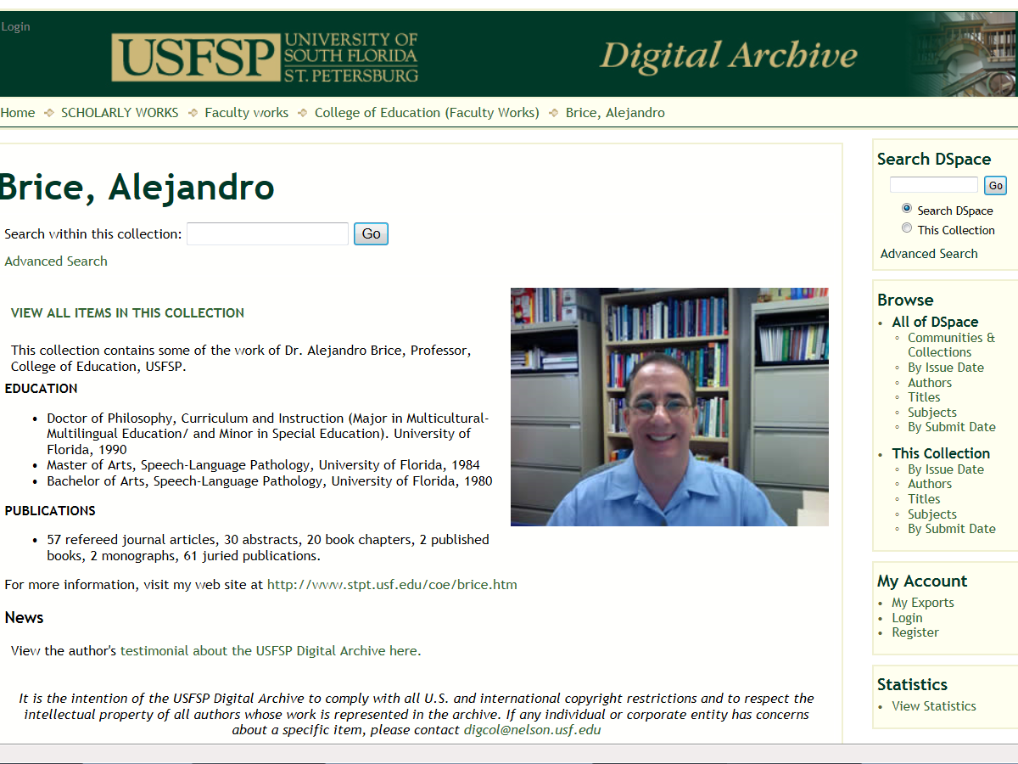
Recovering USFSP Academic

Slide 37
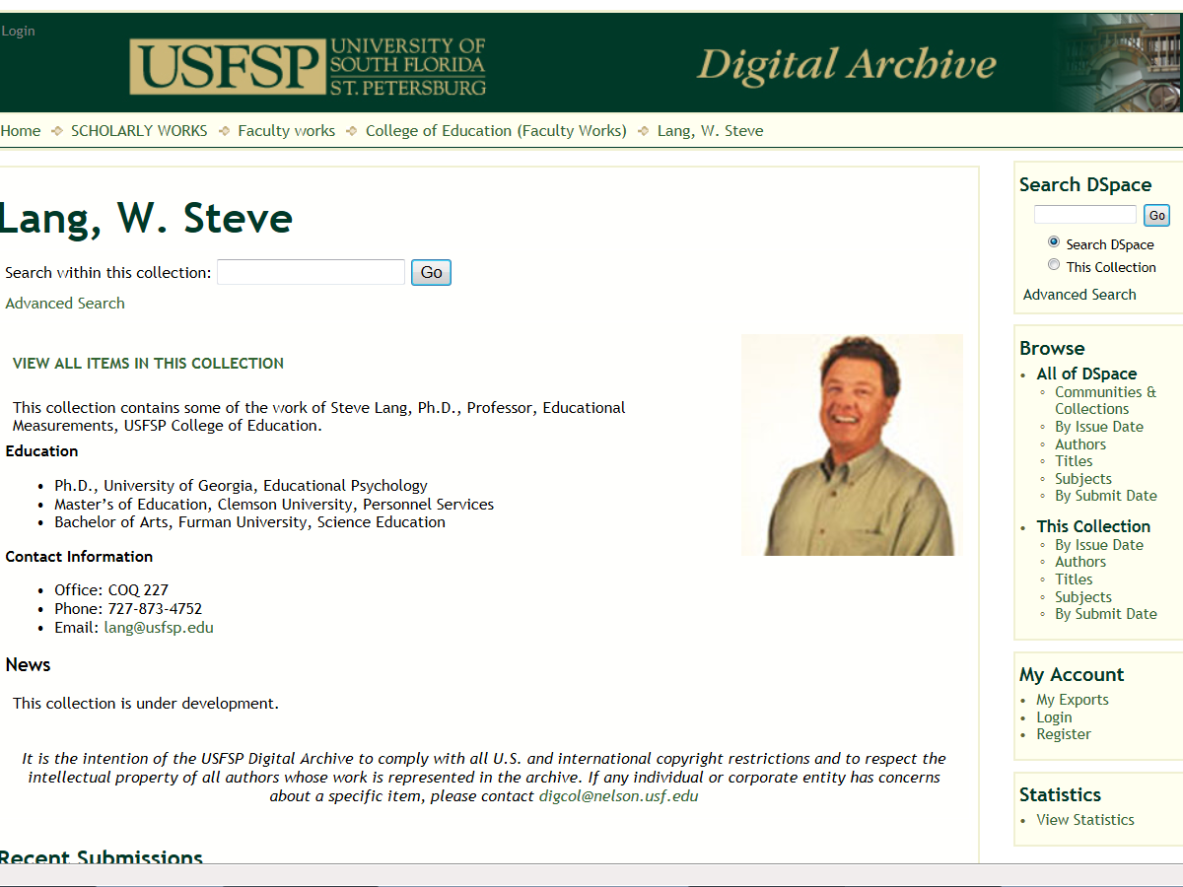
Recovering USFSP Academic

Slide 38
