Slide 1

Florida Atlantic University Libraries
Library Collections
Presentation of
Carol Hixson (hixson@fau.edu), Dean of University Libraries
to the University Faculty Senate
With input from
Jeff Sundquist, Assistant Dean for Research and Collections
Maris Hayashi, Head of Collection Management
February 26, 2018

Slide 2
Budget for Collections
Rate of Inflation for Library Collections (Print & Electronic)
  7-10% annually
  83.8% over last ten years
FAU Libraries Budget for Collections
  2008 $3 million
  2017 $3 million
  To keep pace with inflation: $5.5 million needed
Notes:
This is information that has been widely shared here and elsewhere since August

Slide 3
In general, how often do you use the library's electronic services or resources from your office, home or other off-campus location?
Notes:
Faculty Survey Opened September 19; Closed October 23
Questions on collections and services
Responses from 385 FAU faculty
Across all Colleges, disciplines, and campuses
All ranks of faculty responded
We asked a set of questions relating to the use and importance of print and electronic collections. This chart shows the overall usages of electronic resources

Slide 4
If the library’s electronic resources were to be significantly reduced, how much would this affect your:
  Very Significant or Significant Impact on:
    Teaching 80.34%
    Research 90.86%
    Remaining at FAU 63.08%
Notes:
These are the numbers for all faculty. Some variation across colleges but not huge

Slide 5
In general, how often do you use the library's print resources (books, journals, etc.)?
Notes:
These are the overall numbers for the use of print

Slide 6
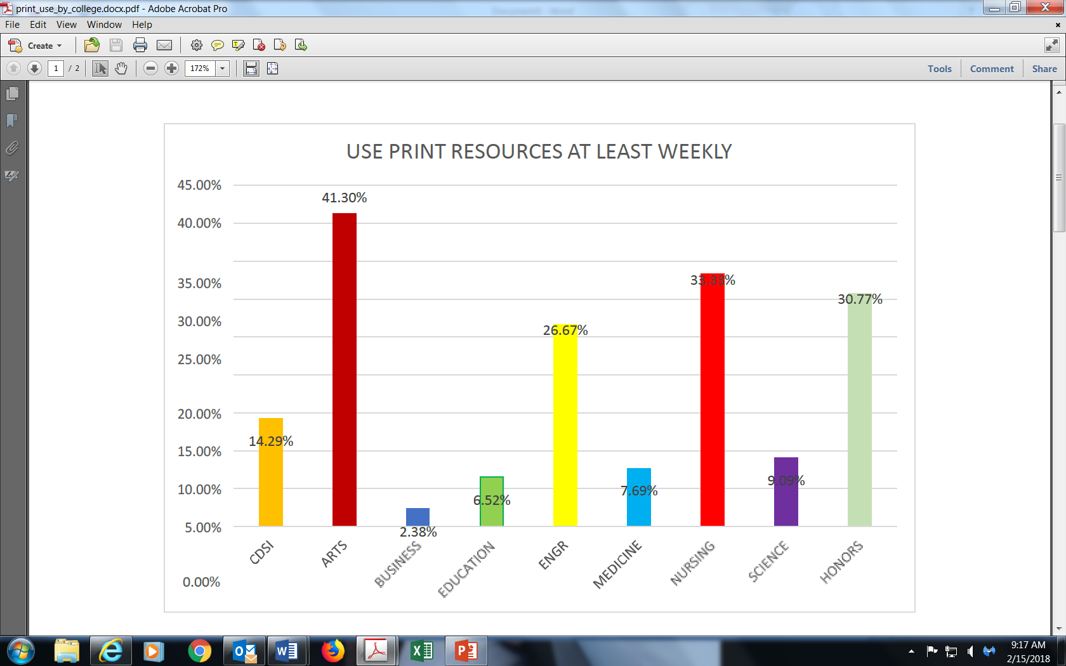
Use print at least weekly by College
Notes:
Significant variation by College. Arts and Letters faculty, Nursing, the Honors College still report heavy usage of print collections

Slide 7
If the library’s physical collections were to be significantly reduced, how much would this affect your:
  Very Significant or Significant Impact on:
    Teaching 61%
    Research 67%
    Remaining at FAU 46%
Notes:
These are the overall numbers. Less than for electronic but not insignificant

Slide 8
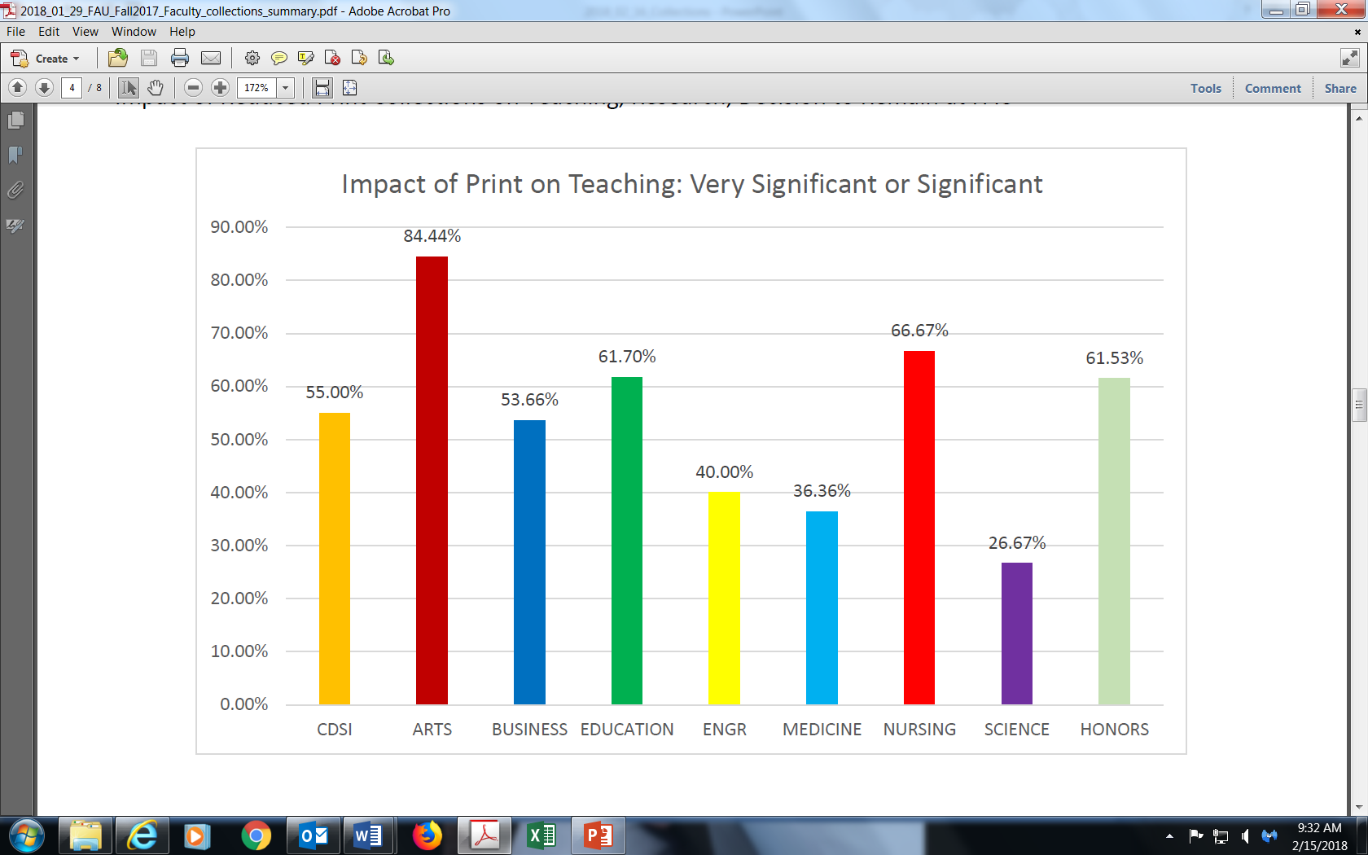
Impact of Print on Teaching by College
Notes:
However, there is significant variation among the Colleges for how important they consider print collections to their teaching

Slide 9
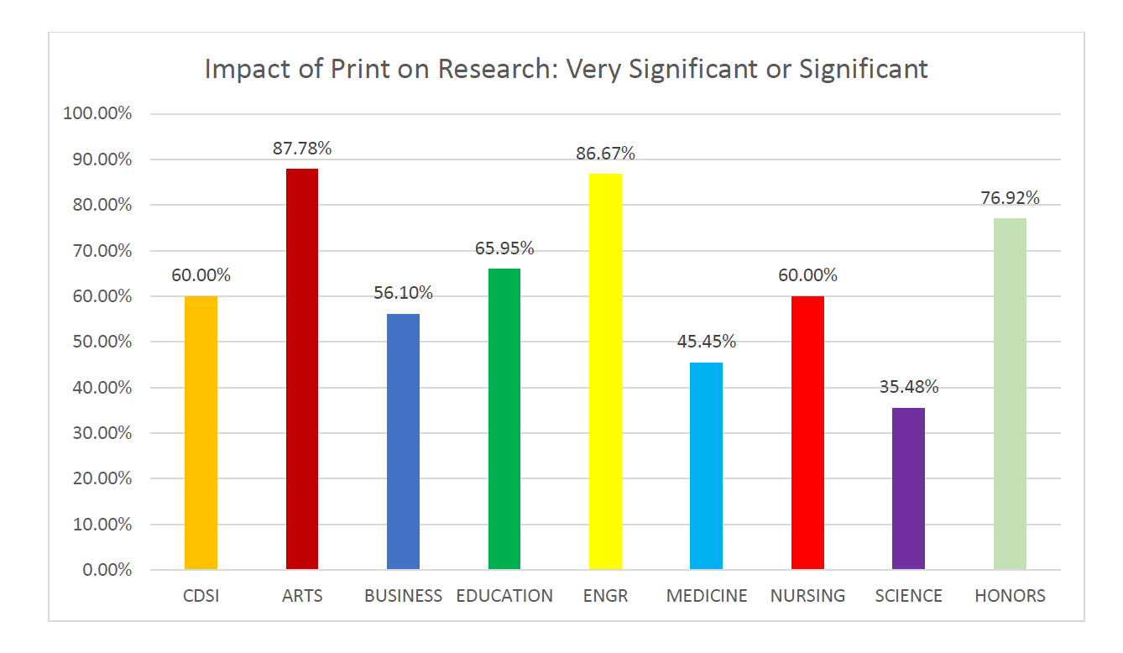
Impact of Print on Research by College
Notes:
There is also significant variation among the Colleges for how important they consider print collections to their research. We cannot base our collection decisions on the needs of only some of the disciplines.

Slide 10
How Have the Libraries Been Coping?
Reducing the amount spent on monographs
  Since FY 13/14: 47% less spent on print books, 86% less spent on e-books, 69% less spent on books overall
Supplementing the collections budget with salary savings
  Already used $144,000 to keep Taylor & Francis going this year
  Allocated $150,000 before the end of this fiscal year for print books
  Asked to keep aside $300,000 to put into collections next year
Supplementing the collections budget with Technology Fee proposals
  This year, 10 of 19 Tech Fee proposals were requests to purchase scholarly content, for a total of $715,859
  Last year, we were awarded $159,889 for four proposals to purchase scholarly content
Notes:
I have been at FAU for 2.5 years. Looking back over the past twelve years, it has become clear that the strategy has been to lessen the impact felt by faculty by reducing the purchase of new monographs. The lack of a new book is much easier to overlook than the loss of access to an entire database. As we found out when the vendor Taylor & Francis “accidentally” cut off access to their database in early January.
The use of salary savings is not a sustainable funding model. For one thing, when we hold positions open longer just to generate money to pay other bills, that has a negative impact on services.
The use of Tech fee proposals helps us supplement electronic collections but does not deal with our systemic issue

Slide 11
Where are we?
We have not cut any electronic package to date
We are committed to the President’s vision of FAU as a top-tier research institution
This is a university-wide issue and not a library problem. We are all on the same side (Colleges, Libraries, Provost’s Office, Division of Research) and we need to find the solutions together
We need College faculty input on the criteria and the processes for deciding what to purchase and what to cut (if we need to cut) to assist Library faculty

Slide 12
Where are we?
We are losing ground in our print and monograph collections and have reached the point where we can no longer maintain the appearance of the status quo for electronic resources, even if we don’t buy any books
Some disciplines have been bearing the brunt of the budget shortfall because they are heavily dependent on books for their teaching and research. The loss of access to their scholarly content has been subsidizing everyone else’s status quo for a number of years
Contracts will be coming due and we project that we will not be able to pay them all. We cannot use credit with vendors
Unless we get a significant and ongoing increase in the collections budget, we will most likely have to make cuts

Slide 13
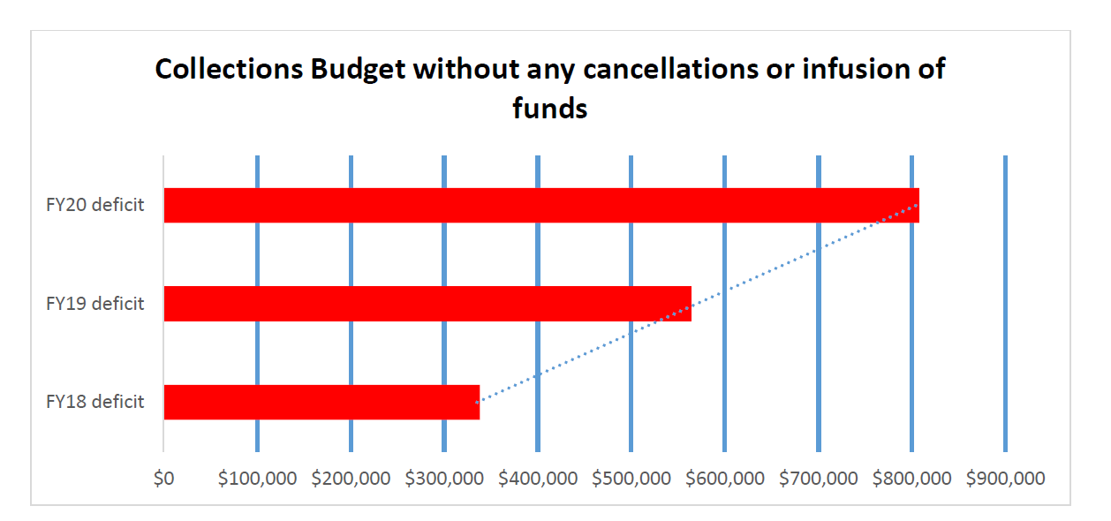
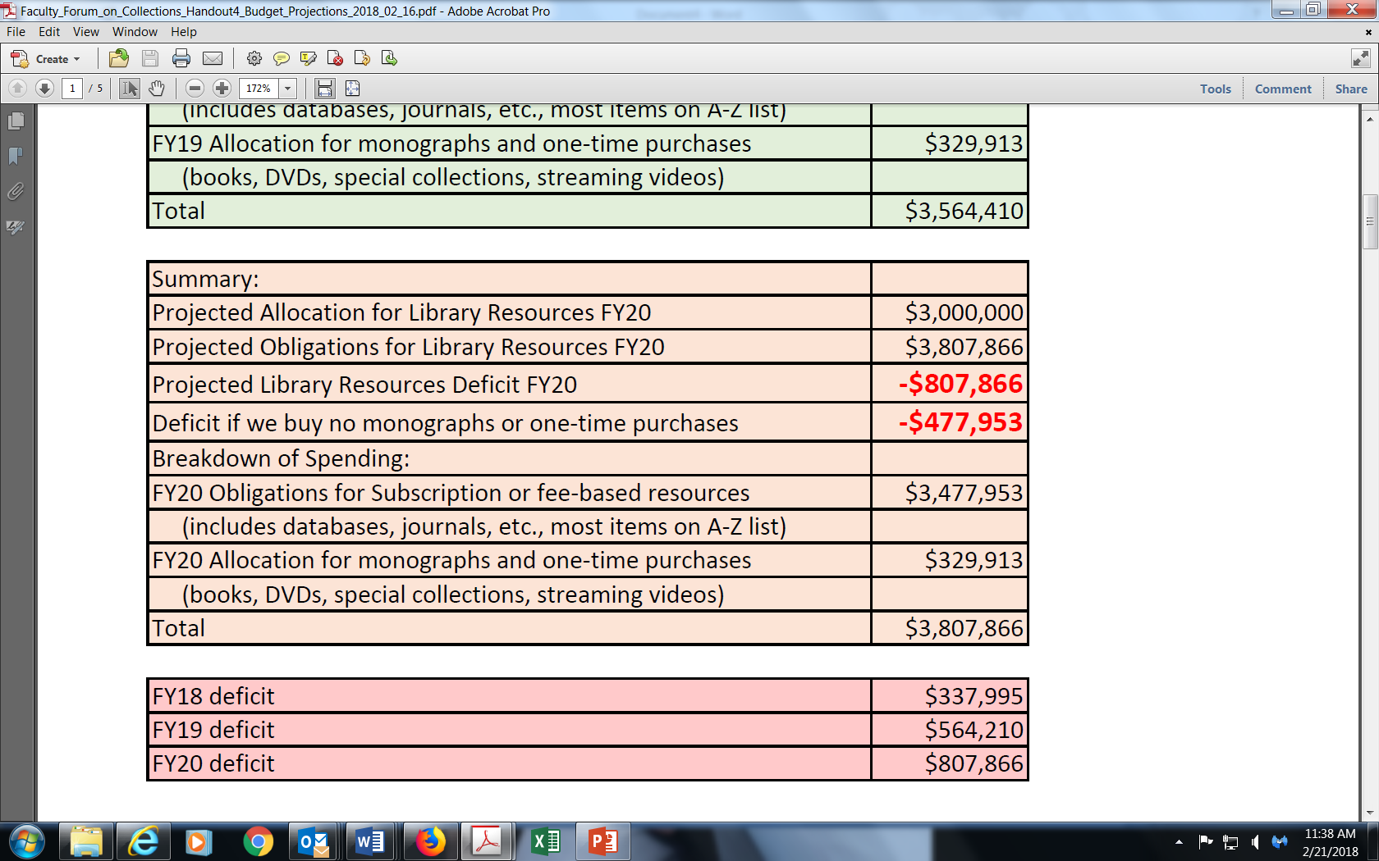
Projected deficits for next 3 years based on rising costs for current electronic packages
Notes:
Without new funds, we will have to make cuts

Slide 14
How Do We Move Forward? Faculty ideas
Request more funding from University (competing priorities (i.e. funding for Summer or support for Grad Students) from same pot of money)
Work with Division of Research to increase support (long-term effort that depends on DoR growth: UF, UCF, USF Libraries get Research funding)
Get grants (granting agencies expect something in return for their funds)
Raise money through development (working on but no immediate fix and donors often have tightly focused collection interests)
Student fee (no other SUS institution does this)
Look at cost-sharing with Colleges (CoM model)
Continue to utilize supplemental funding as possible to fill short-term gaps (not a long-term solution and limits ability to meet other needs)

Slide 15
How Do We Move Forward?
Continue to meet with faculty (Forums, College Councils, Graduate Council, UFS, Collections Advisory Committee)
Develop criteria and process for making cuts (if needed) with College faculty input. For instance:
  Use statistics
  Cost per usage
  Program needs
  Accreditation considerations
  P&T criteria
  Faculty review of lists
  Student success measures
Notes:
We are forming a Collections Advisory Committee whose purpose is to provide input to library faculty whose expertise is in building and maintaining collections for the benefit of all disciplines, all faculty, all students. The Committee will be charged to help develop criteria for making selection decisions and processes that have faculty support. This group will not be making decisions about what to cut but instead advising their library faculty colleagues on processes and criteria.

Slide 16
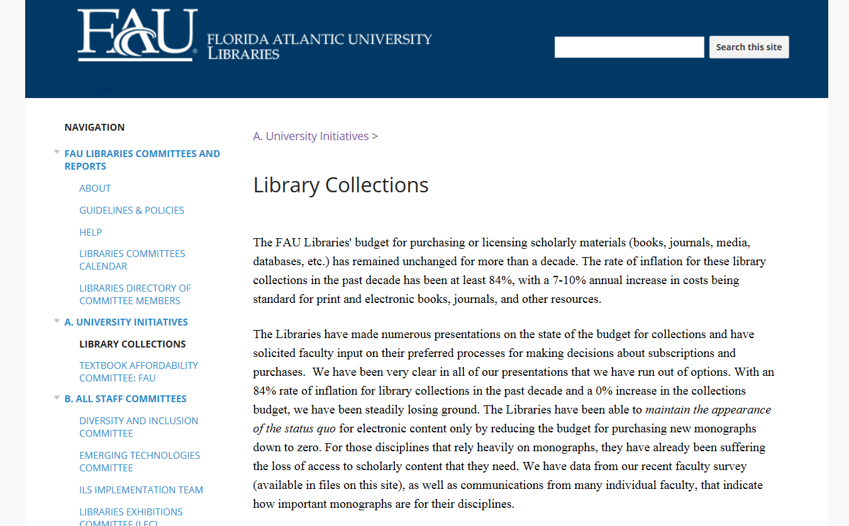
https://sites.google.com/a/faulibs.com/committees// university-committees/library-collections
Notes:
We have a Google site where we are putting all the presentations and other information we have made to various groups. The URL is long but this will be a place where anyone can track what we are doing.

