Slide 1

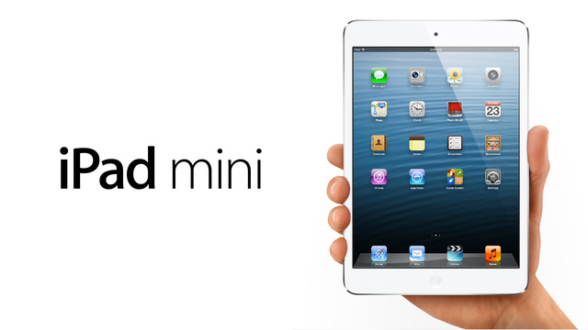

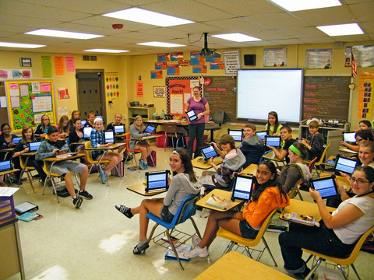
Technology Integration in Second Language Learning-Spanish Immersion
Juan Cuadros, Principal, Buena Vista Spanish Immersion School
EDLD 655 University of Oregon November, 2012
GOAL:
Connection to Research (Instructional Improvement)
Options for Identification, Justification, and Achievement of SIP Goal
Resource Impact – Budget and Staffing
Integrate technology to improve instruction in a Spanish Immersion School.
Employ a 3-year plan to increase teacher technology integration in the Spanish curriculum by 70%, where all students will be provided with access to iPad minis. The 1st year of rolling out the iPad minis will begin with 4th & 5th grades, the second year will include 3rd & 2nd grades, and in the final year, the roll out will include Kinder & 1st grades.
Evidence from research demonstrates
Increase comprehensibility
Introduction of new concepts
Using audio-visual aids such as photos, gestures, sounds, intonation cues, movement
Provides students with different learning styles
Virtual language learning
Cooperative learning activities
Enhance writing quality
Web based lessons
Intercultural opportunities
Create digital content on rate level for each student
Publish work
Apple care for iPad minis
Insurance and maintenance
Professional Development for Staff
Install motion sensors for increase security in the building
Memorandum of understanding with Eugene police
Cost of Applications
Cost of hard cases & chargers
School wide licenses
Wireless internet connection in the building
Projection | Costs | Resources
I-Pad Mini Applications | $115,150. (350 Mini) Est. cost $20,000 | Fleet Funds State & Local Grants Parent Organization EEF Grants Private Donors Local Businesses Scholarships Fundraisers Private Foundations
Cases & Chargers Professional Development | $4,400.00 392 Hours (on going PD) 14 teachers & Admin. | Fleet Funds Parent Organization Local Businesses Fundraisers Fleet Funds Fundraisers State & Local Grants EFF Grants Private Foundations
As a text book for Spanish Literacy
As a text book for English Literacy
As a tool for recording video
As a creative tool for writing projects
As a tool for reading, listening, speaking and writing Spanish
To research projects
To work on homework projects e.g. Spelling City, IXL
To use for special projects using internet, video, face-time,
iTunes, and iTunes apps
for communication i.e. email and Skype, Edmodo
To use as an organizational tool
Intended Outcomes
Introduction: Are you paying attention?
Students will use technology
1. Teachers will increase their confidence integrating technology into the curriculum providing an array of general-purpose tools to students as essential learning tools.
2. Teachers will be provided with curriculum and instructional materials that exploit the capabilities of the i-pad mini.
3. Students will have the capacity to access a wealth of information for their development in second language learning.
4. Teachers will be able to enhance reading, writing, speaking, & listening in Spanish.
5. Students will have the opportunity to engage other students from Spanish speaking countries via internet.
6. Students learn to become independent and self-directed learners.
7. Student’s assessment scores improve i.e. easyCBM, OAKS & in-class assessments.
8. Parents are engaged and invested in their students gains in second language learning through the technology.
9. Creating a school community that is 21st century ready.
10. Teachers and students become more proficient with different programs i.e. PowerPoint, virtual whiteboard, keynote, etc.
11. Create digital communities for parents.
12. Create technology clubs for students.
13. Provide multiple platforms for students to learn and for teachers to instruct.
Buena Vista Spanish Immersion is a K-5 school in the Eugene 4J School District that is committed to using technology to engage students in the learning process, and to improve instruction. As a Spanish immersion school, the potential of using mobile devices are endless. “Computing technologies have profoundly transformed just about every major organization and of human endeavor (Norris & Sololway).”
The students of today are digital learners. Schools need to be better prepared to meet the needs of 21st century learners for a rapidly developing world. It is not out of the question to take an elementary classroom outside to conduct experiments when the teacher can send the students assignments via email or digitally. According to research, mobile learning pilot programs will not only create and reach a new generation of learners but will ultimately change the way teachers teach and engage students.
In order to reach the intended outcomes and goals using mobile devices for all students teachers cannot use them simply as a supplemental tool. The number one factor that stops mobile learning pilot programs is the lack of professional development for teachers. In order to improve and change the way teachers instruct today's digital learners is to have consistent and on going professional development. This will enable teachers to develop and boost lesson plans that combine the state’s curriculum with mobile learning.
Second language learning is a living, breathing and ever changing experience. It is no coincidence that technology is rapidly changing and the way see the world. Using technology to enhance second language learning in the classroom is an advantage teachers need to make crisp-looking, visually appealing products to capture student’s interest.
Action Plan
Citations
Timeline (3 years) September 2013-2020 | Start the program for school year 2013-2014 The first year of the program will start with 4th and 5th grades The second year will of the program will include 3rd and 2nd grades The final year will include 1st and kinder grades
Training (Professional Development) | Parents sign agreement on proper usage, monitor and care contract Students sign agreement on proper usage and care contract. Students receive workshop usage on applications Teachers sign agreement on proper usage, monitor and care contract. Teachers receive workshop usage on applications
NETS*S (National Education Technology Standards for Students) | Scope an sequence K-5 (4J TILT program)
Monitoring and Evaluation | Data reviewed by technology team School’s Site council Articulated scope and sequence K-5 Software and applications to support second language learning Technology curriculum with benchmark goals Teachers and Staff professional development Parent workshops on technology Grade level websites Reports for Administration and stakeholder groups District level tech support once every two weeks
Wang, Li. (2005)The Advantages of Using Technology in Second Language Education.
Chen, Jie and Dym, Warren. (2003) Using Computer Technology to Bridge School and Community.
Puente, Kelly. (2012) Mobile Devices Drive Creative Instruction.
Dukes, Christina. Best Practices for Integrating technology into English Language Instruction
T4.jordan.k12.ut.us (video) Pay Attention
QUOTE: Technology & Education
“How do we turn our classrooms into learning engines? Pay attention to our children’s intensely rich information experiences.”
Warlick. D. (2008) Teaching and Learning on the Edge of Change

