Slide 1

The University of Oregon
Serials Cancellation Project 2008-10
Collection Evaluation During the Economic Crisis:
Case Studies in Academia
David C. Fowler, Head
Licensing, Grants Administration and Collections Analysis
University of Oregon Libraries
June 27, 2010

Slide 2
The Overall Situation:
University of Oregon has historically been neither a very rich or very poor public university.
Oregon ranks 43rd in the amount of state spending per student at public universities.
Over the years it has, by necessity, weaned itself off public funding.
The State of Oregon now provides less than 10% of UO’s funding.
Notes:
As a result, the university, like the Coast Guard, another victim of perpetual budget cuts, has learned to do more with less, and has developed a “mean and lean” ethos, taking pride in its ability to accomplish much with far fewer resources than many of our ARL comparitors.
X
The UO’s current president, Richard Lariviere is proposing to the State Board of Higher Education a plan that would stabilize the school’s finances during rising a falling state budget cycles by issuing $1 billion in bonds to operate the school for the next 30 years.
This number has been shrinking gradually of the years, causing people to remark that UO is a “state university in name only.”

Slide 3
The Overall Situation:
Due to the 2008-09 economic downturn and other budgetary pressures, the UO took a 20% cut in state funding in the current biennium.
The University recently raised tuition by 7.5% to help bridge the gap. Another 6% is due next year (2011).
The University Foundation has worked to raise $853,000,000 in new donations and pledges to help bolster its endowment in the last two years.
Notes:
The remaining 90+% is received from private gifts, research grants and student tuition.
An additional 7% cut has recently been instituted before the end of FY09 to cover projected state budget shortfalls.
2)
3) However, because of state fund-raising rules, donations must be invested for several years, before we can begin drawing on the interest, and very large portions of the money have various stipulations on its use (athletics, construction, etc.)

Slide 4
The Library Budget Crisis:
Similar cuts to what the University absorbed impacted the library initially.
Dating back to the last serials cancellation project in 2003-05, the library worked to eliminate as much format duplication as possible.
However, serials inflation was gradually catching up with the savings previously achieved.
Notes:
The provost exempted the library from certain cuts, however.
The library budget was able to coast on the savings created by these actions for several years, without having to worry about materials budget deficits.
Projections showed a modest deficit occuring, beginning in 2008-09, and growing rapidly after that.
Adjustments to the collections budget in the last decade have swung from +2.75% to -2.75%, which is not huge, but which certainly does not cover inflation.

Slide 5
Notes:
This slide illustrates the collections budget trend at UO from 1992 to 2009 (Blue Line). It’s gone from about $3.5 million to a little over $5 million in that time.
We’ve remained well under HEPI Index (Orange Line) since about 2002 and under the Portland CPI (the closest local large urban area) (Brown Line) since about 2005.
Monographs expenditures (Green Line) have risen by 19% overall, but have remained hovering in the $1 million range for the most part.
Miscellaneous collections expenditures (Purple Line) have decreased by 23% overall, but have mostly hovered around $500,000.
The real story is the serials expenditure line (Red Line), which has risen by 89% (about $2 million) over this time.
The UO libraries executed five serials cancellation projects in sixteen years, cutting $2.69 million in subscriptions. In unadjusted dollars, the serials budget would have risen by nearly $5 million without these.

Slide 6
Issues and Conundrums:
The Library itself raised $20 million out of the UO total of $853 million. Wouldn’t that help?
Journal prices inflate, on average, between 8 and 10 percent each year.
If we didn’t reduce the materials budget, our ability to purchase other collection items would be compromised.
In previous cancellation projects, the library established targets based on discipline-variable inflation factors, materials costs and past spends.
Notes:
Of that, only $5 million was pegged for collections. Half of that was pledged to support the sciences. $400K were in cash donations that could be used without restriction. The remainder is required to be put into endowments, which are currently producing $170,000 in income to support library collections. The library would have to increase its endowments by $9 million ANNUALLY to address inflation, because:
The provost has given the library budget augments periodically, but these are unpredictable, and no substitute for a consistent, programmed budget increase. These augments have ranged from 0 to 3% a year.
Our ability to purchase monographic items (New books, video, audio, some databases) would be steadily reduced and at an 8% serials inflation rate (around $350,000 a year), the book budget would disappear.
This resulted in the sciences cancelling the most, followed by social sciences and then arts and humanities. This time around, available data suggested that, even though their relative cost was lower, inflation factors in the social sciences and humanities were now inflating equal to, or greater than the sciences. As a result, cancellation target percentages would be kept uniform this time around.

Slide 7
Issues and Conundrums:
The Supplies & Services budget could not realistically be cut.
We had to discourage cancellations of titles that were available in aggregator databases like Lexis-Nexis and Academic Search Premier.
Notes:
A modern research library has to be to buy the technology required for students and researchers to access and exploit the data that we can provide. Most importantly, the vast majority of these costs were already being paid out of gift funds.
This was not a requirement, but was strongly discouraged. Content stability in these databases is unpredictable – titles come and go constantly and libraries have no control over that. Second, the “full text” provided may be circumscribed, or lack graphs, charts and illustrations. Third, it may be embargoed. Fourth, there is some evidence to suggest that publishers pull their content from these services if they believe libraries are cancelling paid subscriptions to rely on it.

Slide 8
The Plan:
The renewal cycle dictated the calendar.
Eliminate any remaining format duplication in titles.
Target high-cost/low-use titles.
Some of our “Big Deal” deals would have to be broken.
Notes:
Titles to cut needed to be identified by the end of May 2009. The review of titles began immediately and needed to be concluded by the end of the Spring 2009 term.
2) This had largely already been accomplished, but any further print/electronic/microfilm duplication would be targeted.
3) This was key to reaching targets as rapidly as possible, while cutting the fewest titles. Usage statistics and pricing information fed into the 360 Counter tool were manipulated and cost-per-use (CPU) figures were developed and ranked.
4) We withdrew from our consortial deals with Elsevier (though the Orbis-Cascade Alliance) and Wiley (though GWLA). The Wiley contract was terminating anyway, so we chose not to renew it. Without doing this, we would not have had adequate freedom to maneuver, as we cancelled high-cost titles.

Slide 9
Timeline:
Jan 2009 – UO faculty notified of the serials cancellations.
Feb 2009 – Database cancellations finalized.
Mar 2009 – UO cancellation lists shared with Oregon State University and avenues of shared collection development/coordinated cancellations explored.

Slide 10
Timeline:
Apr 2009 (early) – Completed cancellation lists made available for faculty review.
Apr 2009 (late) – Final list sent to Acquisitions department for troubleshooting.
May 2009 – Evaluation/selection phase of the cancellation project completed.

Slide 11
The Plan:
Prior to the serials reductions, monographic allocations were reduced by 25% ($217,000) in 2008-09.
A database cancellation project immediately preceded the journals cancellation project. This netted $157,000 in savings.
After this, it was determined that $1.2 million (27% of the $4.4 million materials budget) would be cut over a two-year period.
Notes:
This was done to help stave off a projected budget imbalance, and before the full impact of the economic downturn was known.
The full amount of the journals cut could not be known until we tallied the total database dollars cut and distributed the cuts to each fund line. The total ended up being 32 titles, totaling $150,000. These ranged from Columbia Earthscape ($411) to INSPEC ($39,760).
For FY09 a cut of $842,000 was projected. For FY10, and additional cut of $350,000 would be needed to meet the target.

Slide 12
The Plan:
Using 360 Counter, we took the 2007 and 2008 journal cost and usage statistics and determined the cost-per-use (CPU), and then ranked them overall and within their aggregator. This information was provided to subject specialists to help guide their de-selection decisions.

Slide 13
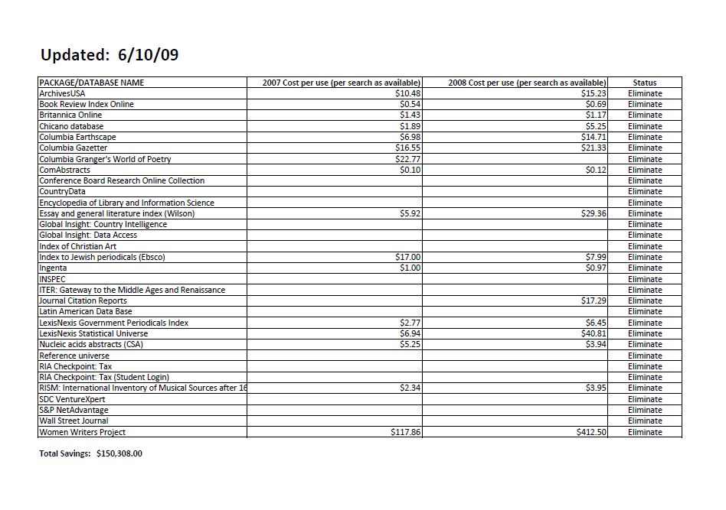
Notes:
Here are the databases selected for cancellation prior to the serials project.

Slide 14
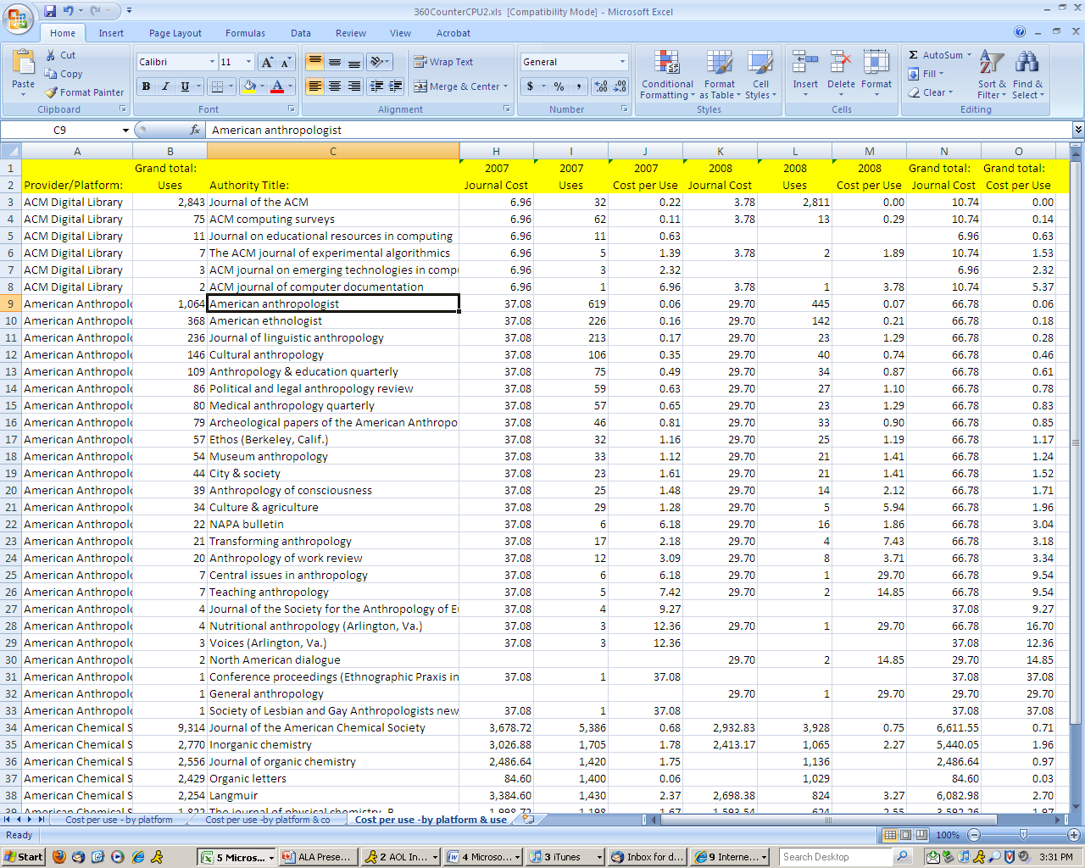
Notes:
This is an example of the spreadsheets we created that calculated CPU for most of our electronic journals.

Slide 15
Implementation:
As the economic crisis hit the State of Oregon and the Oregon, there were threats of additional rescissions being mandated by the state.
Subject specialists were responsible for meeting the target cuts in each of their funds.
General reference funds were temporarily suspended and replaced with gift funds.
Notes:
The library was very fortuitous by mostly having the University cover its portion of the rescissions through central reserves, or having the provost holding the library harmless in the process, preventing further damage to the collections.
If they governed multiple funds, they were allowed to trade cuts between them to meet their goals.
Additionally, library science lines were zeroed out.

Slide 16
Implementation:
Pay-per-view access to Science Direct was rising at an unsustainable rate, and it was also decided to cut this service.
The new serials budget was zeroed out. Subject specialists would be required to free up funds for new titles in the future by cancelling existing titles.
We cut the multi-year shared-access GWLA deal for Wiley journals.
Notes:
In addition, there had been several instances of PPV abuse which had cost us many thousands of dollars and as we did not have the human resources to mediate it, it was determined to bank the savings.
This would be a one-for one exchange of dollars. On occasions when new serials money did surface, the Collection Managers Group has been taking recommendations from subject specialists and making those choices.
In its place, we purchased a smaller set of titles that the UO subscribed to. This is a year to year deal.

Slide 17
Implementation:
The UO Collection Manager’s Group began meeting with their Oregon State University counterparts to look at ways to collaborate on collection development in the future.
The biggest success from this effort was collaboration on a shared Elsevier collection deal.
Portland State University was later added to this particular initiative.
Notes:
The goal of these efforts was to reduce duplication of content between the schools (only 40 miles apart on I-5), thus enabling each school to purchase more books than they would be able to on their own, while relying on rapid-ILL to share resources between them.
Results have been mixed. ILL initiatives have been well-used, but CD collaboration seems to have stalled, due in part to differing collection philosophies, differing audiences and differences of opinion on how much duplication is necessary.
The previous deal, brokered by the Orbis-Cascade Alliance was too expensive for both schools and it restricted our flexibility to cancel an adequate amount of titles to be able to meet our overall goals.
Although UO-OSU planning for the Elsevier deal was fairly advanced, it was determined that adding PSU would enhance our cost-benefit ratio. In addition, PSU’s academic and research aims in many ways were more closely aligned with UO’s, than OSU’s were.
UO had already been on an interim 1-year deal that preserved Orbis shared access, but OSU and PSU had already signed multi-year deals, which they were required to break in order to enter into a new deal.
Over the summer and fall of 2009, three-way negotiations with Elsevier took place, and a new deal with shared access and a Unique Title List was brokered, which enabled each school to collectively maintain access to all titles that accounted for 90% of usage AND to meet their respective cancellation goals.

Slide 18
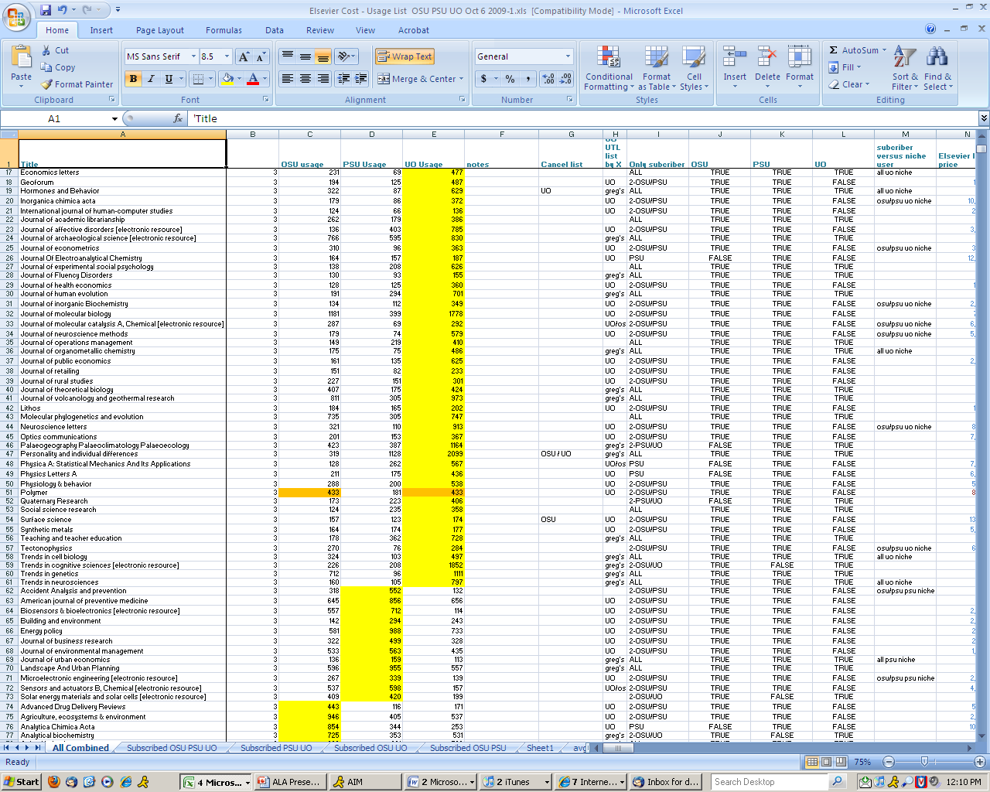
Notes:
This is an example of a spreadsheet created by Dean Walton, a science librarian at UO, that used an algorithm to measure combined use, cost-per use, Eigen factors, article influence rankings and whether or not a title’s usage was wide for all schools, or just for one (“niche”) and whether or not a title was in the highest 90% of usage ranking.

Slide 19
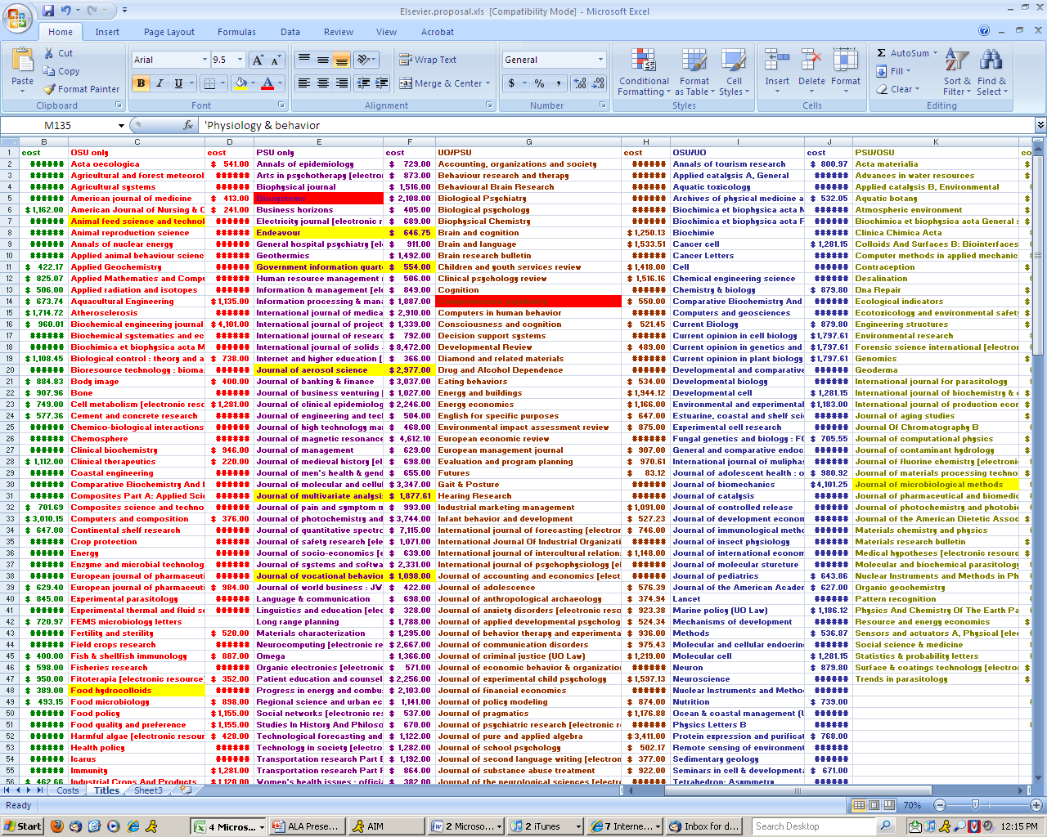
Notes:
This is the spreadsheet that we used to list out our final selected titles; Titles to be subscribed to individually, by UO, OSU and PSU; as well as shared titles that we would get for a discounted access price from Elsevier; These were UO-OSU, UO-PSU, OSU-PSU and “Big 3.”

Slide 20
The Aftermath:
We have a sustainable materials budget for the next few years.
Better than expected library income and some augments enabled us to indefinitely postpone the Year 2 serials cancellation.
We have maintained electronic access to our most-used titles, while shedding many high-cost, low-use titles.
We still lack a materials budget indexed to inflation, and rely chiefly on (unreliable) one-time augments to the budget.
Notes:
-
A recently-announced State rescission will be covered by central funds at the University level and the library will not suffer cuts. However, various strategic funding requests that we had made, will likely not be funded now, as the money targeted for that will now be used to cover the rescission.
-
A new budget model, that taxed academic departments for central services (such as the Library) was supposed to be implemented this year, but has been postponed due to the uncertain economy.

Slide 21
The Aftermath:
There is recognition that we, as a library, and as larger community cannot continue to business as usual.
Efforts have been made to set aside funding for open-access sponsorship and publishing by UO faculty.
Another cancellation project will be inevitable.
Notes:
We are encouraging faculty to be aware of their copyright retention abilities, and to spend time becoming familiar with journal pricing and inflation rates in their field.
Additionally, education efforts have been made to inform faculty and their supervisors about the unsustainability of the current academic publishing model, and we are encouraging them to re-think where they are publishing and editing, and what publications are “must haves” for submitting articles, in order to gain tenure.
-

Slide 22
Thank you.
Questions?
David C. Fowler
University of Oregon
dcfowler@uoregon.edu

