Slide 1
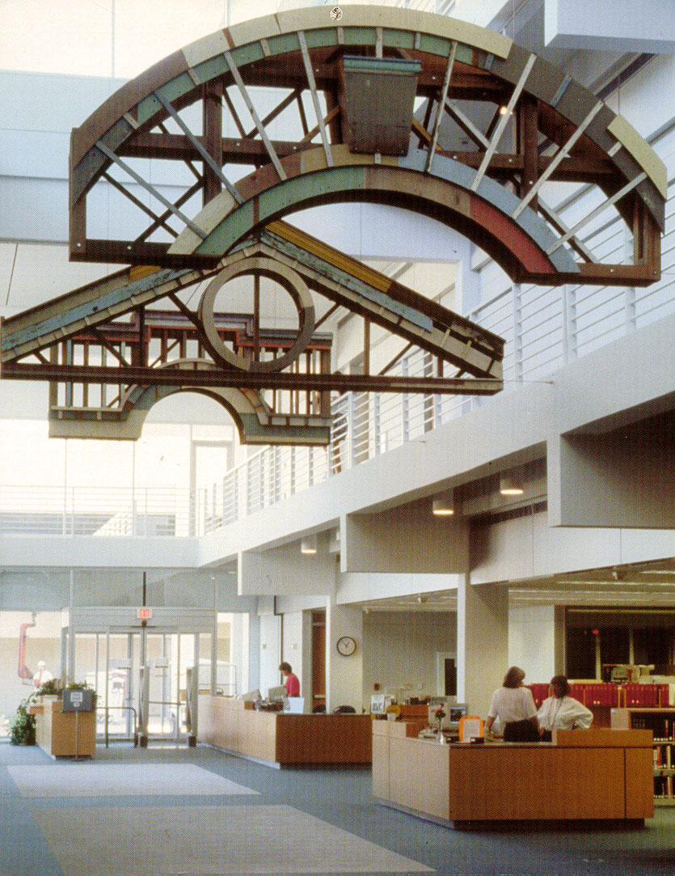

WHITHER (OR WITHER) LIBRARIES?
Presentation to the
University of South Florida
Foundation Board
By
Carol Hixson, Dean
Nelson Poynter Memorial Library
USFSP
February 25, 2011
Notes:
My name is Carol Hixson and I am the Dean of Library here at USFSP.
My presentation title is intended to confront you with the fundamental challenge we (and all libraries) are facing today: Are we going to become obsolete (wither) or are we going to continue and, if so, where are we headed?

Slide 2

Who am I?
Librarian for 27 years
Previously UL at University of Regina
Expert in digital archives and collections
Published author
First generation in college
Studied 6 languages
World traveler
Art lover
Notes:
Librarian for 27 years, with 7 years as library support staff and 2 years as student assistant in my college library before that. I’ve worked at some of the world’s premiere academic institutions: Cornell University, UCLA, Indiana University and the University of Oregon. I never planned to become a librarian. I fell into it because I majored in foreign languages-- and academic libraries are always looking for people with foreign language skills. It was in graduate school that I learned to respect the profession and to be proud of being a librarian.
Prior to USFSP I was the University Librarian (dean of library) at the University of Regina in Saskatchewan
At Regina and at the University of Oregon, I was responsible for creating digital archives and collections, often working in collaboration with other cultural heritage groups from the broader community. I have been an invited speaker throughout North America and in Spain on digital archives and digital collections.
I have written peer-reviewed articles on digital collections and other topics and have edited two training manuals for the Library of Congress. I am also proud of my work as an assistant editor for volumes 5 and 6 of the Cornell University Press Publication Lafayette in the Age of the American Revolution
I was the first person in my family to go to college and I’m proud to be an alumnus of Grinnell College and Drexel University. Being the first in my extended family to go to college has made me passionate about education
I have studied 6 foreign languages and speak 3 of them pretty well – mais minha coracao e brasileira
I have traveled extensively in Europe, Canada, and parts of South America where I have enjoyed putting my study of foreign languages to use and meeting new people
In my travels, I always visit art museums and I have served on the boards of art museums and currently serve on the St. Petersburg City Advisory Committee on Art

Slide 3
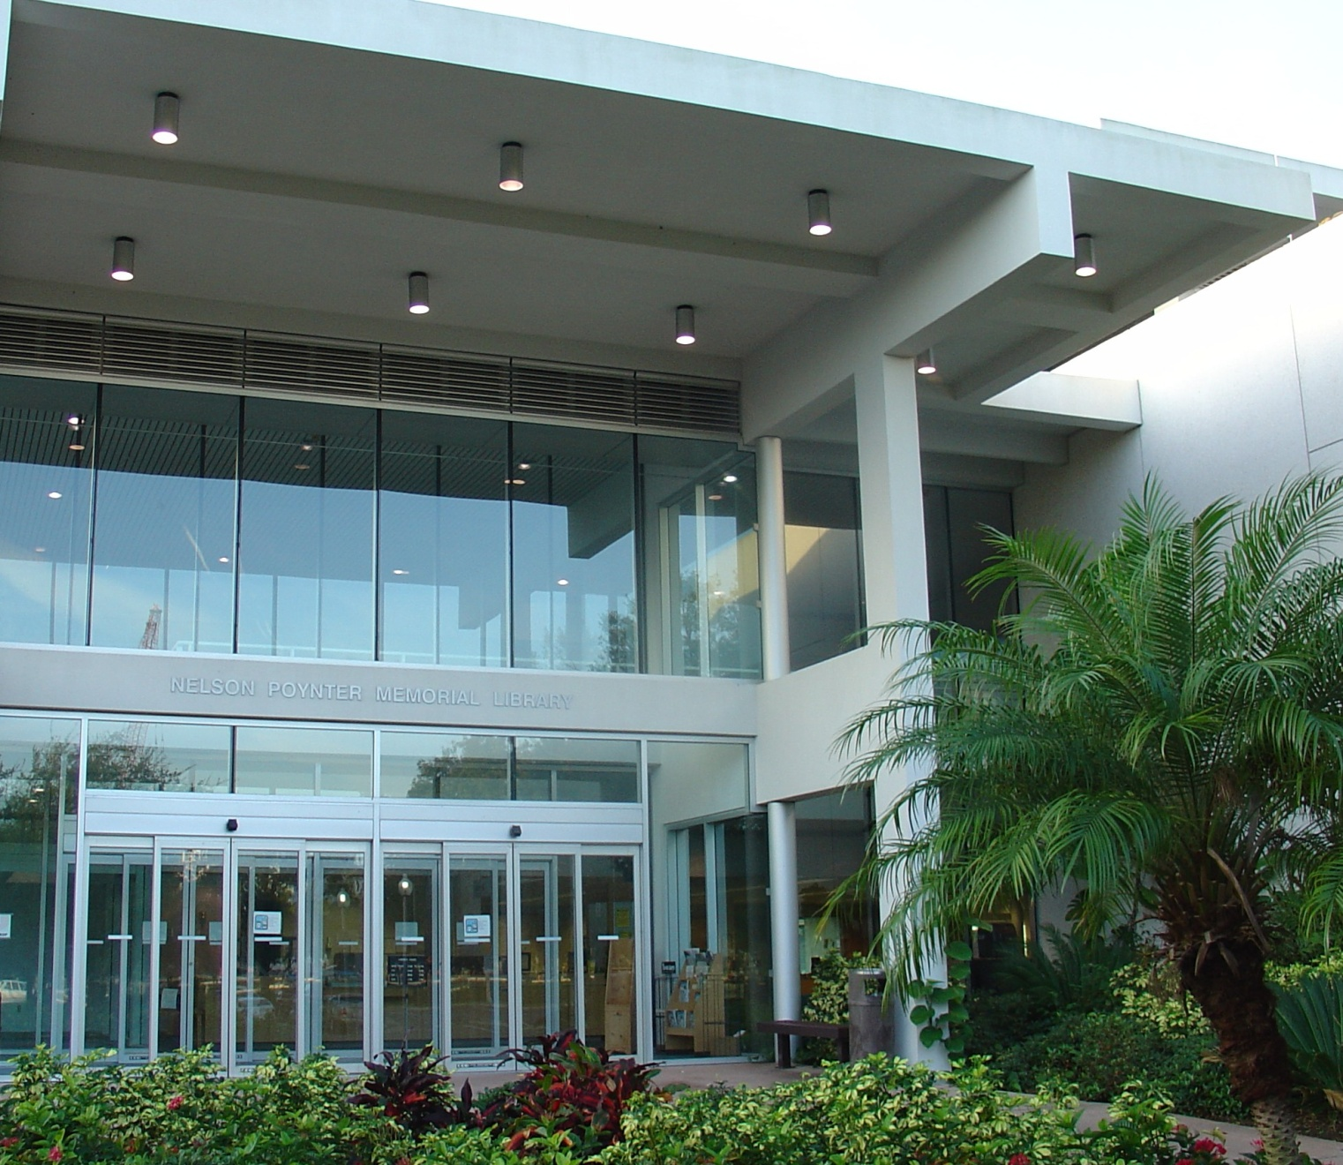

Nelson Poynter Memorial Library
Notes:
The Nelson Poynter Memorial Library is an autonomous institution whose primary mission is to serve the separately accredited University of South Florida St. Petersburg.
We serve the three colleges of USFSP: College of Business, College of Arts and Sciences, and College of Education.
In addition, we are the first point of service for USF Tampa’s College of Marine Sciences, located here in St. Petersburg.

Slide 4
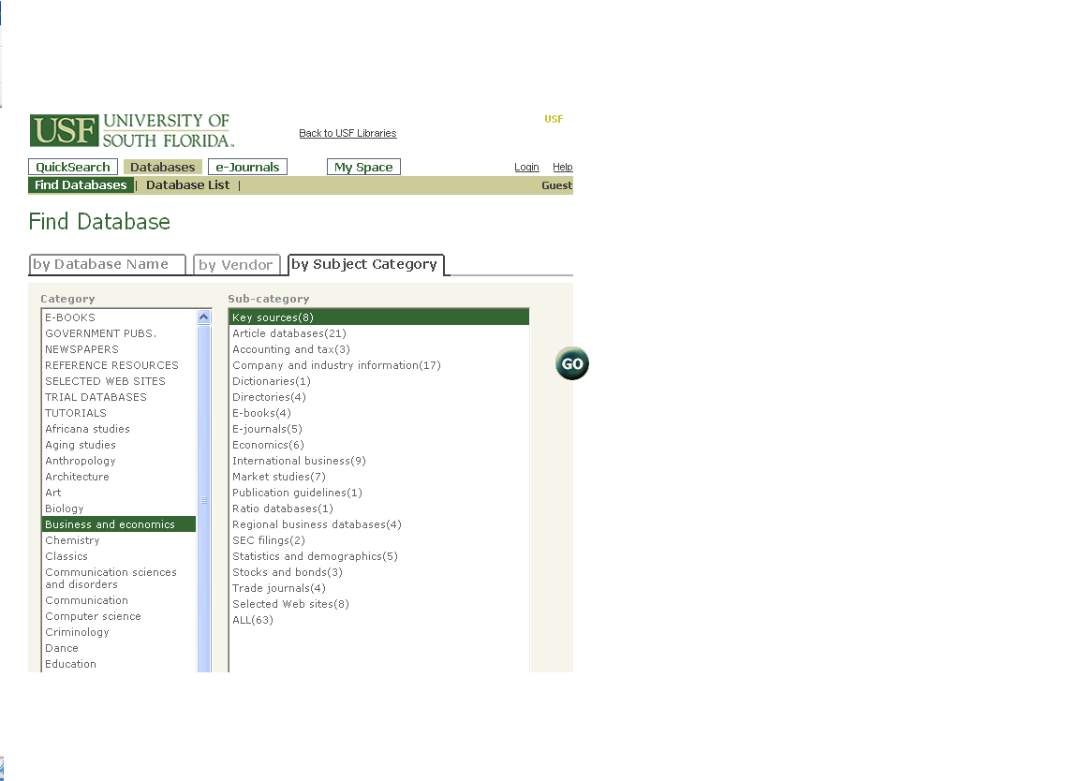

Separate but Connected
Notes:
While we are an autonomous institution reporting upward to the Regional Vice Chancellor for Academic Affairs, Dr. Norine Noonan, we collaborate with USF Tampa and the other institutions of the USF System in the area of interlibrary loans and shared access to electronic resources.
Thanks to this collaboration, we provide 24/7 access to over a million electronic books, journals, databases, and art images.

Slide 5
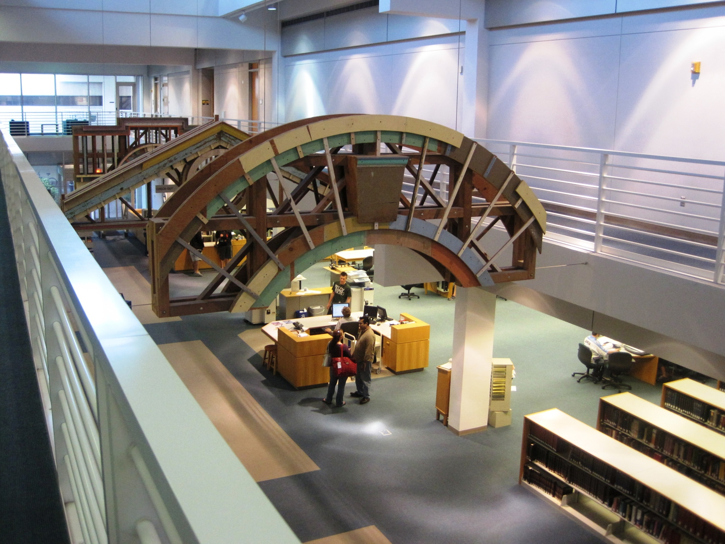

Notes:
The Poynter Library is open 79 hours a week and provides all the usual services that you would expect:

Slide 6
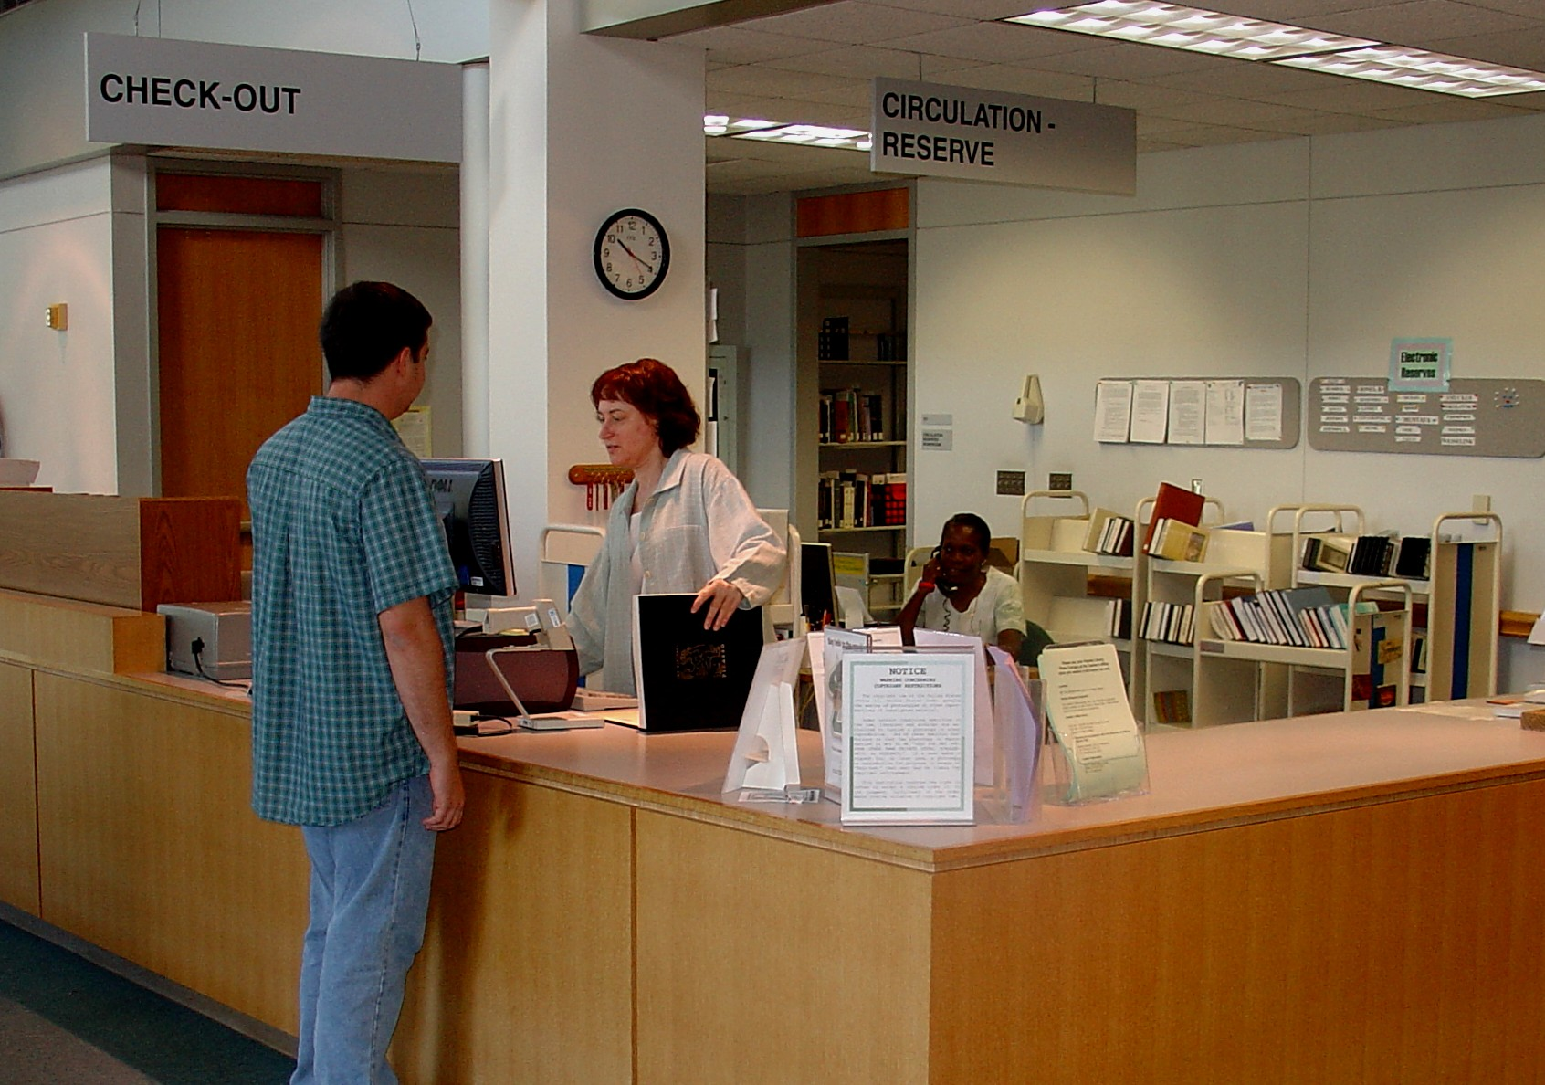

Circulation, Reserves, ILL
Notes:
We circulate materials from a collection of about 300,000 books, journals, and media.
We maintain reserve collections in support of courses.
We provide access to the world’s libraries through interlibrary loans.

Slide 7
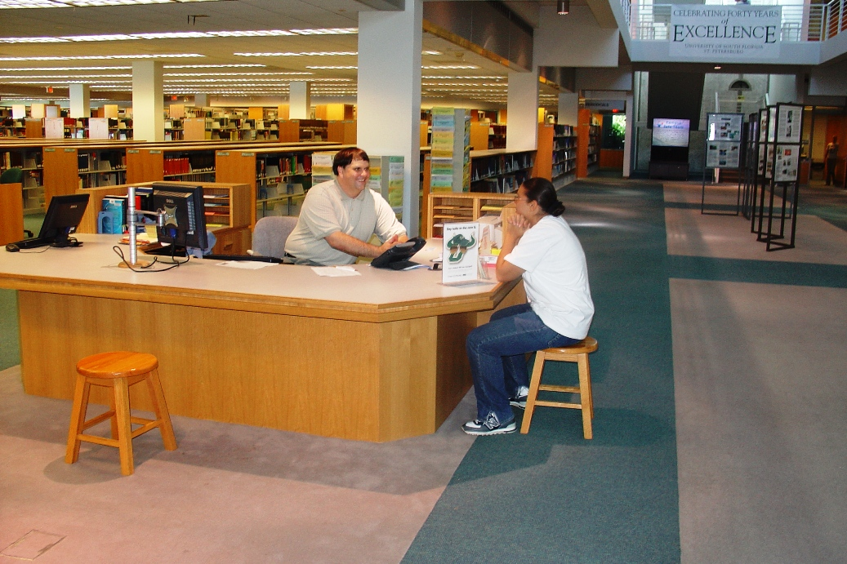

Reference and Research
Notes:
We provide reference and research assistance for the students and faculty

Slide 8
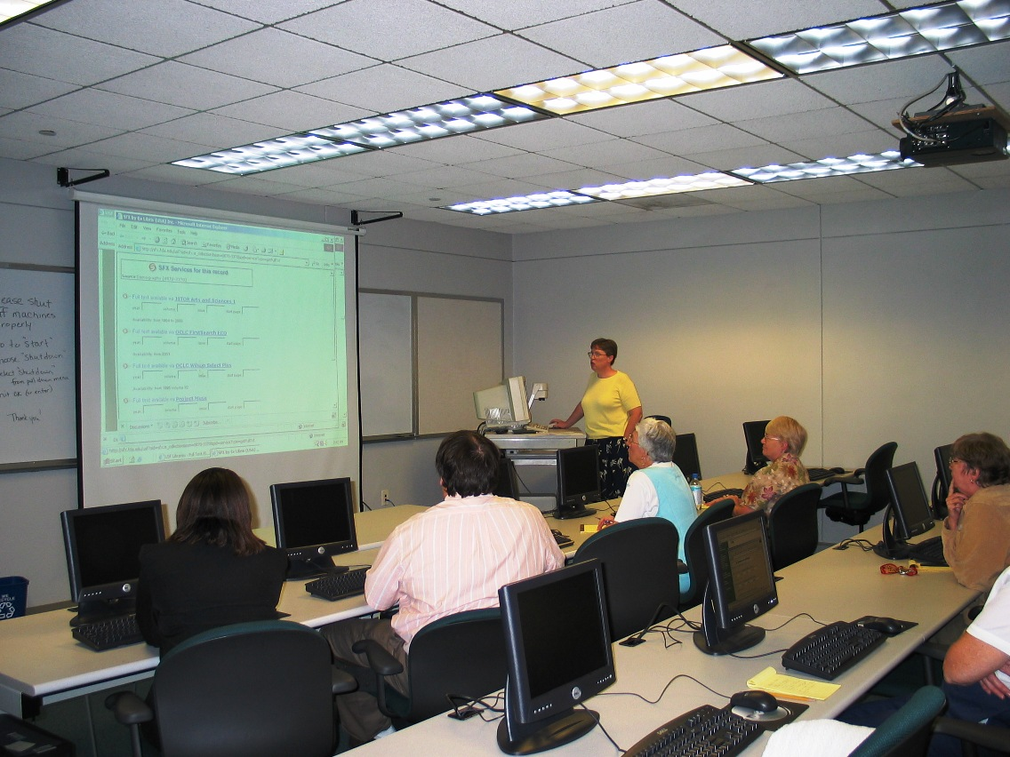

Instruction
Notes:
We provide instruction in the use of the library to classes at the request of faculty.
We teach a 3-credit course on Library and Internet Research Skills through the College of Arts and Sciences.

Slide 9
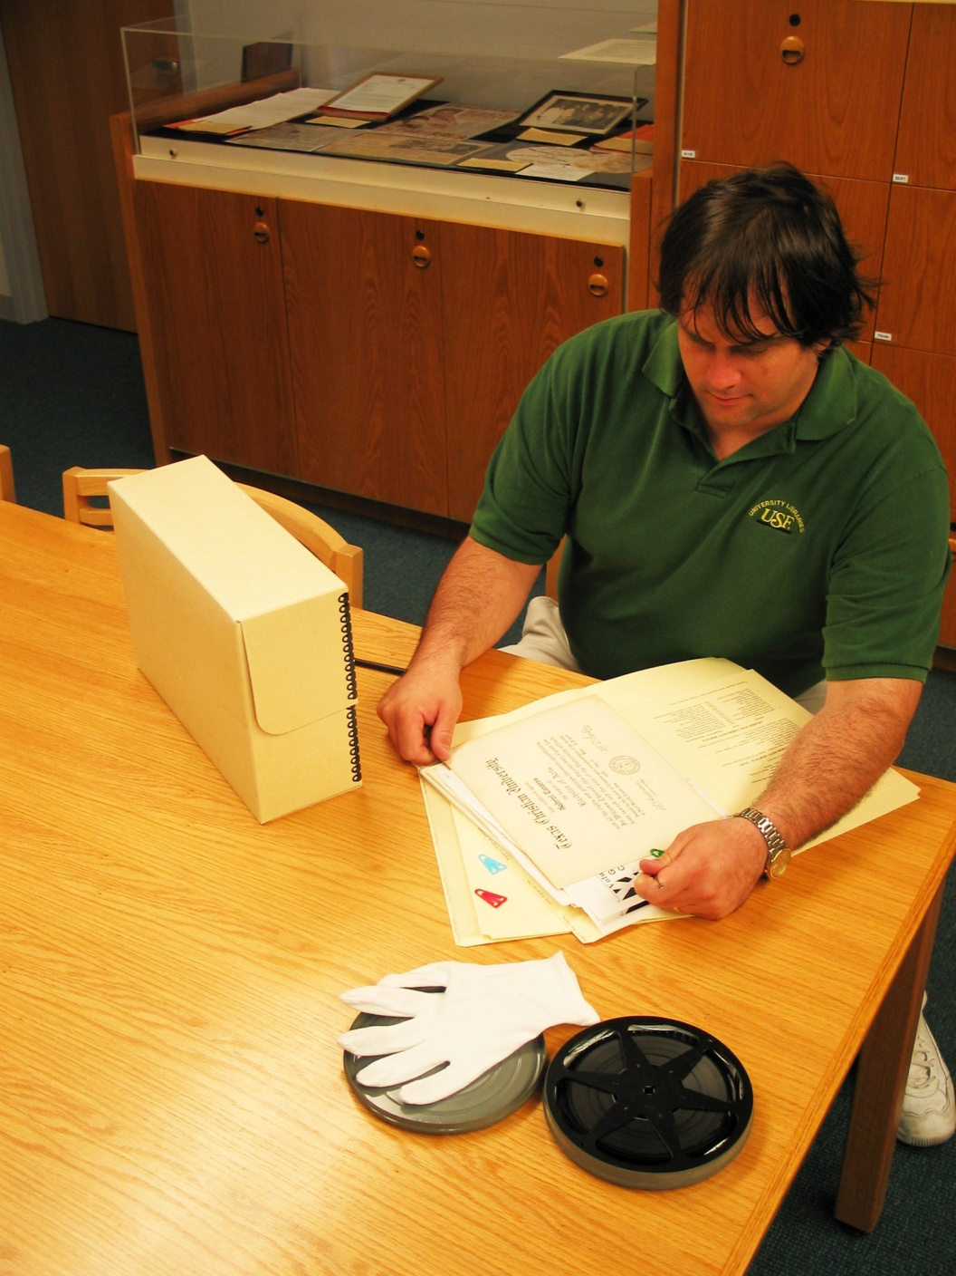

Special
Collections
Rare books
Oral histories
Photographs
Memorabilia
Manuscripts
University archives
Papers of noteworthy people
Assistance of an expert librarian and historian
Notes:
In addition, our library has a growing special collections, carefully selected and nurtured by historian and librarian James Schnur.
We focus on collections in marine science, local and regional history, and journalism and media studies. We work with faculty to bring undergraduate and graduate students in contact with primary source materials as part of their classroom and research experience.
Some of our notable oral histories include
Grace C. Allen, wife of USF’s first president, John S. Allen, interviewed by Jim Schnur in 1996.
Phyllis C. Marshall, charter staff member and longtime student affairs administrator. The Marshall Center is named after her.
Ernest Boger, the first African-American student admitted to the University of South Florida in the early 1960s (before USFSP existed).

Slide 10
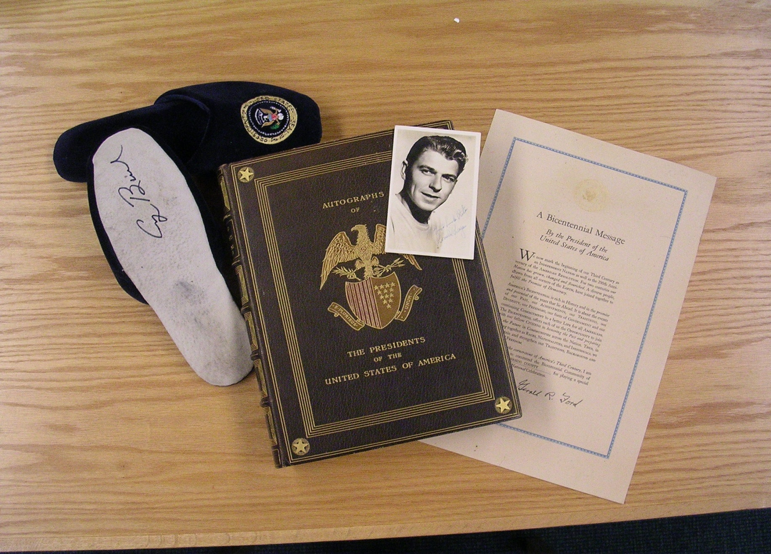
Notes:
In addition to the institutional archives, this department includes nearly 140 unique book and manuscript collections focusing on areas such as ichthyology, natural history, oral history, Tampa Bay regional history, presidential signatures, and Twainiana.

Slide 11
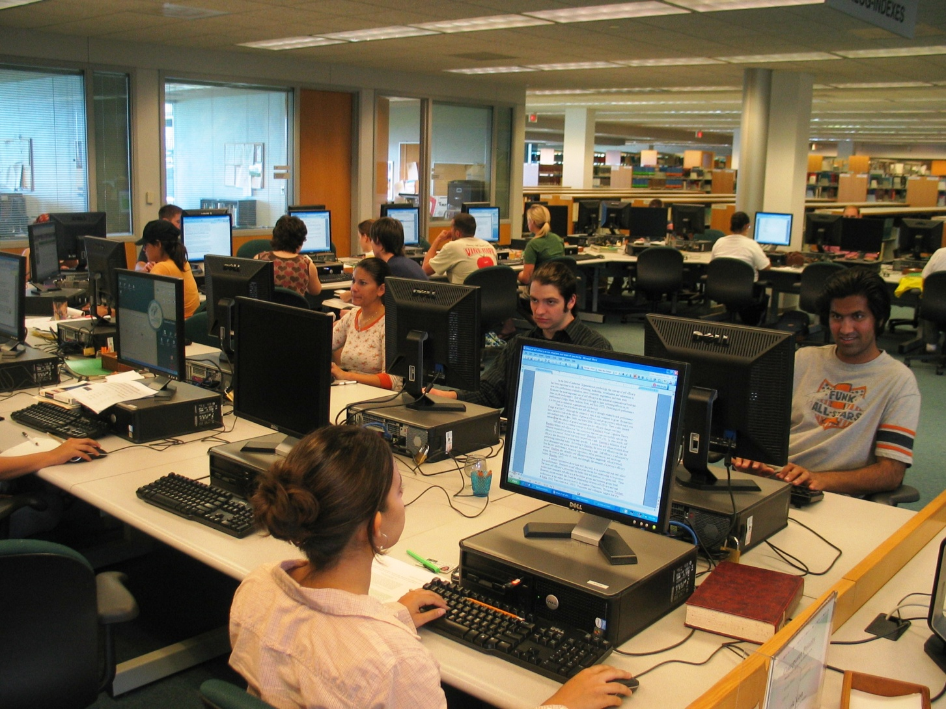

Information Commons
Notes:
We give one-on-one assistance at our Information Commons with 45 networked computers providing access to library resources, course materials, the Internet, Microsoft Office and specialized research applications such as SPSS.

Slide 12
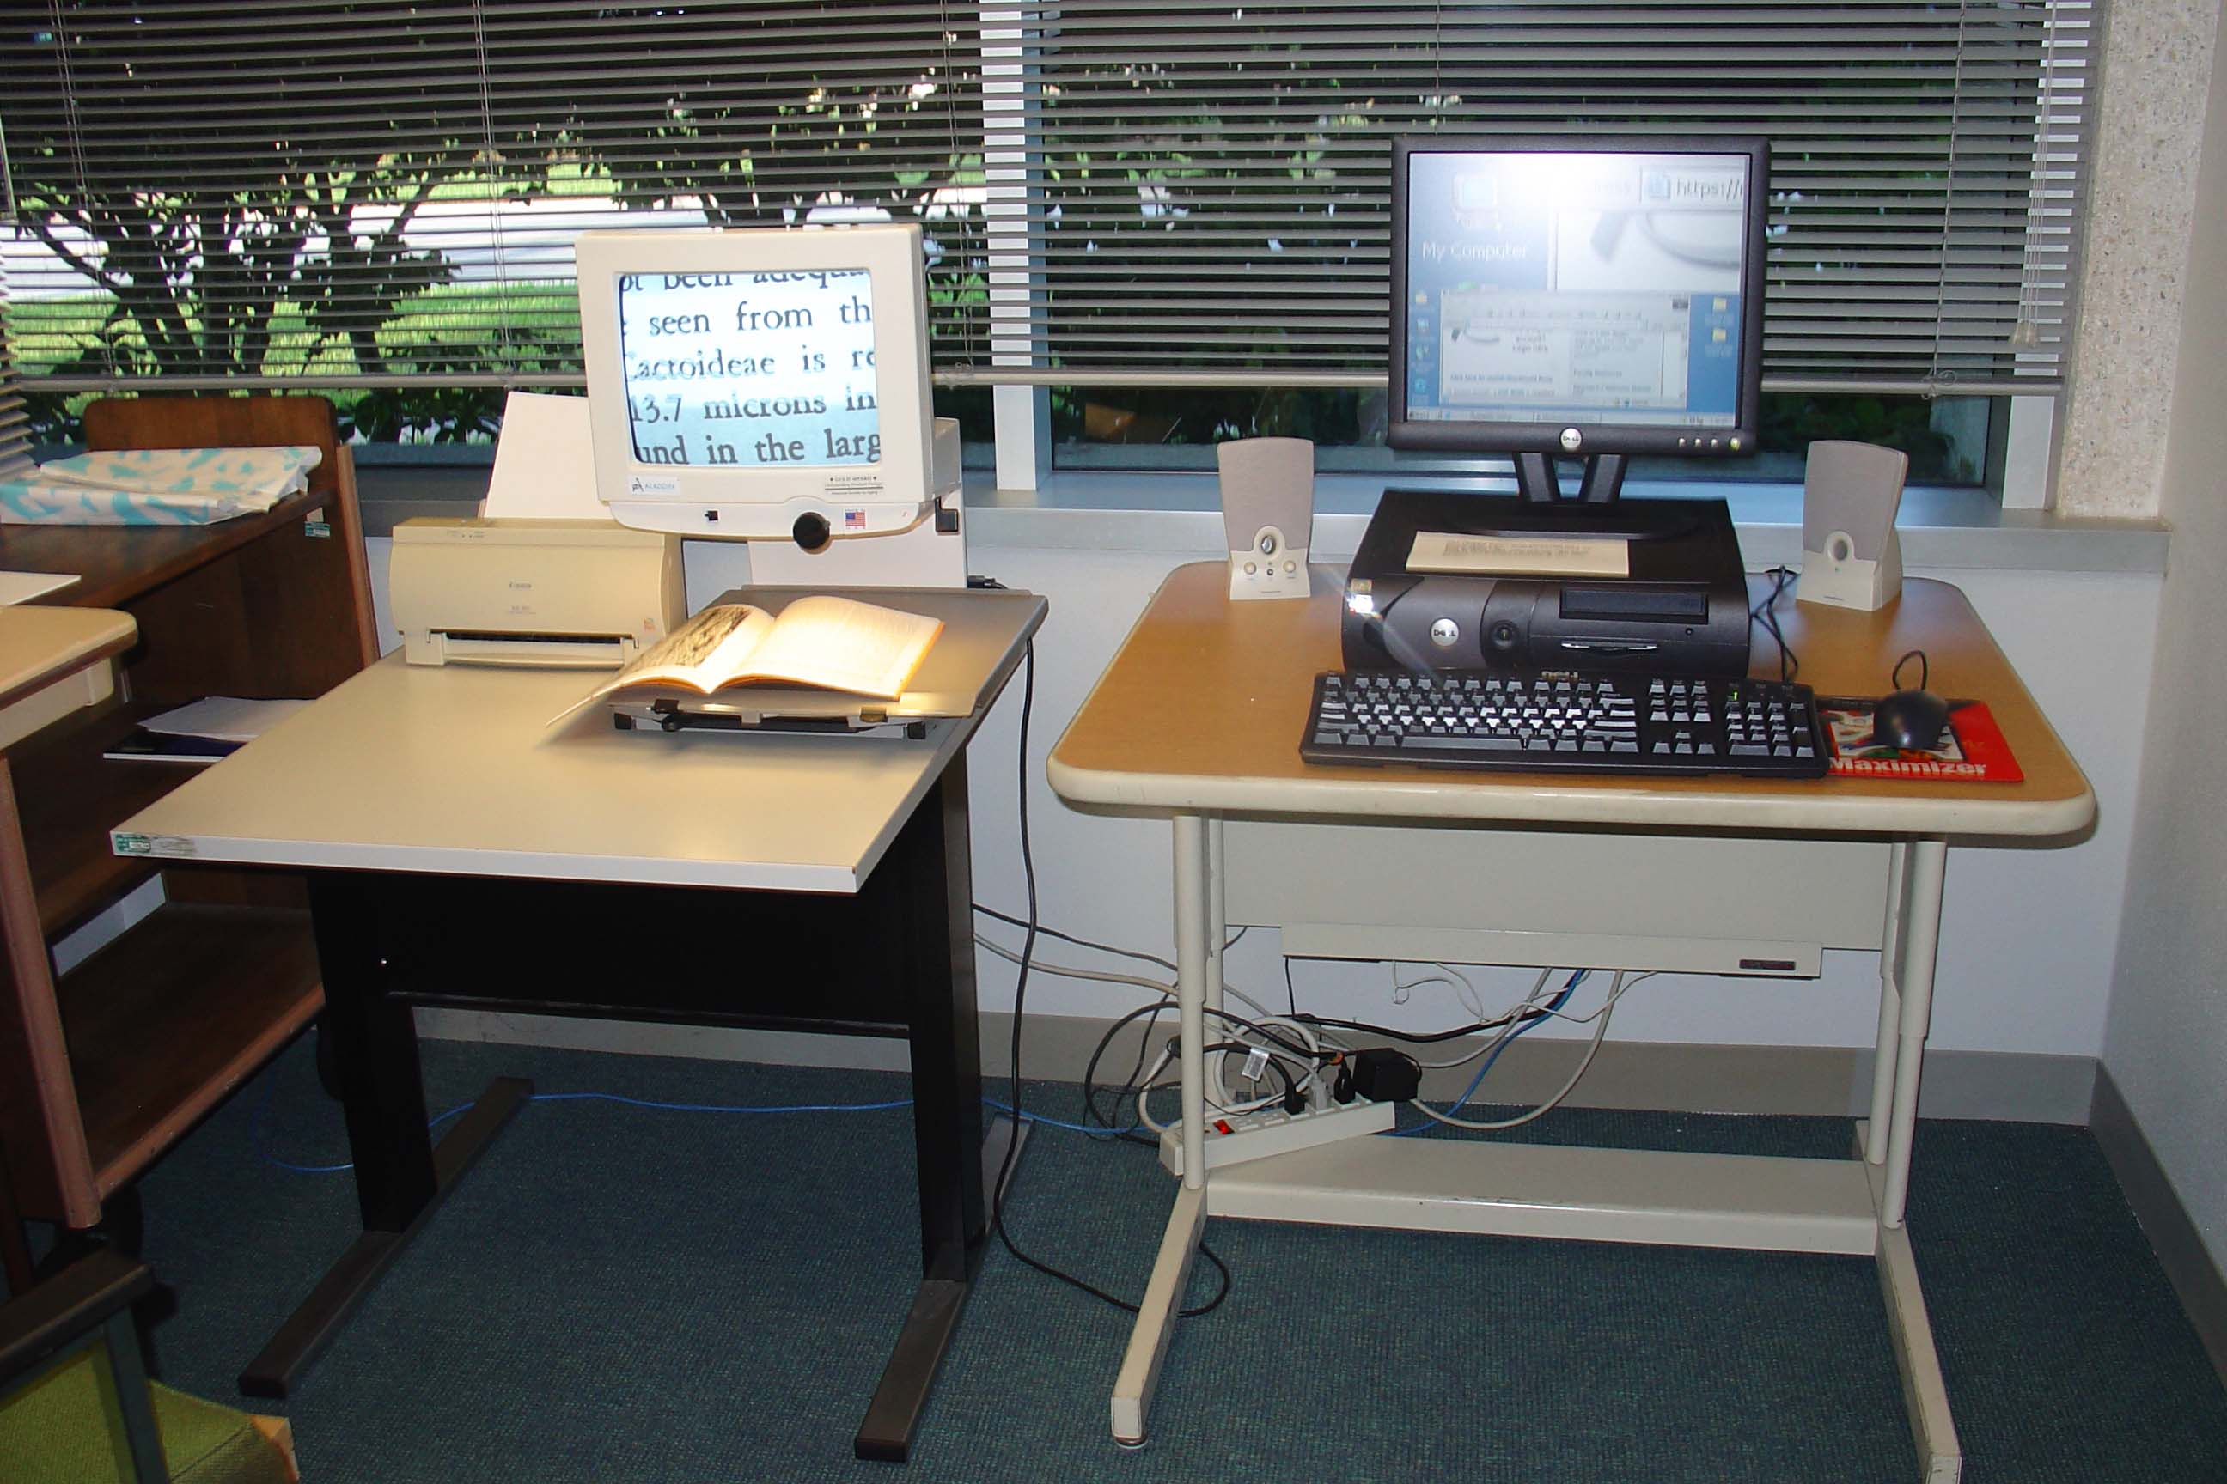
Special Needs Support
Notes:
We have equipped a room with special technology to assist a growing number of students (some of them returning vets) who have physical limitations that make it difficult or impossible to use the library’s resources on their own.

Slide 13
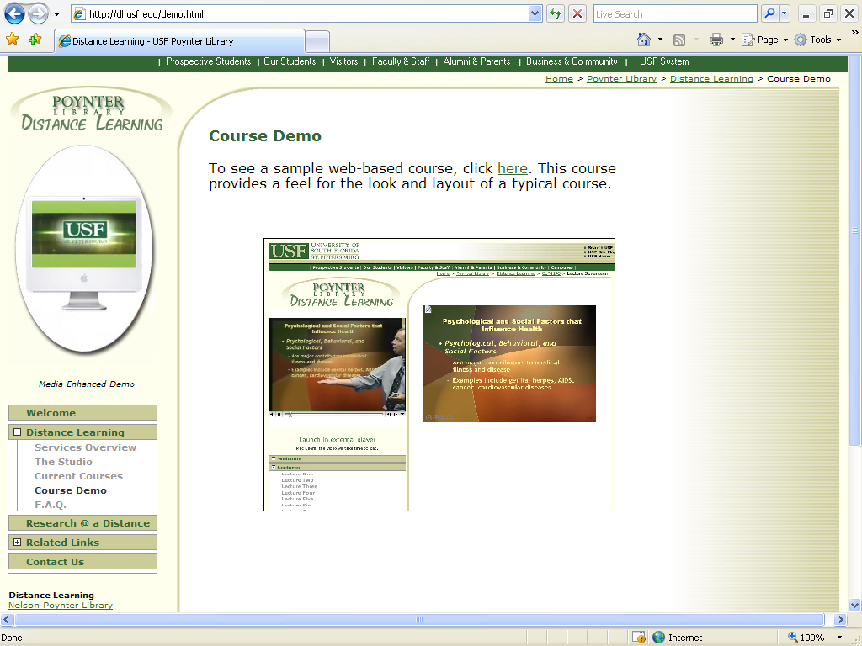

Distance Learning Support
Notes:
What you might not expect is that we also provide technical support for a growing number of online courses and provide instruction for faculty in the use of the Blackboard course management system.
We also provide AV support to the campus for classrooms technology, meetings, conferences, and other events.
And we do all this with 20 people, at a time when enrollment and course offerings are growing and financial resources are shrinking.

Slide 14
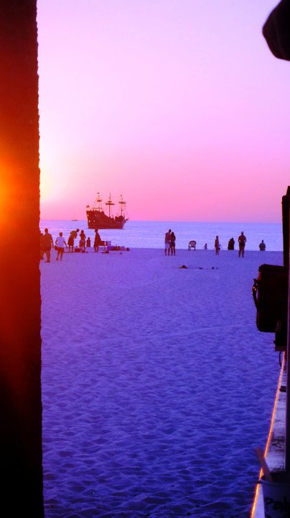
Notes:
Before I share with you my hopes and vision for our library, let me provide you my assessment of our environment – the library environment, the academic environment
What’s on the horizon?

Slide 15

Environmental scan
From gatekeepers to gate openers
We do not operate in a vacuum
Expectations are growing
Education is undergoing a revolution
Notes:
Libraries are not in charge of information – we used to be considered gatekeepers. We see ourselves today as gate openers
We don’t operate in a vacuum – we are part of an academic and broader community that is facing huge challenges and is making fundamental changes to the way it operates.
Expectations are growing – expectation of strong customer service; expectation of our students that they will be able to customize their experience; expectation of instant gratification or response
Education is changing dramatically and quickly – more online and distance courses, greater collaboration among students, greater interdisciplinarity, great need for accountability, growing competition among institutions for students

Slide 16

Environmental scan
Unprecedented financial challenges
Lifelong learning
Greater diversity in our communities
Technology is pervasive and disruptive
Notes:
Financial resources are tight – unprecedented in the lifetime of everyone in this room today . We are facing the imminent loss of federal stimulus funding and a reduced budget from the state. More than ever, we need to be out asking for private sector resources or generating income in order to support new projects-- or even core services. We invite anyone to support the library
There is a recognized need for ongoing professional development and continuing education – we must all be lifelong learners – whether it is within our institution or within the broader community. No one can rest on past laurels or past skillsets
Greater diversity – ethnically, linguistically, culturally, age, special physical needs. We need to be sensitive to the special needs of our increasingly diverse group of students and faculty and try to provide effective service to everyone
Technology has invaded every aspect of our lives and is changing the way that people interact with each other and with information.

Slide 17
Top Technology Trends
Mobile devices
Game-based learning
E-books
Augmented reality
Learning analytics
Gesture-based computing
Notes:
The 2011 Horizon report, produced by the New Media Consortium and Educause, identified six technology trends on the horizon for higher education. I’m going to talk briefly about the first four
Mobile devices – more people now access the web through mobile devices than through computers. Here in the library we have been looking at the use of mobile devices for accessing the library’s website and electronic resources. We are also investigating the use of QR (quick response) codes to link students directly to our online “ask a librarian” service when the reference desk is not staffed.
Game-based learning – today’s students have grown up with video games. We know that they want to interact – they don’t want to be passive recipients of lectures. As the library supports the further development of online courses, we are taking this and other technology trends into account to help faculty develop better courses.
E-books –we provide access to about 350,000 electronic books and we have to keep on top of the changing world of digital rights and help users navigate these resources technically and legally. For instance, in classes and every day at the information commons, we have to help students figure out how to cite information properly because different devices or packages present the same information on different pages or different locations within a text. Just one example
Augmented reality is layering virtual information over actual locations. This is the technology that allows you, for instance, to walk through a museum with a headset and have the information you hear relate to the pictures in the room where you happen to be located. There are a number of possible library applications of this technology that we are investigating, such as linking books in the stacks to related electronic resources.

Slide 18
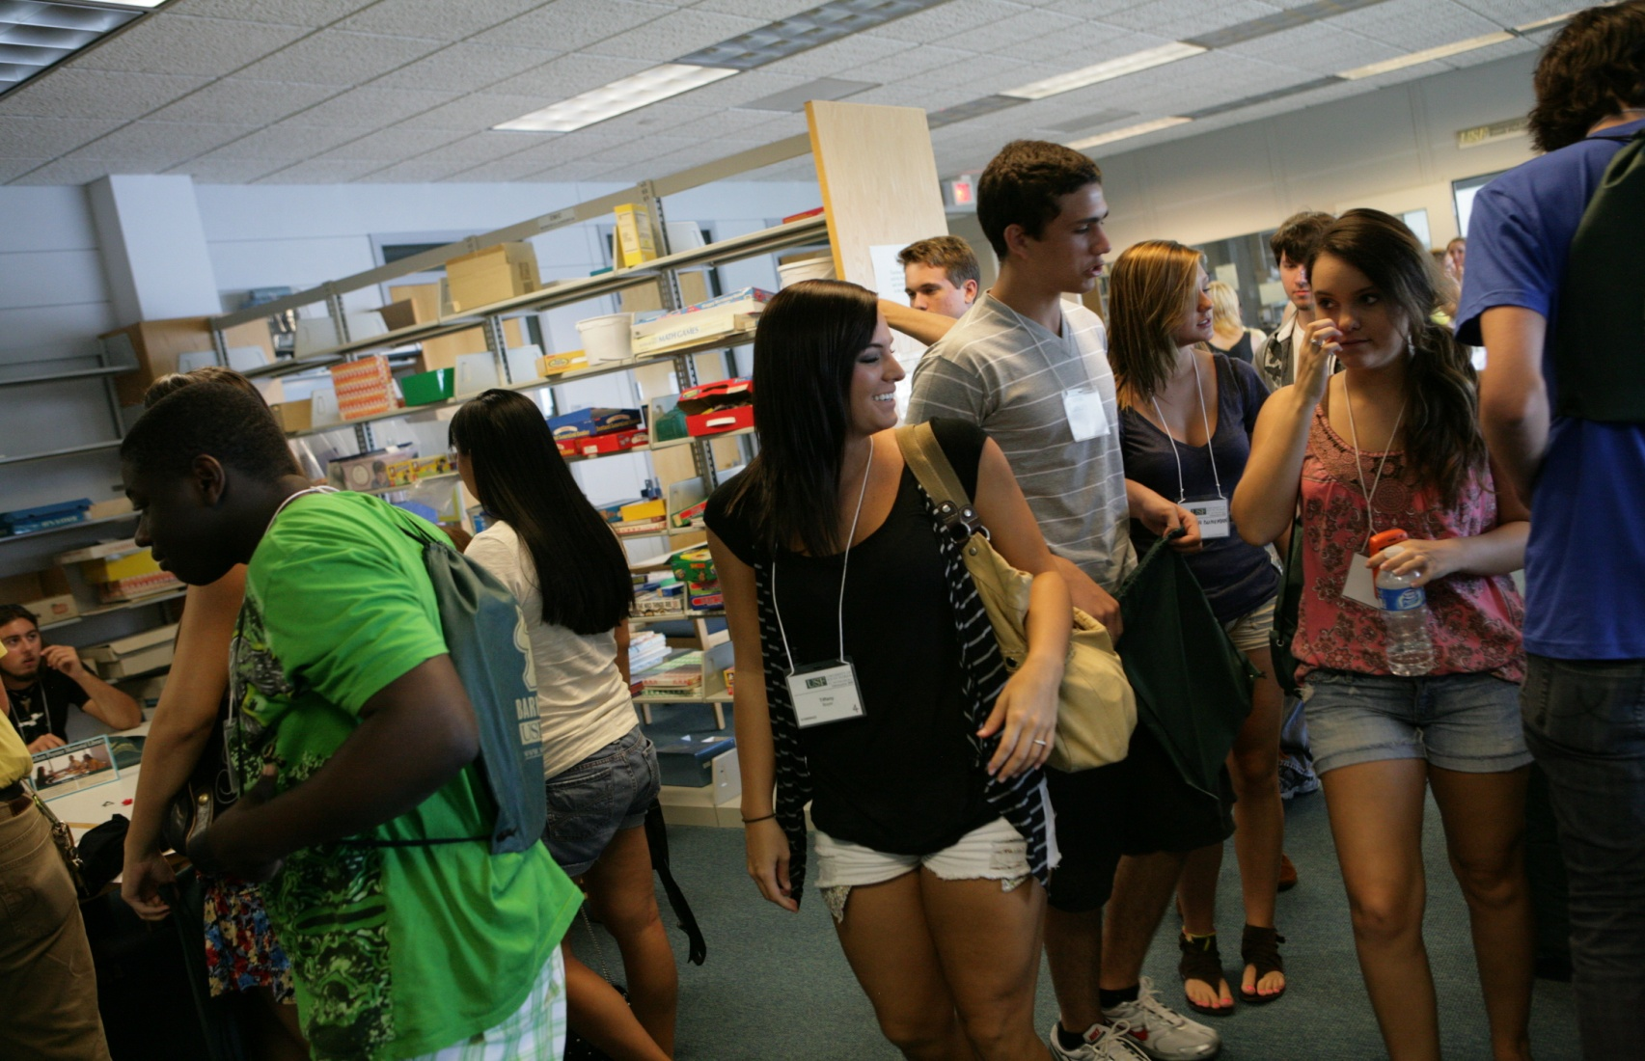
Whither the Library?
Notes:
What is the vision we are working towards? Where are we headed?

Slide 19
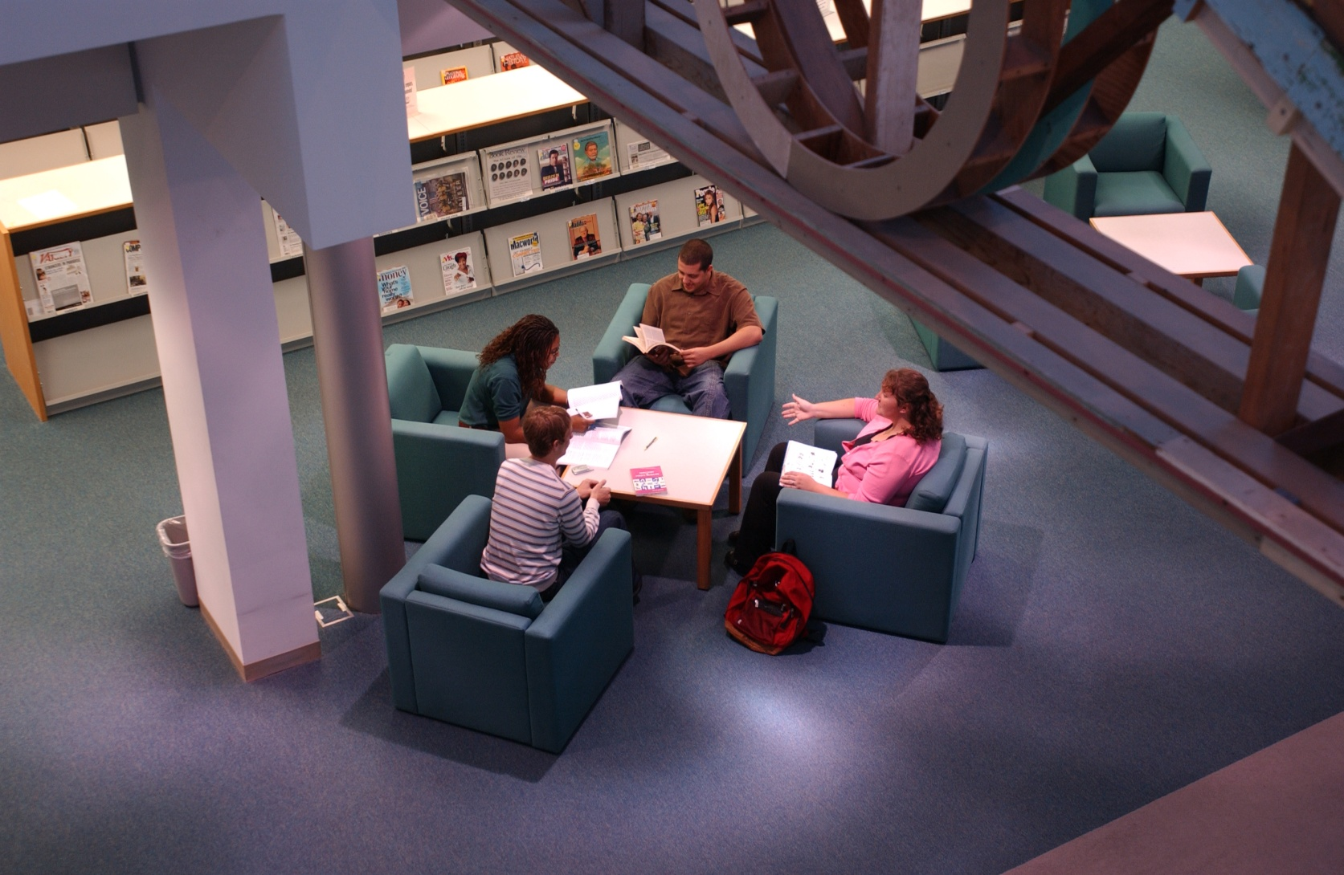

Student-Centered
Notes:
First and foremost, our vision is to be student centered in everything we do.
Students have choices and they are exercising those choices. They expect to be involved in the discussions and the decision-making about the future of their institution.
This is what Jeannette Woodward in the book _Creating the Customer-Driven Academic Library_ explains as taking the Web 2.0 concept (interactive and user centered) and expanding it to ALL interactions with our patrons. It is viewing our library patrons as FULL PARTNERS as we move forward.

Slide 20
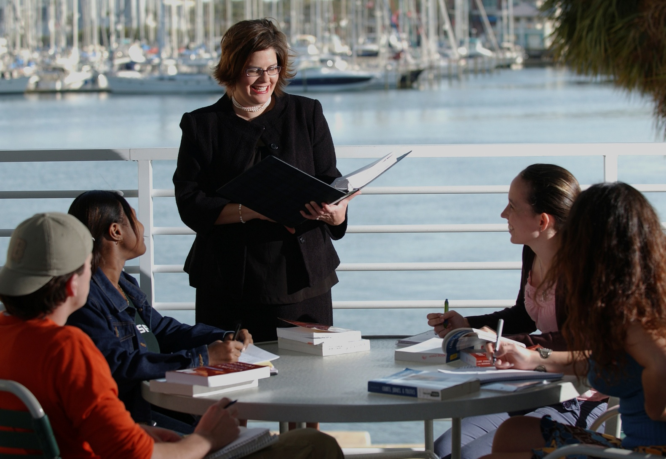

Responsive and Accountable
Notes:
We believe it is essential that we be responsive and accountable.
To help us make responsible decisions, we collect data – on how our building and collections are being used, on the perceptions that our students and faculty have of our current services, on what new services our University community needs to be successful.

Slide 21
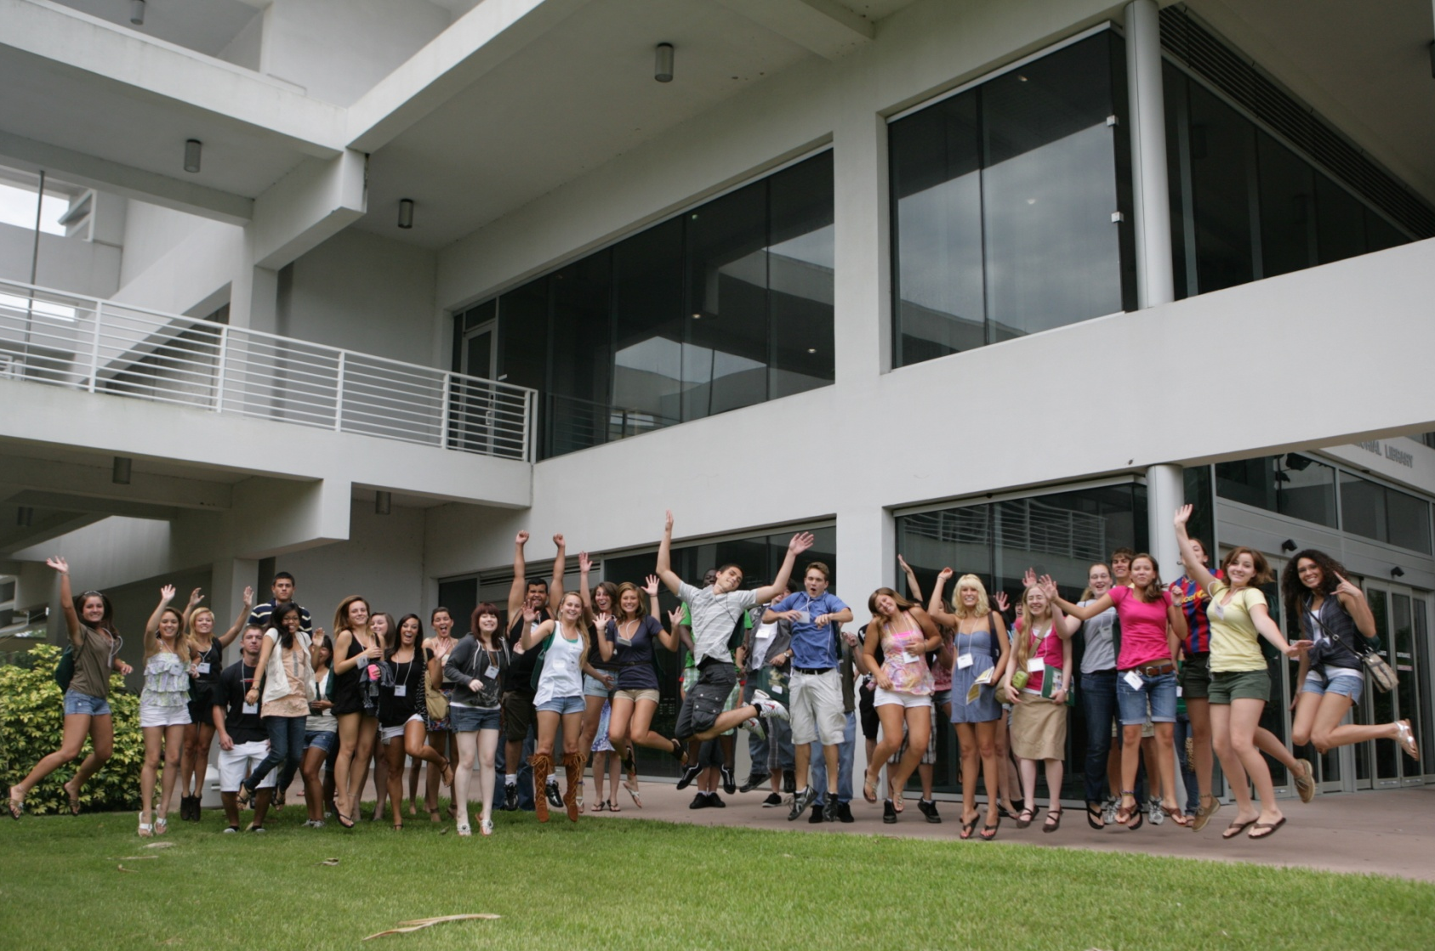

Integral to the University
Notes:
Our vision is to be at the center of everything going on academically on campus. We exist to serve every member of the USFSP community and give each one of them the tools that they need to be successful

Slide 22
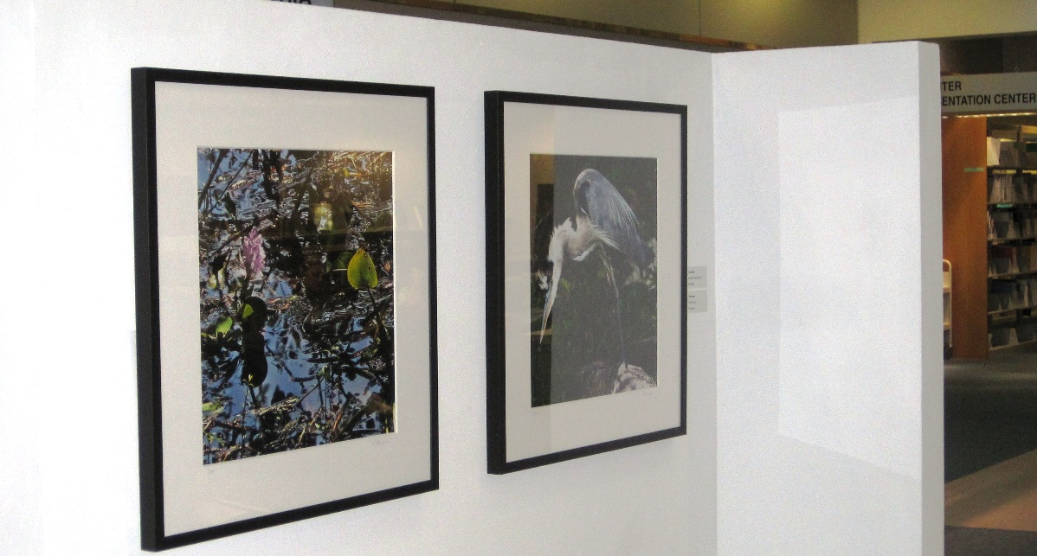

Engaged with the Community
Notes:
We strive to be actively engaged and working in partnership with our community.
We just hosted an interactive exhibit curated by the Morean Arts Center of the work of photographer Dick Jacobs, pictured here.
We have sponsored or hosted book talks by nationally known authors like Gail Sheehy, as well as local authors such as Mary Ann Marger who is speaking in the library March 1.
We are working with a city agency to secure grant funding that would support the creation of a digital collection of an important St. Petersburg community project.
The list of such conversations, explorations, and partnerships keeps growing.

Slide 23
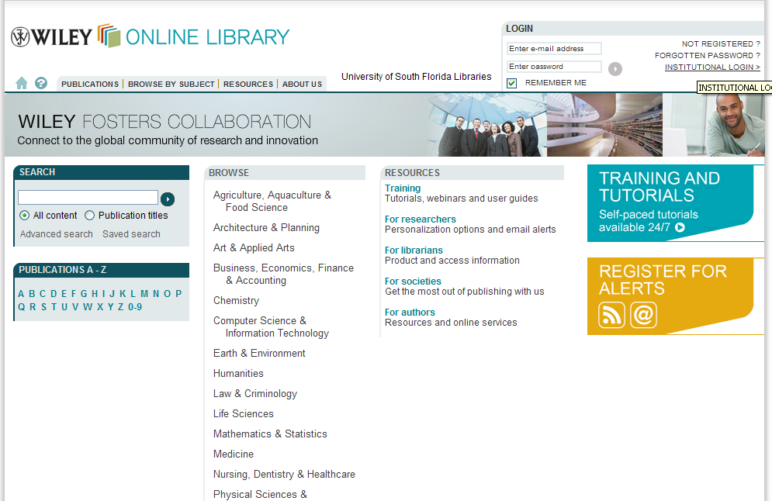
Information Experts
Notes:
A key aspect of who we are is to be information experts. Library staff must know how to access, evaluate, and utilize all types of information: be it a licensed e-journal, a print monograph, an image from a special collection or archive, a web site, or an article from Wikipedia or a blog.
Our role is not to judge the information, but to provide our users with the skills they need to make their own independent judgments.

Slide 24
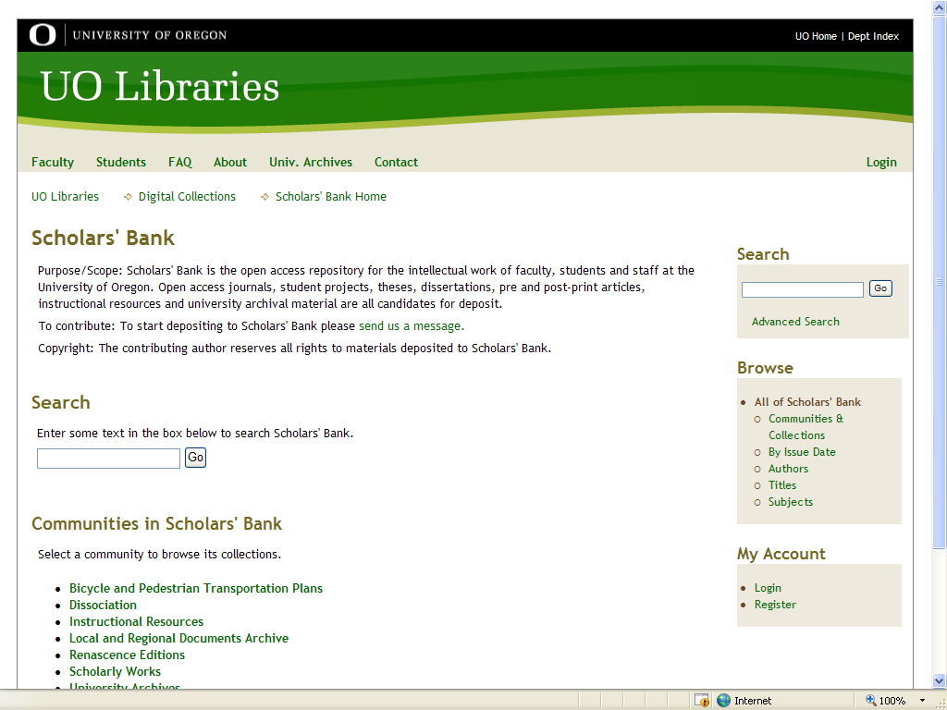

Intellectual Property
Notes:
A vision we share with our faculty and students is that we will continue to be well versed in copyright and intellectual property issues.
One of the ways in which we are demonstrating both our expertise and our leadership in this area is in our work to develop a digital archive for the intellectual output of the University, like this one –Scholars’ Bank -- that I helped develop at the University of Oregon.

Slide 25
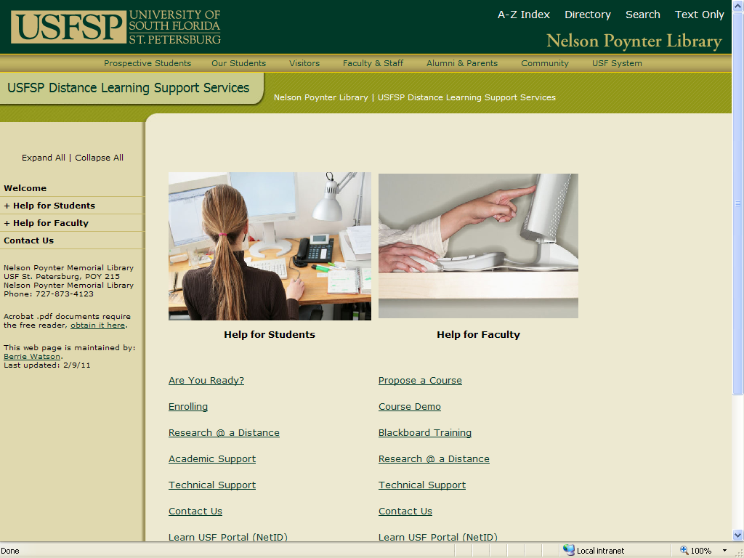
Leadership
Notes:
Our vision is to show leadership in helping to chart the University’s path through the changing educational, scholarly, and information environments.
One example is in our coordination of support for online/distance education.

Slide 26
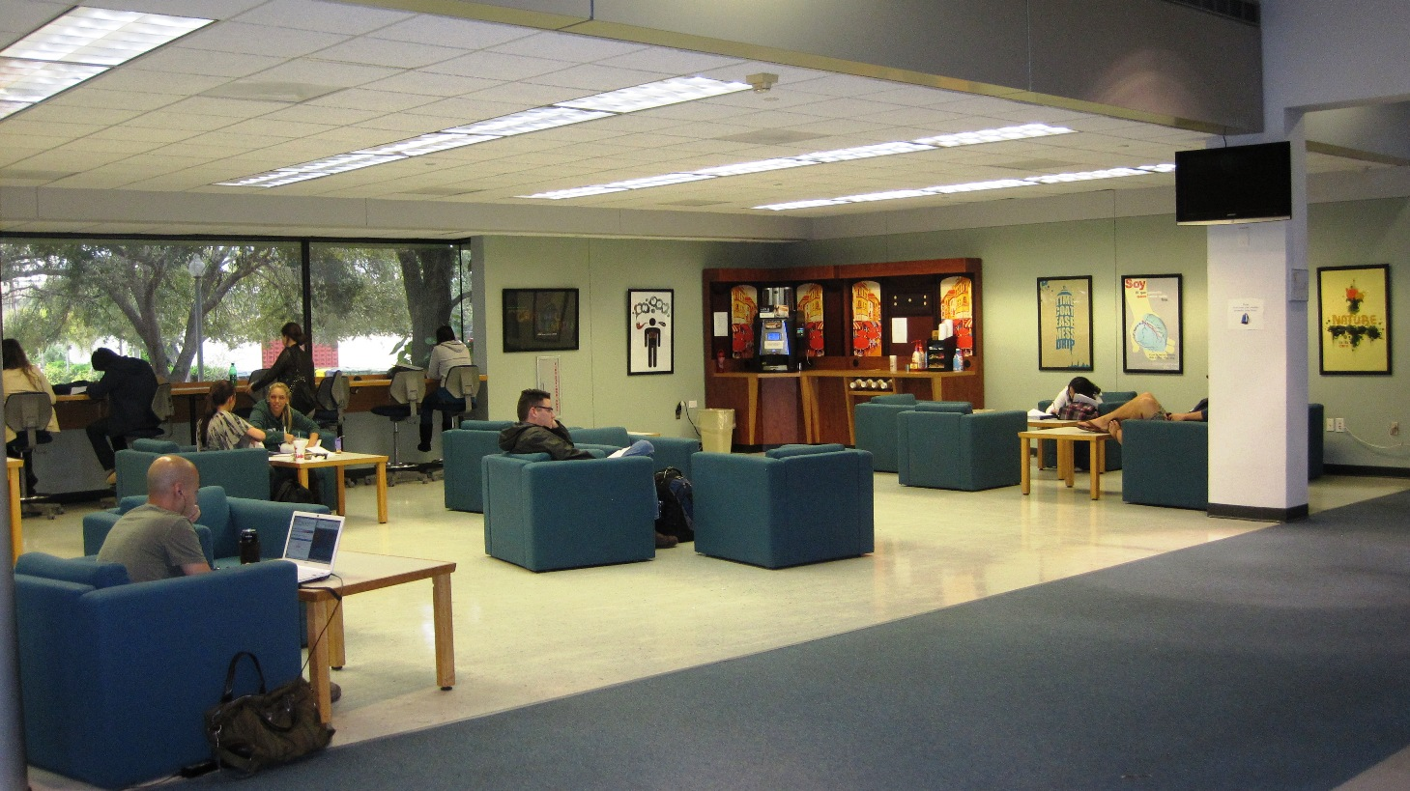

Using Space Creatively
Notes:
We are blessed to come to work in a beautiful physical space. It’s a space that many others want to share with us, evidenced by Foundation’s decision to host your luncheon in the library atrium today.
Our goal is to make use of our space in creative ways that enhance the life of the members of the University community and that help them discover and explore the resources they need to be successful lifelong learners.

Slide 27
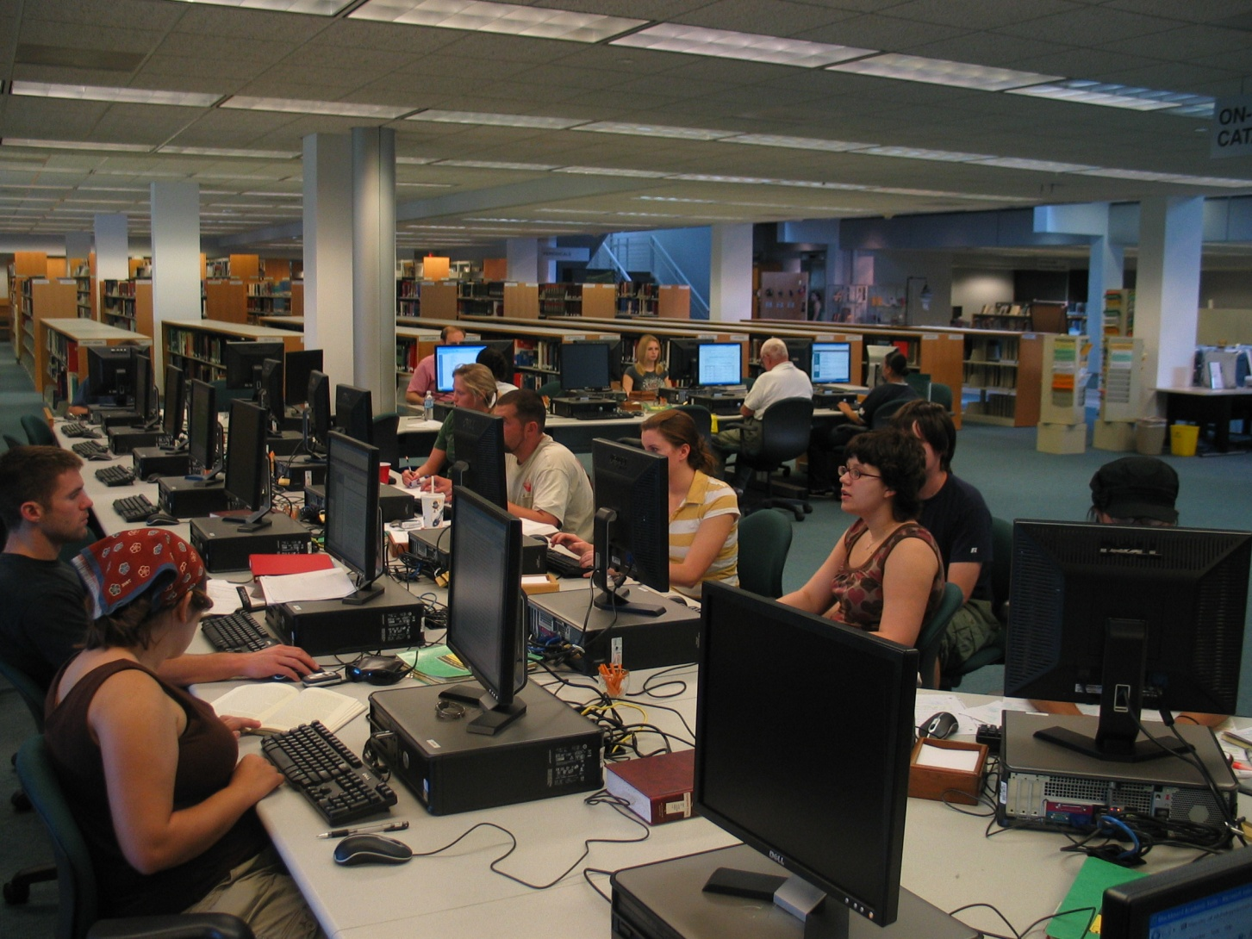

Suite of Services
Notes:
If there is a single message you take away with you today, I want it to be this one:
The library today is comprised of a suite of ubiquitous services, and not just a collection of resources tied to a particular physical space.
Success in student learning is our main goal, providing a range of services where and when students and faculty need them, with the right technology and staff trained to support them.

Slide 28
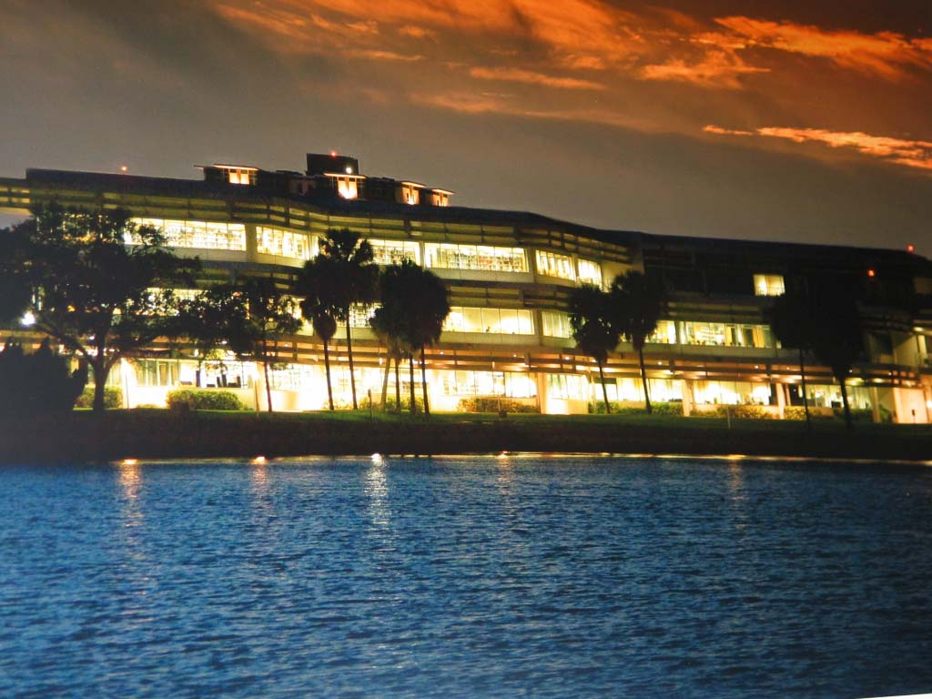

Moving Forward
Notes:
How do we move forward? How do we nurture our vision and make sure we don’t wither away but are a guiding light?
Among other things…

Slide 29
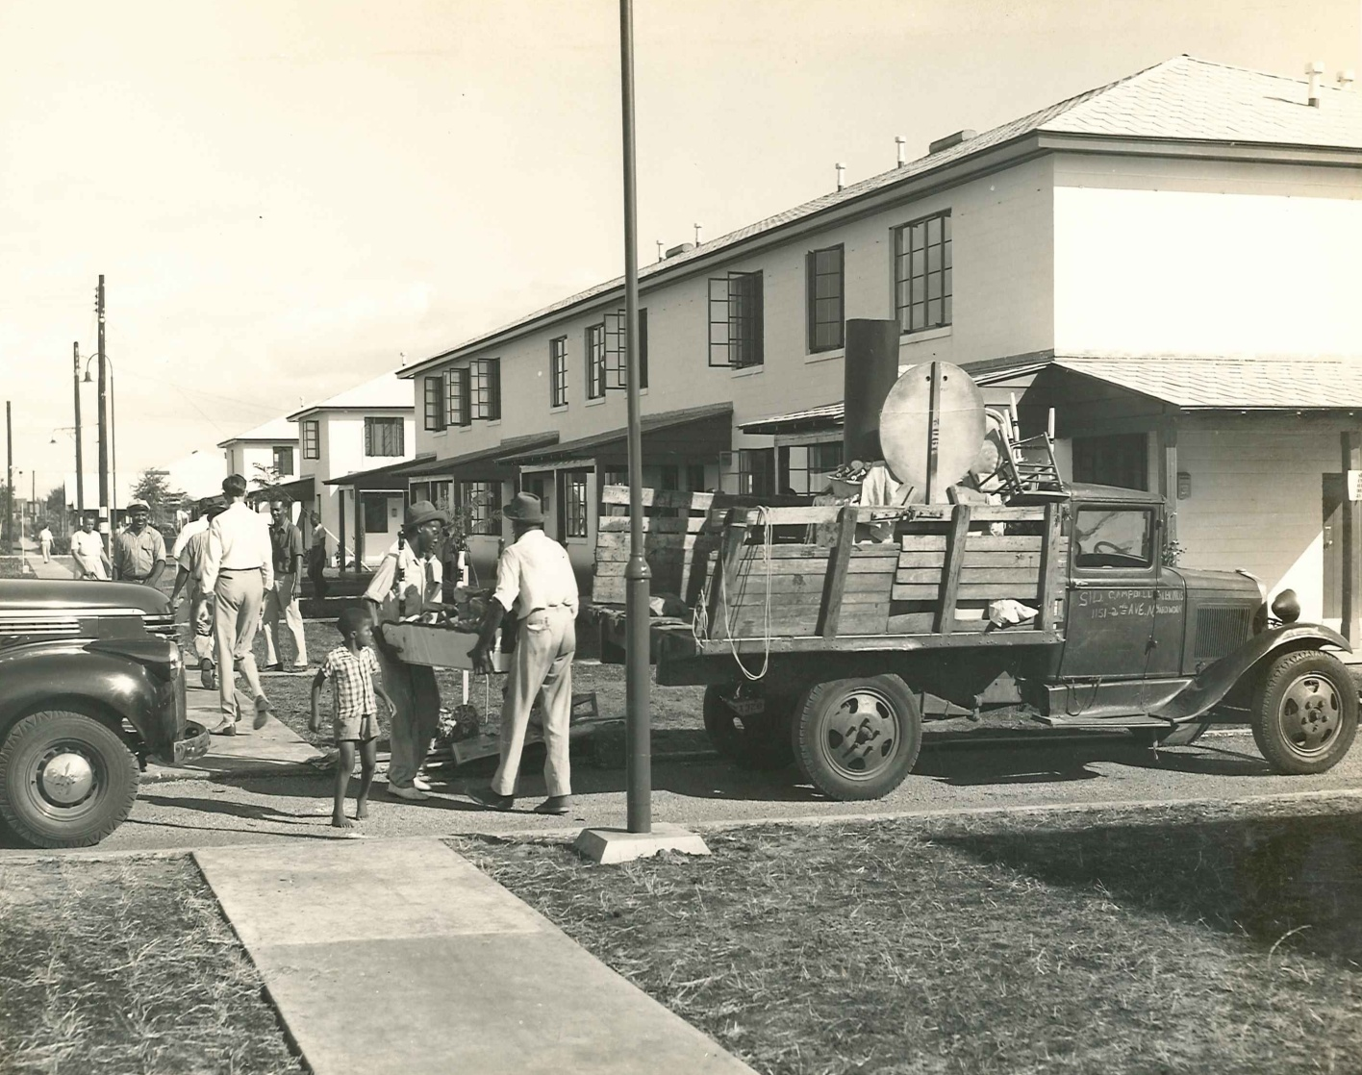
Collaborate
Notes:
One of the most important things we can do is strengthen our community connections and look for opportunities for collaboration. By collaborating, we share expertise and we leverage our resources for maximum advantage.
Many of the materials we have in our Special Collections and Archives are opening doorways to exciting community collaborations, such as this one from our Jordan Park collection which includes photographs and property information about locations where people lived before Jordan Park was constructed. Most of these homes are on the present-day site of Tropicana Field and the adjacent parking lots, or just west of the Trop.

Slide 30
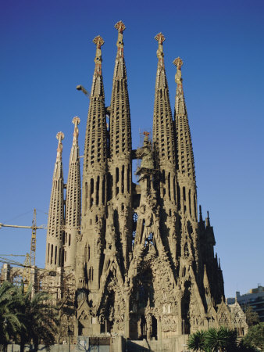

Dream Big
Notes:
I also believe in dreaming big, in spite of limited resources. I have found that reality will limit us soon enough and that sometimes you can accomplish a lot more than you thought possible -- just by dreaming big.
We have to help our faculty develop and present new types of course materials, such as multi-media, digital images, streaming video and audio;
we must provide them the means of making their work available over time through reliable digital archives;
we must help them navigate the increasingly complex world of intellectual property in the digital era.
we must be active partners in scholarly communication and instruction, as well as provide access to a variety of rich information resources.

Slide 31
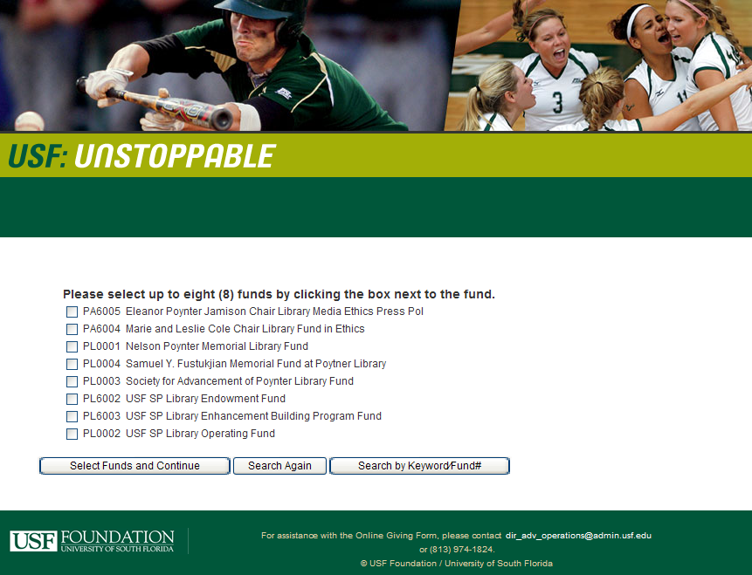
Help from Our Friends
Notes:
Our friends at the Foundation have always helped us realize our dreams and we always encourage anyone we speak with to join us on our quest.

Slide 32
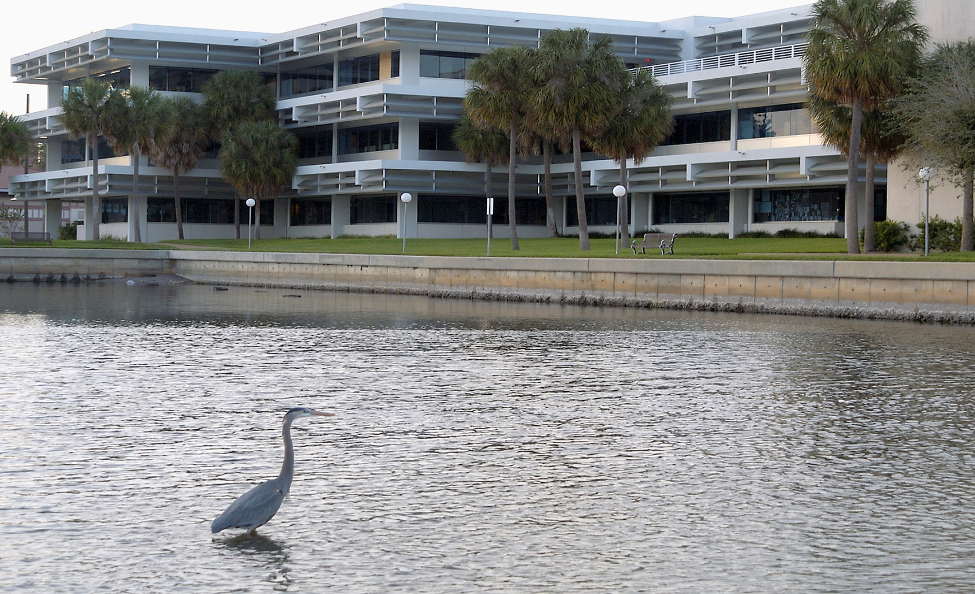

Never Forget the Power of Beauty
Notes:
Last month at a talk given in the library, photographer Dick Jacobs quoted the philosopher Plato who said that “the object of education is to teach us to love beauty.” Whether one agrees with that philosophy or not, it is important not to forget the power of beauty to inspire us.
As you will see at lunch, the Nelson Poynter Memorial Library, through its beauty and functionality, inspires us every day to strive for greatness. There is no danger of us withering away because we are a key player in the greatest game in town – helping our citizens to grow and become the best that they and we can become.

